Slide 1

Flare activity of the fully convective
M-dwarf V374 Peg
Krisztián Vida
K. Oláh, L. van Driel–Gesztelyi, L. Kriskovics, Zs. Kővári
Konkoly Observatory

Slide 2
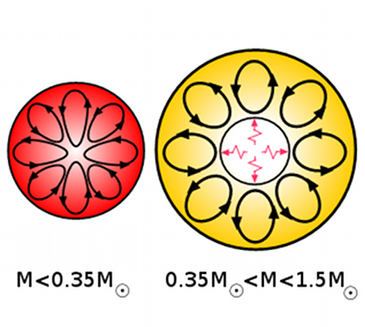
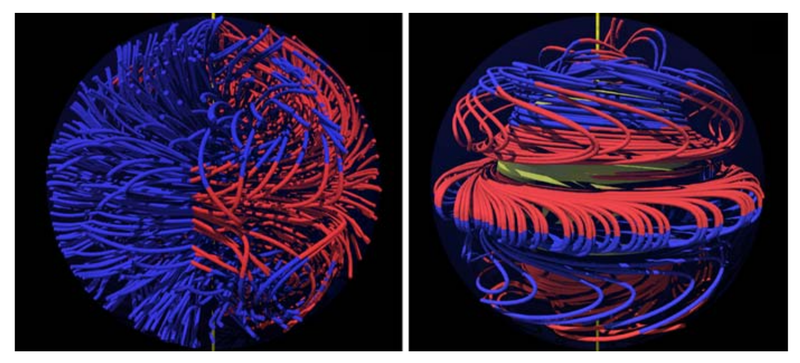
Background of V374 Peg
Fast rotation rate (P~0.5d)
Low-mass (0.28M☉) M-dwarf
Magnetic fields are sustained in this mass-regime differently than in
solar-like stars
Stellar activity is possible but
slightly different:
Slower surface evolution and
No activity cycles expected
Possibly an α²-dynamo
Solar-like αΩ or distributed α²Ω dynamo
Strassmeier, 2009 A&ARv 17, 251

Slide 3
Background of V374 Peg
ZDI (Zeeman-Doppler Imaging) measurements of V374 Peg show a stable dipole-like magnetic field (axisymmetric, poloidal)
?
Possibly an α²-dynamo
Solar-like αΩ or distributed α²Ω dynamo
Donati et al. 2006,
Sci, 311, 633
Strassmeier, 2009 A&ARv 17, 251

Slide 4
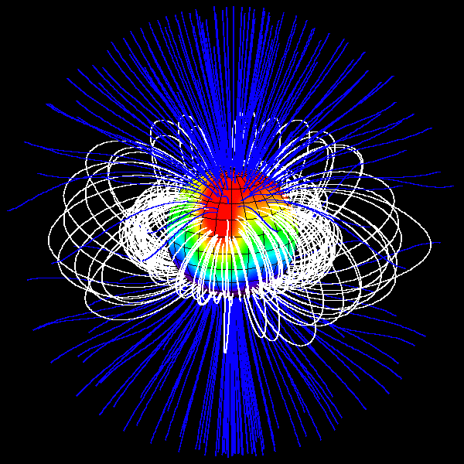
Background of V374 Peg
fallback slide
ZDI-measurements of V374 Peg show a stable dipole-like magnetic field
?
Possibly an α²-dynamo
Solar-like αΩ or distributed α²Ω dynamo
Donati et al. 2006,
Sci, 311, 633
Strassmeier, 2009 A&ARv 17, 251

Slide 5
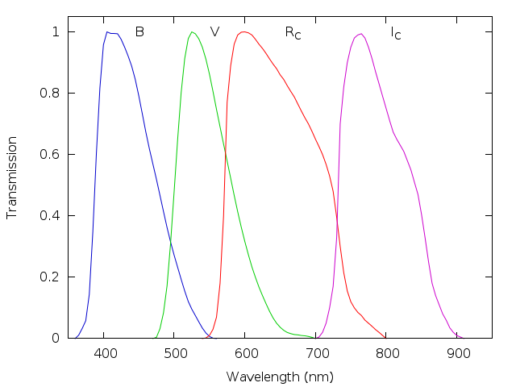
Overview of observations
Multi-passband (BVRI) data from 71 nights covering 5 years
 | Effective wavelength (nm) | Bandwidth (nm)
B | 436 | 89
V | 545 | 84
R | 641 | 158
I | 798 | 154

Slide 6
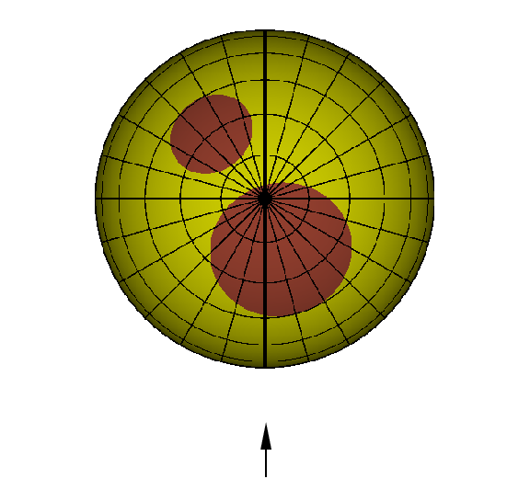
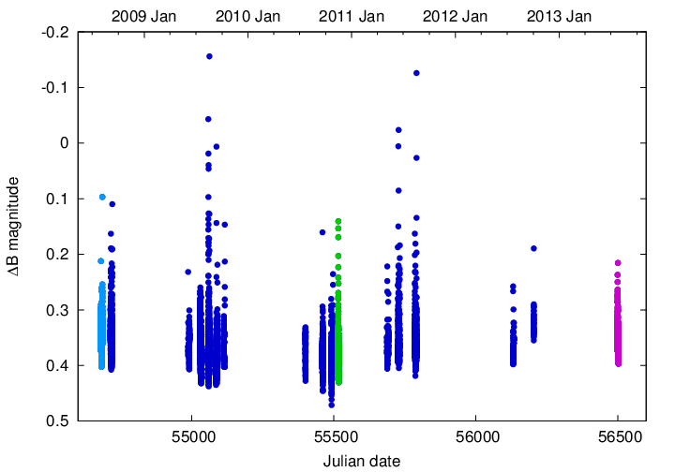
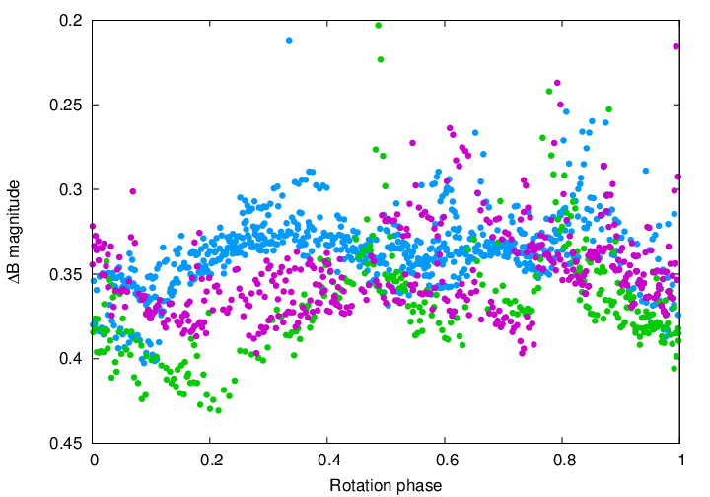
Overview of observations
Multi-passband (BVRI) data from 71 nights covering 5 years
Frequent flaring
Quite stable light curve with two large activity nests
polar view of a sample spot model

Slide 7
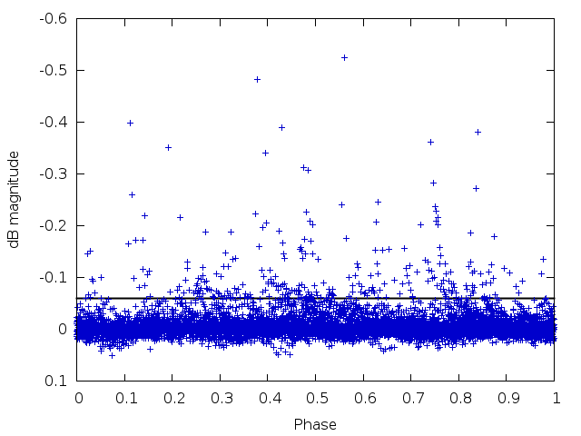
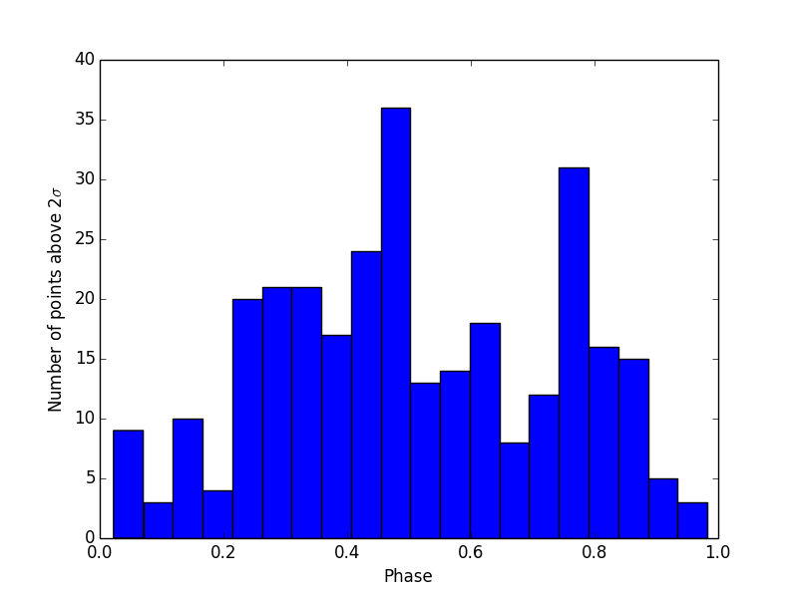
Connection between flares and active nests
Flares seem to be more frequent at one of the spotted regions, but appear at every phase of the rotation
Number of light curve points above 2σ after removing the effect of spottedness
2σ

Slide 8
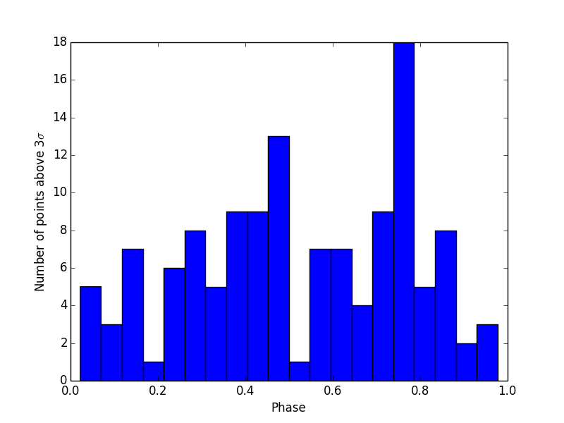
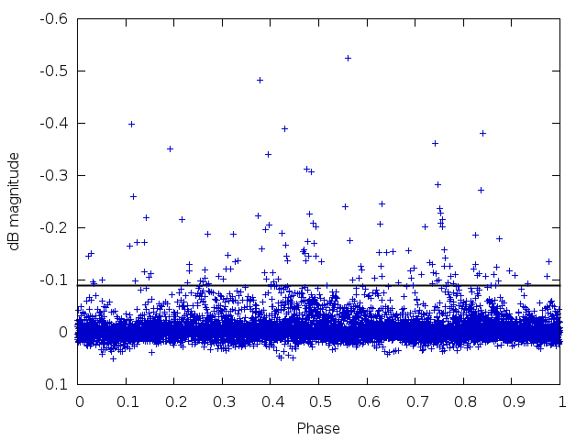
Connection between flares and active nests
Flares seem to be more frequent at one of the spotted regions, but appear at every phase of the rotation
Number of light curve points above 3σ after removing the effect of spottedness
3σ

Slide 9
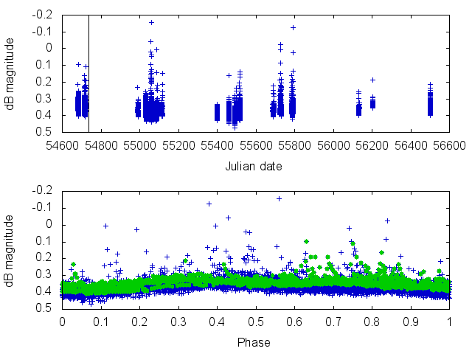
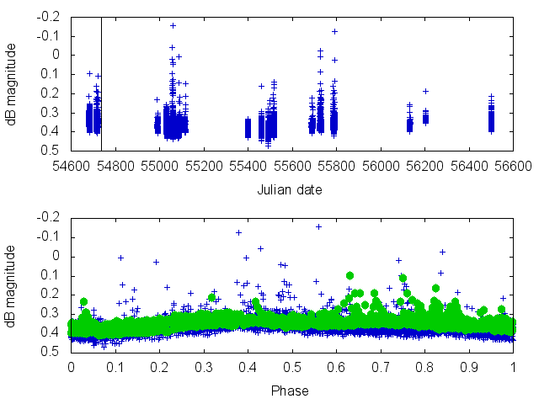
fallback slide
Connection between flares and active nests
Flares seem to be more frequent at one of the spotted regions
Number of light curve points above 3σ/2σ after removing the effect of spottedness
3σ
2σ

Slide 10
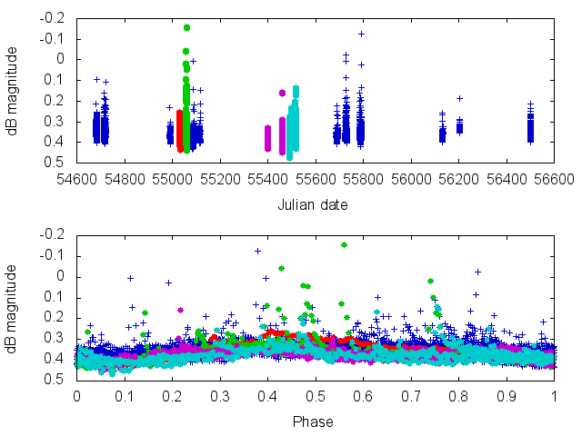
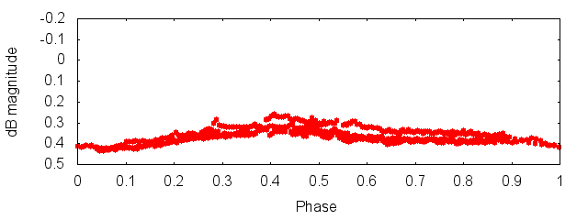
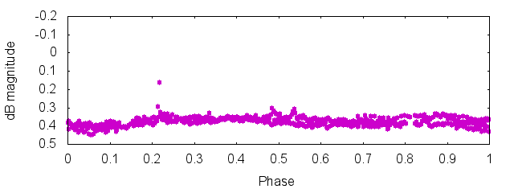
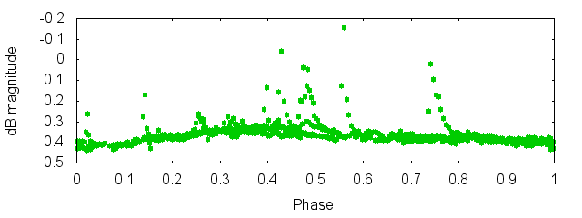
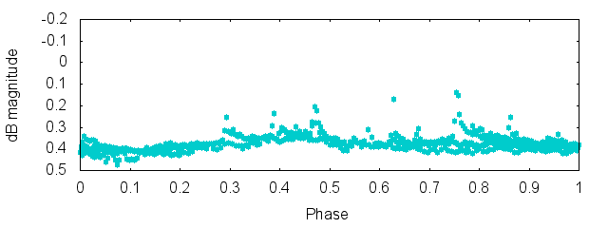
Connection between flares and active nests
Flares seem to be more frequent at one of the spotted regions
Quiet and active states change on ~weekly/monthly time scale
Could be due to energy build-up
6 days without flares
62 days with minor flares
5 days
20days later
frequent flaring
30 days
27days later
frequent flaring

Slide 11
Connection between flares and active nests
Flares seem to be more frequent at one of the spotted regions
Quiet and active states change on ~weekly/monthly time scale
Could be due to energy build-up
6 days
62 days
These daily changes in the light curve might be the result of surfacing/decaying flux ropes → new, smaller spots are born/disappear

Slide 12
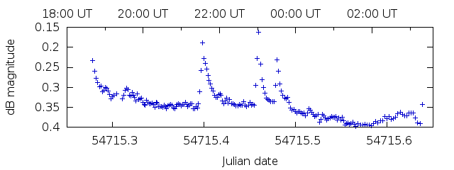
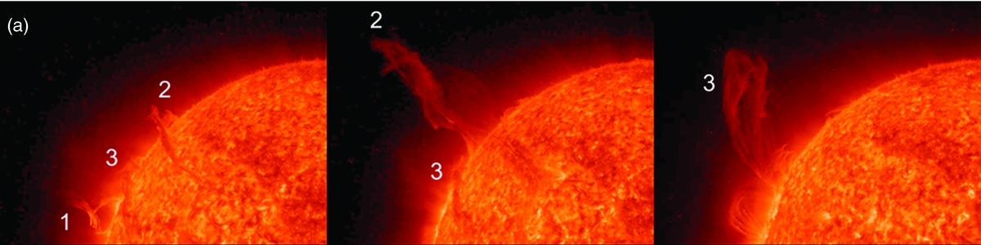
Possible sympathetic eruption(s)
Several similar events, one example from 2008 Sept. 5/6.
May be similar to solar events, e.g. on 2010 Aug. 1.
02:56
9:16
22:06
(link)

Slide 13
Possible sympathetic eruption(s)
Several similar events, one example from 2008 Sept. 5/6.
May be similar to solar events, e.g. on 2010 Aug. 1.
Model of the event: Török et al. 2011 ApJ 739 L63
02:56
9:16
22:06
(link)

Slide 14
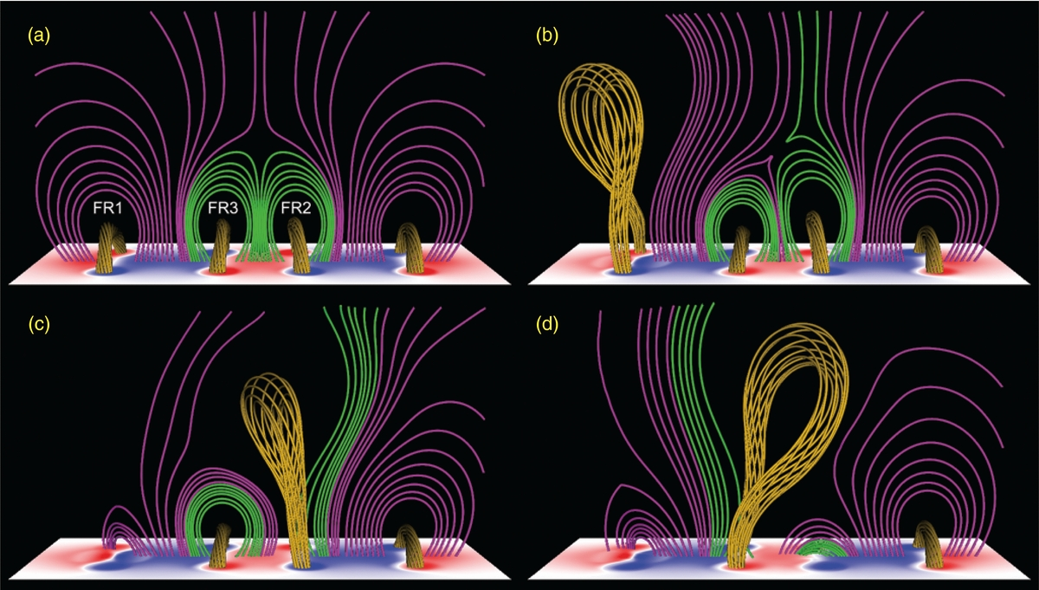
Possible sympathetic eruption(s)
fallback slide
Several similar events, one example from 2008 Sept. 5/6.
May be similar to solar events, e.g. on 2010 Aug. 1.
Model of the event: Török et al. 2011 ApJ 739 L63

Slide 15
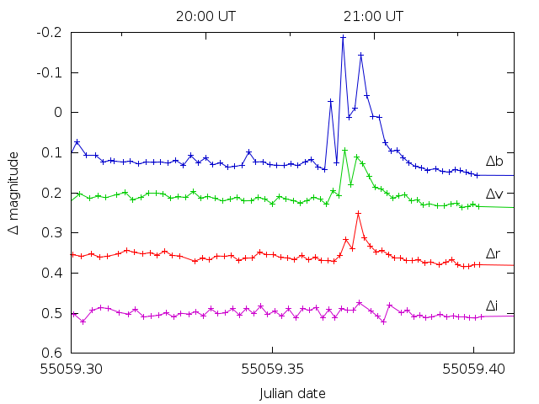
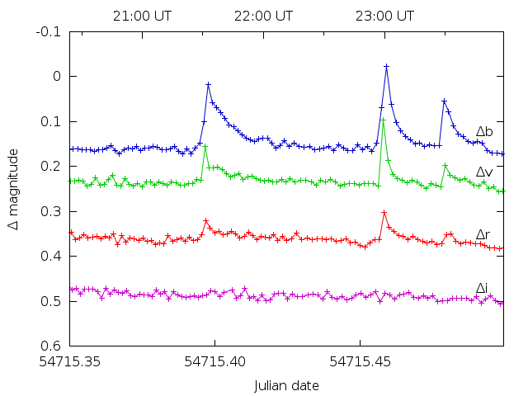
Flare gallery
 | Effective wavelength (nm) | Bandwidth (nm)
B | 436 | 89
V | 545 | 84
R | 641 | 158
I | 798 | 154
Larger events visible in BVR bands
Complex light curve structure (multiple eruptions)
Possible CMEs?
Typical time scale ~10 mins
Point source → actual geometry unknown
This is not the quiescent state!
t~36min
t~80min
~25min
~25min
436nm
545nm
641nm
798nm
total ~2.5h

Slide 16
Summary
V374 Peg is a fast-rotating fully
convective M-dwarf
Magnetic dynamo probably different from
solar case
Strong activity observed – frequent flaring
Stable surface configuration (both from ZDI and light curves)
Daily variations in the light curve
Flares more frequent at one of the active nests
Weekly/monthly alternation between of flaring/quiet states
Possibly sympathetic flares observed
Complex flare structures

Slide 17
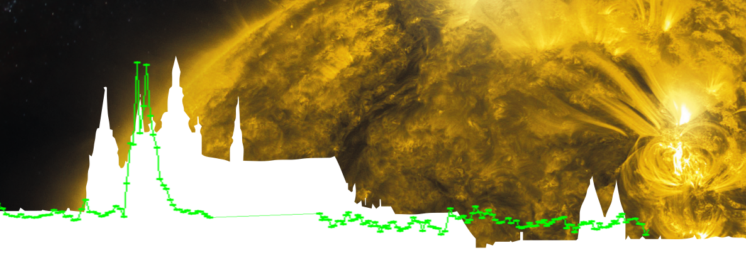
+1: Our best “model fit” to the 2009/08/15 event

