Slide 1
Recent photometric observations of Virtual Impactors and space mission asteroid targets (project NEOSource)
Petr Pravec
Astronomical Institute AS CR, Ondřejov Observatory, Czech Republic
34th Meeting of the NASA Small Bodies Assessment Group (SBAG)
Baltimore, MD, USA (Virtual)
2026 January 13-14
Jet Propulsion Laboratory
California Institute of Technology
Davide Farnocchia

Slide 2
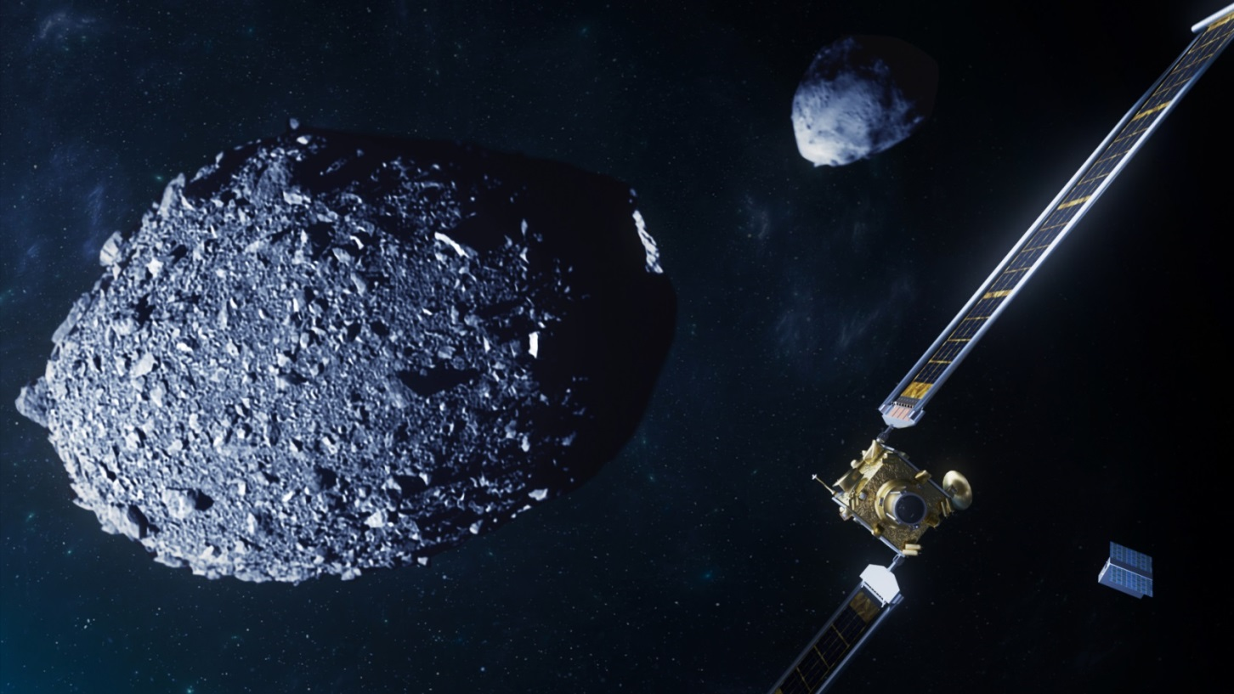
Project NEOSource
Targeted lightcurve photometry of interesting (scientifically, for planetary defense, or space missions) asteroids.
Our team: P. Pravec, P. Fatka, P. Scheirich (scientists), P. Kušnirák, K. Hornoch, H. Kučáková, A. Galád (observers), M. Velen (sw)
Recently supported by Praemium Academiae 2024 award from the Czech Academy of Sciences (since January 2025).
Our focus:
Potentially dangerous asteroids (Virtual Impactors) during their close approaches to Earth
Asteroids that are planned or potential targets of space missions
Determined or estimated asteroid properties:
Spin rate, axis, and state (excited vs basic spin state)
Size, shape, albedo, color
Binarity (and physical and orbital parameters of the satellite)

Slide 3
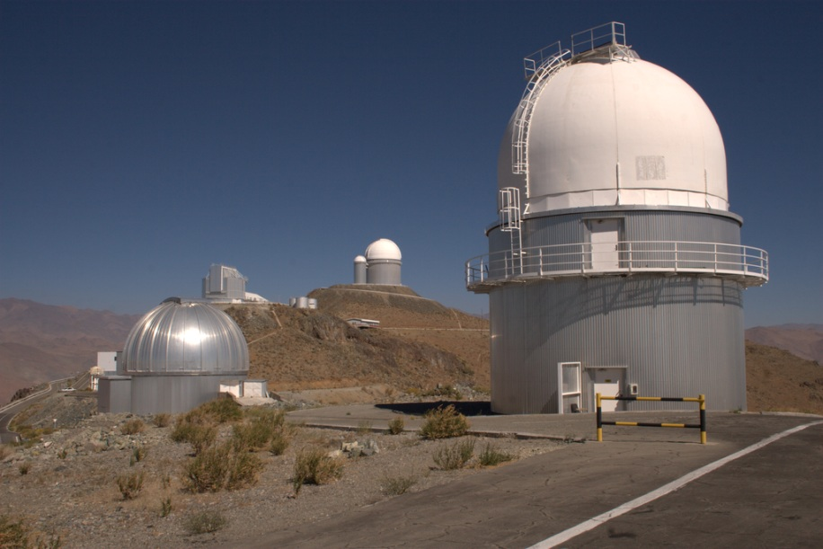
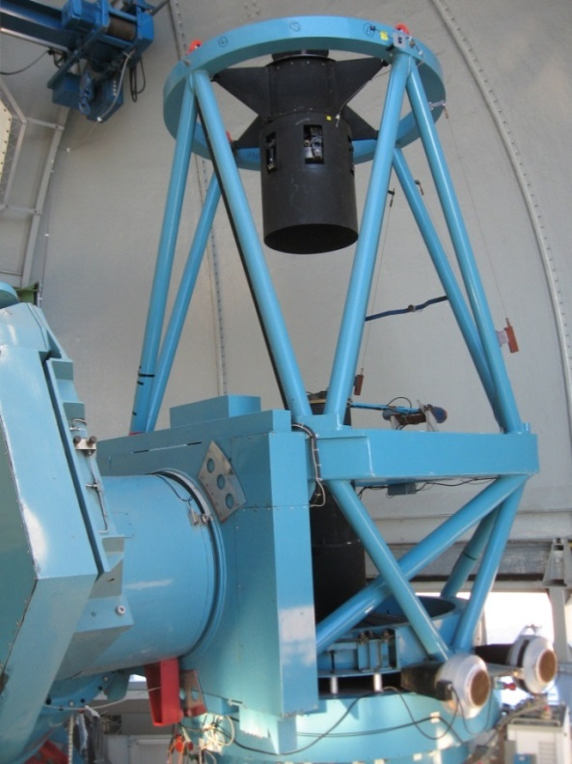
Main instrument: Danish 1.54-m telescope (DK154)
A remotely-operated photometric telescope at ESO La Silla, Chile.
Operated collaboratively by the MiNDSTEp team of the Niels Bohr Institute, Copenhagen University (owner) and the Asteroid Physics team of the AI AS CR Ondřejov.
Precise time-resolved (lightcurve) photometry for NEAs up to V = 20. High-quality astrometry up to V = 23.5.

Slide 4
Observations of potentially dangerous NEOs
Several nights per lunation typically available at DK154 for our observations of potentially dangerous NEOs (VIs).
Semi-flexible allocation of observing nights and time (depending also on other programs running at the telescope).
Targets selected from JPL’s Sentry and ESA’s Risk List – “last minute” updates of our target list (several hours before an observing night).
Observed 20+ NEOs from the risk lists in 2025, of them following four still remain on Sentry:
2024 YR4
2025 QP3
2025 VP2
2025 WZ3

Slide 5
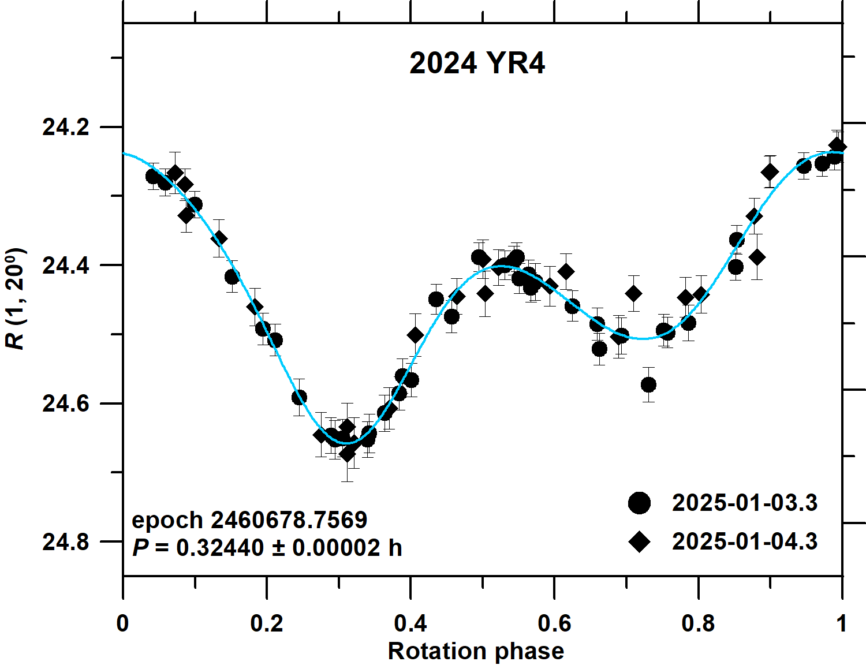
2024 YR4
We took thorough photometric data on 2025 Jan. 3 and 4 (~one week after its discovery and a few days after it was identified as dangerous).
First determination of its spin period P = 0.32440 ± 0.00002 h (announced via the SBO-NASA community via the the SBO-NASA mailing list on January 3).
Constraint on its spin state: Principal axis rotation (or close to it).
Determined/estimated also its H and (V – R).
Astrometric observations on 18 nights (53 positions, rms residual 0.05”) until 2025Feb. 6 (coll.XXXXXX XXXX XXXX Feb. 6 (collaboration with M. Micheli)
Rivkin, Mueller, MacLennan, Holler, Burdanov, de Wit, Pravec, et al., "JWST Observations of Potentially Hazardous Asteroid 2024 YR4", RNAAS 9, 70, 2025
Devogele, Hainaut, Micheli, Pravec, et. al., “Rapid-response characterization of near-Earth asteroid 2024 YR4 during a Torino Scale 3 alert”, Journal of the Astronautical Sciences, in press.
Micheli, Devogele, Denneau, Ryan, Ryan, Pravec, et al., “Astrometric follow-up of near-Earth asteroid 2024 YR4 during a Torino scale level 3 alert”, Journal of the Astronautical Sciences, in press.

Slide 6
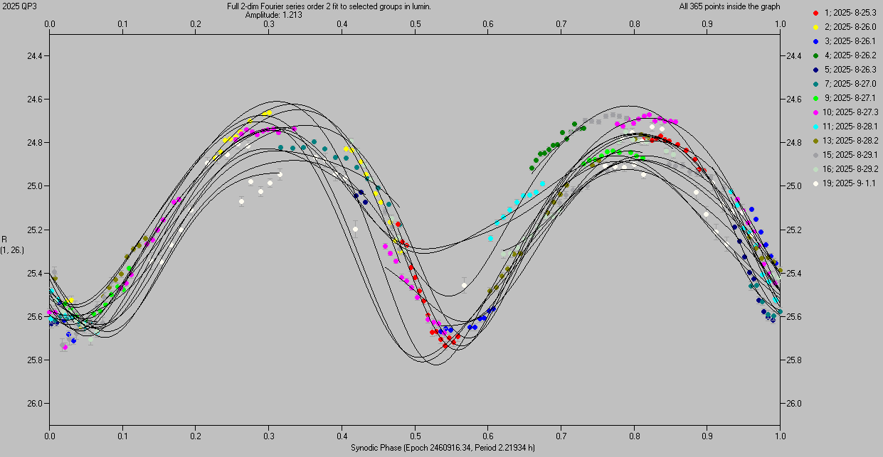
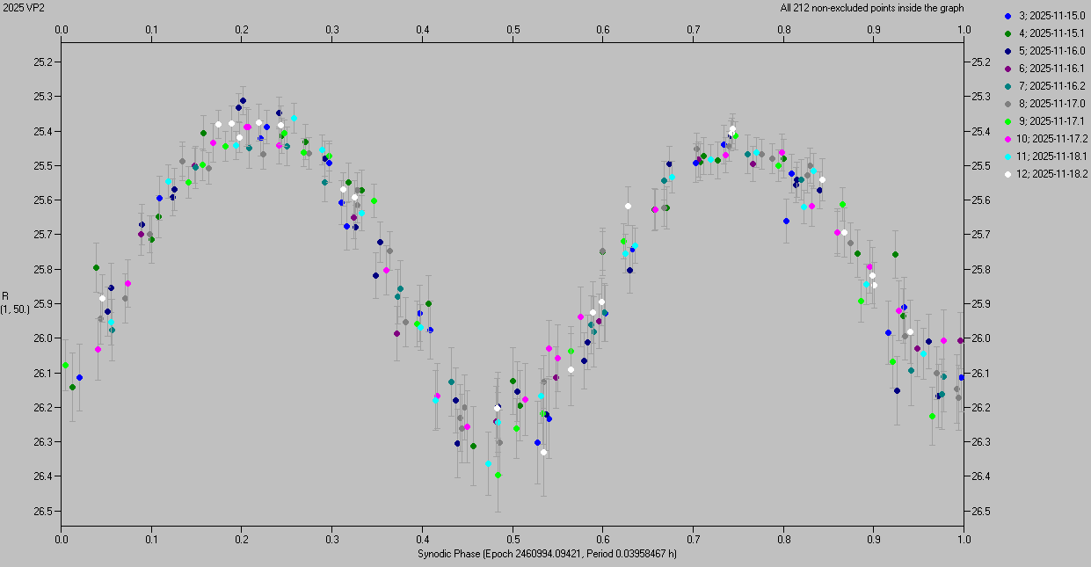
2025 QP3 and 2025 VP2
Observed 2025-08-25 to 2025-09-01 (2025 QP3) and 2025-11-15 to 2025-11-18 (2025 VP2).
Both are (super-)fast rotating tumblers. Their main periods P = 2.2193 ± 0.0008 h and 0.0395847 ± 0.0000002 h, respectively.
Determined/estimated also their H and (V – R). High-quality astrometry (errors < 0.1”) also done (M. Micheli).

Slide 7
Observations of (potential) s/c asteroid targets
Several tens of nights at DK154 used for photometric lightcurve characterization of following (in flight, prepared or potential) space mission targets in 2025:
JAXA’s Hayabusa2#: (98943) Torifune, (162998) 2001 SK162
ESA’s Hera extended mission: binary asteroids (1480) Aunus, (2535) Hameenlinna
UAE’s EMA: (10253) Westerwald, (13294) Rockox, (23871) 1998 RC76, (59980) 1999 SG6, (88055) 2000 VA28
JAXA’s DESTINY+: (3200) Phaethon, (154276) 2002 SY50, 2024 YR4
RAMSES backup target: 2011 CG2
Objects “of interest to NASA” (or from NHATS): (3361) Orpheus, (350523) 2000 EA14, (612227) 2001 QC34, 2012 XF55, 2025 QP3 (also VI, see previous slide), 2025 WN1
Data prepared for publication (e.g., 98943 Torifune update to Fatka+2025; 3200 Phaethon within the D+GOWG).
I plan to present an overview of the results at the ACM 2026 conference in Poznan, Poland, in July 2026, followed by a paper in the 2nd half of the year.
A summary data for a part of the objects available in the list linked at https://space.asu.cas.cz/~ppravec/newres.htm

Slide 8
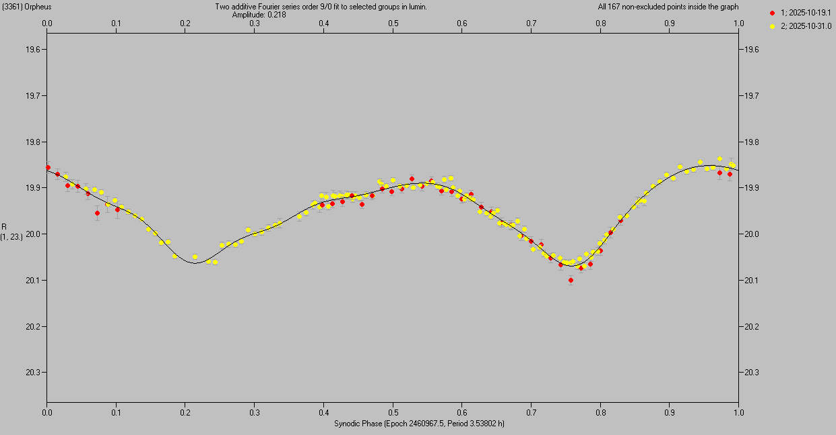
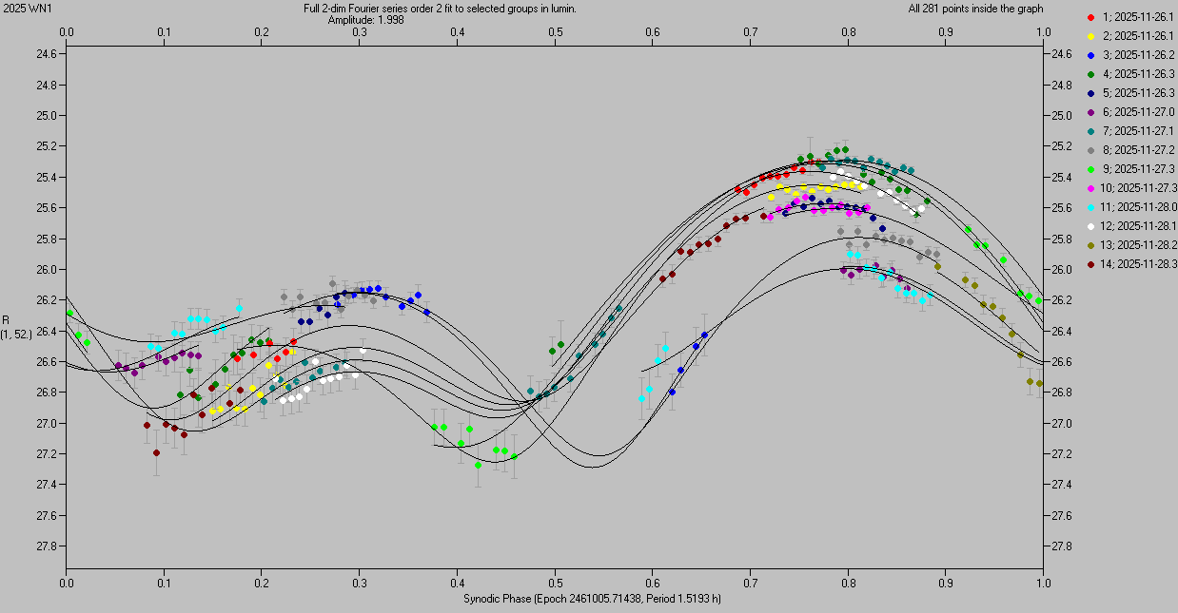
(3361) Orpheus and 2025 WN1
Orpheus is an NHATS object. We observed it on 2025-10-19 and 2025-10-31, confirmed its P = 3.538 h and principal axis rotation. Its spin&shape modeling to be done (using our and other data from previous apparitions); was also observed with the Goldstone radar in 2021.
2025 WN1 was announced as object “of interest to NASA” on the SBO-NASA mailing list in November. We observed it from 2025-11-26 to 2025-11-28, found it to be a fast rotating tumbler with main periods of 1.5193 ± 0.0004 h and 2.2131 ± 0.0008 h. Also did high-quality astrometry with errors < 0.1” (M. Micheli).

Slide 9
Plans for observations in 2026 (and beyond)
Continuation and further enhancement of our observing program in this and following years. (Have got funding for ~80 nights at DK154 per year.)
Our focus in this year still on:
Potentially dangerous asteroids (VIs) during their close approaches to Earth
Asteroids that are planned or potential targets of space missions
Re. 1. More VIs expected to be followed up (also as LSST begins regular survey).
Re. 2. Data for more (potential) space mission targets to be taken (e.g., 2017 SL14, 2025 VD24, EMA targets).
Continuing and enhancing our collaborations, e.g.,
With ESA (also within the EU/ESA NEOPOPS project)
Within DESTINY+ Ground Observations WG
With NASA (informally) on targets that are “of interest to NASA”.

Slide 10
Thank you!

