Slide 1
Physical parameters of near-Earth and small main-belt binary asteroids
Petr Pravec
Astronomical Institute AS CR, Ondřejov, Czech Republic
Binaries in the Solar System VI workshop
Cote d’Azur Observatory, Nice, France
2025 September 15-17

Slide 2
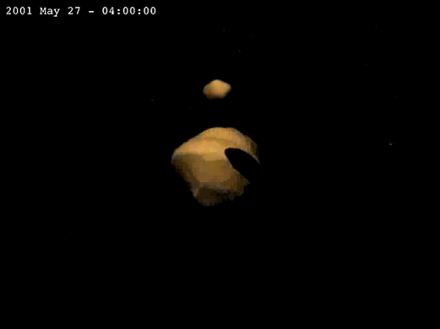
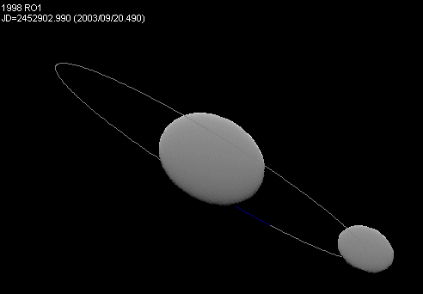

Small asteroid systems
Systems of 2 or more components, bound or unbound.
Bound asteroids –
Binary/multiple systems:
About 15% (±4%) of asteroids smaller than 15 km are binary.
Currently known more than 300 of them.
(Ostro et al. 2006)
(Scheirich and Pravec 2009)
Unbound asteroids –
Asteroid pairs:
Have highly similar heliocentric orbits (due to low-speed separation).
Currently identified more than 200 of them.
(Pravec et al. 2010)

Slide 3
Observational techniques for detection of small asteroid systems (ordered by the number of observed binaries)
Photometry
Radar
Adaptive optics
Stellar occultations
S/c imaging

Slide 4
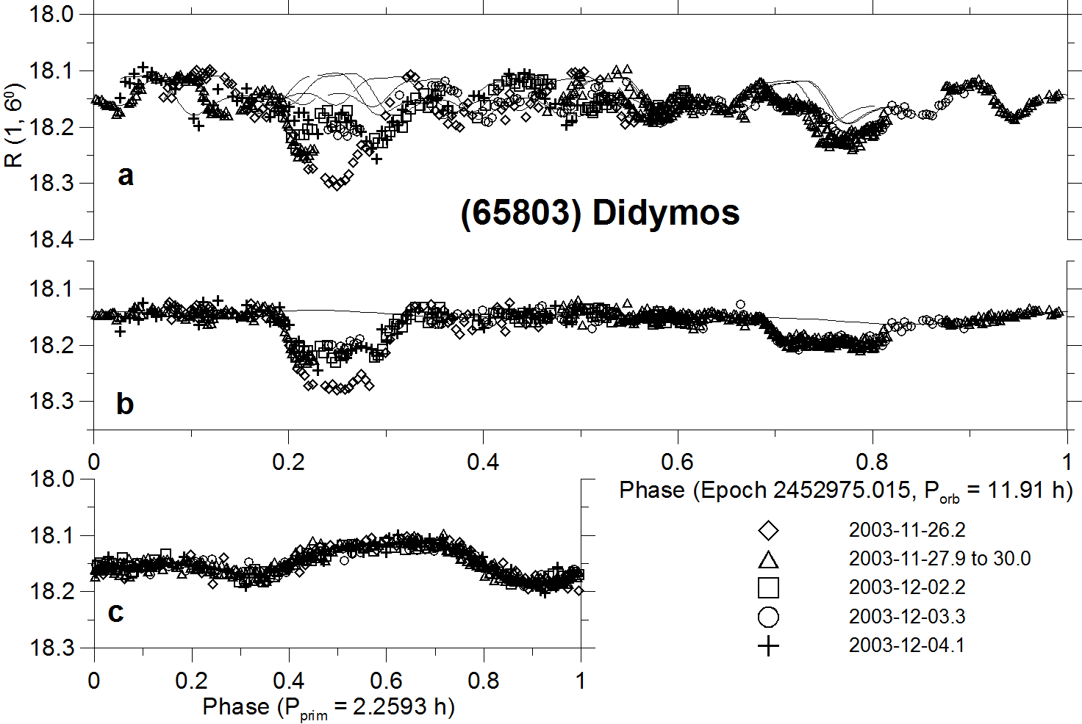
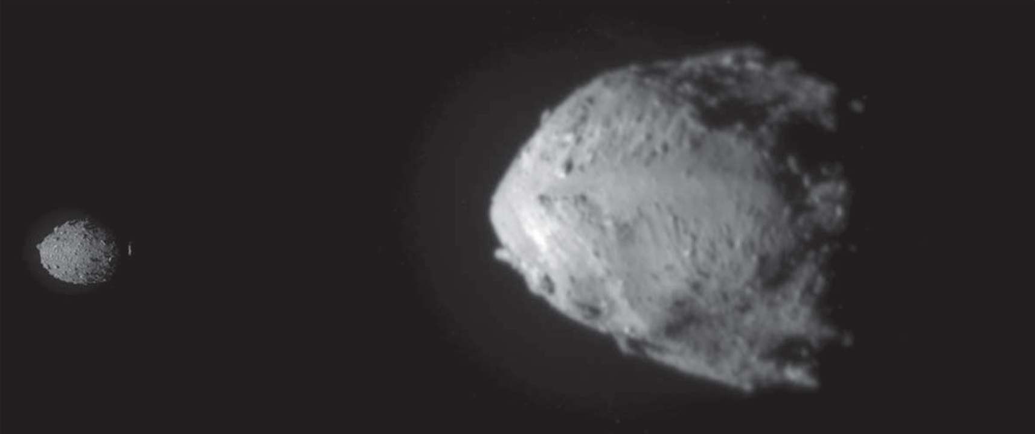
(65803) Didymos Photometric discovery and radar co-discovery of its satellite
The asteroid was discovered by Spacewatch from Kitt Peak on 1996 April 11.
Its binary nature was revealed by both photometric and radar observations taken around its close approach to Earth (min. distance 0.05 AU) during 2003 November 20-24 (Pravec et al. 2003).
Mutual events (eclipses+occultations) between the binary system components observed in 2003 (a sample of the data is shown):
DRACO@DART images of the primary Didymos (right) and the secondary Dimorphos (left):
(Chabot et al. 2024)
(Pravec et al. 2006)

Slide 5
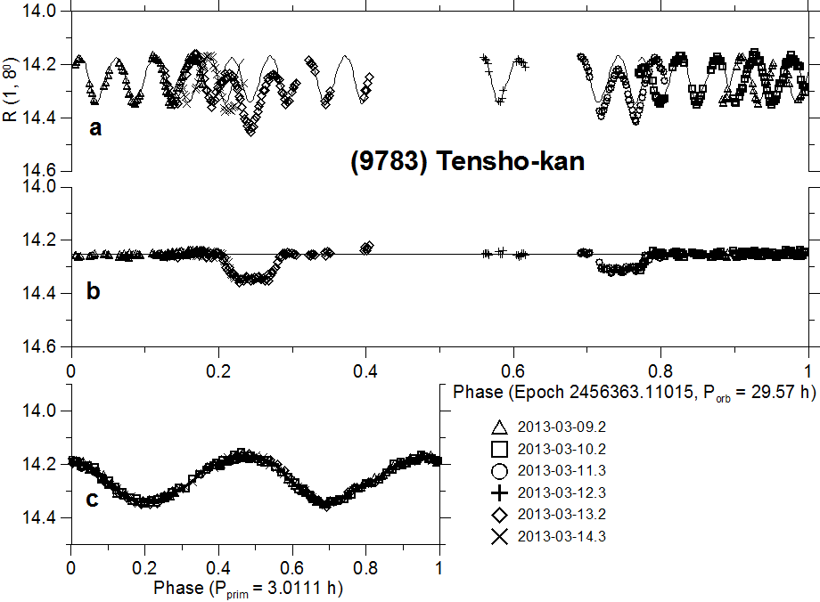
Photometric observations of a binary asteroid
Full lightcurve
Binary asteroid lightcurve decomposition (Pravec et al. 2006, 2022, 2024):
Mutual events
eclipses/occultations
Primary rotational lc

Slide 6
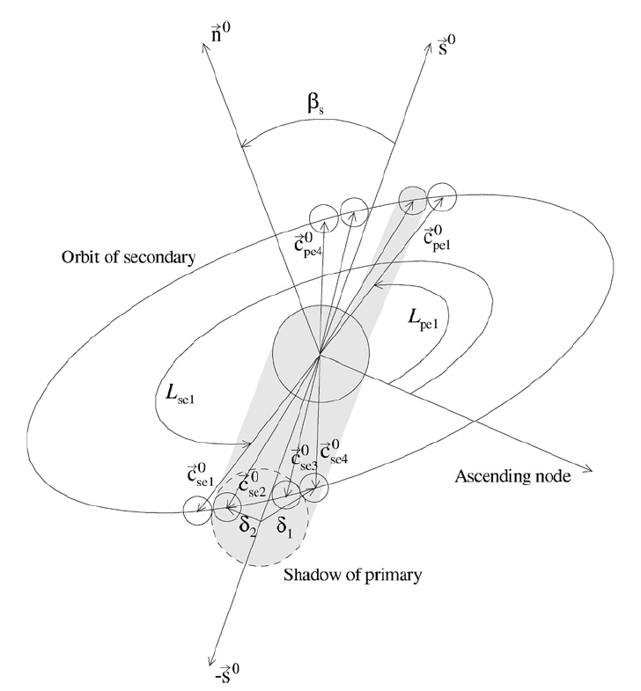
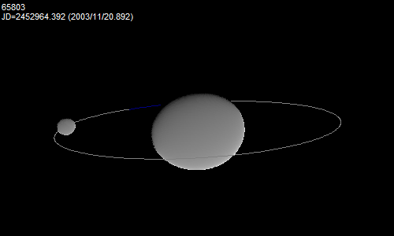
Modeling of binary asteroids from photometry
Modeling of observed mutual events (their timings and shapes) between system’s components and their rotational lightcurves.
Derived/constrained parameters:
P1, (P2) .... primary (secondary) periods
D2/D1 .... ratio of effective diameters
a1/b1, (b1/c1), (a2/b2) …. axial ratios
Porb, Lorb, Borb, a_{orb}, e_{orb}, Morb …. mutual orbit
ρ₁ …. primary bulk density
More parameters when combined with radar,
thermal or spectral data.
(Scheirich and Pravec 2009)

Slide 7
Properties of small binary asteroid systems

Slide 8
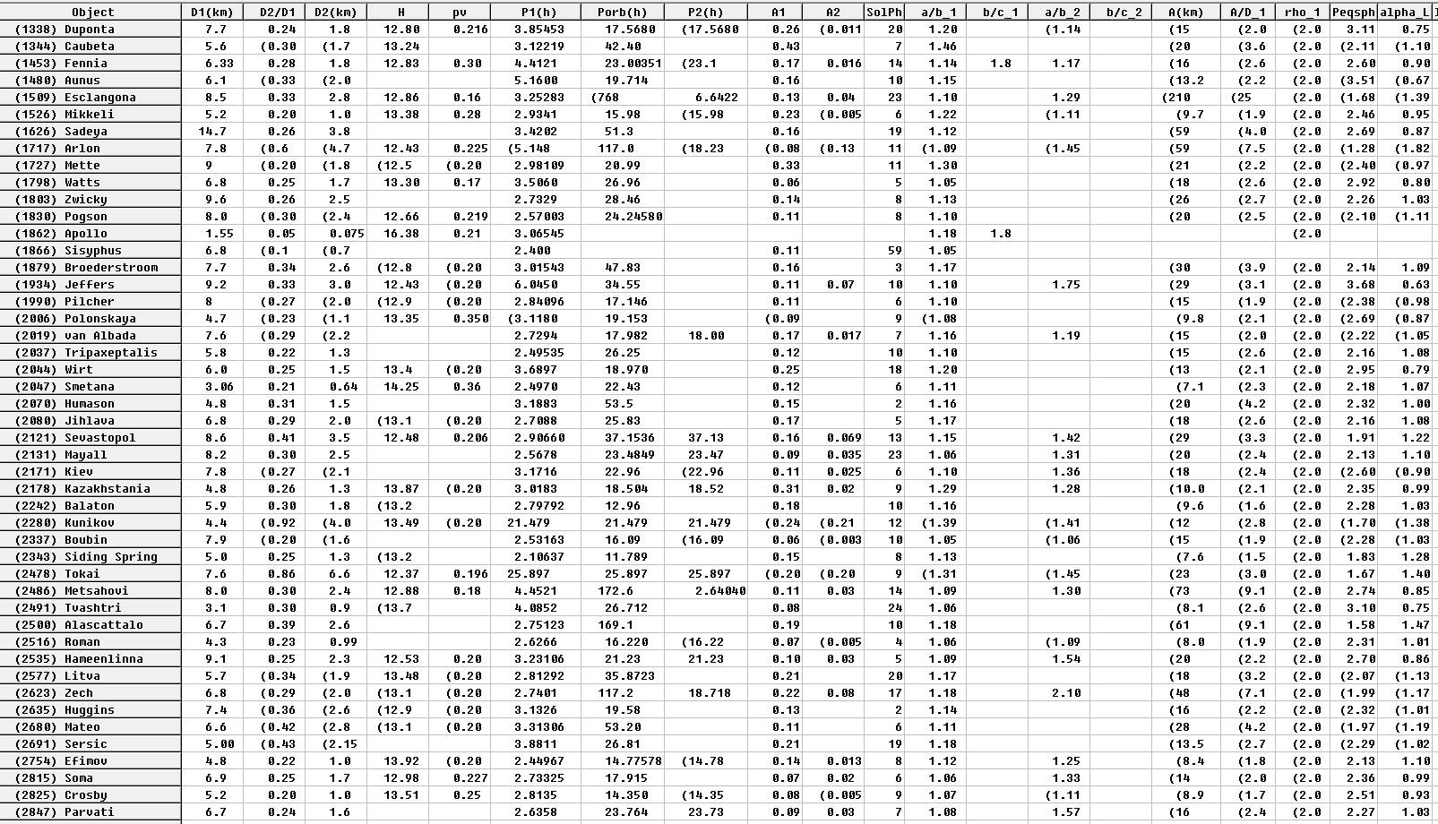
Data on small binary asteroid parameters
Ondřejov Binary Asteroid Parameters database:
https://space.asu.cas.cz/~asteroid/binastdata.htm
First published in Pravec and Harris (2007). Updated semi-regularly since then.
Another major update in progress.

Slide 9
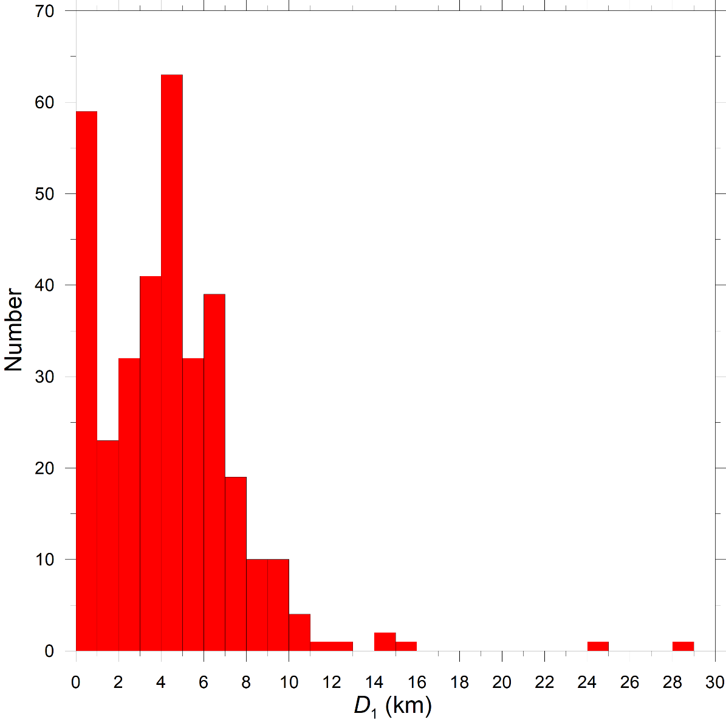
Primary sizes (1)
Main features of the size distribution:
Binaries larger than D₁ ~ 15 km are rare.
Approximately exponential increase with D₁ from 12 downto 4 km – probably just reflecting the MBA SFD.
The drop from 4 downto 1 km probably just an observational bias (MBA binaries harder to detect, NEAs not numerous enough to compensate).
The peak at the lowest bin (D₁ = 0 to 1 km) are NEA binaries – lightcurve and radar observations focus on them.

Slide 10
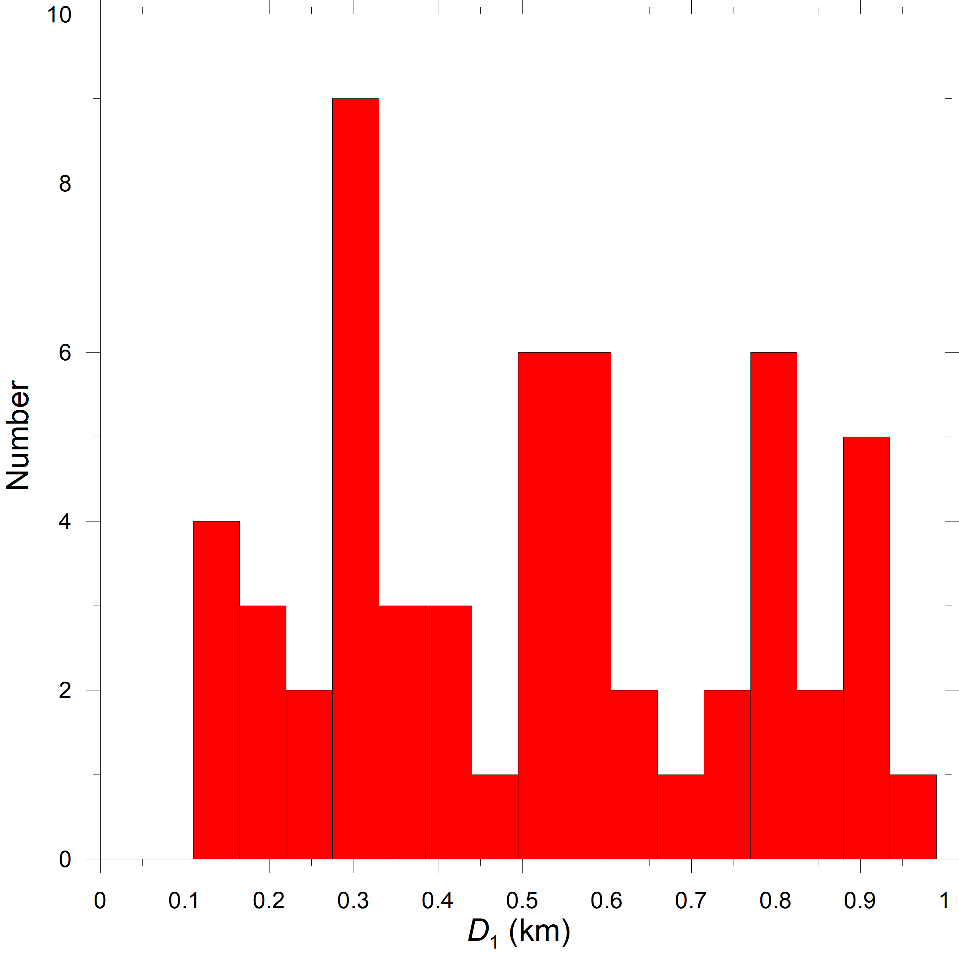
Primary sizes (2)
NEA binaries below D₁ = 1 km:
Probably just random fluctuations downto (nearly) 0.1 km.
The lack of binaries with D₁ about and less than 0.1 km is real!
The smallest known binary is 2020 AZ2 with D₁ = 135 ± 16 m.
Coincides with the “transition” diameter around 150 m between larger (mostly) sub-critically rotating asteroids (nearly cohesionless rubble piles?) and smaller ones with (mostly) superfast rotations (with more significant cohesion?)
Cohesion seems to play a significant role in formation or evolution/survival of small binaries.

Slide 11
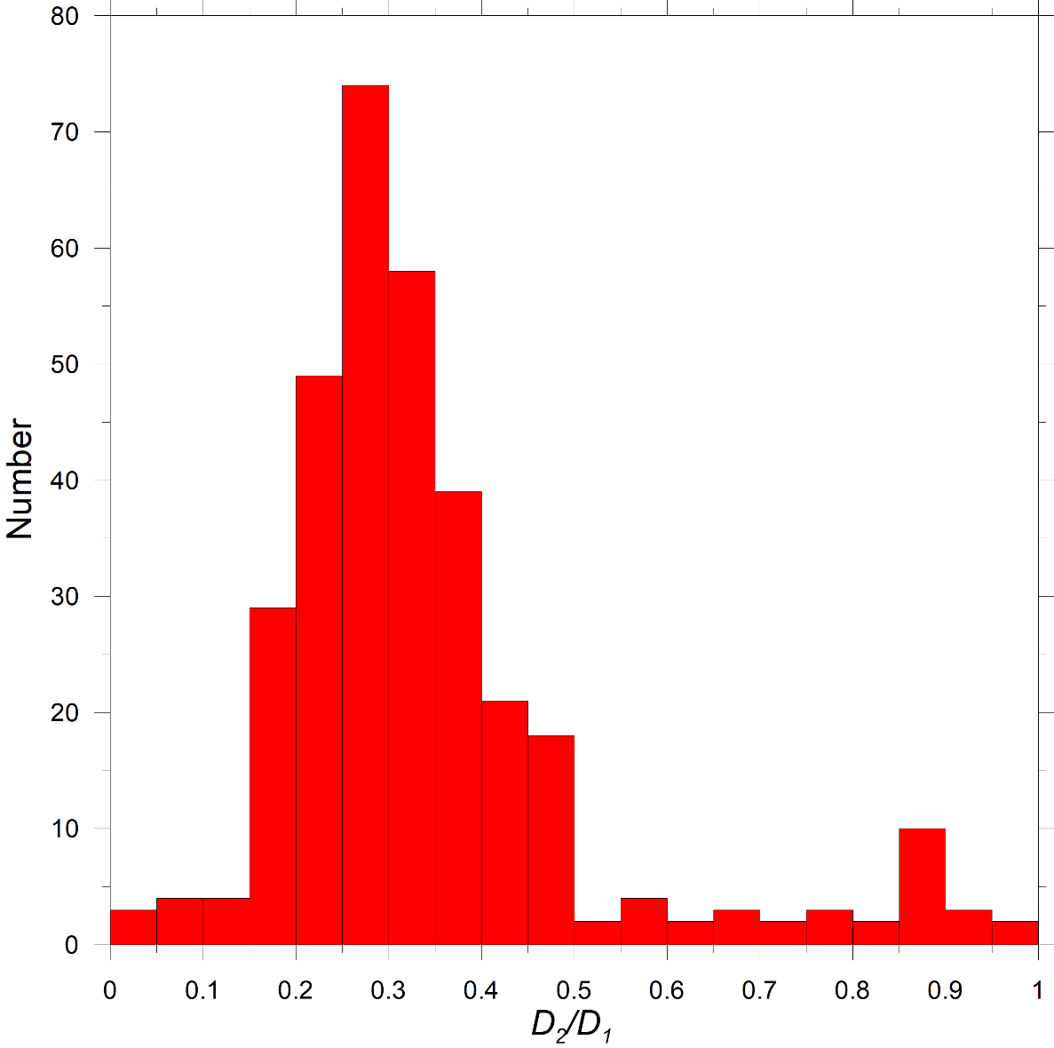
Component size ratios
Main features of the secondary-to-primary diameter distribution:
Fully synchronous (tidal synchronization) binaries with high size ratios are relatively rare. Uniform distribution – real feature or observational artifact?
Increase with D₂/D₁ from 0.5 downto 0.25 is real – smaller satellites are more numerous.
The drop from 0.25 downto 0.15 is an observational selection effect (decreasing sensitivity of the photometry method).
Below D₂/D₁ = 0.15, only radar occasionally detects binaries (photometry insensitive).

Slide 12
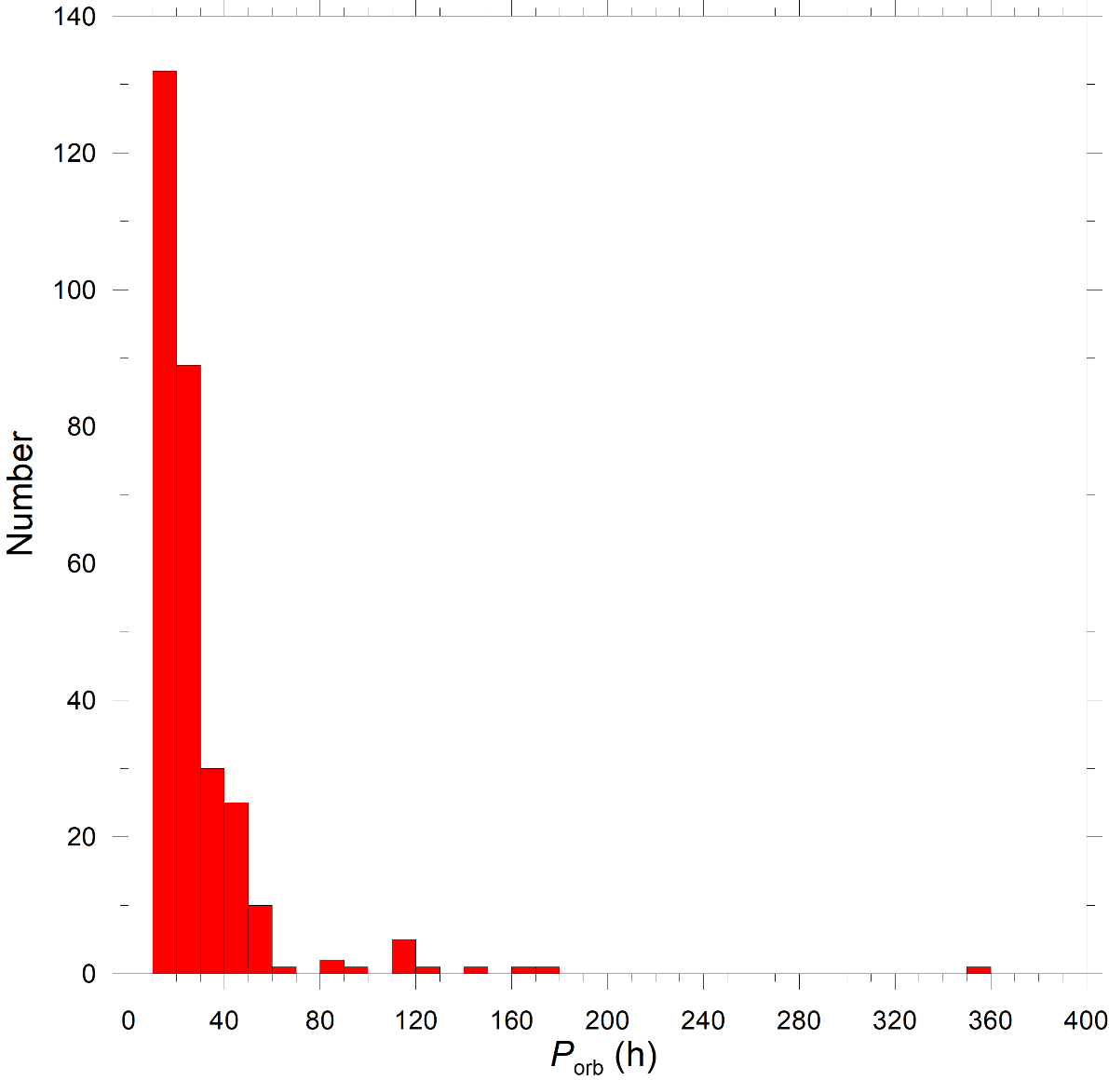
Secondary orbits/orbital periods (1)
Strong observational selection effect of the photometry technique against wider binaries (longer P_{orb}).
Wide MBA binaries (with satellites on distant orbits) do exist – detected with the AO technique (and potentially also from stellar occultations)
Radar – wide NEA binaries could be detected, but they are not seen; there is really a paucity of wide binaries among NEAs!

Slide 13
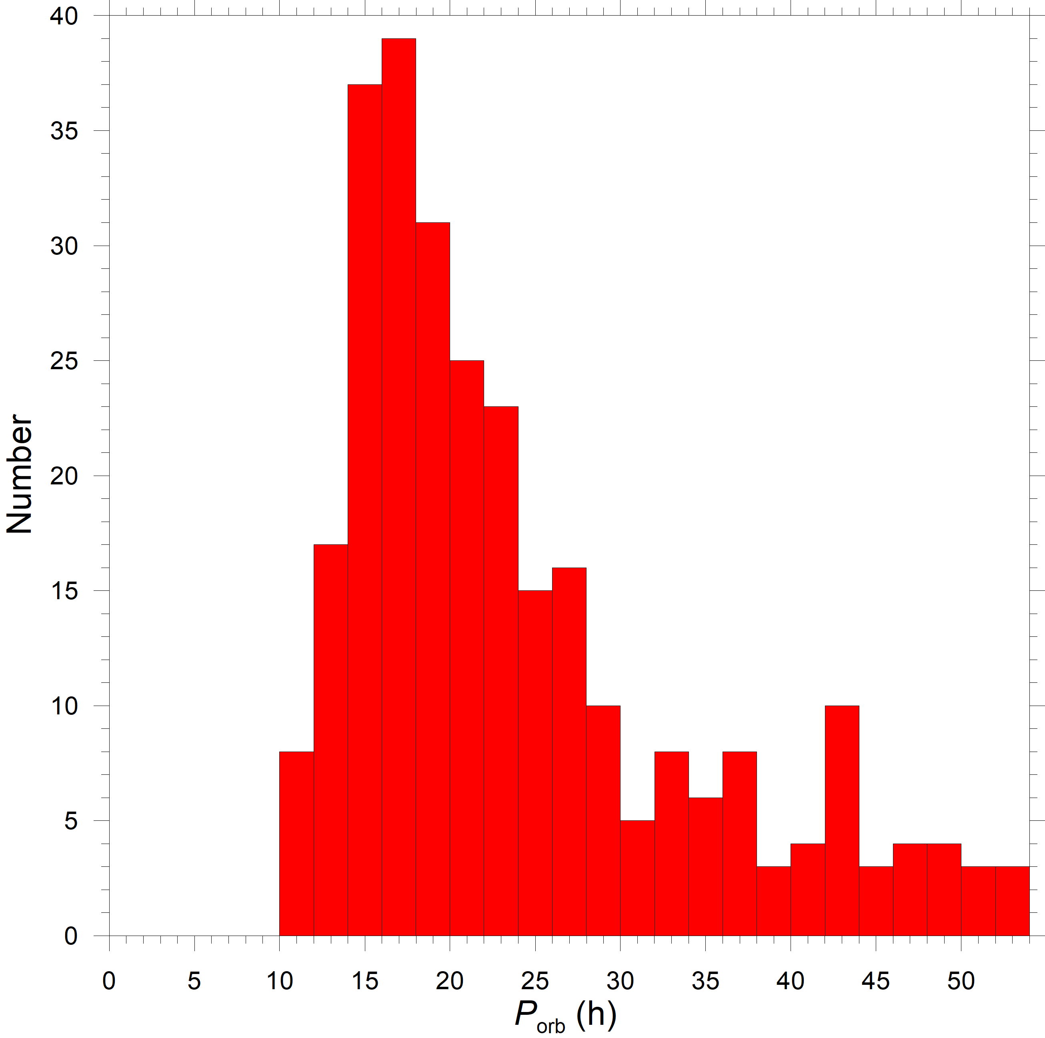
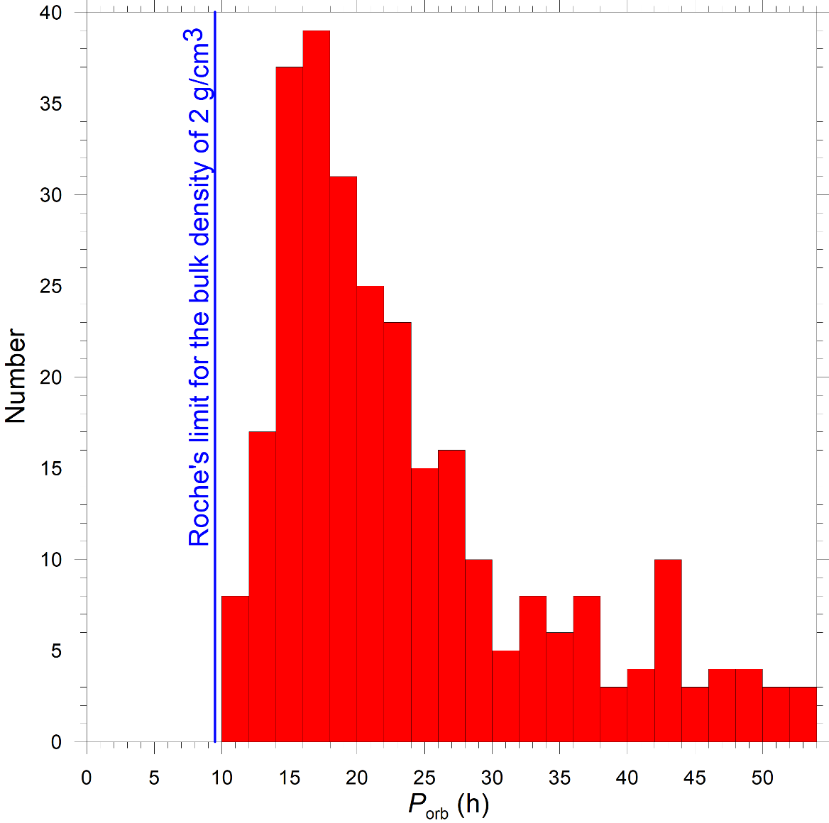
Secondary orbits/orbital periods (2)
The P_{orb} distribution for tight binaries (with satellites on close orbits):
The decrease from P_{orb} = 18 to 30 h rather steep – probably partially real feature (observational bias not so prominent at these P_{orb} values).
The decrease from P_{orb} = 16 downto 10 h is a real feature.
The peak of the P_{orb} distribution for NEA and small MBA binaries at about 17 h is real.
The lack of binaries with P_{orb} < 10 h is real. Consistent with Roche’s limit for strengthless satellites.
Didymos is one of the tightest binaries!

Slide 14
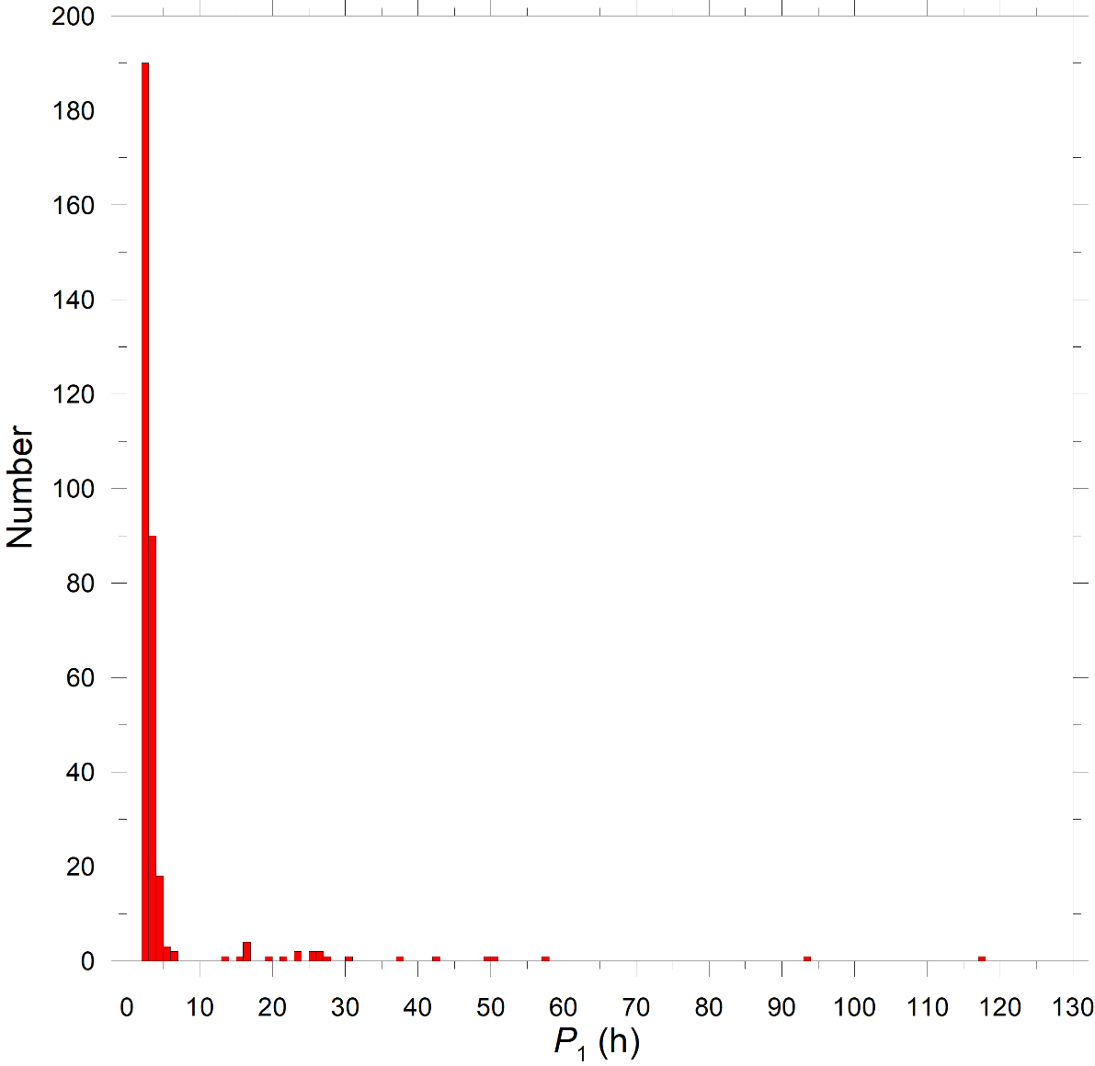
Primaries – spin periods (1)
Vast majority of primaries are fast rotators.
Primaries with slow rotations in the realm of 10s of hours – tidally synchronized (systems with high size ratios D₂/D₁ = 0.5 to 1).

Slide 15
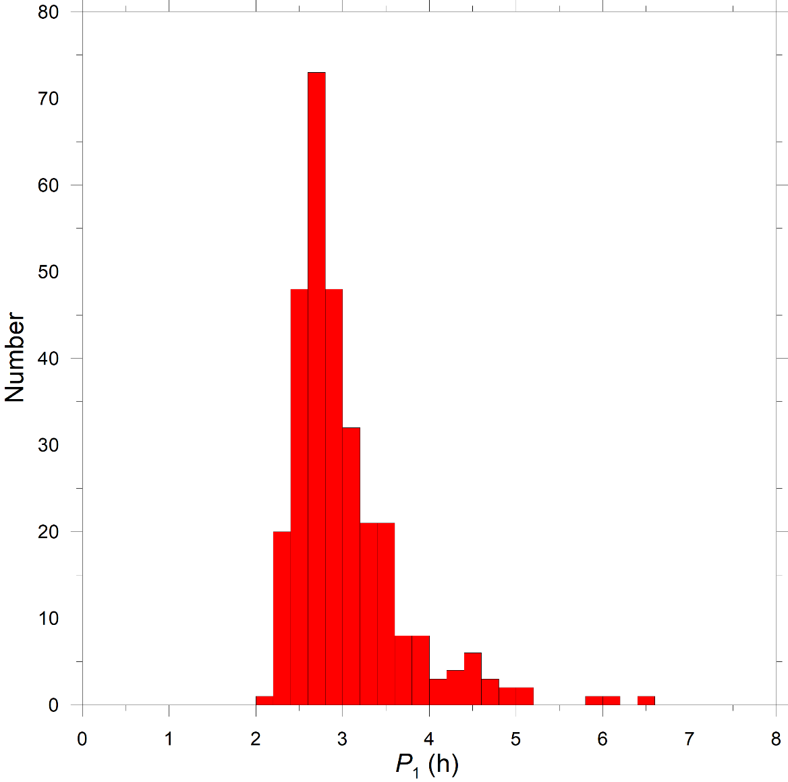
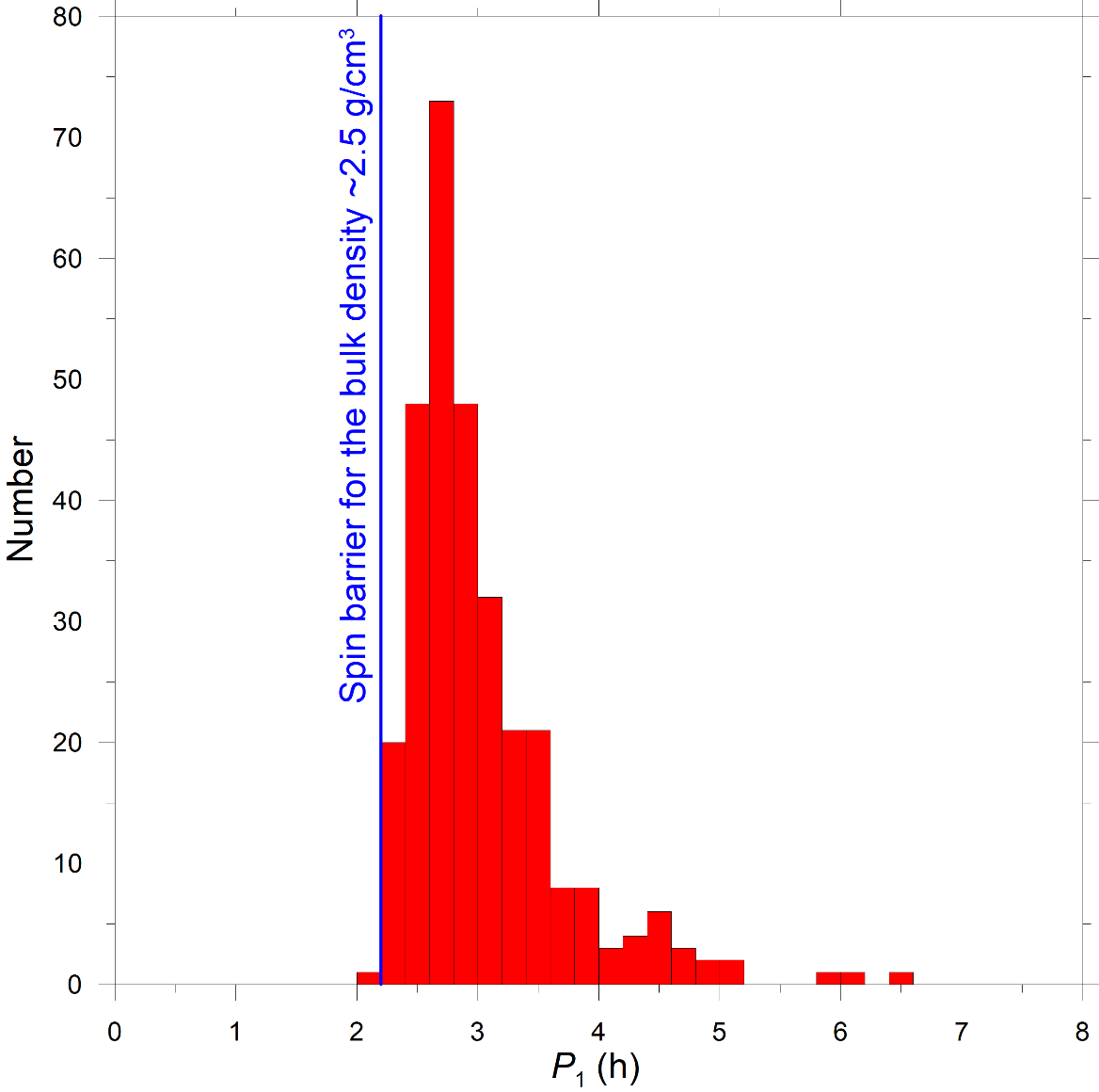
Primaries – spin periods (2)
The P₁ distribution of not-fully-synchronous binaries (with D₂/D₁ < 0.5):
Most primaries have spin periods between 2.2 and 3.6 h.
The peak at P₁ = 2.7 h is real.
Primaries do not rotate faster than the “spin barrier” for (effectively) cohesionless bodies. The fastest rotating primary: (2343) Siding Spring with P₁ = 2.1064 ± 0.0001 h.
Didymos is one of the fastest rotating primaries!

Slide 16
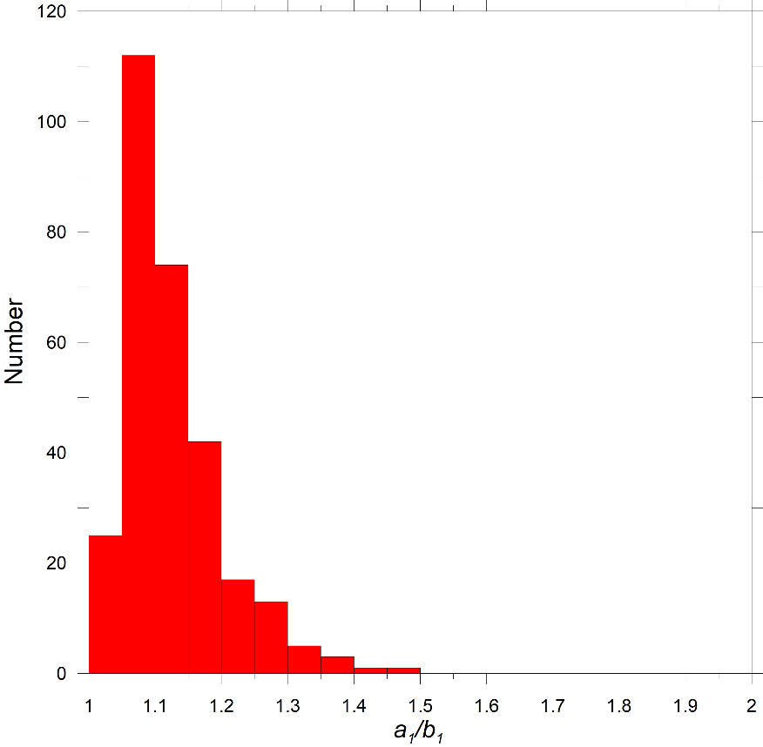
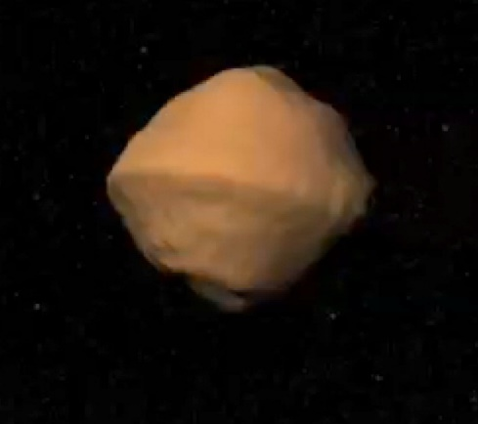
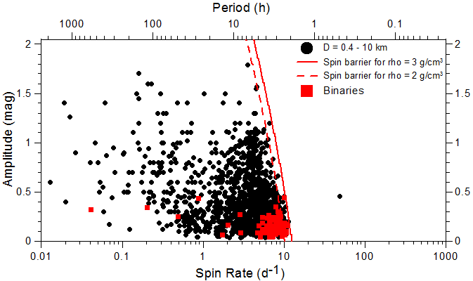
Primaries – shapes
Primary equatorial elongations:
1) Primaries tend to be nearly (but not perfectly) spheroidal.
2) They are less elongated than typical single asteroids of similar sizes.
Didymos is one of the least elongated primaries!
Didymos:
The primary of 1999 KW4:
(Chabot et al. 2024)
(Ostro et al. 2006)

Slide 17
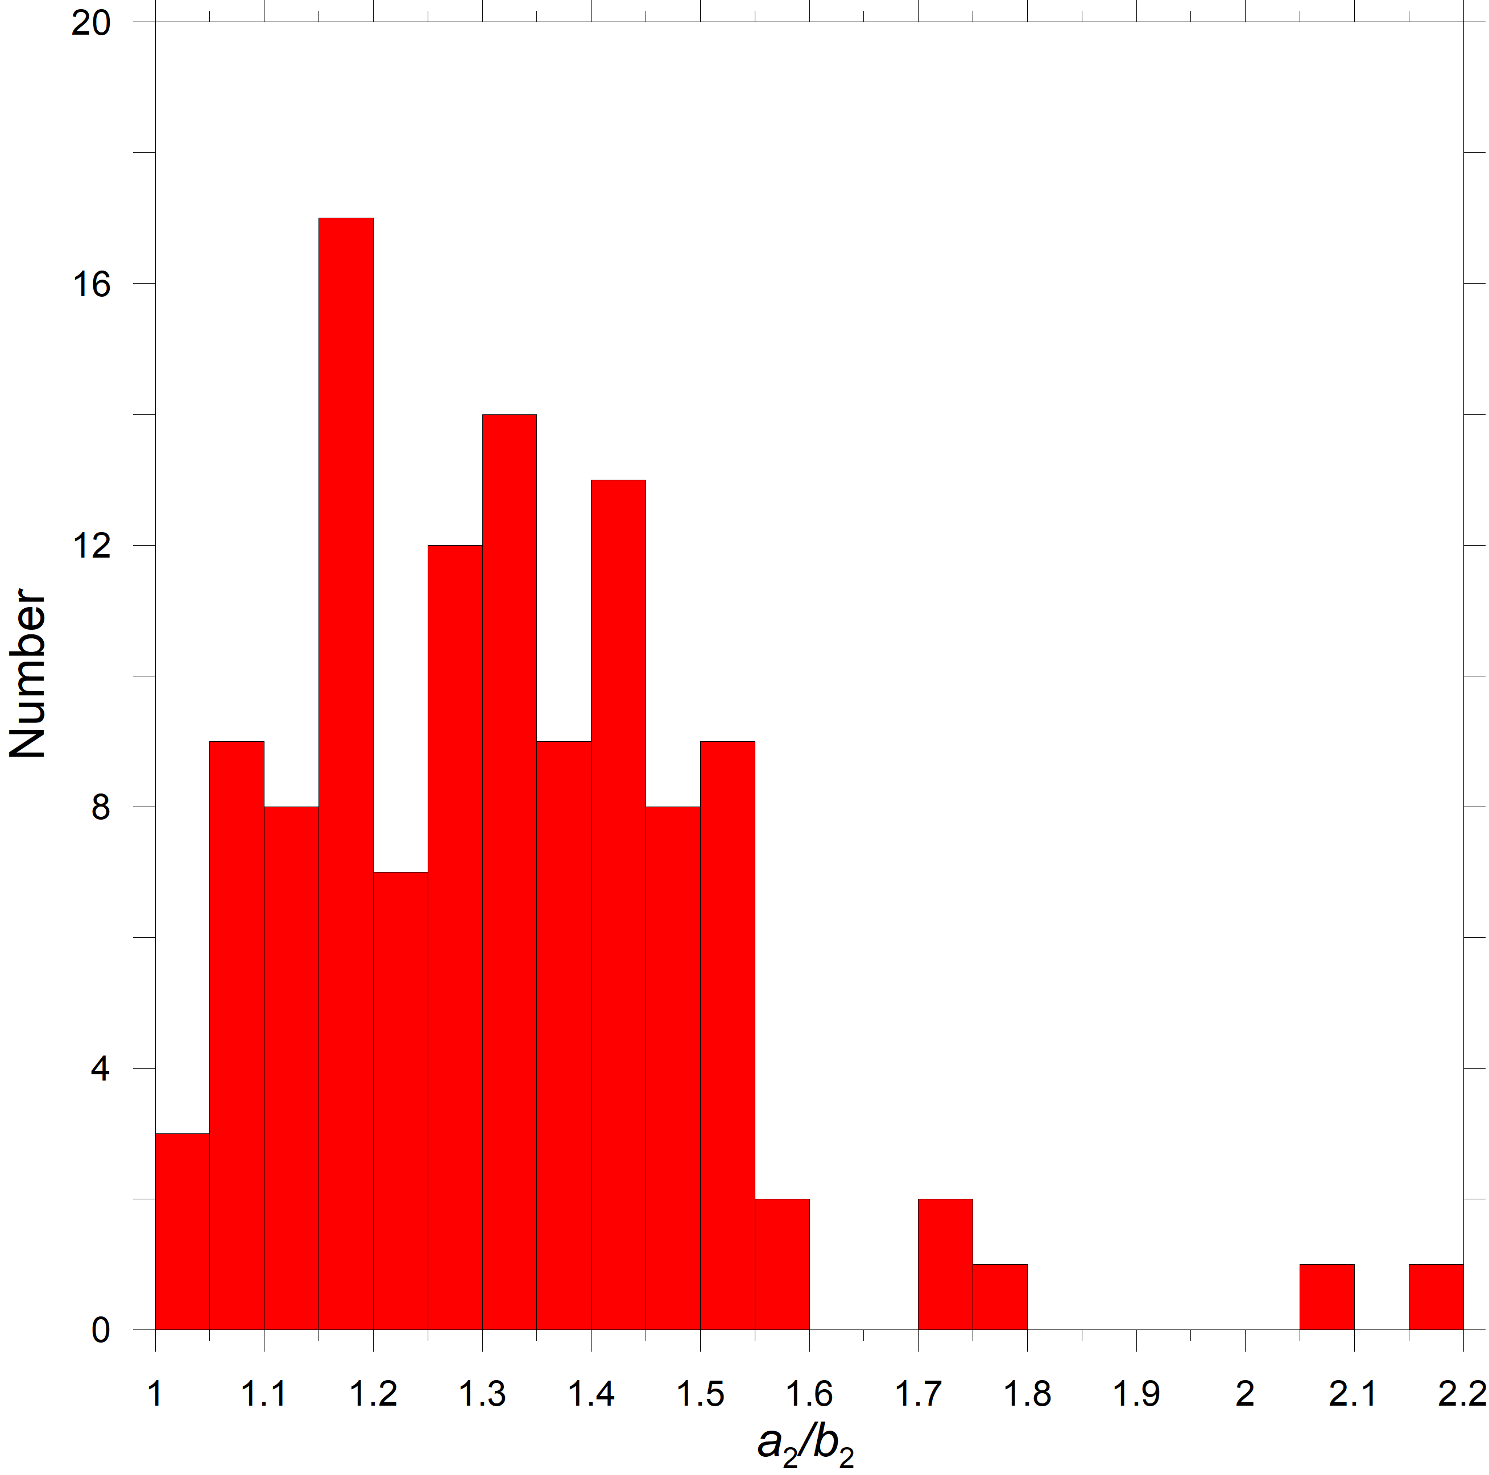
Secondaries – shapes
Secondary equatorial elongations:
Very elongated secondaries with a₂/b₂ > 1.6 are rare.
Distribution of equatorial elongations below a₂/b₂ = 1.6 approximately uniform (fluctuations may not be real).
Oblate secondary shapes with a₂/b₂ = 1.00 to 1.05 underrepresented (the photometry method has a suppressed sensitivity to them).
Dimorphos (oblate figure) one of the least elongated secondaries!

Slide 18
Conclusions
The data on physical properties of small binary asteroids – reveals many interesting characteristics of the binary asteroid population.
Need to understand observational biases present in the data, so that we can interpret the features apparent in the data correctly.
Didymos-Dimorphos is *not* a typical binary asteroid system, but it is rather an “end member” of the population of binary asteroids in a number of characteristics (very tight orbit, very fast primary rotation, low primary equatorial elongation, oblate secondary).
Thank you!

Slide 19
Additional slides (for possible discussion)

Slide 20
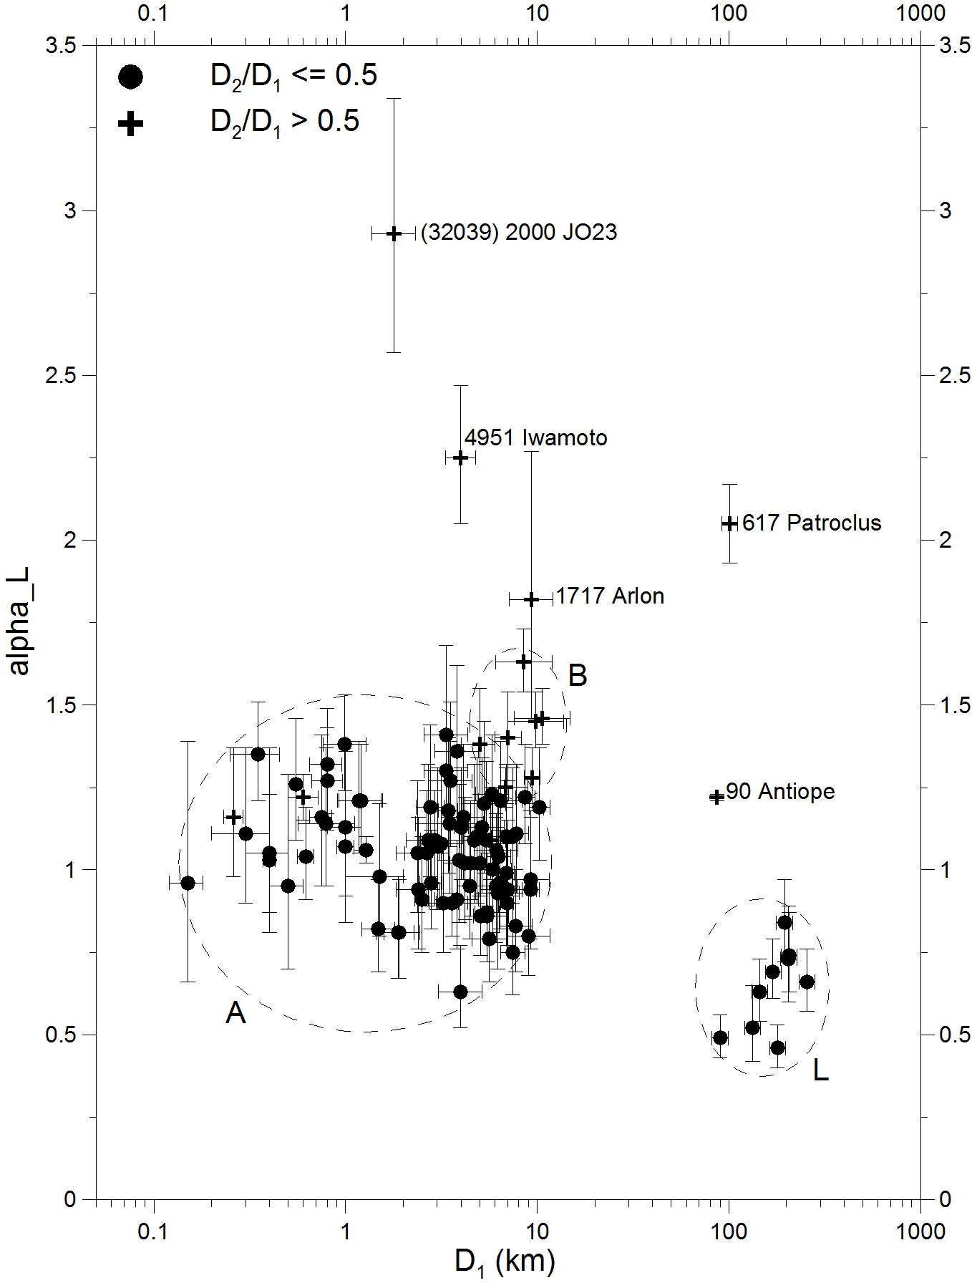
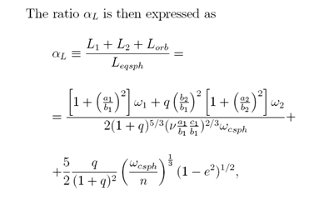
Total angular momentum
Small asteroid binaries have the total angular momentum close to critical.
α_{L} is the total angular momentum of the binary system normalized to the angular momentum of a critically rotating equivalent sphere with zero tensile strength and angle of friction/repose of 90°.
For systems originating from critically spinning rubble piles, e.g., by a spin fission, α_{L} is close to 1 (Pravec and Harris 2007).
(65803) Didymos

Slide 21
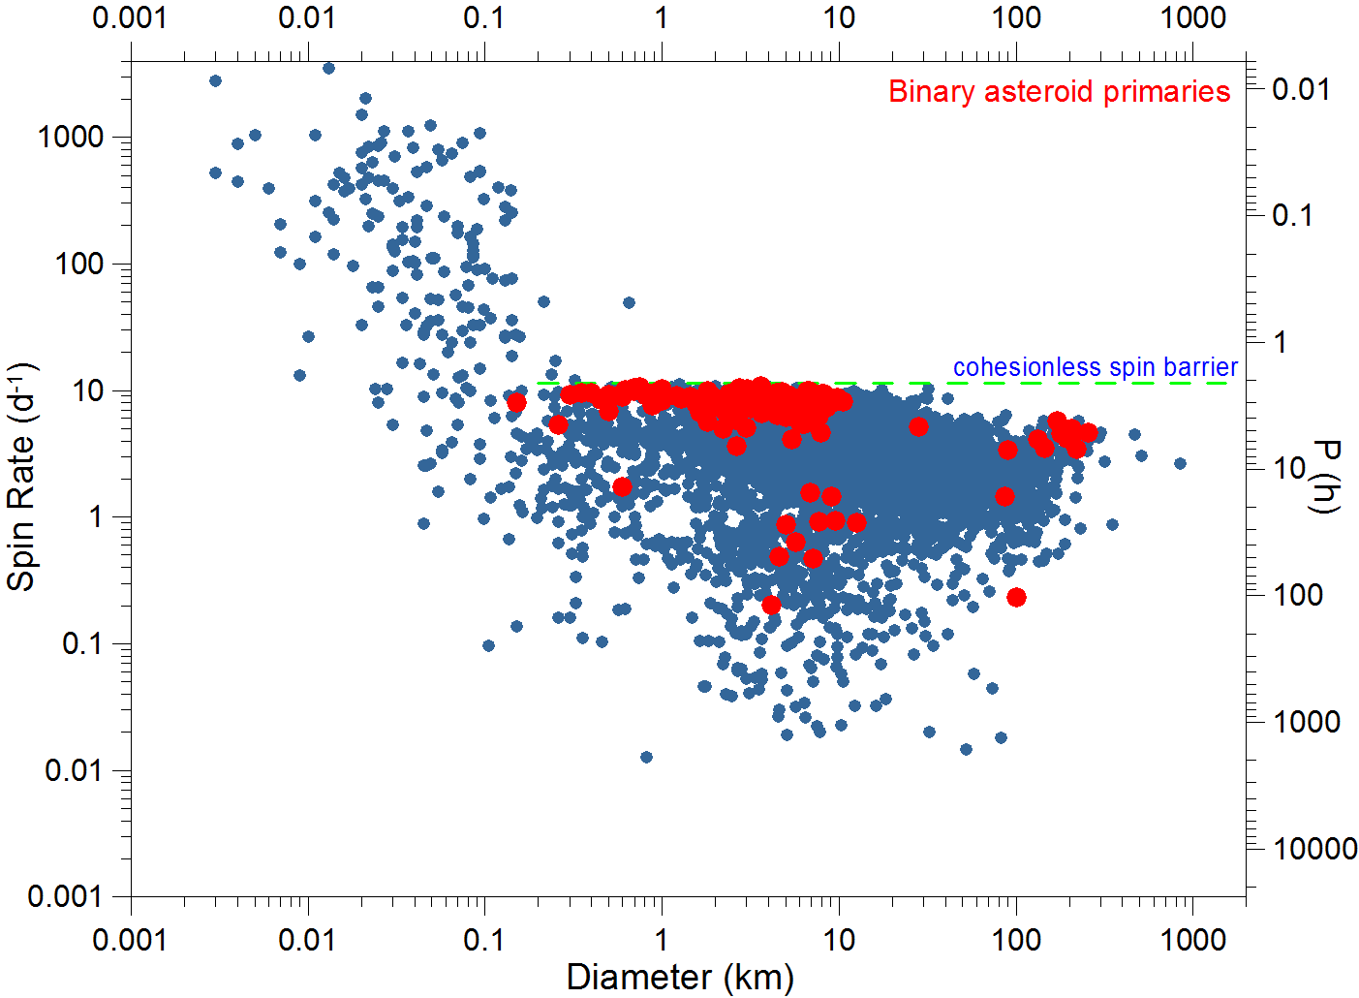
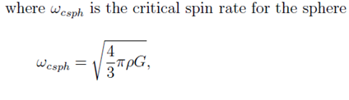
Primary rotations (mostly fast)
(65803) Didymos
Primaries concentrate below the spin barrier at 2.2 h; their rotational periods are mostly between 2.2 and 4 hours, with a tail to longer periods (some primaries were slowed down by spin-orbit interaction with large secondaries).
This suggests that they are gravity-dominated aggregates (might call them “rubble piles”), though a small cohesion is not ruled out.
At the spin barrier – balance between the gravity and centrifugal acceleration at the equator of a sphere with ρ ~ 3 g/cm³, taking into account also the angle of repose/ friction of 30-40°.

Slide 22
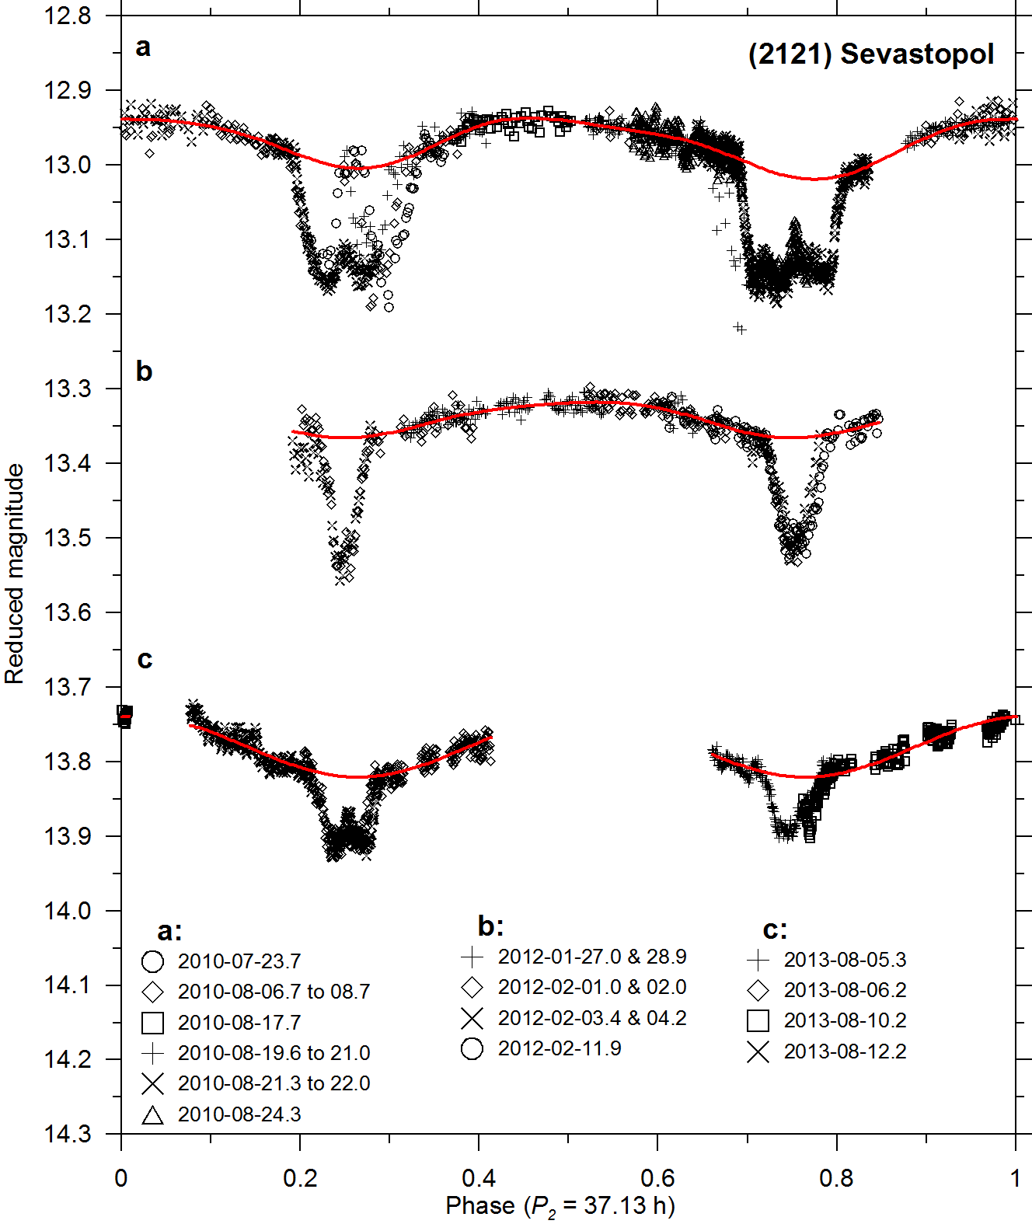
Secondary rotations
Secondaries on close orbits (a/D₁ <~ 3) are mostly on low (near-zero) eccentricity orbits and in synchronous rotations (in 1:1 spin-orbit resonance). Their long principal axes are approximately aligned with the primary and secondary COMs, libration angles are constrained to be mostly < 20° (Pravec et al. 2016).
Rotation of the secondary of
(65803) Didymos has not been observationally constrained yet, but we expect it is in 1:1 synchronous state, like other close asteroid secondaries with similar properties.
The next opportunity to directly establish the rotation of Didymoon will be during 2017-03-21 to 04-03 (two nights with a 6-m or larger telescope needed).
Secondary rotational mimima aligned with mutual events
P_{orb}/2 (e ~ 0)

Slide 23
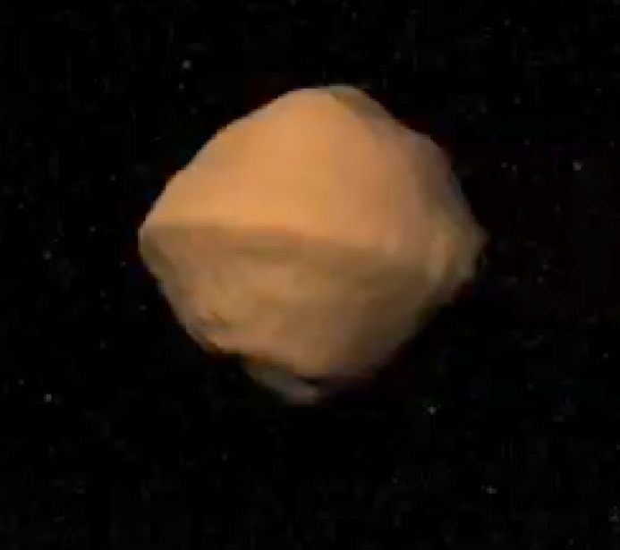
Primary shapes
Primaries:
not far from spheroidal, low equatorial elongations: a₁/b₁ = 1.1 ± 0.1 for > 90% of systems
A primary shape not far from rotational symmetry suggested to be a requirement for satellite formation or orbital stability (Walsh et al. 2008, Scheeres 2007).
Model of the primary of 1999 KW4 (Ostro et al. 2006)
(65803) Didymos

Slide 24
Primary shapes (cont.)
Model of the primary of 1999 KW4 (Ostro et al. 2006)
The primary’s “top shape” with equatorial ridge – suggested to be a result of “landsliding” and re-deposition of a large amount of regolith by tides from the secondary (Harris et al. 2009).
Preliminary model of Didymos’ primary shows it has a similar shape (Benner and Naidu, in prep.)
Suggests a rubble pile character of the “surface layer” at least.
Extremely low rigidity suggested from the apparent tidal-YORP equilibrium for 1996 FG3 (Scheirich et al. 2015). This suggests that also the interior of the primary is rubble pile.

Slide 25
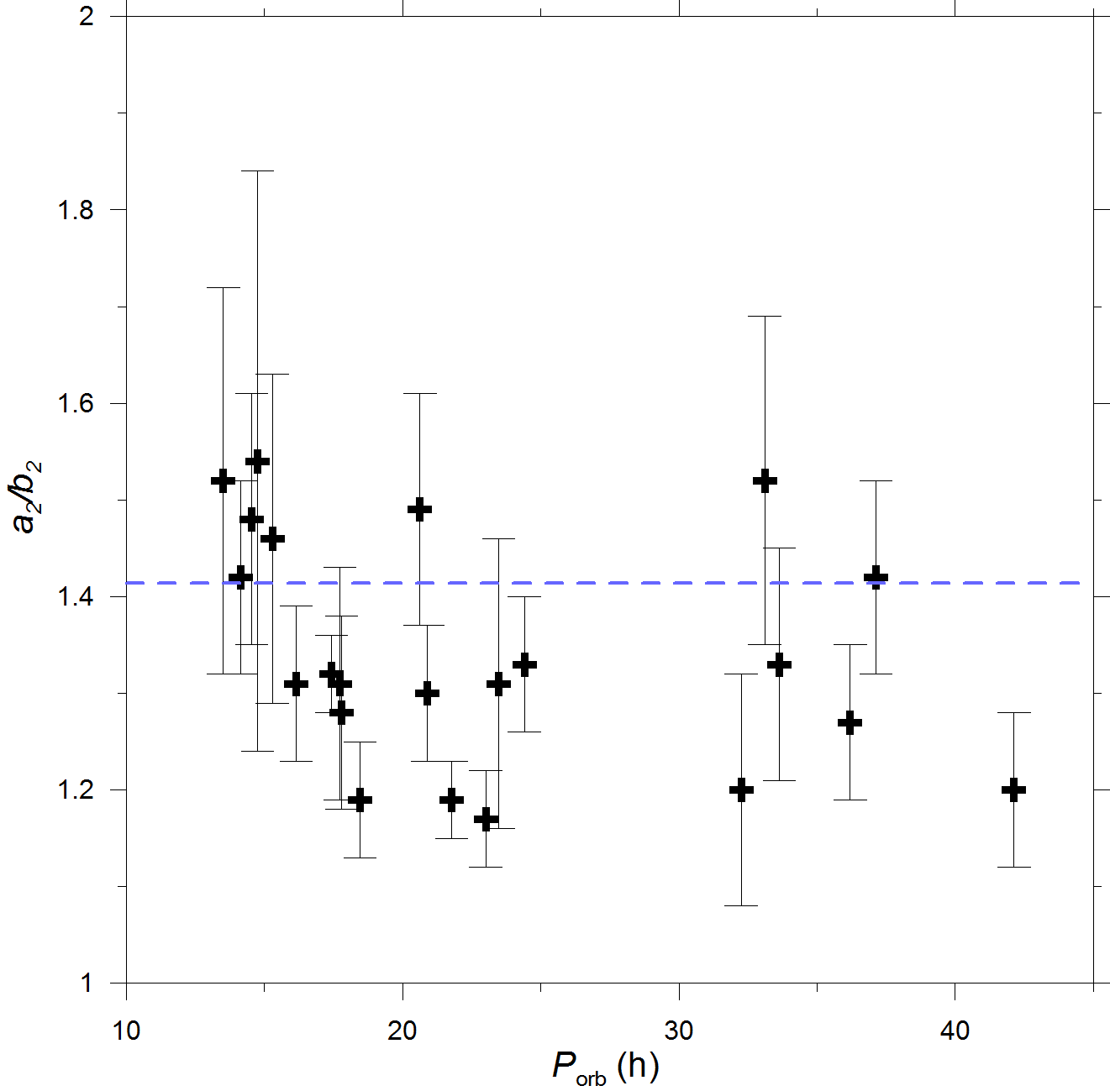
Secondary shapes
Secondary equatorial elongations (a₂/b₂) derived from amplitudes of synchronous secondary rotational lightcurves reveal an upper limit of a₂/b₂ ~ 1.5 (Pravec et al. 2016).
This may be due to chaotic rotations of more elongated secondaries or because they do not form or stay very elongated in gravitational (tidal) field from the primary.
We expect that Didymoon also has a₂/b₂ <~ 1.5.

Slide 26
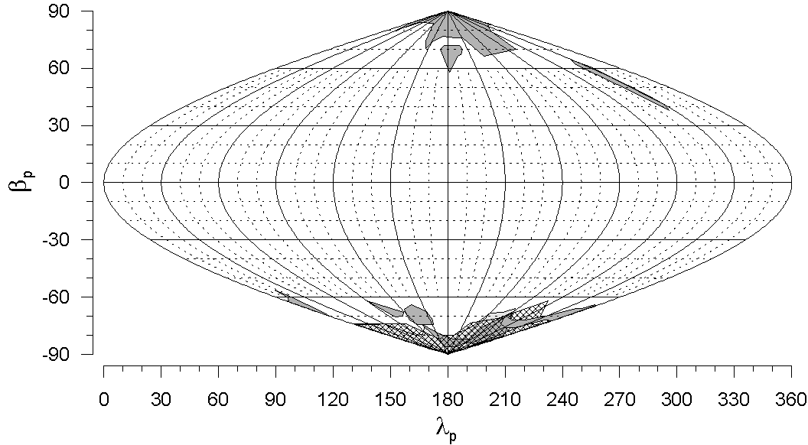
Orbital pole distribution
Orbital poles of small binary MBAs show a highly anisotropic distribution: they are oriented preferentially up/down-right, concentrating within 30° of the ecliptic poles (Pravec et al. 2012). A smaller sample of NEA binary orbital poles show a similar distribution (Scheirich et al., in prep.)
It is proposed to be due to the YORP tilt of spin axes of their parent bodies or the primaries toward the asymptotic states near obliquities 0 and 180°.
(65803) Didymos

Slide 27

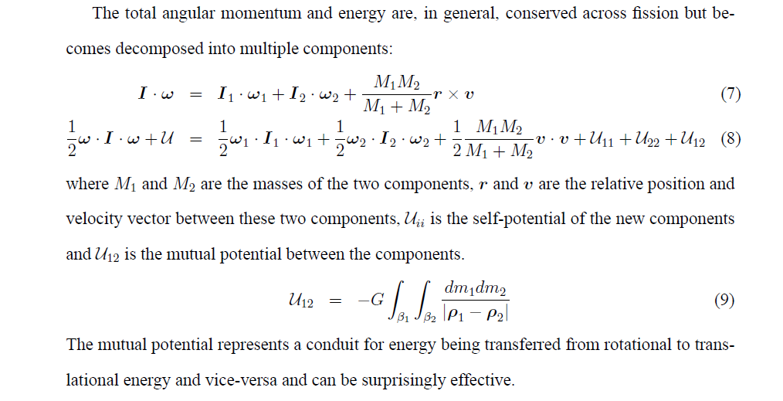
Pair formation by spin fission due to YORP spin-up
(Pravec et al. 2010)
Rotational fission theory by Scheeres
(Icarus 189, 370, 2007):
Spun-up by YORP, the “rubble pile” aster-
oid reaches a critical spin rate and fissions.
The secondary orbiting the primary, energy
being transferred from rotational to transla-
tional energy and vice-versa. If q < ~0.2,
the proto-binary has a positive free energy
and the two components can escape from
each other, after a period of chaotic orbit
evolution (~ several months), and become
an “asteroid pair”.

