Slide 1
Population of small asteroid systems:
Binaries, triples, and pairs
Petr Pravec
Astronomical Institute AS CR, Ondřejov, Czech Republic
AIM Science Meeting
ESAC, Madrid, 2016 March 1

Slide 2
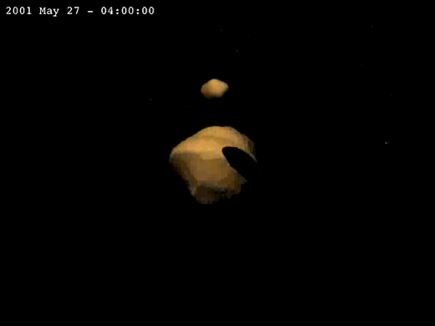
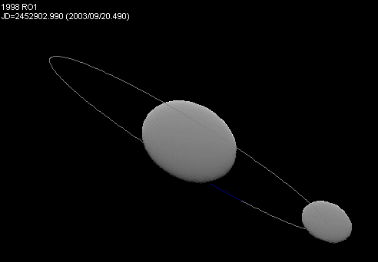

Asteroid systems
Systems of 2 or more components, bound or unbound.
Bound asteroids –
Binary/ternary systems:
About 15% (±4%) of asteroids smaller than 15 km are binary.
Currently known (discovered) more than 150 of them.
Bound asteroids –
Binary/ternary systems:
(Ostro et al. 2006)
(Scheirich and Pravec 2009)
Unbound asteroids –
Asteroid pairs:
Have highly similar heliocentric orbits (due to low-speed separation).
Currently identified more than 200 of them (all in the main belt).
Unbound asteroids –
Asteroid pairs:
(Pravec et al. 2010)

Slide 3
Observational techniques for detection and description of asteroid systems
Photometry (light curve observations)
Radar
Adaptive optics

Slide 4
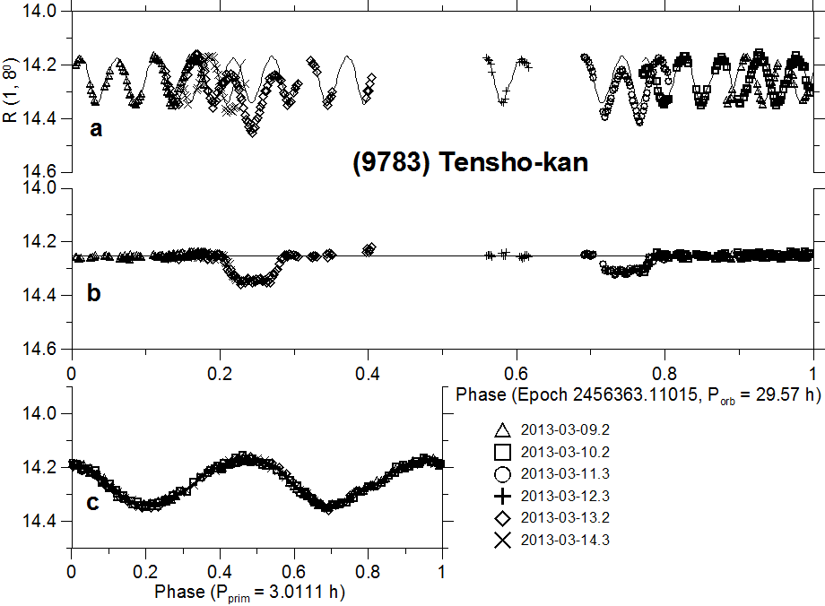
Photometric observations of a binary asteroid
Full lightcurve
Decomposition:
Mutual events
eclipses/occultations
(after lc decomposition, i.e.,
the primary rotational lc was
subtracted)
Primary rotational lc
(enlarged)

Slide 5
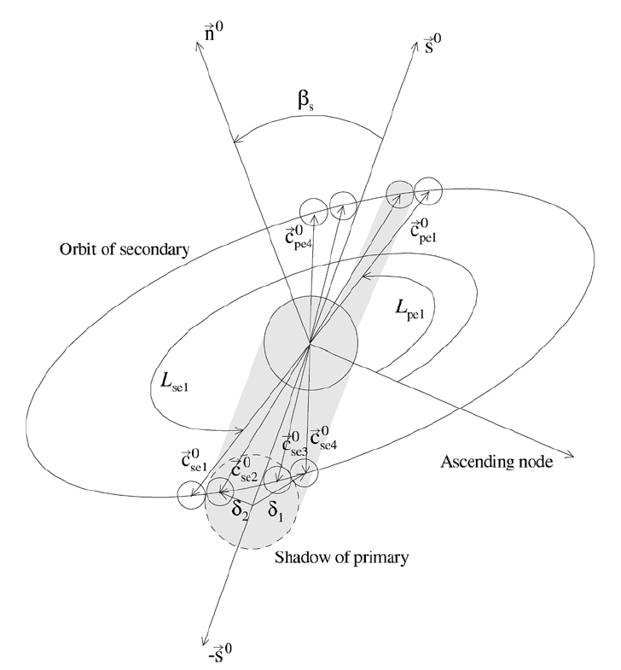
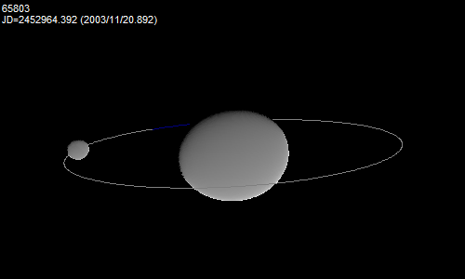
Modeling of binary asteroids from photometry
Modeling of observed mutual events (their timings and shapes) between system’s components and their rotational lightcurves.
Derived/constrained parameters:
P1, (P2) .... primary (secondary) periods
D2/D1 .... ratio of effective diameters
a1/b1, (b1/c1), (a2/b2) …. axial ratios
Porb, Lorb, Borb, a_{orb}, e_{orb}, Morb …. mutual orbit
ρ₁ …. primary bulk density
More parameters when combined with radar,
thermal or spectral data.
(Scheirich and Pravec 2009)

Slide 6
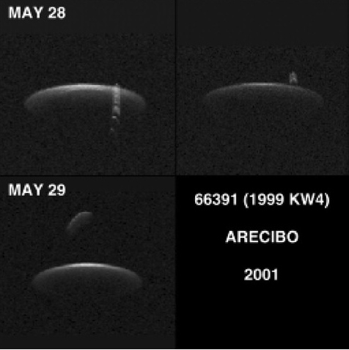
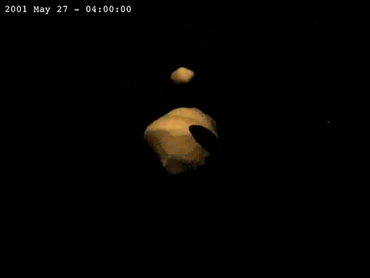
Radar observations of a binary asteroid
The best characterized binary: (66391) 1999 KW4 observed with
the Arecibo radar in 2001 at distance 0.042-0.050 AU. The detailed model constructed by Ostro et al. (Science 314, 1276-1280, 2006).
Radar images:
Frequency (Hz)
Distance from radar (m)
Model of the binary system:

Slide 7
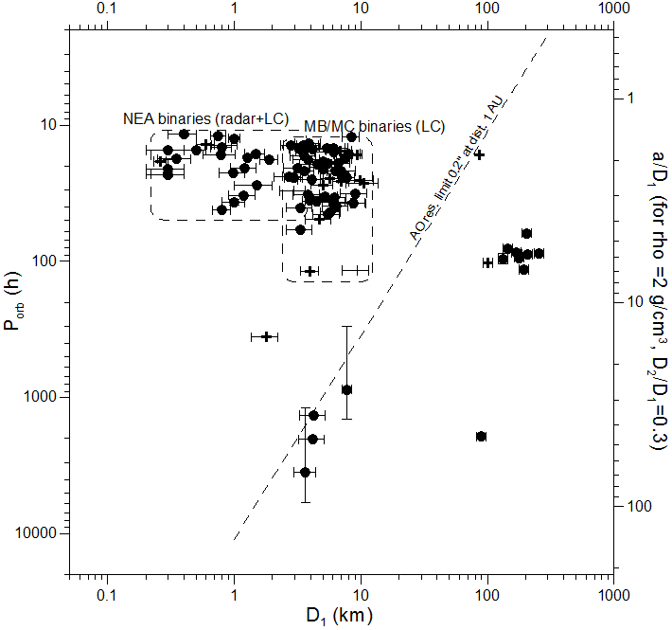
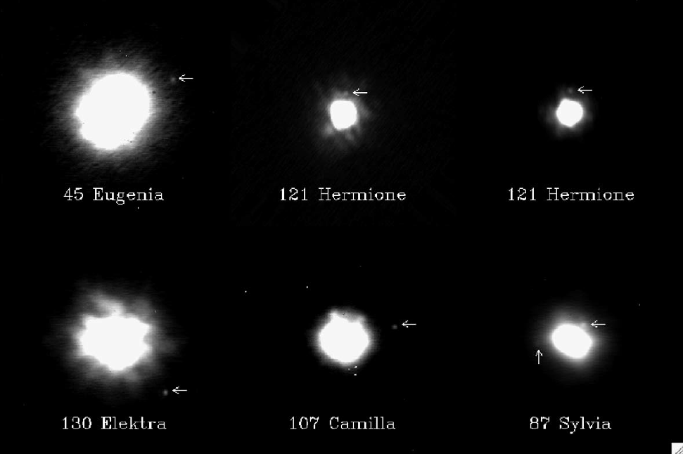
Adaptive optics observations
Typical resolution limit: angular separation 0.2 arcsec.
Limited to wide/large binary systems.
(Marchis et al. 2006)
(Scheirich and Pravec 2012)

Slide 8
Observational techniques - summary
Each of the three techniques has strong points as well as limitations. Main ones:
Radar + Detailed model of the primary and a lower-resolution model of the secondary (when sufficient S/N and sky coverage)
+ Direct determination of the mutual orbit (when sufficient S/N and sky/time coverage)
– Echo strength decreases with the 4th power of the distance from target; efficient for objects closer than ~0.1 AU (only limited data for more distant NEAs)
– Observing windows for radar observations are usually short (days, rarely weeks), precluding or limiting studies requiring long time coverage.
Photometry + Binary asteroids detected at large distances
+ Long time coverage can be obtained (depending on favorable observing circumstances, e.g., angular distance from the sun, phase angle)
– Only limited constraints on primary and secondary shapes
– Determination of absolute dimensions requires adding thermal data (a constraint possible when albedo estimated based on spectral data)
Adaptive optics + Direct resolution of system’s components: Astrometric solution for the mutual orbit
– Limited to wide/large binary systems; most binary systems not resolved.

Slide 9
Properties of small asteroid systems

Slide 10
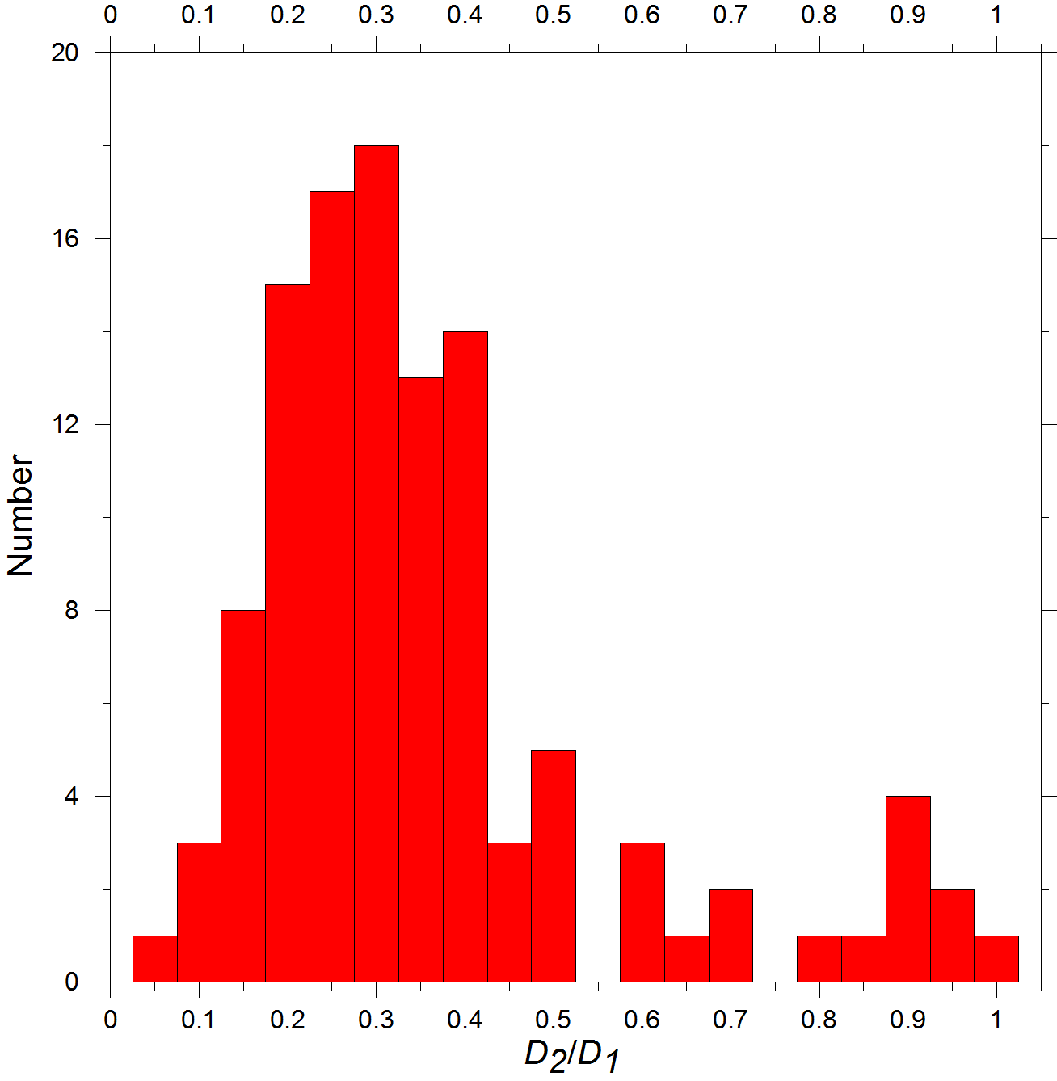
Component size ratios
Secondaries mostly less than half primary diameter (less than ~10% primary mass)
Largest D₂/D₁ close to 1 (“Double Asteroids”)
(69230) Hermes, (809) Lundia, (854) Frostia,
(1089) Tama, (1139) Atami, (1313) Berna, (2478) Tokai,
(4492) Debussy, (4951) Iwamoto – all have D₂ /D₁
between 0.8 and 1
Smallest D₂/D₁ (observational sensitivity-limited)
(1862) Apollo: D₂/D₁ ~ 0.04 (Ostro et al. 2005, unc. factor 2)
Systems with D₂/D₁ < ~0.4-0.5 abundant.
Decrease at D₂/D₁ < 0.3 and especially below 0.2
maybe observational bias.
(65803) Didymos

Slide 11
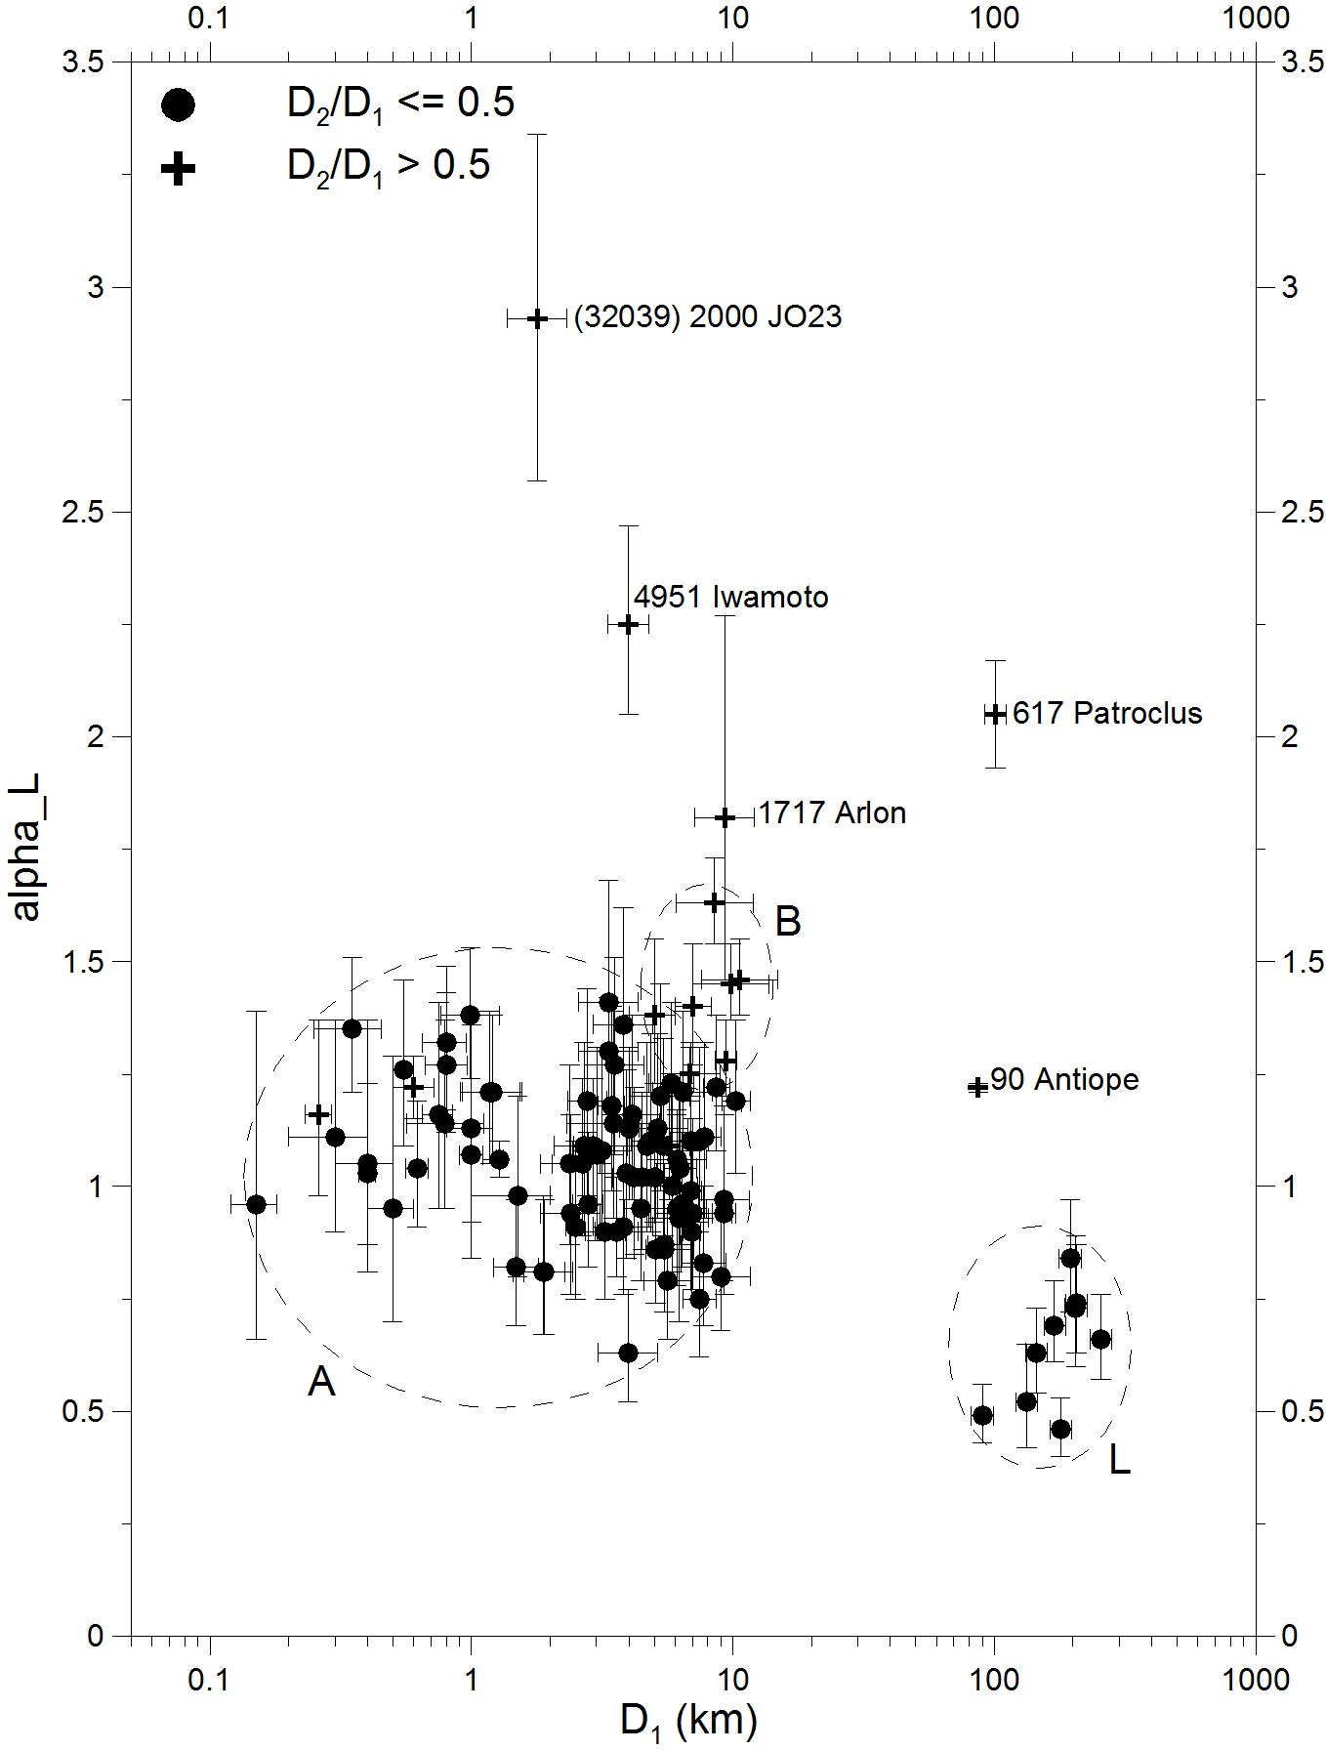
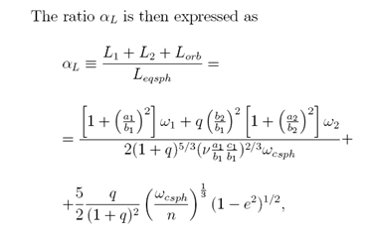
Total angular momentum
Small asteroid binaries have the total angular momentum close to critical.
α_{L} is the total angular momentum of the binary system normalized to the angular momentum of a critically rotating equivalent sphere with zero tensile strength and angle of friction/repose of 90°.
For systems originating from critically spinning rubble piles, e.g., by a spin fission, α_{L} is close to 1 (Pravec and Harris 2007).
(65803) Didymos

Slide 12
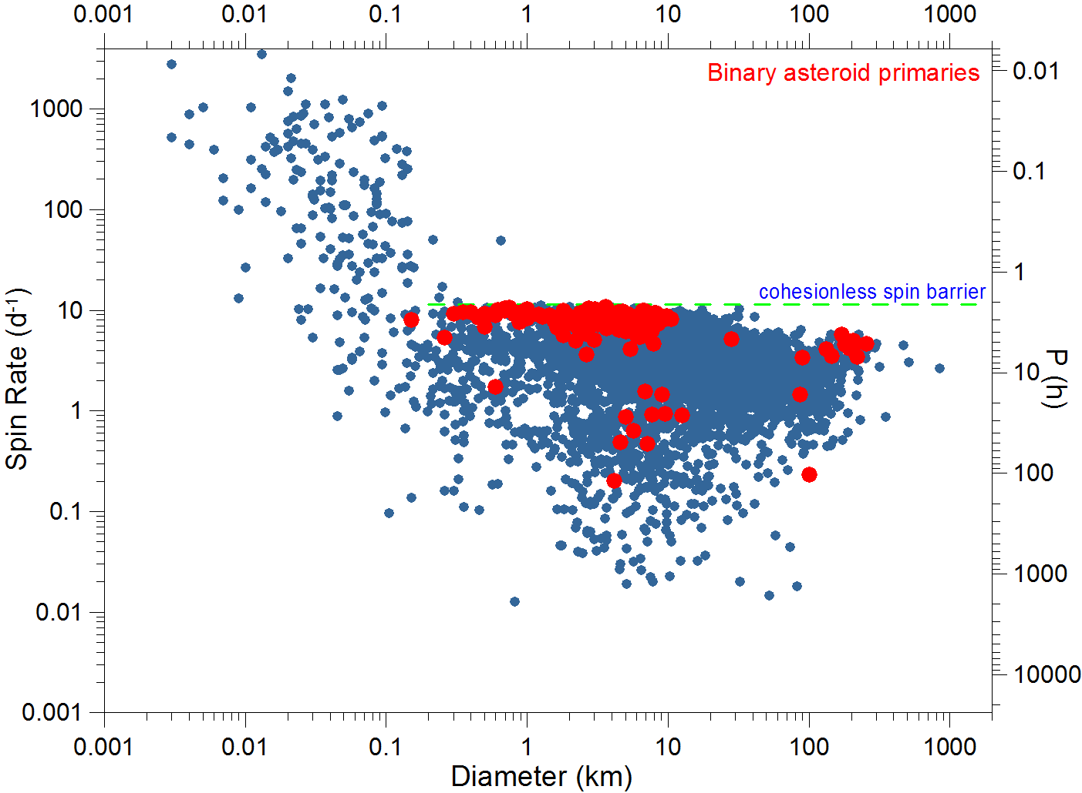
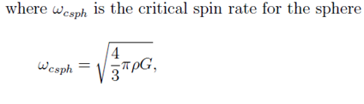
Primary rotations (mostly fast)
(65803) Didymos
Primaries concentrate below the spin barrier at 2.2 h; their rotational periods are mostly between 2.2 and 4 hours, with a tail to longer periods (some primaries were slowed down by spin-orbit interaction with large secondaries).
This suggests that they are gravity-dominated aggregates (might call them “rubble piles”), though a small cohesion is not ruled out.
At the spin barrier – balance between the gravity and centrifugal acceleration at the equator of a sphere with ρ ~ 3 g/cm³, taking into account also the angle of repose/ friction of 30-40°.

Slide 13
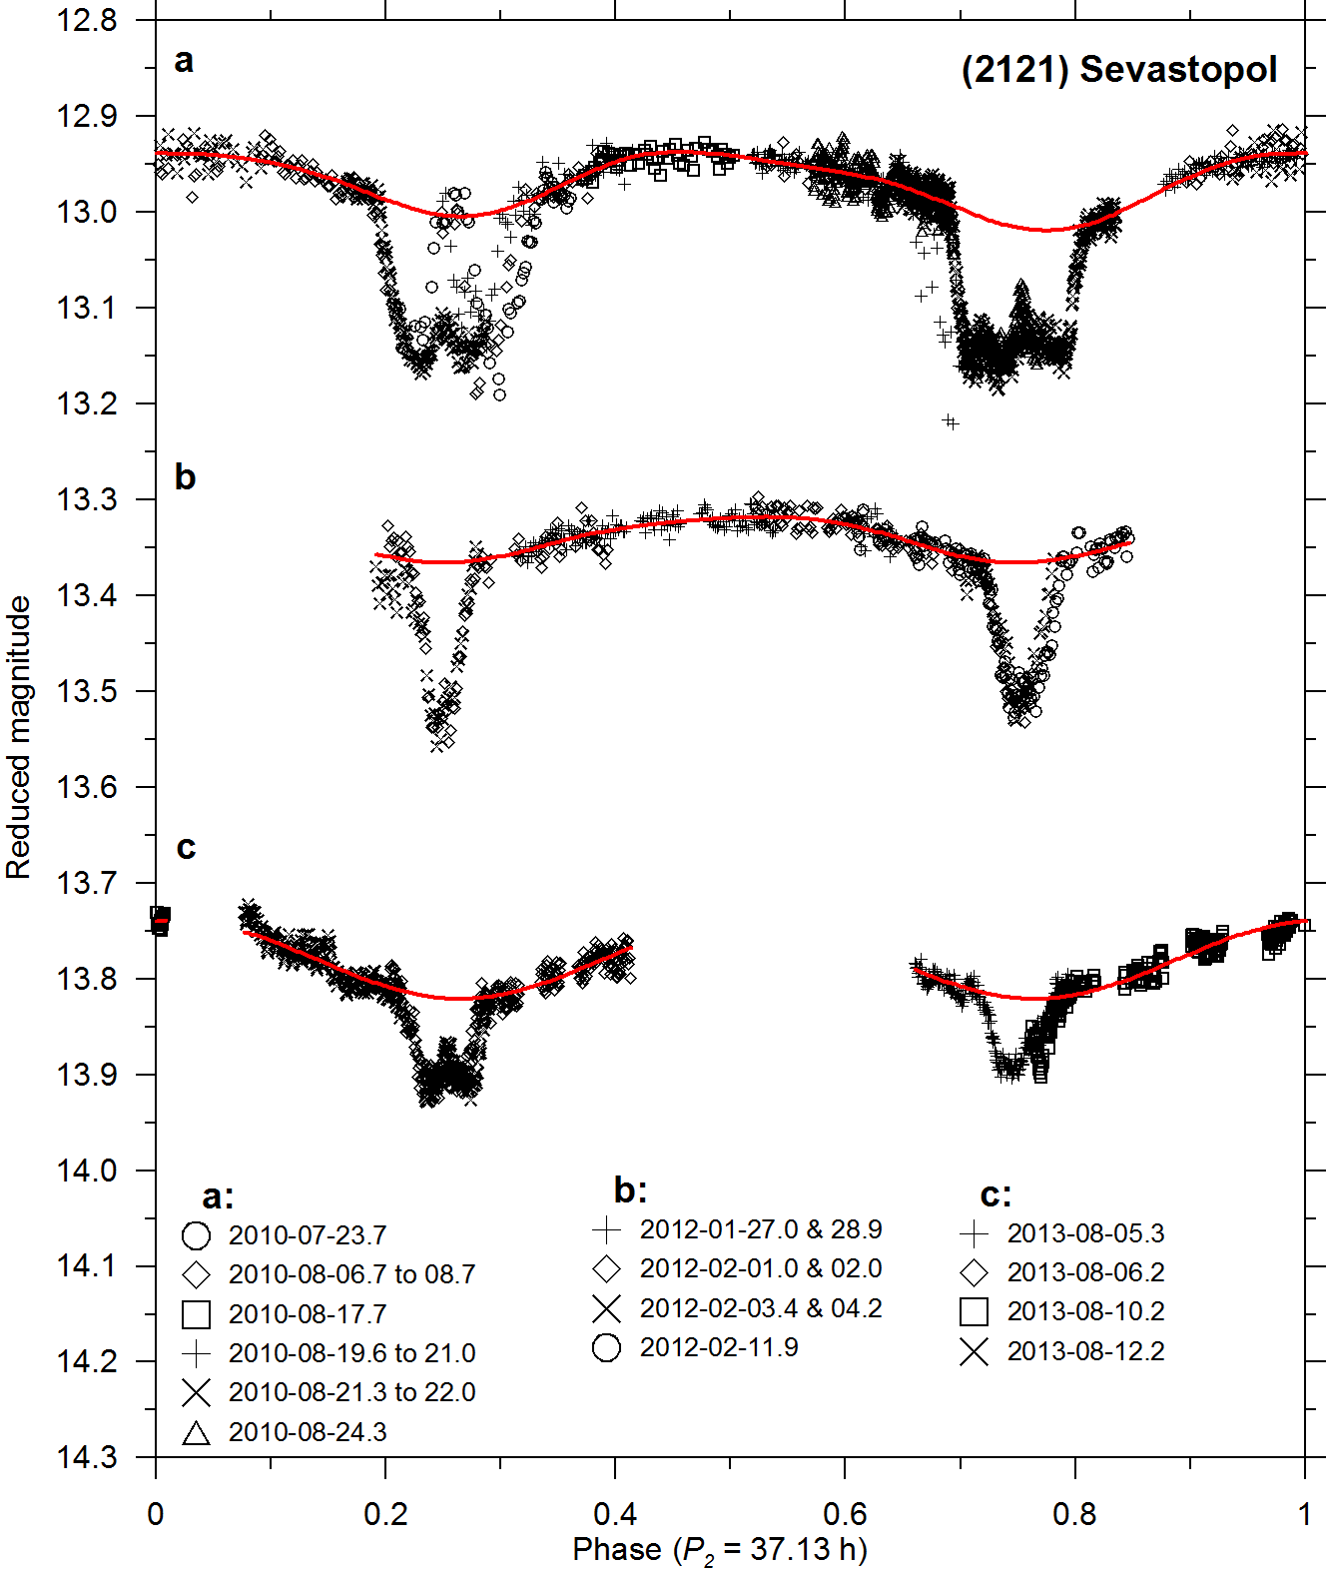
Secondary rotations
Secondaries on close orbits (a/D₁ <~ 3) are mostly on low (near-zero) eccentricity orbits and in synchronous rotations (in 1:1 spin-orbit resonance). Their long principal axes are approximately aligned with the primary and secondary COMs, libration angles are constrained to be mostly < 20° (Pravec et al. 2016).
Rotation of the secondary of
(65803) Didymos has not been observationally constrained yet, but we expect it is in 1:1 synchronous state, like other close asteroid secondaries with similar properties.
The next opportunity to directly establish the rotation of Didymoon will be during 2017-03-21 to 04-03 (two nights with a 6-m or larger telescope needed).
Secondary rotational mimima aligned with mutual events
P_{orb}/2 (e ~ 0)

Slide 14
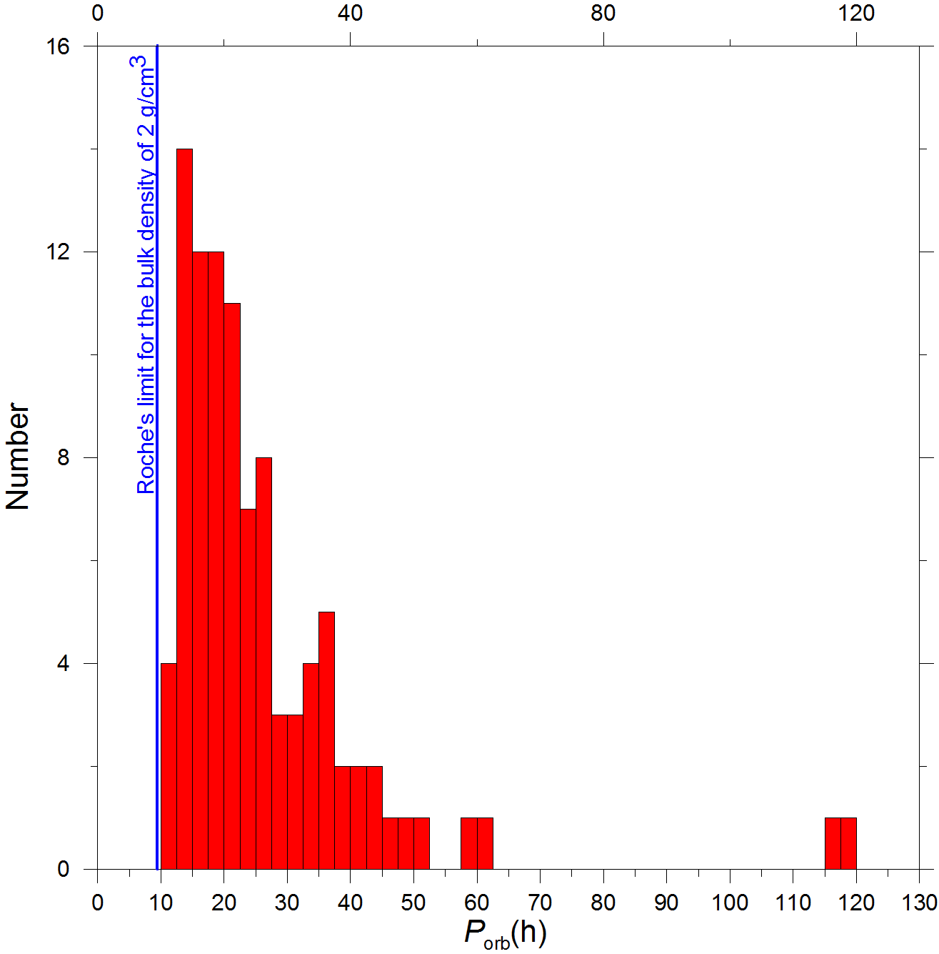
Secondaries above the Roche’s limit for strenghtless satellites
Distances between components:
Shortest P_{orb}:
(65803) Didymos: 11.920 ± 0.005 h
(Scheirich and Pravec 2009, updated)
2006 GY2: 11.7 ± 0.2 h
(Brooks 2006)
Corresponds to a/R₁ ~ 3.0. Consistent with the Roche’s limit for strengthless satellites at a/R₁ = 2.54 (for same densities of the two bodies) that corresponds to P_{orb} ~ 9.5 h for the bulk density of 2 g/cm³.
Alternative hypothesis: Closer orbits may be unstable or short-living?

Slide 15
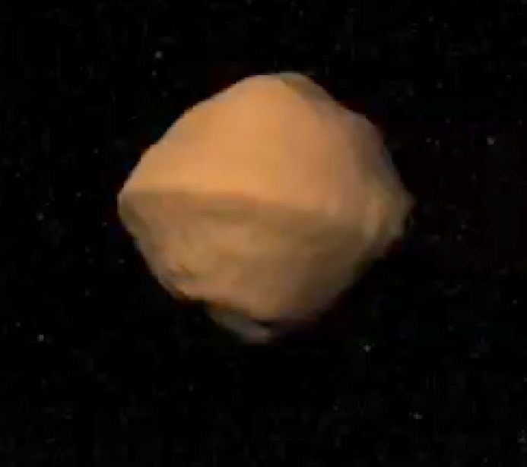
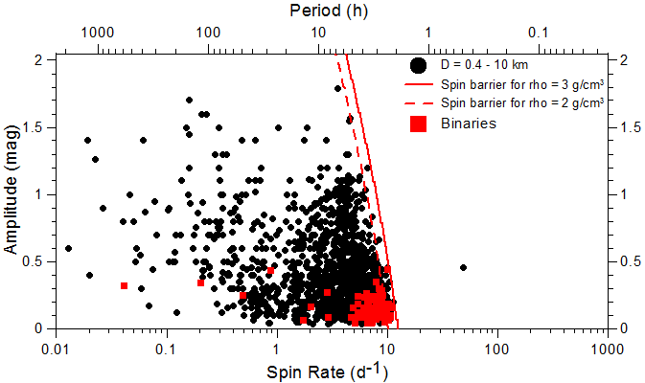
Primary shapes
Primaries:
not far from spheroidal, low equatorial elongations: a₁/b₁ = 1.1 ± 0.1 for > 90% of systems
A primary shape not far from rotational symmetry suggested to be a requirement for satellite formation or orbital stability (Walsh et al. 2008, Scheeres 2007).
Model of the primary of 1999 KW4 (Ostro et al. 2006)
(65803) Didymos

Slide 16
Primary shapes (cont.)
Model of the primary of 1999 KW4 (Ostro et al. 2006)
The primary’s “top shape” with equatorial ridge – suggested to be a result of “landsliding” and re-deposition of a large amount of regolith by tides from the secondary (Harris et al. 2009).
Preliminary model of Didymos’ primary shows it has a similar shape (Benner and Naidu, in prep.)
Suggests a rubble pile character of the “surface layer” at least.
Extremely low rigidity suggested from the apparent tidal-YORP equilibrium for 1996 FG3 (Scheirich et al. 2015). This suggests that also the interior of the primary is rubble pile.

Slide 17
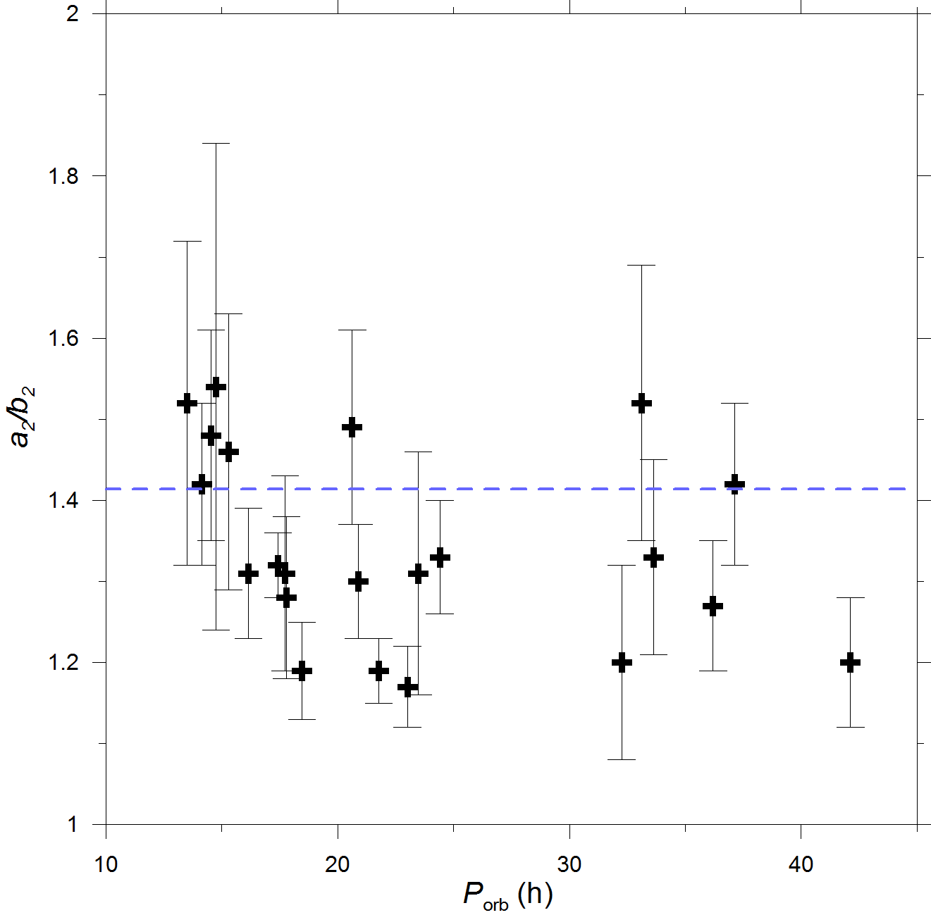
Secondary shapes
Secondary equatorial elongations (a₂/b₂) derived from amplitudes of synchronous secondary rotational lightcurves reveal an upper limit of a₂/b₂ ~ 1.5 (Pravec et al. 2016).
This may be due to chaotic rotations of more elongated secondaries or because they do not form or stay very elongated in gravitational (tidal) field from the primary.
We expect that Didymoon also has a₂/b₂ <~ 1.5.

Slide 18
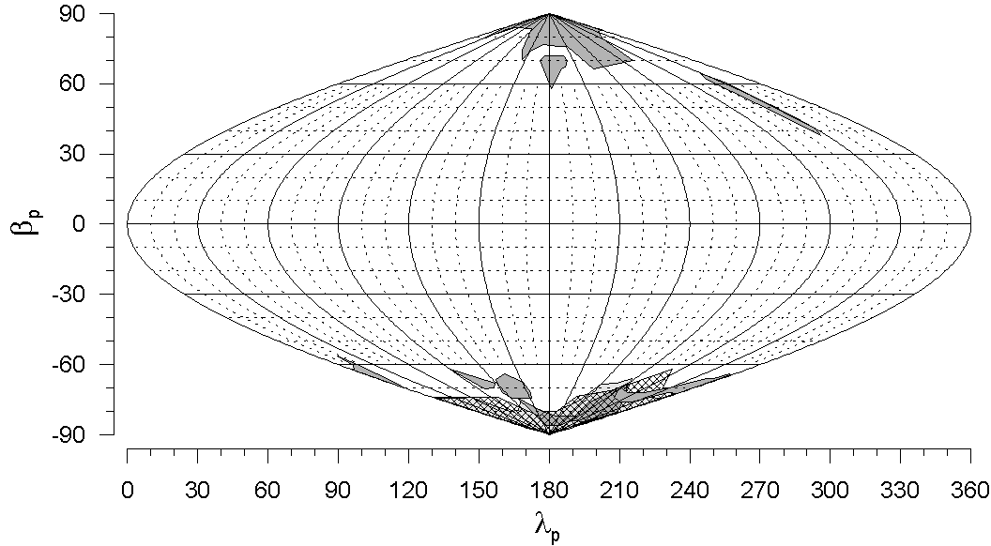
Orbital pole distribution
Orbital poles of small binary MBAs show a highly anisotropic distribution: they are oriented preferentially up/down-right, concentrating within 30° of the ecliptic poles (Pravec et al. 2012). A smaller sample of NEA binary orbital poles show a similar distribution (Scheirich et al., in prep.)
It is proposed to be due to the YORP tilt of spin axes of their parent bodies or the primaries toward the asymptotic states near obliquities 0 and 180°.
(65803) Didymos

Slide 19
Binary/pair/multiple asteroid formation

Slide 20
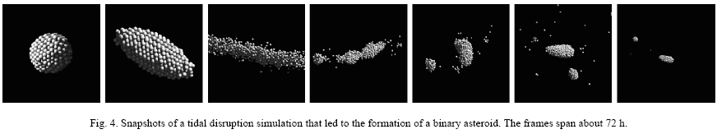
Binary formation theories
Ejecta from large asteroidal impacts (e.g., Durda et al. 2004) – does not predict the observed critical spin.
Tidal disruptions during close encounters with terrestrial planets (Bottke et al. 1996; Richardson and Walsh) – does not work in the main belt, so, it cannot be a formation mechanism for MB binaries. It may contribute to and shape the population of NEA binaries.
Fission of critically spinning parent bodies spun up by YORP
– appears to be a primary formation mechanism for small binary asteroids (e.g., Walsh et al. 2008) as well as for asteroid pairs (Scheeres 2007, Pravec et al. 2010)
(Walsh and Richardson 2006)

Slide 21
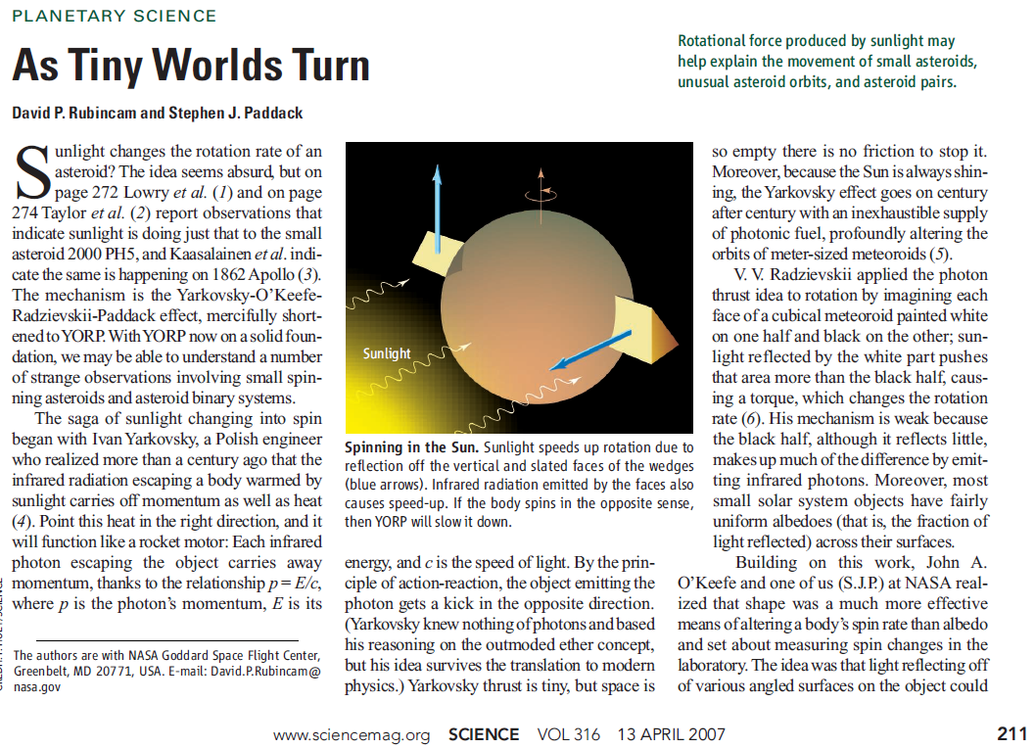
Yarkovsky-O'Keefe-Radzievskii-Paddack (YORP) effect
(Rubincam and Paddack 2007)

Slide 22

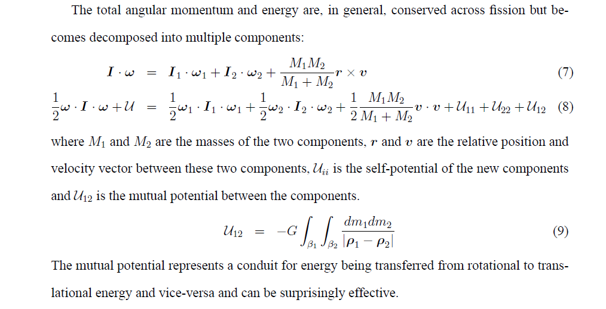
Pair formation by spin fission due to YORP spin-up
(Pravec et al. 2010)
Rotational fission theory by Scheeres
(Icarus 189, 370, 2007):
Spun-up by YORP, the “rubble pile” aster-
oid reaches a critical spin rate and fissions.
The secondary orbiting the primary, energy
being transferred from rotational to transla-
tional energy and vice-versa. If q < ~0.2,
the proto-binary has a positive free energy
and the two components can escape from
each other, after a period of chaotic orbit
evolution (~ several months), and become
an “asteroid pair”.

Slide 23
Didymos in context of the binary asteroid population
Didymos appears to be a typical member of the population of small binary asteroids formed by spin-up fission, in most of its characteristics.
With P₁ = 2.26 h and P_{orb} = 11.9 h, it lies close to the high end of the distributions of primary rotational and secondary orbital rates among small binary asteroid systems – this might be due to its bulk density higher than average for binary asteroids.
Thank you!

Slide 24
Thank you

