Slide 1
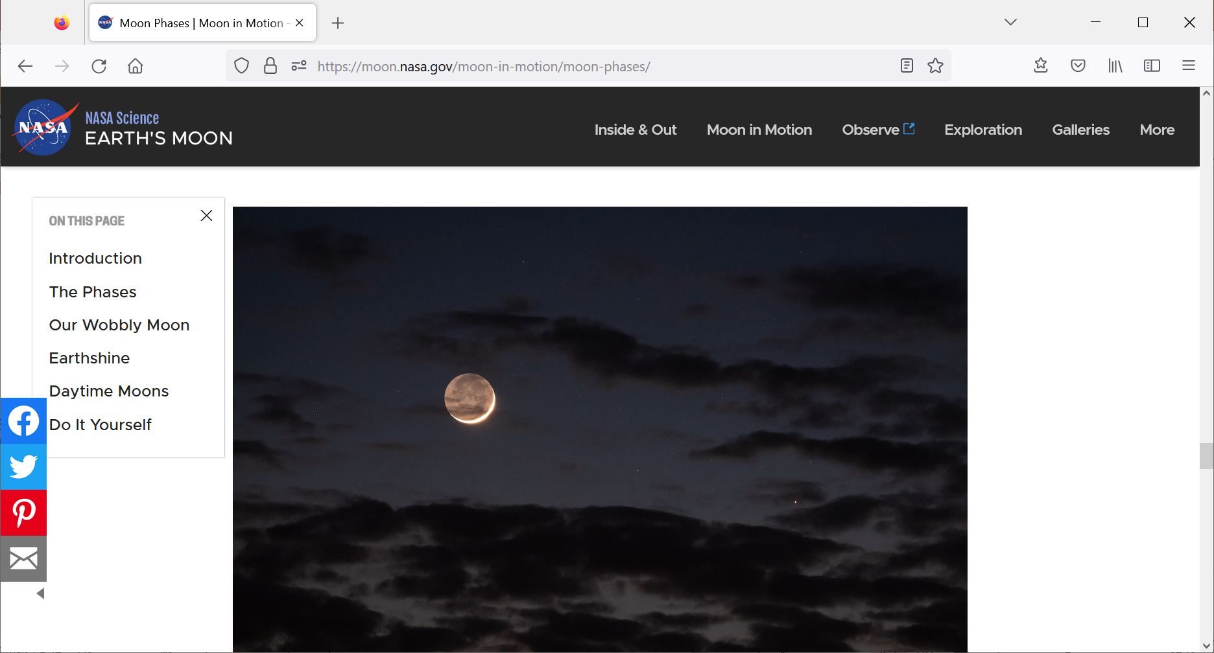
Voda na Měsíci
MÚ AV ČR a ČAS Praha
11. 6. 2025
Přednáší Jaroslav Klokočník
Prof. Jan Kostelecký , Katedra geodezie a důlniho měřctvi,
Hornicko-geologicka fakulta VSB - TU Ostrava,
& Výzkumny ustav geodeticky, topograficky a kartograficky, GO Pecný, Ondřejov,
kost@fsv.cvut.cz
Aleš Bezděk, ASÚ AV Ondřejov, bezdek@asu.cas.cz;
© animace topografie pro Zemi, Mesic i Mars
https://www.asu.cas.cz/~bezdek/vyzkum/rotating_3d_globe/
Václav Cílek, GÚ AV Praha, cilek@gli.cas.cz
Credit: Zolt Levay

Slide 2
Our contribution to search for ground water
at the southern pole of the Moon
(independent of all other approaches)
IM-1/Odysseus
(Intuitive Machines, Nova-C lunar lander named Odysseus)
at the Malapert A crater (near the southern pole)
(e.g., https://www.intuitivemachines.com/im-1;
https://nssdc.gsfc.nasa.gov/nmc/spacecraft/display.action?id=IM-1-NOVA)
forthcoming Artemis programme
(e.g.: https://www.nasa.gov/feature/artemis/;
https://www.nasa.gov/wp-content/uploads/2020/12/artemis_plan-20200921.pdf)

Slide 3
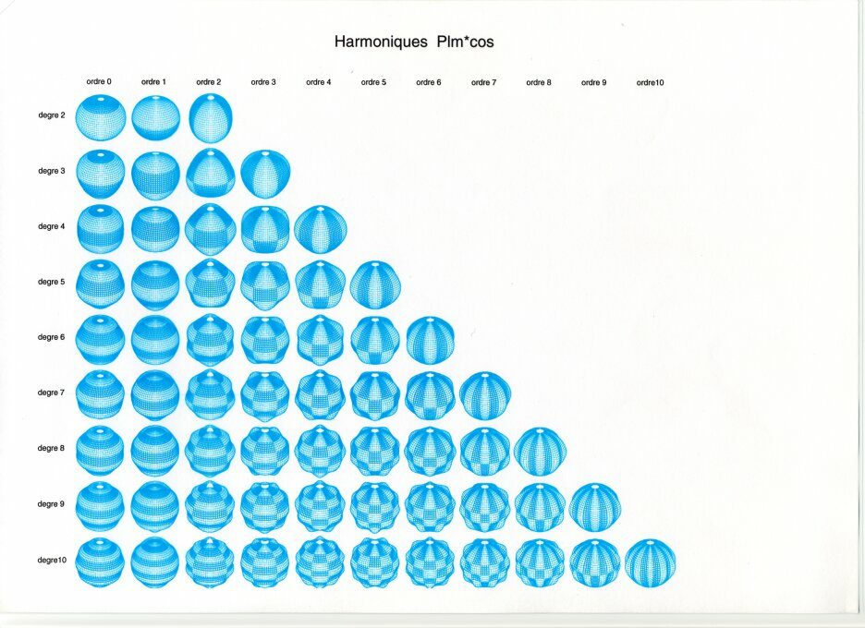
Spherical harmonics , example : P_{lm}(sinϕ) cos mλ
Potential of gravitation :
Stokes coefficients :
►

Slide 4
Gravitational aspects (descriptors)
Gravity aspect | Explanation
T | Disturbing static gravitational potential
Δg | Gravity anomaly or perturbation (various versions)
Γ | Marussi tensor (just 5 independent second derivatives of T)
T_{zz} | Element of the Marussi tensor (second derivative of T in the radial direction), usually most important
I_{j} | 3 gravity invariants of the Γ (I₀, I₁, I₂); preserved under any coordinate rotation
I | a ratio of I₁, I₂; when I~0, the causative body is ~2D; when I →1, causative body is 3D
θ | Strike angle is the main direction of Γ, under certain conditions
vd | Virtual deformation based on horizontal derivatives of T in latitudinal and longitudinal directions, expressing dilatation and pure sheer (compression)

Slide 5

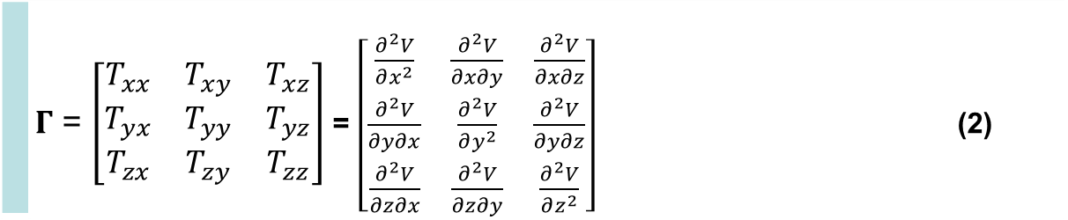
Disturbing static gravitational potential outside the Earth masses in spherical harmonic expansion
 | $$T\left(r,φ,λ\right)=\frac{GM}{r}\sum_{l=2}^{∞}{\sum_{m=0}^{l}{{\left(\frac{R}{r}\right)}^{l}\left({C^{′}}_{l,m}cos mλ+S_{l,m}sin mλ \right)}} P_{l,m}\left(sin φ\right)$$
where GM is a product of the universal gravitational constant and the mass of the Earth (also known as
the geocentric gravitational constant), r is the radial distance of an external point where T is computed,
R is the radius of the Earth (which can be approximated by the semi-major axis of a reference ellipsoid),
P_{l,m} (sin φ) are the Legendre associated functions, l and m are the degree and order of the harmonic expansion,
(φ, λ) are the geocentric latitude and longitude, C’_{l,m} and S_{l,m} are the harmonic geopotential coefficients
(Stokes parameters), fully normalized, C’_{l,m} = C_{l,m} – C^{el}_{l,m}, where C^{el}_{l,m} belongs to the reference ellipsoid.
The spherical approximation of the gravity anomaly Δg is computed
$∆g=−\frac{∂T}{∂r}−2\frac{T}{r}$
or one can use the gravity disturbance (it is the same but without the second term).
Gravity gradient tensor Γ (the Marussi tensor) is a tensor of the second derivatives of
the disturbing potential T:
 | $Γ$ = $\left[\begin{matrix}T_{xx} & T_{xy} & T_{xz} \\ T_{yx} & T_{yy} & T_{yz} \\ T_{zx} & T_{zy} & T_{zz}\end{matrix}\right]$ = $\left[\begin{matrix}\frac{∂^{2}V}{∂x^{2}} & \frac{∂^{2}V}{∂x∂y} & \frac{∂^{2}V}{∂x∂z} \\ \frac{∂^{2}V}{∂y∂x} & \frac{∂^{2}V}{∂y^{2}} & \frac{∂^{2}V}{∂y∂z} \\ \frac{∂^{2}V}{∂z∂x} & \frac{∂^{2}V}{∂z∂y} & \frac{∂^{2}V}{∂z^{2}}\end{matrix}\right]$ (2)
Notes:
Legendre associated functions,… free-air gravity anomaly, gravity disturbance

Slide 6
Marussi tensor
for the salt dome
right
A.H.Saad, The Leading Edge, 942-950, Aug. 2006

Slide 7


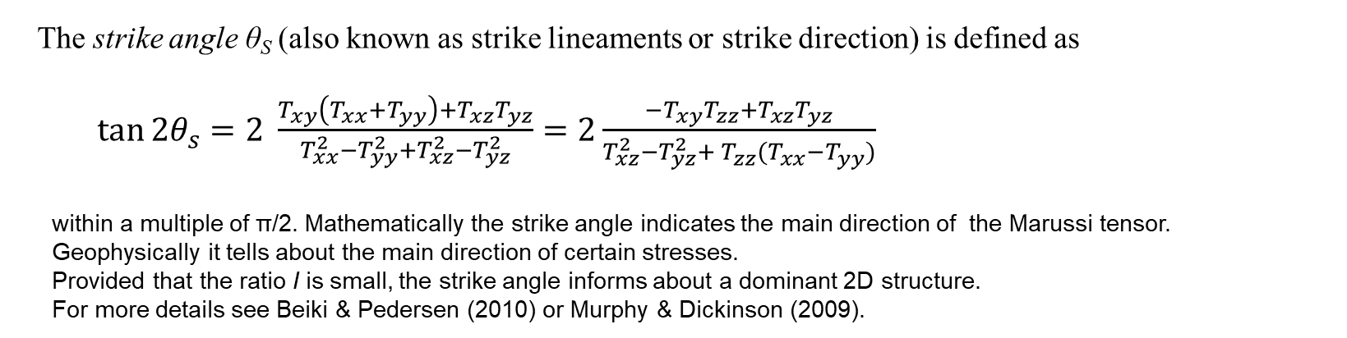

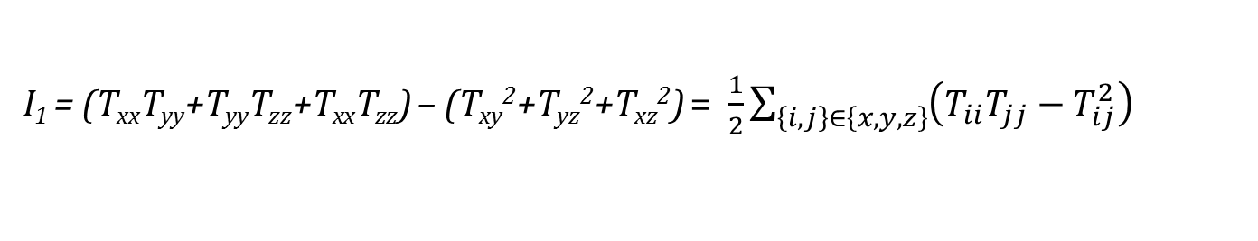
Under any coordinate transformation, Marussi tensor Γ preserves just 3 invariants
$I_{0}=trace \left(Γ\right)=T_{xx}+T_{yy}+T_{zz}=$ 0
I₁ = (T_{xx}T_{yy}+T_{yy}T_{zz}+T_{xx}T_{zz}) – (T_{xy}²+T_{yz}²+T_{xz}²) = $\frac{1}{2}\sum_{\left\{i,j\right\}∈\left\{x,y,z\right\}}{{\left(T_{ii}T_{jj}−T_{ij}^{2}\right)}_{}}$
I₂ = det (Г) = (T_{xx}(T_{yy}T_{zz}-T_{yz}²) + T_{xy}(T_{yz}T_{xz} – T_{xy}T_{zz}) + T_{xz} (T_{xy}T_{yz}-T_{xz}T_{yy}).
Pedersen & Rasmussen (1990) showed that the ratio I of I₁ and I₂ (dimensionless)
$$0≤I=−\frac{{\left({I_{2}}/2\right)}^{2}}{{\left({I_{1}}/3\right)}^{3}}≤1$$
lies between 0 and 1 for any potential field. If the causative body is strictly 2D, then I = 0.
The strike angle θ_{S} (also known as strike lineaments or strike direction) is defined as
$\tan{2θ_{s}}=2 \frac{T_{xy}\left(T_{xx}+T_{yy}\right)+T_{xz}T_{yz}}{T_{xx}^{2}−T_{yy}^{2}+T_{xz}^{2}−T_{yz}^{2}}=2\frac{{−T}_{xy}T_{zz}+T_{xz}T_{yz}}{T_{xz}^{2}−T_{yz}^{2}+{{ T}_{zz}^{}(T}_{xx}^{}−T_{yy}^{})}$
within a multiple of π/2. Mathematically the strike angle indicates the main direction of the Marussi tensor.
Geophysically it tells about the main direction of certain stresses.
Provided that the ratio I is small, the strike angle informs about a dominant 2D structure.
For more details see Beiki & Pedersen (2010) or Murphy & Dickinson (2009).

Slide 8
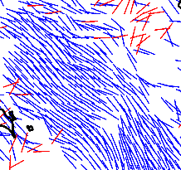
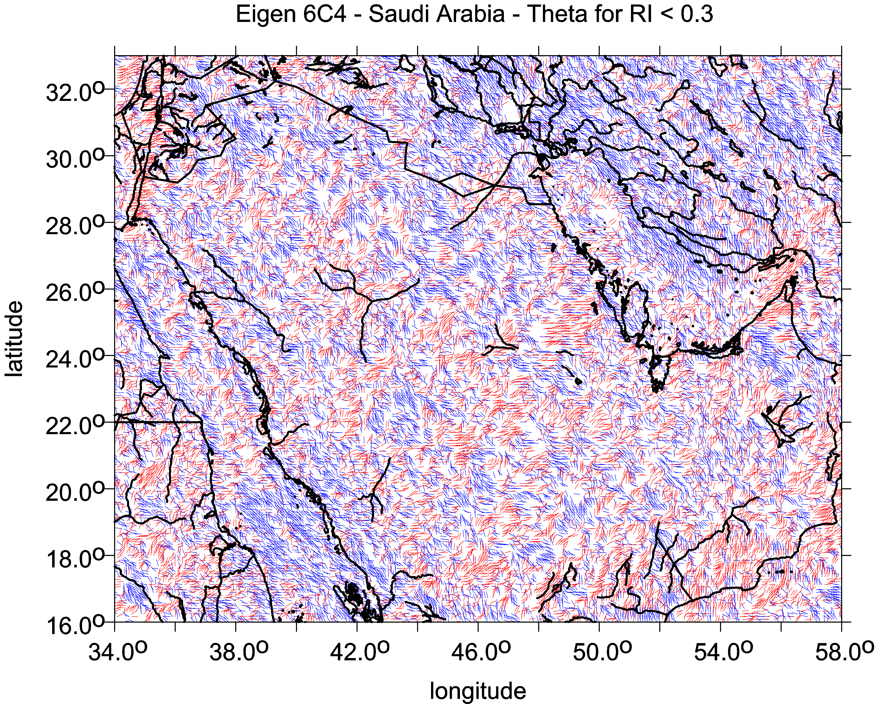
The combed strike angle θ…
…are the strike angles aligned. Being combed, the strike angle indicates existence of impact craters, or task (target) eposits, TD, but yields no proof of them; the indication is not unambiguous as for oil&gas, it may indicate water, ground water, wadi, deep valley, trench, may be also coal; further information needed (topography, geology, geophysics, …) for specific decision…
The combed θ may provide information about the direction of deformations. They are parallel to the weakness in the strength of the rock, e.g., direction schistosity and or presence of faults or micro-fault zones.
Colors: the red colour means its direction is to the north and blue is to the south of the east
combed strike angles in the studied area, disheveled strike angles in the studied area = one way oriented strike angles = strike angles are in diverse directions
comb factor → 1 comb_factor → 0

Slide 9
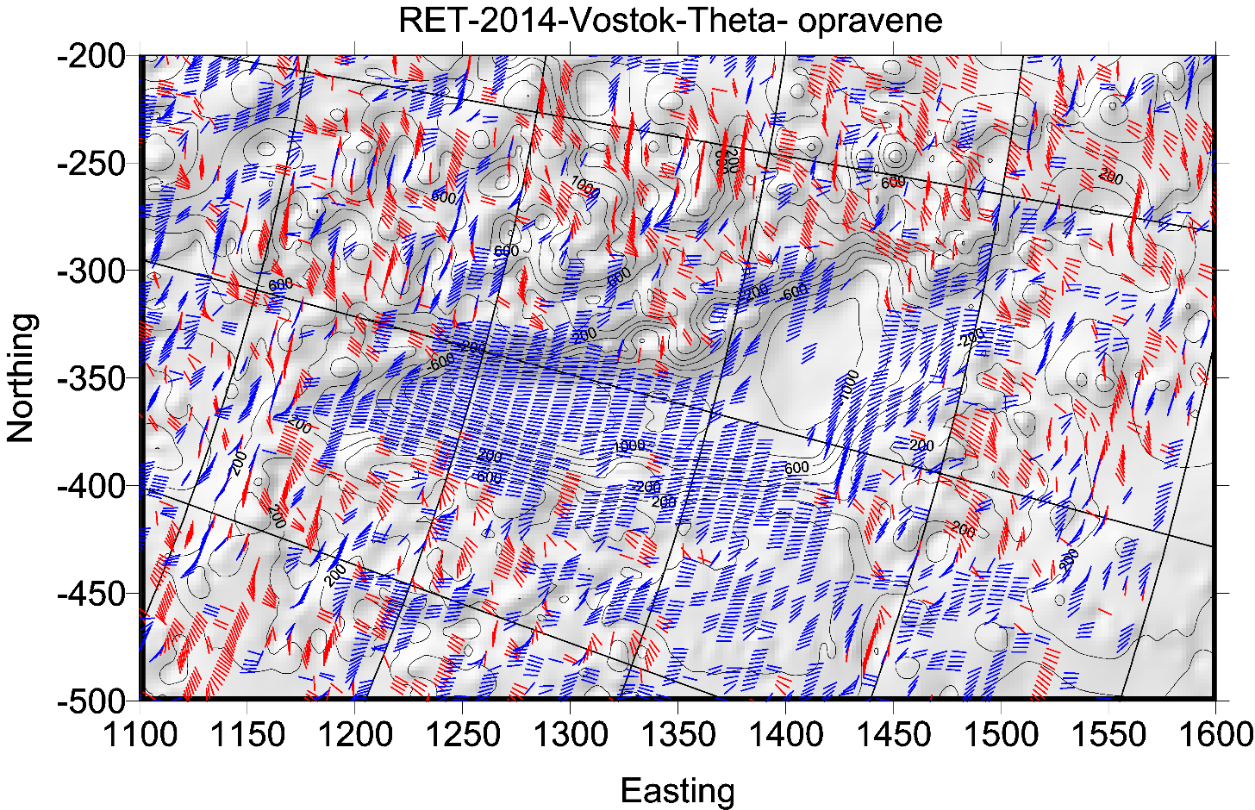
sever vpravo

Slide 10
Virtual deformations (Kalvoda et al. 2012, Klokočník et al. 2013)
directions of such a deformation due to “erosion” brought about solely by “gravity origin”.
If there would be a tidal potential T, then the horizontal shifts (deformations) would exist due to it
and they could be expressed
in north-south direction (latitude direction) … [left] and in east-west direction (longitudinal direction) … [right]
where g is the gravity acceleration 9.81 m⋅s⁻²,
l_{S} is the elastic coefficient (Shida number) expressing the elastic properties of the Earth as a planet (l_{S} = 0.08),
φ and λ are the geocentric coordinates (latitude and longitude) of a point P where we measure T
The apparatus of mechanics of continuum to derive the main directions of the tension is applied (see, e.g., Brdička et al. 2000).
The tensor of (small) deformation E is defined as a gradient of shift. It holds that
The tensor E can be separated into two parts:
where e is the symmetrical tensor and Ω the anti-symmetrical tensor of deformation, respectively. The symmetrical tensor is
and the parameters of deformation are:
Δ = e₁₁ + e₂₂ total dilatation a = ½ (Δ + γ) major semi-axis of ellipse of deformation
γ₁ = e₁₁ - e₂₂ pure cut b = ½ (Δ – γ) minor semi-axis of ellipse of deformation
γ₂ = 2e₁₂ technical cut α = ½ atan(γ₂ / γ₁) direction of main axis of deformation
γ = (γ₁² + γ₂²)^{1/2} total cut
.
$$u_{Φ}=l_{S}\frac{1}{g}\frac{∂T}{∂φ}$$
$$u_{Λ}=l_{S}\frac{1}{gcos φ}\frac{∂T}{∂λ}$$
$$E=\left(\begin{matrix}ε_{11} & ε_{12} \\ ε_{21} & ε_{22}\end{matrix}\right)=\left(\begin{matrix}\frac{∂u_{x}}{∂x} & \frac{∂u_{x}}{∂y} \\ \frac{∂u_{y}}{∂x} & \frac{∂u_{y}}{∂y}\end{matrix}\right)$$
$$E=e+Ω= \left(e_{ij}\right)+\left(Ω_{ij}\right)$$
$e=\left(\begin{matrix}e_{11} & e_{12} \\ e_{21} & e_{22}\end{matrix}\right)=\left(\begin{matrix}ε_{11} & {(ε}_{12}+ε_{21})/2 \\ {(ε}_{12}+ε_{21})/2 & ε_{22}\end{matrix}\right)$

Slide 11
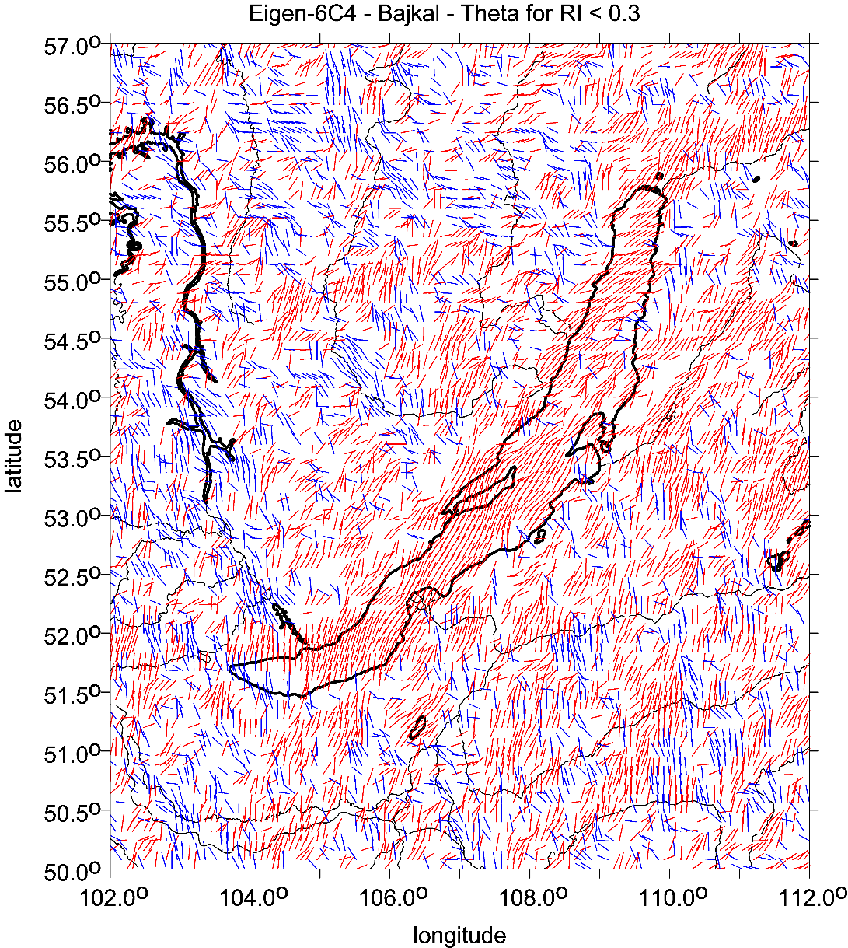
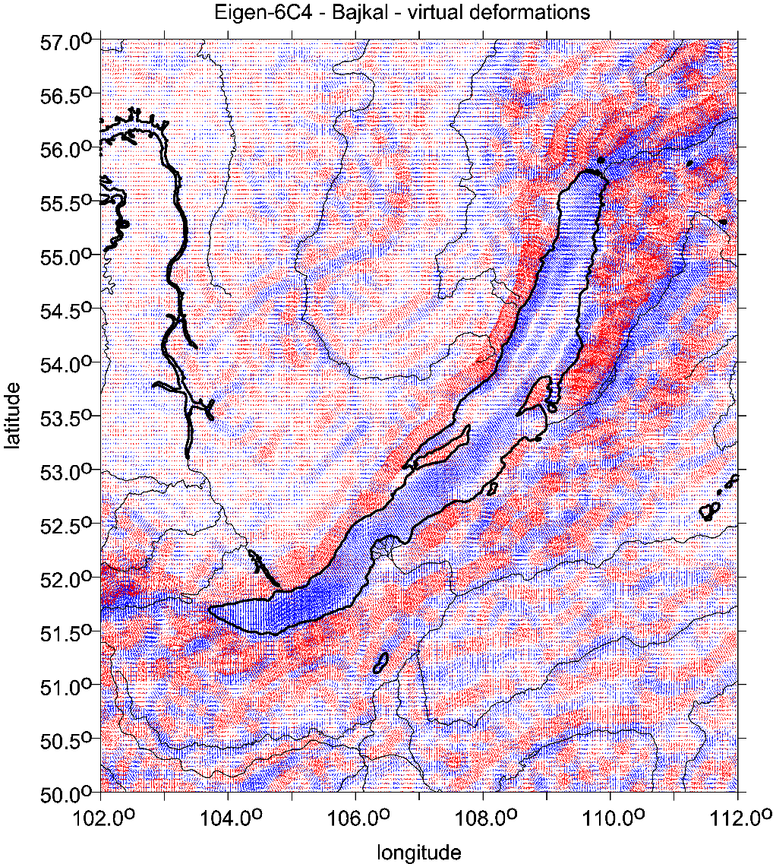

Slide 12
Figures
A note about the units of the gravity aspects:
mGal (miligals) for the gravity anomalies and/or disturbances,
E … Eötvös for the second order potential derivatives,
components of Marussi tensor.
recalling that 1mGal = 10⁻⁵ ms⁻², 1E = 1 Eötvös = 10⁻⁹ s⁻².
The invariants I1 and I2 have units [s⁻⁴] and [s⁻⁶] and their ratio I is dimensionless.
The strike angle θ [deg, ⁰] is expressed in degrees and its demonstration in blue colour signalizes the direction to North from East and
red to South from East
The virtual deformations (vd) are dimensionless and express a direction of dilatation (red) or compression (blue). These units are used in all figures presented below.
Notation: delta g =Δg, Tzz= T_{zz}, RI2=I₁, RI3=I₂, theta = θ

Slide 13
huge impact crater
Vredefort,
South Africa
The strike angles follow rings of the impact structure Vredefort, South Africa. In the central part of the crater they are combed not around the crater but in one prevailing direction.
To draw this, Beiki and Pedersen (2010) used the detailed local airborne gradiometry data

Slide 14
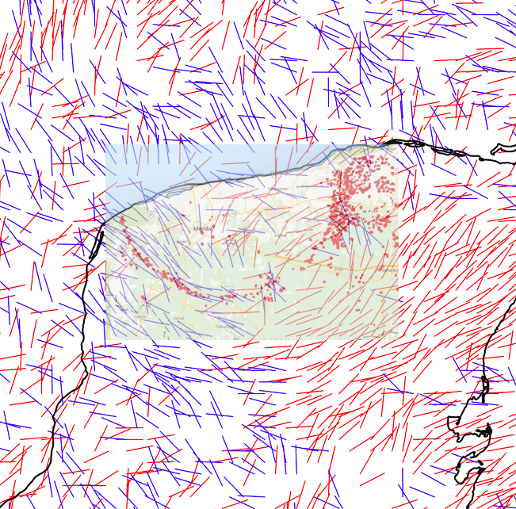
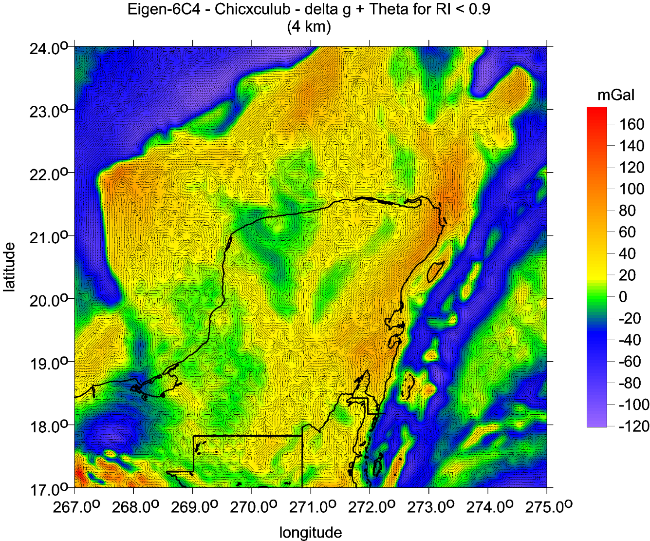
θ [deg]
and
∆g

Slide 15
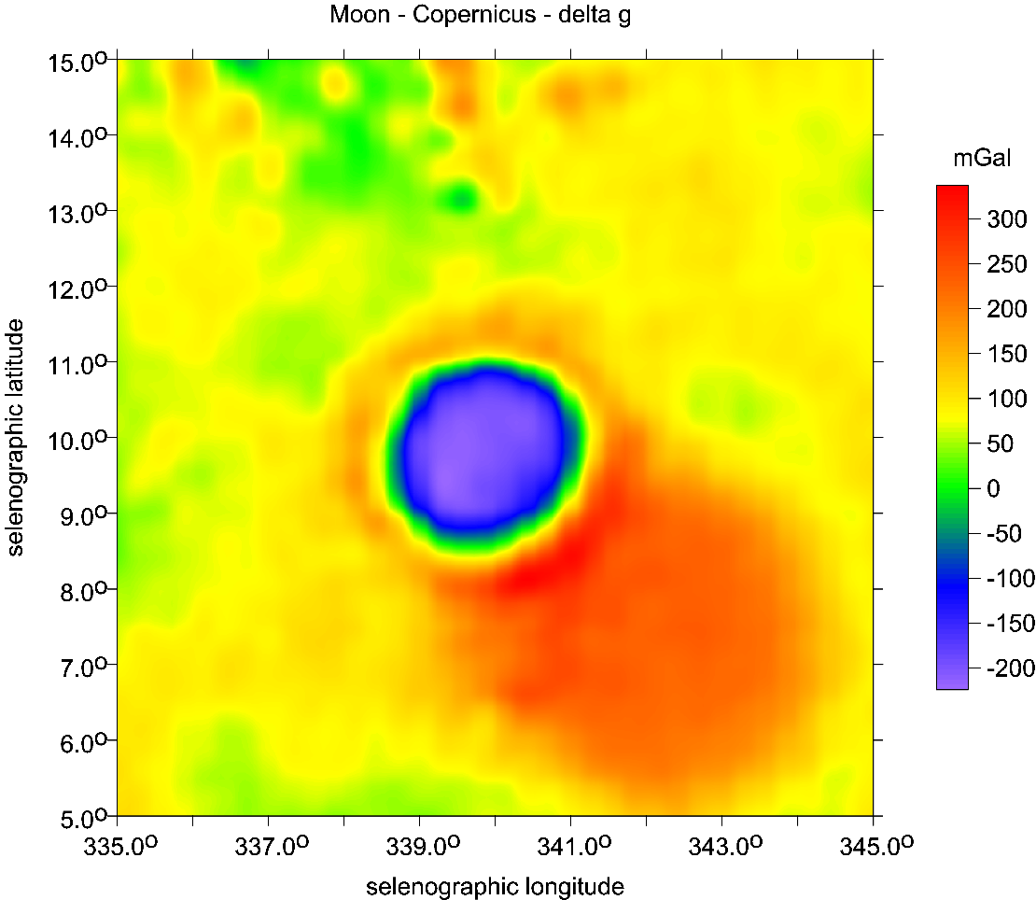
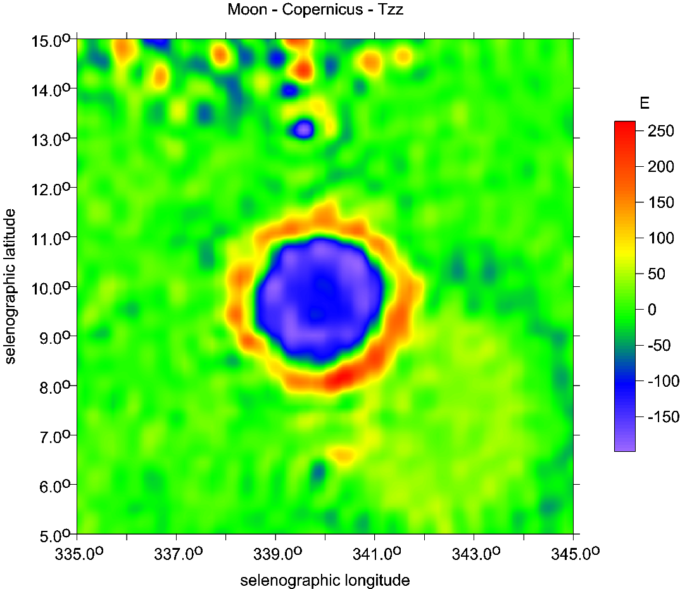
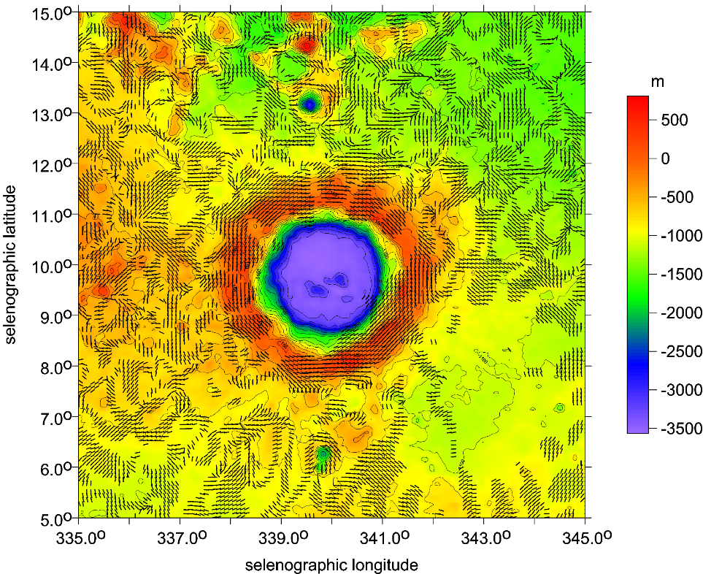
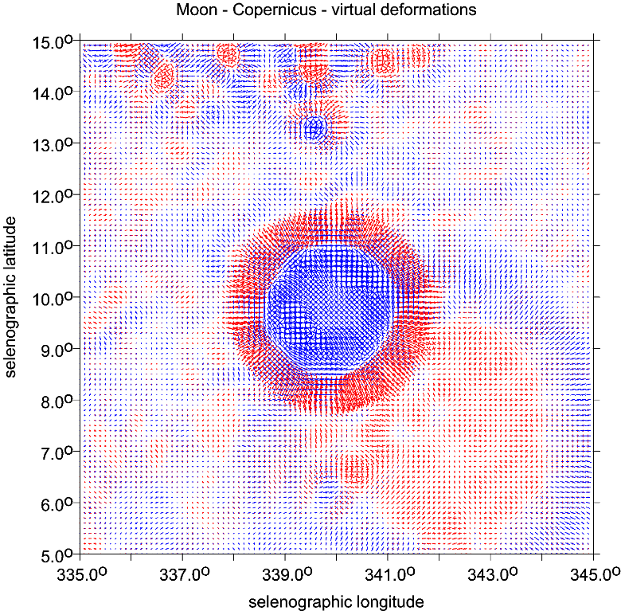
Copernicus main crater and Copernicus H mascon SE

Slide 16
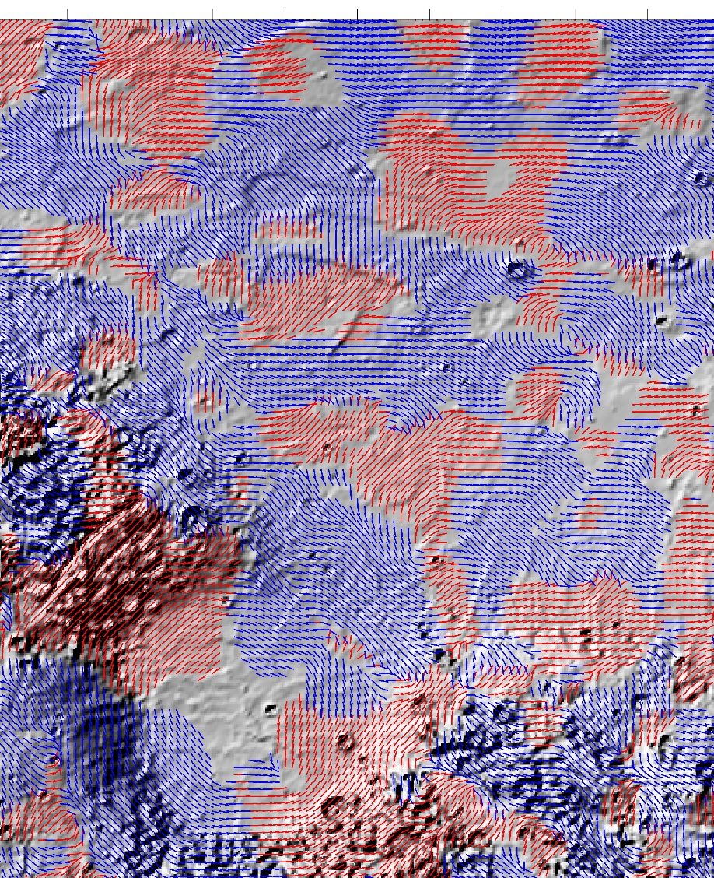
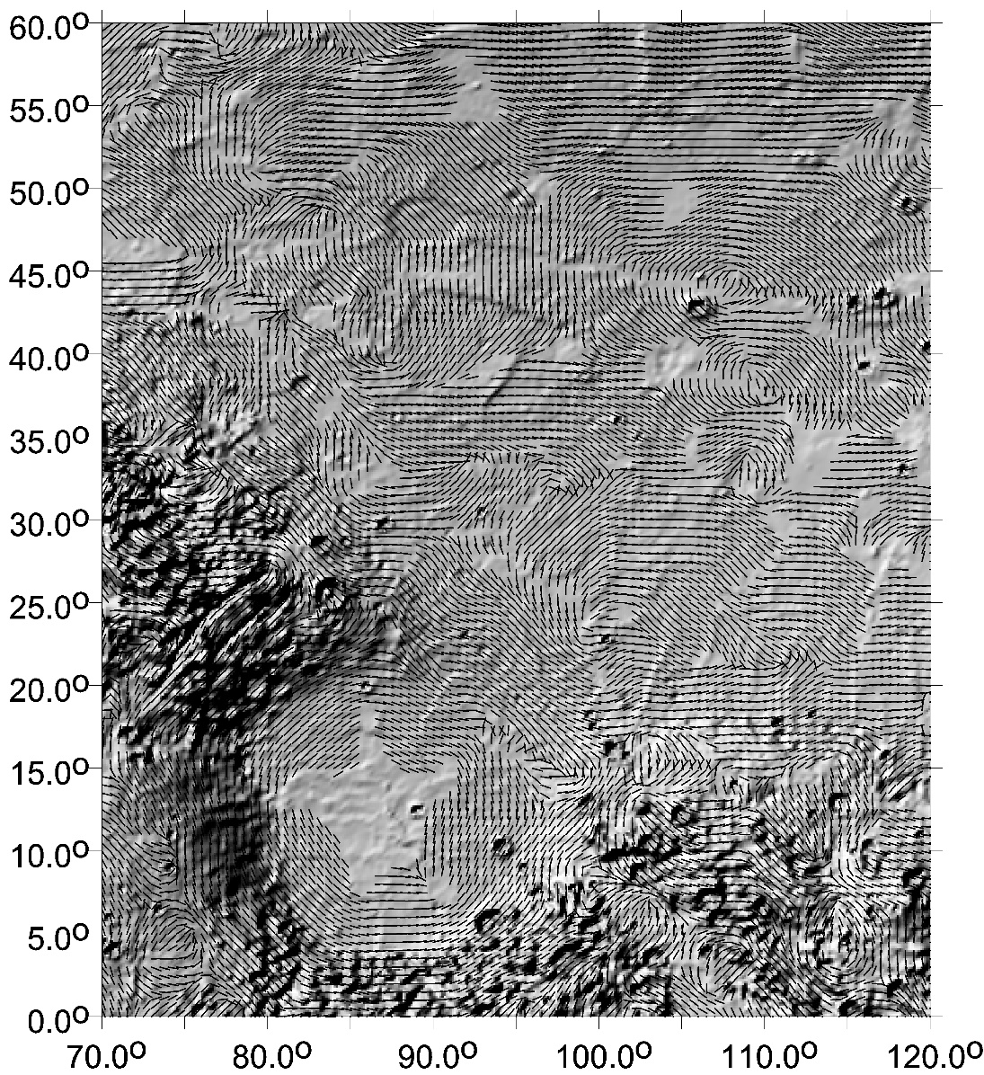
Comments:
The strike angles
Left
combed in plates
Mars
Isidis
Right down
combed in plates
b&w versions

Slide 17
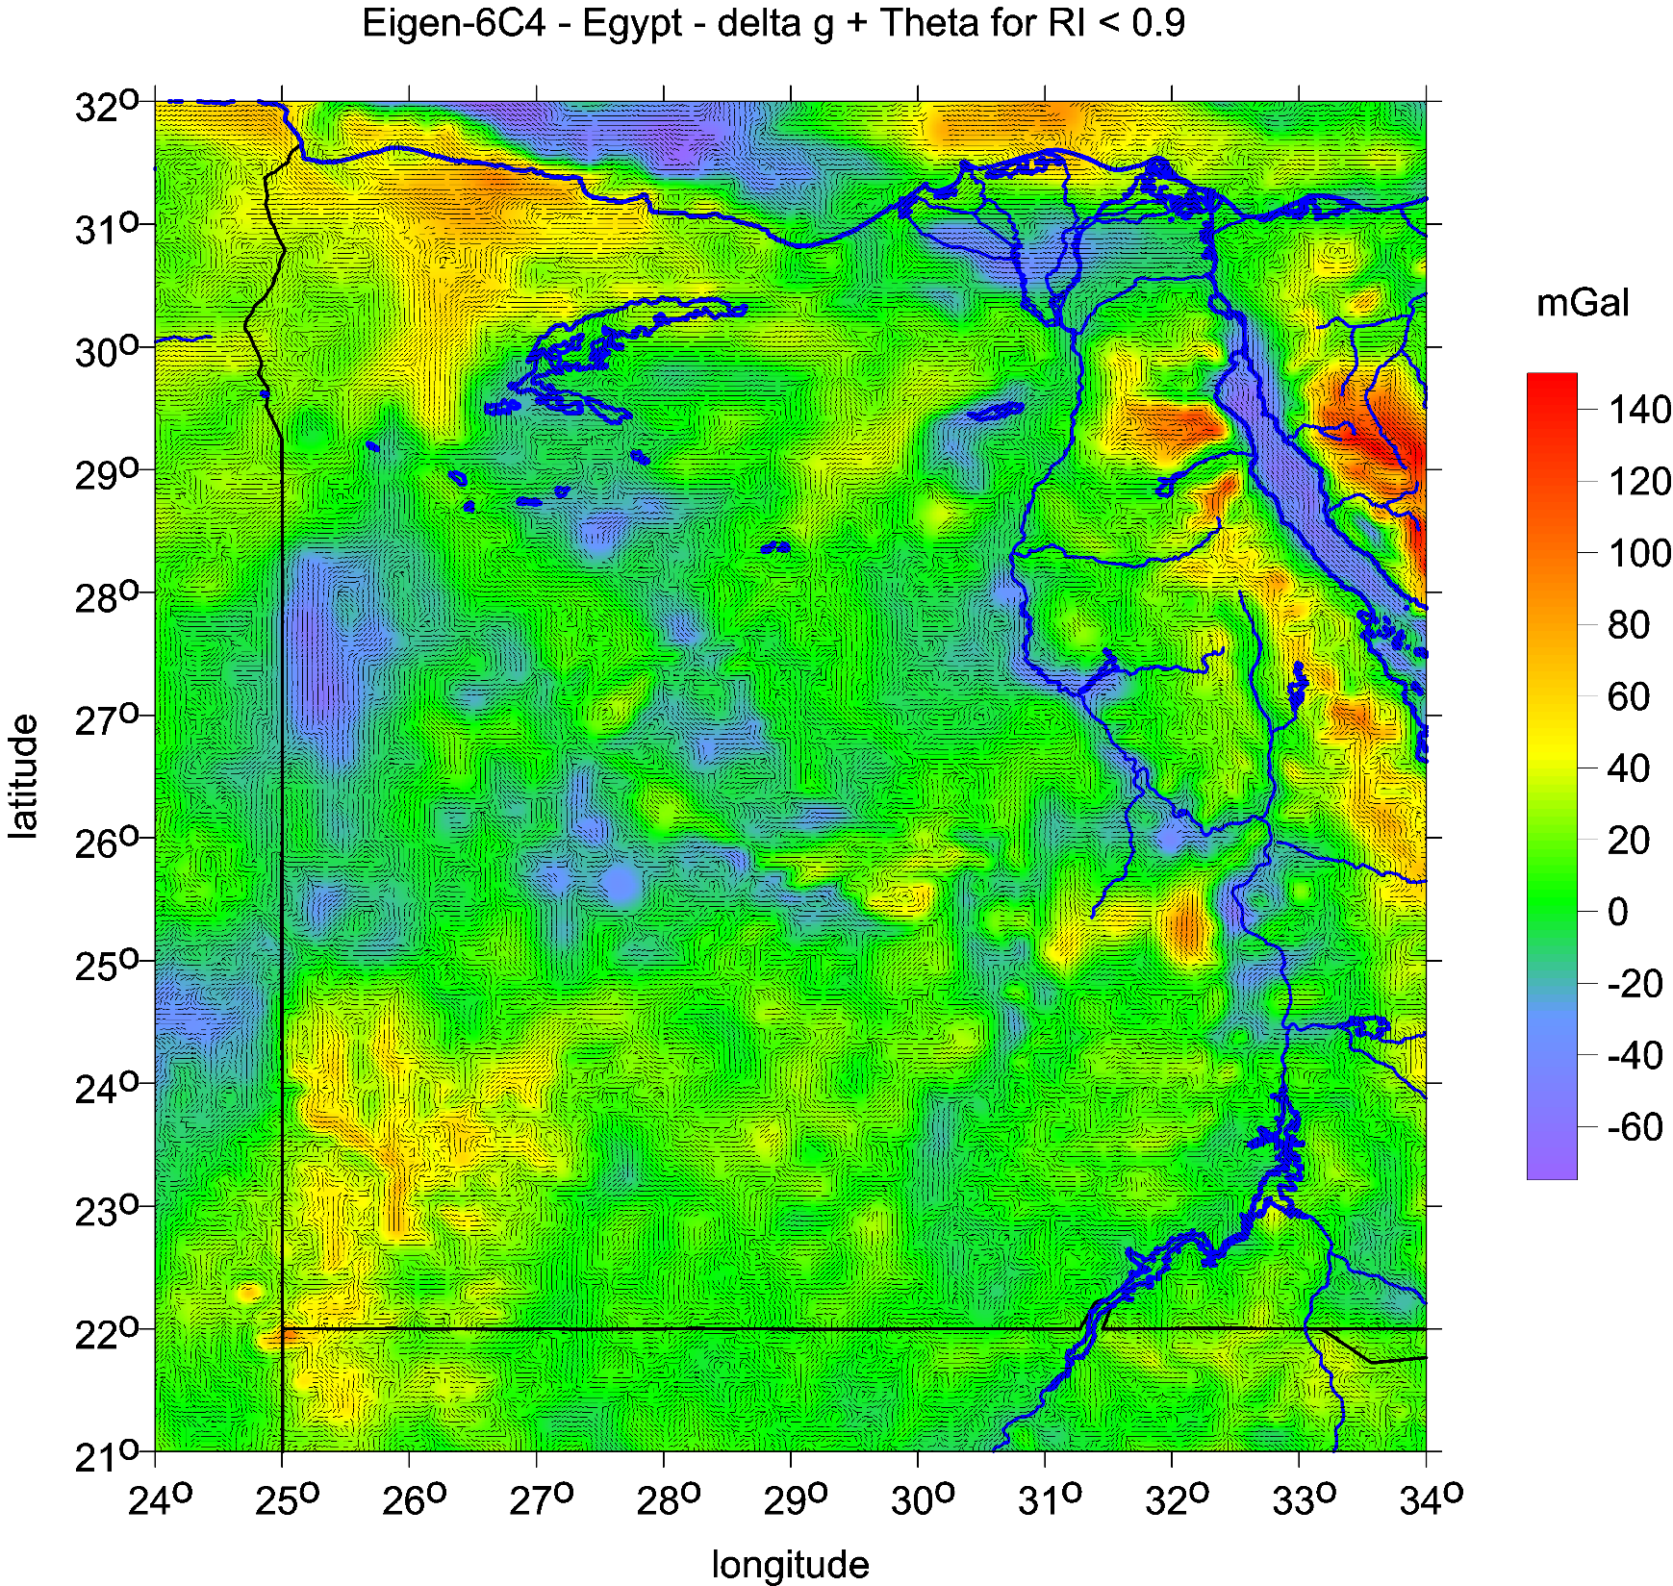
Strike angles

Slide 18
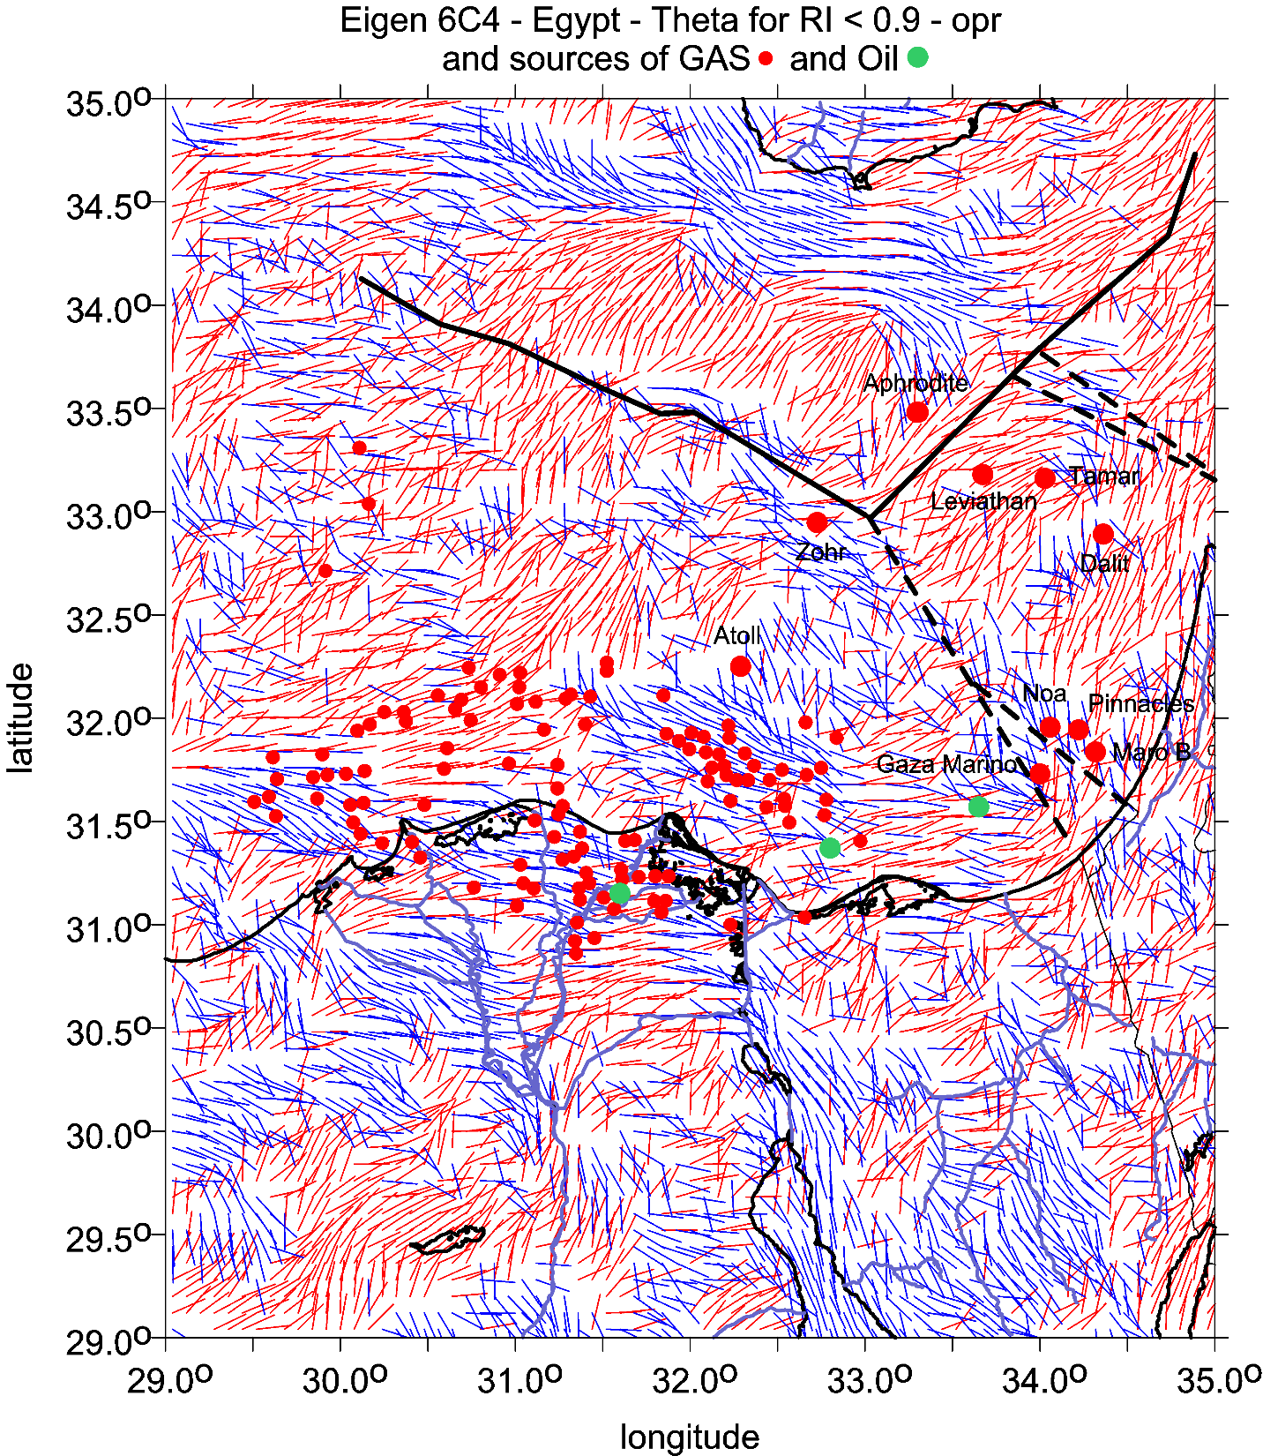

Slide 19
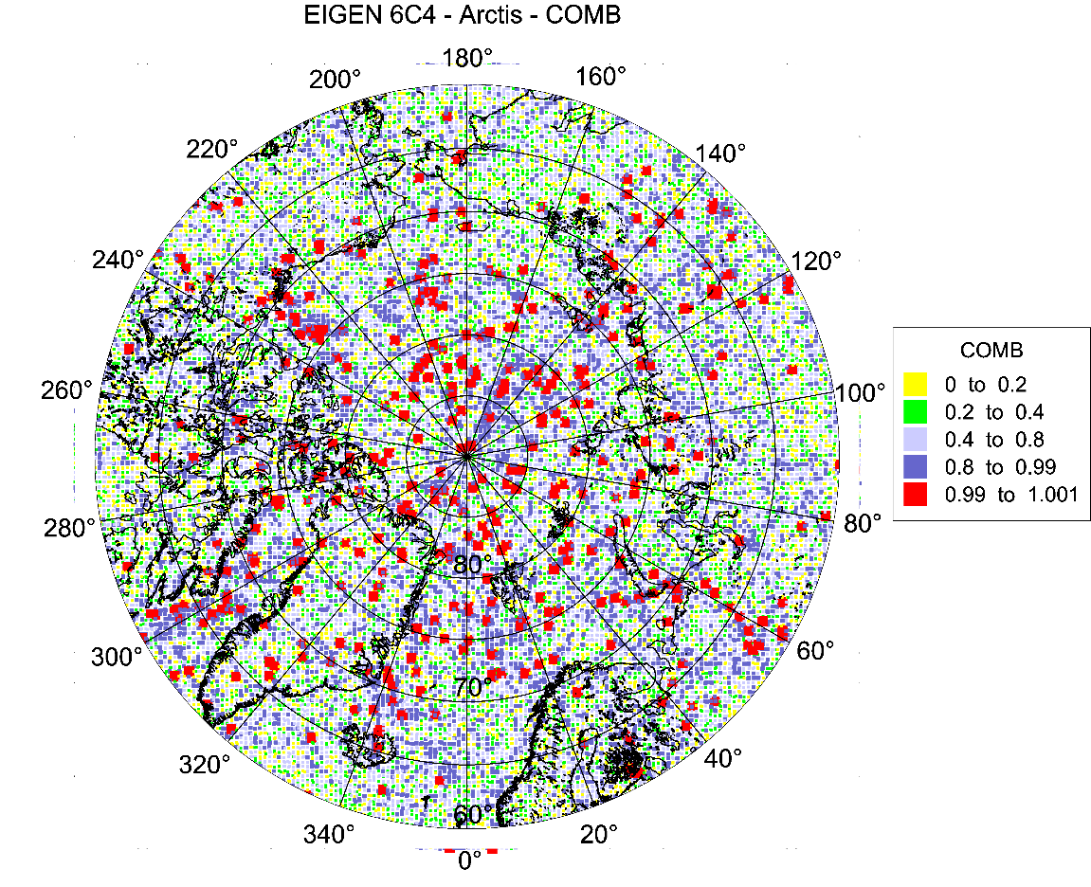
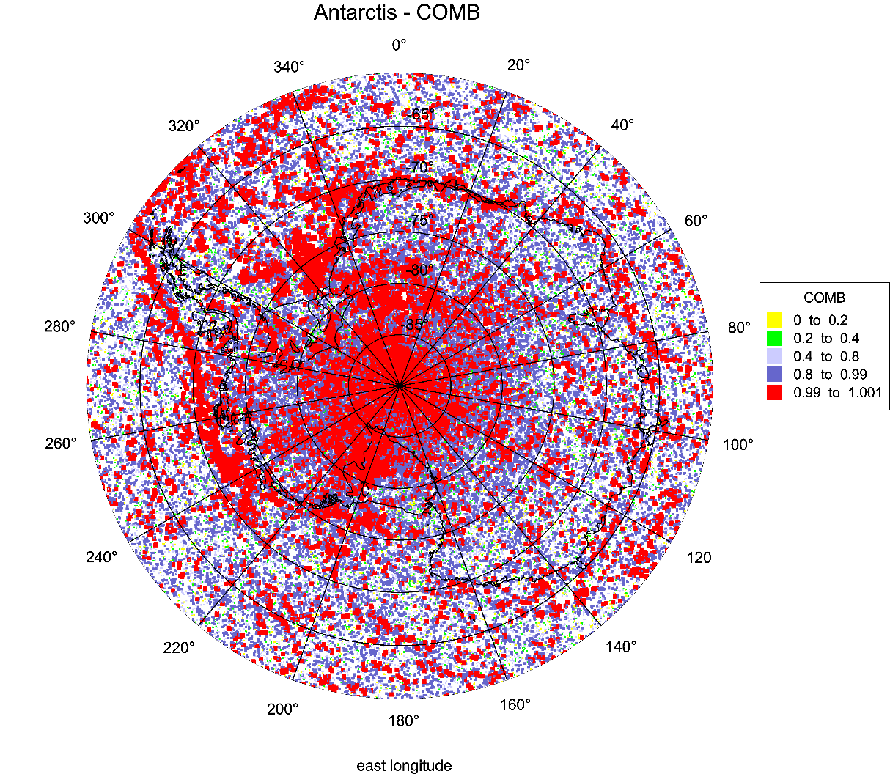
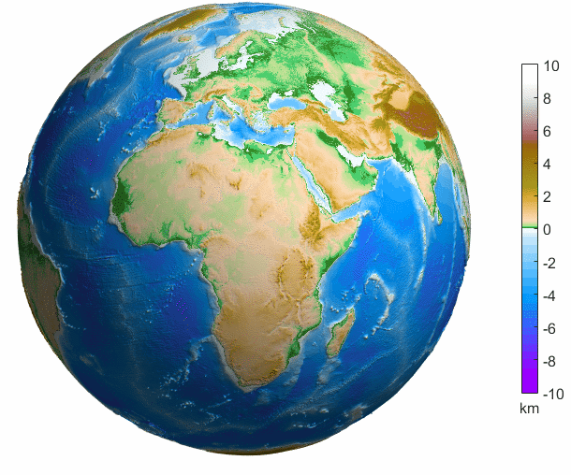
The Earth

Slide 20
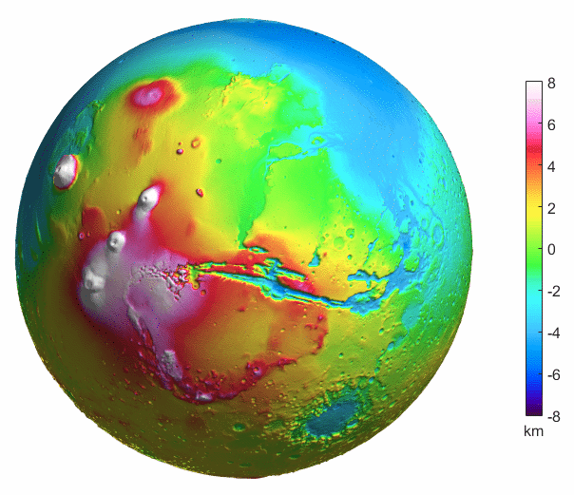
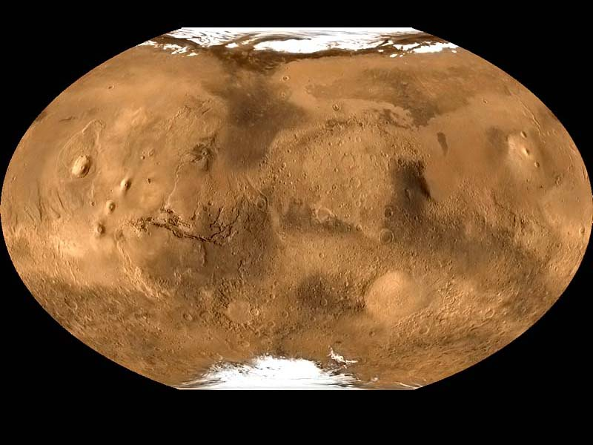
Mars

Slide 21
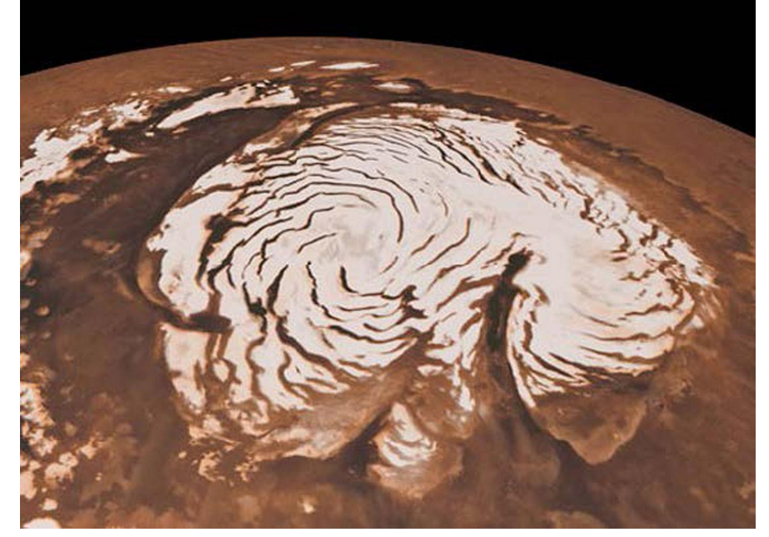
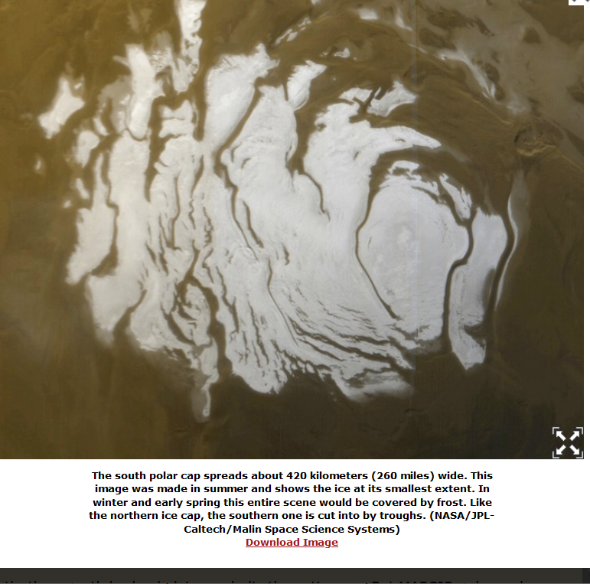
northern
southern

Slide 22
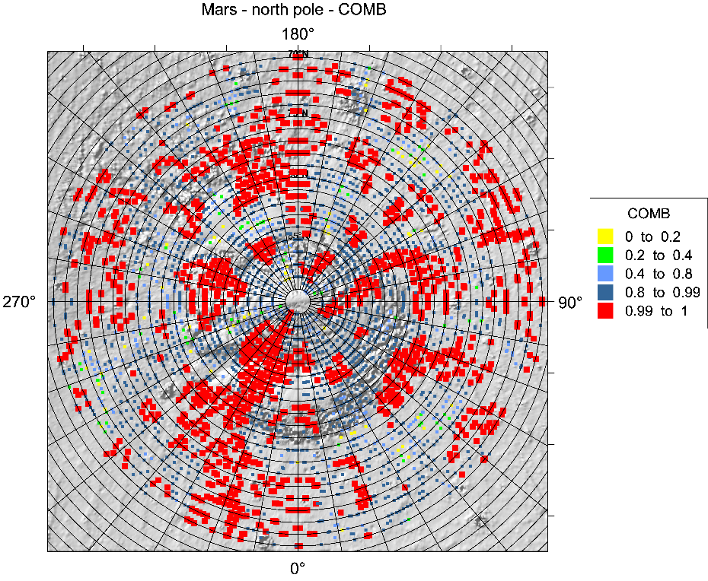
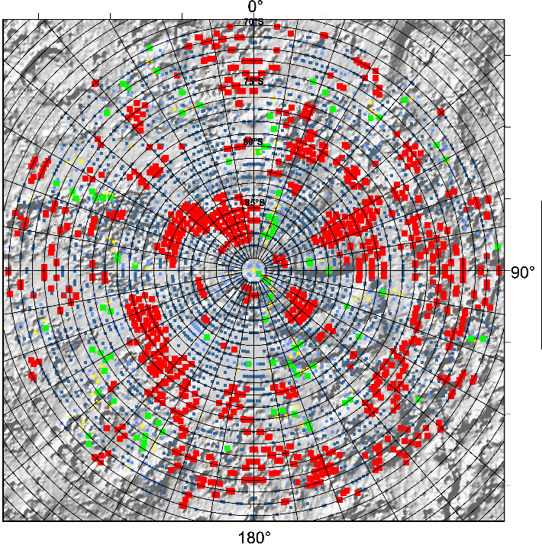
The Comb factors for Mars
north pole zone, left,
south pole zone.
The MOLA topography.
Colour scale is the same for both figures

Slide 23
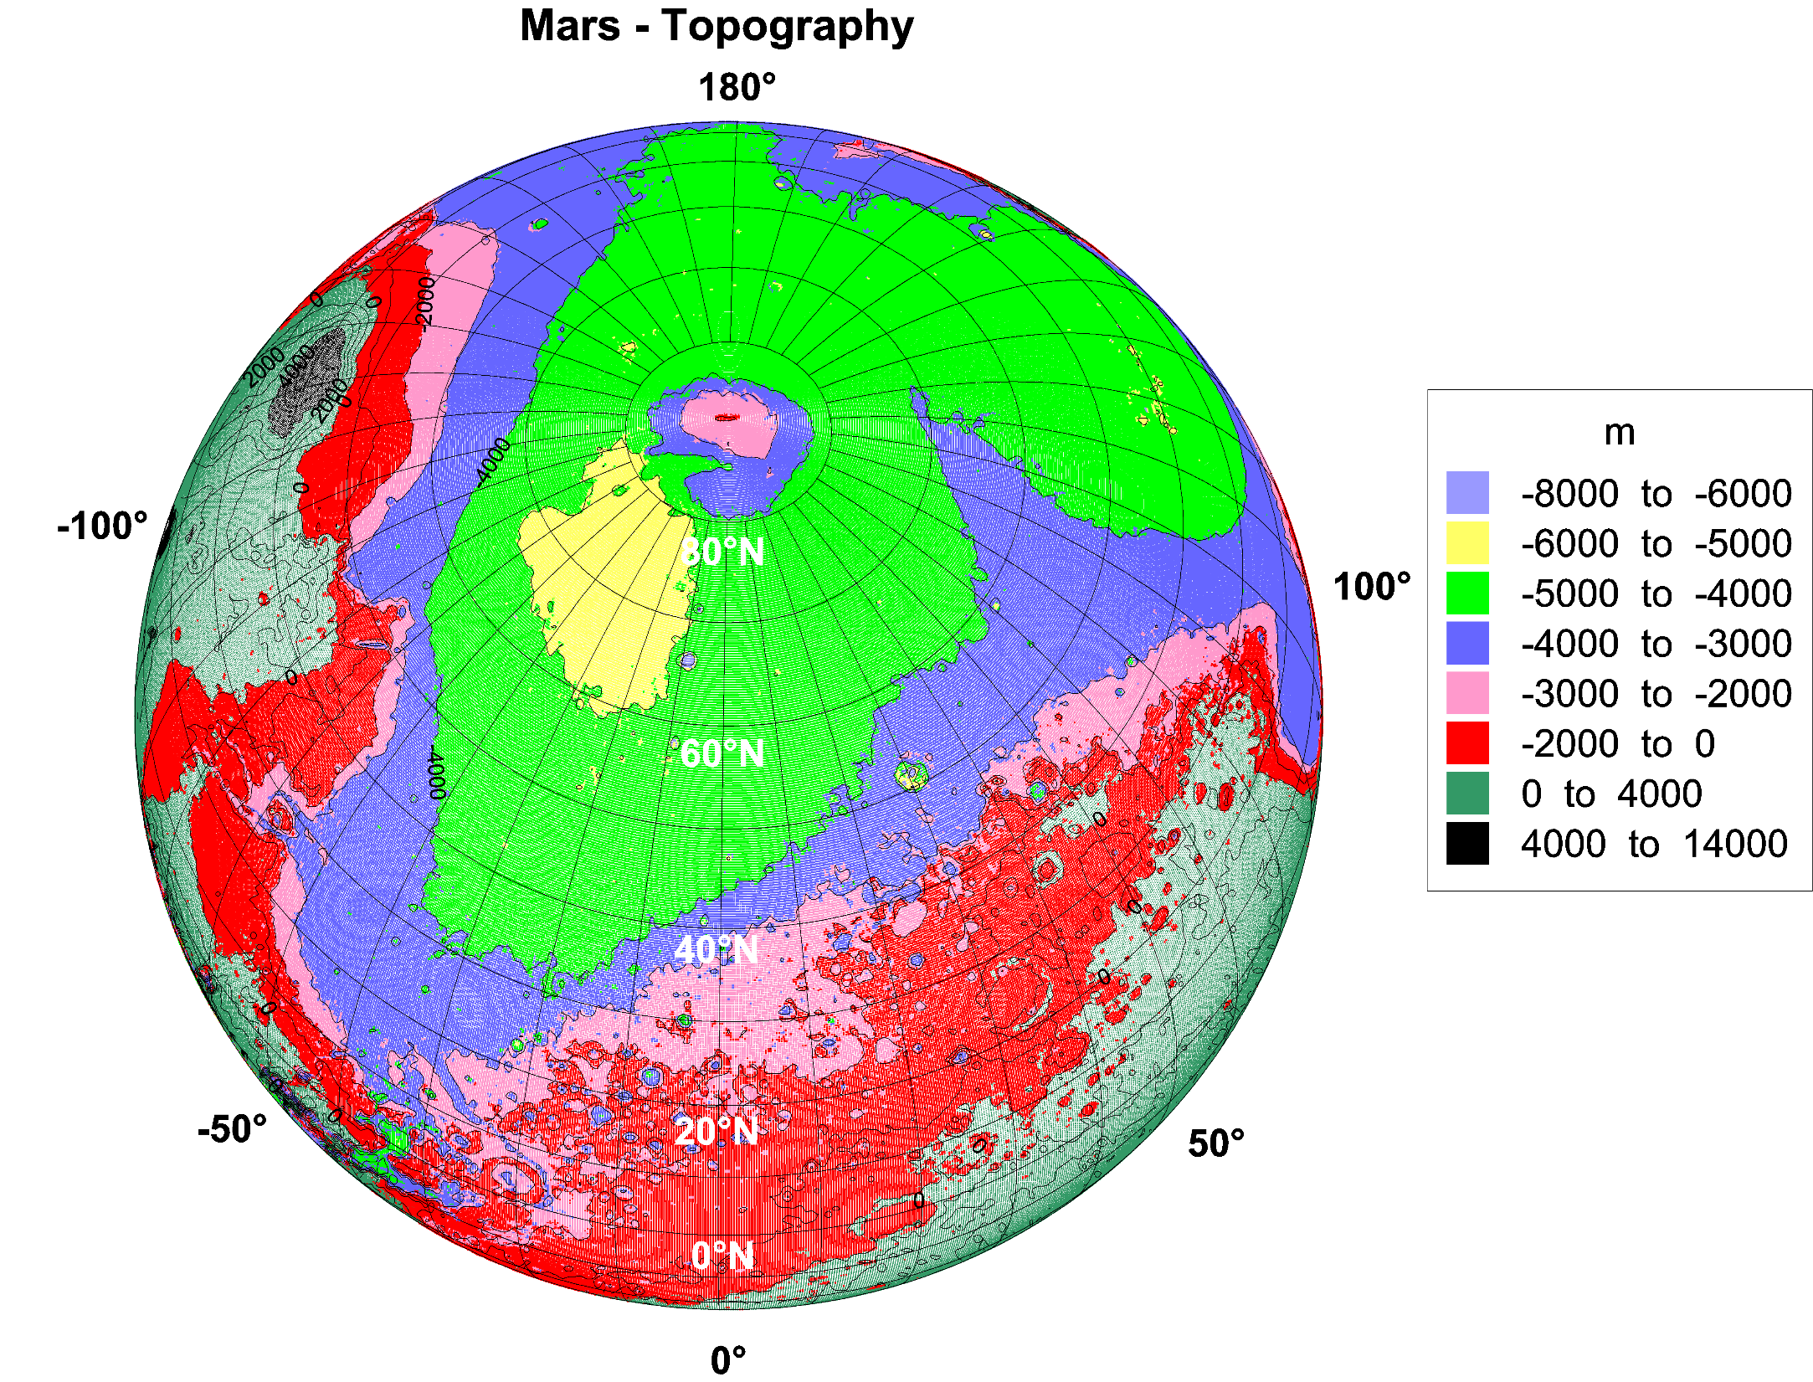

Slide 24
where is the Medusae Fossae Formation on Mars?
based on the MOLA data of the MGS mission

Slide 25
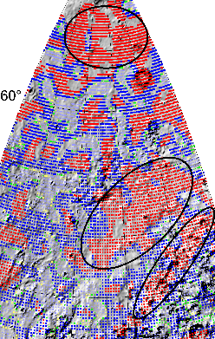
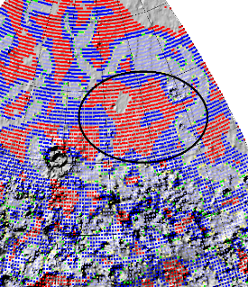
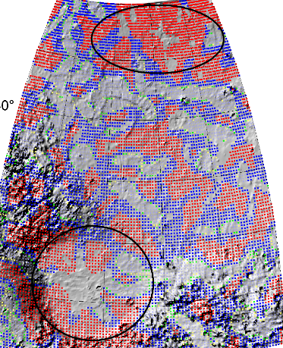
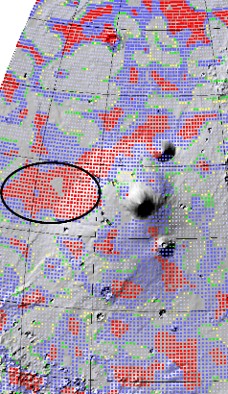
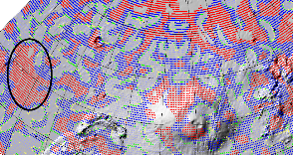
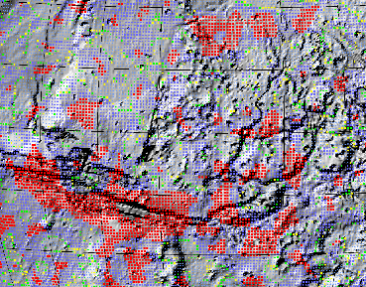
Review of localities with the highest Comb factor of the strike angles
in the hypothetical northern Martian paleo-ocean

Slide 26
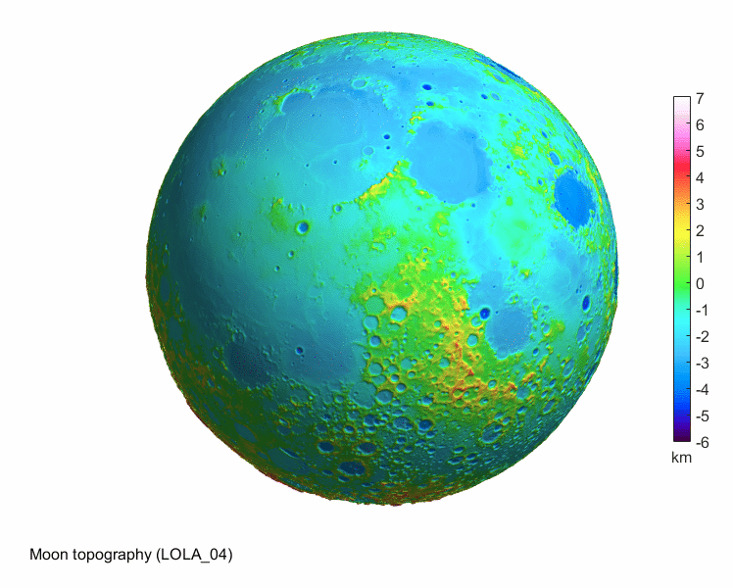
The Moon
The Moon

Slide 27
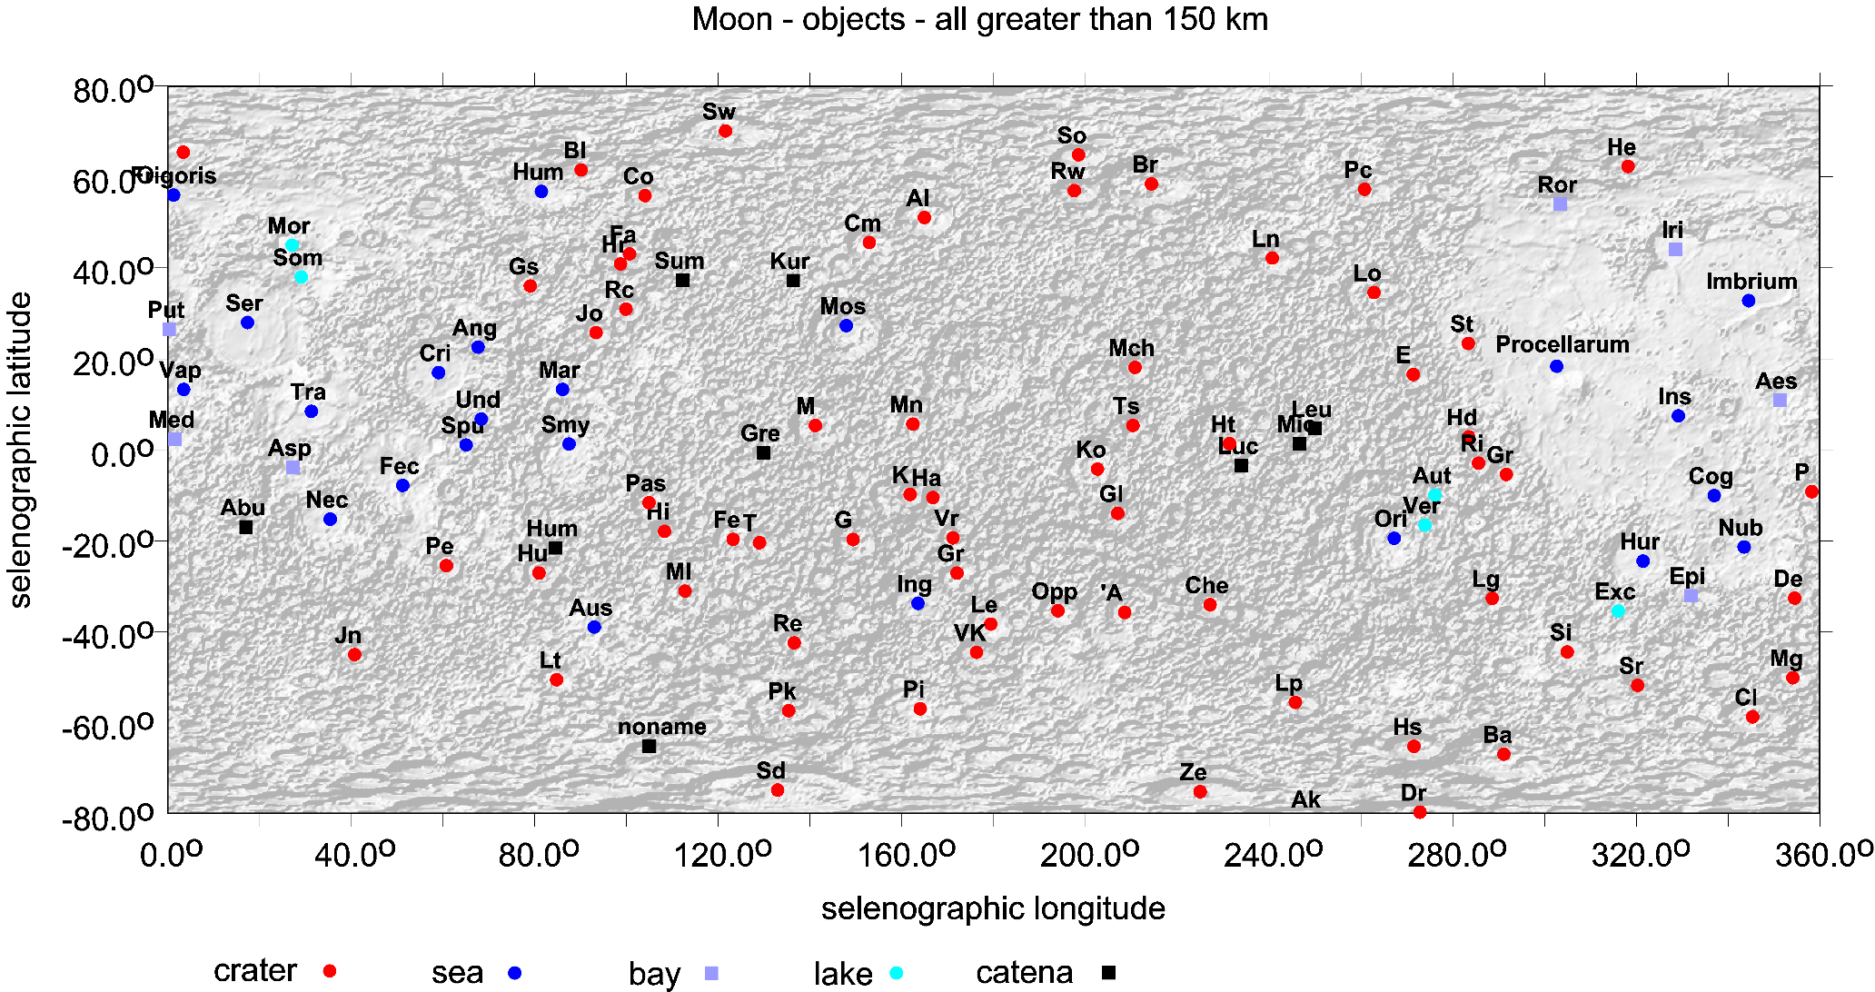
Global view on the Moon, LOLA topography and nomenclature
from Klokočník, et al. (2022b), fig 81.1a
Surface topography data from a lunar digital elevation model
from the measurements of the LOLA (Lunar Orbiter Laser Altimeter) on
the NASA LRO (Lunar Reconnaissance Orbiter) spacecraft.
The heights are given relative to a reference radius of 1737.4 km.
A nominal precision of the LOLA altimeter heights ~10 cm.

Slide 28
1.
“The absence of any bodies of water on the Moon is placed beyond doubt, both by actual telescopic examination and by inference from absence of clouds. There are no streams, lakes or seas…” Dana (1846).
2.
Urey 1956, Newell 1972, Crotts (2011, 2012)
3.
Water (or hydroxyl) imbedded in some minerals, regolith, groundwater or ice =
not drinkable without some processing; it can be tainted with chemical and isotopic components. The volcanic samples collected by Apollo astronauts contained traces of water. Water vapor ions observed by the mass spectrometer near the Apollo 14 landing site.
4.
The first definitive discovery of water on the Moon was made in 2008 by the Indian mission Chandra-yaan 1 (hydroxyl molecules spread across the lunar surface but concentrated at the poles).
5.
Honniball et al. (2021) confirmed the presence of water, SOFIA (NASA/DLR Stratospheric Observatory for Infrared Astronomy), at Clavius and Mare Serenitatis.
6.
IM 1 and Artemis.
Citace: Klokočník, J., Kostelecký, J., Cílek, V., Kletetschka, G., Bezděk, A. 2022. Gravity aspects from recent gravity field model GRGM1200A of the Moon and analysis of magnetic data, Icarus 384, 115086; https://doi.org/10.1016/j.icarus.2022.115086.

Slide 29
Lunar water arrives continuously from
Comets and asteroids impacts,
icy micrometeorites colliding on the lunar surface, and
lunar dust interactions with the solar wind
(ii) the solar wind. Water can be continuously produced by the
hydrogen ions (protons) of the solar wind to impact oxygen
bearing minerals
(iii) the Earth’s atmosphere
Kletetschka et al. (2022).
Data from the Kaguya lunar orbiter (launched by JAXA, Japan
Aerospace Exploration Agency, in 2008) observed significant
numbers of oxygen ions during a time when the Moon was inside
the geomagnetic field of the Earth.
Citace:
Kletetschka, G., Klokočník, J., Hasson, N., Kostelecký, J., Bezděk, A., Karimi, K. 2022. Distribution of water phase near the poles of the Moon from gravity aspects,
Sci. Reps. 12 (1), 4501; doi: 10.1038/s41598-022-08305-x

Slide 30
direct application for
Artemis mission
Tvar zemské magnetosféry. Rovina oběžné dráhy Měsíce kolem Země je skoro totožná s rovinou oběžné dráhy Země kolem Slunce. Magnetosféra Země směrem od Země sahá daleko za oběžnou dráhu Měsíce kolem Země. Měsíc prolétá zemskou magnetosférou každý měsíc kolem úplňku po dobu asi pěti dnů. Z ionosféry se ionty dostávají do magnetosféry a pohybují se podél oranžových šipek. Zelené šipky ukazují na pohyb iontů díky tzv. “rekonekci“ (přepojení siločar magnetického pole, což způsobí urychlení iontů v magnetosféře směrem k Zemi). IMF meziplanetární magnetické pole se slunečním větrem SW, MP magnetopauza, UWI ionty ze Země, které se mohou dostat na Měsíc.

Slide 31
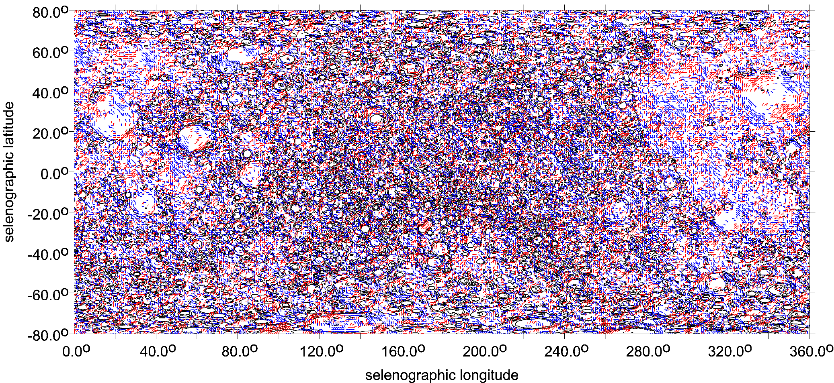
The global satellite gravity field models of the Moon from the GSFC and JPL NASA.
Developed from the GRAIL observations, Gravity Recovery and Interior Laboratory,
two satellites in low orbits, in spherical harmonic expansion up to (d/o) = 1200
and 1500, respectively, GRGM1200A (Lemoine et al., 2014) and GL1500E
(Konopliv et al., 2014), and compared. All the results presented here are based on
the GRGM1200A model; cut at a maximum of d/o = 600
Global view on the Moon, strike angles, I<0.3
blue colour signalizes the direction to West from North and red to East from North.
from Klokočník, et al. (2022b), fig 81.6b

Slide 32
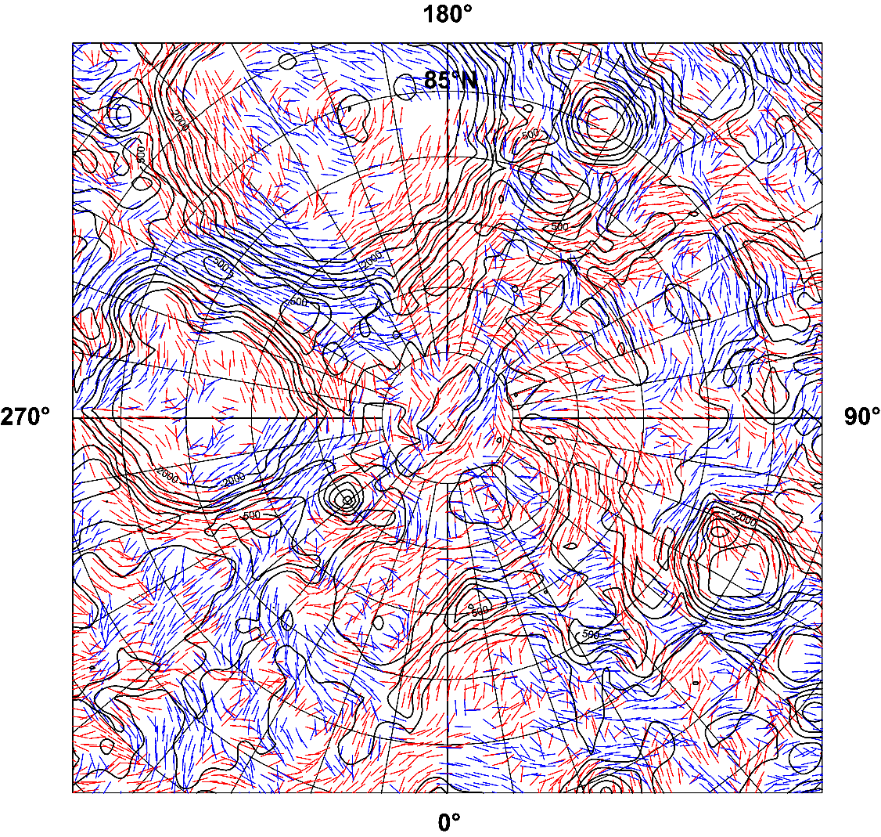
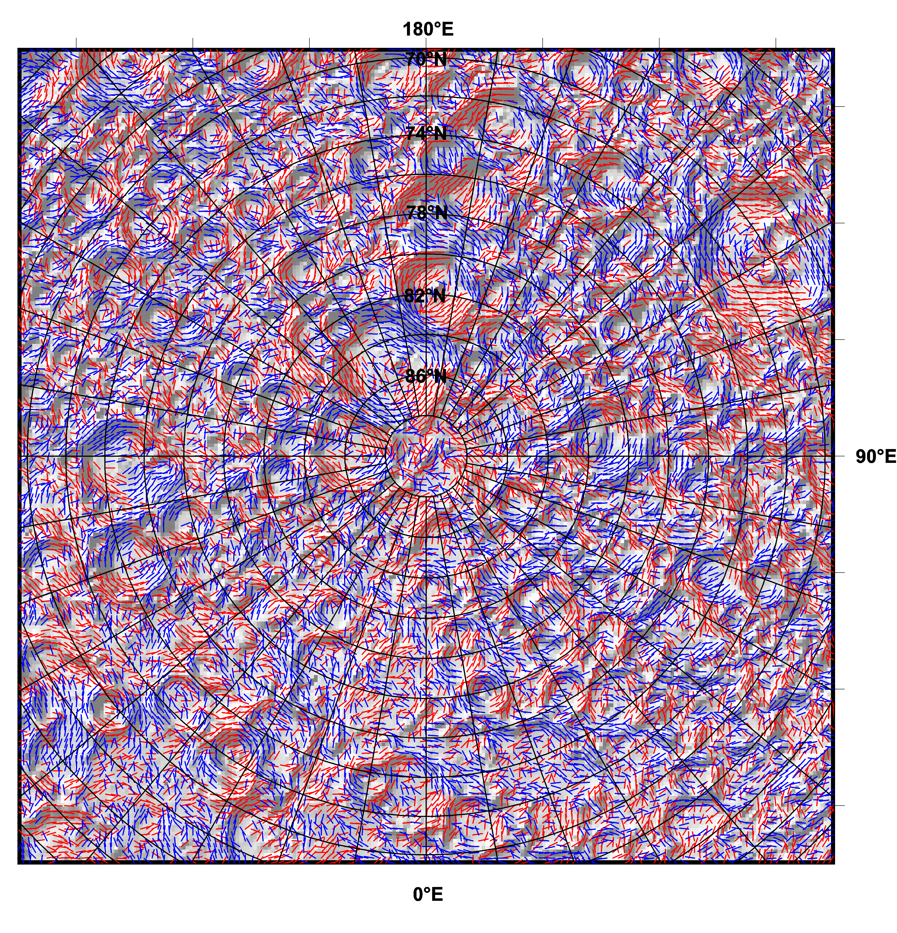
North pole area
Strike angles
Θ [deg], I<0.9

Slide 33
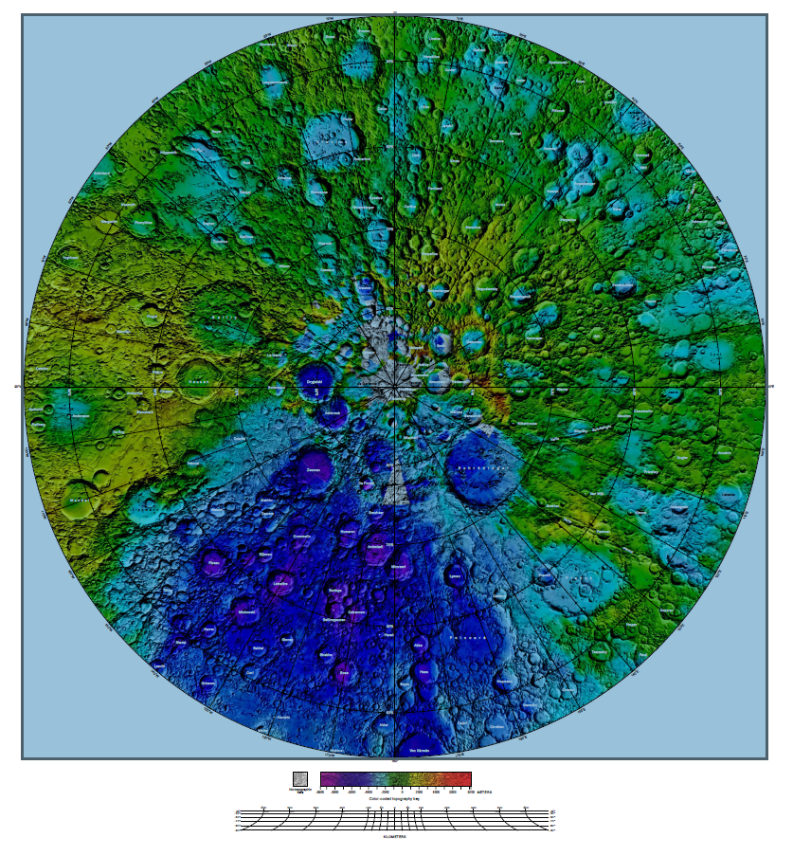
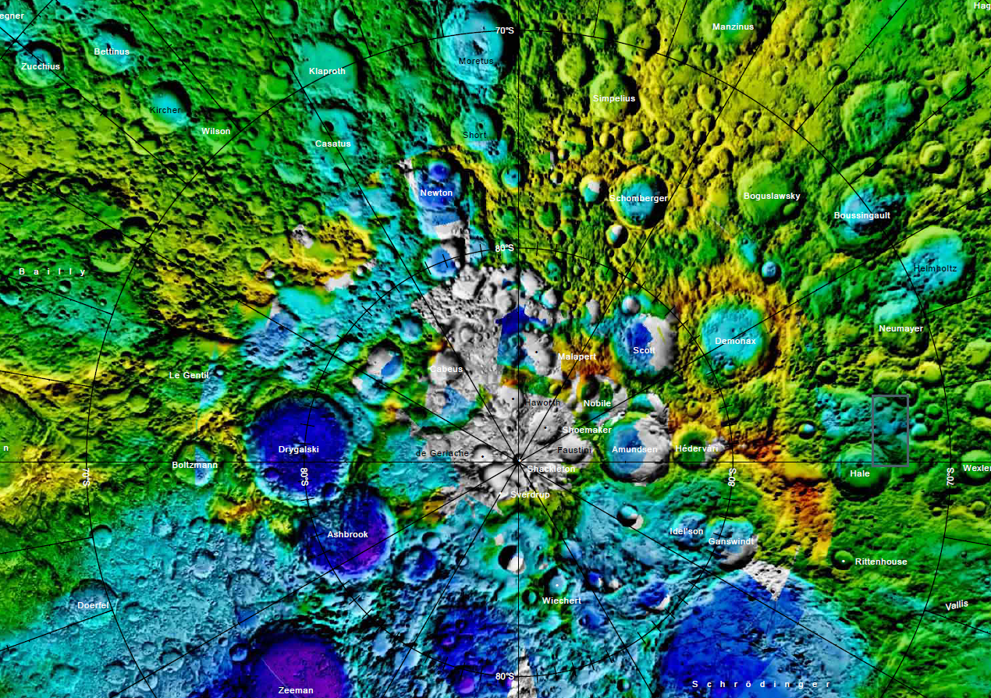
South pole area series
.
South Pole Aitken basin
Gazetteer of Planetary Nomenclature
2024 USGS
Moon 1:10 million-scale
Shaded Relief
and Color-coded Topography

Slide 34
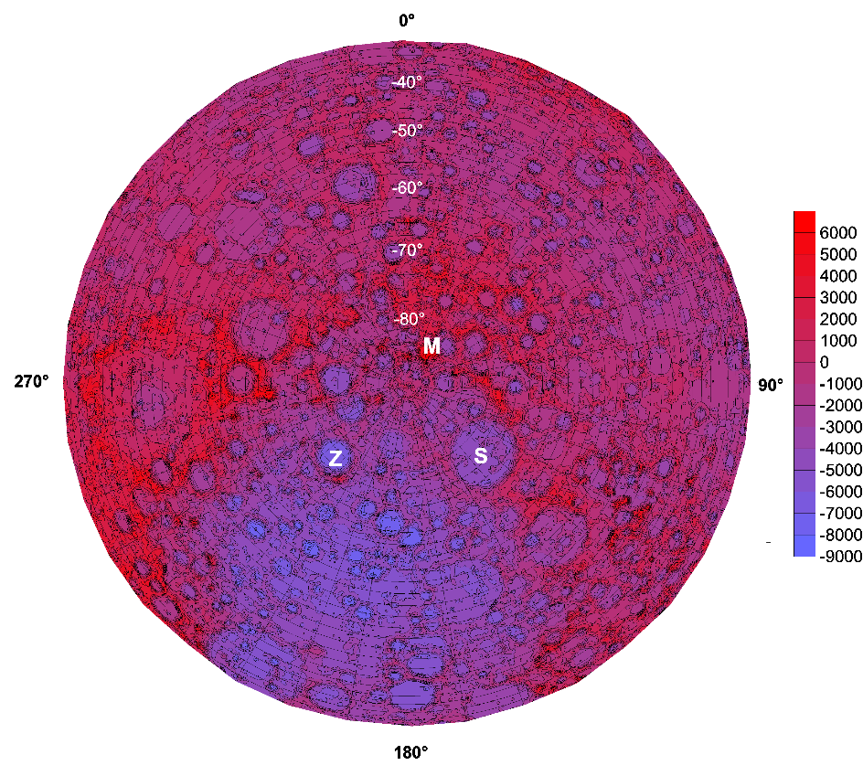
blue circular zone = the Aitken
M Malapert,
S Schrödinger, Z Zeeman crater
LOLA
M
S

Slide 35
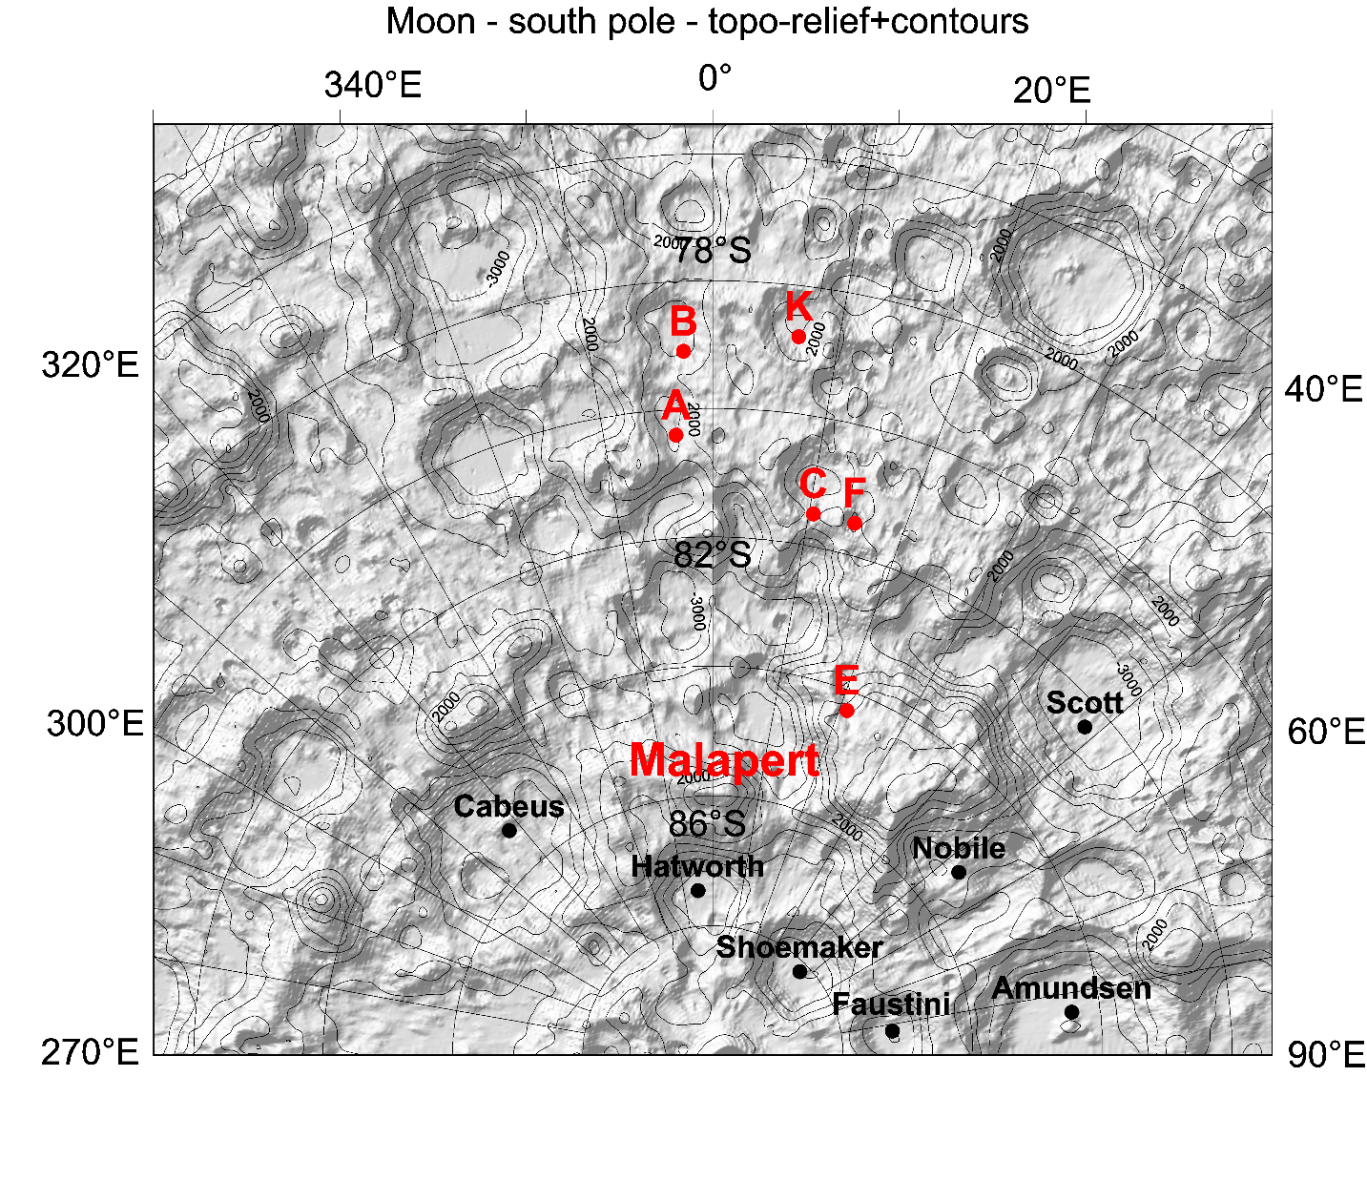

Slide 36
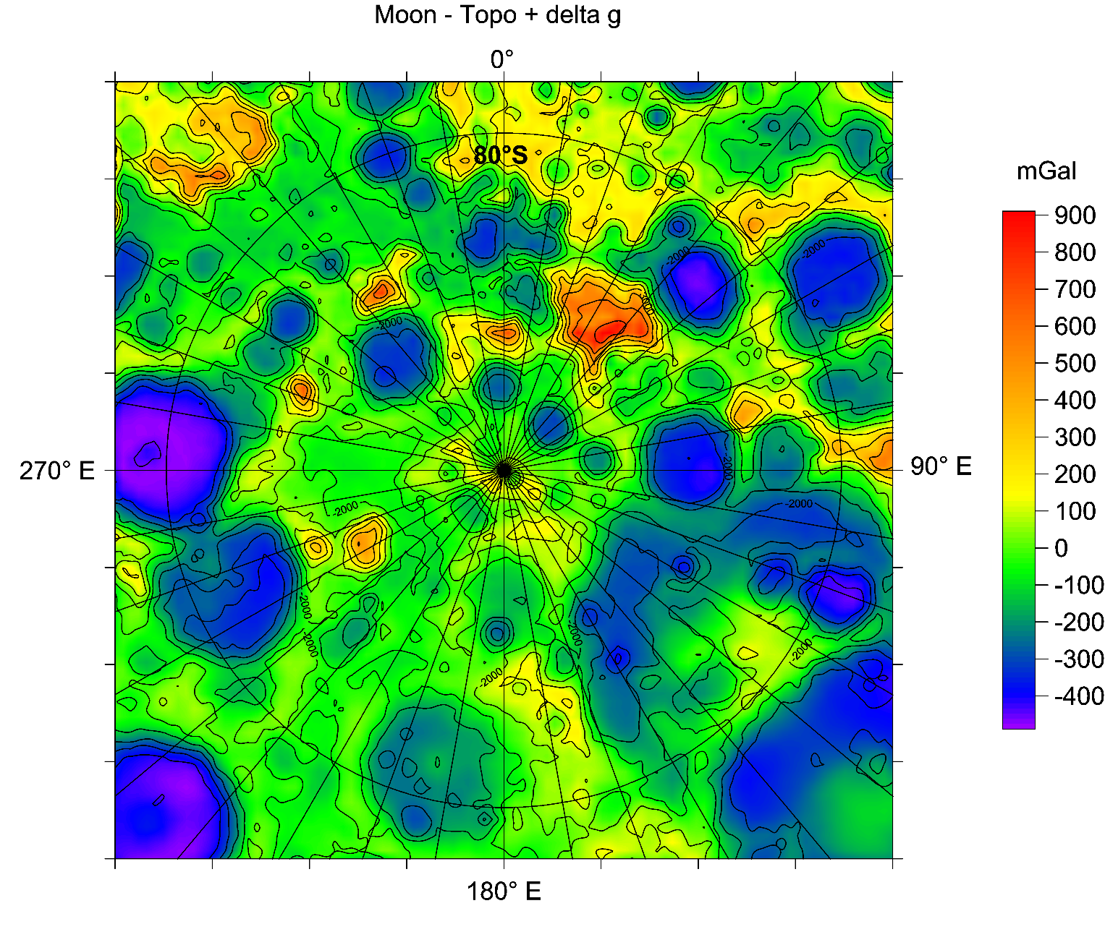
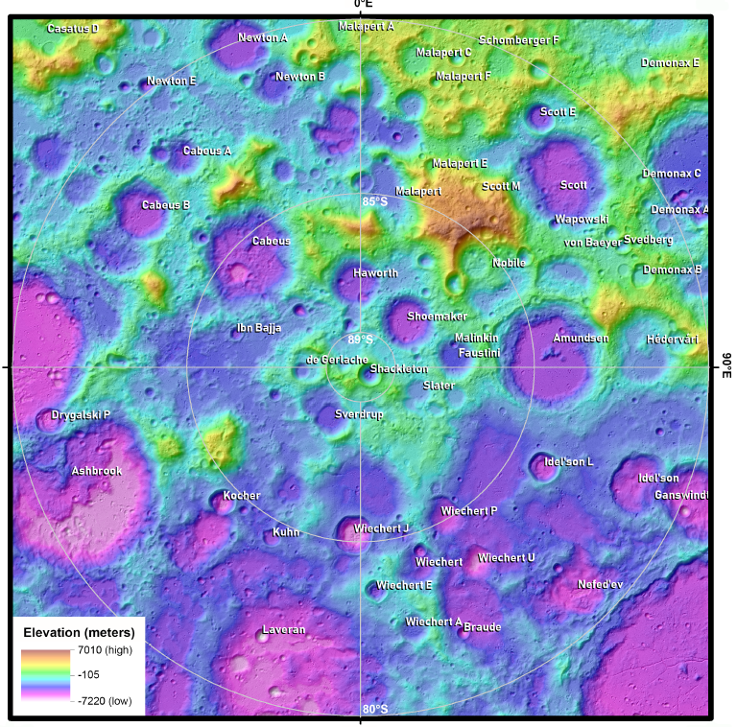
South pole area series
M Malapert massif, H Haworth,
S Shoemaker, A Amundsen,
N Nobili, F Faustini, Sc Scott,
Sh Shackleton, D de Gerlach,
C Cabeus, L Laveran

Slide 37
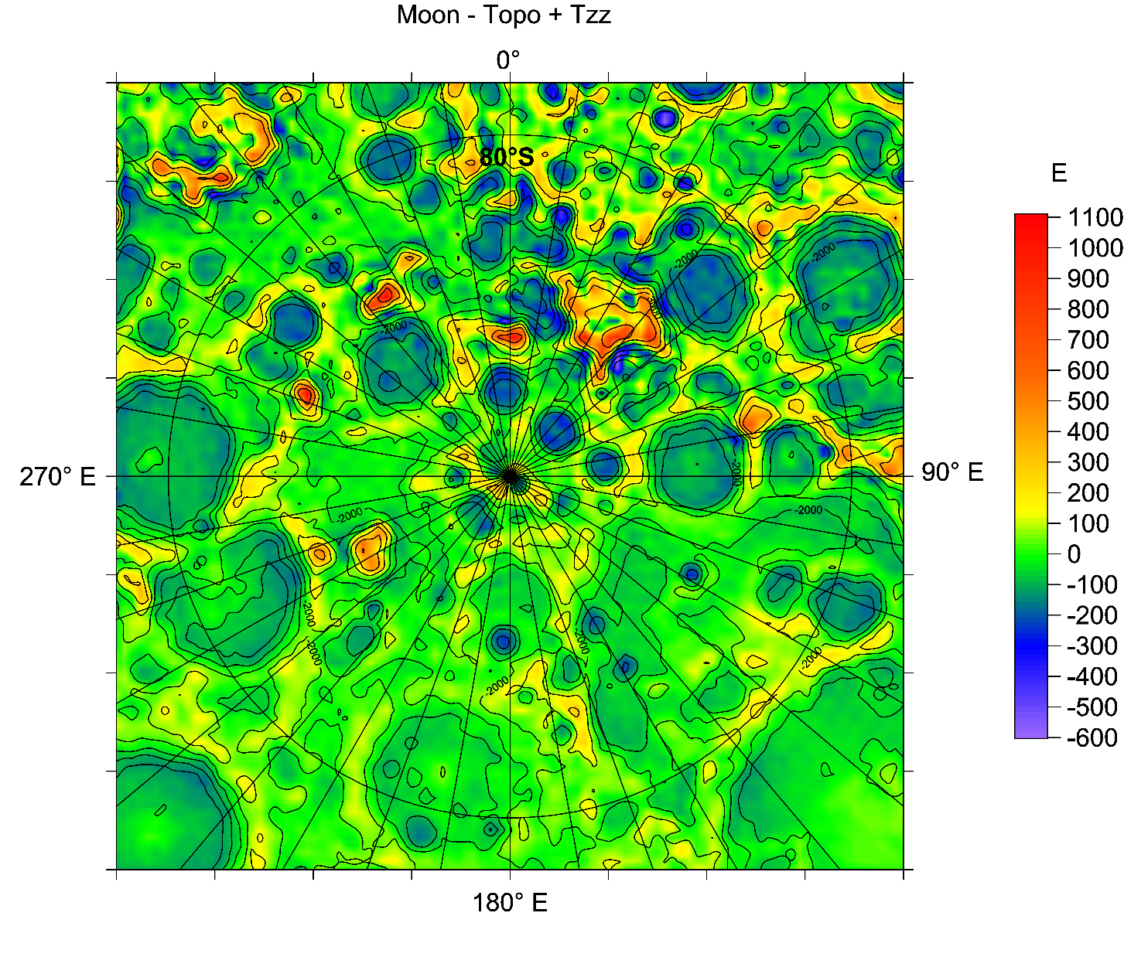
South pole area series

Slide 38
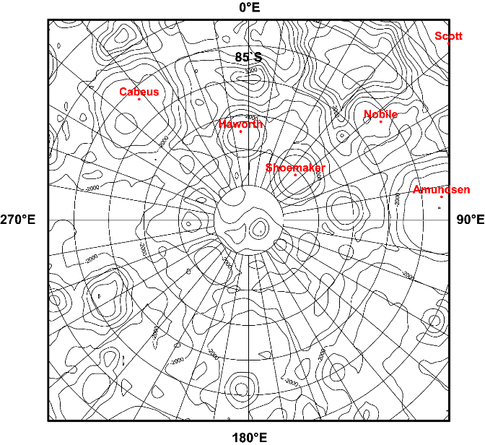
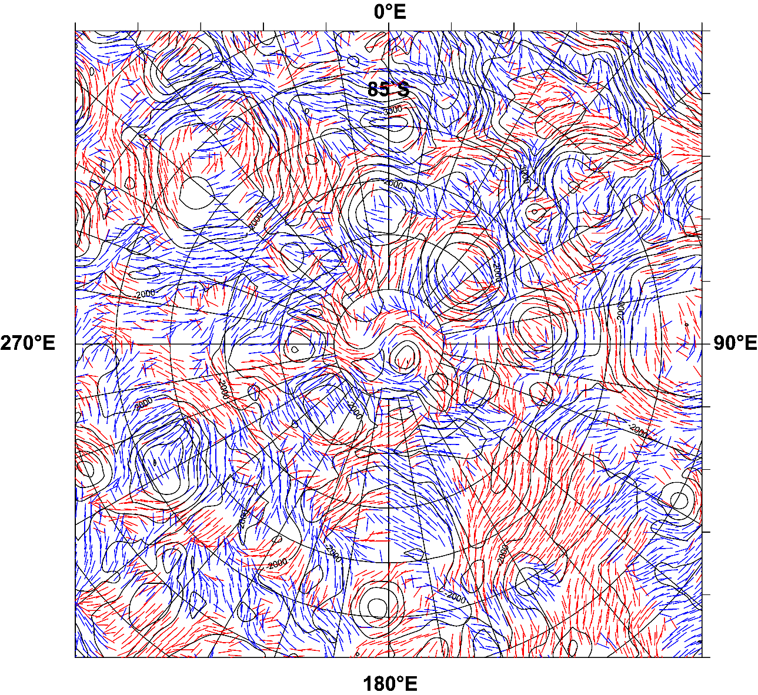
South pole area series
South pole
LOLA topo &
Strike angles θ [deg], I<0.9

Slide 39

Strike angles
θ [deg]

Slide 40

Strike angles
θ [deg]
Hatworth Shoemaker Faustini

Slide 41


Strike angles
θ [deg] near
Malapert A,
landing side of IM1,
Malapert craters A,B,C,…K
with
LOLA topo
(shaded relief left],
contour lines,
right [m])

Slide 42

Strike angles
Comb factors

Slide 43




Slide 44

body | the Earth ♁ | the Moon | Mars ♂
south north | 10 2 | 8 6 | 1.1 1.5
The comparison of the ratios r=P/A for the Earth, the Moon, and Mars for the Comb>0.99
between their polar P and non-polar A areas [“polar” means for planetographic latitudes
> |70⁰|, the non-polar latitudes are within the interval (-70,70)]
south north | 20% 4% | 31% 23% | 23% 30%
others | 2% | 4% | 20%
The ratios „Comb>0.99 to Comb<0.99” for the same areas, P or A, expressed in per cents

Slide 45

LOLA topography
[m]
Aitken basin mostly in blue colour
= a huge lowland
(Aitken) = 35%
(all excl. Aitken) = 20%
r = 35/20 ~ 2

Slide 46

Comb factors
and the LOLA topo

Slide 47

South pole area series
Comb factors,
the LOLA topography, and reconstruction of a hypothetical south polar cap

Slide 48



www.asu.cas.cz/~jklokocn;
www.asu.cas.cz/~jklokocn/
PPT_od2025
www.asu.cas.cz/~jklokocn/
MOON25_supplements/
jklokocn@asu.cas.cz
Klokočník, J., Kostelecký, J., Cílek, V., Bezděk, A., Kletetschka, G. 2022b. Atlas of the Gravity and Magnetic Fields of the Moon. Springer, 263 pp., ISBN: 978-3-031-08867-4; https://doi.org/10.1007/978-3-031-08867-4_2
Klokočník, J., Kostelecký, J., Cílek, V., Kletetschka, G., Bezděk, A. 2022. Gravity aspects from recent gravity field model GRGM1200A of the Moon and analysis of magnetic data, Icarus 384, 115086; https://doi.org/10.1016/j.icarus.2022.115086.

