Slide 1

Objevy možných sopek, jezer a impaktního kráteru pod ledem Antarktidy z nejnovějších družicových a radarových dat
Café Barrande, 10.1.2019
Jaroslav Klokočník s kolegy
Notes:
Satellite dynamics (…) and physical geodesy, use of their theory and numerical results s/c….

Slide 2
www.asu.cas.cz/~jklokocn
www.asu.cas.cz/~jklokocn/Cafe-Barrande
Poděkování spolupracovníkům:
Jan Kostelecký
Aleš Bezděk
Jan Kalvoda
Václav Cílek
Ivan Pešek
B. Bucha
Christoph Foerste
Nikolaos S. Pavlis
H.D. Pritchard
Christian Hirt
C.K. Shum
L.V. Eppelbaum
M. Beiki
Rune Floberghagen …

Slide 3
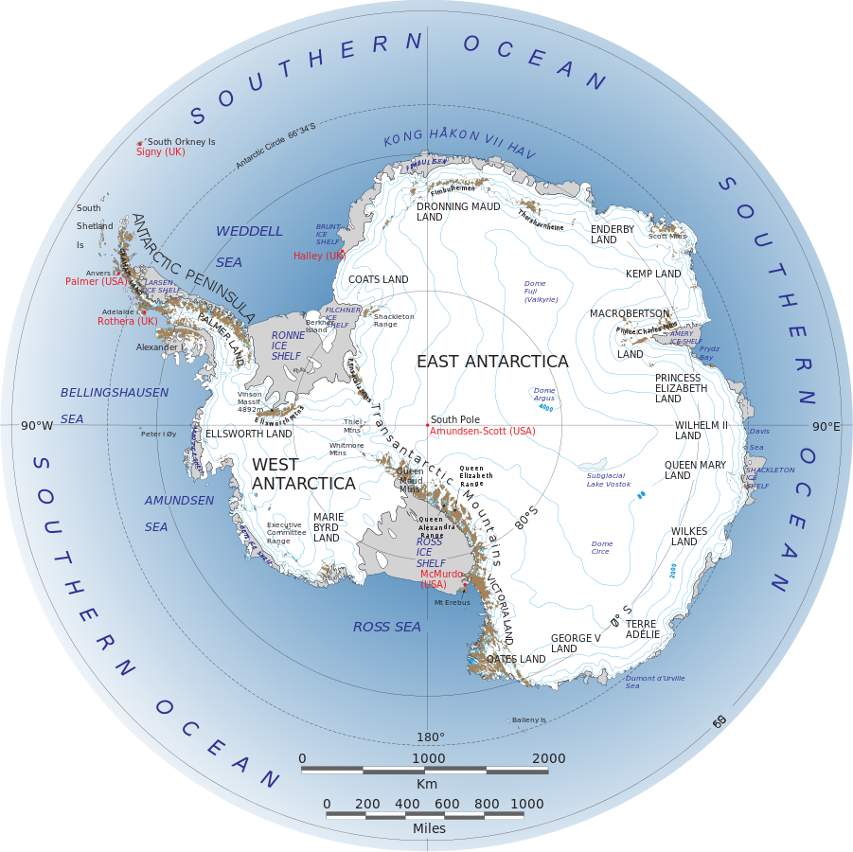

Slide 4
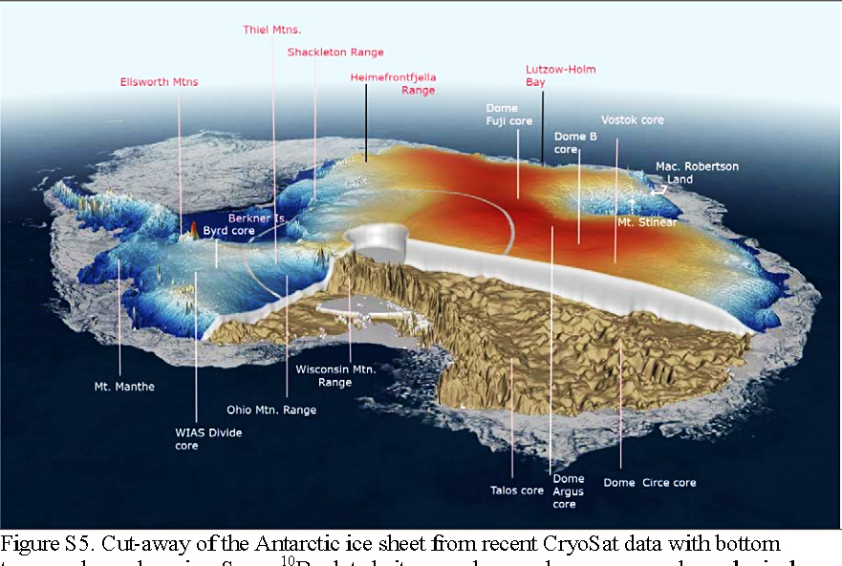

Slide 5
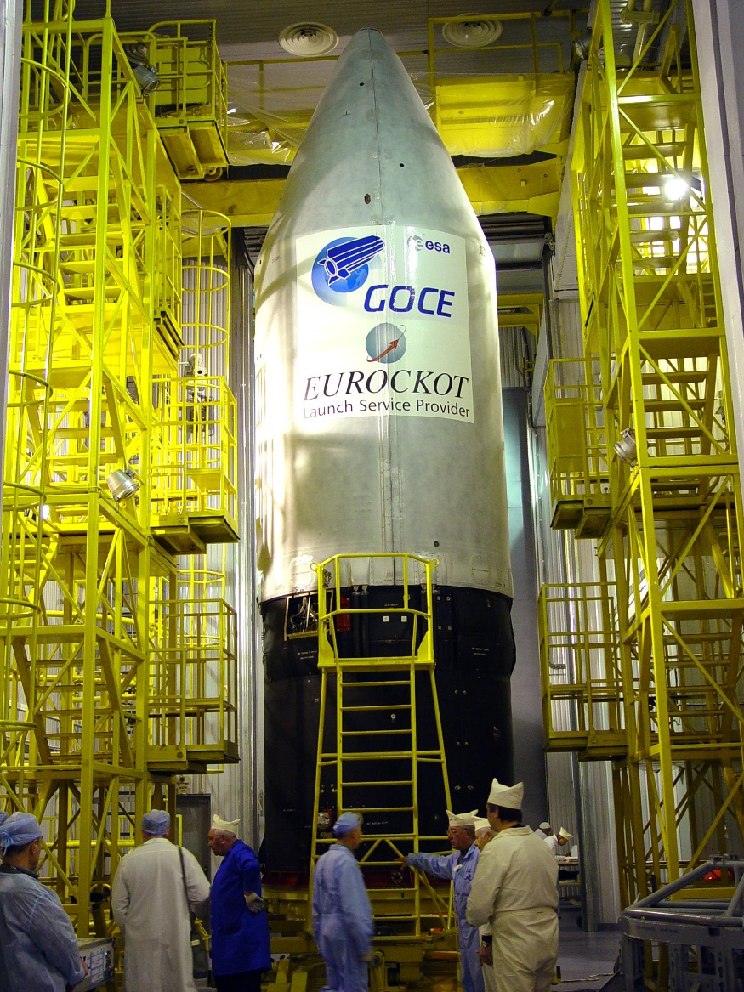
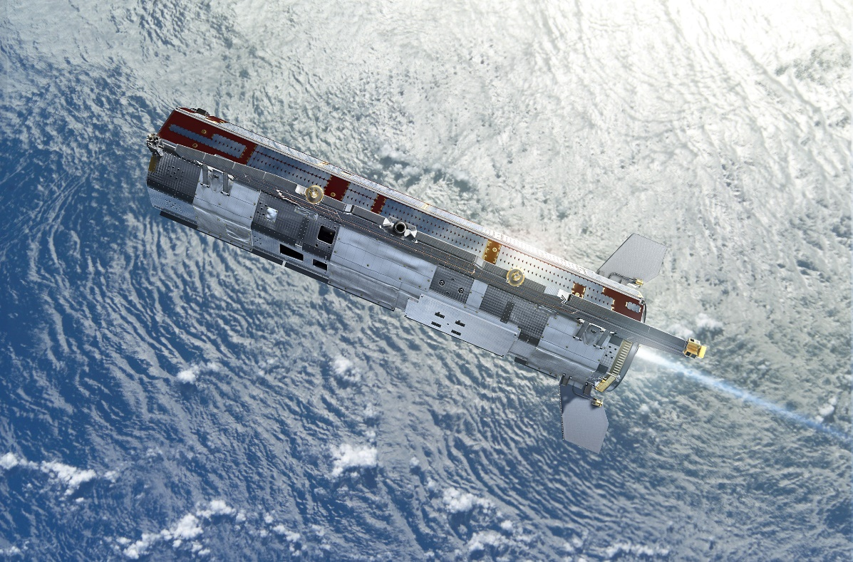
GOCE 2009-2013
(Gravity field and steady-state Ocean Circulation Explorer, ESA)
1mGal = 10⁻⁵ ms⁻², 1E = 1 Eötvös = 10⁻⁹ s⁻²
1 mGal = 10⁻⁵ ms⁻², 1 E = 1 Eötvös = 10⁻⁹ s⁻²
1 mE = 10⁻¹² s⁻²

Slide 6
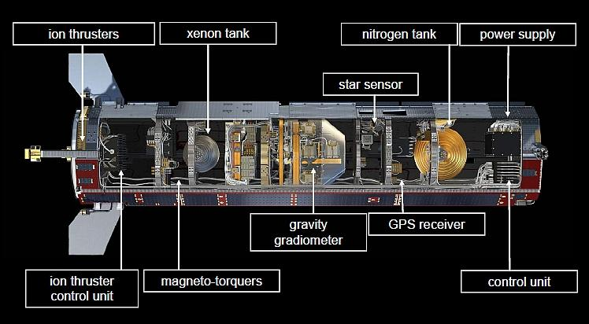

Slide 7
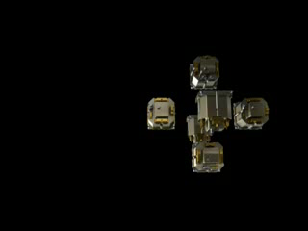

Slide 8
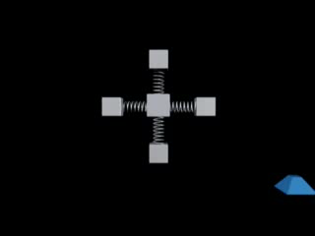

Slide 9
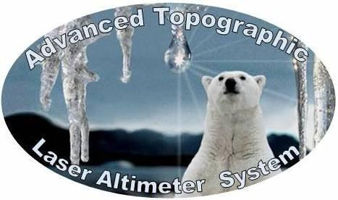
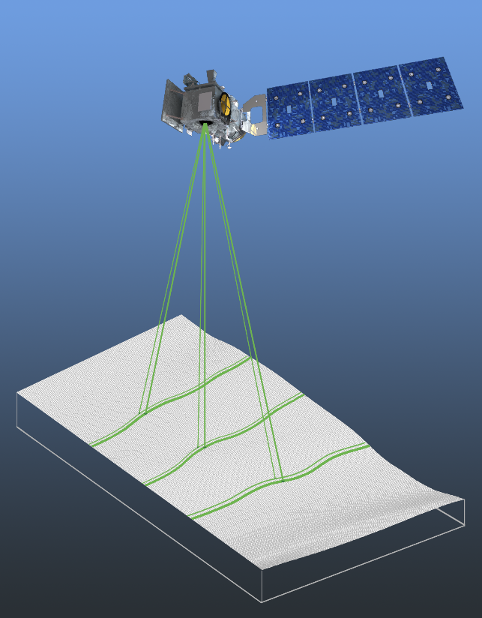
ICESAT 2 2017-
The sole instrument on ICESat-2 will be the Advanced Topographic Laser Altimeter System (ATLAS). The ATLAS laser will emit visible, green laser pulses at a wavelength of 532 nm.
As a result of ICESat's success, the National Research Council's (NRC) 2007 Earth Science Decadal Survey recommended a follow-on mission to continue the ICESat observations. In response, NASA tasked its Goddard Space Flight Center (GSFC) with developing and deploying the ICESat-2 mission - now scheduled for launch in 2017. The primary goals of the ICESat-2 mission are consistent with the NRC's directives: to deploy a spaceborne sensor to collect altimetry data of the Earth's surface optimized to measure ice sheet elevation change and sea ice thickness, while also generating an estimate of global vegetation biomass.

Slide 10
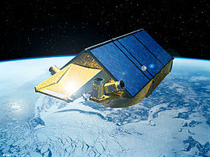
G(I)PR Cryosat (2) ESA, 2010-
vlnová délka ~1 m
vlnová délka radaru
obvykle 0.3 - 30 m.
Použití na družicích
i letadlech
SIRAL: SAR Interferometer Radar Altimeter DORIS: Doppler Orbitography and Radiopositioning Integration by Satellite LRR: Laser Retroreflector

Slide 11
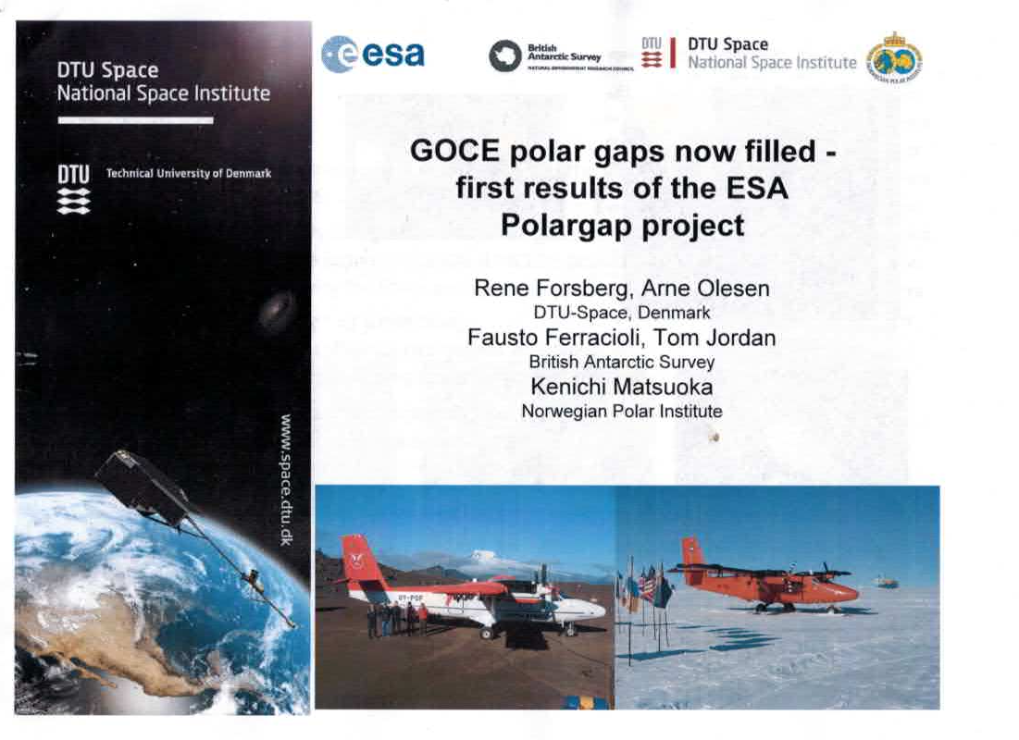

Slide 12
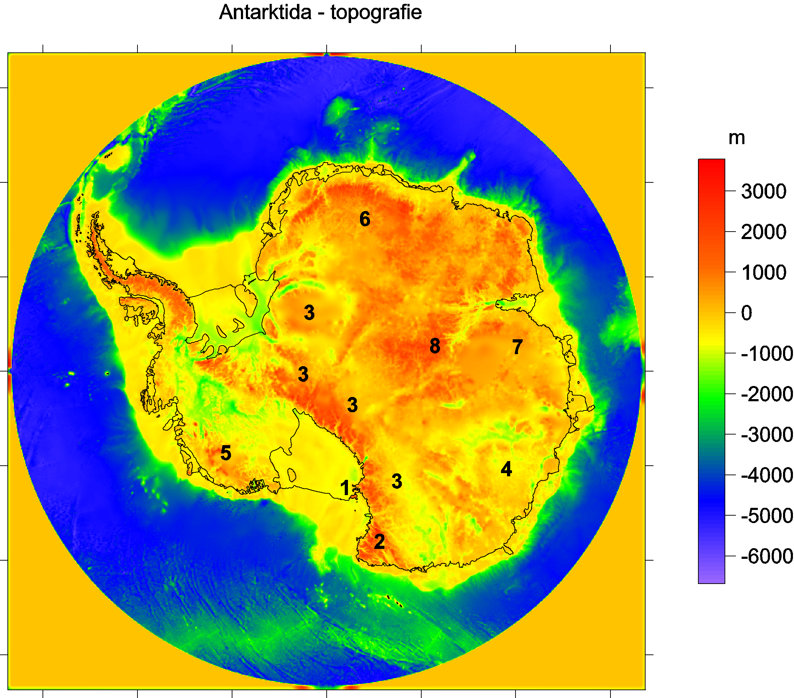
Bedmap2 bedrock topography
Ross shelf glacier
and Ross Island,
2 Victoria Land
3 Transantarctic Mountains
4 Wilkes Land
5 Marie Byrd Land
Queen (Dronning)
Maud Land
7 Princess Elizabeth Land
Gamburtsev Mountains
(under the ice).
Lake Vostok
9

Slide 13
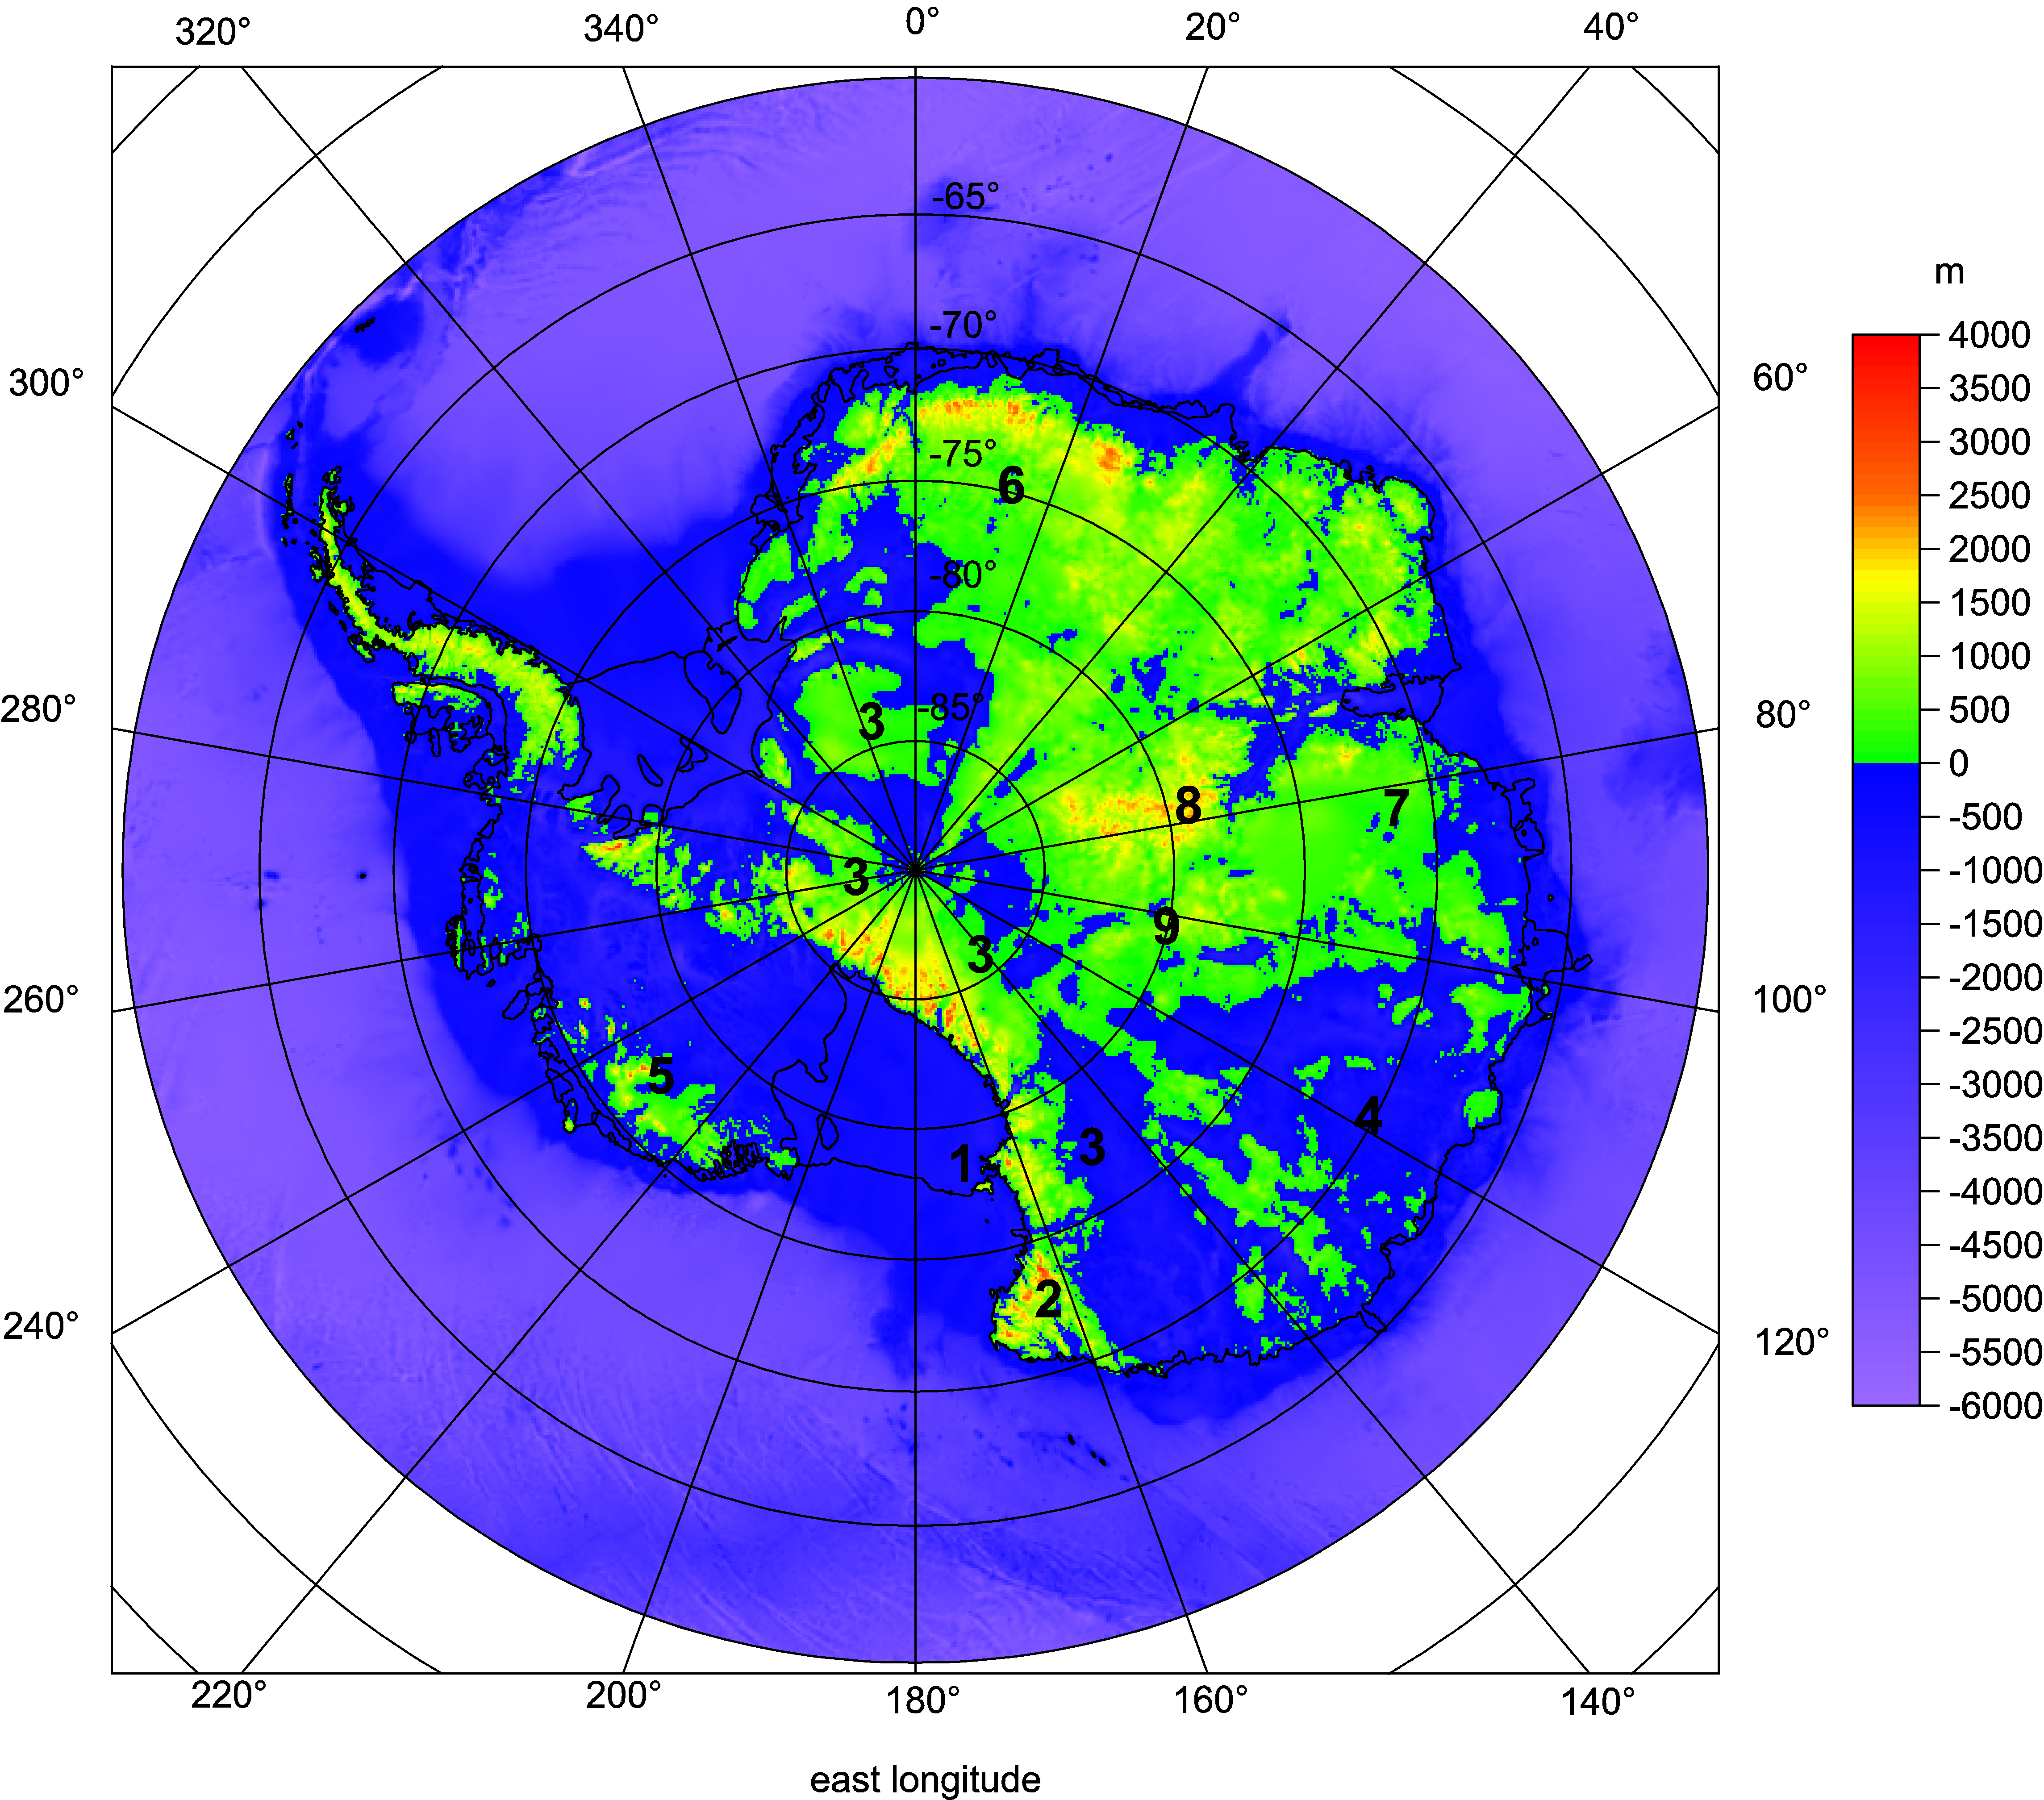

Slide 14
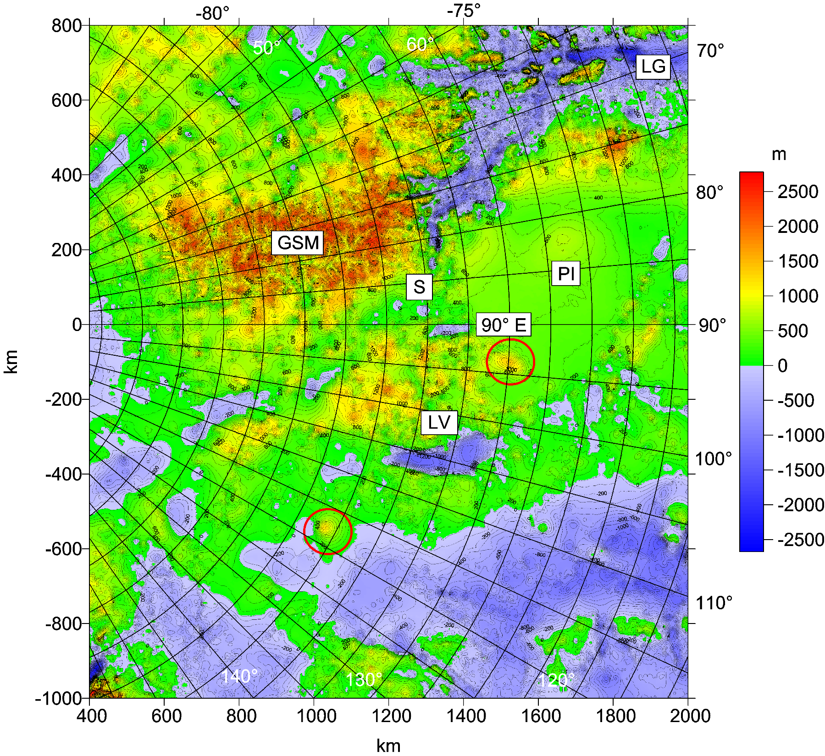
WL

Slide 15
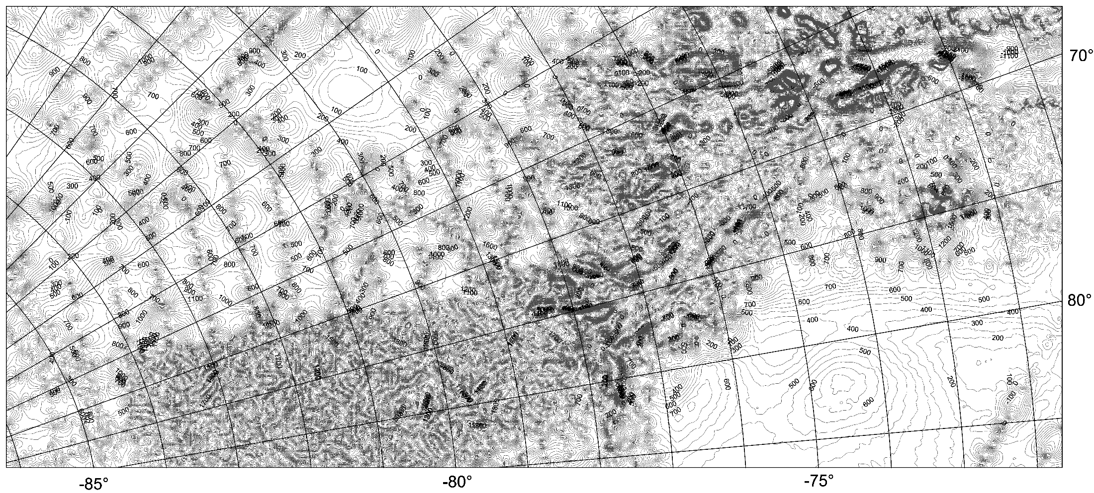

Slide 16
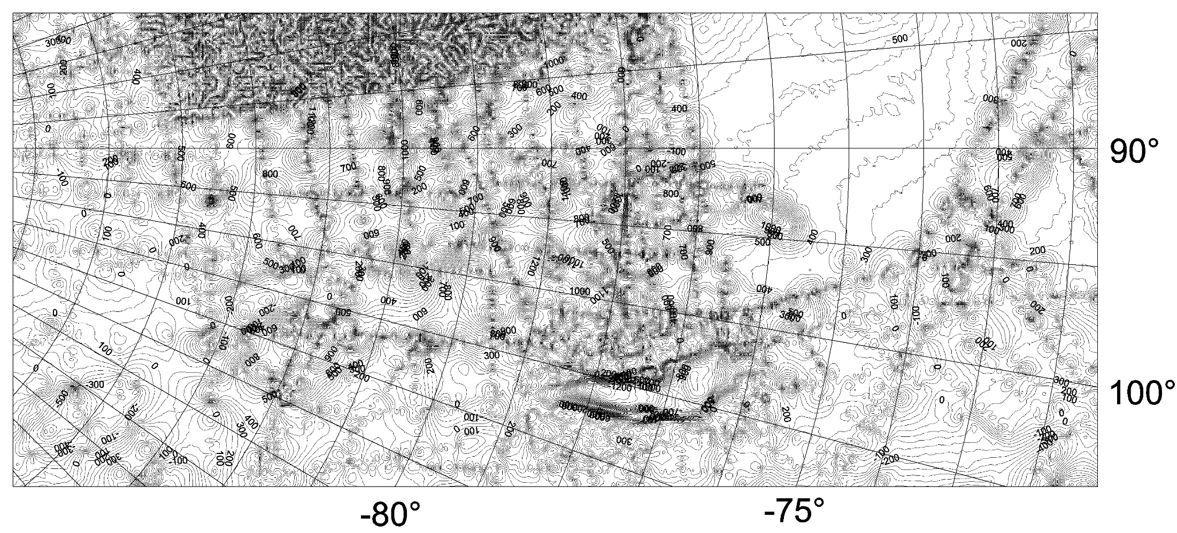

Slide 17
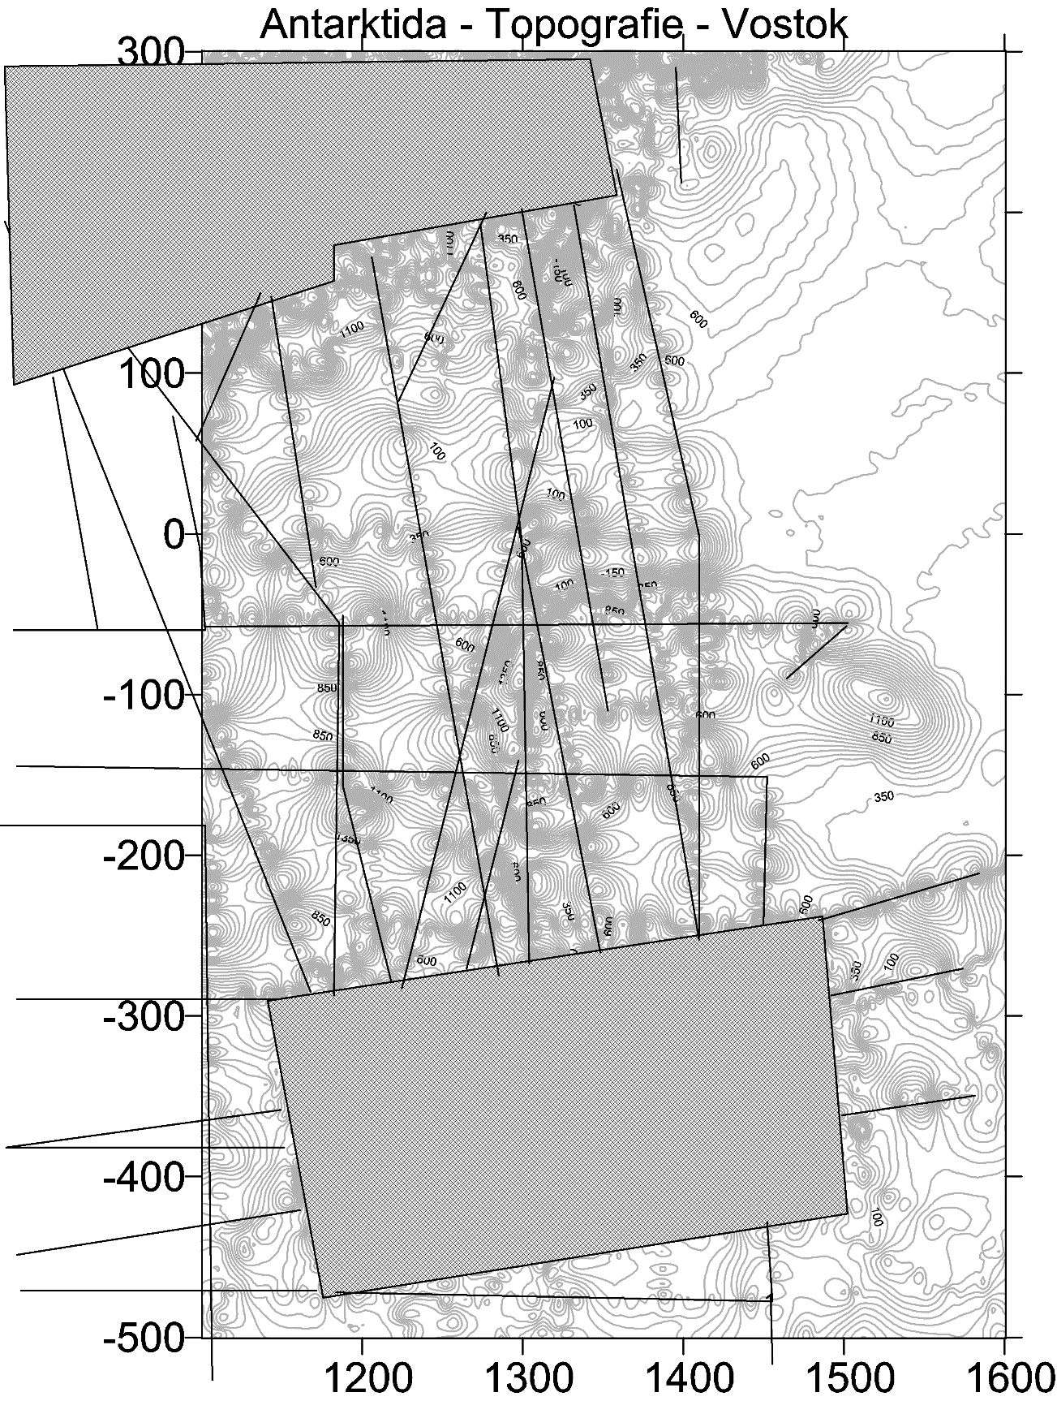
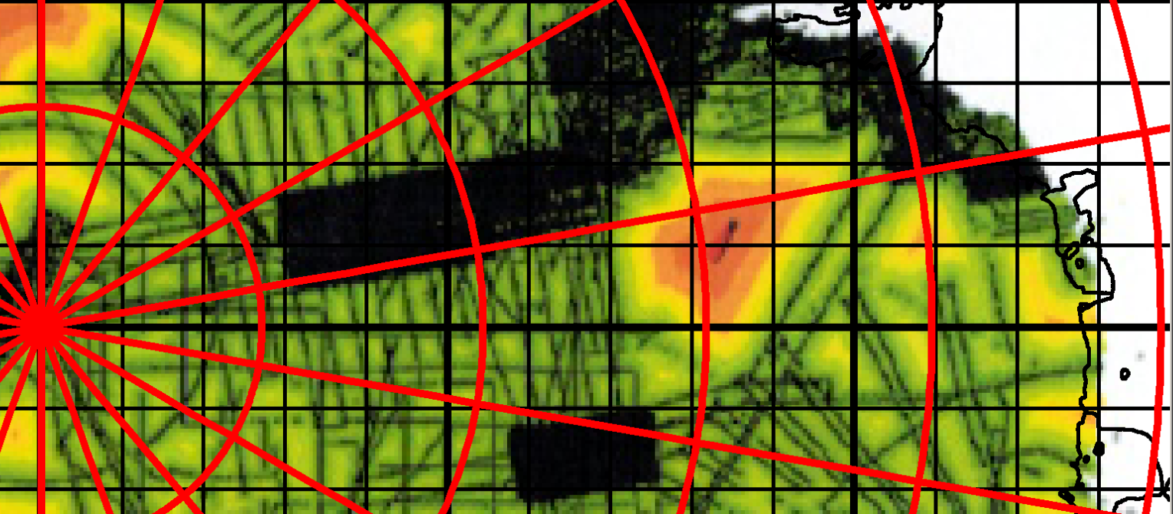

Slide 18
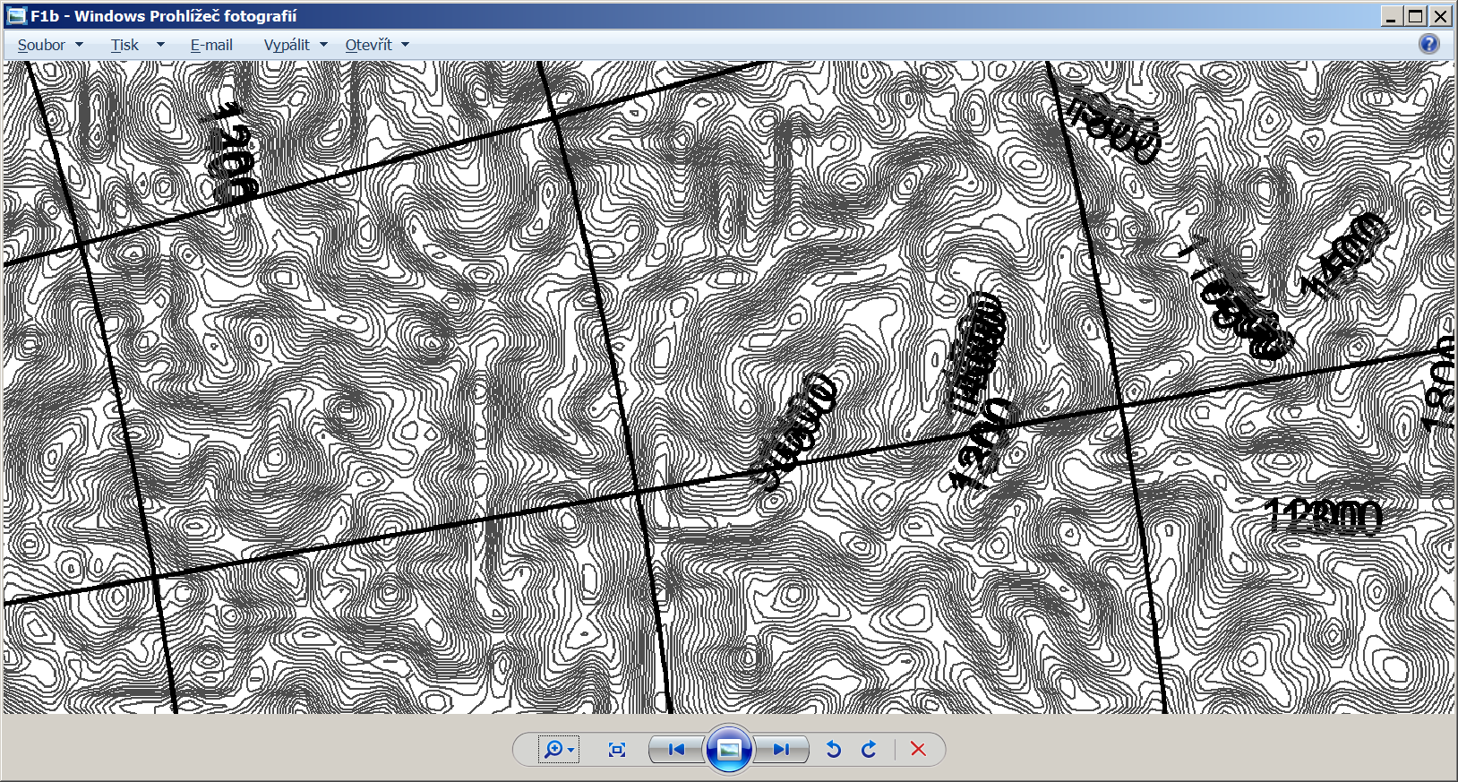
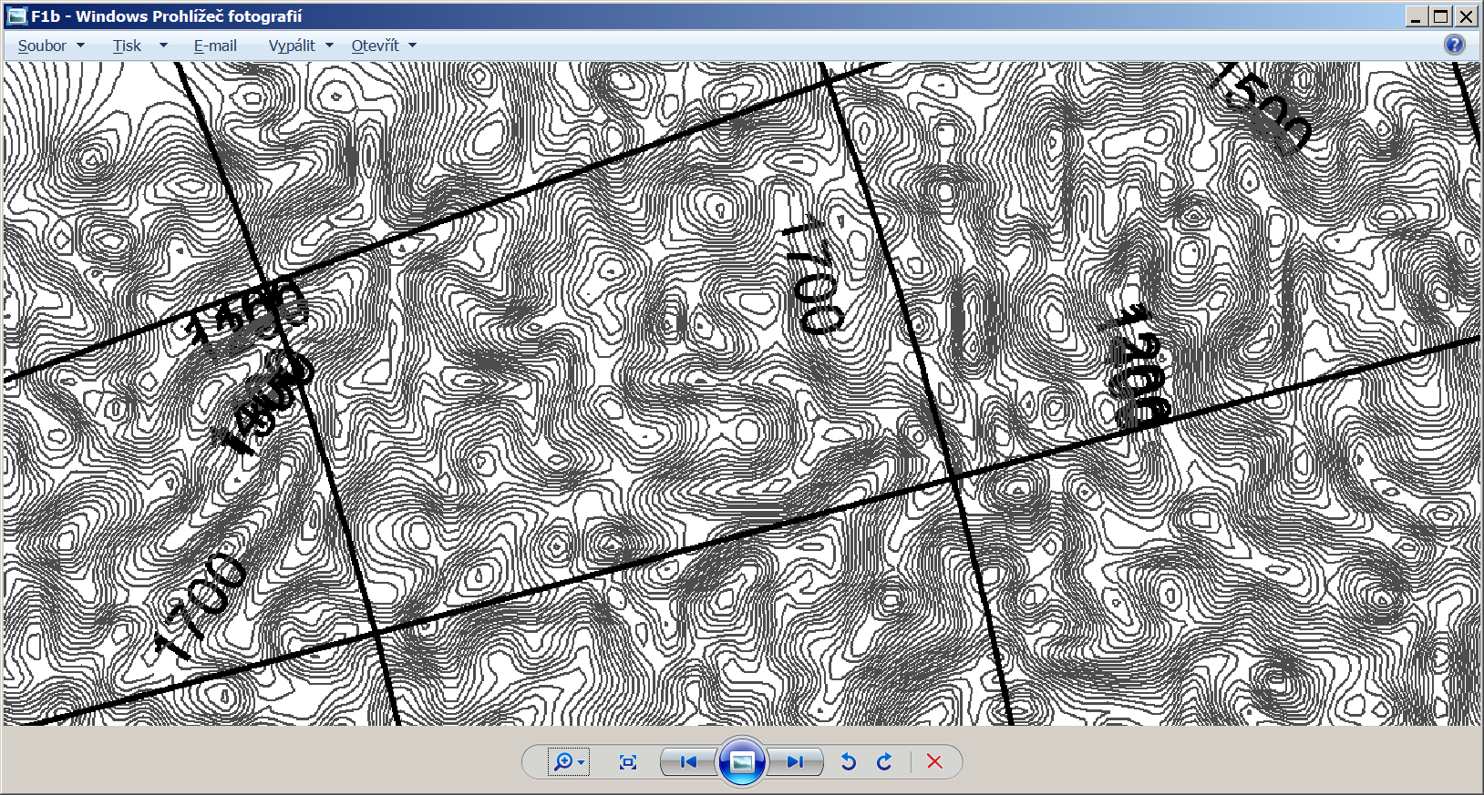
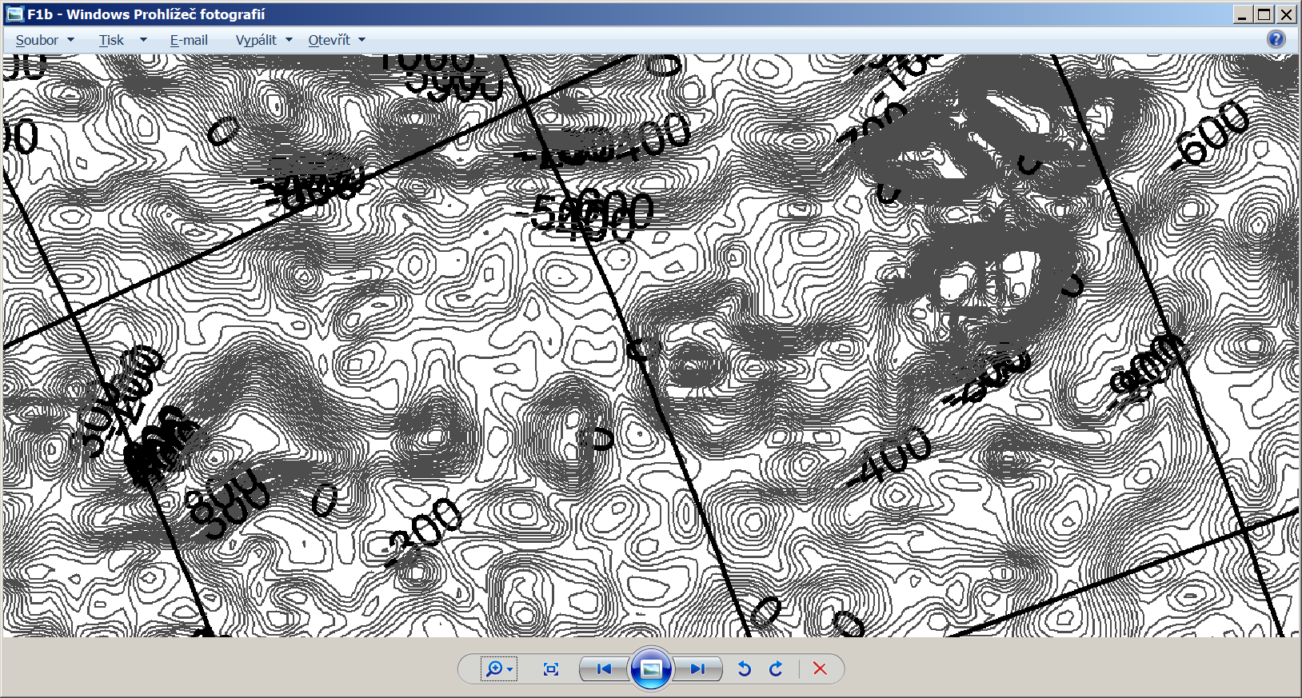
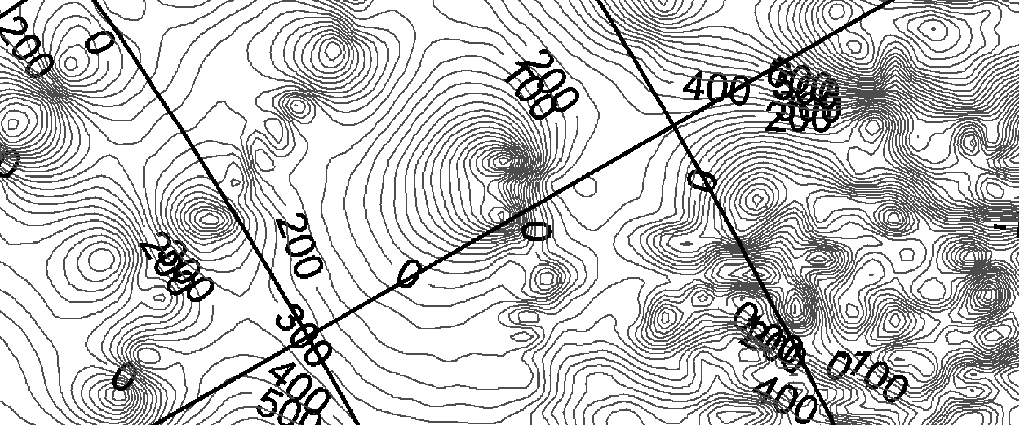

Slide 19
Stručný nástin teorie

Slide 20

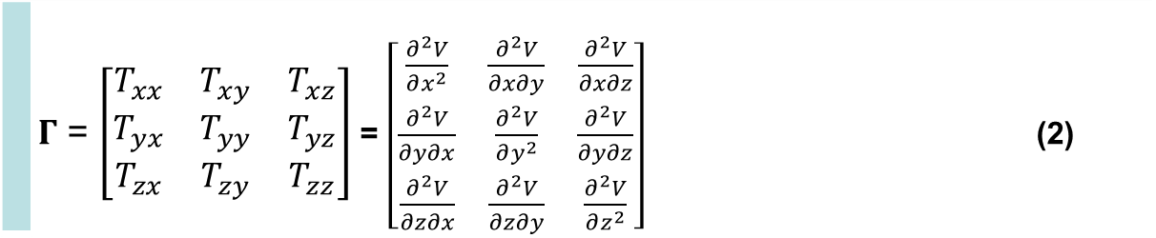
Disturbing static gravitational potential outside the Earth masses in spherical harmonic expansion
 | $$T\left(r,φ,λ\right)=\frac{GM}{r}\sum_{l=2}^{∞}{\sum_{m=0}^{l}{{\left(\frac{R}{r}\right)}^{l}\left({C^{′}}_{l,m}cos mλ+S_{l,m}sin mλ \right)}} P_{l,m}\left(sin φ\right)$$
where GM is a product of the universal gravitational constant and the mass of the Earth (also known as
the geocentric gravitational constant), r is the radial distance of an external point where T is computed,
R is the radius of the Earth (which can be approximated by the semi-major axis of a reference ellipsoid),
P_{l,m} (sin φ) are the Legendre associated functions, l and m are the degree and order of the harmonic expansion,
(φ, λ) are the geocentric latitude and longitude, C’_{l,m} and S_{l,m} are the harmonic geopotential coefficients
(Stokes parameters), fully normalized, C’_{l,m} = C_{l,m} – C^{el}_{l,m}, where C^{el}_{l,m} belongs to the reference ellipsoid.
The spherical approximation of the gravity anomaly Δg is computed
$∆g=−\frac{∂T}{∂r}−2\frac{T}{r}$
or one can use the gravity disturbance (it is the same but without the second term).
Gravity gradient tensor Γ (the Marussi tensor) is a tensor of the second derivatives of
the disturbing potential T:
 | $Γ$ = $\left[\begin{matrix}T_{xx} & T_{xy} & T_{xz} \\ T_{yx} & T_{yy} & T_{yz} \\ T_{zx} & T_{zy} & T_{zz}\end{matrix}\right]$ = $\left[\begin{matrix}\frac{∂^{2}V}{∂x^{2}} & \frac{∂^{2}V}{∂x∂y} & \frac{∂^{2}V}{∂x∂z} \\ \frac{∂^{2}V}{∂y∂x} & \frac{∂^{2}V}{∂y^{2}} & \frac{∂^{2}V}{∂y∂z} \\ \frac{∂^{2}V}{∂z∂x} & \frac{∂^{2}V}{∂z∂y} & \frac{∂^{2}V}{∂z^{2}}\end{matrix}\right]$ (2)
Notes:
Legendre associated functions,… free-air gravity anomaly, gravity disturbance

Slide 21
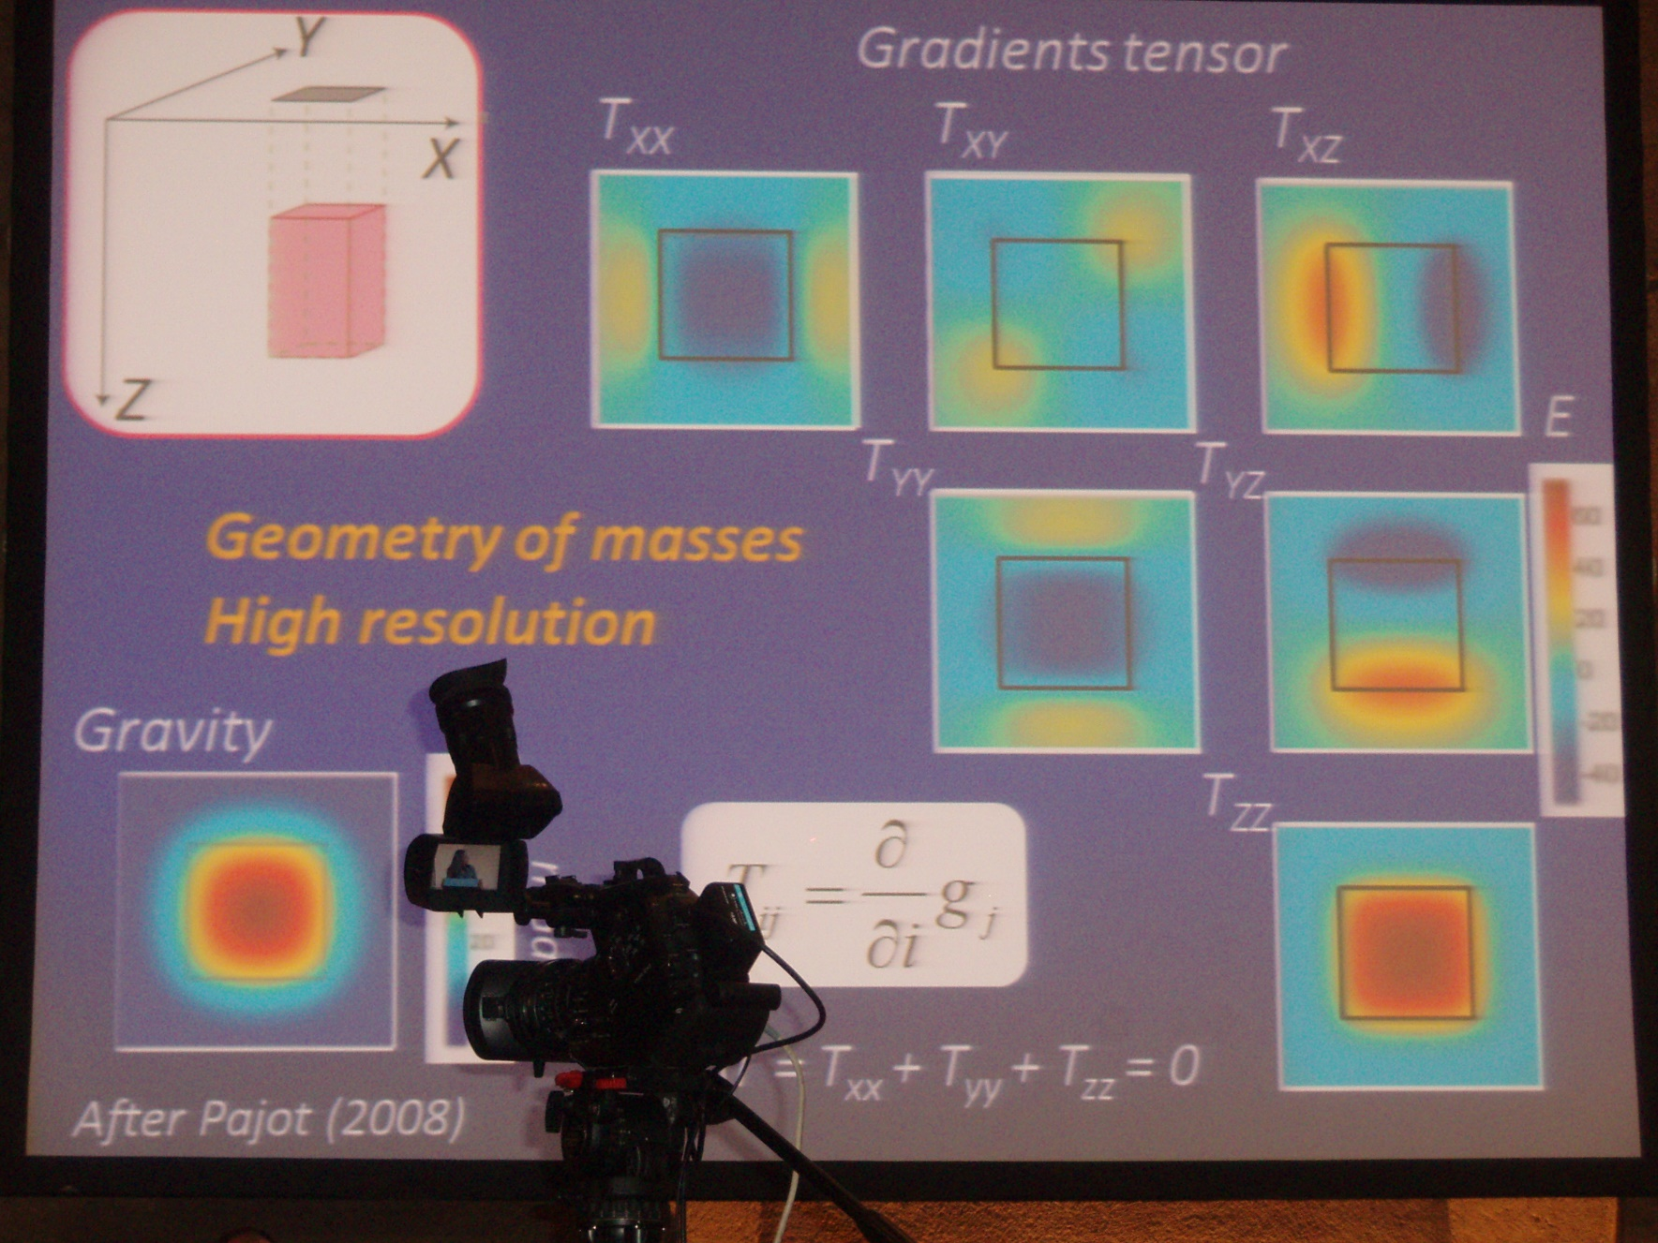
Obsah obrázků
The second order derivatives and the invariants provide evidence about details of near-surface (not deep) structures. The Marussi tensor was already used in local scales (a few kilometers) for petroleum, metal, diamond, ground water etc. explorations (e.g., Murphy and Dickinson, 2009; Mataragio and Kieley, 2009). The full Marussi tensor is a richer source of information than the standard single gravity anomalies. This extra information can be applied by tensor imaging techniques to enhance a target anomaly definition, as tested for local features (minerals, oil and gas industry), e.g., by Saad (2006)) or
Dickinson et al. (2009).

Slide 22
A.H.Saad, The Leading Edge, 942-950, Aug. 2006

Slide 23
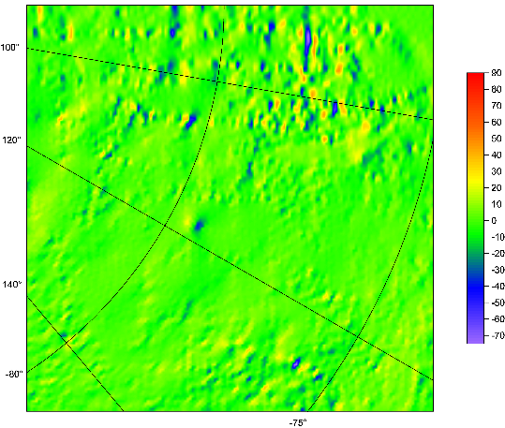
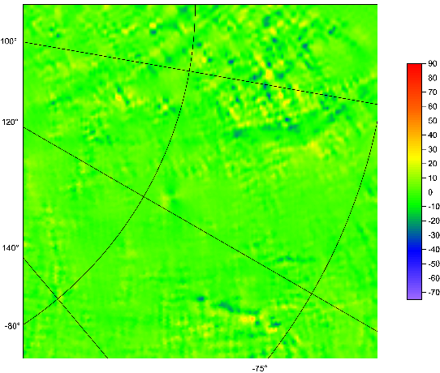
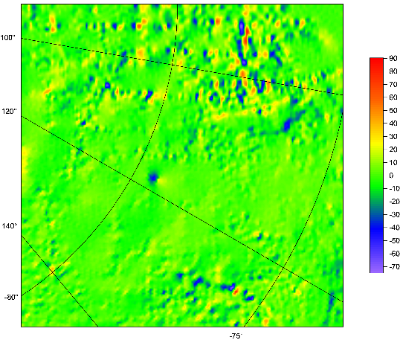
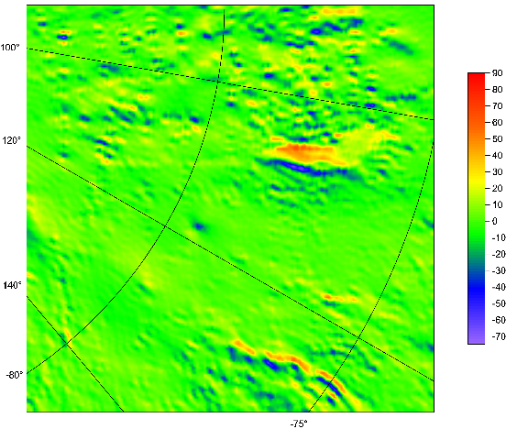
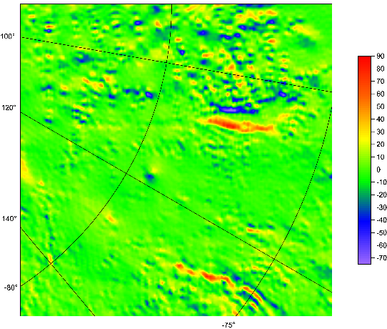
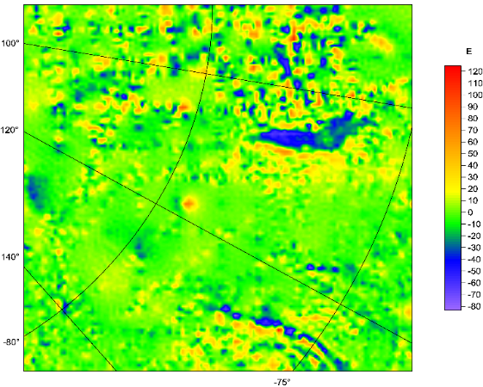
Marussi tensor
of the second derivatives T_{ij}
organized as follows:
T_{xx} T_{xy} T_{xz}
T_{yy} T_{yz}
T_{zz}

Slide 24


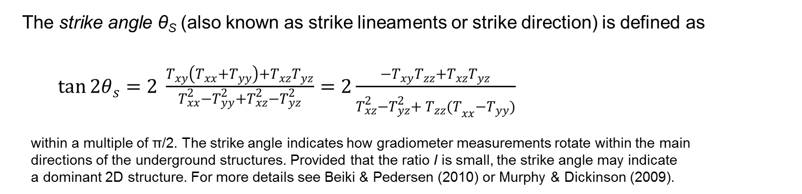
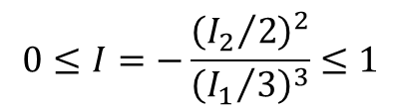
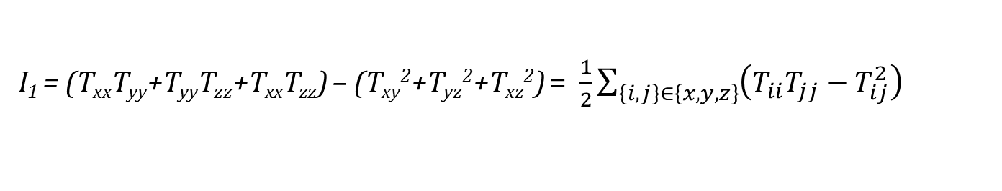
Under any coordinate transformation, Γ preserves
just 3 INVARIANTs
$I_{0}=trace \left(Γ\right)=T_{xx}+T_{yy}+T_{zz}=$ 0
I₁ = (T_{xx}T_{yy}+T_{yy}T_{zz}+T_{xx}T_{zz}) – (T_{xy}²+T_{yz}²+T_{xz}²) = $\frac{1}{2}\sum_{\left\{i,j\right\}∈\left\{x,y,z\right\}}{{\left(T_{ii}T_{jj}−T_{ij}^{2}\right)}_{}}$
I₂ = det (Г) = (T_{xx}(T_{yy}T_{zz}-T_{yz}²) + T_{xy}(T_{yz}T_{xz} – T_{xy}T_{zz}) + T_{xz} (T_{xy}T_{yz}-T_{xz}T_{yy}).
Pedersen & Rasmussen (1990) showed that the ratio I of I₁ and I₂ defined as
$$0≤I=−\frac{{\left({I_{2}}/2\right)}^{2}}{{\left({I_{1}}/3\right)}^{3}}≤1$$
lies between zero and unity for any potential field. If the causative body is strictly 2D, then I =0.
The strike angle θ_{S} (also known as strike lineaments or strike direction) is defined as
$\tan{2θ_{s}}=2 \frac{T_{xy}\left(T_{xx}+T_{yy}\right)+T_{xz}T_{yz}}{T_{xx}^{2}−T_{yy}^{2}+T_{xz}^{2}−T_{yz}^{2}}=2\frac{{−T}_{xy}T_{zz}+T_{xz}T_{yz}}{T_{xz}^{2}−T_{yz}^{2}+{{ T}_{zz}^{}(T}_{xx}^{}−T_{yy}^{})}$
within a multiple of π/2. The strike angle indicates how gradiometer measurements rotate within the main
directions of the underground structures. Provided that the ratio I is small, the strike angle may indicate
a dominant 2D structure. For more details see Beiki & Pedersen (2010) or Murphy & Dickinson (2009).

Slide 25
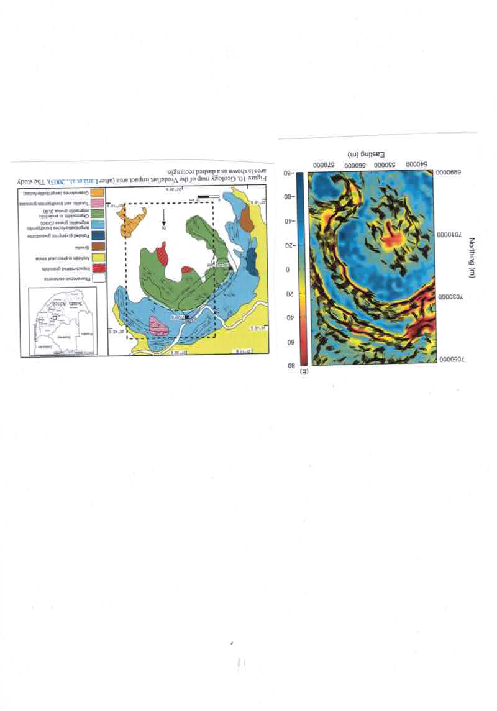
Huge impact crater Vredefort, Africa
Beiki and Pedersen 2011

Slide 26
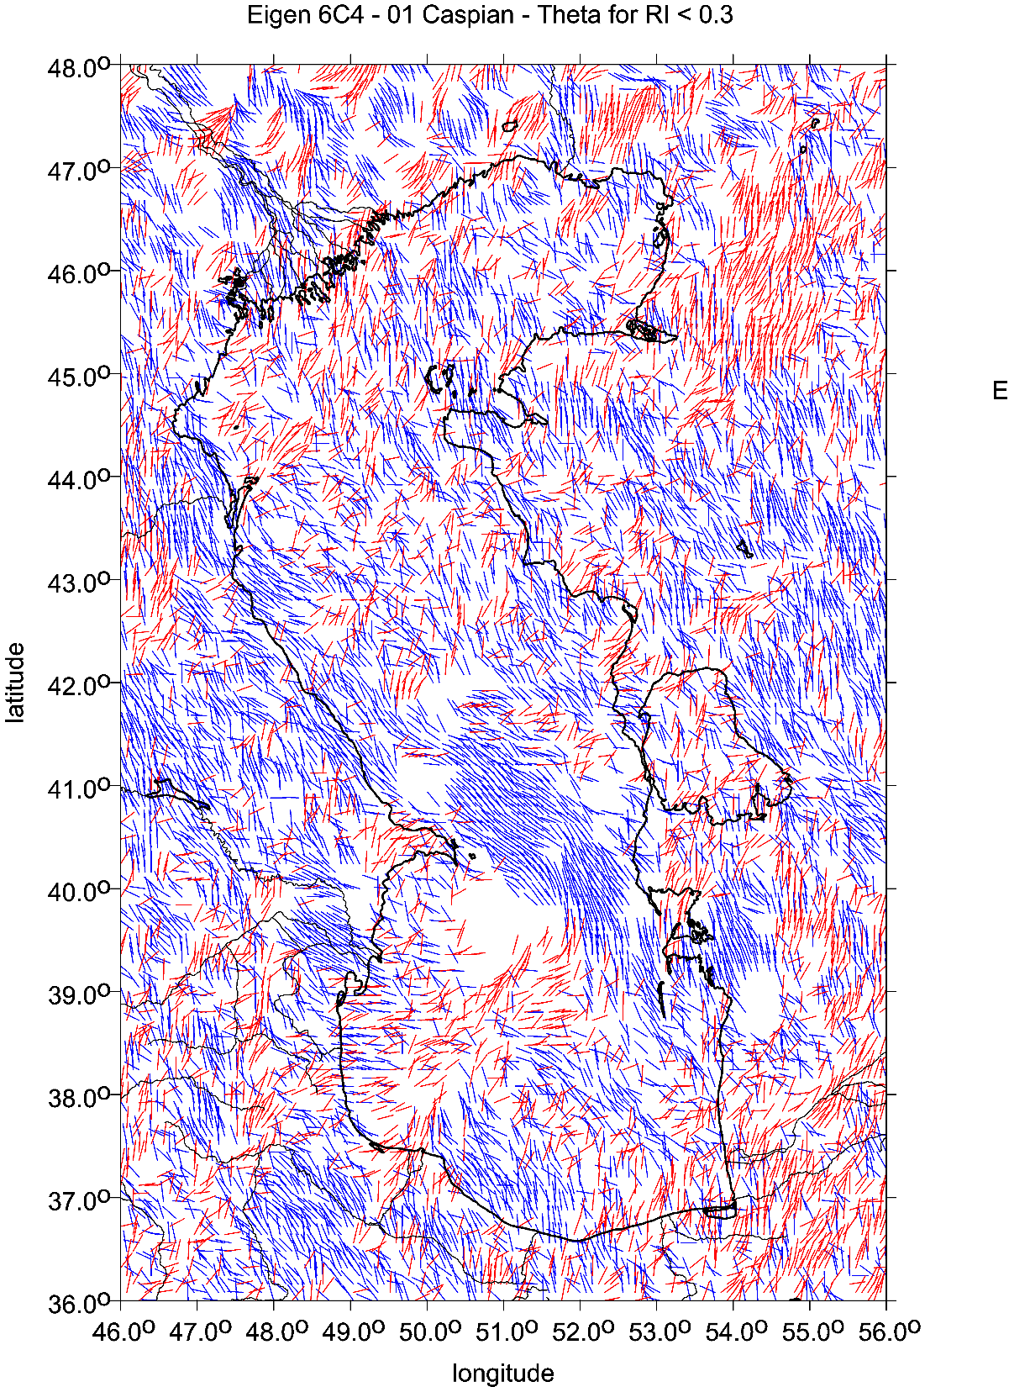

Slide 27
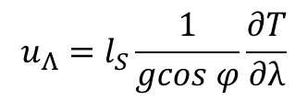



Virtual deformations (Kalvoda et al. 2012, Klokočník et al. 2013)
Virtuální deformace ukazují, jak by se příslušný materiál roztekl, kdyby byl dokonale tekutý
directions of such a deformation due to “erosion” brought about solely by “gravity origin”.
If there would be a tidal potential T, then the horizontal shifts (deformations) would exist due to it
and they could be expressed
in north-south direction (latitude direction) … [left] and in east-west direction (longitudinal direction) … [right]
where g is the gravity acceleration 9.81 m⋅s⁻²,
l_{S} is the elastic coefficient (Shida number) expressing the elastic properties of the Earth as a planet (l_{S} = 0.08),
φ and λ are the geocentric coordinates (latitude and longitude) of a point P where we measure T
The apparatus of mechanics of continuum to derive the main directions of the tension is applied (see, e.g., Brdička et al. 2000).
The tensor of (small) deformation E is defined as a gradient of shift. It holds that
The tensor E can be separated into two parts:
where e is the symmetrical tensor and Ω the anti-symmetrical tensor of deformation, respectively. The symmetrical tensor is
and the parameters of deformation are:
Δ = e₁₁ + e₂₂ total dilatation a = ½ (Δ + γ) major semi-axis of ellipse of deformation
γ₁ = e₁₁ - e₂₂ pure cut b = ½ (Δ – γ) minor semi-axis of ellipse of deformation
γ₂ = 2e₁₂ technical cut α = ½ atan(γ₂ / γ₁) direction of main axis of deformation
γ = (γ₁² + γ₂²)^{1/2} total cut
.
$$u_{Φ}=l_{S}\frac{1}{g}\frac{∂T}{∂φ}$$
$$u_{Λ}=l_{S}\frac{1}{gcos φ}\frac{∂T}{∂λ}$$
$$E=\left(\begin{matrix}ε_{11} & ε_{12} \\ ε_{21} & ε_{22}\end{matrix}\right)=\left(\begin{matrix}\frac{∂u_{x}}{∂x} & \frac{∂u_{x}}{∂y} \\ \frac{∂u_{y}}{∂x} & \frac{∂u_{y}}{∂y}\end{matrix}\right)$$
$$E=e+Ω= \left(e_{ij}\right)+\left(Ω_{ij}\right)$$
$e=\left(\begin{matrix}e_{11} & e_{12} \\ e_{21} & e_{22}\end{matrix}\right)=\left(\begin{matrix}ε_{11} & {(ε}_{12}+ε_{21})/2 \\ {(ε}_{12}+ε_{21})/2 & ε_{22}\end{matrix}\right)$

Slide 28
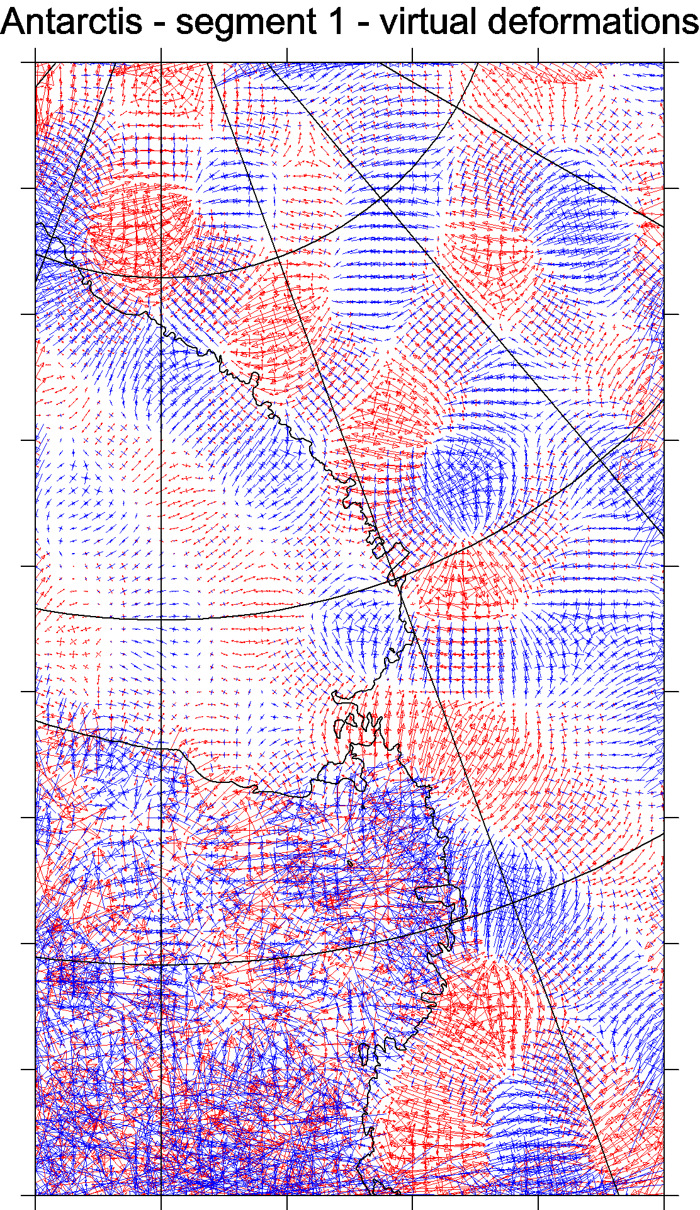
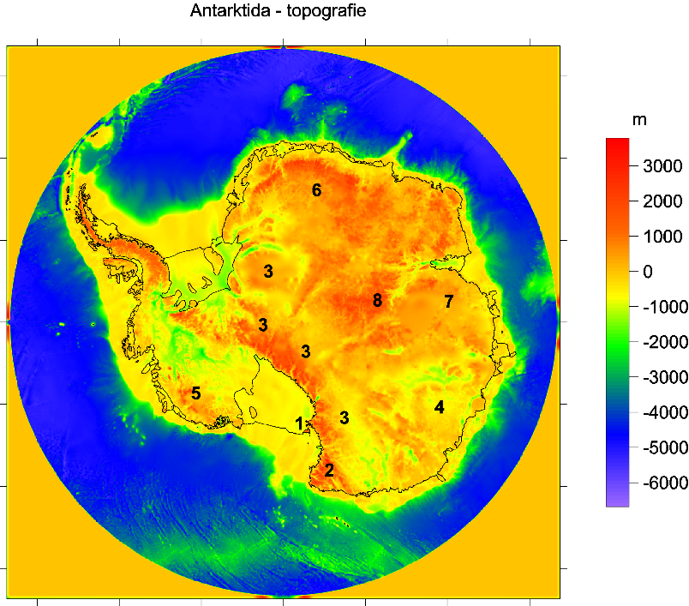
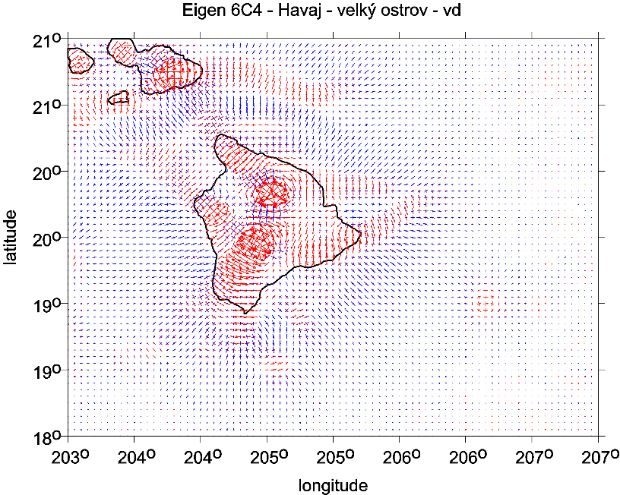

Slide 29
Using the harmonic geopotential coefficients of the global gravitational model EGM 2008, the following physical quantities are computed: the gravity anomalies Δg (or disturbances) [scale 1mGal = 10-5 ms-2], the full Marussi tensor Γ of the second derivatives of the disturbing potential [1E = 1 Eötvös = 10-9 s-2], namely its radial component, sometimes denoted Tzz or Trr, the invariants of the gravity field I0, I1, I2 = det(Γ), computable from the components of the Marussi tensor, their specific ratio I and the strike angle θ. These quantities are known from theory of Pedersen & Rasmussen (1990) and Beiki & Pedersen (2010). A “virtual deformation” has been added (Kalvoda et al. 2013, following Brdička et al 2000). Some of these quantities are functionals of the geopotential in a mathematical sense and some of them are not. Therefore, they are concisely designated in the paper as aspects of the geopotential.
Numerical stability
in computations of second derivatves and other gravity aspects derived from them
to very high degree and order
Many authors … Fukusima (2012),
Bucha and Janák (2013) A MATLAB-based graphical user interface program for computing functionals of the geopotential up to ultra-high degrees and orders ,
Computers &Geosciences 56(2013)186–196

Slide 30
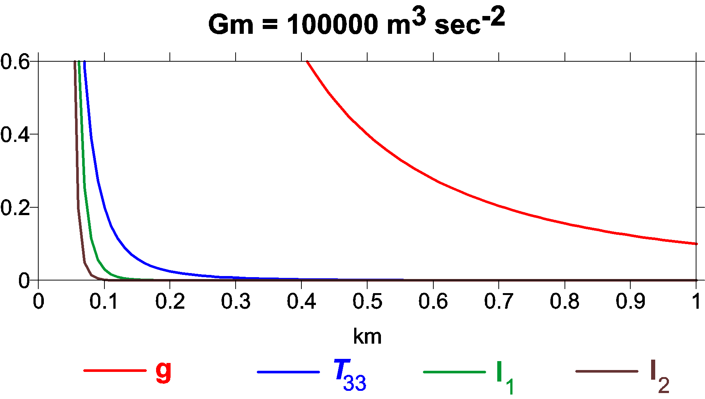
Comparison of sensitivity of various functions of the disturbing potential mass point case / an illustrative simplification x axis depth beneath surface [km], y axis reference value of functionals for given gravitational constant GM describing respective point mass body

Slide 31
Data – recent gravity field models
satellite bedrock topography and
their combination
EGM 2008 *
EIGEN 6C4 **
BEDMAP 2 bedrock topography ***
Pavlis, N. K., Holmes, S. A., Kenyon, S. C. & Factor, J. K. 2008a. An Earth Gravitational Model to degree 2160: EGM 2008. EGU General Assembly 2008,
Vienna, 13–18 April 2008.
Pavlis, N. K., Holmes, S. A., Kenyon, S. C. & Factor, J. K. 2008b. EGM2008: An overview of its development and evaluation. National Geospatial-Intelligence Agency, USA, conf.: Gravity, Geoid and Earth Observation 2008, Chania, Crete, Greece, 23–27 June 2008.
Pavlis, N. K., Holmes, S. A., Kenyon, S. C. & Factor, J. K. 2012. The development and evaluation of the Earth Gravitational Model 2008 (EGM2008). J. Geophys. Res. 17, B04406, doi: 10.1029/2011JB008916, 2012.
** Förste Ch., Bruinsma S., Abrykosov O., Lemoine J-M. et al 2014. The latest combined global gravity field model including GOCE data up to degree and order 2190 of GFZ Potsdam and GRGS Toulouse (EIGEN 6C4). 5th GOCE user workshop, Paris 25 – 28, Nov. 2014.
*** Fretwell P, Pritchard H, Vaughan D, Bamber J, et al. 2013. Bedmap2: improved ice bed, surface and thickness datasets for Antarctica. The Cryosphere, 7, 375–393, 2013,
doi: 10.5194/tc-7-375-2013; https://secure.antarctica.ac.uk/data/-bedmap2/

Slide 32
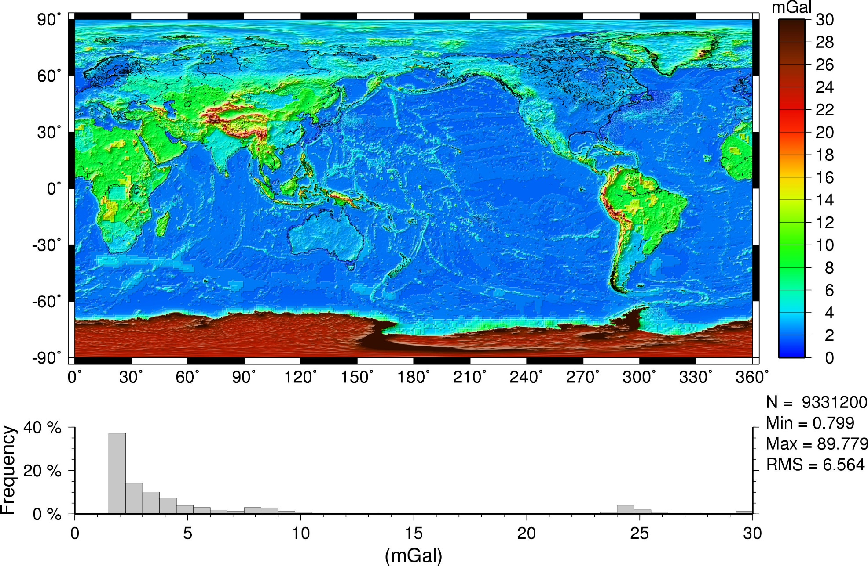
5′×5′ Δg Commission Error: EGM2008 (Nmax=2159)

Slide 33
The Gravity Field Model EIGEN-6C4
EIGEN-6C4 (European Improved Gravity model of the Earth by New techniques) is a high resolution static global combined gravity field model up to degree and order 2190. It has been elaborated jointly by GFZ Potsdam and GRGS Toulouse (Foerste et al. 2014) and contains the following satellite and ground data:
LAGEOS (for degrees of harmonics from 2 to30)
high orbiting geodynamic satellite: 1985 – 2010
Previous gravity model GRACE RL03 GRGS (deg. 2 - 130):
ten years 2003 – 2012
GOCE-SGG data, processed by the direct approach incl. the gravity gradient components T_{xx}, T_{yy}, T_{zz} and T_{xz} throughout whole life of the GOCE satellite. The GOCE polar gaps were stabilized…
- Terrestrial data (max degree 370): DTU12 ocean geoid data and an EGM2008 geoid height grid for the continents.
The combination of these different satellite and surface data sets has been done by a band-limited combination of normal equations (to max degree 370), which are generated from observation equations for the spherical harmonic coefficients. The resulted solution to degree/order 370 has been extended to degree/order 2190 by
a block diagonal solution using the DTU10 global gravity anomaly data grid.

Slide 34
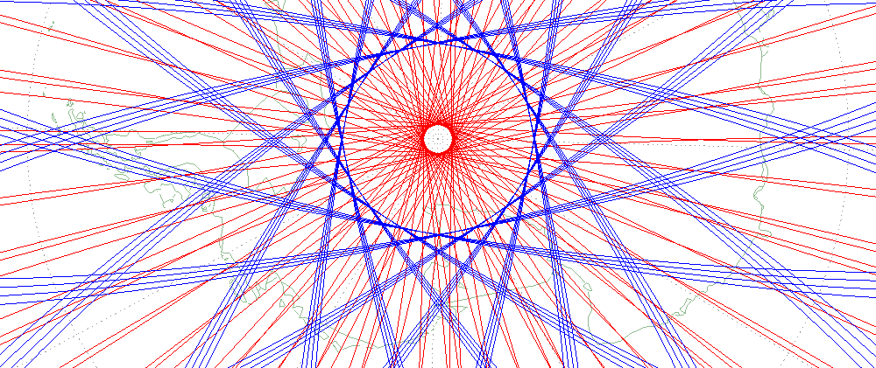
A usual simple estimation of the smallest representable feature of the gravity field
or the shortest half-wavelength L_{half} (as a distance on the sphere)
that can be resolved with all C_{lm}, S_{lm} to L_{max}, is
L_{half} = π R/ L_{max}
or equivalently, taking the circumference 2πR = 40 050 km:
L_{half} = 2 π R/ 2 L_{max} = 40 050/ 2 L_{max}
For L_{max}= 300 and 2190, we have L_{half} = 67 and 9 km, respectively. BUT:
GOCE
and GRACE
groundtrack
densification
at poles
Example: Ground tracks of satellite missions GRACE (red) and GOCE (blue) near the South Pole. The latitude turning points result from orbit inclination, which is 89° for GRACE and 96.7° for GOCE. The ground track points of both missions are displayed for 5 days in December 2010.

Slide 35
Bedmap2 bedrock topography
Ross shelf glacier
and Ross Island,
2 Victoria Land
3 Transantarctic Mountains
4 Wilkes Land
5 Marie Byrd Land
Queen (Dronning)
Maud Land
7 Princess Elizabeth Land
Gamburtsev Mountains
(under the ice).
Lake Vostok
9
Fretwell P, Pritchard H, Vaughan D, Bamber J, et al. 2013. Bedmap2: improved ice bed, surface and thickness datasets for Antarctica. The Cryosphere, 7, 375–393; DOI: 10.5194/tc-7-375-2013.
Notes:
Ošidný, zrádný treacherous, deceptive
Zavádějící misleading

Slide 36
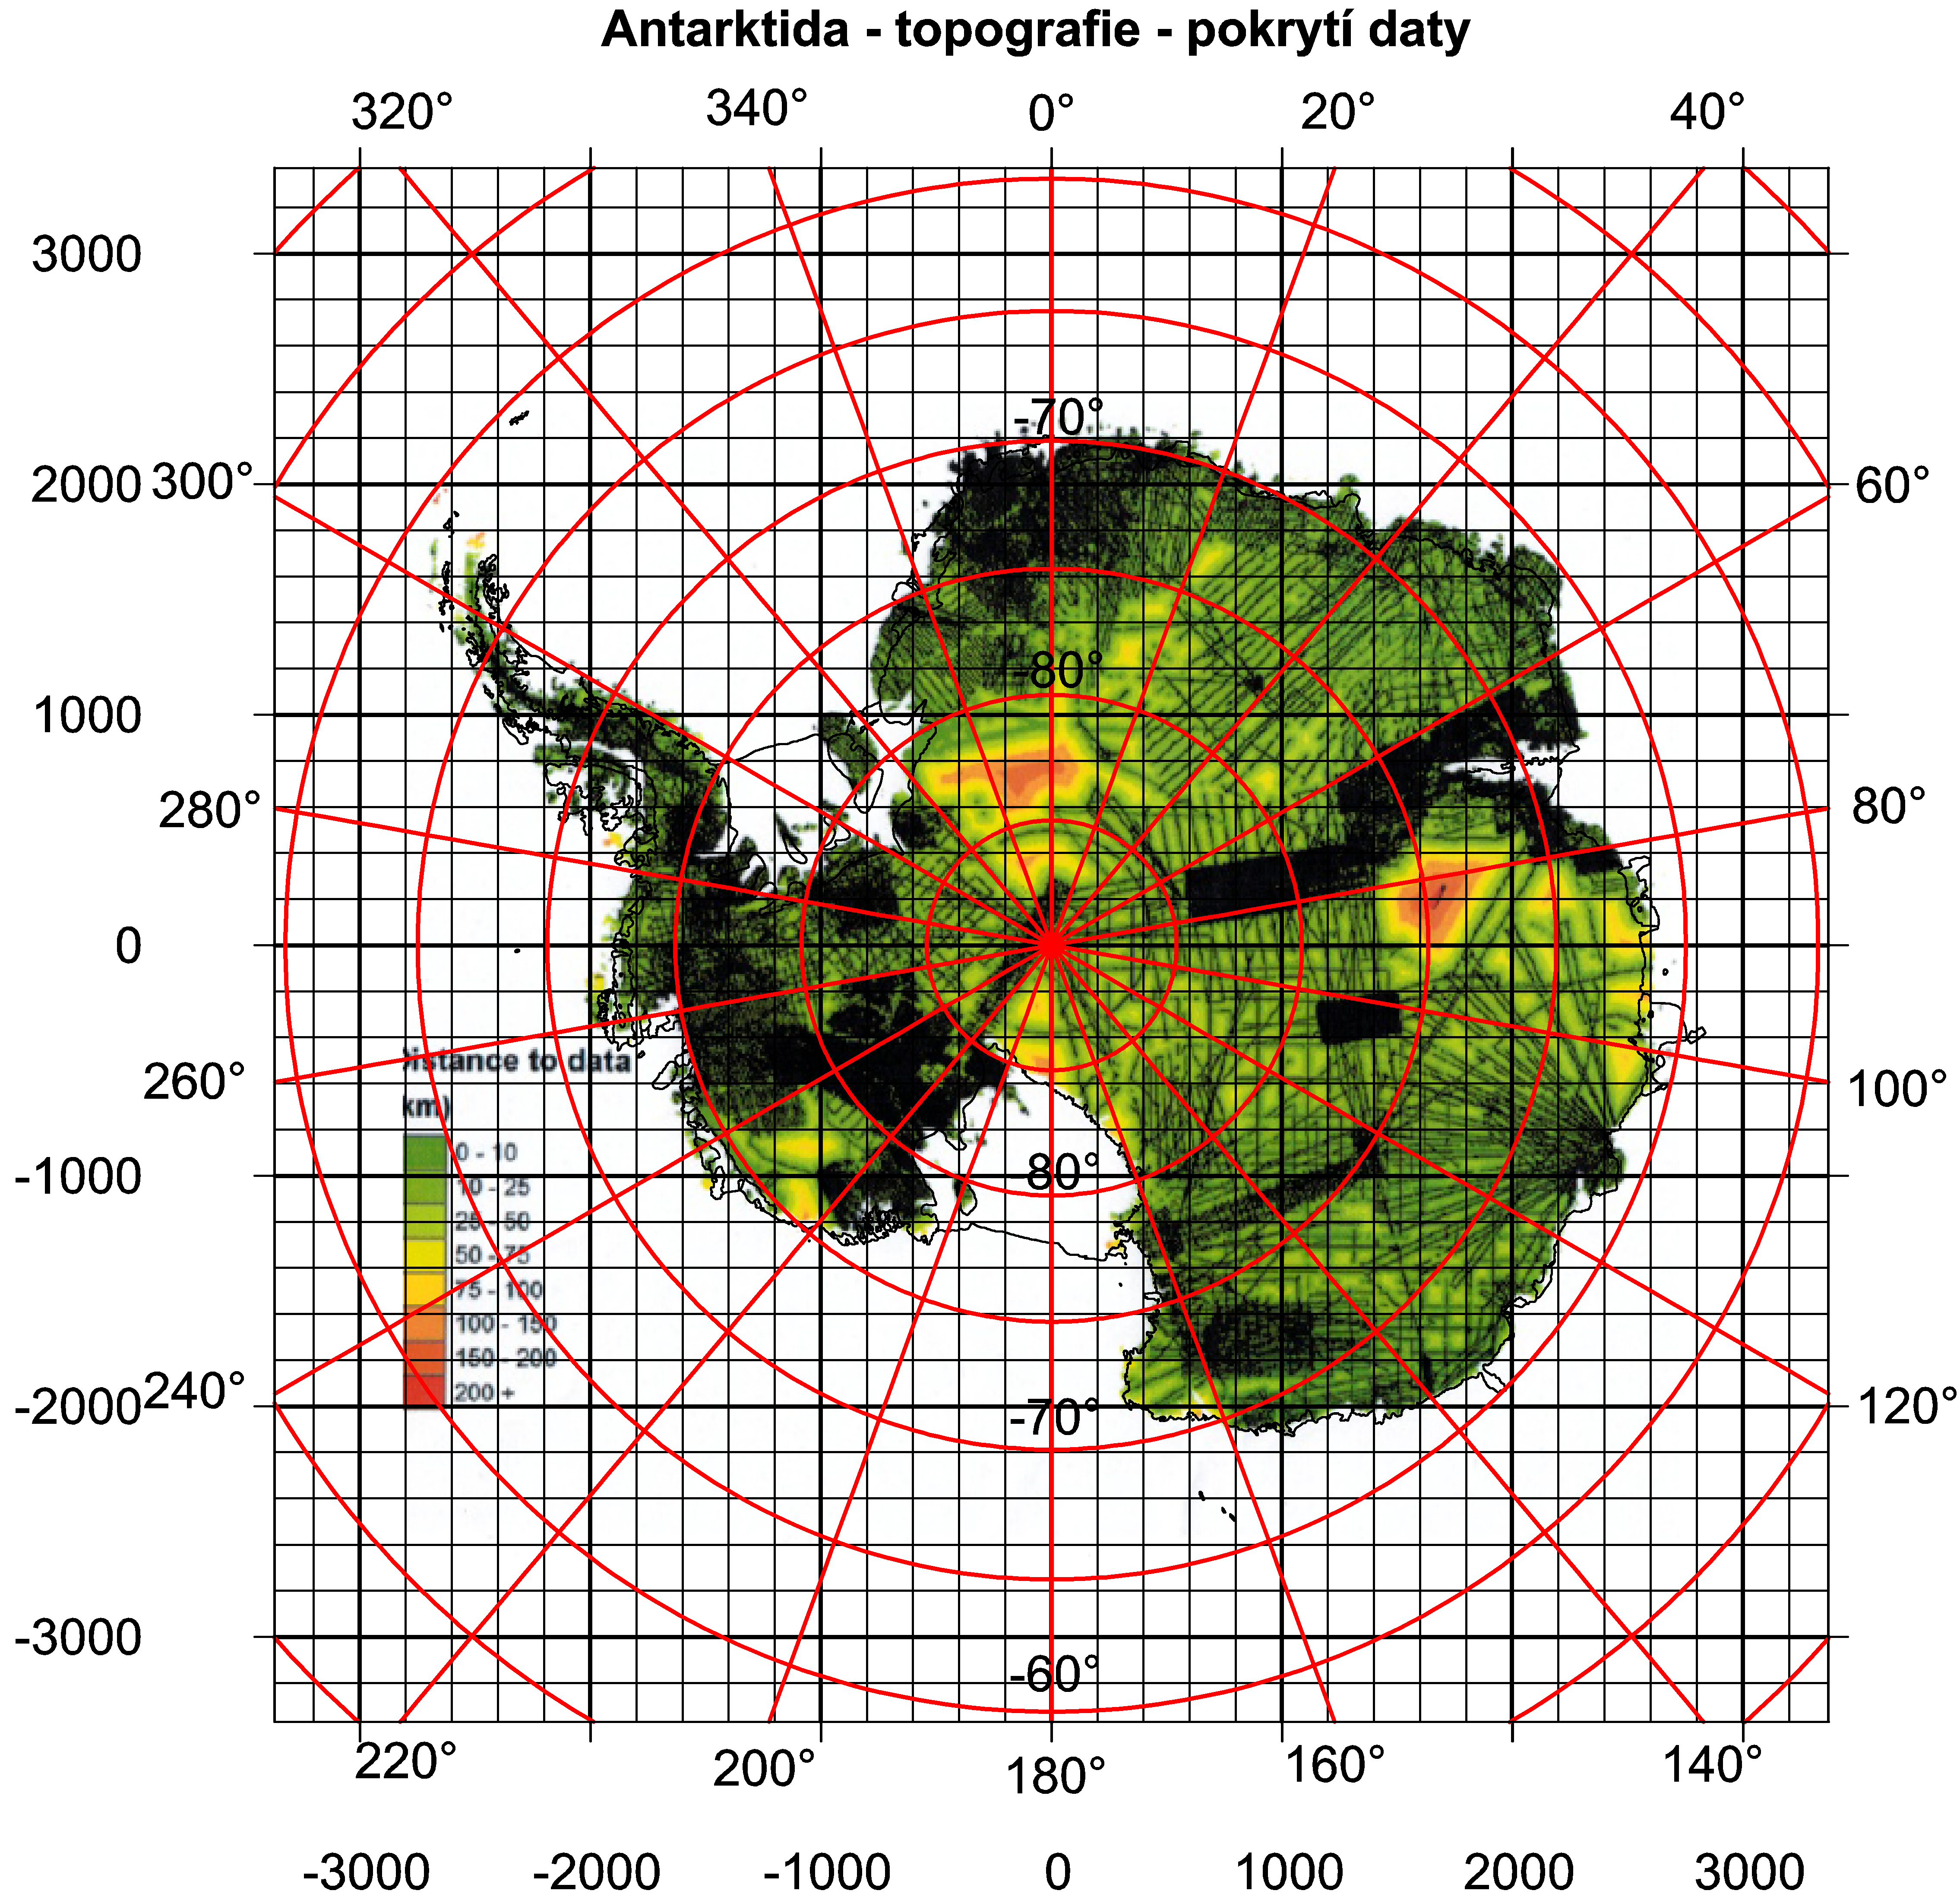
Kritická obhlídka dat

Slide 37
cont./pokrač.
SatGrav RET 2014
Hirt Ch. et al 2016,
A new degree-2190 (10 km resolution) gravity field model for Antarctica
developed from GRACE, GOCE and Bedmap 2 data,
J Geod 90: 105-127.

Slide 38
Plotting
Plotting is important for visualizing our results; we make use of strongly non-linear scales to emphasize various features which otherwise might remain hidden.
A note about the units of plotted aspects:
mGal (miligals) for the gravity anomalies and/or disturbances,
E … Eötvös for the second order potential derivatives,
components of Marussi tensor.
The invariants I1 and I2 have units [s⁻⁴] and [s⁻⁶] and their ratio I is dimensionless.
The strike angle θ is expressed in degrees and its demonstration in red means its direction to the East and in blue to the West of the local meridian.
The virtual deformations (vd) are dimensionless and express a direction of dilatation (red) or compression (blue). These units are used in all figures presented below.
1mGal = 10⁻⁵ ms⁻², 1E = 1 Eötvös = 10⁻⁹ s⁻²

Slide 39
Examples of typical gravitational signal (trace, signature) of diverse geological/geomorphological/geophysical structures

Slide 40
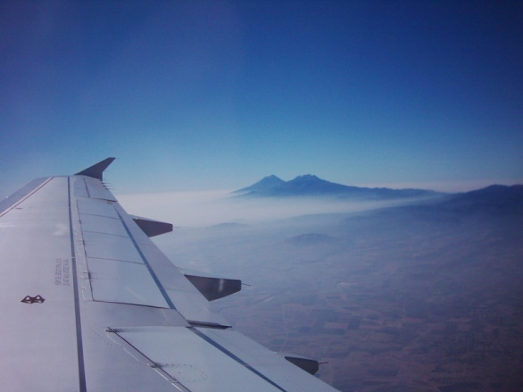
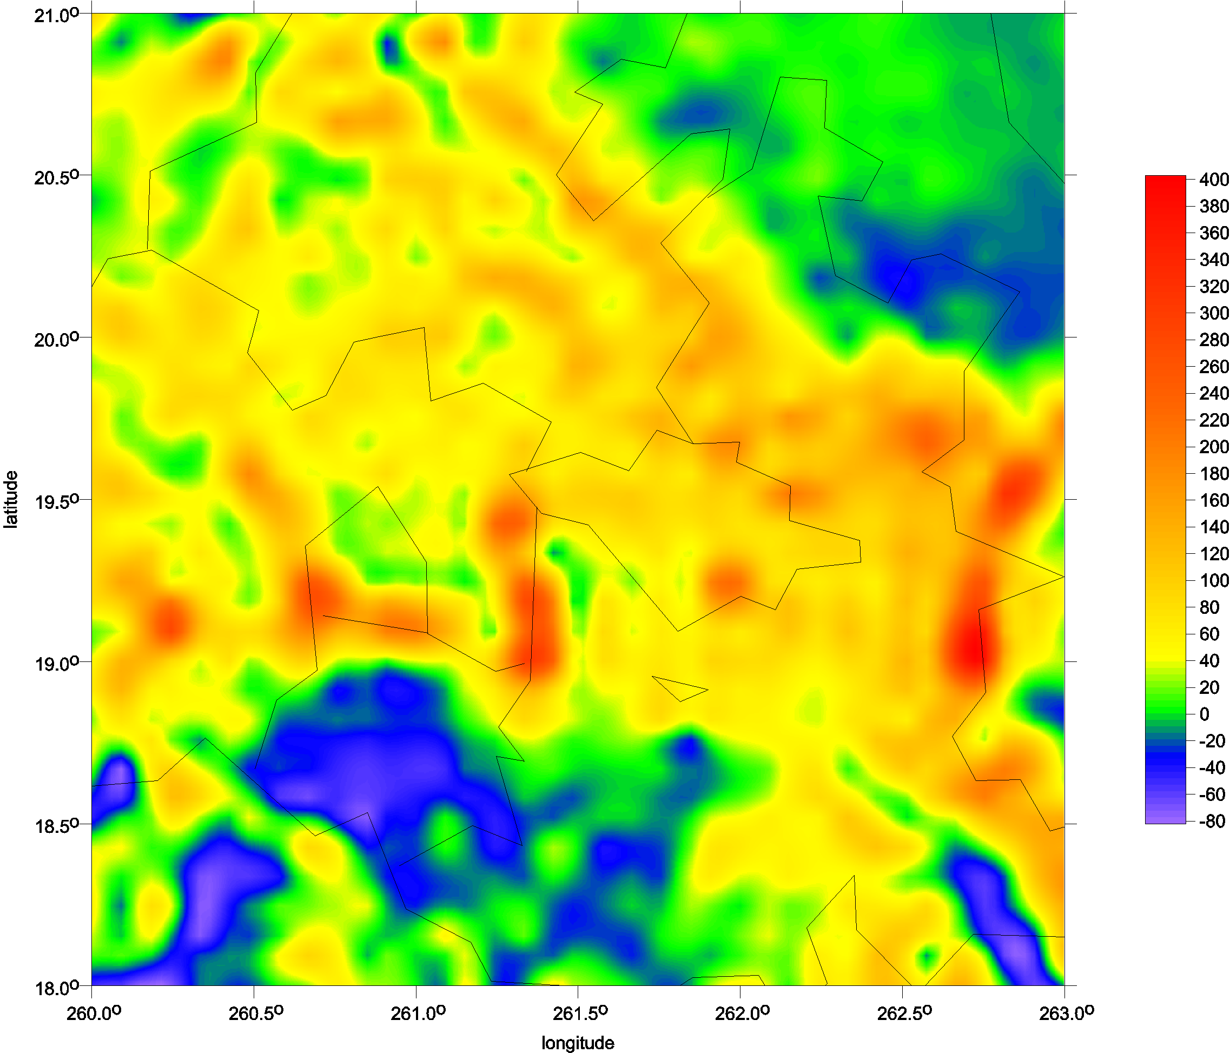
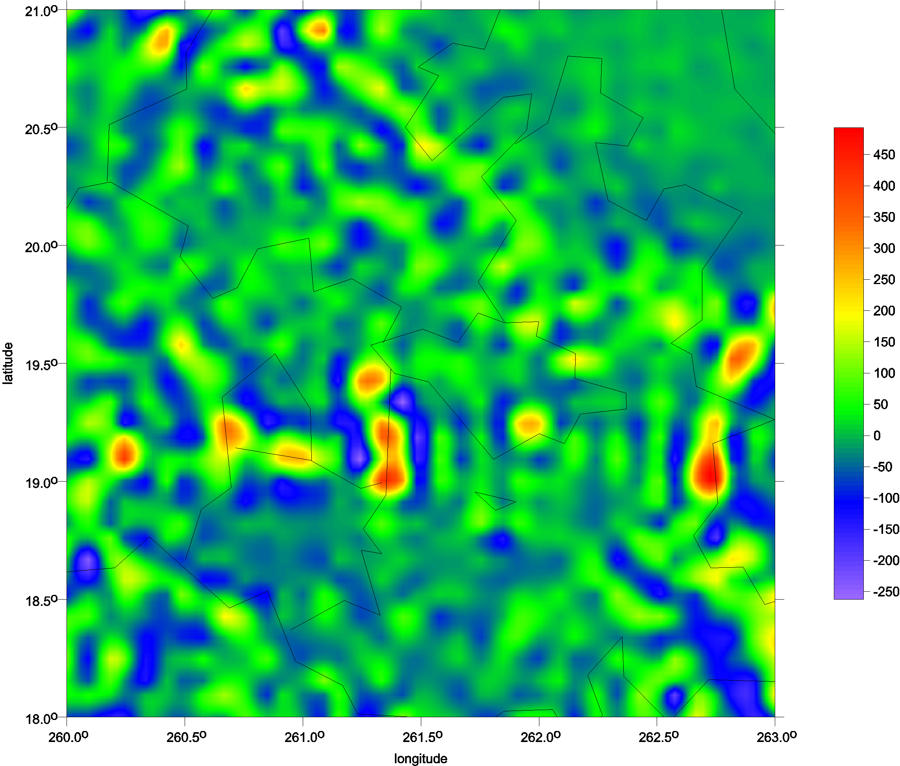
Typical volcanoes
Popokatepetl and Iztaccihuatl
Popocatepetl
Itzaccihuatl
∆g
T_{zz}

Slide 41
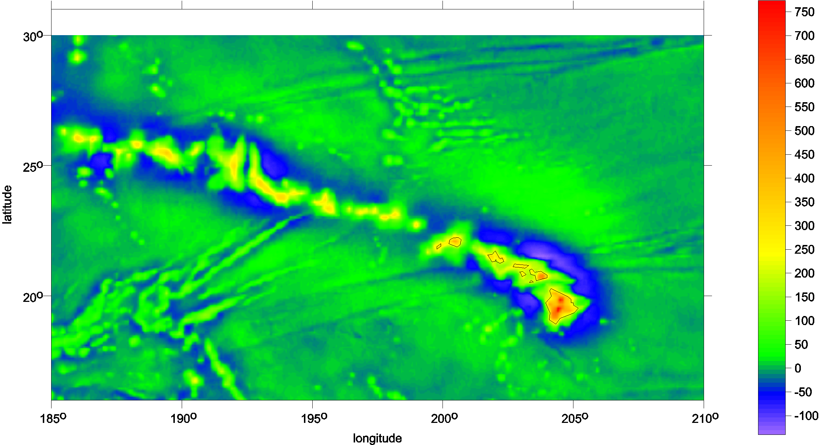
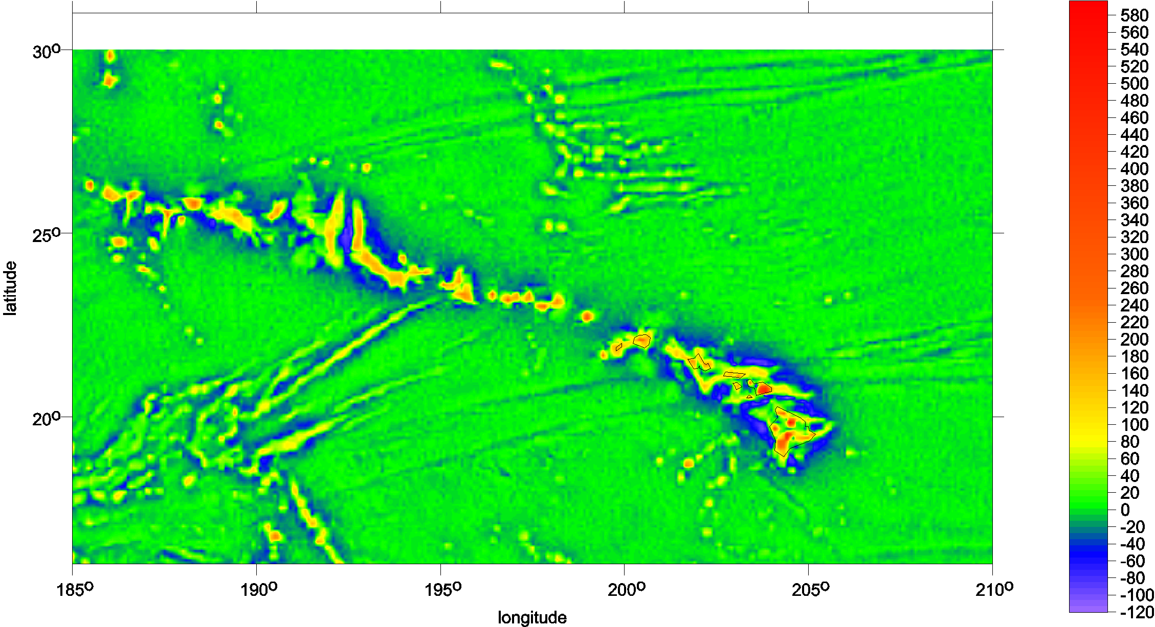
Hawai
gravity disturbance
Tzz

Slide 42




Hawai, the Big island

Slide 43


Fuji, Japan

Slide 44


subduction zone, volcanoes under sea SE of Japan
virtual deformations
The strike angle θ_{S} for the ratio I > 0.3.

Slide 45



Large impact crater on the Earth
Popigai, Siberia, diameter ~100 km
Δ g Tzz vd
more in Klokočník et al. 2010

Slide 46


Chicxulub
Yucatan

Slide 47


Mt Olymp, Mars
Marty et al,
potential to 95

Slide 48


Ethiopia
African land with quality terrestrial data in EGM 2008, rich river network, huge erosion

Slide 49

Himaláj

Slide 50



Yucon - Alaska
∆g
Google Earth
T_{rr}

Slide 51



Grand Canyon
Δg
T_{zz}

Slide 52


red… dilatation
blue …compression

Slide 53


Slide 54


Slide 55


Slide 56
Volcanoes in Antarctica
known and suspected

Slide 57



Slide 58



Slide 59


Mount Erebus is the second highest volcano in Antarctica (after Mount Sidley)
and the southernmost active volcano on earth. It is the sixth highest mountain on
an island. With a summit elevation of 3,794 metres, it is located on Ross Island,
which is also home to three inactive volcanoes, Mount Terror, Mount Bird, and Mount Terra Nova.
The volcano has been active since c. 1.3 million years ago and is the site of the Mount Erebus Volcano
Observatory run by the New Mexico Institute of Mining and Technology]
the RAT14 combination of the gravity from the EIGEN 6C4 and the topography from the Bedmap 2 in T_{zz},
the Ross Island topography detail.

Slide 60




e
f g
 | Version to print Weather at: Sidley Object map: Sidley |  | Regions: Antarctica Objects: Mt. Sidley (4181m) Activities: Mountaineering Service: VIP Program's difficulty: 3, relatively easy ( technical 2 + altitudinal 1 ) Group size: 6-10 Price: 56 990 USD or see cheaper option » Deposit for reservations 5 000 USD Full payment 90 days before No refund if you cancel less than 90 days! Buy it CHEAPER - TODAY!!! Next month the price will rise. The price is fixed at the moment of prepayment. Dates ( Days 17 / Nights 16 )………………..

Slide 61
Antarctica
global views

Slide 62


Slide 63


Slide 64


Slide 65


Slide 66


Slide 67
Antarctica
zooms and details

Slide 68



Slide 69


Slide 70


Slide 71


Slide 72



Slide 73


Slide 74



Bedmap 2 for the Executive Comm. Range with Mt Sidley [m asl].
Mount Sidley, in Marie Byrd Land, is the largest volcano that rises above the surface of the ice. Seismologists has detected new volcanic activity under the ice about 60 km away. (Washington University)

Slide 75



Slide 76



Slide 77




Subglacial volcanoes
Podledovcové sopky
Volcanoes in Antarctica
known and suspected

Slide 78


Slide 79


Slide 80



Slide 81


Slide 82



Example 1
Geographic coordinates: φ = 79⁰ 19‘ S, λ = 118⁰ 00‘ E, h = 2.3 km
Name of candidate: Dana.
Example 2
Geographic coordinates: φ = 75⁰ 59‘ S, λ = 93⁰ 57‘ E, h = 2.5 km
Name of candidate: Zuzana.

Slide 83


Slide 84


Slide 85
Nová možná subglaciální jezera,
jezerní pánev,
propojení jezerní oblasti řekami,
nové detaily o jezeru Vostok

Slide 86



Slide 87

Lake Vostok z altimetrie ERS 1

Slide 88

T_{zz}. Numbers show lakes from the inventory of Wright & Siegert (2012), rectangles potential new lakes nearby, M is Magda, D Denisa, and L Lucie.

Slide 89


Slide 90

Mezi LV a GSM
90 E Basin

Slide 91



Slide 92


Reproduced from Studinger et al. (2004), fig.1c
Klokocnik et al 2018

Slide 93



Slide 94


Tzz [E] I1 [s-4]

Slide 95

Impact
crater/mascon
in Wilkes Land

Slide 97

Frese, RR von; Potts, L; Wells, S.; Gaya-Piqué, L.; Golynsky, A. V.; Hernandez, O.; Kim, J.; Kim, H.; Hwang, J. (2006). "Permian–Triassic mascon in Antarctica". Eos Trans. AGU, Jt. Assem. Suppl. 87 (36): Abstract T41A–08.
Frese, R. von, Potts, L., Wells, S., Leftwich, T., Kim, H., et al., 2009. GRACE gravity evidence for an impact basin in Wilkes Land, Antarctica, Geochemistry, Geophysics, and Geosystems, 10, #2, Q02014,
doi: 10.1029/2008GC002149.
Frese, R. von, Kim, H.R., Leftwich, T.E., Kim J.W. and A.V. Golynsky. 2013. Satellite magnetic anomalies of the Antarctic Wilkes Land impact basin inferred from regional gravity and terrain data,
Tectonophysics 585, 185–195.

Slide 98

World Digital Magnetic Anomaly Map, NOAA 2010, GMT v. 4.0
plus specific magnetic anomaly map for Antarctica

Slide 99


Impact
crater/mascon
in Wilkes Land

Slide 100


Slide 101


∆g [mGal]
Tzz [E]

Slide 102


I1[s-4]
vd [-]

Slide 103



Slide 104


Slide 105


jklokocn@asu.cas.cz
www.asu.cas.cz/~jklokocn
www.asu.cas.cz/~jklokocn/Cafe-Barrande

