Slide 1
Resolvability of gravity field parameters
in a repeat orbit: degree/order limit
J. Klokočník¹, J. Kostelecký², C. A. Wagner³, A. Bezděk¹
¹Astronomical Institute, Academy of Sciences of the Czech Republic, p.r.i. (ASÚ)
CZ – 251 65 Ondřejov Observatory, Czech Republic
jklokocn@asu.cas.cz, bezdek@asu.cas.cz
²Research Institute of Geodesy, Topography and Cartography (VÚGTK),
CZ – 250 66 Zdiby and TU Ostrava, CZ – 708 33 Ostrava-Poruba, Czech Republic, kost@fsv.cvut.cz
³ 2801 Roesh Way, Vienna Va., 22181, USA; e-mail: carl.wagner2@verizon.net
IUGG Prague 29 June G2
Notes:
joint/collective work

Slide 2
Abstract
One of the limiting factors in the determination of gravity field parameters is the spatial sampling, namely during phases when the satellite is in a repeat orbit at a low order resonance. This often happens when it is freely passing (drifting) through the atmosphere and encountering various repeat orbits or when it is not drifting but is placed into a preselected repeat orbit to perform specific measurements. This research was triggered in 2004 by the significant but only temporary (2–3 months long) decrease of the accuracy of monthly solutions for the gravity field variations derived from GRACE. The reason for the dip was the 61/4 resonance in the GRACE orbits in autumn 2004. At this resonance, the ground track density decreased and large (mainly longitude) gaps appeared in the data-coverage of the globe. The problem of spatial sampling has been studied repeatedly and simple rules have been derived to limit the maximum order for unconstrained solutions (inversions) for gravity field parameters or their variations. We extend this insight over all achievable latitudes and investigate the ground track density and maximum distances between subsatellite points at arbitrary latitude (specifically for CHAMP, GRACE, and resonant tuned GOCE]. We demonstrate clearly how latitude is important and affects the choice of an order resolution limit. A new order resolution rule is presented, based on the average maximum distance between subsatellite points integrated over achievable latitudes.
Abstract

Slide 3
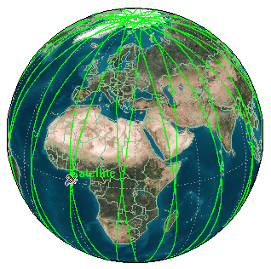
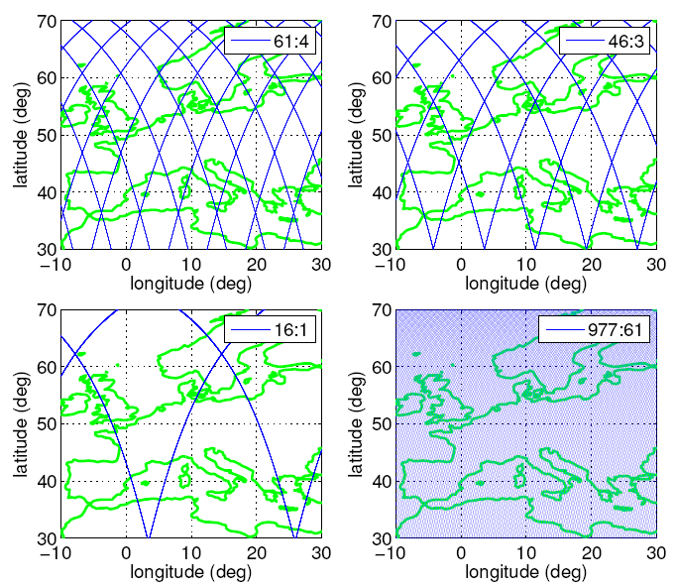
Orbital resonances
Orbital resonance β:α (or β/α)
β nodal revolutions and α nodal days
ERM (exact repeat mission, orbit, resonant orbit)
Modelling of gravity field
Dense enough grid of groundtracks
Unique determination of the
gravity field theoretically only to
β/2 or β …. (β –α) depending on parity
Search for better RULE for
maximum order of harmonics;
the limit depends also on
latitude and inclination!

Slide 4
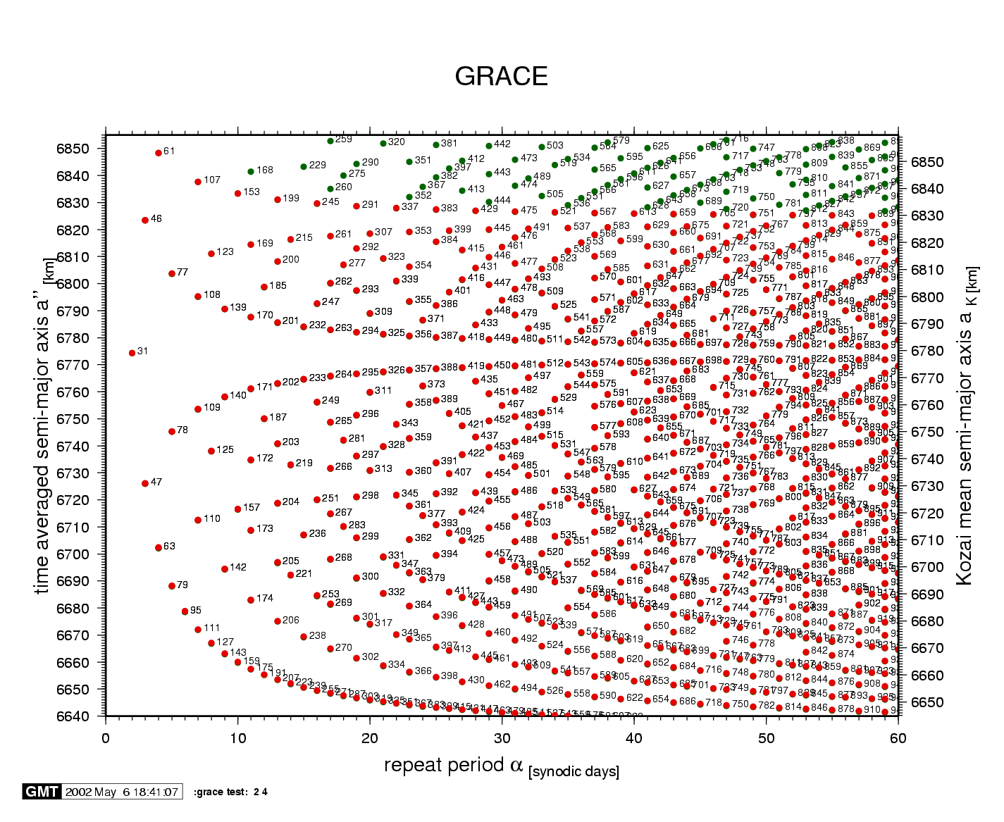

Slide 5
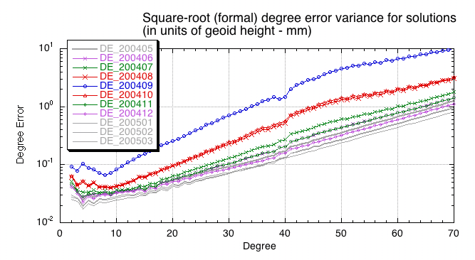
GRACE 61/4

Slide 6
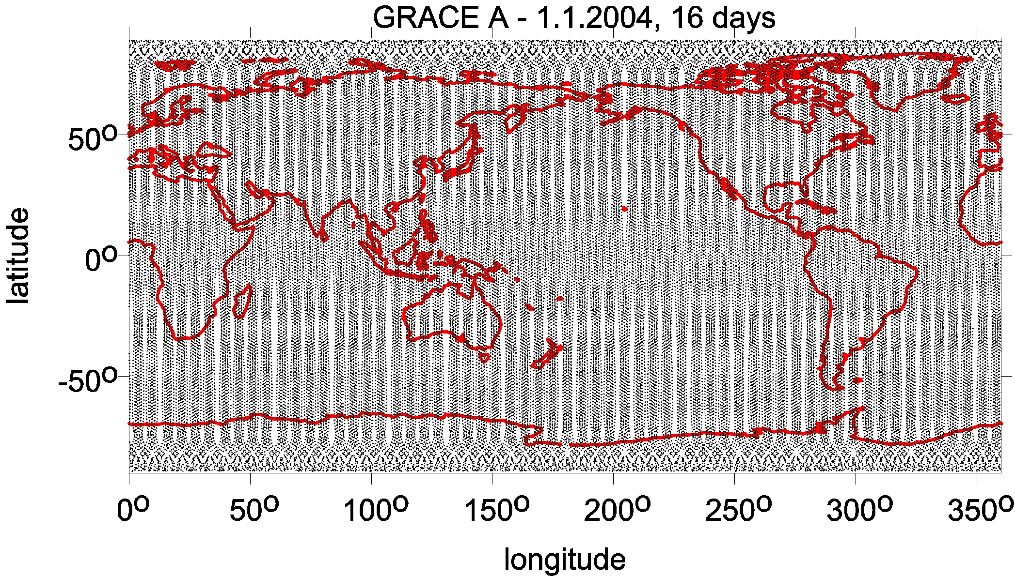
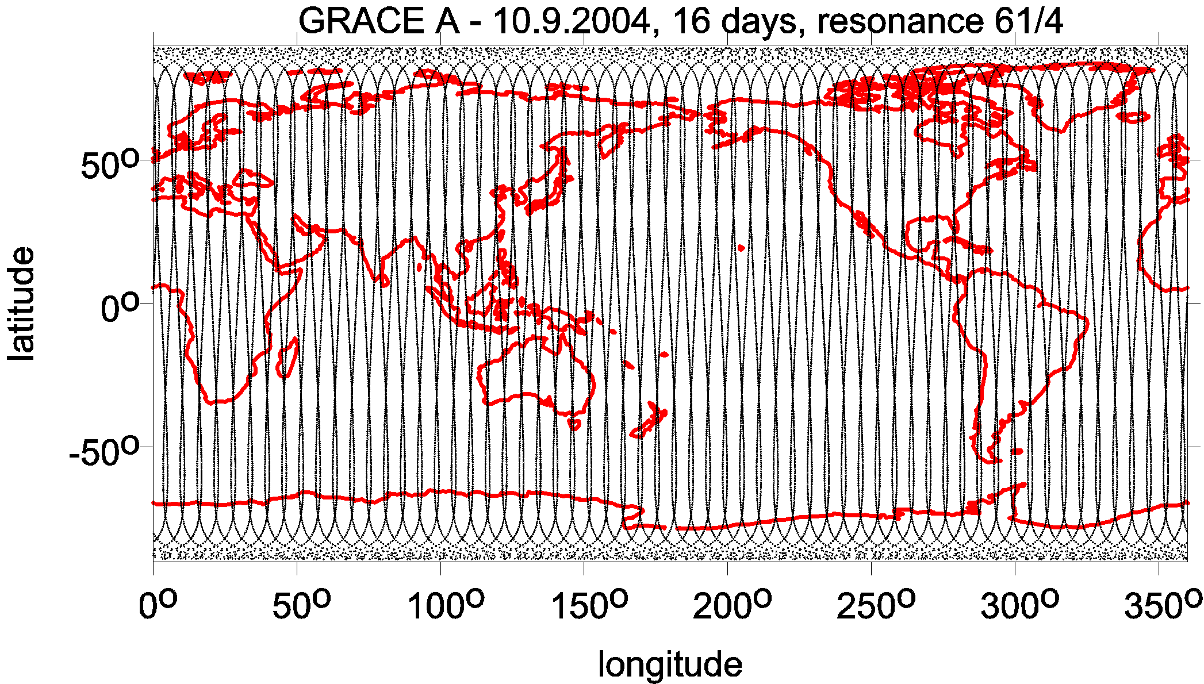
6161/461
61/4
resonance

Slide 7
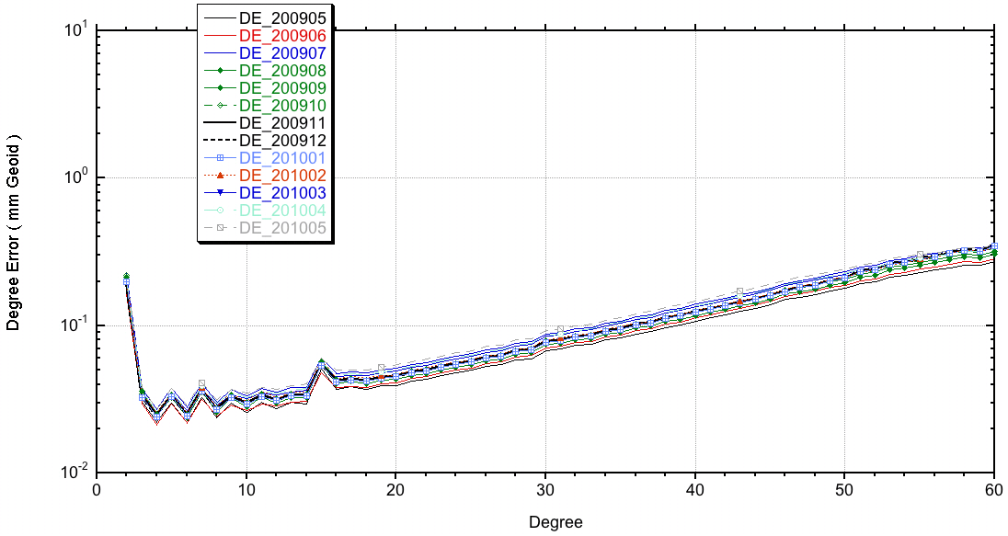
GRACE 107/7

Slide 8
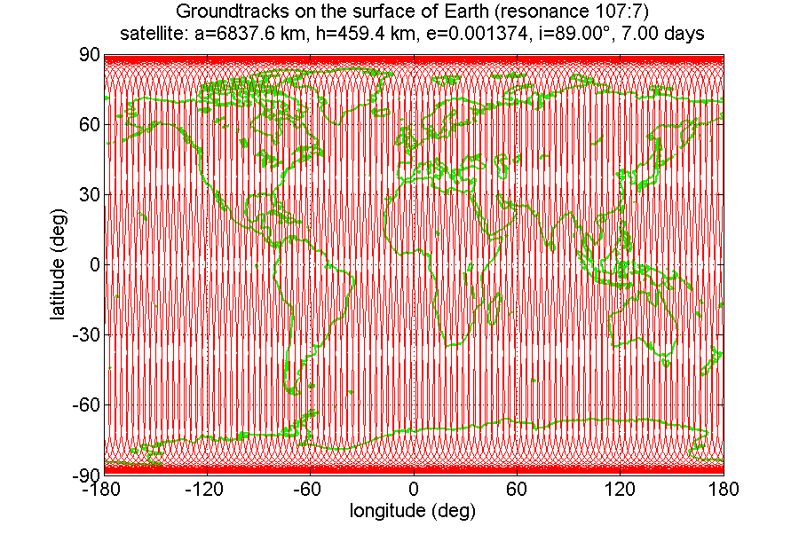
Ground track density in vicinity of 107/7 repeat orbit

Slide 9
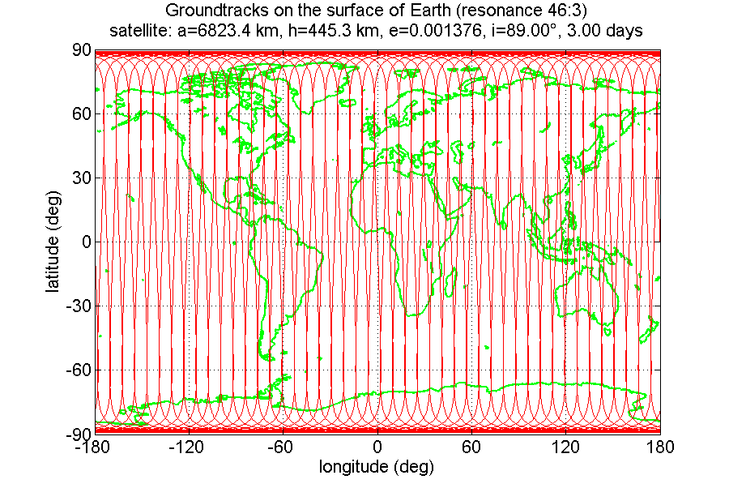
Ground track density in vicinity of 46/3 repeat orbit

Slide 10
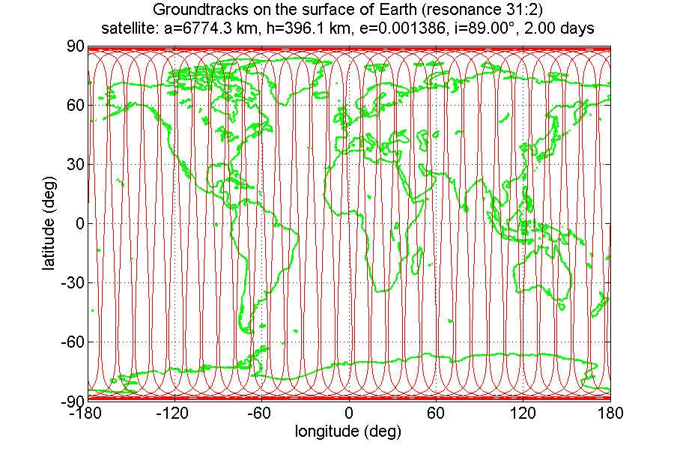
Ground track density in vicinity of 31/2 repeat orbit

Slide 11
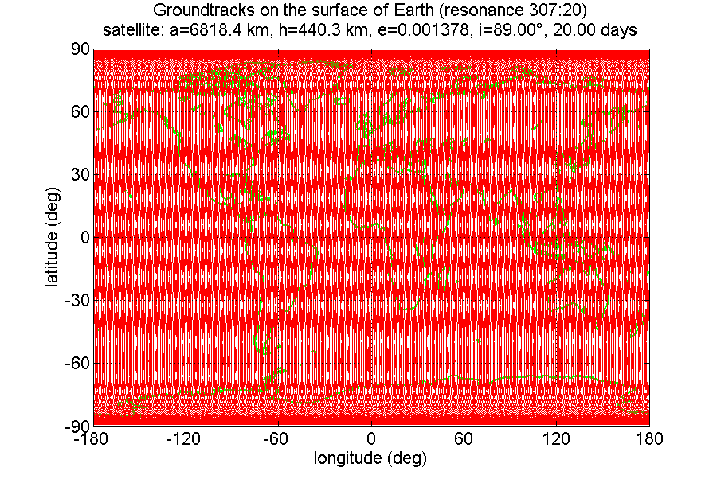

Slide 13
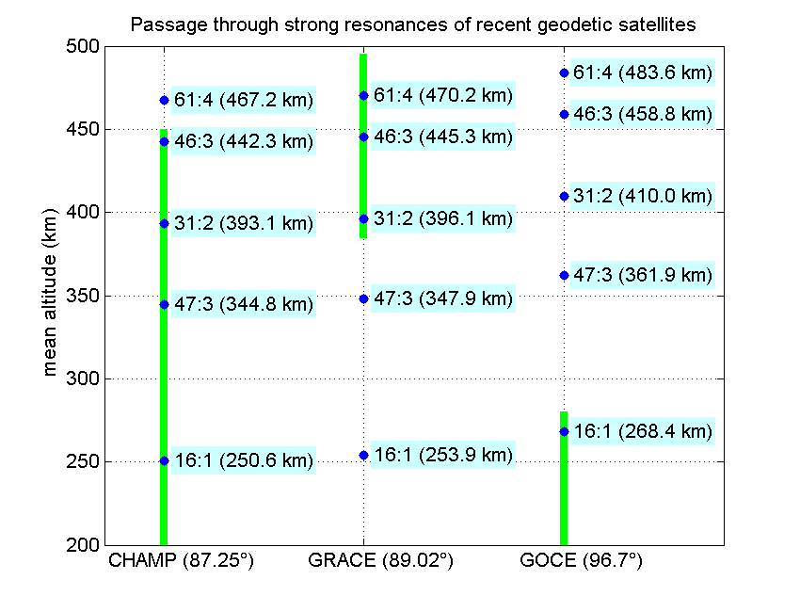
Orbital resonances and quality of gravity field models
CHAMP:
46/3,
31/2 (3 times), 47/3 (twice),…
orbit manoeuvres
GRACE: 61/4, 107/7, 47/3,
31/2,… free fall,
Worse quality of monthly gravity solutions
GOCE: 16/1
Stable orbit altitude
during measuring phases
Avoiding gradiometer measurements near
the 16/1 repeat orbit
Sophisticated orbit
choice and fine
orbit tuning is needed
Notes:
naturally
affect zasáhnout (negativně)

Slide 14
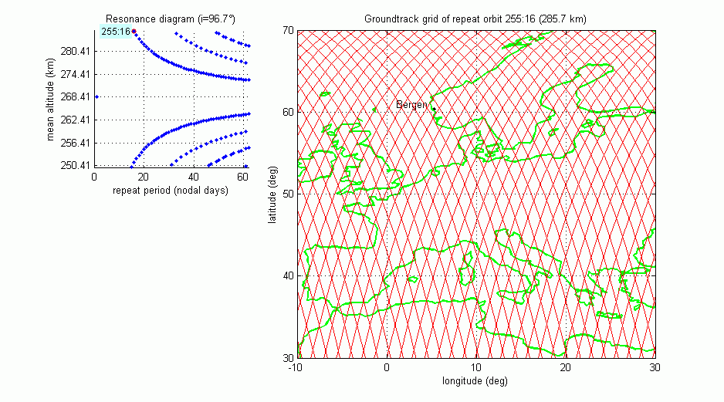
GOCE groundtrack animation for the initial free-fall phase
GOCE decreased its initial altitude of 280 km to the planned measurement altitude of 254.9 km by means of free fall

Slide 15
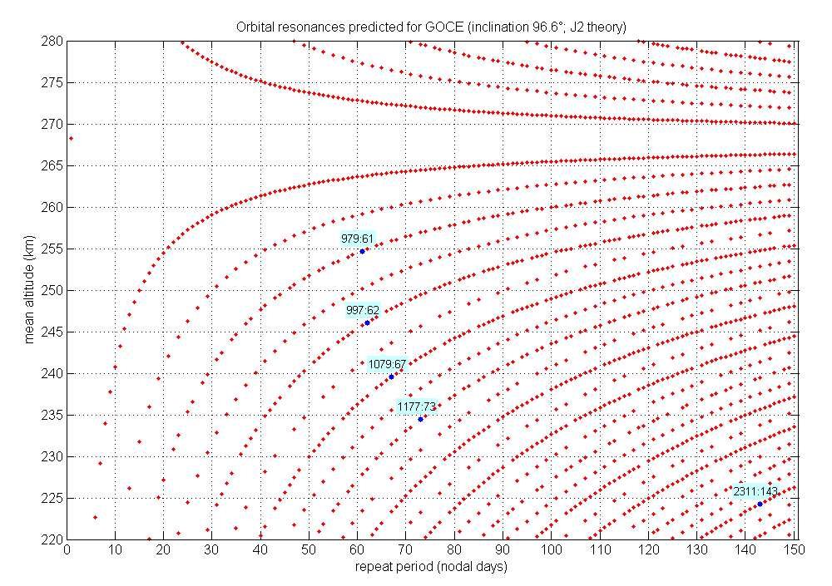
GOCE
MOPs
61:979 @254.9 km mean altitude, held for about 3 years of operations
62:997 @ 246 km mean altitude, held for 1 cycle in Sep/Oct 2012
67:1079 @ 240 km mean altitude, held for 1 cycle in Dec2012/Jan2013
73:1177 @ 235 km mean altitude, held for 1 cycle in March/April 2013
143:2311 @ 223.9 km mean altitude, starting from early June 2013
(Priv. commun., R. Floberghagen, 2014)

Slide 16
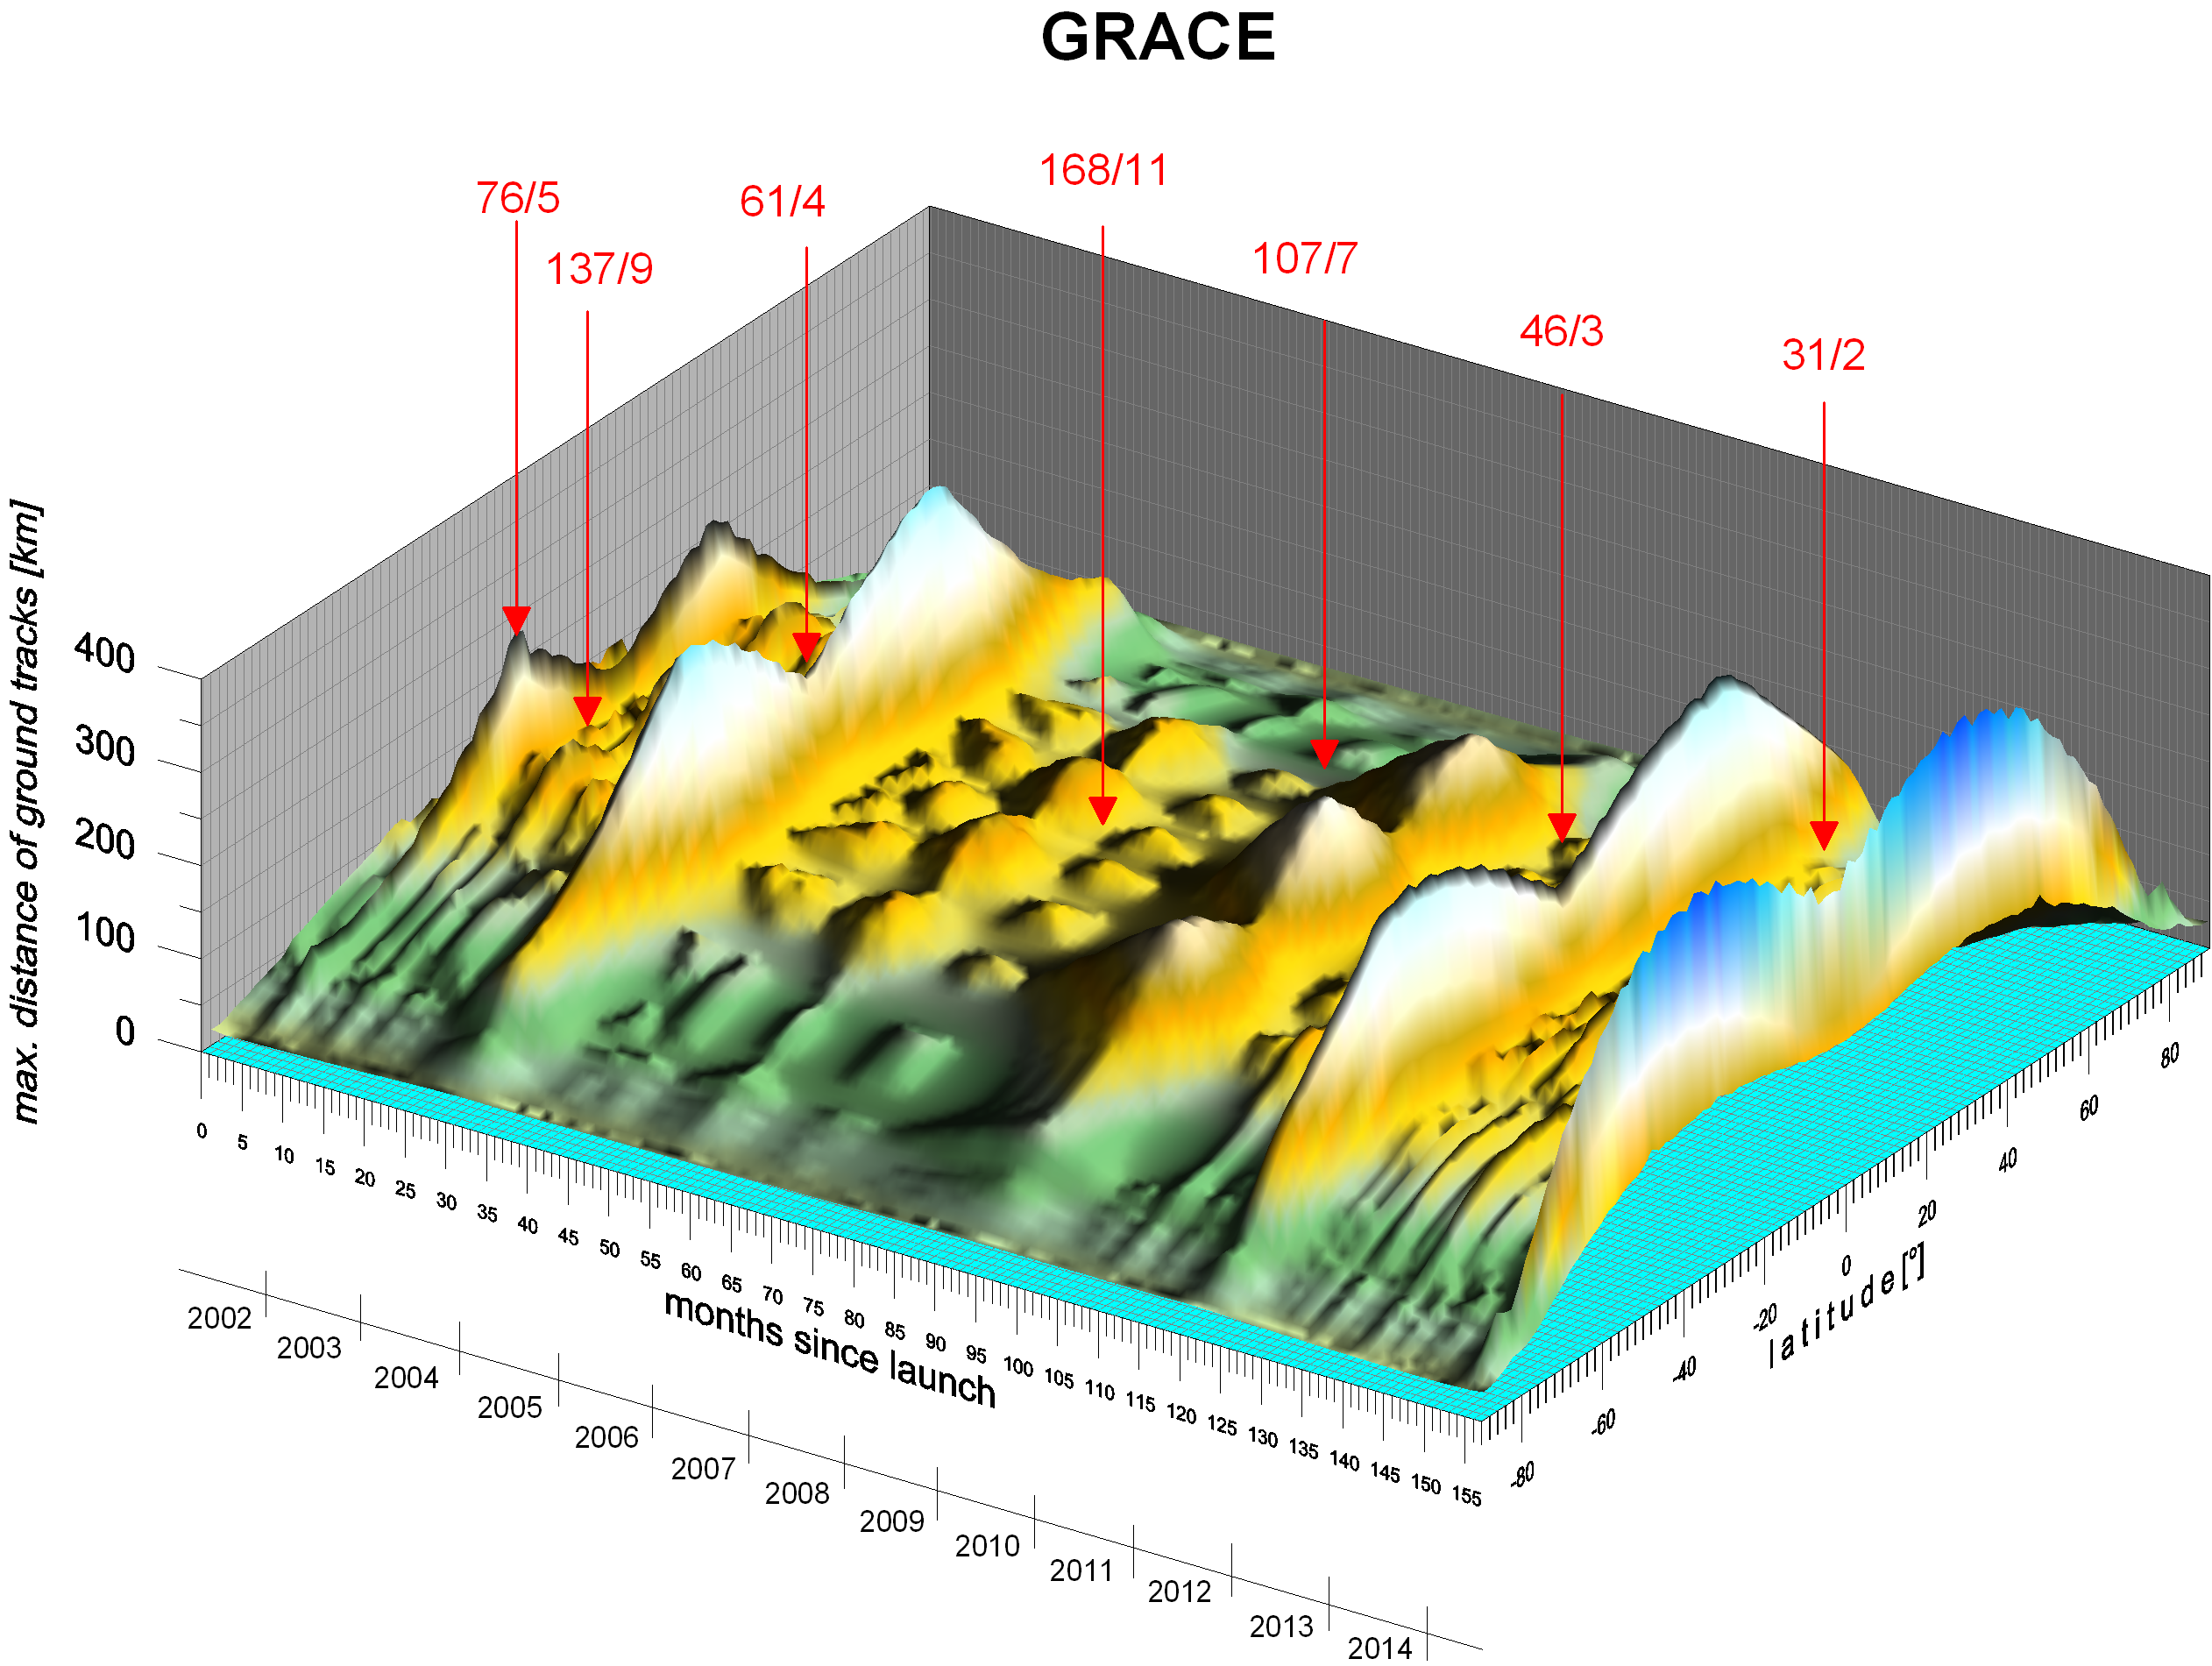
GRACE low order orbit resonances encountered

Slide 17
Summary from previous ground track plots and the 3D plot of actual distances (densities, spacing) for GRACE (in time evolution):
DENSITY DEPENDS STRONGLY ON LATITUDE
(in addition to dependence on β)
Any rule for maximum degree/order of determinable harmonics for gravity field parameters or their time variations
has to account for an effect of latitude!

Slide 18
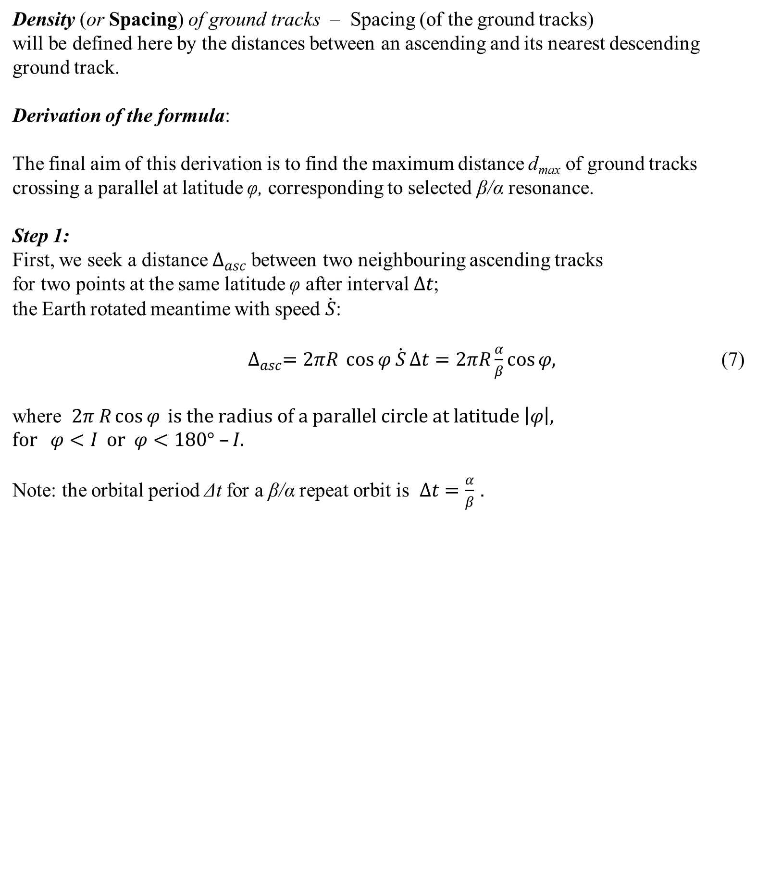

Slide 19
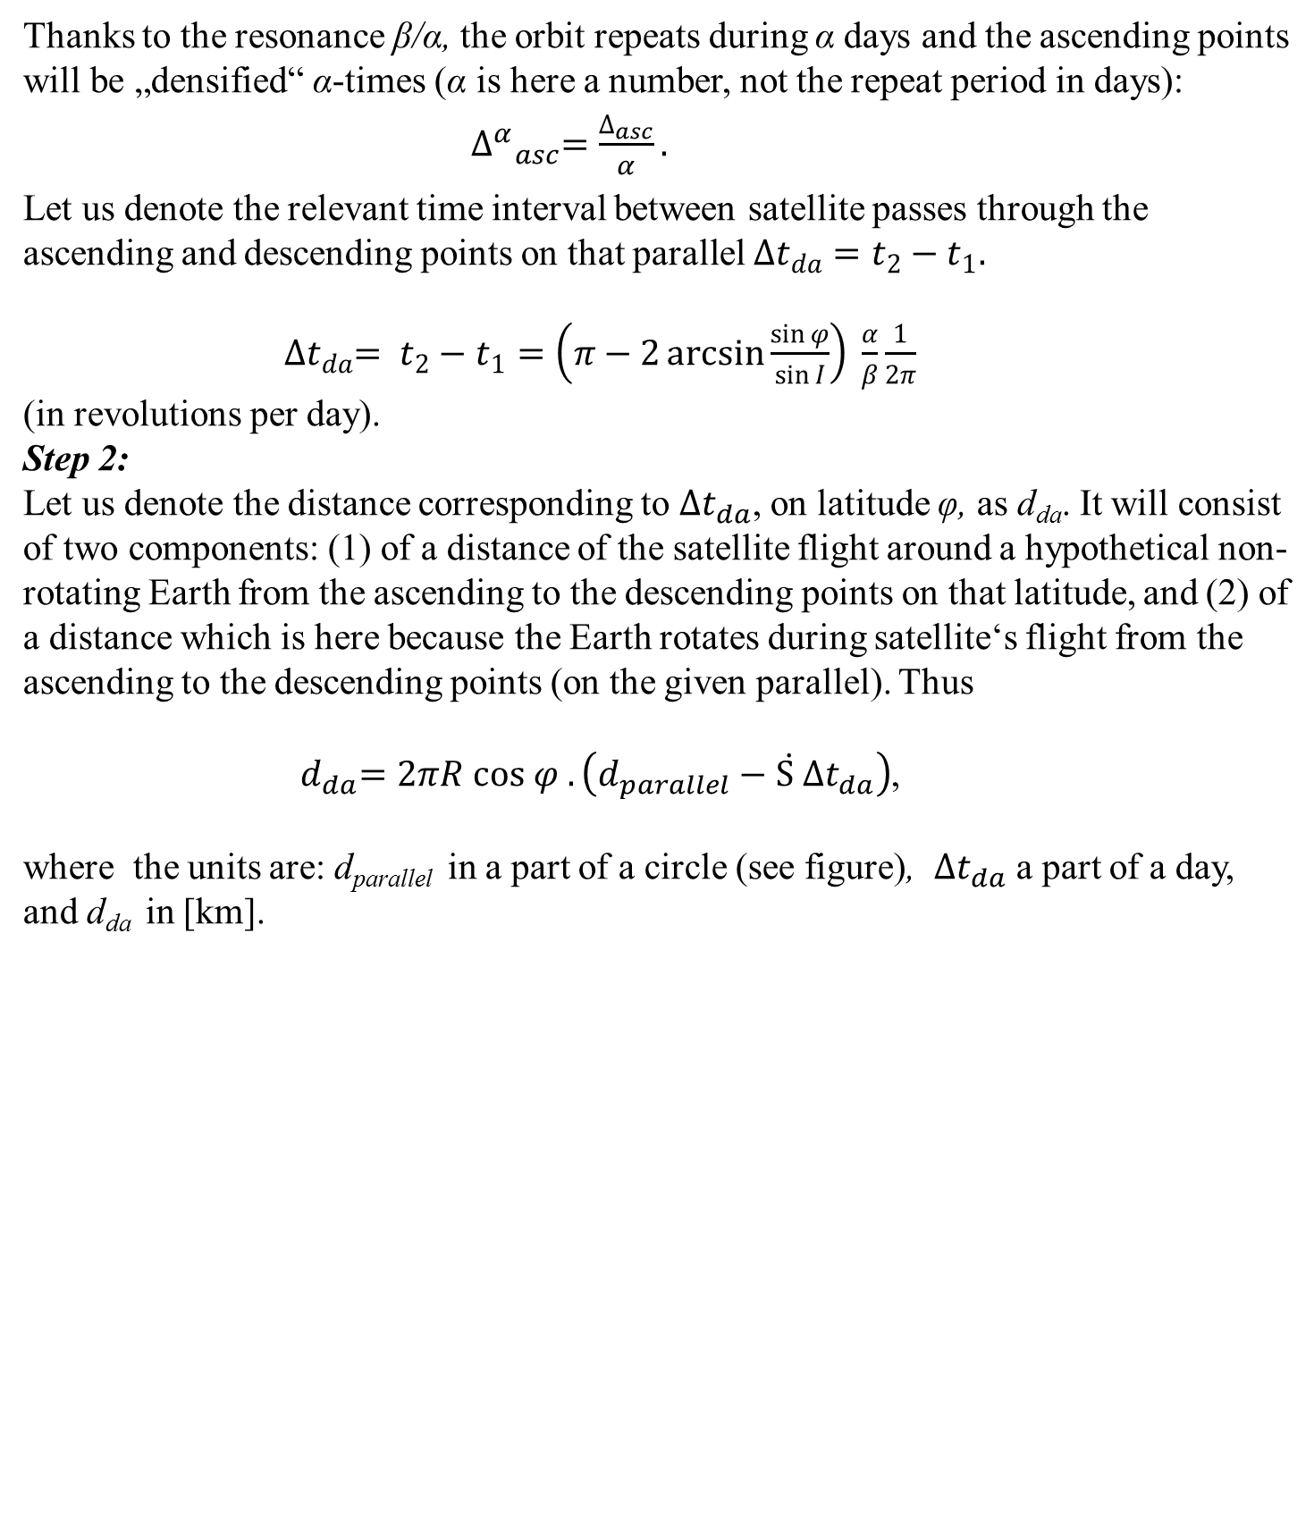

Slide 20
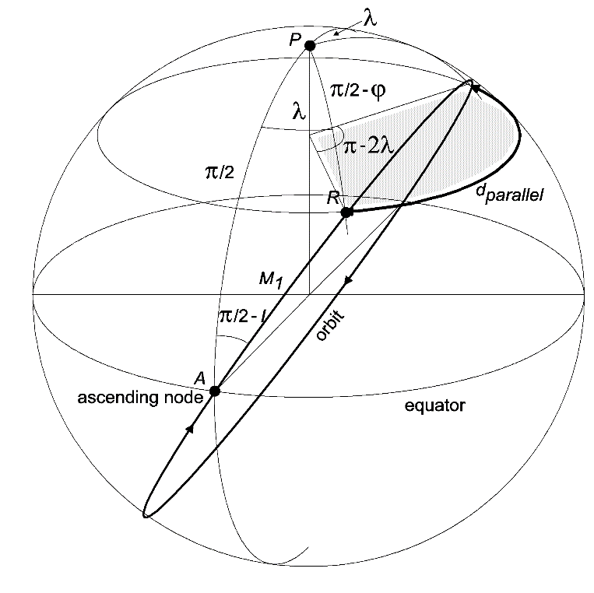
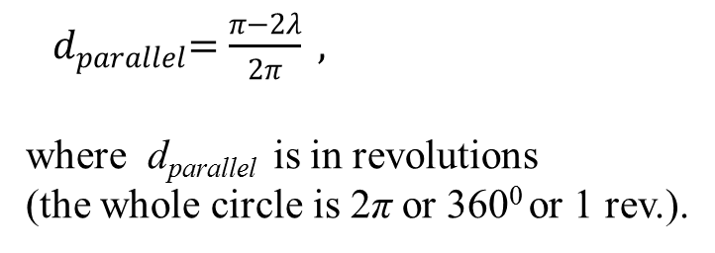
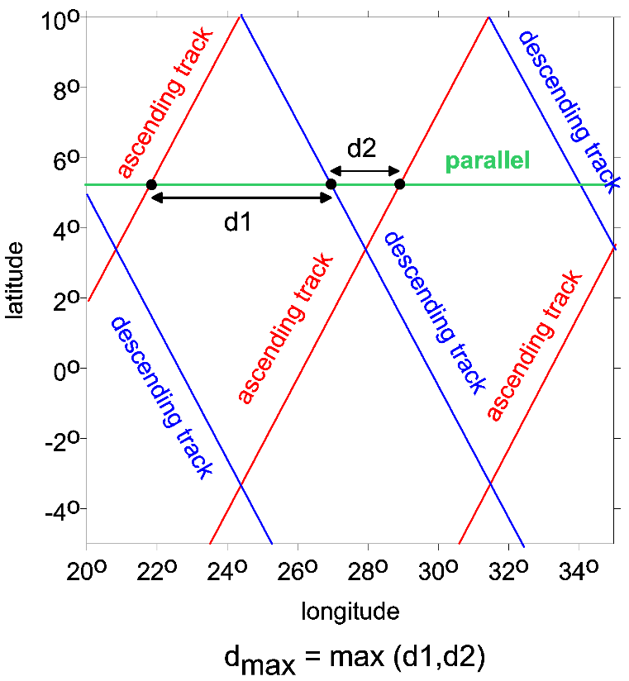
Spherical geometry for the derivation of the distance between the ascending and descending tracks at latitude φ:
Step 3:
d₁ = mod (d_{da}, Δ^{α}_{asc}), d₂ = Δ^{α}_{asc} - d₁,
d_{max} = max (d₁, d₂).

Slide 21
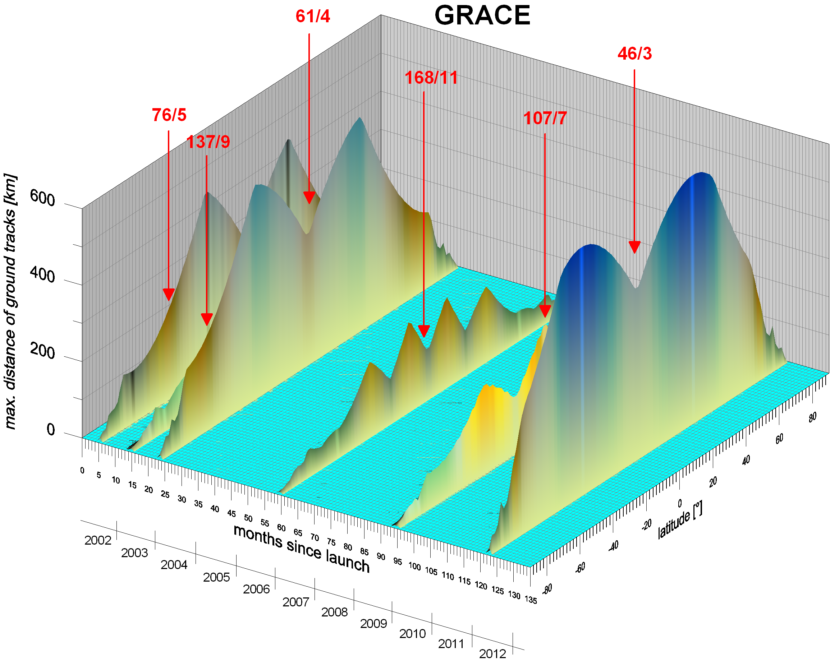
Theoretical max. distances of ground tracks of GRACE computed by our new formula accounting for latitude
d_{max}

Slide 22

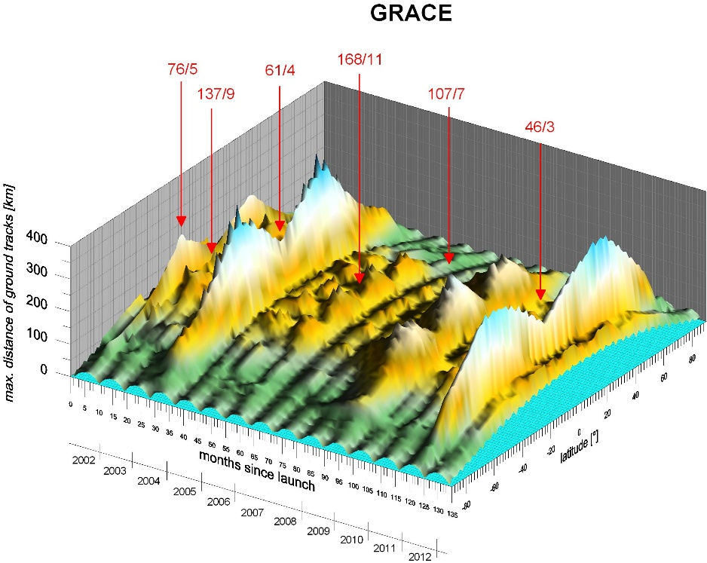
A comparison between our theory and data (case of GRACE)
theory
data
(actual orbit)

Slide 23
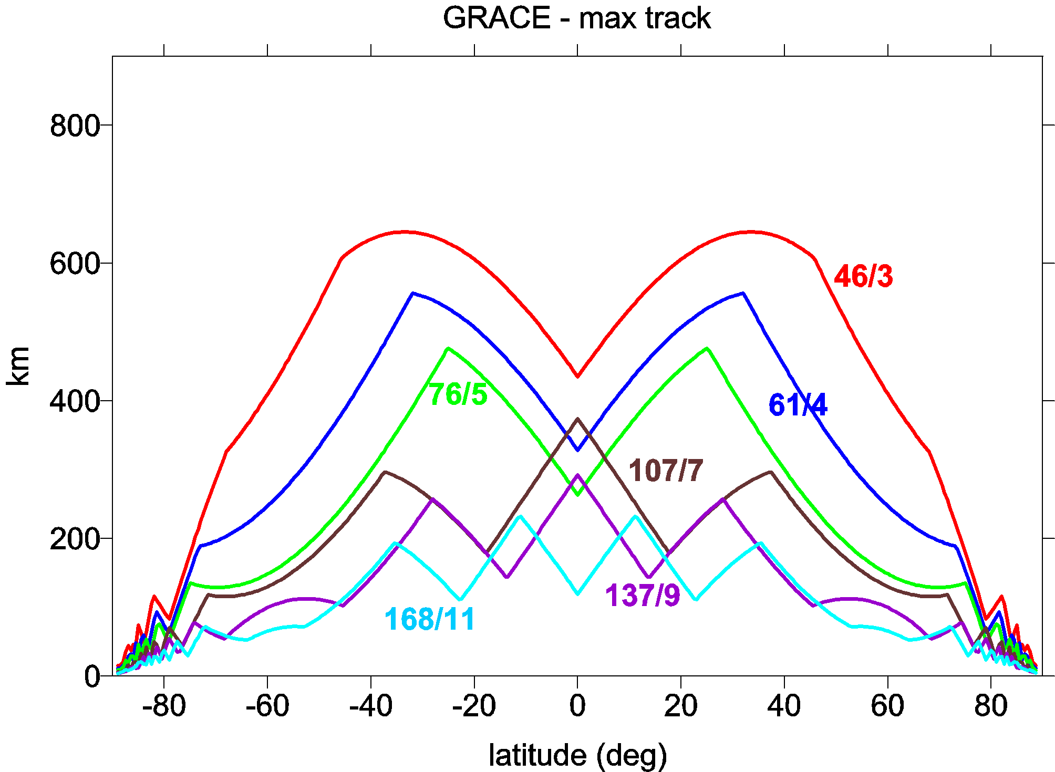
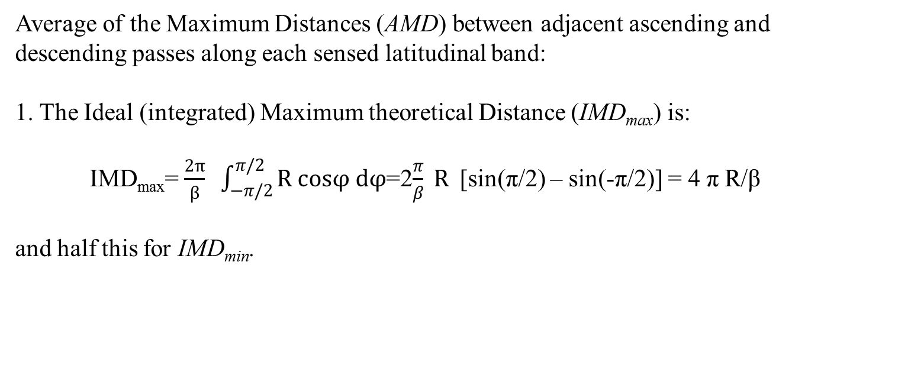
The new rule accounting also for latitude
Theoretical distances d_{max} of the ground tracks for GRACE for several important resonances.
How to estimate a mean value of d_{max} over all latitudes covered by the given orbit for the given
resonance?

Slide 24
2. AMD_{max} from pole to pole is: AMD_{max} =IMD_{max}/π = 4R/β
and half this for AMD_{min}:
AMD_{min}=IMD_{min}/π = 2R/β.
3.
The two extremes of M_{max}, β and β/2, suggest the simple formulae for M_{max} as a linear function of AMD (note the negative ratio M_{max}/AMD forecast above):
M_{max} = (β/2) [3 – β AMD/(2R)].
When AMD = AMD_{min}=2R/β, M_{max} = β (one extreme for Nyquist pole to pole coverage). Similarly, when AMD = AMD_{max}=4R/β, M_{max} = β/2 (the other extreme for Nyquist coverage).
Next figure shows M_{max} for selected resonances of CHAMP and GRACE.

Slide 25
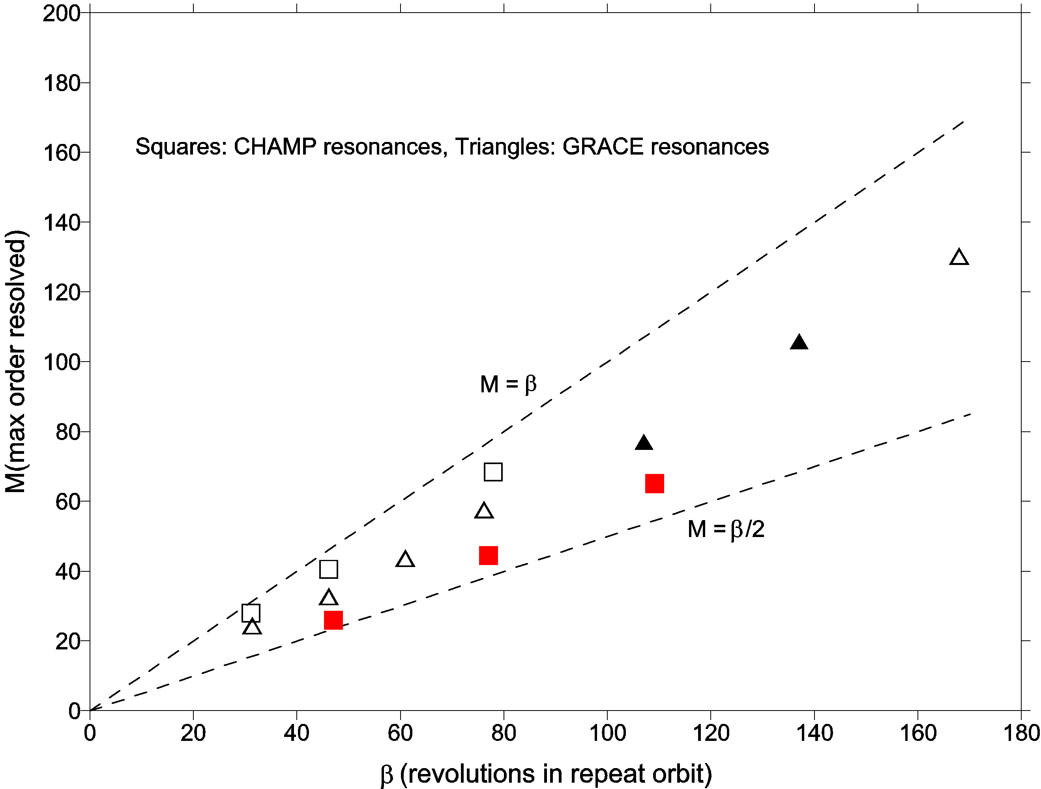
Filled symbols have (alpha, beta) of the same parity,
Klokocnik et al, ASR 2015, publ. on line

Slide 26
Strong resonance 31/2 in the official GRACE team products The resonance 31/2 caused problems to nominal Level-2 GRACE
products for February 2015. This problem also affected
the January and March 2015 solutions. For example, the Feb 2014 monthly gravity fields produced
by CSR are limited to: - A standard 60x60 solution where more aggressive
than normal post-processing may be required. - Additionally, a deviant 60x30 product for experimental use
is provided too. - No 96x96 solution will be generated and delivered.
(Source: GRACE SDS Newsletter for February 2015)

Slide 27
Conclusion
Previous rules for maximum order to which gravity field parameters or their variations should be solved
(1) β/2 Wagner et al (2006)
or (2) β Colombo’s (Nyquist-type) rule
or 3) (β/2 or β) when (β –α) is even/odd, respectively
(Weigelt et al, 2009).
did not account for latitude. But the resolvability limit strongly depends on LATITUDE (see theory above). This was ignored by all old rules.
The new rule M_{max} = (β/2) [3 – β AMD/(2R)]
accounts also for latitude (via AMD).
References:
Colombo O (1984b) The global mapping of gravity with two satellites,
in: Netherl Geod Comm, publ on Geodesy 7(3).
Klokočník J, Wagner CA, Kostelecký J, Bezděk A, Novák P, McAdoo D (2008) Variations in the accuracy of gravity recovery due to ground track variability: GRACE, CHAMP, and GOCE,
J Geod 82, 917–927, doi: 10.1007/s00190-008-0222-0.
Wagner CA, Mc adoo D, Klokočník J, Kostelecký J. (2006) Degradation of geopotential recovery from short repeat-cycle orbits: application to GRACE monthly fields,
J Geod 80, 94-103, doi: 10.1007/s00190-006-0036-x.
Weigelt M, Sideris MG, Sneeuw N (2009) On the influence of the ground tracks on the gravity field recovery from high-low satellite-to-satellite tracking missions: CHAMP monthly gravity field recovery using the energy balance approach revisited,
J Geod. 83, 1131–1143, doi:10.1007/s00190-009-0330-5.

