Slide 1
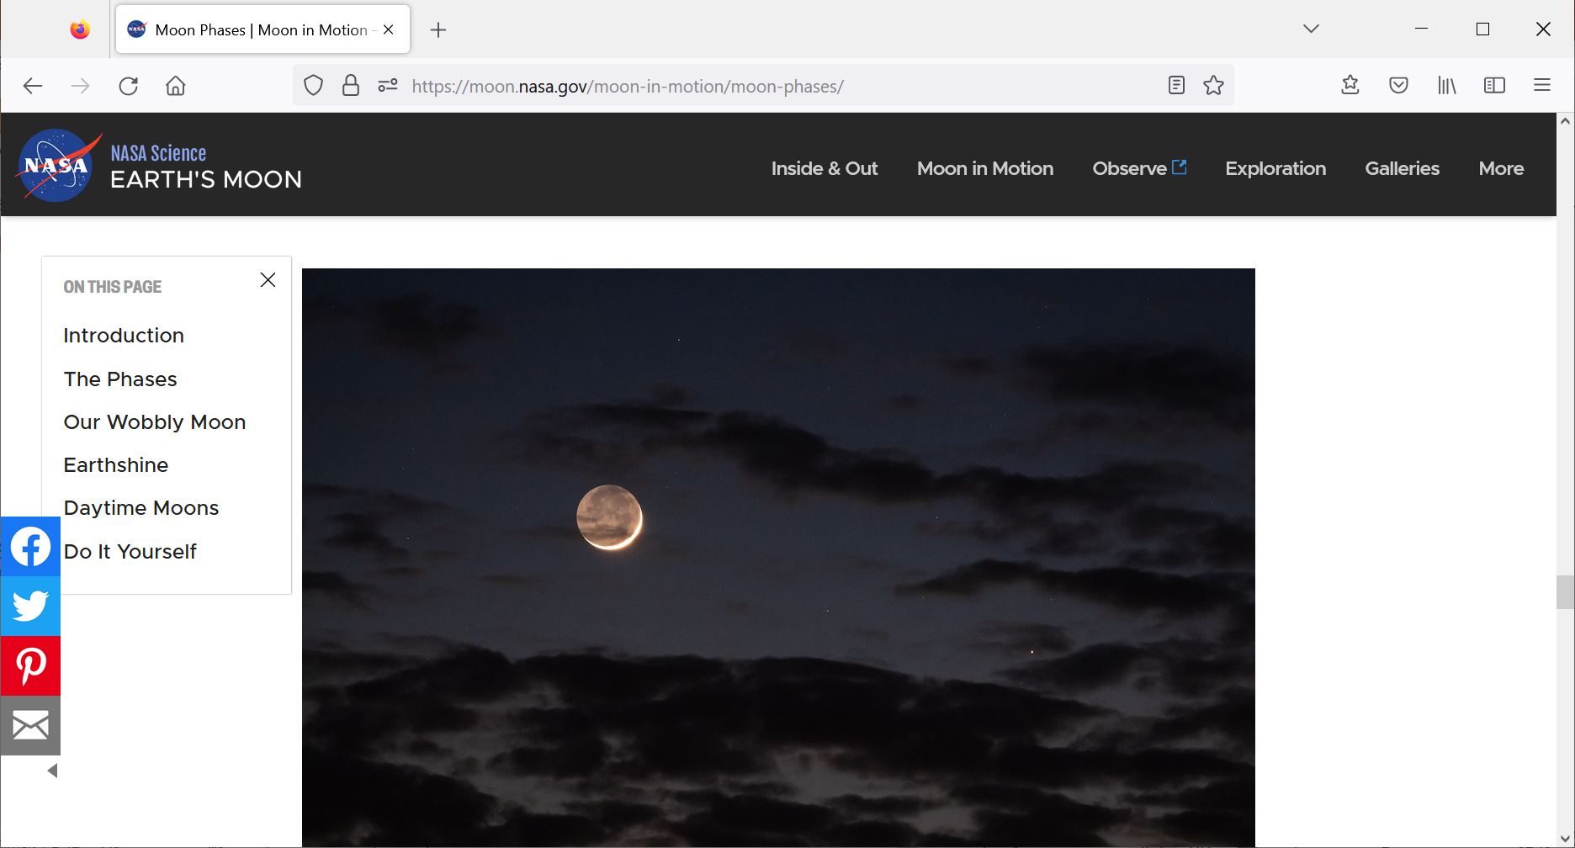
Credit: Zolt Levay

Slide 2

New findings about
the gravity field of the Moon
by means of the gravity aspects
figures mostly by Jan. Kostelecký
Ondřejov Observaroty, December 2022
Jaroslav Klokočník with colleagues
Klokočník, J., Kostelecký, J., Cílek, V., Kletetschka, G., Bezděk, A. (2022).
Gravity aspects from recent gravity field model GRGM1200A of the Moon
and analysis of magnetic data. Icarus 384, 115086.
https://doi.org/10.1016/j.icarus.2022.115086

Slide 3
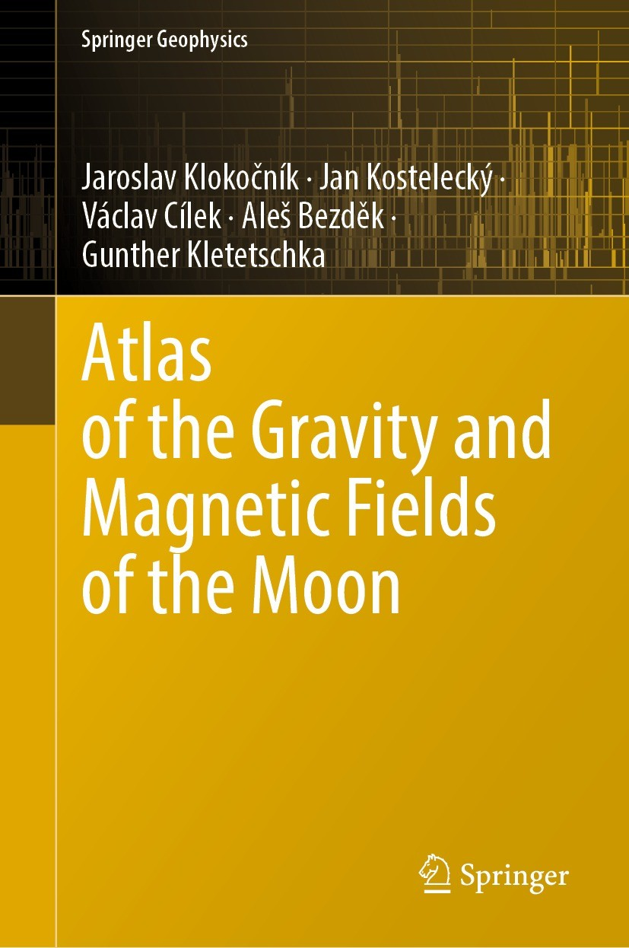

https://doi.org/10.1007/978-3-031-08867-4

Slide 4
Gravitational aspects (descriptors)
Gravity aspect | Explanation
T | Disturbing static gravitational potential
Δg | Gravity anomaly or perturbation (various versions)
Γ | Marussi tensor (just 5 independent second derivatives of T)
T_{zz} | Element of the Marussi tensor (second derivative of T in the radial direction), usually most important
I_{j} | 3 gravity invariants of the Γ (I₀, I₁, I₂); preserved under any coordinate rotation
I | a ratio of I₁, I₂; when I~0, the causative body is ~2D; when I →1, causative body is 3D
θ | Strike angle is the main direction of Γ, under certain conditions
vd | Virtual deformation based on horizontal derivatives of T in latitudinal and longitudinal directions, expressing dilatation and pure sheer (compression)

Slide 5
The gravity disturbances (anomalies) are in milligals [mGal], the second order derivatives in Eötvös [E]. Negative values are in blue colour, positive in red. Recall that 1mGal = 10⁻⁵ ms⁻², 1E ≡ 1 Eötvös = 10⁻⁹ s⁻² and that the invariants have units I₁ [s⁻⁴] and I₂ [s⁻⁶]. The strike angles are in degrees and vd are dimensionless.
We count azimuths from North to East (=90 deg E), South, West, and back to North (=360 deg E). We count longitudes from the main meridian (defined by astronomers) to East from 0 to 360 degrees (this differs from astronomers).
The strike angle θ [deg, ⁰] is expressed with respect to the local meridian; its red colour means its direction to the north and blue to the south of the east.
The strike angles are angles, not vectors. We plot them as short abscissae of the same length everywhere, in a regular network (5x5 arcmin). It does not mean that in the real world something like a regular net of tensions exist: geological and geophysical lineaments are never of a constant or identical length, and neither are they separated by uniform distances.

Slide 6
Ground Resolution
A usual simple estimate of the smallest representable feature of the gravity field or the shortest half-wavelength L_{half} (as a distance on a sphere) that can be resolved with all C_{lm}, S_{lm} to L_{max}, is
L_{half} = π R/ L_{max}
or equivalently, taking the circumference 2πR = 40 050 km for the Earth:
L_{half} = 2 π R/ (2 L_{max}) = 40 050/ (2 L_{max}).
This L_{half} is what we call the “ground resolution”. For L_{max}= 300 and 2190, we have L_{half} = 67 and 9 km, respectively. The former limit roughly corresponds to the resolution of the GOCE data alone, and the latter belongs to the combined models, EGM 2008, EIGEN 6C4 or SatGavRET2014 (in the case of the Earth).
Body R [km] max d/o of resolution [km]
rounded model used
-----------------------------------------------------------------
Earth 6380 2190 9
Moon 1740 600 9
Mars 3400 80-120 130-90
Venus 6050 120 160

Slide 7
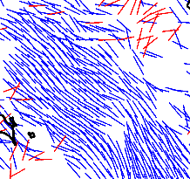
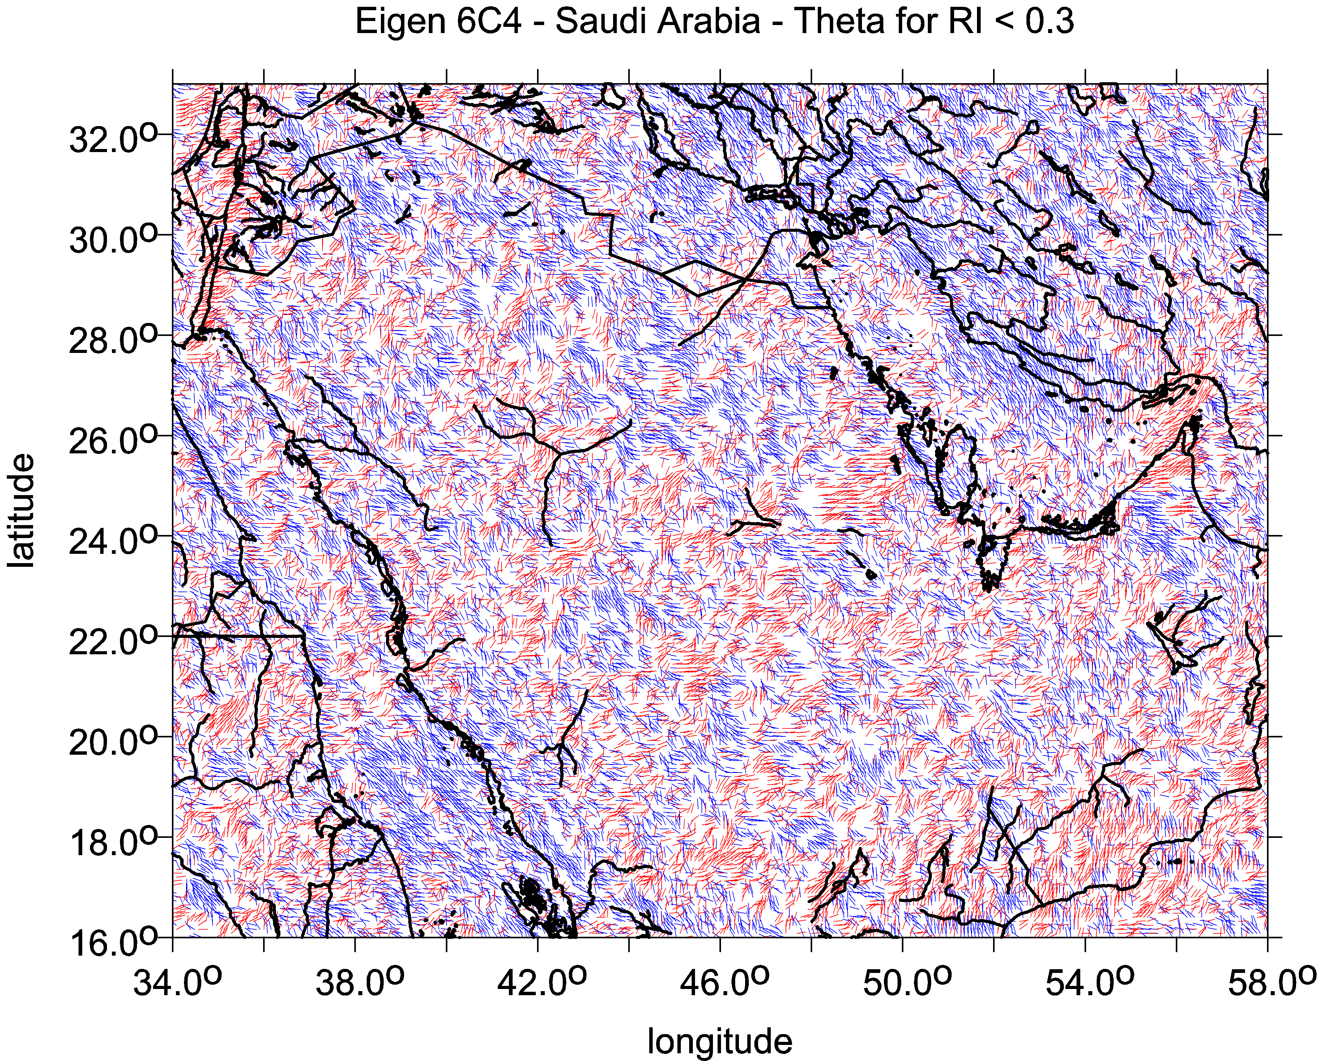
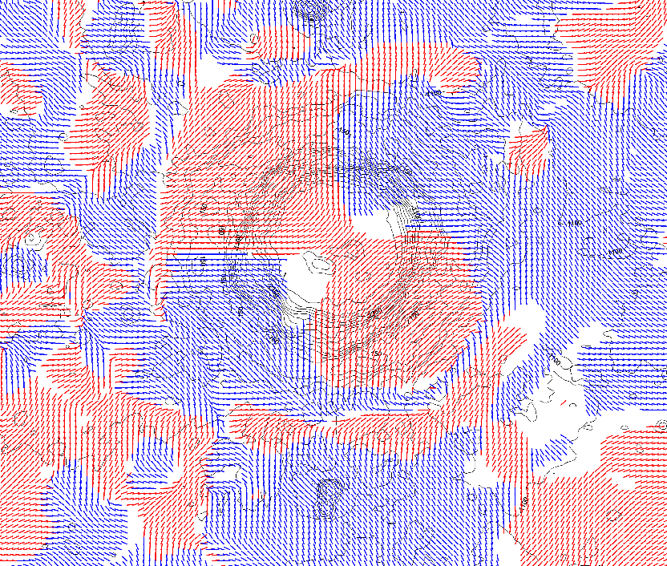
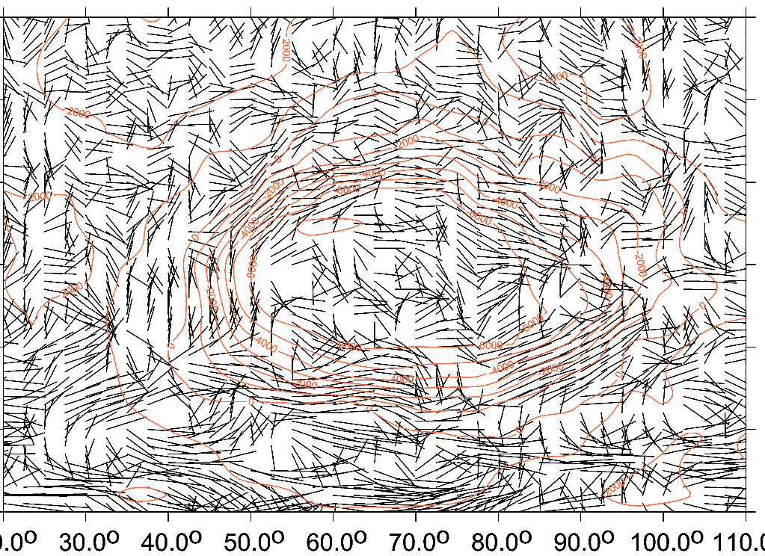
Comments:
Left
highly combed,
linearly
Right
dishevelled
Left
combed,
creating a halo
around the crater
segments
in color
Right
halo
in black&white
the Moon/Copernicus Hellas basin on Mars

Slide 8
impact crater
Vredefort, South Africa
The strike angles follow rings of the impact structure Vredefort, South Africa. In the central part of the crater they are combed not around the crater but in one prevailing direction.
To draw this, Beiki and Pedersen (2010) used the detailed local airborne gradiometry data, which we have not available and the resolution of our data source (EIGEN 6C4) is not sufficient for this purpose.

Slide 9
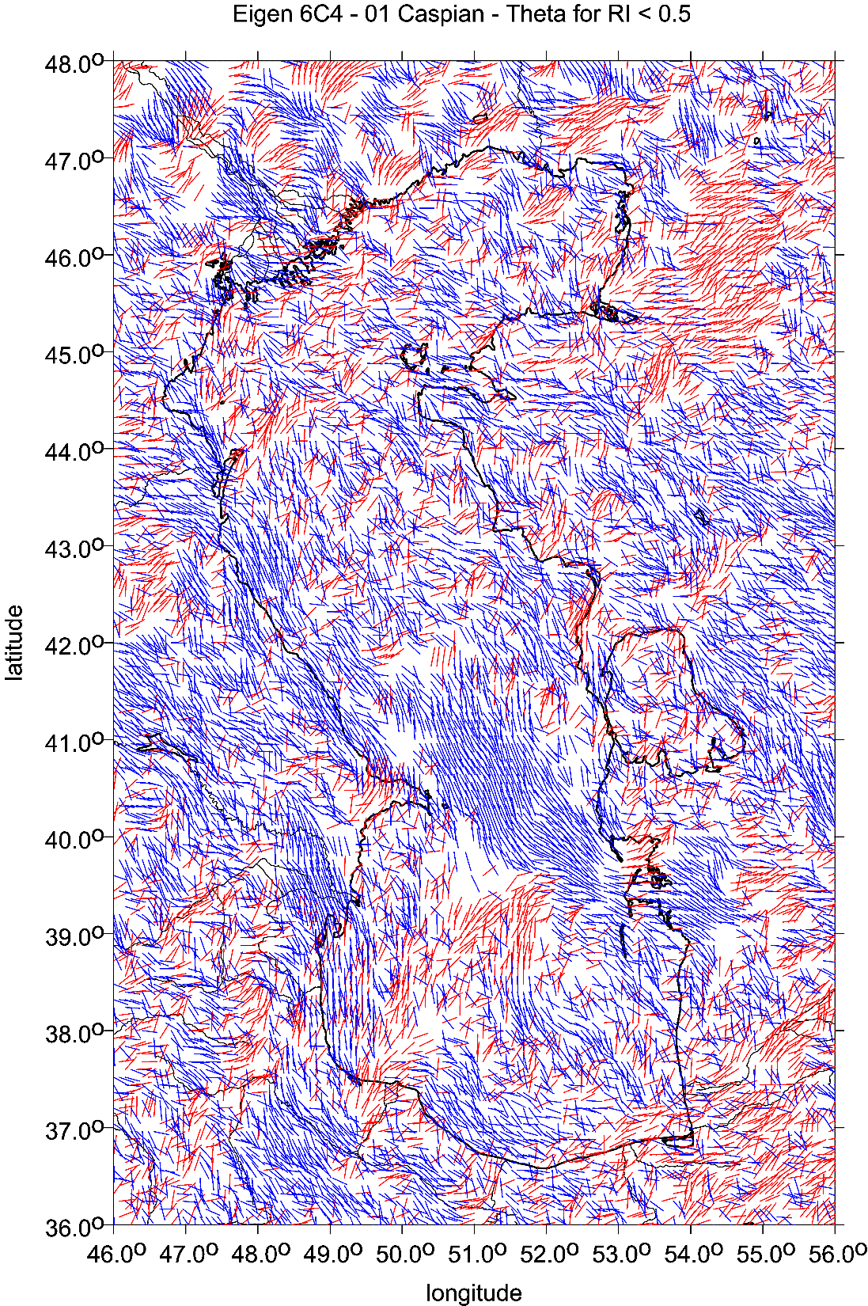
Reasons for the strike angles
to be aligned:
higher porosity, lower density
of the causative body,
in particular:
water, river valley, trench,
ground water,
paleolakes,
permafrost, regolith,
subglacial lakes and rivers,
oil&gas deposits,
coal,
hydrocarbons occurences
sufficiently large to be well above
the ground resolution
of the gravity field model in use
for the celestial body in question

Slide 10
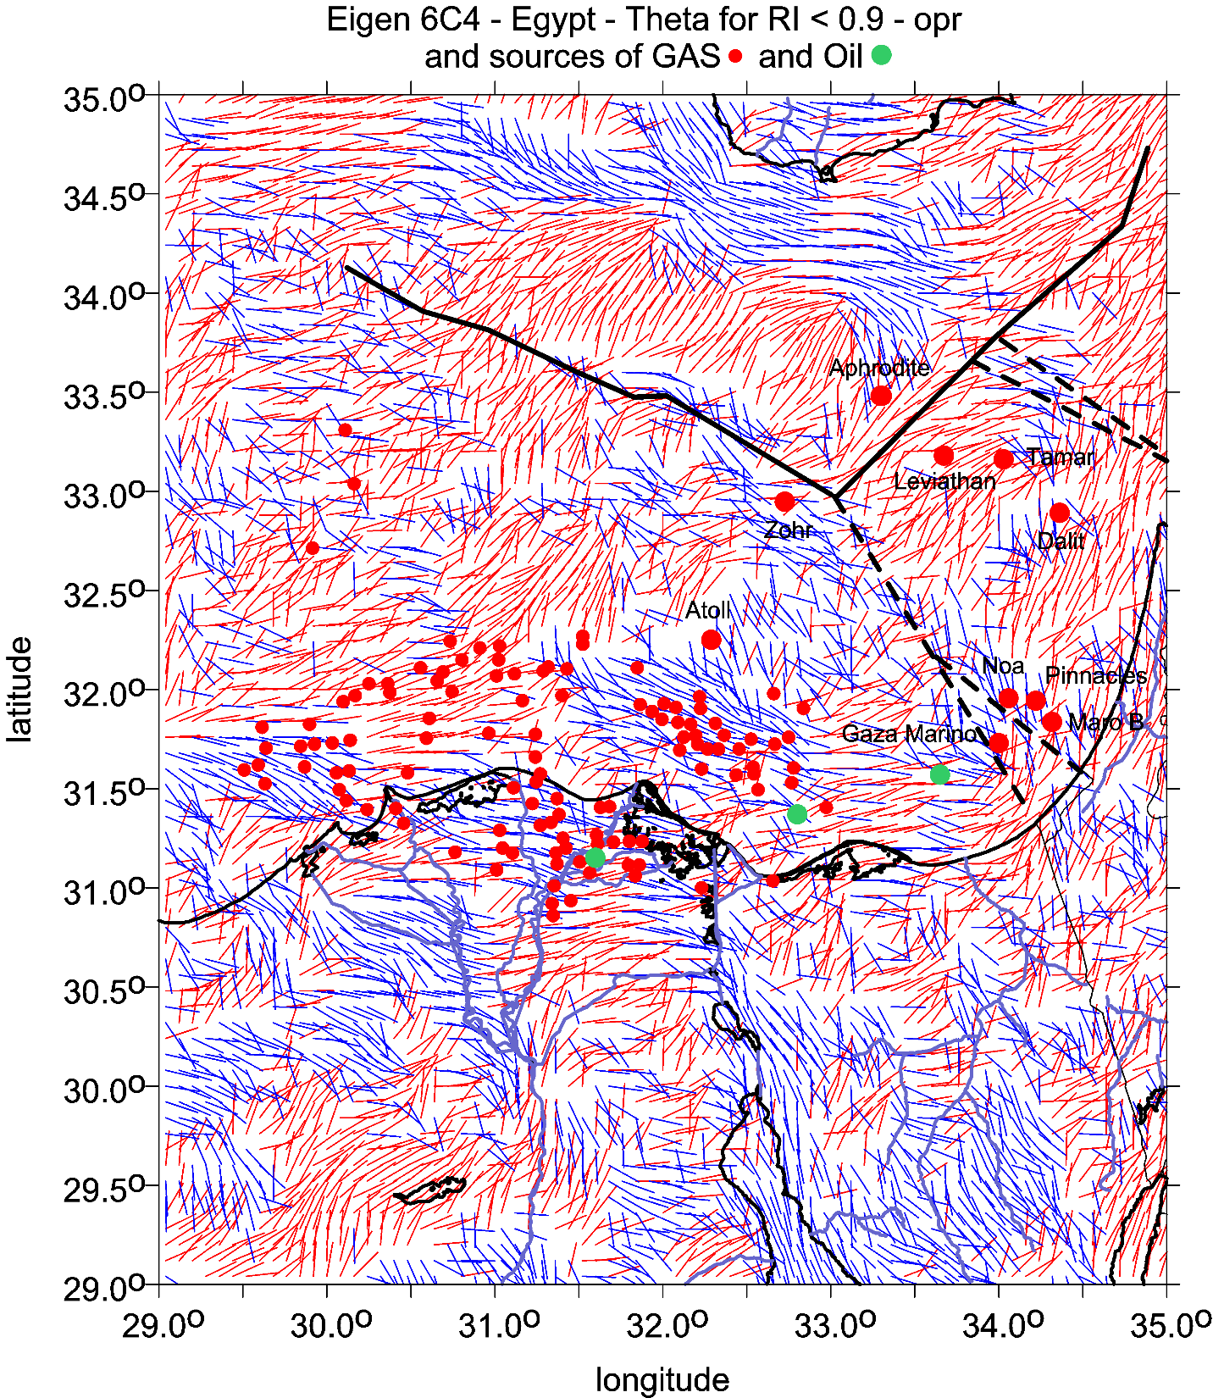

Slide 11
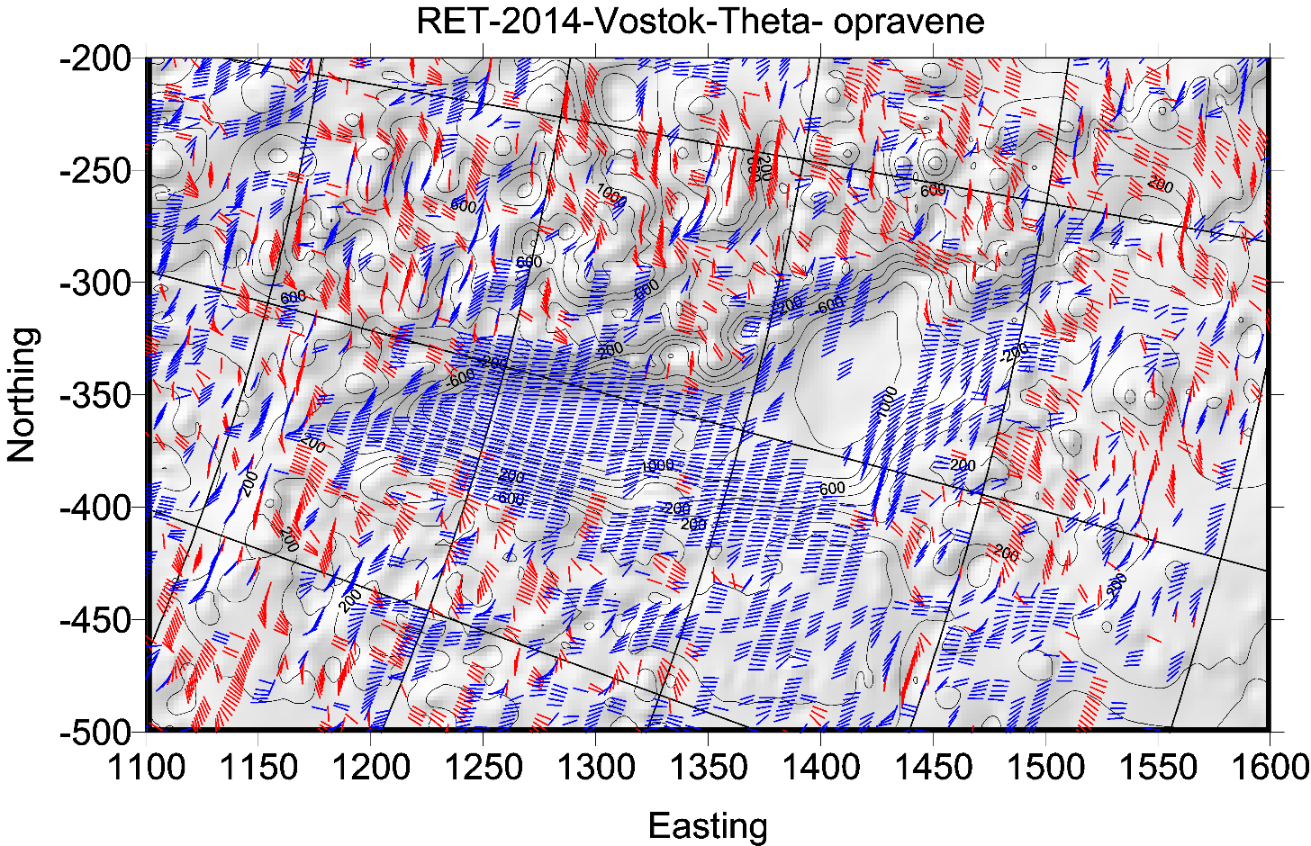
sever vpravo

Slide 12
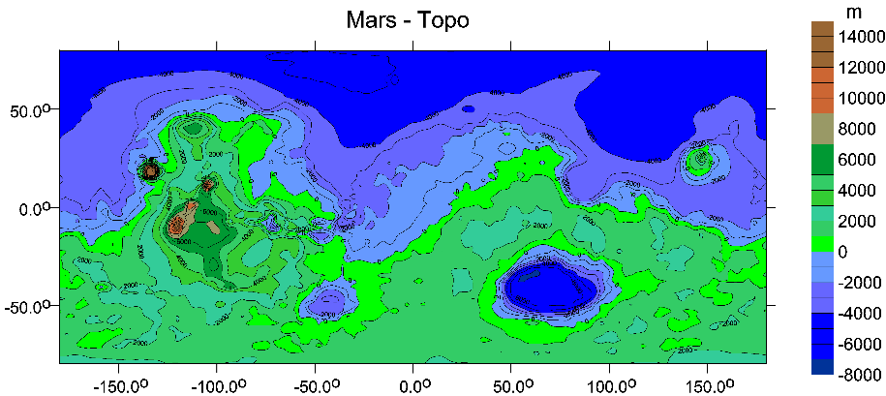
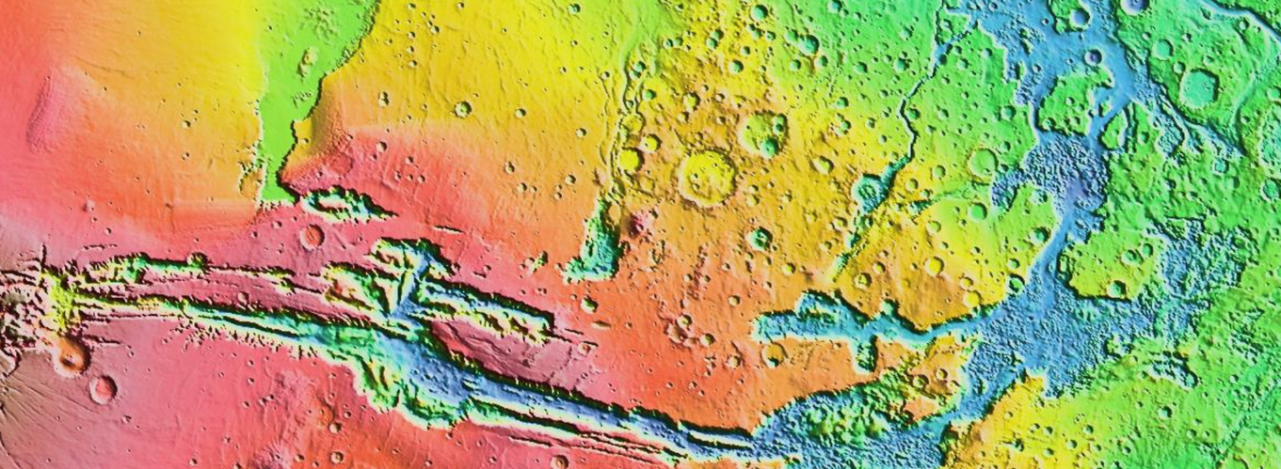
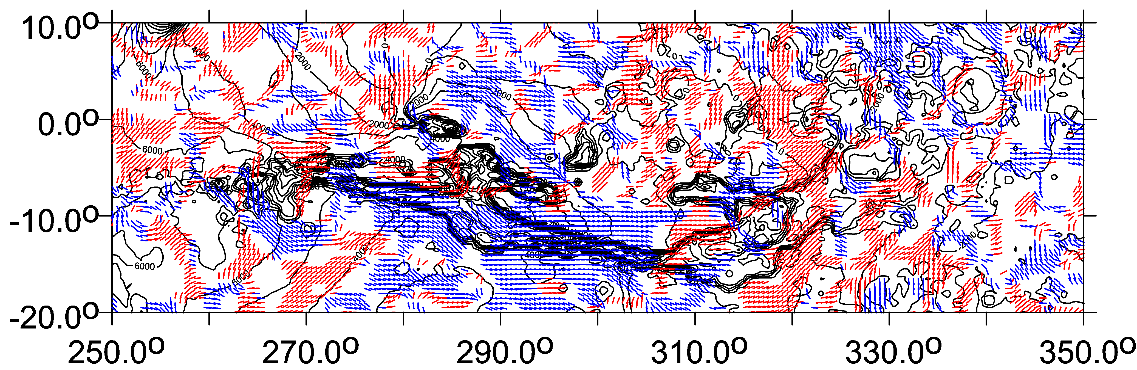
Mars, Valles Marineris

Slide 13
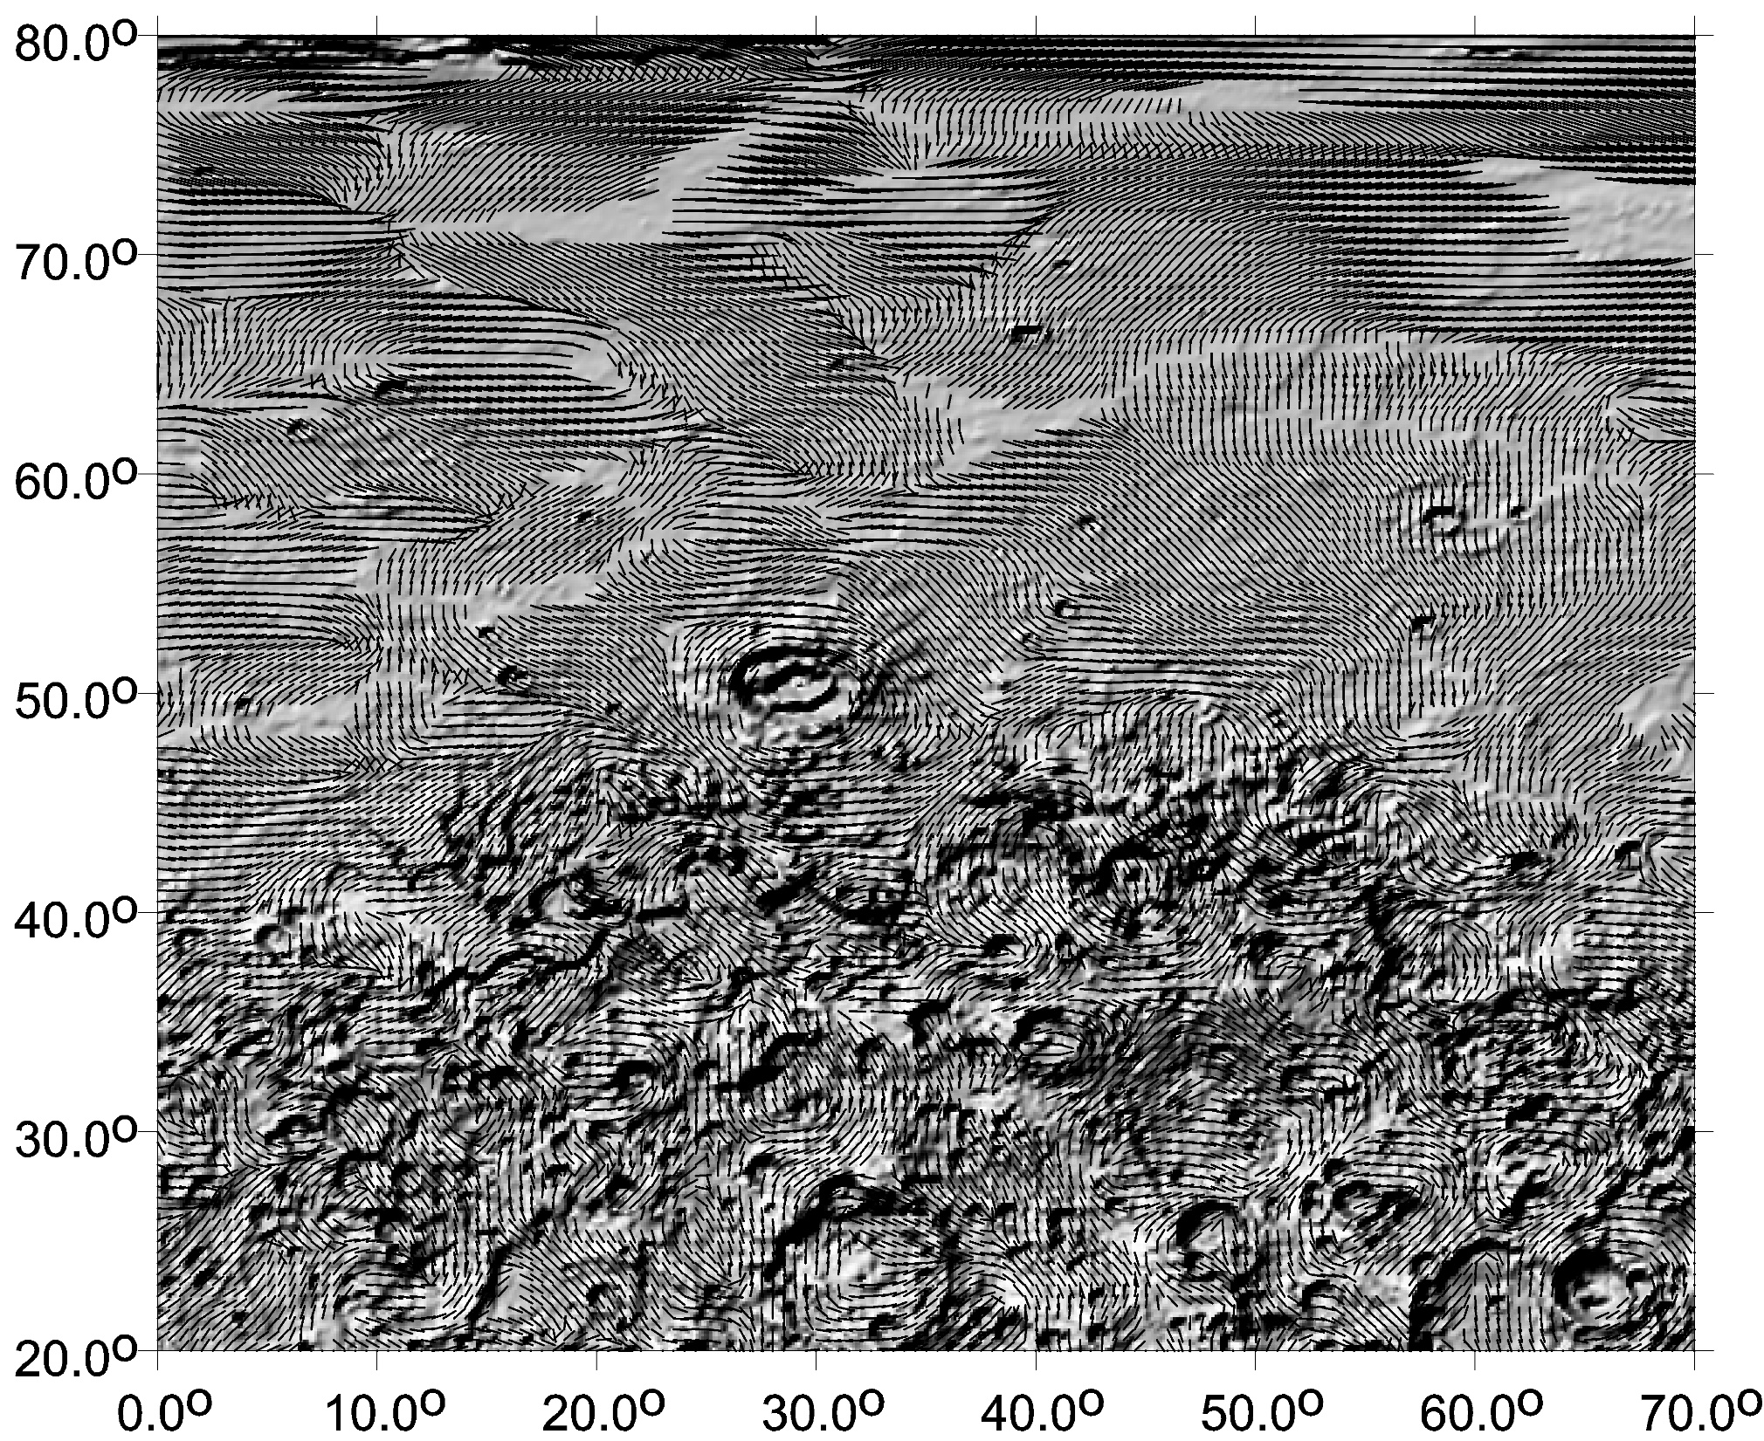

Slide 14
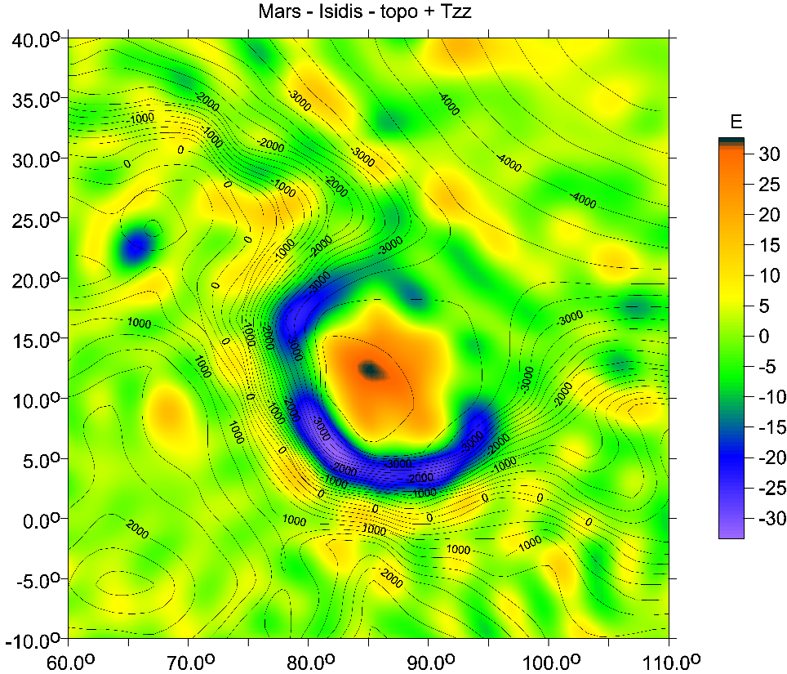
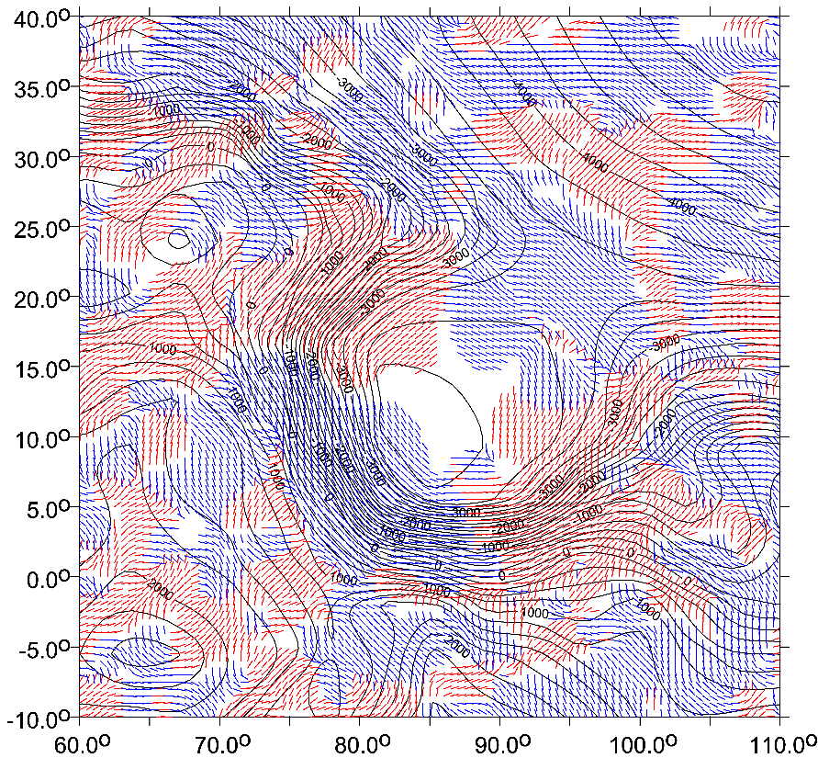
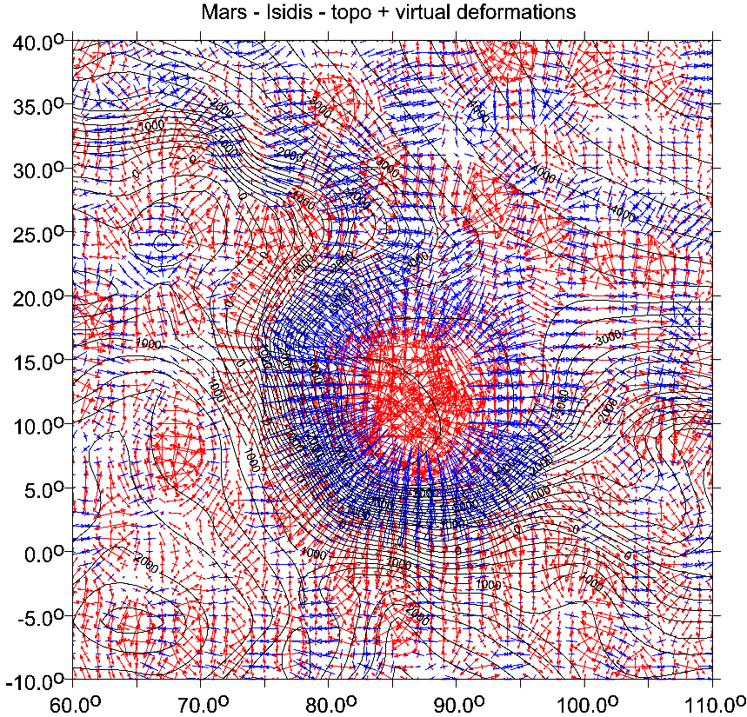
ISIDIS = volcano, nothing else

Slide 15
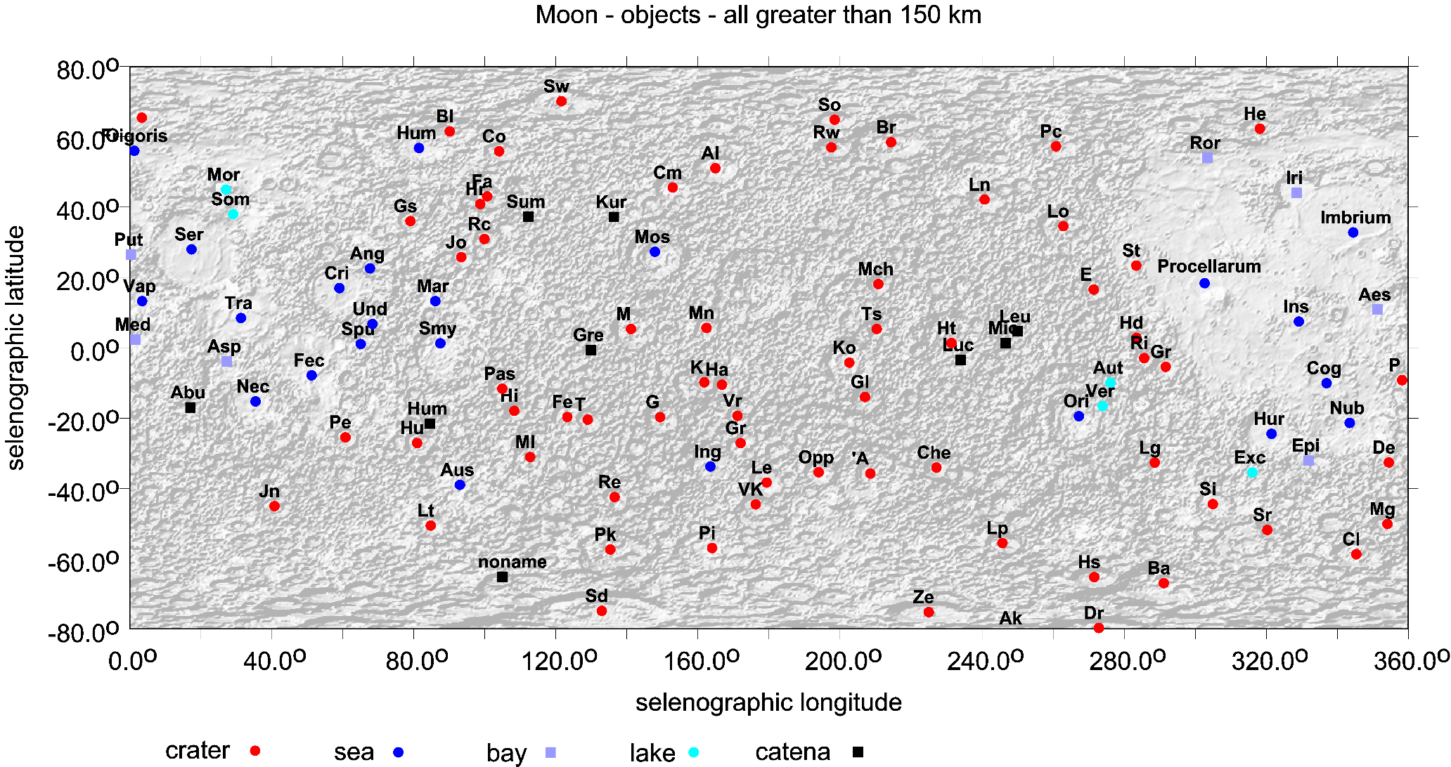
Fig. Supp. 1: surface topography for the Moon from LOLA [m],
the features with diameter or length greater/longer than 150 km.
North up

Slide 16
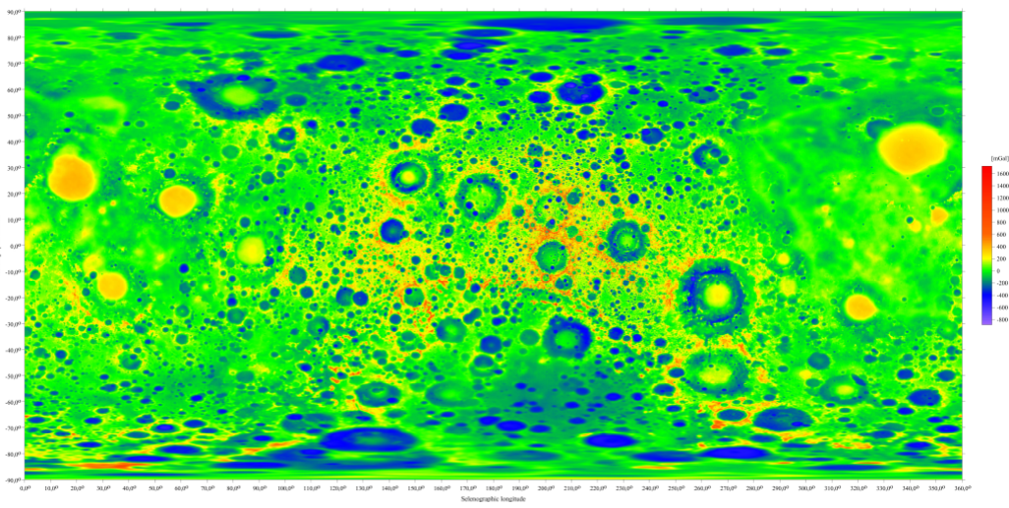
mGal
Fig. Supp. 2: the gravity anomalies Δg [mGal] for the Moon
with GSFC NASA gravity model GRGM1200A (Lemoine et al 2014), cut at maximum d/o= 600.

Slide 17
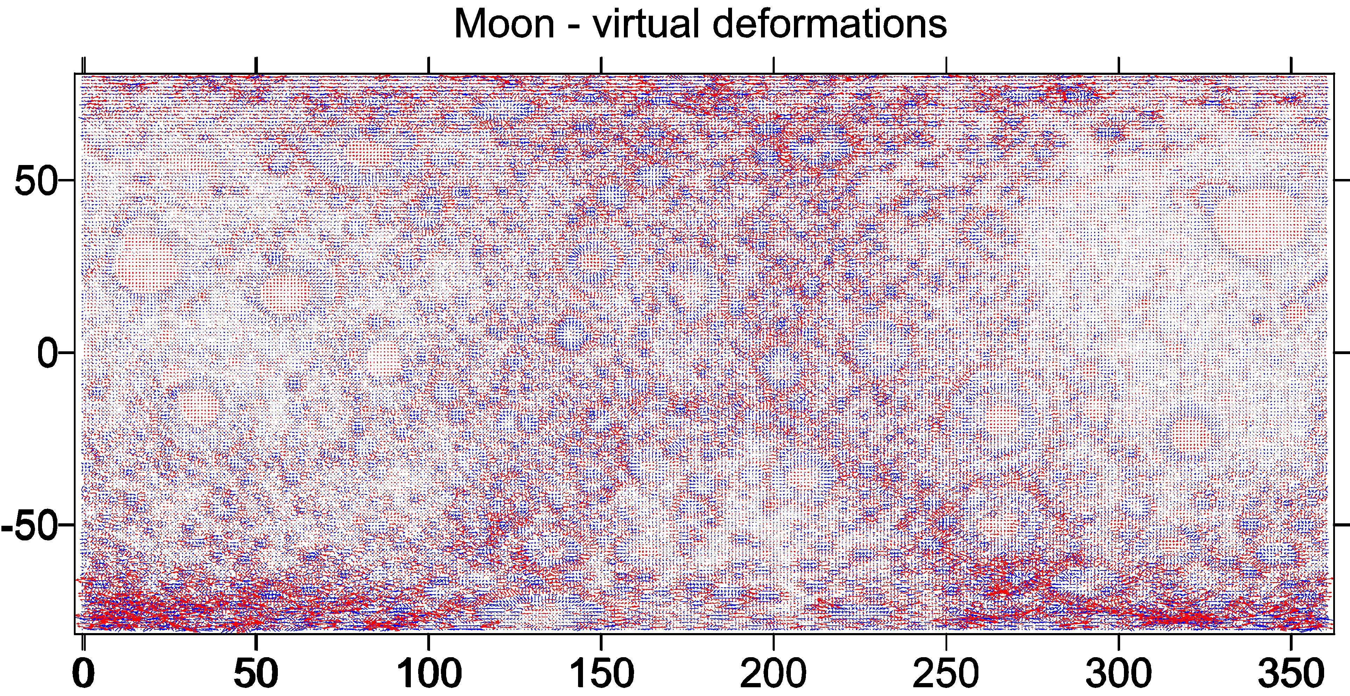
vd [-]
Fig. Supp. 3: the virtual deformations for the Moon
with GSFC NASA gravity model GRGM1200A (Lemoine et al 2014), cut at maximum d/o= 600.

Slide 18
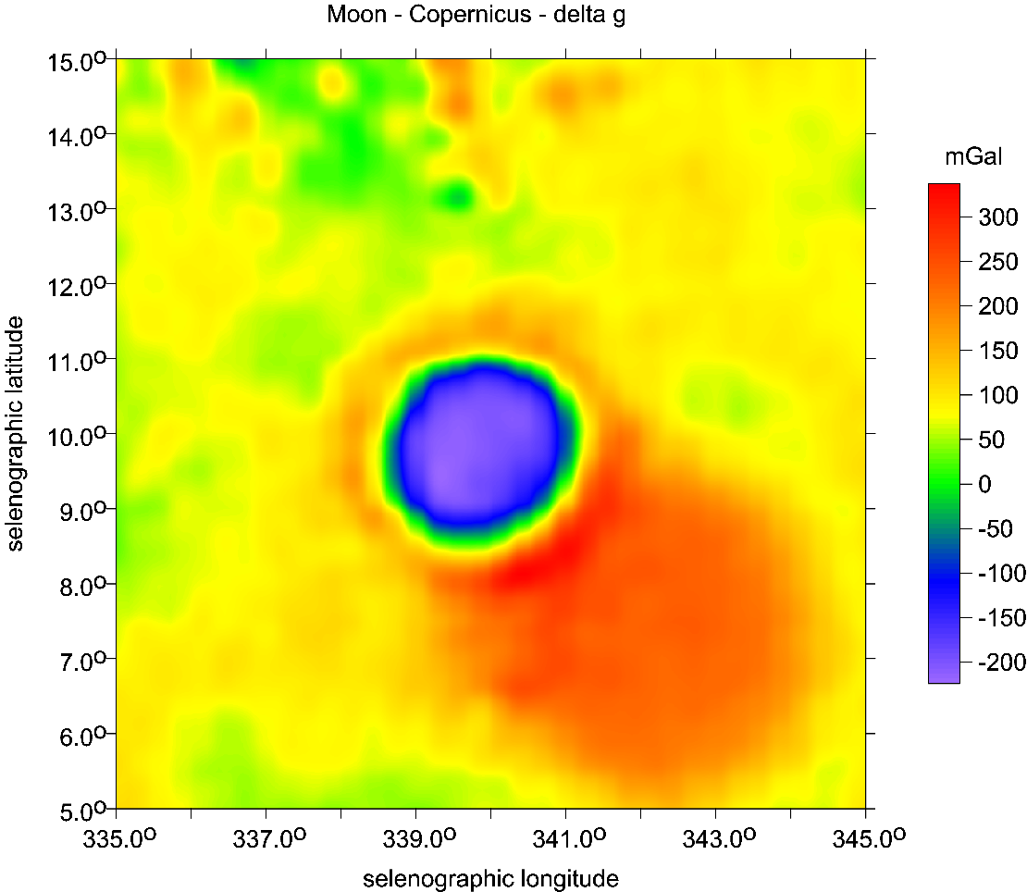
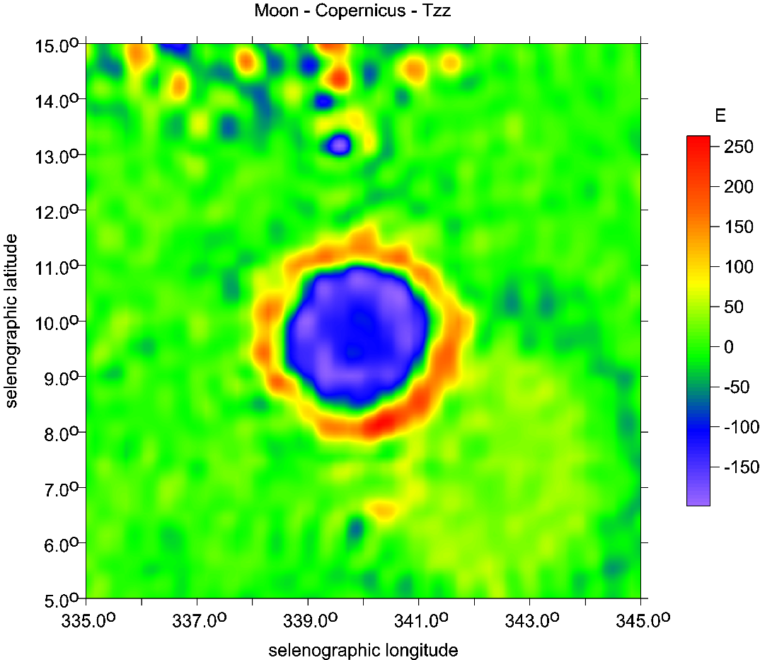
Copernicus
main crater
and Copernicus H
older, bigger feature
in SE direction
∆g [mGal]
Tzz [E]
mass concentration (or mascon) is a region of a planet's or Moon's crust that contains a large positive gravity anomaly. In general, the word "mascon" refers to an excess distribution of mass on or beneath the surface; this term is most often used to describe a geologic structure that has a positive gravitational anomaly associated with a feature (e.g. depressed basin) that might otherwise have been expected to have a negative anomaly, such as the "mascon basins" on the Moon.

Slide 19
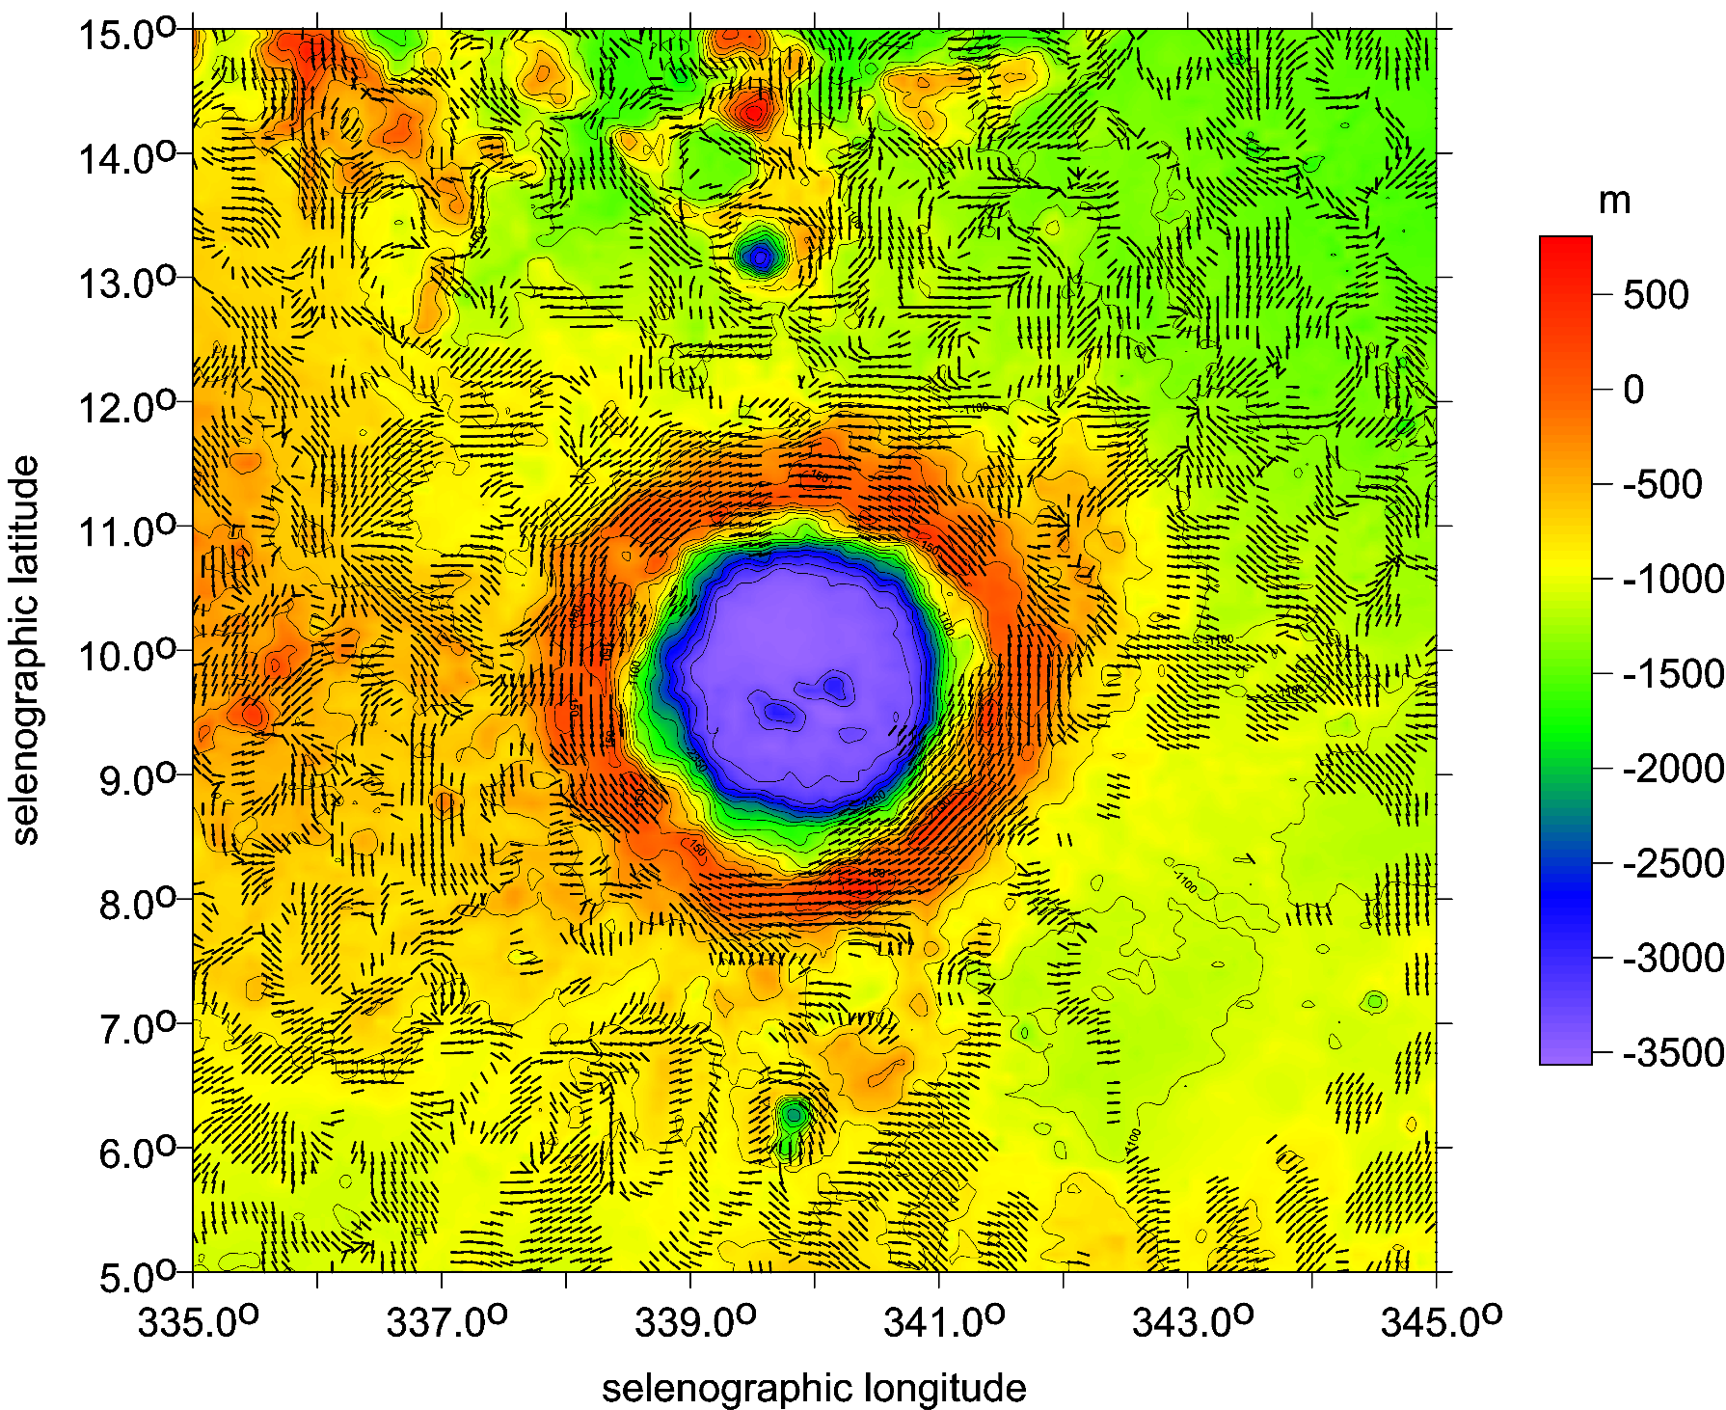
Copernicus
strike angles
θ [deg]
and topography

Slide 20
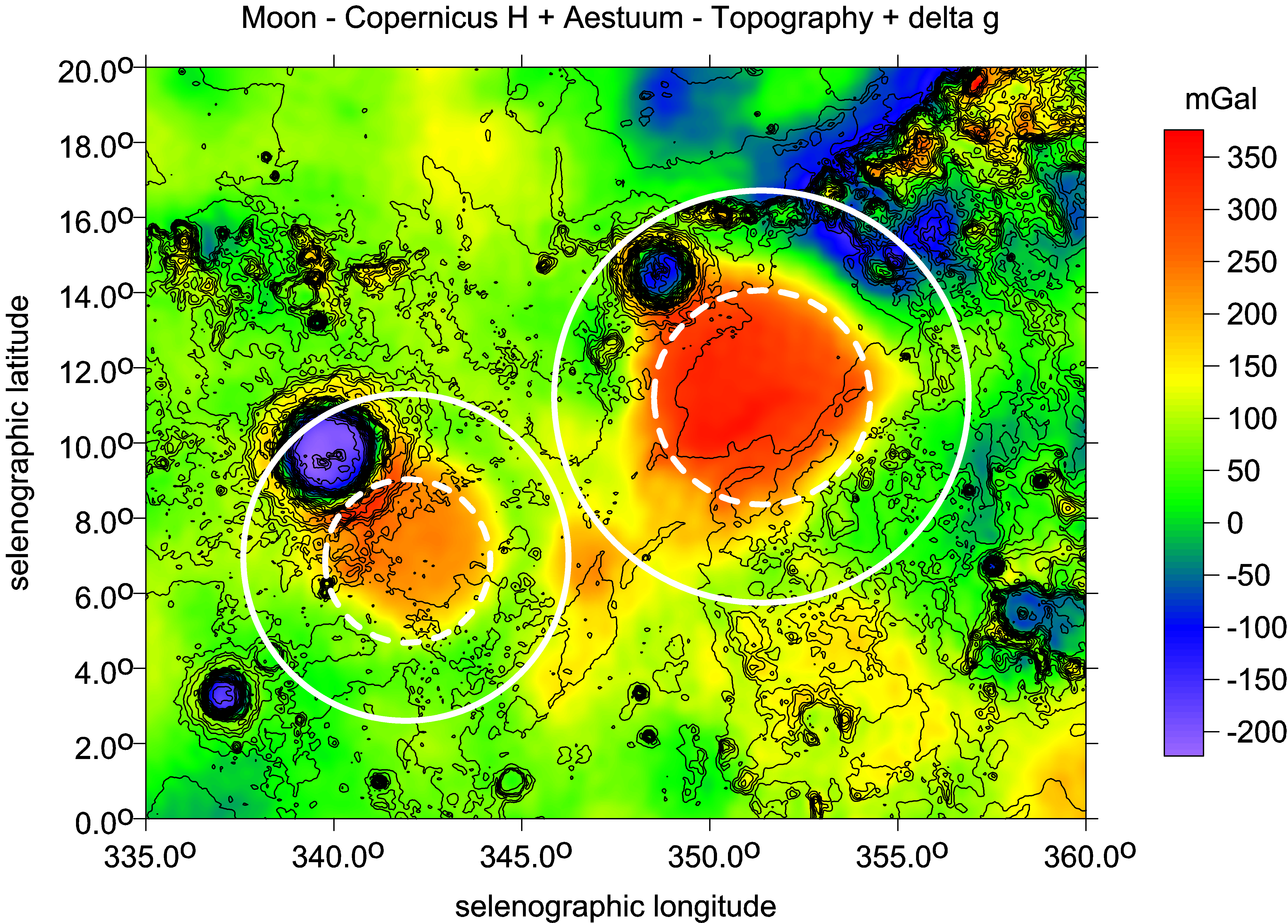

Slide 21
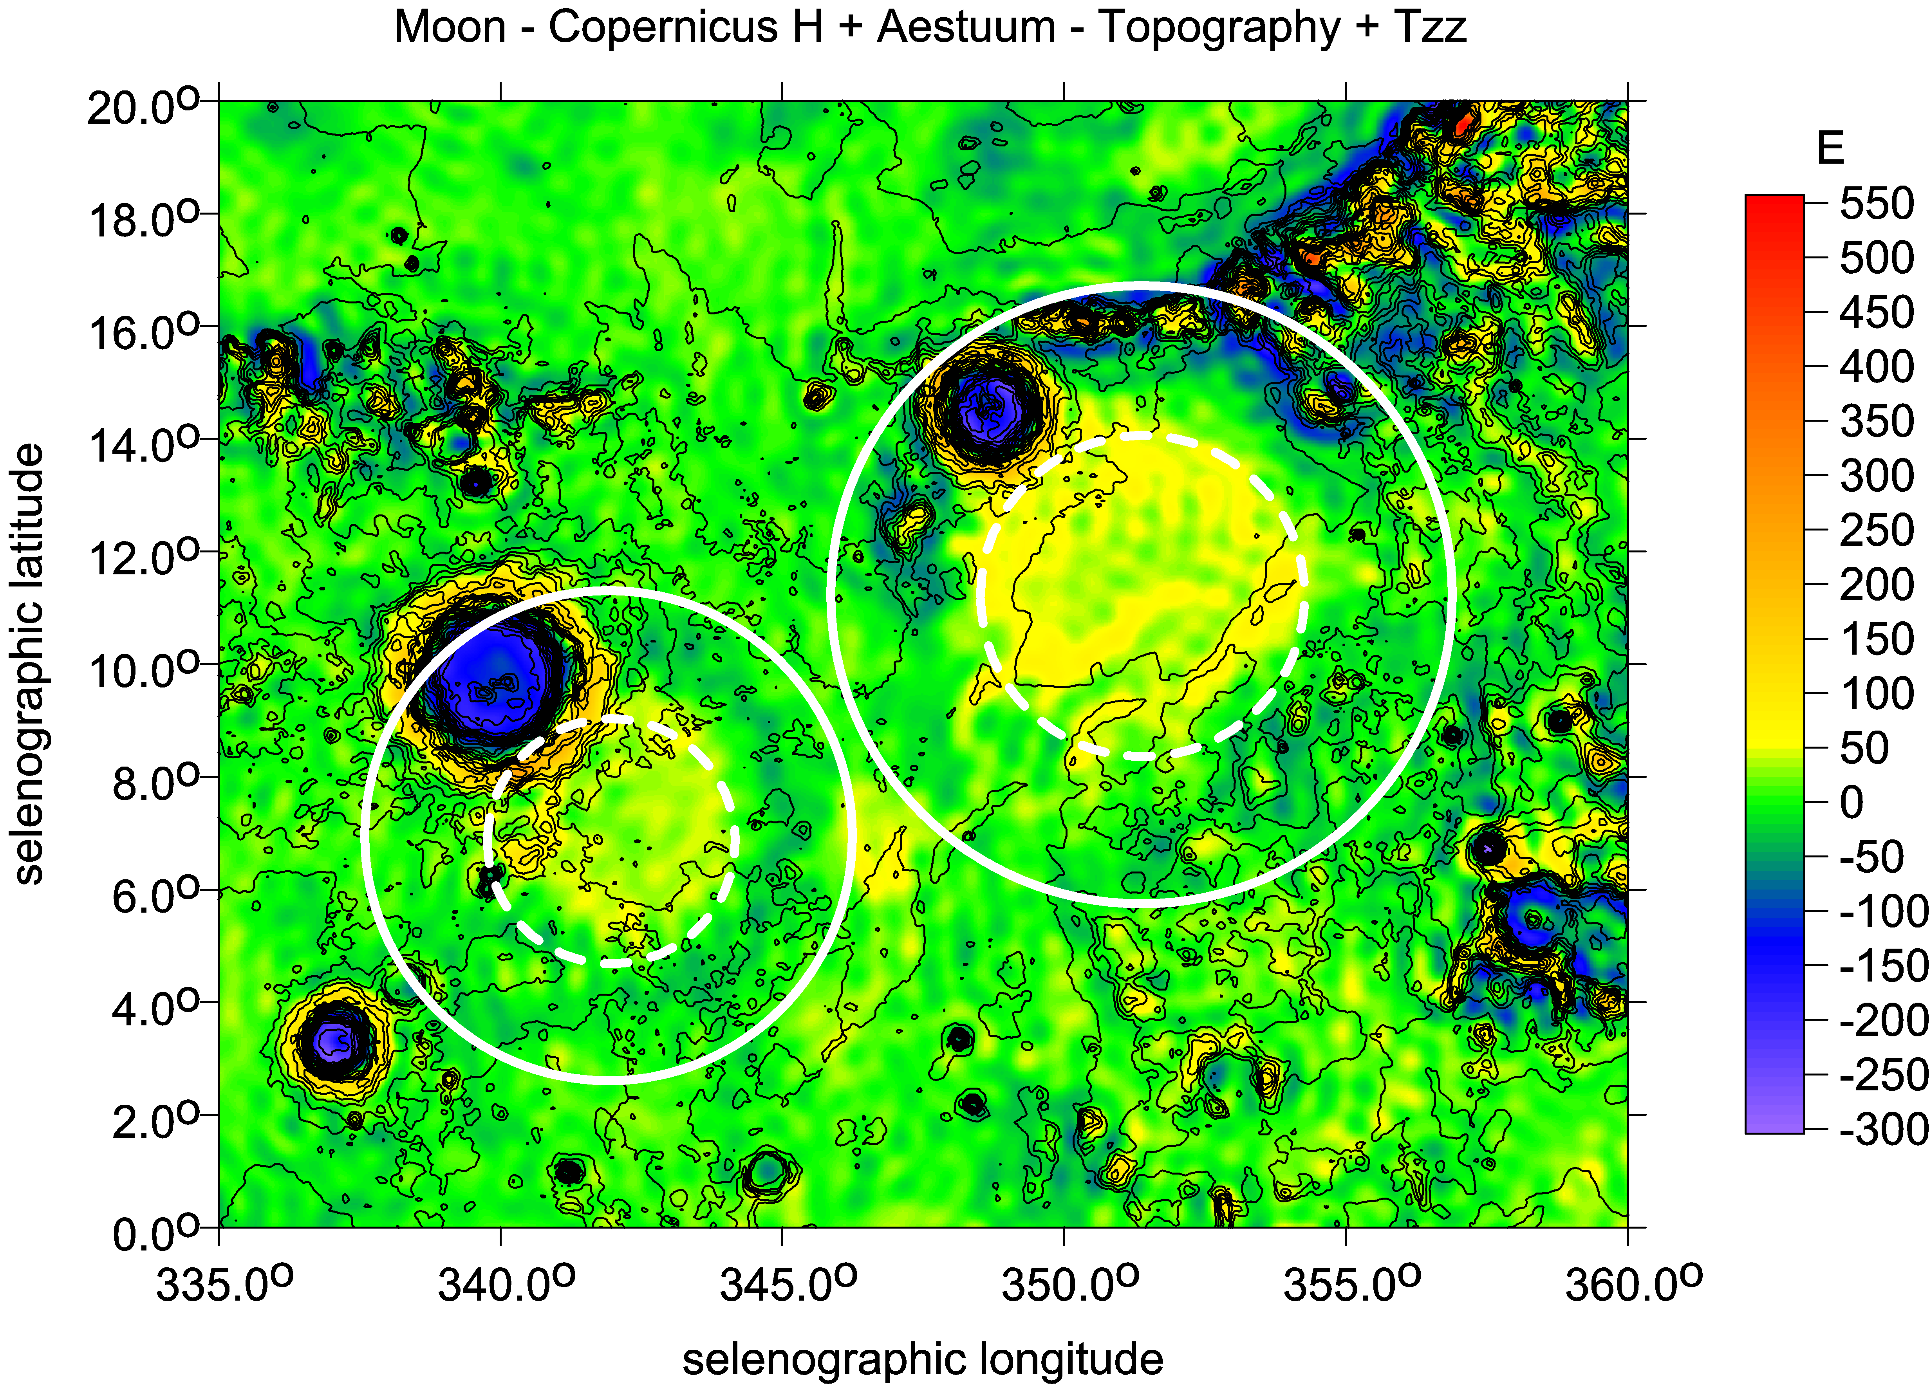

Slide 22
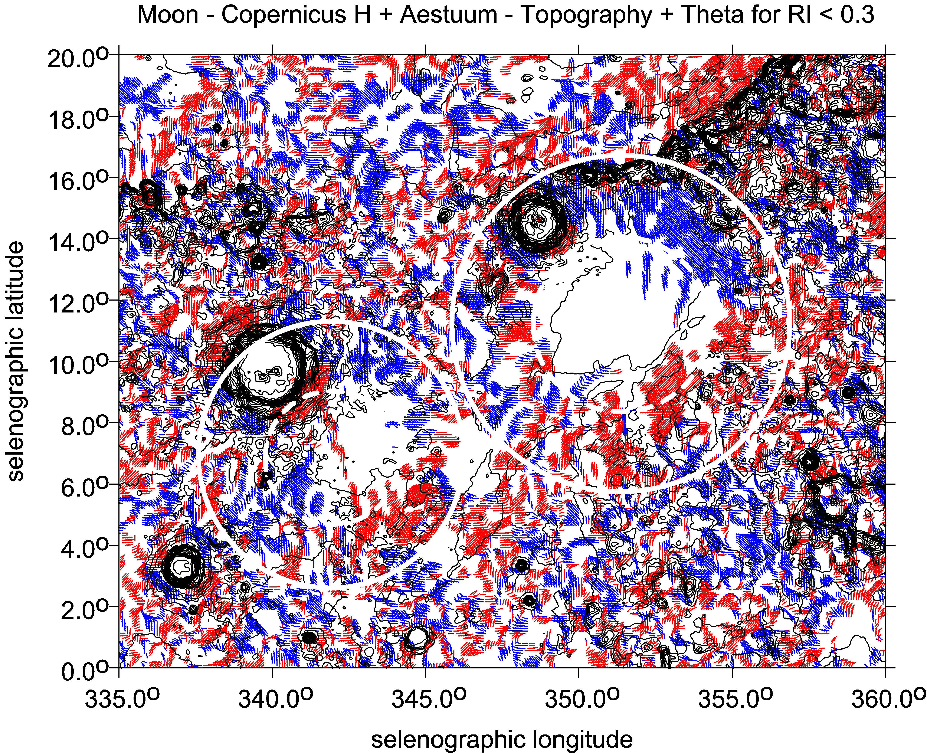

Slide 23
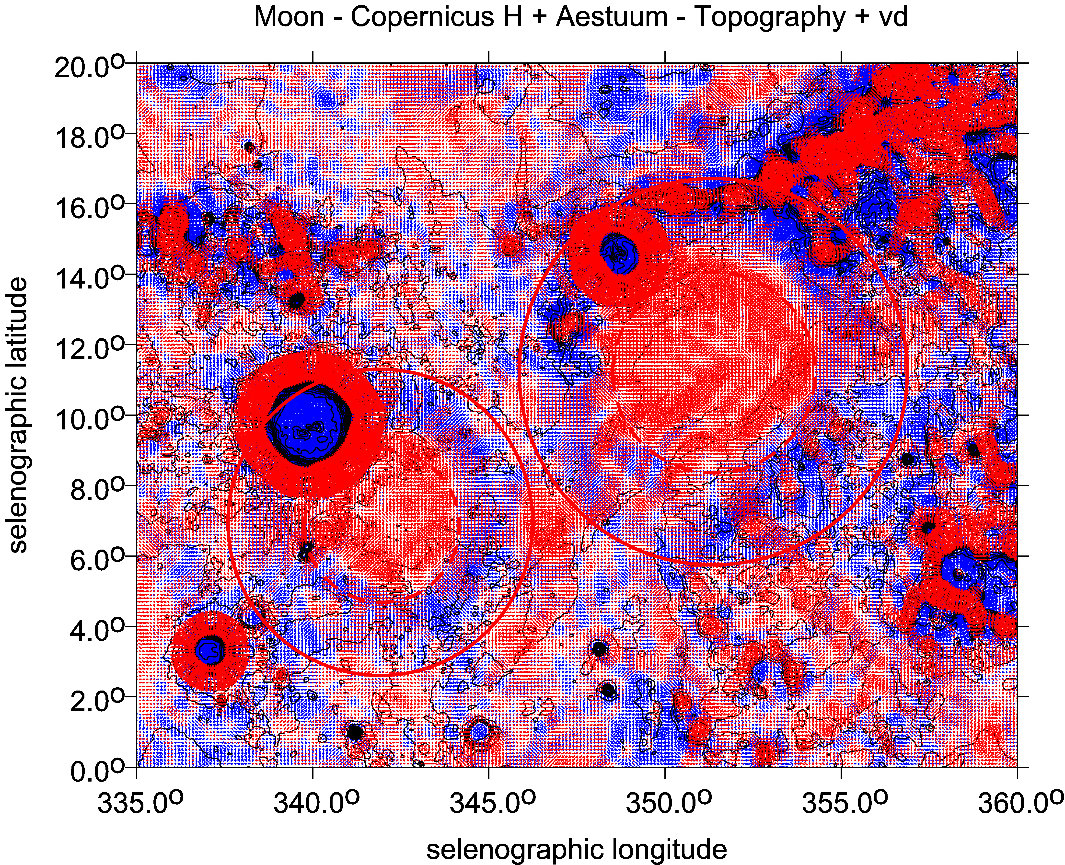

Slide 24
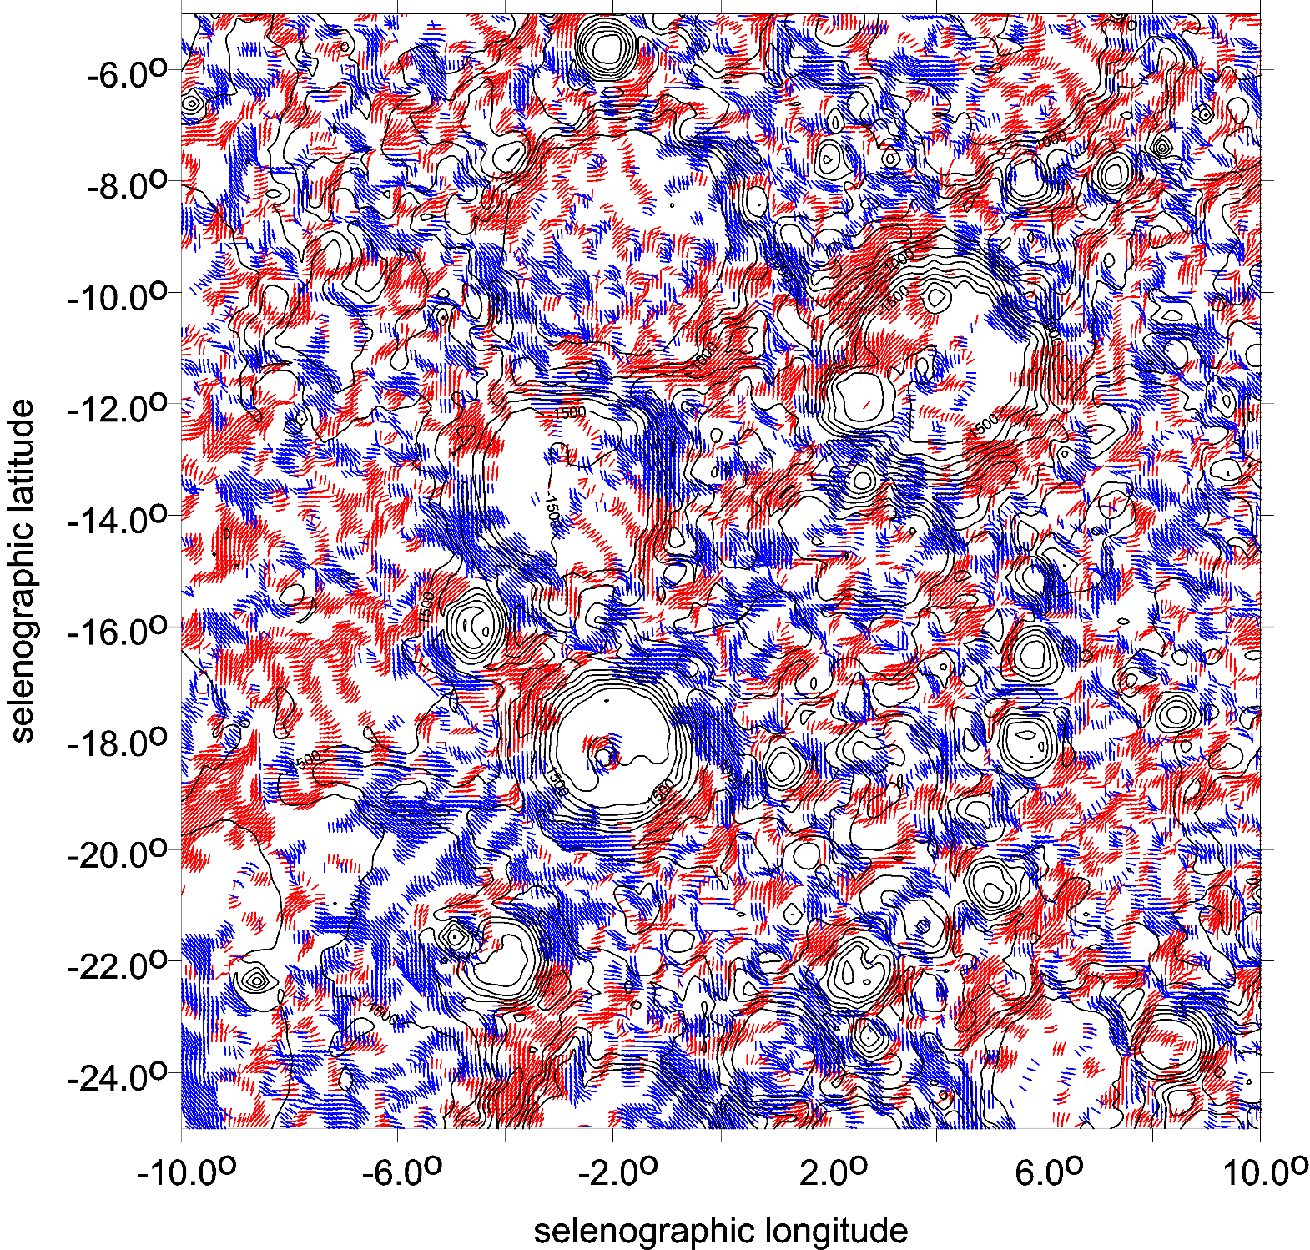
Ptolemaios
θ [deg]

Slide 25
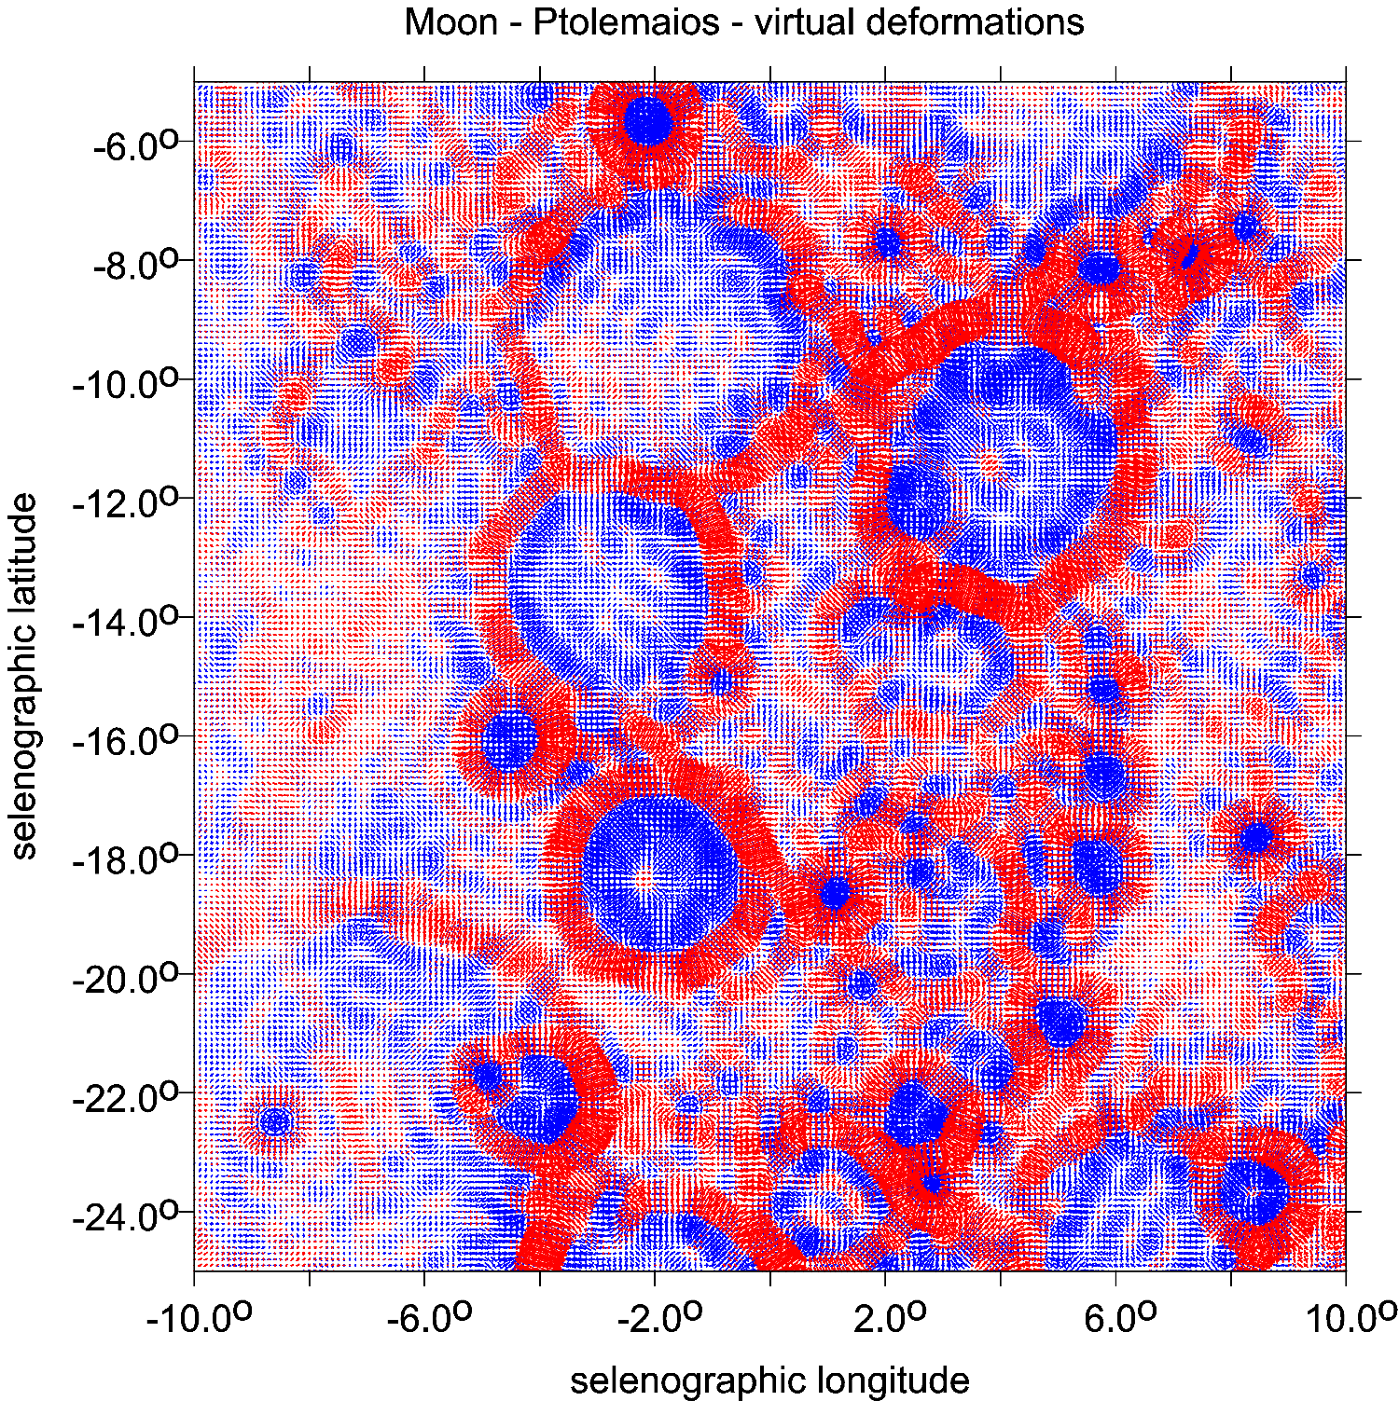
Ptolemaios
vd [-]

Slide 26
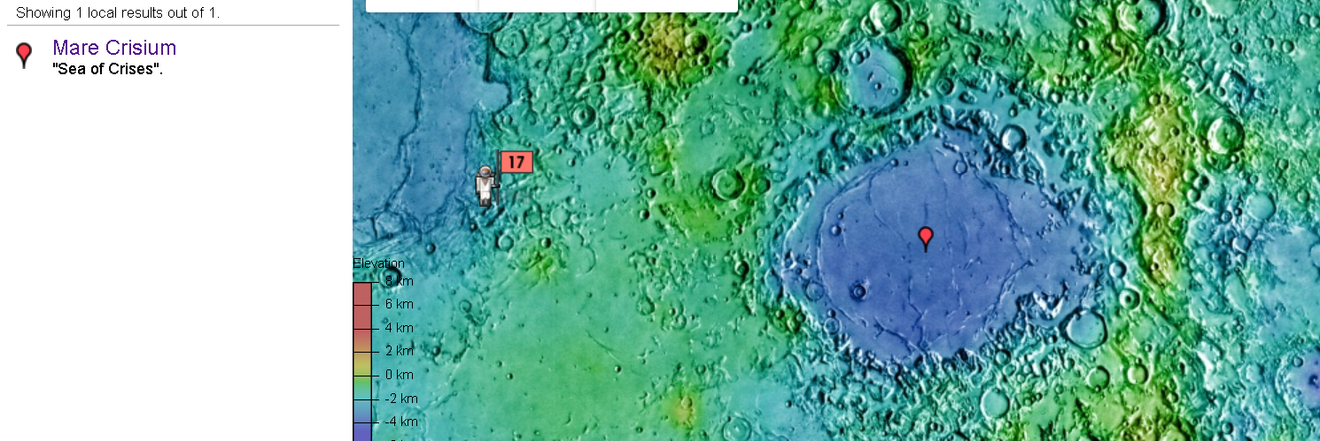
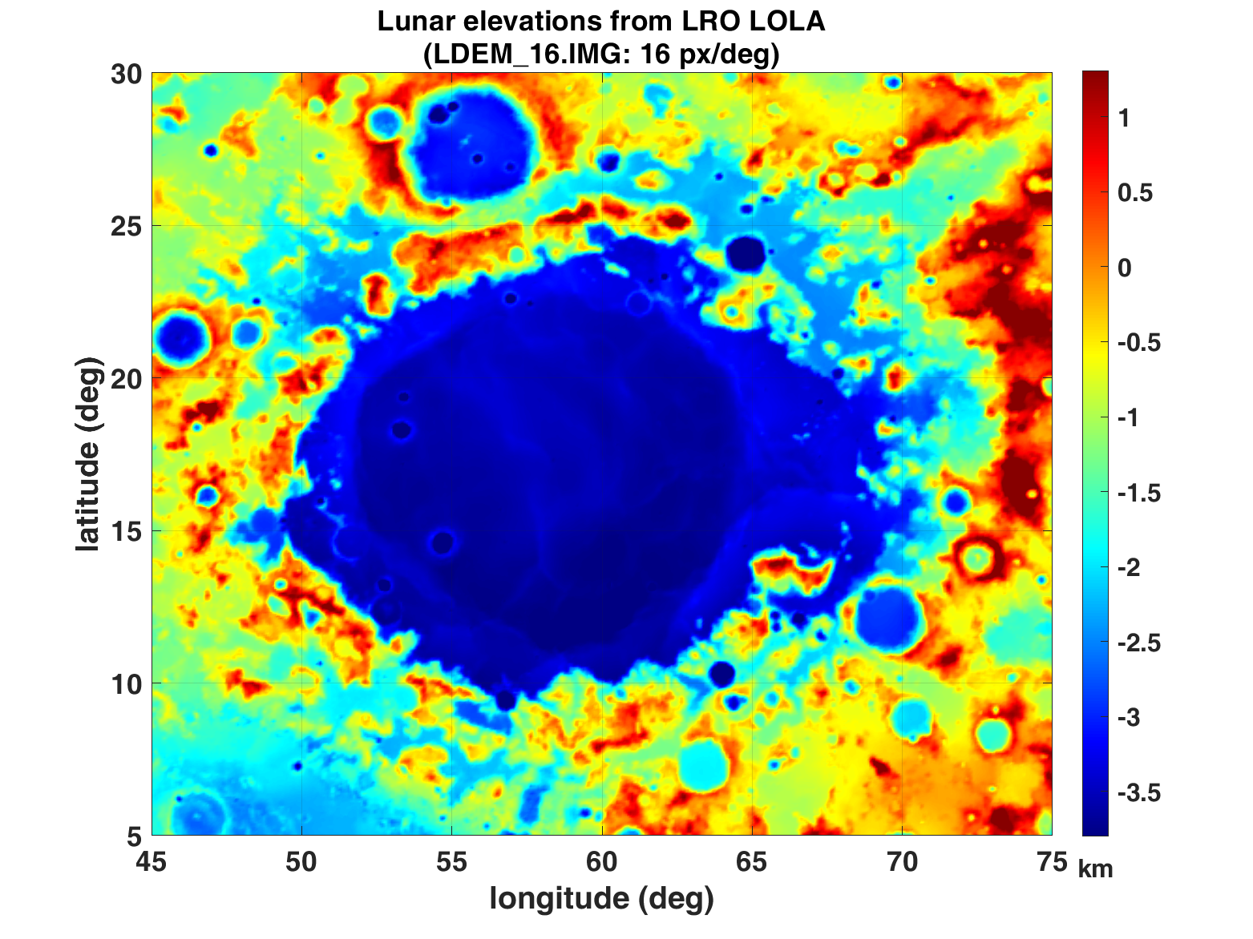
Mare Crisium
topography
Figs. Supp. 44-49
series for Mare Crisium

Slide 27
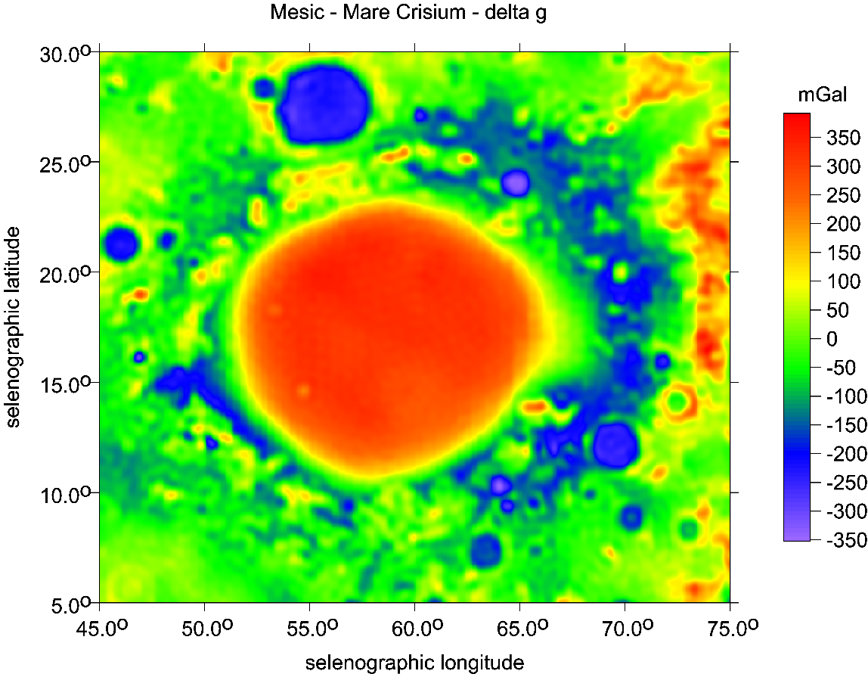
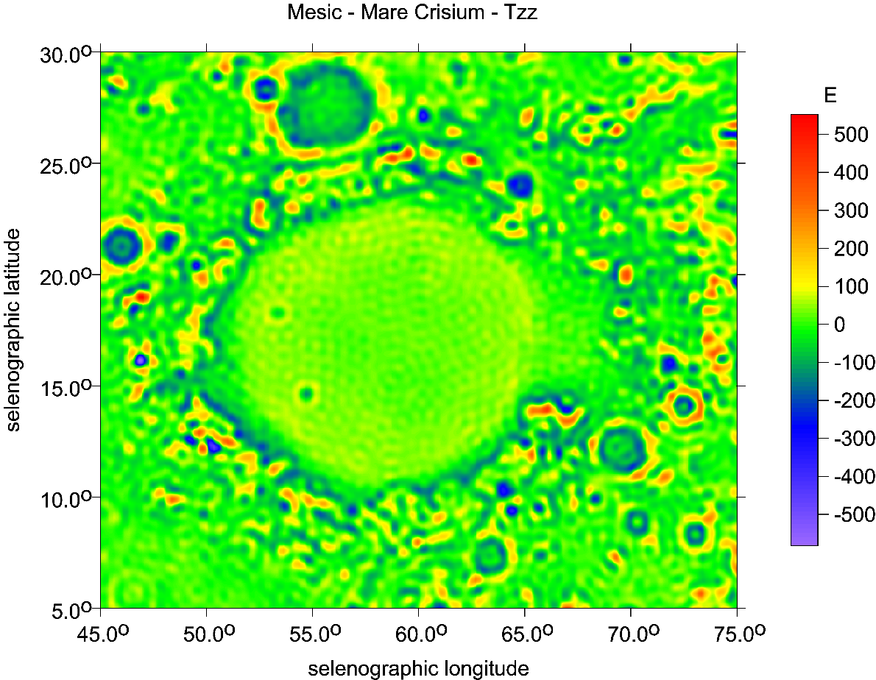
Mare Crisium

Slide 28
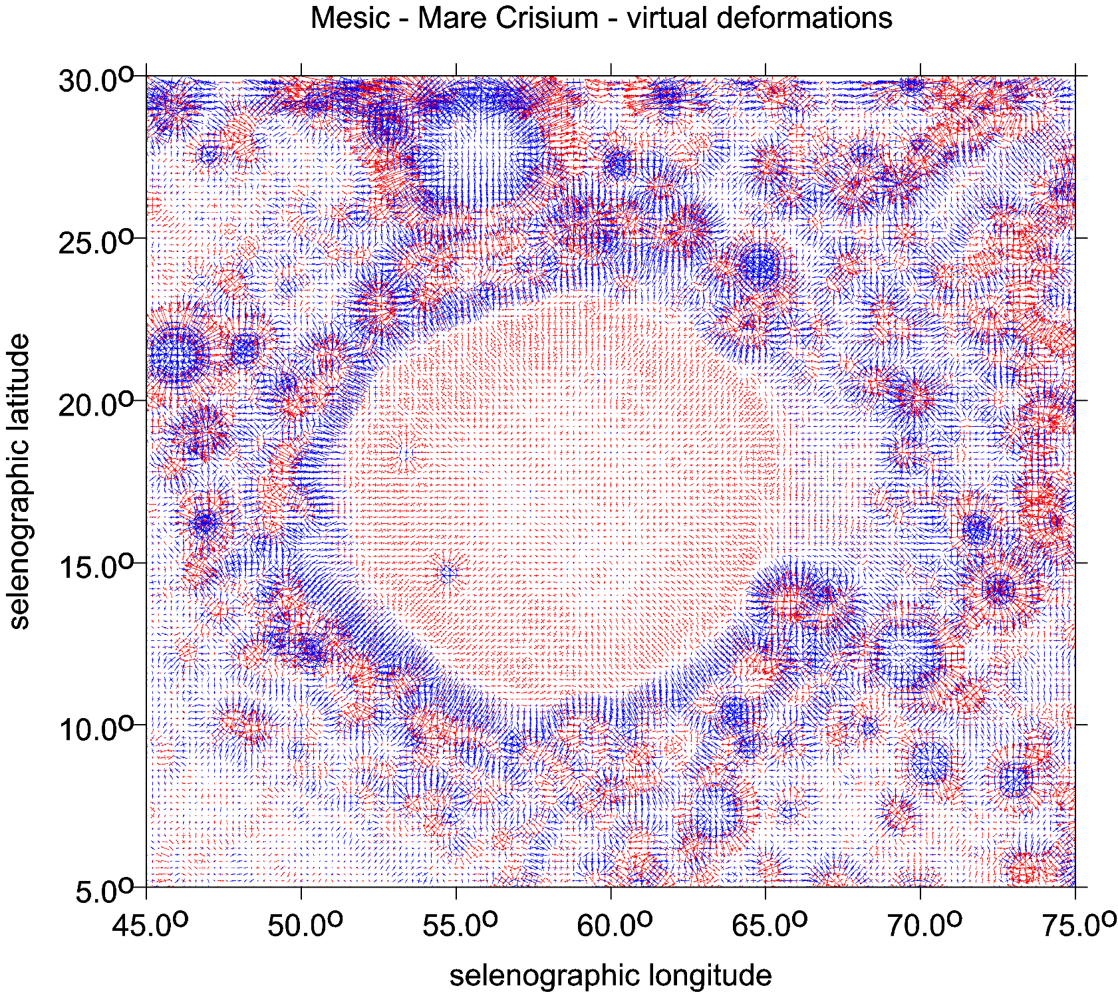
Mare Crisium

Slide 29
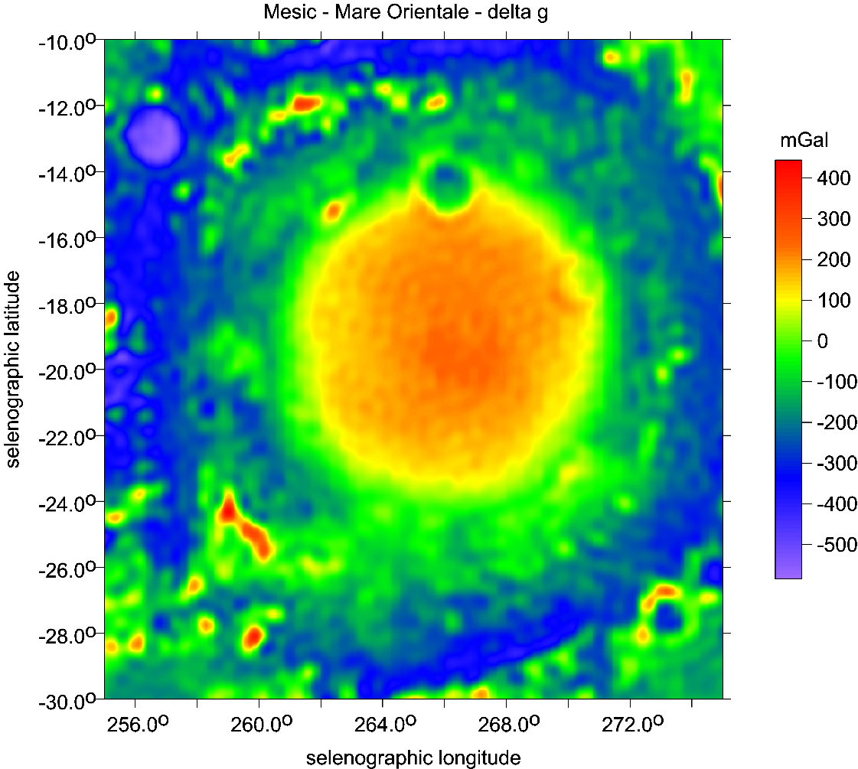
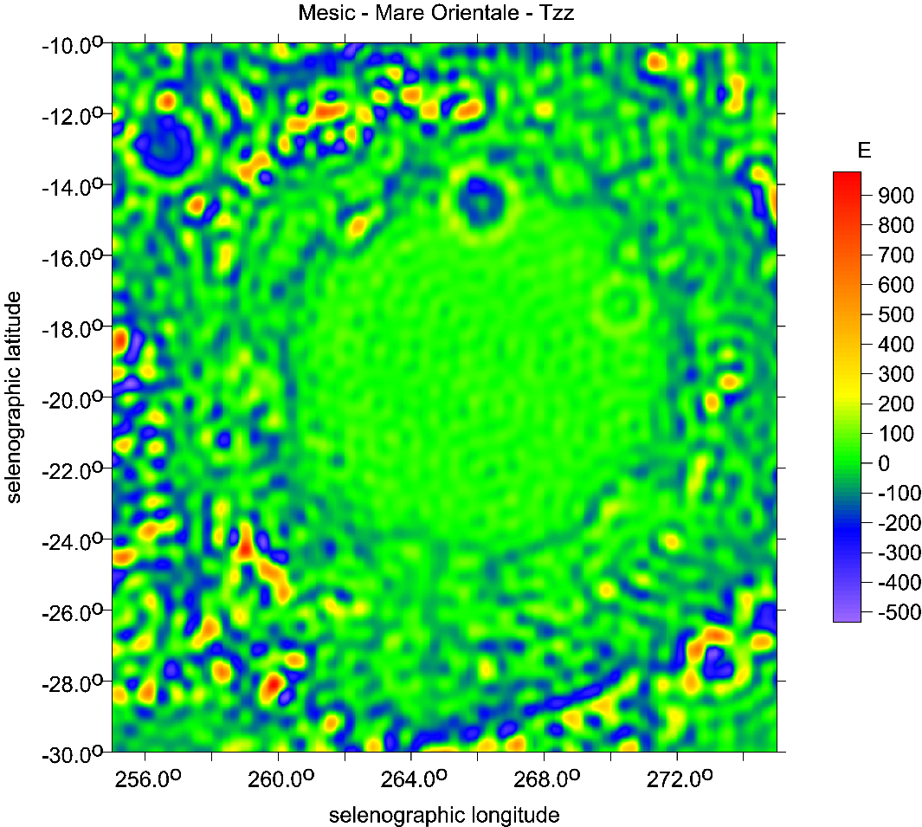
Mare Orientale

Slide 30
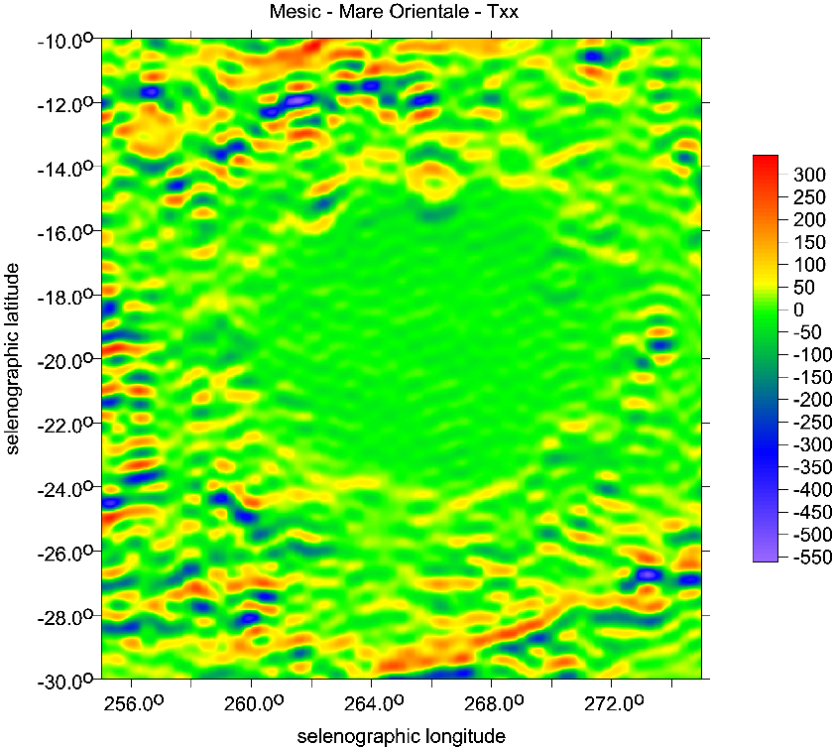
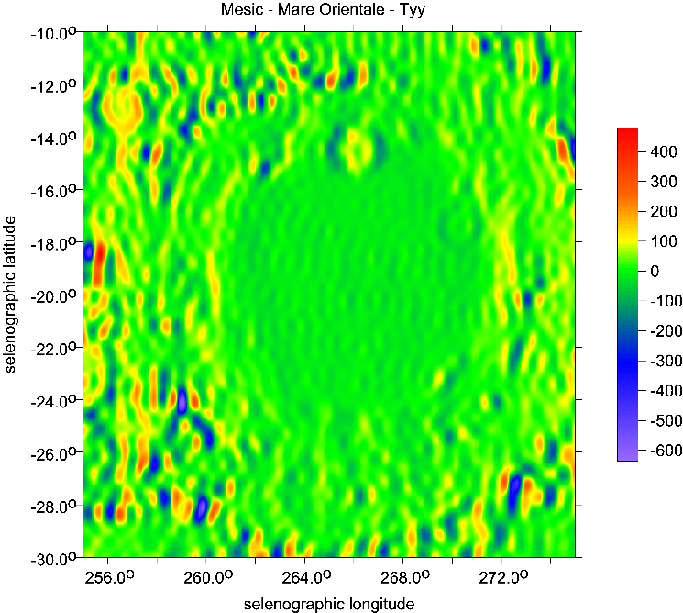

Mare Orientale
The main diagonal terms
of the Marussi tensor [E]

Slide 31
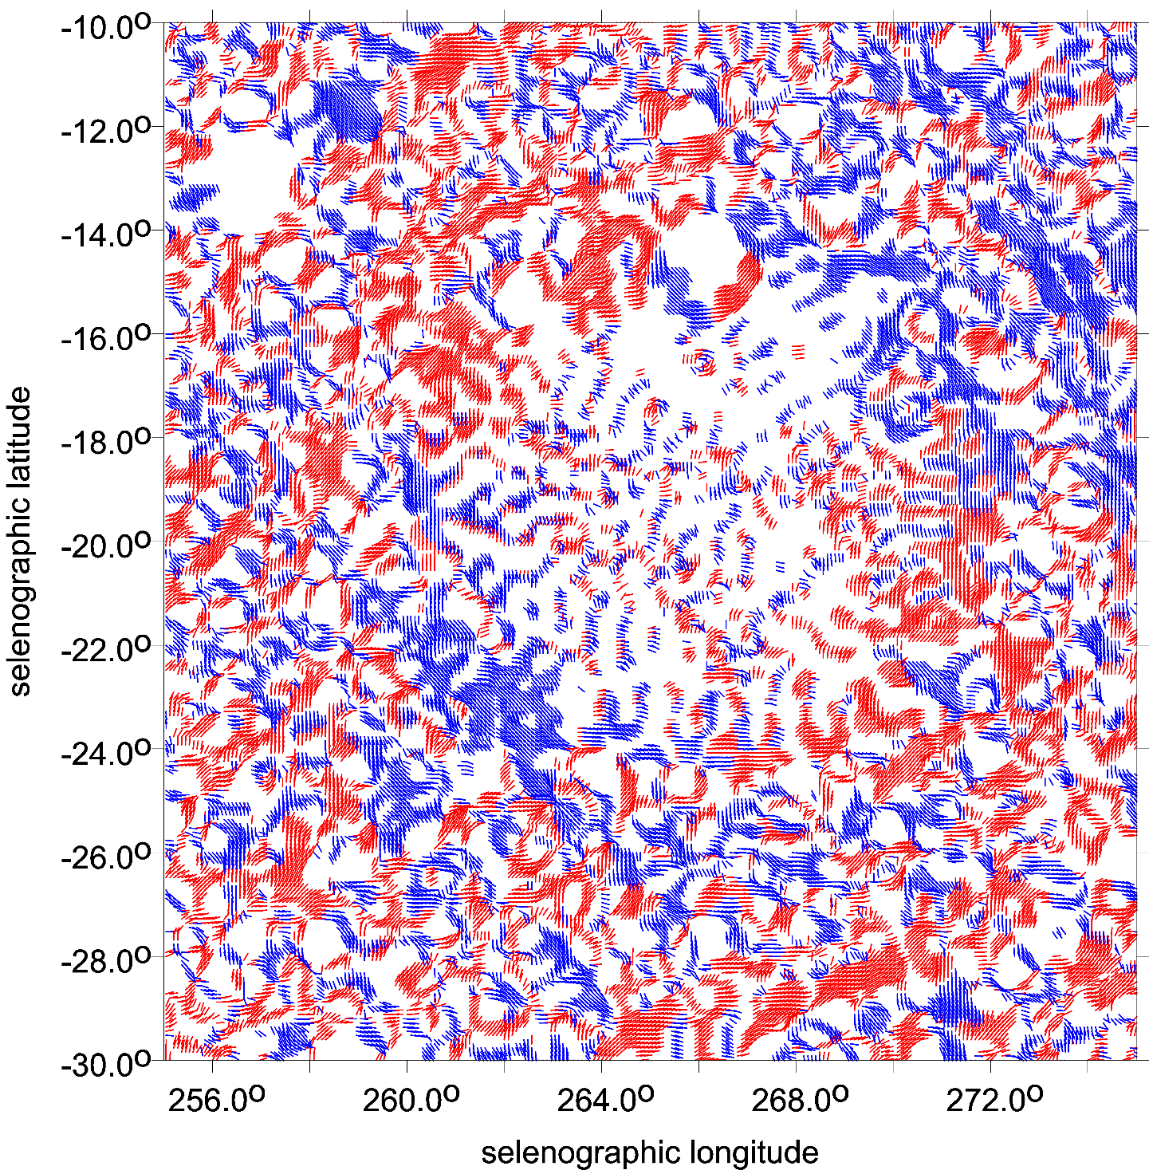
Mare Orientale
θ [deg]

Slide 32
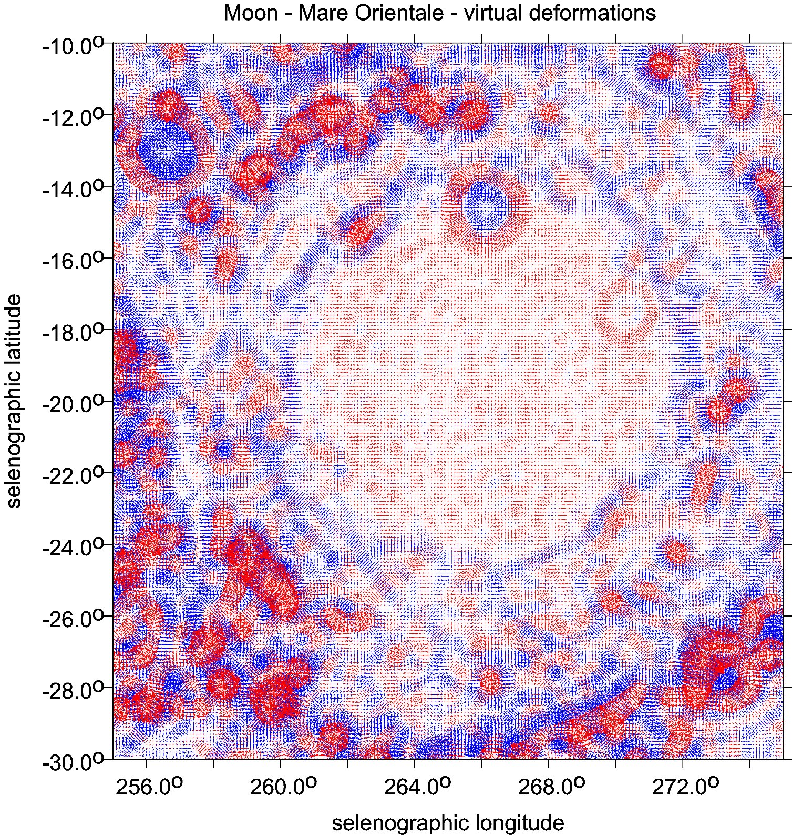
Mare Orientale
Mare Orientale

Slide 33
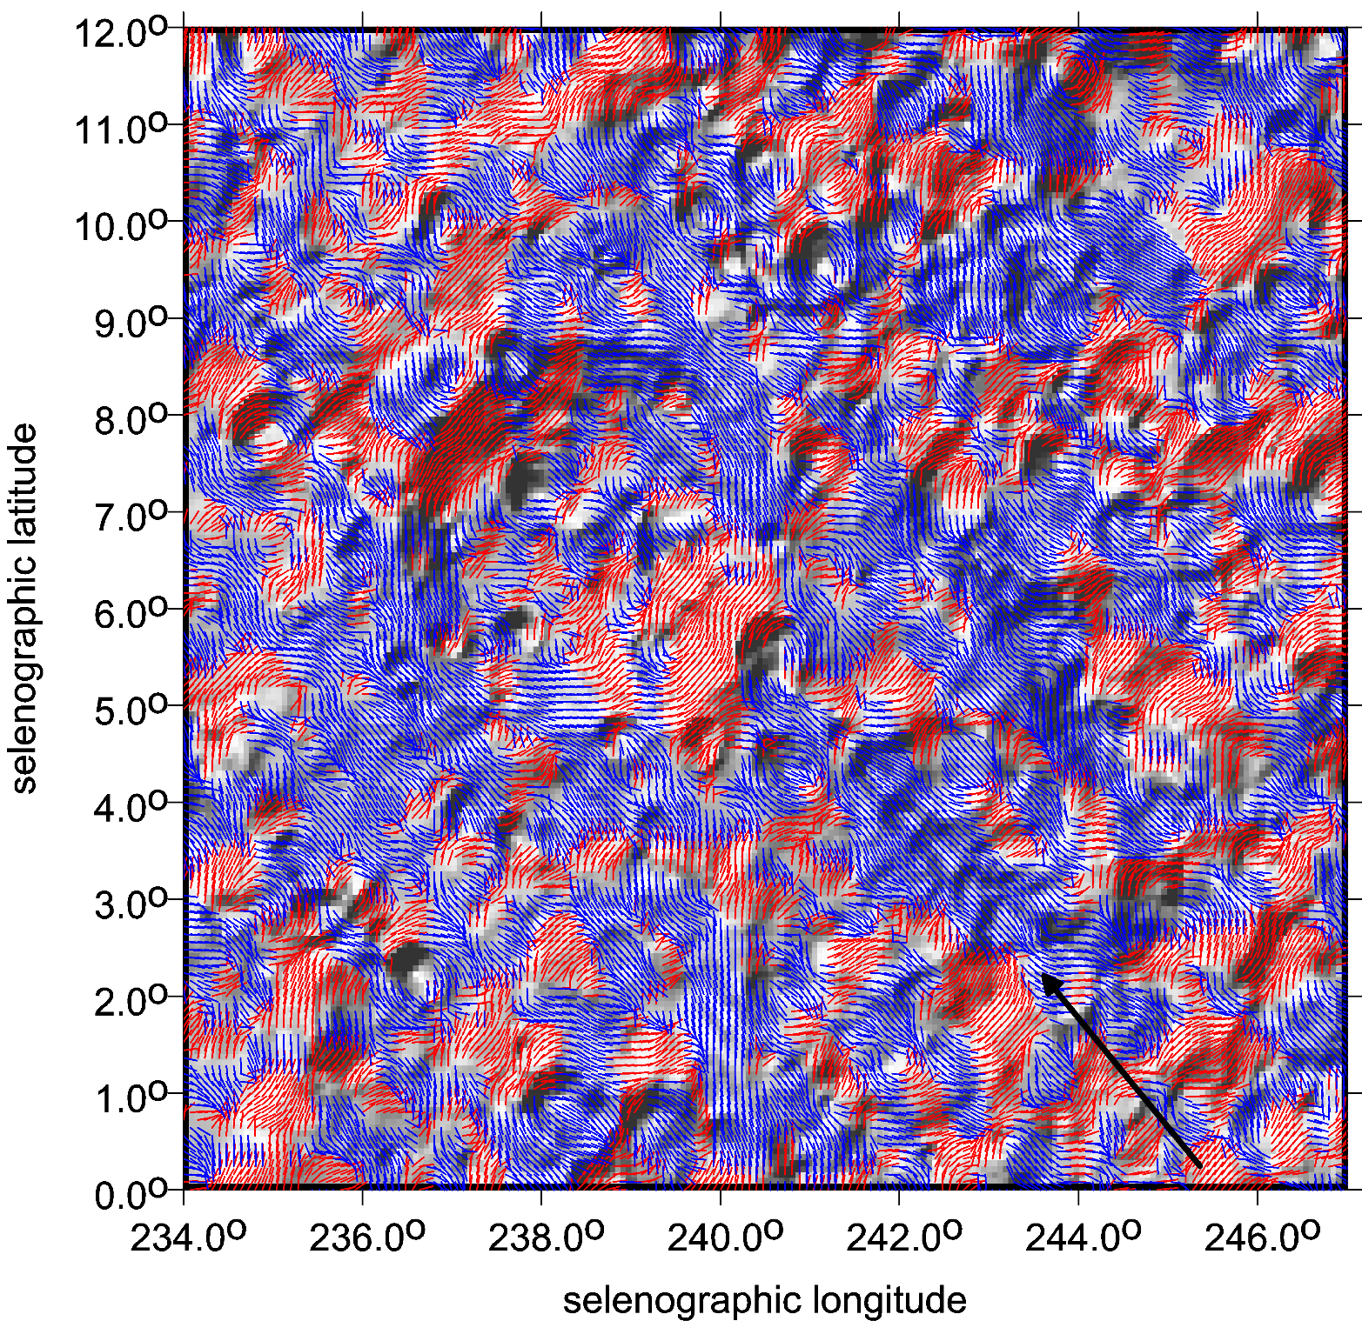
Michelson
crater and catena
Fig. Supp. 65
for Michelson
θ [deg]

Slide 34
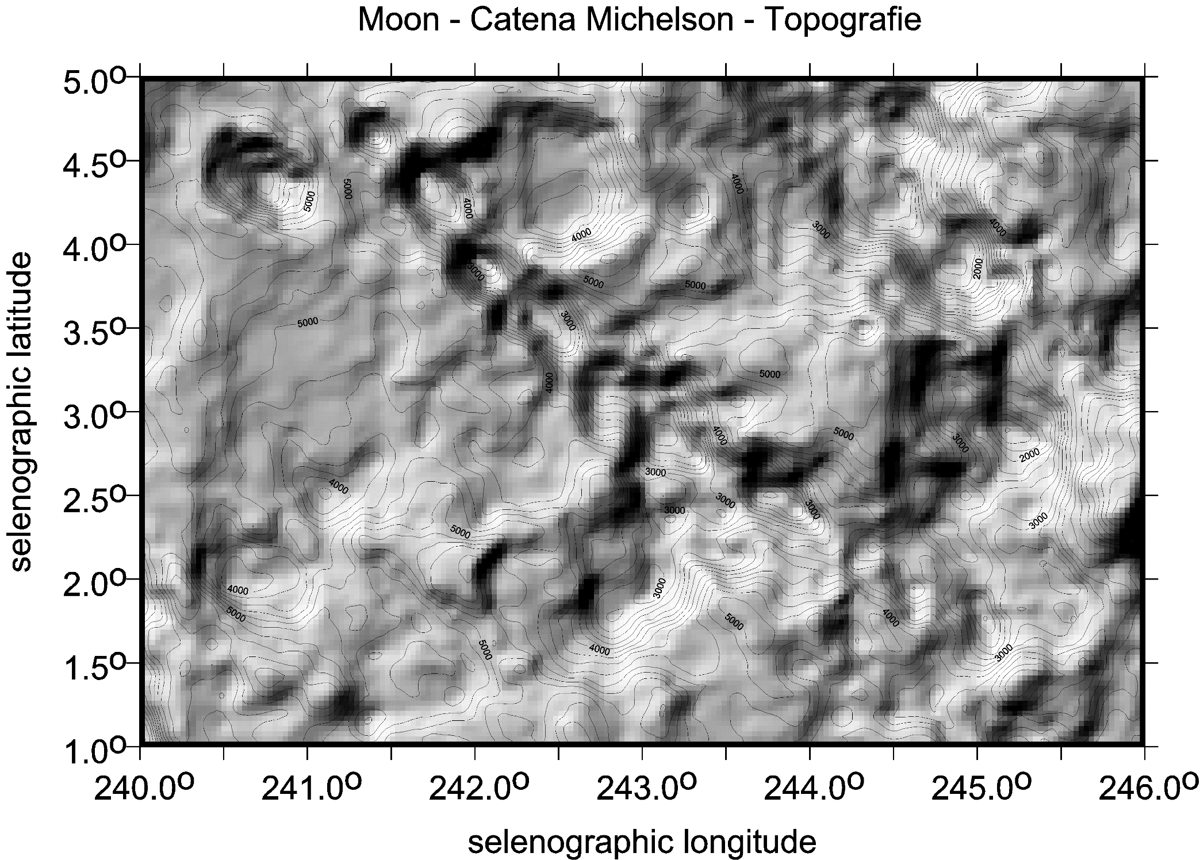

Slide 35
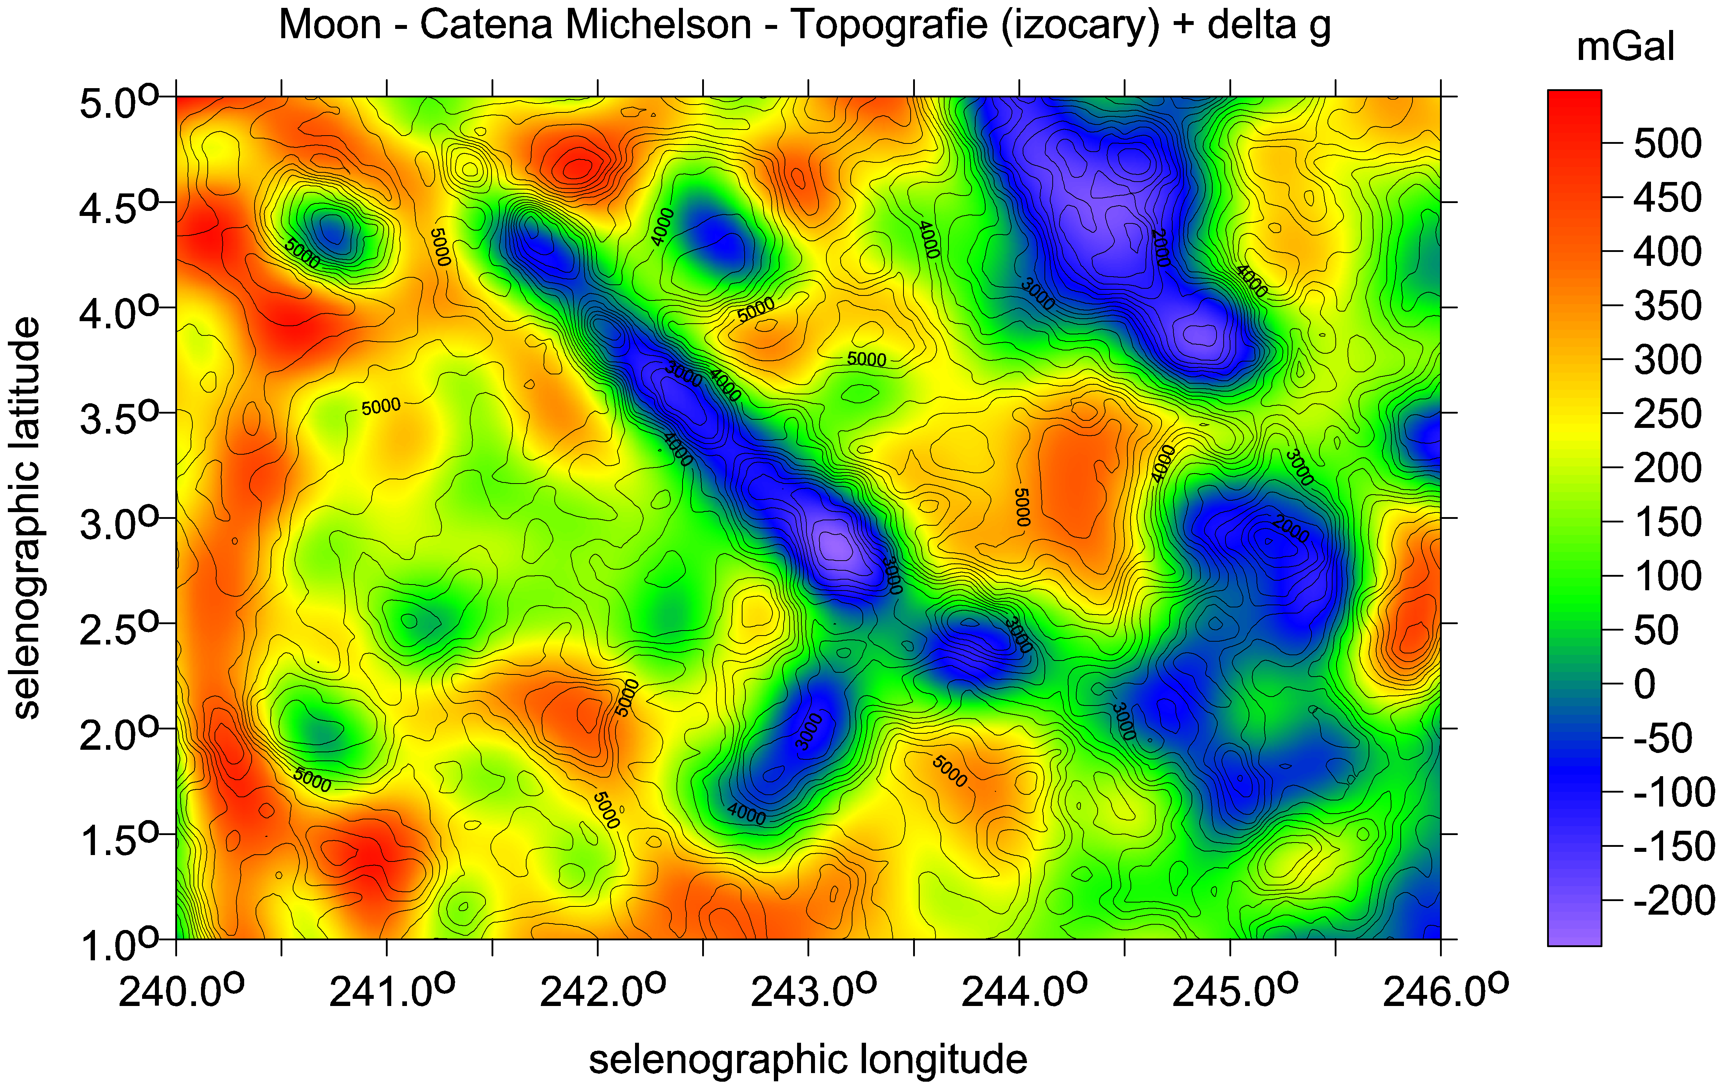
Catena Michelson ∆g [mGal] with LOLA topography [m]

Slide 36
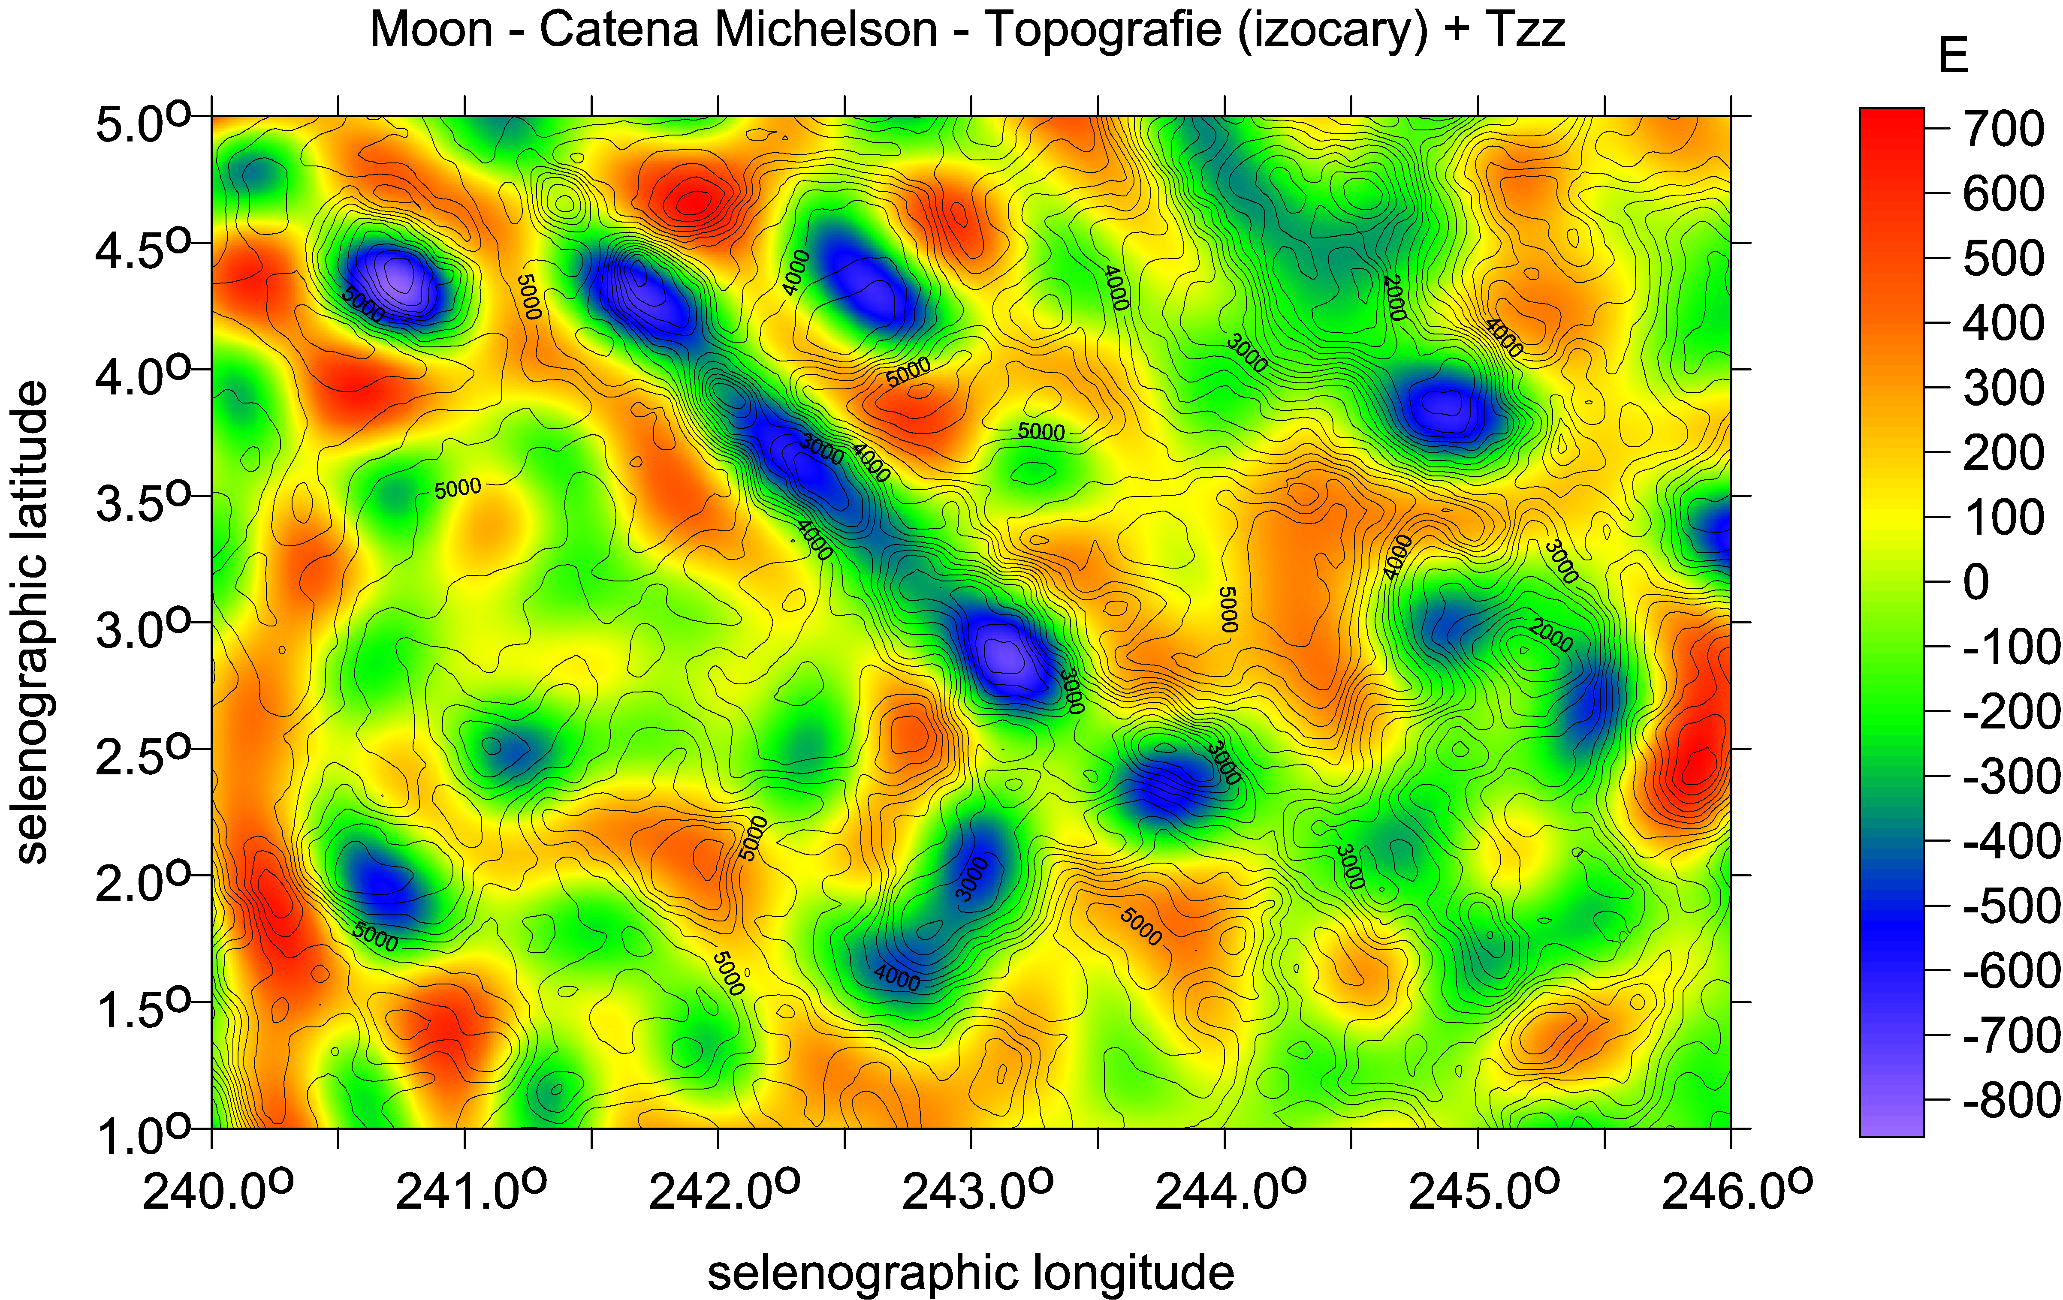
Catena Michelson Tzz [E] with LOLA topography [m]

Slide 37
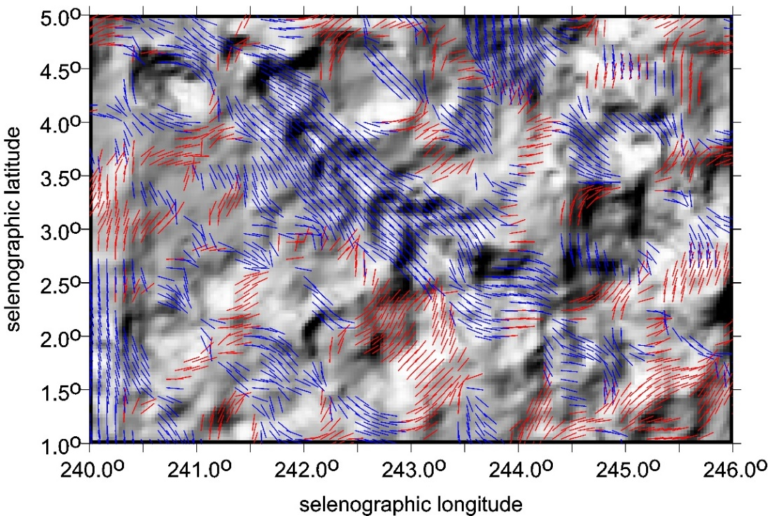
Catena Michelson near the crater Michelson, the far side of the Moon;
the topography [m] with the strike angles θ [⁰],
strongly combed along with the long axis of catena.

Slide 38
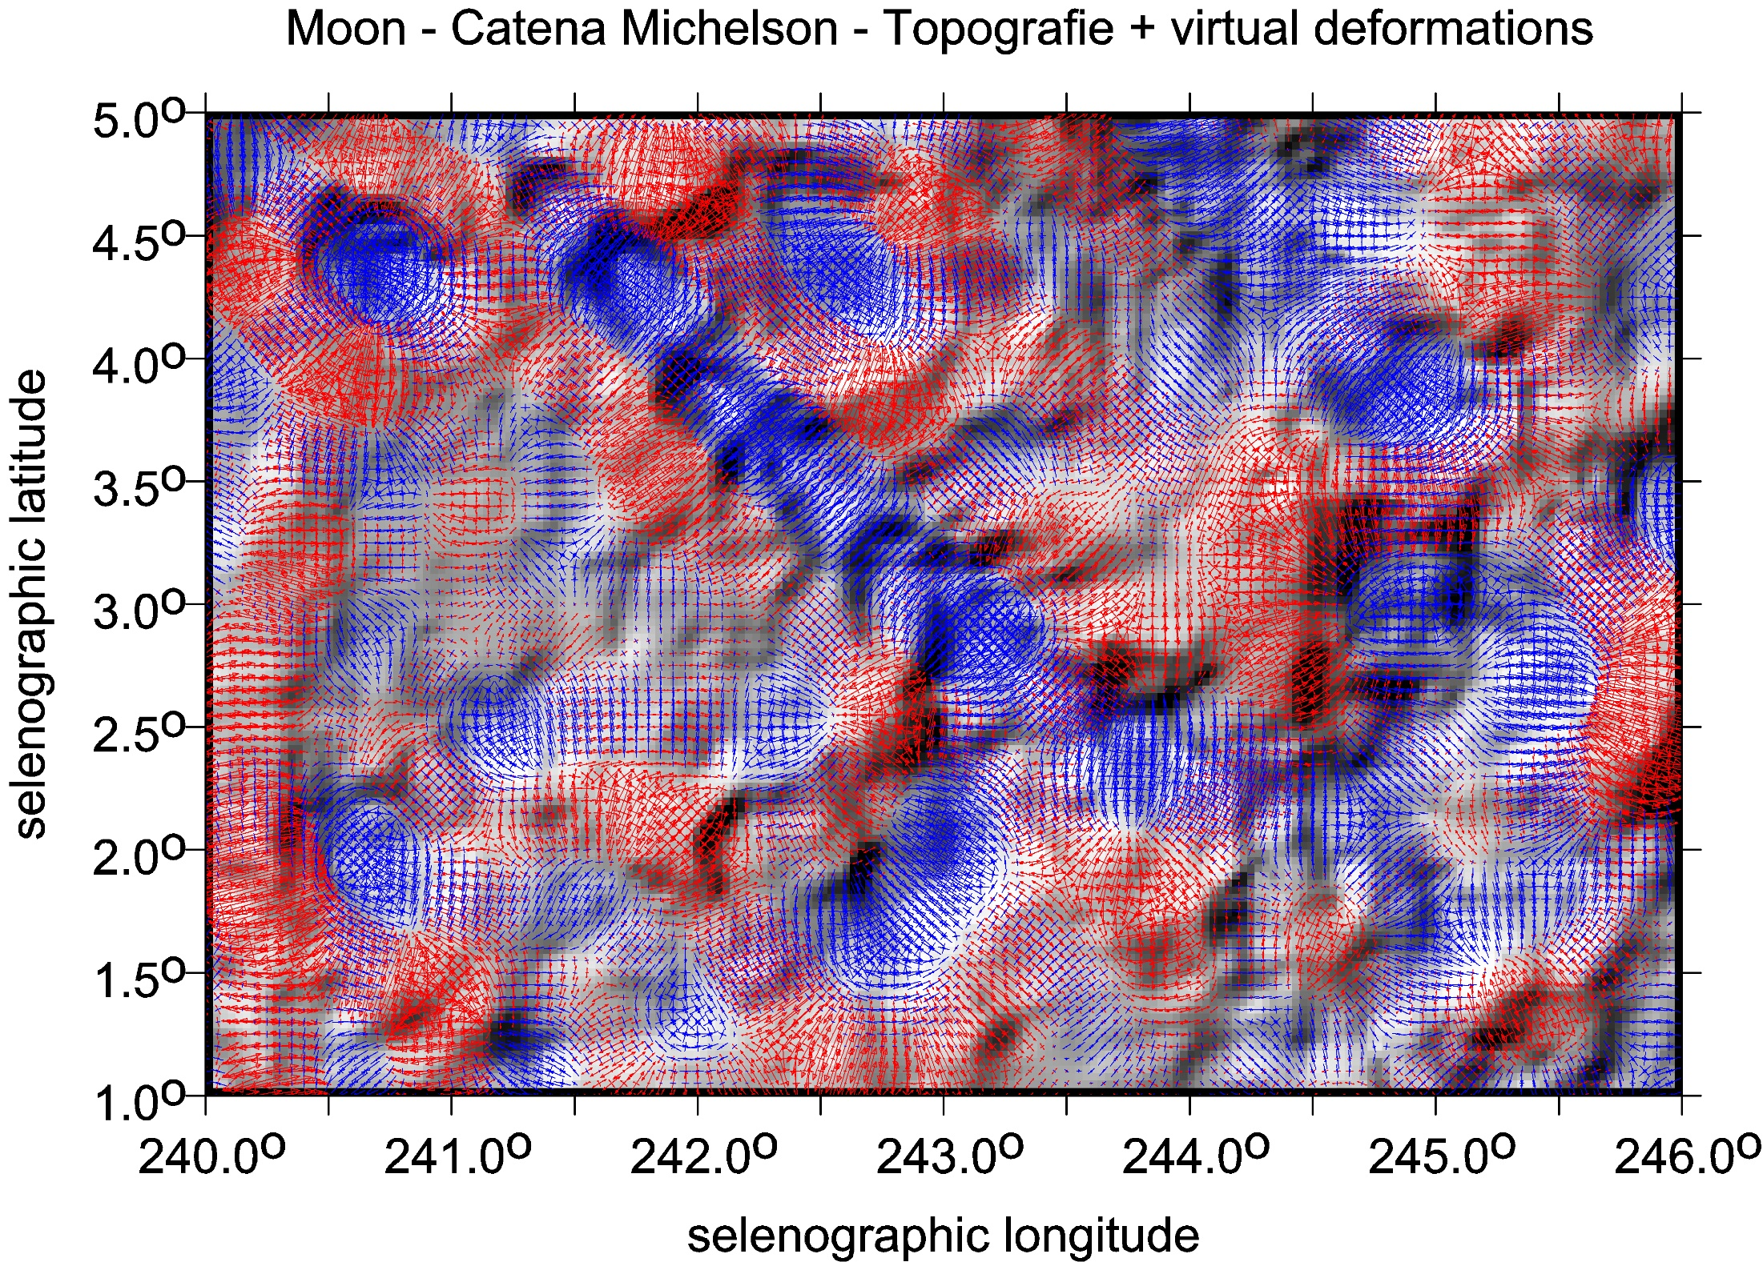

Slide 39
direct application for
Artemis mission
Tvar zemské magnetosféry. Rovina oběžné dráhy Měsíce kolem Země je skoro totožná s rovinou oběžné dráhy Země kolem Slunce. Magnetosféra Země směrem od Země sahá daleko za oběžnou dráhu Měsíce kolem Země. Měsíc prolétá zemskou magnetosférou každý měsíc kolem úplňku po dobu asi pěti dnů. Z ionosféry se ionty dostávají do magnetosféry a pohybují se podél oranžových šipek. Zelené šipky ukazují na pohyb iontů díky tzv. “rekonekci“ (přepojení siločar magnetického pole, což způsobí urychlení iontů v magnetosféře směrem k Zemi). IMF meziplanetární magnetické pole se slunečním větrem SW, MP magnetopauza, UWI ionty ze Země, které se mohou dostat na Měsíc.

Slide 40
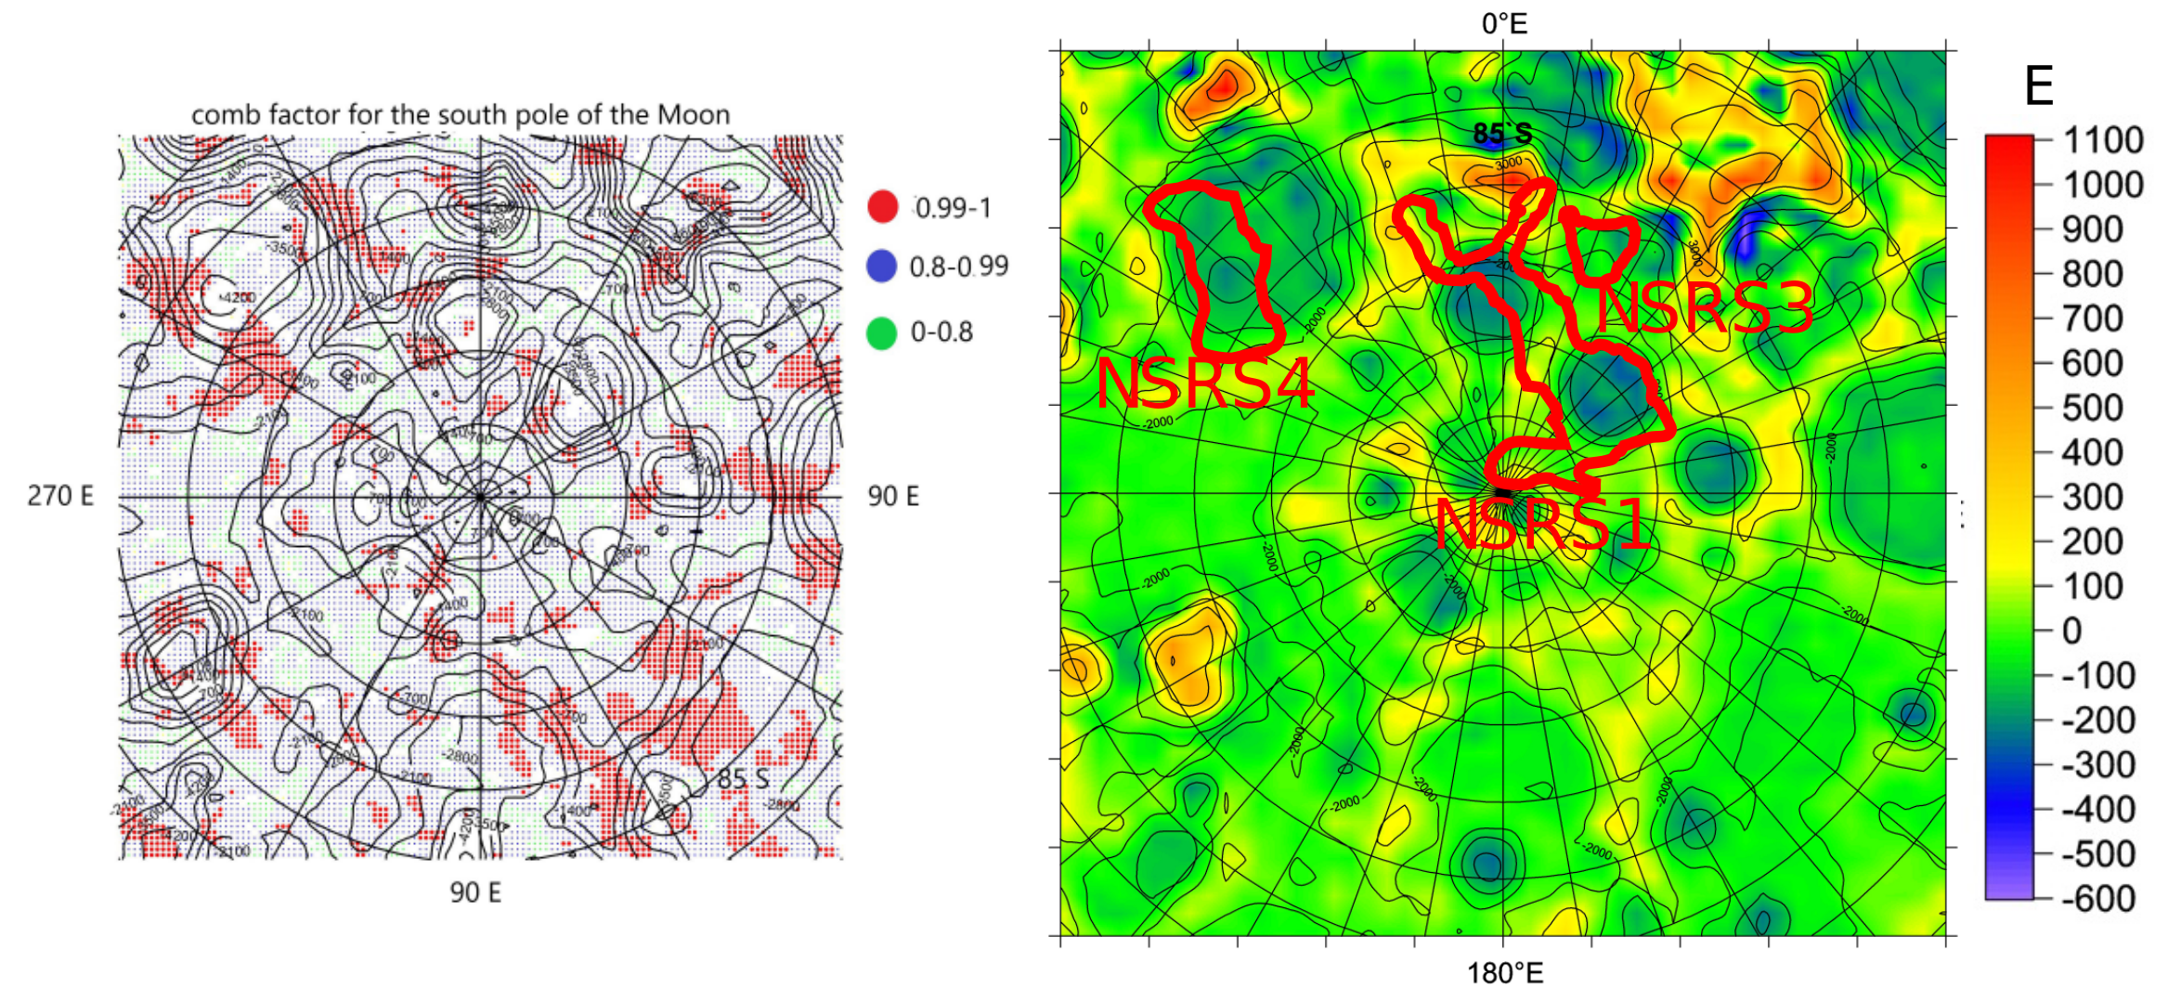
Oblast kolem jižního pólu Měsíce, vlevo úhly napětí (největší učesanost červeně), vpravo druhé radiální derivace poruchového potenciálu (v jednotkách Eötvös) z nejnovějšího modelu gravitačního pole Měsíce z měsíčních družic (lunárních orbiterů), spolu s topografií měsíčního povrchu z laserového altimetru LOLA (vrstevnice). Tři oblasti označené červeně NSR S1, NSR S3 a NSR S4 s potenciálně na vodu bohatým permafrostem (regolitem) z nezávislých měření. Obrázky J. Kostelecký, G. Kletetschka, K. Karimi z [1].
Citace [1] Kletetschka G, Klokočník J, Hasson N, Kostelecký J, Bezděk A, Karimi K. 2022, Distribution of water phase near the poles of the Moon from gravity aspects. Scientific Reports (Springer-Nature), Mar 16;12(1): 4501; doi: 10.1038/s41598-022-08305-x.
Více info o našich pracech tohoto typu na www.asu.cas.cz~/jklokocn.

Slide 41
https://doi.org/10.1007/978-3-031-08867-4

Slide 42

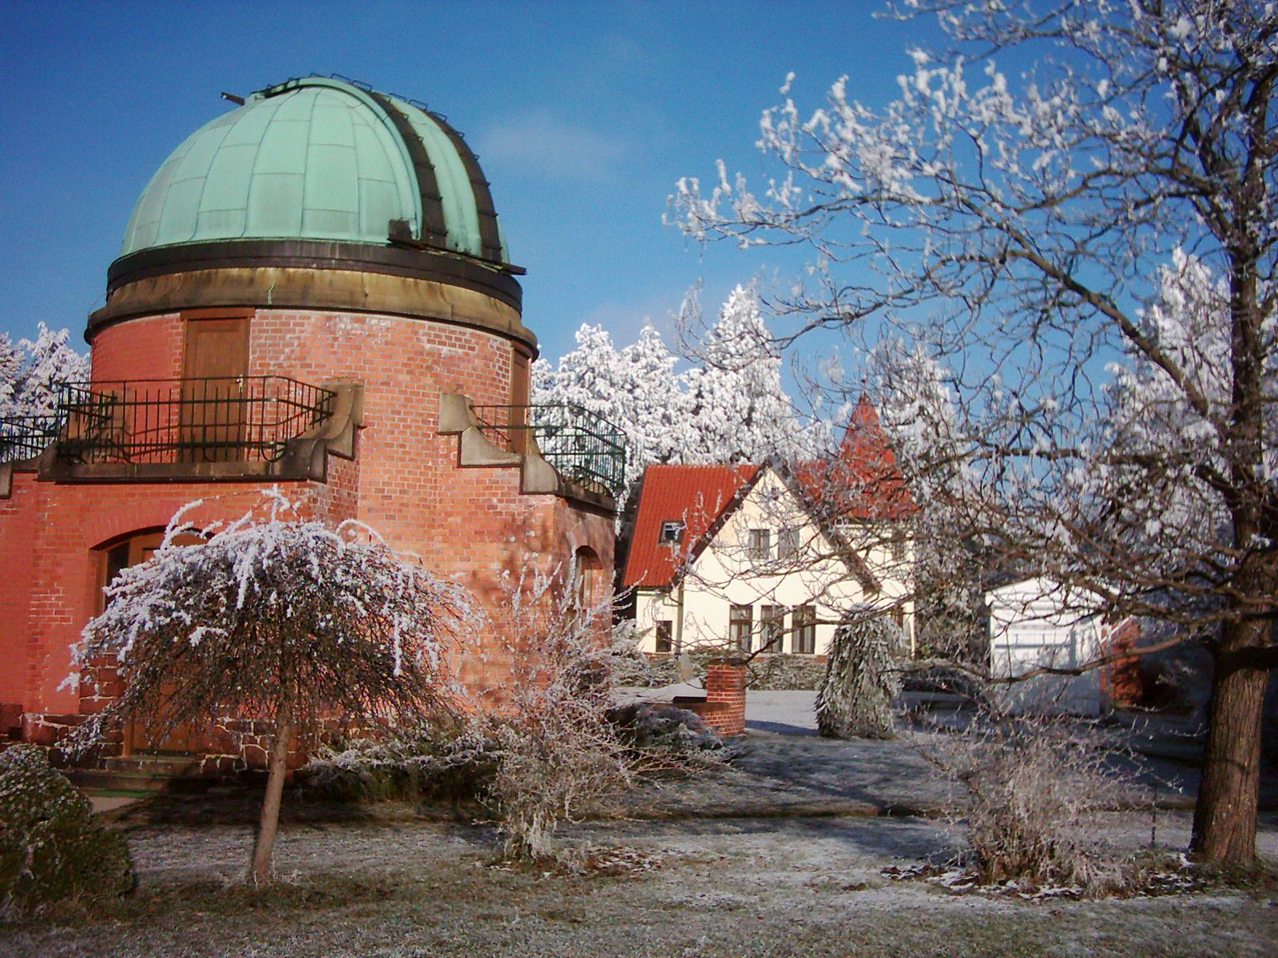
www.asu.cas.cz/~jklokocn

