Slide 1







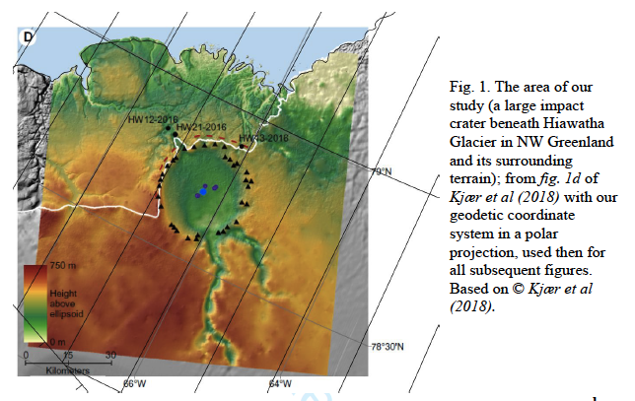
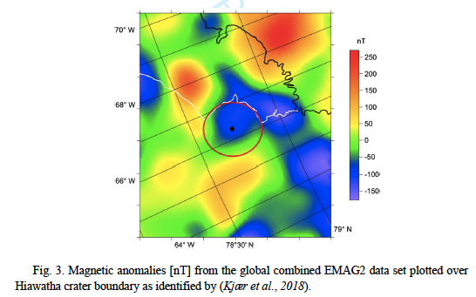
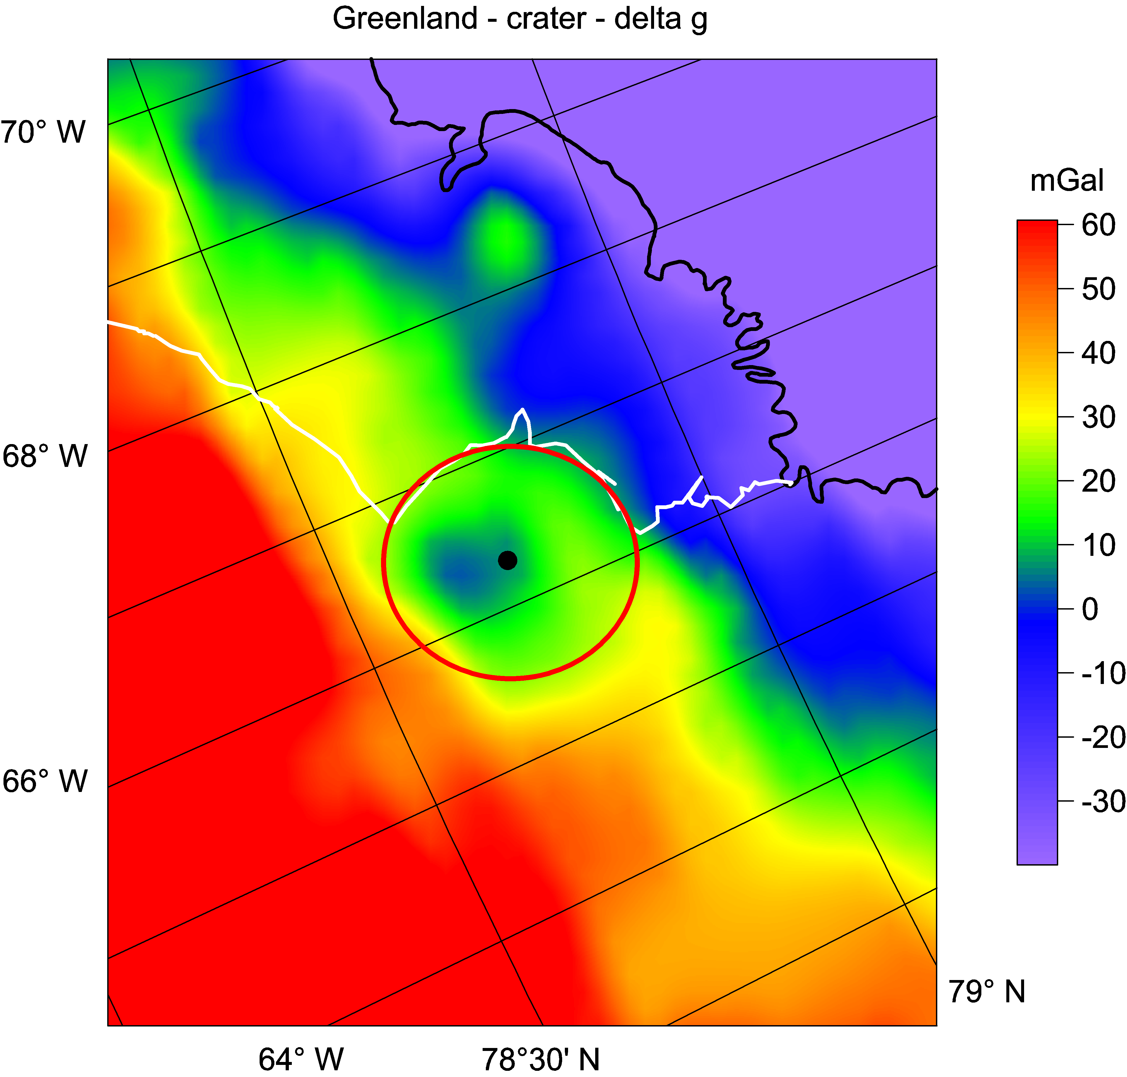
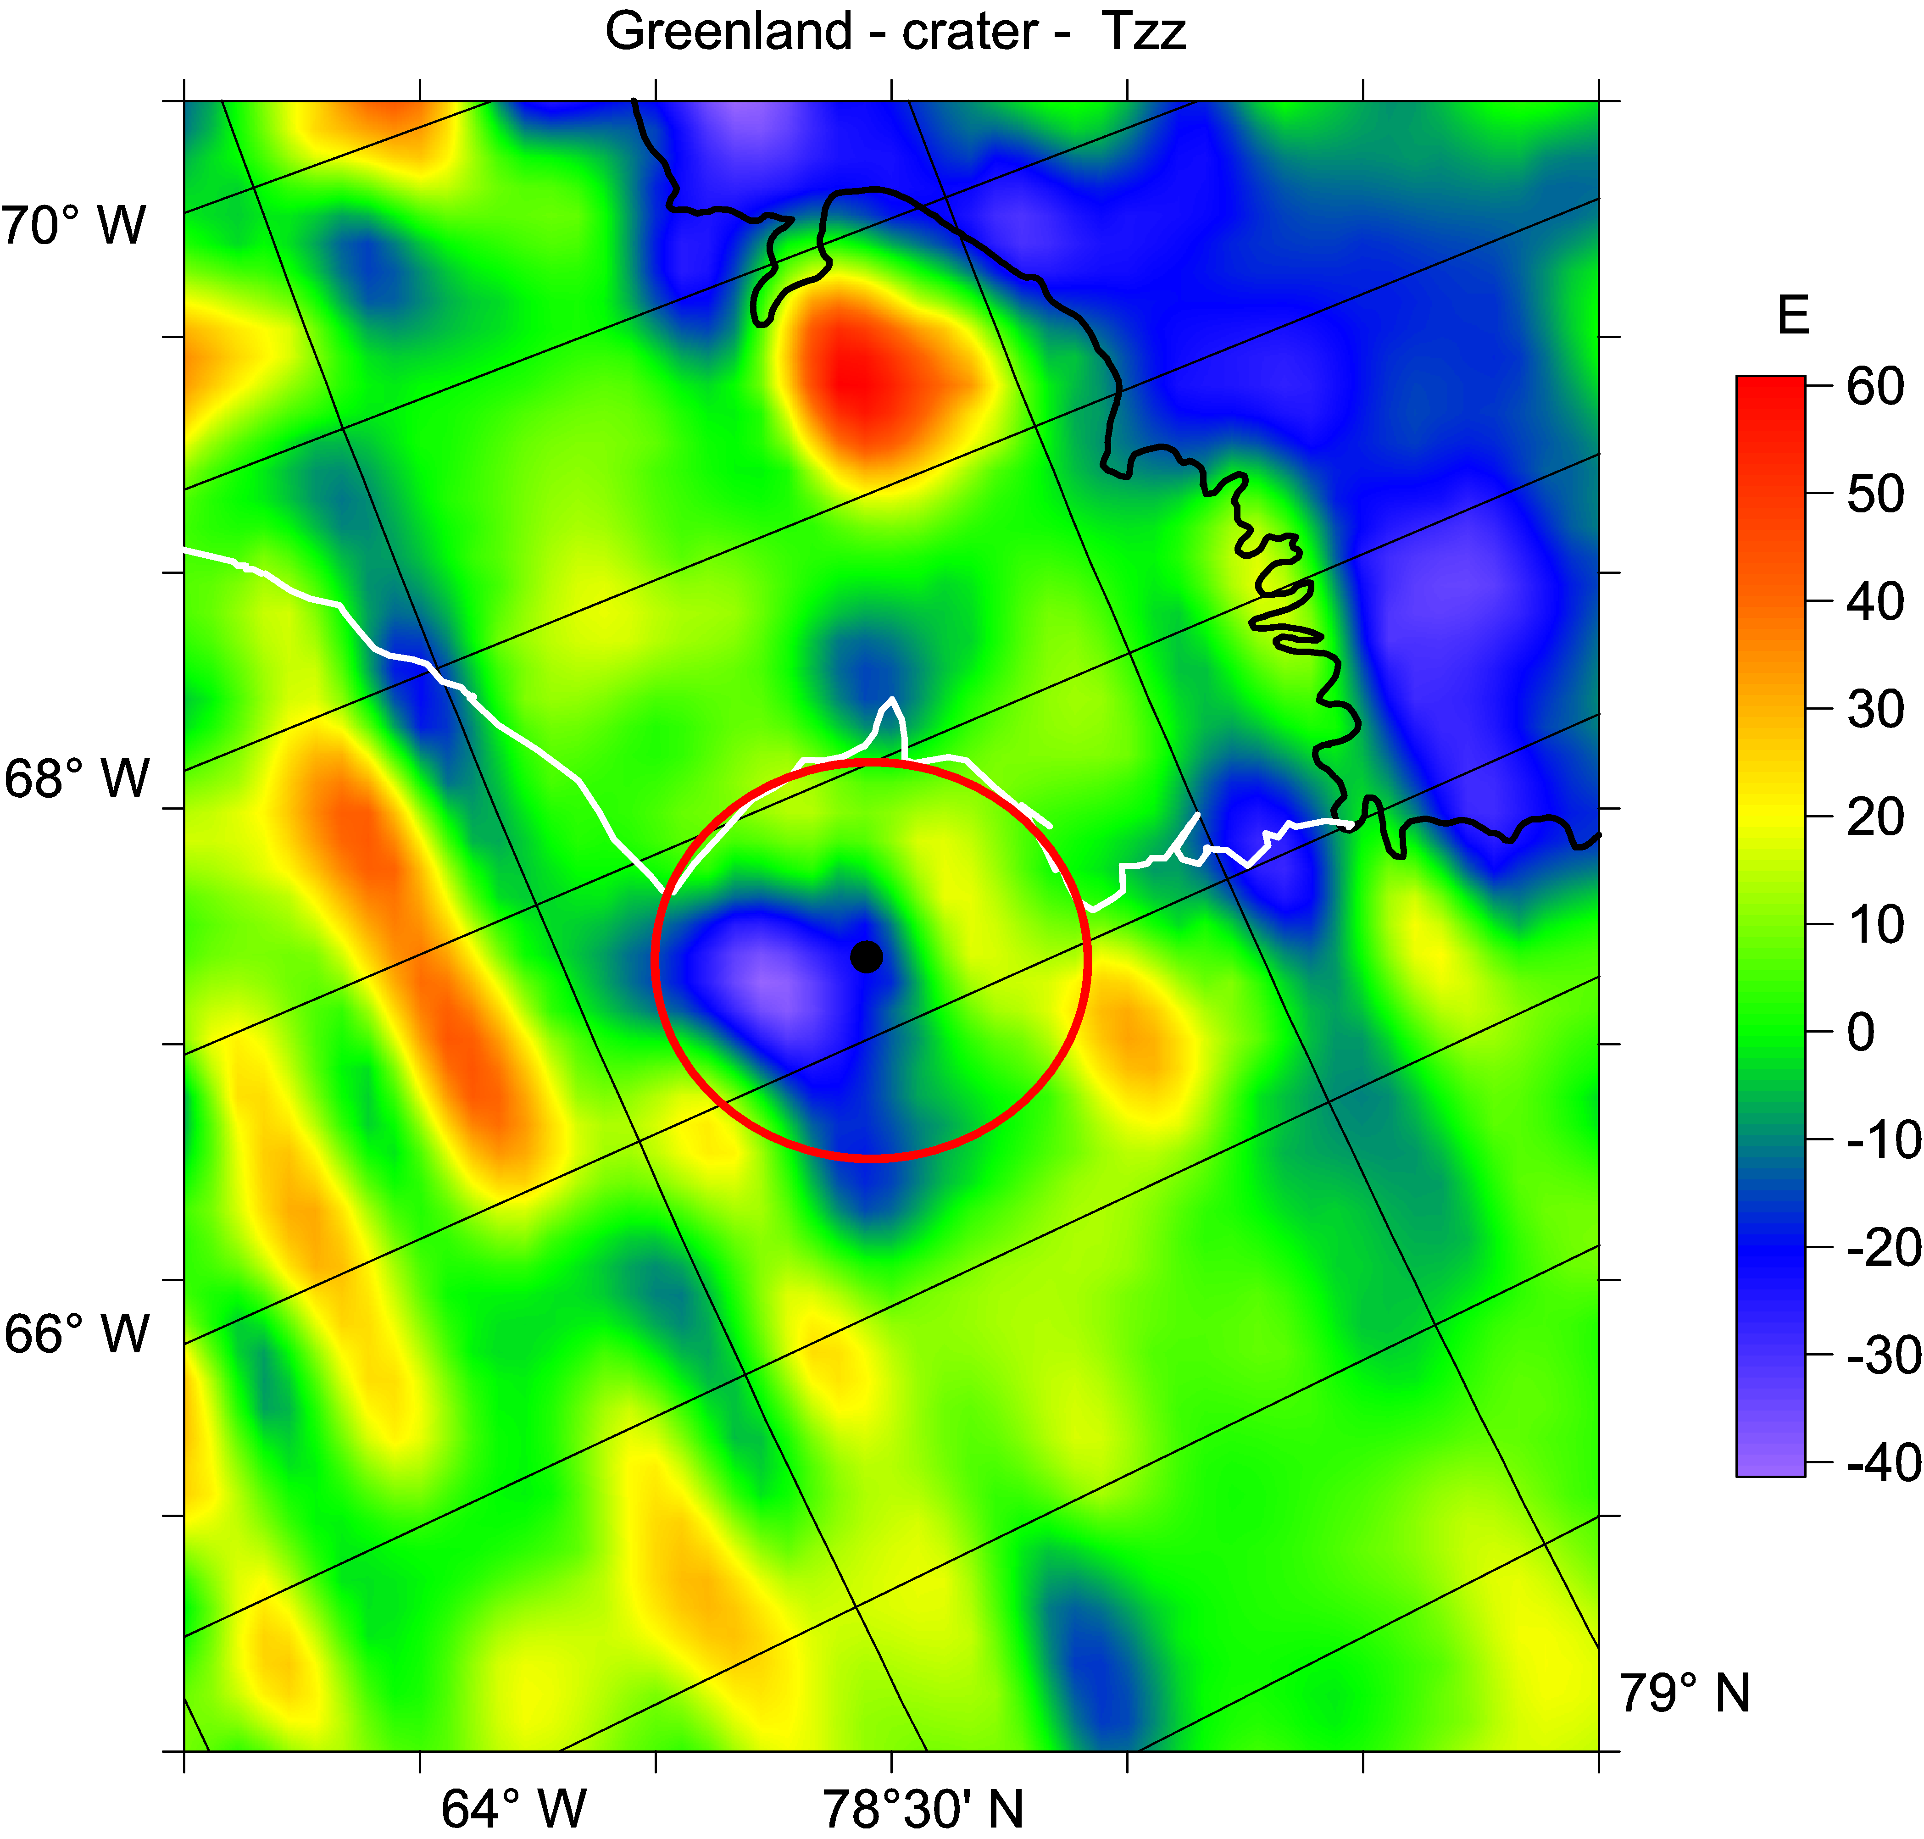
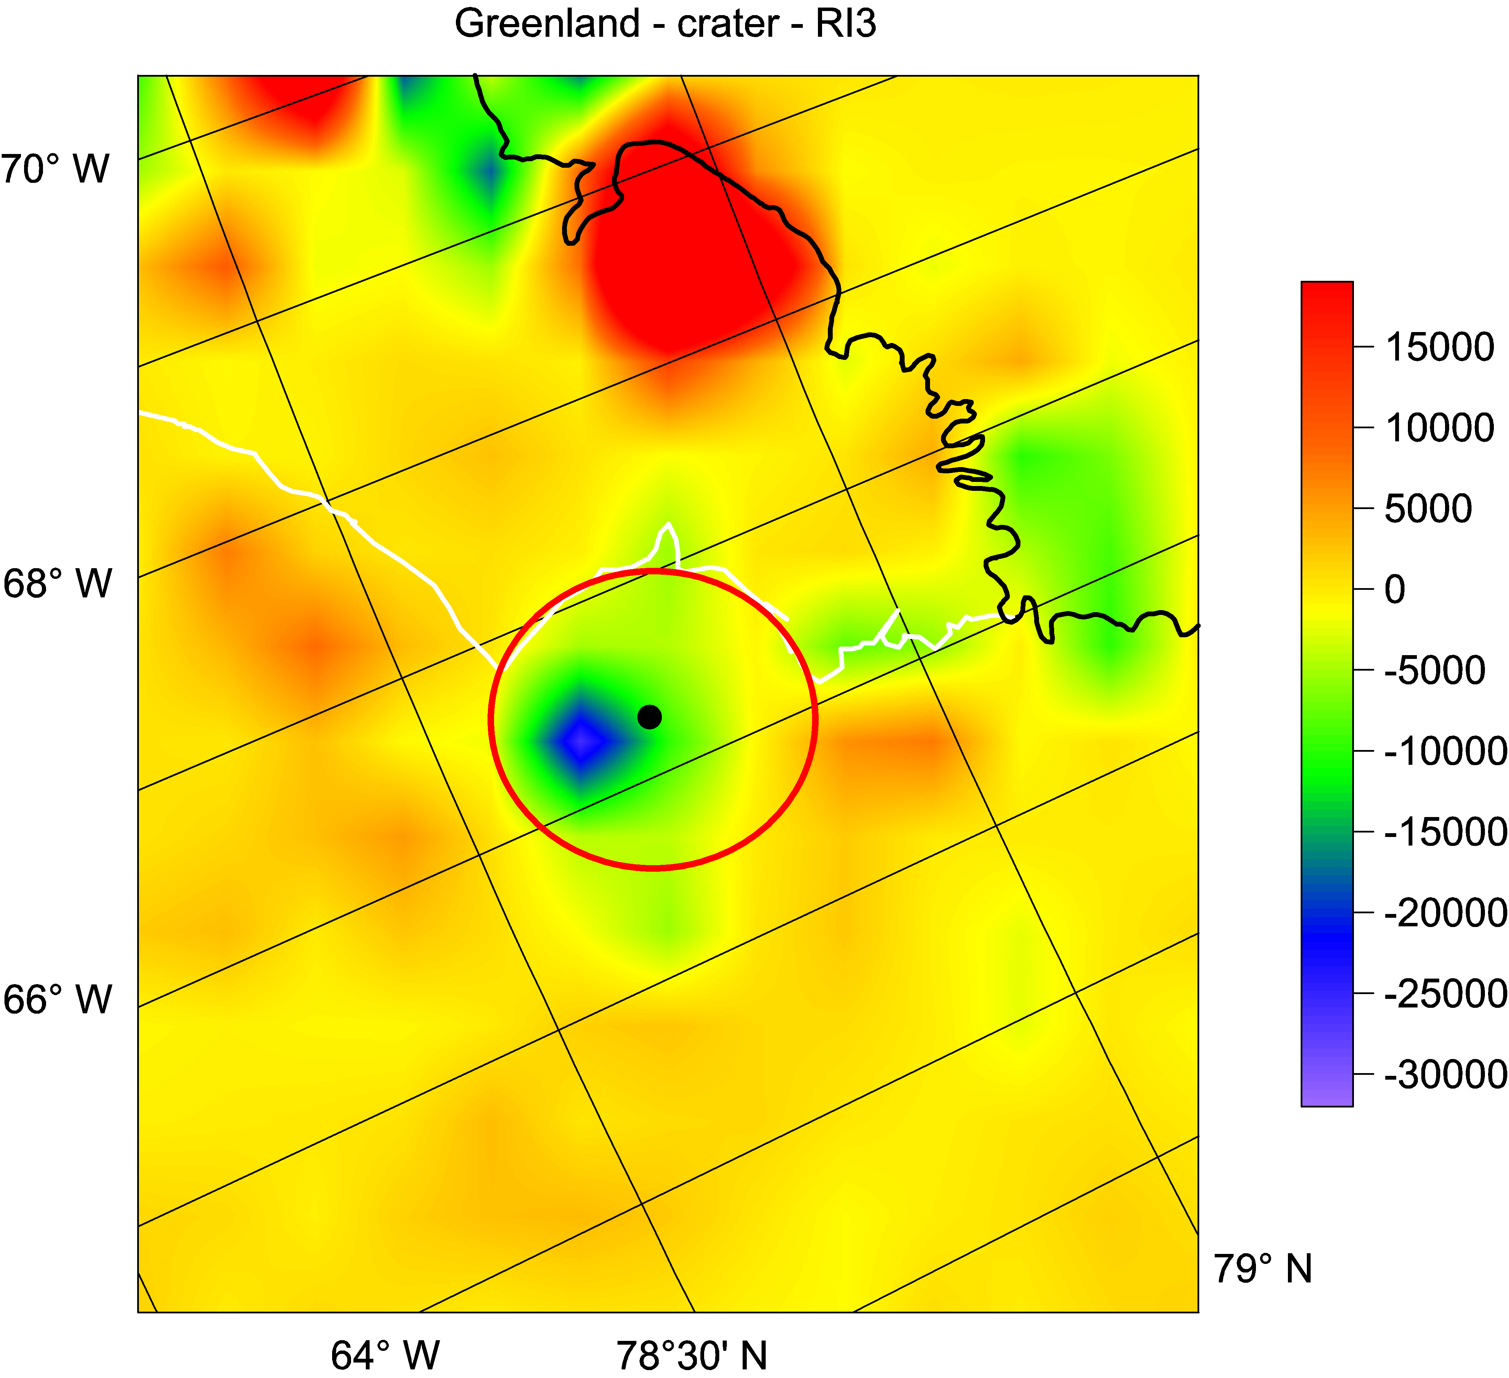
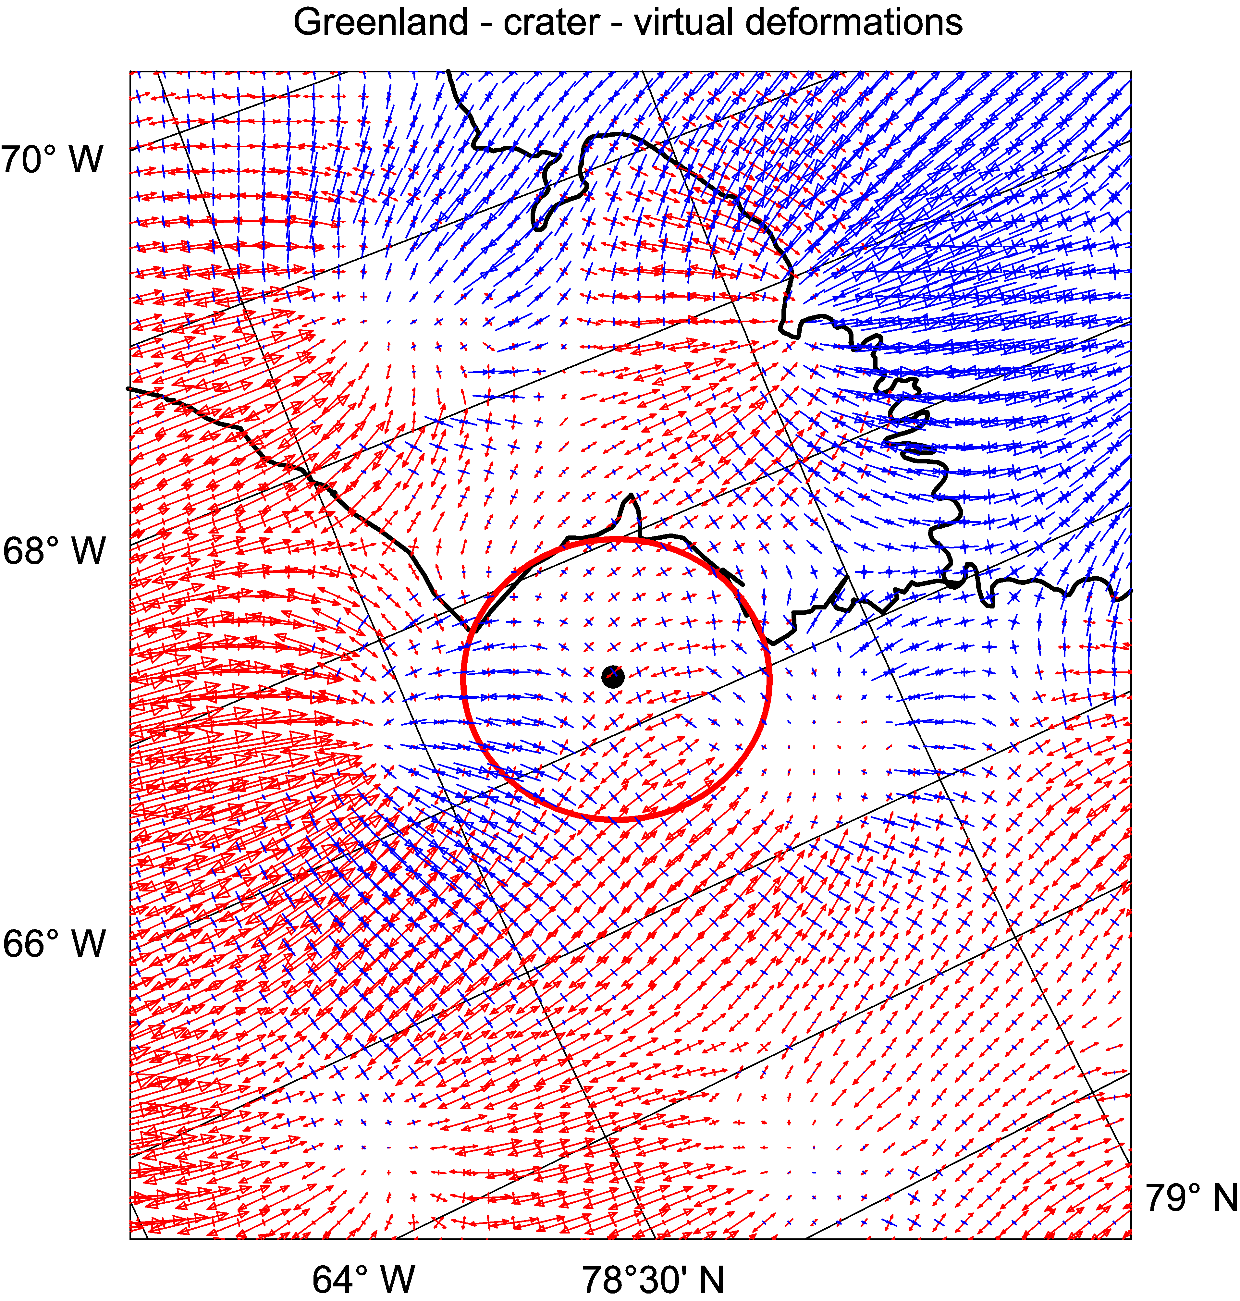
EGU 2019, Friday, 12 Apr 2019, X2.266
A support to discovery of subglacial impact crater in northwest Greenland by gravity aspects from Earth gravity model EIGEN 6C4 and other data
J. Klokočník ¹, J. Kostelecký ^{2,3}, A. Bezděk ^{1.4}, V. Cílek ⁵, G. Kletetschka ^{5,6,7}
¹ Astronomical Institute, Czech Academy of Sciences, CZ 251 65 Ondřejov, Fričova 298, Czech Republic, ² Research Institute of Geodesy, Topography and Cartography, CZ 250 66 Zdiby 98, Czech Republic
³ Faculty of Mining and Geology, VSB-TU Ostrava, CZ 708 33 Ostrava, Czech Republic, ⁴ Faculty of Civil Engineering, Czech Technical Univeristy in Prague, CZ 166 29 Praha 6, Czech Republic
⁵ Geological Institute, Czech Academy of Sciences, CZ 165 00 Praha 6, Rozvojová 269, Czech Republic,
⁶ Department of Applied Geophysics, Charles Univ, Albertov 6, Prague, Czech Republic
⁷ Geophysical Institute, University of Alaska Fairbanks, 903 N Koyukuk Drive, Fairbanks, AK, USA
Introduction: Kjær et al [1] reported the discovery of a large impact crater in NW Greenland under Hiawatha Glacier. The bedrock topography from airplane surveys shows a “flat depression with a diameter 31.1±0.3 km, a rim-to-floor depth 320±70 m” and a central uplift. It is „slightly asymmetric, with a gentler slope toward the southwest and maximum depth in the southeast of the structure“ [1]. The age is not clear but could be from Pleistocene age, allowing it to play a role during an onset of Younger Dryas [2, 3, 4, 5]. We checked this location for any available gravity and magnetic expres-sions.
Results:
We derived the gravity aspects computed with EIGEIN 6C4, namely the gravity disturbances Δg (in miligals), the second radial derivative Tzz (in Eötvös), one of the gravity invariants I2 (in s-6), and the virtual defor-mations vd [7].
For an impact crater, it is expected – based on our experience with proven impact craters ¬– that Δg and Tzz will be negative inside the crater, changing positive and negative values for the respective rims and space between them around the crater, the invariants have extreme values inside and around the crater concentrat-ed to local extrema in the rim(s), and vd inside the crater show the compression, around dilatation.
Exactly as expected for a typical impact crater, we could see the just described characteristics of our gravi-ty aspects for this crater under Hiawatha Glacier, NW Greenland. These results therefore independently sup-port the crater discovery [1] from new aspects. We do not see, however, any central uplift. Either it is not there or due to a low resolution of EIGEN 6C4.
We note that the geometric centre of the surface and the bed topography derived from Figs. 1 c, d in [1] and the centre of the features shown by the gravity aspects have a significant offset. The gravity aspects show a shift to the south by about 25 km. We specu-late that this may be due to a slant angle of the impact-ing asteroid (impactor) or due to a subsequent geological evolution on the spot or both. While the former variant was suggested [1] we bring analyses of magnetic data set EMAG2.
Note that the magnetic anomaly map shows large negative anomaly centered towards north from the center of the impact crater. The distribution of the magnetic anomalies in this area s dictated by the underlying geology and in this part of precambrian shield the negative magnetic anomalies often indicate presence of underlying allochtonous crustal blocks with reversed magnetizations [17]. However, in terms of meteorite impact, the negative anomaly could also originate from the shock delivered to the Precambrian gneiss sheet. This sheet contains magnetic carriers that in general include both induced and remanent magnetic expression [17]. Impact demagnetizes this crust to a shock pressure wave that decays away from the impact structure depending on the nature of magnetic carrier [18, 19]. Crust acquires a demagnetized volume that is concentrated within the crater boundaries. This causes the return flux from the neighbouring magnetized crust to go through this magnetic gap and contributes to a negative magnetic expression. However, because this impactor contained iron, and significant component of the impactor material distributes according to the angle of the impact [20], the collapse of the negative magnetic anomaly in the southern part of the crater is consistent with an overwhelming presence of the impactor material south from the crater center. This is consistent with our observation of the negative magnetic anomaly does not go all the way to the southern rim of the crater. Positive magnetic flux coming through this part of the crater is consistent with the gravity data, that the impact angle was coming from the north direction to-wards the south. The iron rich breccia, incorporated in the southern portion of the crater, contributes with the overall induced positive magnetic flux that is consistent with the gravity asymmetry.
Conclusions:
We independently support the recent discovery of a large impact crater beneath Hiawatha Glacier in north-west Greenland [1]. We use gravity aspects derived from the Earth gravity field model EIGEN 6C4 and digital magnetic anomaly field database.
Method and data:
The gravity aspects (gravity anomalies/disturbances Δg, second radial derivatives Tzz as a part of the Marussi tensor, the gravity invariants Ii and their specific ratio, known also as a “2D indicator”, the strike angles and virtual deformations vd) were computed from the global, static, combined (from satellite and terrestrial data) gravity field model EIGEN 6C4 [6]. This gravity model is expanded in spherical harmonics (geopotential coefficients, also known as Stokes parameters) to degree and order 2190 and yields the ground resolution of about 9 km and typical precision 10 mgal (but not everywhere). The input data to compute all the gravity aspects, are the geopotential harmonic coefficients. These specific derived gravity aspects together provide a more complex view about the causative (under-ground) density variations and bodies than only the traditional gravity anomalies. For theory and more detailes see [7]. We have tested various structures with this method (e.g. confirmed the discoveries of paleo-lakes under the sands of Sahara [8], tested oil and gas deposits by means of the strike angle [9], found candidates for subglacial volcanoes and lakes in Antarctica [10,11], and supported the hypothesis about a giant subglacial impact crater in Wilkes Land [12]). For Antarctica, we used SatGravRET2104 gravito-topography model [13], instead of EIGEN 6C4. We apply this approach to Greenland; and make a use of EIGEN 6C4.
While we are well aware that the gravity data alone are complex, other data types are welcome; in this case they were provided by [1] by a set of in situ data. We add magnetic anomalies from the EMAG2 project , which is a global 2-arc-minute resolution grid of the anomaly of the magnetic intensity at an altitude of 4 km above mean sea level, compiled from satellite, marine, aeromagnetic and ground magnetic surveys [14,15,16].
Acknowledgements: This work has been prepared in the frame of the project RVO #679 858 15 (Czech Academy of Sciences, Czech Republic, CR) and partly supported by the project LO 1506 (PUNTIS) from the Ministry of Edu-cation of the CR. G. Kletetschka was supported by the grant from GACR 17-05935S and by the project RVO #679 859 39. The input data – harmonic geopotential coefficients of EIGEN 6C4 and the magnetic anoma-lies – are publicly available; data to our figures (in surfer, png files) and our figures with high resolution can be received from J. Kostelecky (kost@fsv.cvut.cz) on a request.
References:
[1] Kjær, K.H., et al. (2018). Science Advances 4, 11: eaar8173. [2] Kletetschka, G., et al. (2018). Journal of Geology, 126, 561-575. [3] Wittke, J. H., et al. (2013). PNAS 110, (23), E2088-E2097, [4] Wolbach, W. S., et al. (2018), Journal of Geology, 126(2), 165-184. [5] Wolbach, W. S., et al. (2018), Journal of Geology, 126(2), 185-205. [6] Foerste Ch., et al. (2014). 5th GOCE, Paris 25–28. [7] Klokočník J., et al. (2017). Gravitational Atlas of Antarctica. Spring-er Geophysics, 113 pp, ISBN 978-3-319-56639-9. [8] Klokočník J. et al, (2017). Arab. J. Geosci. 10, 199. [9] Klokočník J. and Kostelecký J., (2015). Arab. J. Geosci., 8, 3515. [10] Klokočník J., et al. (2017). Annals of Geoph. 60, 6, S0661. [11] Klokočník J., et al. (2018). Polar Science, Elsevier, https://doi.org/10.1016/j.polar.2018.05.002. [12] Klokočník J., et al. (2018). Earth, Planets and Space 70, 135, Springer Open Access. [13] Hirt Ch., et al. (2016). J. Geod. 90, 105–127. [14] Bankey, V., et al. (2002). Rep., Denver, Colorado, USA. [15] Maus, S., et al. (2009). Geochemistry, Geophysics, Geosystems 10, Q08005. [16] Ravat, D., et al. (2002). Geophysics, 67(2), 546-554. [17] Kletetschka, G., and J. H. Stout (1998). Geophysical Research Letters, 25(2), 199-202. [18] Adachi, T., and G. Kletetschka (2008). Studia Geophysica Et Geodaetica, 52(2), 237-254. [19] Klete-tschka, G., et al. (2004). Meteoritics & Planetary Science, 39(11), 1839-1848. [20] Pierazzo, E., and H. J. Melosh (2000). Meteorit. Planet. Sci., 35(1), 117-130
a. b.
c. d.
Figs. 2 a-d. The gravity aspects: (a) gravity disturbances Δg [miligals], (b) the radial component of the Marussi tensor of the second derivatives T_{zz} [Eötvös]), (c) the gravity invariant I₂ [s⁻⁶], and (d) the virtual deformations vd [dimensionless, blue for zones with the compression, red for the dilatation], all computed from the full static global Earth gravity field model EIGEN 6C4 (complete till degree and order 2190) with the ground resolution about 9 km.

