Slide 1

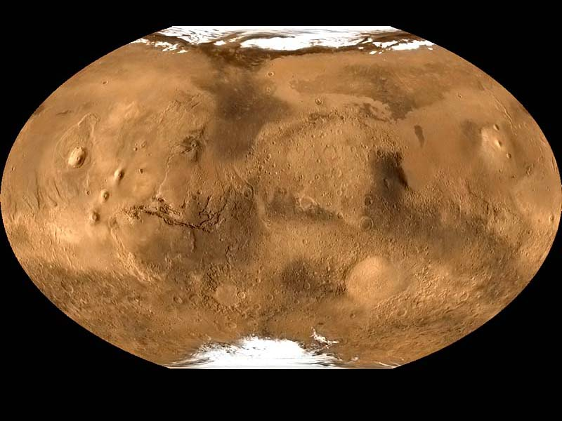
MFF UK 1/2024
www.asu.cas.cz/~jklokocn
MARS
obrázky vesměs
J. Kostelecký
surfer
Výpočty vesměs A. Bezděk
Spolupráce:
V. Cílek, G. Kletetschka,
K. Karimi a další
Přednáší: J. Klokočník
Poznatky o gravitačním poli pomocí gravitačních aspektů

Slide 2
Gravitational aspects (descriptors)
Gravity aspect | Explanation
T | Disturbing static gravitational potential
Δg | Gravity anomaly or perturbation (various versions)
Γ | Marussi tensor (just 5 independent second derivatives of T)
T_{zz} | Element of the Marussi tensor (second derivative of T in the radial direction), usually most important
I_{j} | 3 gravity invariants of the Γ (I₀, I₁, I₂); preserved under any coordinate rotation
I | a ratio of I₁, I₂; when I~0, the causative body is ~2D; when I →1, causative body is 3D
θ | Strike angle is the main direction of Γ, under certain conditions
vd | Virtual deformation based on horizontal derivatives of T in latitudinal and longitudinal directions, expressing dilatation and pure sheer (compression)

Slide 3

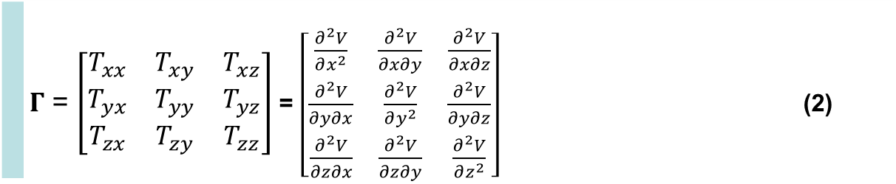
Disturbing static gravitational potential outside the Earth masses in spherical harmonic expansion
 | $$T\left(r,φ,λ\right)=\frac{GM}{r}\sum_{l=2}^{∞}{\sum_{m=0}^{l}{{\left(\frac{R}{r}\right)}^{l}\left({C^{′}}_{l,m}cos mλ+S_{l,m}sin mλ \right)}} P_{l,m}\left(sin φ\right)$$
where GM is a product of the universal gravitational constant and the mass of the Earth (also known as
the geocentric gravitational constant), r is the radial distance of an external point where T is computed,
R is the radius of the Earth (which can be approximated by the semi-major axis of a reference ellipsoid),
P_{l,m} (sin φ) are the Legendre associated functions, l and m are the degree and order of the harmonic expansion,
(φ, λ) are the geocentric latitude and longitude, C’_{l,m} and S_{l,m} are the harmonic geopotential coefficients
(Stokes parameters), fully normalized, C’_{l,m} = C_{l,m} – C^{el}_{l,m}, where C^{el}_{l,m} belongs to the reference ellipsoid.
The spherical approximation of the gravity anomaly Δg is computed
$∆g=−\frac{∂T}{∂r}−2\frac{T}{r}$
or one can use the gravity disturbance (it is the same but without the second term).
Gravity gradient tensor Γ (the Marussi tensor) is a tensor of the second derivatives of
the disturbing potential T:
 | $Γ$ = $\left[\begin{matrix}T_{xx} & T_{xy} & T_{xz} \\ T_{yx} & T_{yy} & T_{yz} \\ T_{zx} & T_{zy} & T_{zz}\end{matrix}\right]$ = $\left[\begin{matrix}\frac{∂^{2}V}{∂x^{2}} & \frac{∂^{2}V}{∂x∂y} & \frac{∂^{2}V}{∂x∂z} \\ \frac{∂^{2}V}{∂y∂x} & \frac{∂^{2}V}{∂y^{2}} & \frac{∂^{2}V}{∂y∂z} \\ \frac{∂^{2}V}{∂z∂x} & \frac{∂^{2}V}{∂z∂y} & \frac{∂^{2}V}{∂z^{2}}\end{matrix}\right]$ (2)
Notes:
Legendre associated functions,… free-air gravity anomaly, gravity disturbance

Slide 4
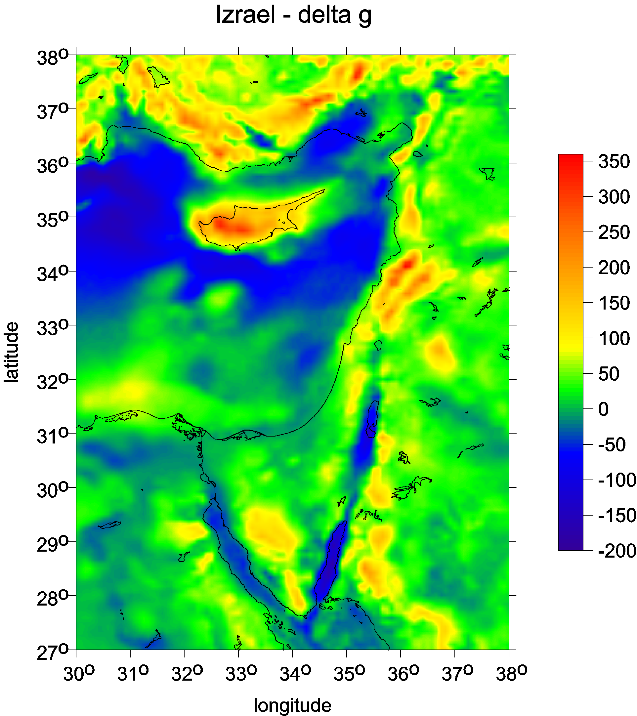

Slide 5
A.H.Saad, The Leading Edge, 942-950, Aug. 2006

Slide 6
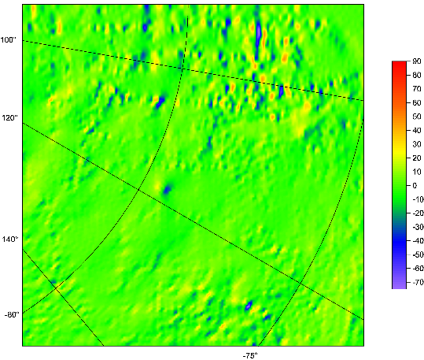
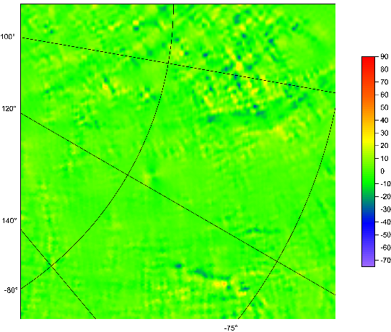
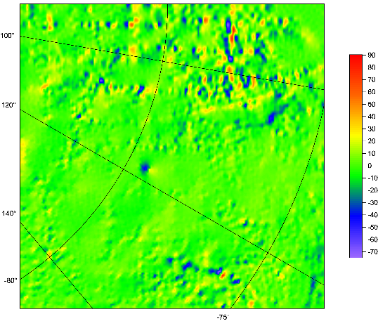
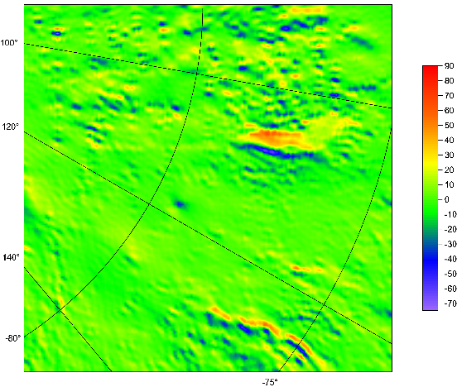
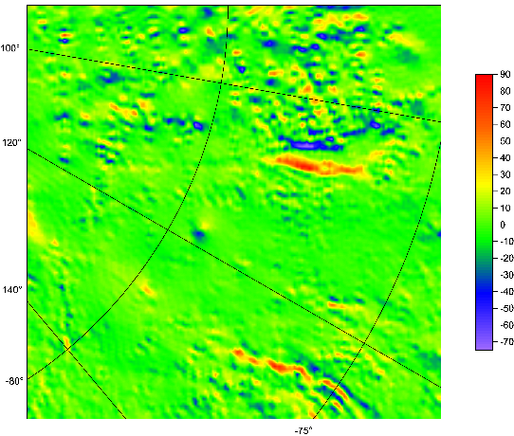
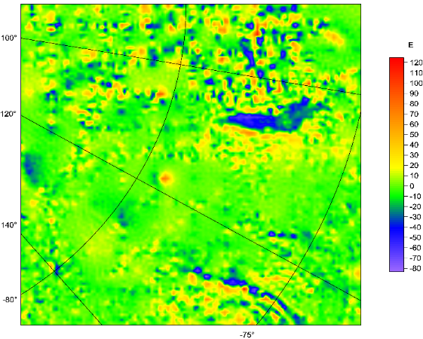
Lake Vostok
East Antarctica
Marussi tensor
of the second derivatives T_{ij}
organized as follows:
T_{xx} T_{xy} T_{xz}
T_{yy} T_{yz}
T_{zz}
West is up

Slide 7


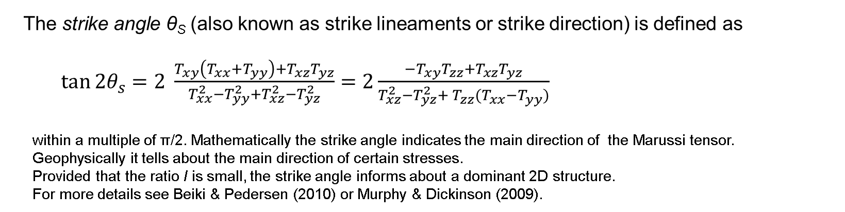

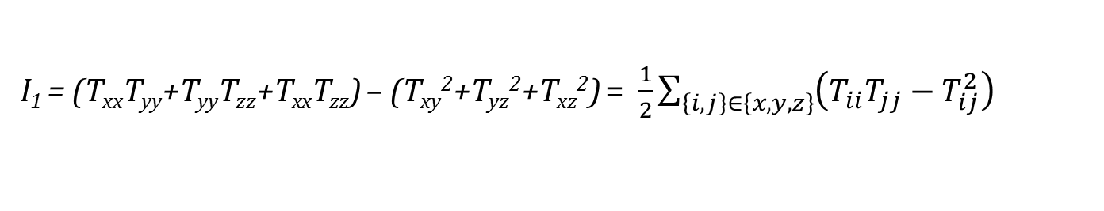
Under any coordinate transformation, Γ preserves
just 3 INVARIANTs
$I_{0}=trace \left(Γ\right)=T_{xx}+T_{yy}+T_{zz}=$ 0
I₁ = (T_{xx}T_{yy}+T_{yy}T_{zz}+T_{xx}T_{zz}) – (T_{xy}²+T_{yz}²+T_{xz}²) = $\frac{1}{2}\sum_{\left\{i,j\right\}∈\left\{x,y,z\right\}}{{\left(T_{ii}T_{jj}−T_{ij}^{2}\right)}_{}}$
I₂ = det (Г) = (T_{xx}(T_{yy}T_{zz}-T_{yz}²) + T_{xy}(T_{yz}T_{xz} – T_{xy}T_{zz}) + T_{xz} (T_{xy}T_{yz}-T_{xz}T_{yy}).
Pedersen & Rasmussen (1990) showed that
the ratio I of I₁ and I₂ (dimensionless) defined as
$$0≤I=−\frac{{\left({I_{2}}/2\right)}^{2}}{{\left({I_{1}}/3\right)}^{3}}≤1$$
lies between 0 and 1 for any potential field. If the causative body is strictly 2D, then I = 0.
The strike angle θ_{S} (also known as strike lineaments or strike direction) is defined as
$\tan{2θ_{s}}=2 \frac{T_{xy}\left(T_{xx}+T_{yy}\right)+T_{xz}T_{yz}}{T_{xx}^{2}−T_{yy}^{2}+T_{xz}^{2}−T_{yz}^{2}}=2\frac{{−T}_{xy}T_{zz}+T_{xz}T_{yz}}{T_{xz}^{2}−T_{yz}^{2}+{{ T}_{zz}^{}(T}_{xx}^{}−T_{yy}^{})}$
within a multiple of π/2. Mathematically the strike angle indicates the main direction of the Marussi tensor.
Geophysically it tells about the main direction of certain stresses.
Provided that the ratio I is small, the strike angle informs about a dominant 2D structure.
For more details see Beiki & Pedersen (2010) or Murphy & Dickinson (2009).

Slide 8
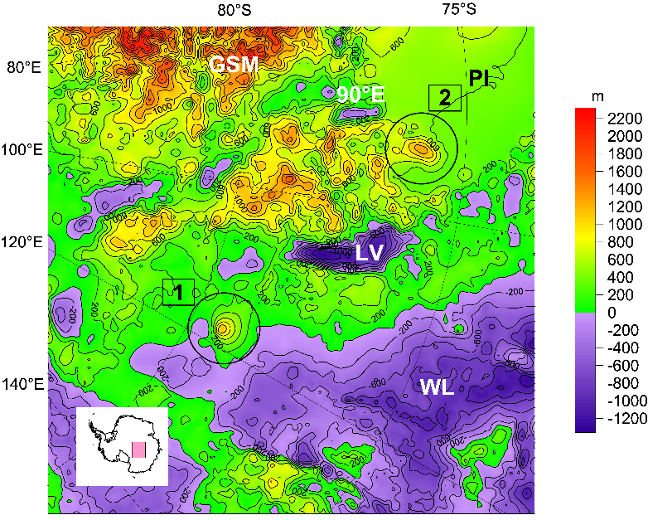
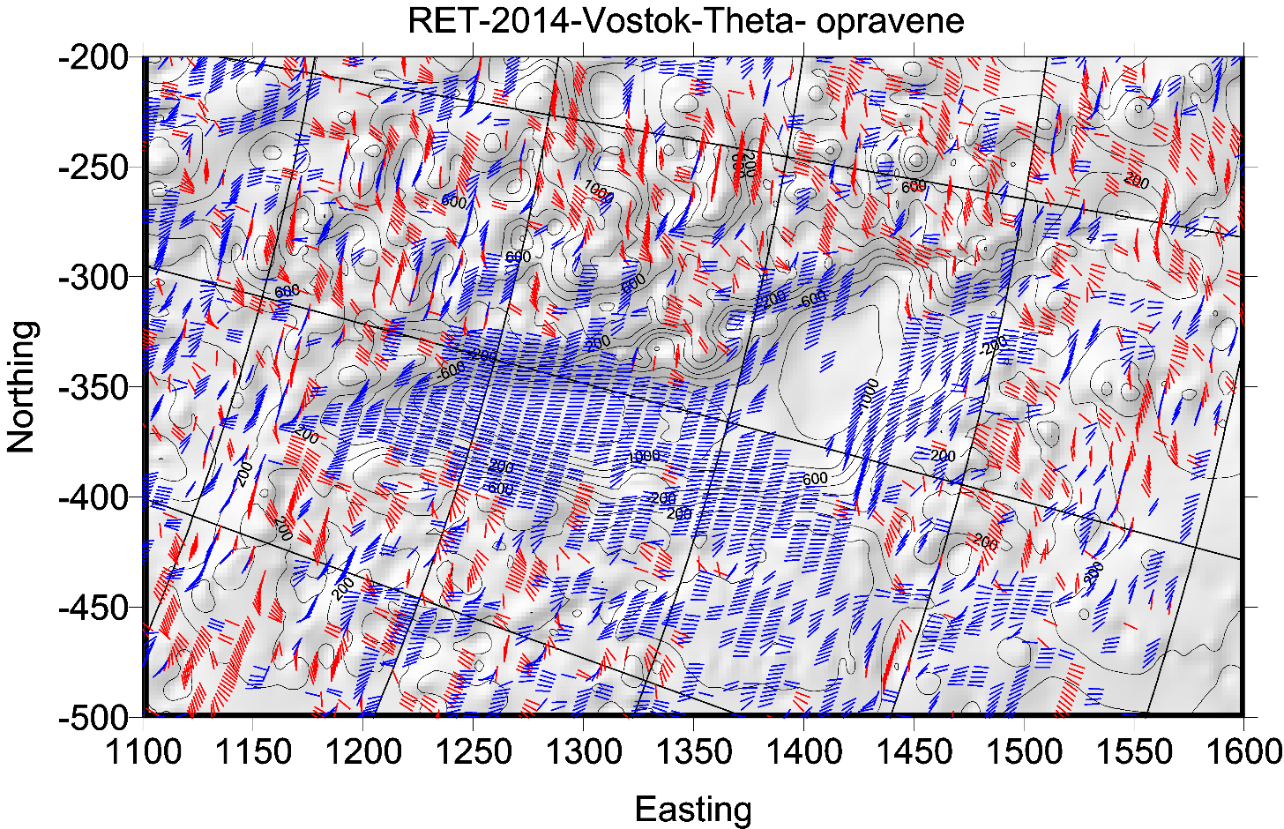

Slide 9
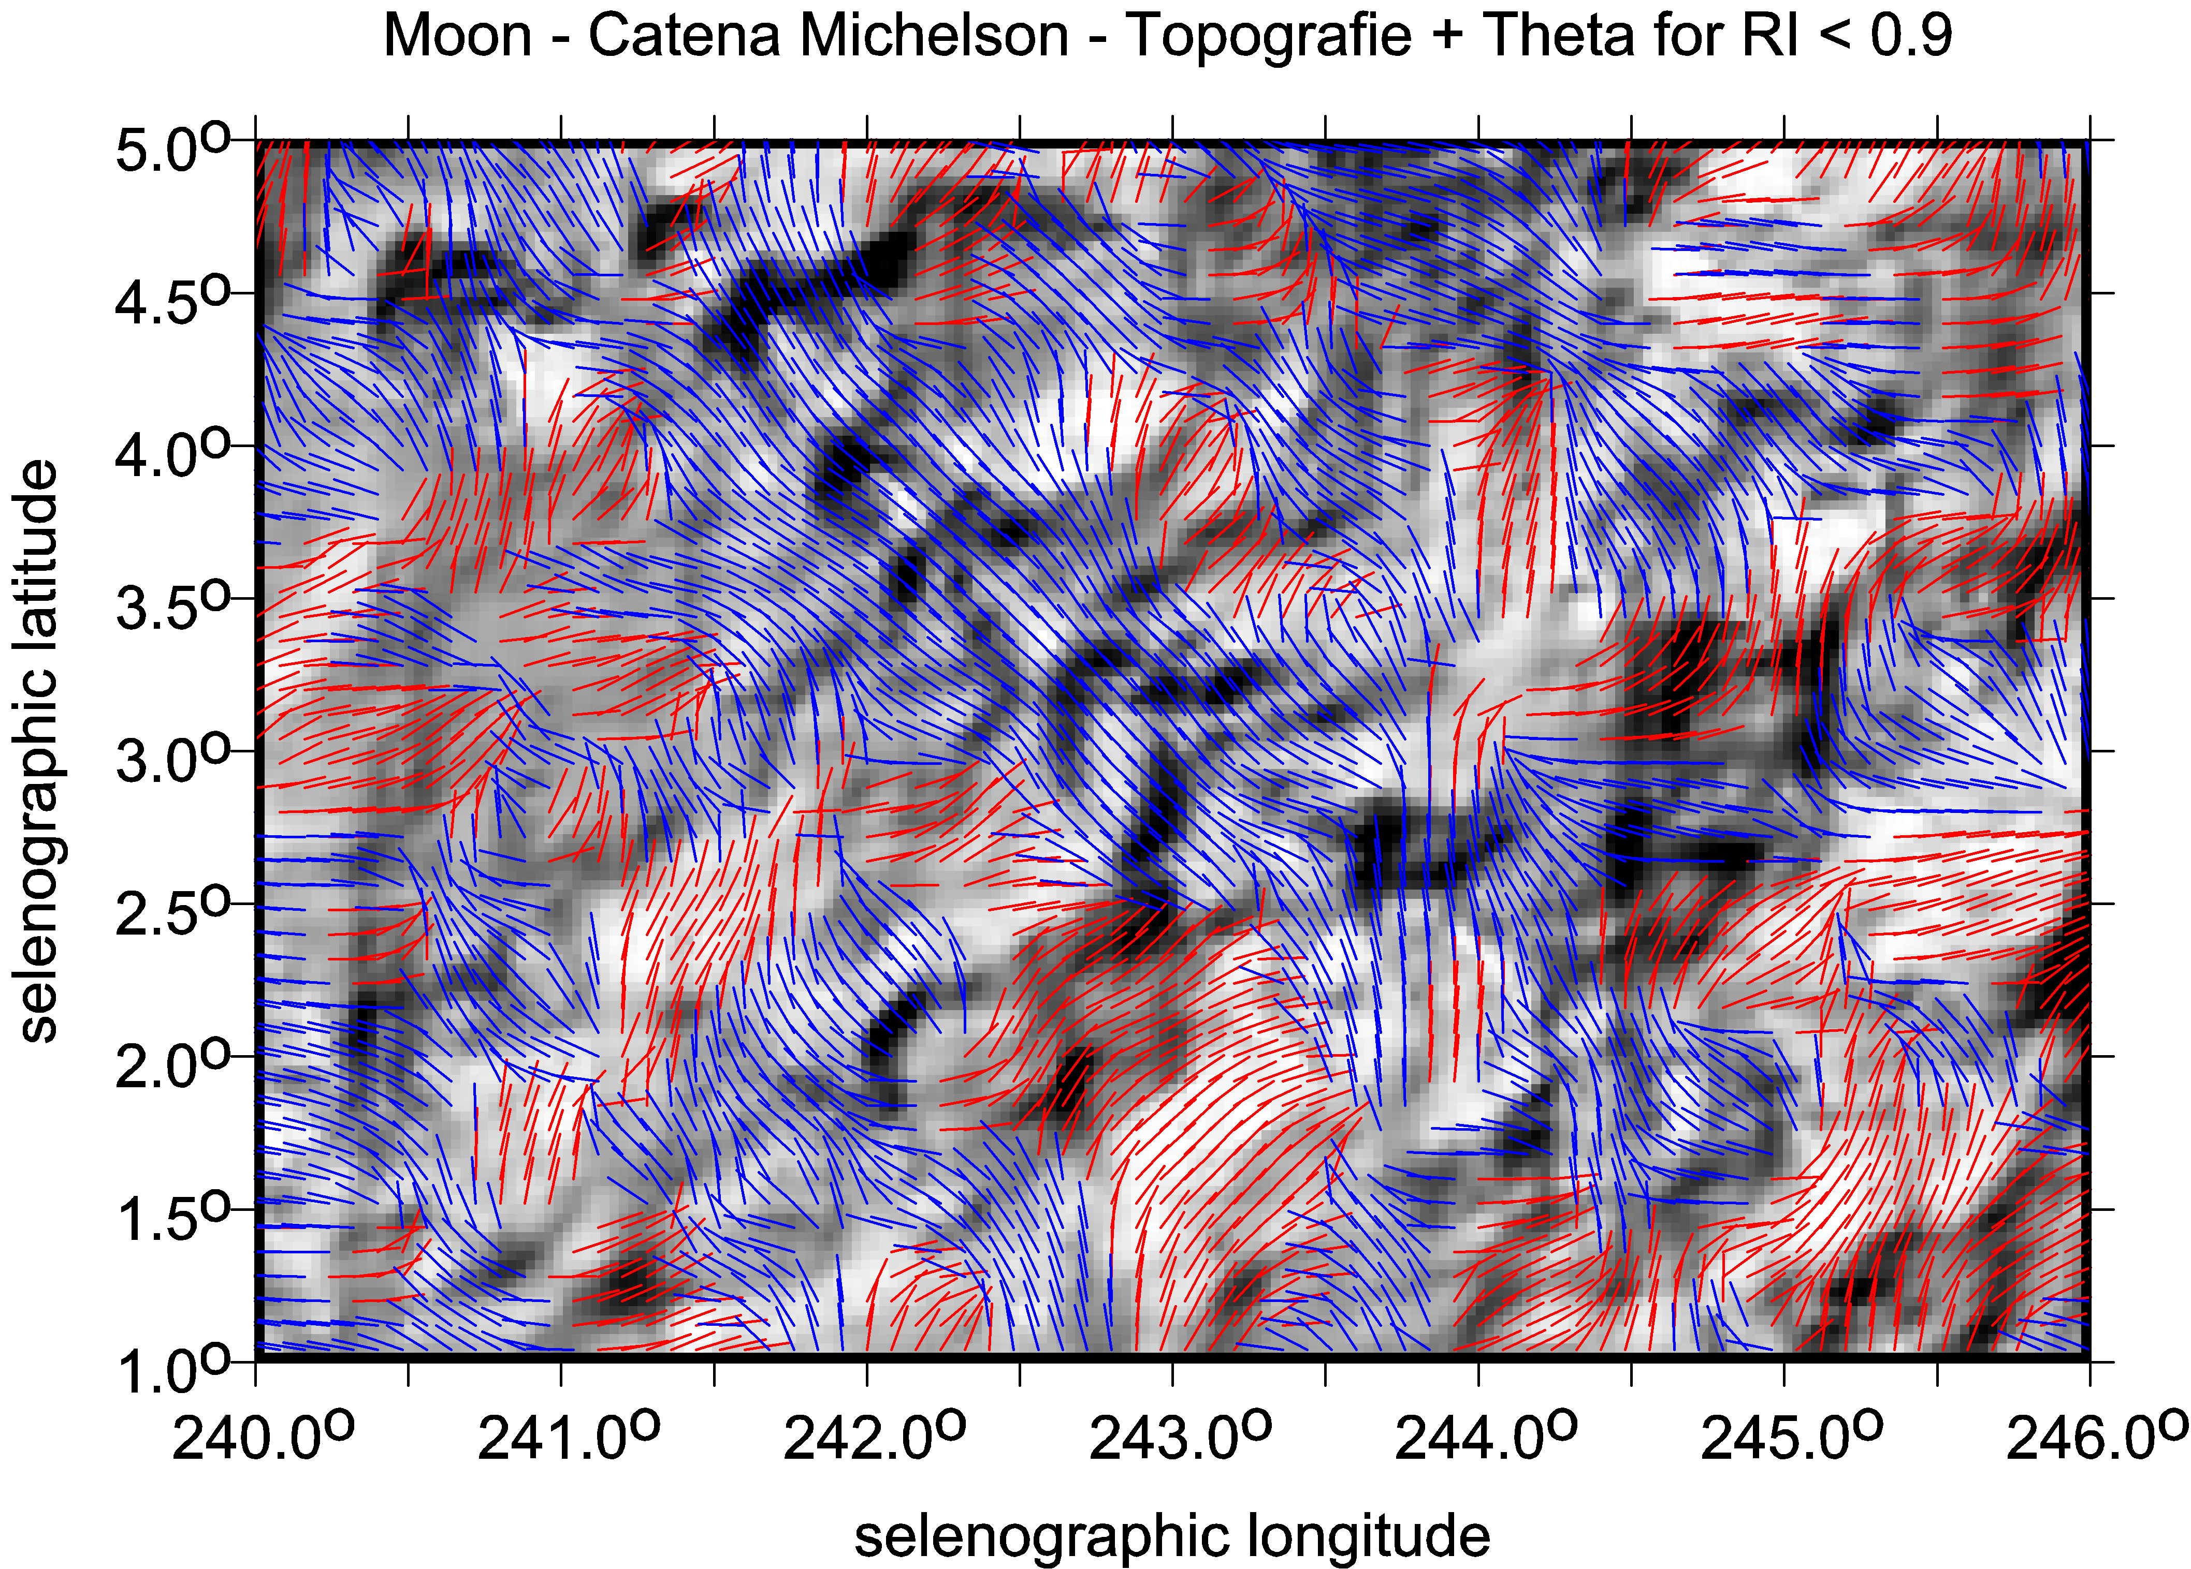

Slide 10
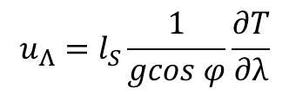



Virtual deformations (Kalvoda et al. 2012, Klokočník et al. 2013)
directions of such a deformation due to “erosion” brought about solely by “gravity origin”.
If there would be a tidal potential T, then the horizontal shifts (deformations) would exist due to it
and they could be expressed
in north-south direction (latitude direction) … [left] and in east-west direction (longitudinal direction) … [right]
where g is the gravity acceleration 9.81 m⋅s⁻²,
l_{S} is the elastic coefficient (Shida number) expressing the elastic properties of the Earth as a planet (l_{S} = 0.08),
φ and λ are the geocentric coordinates (latitude and longitude) of a point P where we measure T
The apparatus of mechanics of continuum to derive the main directions of the tension is applied (see, e.g., Brdička et al. 2000).
The tensor of (small) deformation E is defined as a gradient of shift. It holds that
The tensor E can be separated into two parts:
where e is the symmetrical tensor and Ω the anti-symmetrical tensor of deformation, respectively. The symmetrical tensor is
and the parameters of deformation are:
Δ = e₁₁ + e₂₂ total dilatation a = ½ (Δ + γ) major semi-axis of ellipse of deformation
γ₁ = e₁₁ - e₂₂ pure cut b = ½ (Δ – γ) minor semi-axis of ellipse of deformation
γ₂ = 2e₁₂ technical cut α = ½ atan(γ₂ / γ₁) direction of main axis of deformation
γ = (γ₁² + γ₂²)^{1/2} total cut
.
$$u_{Φ}=l_{S}\frac{1}{g}\frac{∂T}{∂φ}$$
$$u_{Λ}=l_{S}\frac{1}{gcos φ}\frac{∂T}{∂λ}$$
$$E=\left(\begin{matrix}ε_{11} & ε_{12} \\ ε_{21} & ε_{22}\end{matrix}\right)=\left(\begin{matrix}\frac{∂u_{x}}{∂x} & \frac{∂u_{x}}{∂y} \\ \frac{∂u_{y}}{∂x} & \frac{∂u_{y}}{∂y}\end{matrix}\right)$$
$$E=e+Ω= \left(e_{ij}\right)+\left(Ω_{ij}\right)$$
$e=\left(\begin{matrix}e_{11} & e_{12} \\ e_{21} & e_{22}\end{matrix}\right)=\left(\begin{matrix}ε_{11} & {(ε}_{12}+ε_{21})/2 \\ {(ε}_{12}+ε_{21})/2 & ε_{22}\end{matrix}\right)$

Slide 11
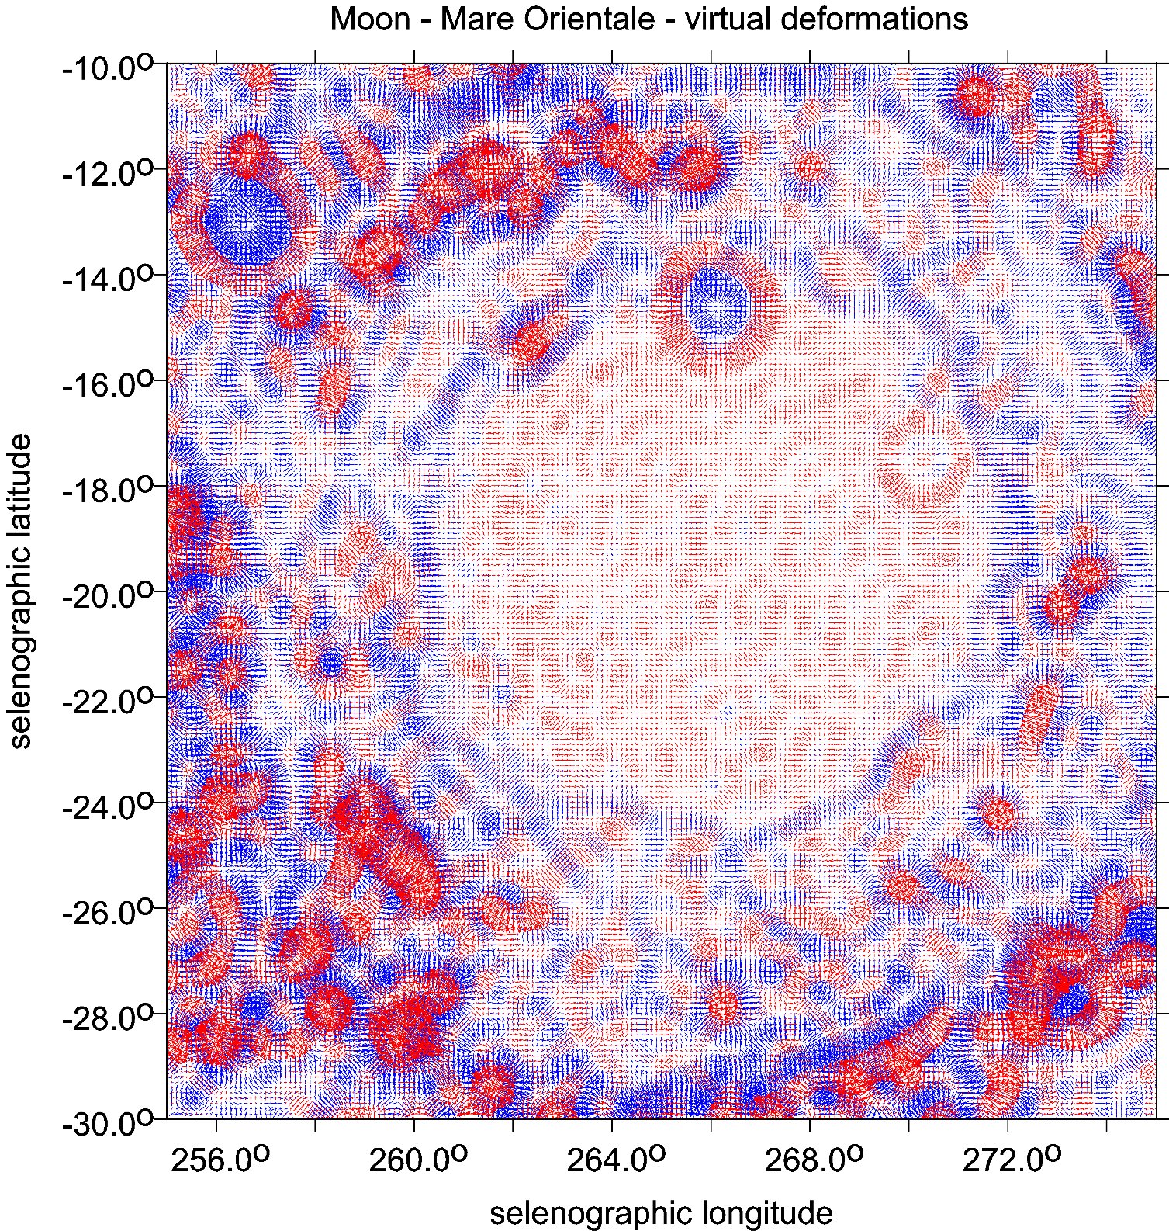
Mare Orientale

Slide 12
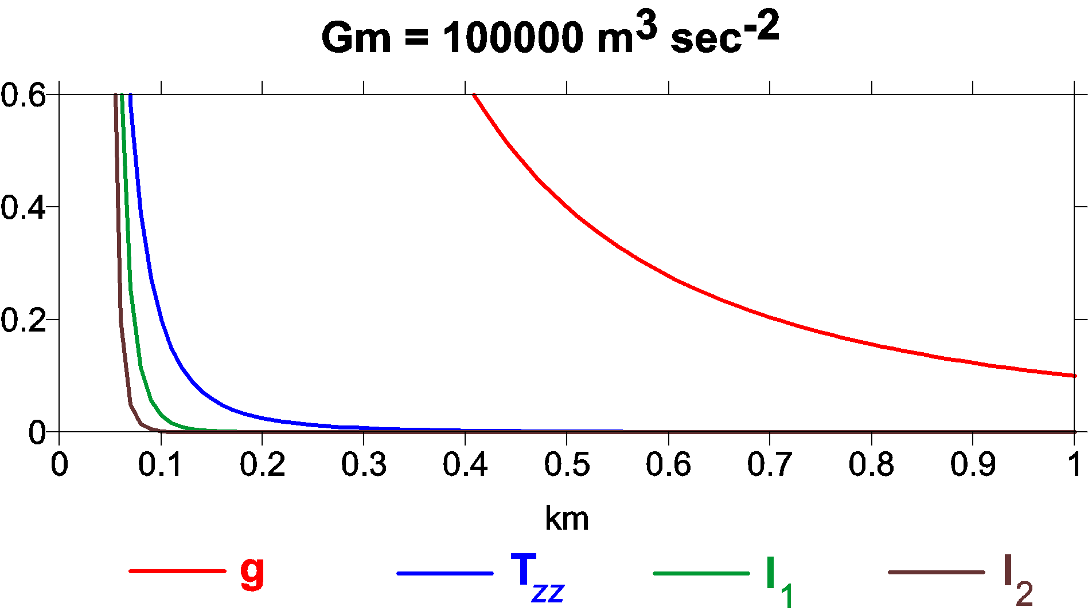
An example of decrease in the values of the gravity aspects of the model potential with increasing distance (depth) from their source. On the x axis there are depths in kilometres, on the y axis there is an arbitrary quantity
(for a simple intercomparison). This is an illustrative case for a mass point with randomly selected value of GM (here Gm, representing a spherical density anomaly).

Slide 13
Ground Resolution
A usual simple estimate of the smallest representable feature of the gravity field or the shortest half-wavelength L_{half} (as a distance on a sphere) that can be resolved with all C_{lm}, S_{lm} to L_{max}, is
L_{half} = π R/ L_{max}
or equivalently, taking the circumference 2πR = 40 050 km for the Earth:
L_{half} = 2 π R/ (2 L_{max}) = 40 050/ (2 L_{max}).
This L_{half} is what we call the “ground resolution”. For L_{max}= 300 and 2190, we have L_{half} = 67 and 9 km, respectively. The former limit roughly corresponds to the resolution of the GOCE data alone, and the latter belongs to the combined models, EGM 2008, EIGEN 6C4 or SatGavRET2014 (in the case of the Earth).
Body R [km] max d/o of resolution [km]
rounded model used
-----------------------------------------------------------------
Earth 6380 2190 9
Moon 1740 600 9
Mars 3400 80-120 130-90
Venus 6050 120 160

Slide 14
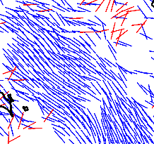
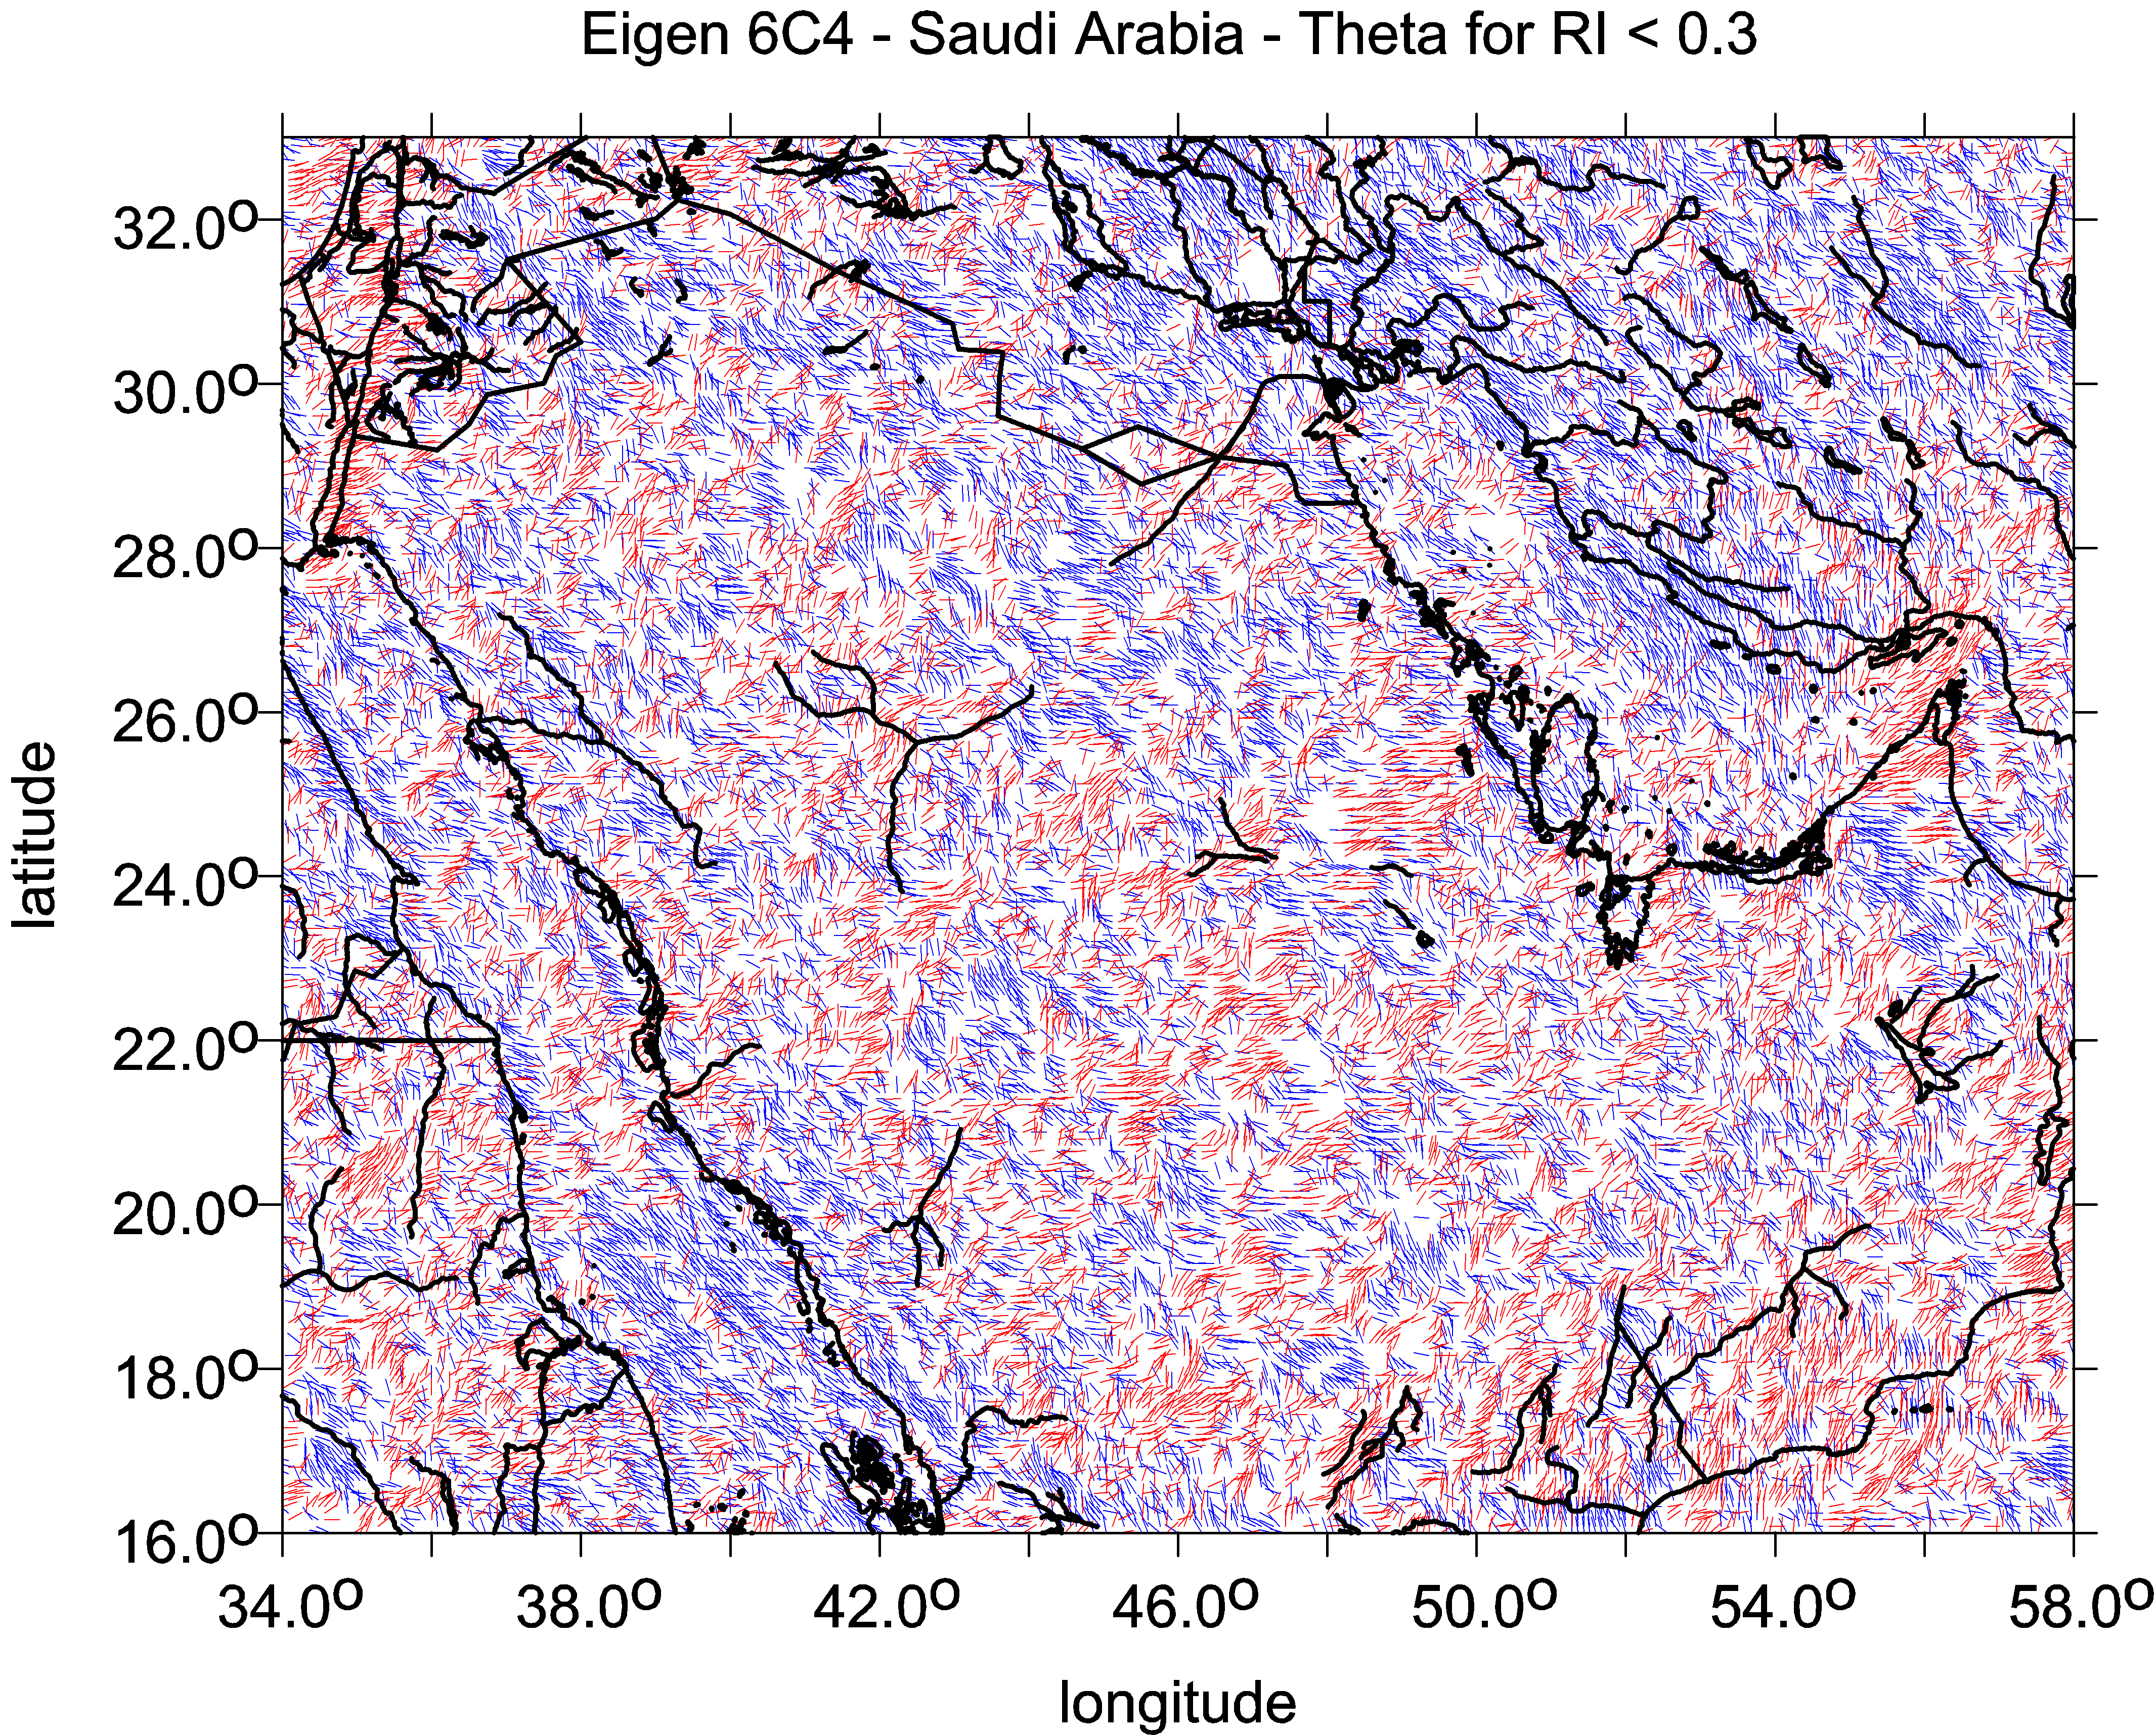
The combed strike angle
Strike angles aligned. Being combed, the strike angle indicates existence of impact craters, or task deposits, but yields no proof of them; the indication is not unambiguous as for oil&gas, it may indicate water, ground water, wadi, deep valley, trench, may be also coal; further information needed (topography, geology,…) for specific decision…
combed strike angles in the studied area, disheveled strike angles in the studied area = one way oriented strike angles = strike angles are in diverse directions
comb factor → 1 comb_factor → 0

Slide 15
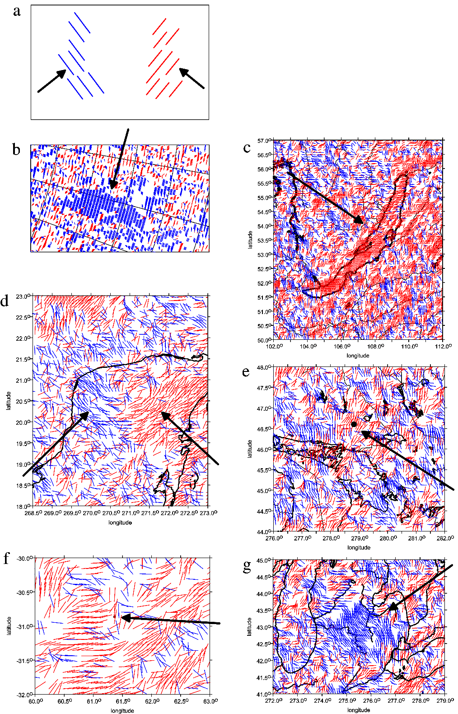
Strike angles for the impact angle – tutorial
a theory
b Lake Vostok, Antarctica
c Lake Bajkal, Russia
d impact crater Chicxulub, north Yucatan
e impact crater Sudbury, Canada
f probable impact crater Burckle, Indian Ocean
g Saginaw Bay, the Great Lakes, USA
The arrows show direction rectangular to the direction
of the strike angles
red colour means their direction to the west and
blue to the east of the local meridian

Slide 16
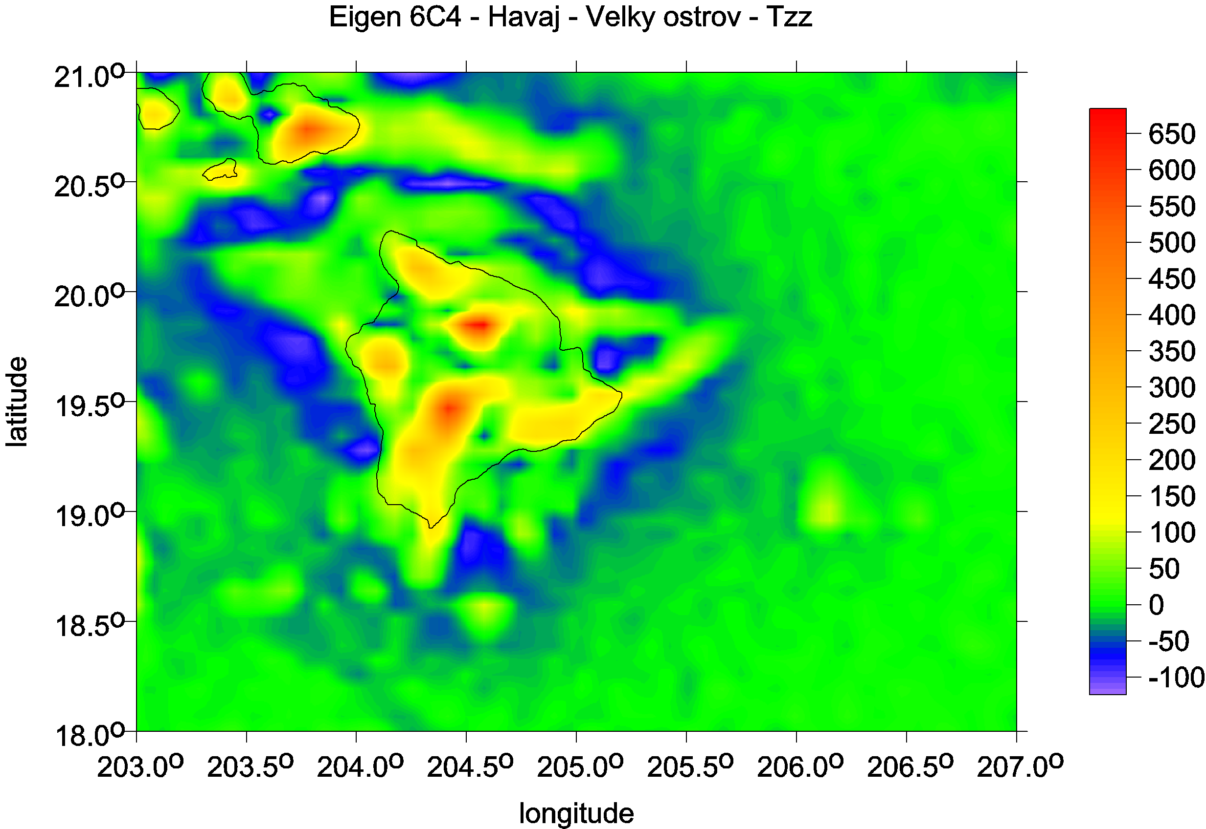
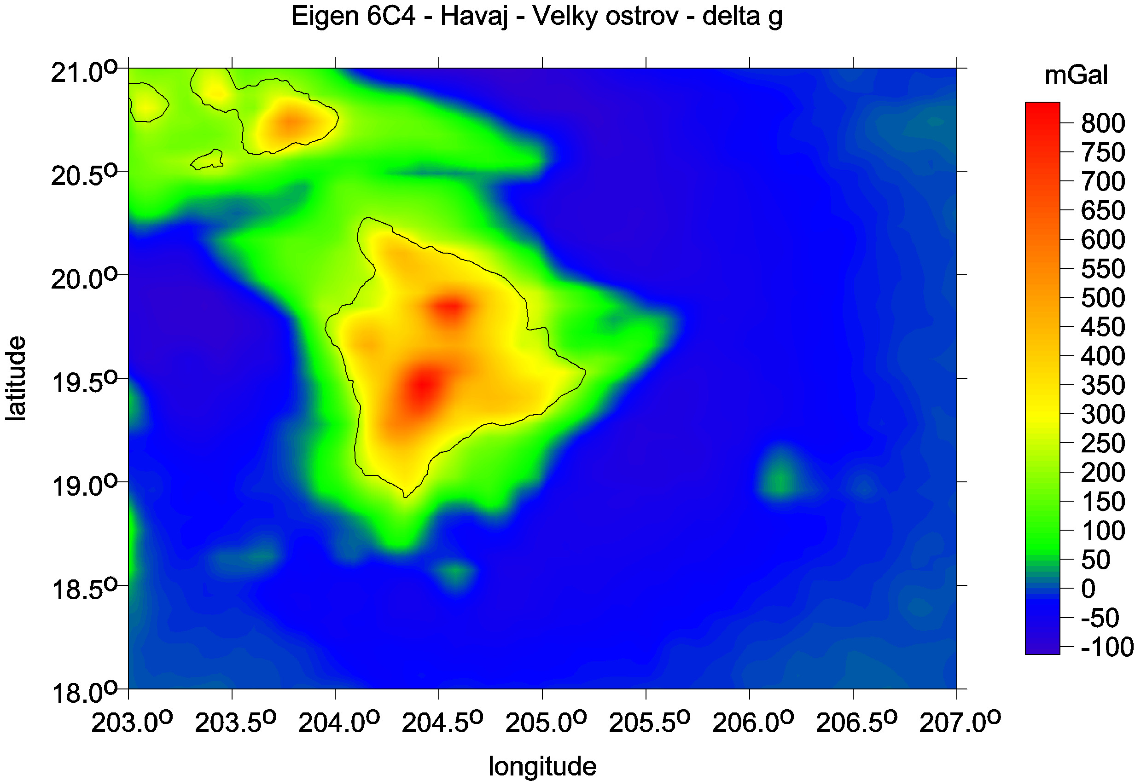
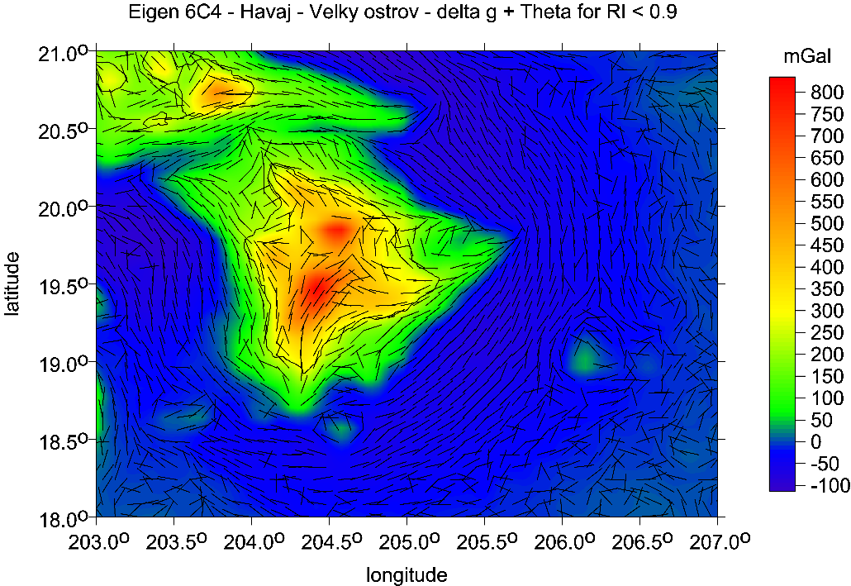
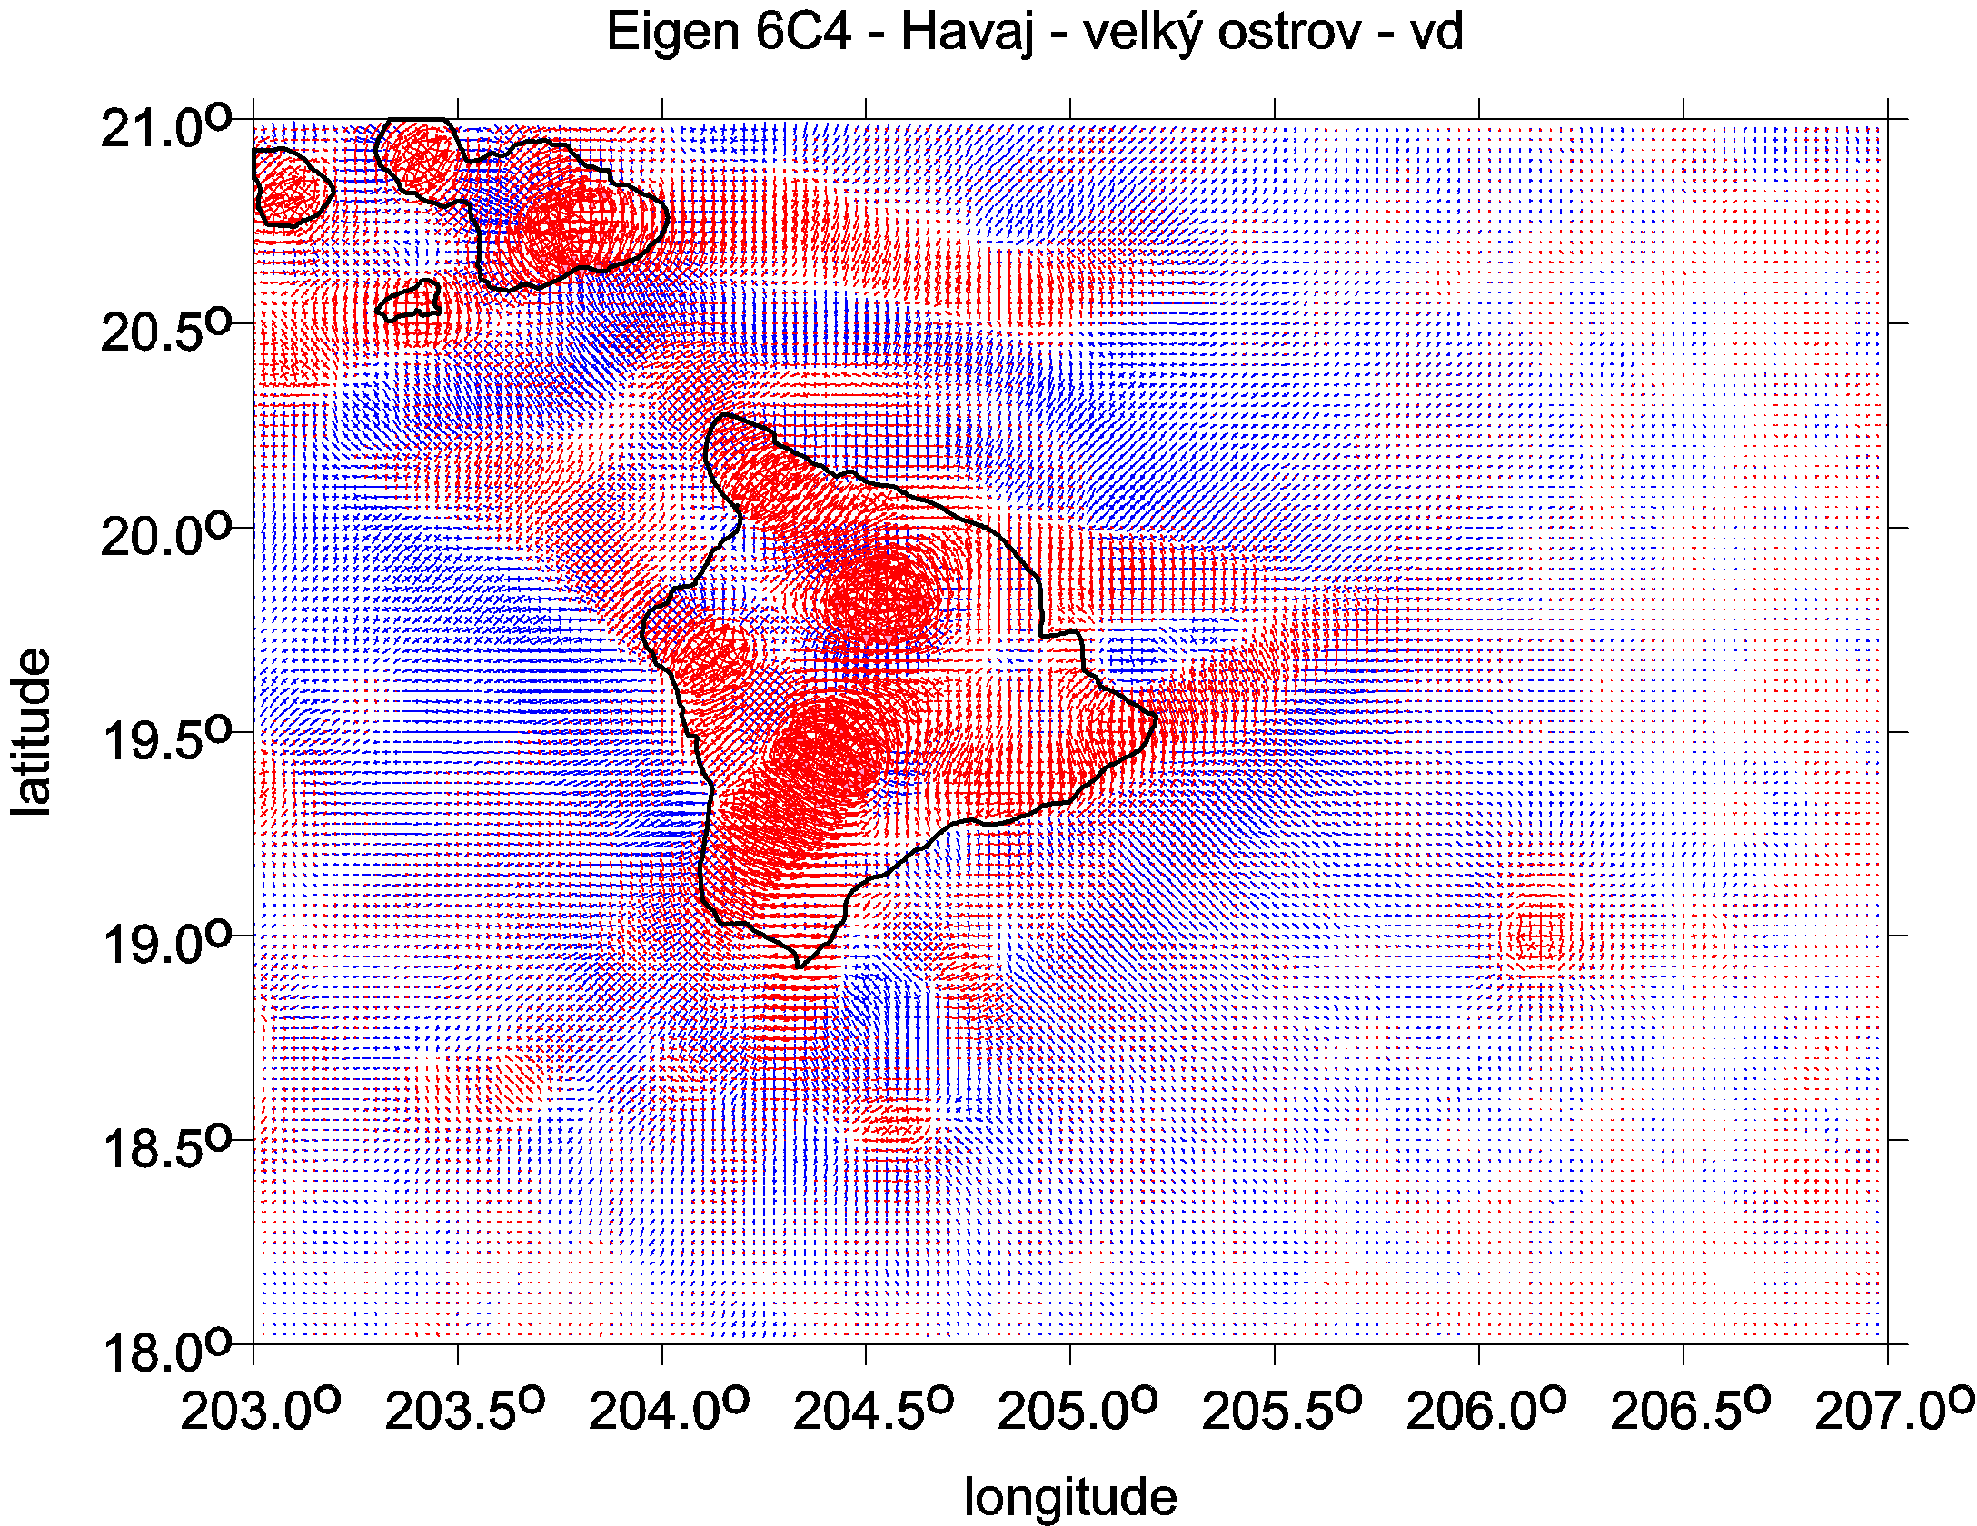
Big Island Hawaii

Slide 17
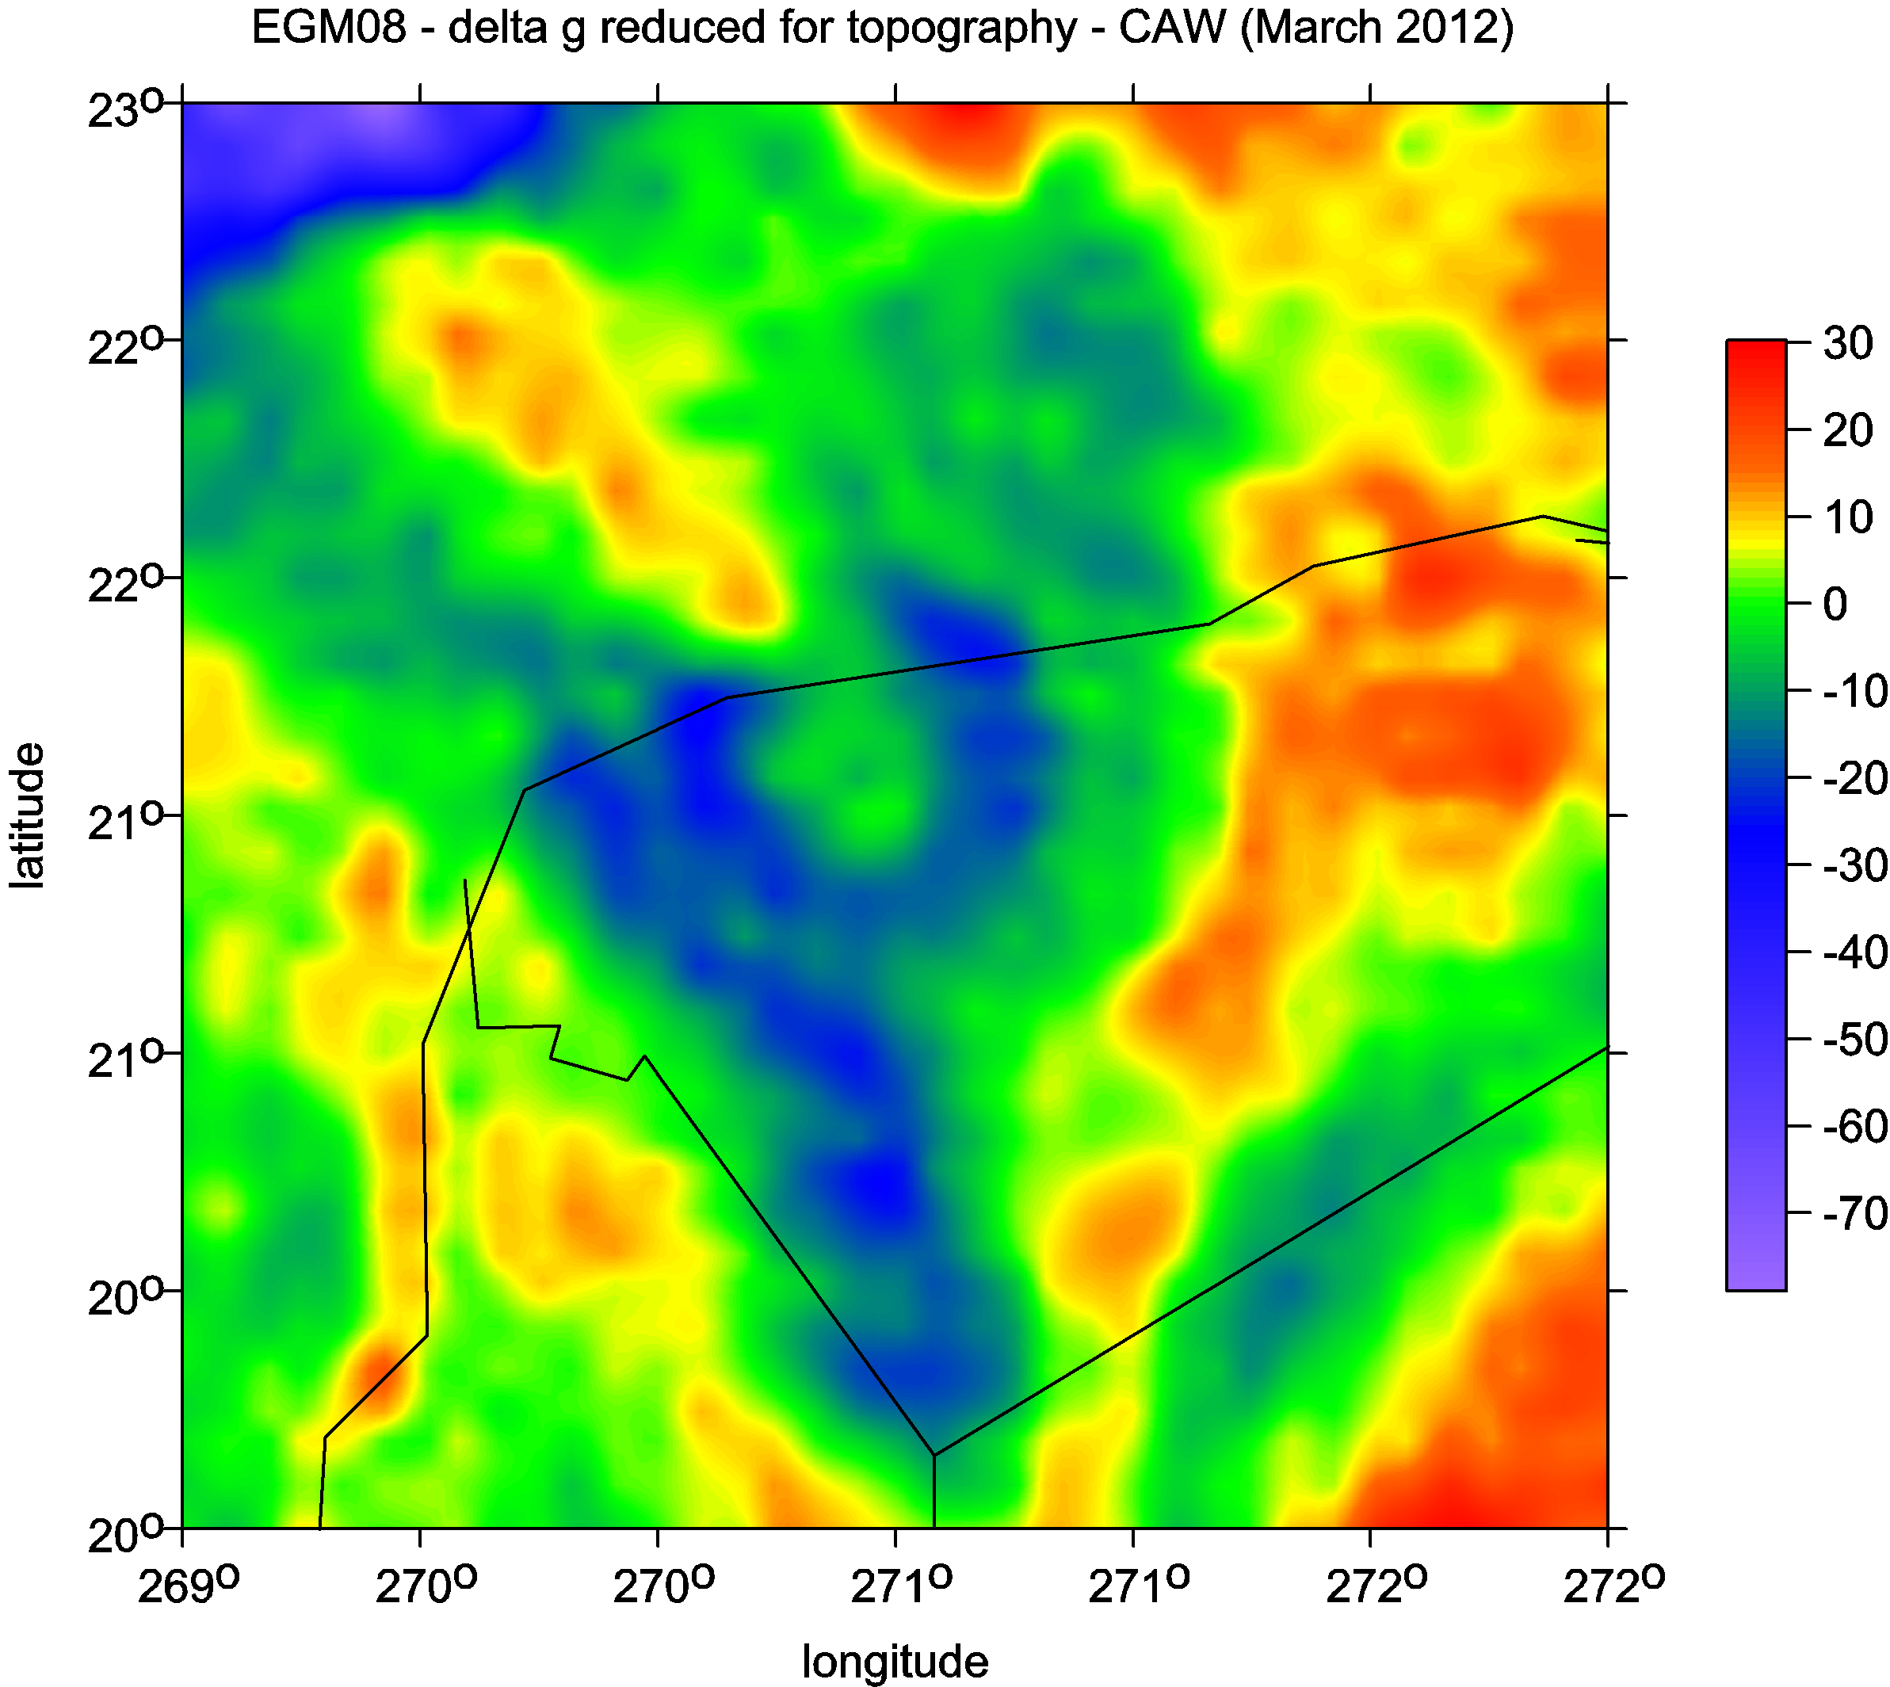
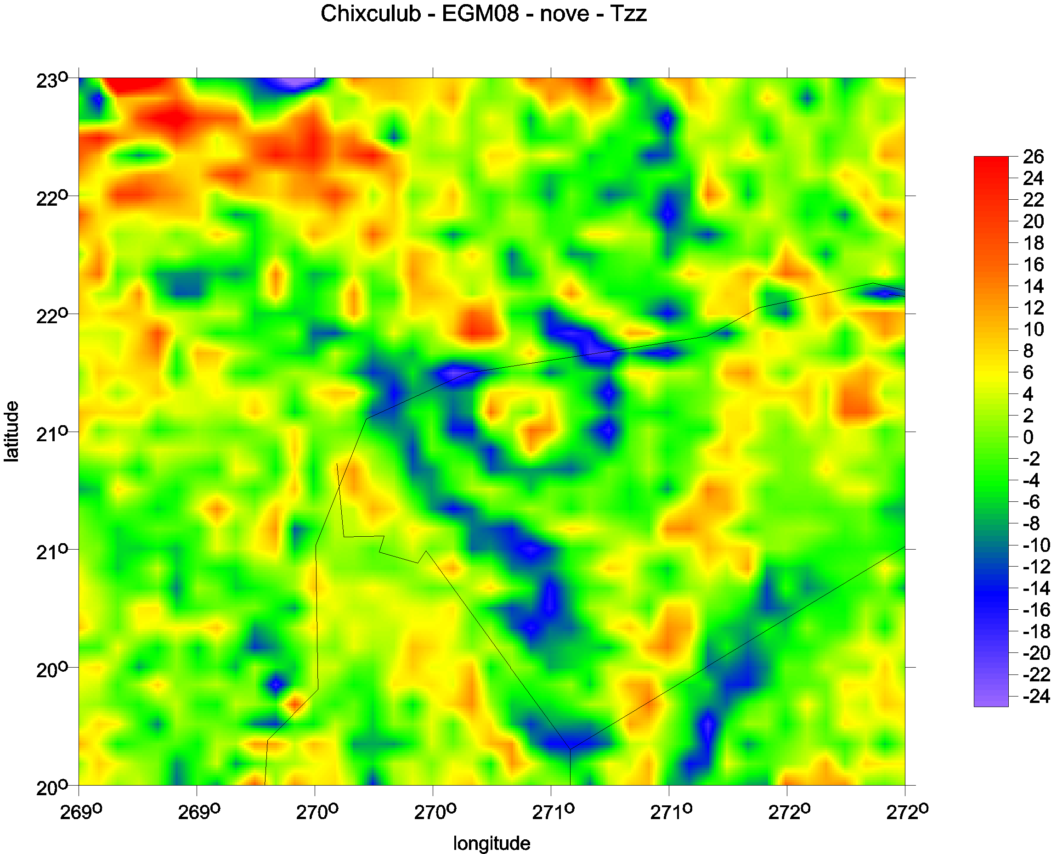
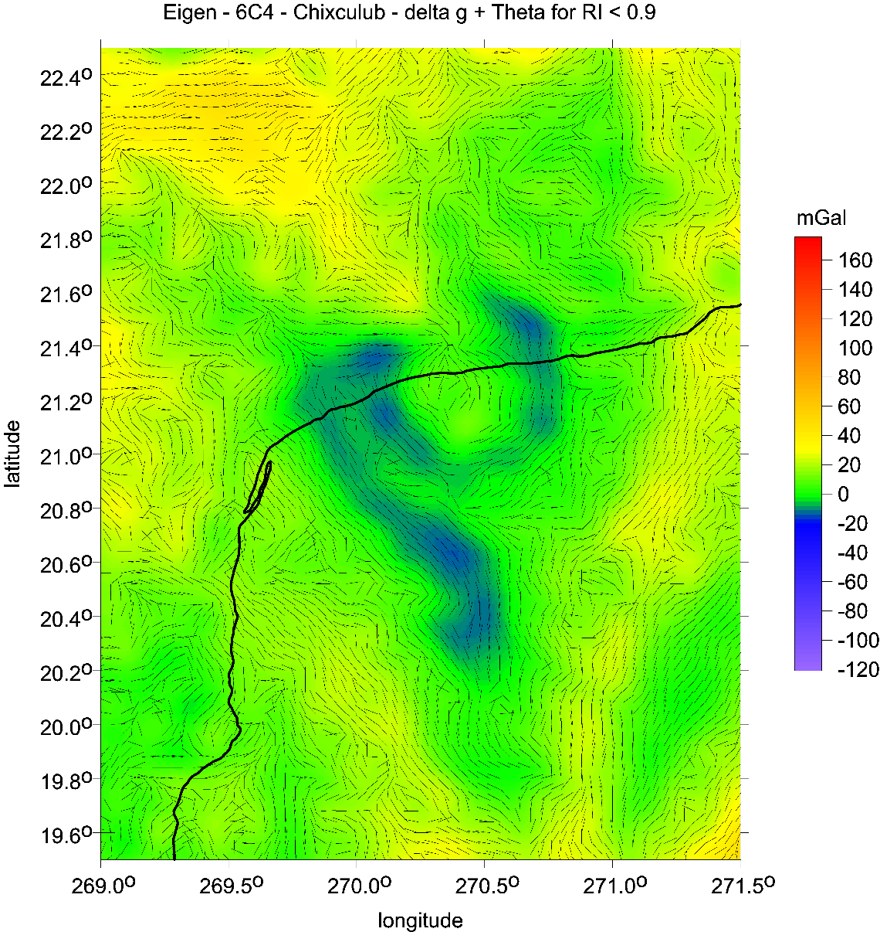
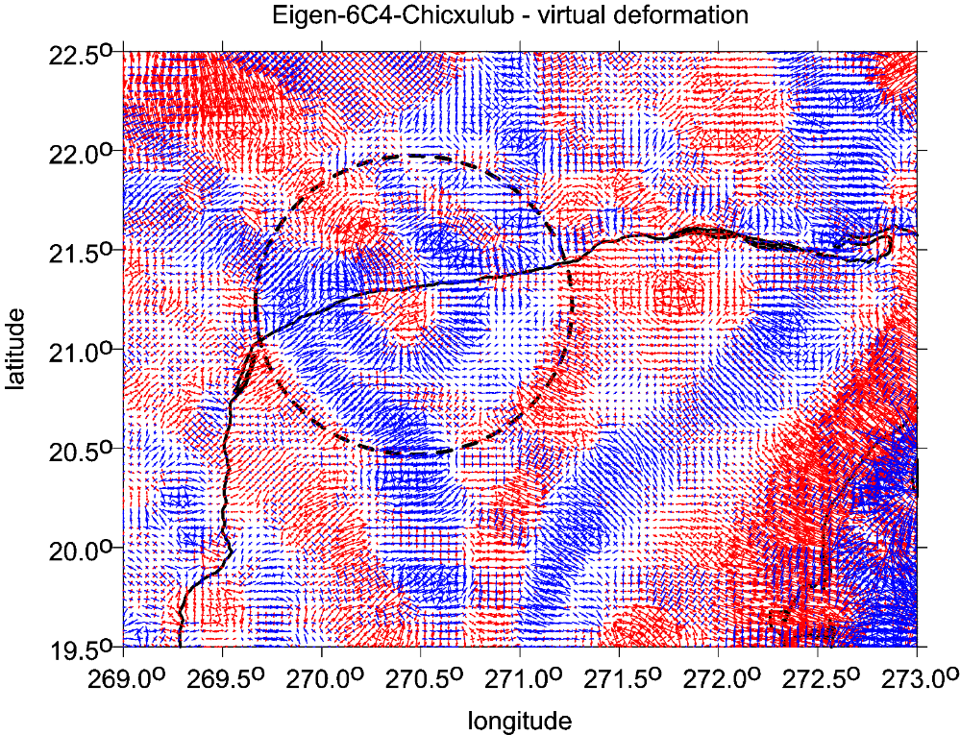
Chicxulub
locations of cenote (dots) versus strike angles

Slide 18
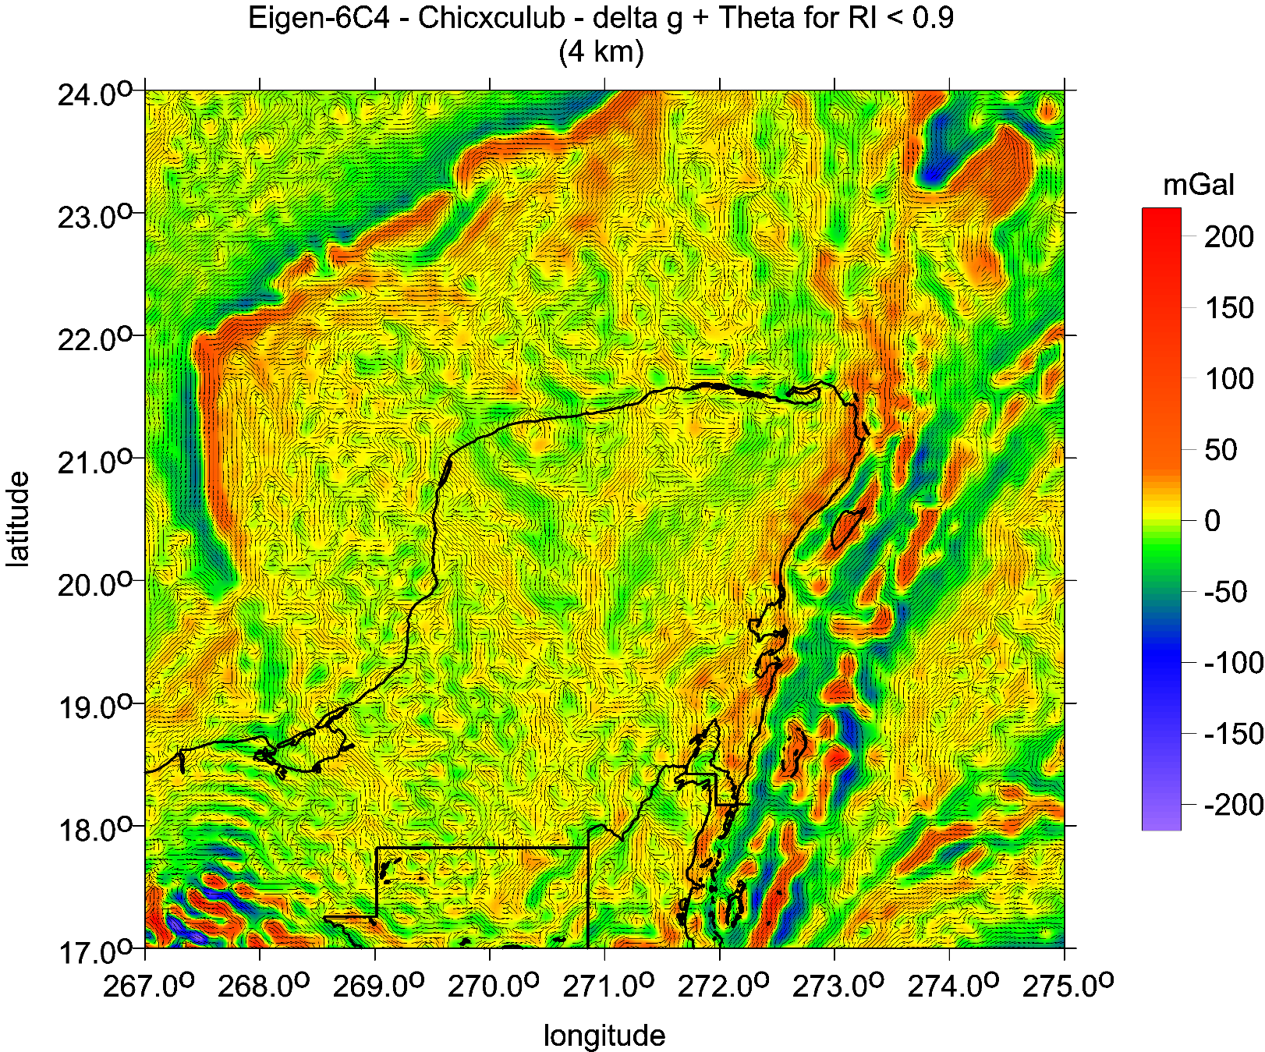
E
Chicxulub,
Yucatan
Mexico
Strike angles
Strike angles [deg], I<0.9, with Tzz [E])

Slide 19
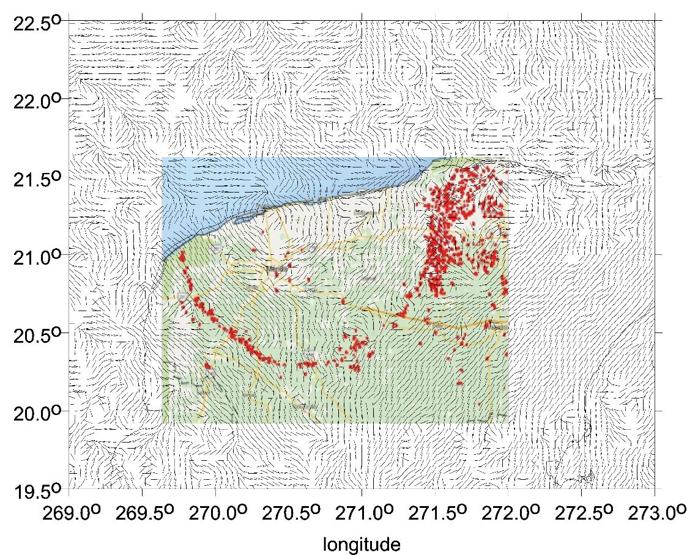
CHICXULUB:
gravity anomalies [mGal] from EIGEN 6C4, left: strike angles and cenotes

Slide 20
impact crater
Vredefort, South Africa
The strike angles follow rings of the impact structure Vredefort, South Africa. In the central part of the crater they are combed not around the crater but in one prevailing direction.
To draw this, Beiki and Pedersen (2010) used the detailed local airborne gradiometry data, which we have not available and the resolution of our data source (EIGEN 6C4) is not sufficient for this purpose.

Slide 21
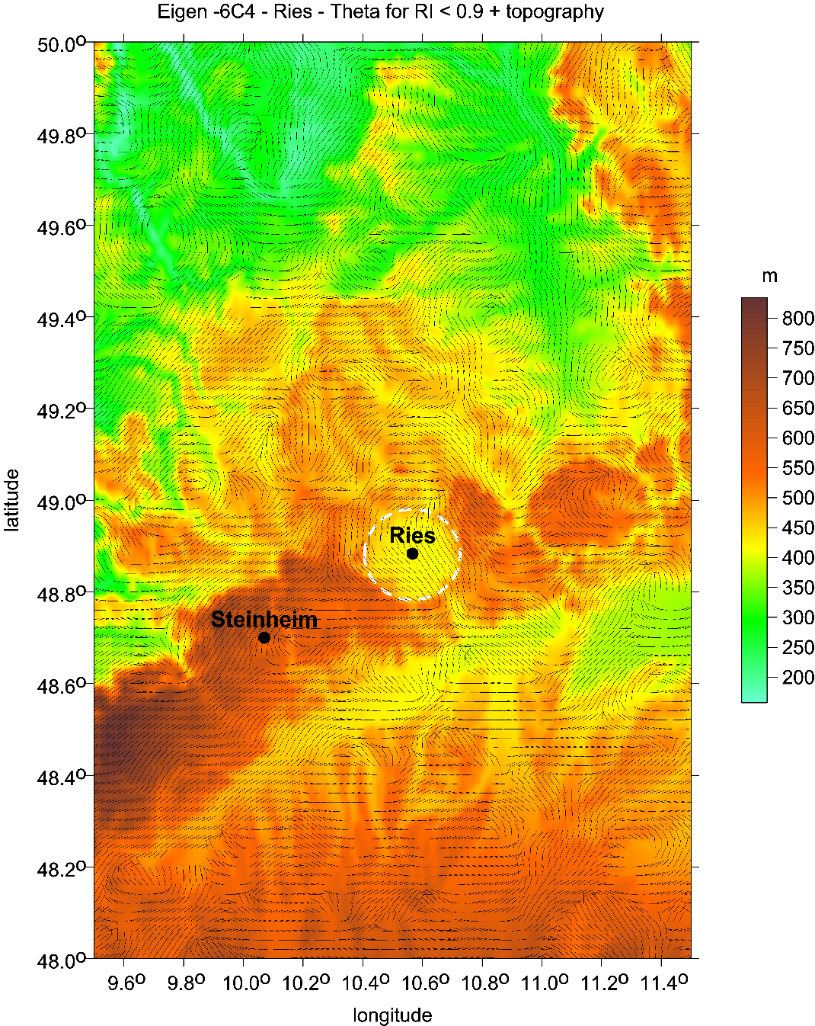
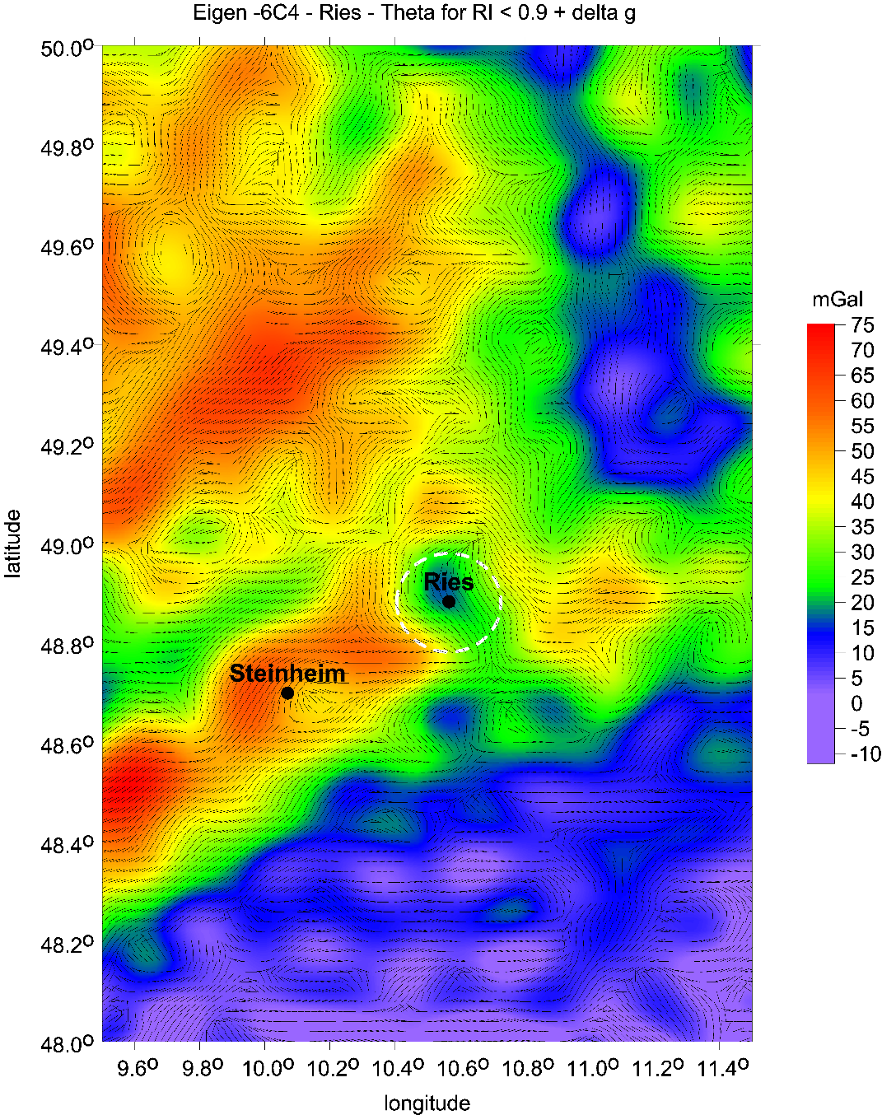
Impact craters Ries and Steinheim, Germany
Strike angles [deg], I<0.9, with ETOPO 1 topography [m] (left) Strike angles, I<0.9, with ∆g (right))

Slide 22
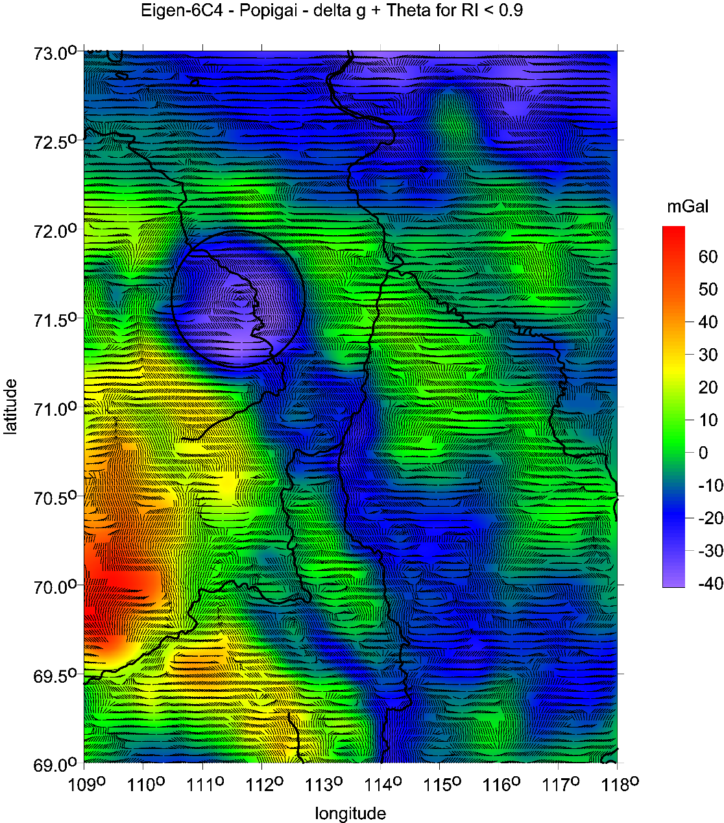
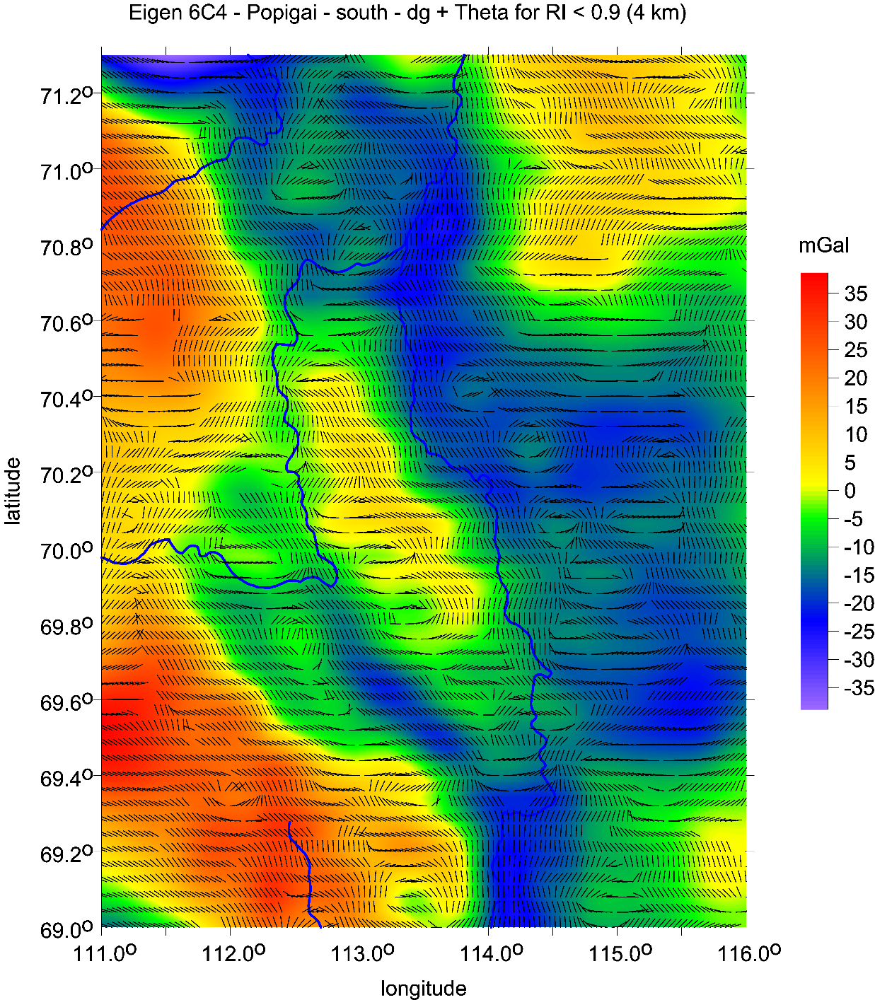
Popigaj,
the main crater
the whole set (left)
southern-east part with possible craters
Popigaj II, II, and IV
(see ©Klokočník et al 2010, SE EGU and Google Earth)

Slide 23
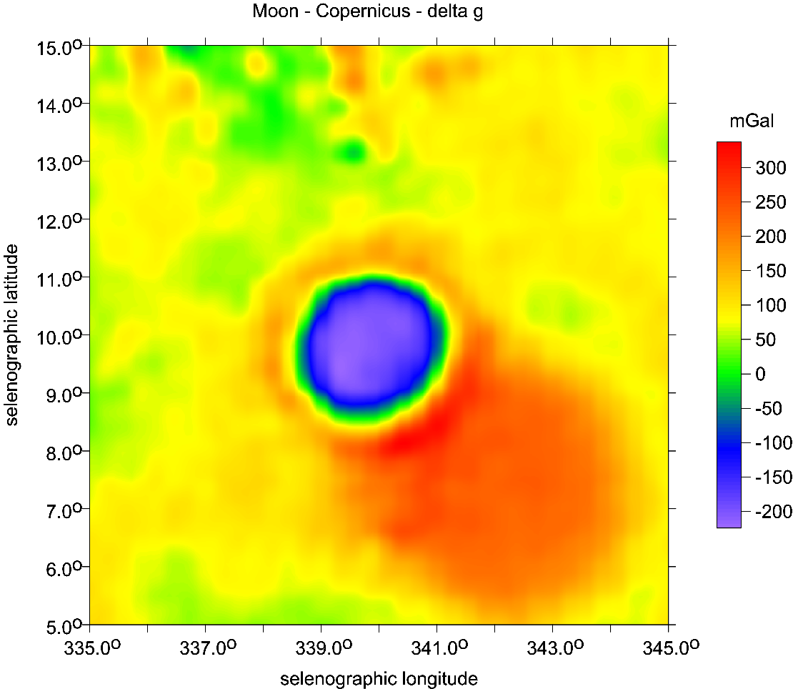
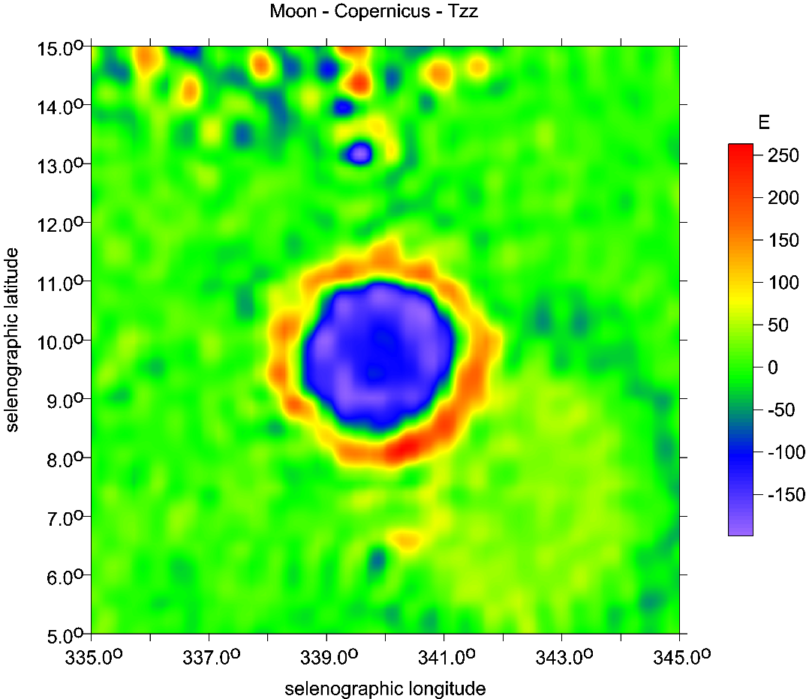
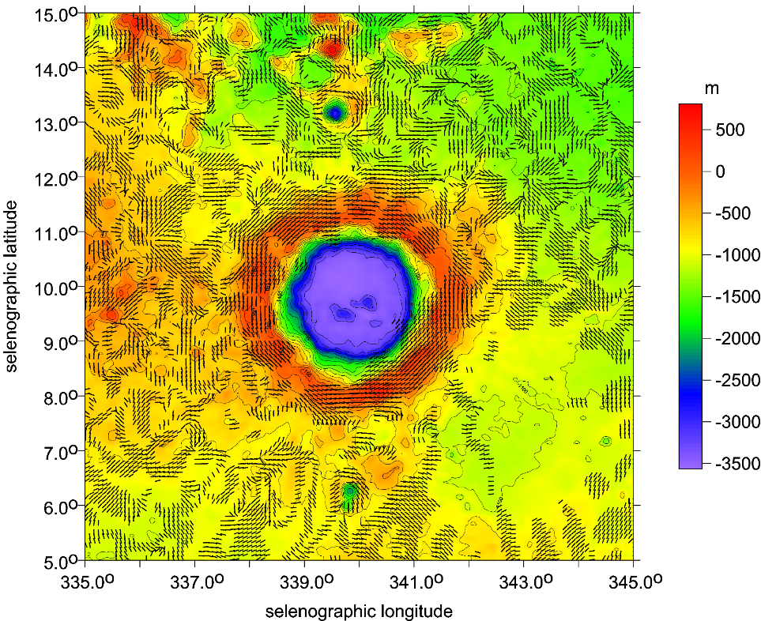
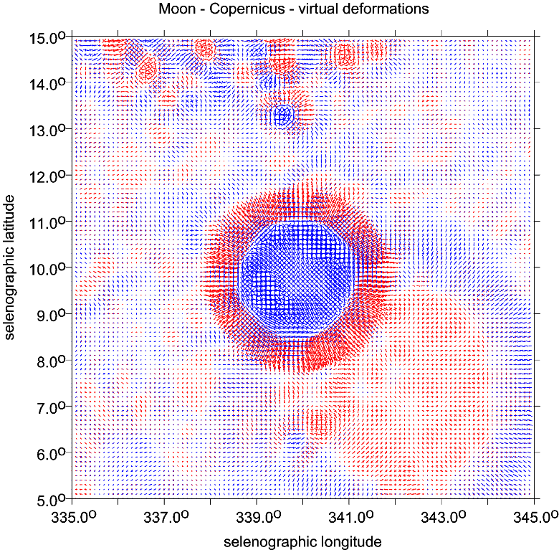
Copernicus main crater and Copernicus H mascon SE

Slide 24
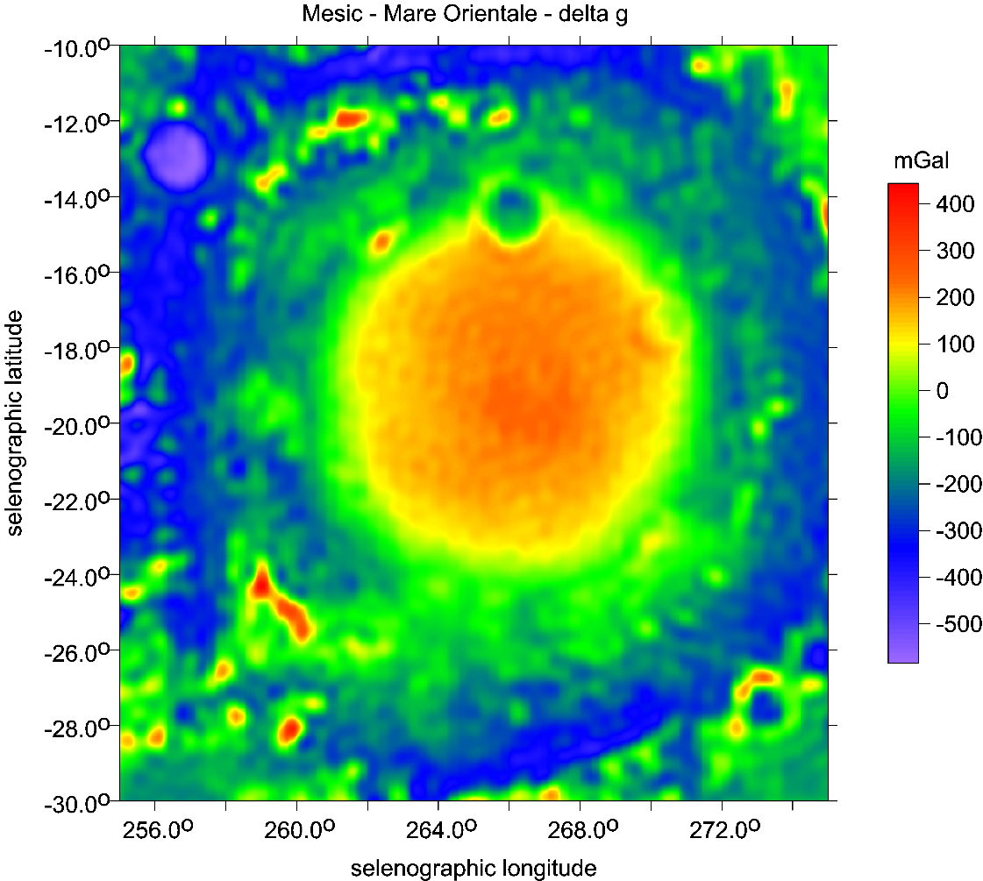
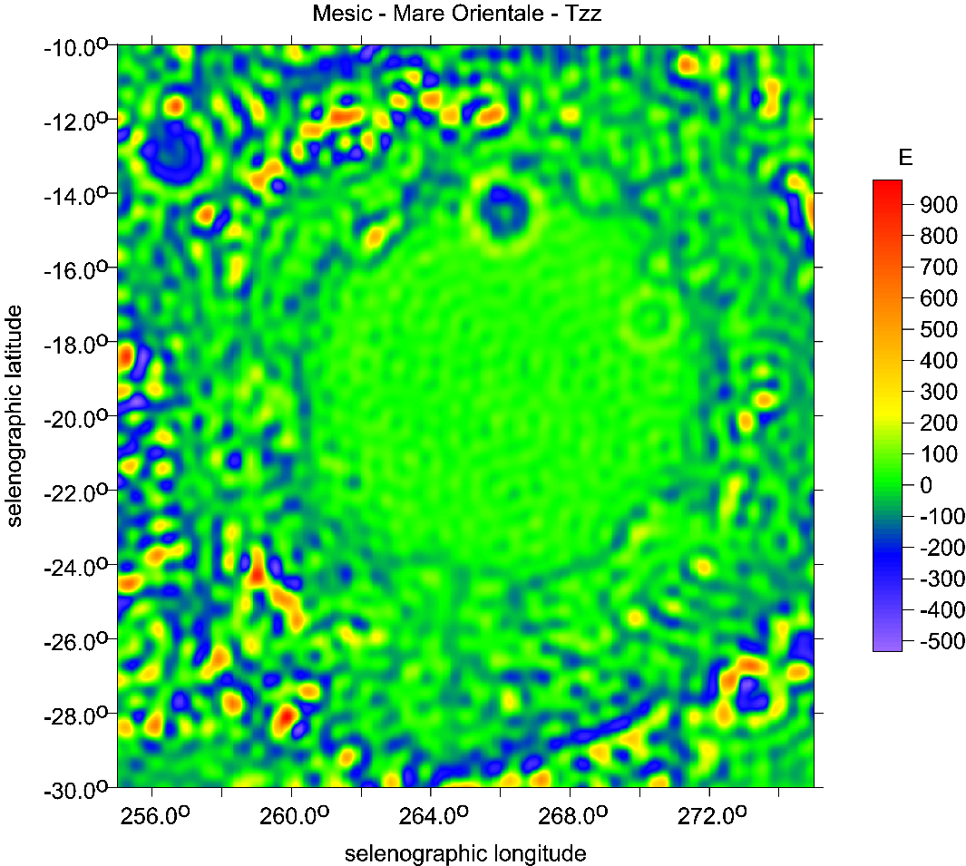
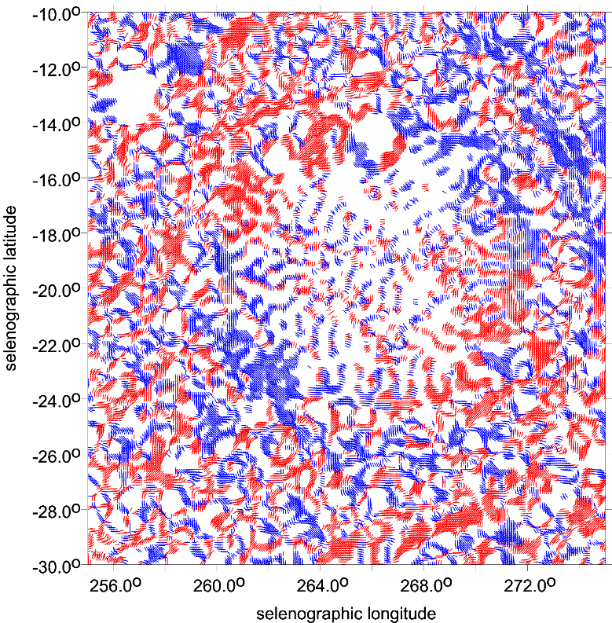

Mare Orientale

Slide 25
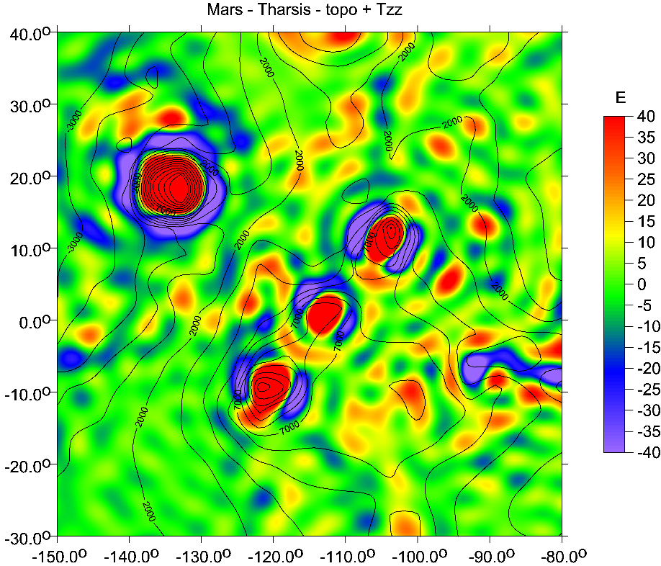
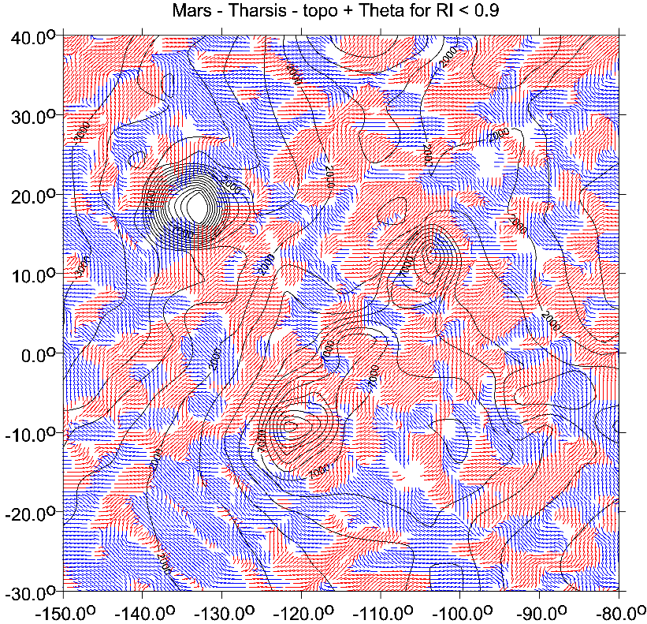
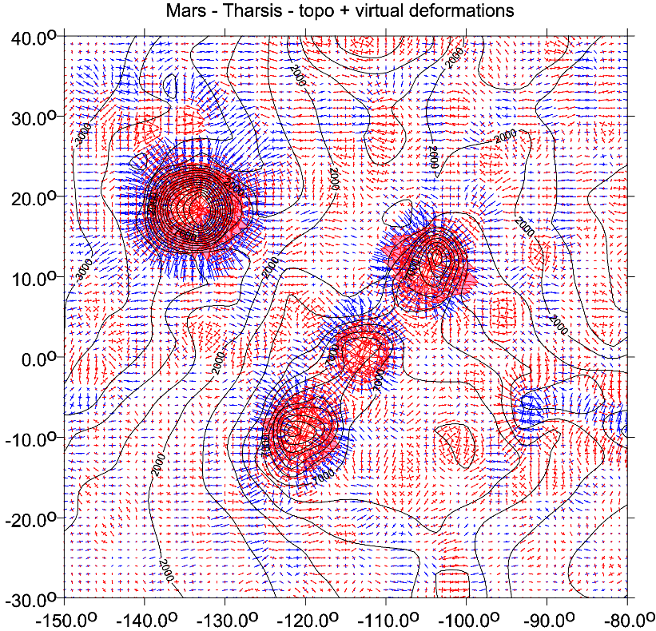
Tharsis

Slide 26
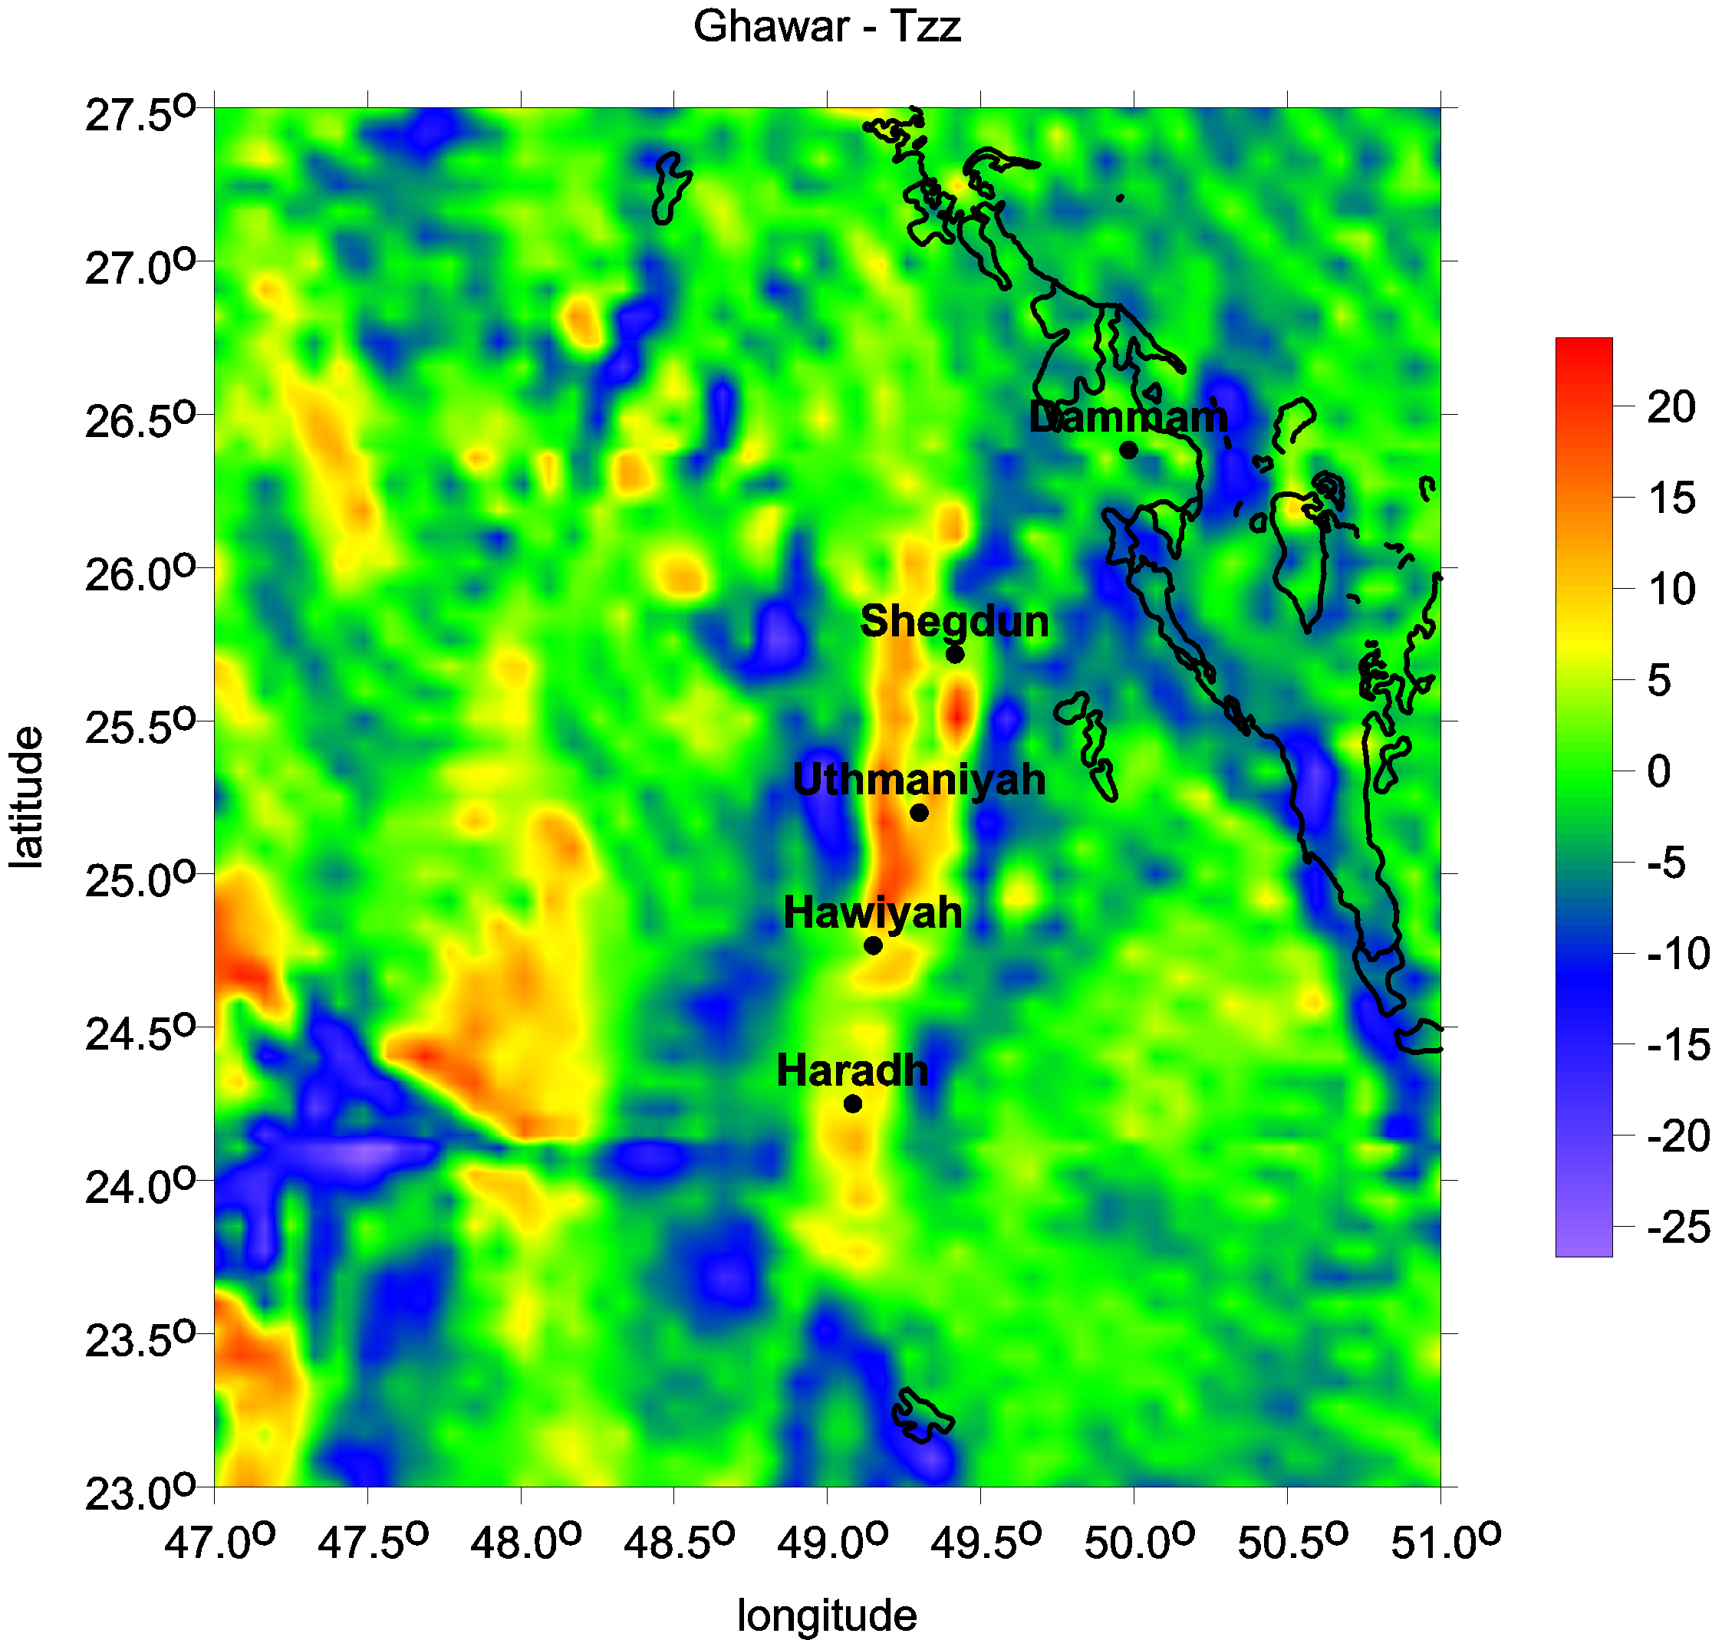

Slide 27
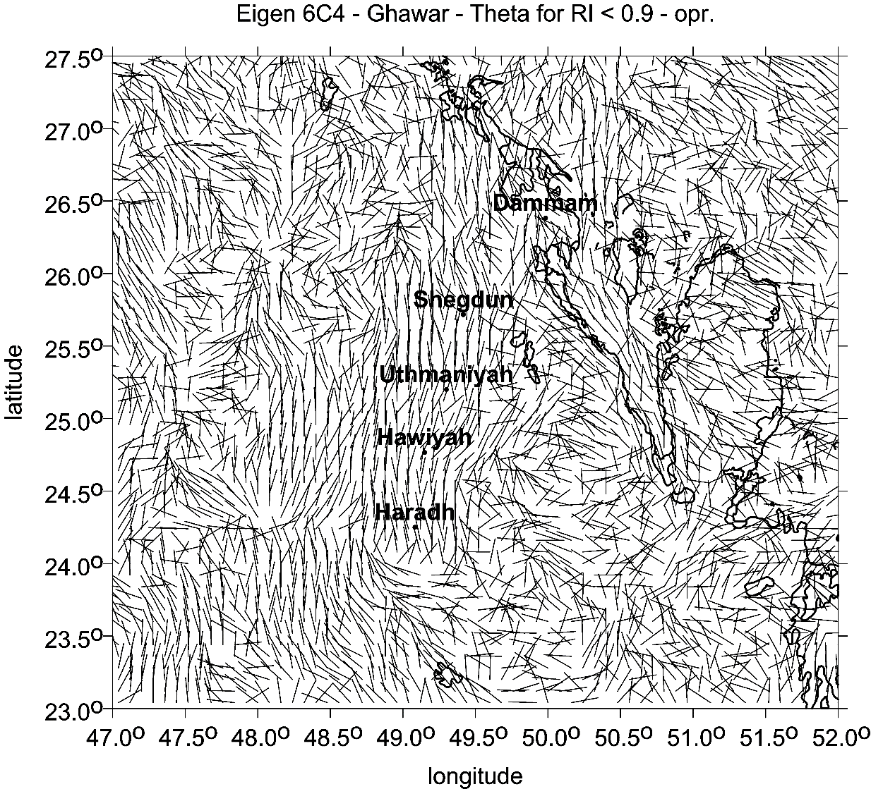
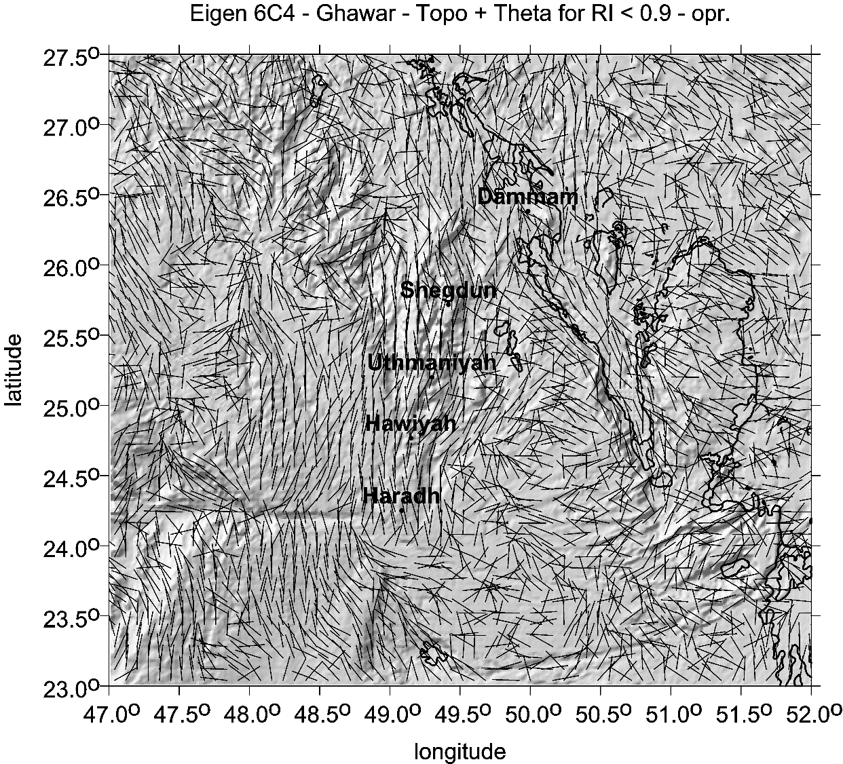
Ghawar, Saudi Arabia

Slide 28
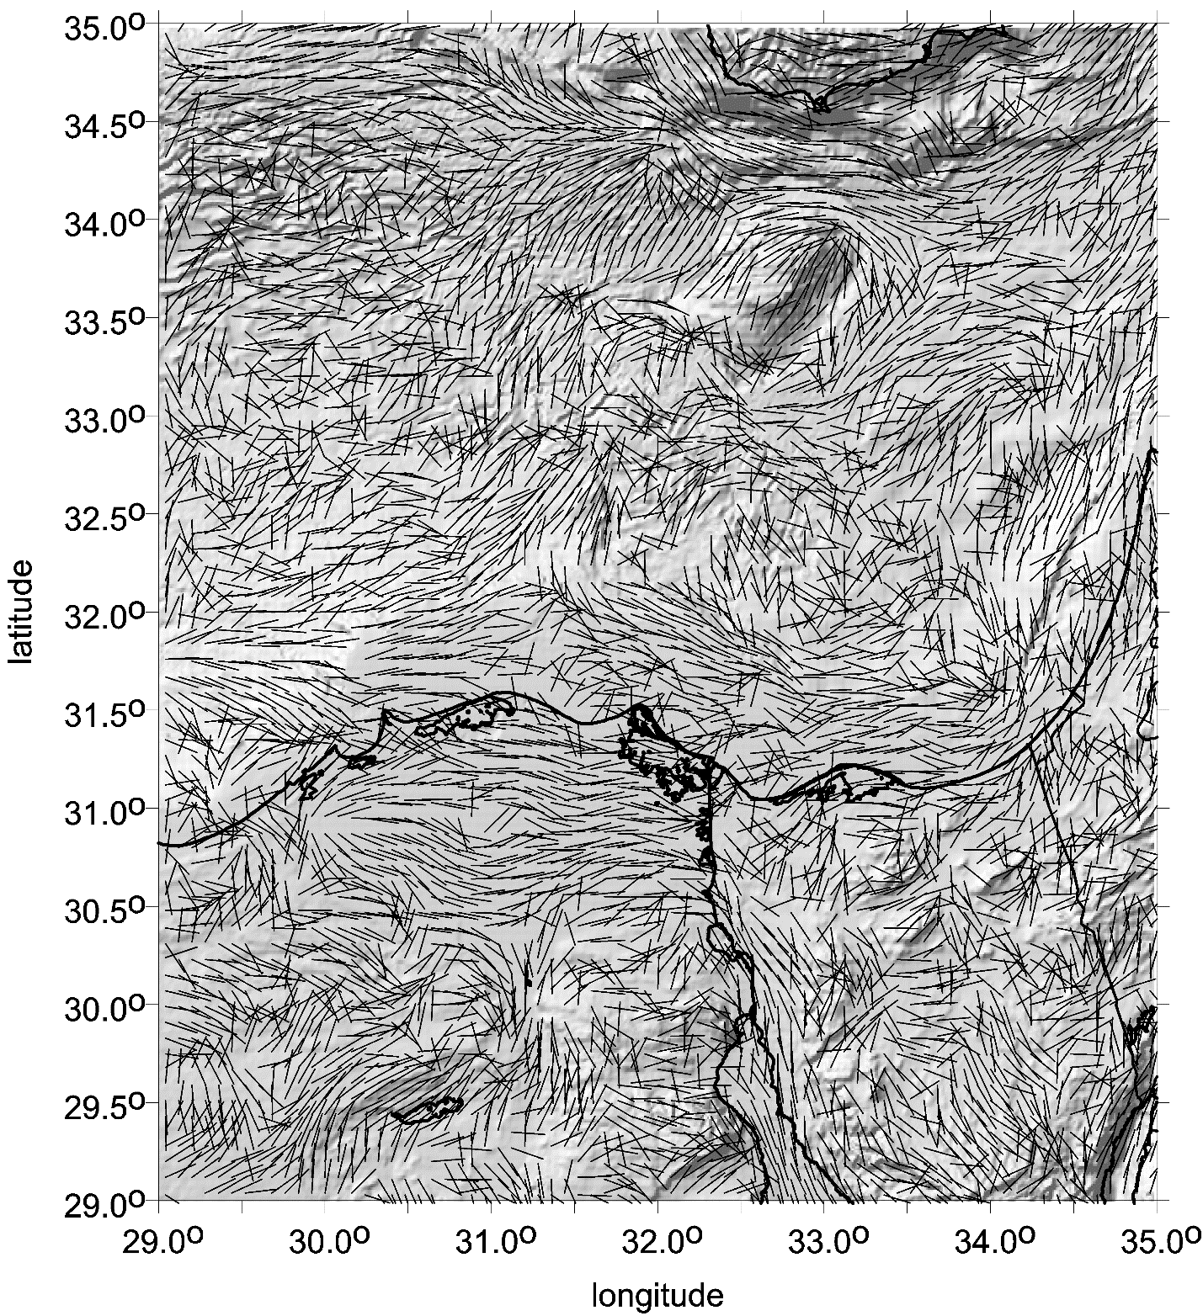

Slide 29


Slide 30



Slide 31

Strike angles

Slide 32



Slide 33

Mars
Valles Marineris

Slide 34



Mars Global Surveyor + MOLA (1996-2007)
Mars Reconnaissance Orbiter (MRO) 2006-
Artist's rendering, from NASA, of the 2001 Mars Odyssey spacecraft
in mission configuration
.
Mars Odyssey mission, executed from orbit of the planet Mars,
focused on astrobiology studies from orbit,
and consistent monitoring of the planet's environment.

Slide 35


řístroje a experimenty
Ilustrace sondy Mars Express
(MEX, ESA)
Přístroje věnované průzkumu povrchu a podpovrchových struktur:
HRSC (High Resolution Stereo Camera) –
stereokamera kombinovaná s kamerou s vysokým rozlišením
OMEGA (Visible and Infrared Mineralogical Mapping Spectrometer) –
spektrometr pracující ve viditelné a infračervené oblasti
MARSIS (Sub-surface Sounding Radar Altimeter)
dlouhovlnný radar určený k průzkumu podpovrchových struktur do hloubky cca 5 km
Přístroje věnované průzkumu atmosféry a ionosféry Marsu:
PFS (Planetary Fourier Spectrometer) – Fourierovský spektrometr
SPICAM (Ultraviolet and Infrared Atmospheric Spectrometer)
spektrometr pracující v ultrafialovém a infračerveném oboru
ASPERA (Energetic Neutral Atoms Analyser) – analyzátor neutrálních částic
Součástí výzkumného programu je také:
MaRS (Mars Radio Science Experiment) – program na zpřesňování gravitačních dat
a výzkum ionosféry ze zachycených radiových signálů

Slide 36
The gravity field model of Mars used:
JPL-MARS-MRO120F (Konopliv et al 2020)
Alex S. Konopliv , Ryan S. Park , Attilio Rivoldini , Rose‐Marie Baland Sebastien Le Maistre Tim Van Hoolst Marie Yseboodt, Veronique Dehant 2020. Detection of the Chandler Wobble of Mars from Orbiting Spacecraft , Geophys Res Letts 47, e2020GL090568, https://doi.org/10.1029/2020GL090568.
Detailed global surface topography of Mars in resolution 0,25° from MOLA
https://pgda.gsfc.nasa.gov/products/62
Smith, D. E., M. T. Zuber, H. V. Frey, J. B. Garvin, J. W. Head, D. O. Muhleman, et al. (2001), Mars Orbiter Laser Altimeter: Experiment summary after the first year of global mapping of Mars, J. Geophys. Res., 106, 23689–23722, DOI: 10.1029/2000JE001364.
http://www.asu.cas.cz/~bezdek/JK&JK/Mars/topografie_MOLA/ref/
Mars currently has no global magnetic field of internal origin (dynamo). It possesses regions with remanent magnetic field of various intensities (Kletetschka et al., 2009) that at altitude of 400 km may reach several thousand nanoteslas locally, but often is less than 15 nT [nanoTesla] (Connerney et al., 2005; Connerney et al., 2001). Note that similar small values (<15 nT) were estimated, from various models based on both MAVEN (Mars Atmosphere and Volatile EvolutioN) and MGS measurements, at the ground location of Mars with InSight lander (Interior Exploration using Seismic Investigations, Geodesy and Heat Transport, 2018) with prediction of <400 nT on the surface (Johnson et al., 2020; Yu et al., 2018).

Slide 37

Tutorial
Spherical harmonics , example : P_{lm}(sinϕ) cos mλ
Potential of gravitation :
Stokes coefficients :

Slide 38
Mars (gravity model JGMRO_120 F):
GM (C₀₀) = 0.4282837 × 10¹⁴ [m³ s⁻²]
C₂₀ = -0.88 10⁻³ C₃₀ = -0.12 10⁻⁴ C₅₀ = -0.17 10⁻⁵
C₂₂ = -0.85 10⁻⁴, S₂₂ = 0.49 10⁻⁴
J₂₂ = 0.98 10⁻⁴,
λ₂₂^{stable} = 165. 3ºE, λ₂₂^{unstab} = 75. 2ºE
The Earth (gravity model EIGEN 6C4):
GM (C₀₀) = 3.986004419 × 10¹⁴ [m³ s⁻²]
C₂₀ = -0.48 10⁻³ C₃₀ = +0.01 10⁻⁴ C₅₀ = +0.69 10^{-7.}
C₂₂ = 2.44 10⁻⁶, S₂₂ = -1.40 10⁻⁶;
J₂₂ = 2.81 10⁻⁶ = 0.03 10⁻⁴,
λ₂₂^{stable} = 75.2ºE, λ₂₂^{unstab} = 165. 3ºE
Basic introductory information about the general shape of the planets – their long-wavelength features, as described by the lowest degree and order harmonic (geo)potential coefficients (Stokes parameters), fully normalized, including a comparison of magnitudes J22 and phases (planetographic longitudes) λ22 [deg] for Mars and the Earth. The values of λ22 correspond to four special points on the equator, the equilibrium stable points (direction λ22stable of the short axis of the equatorial ellipse) and the unstable points (direction λ22unstab of the long axis of the equatorial ellipse). This is well-known and important knowledge for the geostationary telecommunication satellites. It is interesting that the ratio |S22/ C22| is nearly the same for both bodies.

Slide 39
Stručný průvodce po Marsu.
Impaktní pánev Hellas (H), pánev Isidis, oblast u kráteru se slovanským názvem Jezero Crater (Syrtis Major/Isidis) I,
Utopia Planitia – a část Utopia basin (U). Hustak (HU); Sopka Elysium (E);
Sopky oblasti Tharsis (T),
t.j. Olympus Mons (OM), Ascraeus Mons (ASM), Pavonis a Arsia Mons (PM a ARM). Alba Mons (Patera) a Syria Mons (AP a SM),
Tempe Terra (TT); kaňony Valles Marineris (VM), Thaumasia Highlands (TH), starobylá kráterová struktura (AI), Argyre Planitia (AG).
Na pozadí jsou vyneseny tíhové poruchy (gravity disturbances) ∆g [mGal] spočtené z modelu gravitačního pole Marsu
NASA JGMRO_120 F (Konopliv et al., 2020)¹⁴ do stupně a řádu 80 v rozvoji ve sférické harmonické funkce (ground resolution cca 130 km).
Přidány jsou vrstevnice výšek nad referenčním tělesem v metrech (rotační ellipsoid s hlavní poloosou a = 3396.19 km a
pólovým zploštění 1/169.8), odvozené z laserového altimetru MOLA na umělé družici Marsu MGS.¹⁵

Slide 40

Landing sites
Mars map with landing sites - Wikimedia Commons, 2022

Slide 41



Slide 42


Slide 43


Slide 44


Strike angles
with the comb factor
to emphasize
highly combed areas

Slide 45


Slide 46


Slide 47


Northern cap
Southern cap
Assymetry around poles, different size and thickness (southern smaller),
effect of Corriolis force, see also strike angles for more study

Slide 48


Slide 49


Slide 50


Slide 51

The strike angles θ [deg] (with the comb statistics) for the northern polar area.

Slide 52


Slide 53

Valles Marineris (VM) series

Slide 54



Mars, Valles Marineris

Slide 55


Slide 56

Points 1-13 from the previous figure, distance in [km] from point 1

Slide 57


Slide 58

Isidis Planitia (8.4N, 69.5E) MOLA topo
& Syrtis Major (SM) Planum (black spot) shield volcano

Slide 59

ISIDIS = volcano, nothing else
-3800
Tzz [E] the invariant I2 [s-6]

Slide 60


Slide 61


U
θ [deg]
plus landing site of Perseverance

Slide 62



Slide 63



Isidis basin

Slide 64


Slide 65


Slide 66

Name centered at latitude longitude E range latitudes longitudes
----------------------------------------------------------------------------------------------------
Arabia Terra Ar 21N 6 large area
Aeolis Mensae Ae 3S 140 10N-10S 210-240W
Deuteronilus Mensae D 44N 22 40N-48N 325-344W
Protonilus Mensae P 44N 50 40N-47N 37-60E
Nilosyrtis Mensae N 37N 68 30N-37N 51-75E
-----------------------------------------------------------------------------------------------------
Seznam z PSS … J

Slide 67


Nilosyrtis Mensae is an area of Mars in the Casius quadrangle. It is centered on the coordinates of 36.87° N and 67.9° E. Its western and eastern longitudes are 51.1° E and 74.4° E. North and south latitudes are 36.87° N and 29.61° N.^{[2]} Nilosyrtis Mensae is just to the east of Protonilus Mensae and both lie along the Martian dichotomy boundary
36.87°N 67.9°E
Astapus Colles Mounds and Knobs,
Coordinates | 36.87°N 67.9°ECoordinates: 36.87°N 67.9°E
Dim ensions | 705 km across
Naming | a classical albedo feature
western Arabia Terra
near 10.8°N, 4.5°W.
Sedimentary rocks

Slide 68

The gravity aspects for
zones of the Northern paleoocean
1-5
5
3
4
2
1

Slide 69

The feature at (φ = 40ºN, λ = 110ºW) is Alba Patera near Olympus Mons (on the southern edge of this figure).
The oval with the largest area with the highest Comb is located near a crater (with the misleading name of Erebus Montes)
partly buried in sediments in Amazonis Planitia, NW of Olympus.
The slant “rifts” at (25-45ºN, 90-60ºW) belong to Mareotis Fossae and Tempe Fossae

Slide 70

The ovals are (top down) in: 1. Vastitas Borealis lowland [φ = 65-75⁰N, λ = 40-0⁰W]; the crater Lomonosov at (65ºN, 10ºW).
2. The lowland part at Acidalia Planitia [φ = 35-50⁰N, λ = 30-5⁰W].
3. On the border between lowland and highland, Cydonia Mensae [φ = 25-45⁰N, λ = 20-0⁰W]

Slide 71

The oval at [φ = 50-60⁰N, λ = 35-60⁰E] is in the lowlands, crater Lyot is at [φ = 50⁰N, λ = 30⁰E], Deuteronilus Mensae is at [φ ~40⁰N, λ = 10-60⁰E] and Arabia Terra is south of this.

Slide 72

Utopia Planitia
[φ = 50-60⁰N, λ = 85-120⁰E].
Isidis Planitia
[φ = 0-20⁰N, λ = 75-100⁰E]

Slide 73


Elysium
[φ = 20-30⁰N, λ = 125-140⁰E];
see also Fig. S3: 67.
Gale crater at
[φ = 5⁰S, λ = 138⁰E];
Lahars on Mars,
example NW of Elysium Mt.
Reference for the lahars:
Christiansen E. H. et al (1989).
Lahars in the Elysium region of Mars.
Geology 17 (3): 203-206.
https://doi.org/10.1130/0091-7613(1989)017<0203:LITERO>2.3.CO;2

Slide 74






Review of localities with the highest Comb factor of the strike angles
in the hypothetical northern Martian paleo-ocean

Slide 75



jklokocn@asu.cas.cz www.asu.cas.cz/~jklokocn koroze@volny.cz www.jiri-sonnek.cz

