Slide 1


Gravity strike angles as admirable tool to study gravity fields of planets
Jaroslav Klokočník ª, Jan Kostelecký ^{b}, Aleš Bezděk ª
ª Astronomical Institute, Czech Academy of Sciences, CZ 251 65 Ondřejov, Fričova 298, Czech Republic, jklokocn@asu.cas.cz*, bezdek@asu.cas.cz ^{b} Faculty of Mining and Geology, VSB-TU Ostrava, CZ 708 33 Ostrava, Czech Republic, kost@fsv.cvut.cz
The gravity strike angle is one of the gravity aspects (descriptors), functions like the gravity anomaly, derived from the disturbing gravitational potential, from the global gravity field model, developed in terms of harmonic geopotential coefficients (Stokes parameters) of the respective celestial body. All the aspects together describe the causative body beneath the surface (the density anomaly) in a much greater completeness and detail than the traditional gravity anomalies can do themselves. But as always with the gravity field, this inverse task is not unique and advices from geoscientists of various specializations are needed for applications intended to the particular regions.
The strike angles react on changes in porosity of the ground material. They have mathematical as well as geophysical meaning; their physical meaning is still “providing surprises”. The strike angles are usually of diverse directions, but sometimes are aligned into one prevailing direction (linearly combed) or have a special geometry (a halo around the impact craters, on the Earth, the Moon and Mars as well). The reasons for the strike angles to be aligned, we already know, are the following: water, river valley, trench, ground water, paleolakes, permafrost, regolith, subglacial lakes and rivers, oil&gas deposits, coal, hydrocarbons occurrences in general, all located shallowly beneath the surface.
Notes:
Satellite dynamics (…) and physical geodesy, use of their theory and numerical results s/c….

Slide 2
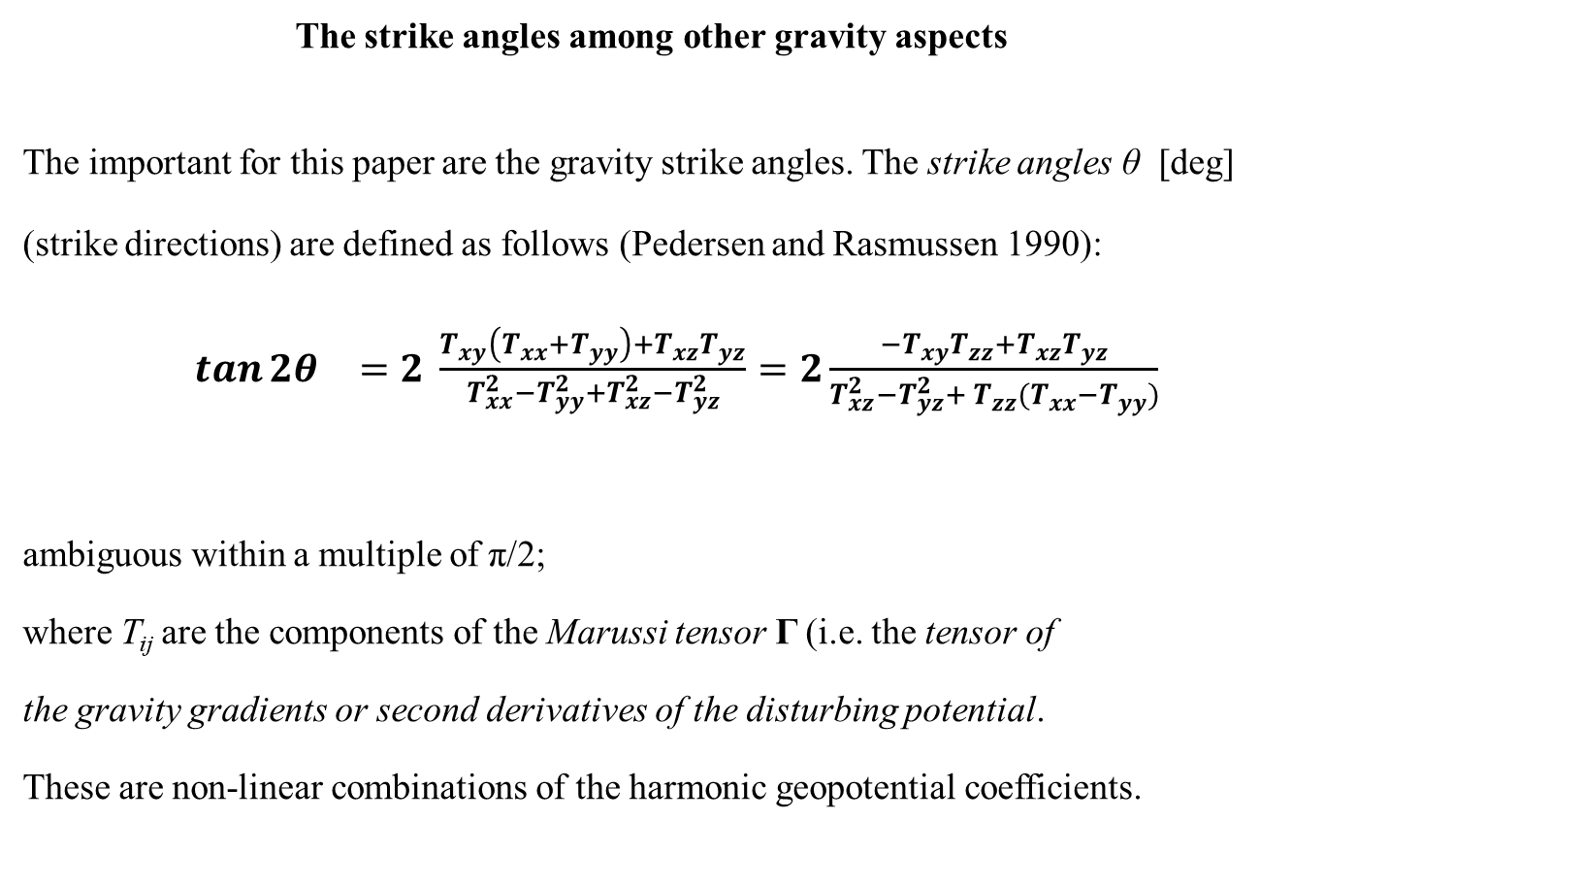
The strike angles among other gravity aspects
The important for this paper are the gravity strike angles. The strike angles θ [deg]
(strike directions) are defined as follows (Pedersen and Rasmussen 1990):
$\tan{2θ_{}}=2 \frac{T_{xy}\left(T_{xx}+T_{yy}\right)+T_{xz}T_{yz}}{T_{xx}^{2}−T_{yy}^{2}+T_{xz}^{2}−T_{yz}^{2}}=2\frac{{−T}_{xy}T_{zz}+T_{xz}T_{yz}}{T_{xz}^{2}−T_{yz}^{2}+{{ T}_{zz}^{}(T}_{xx}^{}−T_{yy}^{})}$
ambiguous within a multiple of π/2;
where T_{ij} are the components of the Marussi tensor Γ (i.e. the tensor of
the gravity gradients or second derivatives of the disturbing potential.
These are non-linear combinations of the harmonic geopotential coefficients.

Slide 3
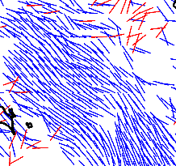
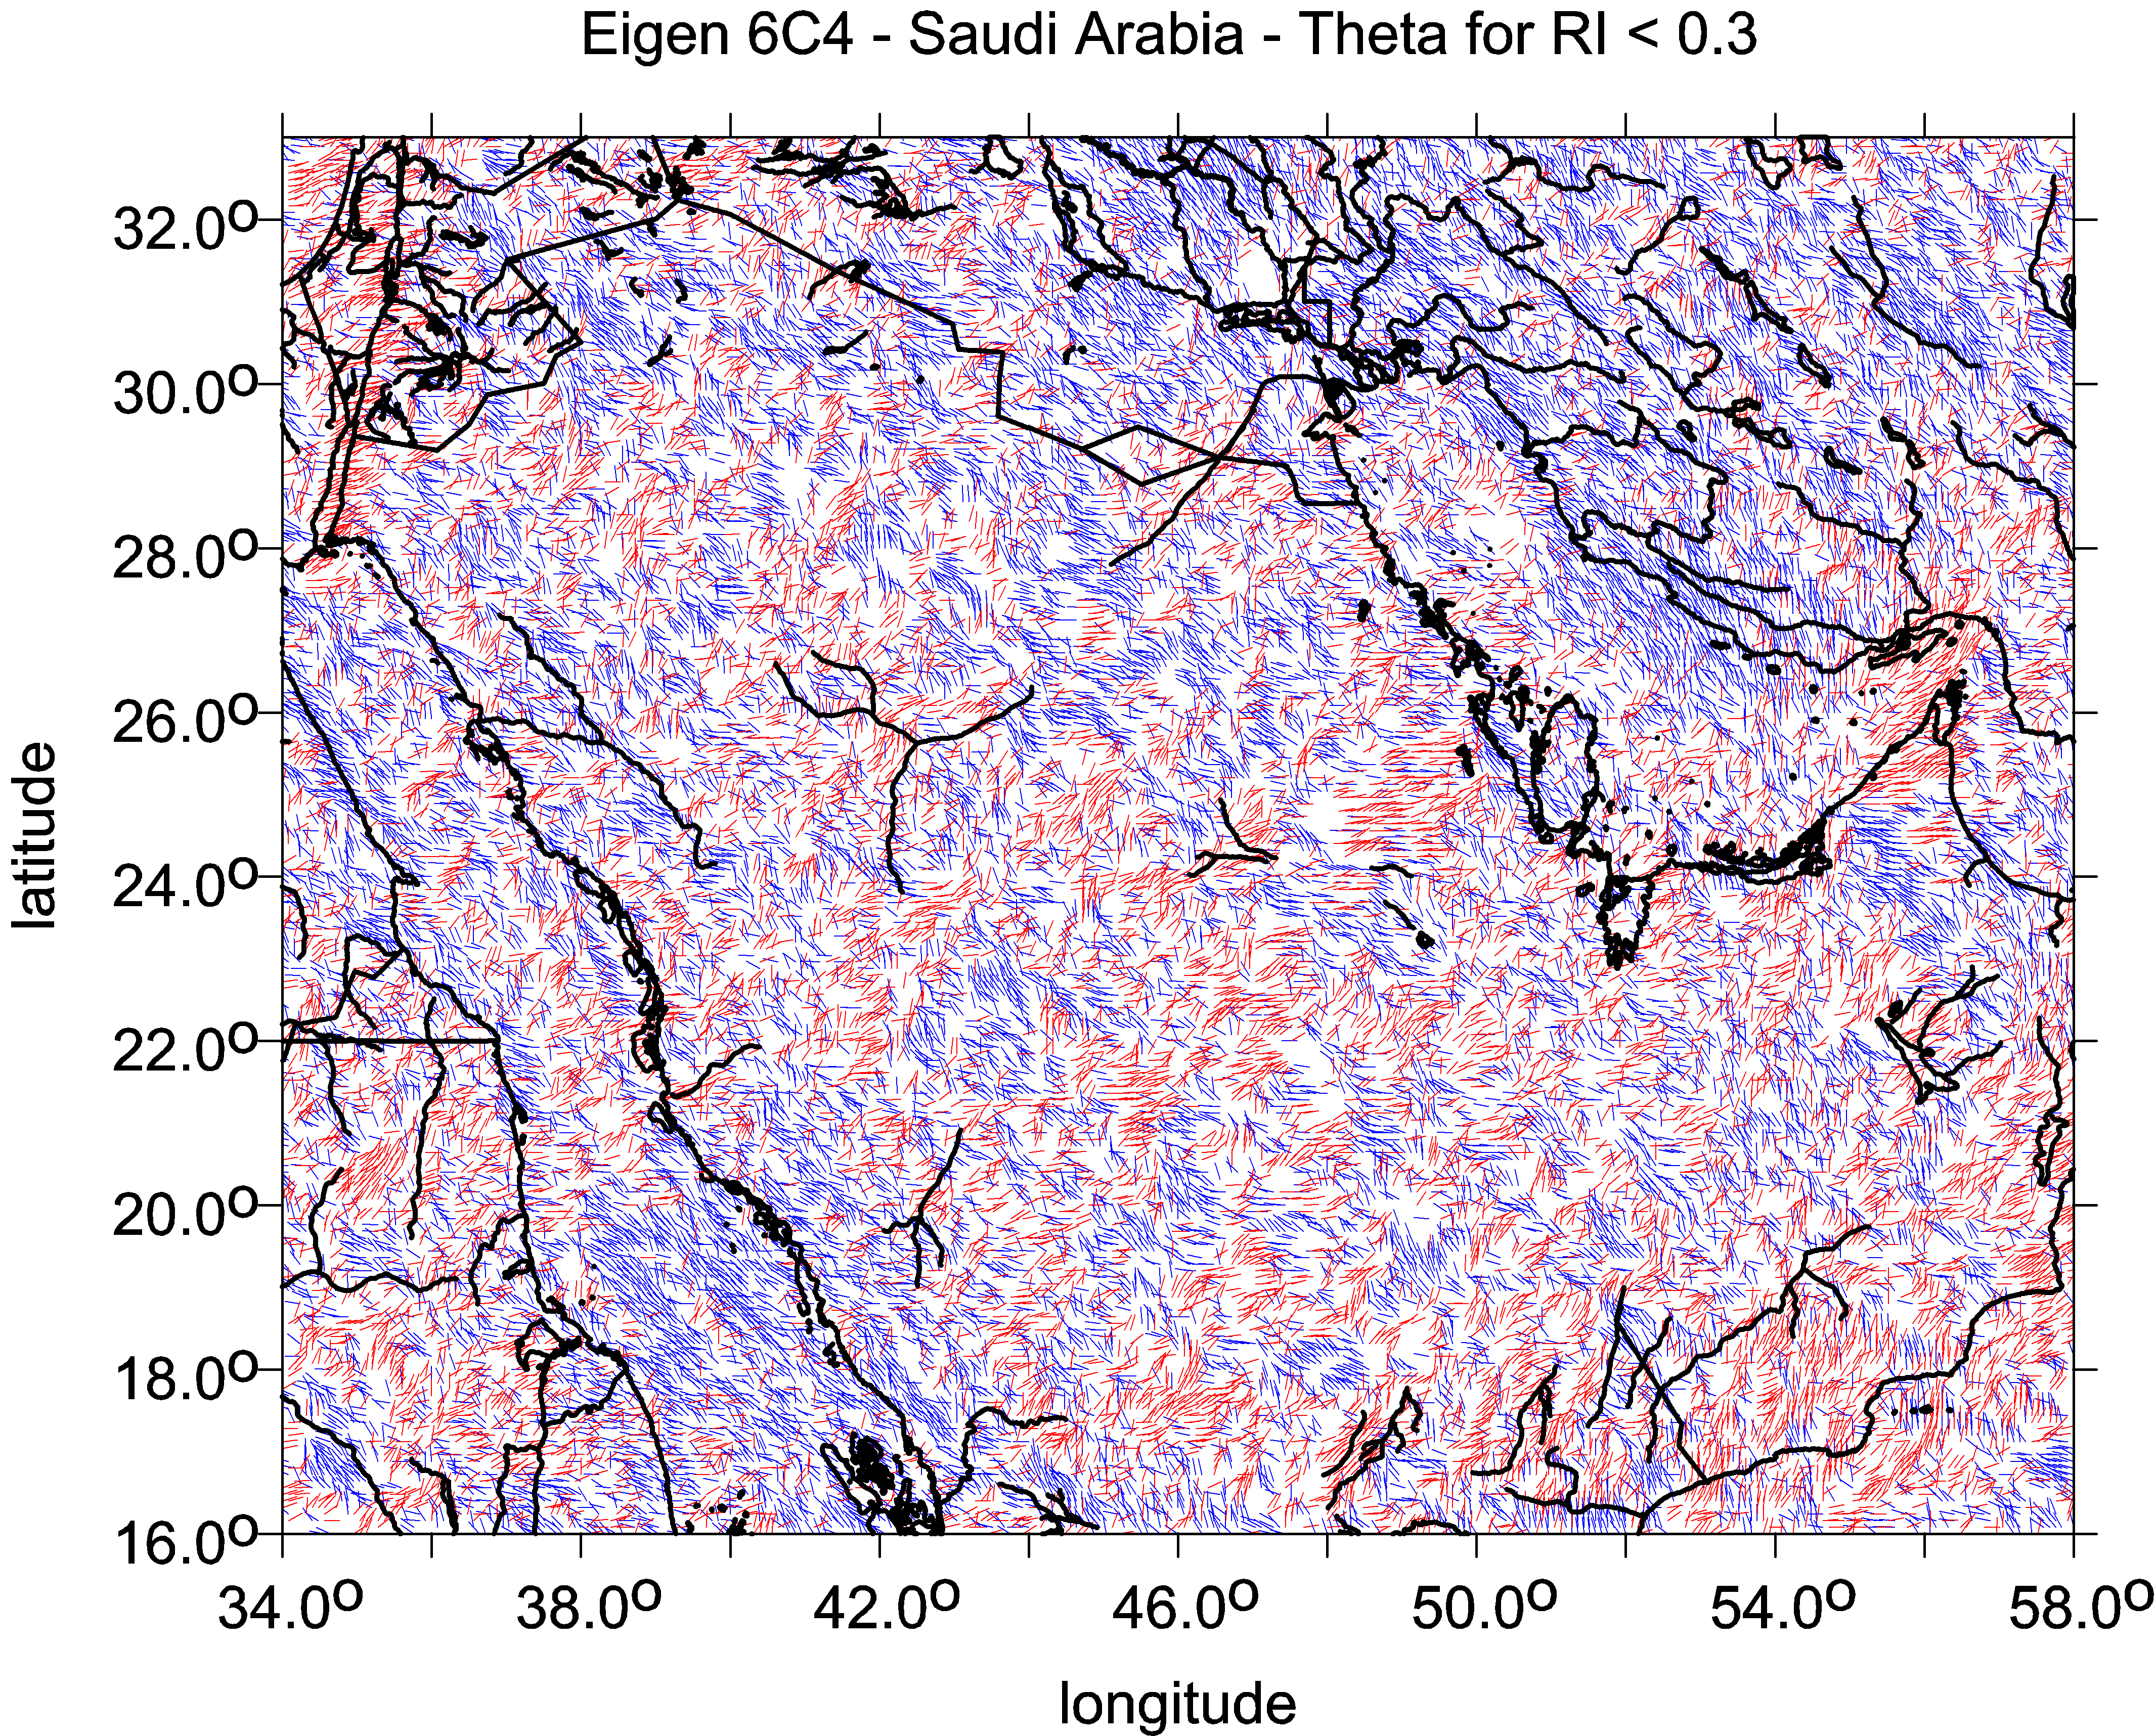
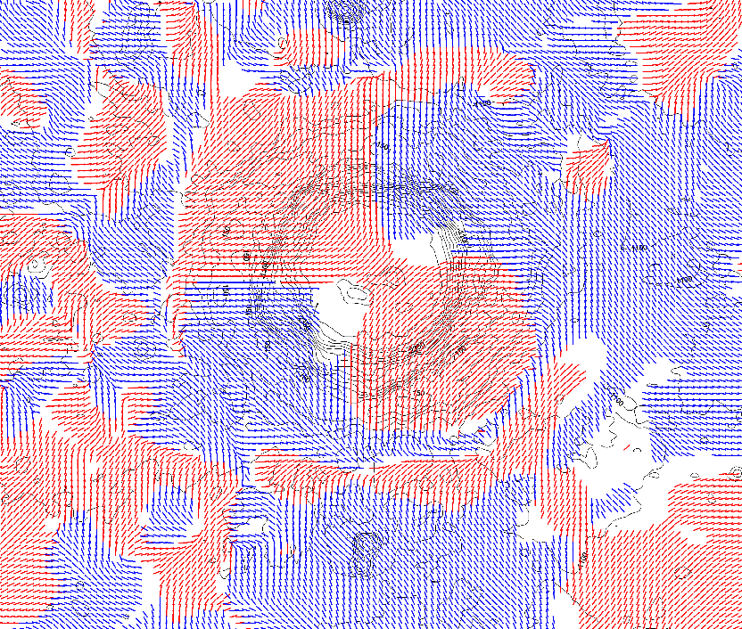
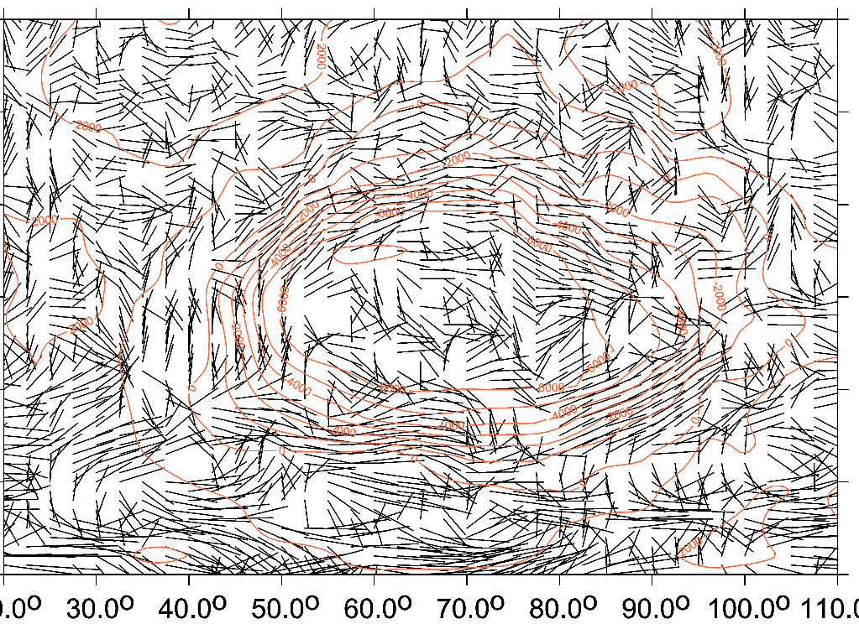
Combed strike angles Comments:
Left
highly combed,
linearly
Right
dishevelled
Left
combed,
creating a halo
around the crater
segments
in color
Right
halo
in black&white
the Moon/Copernicus Hellas basin on Mars

Slide 4
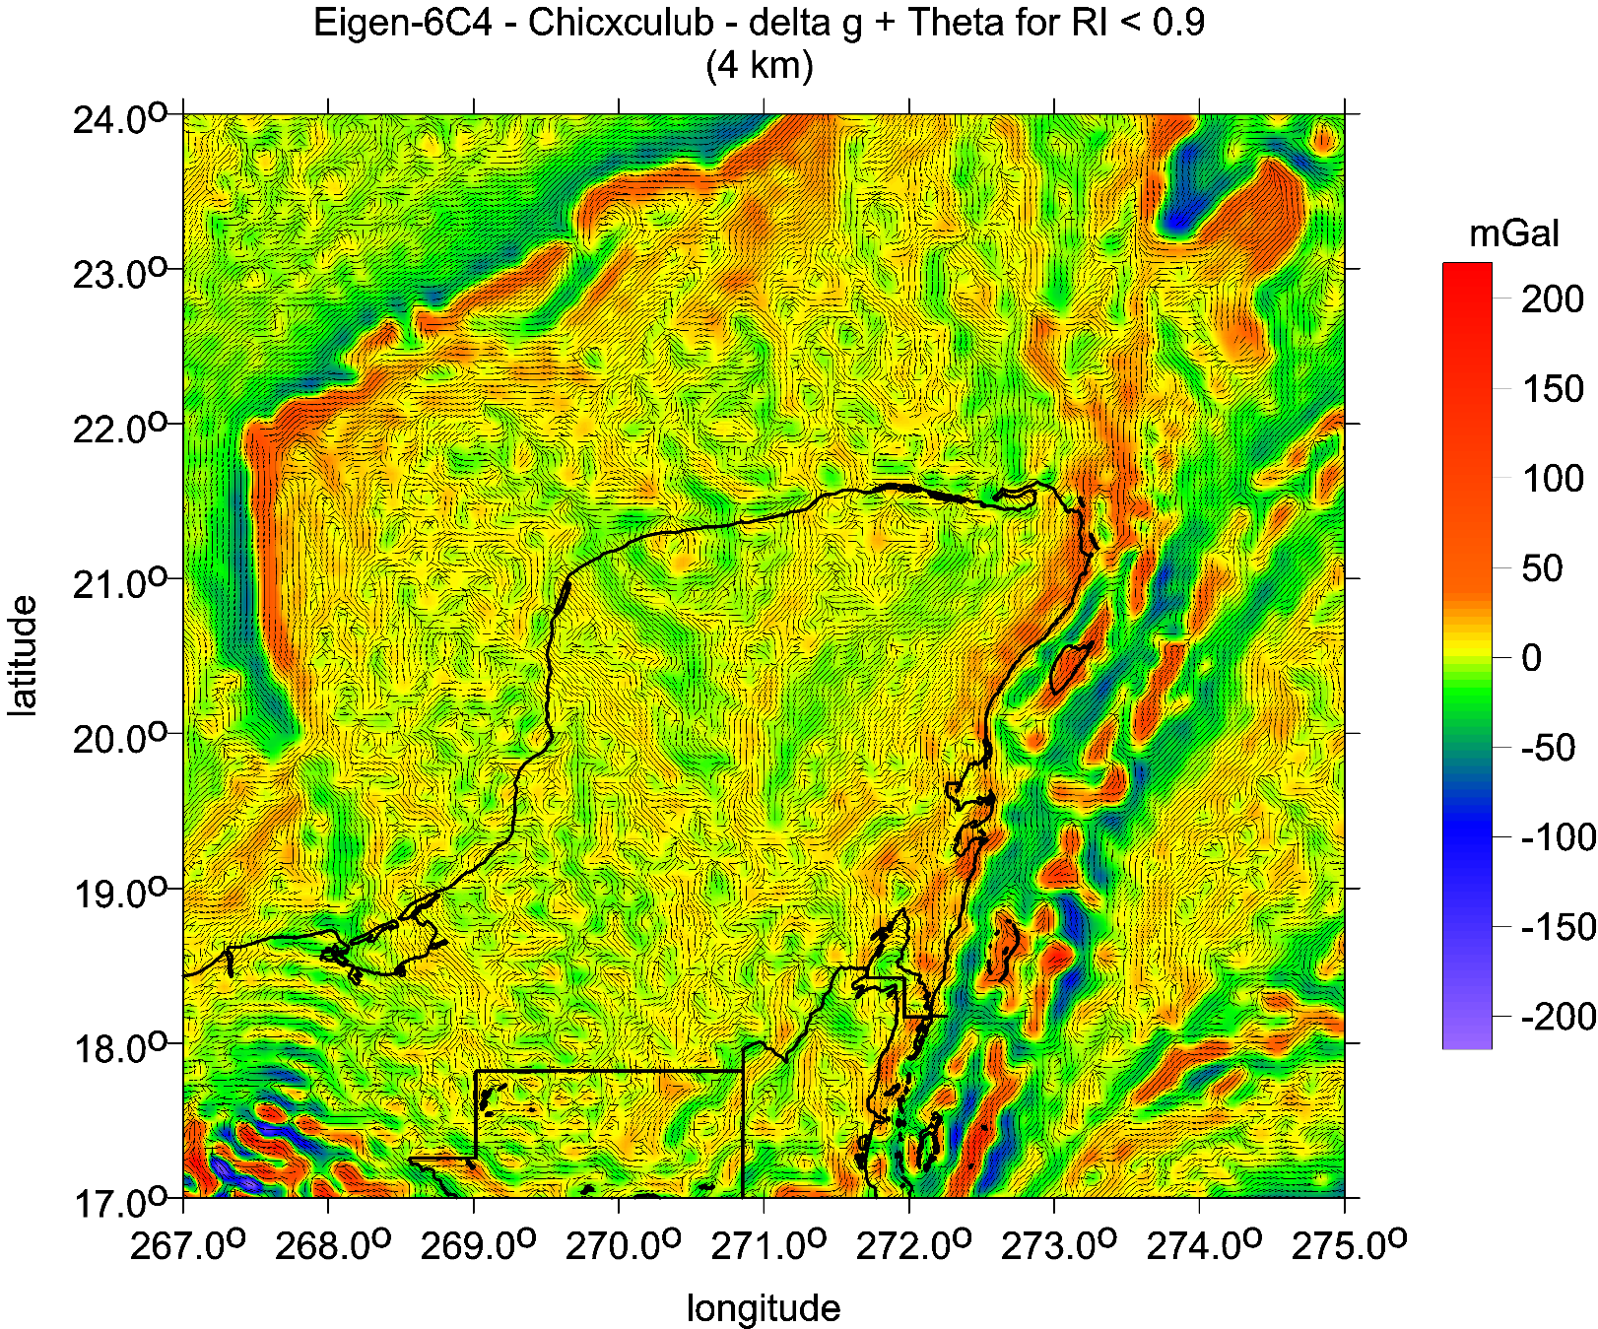
E
Chicxulub,
Yucatan
Mexico
Strike angles
Strike angles [deg], I<0.9, with Tzz [E])

Slide 5
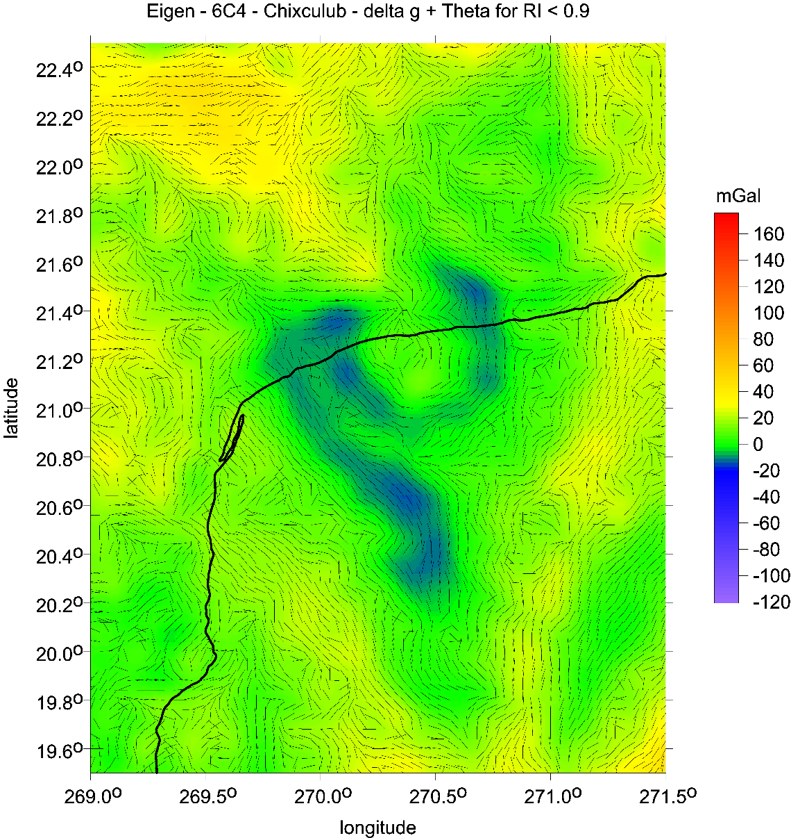
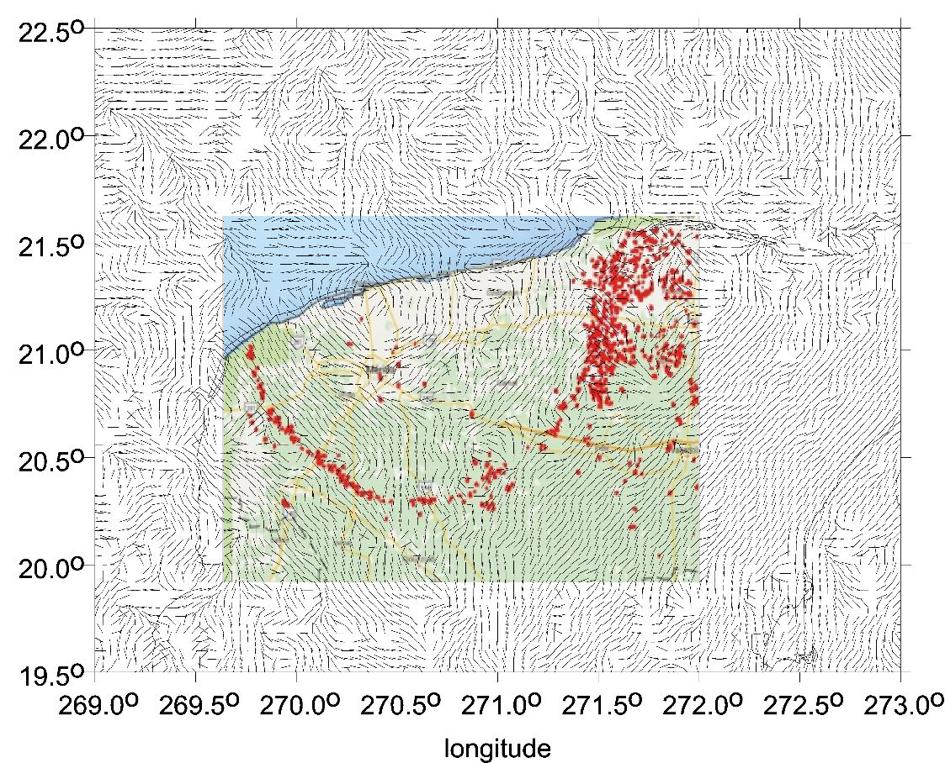
CHICXULUB:
gravity anomalies [mGal] from EIGEN 6C4, left: strike angles and cenotes

Slide 6
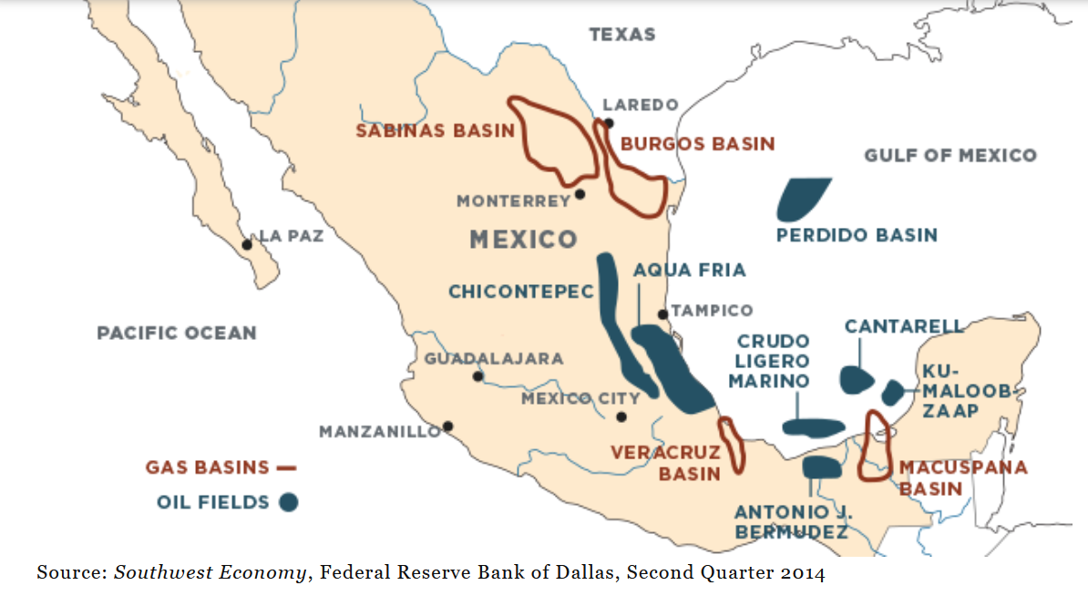
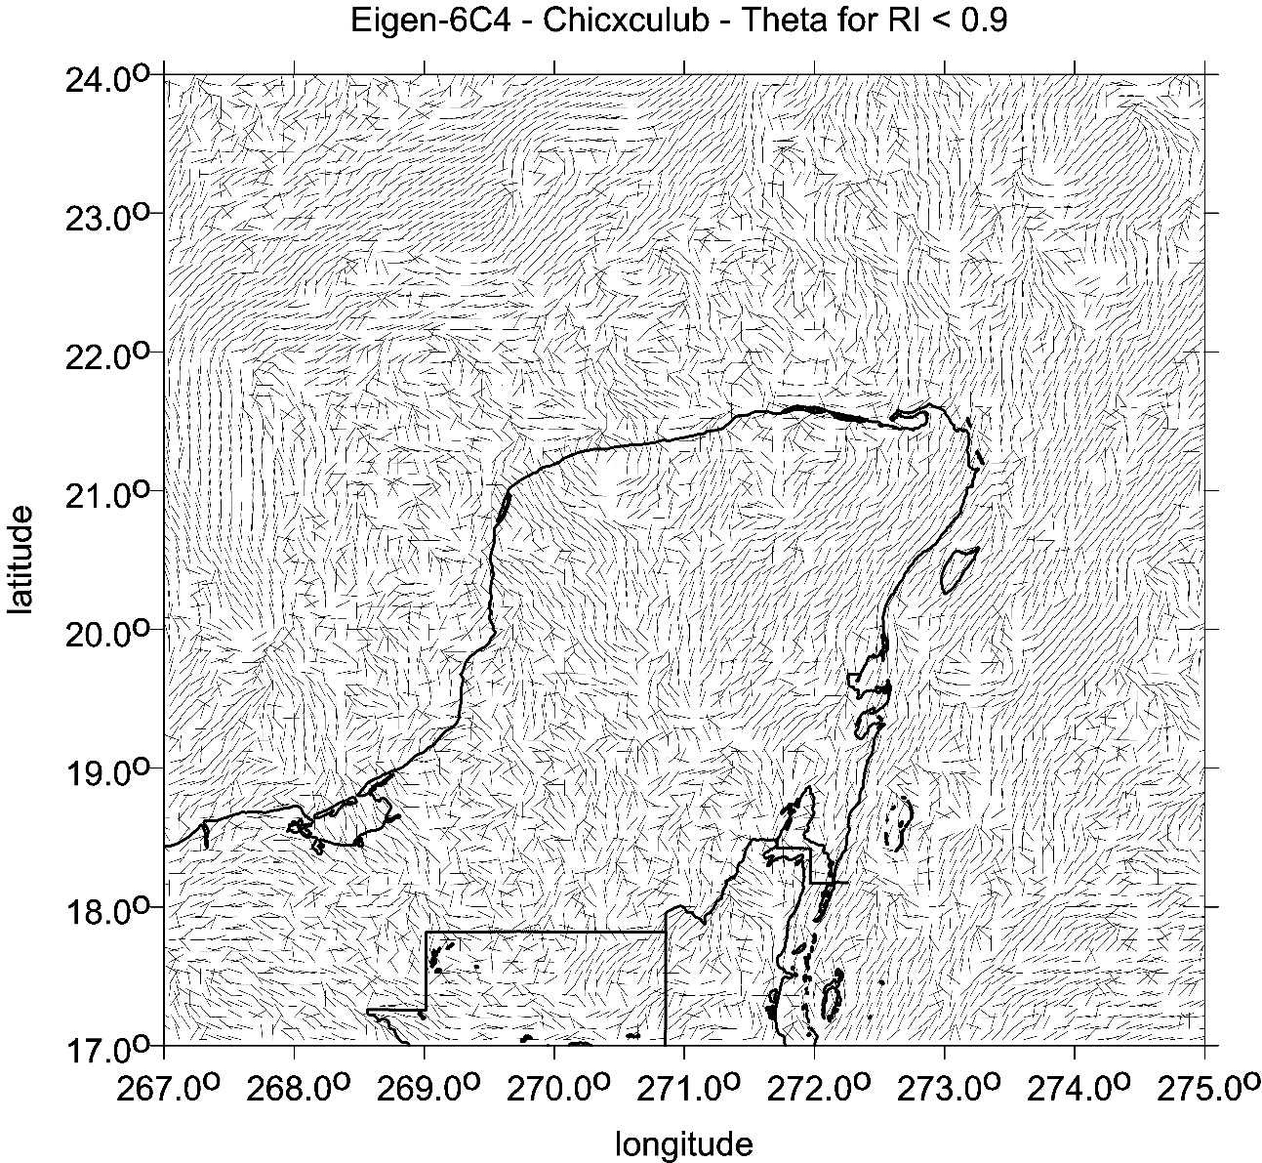
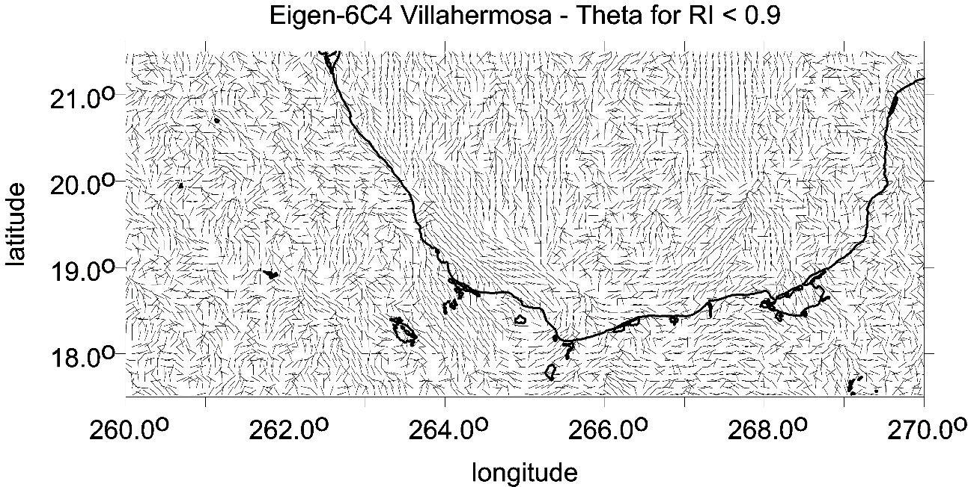
Mexico
Villahermosa, Veracruz
strike angles

Slide 7
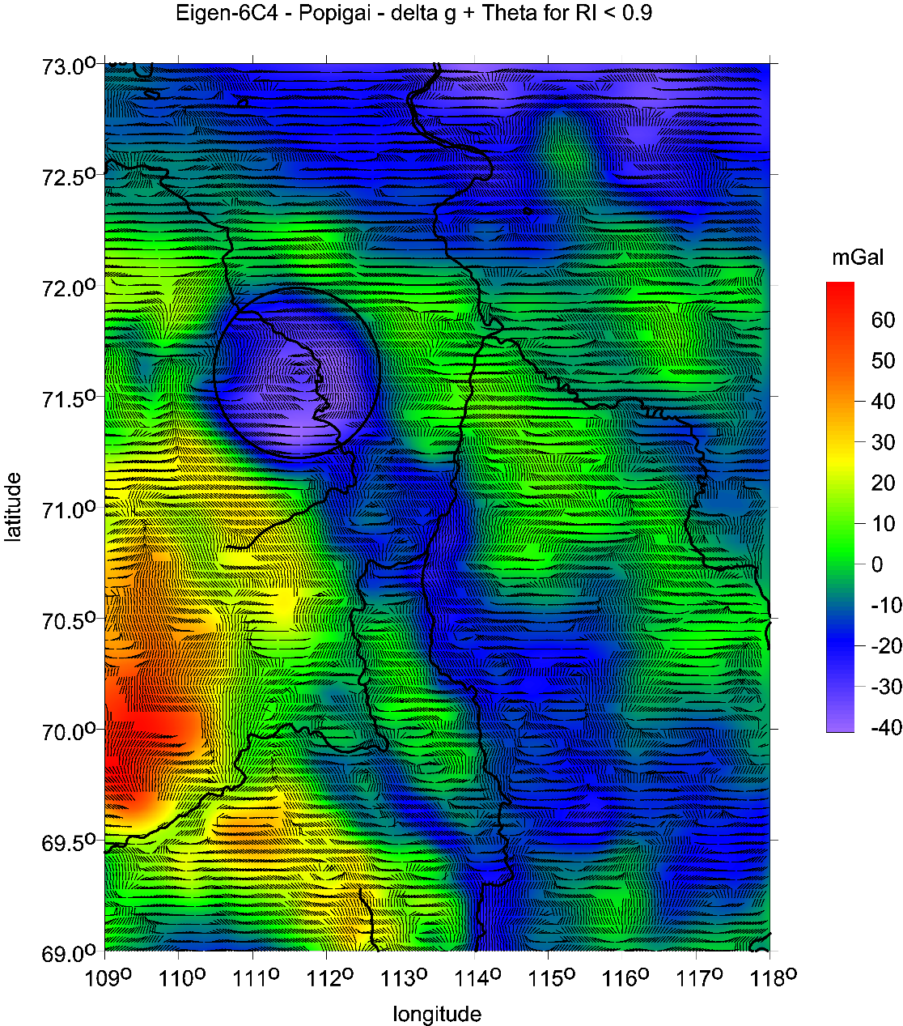
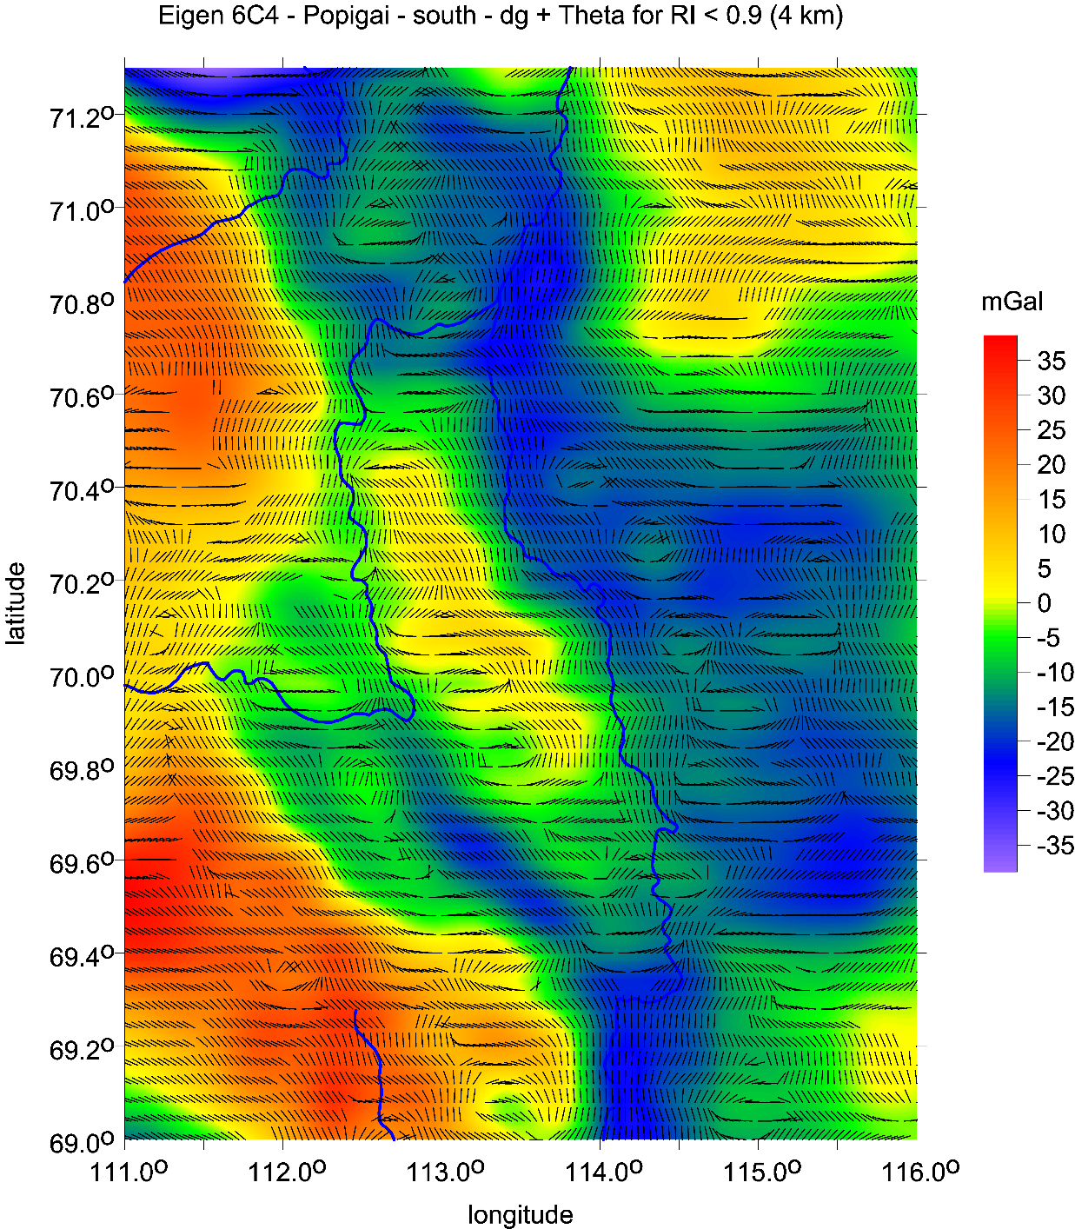
Popigaj,
the main crater
the whole set (left)
southern-east part with possible craters
Popigaj II, II, and IV
(see ©Klokočník et al 2010, SE EGU and Google Earth)

Slide 8
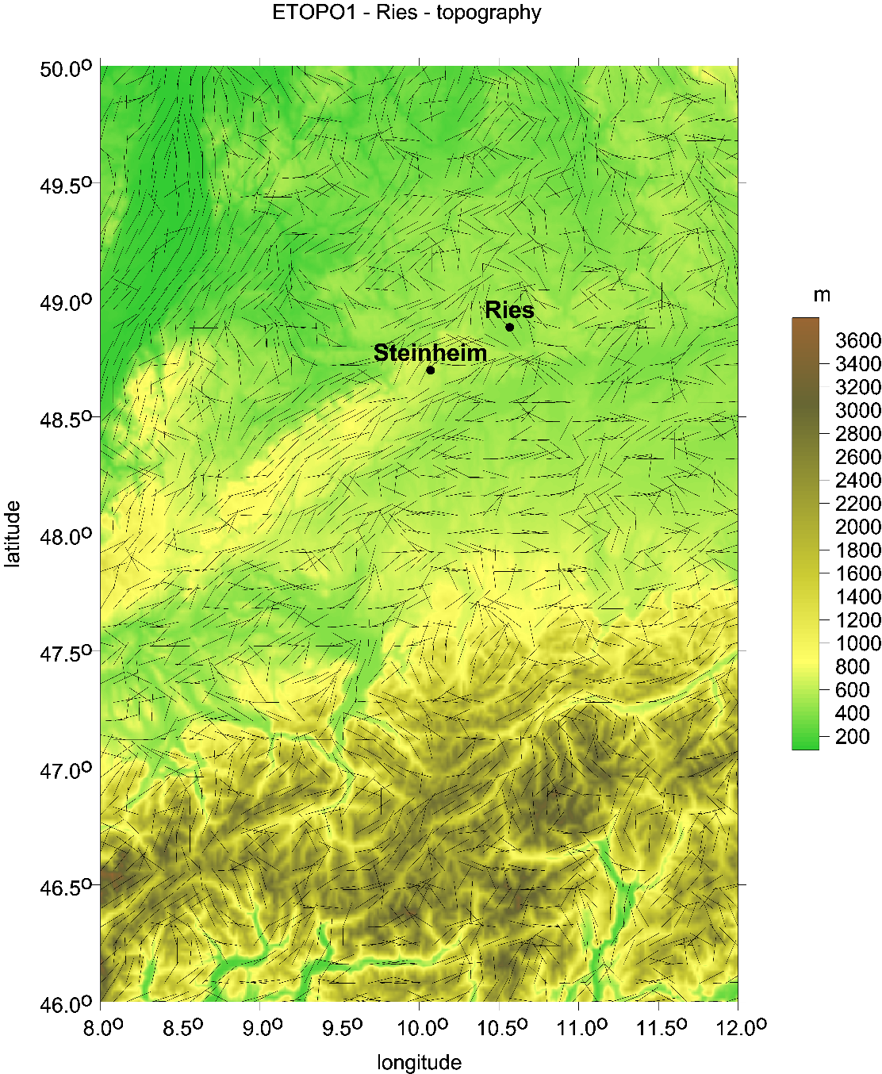
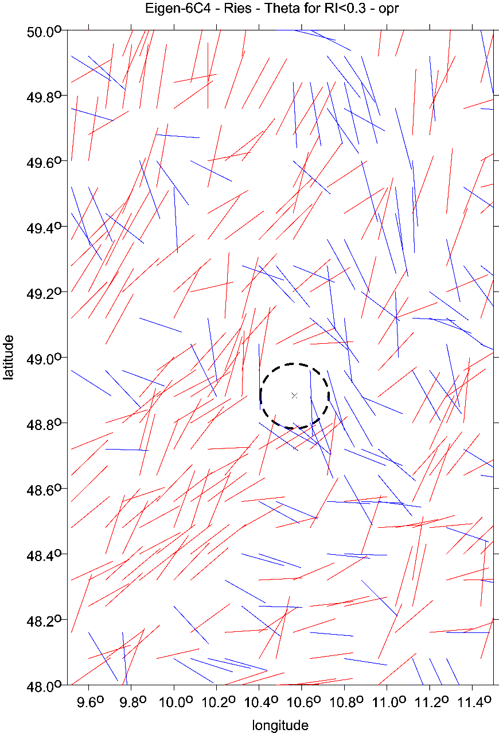
Impact craters Ries and Steinheim, Germany
Strike angles [deg] with ETOPO 1 topography [m] (left) Strike angles (right)
I<0.3)
Strike angles

Slide 9
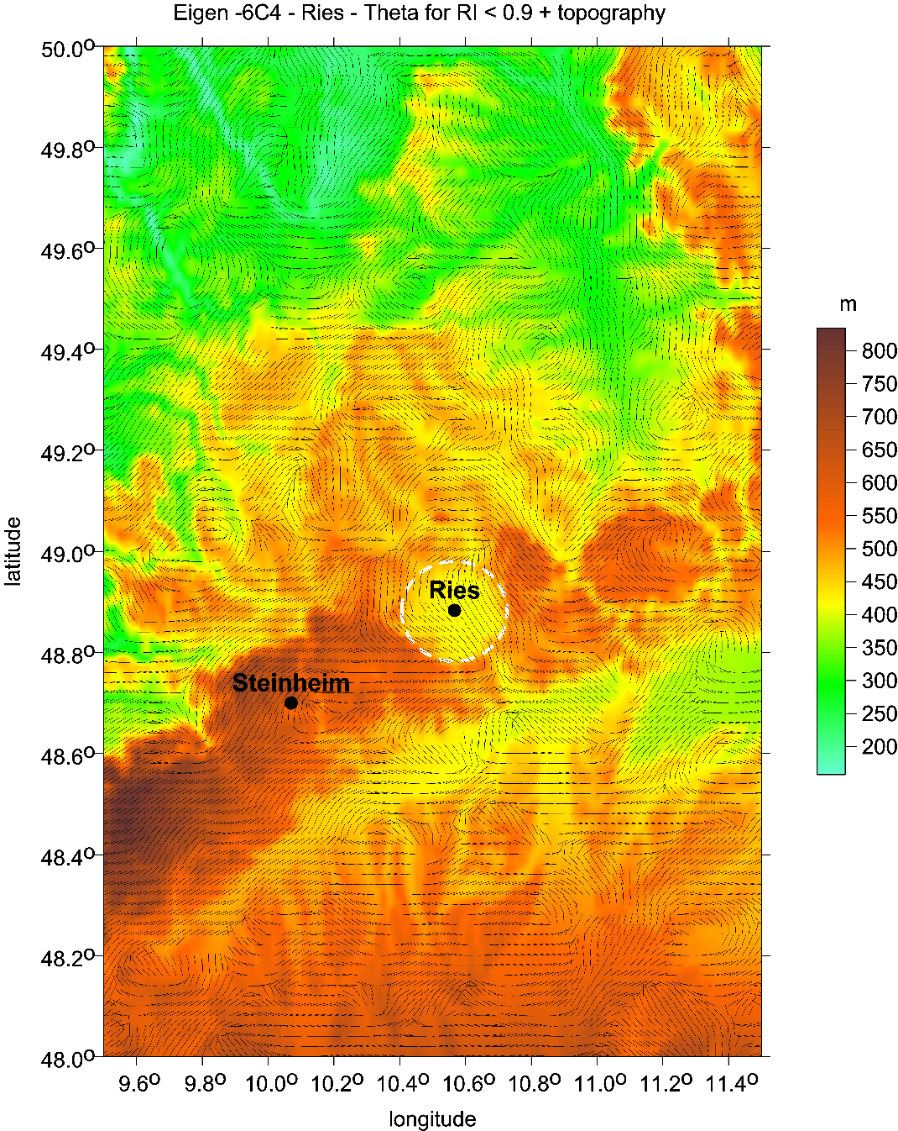
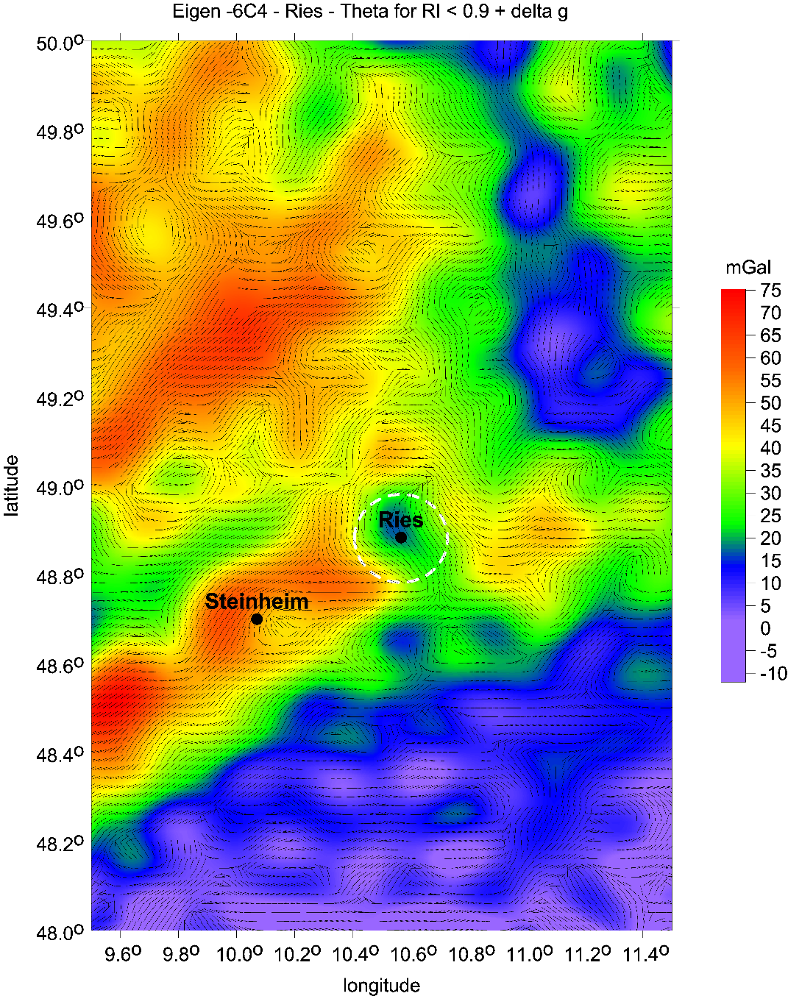
Impact craters Ries and Steinheim, Germany
Strike angles [deg], I<0.9, with ETOPO 1 topography [m] (left) Strike angles, I<0.9, with ∆g (right))

Slide 10
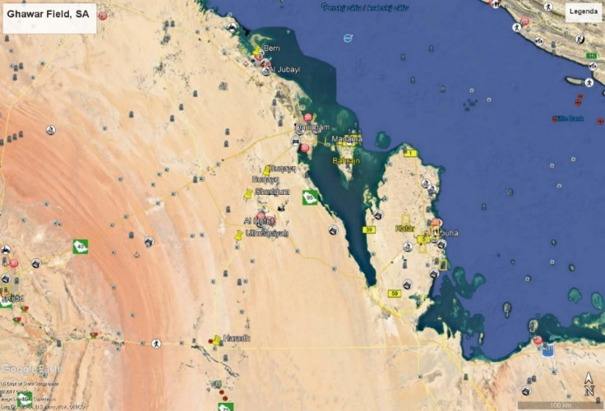
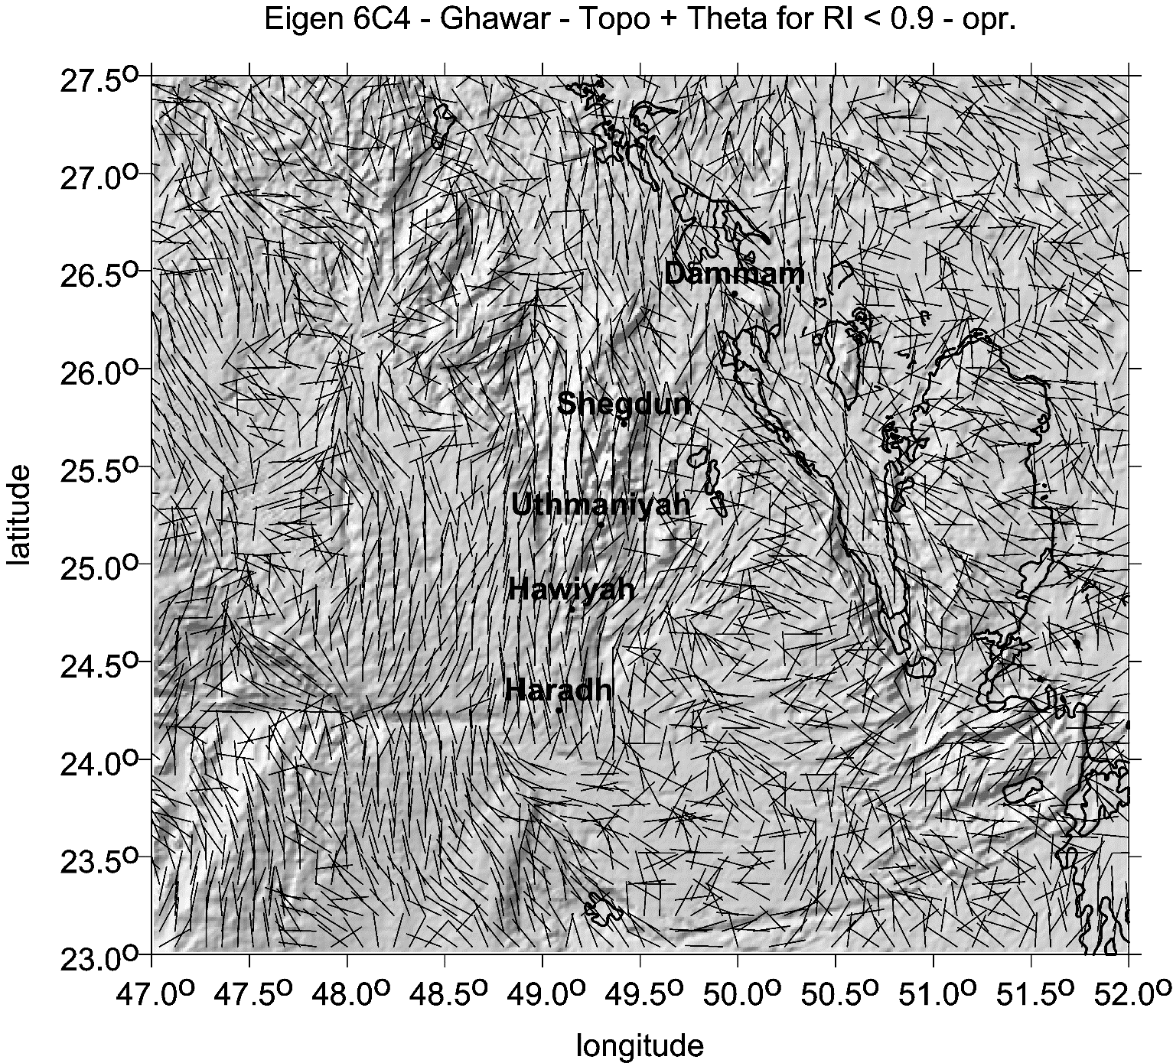
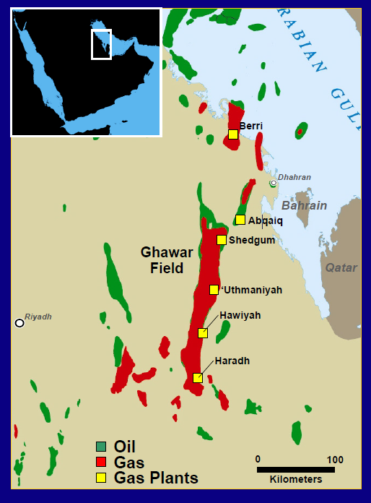
Ghawar
Saudi Arabia
combed strike angles
over oil/gas fields
everywhere EIGEN 6C4 used

Slide 11
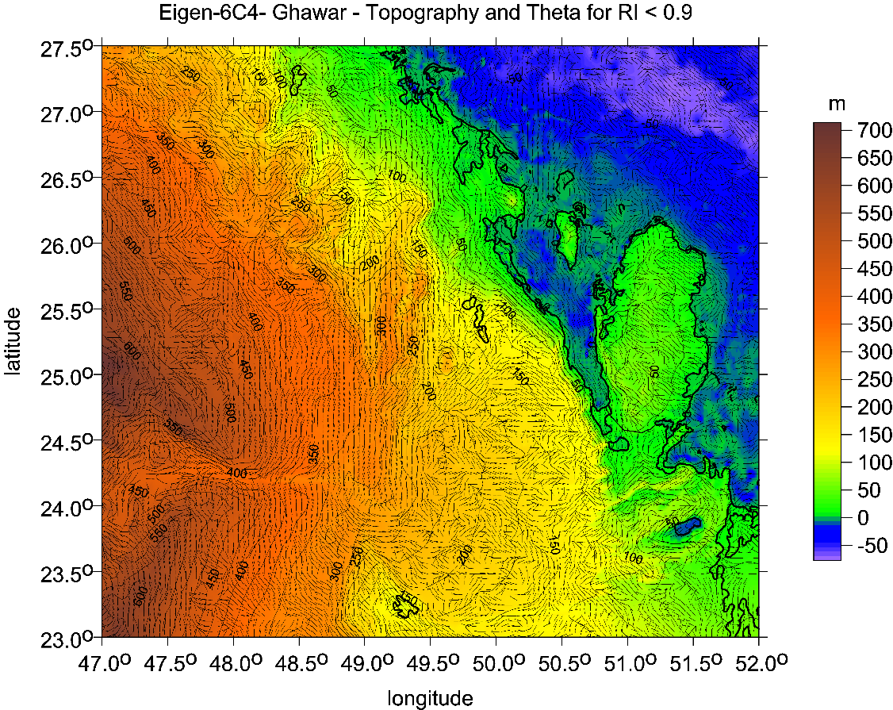
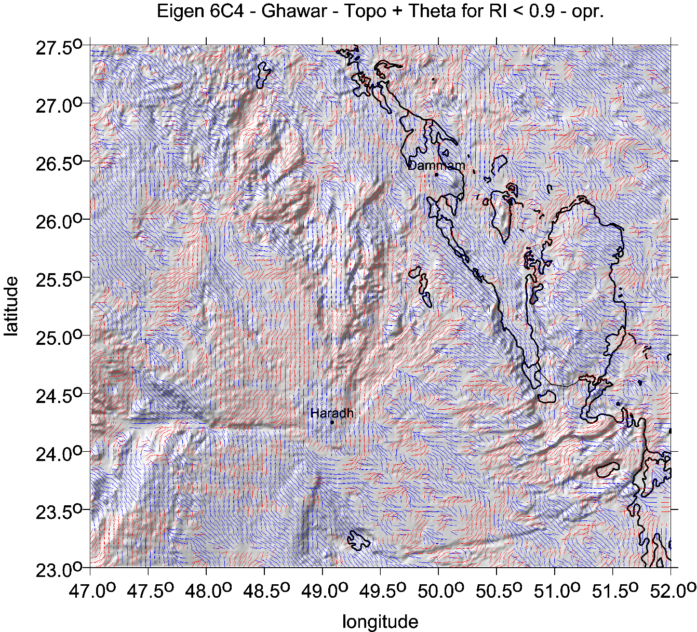
Strike angles

Slide 12
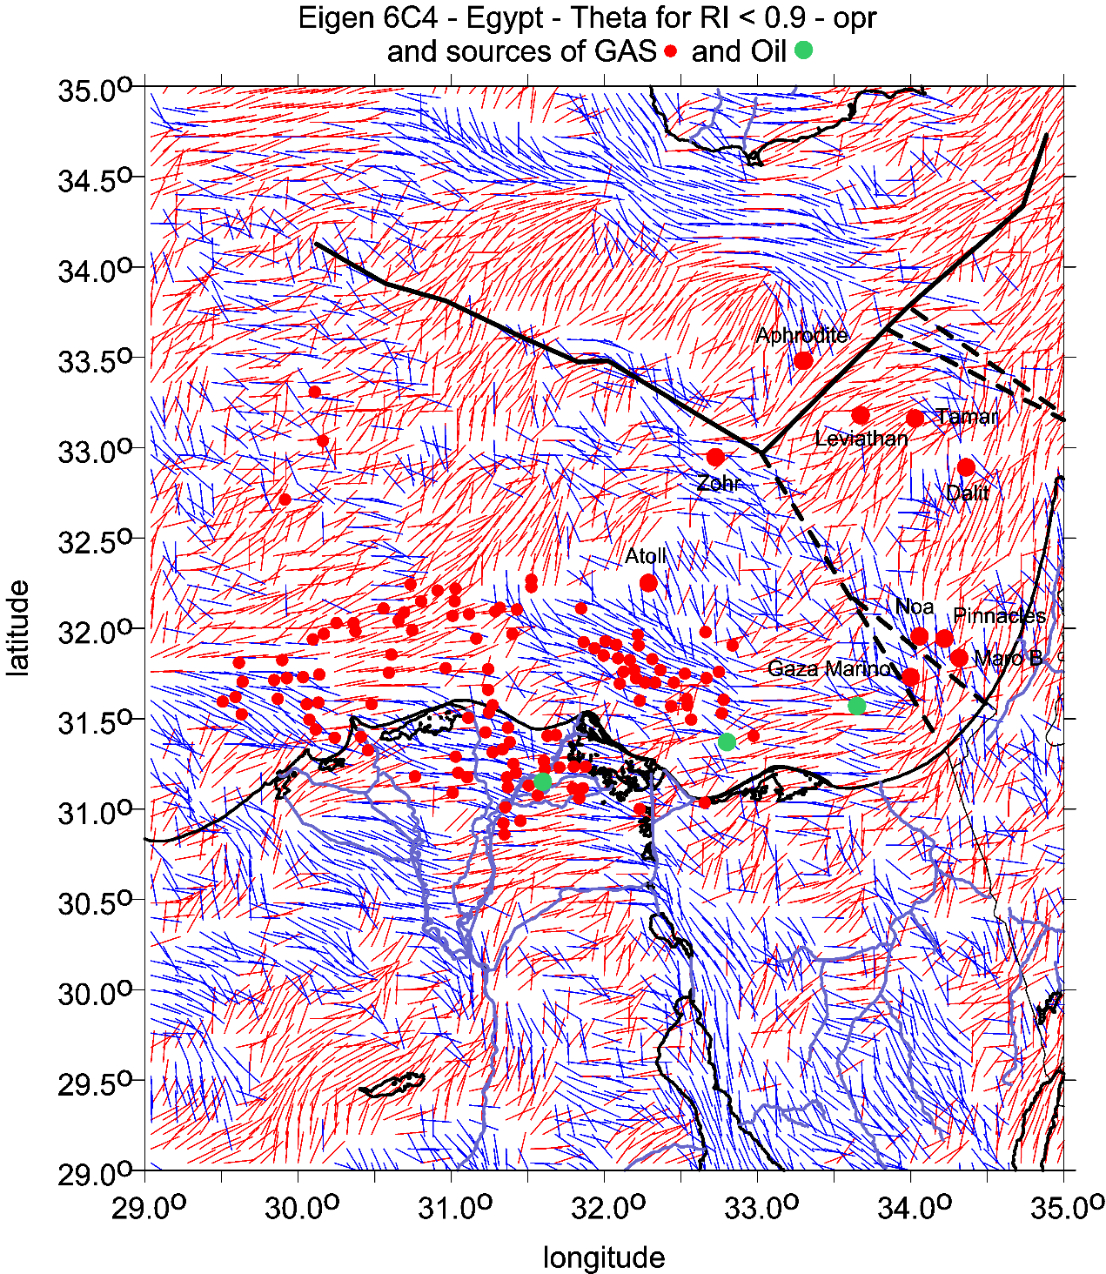
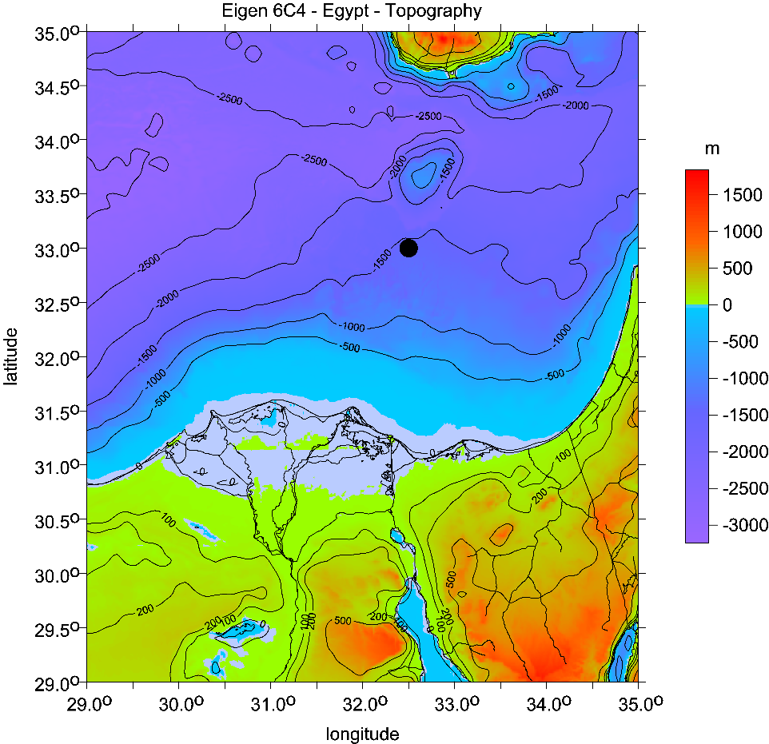
Egypt-Israel
Strike angles

Slide 13
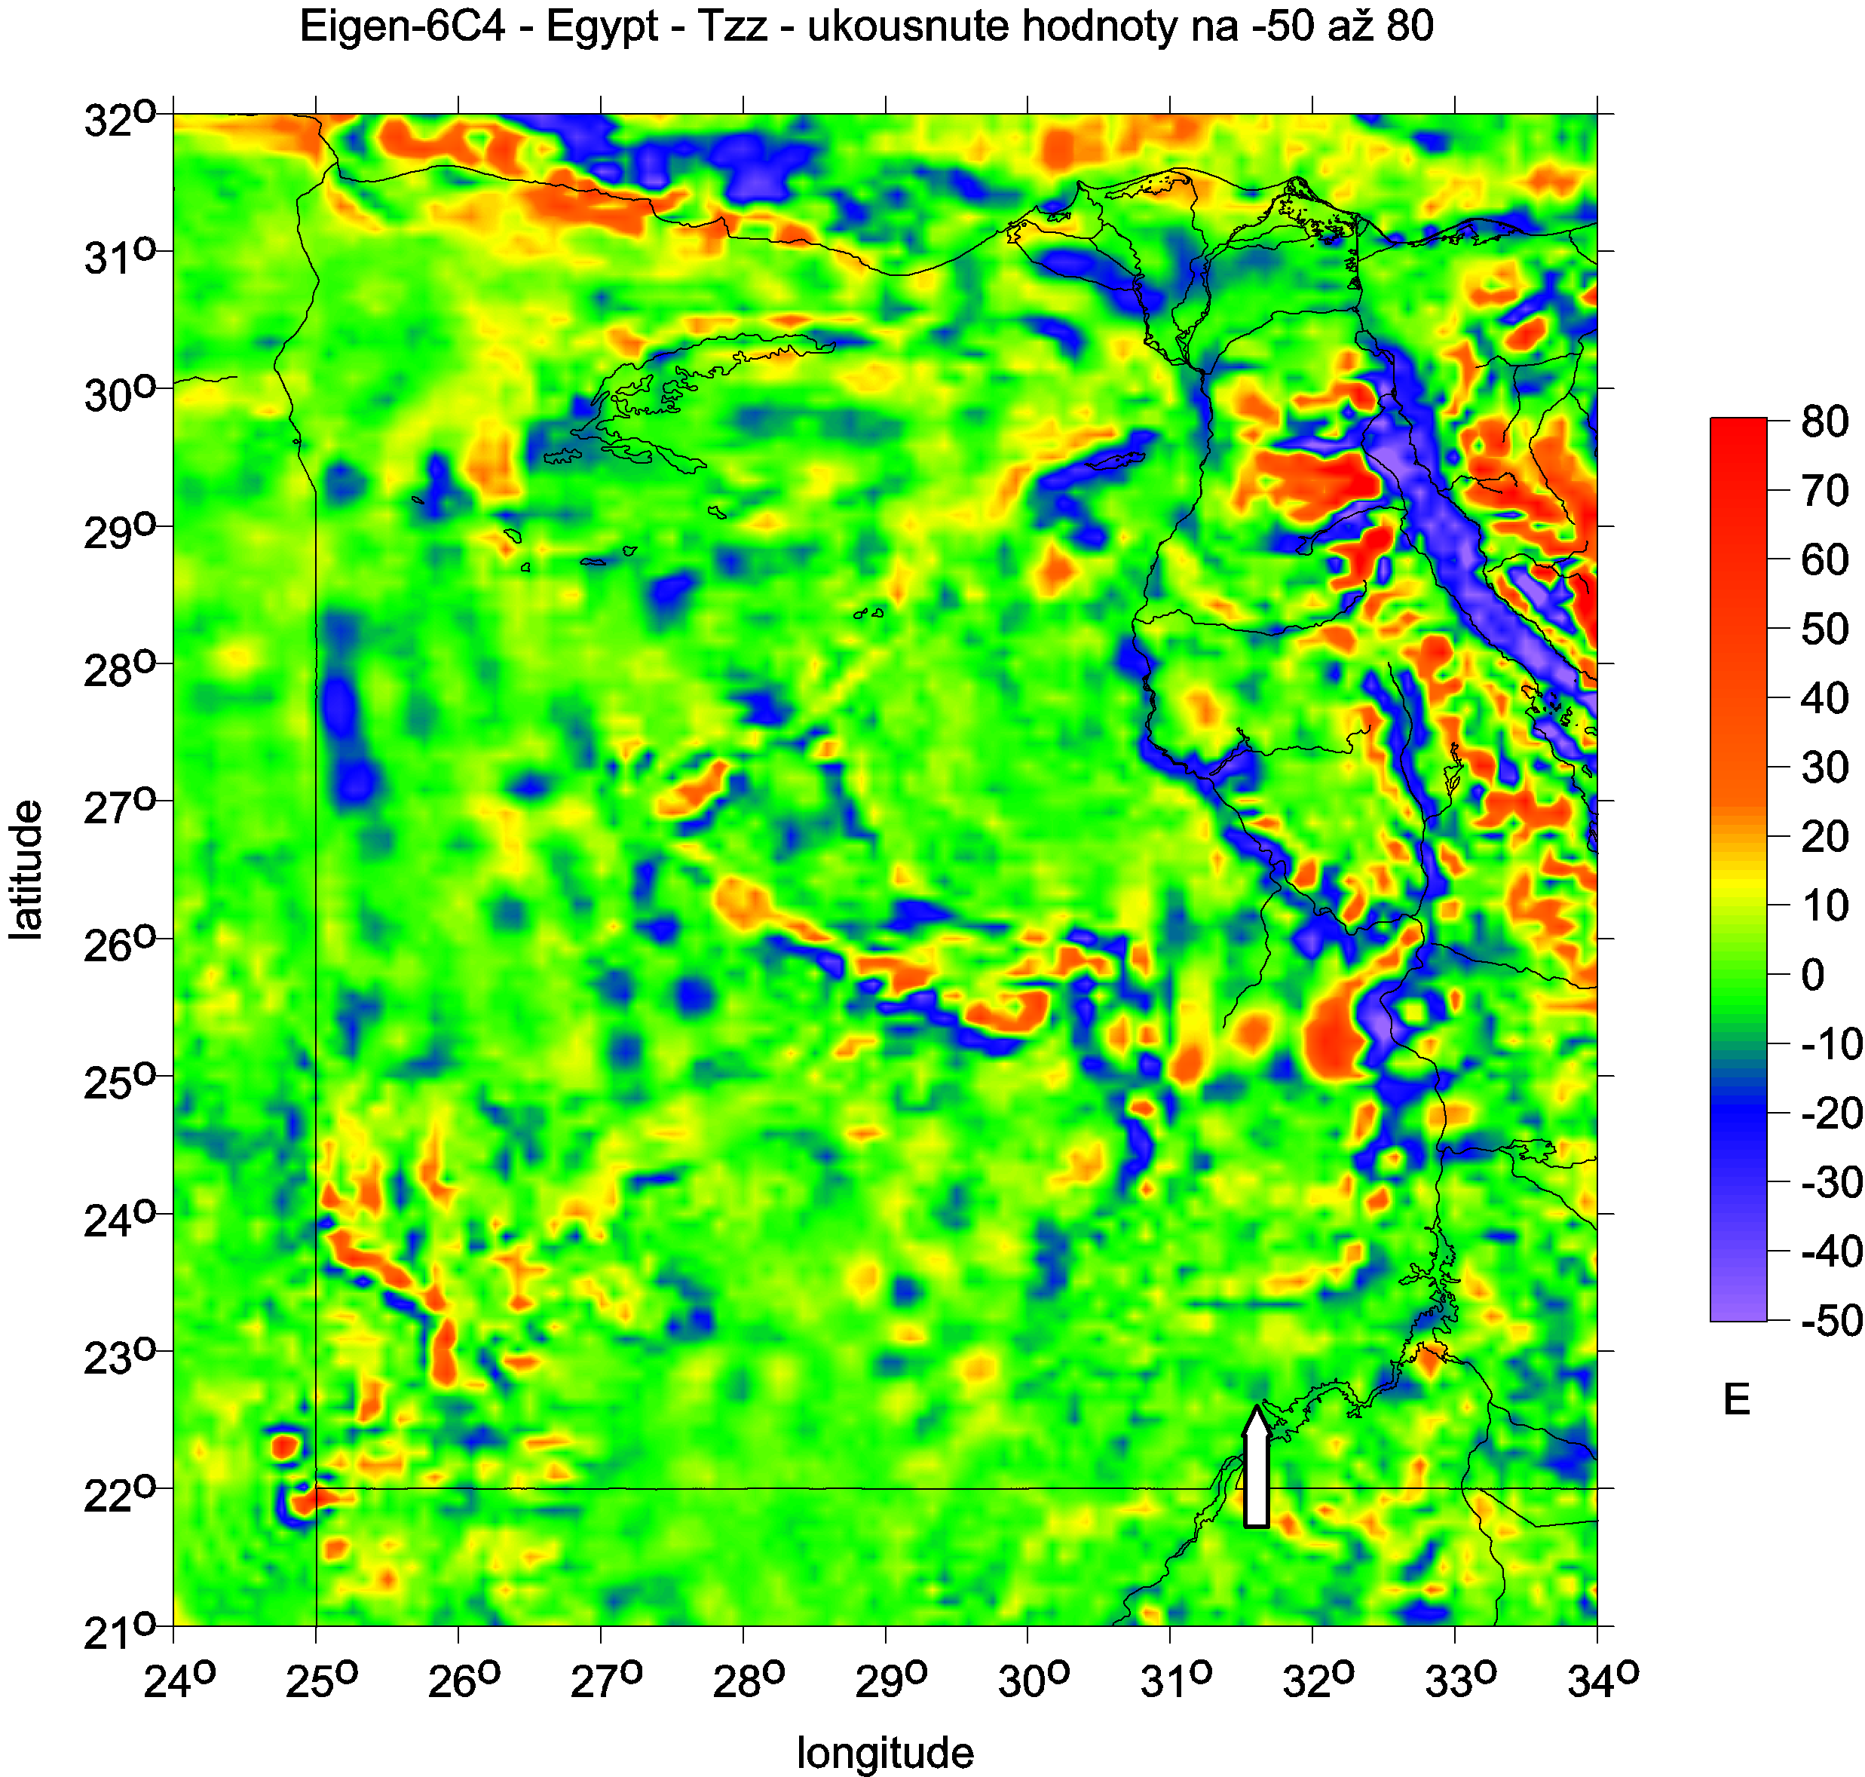

Slide 14
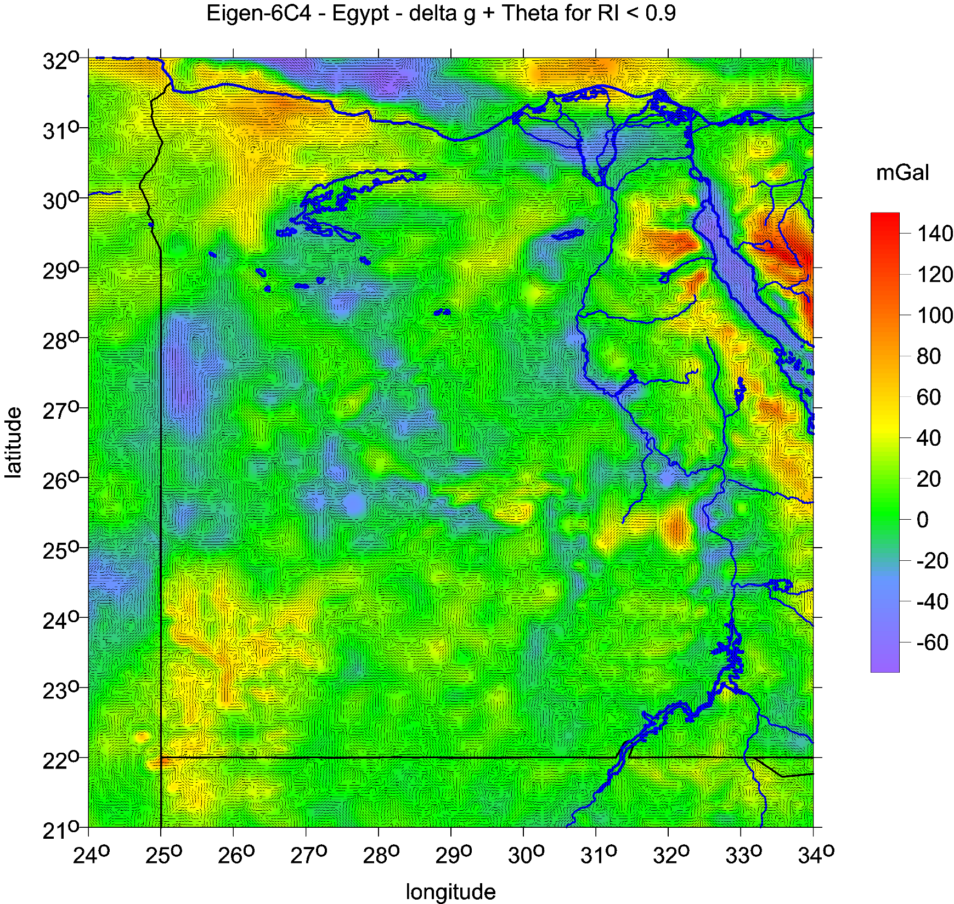
Strike angles

Slide 15
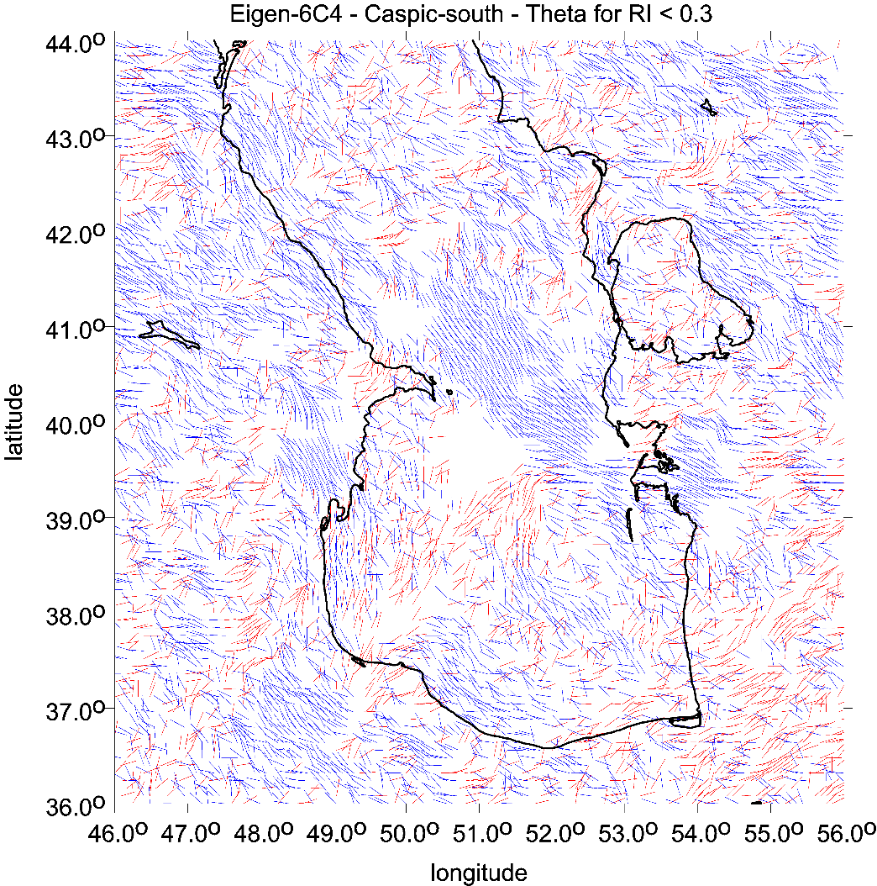
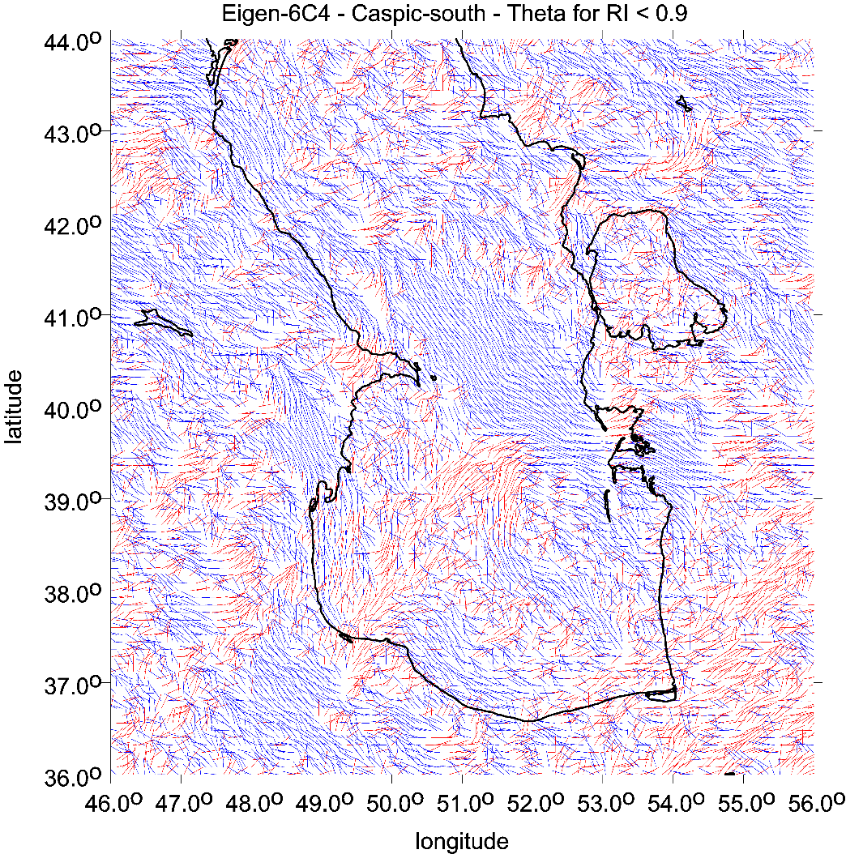
Caspian Sea
Strike angles
The strike angles θ are expressed in degrees [deg, º]
with respect to the local meridian; red colour means
the direction is to the north of east and blue south of east.

Slide 16
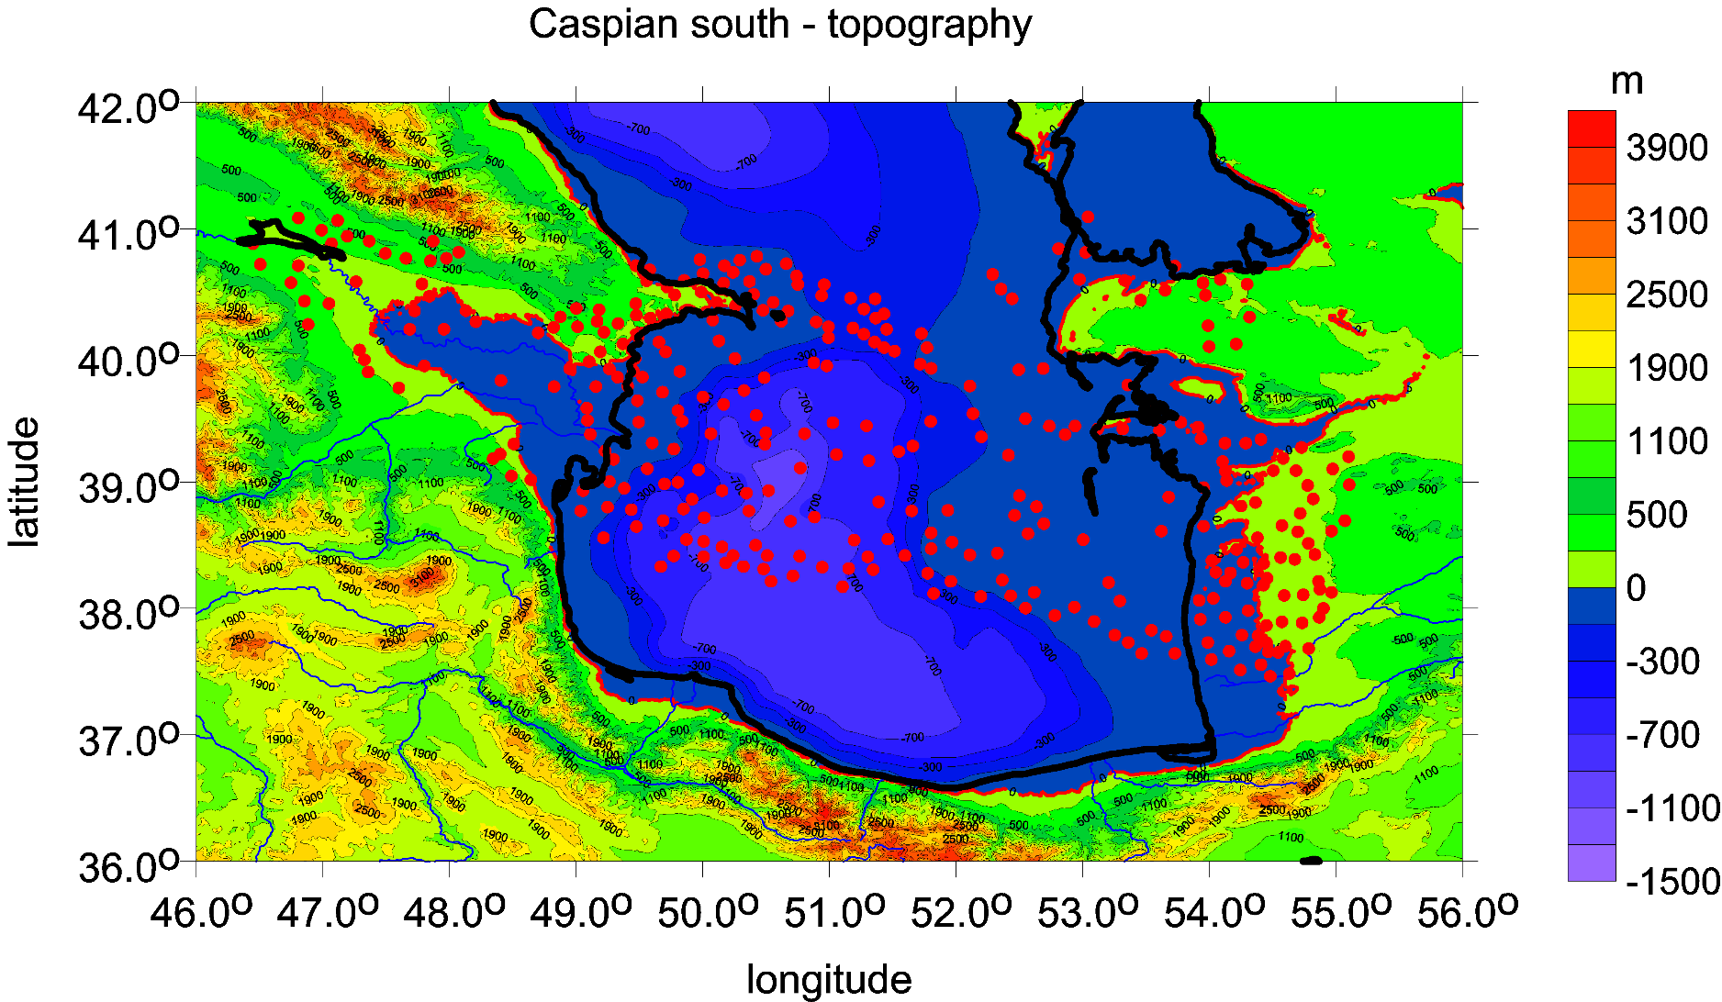
Surface topography from satellite model ETOPO 1 [m] with red dots for oil/gas deposists

