Slide 1




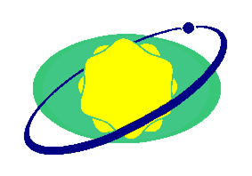

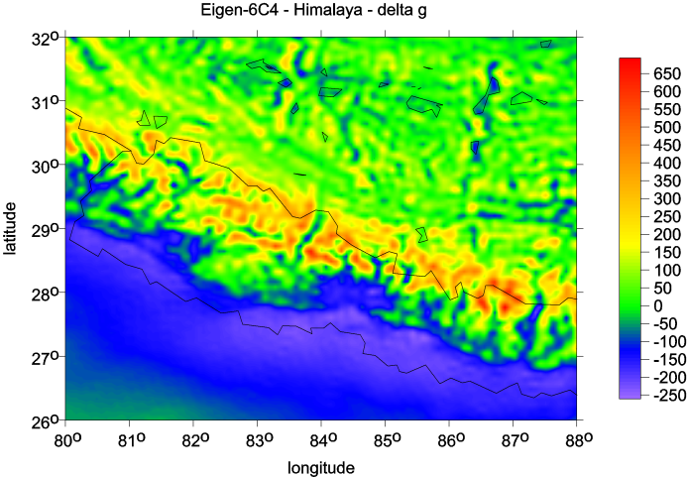
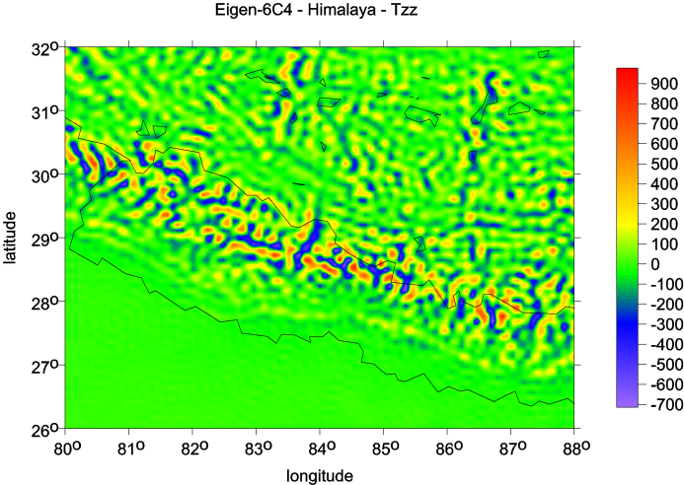
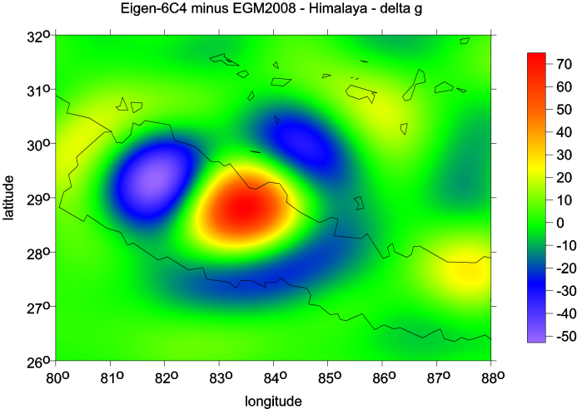
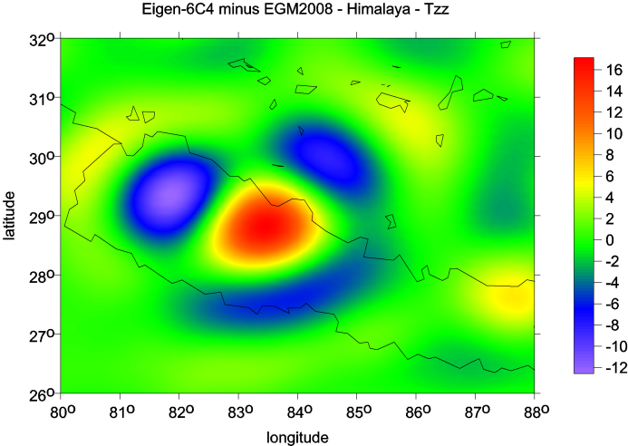
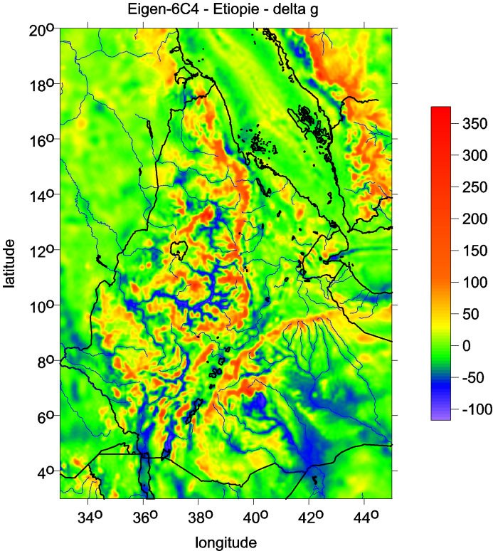
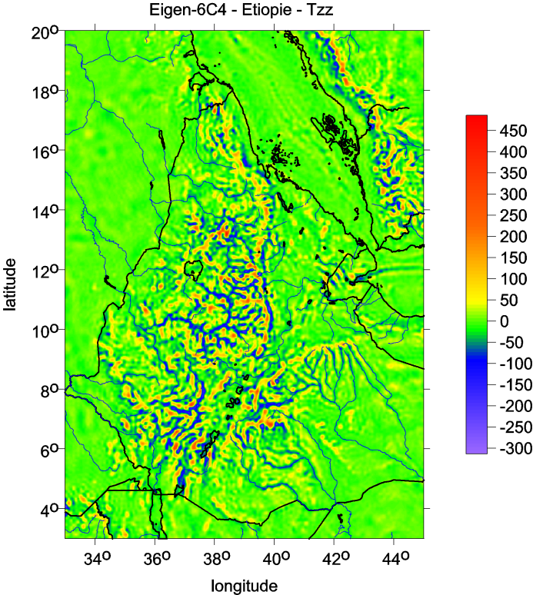
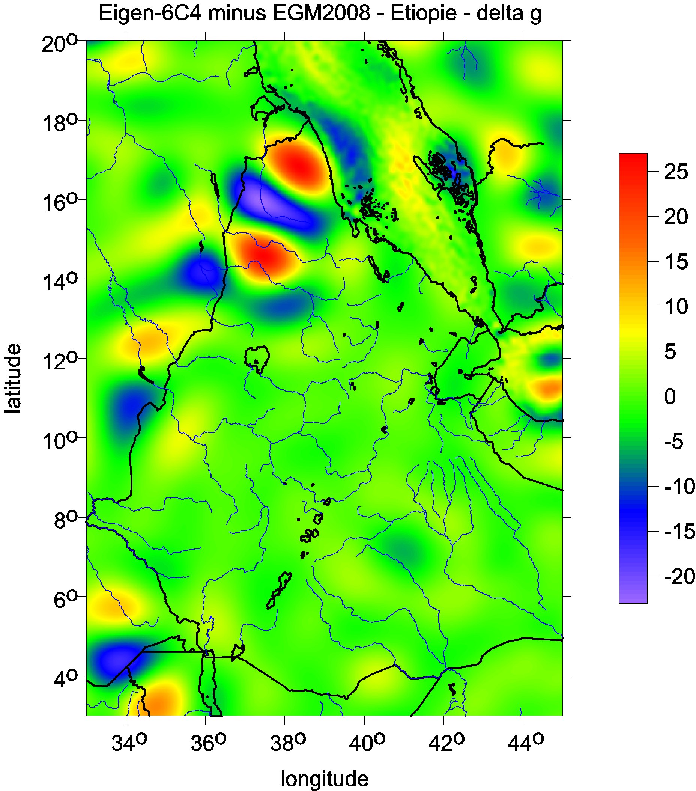
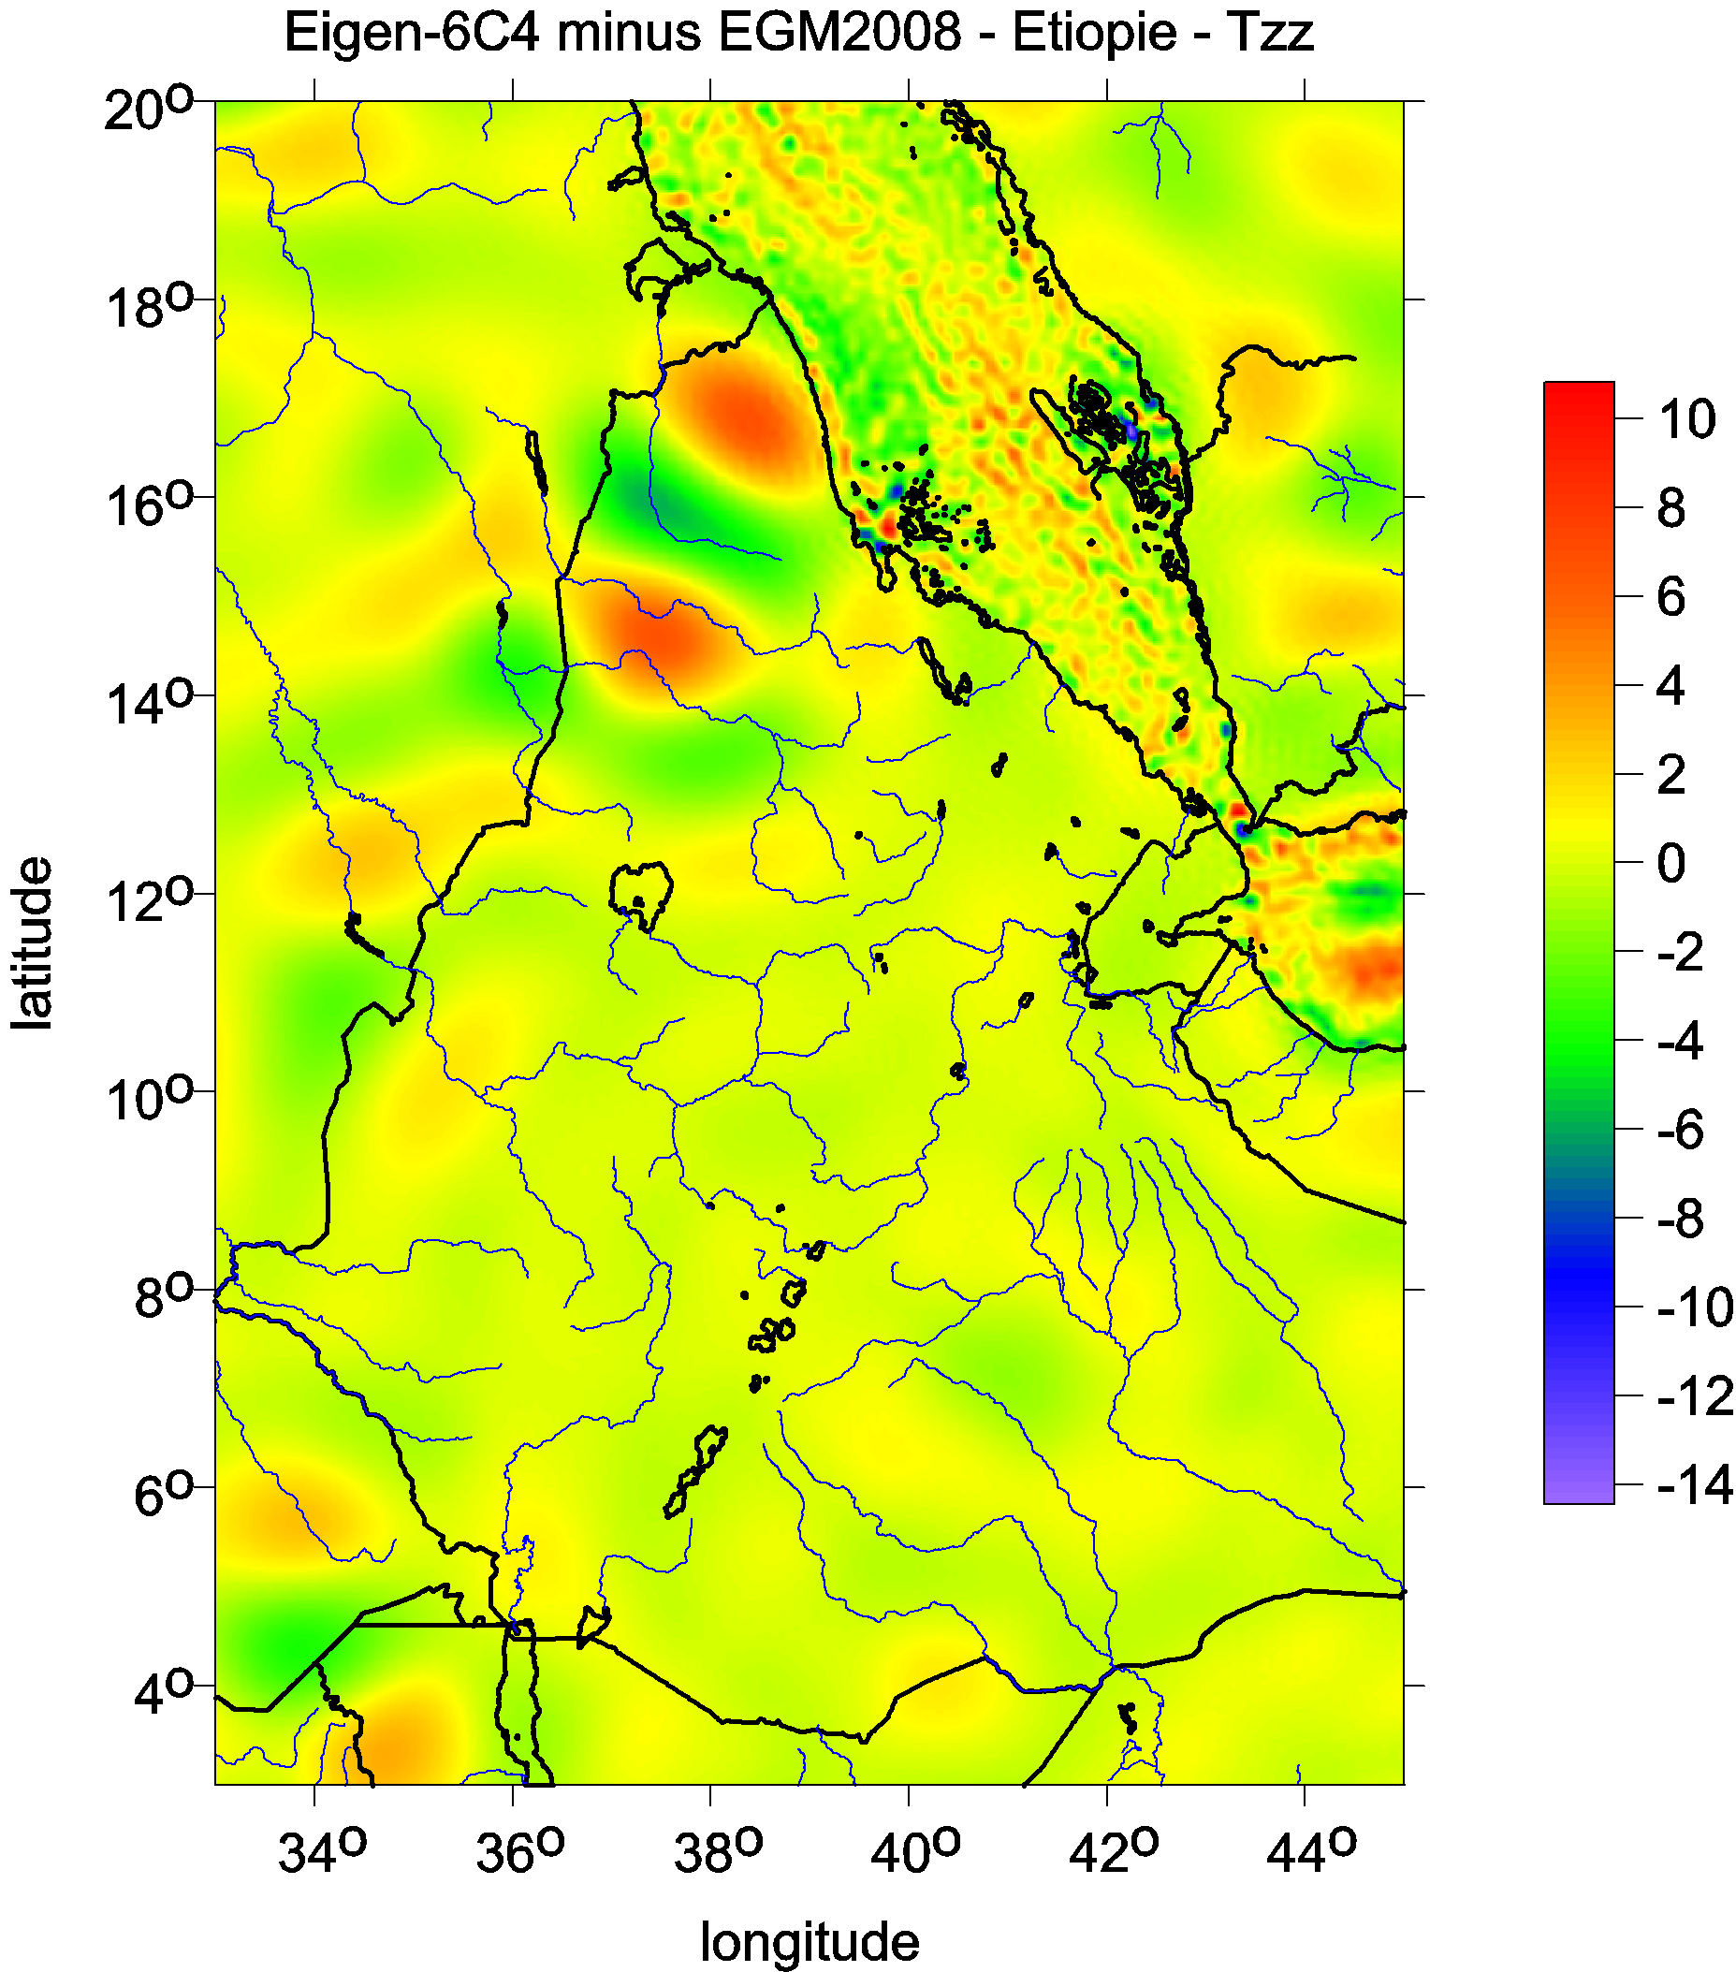
Evaluation of EIGEN-6C4 by means of various functions of gravity potential,
and by GNSS/levelling
J. Klokočník¹, J. Kostelecký^{2,3} , B. Bucha⁴, A. Bezděk¹, Ch. Foerste⁵
Acknowledgments This report has been worked out in the frame of the GA CR grant #13-36843S and program RVO 67985815, project Center of excellence NTIS - CZ.1.05/1.1.00/02.0090 and LM2010008 (CzechGeo EPOS).
¹Astronomical Institute, Academy of Sciences of the Czech Republic, p.r.i. (ASÚ),CZ – 251 65 Ondřejov Observatory, e-mail: jklokocn @asu.cas.cz, bezdek@asu.cas.cz
²Research Institute of Geodesy, Topography and Cartography (VÚGTK) p.r.i., CZ – 250 66 Zdiby
³ Institute of Geodesy and Mining Surveying, HGF TU Ostrava, CZ – 708 33 Ostrava-Poruba, Czech Republic, e-mail: kost@fsv.cvut.cz
⁴Department of Theoretical Geodesy, Faculty of Civil Engineering, STU in Bratislava , SK – 810 05 Bratislava, e-mail: blazej.bucha@gmail.com
⁵ GFZ Potsdam, Dept. Geodesy and Remote Sensing, Telegrafenberg, D – 14473 Potsdam, Germany, e-mail: foer@gfz-potsdam.de
Abstract The combined gravity field model EIGEN-6C4 (Förste et al., 2014) is the latest combined global gravity field model of GFZ Potsdam and GRGS Toulouse. EIGEN-6C4 has been generated including the satellite gravity gradiometry data of the entire GOCE mission (November 2009 till October 2013) and is of maximum spherical degree and order 2190. In this study EIGEN-6C4 has been compared with EGM2008 to its maximum degree and order via gravity disturbances and T_{zz} part of the Marussi tensor of the second derivatives of the disturbing potential. The emphasis is put on such areas where GOCE data (complete set of gradiometry measurements after reductions) in EIGEN-6C4 obviously contributes to an improvement of the gravity field description. GNSS/levelling geoid heights are independent data source for the evaluation of gravity field models. Therefore, we use the GNSS/levelling data sets over the territories of Europe, Czech Republic and Slovakia for the evaluation of EIGEN-6C4 w.r.t. EGM2008.
The Gravity Field Model EIGEN-6C4 EIGEN-6C4 is a static global combined gravity field model up to degree and order 2190. It has been elaborated jointly by GFZ Potsdam and GRGS Toulouse and contains the following satellite and ground data: - LAGEOS (deg. 2 - 30): 1985 - 2010 - GRACE RL03 GRGS (deg. 2 - 130): ten years 2003 - 2012 - GOCE-SGG data, processed by the direct approach incl. the gravity gradient components T_{xx}, T_{yy}, T_{zz} and T_{xz} out of the following time spans: 837 days out of the nominal mission time span 20091101 – 20120801, 422 days out of the lower orbit phase between 20120801 – 20131020. These GOCE data as well as the LAGEOS and GRACE data are the same as used for the 5th release of ESA’s satellite-only gravity field model via the direct approach GO_CONS_GCF_2_DIR_R5 (Bruinsma et al. 2014). For EIGEN-6C4, the GOCE polar gaps were stabilized by the Spherical Cap Regularization using the combined gravity field model EIGEN-6C3stat - Terrestrial data (max degree 370): DTU12 ocean geoid data and an EGM2008 geoid height grid for the continents. The combination of these different satellite and surface data sets has been done by a band-limited combination of normal equations (to max degree 370), which are generated from observation equations for the spherical harmonic coefficients (e. g. Shako et al., 2013) The resulted solution to degree/order 370 has been extended to degree/order 2190 by a block diagonal solution using the DTU10 global gravity anomaly data grid.
Models tested and differences between them The topic and the method are well-established. We continue the work of many other authors. Here we report about our recent tests with EGM2008 (Pavlis et al 2008, 2012) and EIGEN-6C4 (Förste et al. 2014). The models are compared by means of gravity disturbances, part of Marussi tensor elements, (for theory and examples of various applications see Kalvoda et al. 2013; Klokočník et al. 2014) and via GNSS/levelling. We present regional differences for Himalaya, Ethiopia, Europe, and specifically for the Czech Republic. Much more examples are available but cannot be presented due to the lack of space. We selected the following examples: first for an area Himalaya with a low quality of terrestrial data in both models (fill-in data) in a remote area with mountains, Ethiopia - one in the area with better data, outside Europe with very rich river system and erosion and for Europe. GNSS/leveling data for Europe comes from EVRS 1997 campaign, and for the Czech Republic and Slovakia the high quality terrestrial data comes from national GNSS/leveling campaigns. In the differences shown by our figures we see long wavelength discrepancies between the two models, where we anticipate a role of the GOCE data. The differences over Europe (for delta g as well as T_{zz} show significant values for the oceans while the differences over land are small. This is caused by the fact, that EIGEN-6C4 still contains EGM2008 over the continents while recent altimetry-based gravity data were taken for the ocean and sea area. The differences between both models for T_{zz} also show a pixelated pattern (see the figure for Bohemia). We think this phenomenon is caused by noise of the GOCE data which appears more in the second radial derivative of the potential than in the gravity anomaly. Obviously, these differences give no quantitative measure about the accuracy of the compared models. For such a purpose, independent, sufficiently precise and as global as possible data sets are needed. Here in our study we used GNSS/levelling data, which are independent of the models. These data are very precise but not of global expansion.
All figures:
delta g in mGal
T_{zz} in Eötvös

Slide 2
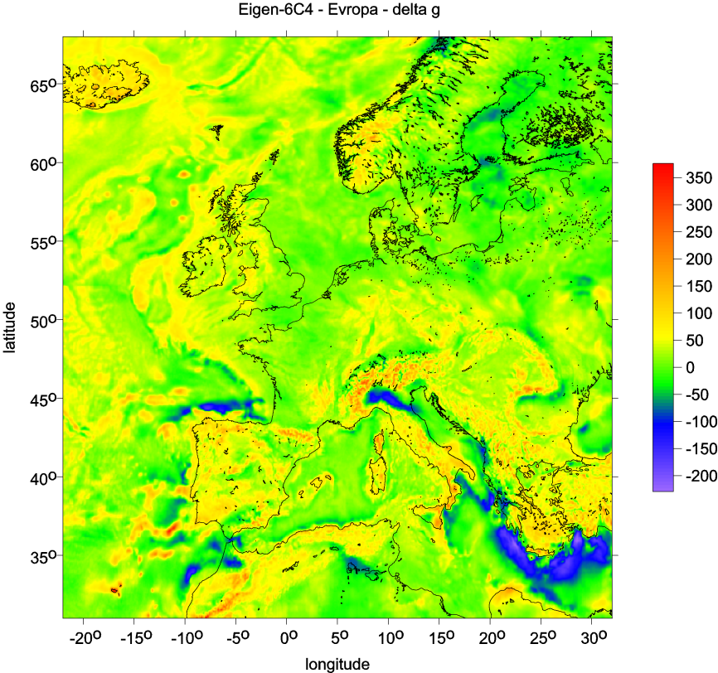
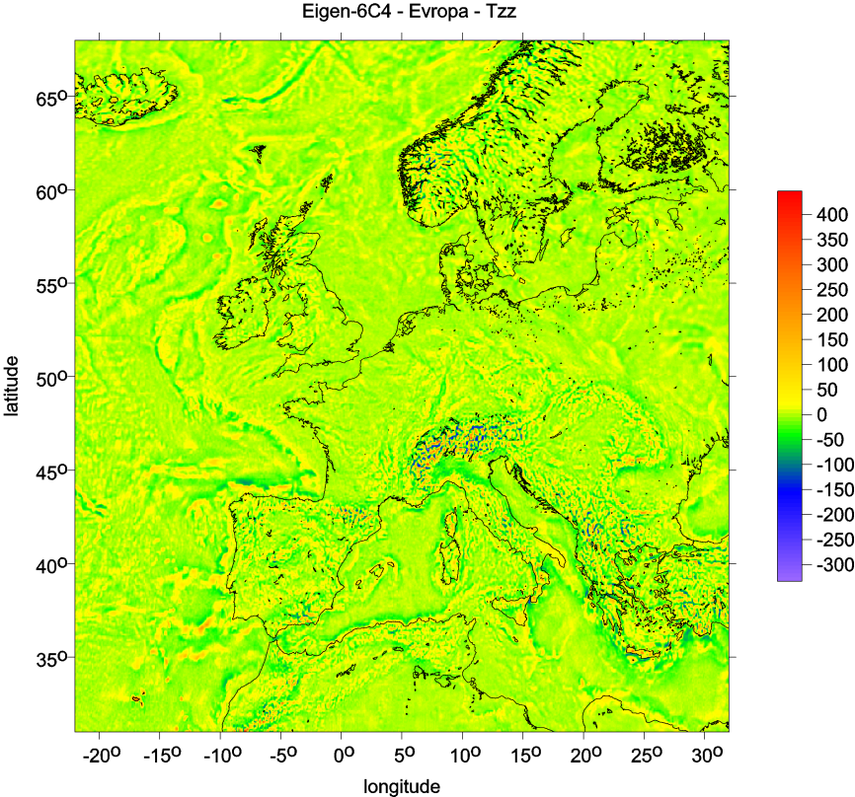
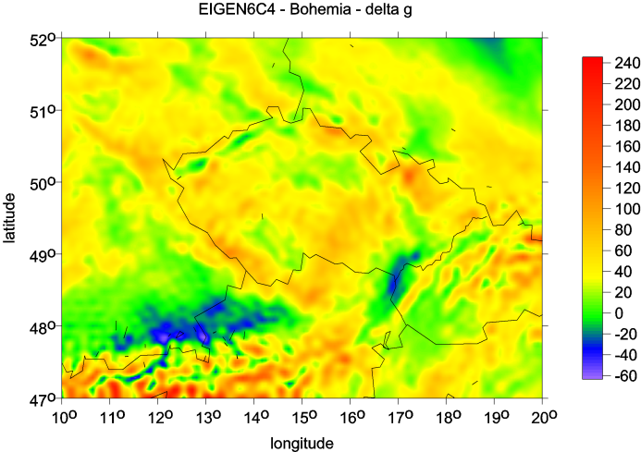
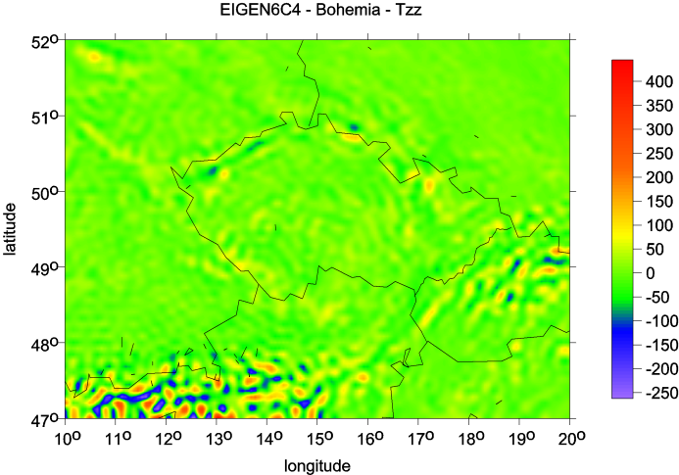
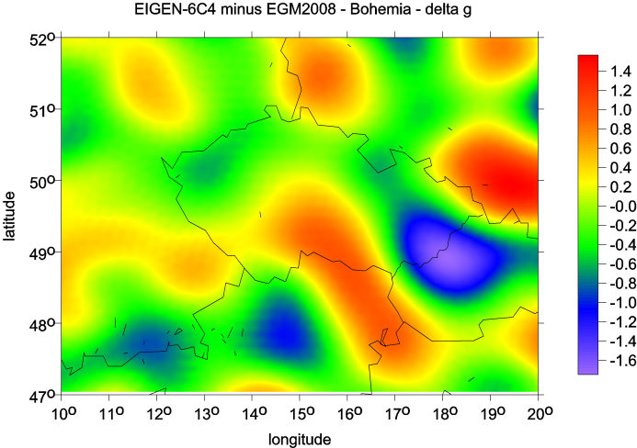
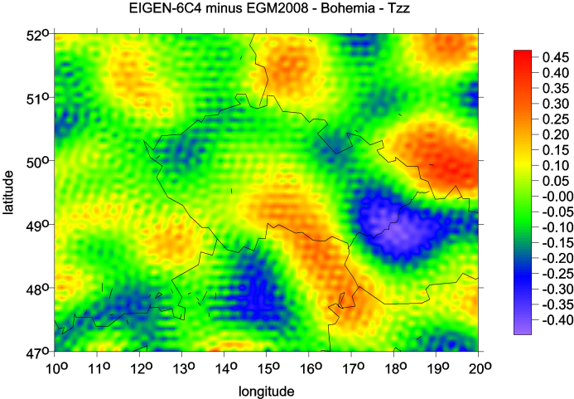
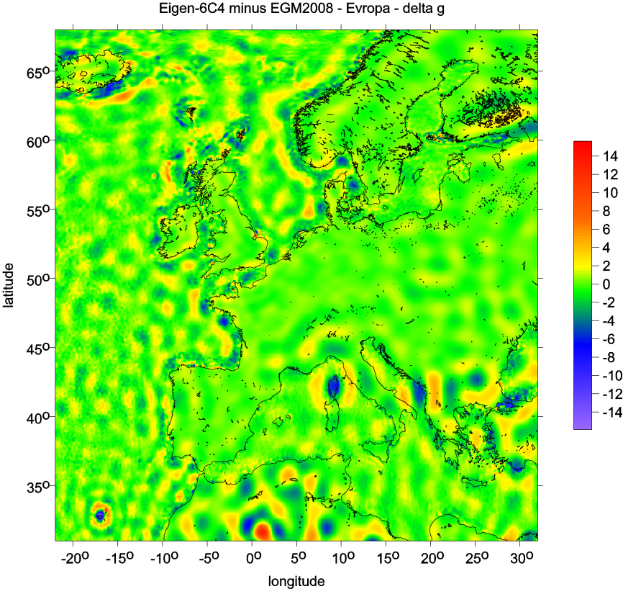
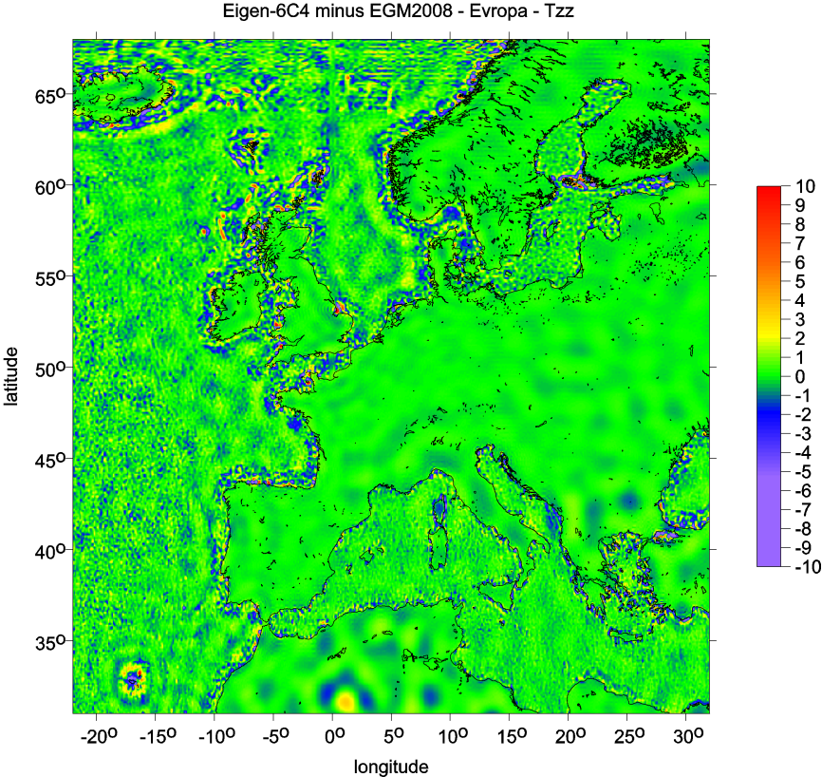
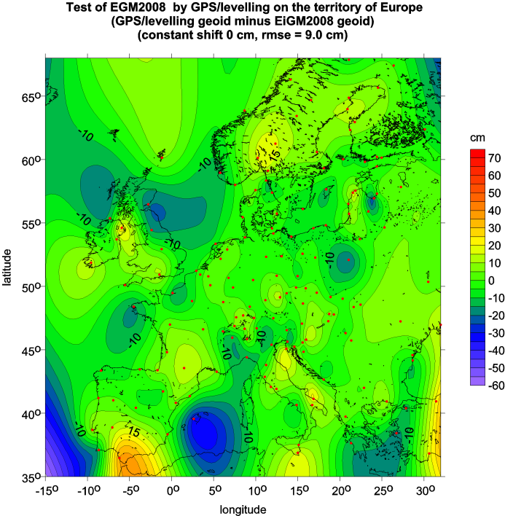
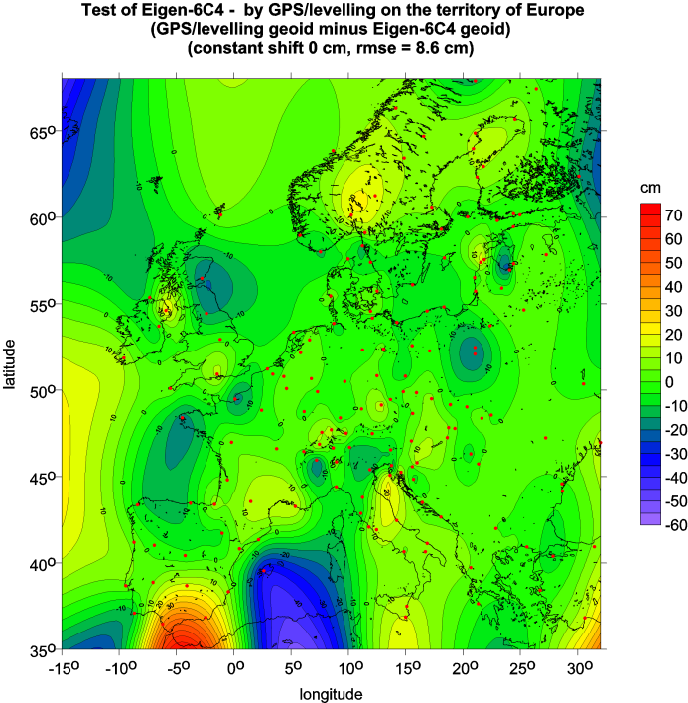
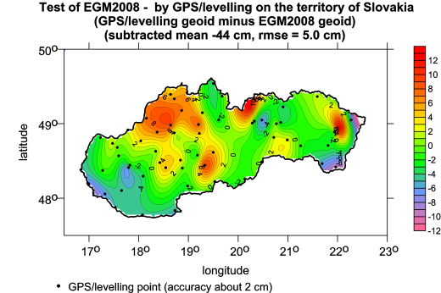
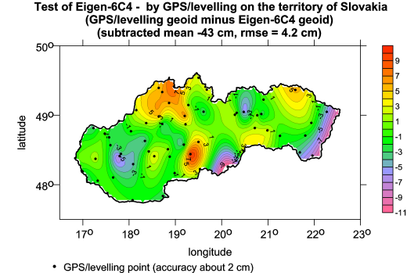
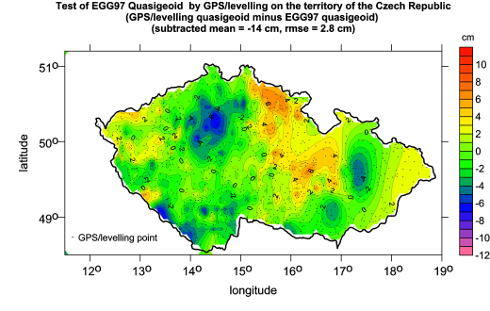
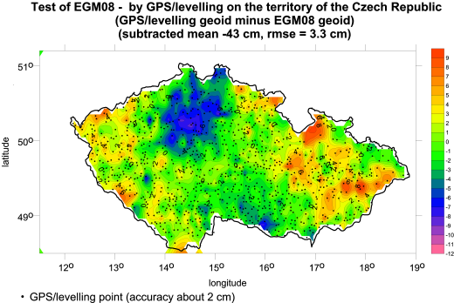
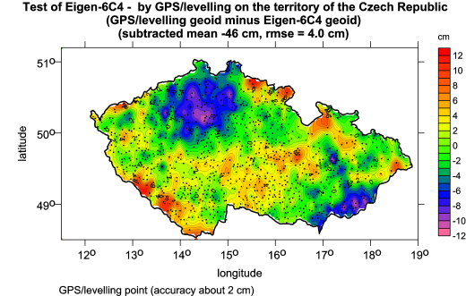
GNSS/levelling Method and data A network of geodetic points has been established on the territory of the Czech Republic during 1996–2006. It enables a direct computation of the geoid (quasigeoid) undulation ξ according to a simple formula (1) ξ = h_{GNSS} - h_{levelling}+ {2}, where h_{GNSS} is the ellipsoidal height with respect to a reference ellipsoid (here GRS80) derived from measurements by the GNSS technology, h_{levelling} is the physical (sea-level) height derived from the levelling, here the normal height according to Molodensky in the Baltic vertical datum, and {2} are small terms of second order, accounting for the curvature of the plumb line. The method and results are described in Kostelecký et al (2012). The network containing 1024 points regularly covering the territory of the Czech Republic has been surveyed by Land Survey Office with the aim to rectify the gravimetric quasigeoid. The GNSS coordinates were measured on selected trigonometric points of the Czech Geodetic Control. The height of these points was already known from trigonometry with accuracy of decimeters; thus, the most precise heights of these points were determined by the method known as “precise geometric levelling” using the nearest points of the Czech State Levelling Network. The accuracy of the physical heights is better than 0.5 cm with respect to the nearest points of the State Levelling Network. For all 1024 points we can then compute the geoid (quasigeoid) undulations by Eq. (1). The accuracy of the GNSS ellipsoidal heights is 1.5 – 2.0 cm. The total error of the height anomaly varies between 1.6 and 2.1 cm, see, e.g., Kostelecký et al. (2012). For the territory of Slovakia the network consists of 64 points measured by Geodetic and Cartographic Institute in Bratislava at the SLOVGERENET (SLOVak GEOdynamic REference NETtwork). The accuracy is approximately the same as in the Czech Republic. The accuracy of the EGG97 quasigeoid is about 3 to 5 cm per 100 km - see Denker et al. (2008). Evaluation of results GNSS/levelling data sets (with the accuracy about 2 cm) have been used to evaluate EGM2008 and EIGEN-6C4 on the territories of the Czech Republic (CZ) and Slovakia (SK) as well as over Europe. While the Czech Republic (CZ) and Slovakia have very dense GNSS/levelling points, for Europa only those with much less density are available for us. For GNSS/levelling heights minus geoid values from EGM2008 and EIGEN-6C4 we obtained: RMS of the differences of 3.3/4.0 cm (CZ), and 5.0/4.2 cm (SK) respectively. The semi-major axis of the ellipsoid used to compute the geoid from respective model is 6378136.3 m for both models. The offset (subtracted mean in Figures) about 40 cm for CZ and SK is caused by using different ellipsoids in the geoid and the GNSS/levelling computations and by using different height systems. For the Czech Republic our Figures show a significant hollow in the northern part. We are sure that this finding is not an artifact of method or computations. To clear up this phenomenon we added a Figure with differences between the GNSS/levelling heights and the quasigeoid model EGG97 (Denker et al., 2008). This figure shows a systematic trend, but the differences between GNSS/levelling and quasigeoid EGG97 a little bit lower than those for the two gravity models. This depression could be caused by a) an inaccuracy of the terrain gravity measurements and/or b) by local recent local deformations (GNSS/levelling observations are from the epoch 2003 and the levelling heights are from 1986 and older). Note also that the authors of both models estimated precision of geoid undulations computed from them in Europe to 0.10–0.15 m RMSE (Foerste et al. 2014). For the European quasigeoid EGG97 the RMS differences between GNSS/levelling height and EGM2008 or EIGEN-6C4 respectively are 9.0/8.4 cm which means an improvement of EIGEN-6C4 vs. EGM2008. This finding is confirmed by additional tests computed for further, larger regions (Canada, USA, Japan, Australia and Brazil). Again, EGEN2008 and EIGEN-6C4 were taken to their maximum degree and order and RMS of differences were computed. The obtained RMS of geoid heigth differences after subtraction of the mean are given in the presented table. The results show an improvement of EIGEN-6C4 vs. EGM2008 for most of the tested regions which should be caused by the inclusion of the novel GOCE satellite data.
Conclusions The global combined high-resolution gravity field models EGM2008 and EIGEN-6C4 have been compared by means of two functions of the disturbing gravitational potential. Here we show examples of differences in delta g and in T_{zz} for Himalaya, Ethiopia, Europe, and namely for the Czech Republic. In our evaluation we see long wave differences between the two models in remote areas of worse terrestrial data. For these regions we assume a positive effect of the GOCE data. The GNSS/levelling data over the territories of Europe, the Czech Republic and Slovakia as well as for further larger regions has been used as an independent data source to evaluate EGM2008 (without GOCE gradiometry measurements) and EIGEN-6C4 (already include them). These tests show an improvement for EIGEN-6C4 compared to EGM2008 for most of the included GPS/Levelling data sets.
References Bruinsma SL, Förste Ch, Abrikosov O, Lemoine J-M, Marty J-Ch, Mulet S, Rio M-H, Bonvalot S (2014) ESA’s satellite-only gravity field model via the direct approach based on all GOCE data, Geoph. Res. Lett., DOI 10.1002/2014GL062045 Bucha B, Janák J (2013): A MATLAB-based graphical user interface program for computing functionals of the geopotential up to ultra-high degrees and orders, Computers & Geosciences, 56, p. 186-196. Denker H, Barriot J-P, Barzaghi R, Fairhead D, Forsberg R, Ihde J, Kenyeres A, Marti U, Sarrailh M, Tziavos I N (2008) The Development of the European Gravimetric Geoid Model EGG07. Institut für Erdmessung, Leibniz Universität Hannover, Schneiderberg 50, D-30167 Hannover, Germany. Förste C, Bruinsma S, Abrykosov O, Lemoine J-M, et al (2014) Tha latest combined global gravity field model including GOCE data up to degree and order 2190 of GFZ Potsdam and GRGS Toulouse, 5th GOCE User Workshop, Paris 25 – 28 Nov. 2014 Floberghagen R, Fehringer M, Lamarre D, Muzi D, Frommknecht B, Steiger C, Pineiro J, da Costa A (2011) Mission design, operation and exploitation of the gravity field and steady-state ocean circulation explorer mission, J Geod 85: 749–758, doi: 10.1007/s00190-011-0498-3SATELLTE. Kalvoda J, Klokočník J, Kostelecký J, Bezděk A (2013) A. Mass distribution of Earth landforms determined by aspects of the geopotential as computed from the global gravity field model EGM 2008. Acta Univ. Carolinae-Geogr., 48, 17-25. ISSN 0300-5402. Klokočník J, Kalvoda J, Kostelecký J, Bezděk A (2013) Gravity Disturbances, Marussi Tensor, Invariants and Other Functions of the Geopotential Represented by EGM 2008, Presented at ESA Living Planet Symp. 9-13 Sept. 2013, Edinburgh, Scotland. Publ. in: August 2014: J Earth Sci. Res 2, 88–101. Kostelecký J, Cimbálník M, Čepek A, Douša J, Filler V, Kostelecký J. jr., Nágl J, Pešek I, Šimek J (2012) Realization of S-JTSK/05. Geodetický a kartografický obzor 58/100, 7, 145–154 (in Czech). Pavlis NK, Holmes SA, Kenyon SC, Factor JK (2008) EGM2008: An overview of its development and evaluation, National Geospatial-Intelligence Agency, USA, presented at conference: Gravity, Geoid and Earth Observation 2008, Chania, Crete, Greece, 23–27 June. Pavlis NK, Holmes SA, Kenyon SC, Factor JK (2012) The development and evaluation of the Earth Gravitational Model 2008 (EGM 2008), J Geophys Res 17: B04406, doi:10.1029/2011JB008916. Reigber C, Luehr H, Schwintzer P (2002) Goce gravitational gradiometry. J Geod 85:777–790. doi:10.1007/s00190-011-0500-0 Shako R, Förste C, Abrikosov O, Bruinsma SL, Marty J-C, Lemoine J-M, Flechtner F, Neumayer KH and Dahle C.(2013), EIGEN-6C: A High-Resolution Global Gravity Combination Model Including GOCE Data, in F. Flechtner et al. (eds.), Observation of the System Earth from Space – CHAMP, GRACE, GOCE and future missions, Advanced Technologies in Earth Sciences, DOI: 10.1007/978-3-642-32135-1_20, Springer-Verlag Berlin Heidelberg 2013 Zeman A, Kostelecký J, Kostelecký J jr, Ryšavý V (2007) Vertical component of the Earth's surface movement in the region of Central Europe (Czech Republic) from the results of satellite geodesy methods and their comparison with the results of repeated terrestrial geodetic methods. Poster presentation at the AGU 2007 Fall meeting.
Root mean square (cm) about mean of GPS/levelling minus model-derived geoid heights (number of points in brackets) for EGM2008 and EIGEN-6C4.
GPS/levelling data set | EGM2008 | EIGEN-6C4
Canada (1930) | 12.6 | 12.4
USA (6169) | 24.6 | 24.5
Australia (201) | 21.5 | 21.1
Japan (816) | 8.2 | 7.8
Brazil (672) | 36.6 | 30.6

