Slide 1
Chicxulub and Popigai
after 15 years*
double or multiple impact craters?
* Klokočník J., Kostelecký J., Pešek I., Novák P., Wagner C.A., Sebera J. 2010. Candidates for multiple impact craters?: Popigai and Chicxulub as seen by the global high resolution gravitational field model EGM08, Solid Earth EGU 1, 71-83; DOI: 10.5194/se-1-71-2010. See also: Is Chicxulub a double impact crater? 6th EGU A. von Humboldt Interntl. Conf. on Climate Change, Natural Hazards, and Societies, Mérida, México, Section: The Cretaceous/Tertiary Boundary and the Chicxulub Impact Crater, paper AvH6-5, 15 March 2010.

Slide 2


Supplement 4
Chicxulub
© ASU & RIGTC

Slide 3
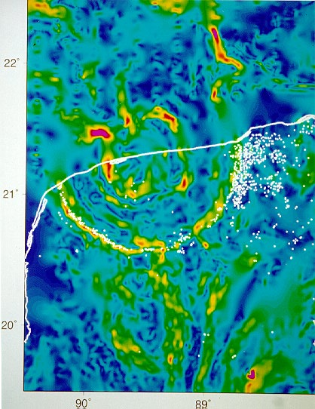
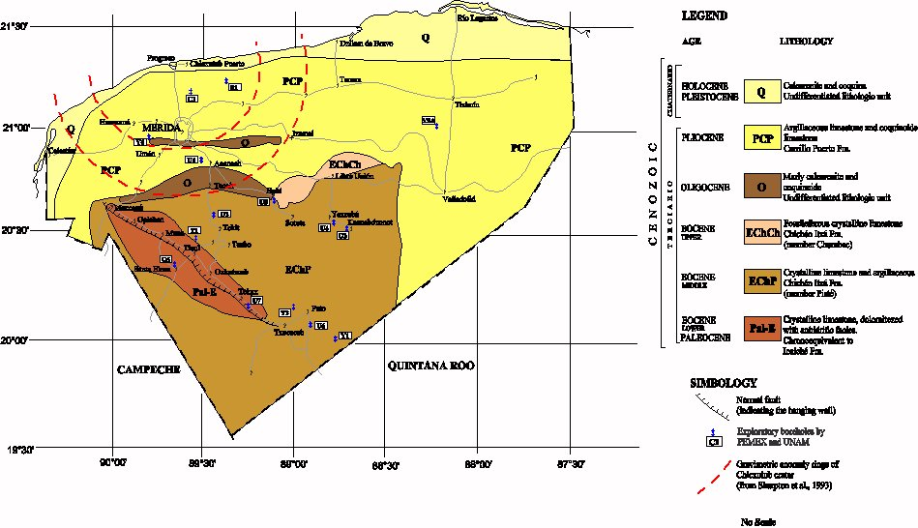
Chicxulub
Alvarez, L.W., Alvarez, W., Asaro, F. & Michel, H.V.
1980. Extraterrestrial cause for the Cretaceous–
Tertiary extinction. Science, v.208, pp.1095–
1108.

Slide 4
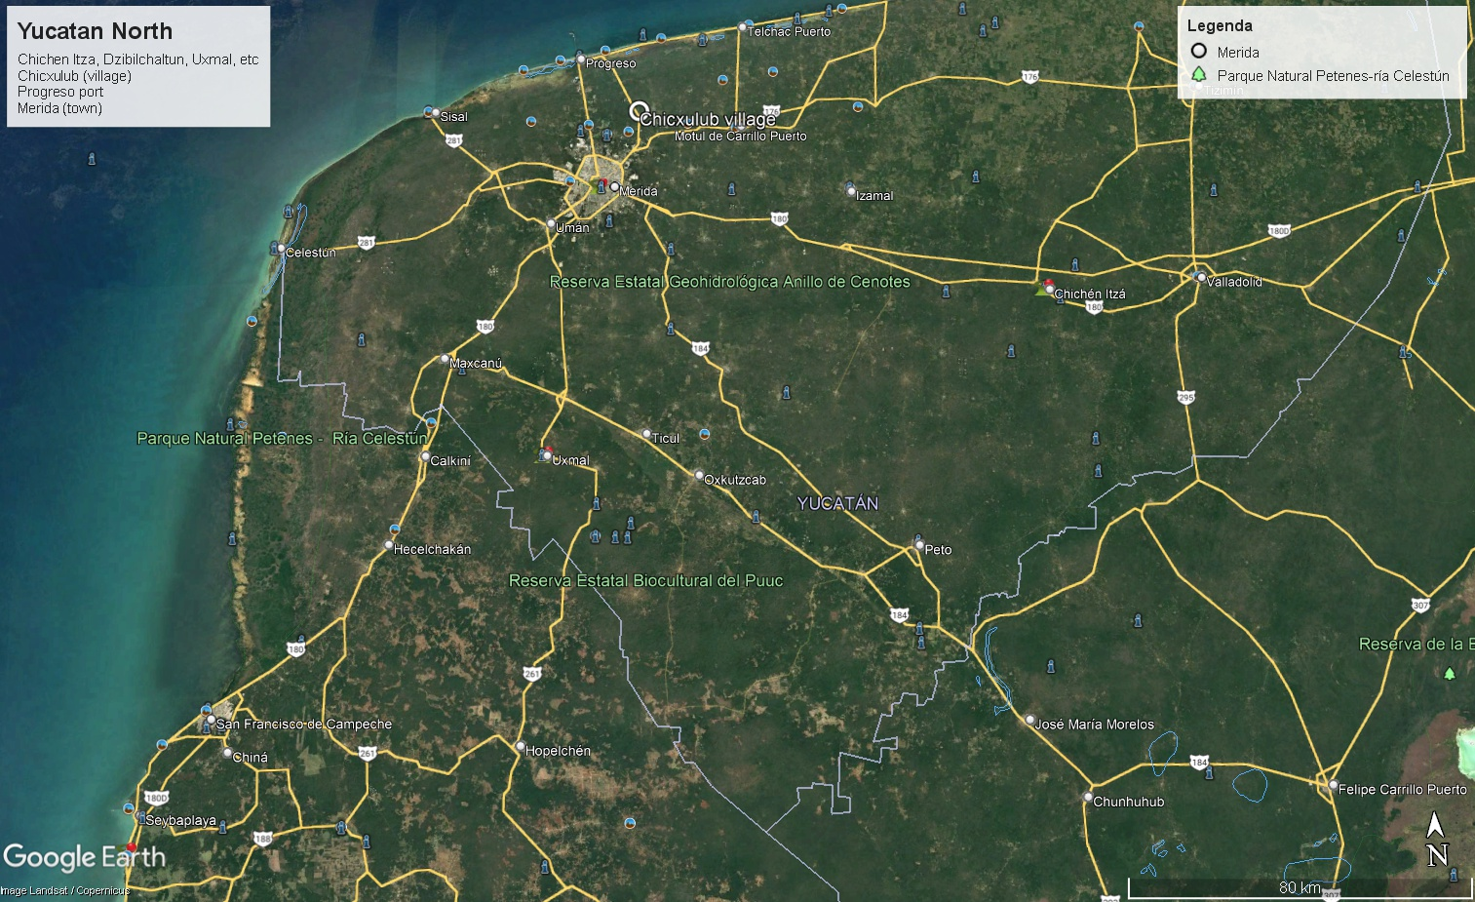
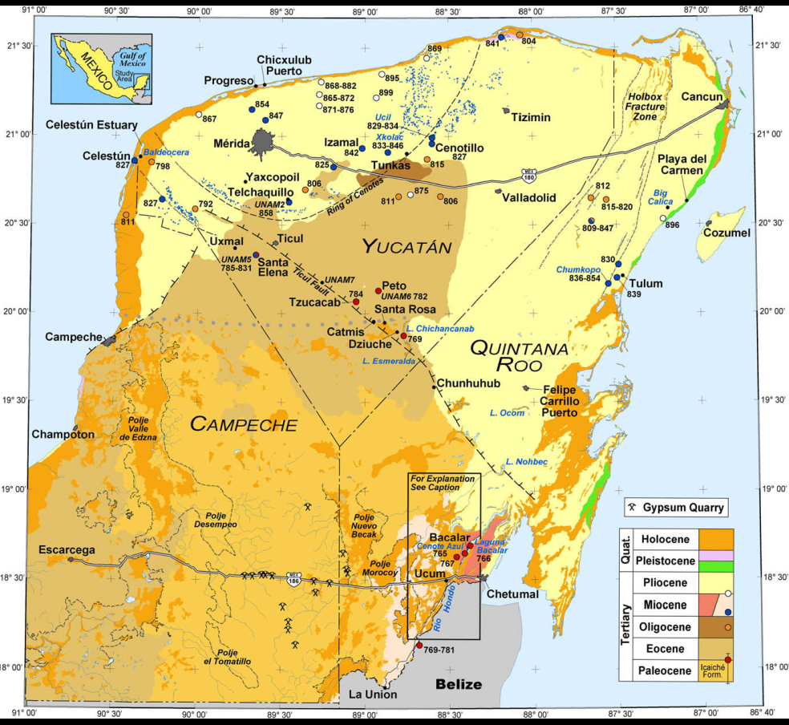
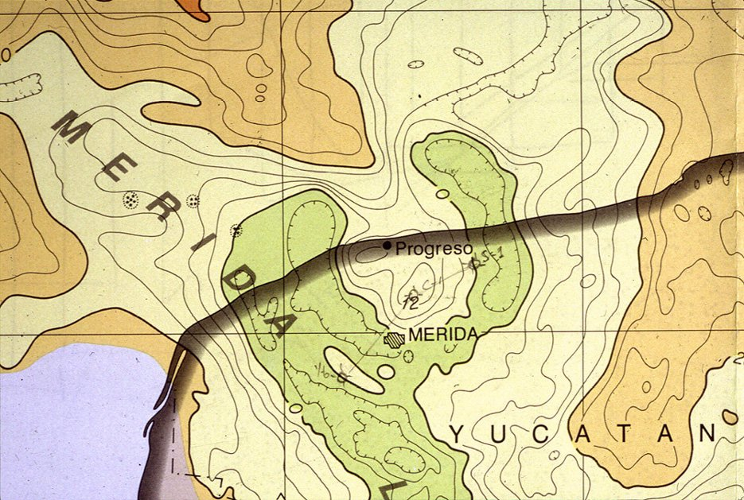

Slide 5
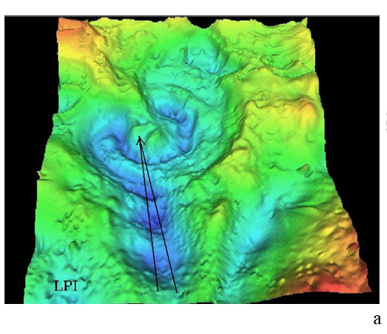
.
Chicxulub historical material
traditional terrestrial
gravity anomalies [mGal] measured
by PEMEX for oil prospection, white dots: cenotes (singholes)
The gravity anomalies with a well-expressed gravitational trace of the Chicxulub crater, D=180 km, age 65.2±4 Ma:
– according to Sharpton, LPI. (http://www.solarviews.com/cap/earth/chicxulb.htm)
.

Slide 6
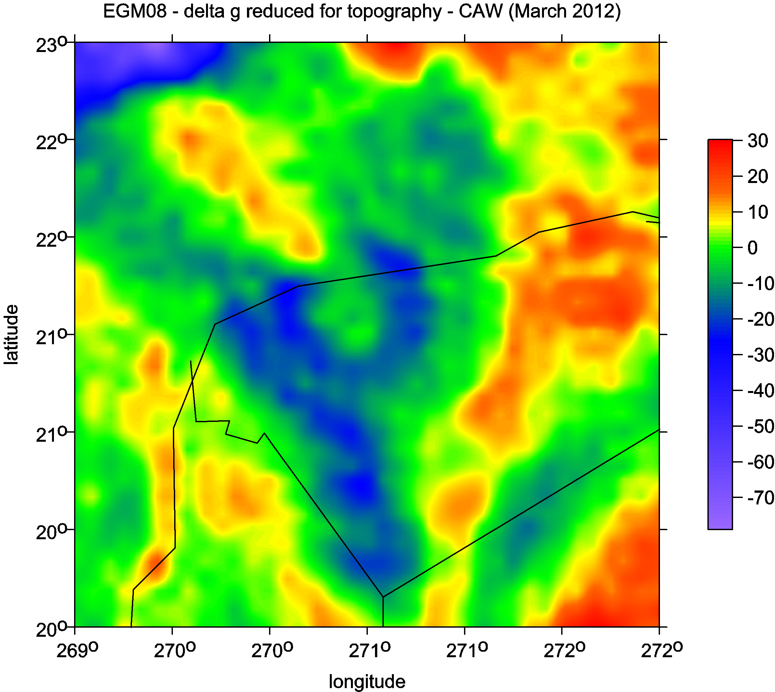
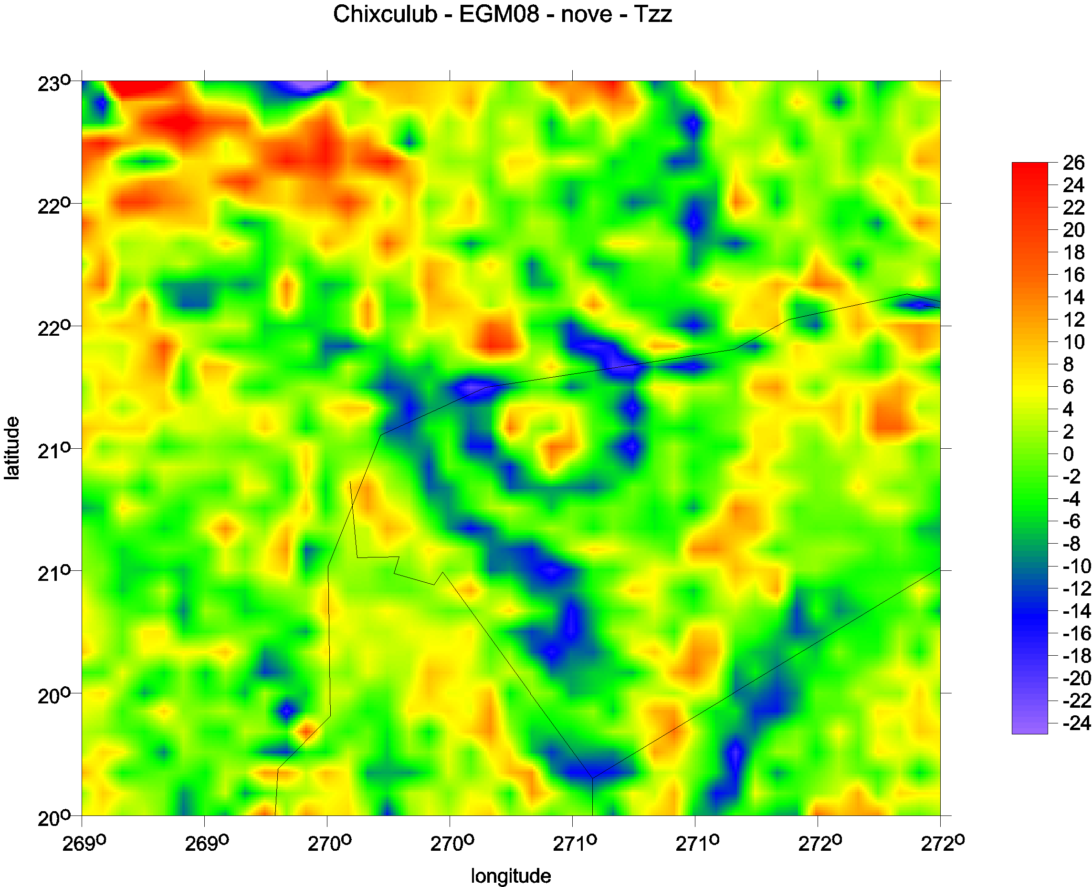
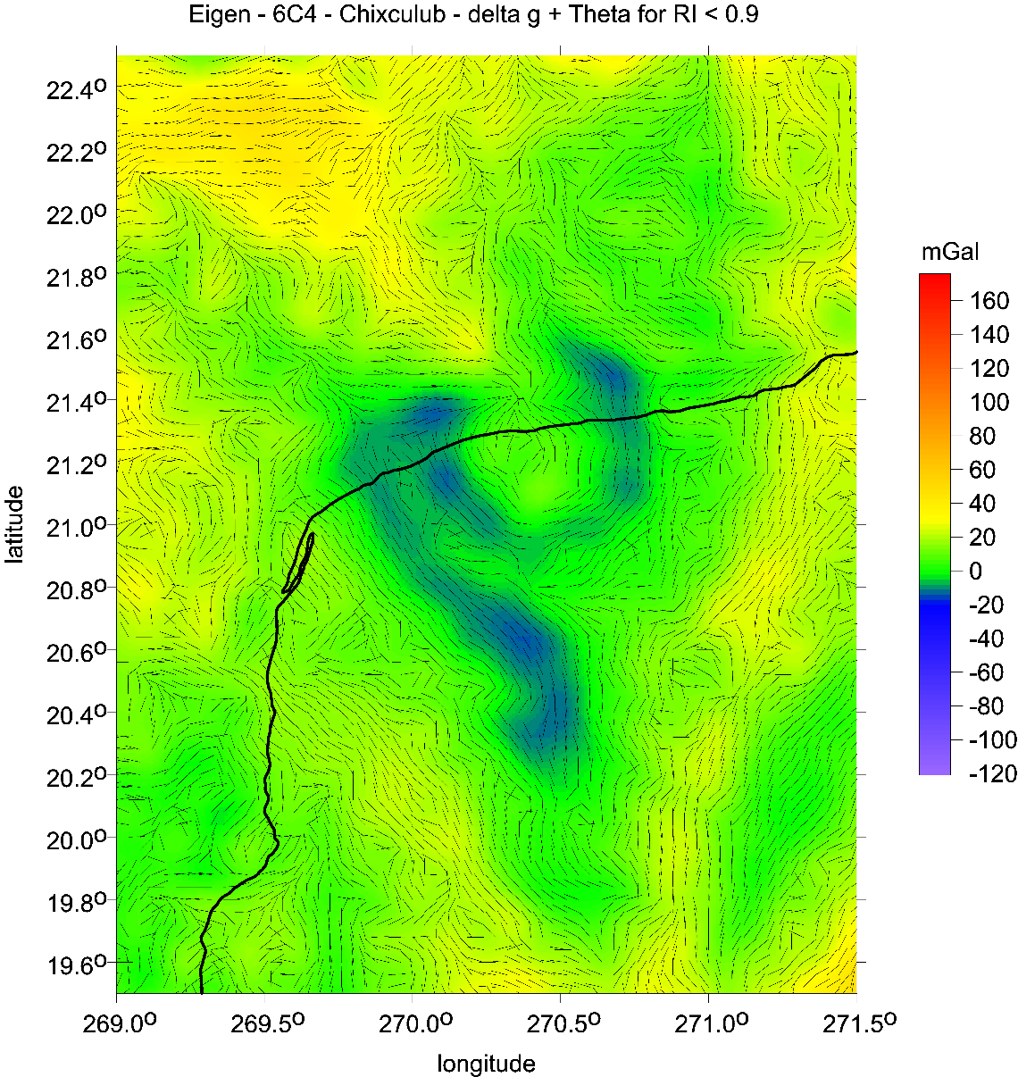
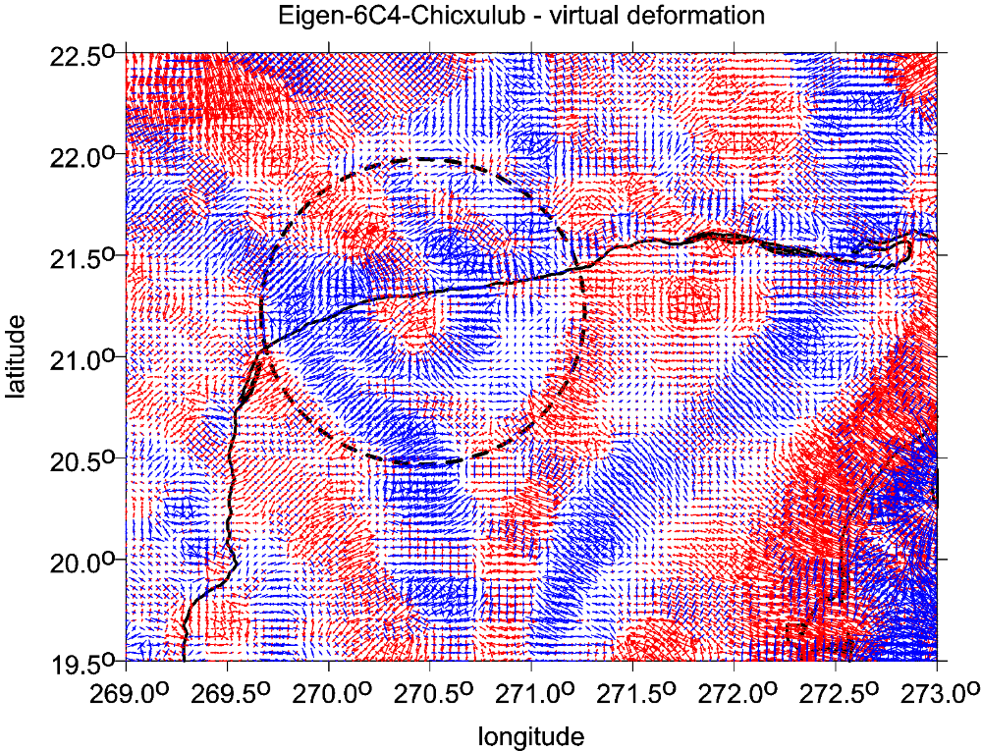
Chicxulub
locations of cenote (dots) versus strike angles

Slide 7
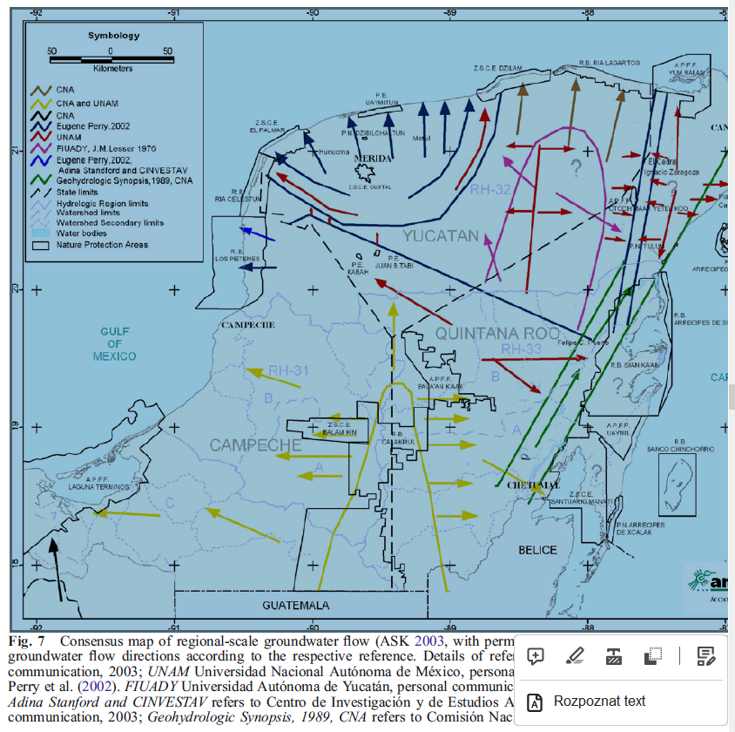
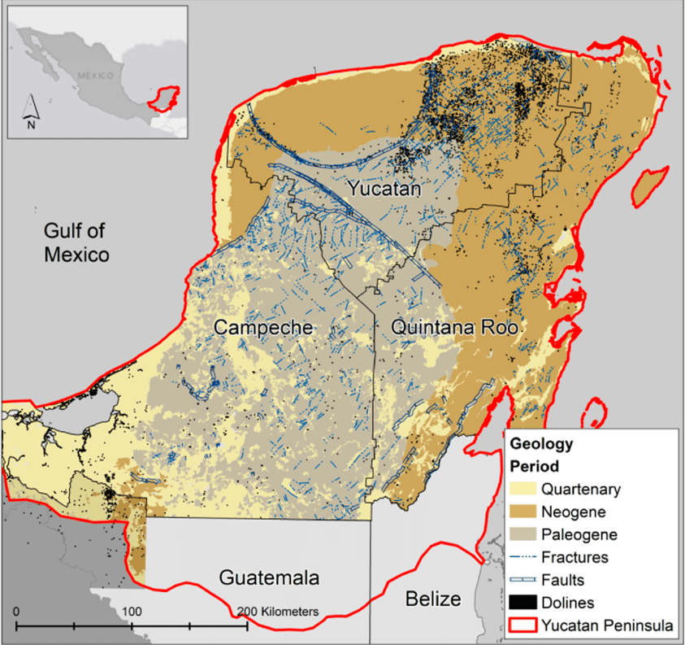
Ramos, E.L. (1975). Geological Summary of the Yucatan Peninsula. In: Nairn, A.E.M., Stehli, F.G. (eds): The Gulf of Mexico and the Caribbean. Springer, Boston, MA. https://doi.org/10.1007/978-1-4684-8535-6_7

Slide 8
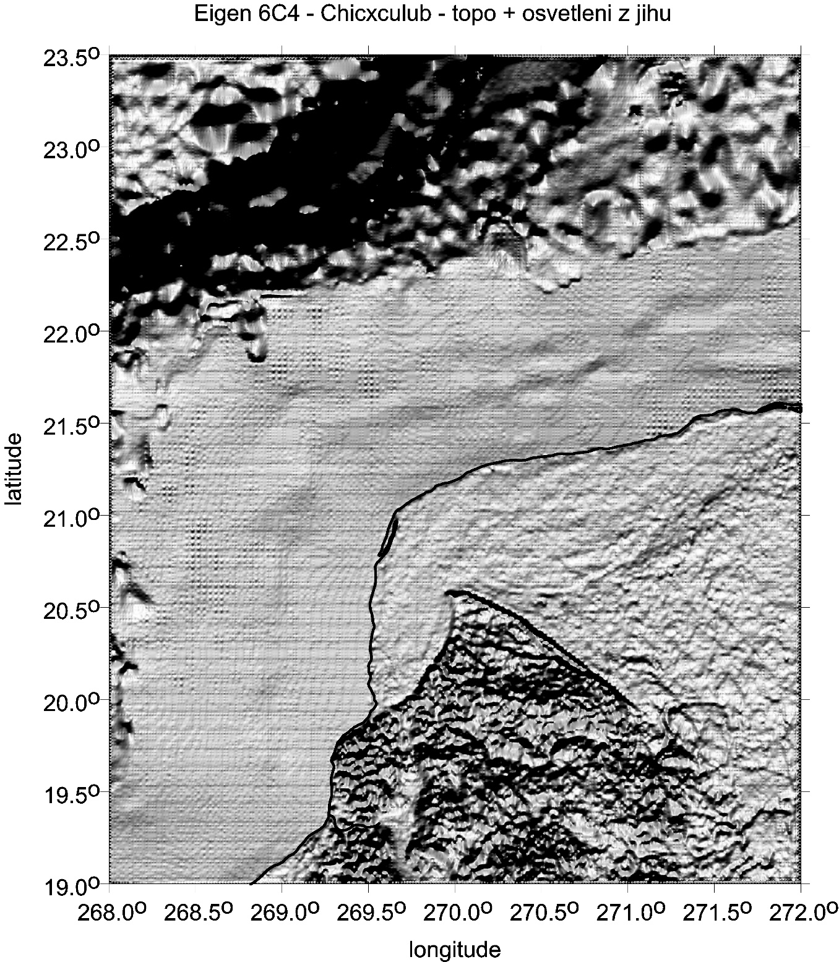
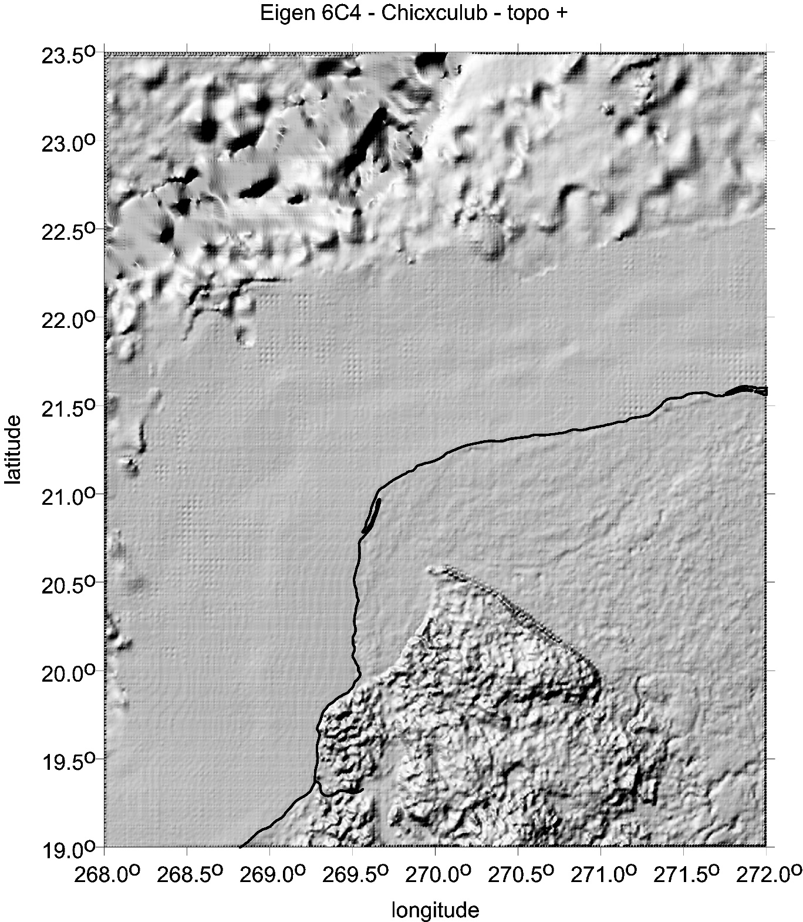
Chicxulub ETOPO 1 3D topography (sunshine from South)
Ticul fault
enhanced topography

Slide 9
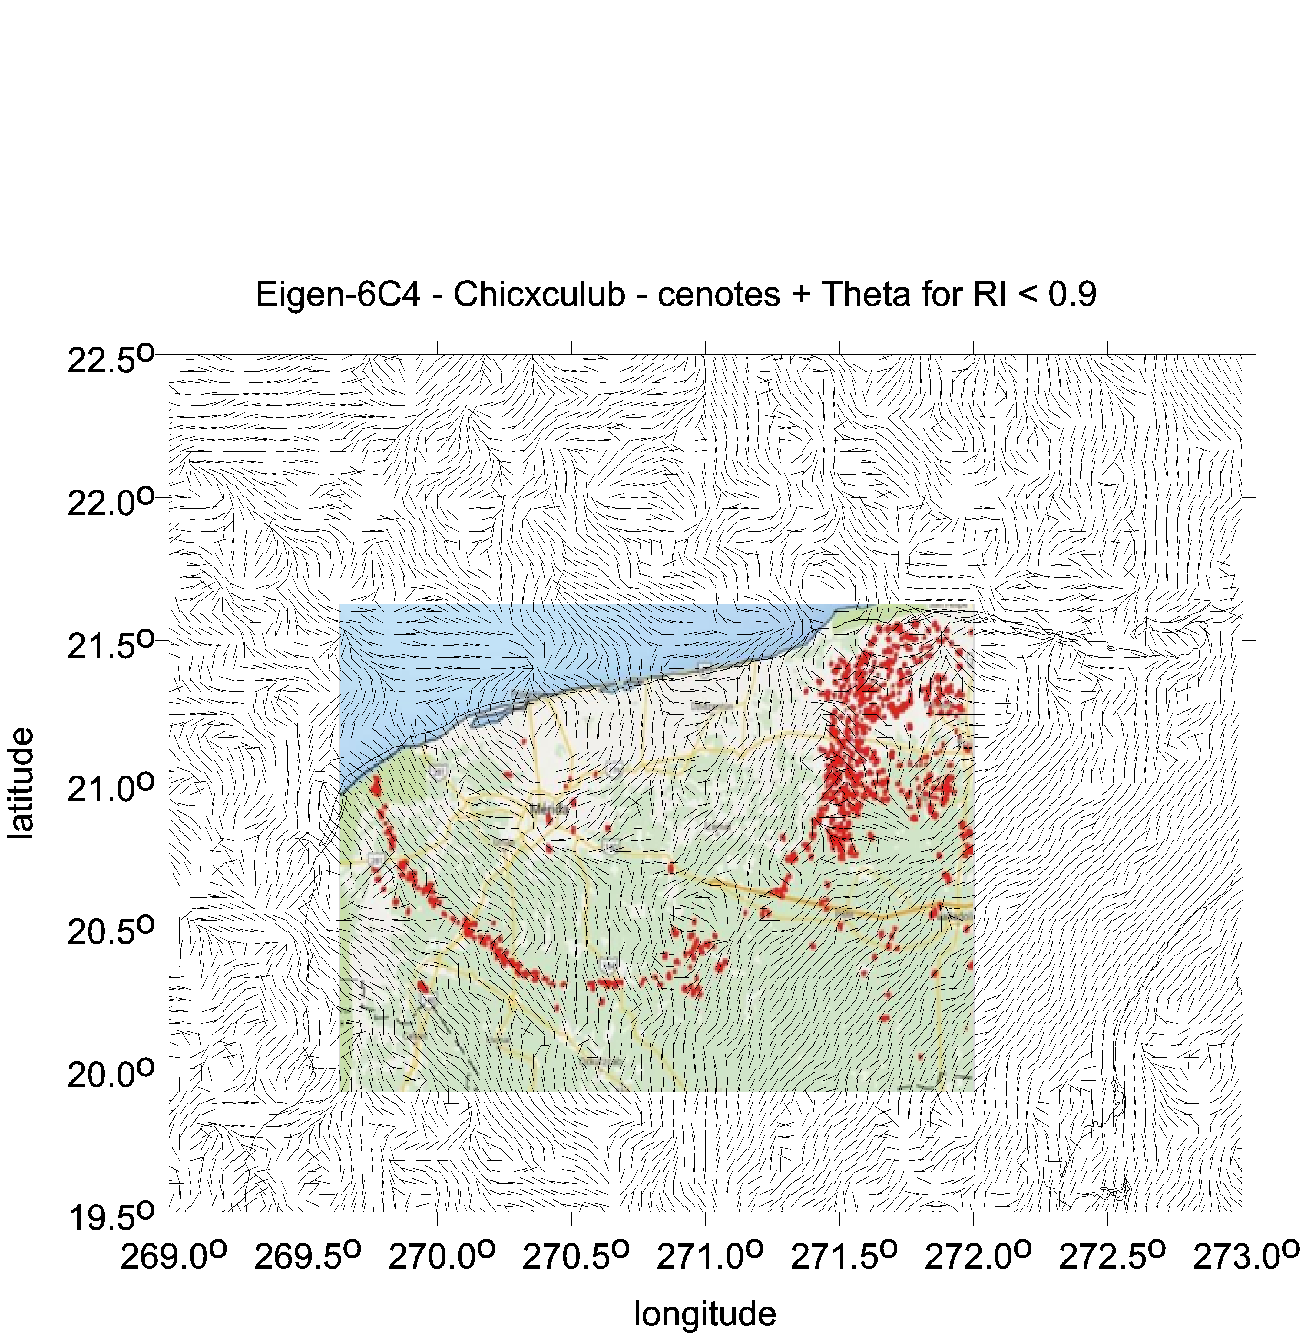
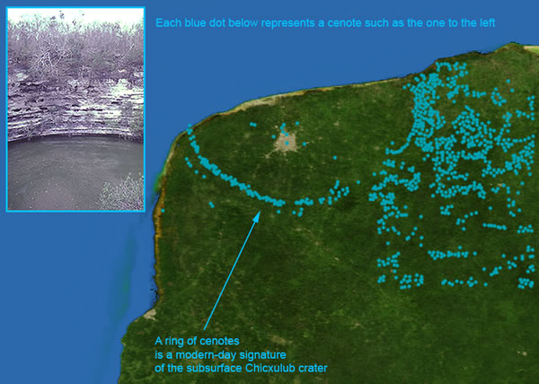
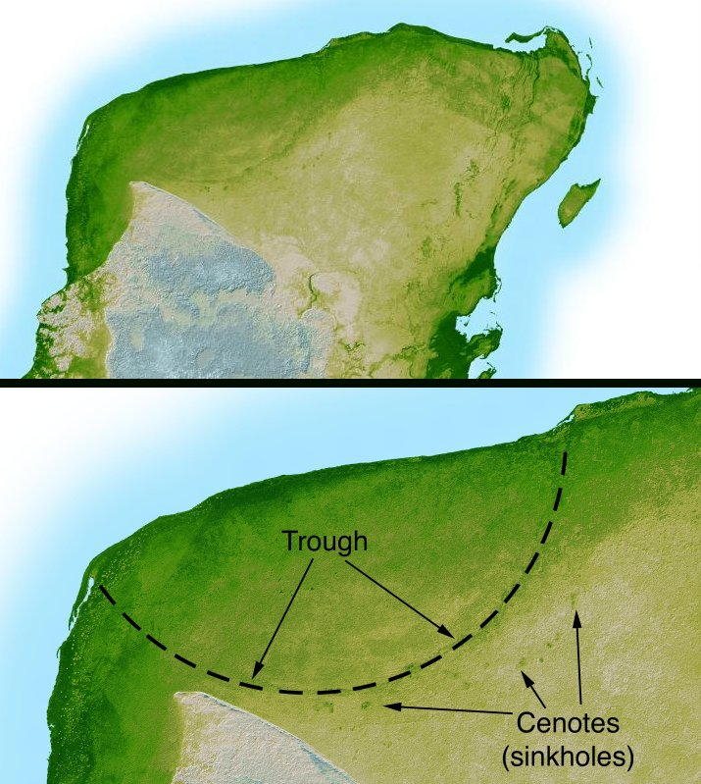
Ring of cenotes
(singholes)

Slide 10
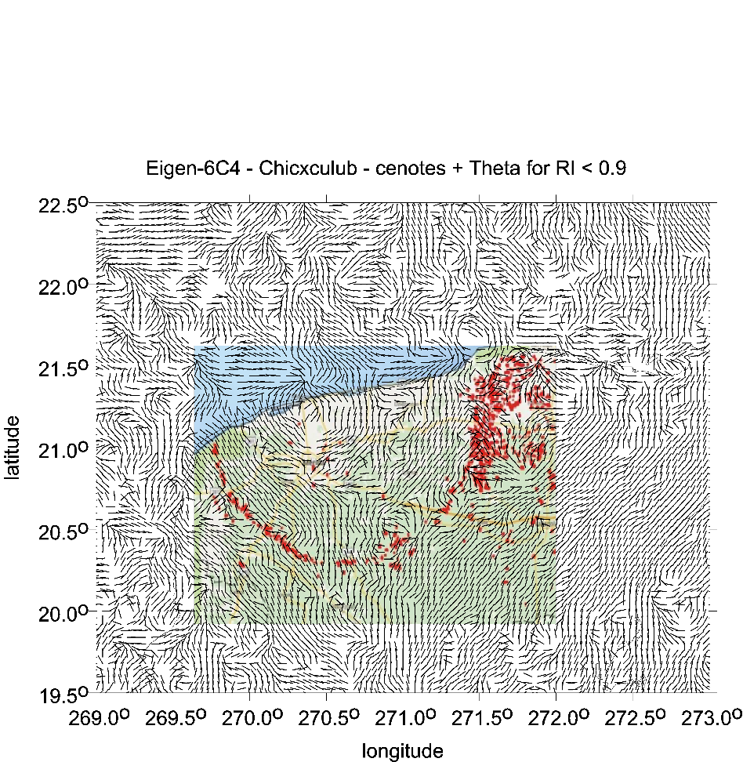
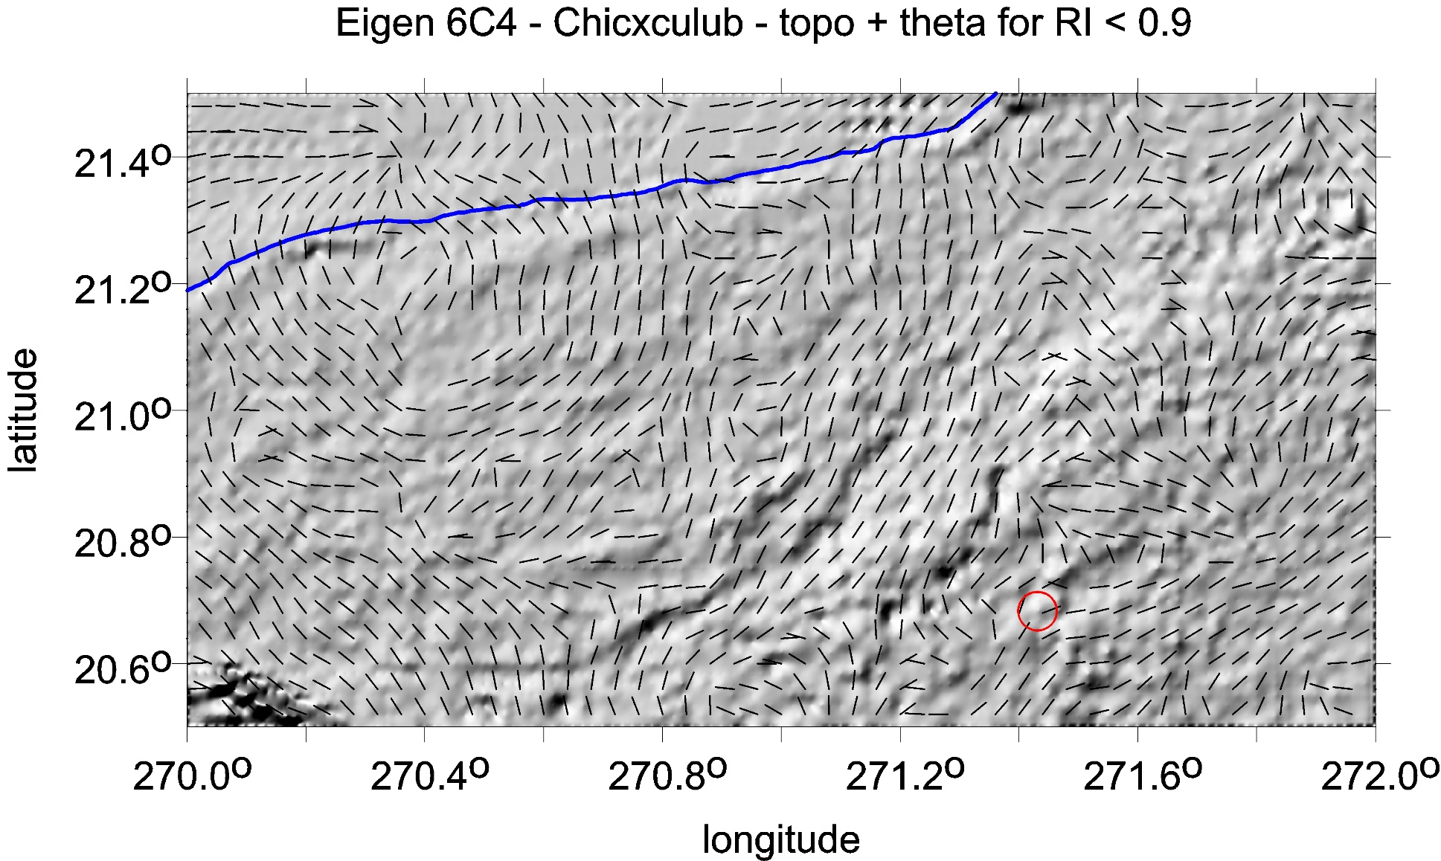

Slide 11
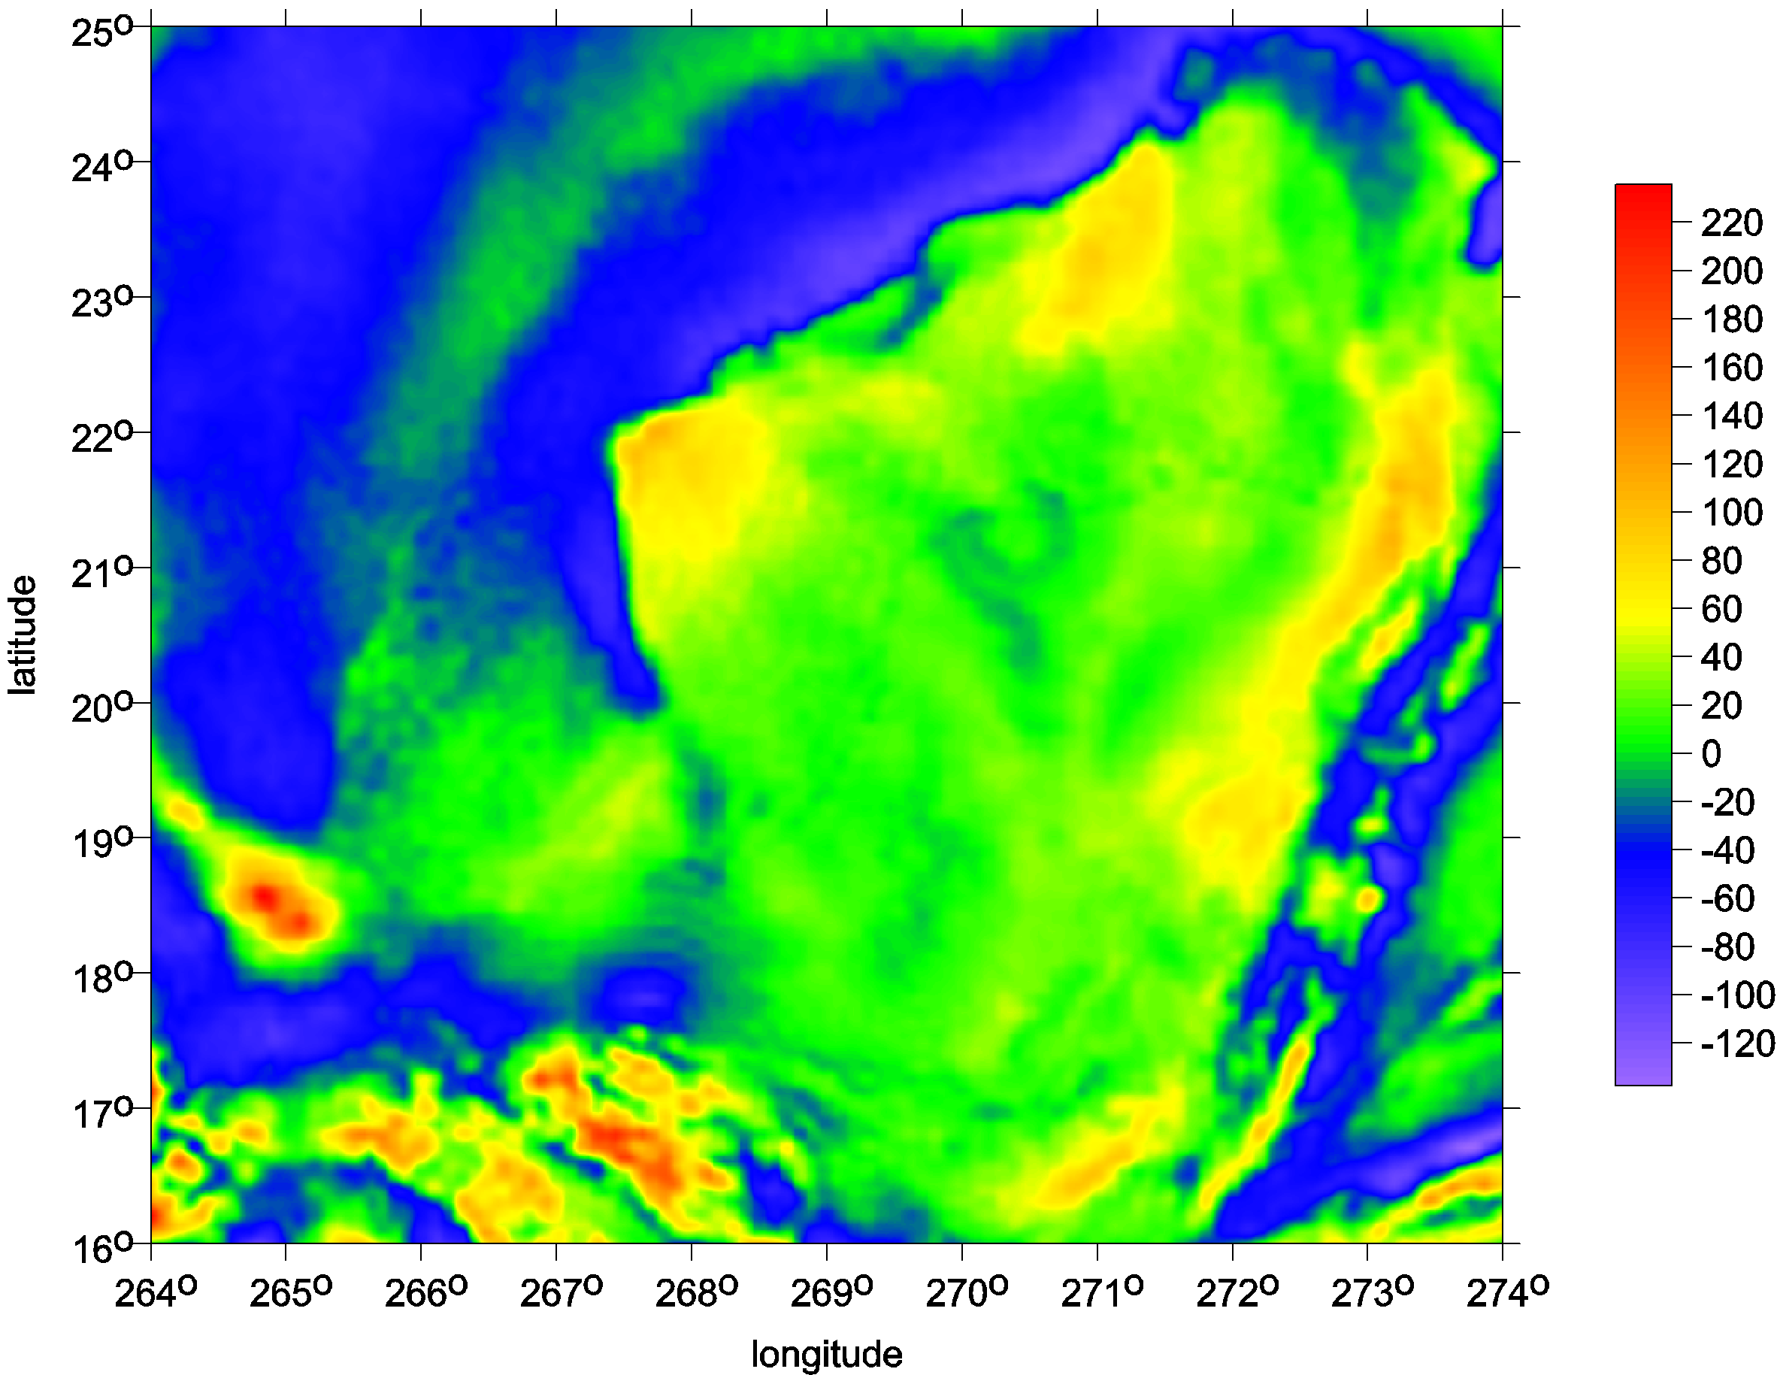
Chicxulub Yucatan
model EIGEN6C4 series
of the gravity aspects

Slide 12
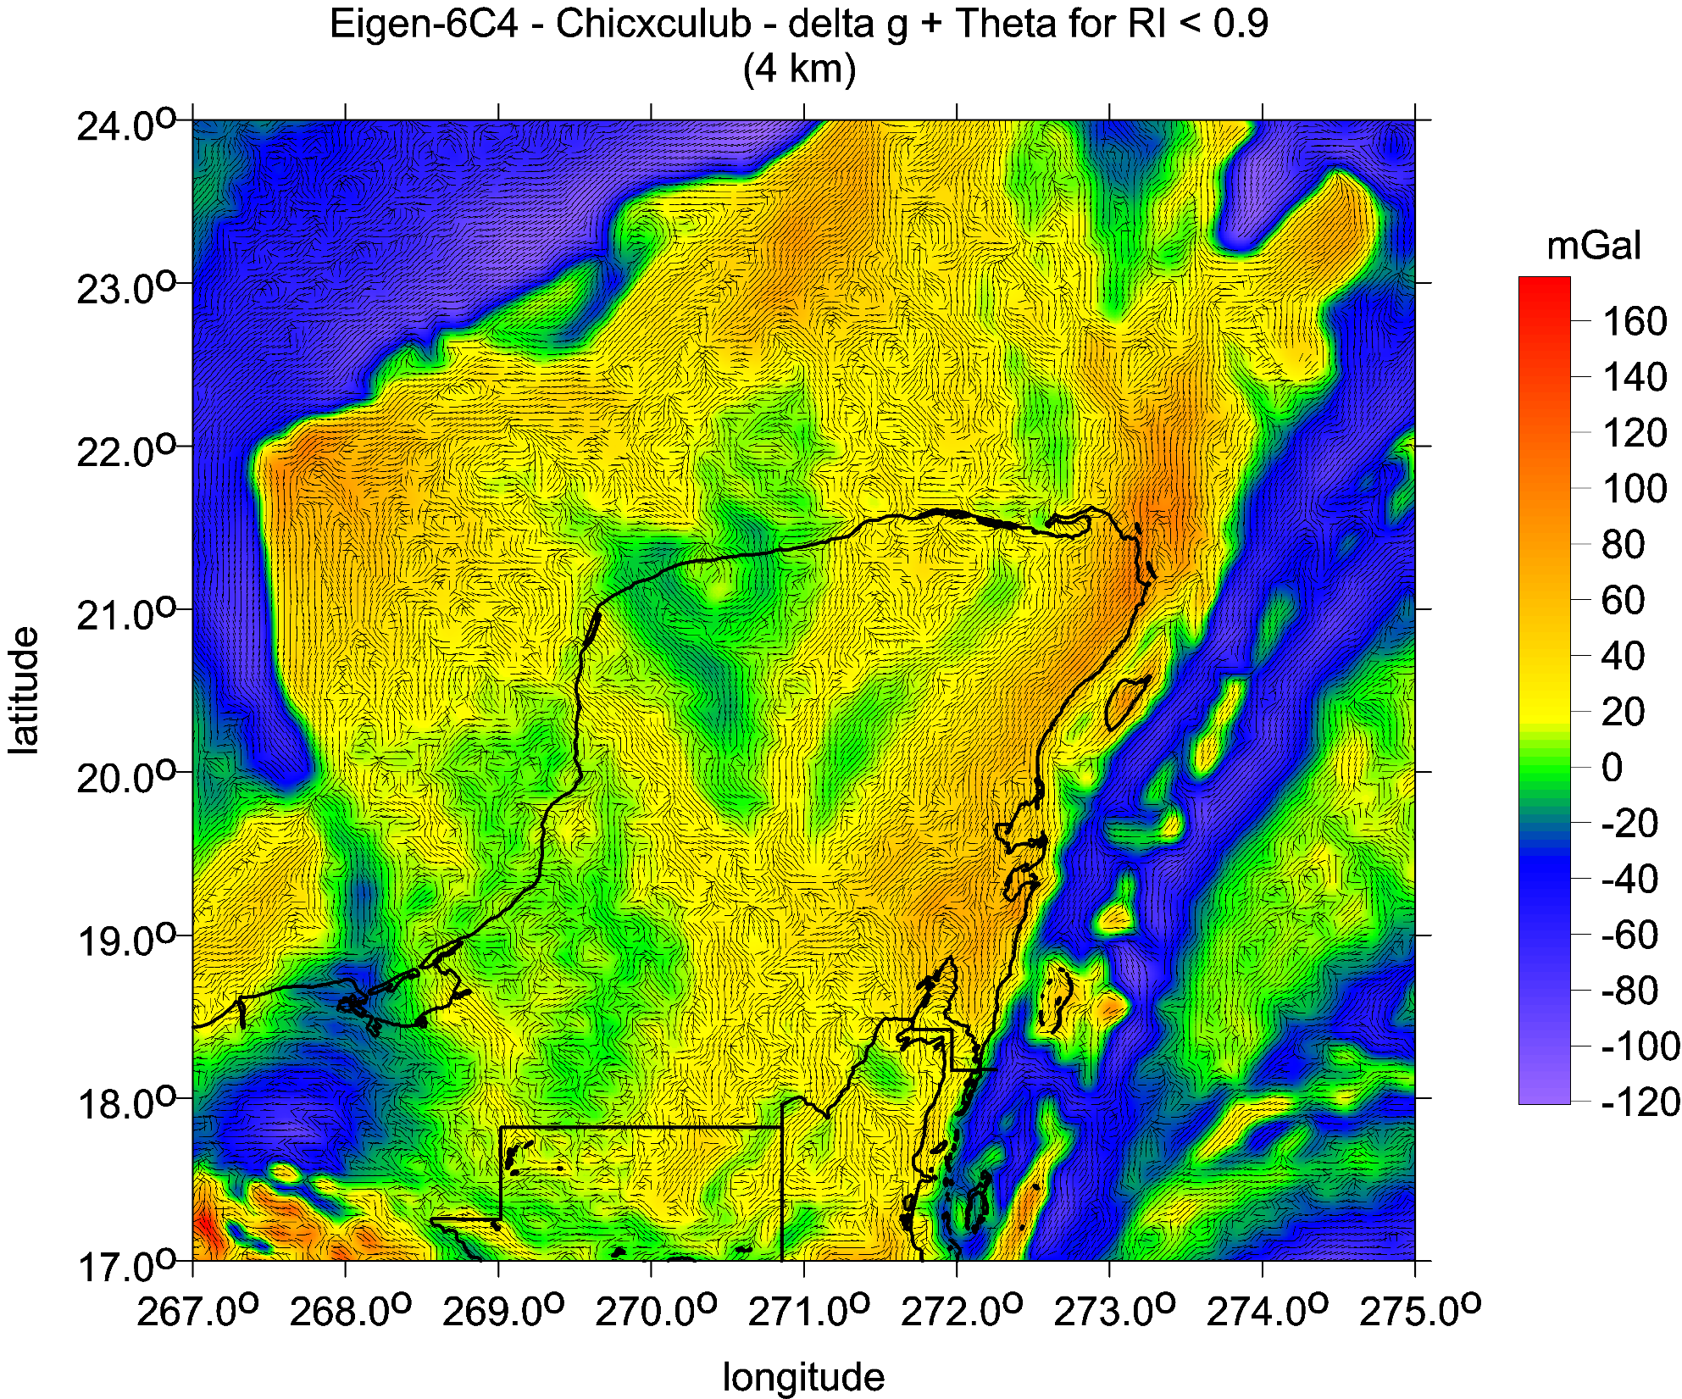

Slide 13
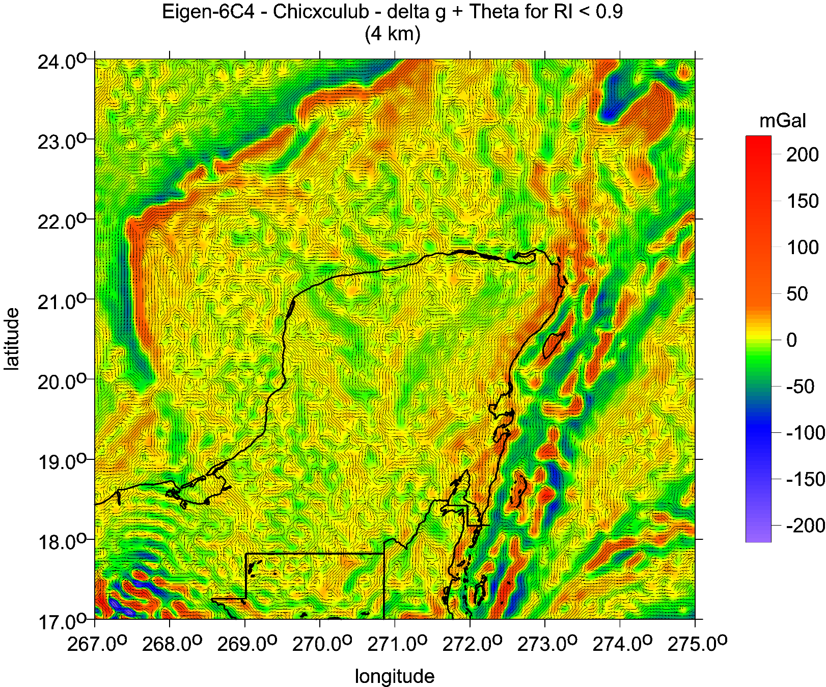
E
Chicxulub,
Yucatan
Mexico
Strike angles θ and Tzz
Strike angles [deg], I<0.9, with Tzz [E])

Slide 14
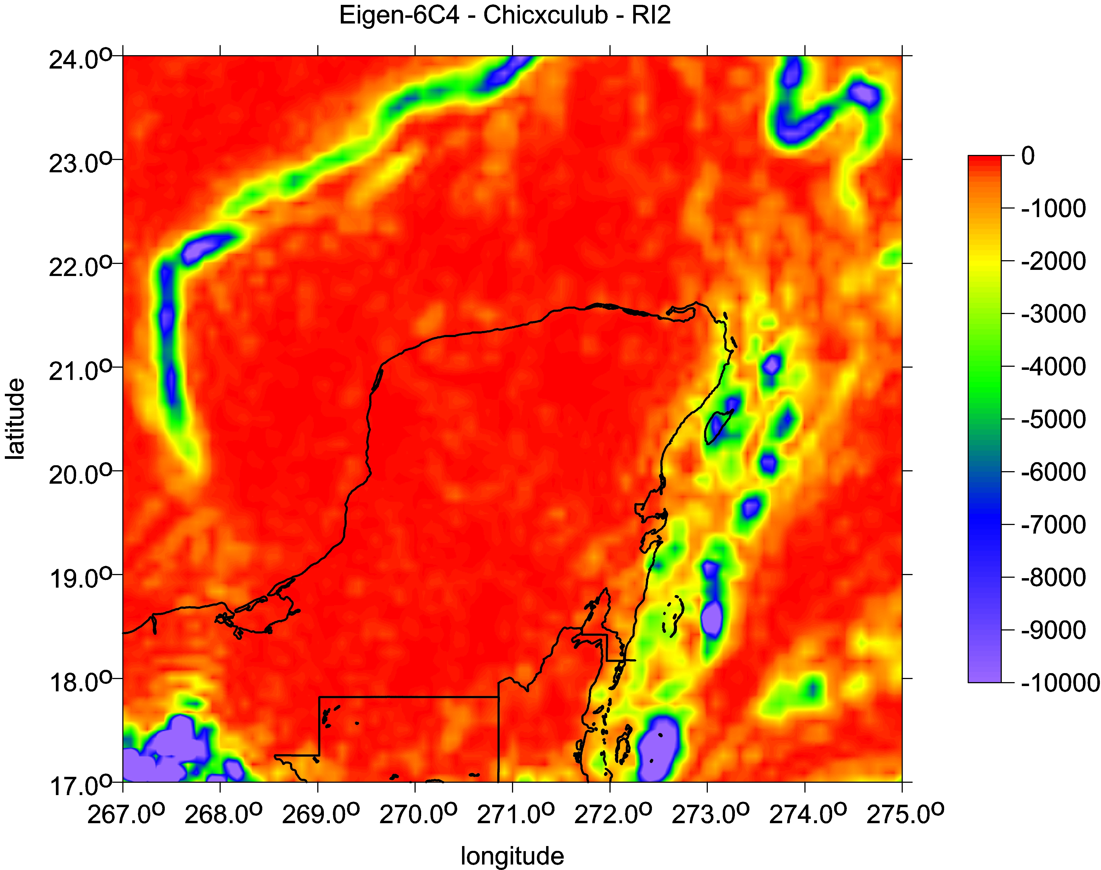
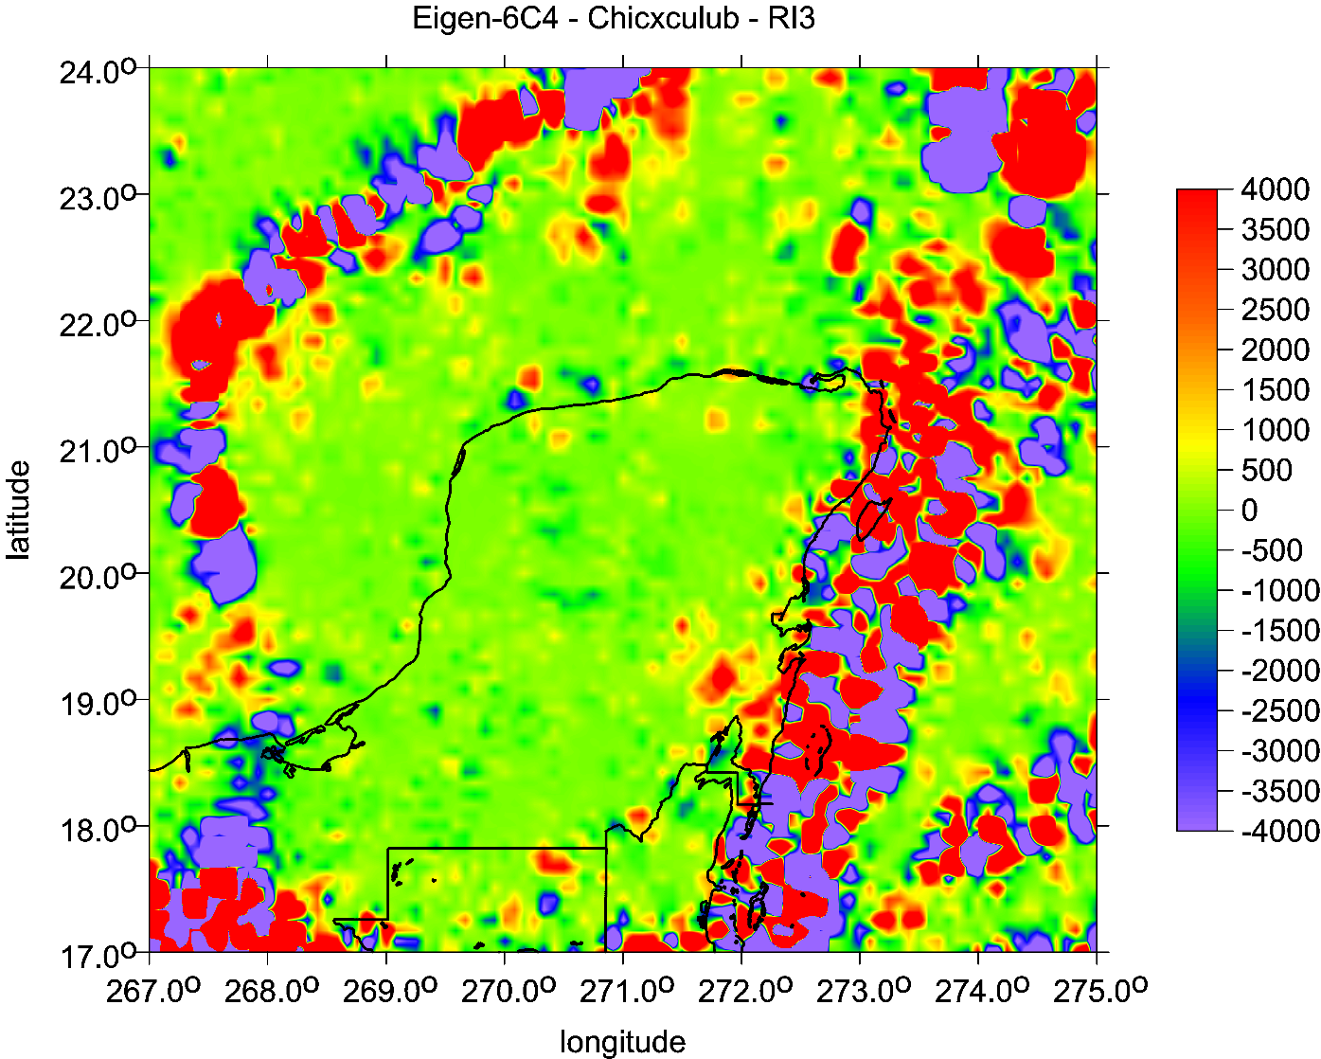
Chicxulub,
Yucatan
Mexico

Slide 15
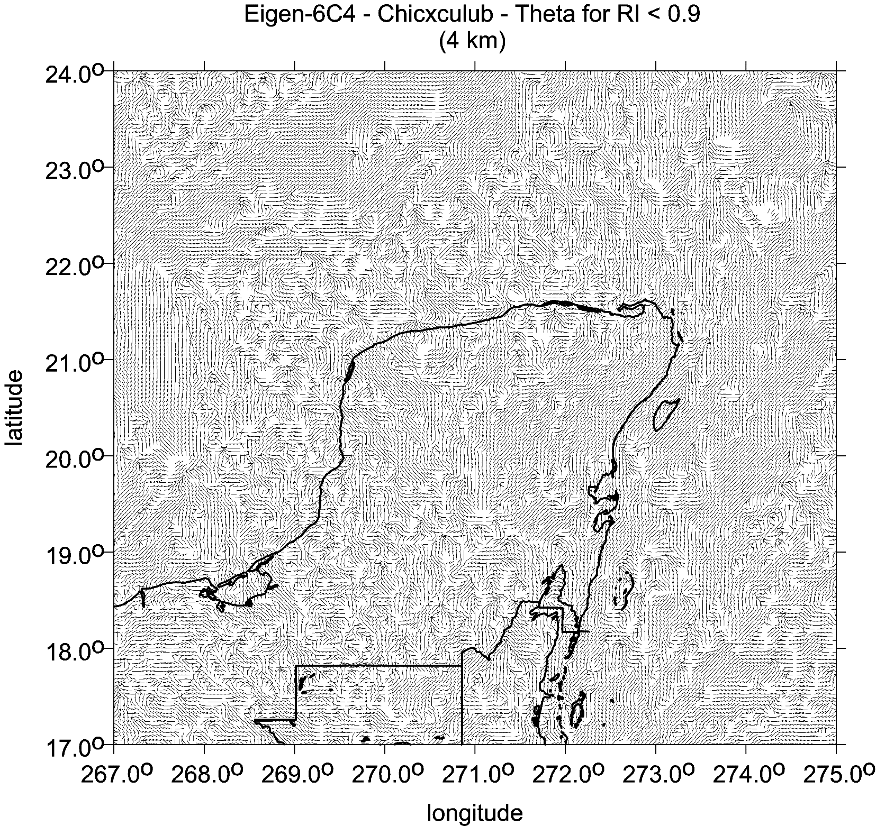
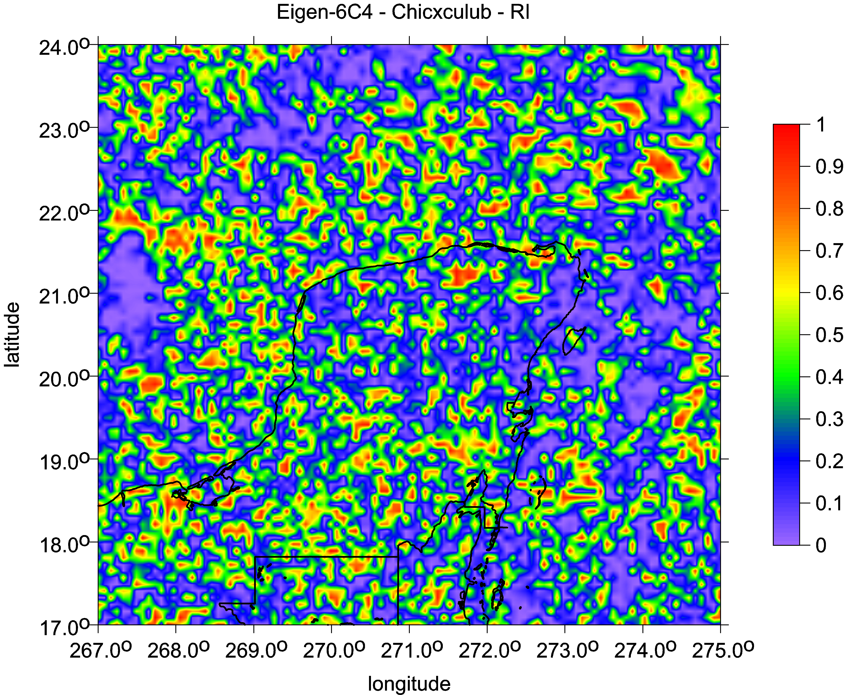
Chicxulub,
Yucatan
Mexico
Ratio I of the invariants
Strike angles θ [deg]

Slide 16
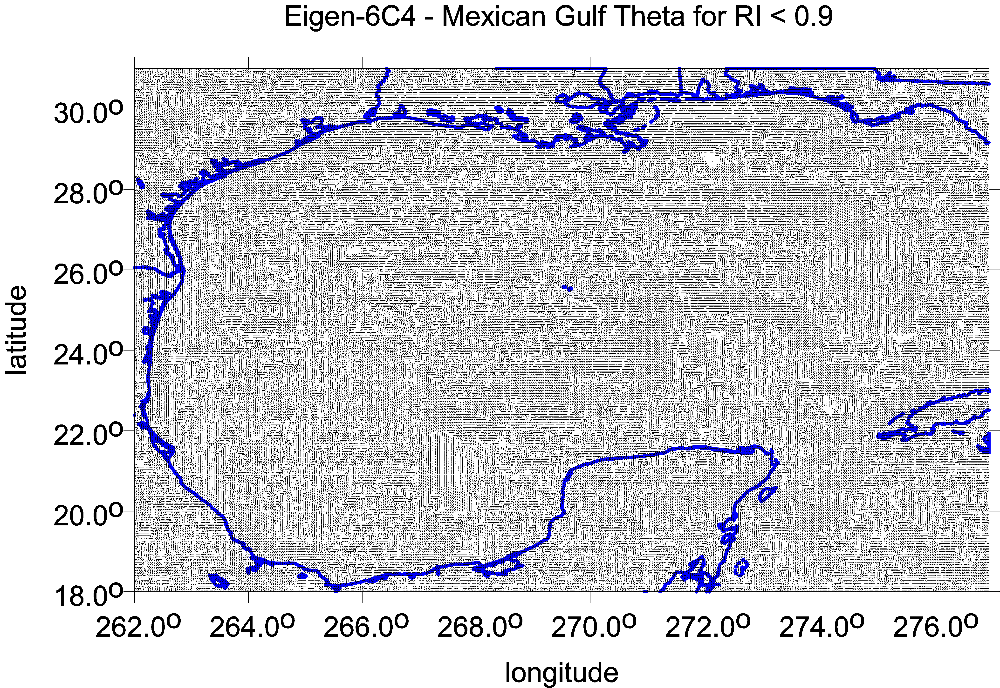

Slide 17
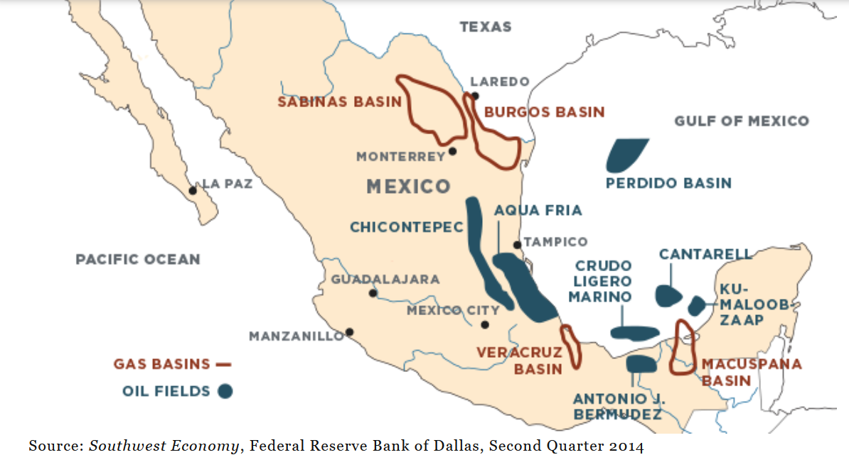
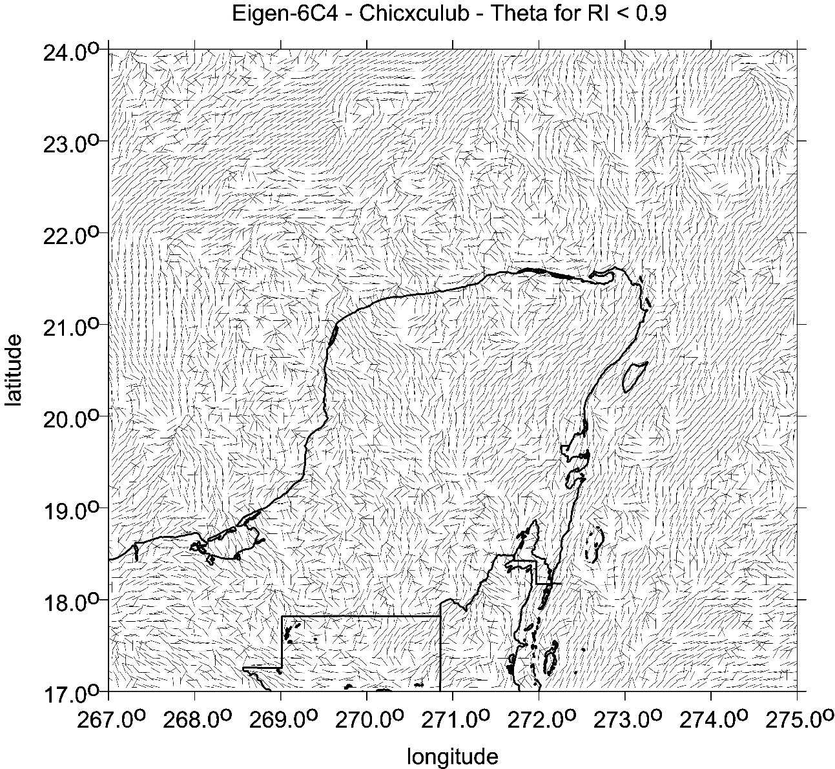
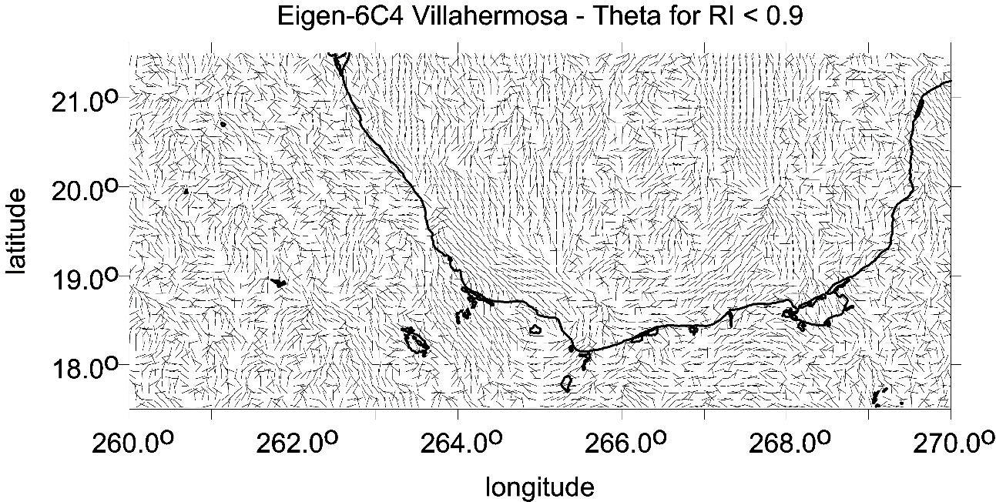
Mexico
Villahermosa, Veracruz
strike angles

Slide 18
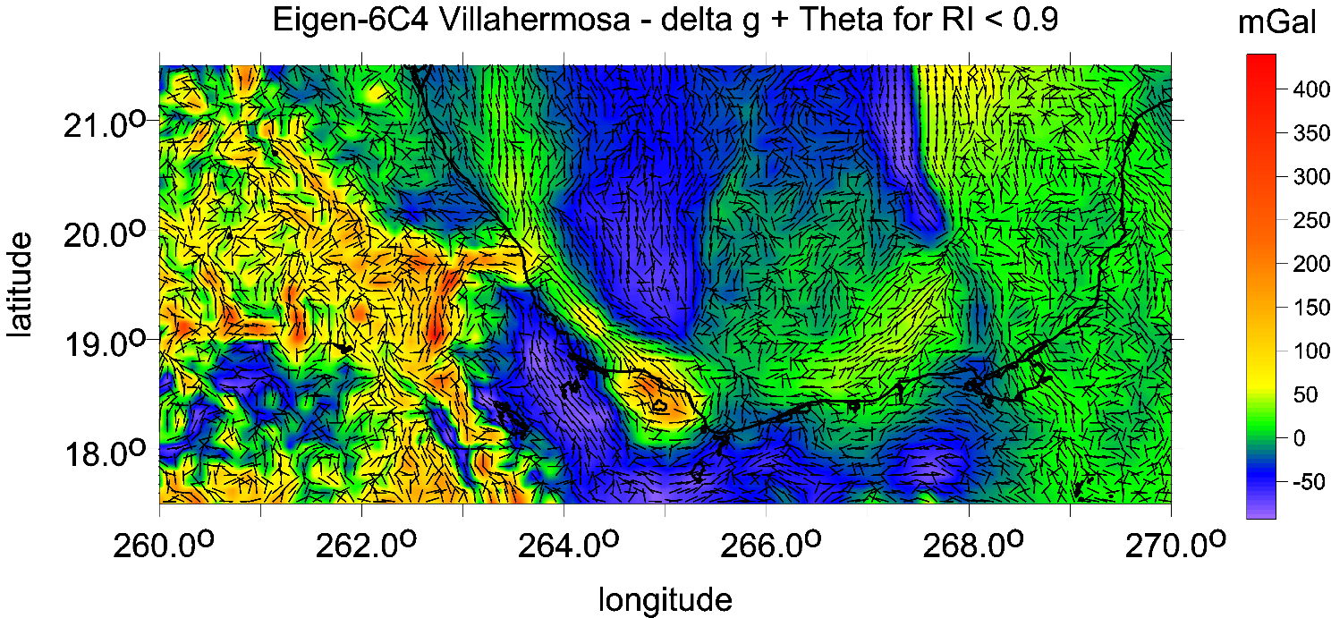
Olmecs locality
Strike angles
and
Strike angles together with ∆g

Slide 19
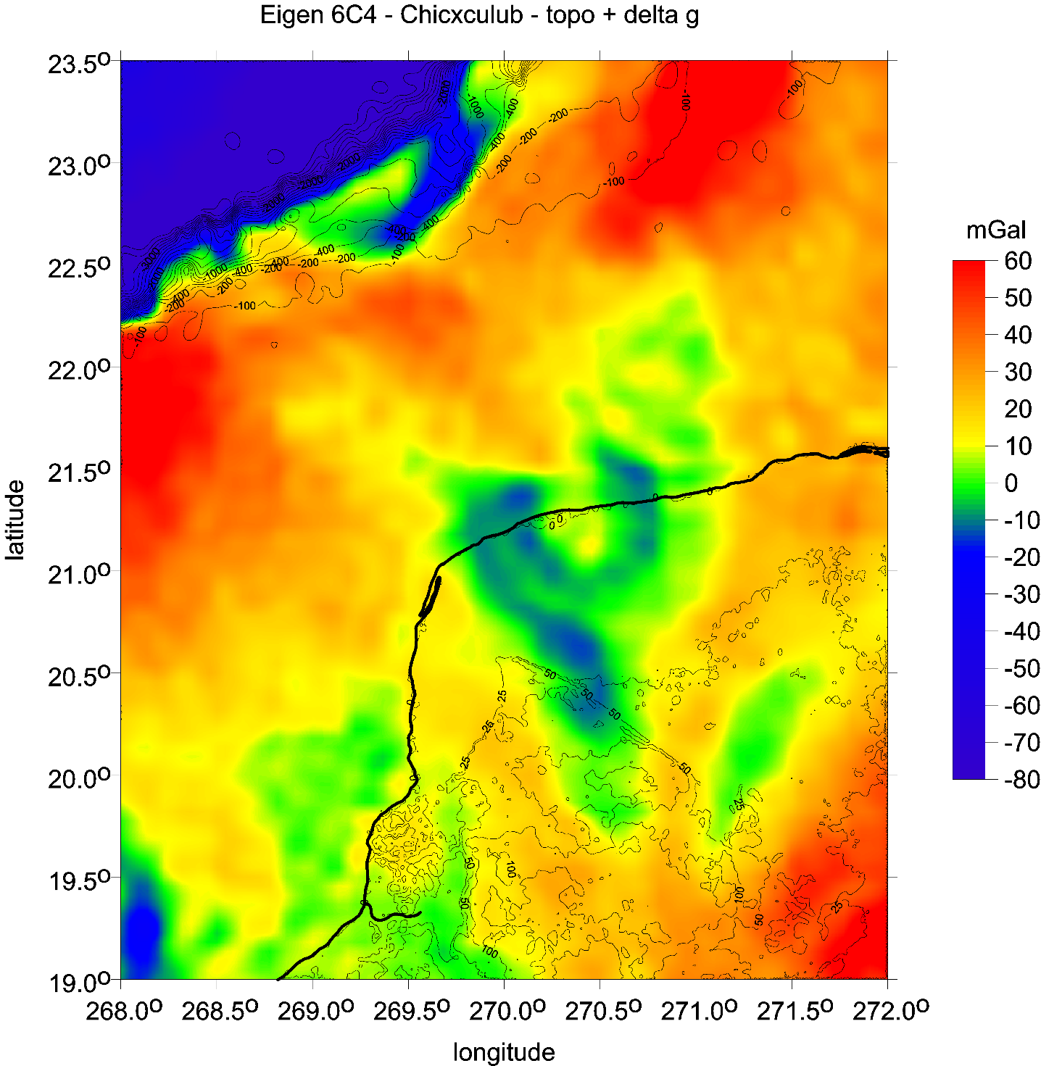
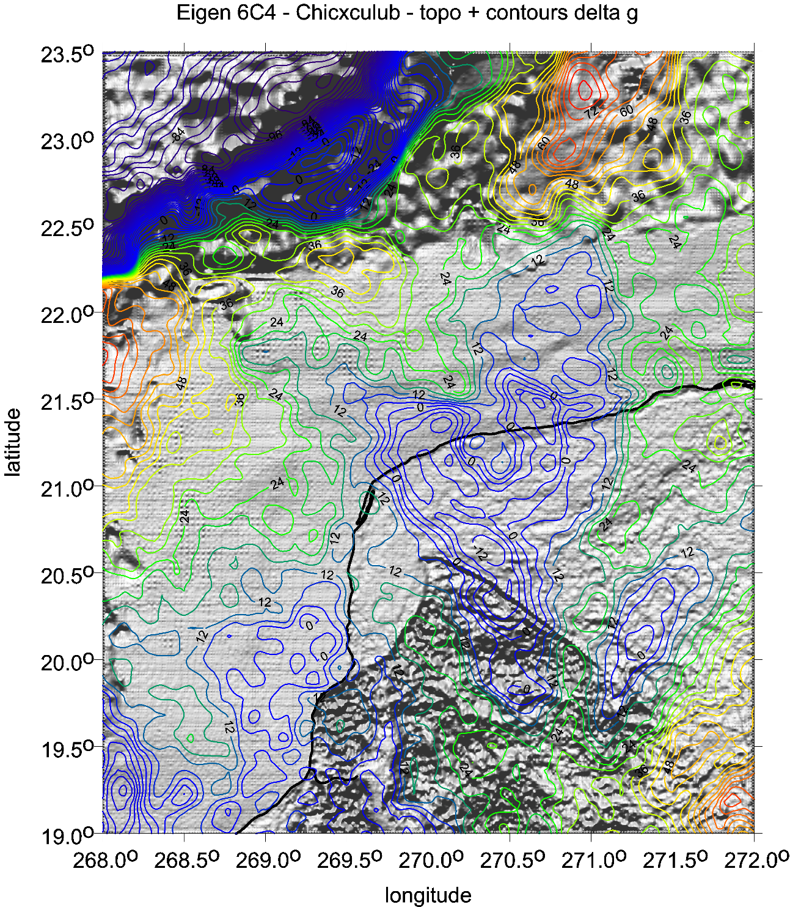
Chicxulub, traditional and alternative view on gravity anomalies
Yucatan
Mexico

Slide 20
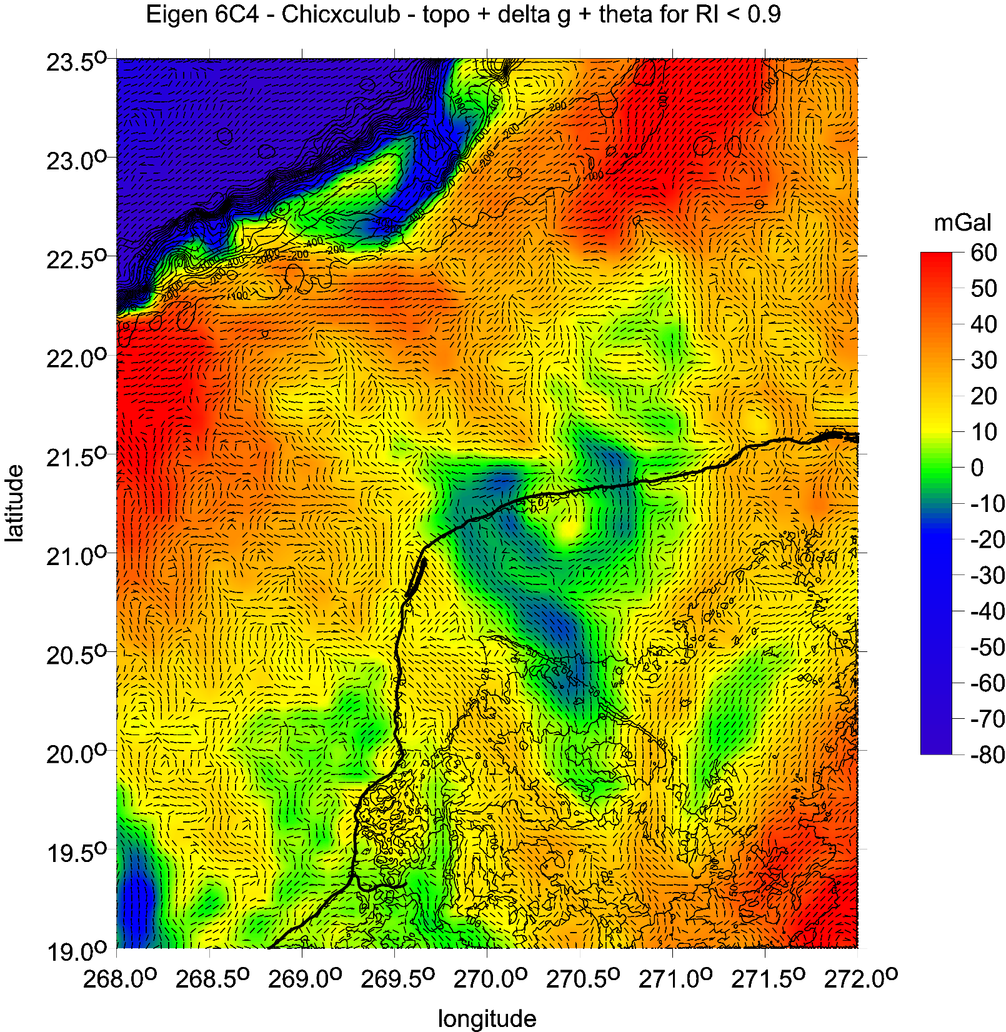
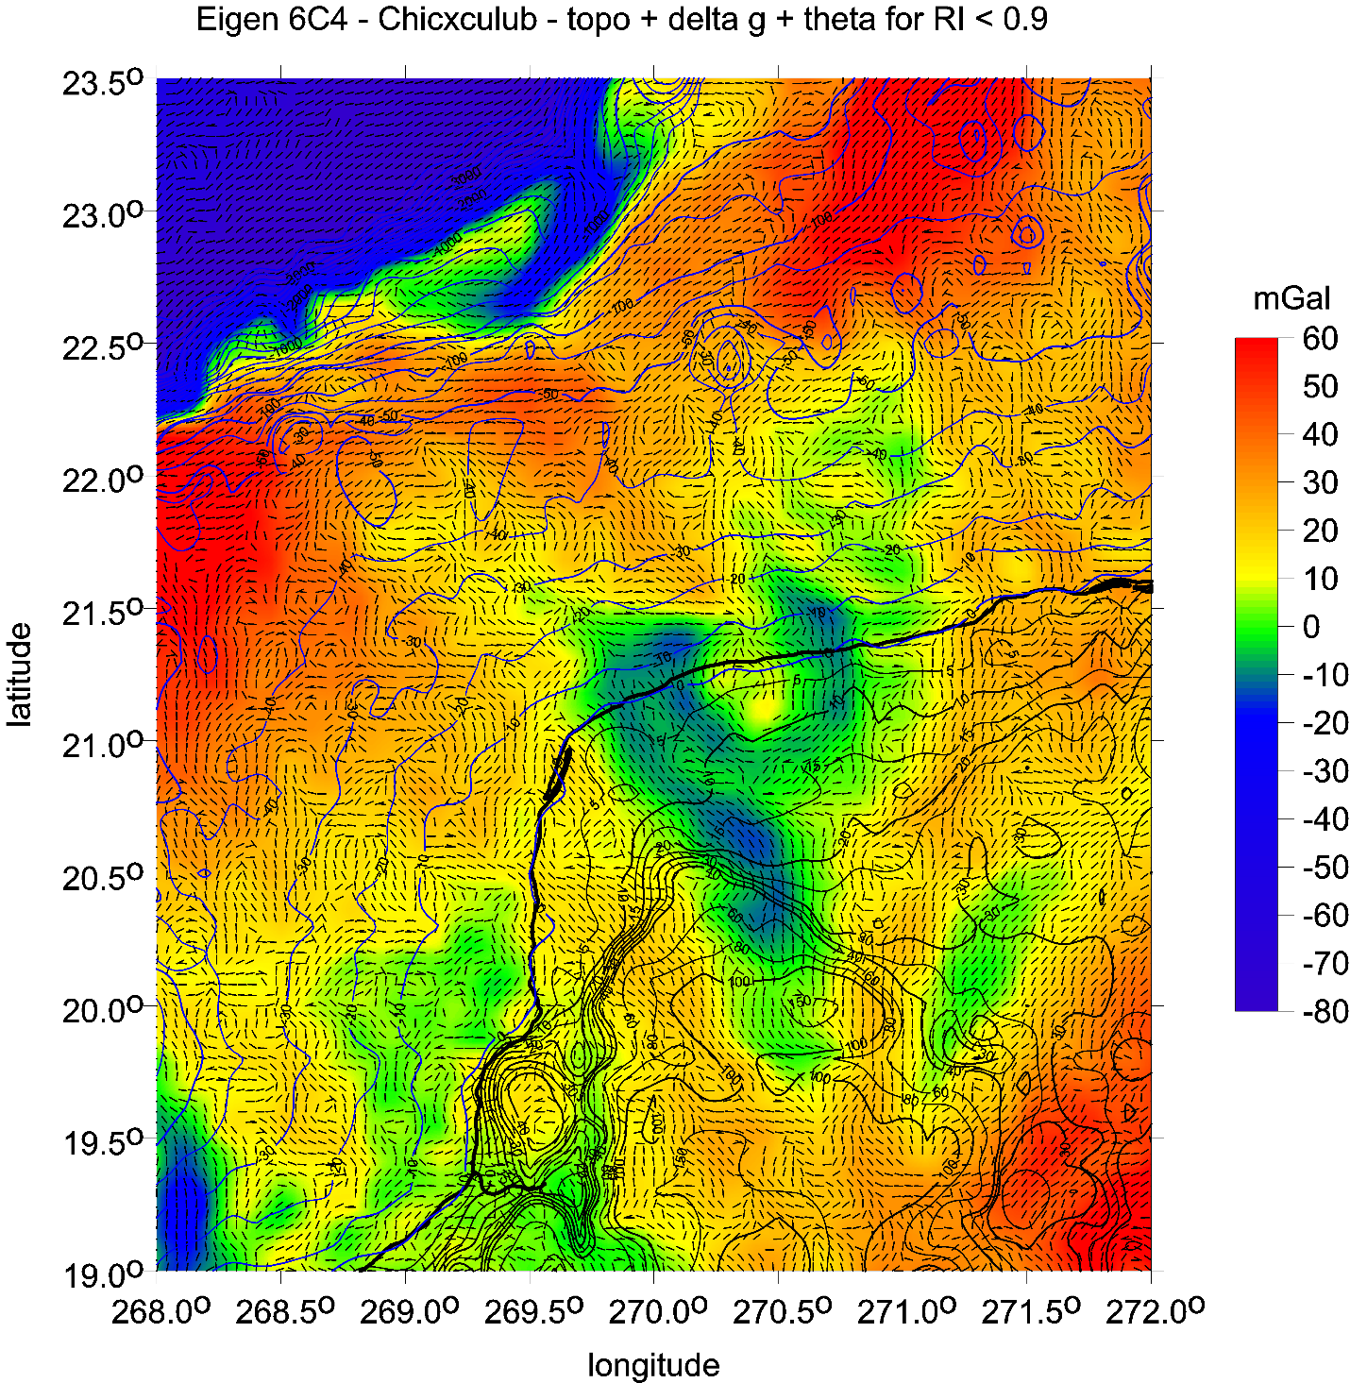
Gravity anomalies and strike angles, with 3D topography or contour lines for topography (ETOPO1)

Slide 21
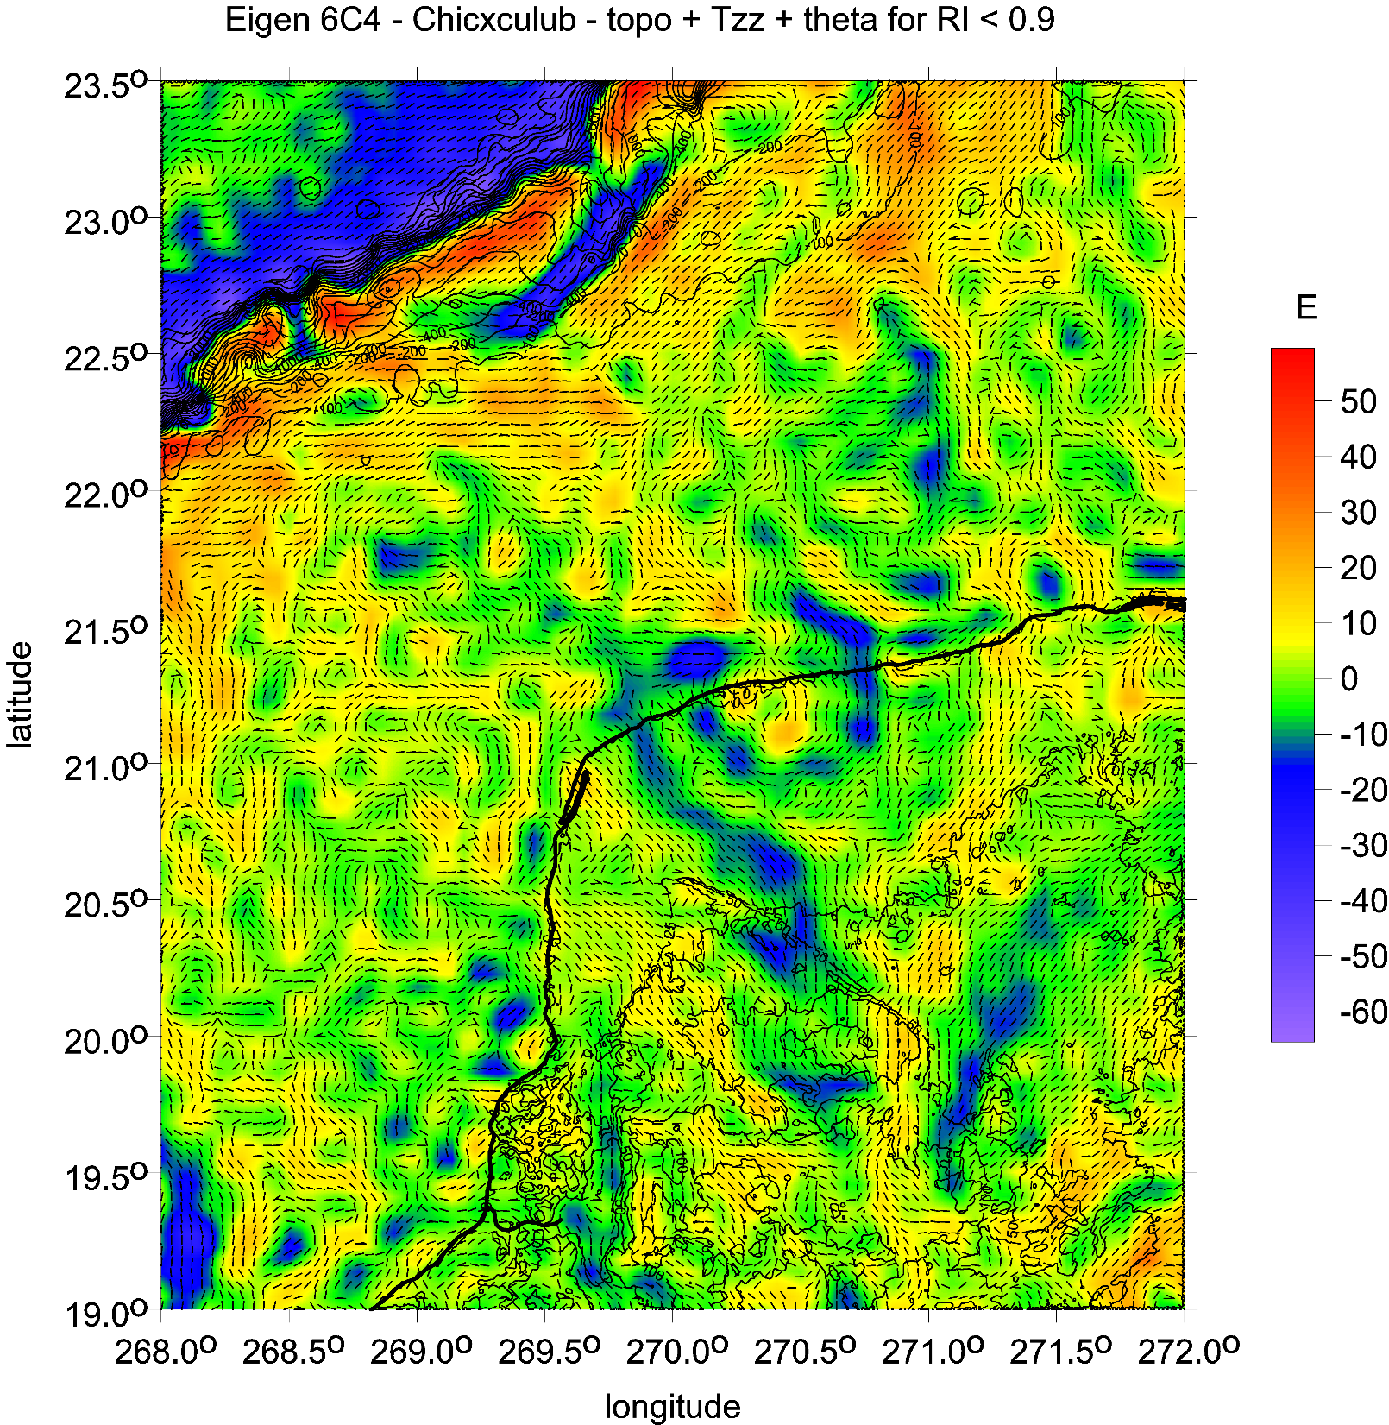

Slide 22
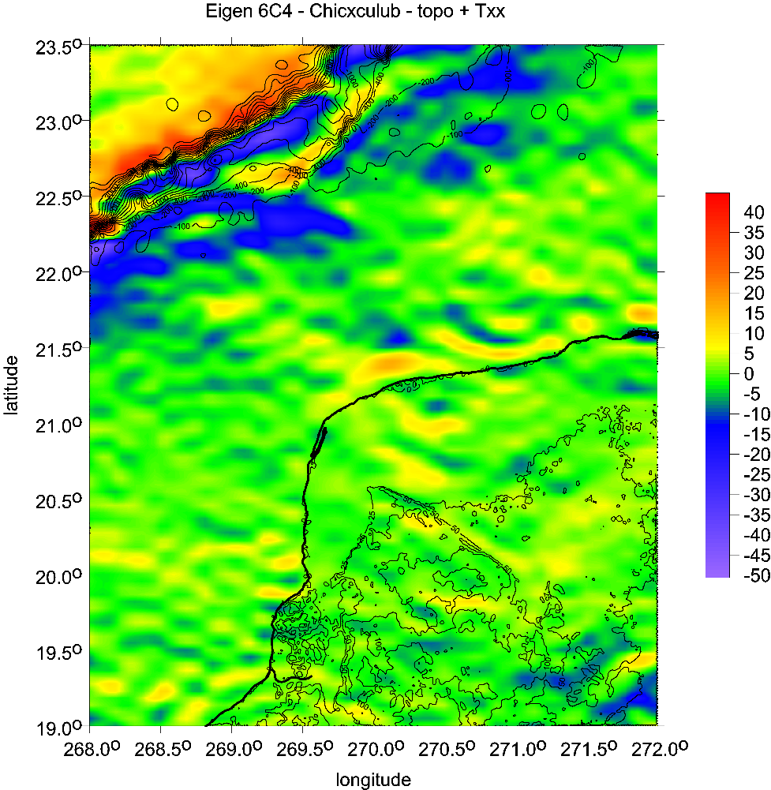
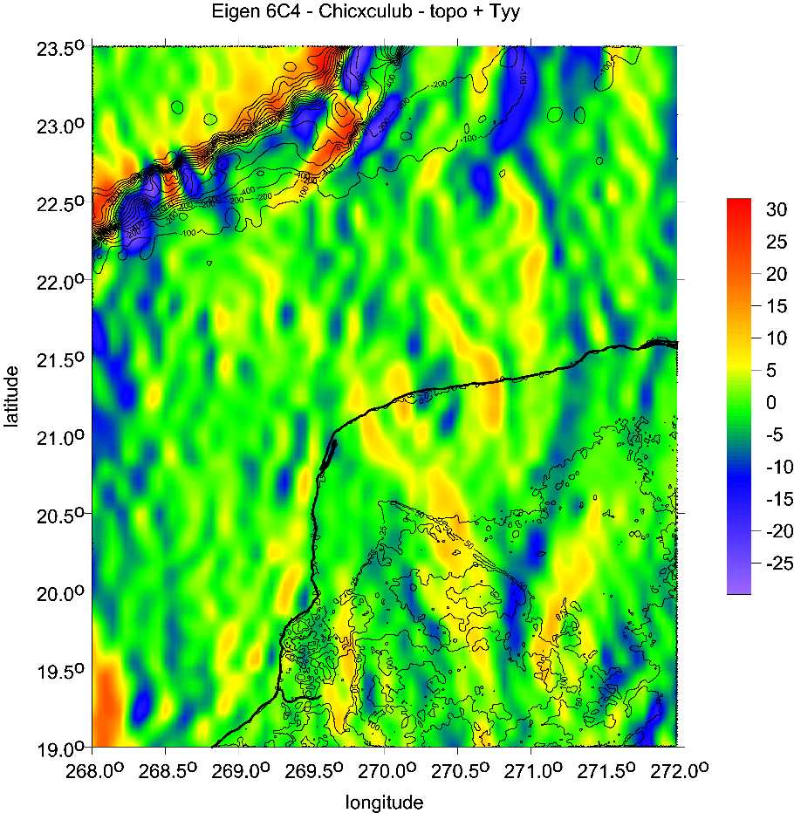
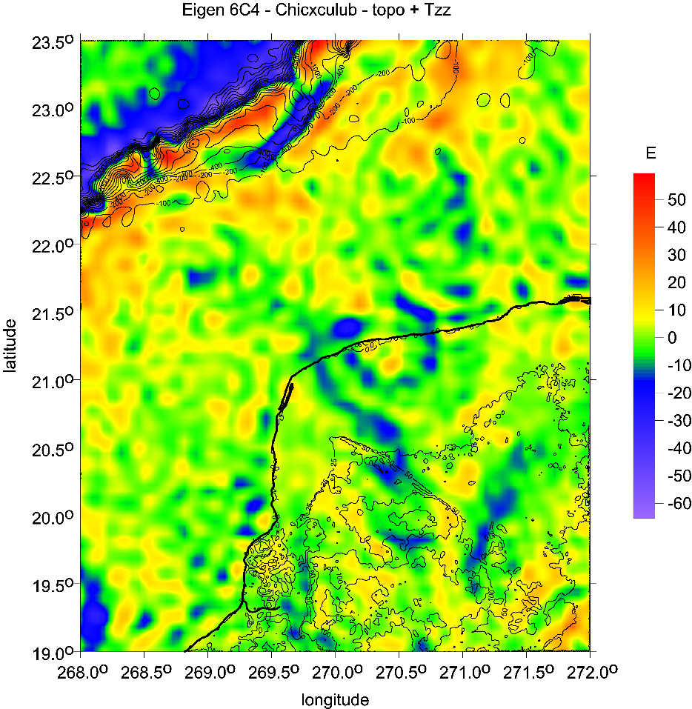
Marussi tensor
the main diagonal
xx, yy, zz components
[E]

Slide 23
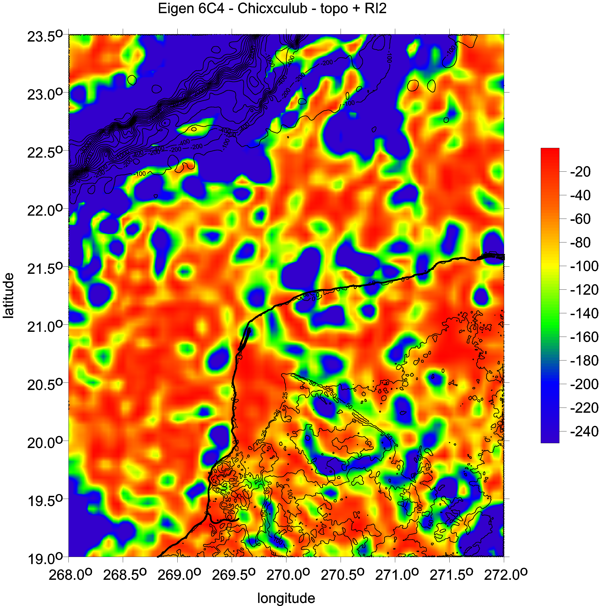
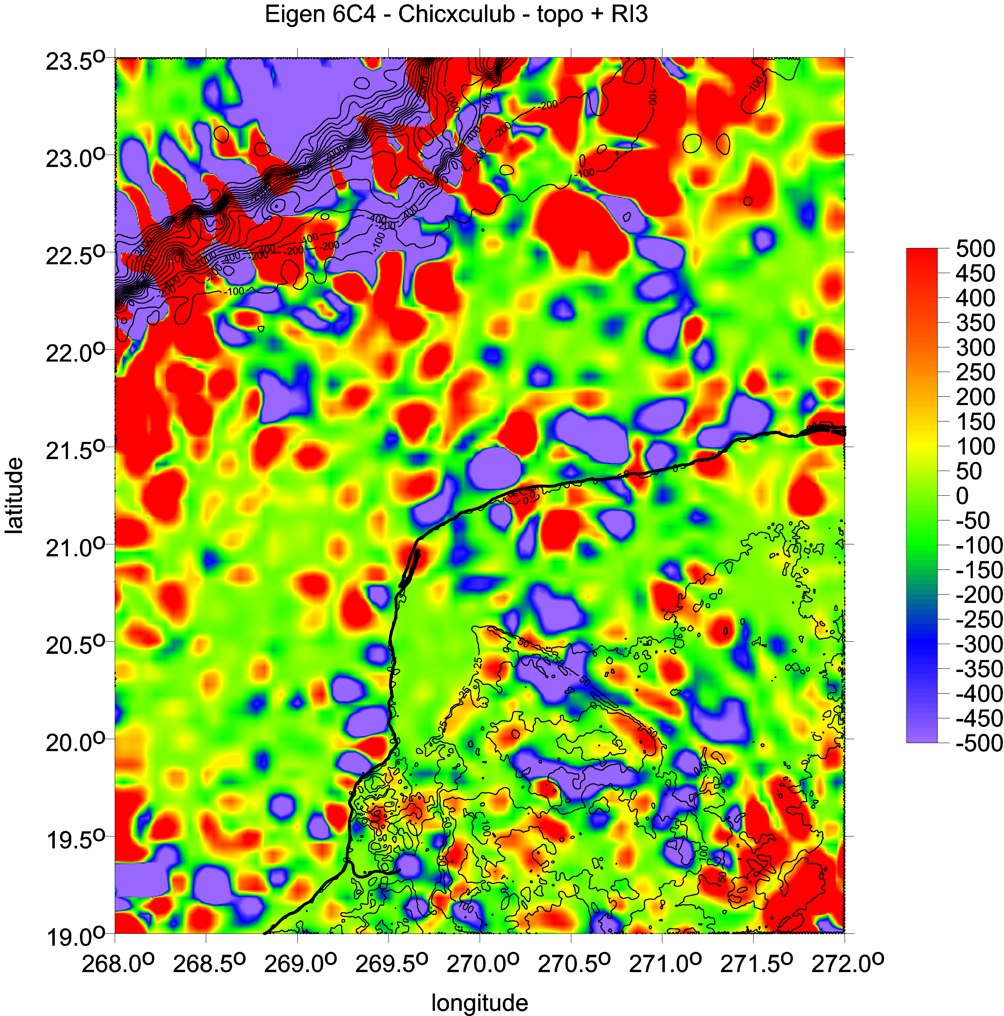

Slide 24
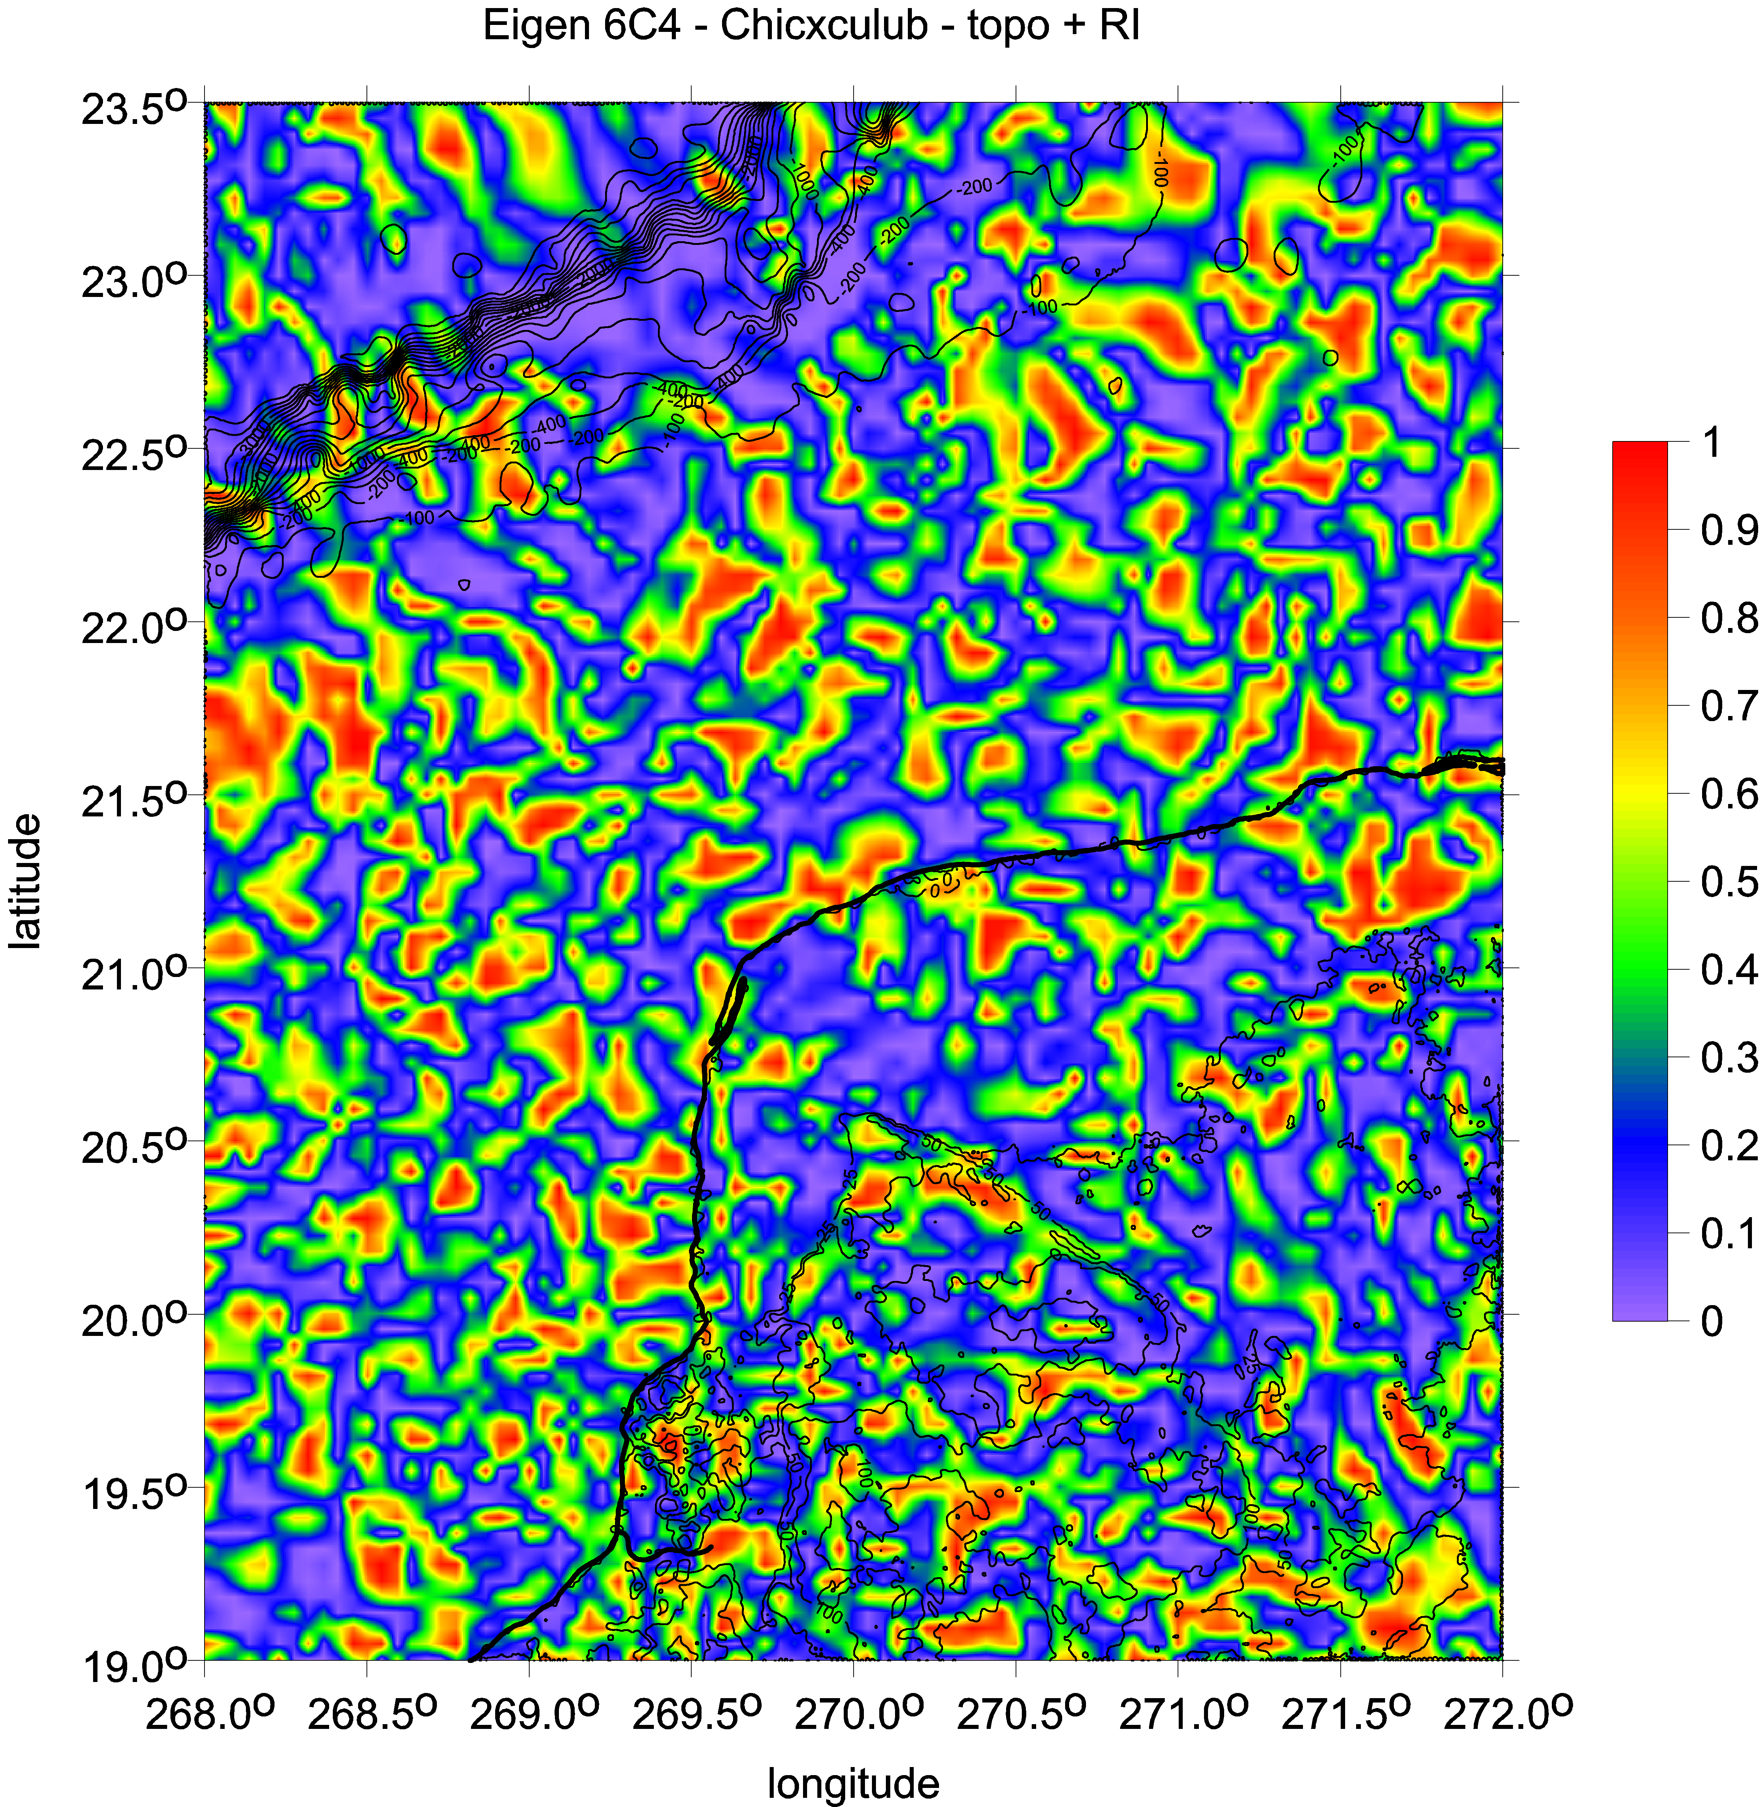
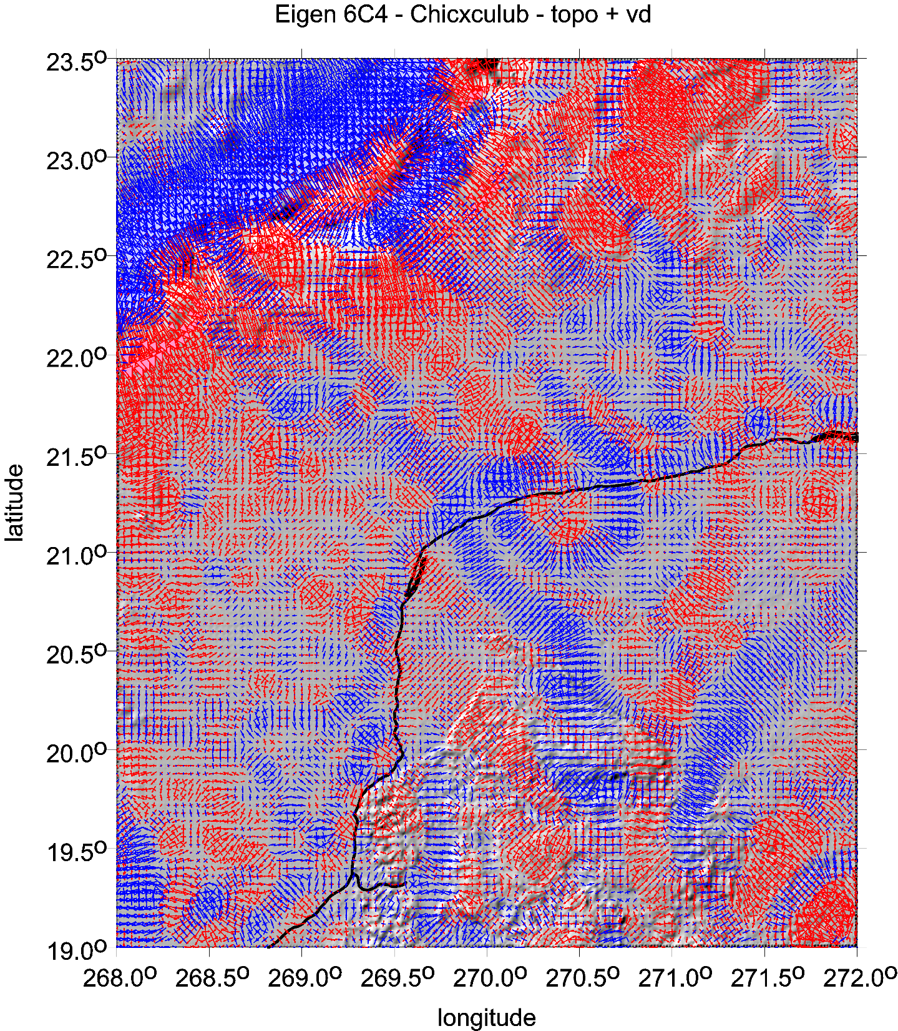

Slide 25
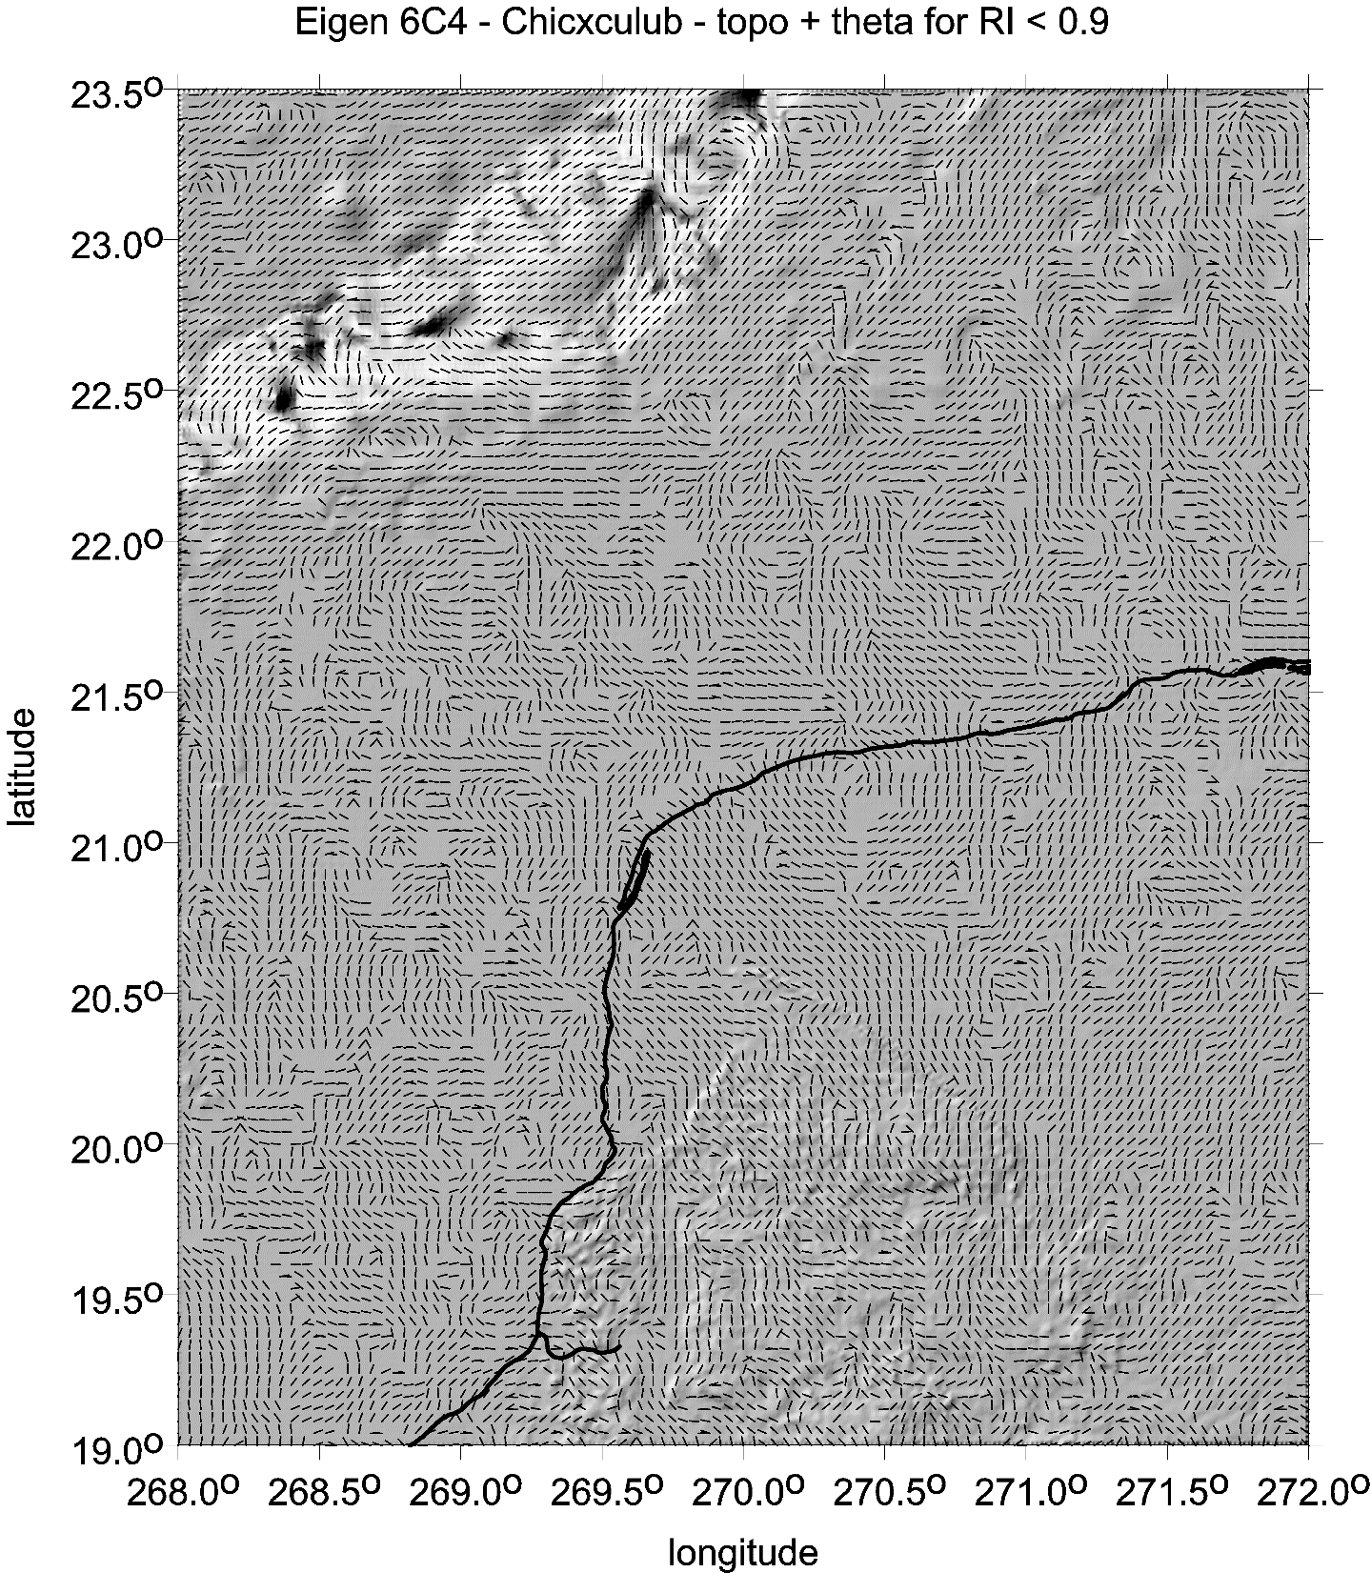
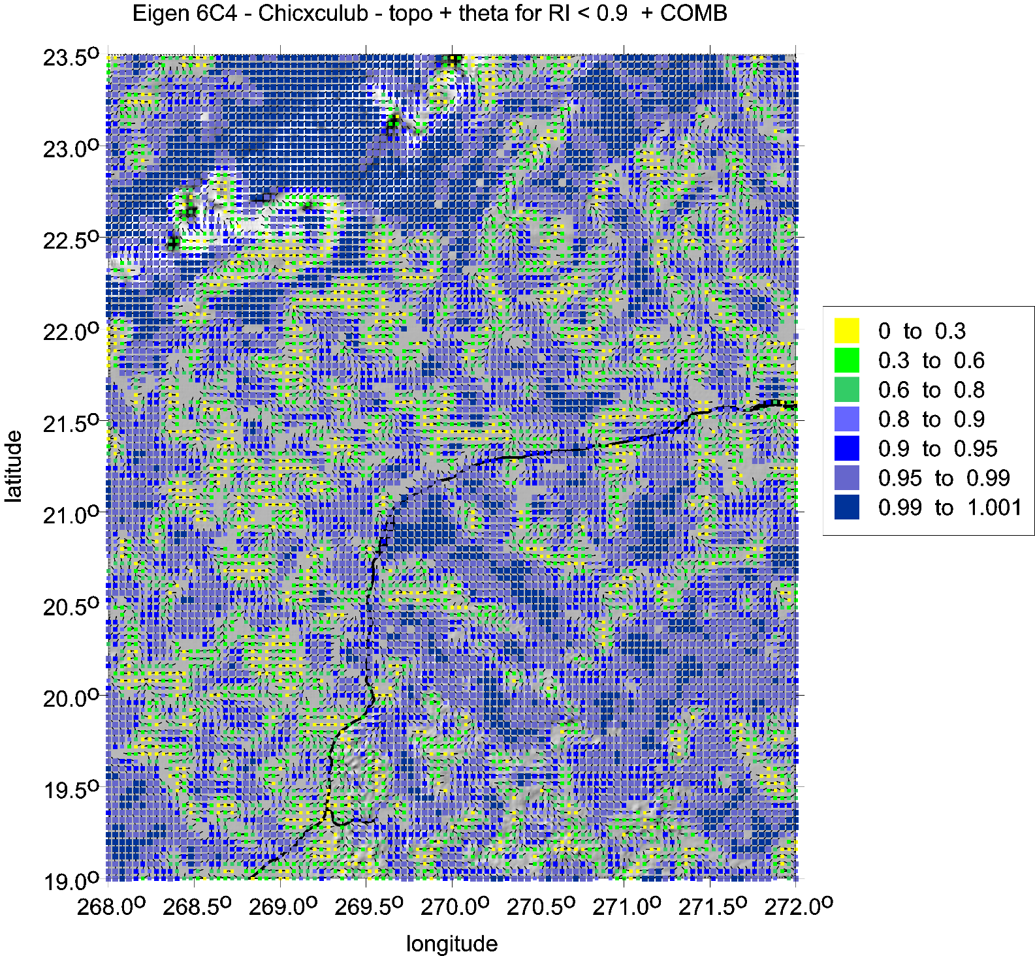

Slide 26
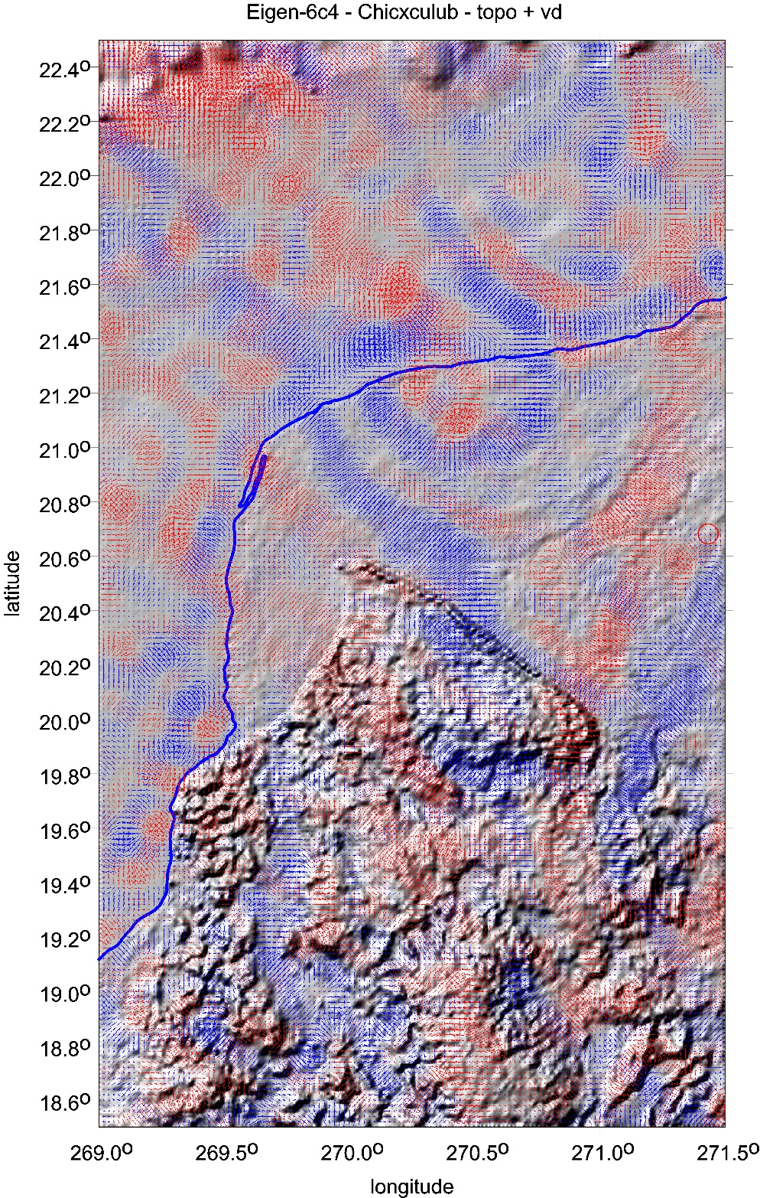
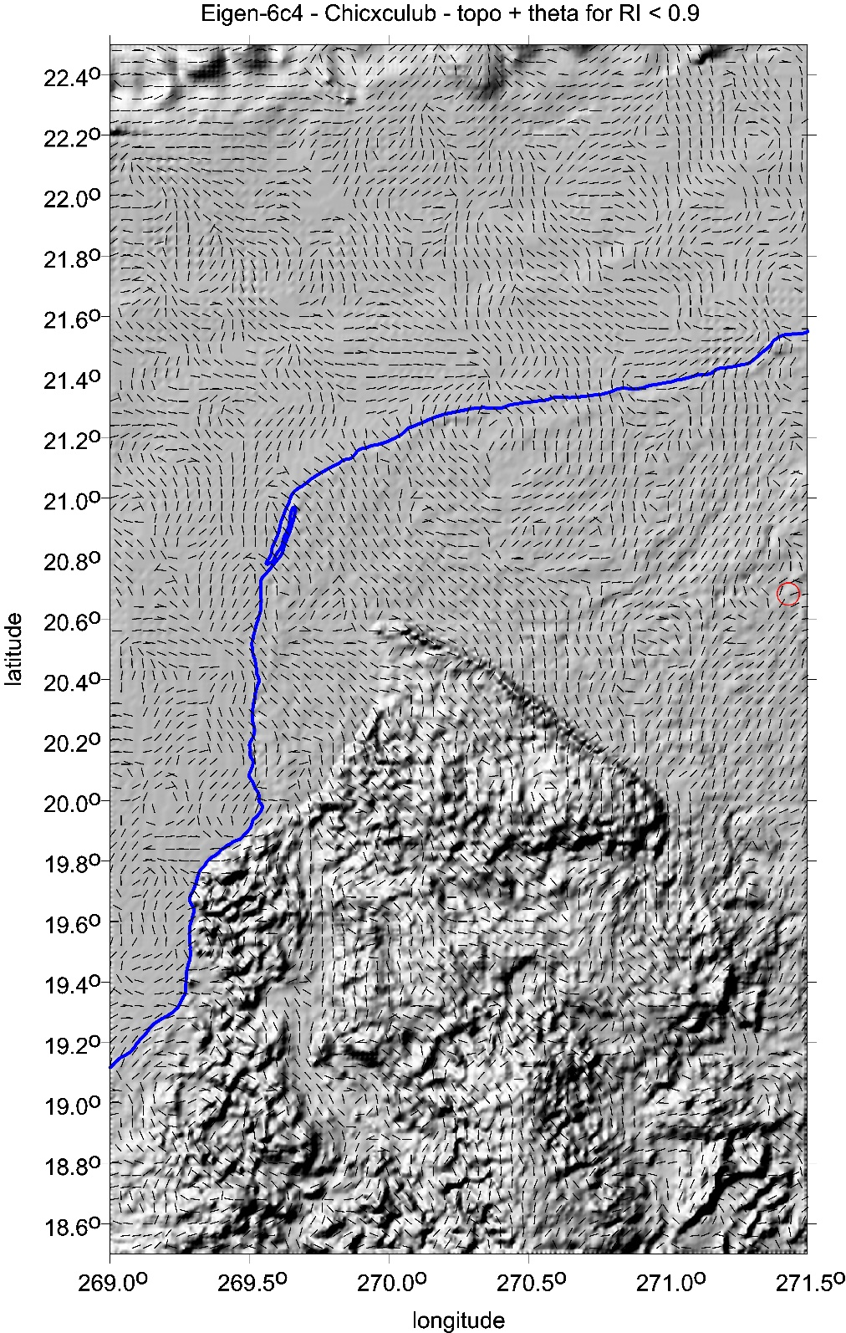

Slide 27
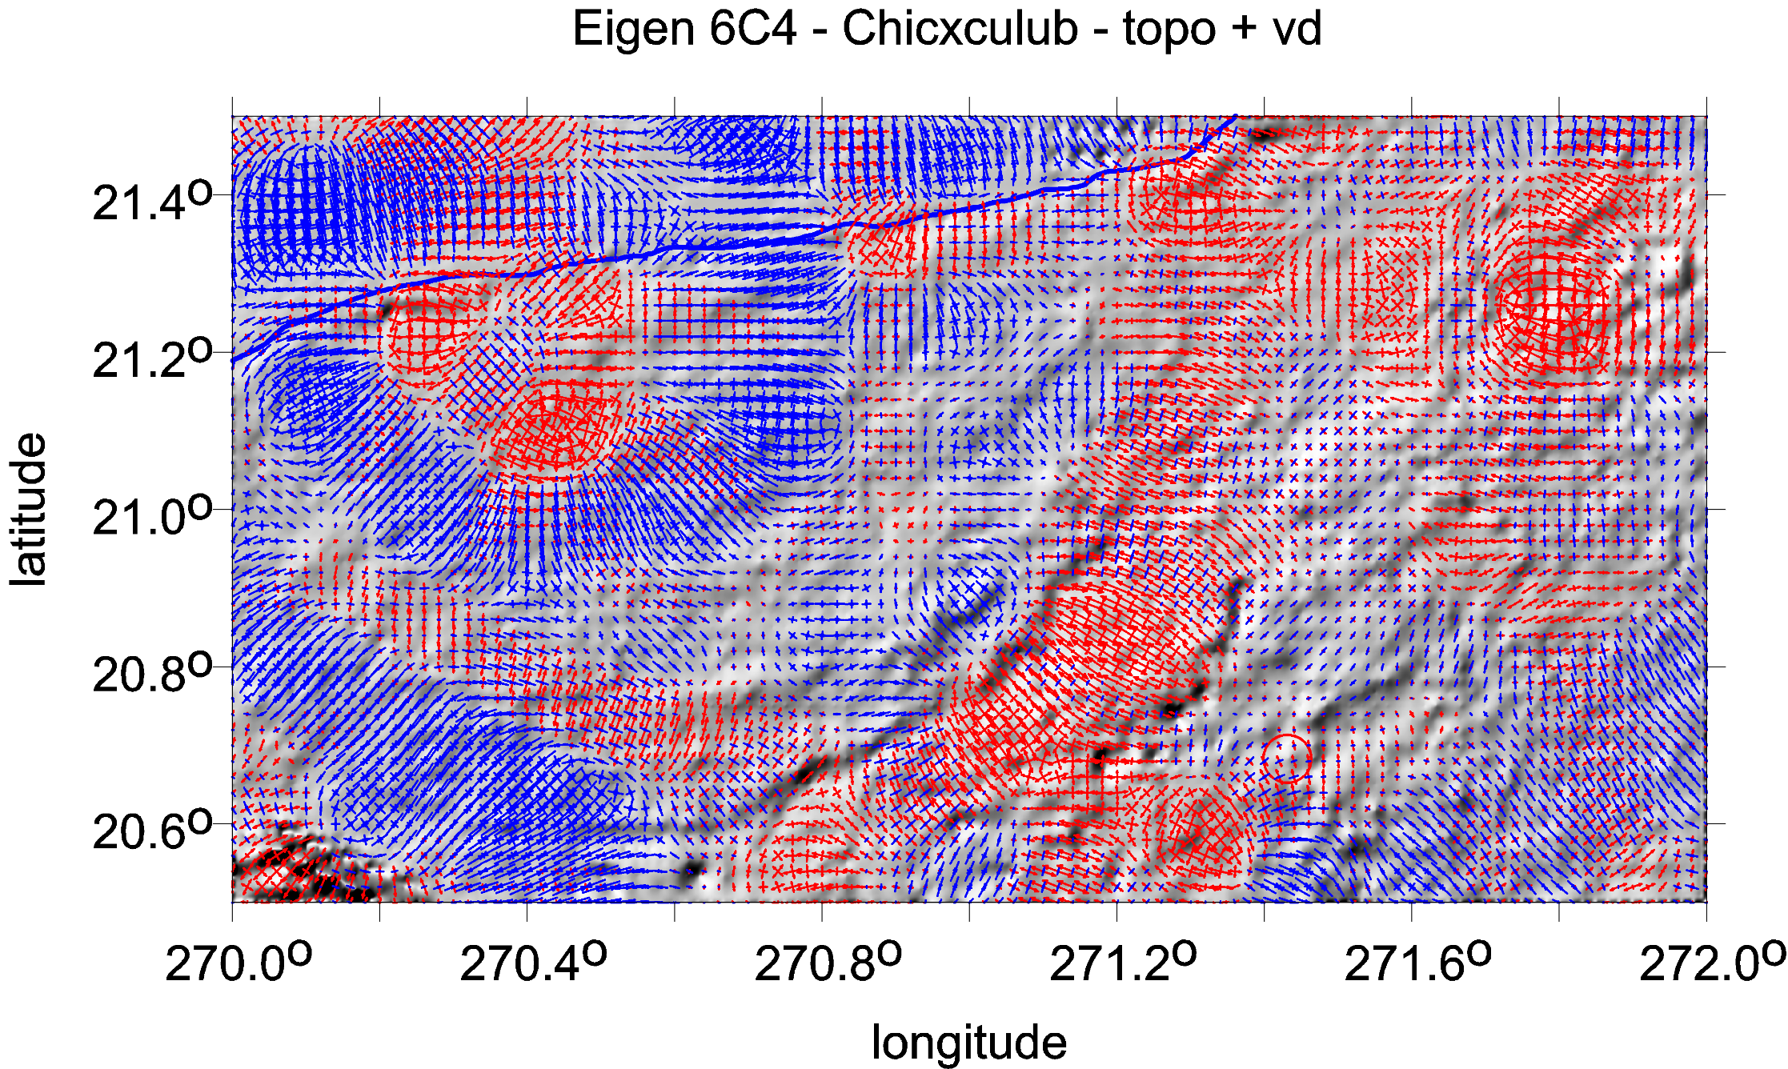
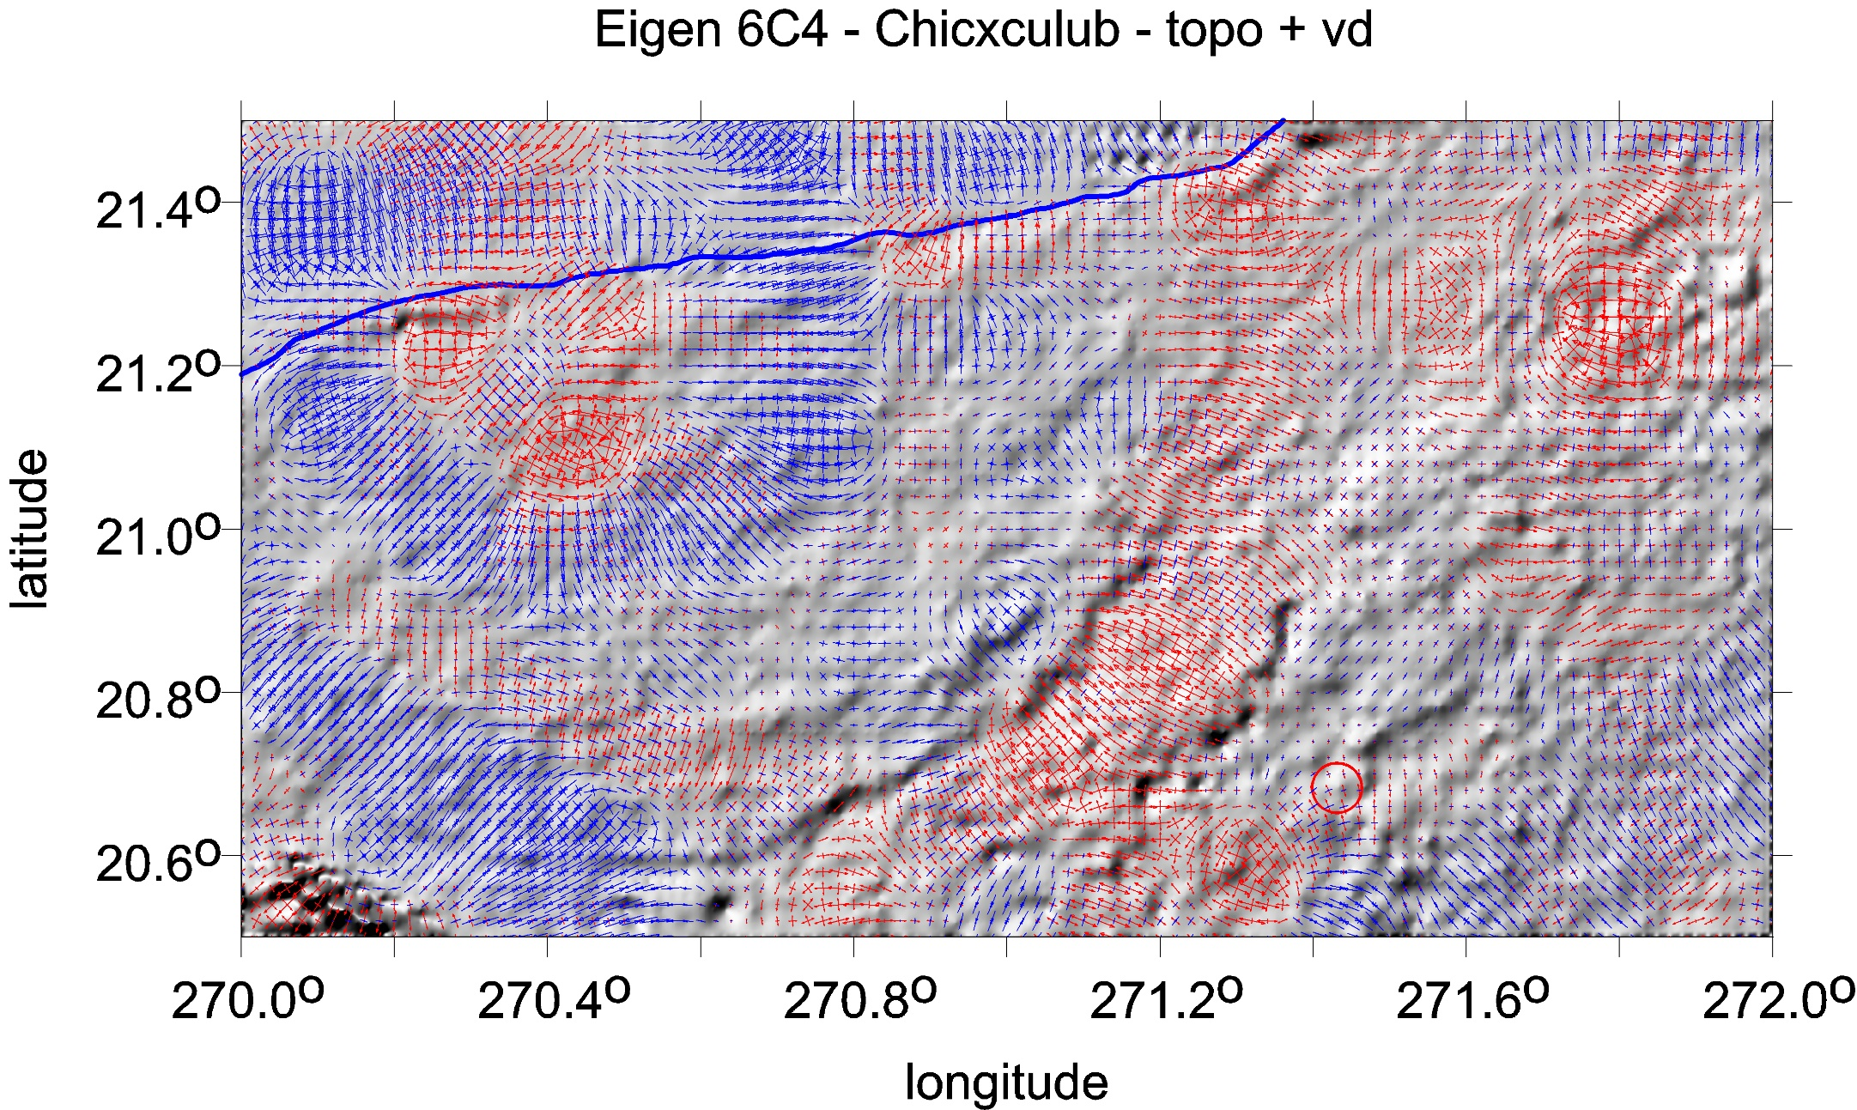

Slide 28
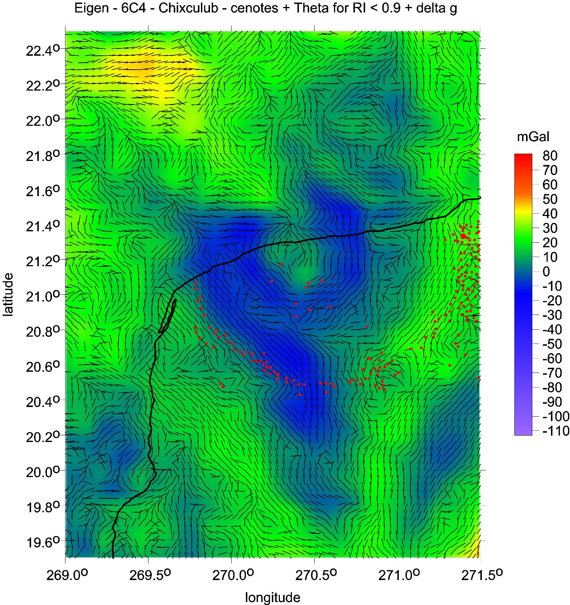
Chicxulub
zoom
gravity anomalies
and strike angles
ring of cenotes as
red dots

Slide 29

Chicxulub
zoom
gravity anomalies
and strike angles
ring of cenotes as
red dots

Slide 30

Chicxulub
gravity anomalies and strike angles
ETOPO 1 topography
Ticul Fault, Ticul Sierra
coastal line
to discussion about the
Southern anomaly (tail)

Slide 31


Magnetic field intensities
according to EMAG2_V2 model
[nanotesla, nT]

Slide 32

www/asu.cas.cz/~jklokocn
jklokocn@asu.cas.cz
The End of S4

