Slide 1
Chicxulub and Popigai
after 15 years*
double or multiple impact craters?
* Klokočník J., Kostelecký J., Pešek I., Novák P., Wagner C.A., Sebera J. 2010. Candidates for multiple impact craters?: Popigai and Chicxulub as seen by the global high resolution gravitational field model EGM08, Solid Earth EGU 1, 71-83; DOI: 10.5194/se-1-71-2010. See also: Is Chicxulub a double impact crater? 6th EGU A. von Humboldt Interntl. Conf. on Climate Change, Natural Hazards, and Societies, Mérida, México, Section: The Cretaceous/Tertiary Boundary and the Chicxulub Impact Crater, paper AvH6-5, 15 March 2010.

Slide 2


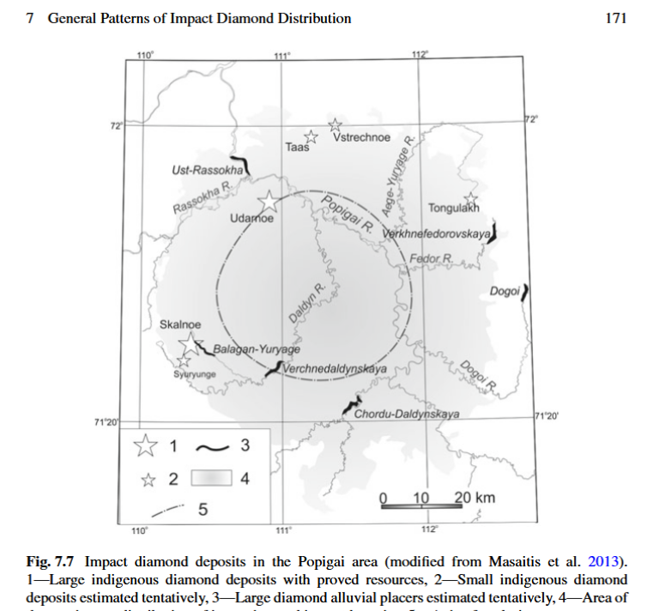
Supplement 3
Popigai family
Reproduced from:
Mashchak, M.S., Masaitis, V.L., Raikhlin, A.I., Selivanovskaya, T.V., Naumov, M.V. 2019. Ed. Masaitis V.L. Popigai Impact Structure and its Diamond-Bearing Rocks, Impact Studies, Springer International Publishing AG, Springer Nature; https://doi.org/10.1007/978-3-319-77988-1_2
© ASU & RIGTC

Slide 3
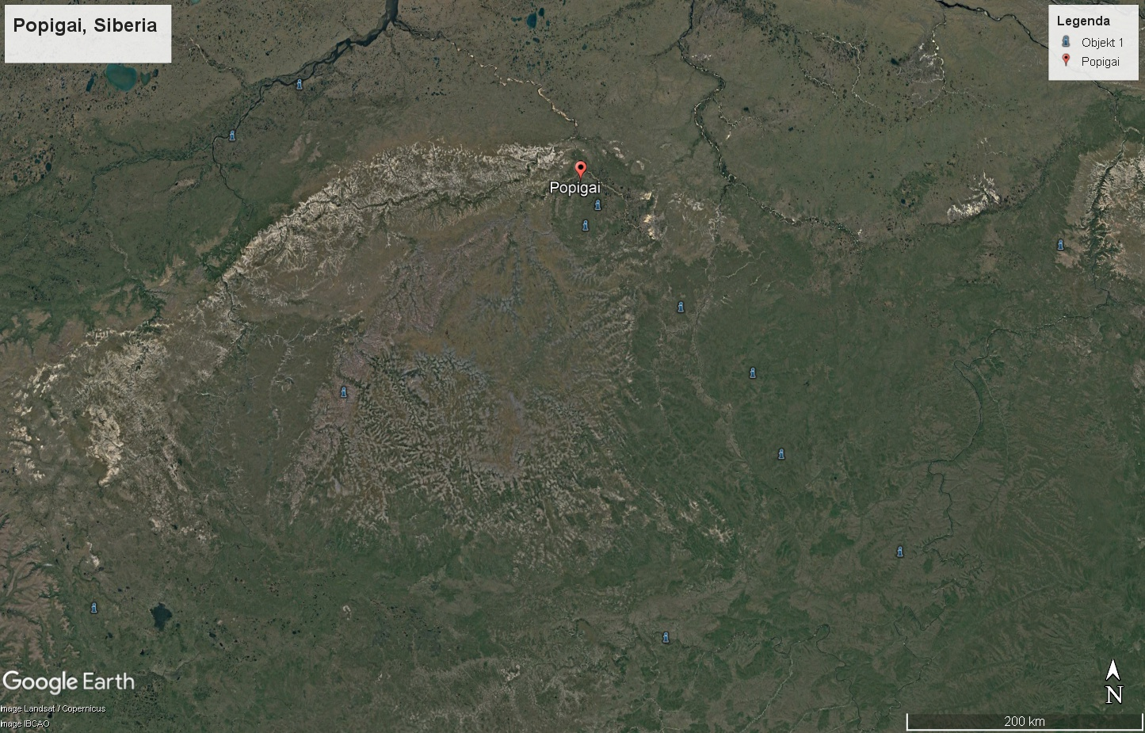
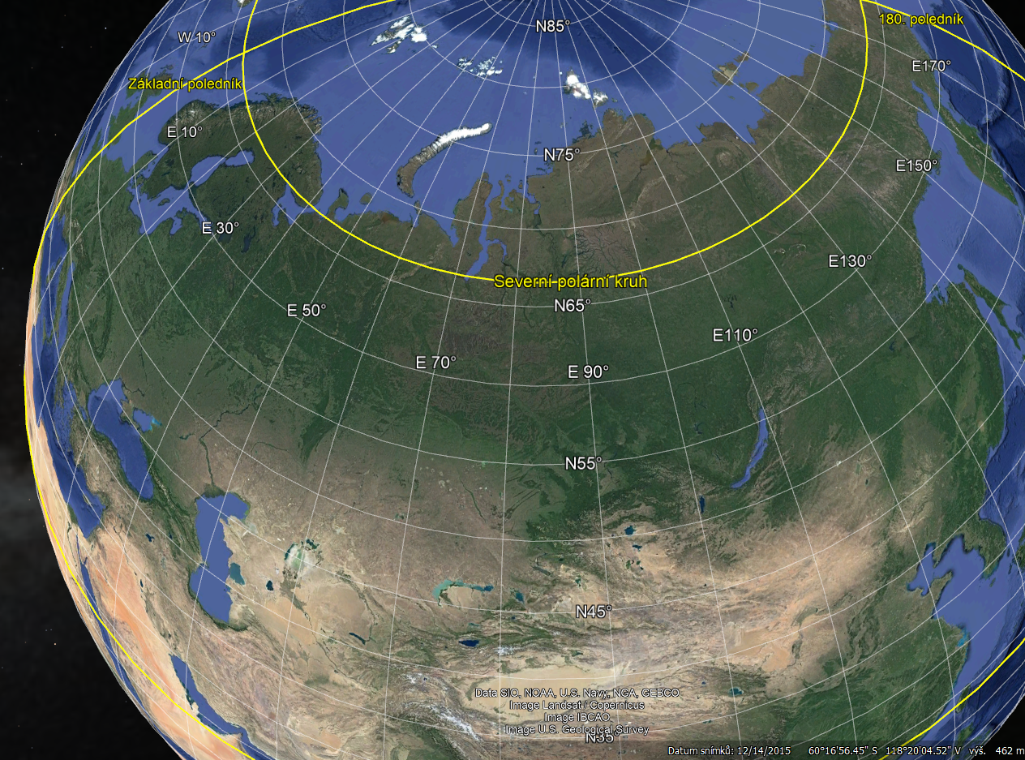
© Google Earth
left
Geological sketch map of the Popigai impact structure, modified after Masaitis et al. (1980). (1) Archean gneisses and schists; (2) Upper Proterozoic and Cambrian quartzites, dolomites, and limestones; (3) Permian sandstones and argillites with sills and dikes of
Triassic dolerites; (4) tagamites; (5) suevites with lenses of fine-grained allogenic breccia, (6) allogenic breccia; (7) center line of annular uplift; (8) center line of annular trough, (9) axes of radial troughs; (10) thrusts, faults.

Slide 4
Popigai
geology of the main
proved impact crater
71o38N. 111o11E
crater center
North Central Siberia
about 100 km from the coast
of the Laptev Sea,
an embayment of the Arctic Ocean.
Late Eocene - 35.7 (± 0.2) May
[by stepwise heating Ar-Ar].
35.7-Ma-old and -100-km-wide multi-ring Popigai
a well- preserved impact structure at the Anabar shield,
central Arctic Siberia, filled with melted and shocked material
that included shock-generated impact diamonds.
Because the structure is exposed, but only slightly eroded,
a variety of impactites are preserved
and accessible for petrological studies.
Geology of the Popigai impact structure, after Masaitis (1994).

Slide 5
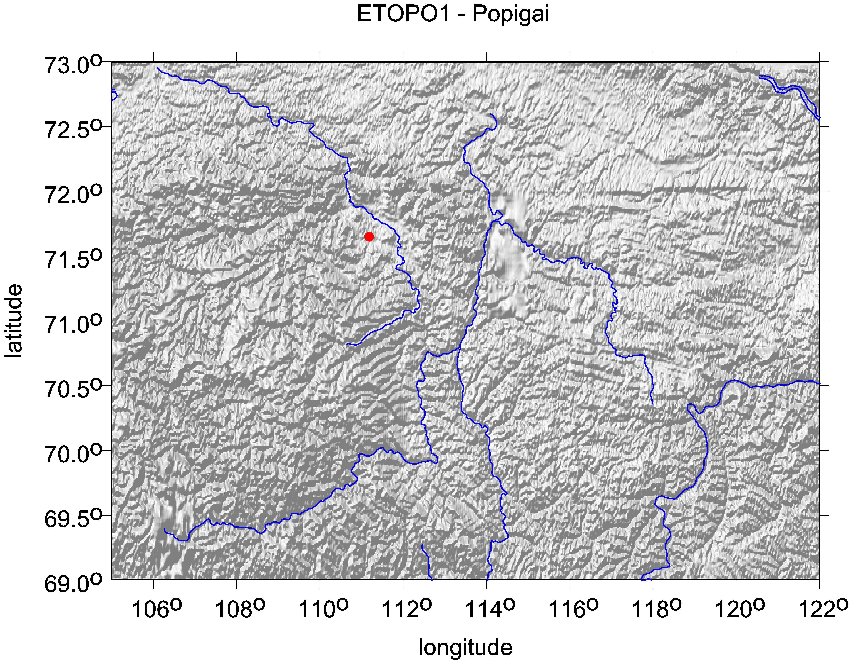
POPIGAI
ETOPO 1
topography [m]

Slide 6
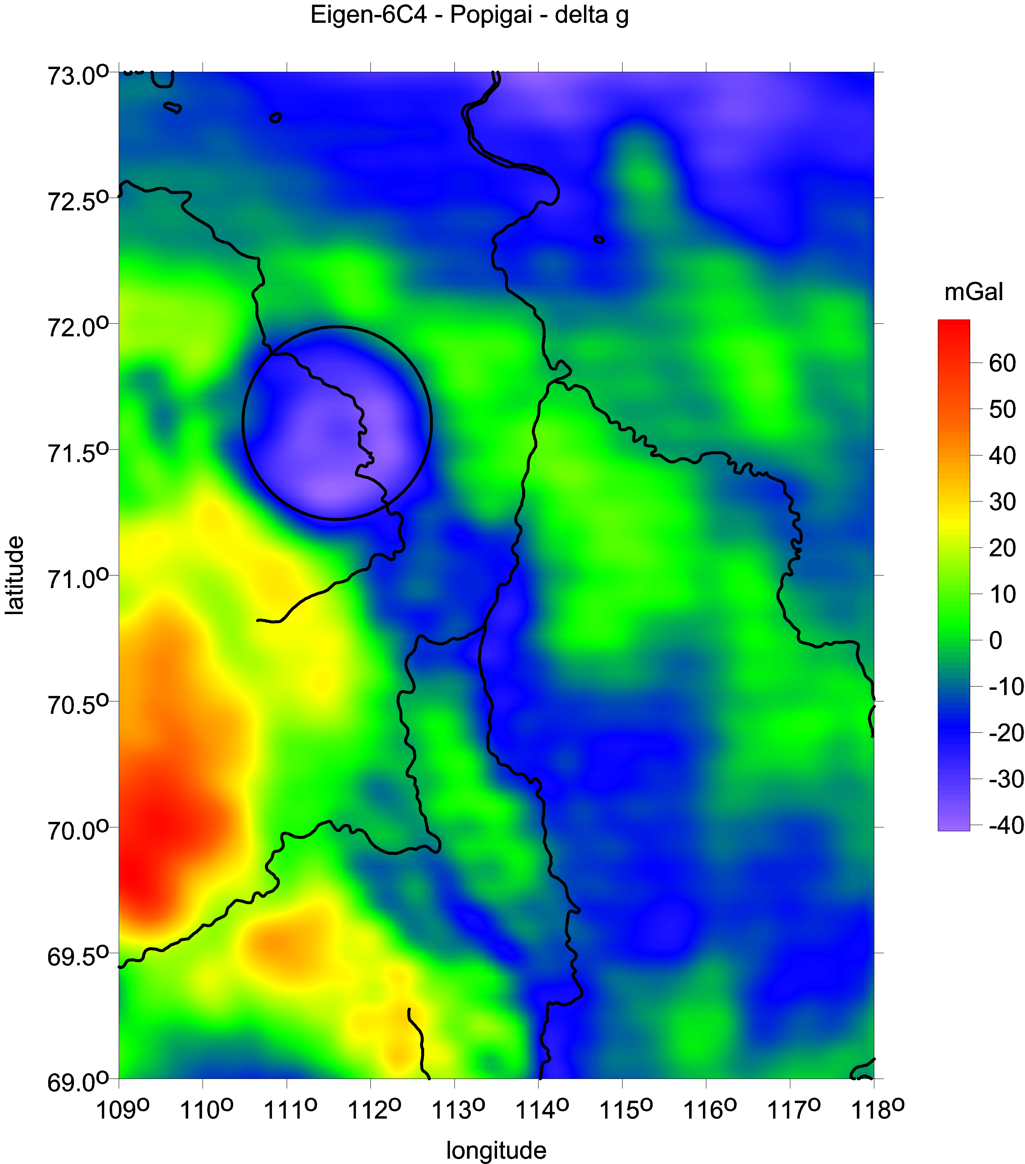
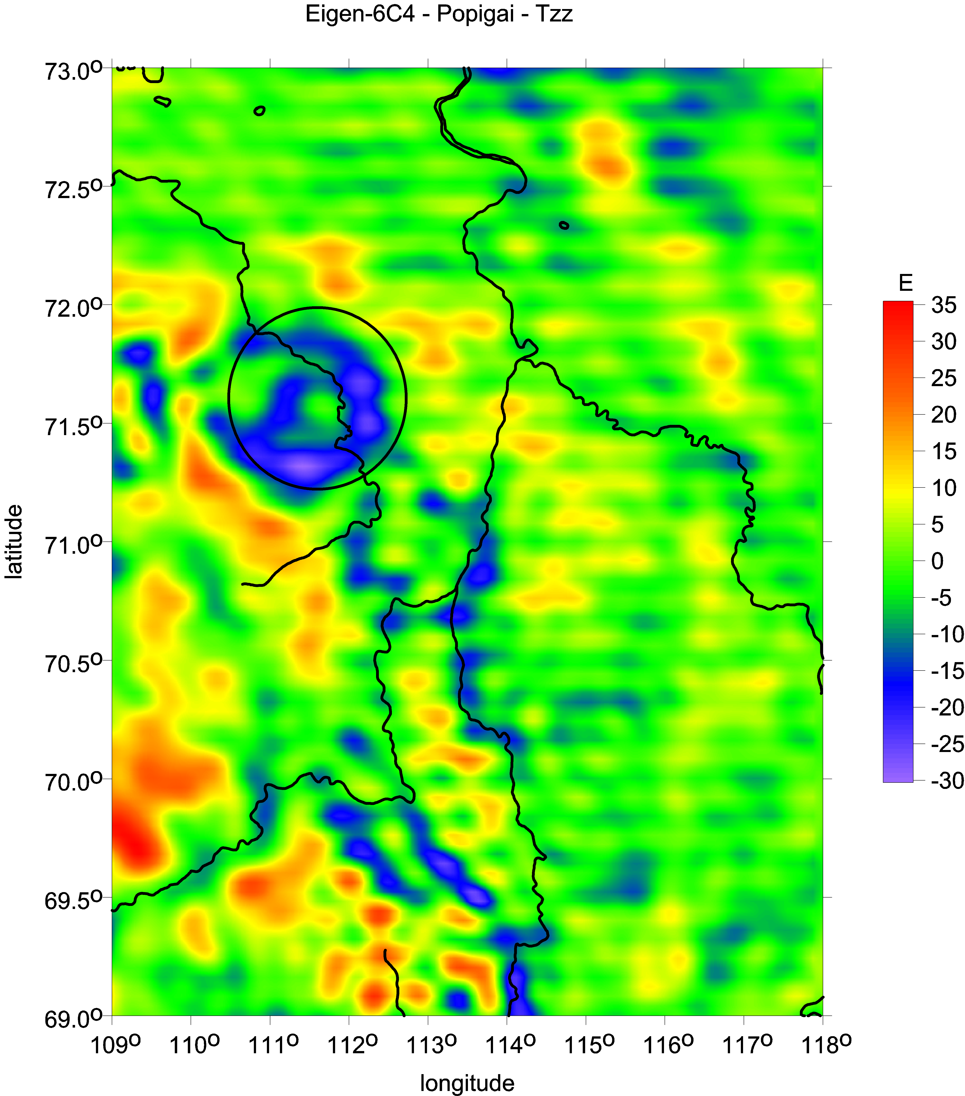
Popigai family: gravity anomalies [mGal] and second radial derivative [E]

Slide 7
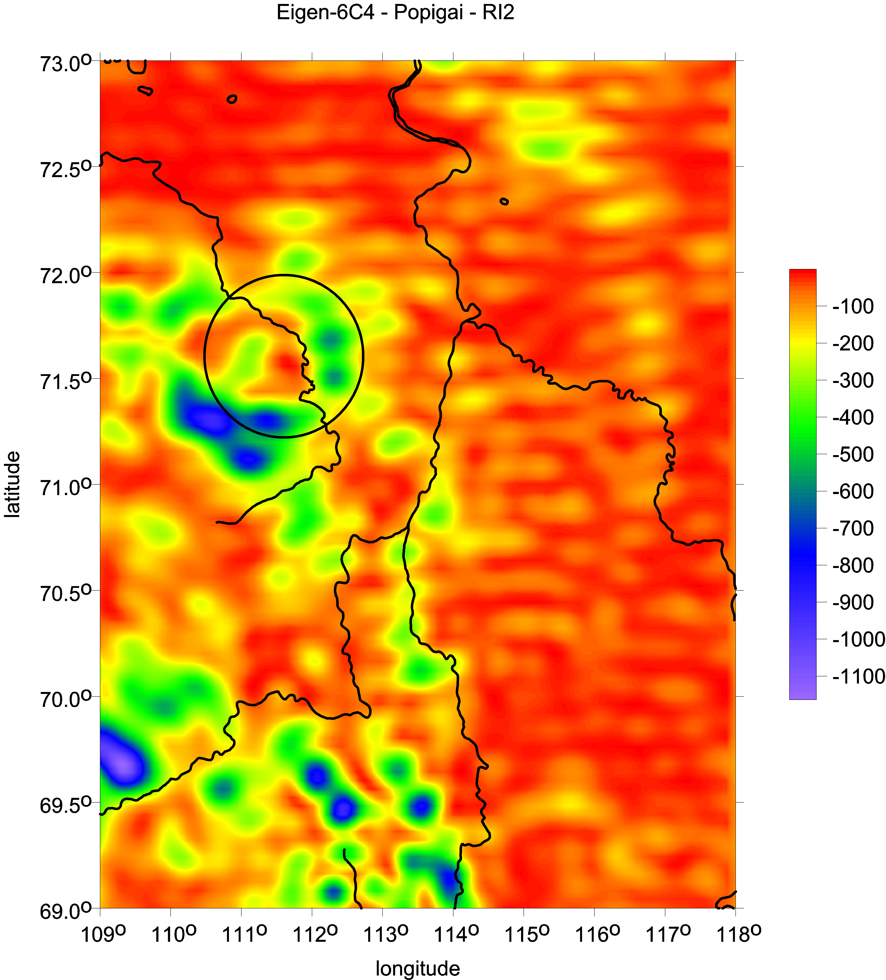
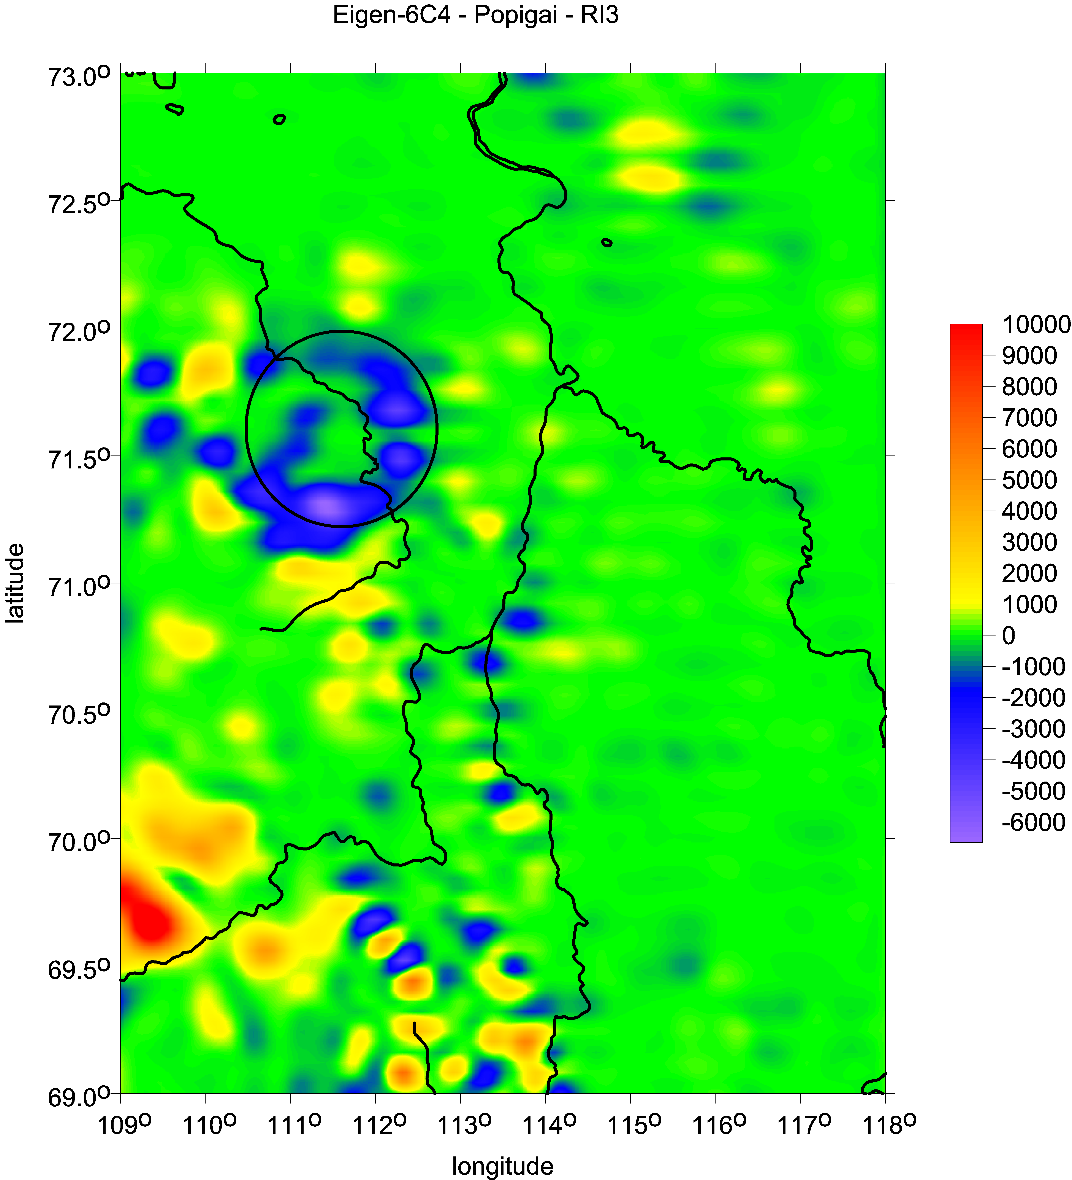
Popigai family: the invariants I1 [s-4] and I2 [s-6]

Slide 8
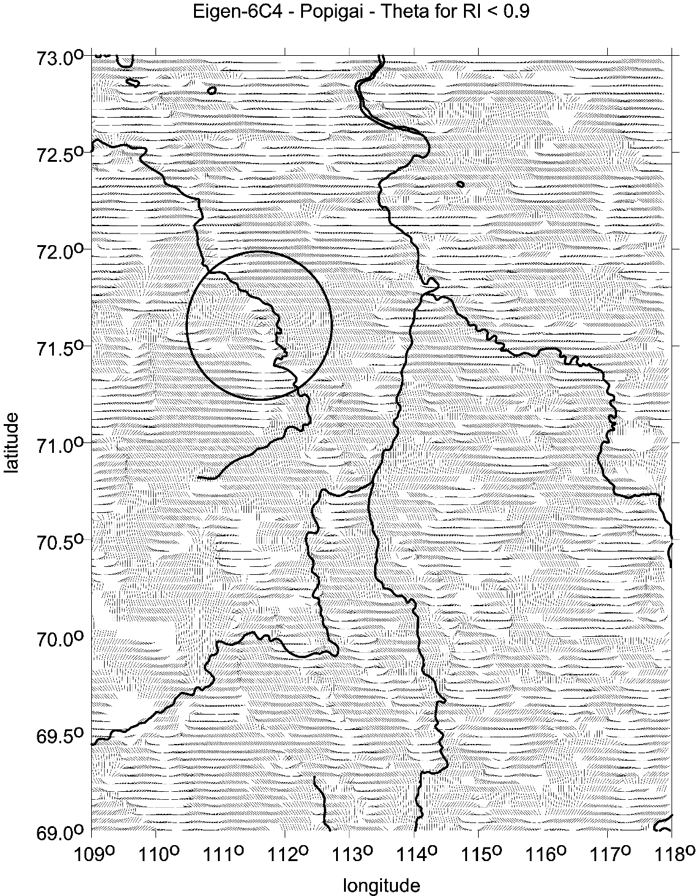
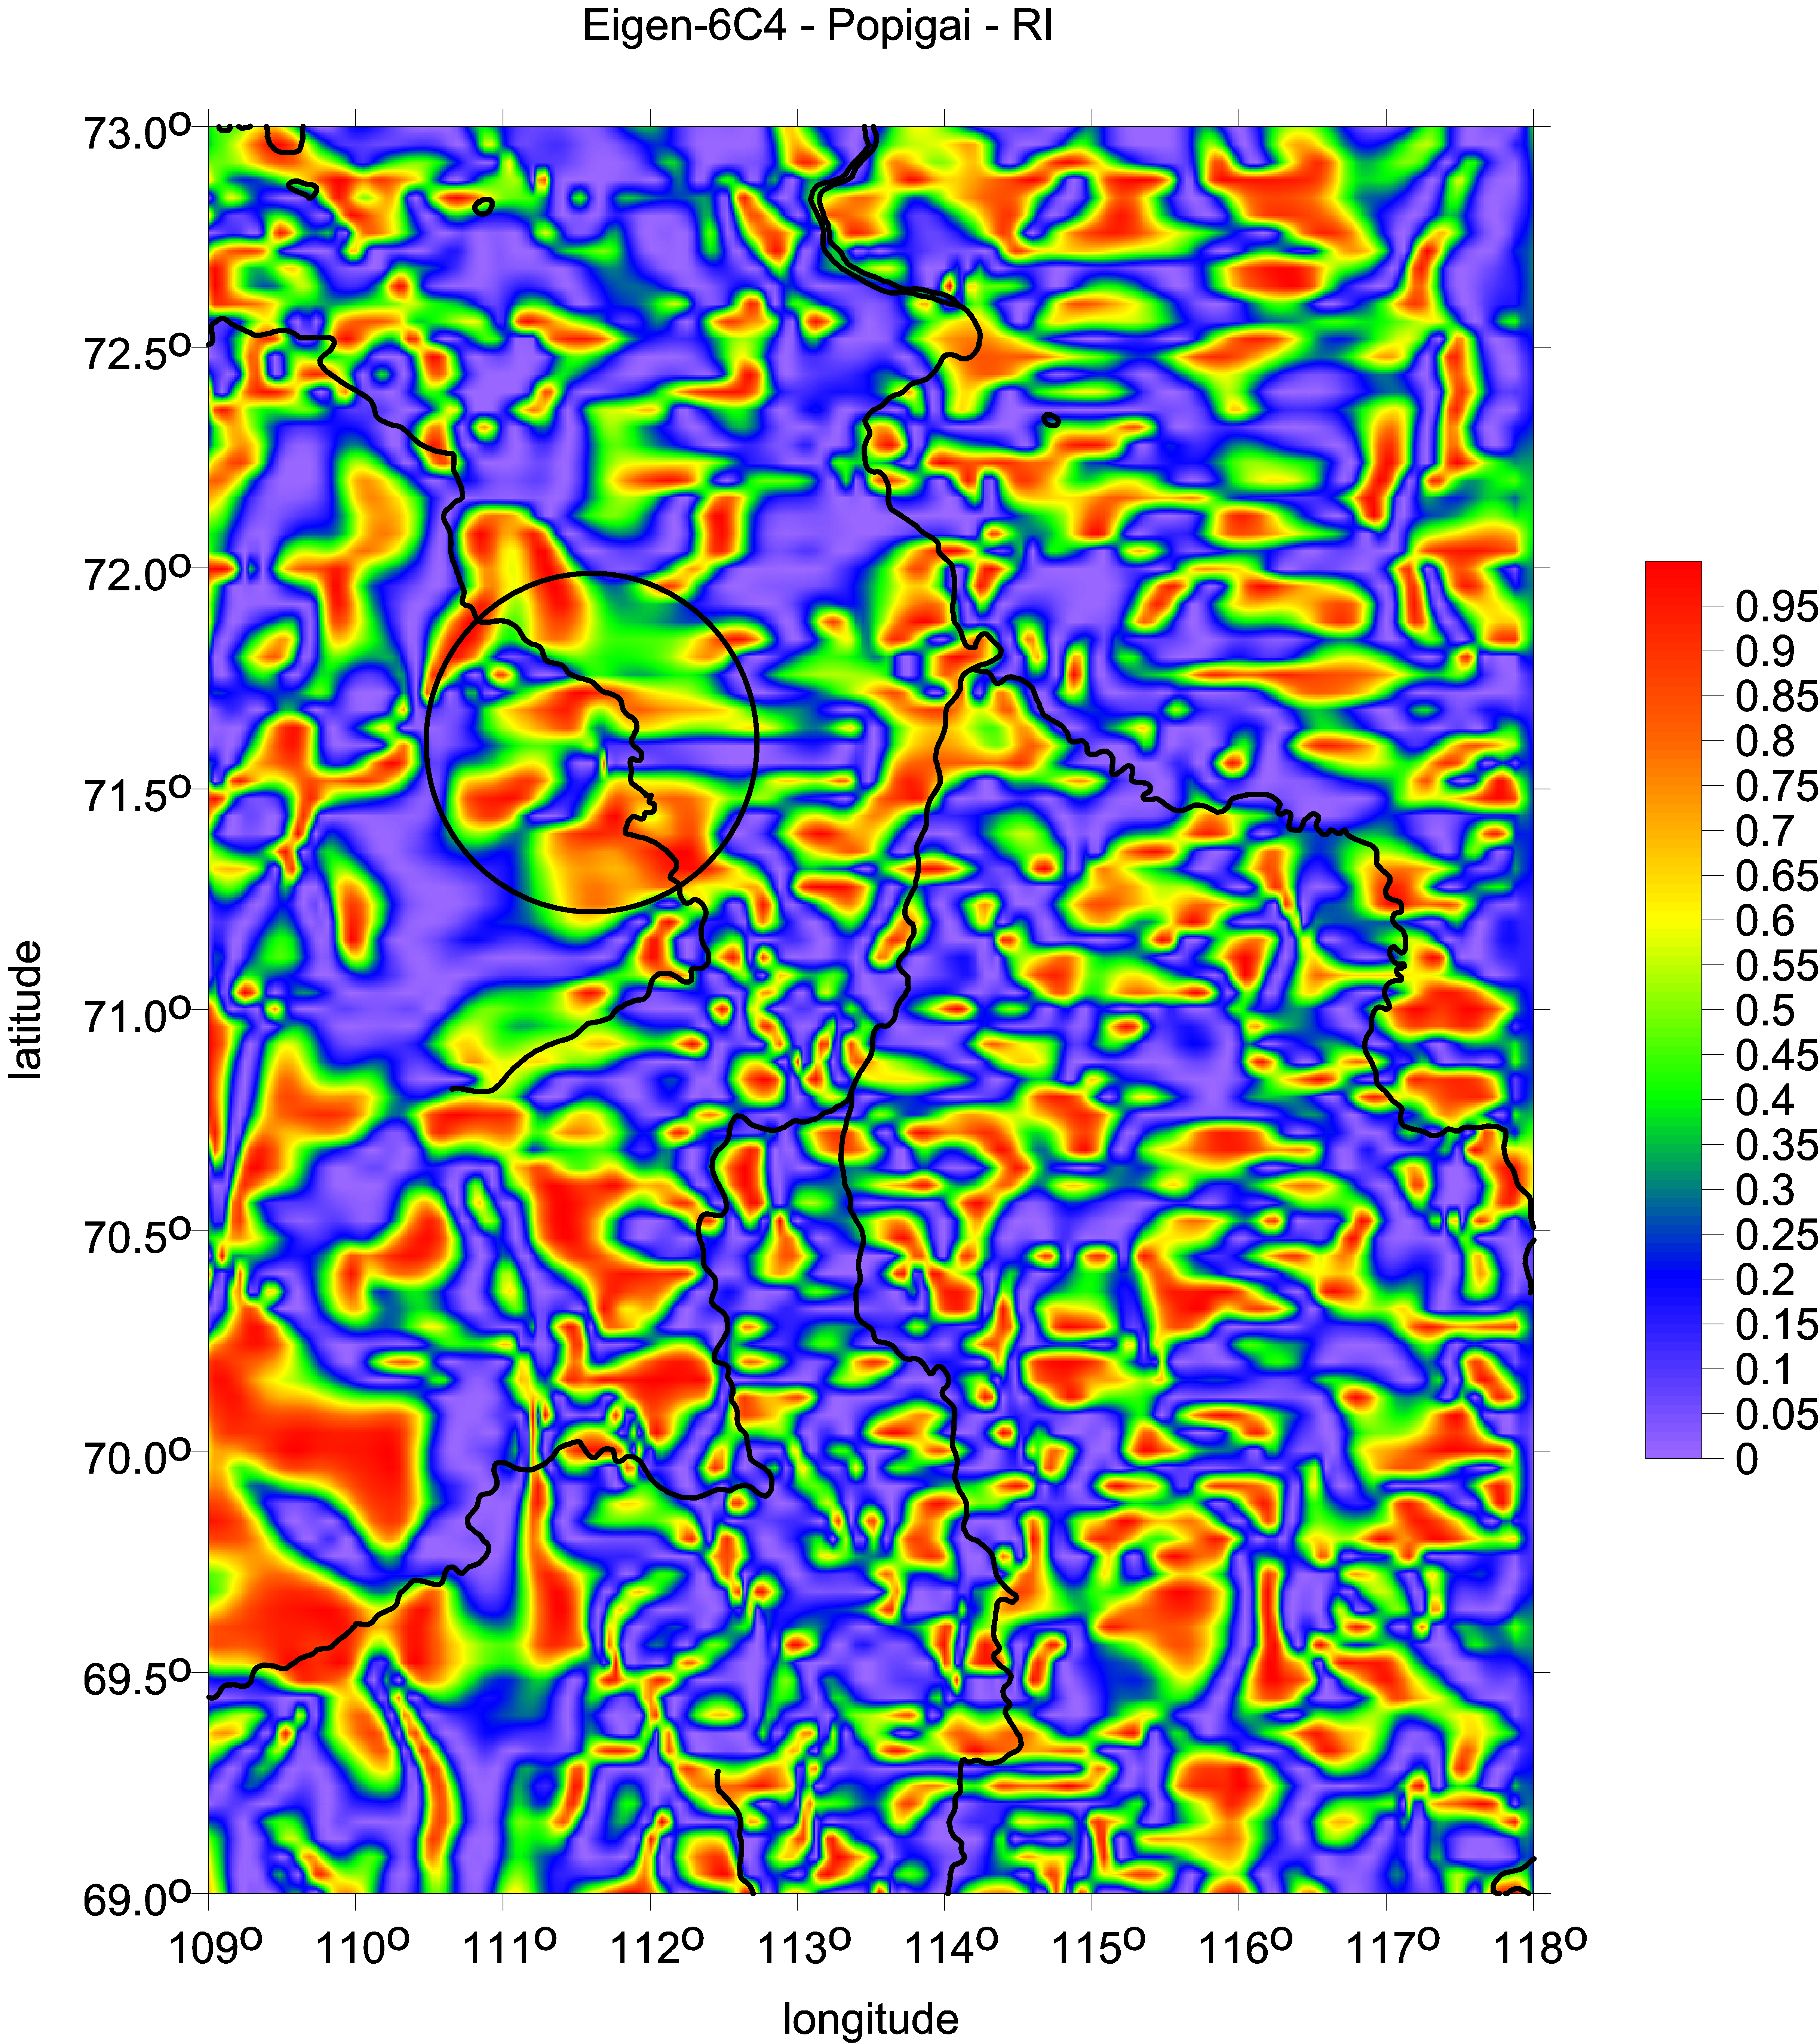
Popigai family: the ratio I of the invariants, strike angles [deg]

Slide 9
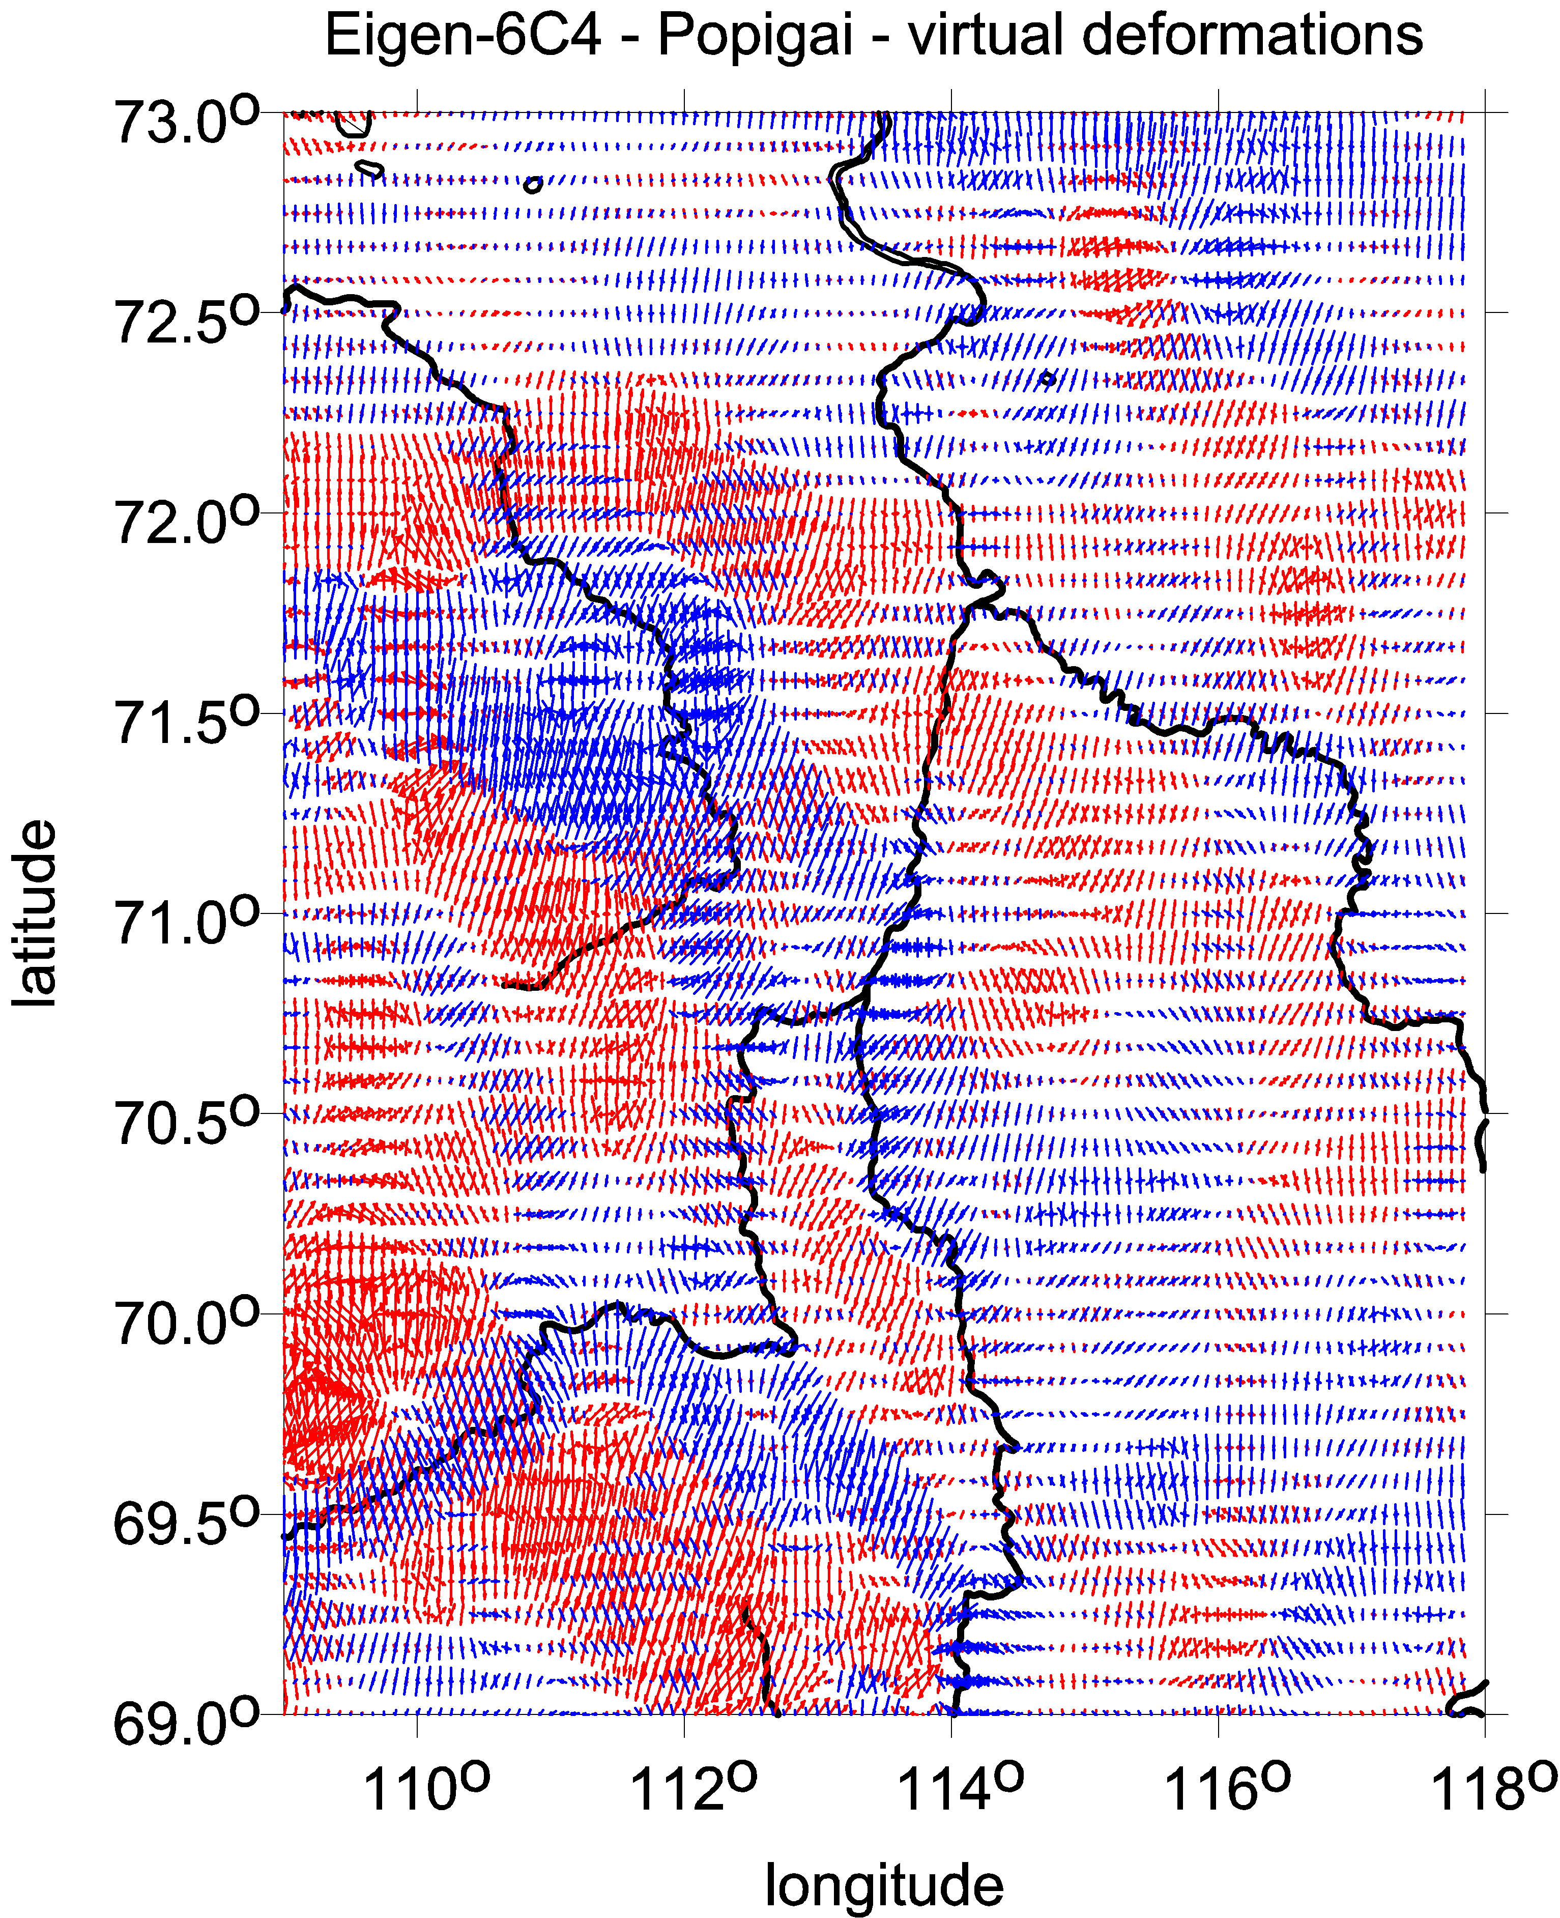
Popigai family:
virtual deformations [-]

Slide 10
Series of figures
with the gravity aspects,
combined with the strike angles
and surface topography ETOPO 1
(contour lines)

Slide 11
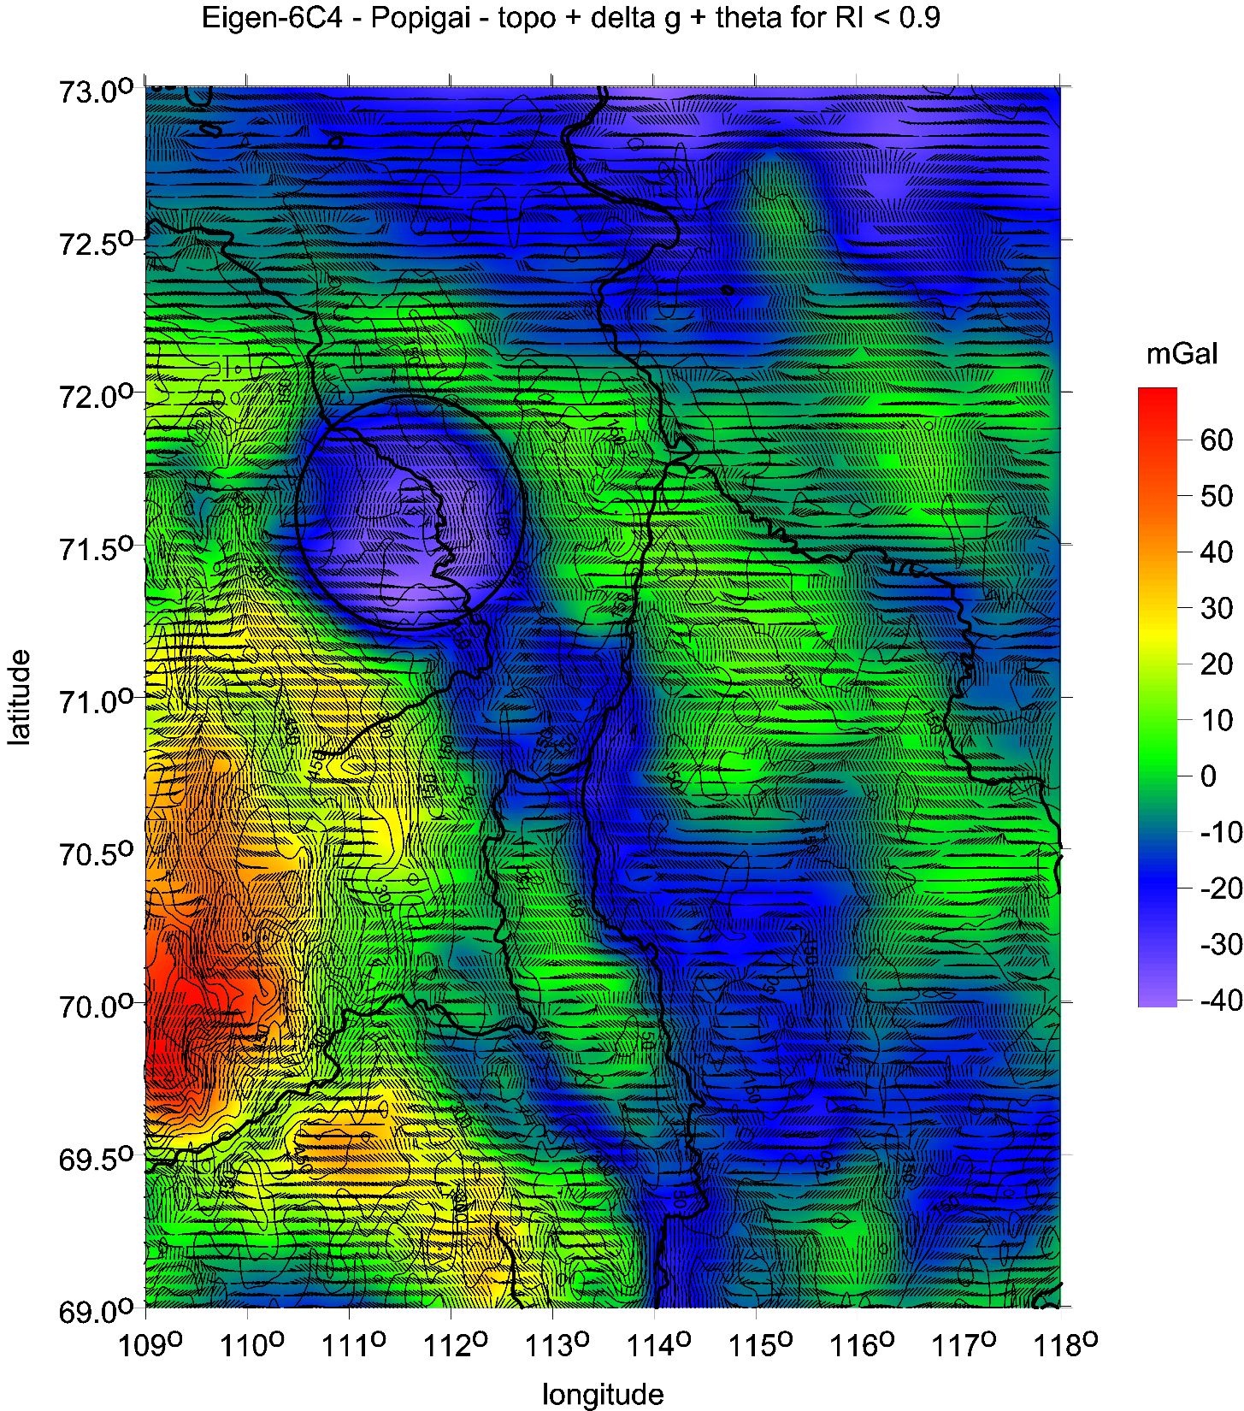

Slide 12
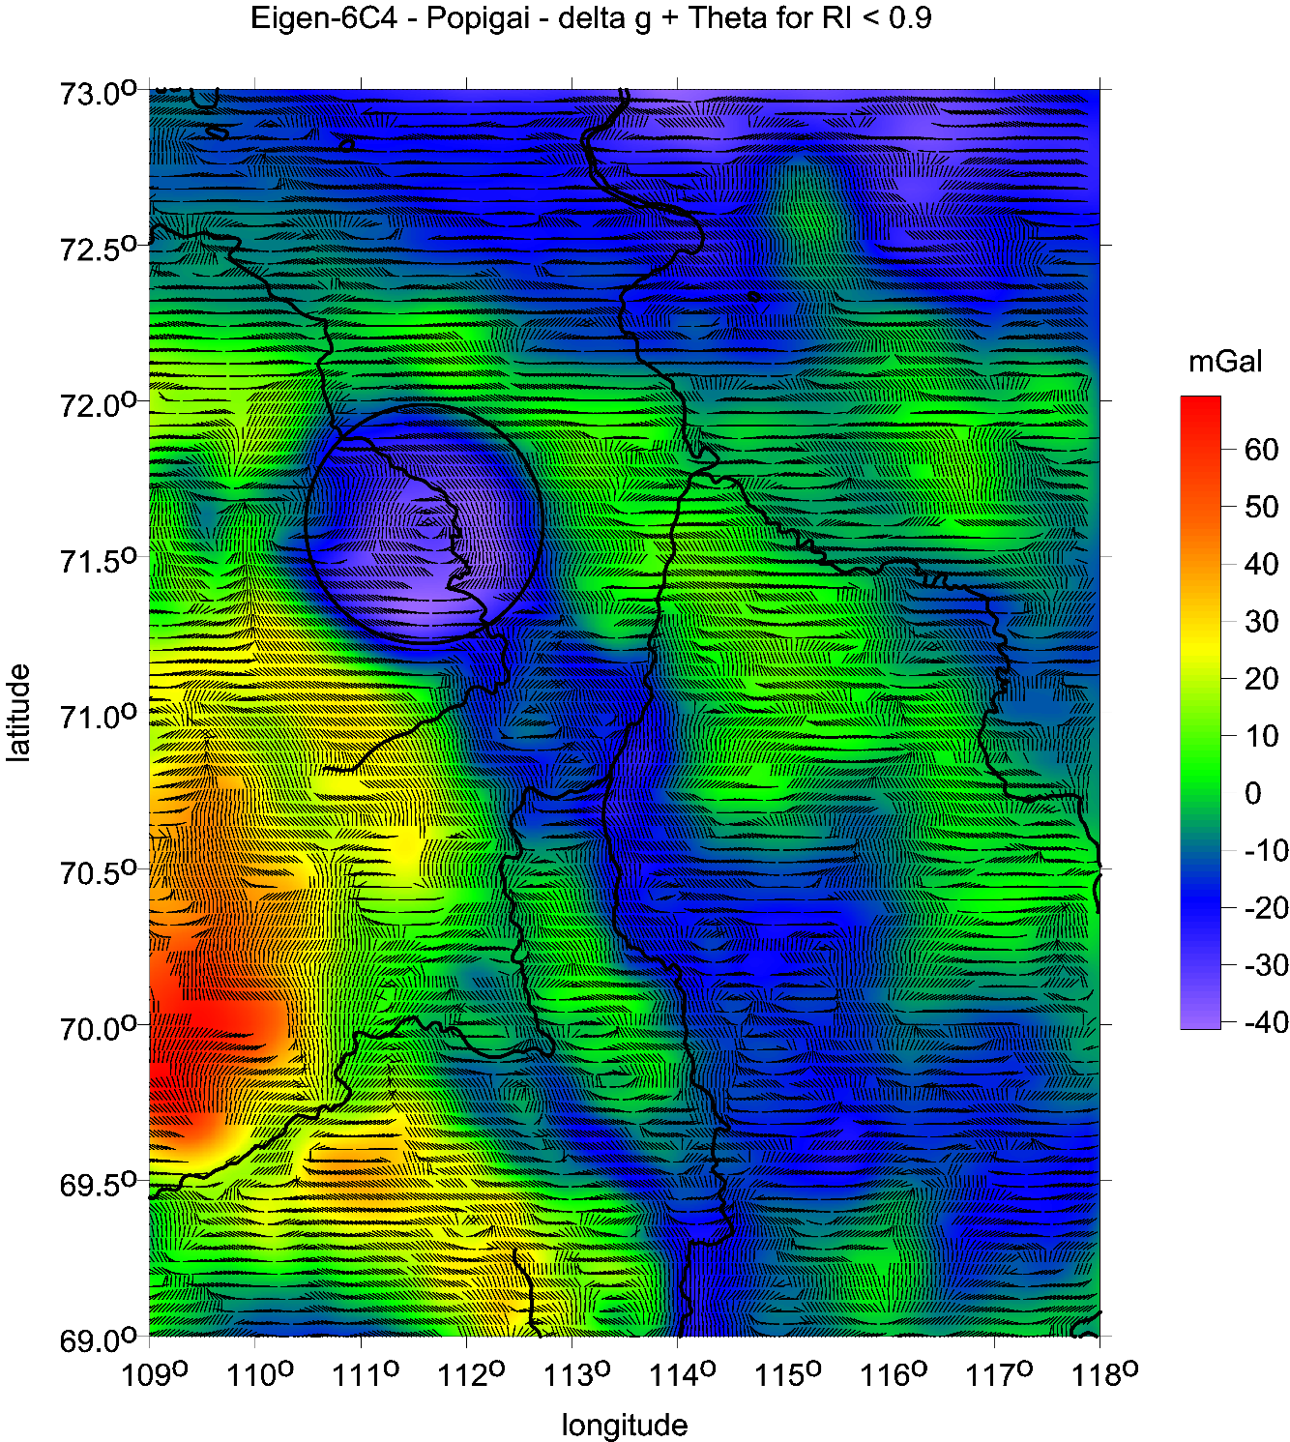
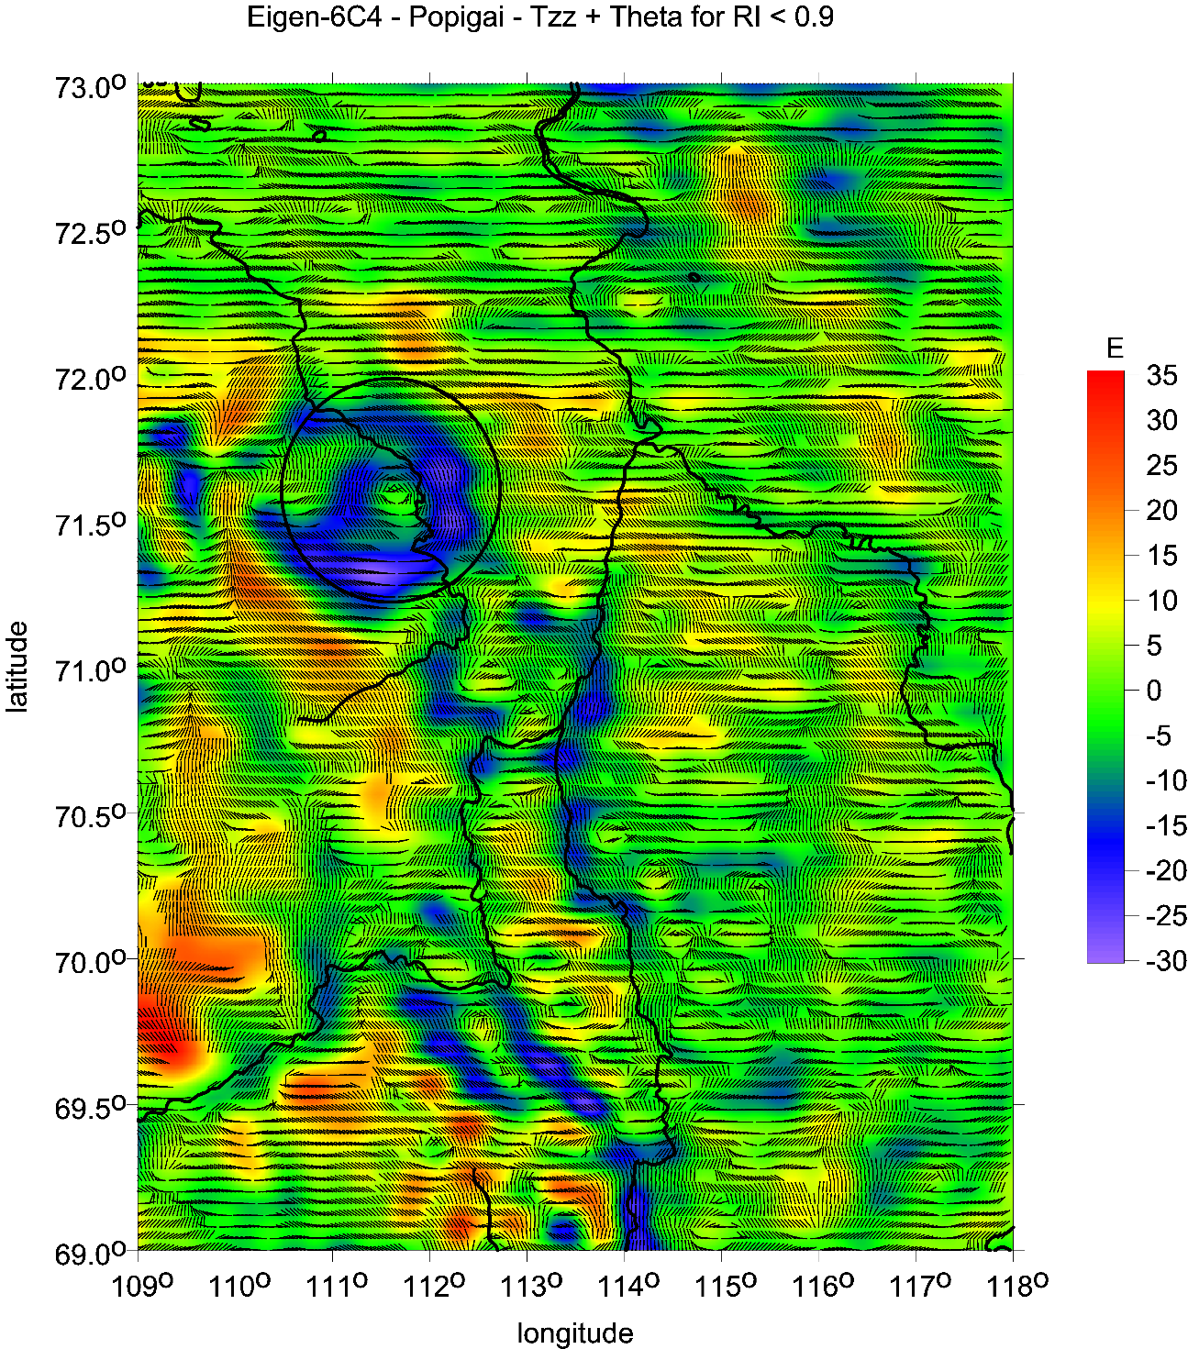
Popigai family: gravity anomalies [mGal] and second radial derivative [E] together with the strike angles [deg]

Slide 13
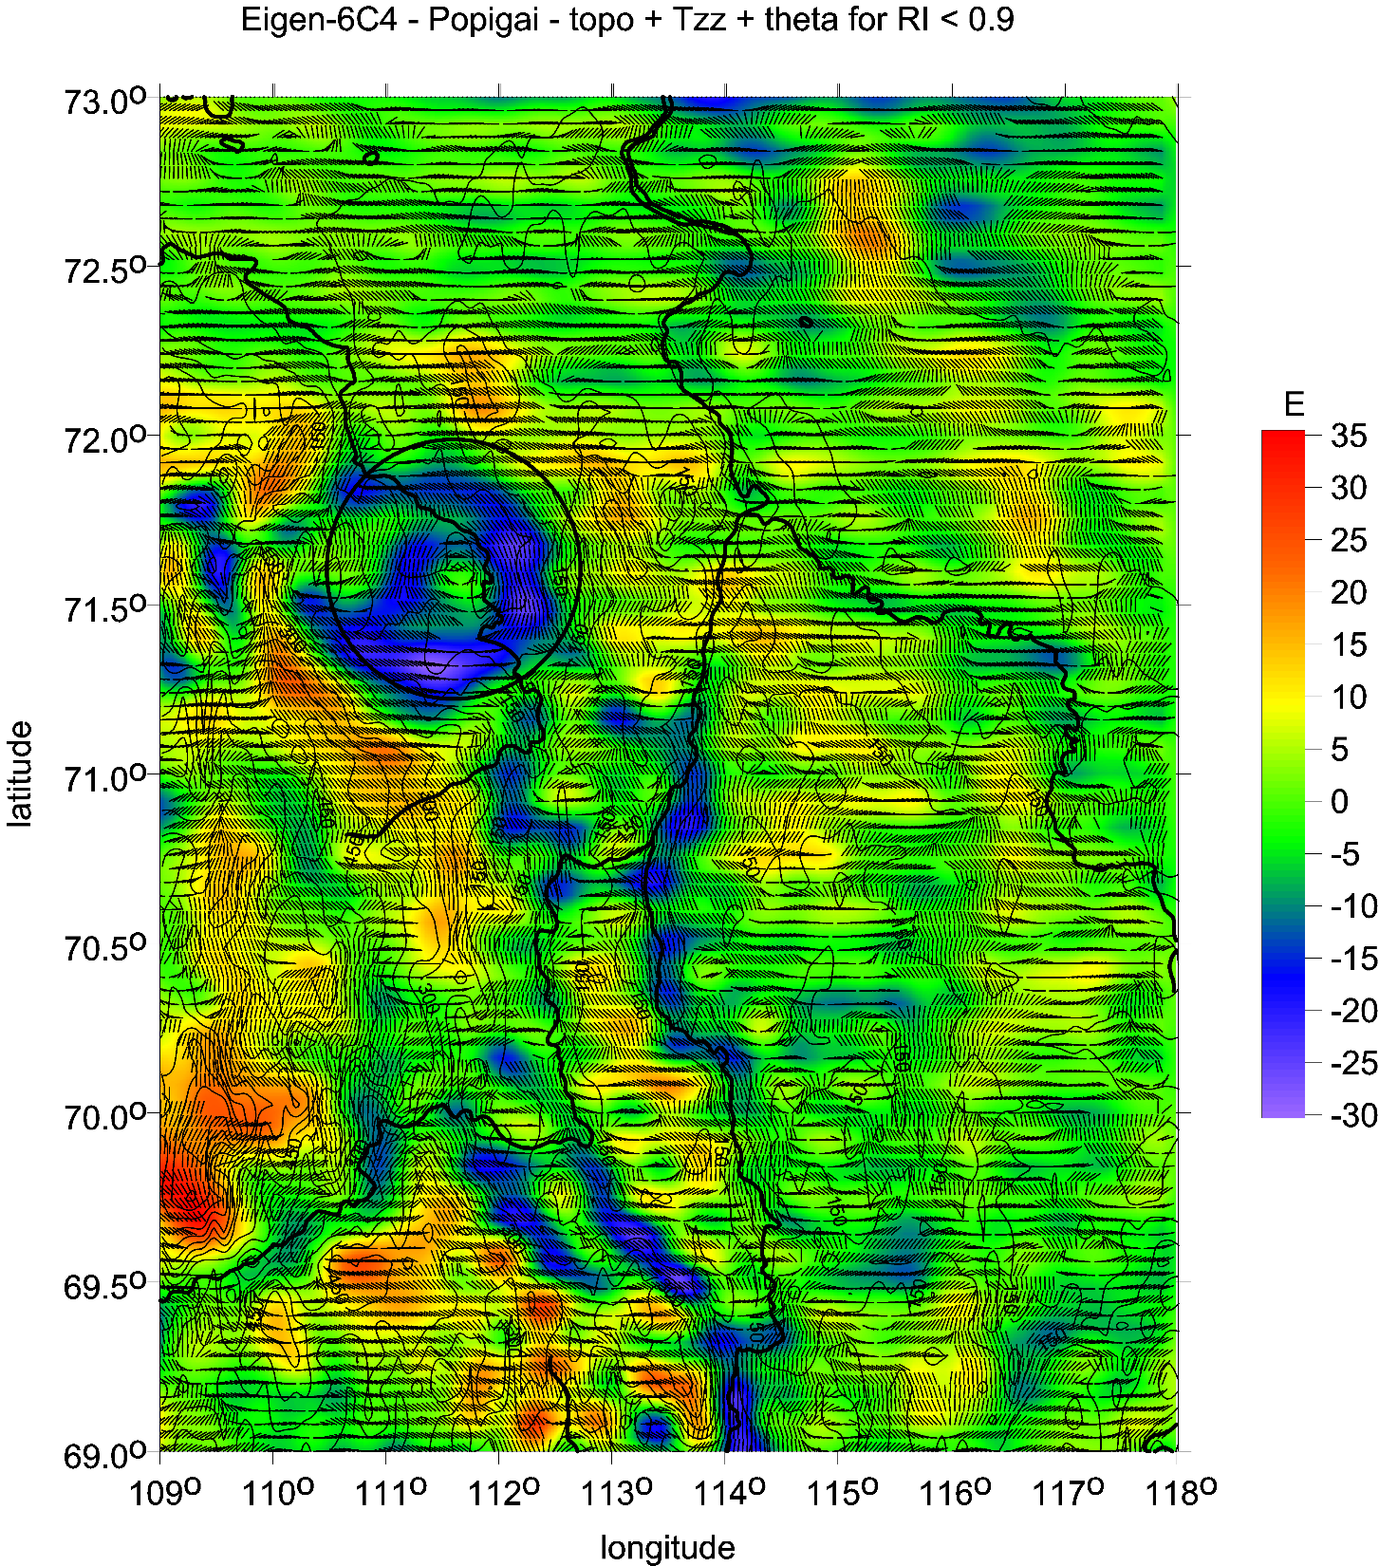
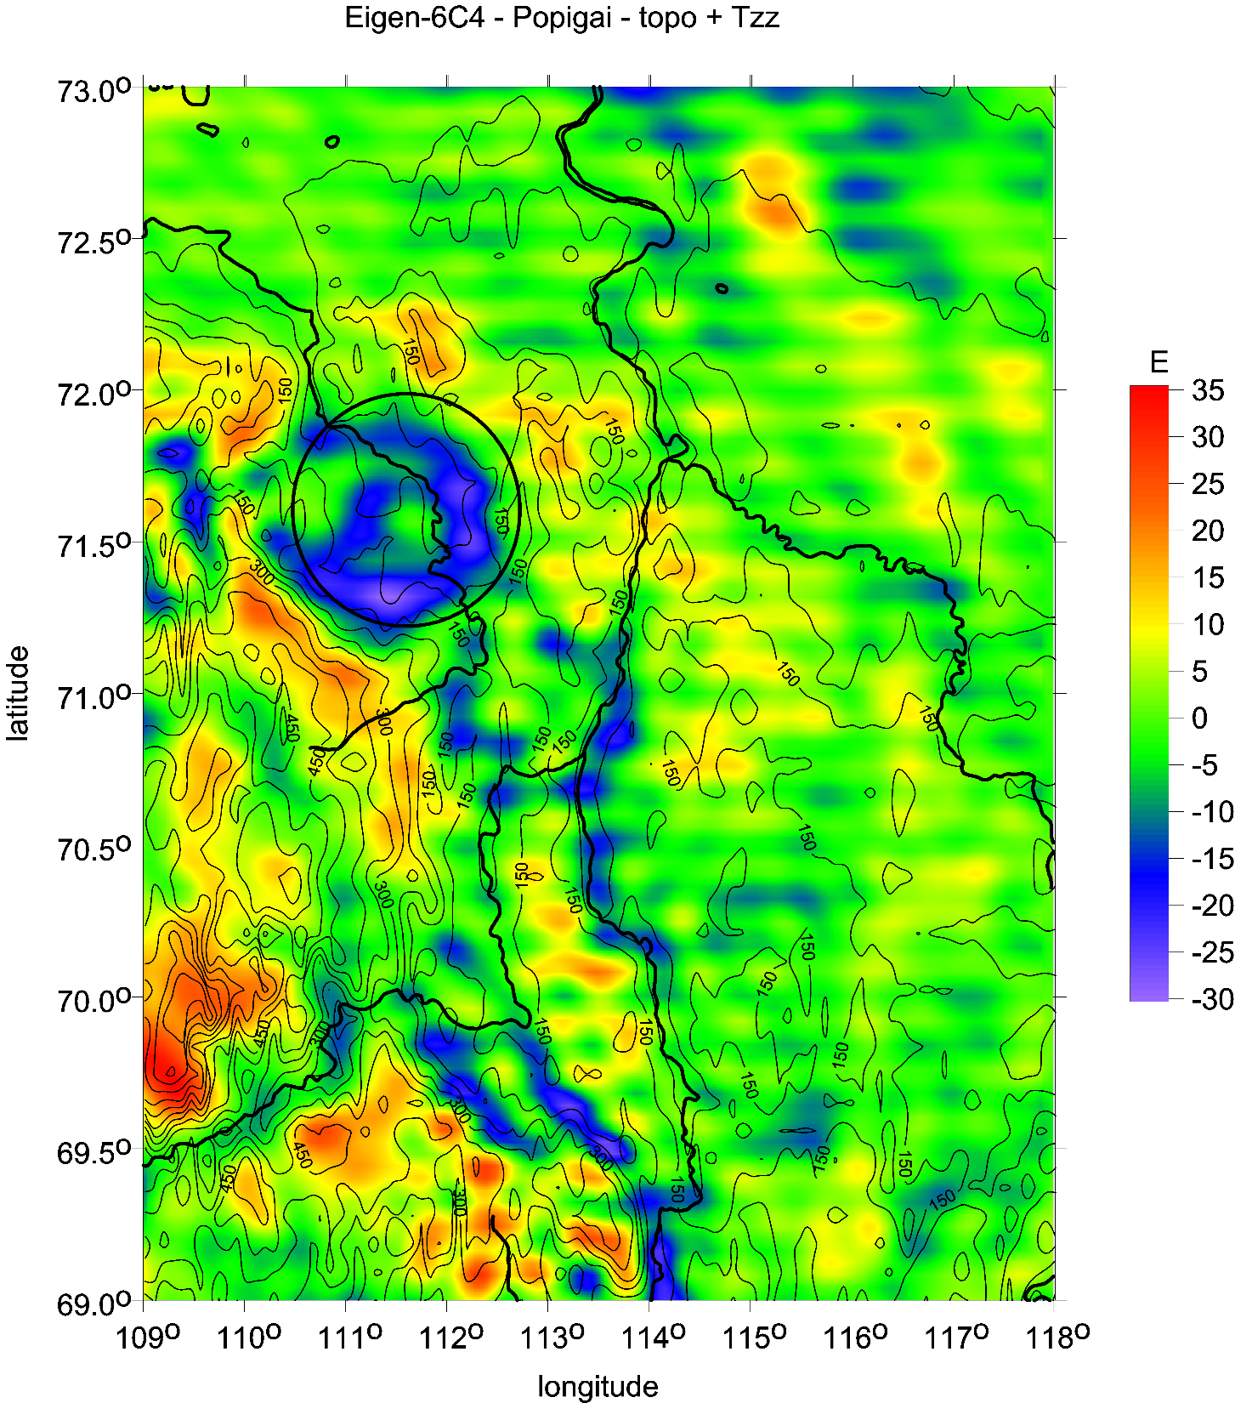

Slide 14
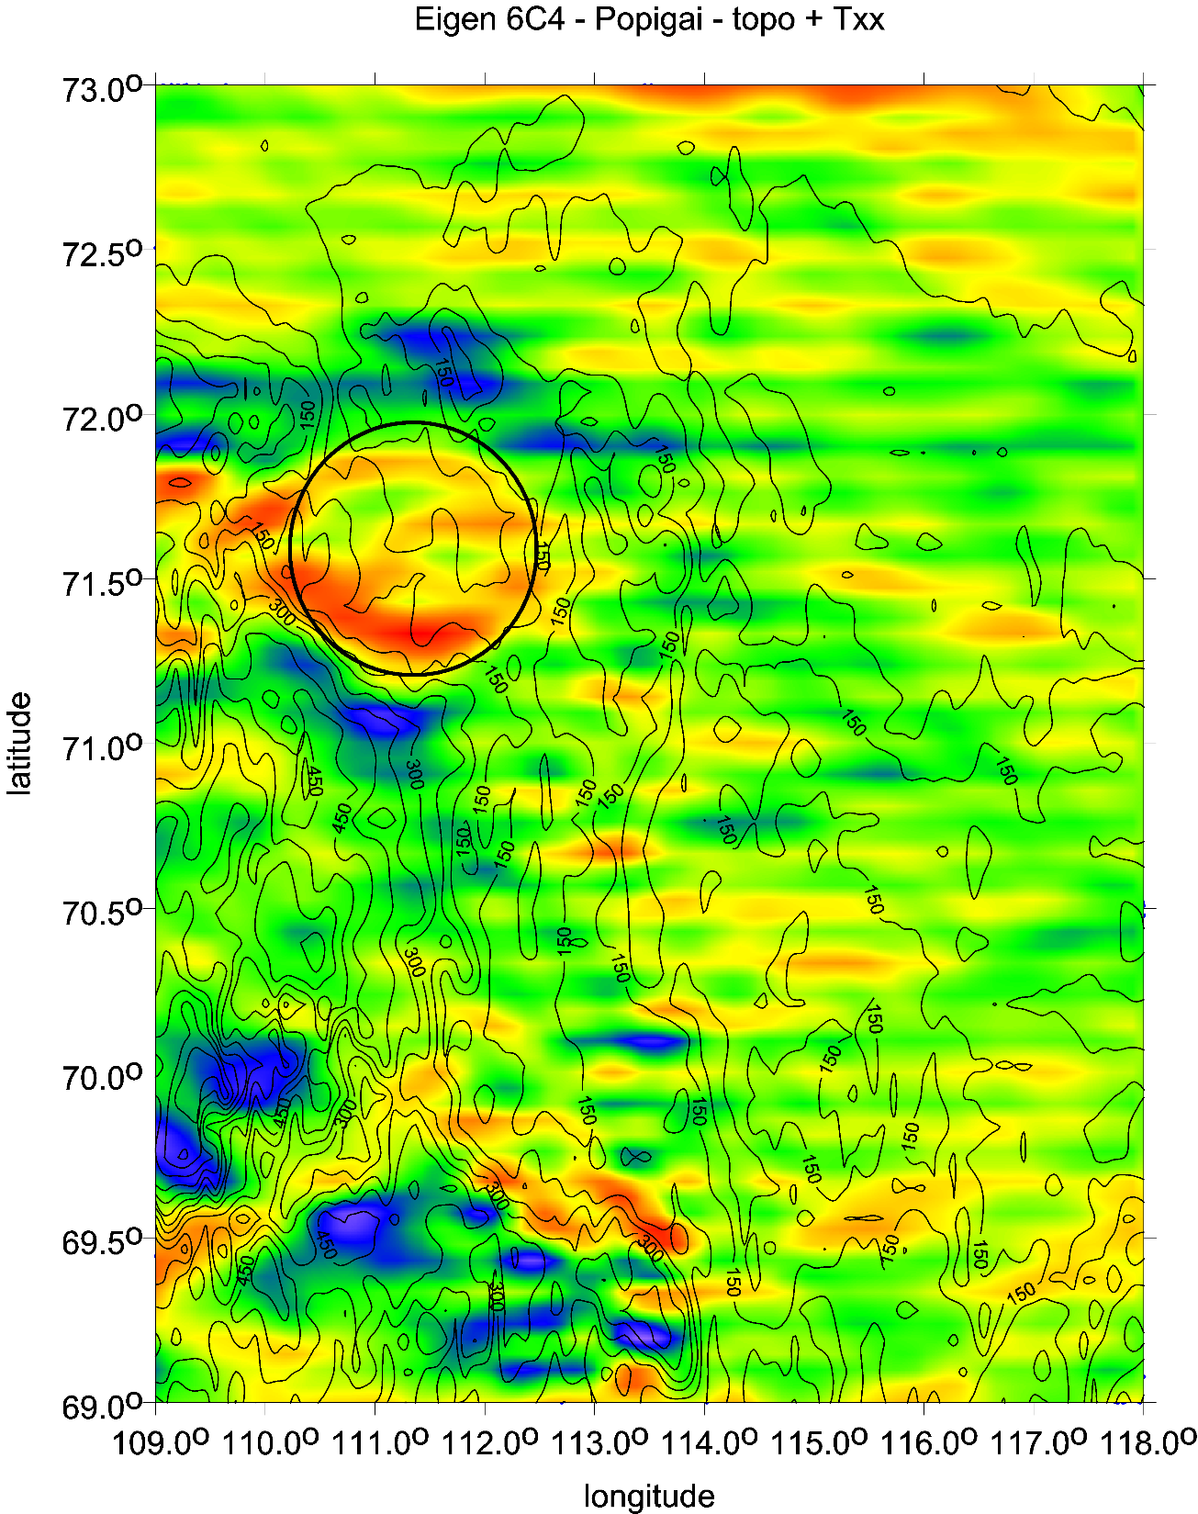

Slide 15
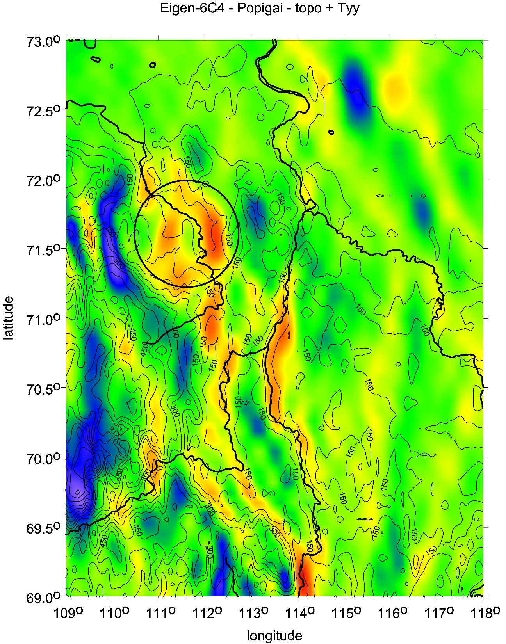

Slide 16
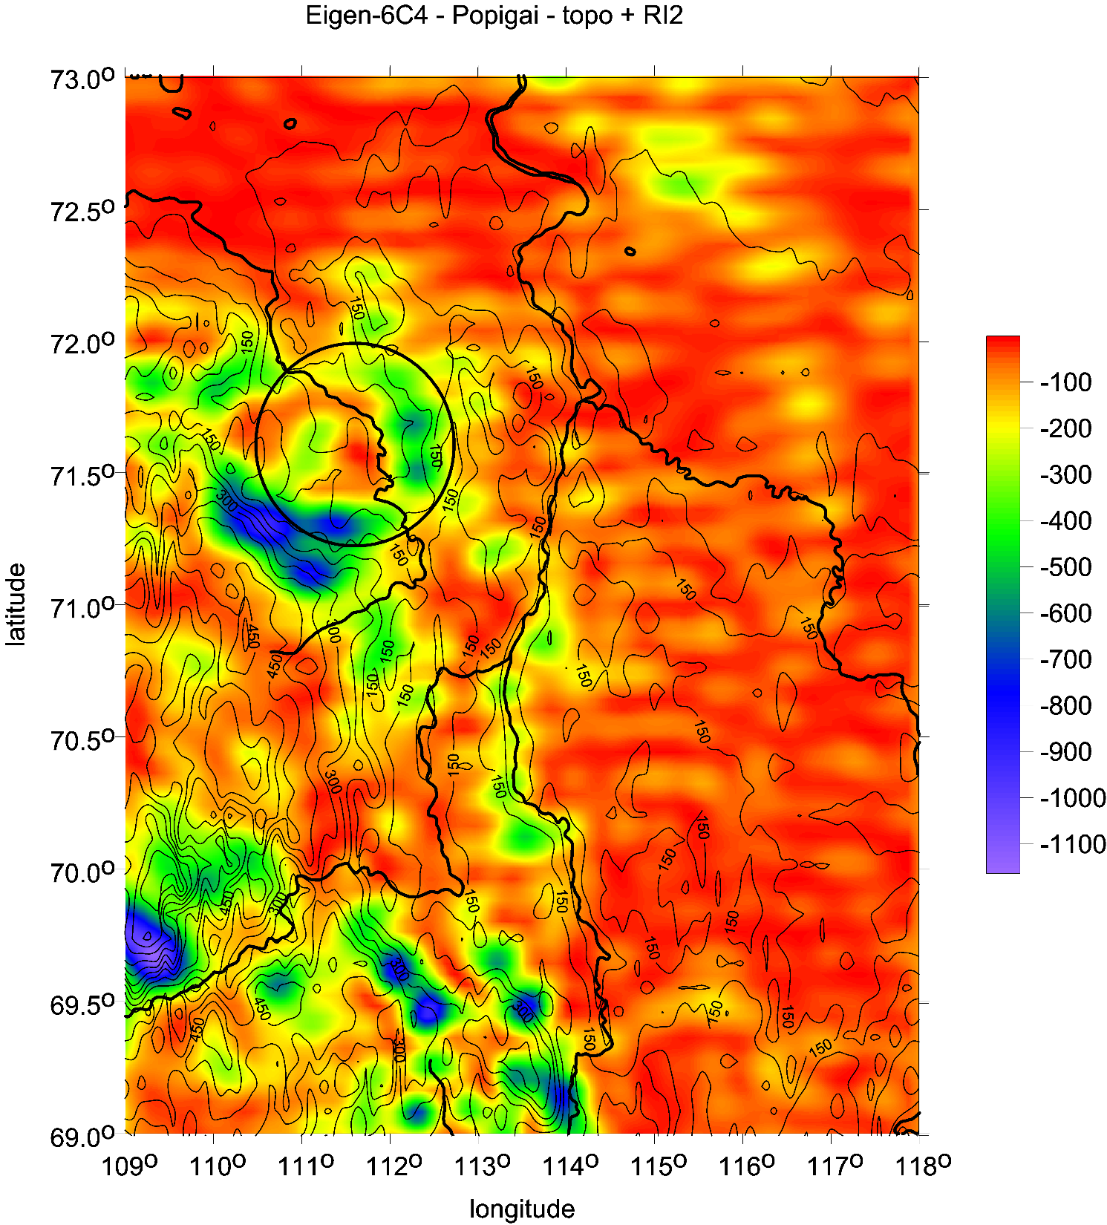

Slide 17
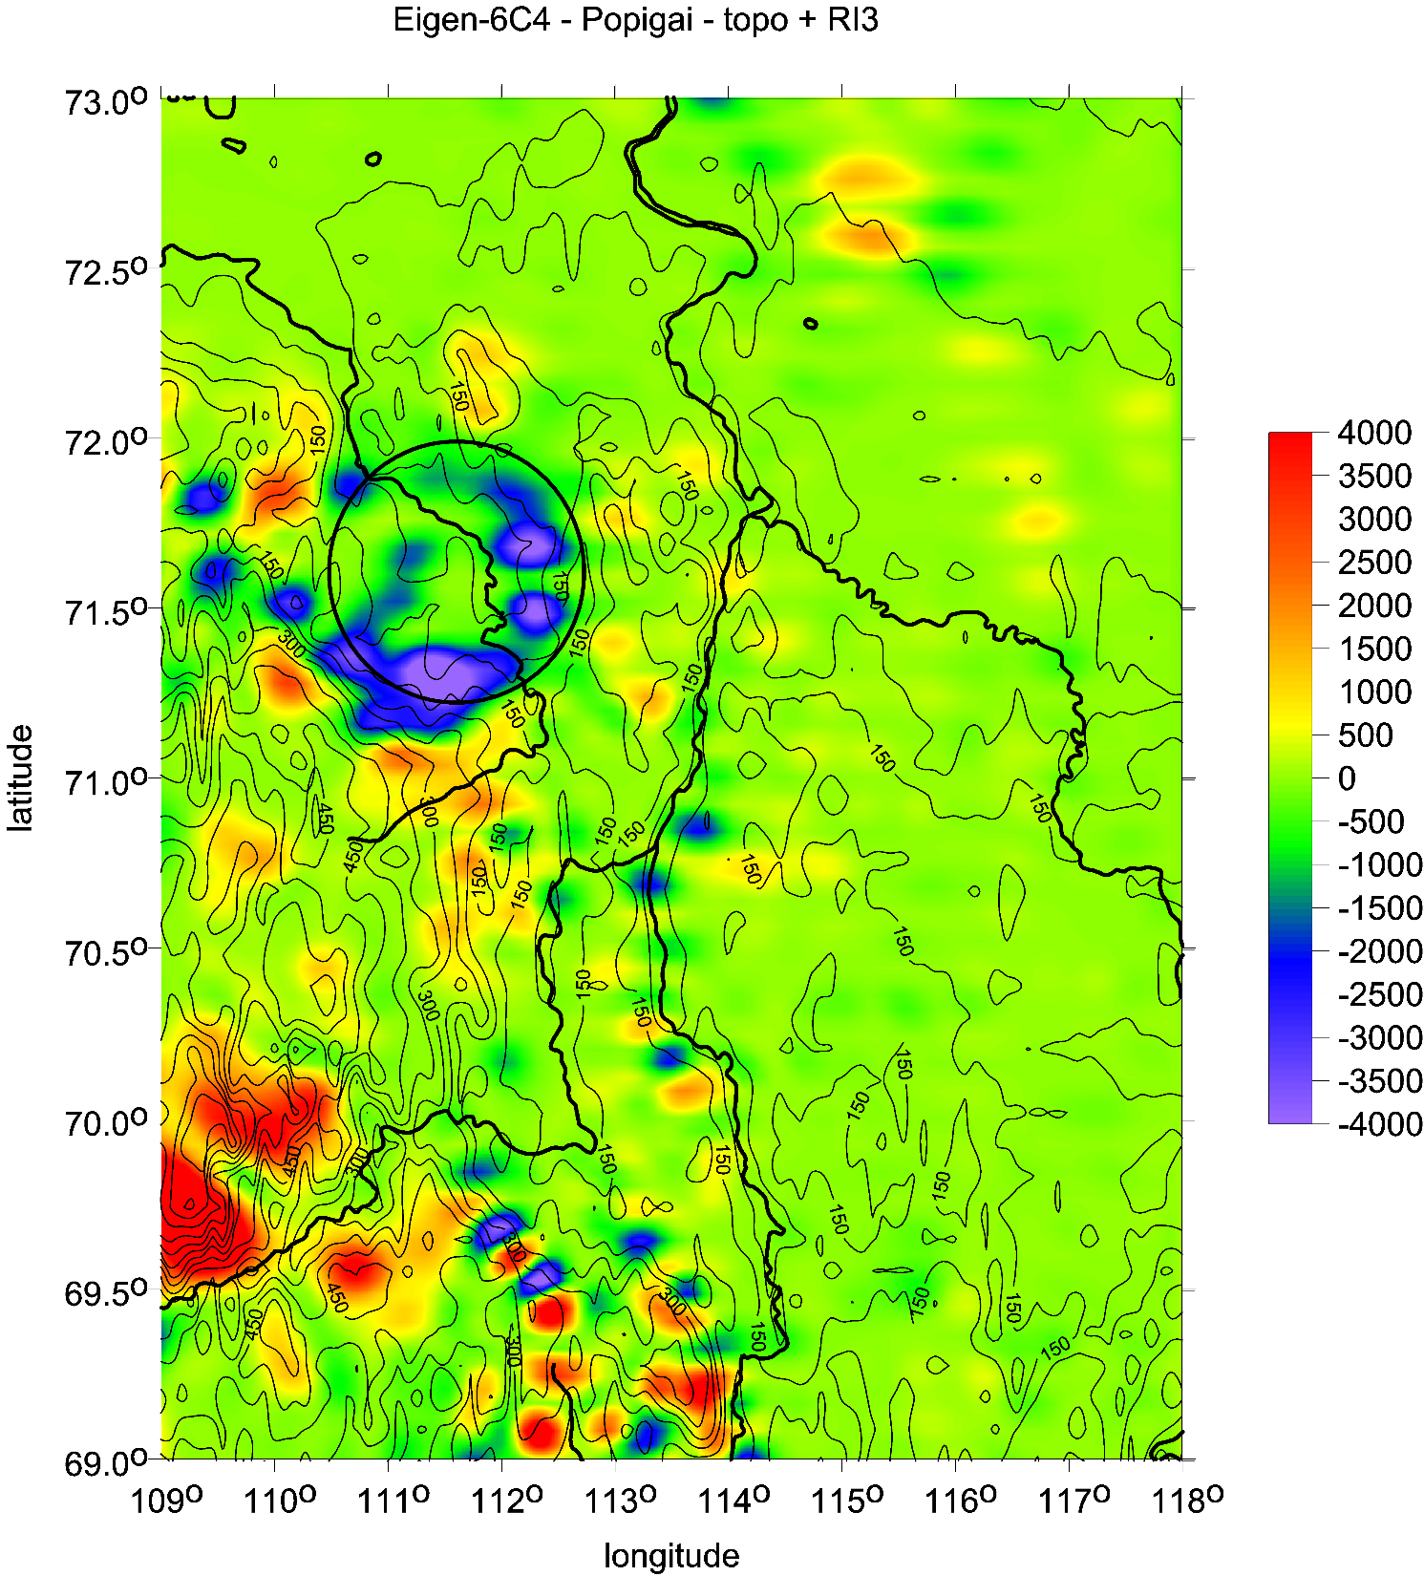

Slide 18
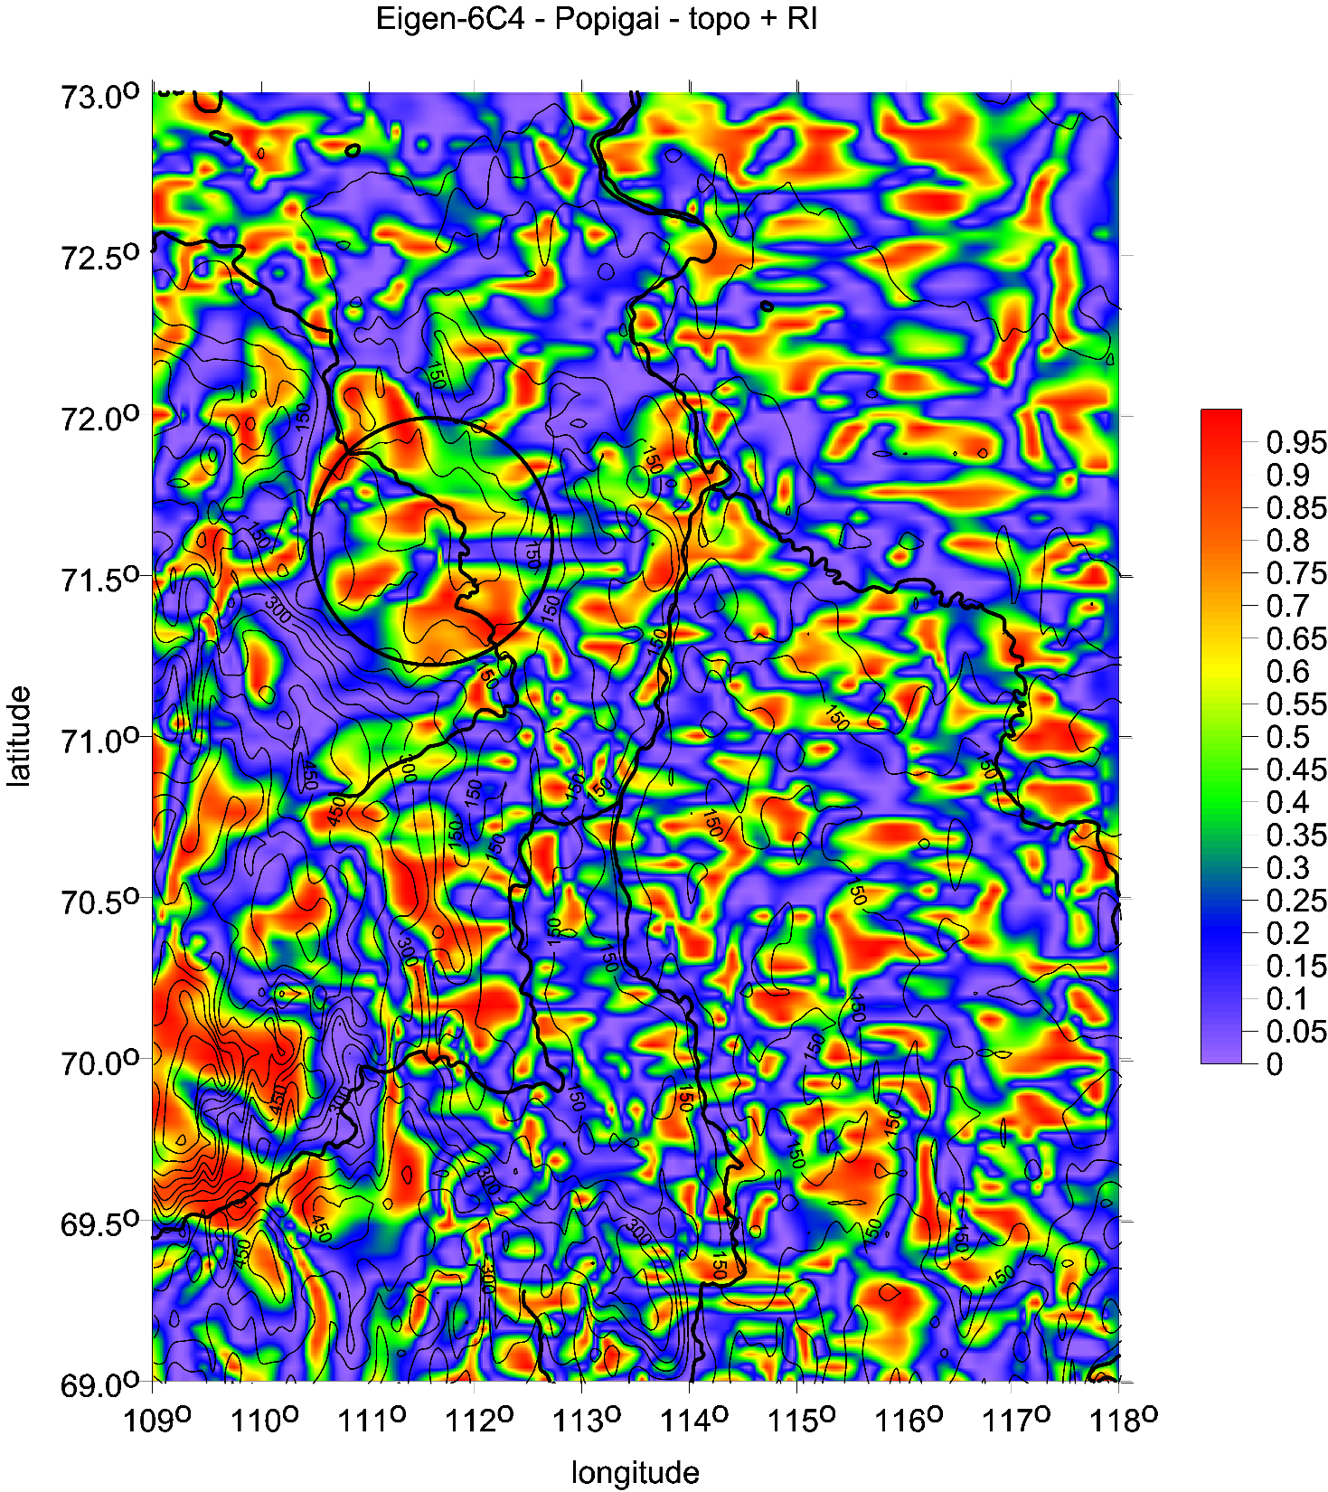

Slide 19
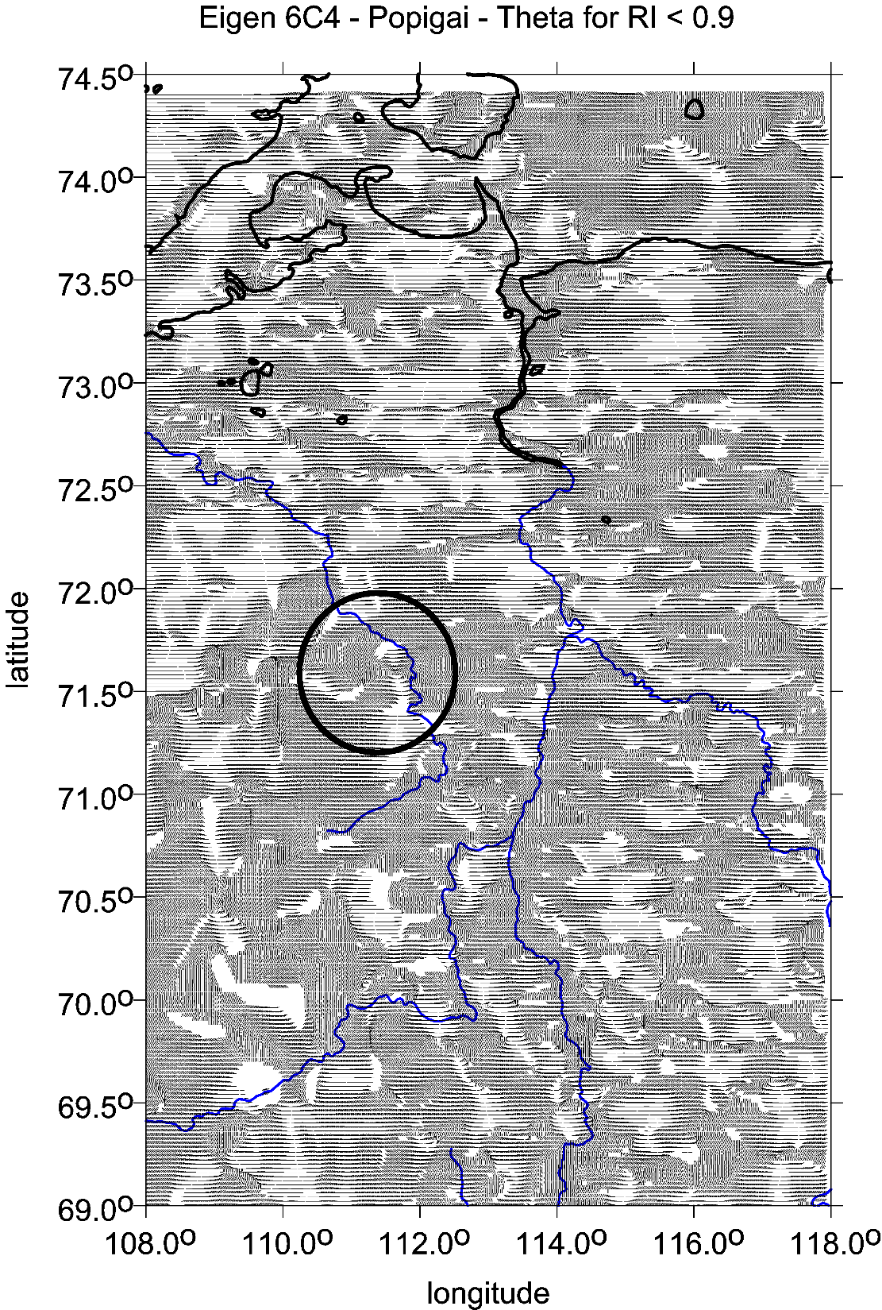
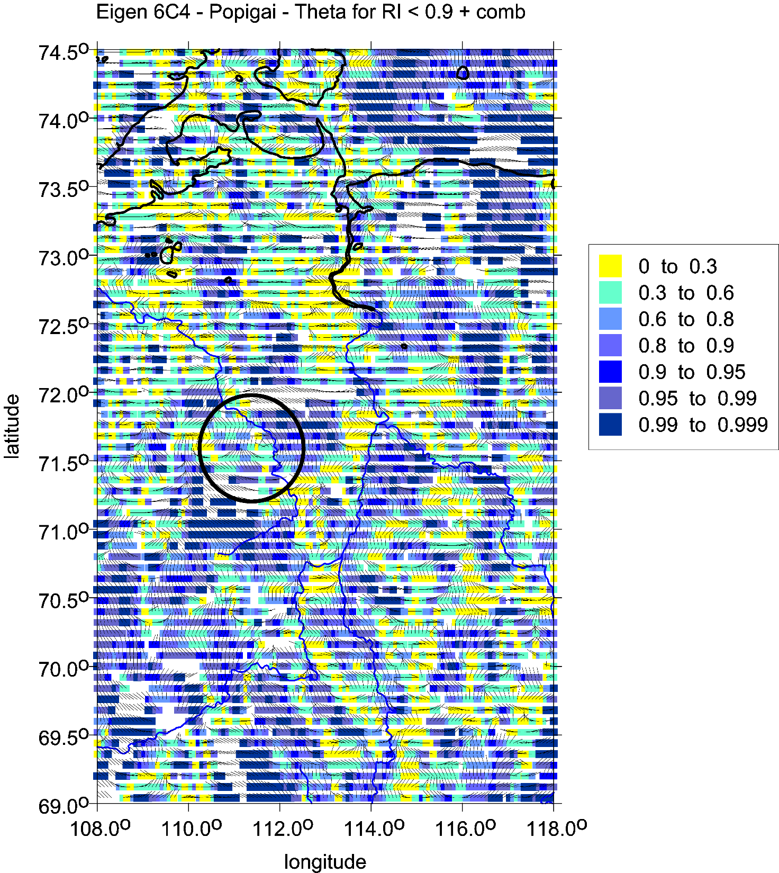

Slide 20
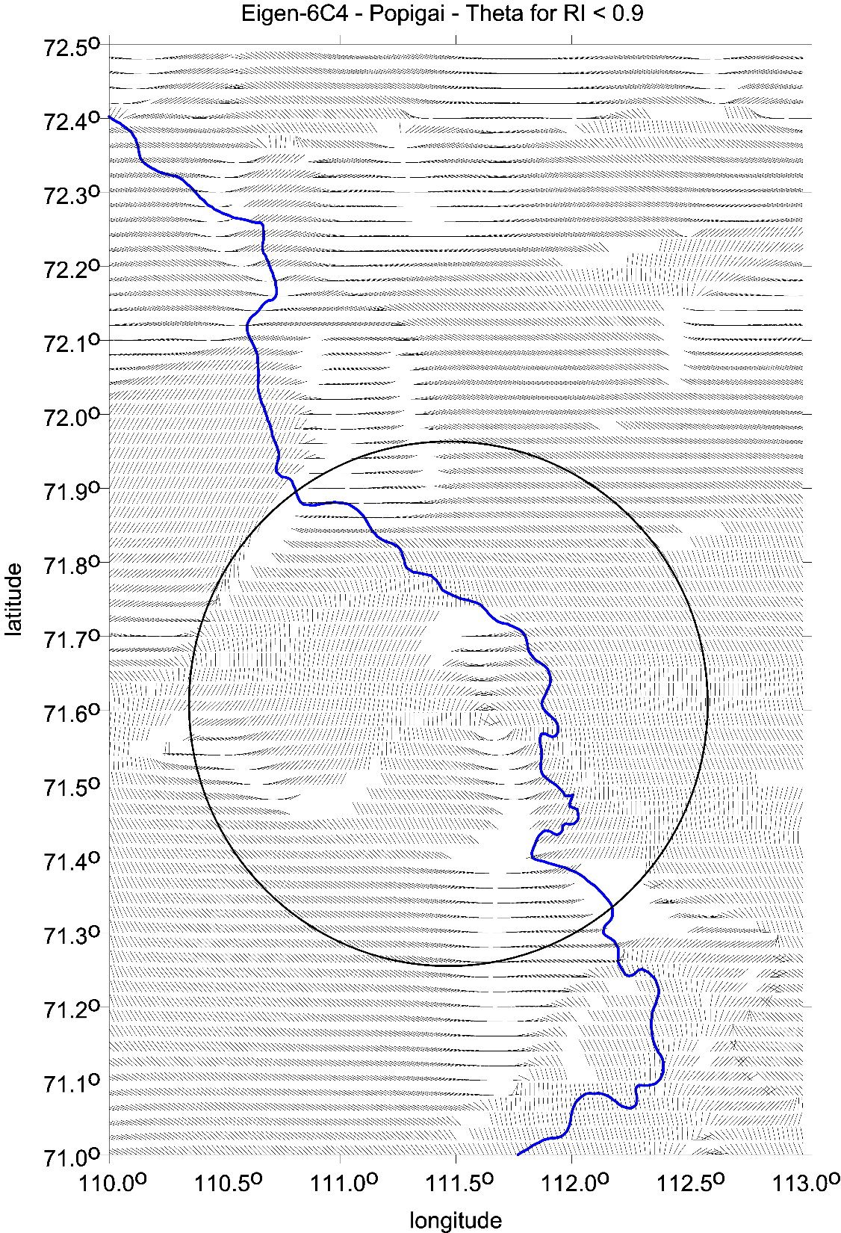
Popigai main crater:
zoom with
the strike angles [deg]
Popigai/Daldyn river (in blue colour)
flowing tru the crater
exposes the impact features

Slide 21
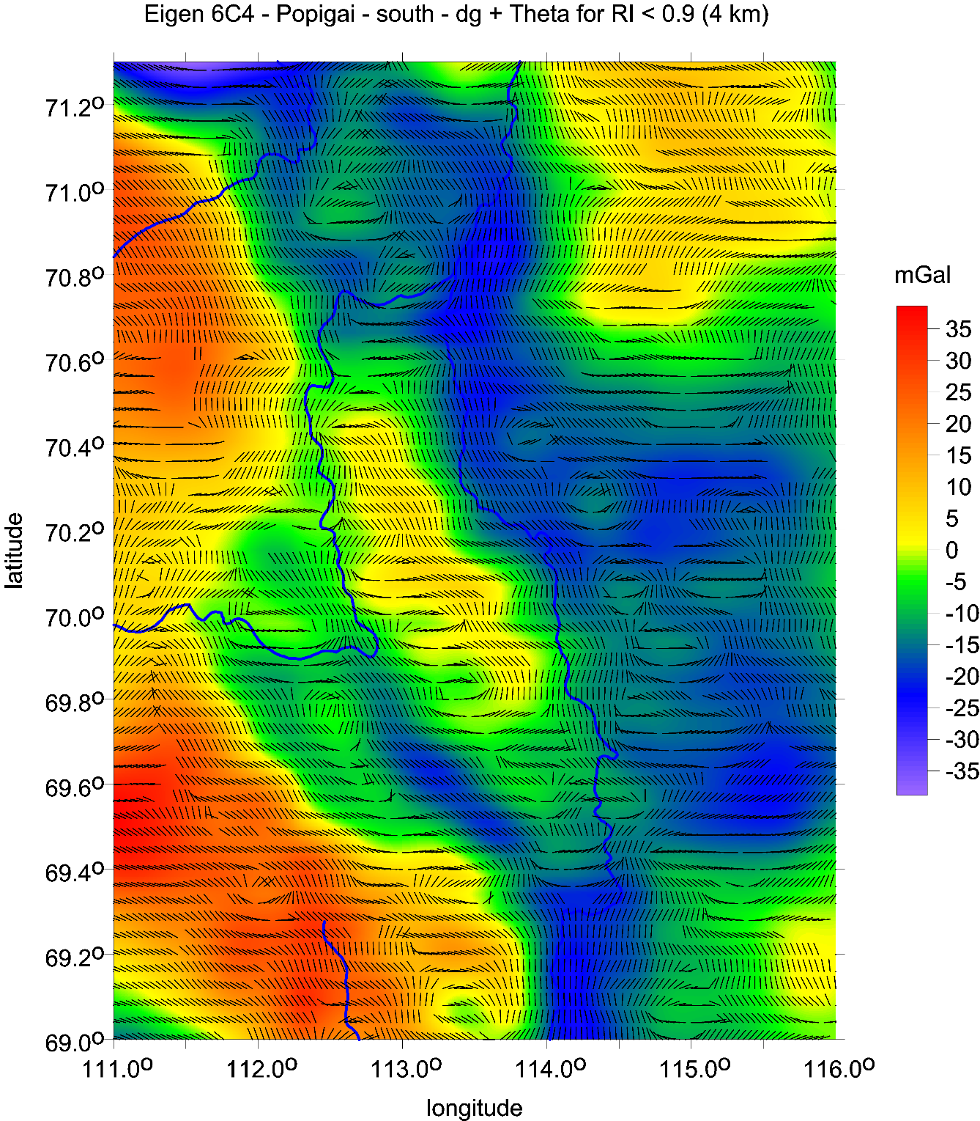
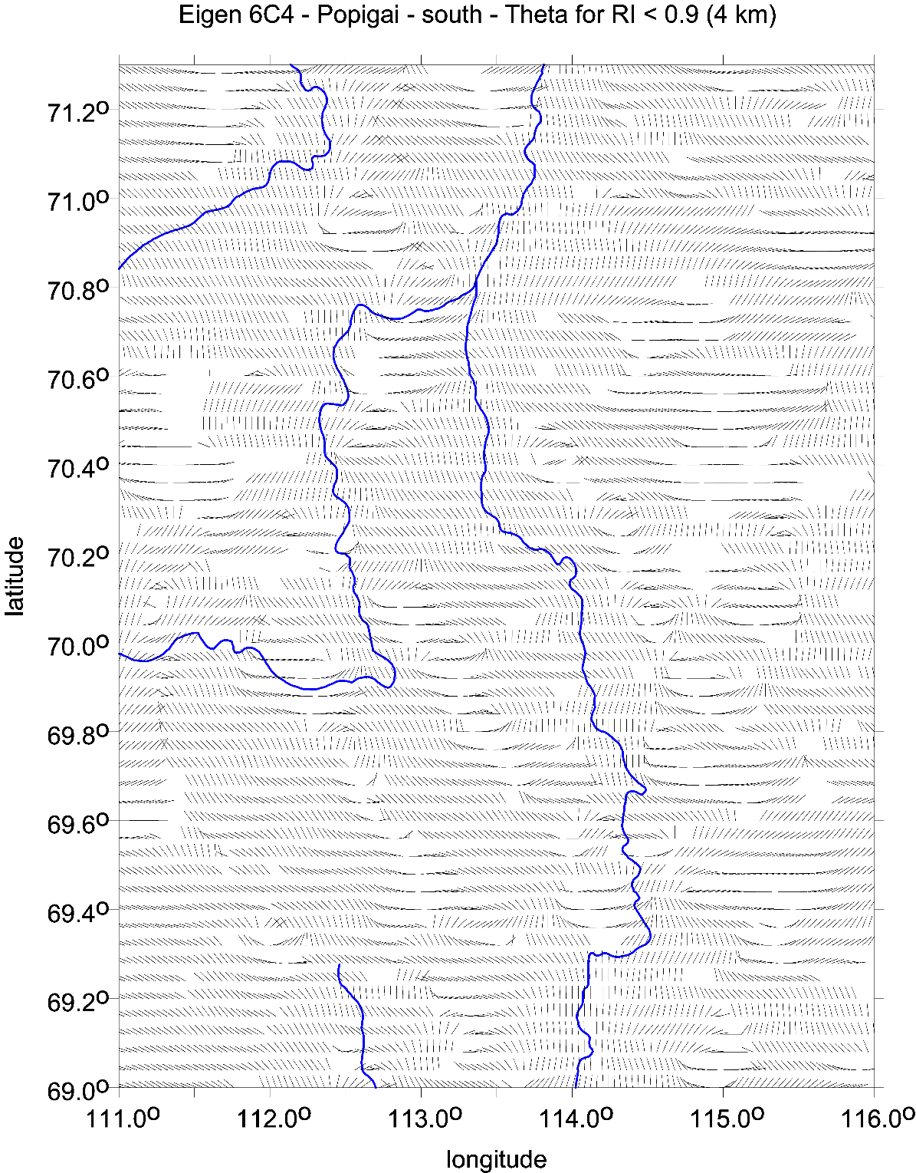
Popigai family
SE part
strike angles
[deg]

Slide 22
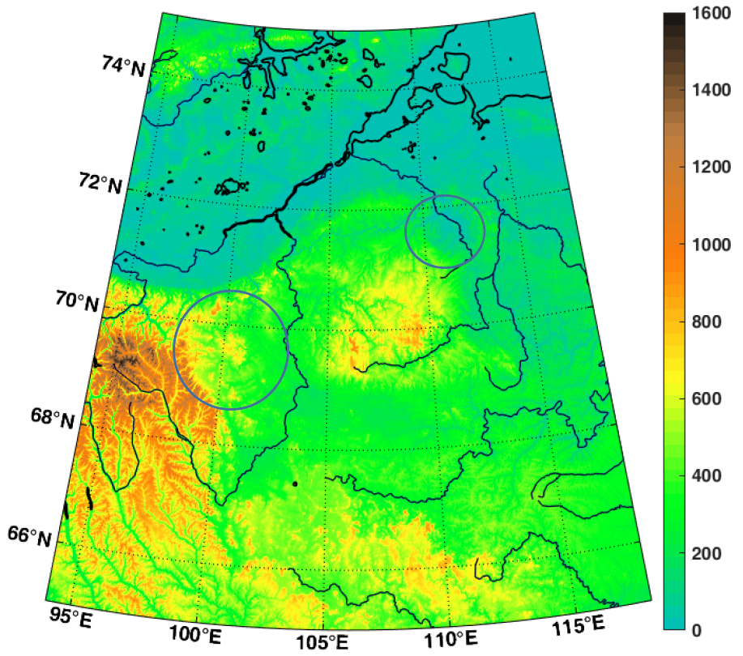
Kotuyakanskaya series, Siberia
near Popigai family
ETOPO 1 topography [m]
References:
Klokočník J, Kostelecký J, Bezděk A, Kletetschka G, Staňková H, 2020.
A 200 km suspected impact crater Kotuykanskaya near Popigai, Siberia,
in the light of new gravity aspects from EIGEN 6C4, and other data.
Scientific Reports (Nature) 10, 6093. https://doi.org/10.1038/s41598-020-62998-6.
Presentace:
Klokočník J, Kostelecký J, Bezděk A, Kletetschka G, Staňková H, 2020.
Detection of 200 km suspected impact crater Kotuykanskaya near Popigai,
Siberia, by new gravity aspects from EIGEN 6C4, and magnetic data from EMAG 2.
11th Planetary Crater Consortium, Honolulu, Hawaii.

Slide 23
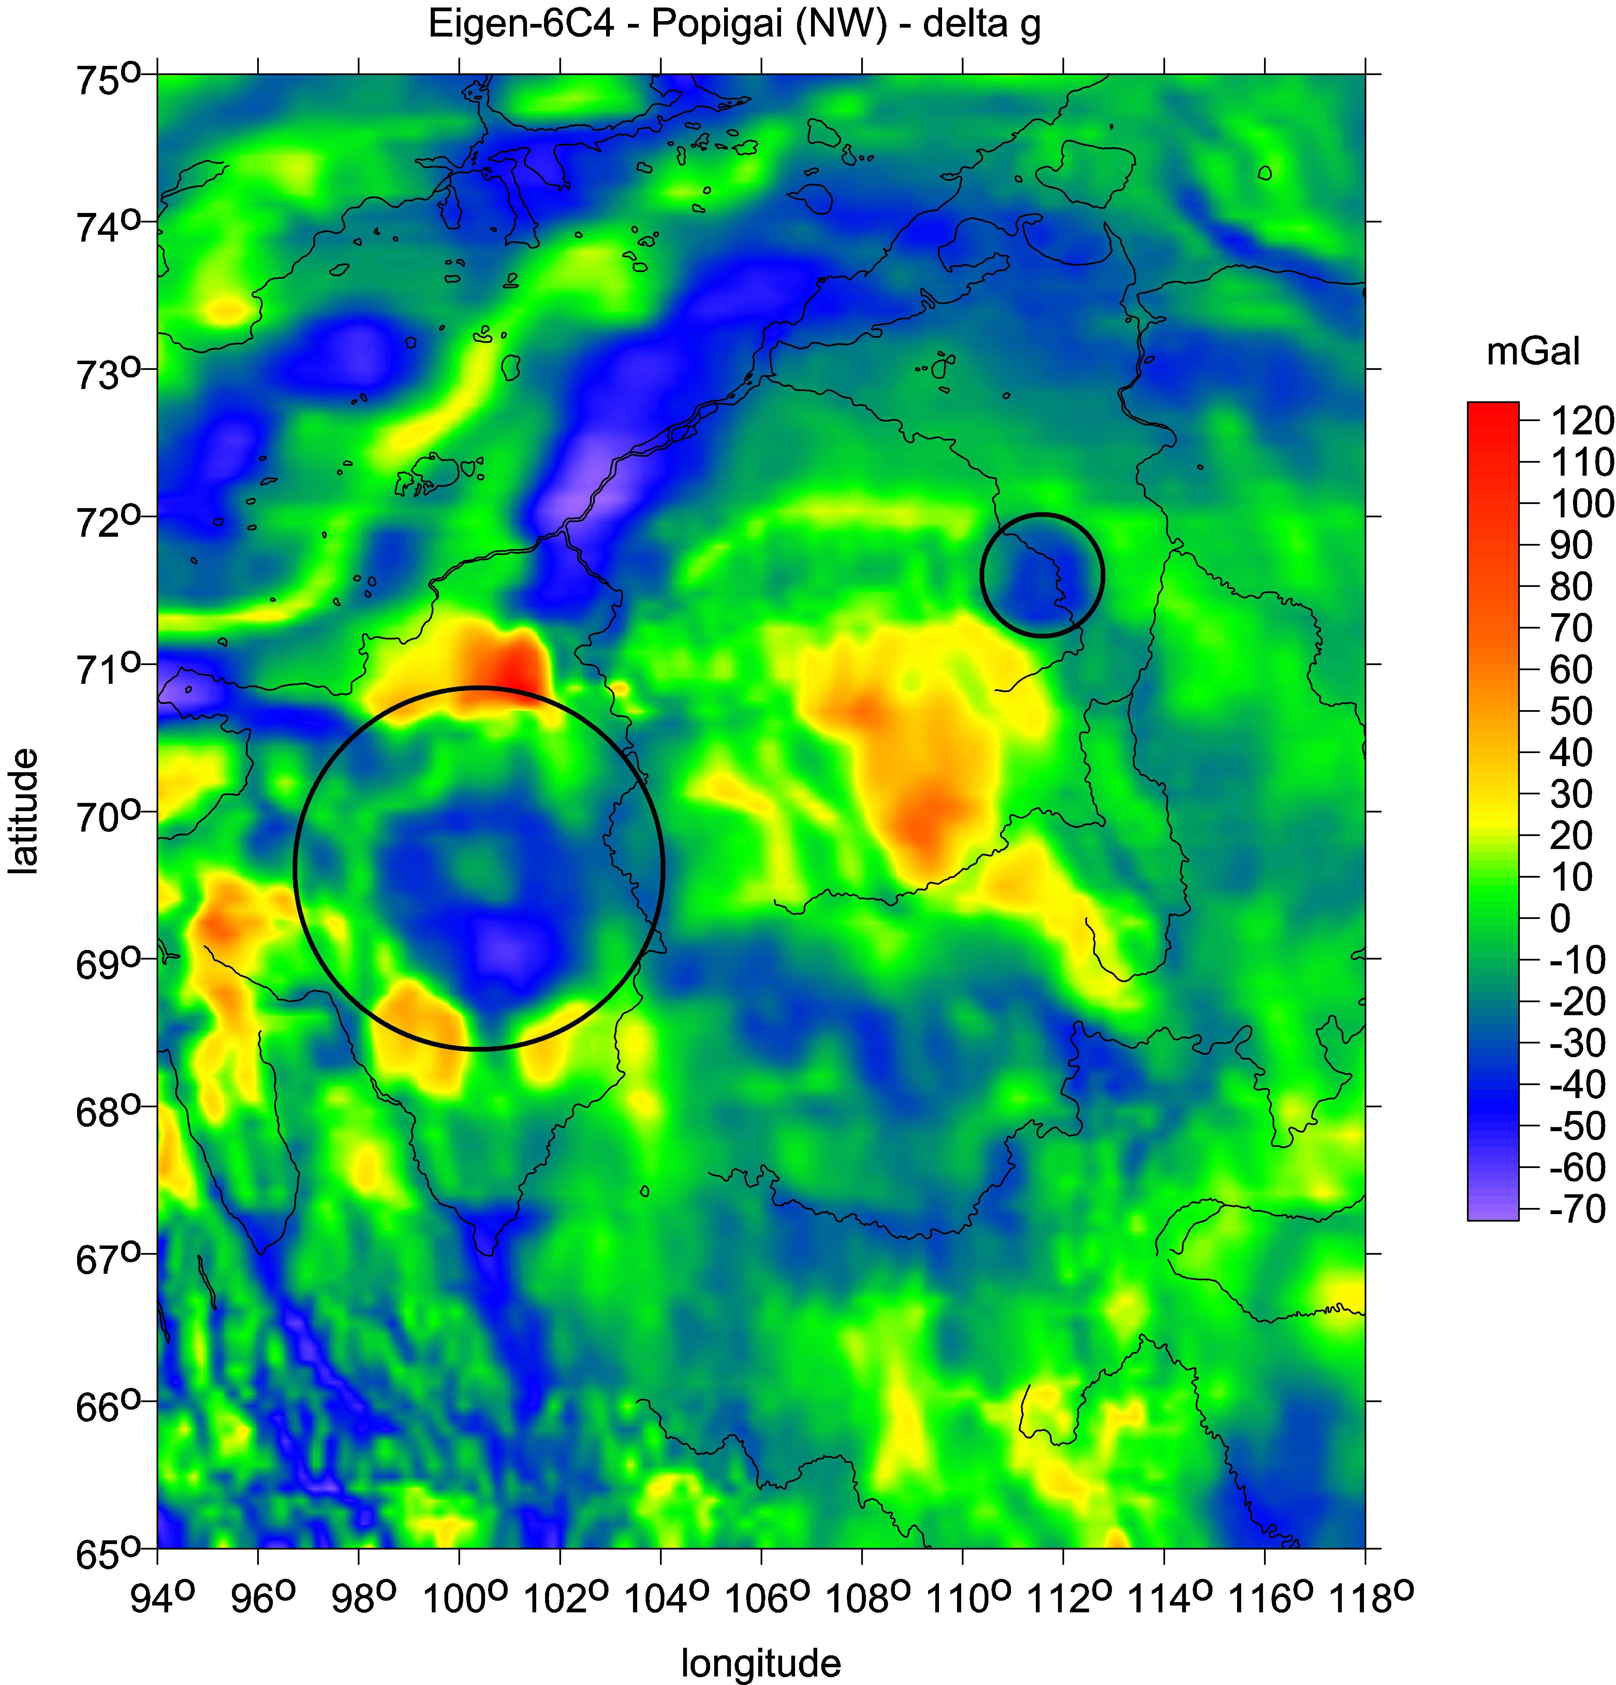
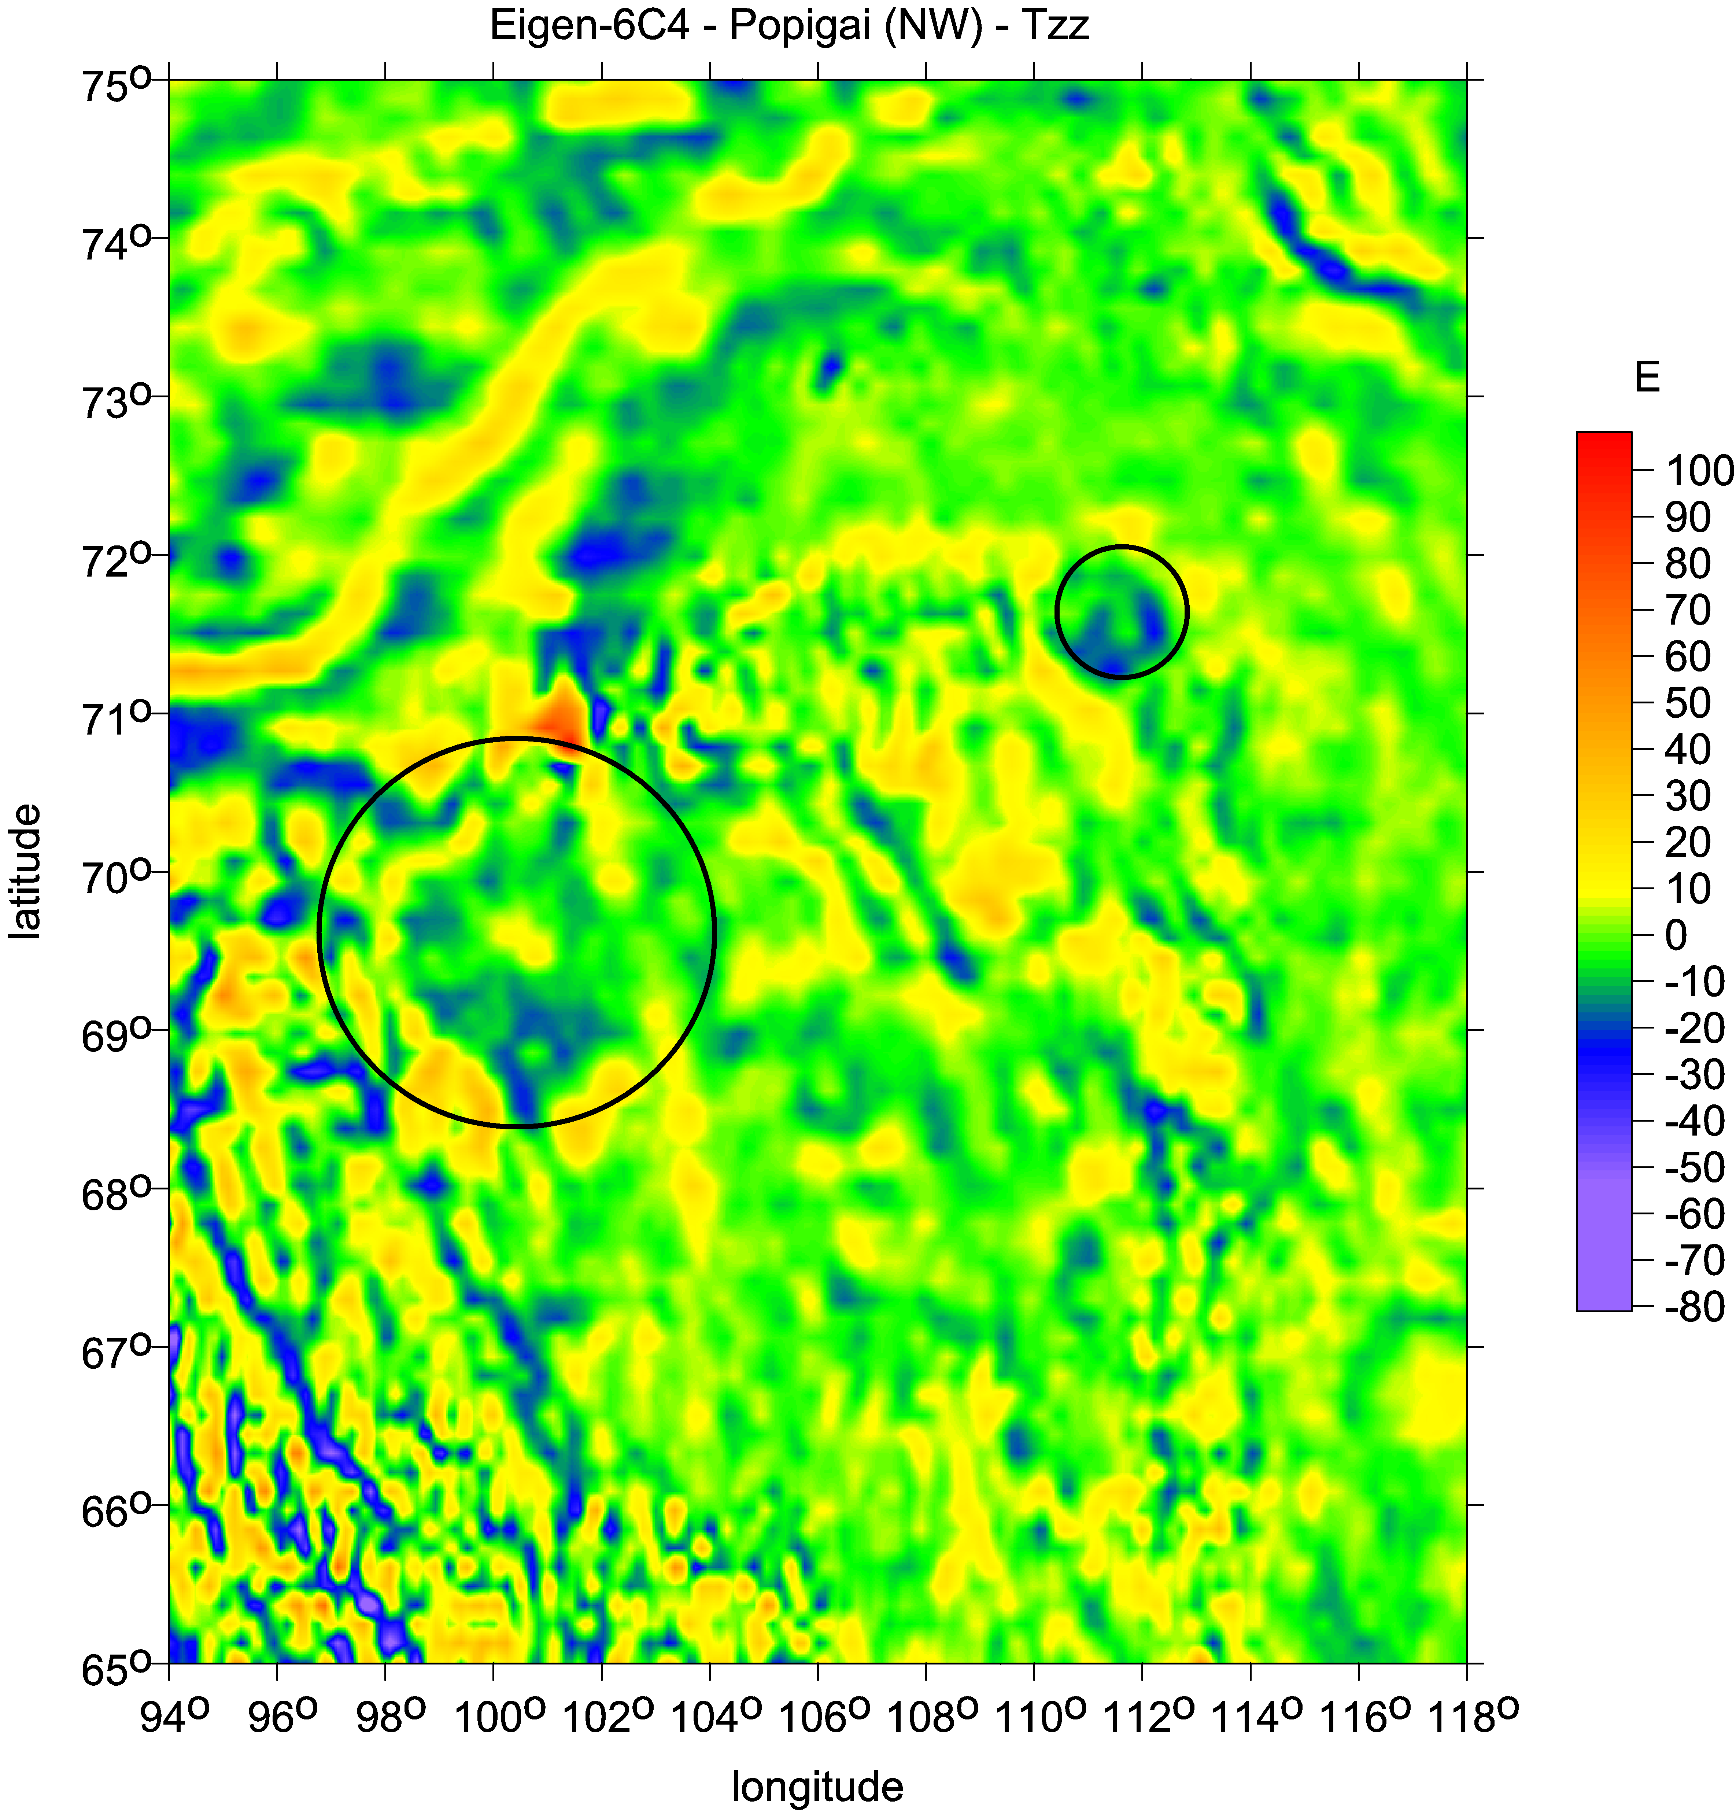
Kotuyakanskaya Popigai

Slide 24
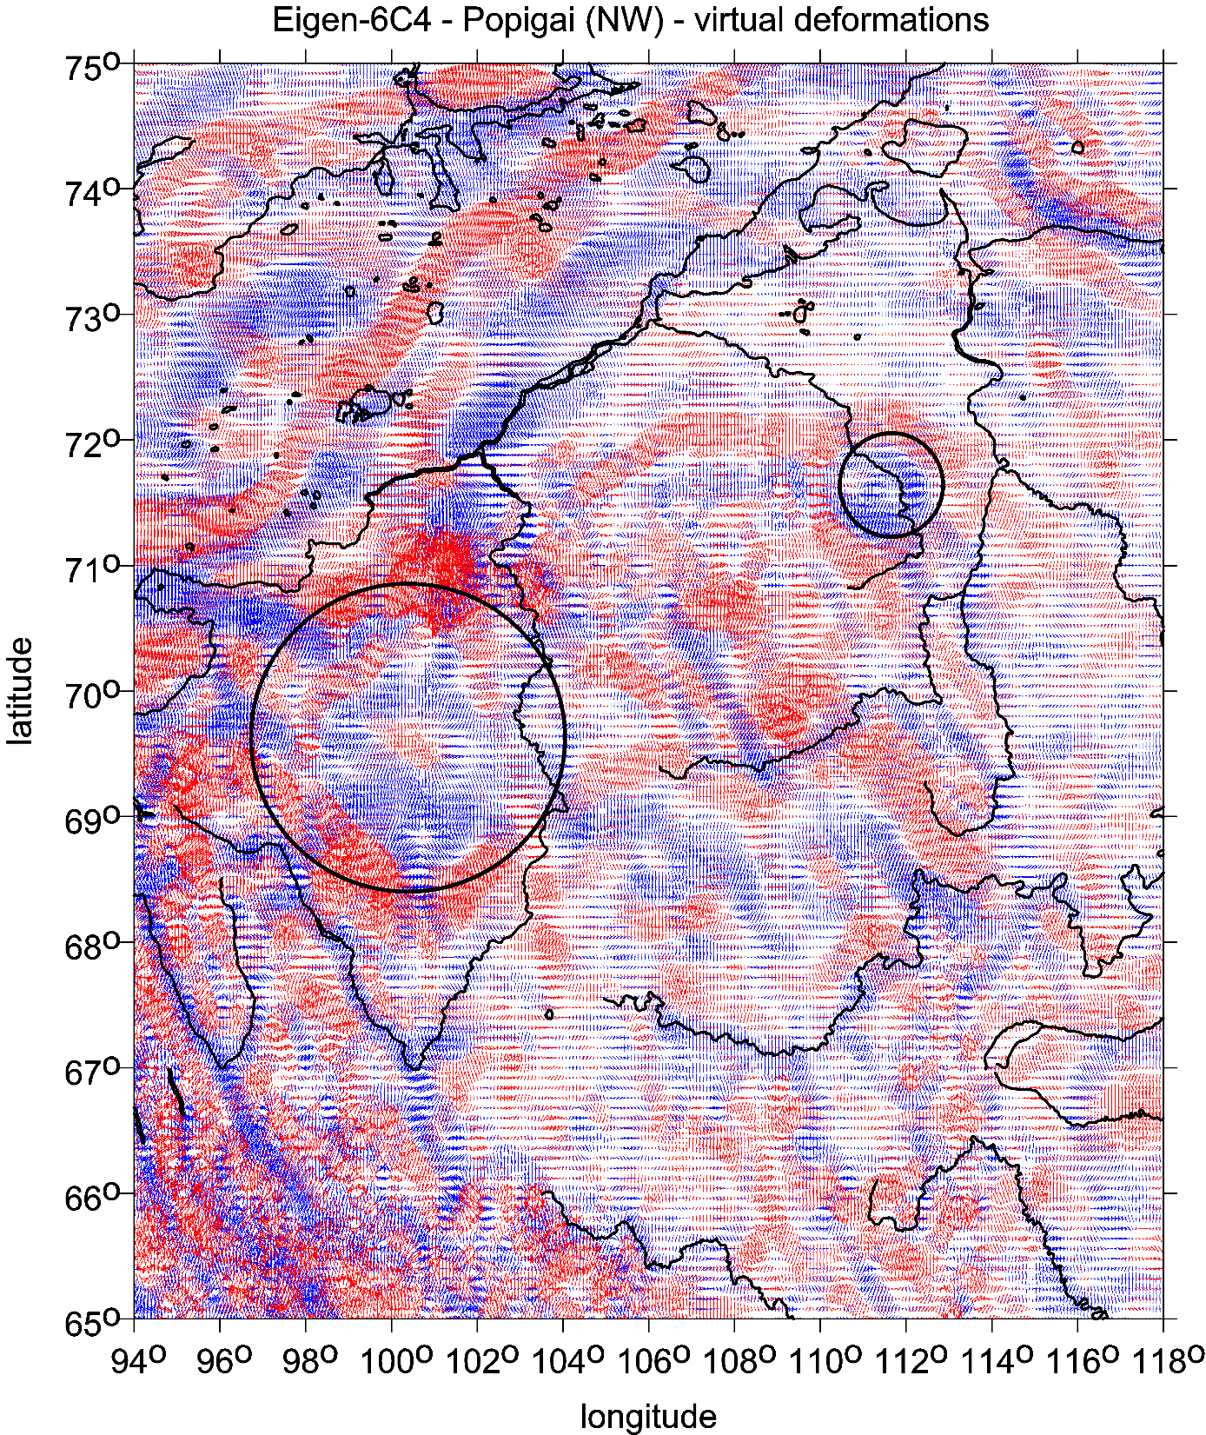
Kotuyakanskaya series
near Popigai family
virtual deformations

Slide 25
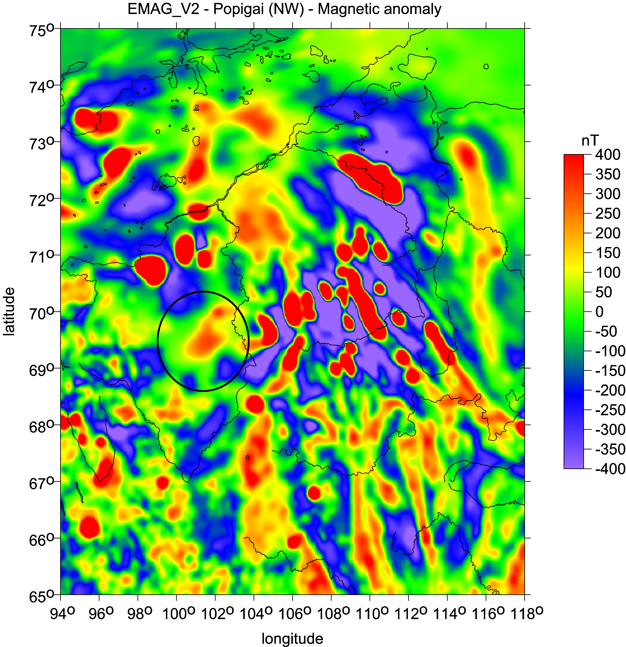
Kotuyakanskaya
near Popigai family
magnetic intensities [nT]

Slide 26
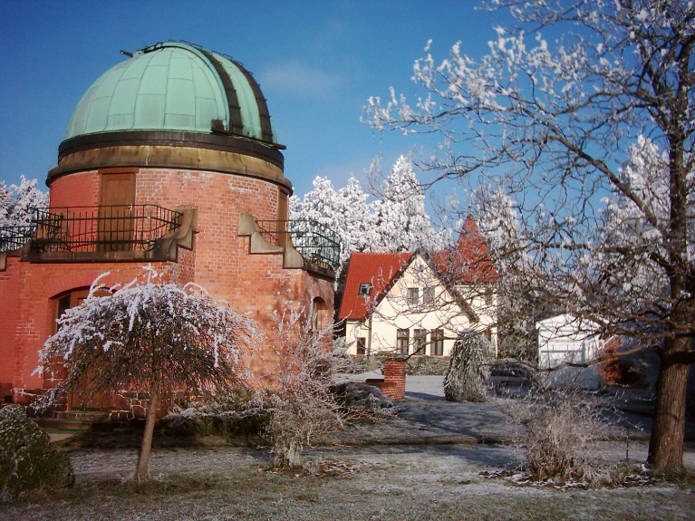
www/asu.cas.cz/~jklokocn
jklokocn@asu.cas.cz
The End of S3

