Slide 1



Antarktida Co družicová gravitační a další data prozrazují o tom, co je našim zrakům ukryto pod ledem Antarktidy Jaroslav Klokočník a kolektiv: Jan Kostelecký, Aleš Bezděk, Blažej Bucha a Ivan Pešek konzultace: Christoph Foerste, Nikolaos Pavlis, Hamish D. Pritchard, Carl A. Wagner, Václav Cílek, Lev Eppelbaum, C. K. Shum a další stáhnutelné z www.asu.cas.cz/~jklokocn/ANTARKTIDA
Notes:
Satellite dynamics (…) and physical geodesy, use of their theory and numerical results s/c….

Slide 2
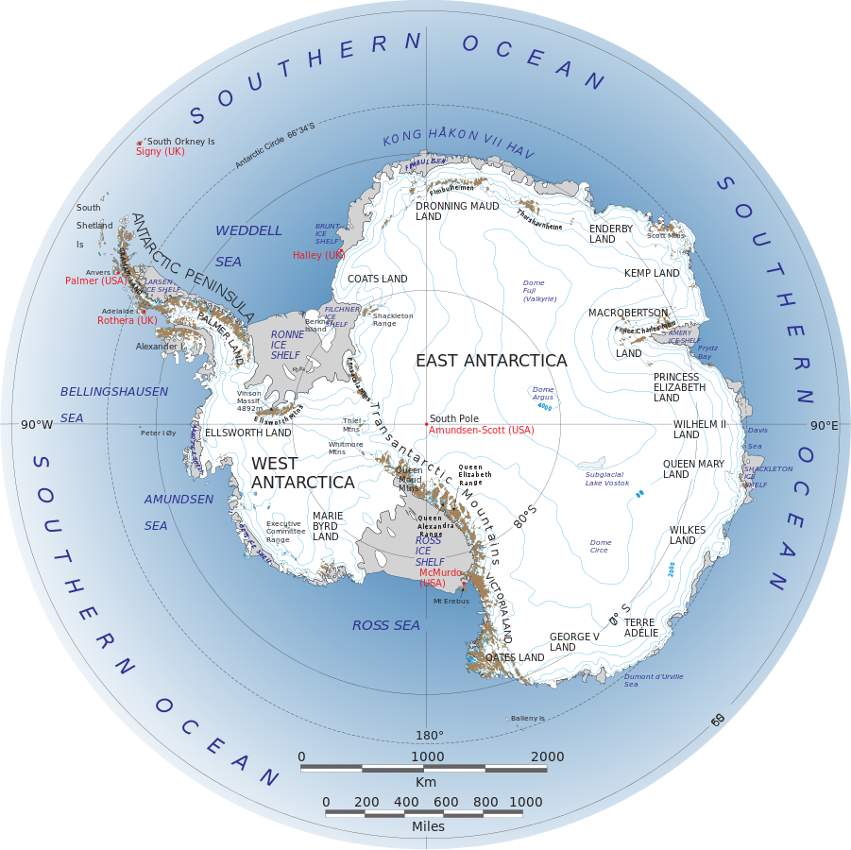

Slide 3
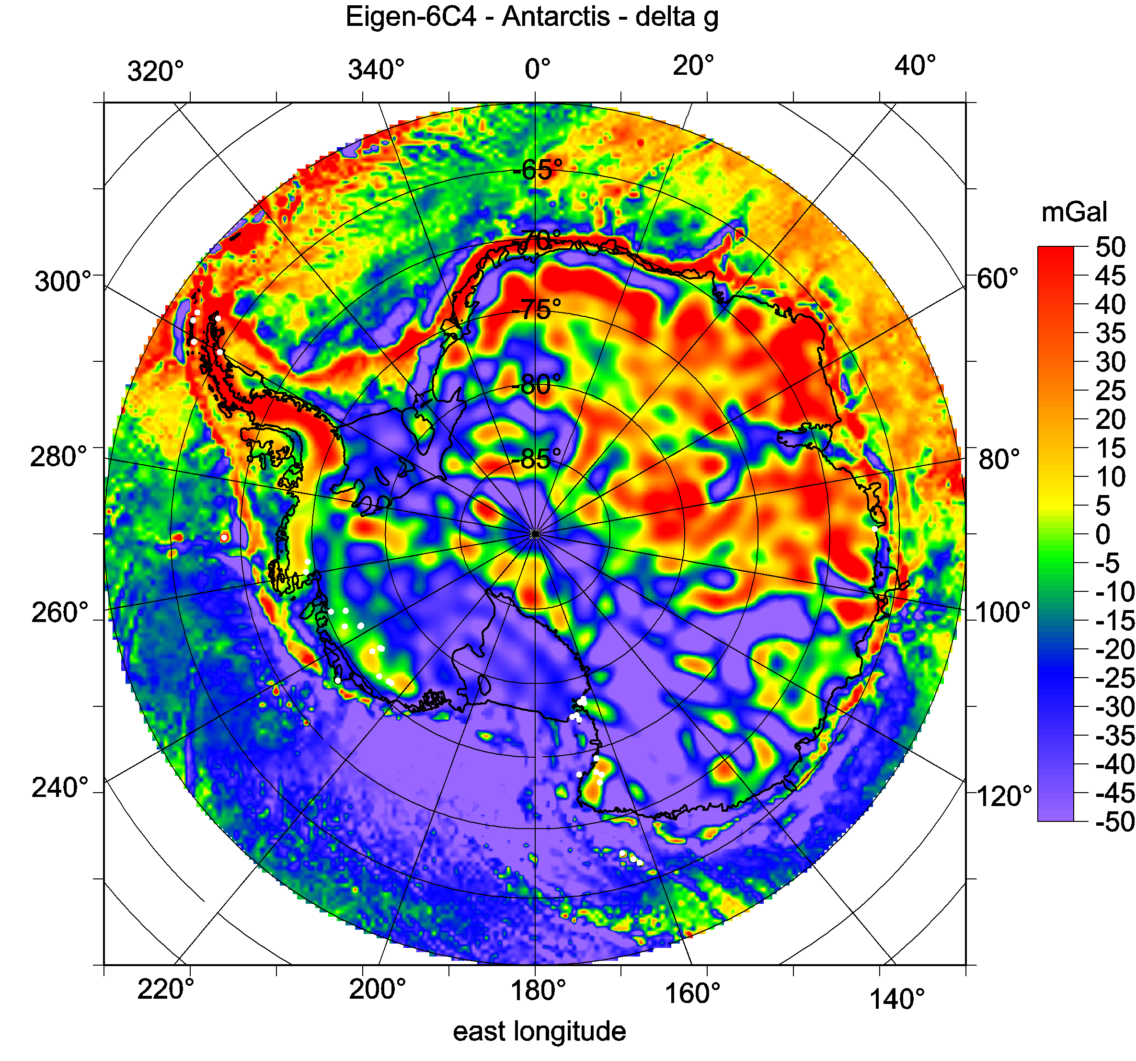

Slide 4
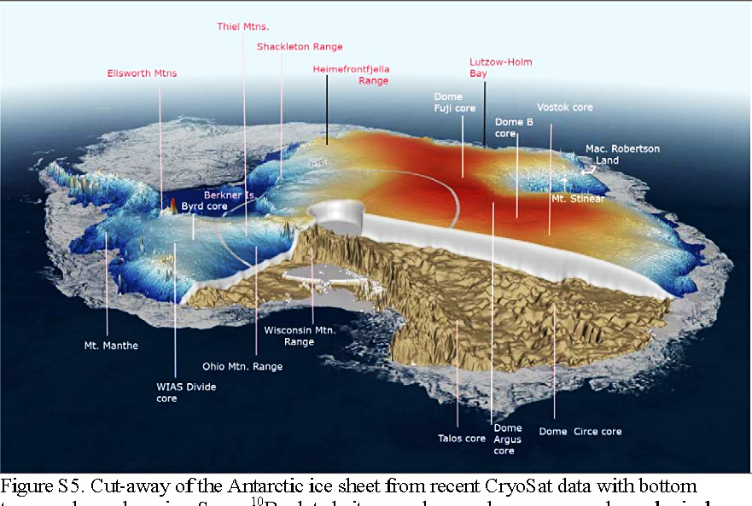

Slide 5
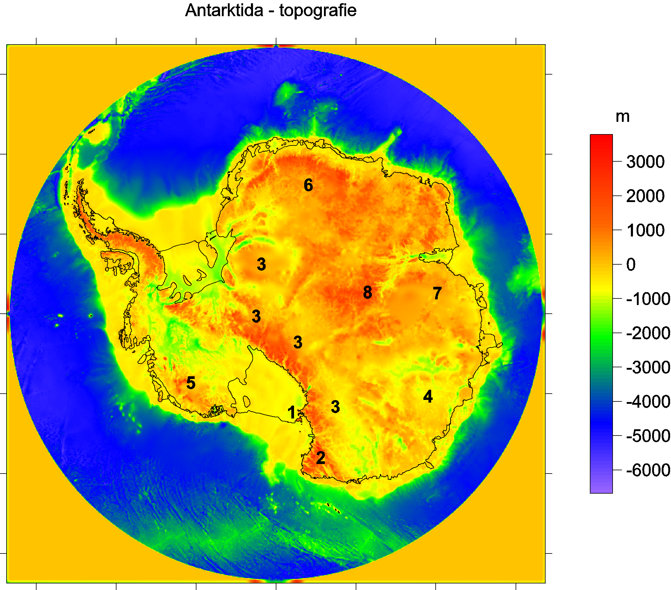
Bedmap2 bedrock topography
Ross shelf glacier
and Ross Island,
2 Victoria Land
3 Transantarctic Mountains
4 Wilkes Land
5 Marie Byrd Land
Queen (Dronning)
Maud Land
7 Princess Elizabeth Land
Gamburtsev Mountains
(under the ice).
Lake Vostok
9

Slide 6
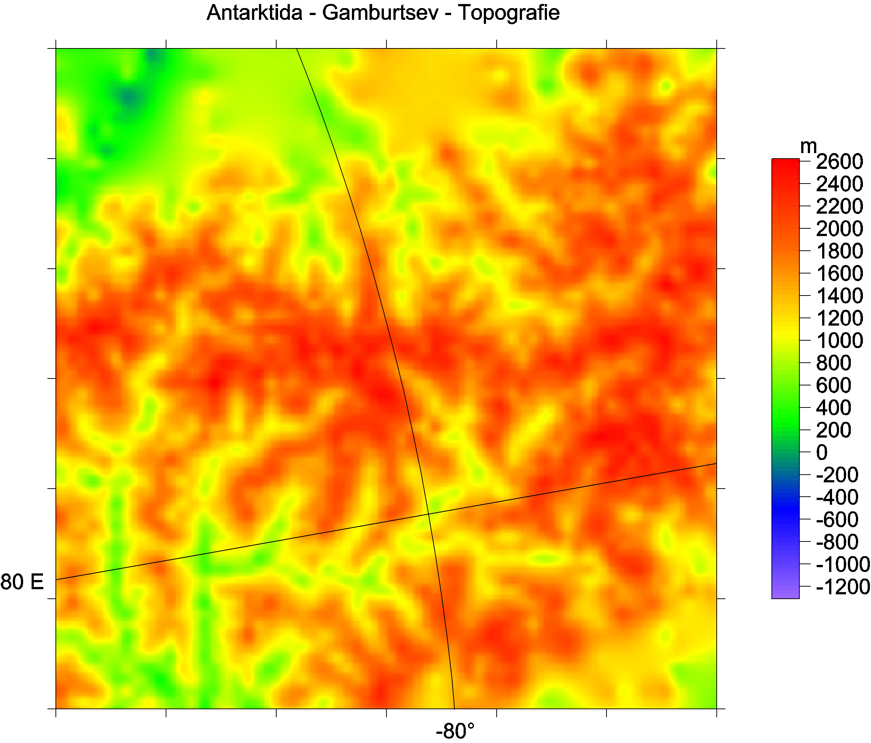

Slide 7
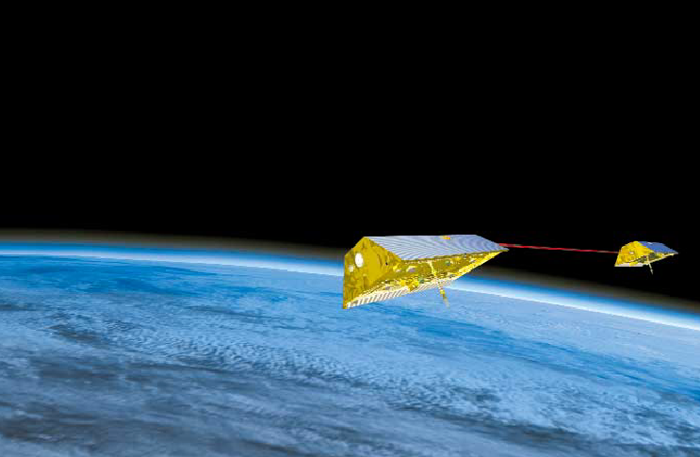
Grace A and B, 2002-
Gravity Recovery And Climate Experiment
(USA + Germany)

Slide 8
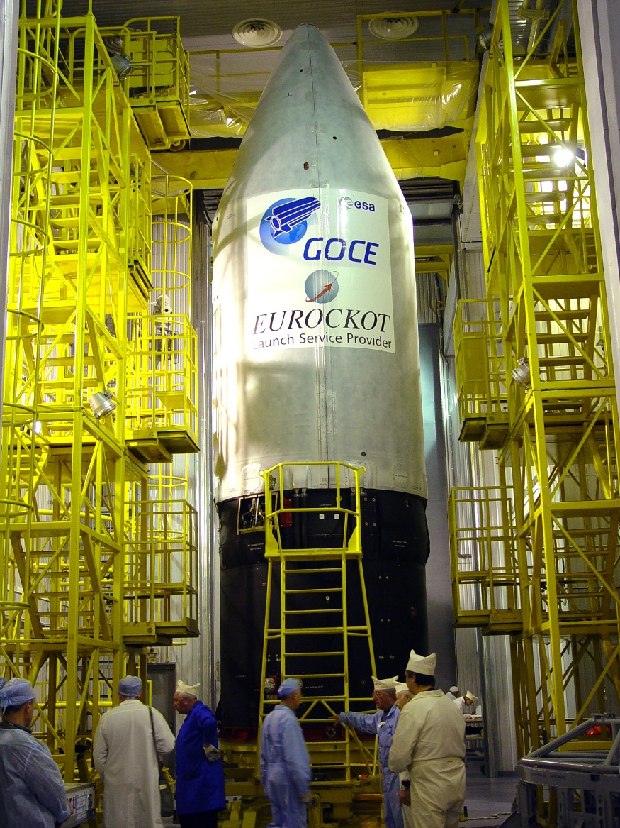
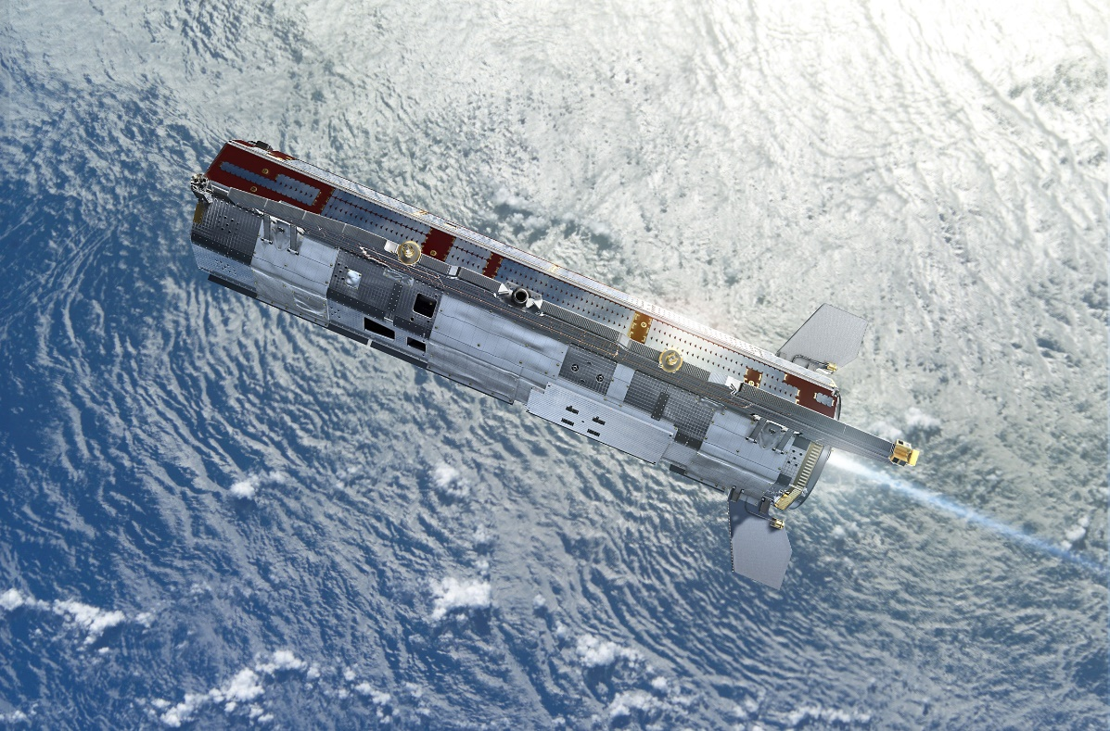
GOCE 2009-2013 (Gravity field and steady-state Ocean Circulation Explorer, ESA)
1mGal = 10⁻⁵ ms⁻², 1E = 1 Eötvös = 10⁻⁹ s⁻²
1 mGal = 10⁻⁵ ms⁻², 1 E = 1 Eötvös = 10⁻⁹ s⁻²
1 mE = 10⁻¹² s⁻²

Slide 9
GOCE inside

Slide 10
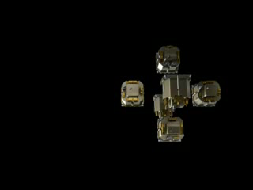

Slide 11
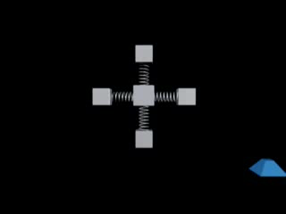

Slide 12
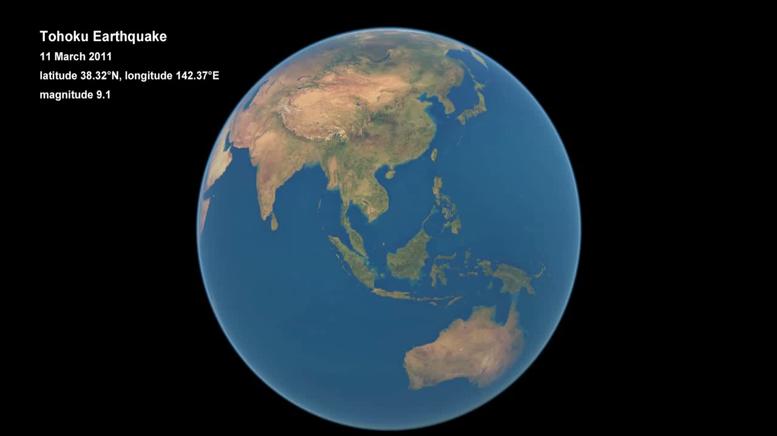

Slide 13
Notes on theory
Poznámky k teorii
2. Data – Earth´s gravity field models,
bedrock topography model of A. and
their combination, GPR
Data - modely tíhového pole Země,
model topografie skalního podloží A.
a jejich kombinace, GPR
3. Typical gravitational signal of diverse
geological and geophysical structures
Typický gravitační signál rozmanitých
geologických a geofyzikálních struktur
4. Aplikace: Volcanoes in Antarctica
Ukázka použití: Sopky v Antarktidě

Slide 14

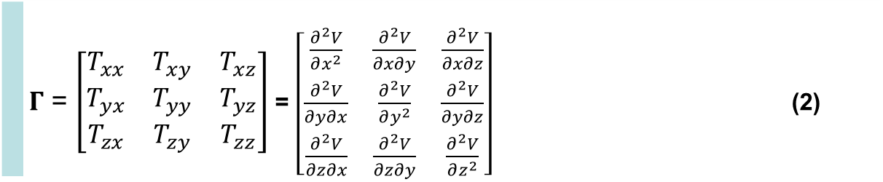
Disturbing static gravitational potential outside the Earth masses in spherical harmonic expansion
 | $$T\left(r,φ,λ\right)=\frac{GM}{r}\sum_{l=2}^{∞}{\sum_{m=0}^{l}{{\left(\frac{R}{r}\right)}^{l}\left({C^{′}}_{l,m}cos mλ+S_{l,m}sin mλ \right)}} P_{l,m}\left(sin φ\right)$$
where GM is a product of the universal gravitational constant and the mass of the Earth (also known as
the geocentric gravitational constant), r is the radial distance of an external point where T is computed,
R is the radius of the Earth (which can be approximated by the semi-major axis of a reference ellipsoid),
P_{l,m} (sin φ) are the Legendre associated functions, l and m are the degree and order of the harmonic expansion,
(φ, λ) are the geocentric latitude and longitude, C’_{l,m} and S_{l,m} are the harmonic geopotential coefficients
(Stokes parameters), fully normalized, C’_{l,m} = C_{l,m} – C^{el}_{l,m}, where C^{el}_{l,m} belongs to the reference ellipsoid.
The spherical approximation of the gravity anomaly Δg is computed
$∆g=−\frac{∂T}{∂r}−2\frac{T}{r}$
or one can use the gravity disturbance (it is the same but without the second term).
Gravity gradient tensor Γ (the Marussi tensor) is a tensor of the second derivatives of
the disturbing potential T:
 | $Γ$ = $\left[\begin{matrix}T_{xx} & T_{xy} & T_{xz} \\ T_{yx} & T_{yy} & T_{yz} \\ T_{zx} & T_{zy} & T_{zz}\end{matrix}\right]$ = $\left[\begin{matrix}\frac{∂^{2}V}{∂x^{2}} & \frac{∂^{2}V}{∂x∂y} & \frac{∂^{2}V}{∂x∂z} \\ \frac{∂^{2}V}{∂y∂x} & \frac{∂^{2}V}{∂y^{2}} & \frac{∂^{2}V}{∂y∂z} \\ \frac{∂^{2}V}{∂z∂x} & \frac{∂^{2}V}{∂z∂y} & \frac{∂^{2}V}{∂z^{2}}\end{matrix}\right]$ (2)
Notes:
Legendre associated functions,… free-air gravity anomaly, gravity disturbance

Slide 15
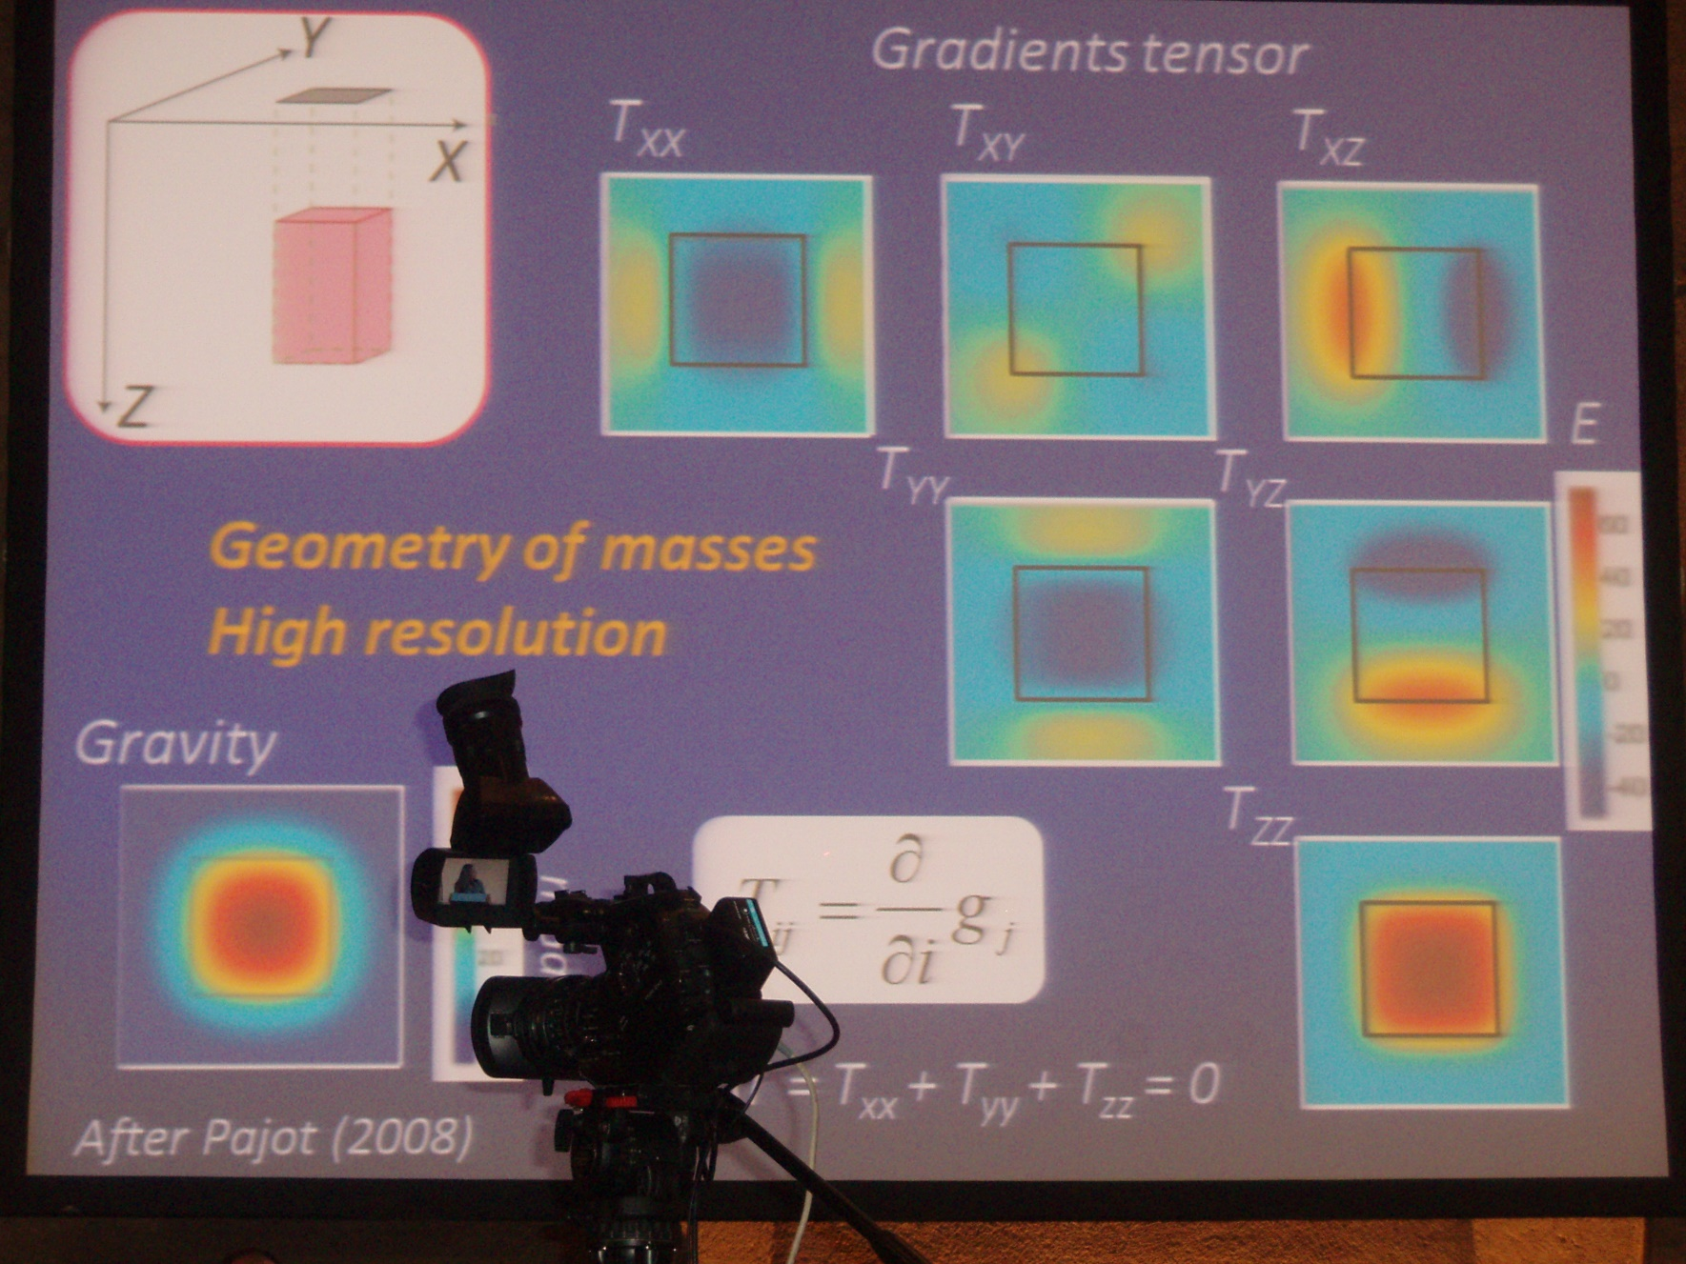
Obsah obrázků
The second order derivatives and the invariants provide evidence about details of near-surface (not deep) structures. The Marussi tensor was already used in local scales (a few kilometers) for petroleum, metal, diamond, ground water etc. explorations (e.g., Murphy and Dickinson, 2009; Mataragio and Kieley, 2009). The full Marussi tensor is a richer source of information than the standard single gravity anomalies. This extra information can be applied by tensor imaging techniques to enhance a target anomaly definition, as tested for local features (minerals, oil and gas industry), e.g., by Saad (2006)) or Dickinson et al. (2009).

Slide 16
A.H.Saad, The Leading Edge, 942-950, Aug. 2006

Slide 17


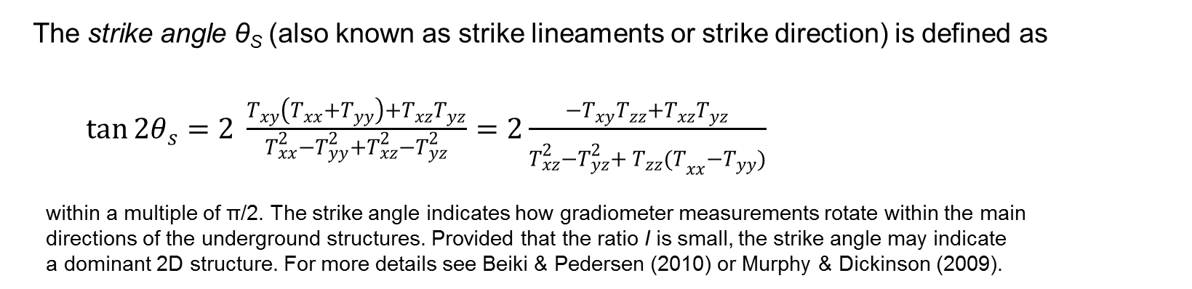
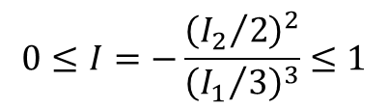
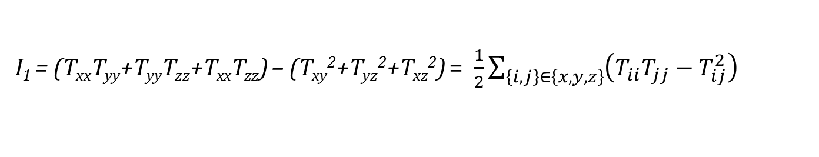
Under any coordinate transformation, Γ preserves
just 3 INVARIANTs
$I_{0}=trace \left(Γ\right)=T_{xx}+T_{yy}+T_{zz}=$ 0
I₁ = (T_{xx}T_{yy}+T_{yy}T_{zz}+T_{xx}T_{zz}) – (T_{xy}²+T_{yz}²+T_{xz}²) = $\frac{1}{2}\sum_{\left\{i,j\right\}∈\left\{x,y,z\right\}}{{\left(T_{ii}T_{jj}−T_{ij}^{2}\right)}_{}}$
I₂ = det (Г) = (T_{xx}(T_{yy}T_{zz}-T_{yz}²) + T_{xy}(T_{yz}T_{xz} – T_{xy}T_{zz}) + T_{xz} (T_{xy}T_{yz}-T_{xz}T_{yy}).
Pedersen & Rasmussen (1990) showed that the ratio I of I₁ and I₂ defined as
$$0≤I=−\frac{{\left({I_{2}}/2\right)}^{2}}{{\left({I_{1}}/3\right)}^{3}}≤1$$
lies between zero and unity for any potential field. If the causative body is strictly 2D, then I =0.
The strike angle θ_{S} (also known as strike lineaments or strike direction) is defined as
$\tan{2θ_{s}}=2 \frac{T_{xy}\left(T_{xx}+T_{yy}\right)+T_{xz}T_{yz}}{T_{xx}^{2}−T_{yy}^{2}+T_{xz}^{2}−T_{yz}^{2}}=2\frac{{−T}_{xy}T_{zz}+T_{xz}T_{yz}}{T_{xz}^{2}−T_{yz}^{2}+{{ T}_{zz}^{}(T}_{xx}^{}−T_{yy}^{})}$
within a multiple of π/2. The strike angle indicates how gradiometer measurements rotate within the main
directions of the underground structures. Provided that the ratio I is small, the strike angle may indicate
a dominant 2D structure. For more details see Beiki & Pedersen (2010) or Murphy & Dickinson (2009).

Slide 18
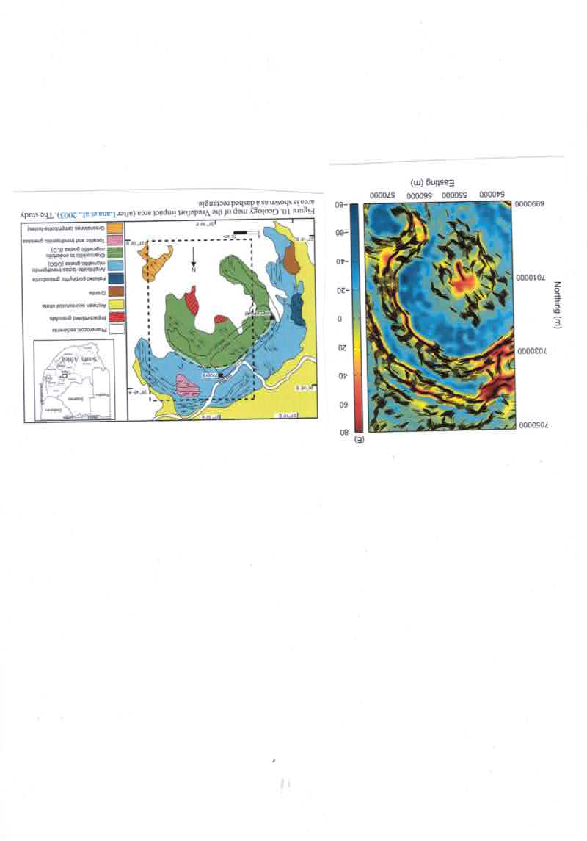
Huge impact crater Vredefort, Africa
Beiki and Pedersen 2011

Slide 19
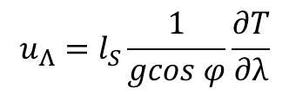



Virtual deformations
(Kalvoda et al. 2012, Klokočník et al. 2013)
directions of such a deformation due to “erosion” brought about solely by “gravity origin”.
If there would be a tidal potential T, then the horizontal shifts (deformations) would exist due to it
and they could be expressed
in north-south direction (latitude direction) … [left] and in east-west direction (longitudinal direction) … [right]
where g is the gravity acceleration 9.81 m⋅s⁻²,
l_{S} is the elastic coefficient (Shida number) expressing the elastic properties of the Earth as a planet (l_{S} = 0.08),
φ and λ are the geocentric coordinates (latitude and longitude) of a point P where we measure T
The apparatus of mechanics of continuum to derive the main directions of the tension is applied (see, e.g., Brdička et al. 2000).
The tensor of (small) deformation E is defined as a gradient of shift. It holds that
The tensor E can be separated into two parts:
where e is the symmetrical tensor and Ω the anti-symmetrical tensor of deformation, respectively. The symmetrical tensor is
and the parameters of deformation are:
Δ = e₁₁ + e₂₂ total dilatation a = ½ (Δ + γ) major semi-axis of ellipse of deformation
γ₁ = e₁₁ - e₂₂ pure cut b = ½ (Δ – γ) minor semi-axis of ellipse of deformation
γ₂ = 2e₁₂ technical cut α = ½ atan(γ₂ / γ₁) direction of main axis of deformation
γ = (γ₁² + γ₂²)^{1/2} total cut
.
$$u_{Φ}=l_{S}\frac{1}{g}\frac{∂T}{∂φ}$$
$$u_{Λ}=l_{S}\frac{1}{gcos φ}\frac{∂T}{∂λ}$$
$$E=\left(\begin{matrix}ε_{11} & ε_{12} \\ ε_{21} & ε_{22}\end{matrix}\right)=\left(\begin{matrix}\frac{∂u_{x}}{∂x} & \frac{∂u_{x}}{∂y} \\ \frac{∂u_{y}}{∂x} & \frac{∂u_{y}}{∂y}\end{matrix}\right)$$
$$E=e+Ω= \left(e_{ij}\right)+\left(Ω_{ij}\right)$$
$e=\left(\begin{matrix}e_{11} & e_{12} \\ e_{21} & e_{22}\end{matrix}\right)=\left(\begin{matrix}ε_{11} & {(ε}_{12}+ε_{21})/2 \\ {(ε}_{12}+ε_{21})/2 & ε_{22}\end{matrix}\right)$

Slide 20
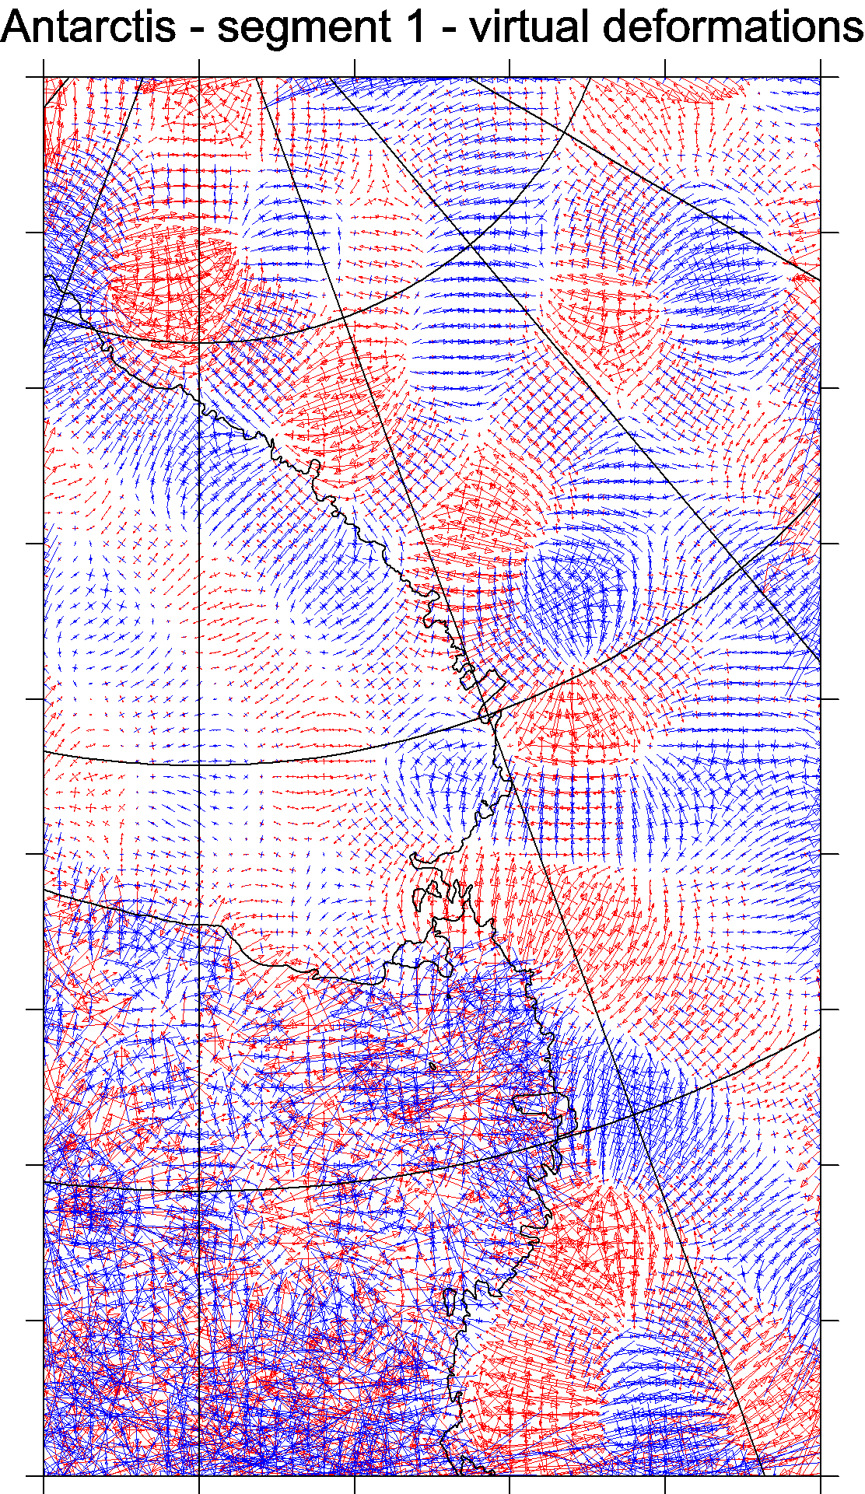
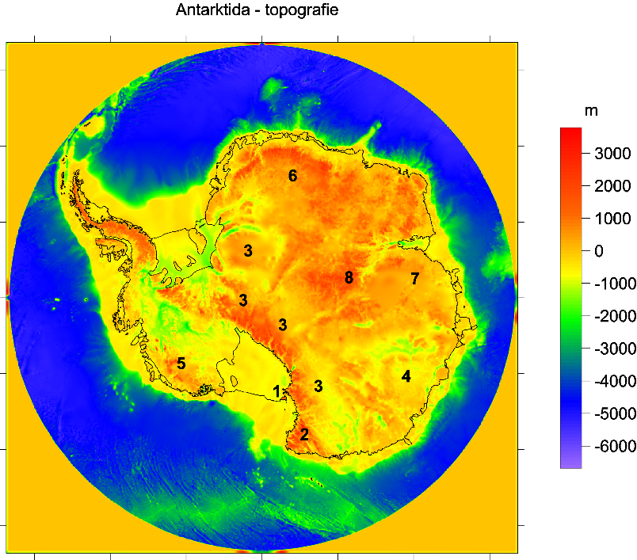
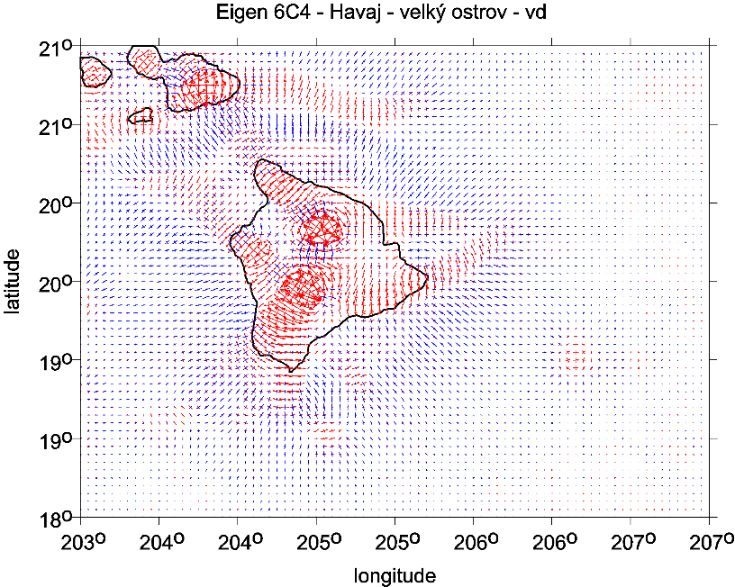

Slide 21
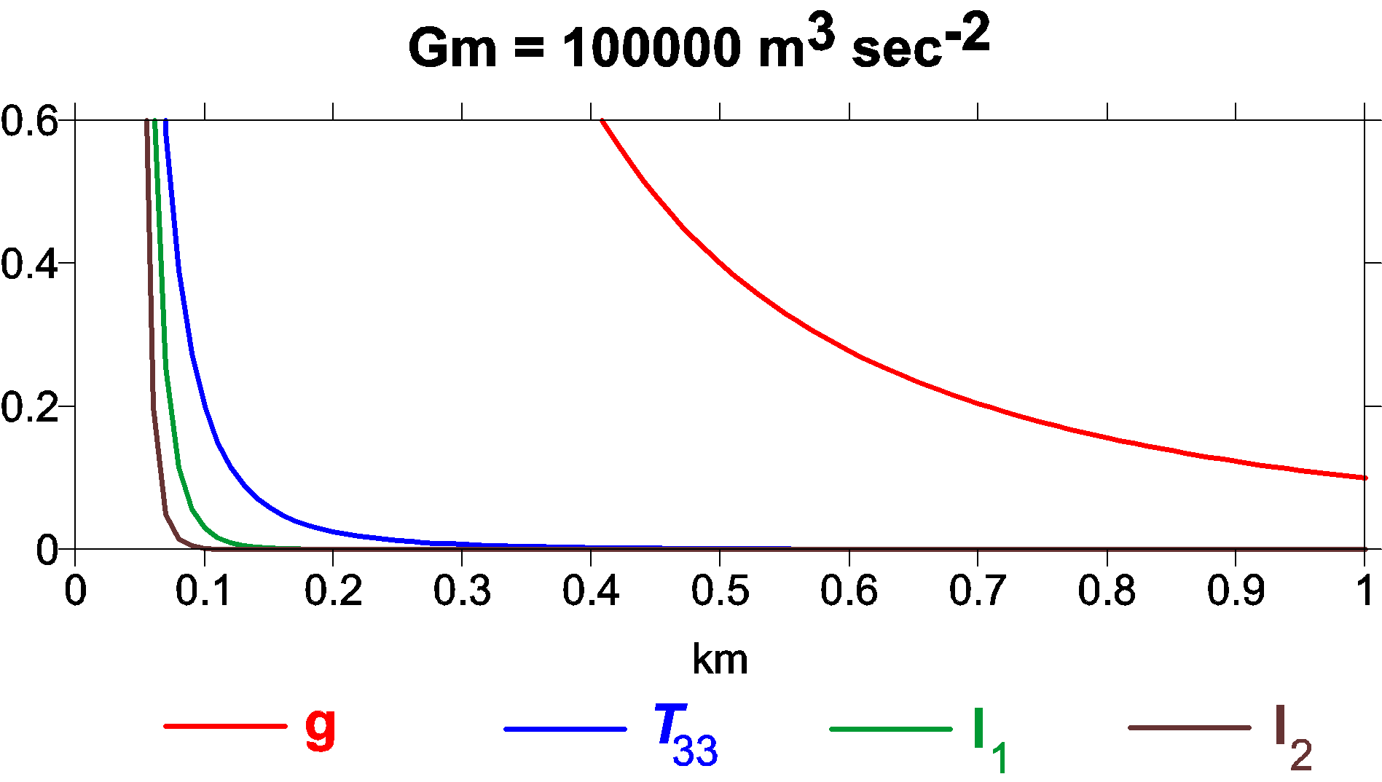
Comparison of sensitivity of various functions of the disturbing potential mass point case / an illustrative simplification x axis depth beneath surface [km], y axis reference value of functionals for given gravitational constant GM describing respective point mass body

Slide 22
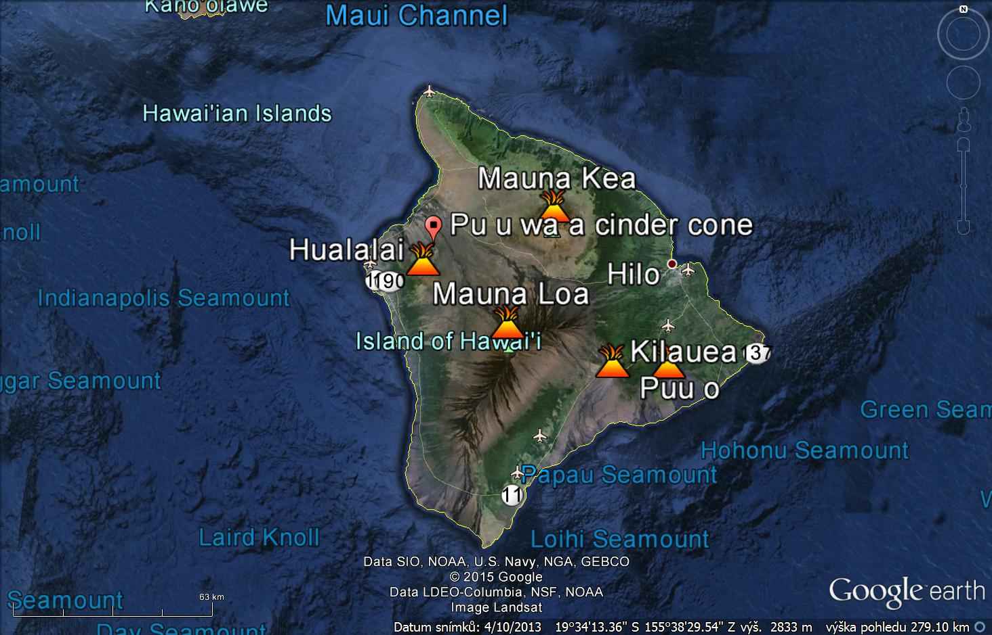
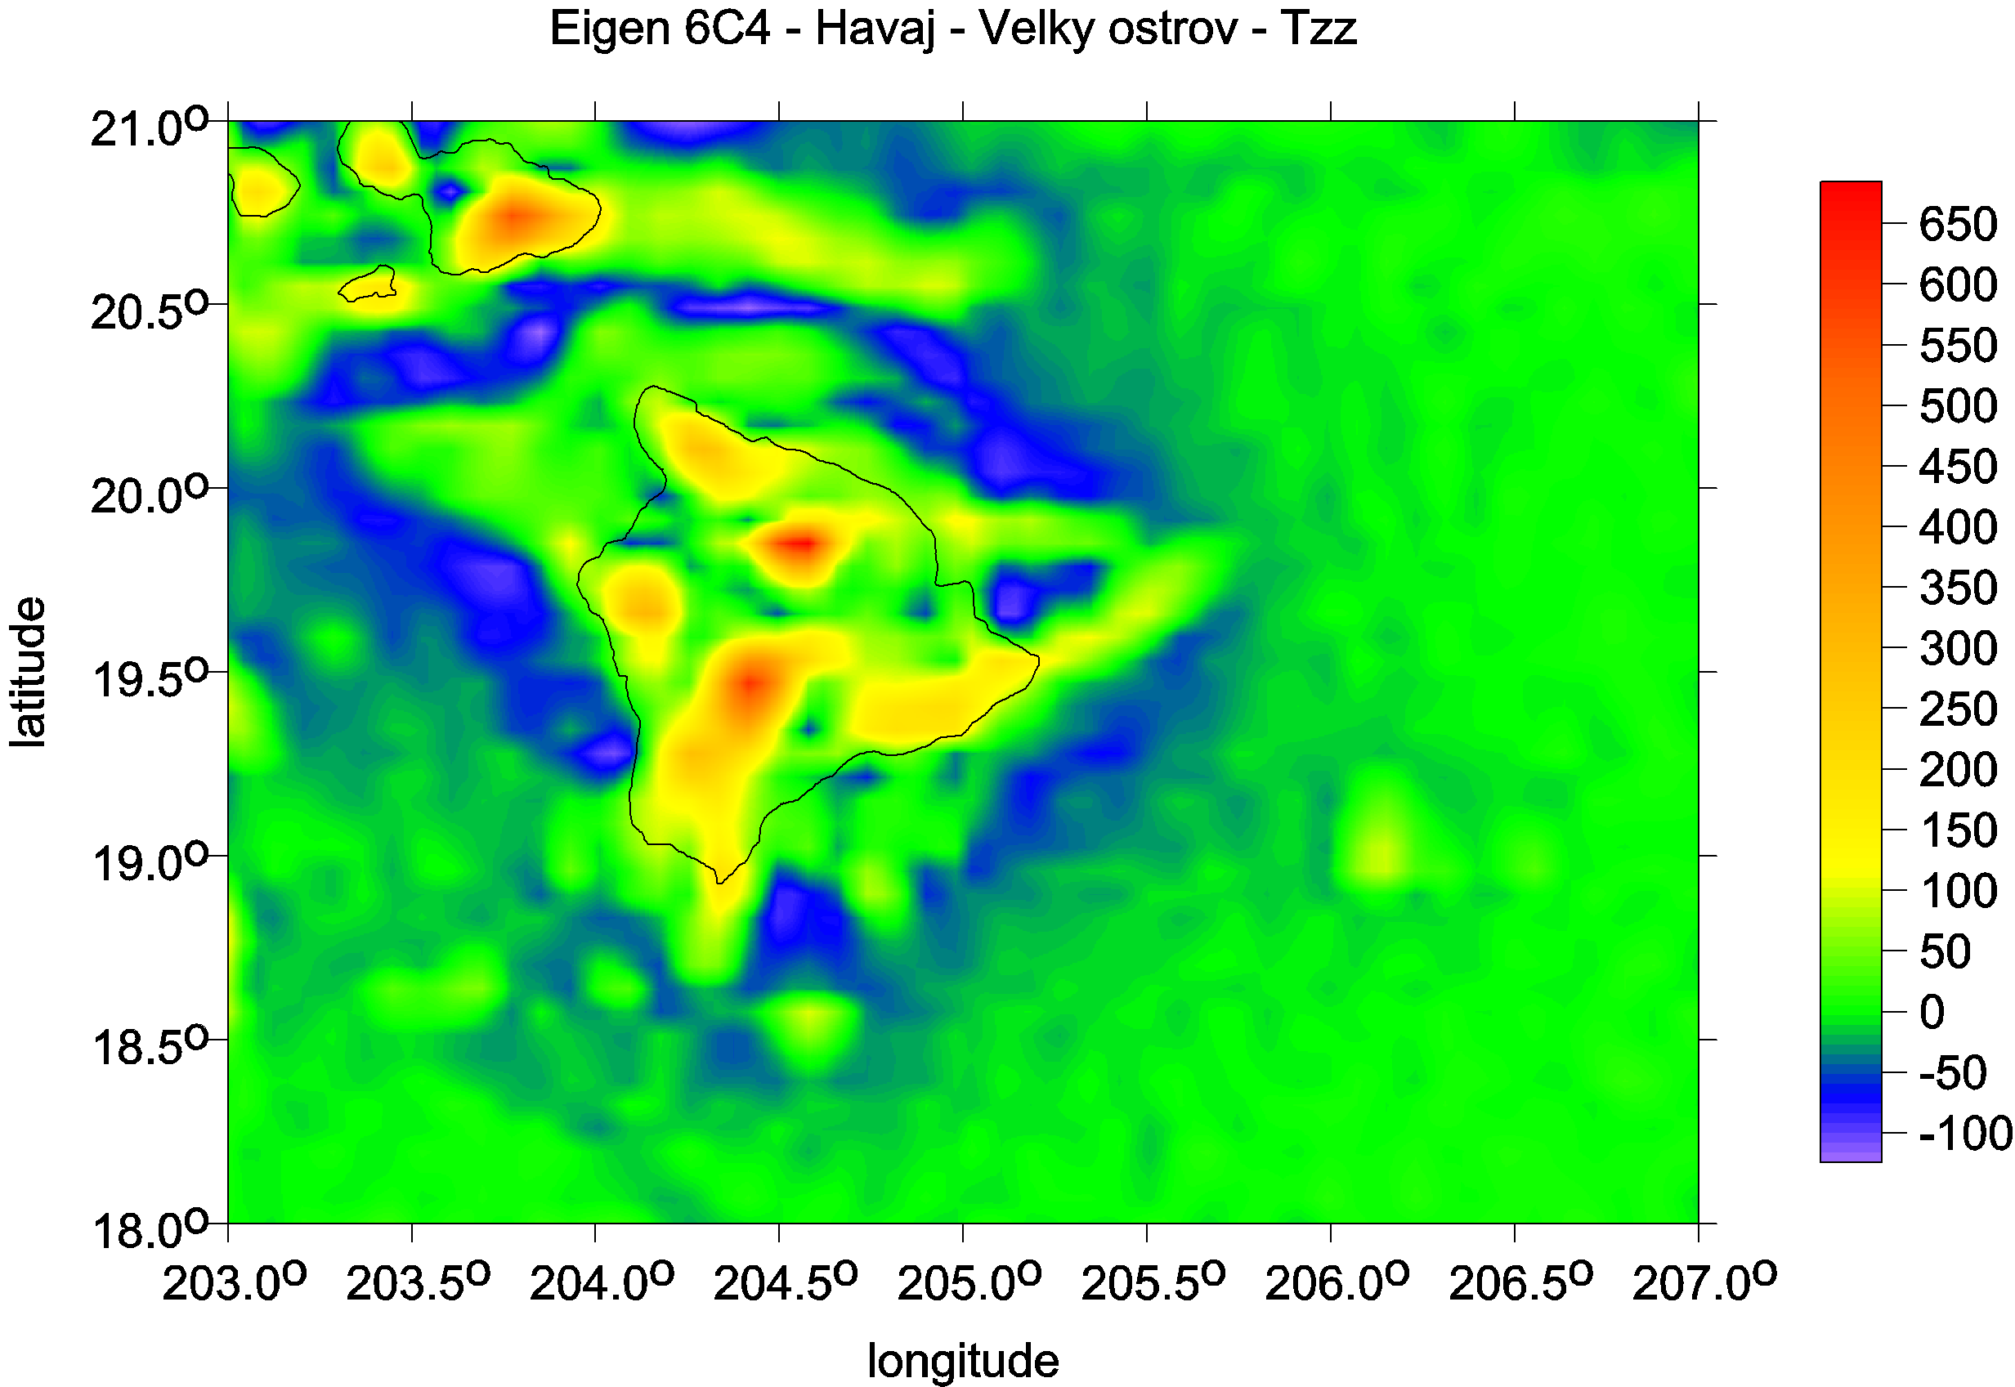
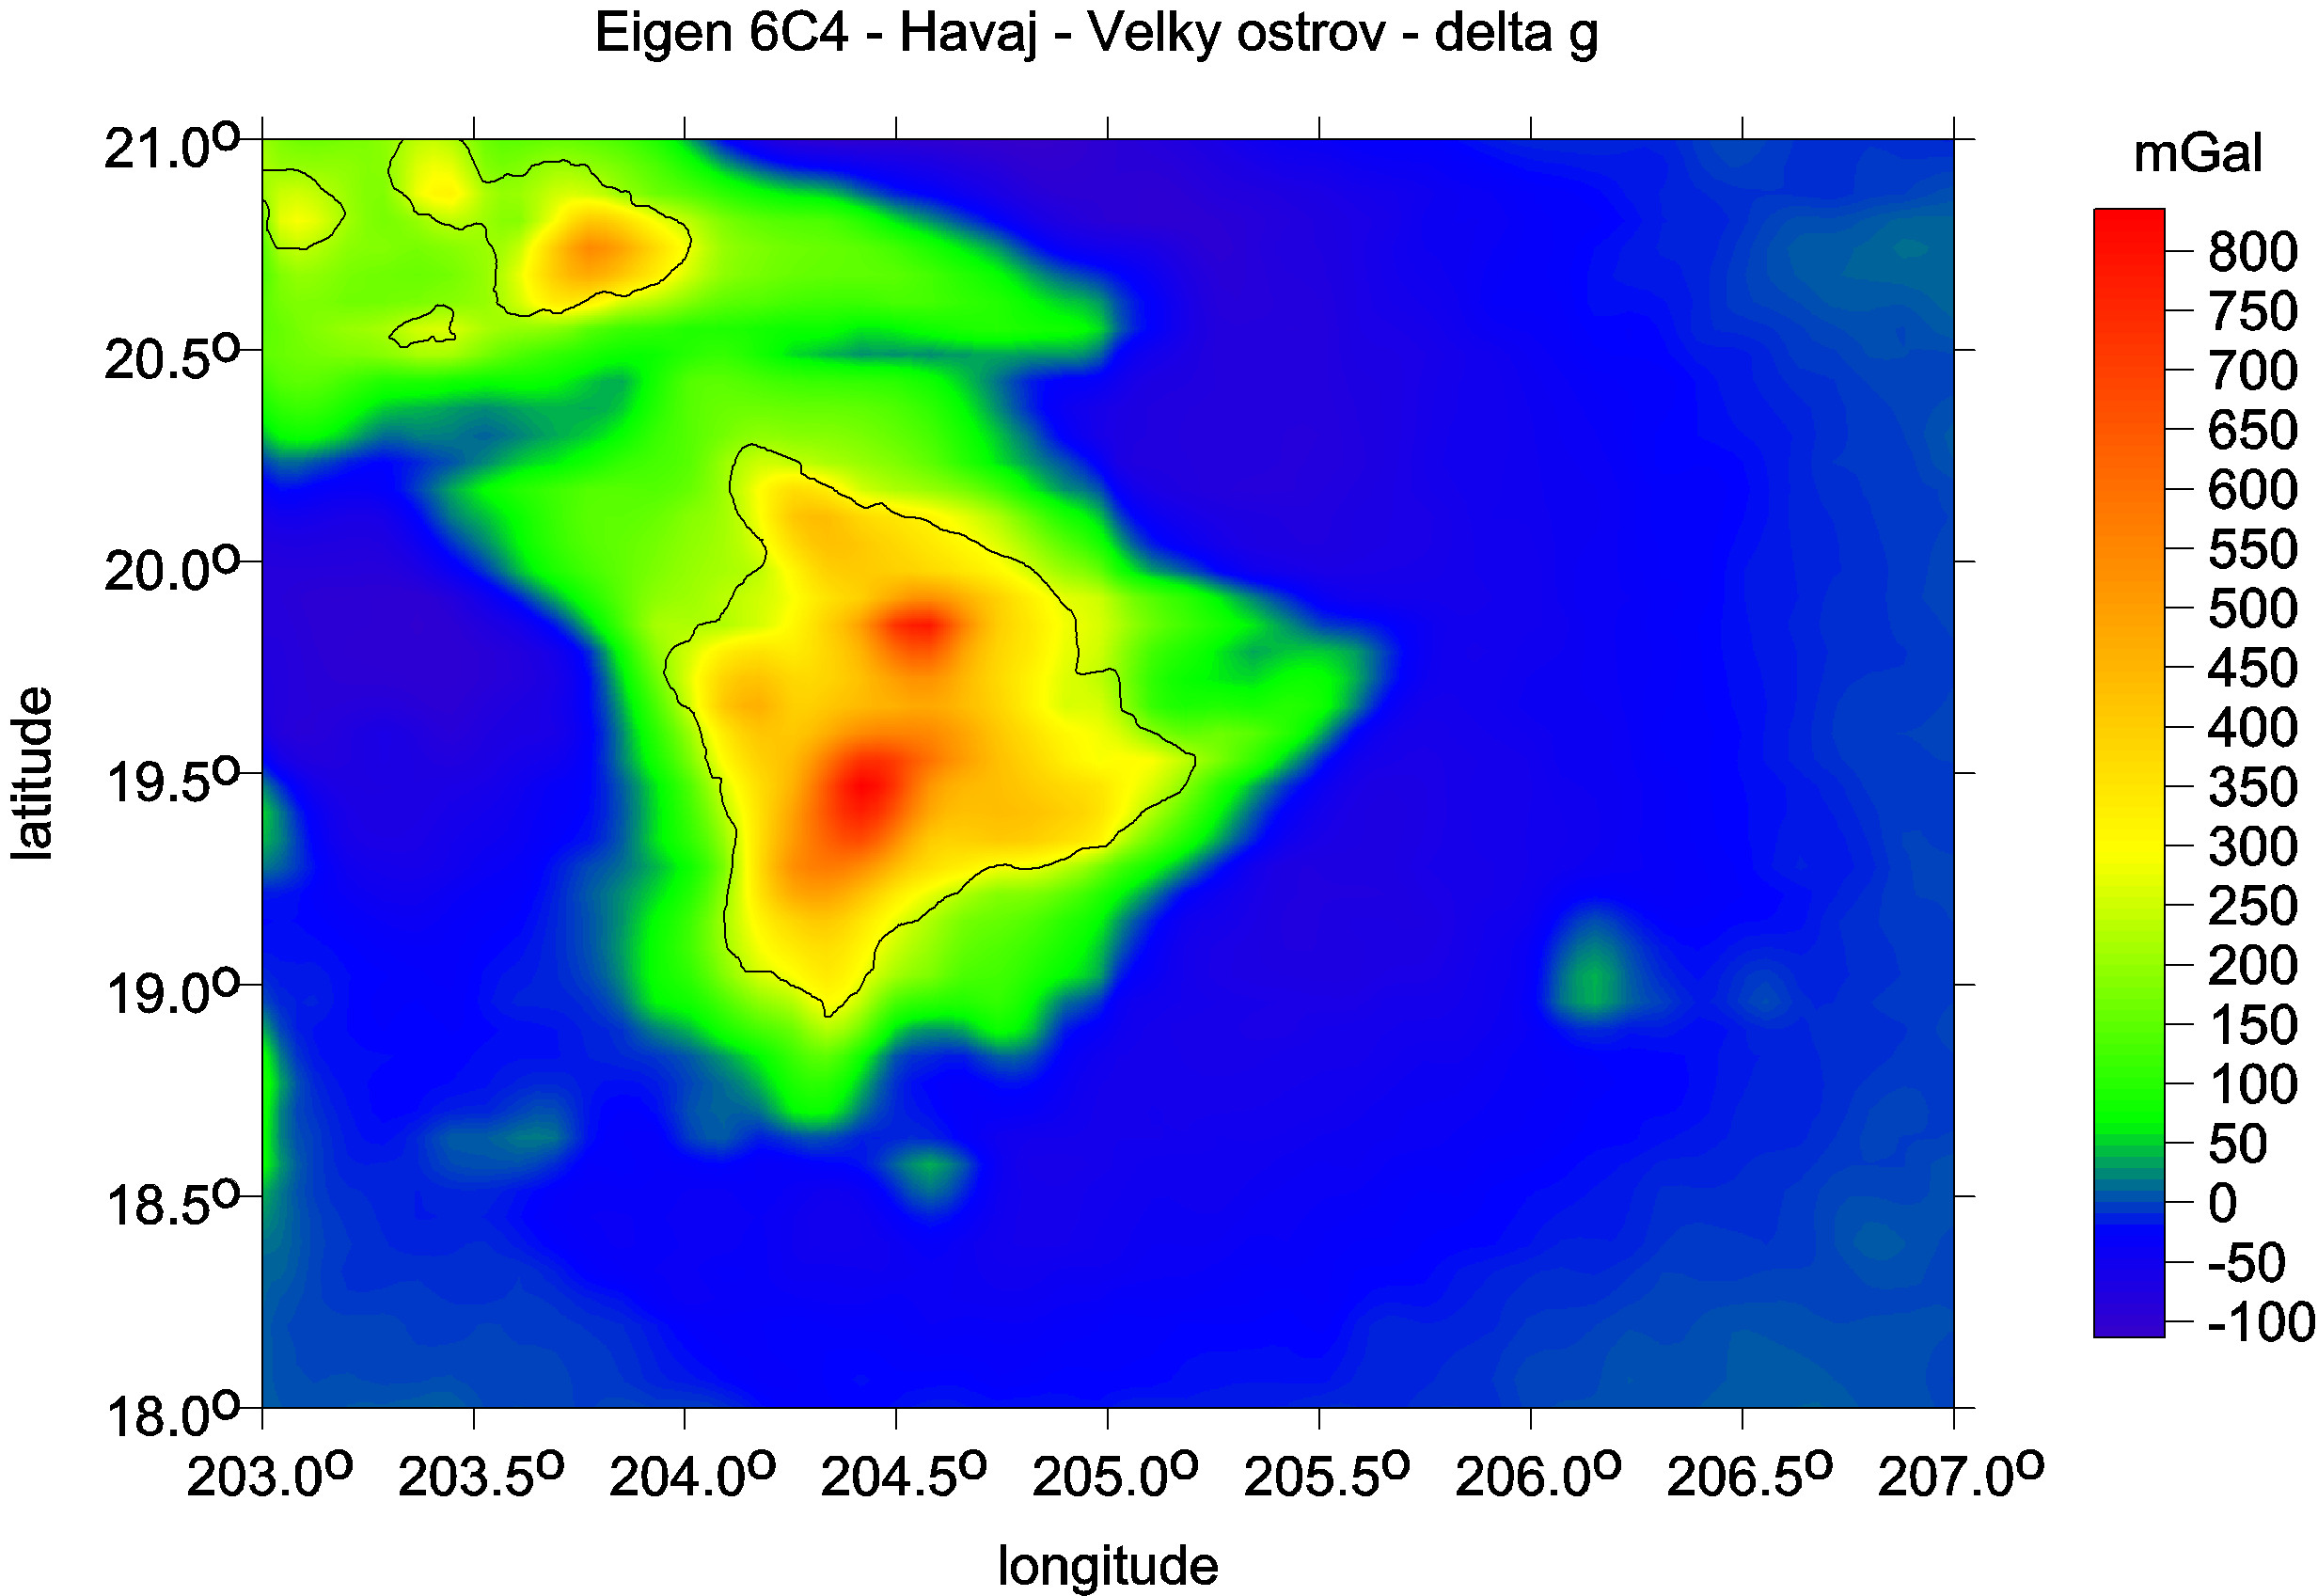
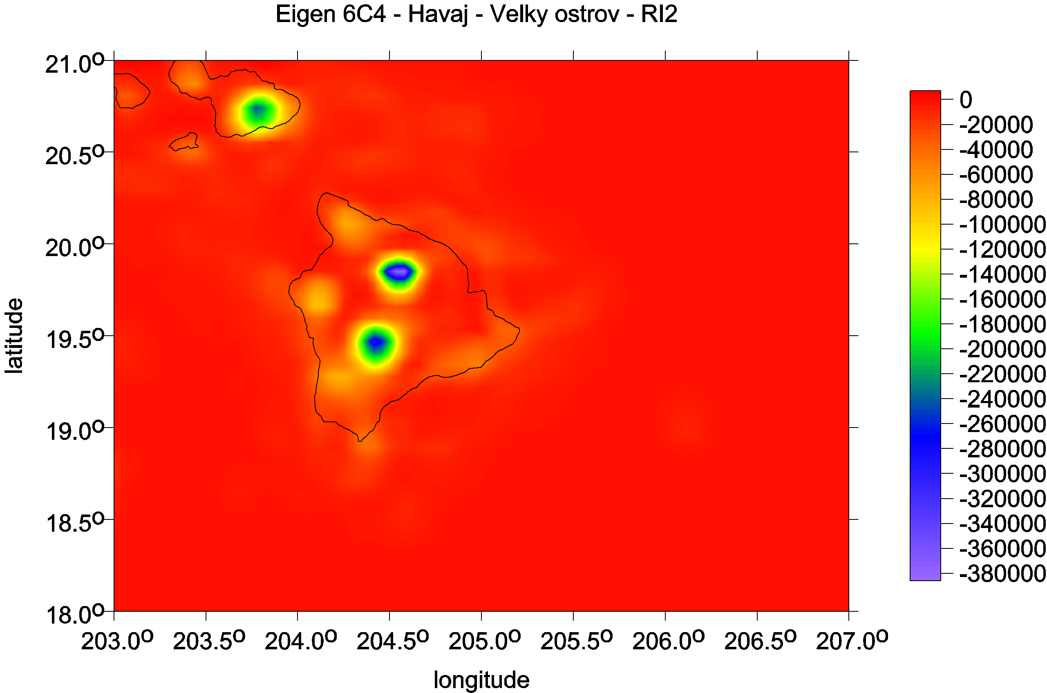
Hawai, the Big island

Slide 23
Data – recent gravity field models
satellite bedrock topography and
their combination
EGM 2008 *
EIGEN 6C4 **
BEDMAP 2 bedrock topography ***
Pavlis, N. K., Holmes, S. A., Kenyon, S. C. & Factor, J. K. 2008a. An Earth Gravitational Model to degree 2160: EGM 2008. EGU General Assembly 2008,
Vienna, 13–18 April 2008.
Pavlis, N. K., Holmes, S. A., Kenyon, S. C. & Factor, J. K. 2008b. EGM2008: An overview of its development and evaluation. National Geospatial-Intelligence Agency, USA, conf.: Gravity, Geoid and Earth Observation 2008, Chania, Crete, Greece, 23–27 June 2008.
Pavlis, N. K., Holmes, S. A., Kenyon, S. C. & Factor, J. K. 2012. The development and evaluation of the Earth Gravitational Model 2008 (EGM2008). J. Geophys. Res. 17, B04406, doi: 10.1029/2011JB008916, 2012.
** Förste Ch., Bruinsma S., Abrykosov O., Lemoine J-M. et al 2014. The latest combined global gravity field model including GOCE data up to degree and order 2190 of GFZ Potsdam and GRGS Toulouse (EIGEN 6C4). 5th GOCE user workshop, Paris 25 – 28, Nov. 2014.
*** Fretwell P, Pritchard H, Vaughan D, Bamber J, et al. 2013. Bedmap2: improved ice bed, surface and thickness datasets for Antarctica. The Cryosphere, 7, 375–393, 2013,
doi: 10.5194/tc-7-375-2013; https://secure.antarctica.ac.uk/data/-bedmap2/

Slide 24
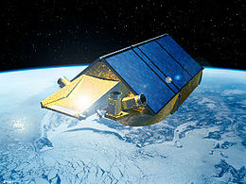
cont./pokrač.
SatGrav RET 2014
Hirt Ch. et al 2016,
A new degree-2190 (10 km resolution) gravity field model for Antarctica
Developed from GRACE, GOCE and Bedmap 2 data,
J Geod 90: 105-127.
G(I)PR Cryosat (2) ESA, 2010-
Vlnová délka radaru ~ 1 m
Použití na družicích i letadlech
SIRAL: SAR Interferometer Radar Altimeter DORIS: Doppler Orbitography and Radiopositioning Integration by Satellite LRR: Laser Retroreflector

Slide 25
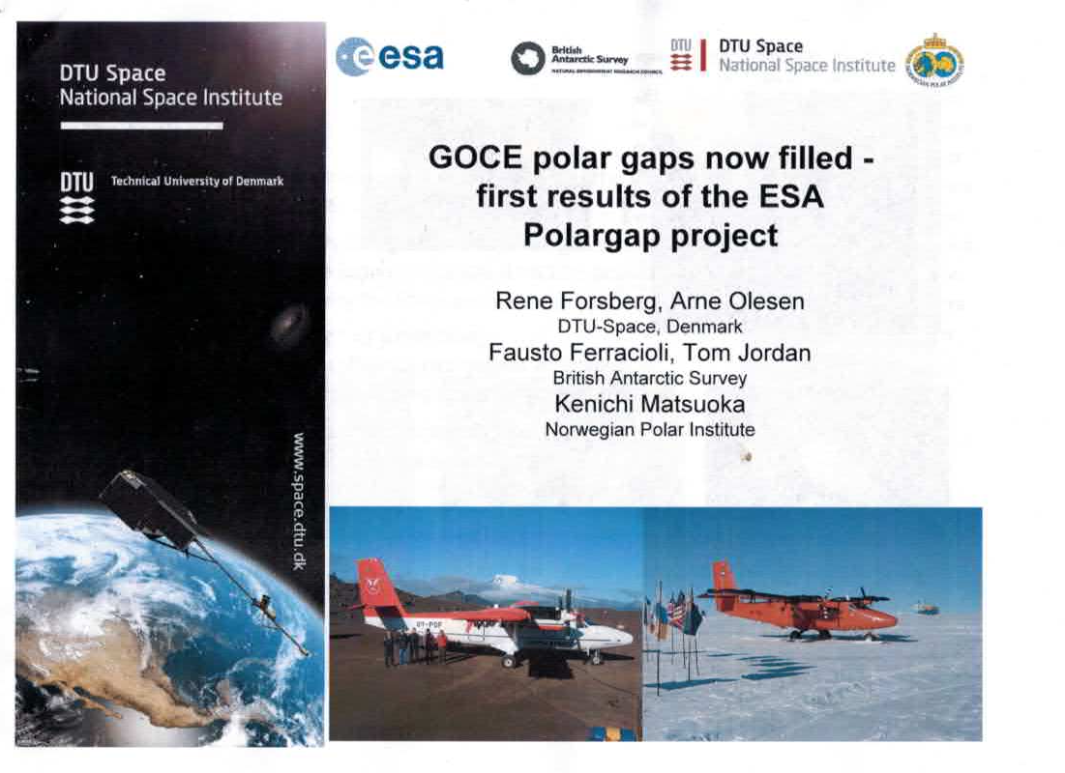

Slide 26
Gravity data (Models of the Earth Gravitational Field)
EGM 2008 is a high resolution static gravity field model (Pavlis et al, 2008, 2012), a combination solution to degree and order 2160; it contains additional coefficients extending to degree 2190 and order 2159.
Satellite data in EGM 2008 come from the GRACE A/B SST (low-low satellite-to-satelllite tracking).
Terrestrial data base of EGM 2008 is very extensive and consists of several sources. Nevertheless, there is not homogeneous gravity anomaly field yet. No terrestrial data in EGM 2008 are available over Antarctica, poorer data (of low precision and reliability) over high mountain belts (s/c „fill-in data“, derived from topography). For these zones, like Himalaya, we have fortunately very large values of the signal (the values of gravity anomalies or other functionals of the geopotential) so that even their larger commission error over these areas does not mean any serious problem.

Slide 27
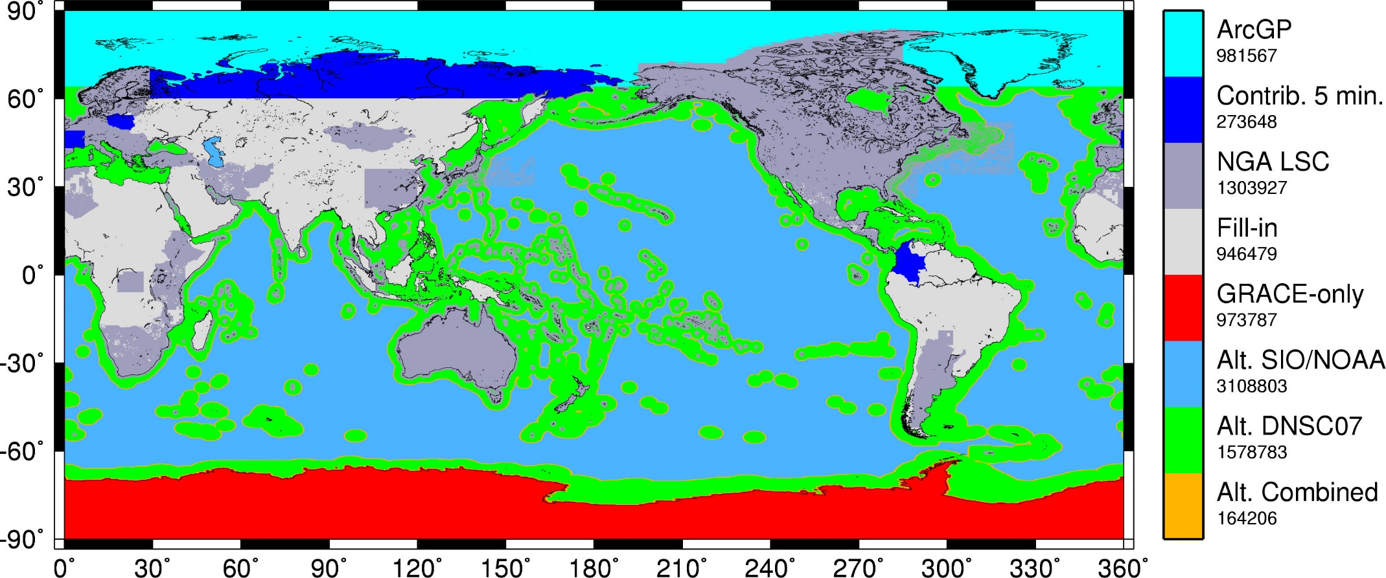
5′×5′ Δg Data Sources (v010808)

Slide 28
Description of a part of input data (terrestrial gravity anomalies) to EGM 2008 by Pavlis et al 2008
“ArcGP”: 5 x 5 minute mean gravity anomalies which were estimated as part of the Arctic Gravity Project.
“Contrib. 5 min”: 5 x 5 minute mean gravity anomalies which were contributed to the project “ready-made”. These mean values were estimated by the contributing person or agency.
“NGA LSC”: 5 x 5 minute mean gravity anomalies which were estimated using Least Squares Collocation (LSC) by NGA.
“Fill-in”: 5 x 5 minute mean gravity anomalies which were computed from the spectral “cut-and-paste” set of coefficients, where, up to l = 720 the coefficients represent the (proprietary) 5 x 5 minute mean gravity anomalies, and from l=721 to Lmax = 2159 they represent the gravity anomalies implied by the Residual Terrain Model effects.
“Alt. SIO/NOAA”: 5 x 5 minute mean gravity anomalies which were estimated by D. Sandwell and W. Smith, using altimetry data.
“Alt. DNSC07”: 5 x 5 minute mean gravity anomalies which were estimated by O. Andersen and P. Knudsen, using altimetry data.
“Alt. Comb.”: 5 x 5 minute mean gravity anomalies which were estimated as a linear combination of the SIO/NOAA and DNSC07 values (to avoid jump discontinuities).

Slide 29
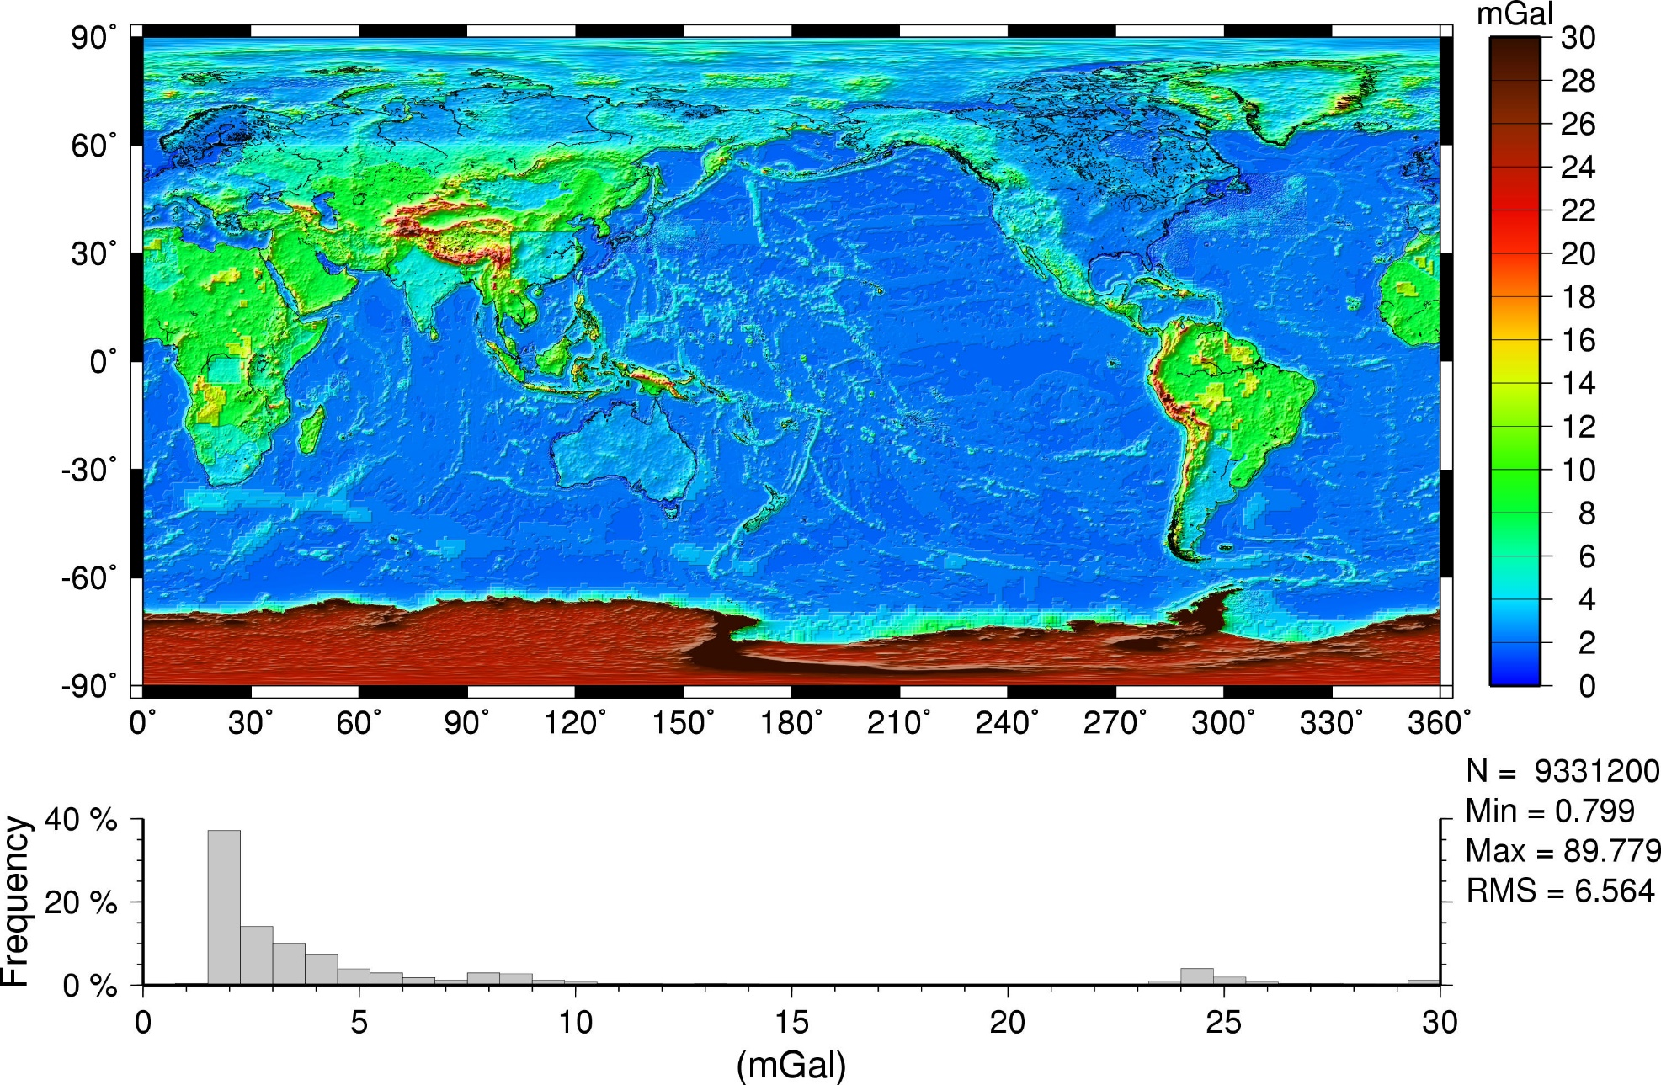
5′×5′ Δg Commission Error: EGM2008 (Nmax=2159)

Slide 30
The Gravity Field Model EIGEN-6C4
EIGEN-6C4 is a high resolution static global combined gravity field model up to degree and order 2190. It has been elaborated jointly by GFZ Potsdam and GRGS Toulouse (Foerste et al. 2014) and contains the following satellite and ground data:
LAGEOS (for degrees of harmonics from 2 to30)
high orbiting geodynamic satellite: 1985 – 2010
Previous gravity model GRACE RL03 GRGS (deg. 2 - 130):
ten years 2003 – 2012
GOCE-SGG data, processed by the direct approach incl. the gravity gradient components T_{xx}, T_{yy}, T_{zz} and T_{xz} throughout whole life of the GOCE satellite. The GOCE polar gaps were stabilized by the
- Terrestrial data (max degree 370): DTU12 ocean geoid data and an EGM2008 geoid height grid for the continents.
The combination of these different satellite and surface data sets has been done by a band-limited combination of normale equations (to max degree 370), which are generated from observation equations for the spherical harmonic coefficients. The resulted solution to degree/order 370 has been extended to degree/order 2190 by
a block diagonal solution using the DTU10 global gravity anomaly data grid.

Slide 31
Using the harmonic geopotential coefficients of the global gravitational model EGM 2008, the following physical quantities are computed: the gravity anomalies Δg (or disturbances) [scale 1mGal = 10-5 ms-2], the full Marussi tensor Γ of the second derivatives of the disturbing potential [1E = 1 Eötvös = 10-9 s-2], namely its radial component, sometimes denoted Tzz or Trr, the invariants of the gravity field I0, I1, I2 = det(Γ), computable from the components of the Marussi tensor, their specific ratio I and the strike angle θ. These quantities are known from theory of Pedersen & Rasmussen (1990) and Beiki & Pedersen (2010). A “virtual deformation” has been added (Kalvoda et al. 2013, following Brdička et al 2000). Some of these quantities are functionals of the geopotential in a mathematical sense and some of them are not. Therefore, they are concisely designated in the paper as aspects of the geopotential.

Slide 32
Plotting
Plotting is important for visualizing our results; we make use of strongly non-linear scales to emphasize various features which otherwise might remain hidden.
A note about the units of plotted aspects:
mGal (miligals) for the gravity anomalies and/or disturbances,
E … Eötvös for the second order potential derivatives,
components of Marussi tensor.
The invariants I1 and I2 have units [s⁻⁴] and [s⁻⁶] and their ratio I is dimensionless.
The strike angle θ is expressed in degrees and its demonstration in red means its direction to the East and in blue to the West of the local meridian.
The virtual deformations (vd) are dimensionless and express a direction of dilatation (red) or compression (blue). These units are used in all figures presented below.
1mGal = 10⁻⁵ ms⁻², 1E = 1 Eötvös = 10⁻⁹ s⁻²

Slide 33
Examples of typical gravitational signal (trace, signature) of diverse geological/geomorphological/geophysical structures

Slide 34
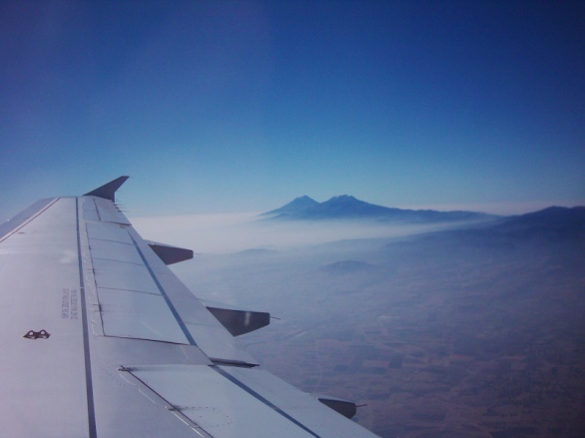
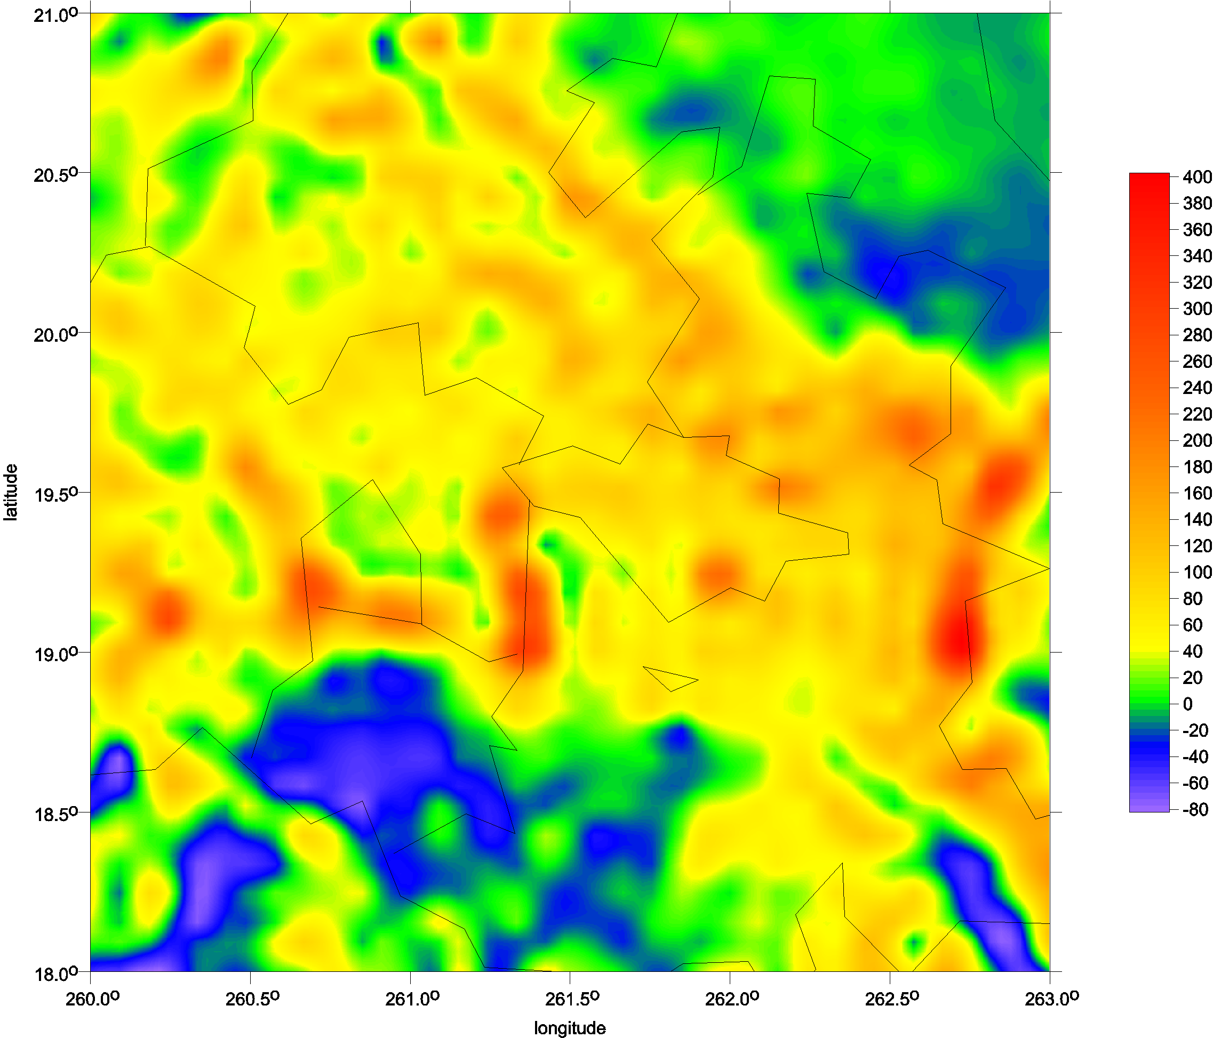
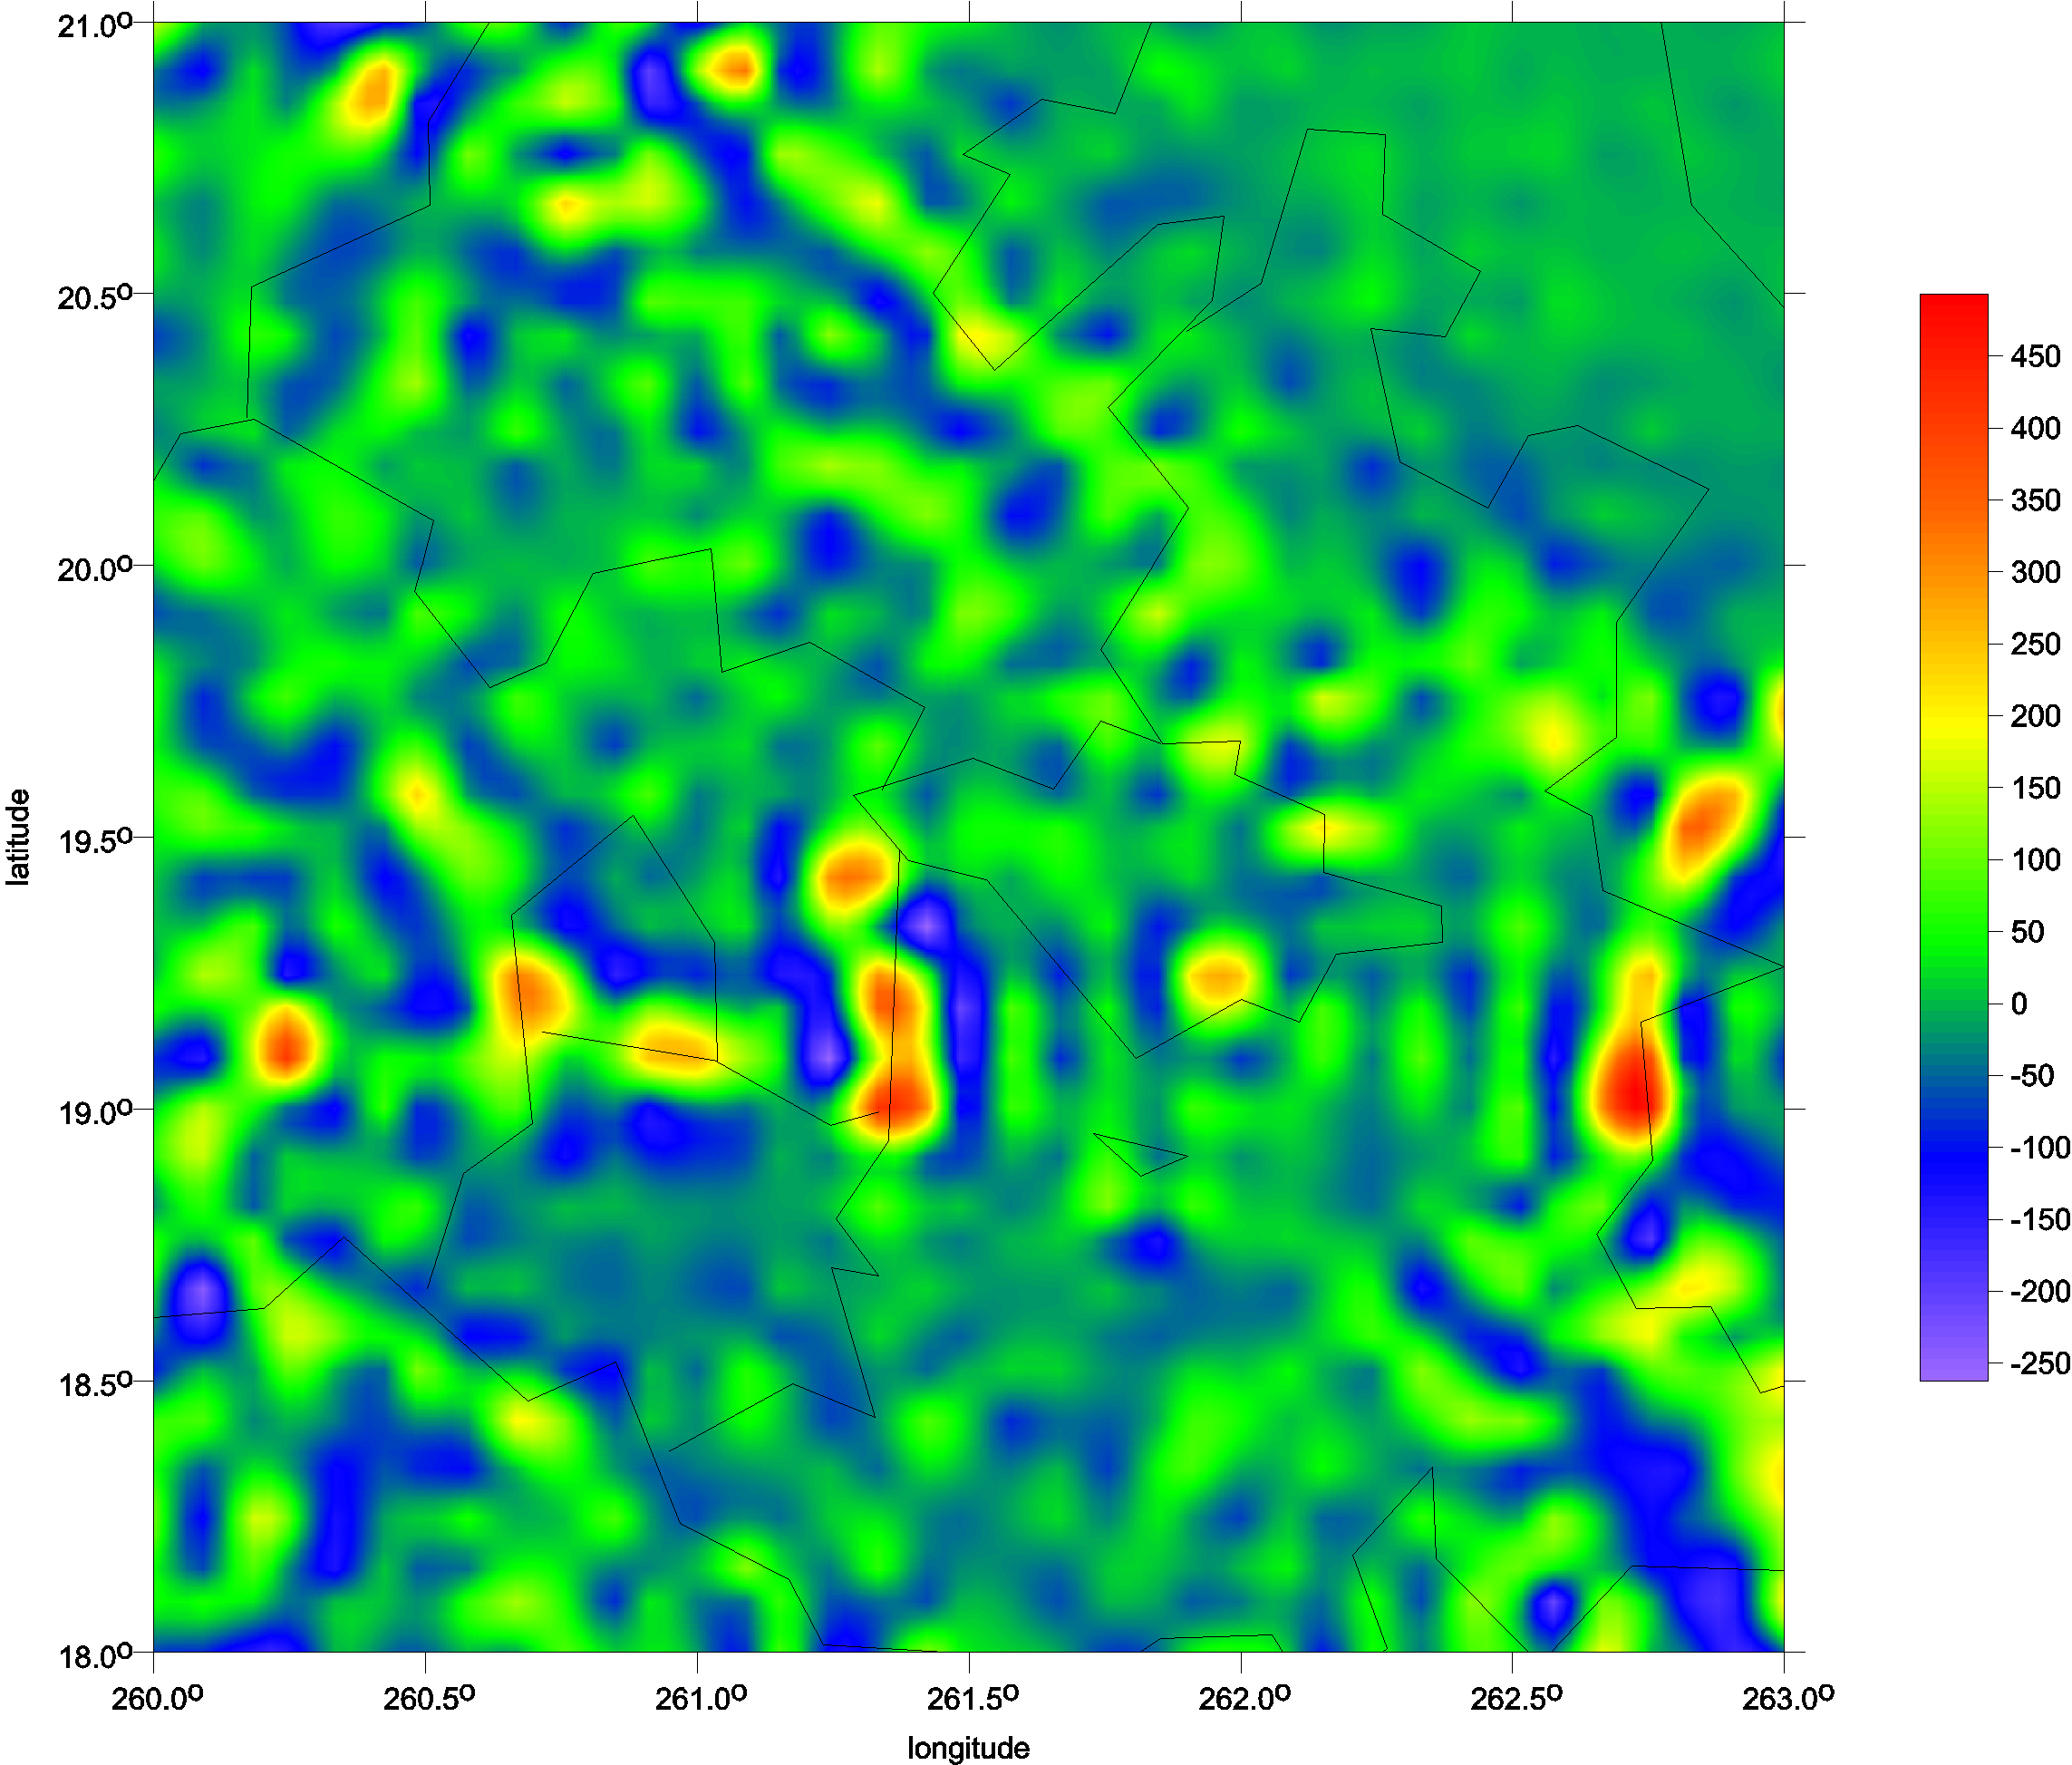
Typical volcanoes
Popokatepetl and Iztaccihuatl
Popocatepetl
Itzaccihuatl
∆g
T_{rr}

Slide 35
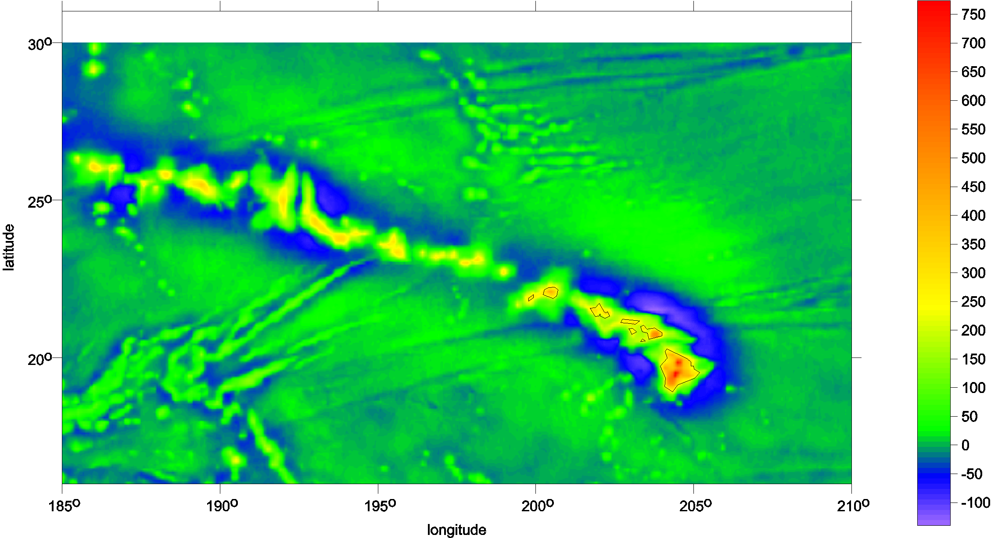
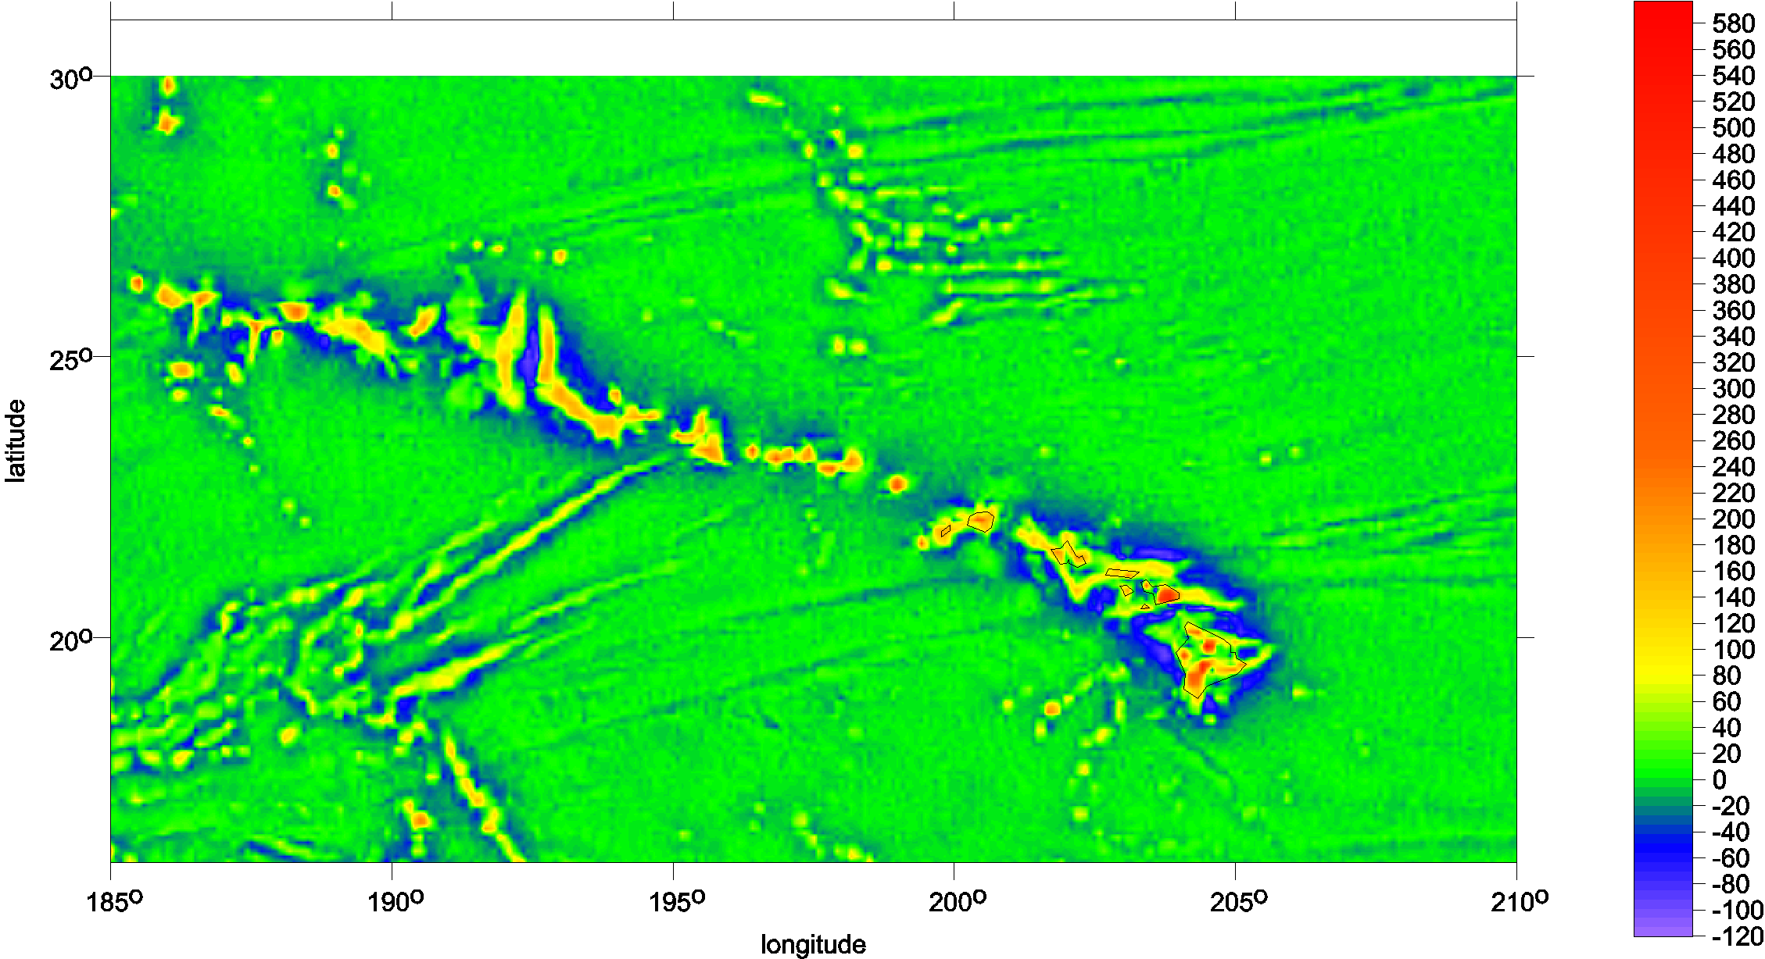
Hawai
gravity disturbance
Tzz

Slide 36
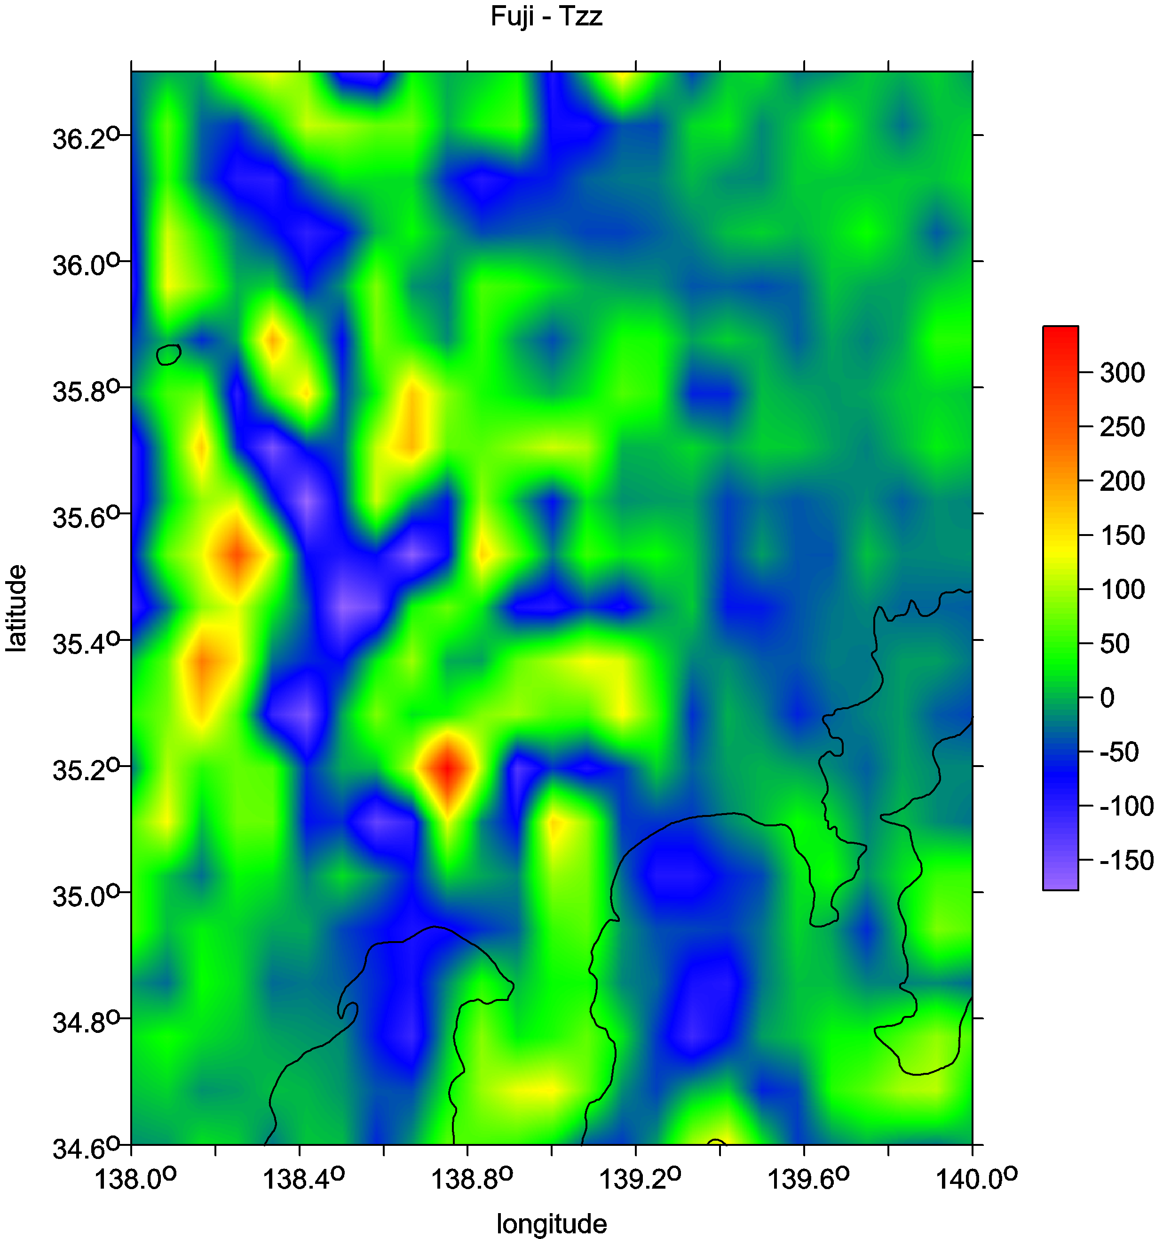
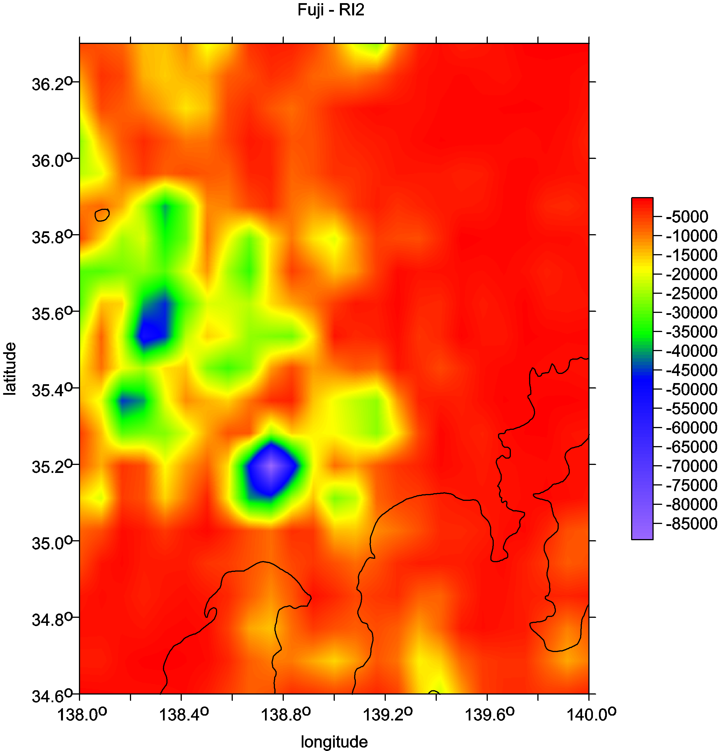
Fuji, Japan

Slide 37
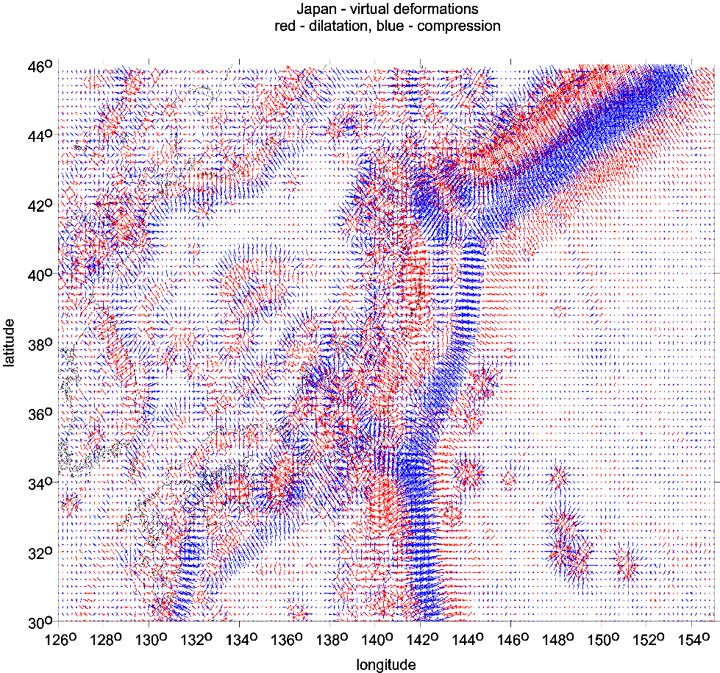
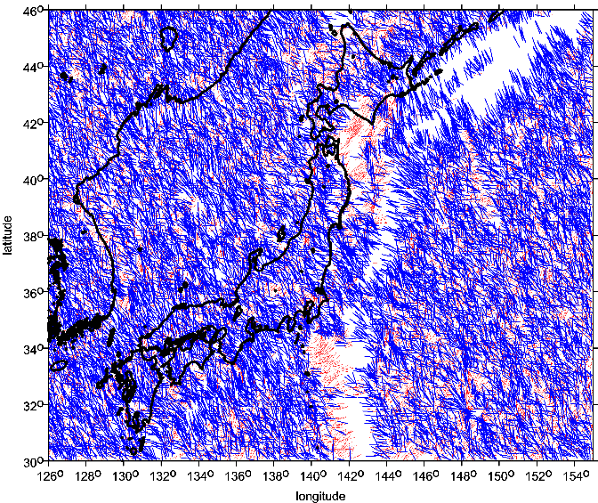
subduction zone, volcanoes under sea SE of Japan
virtual deformations
The strike angle θ_{S} for the ratio I > 0.3.

Slide 38
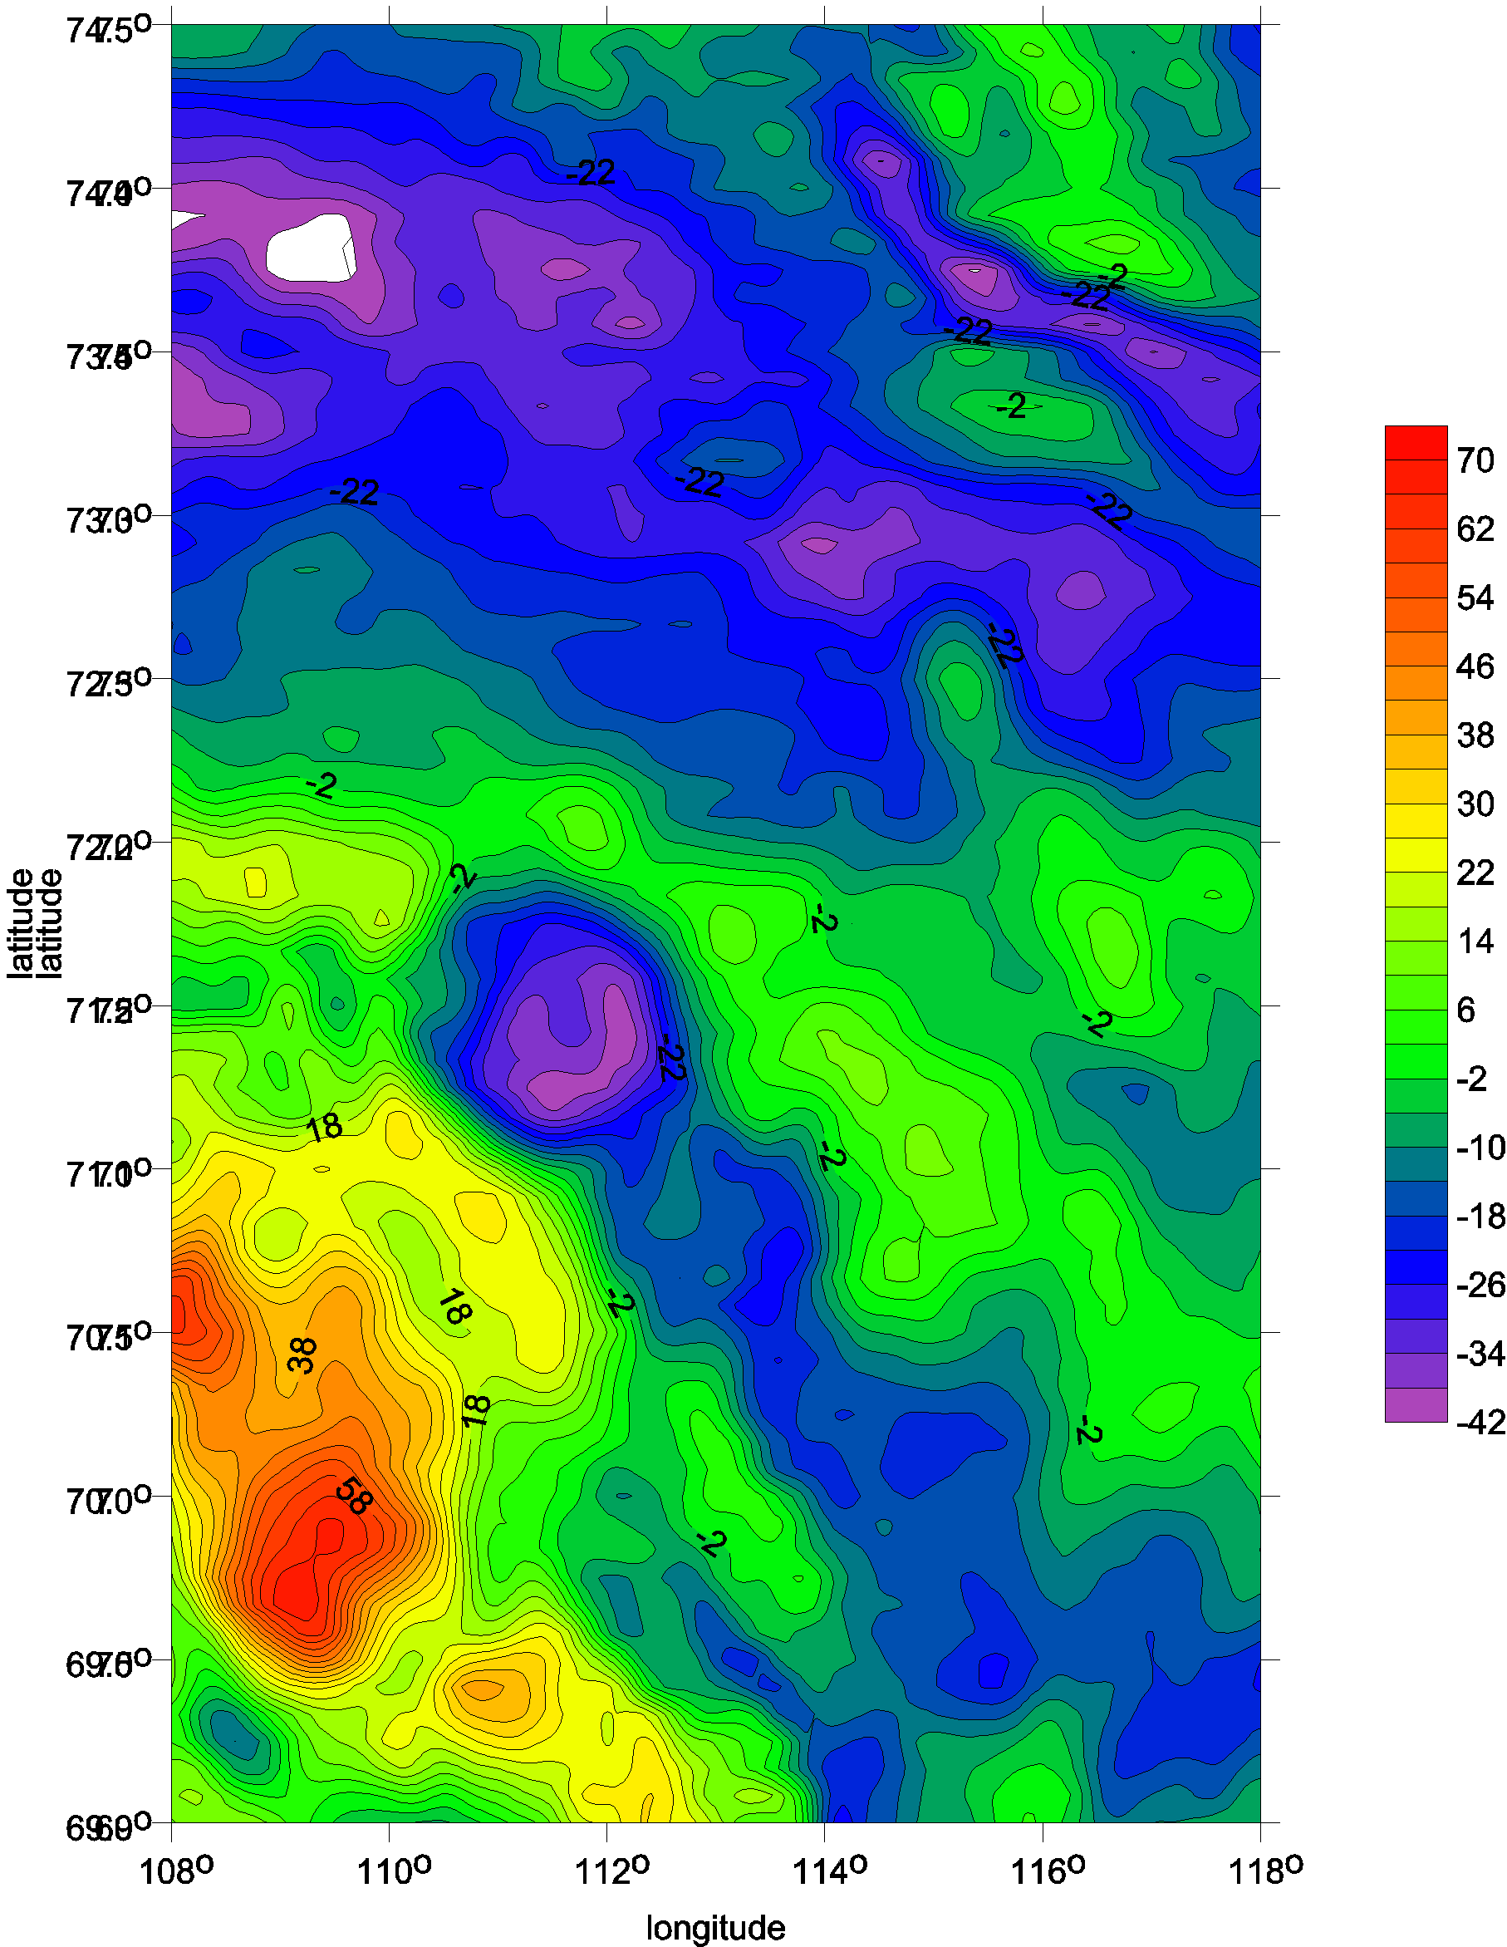
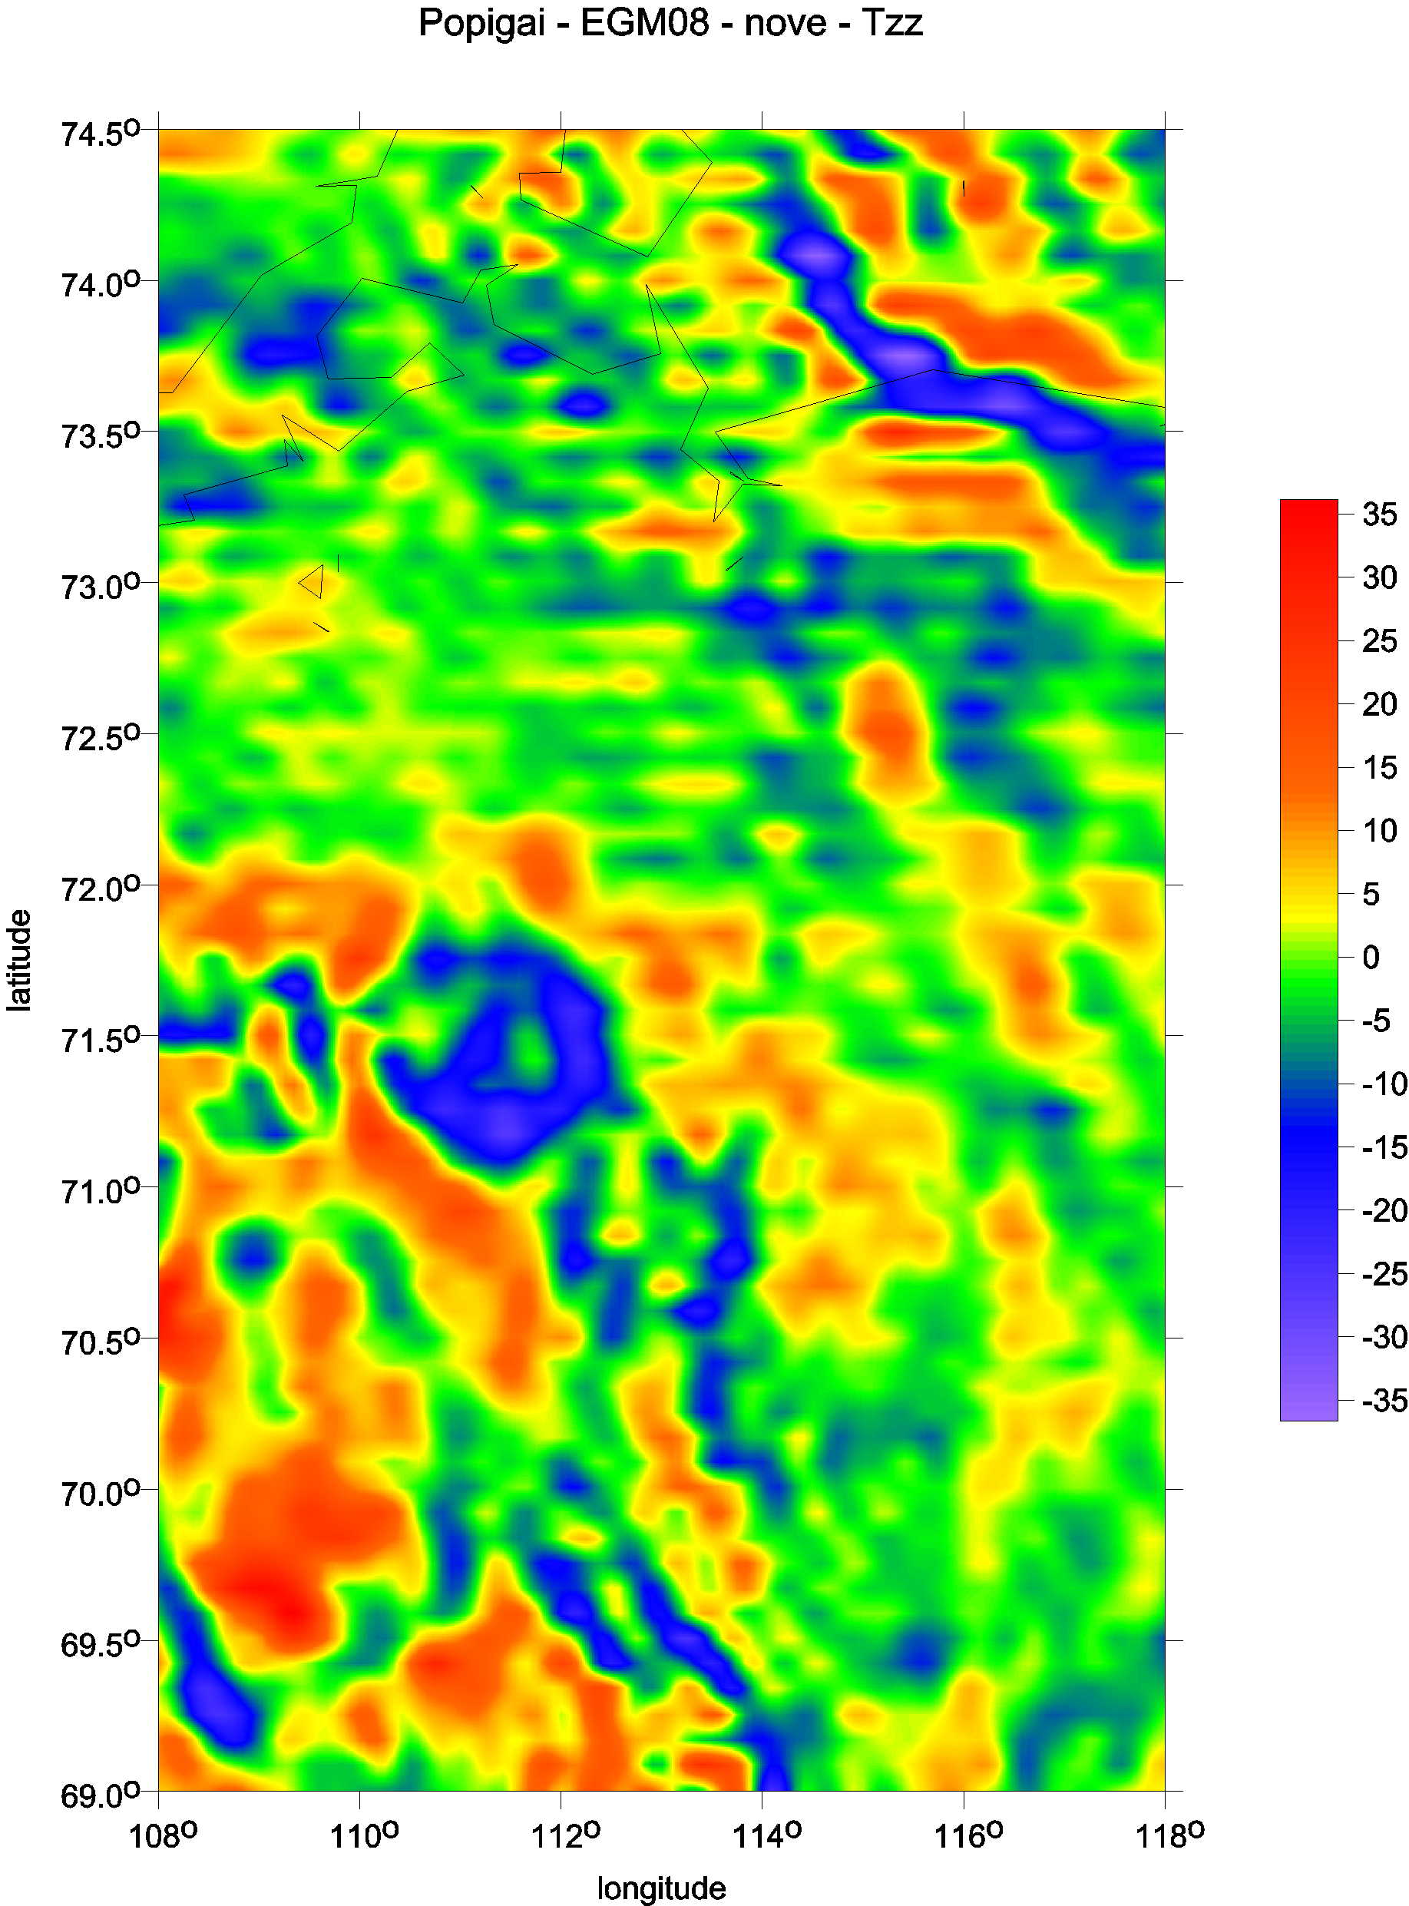
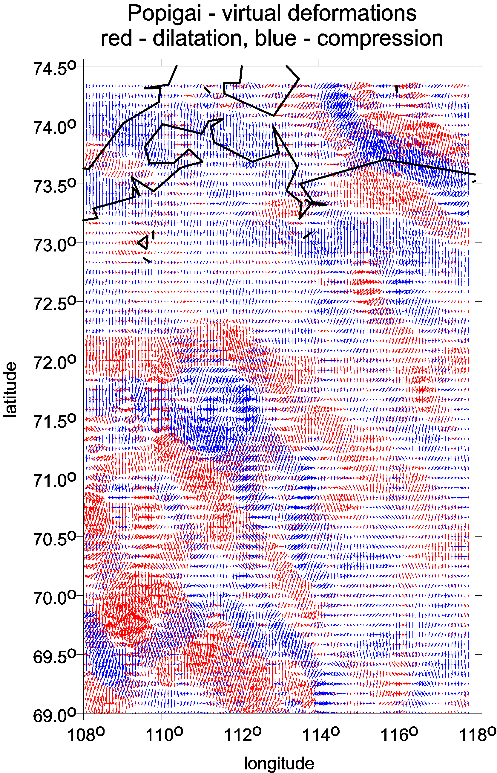
Large impact crater on the Earth Popigai, Siberia, diameter ~100 km Δ g Tzz vd
more in Klokočník et al. 2010

Slide 39
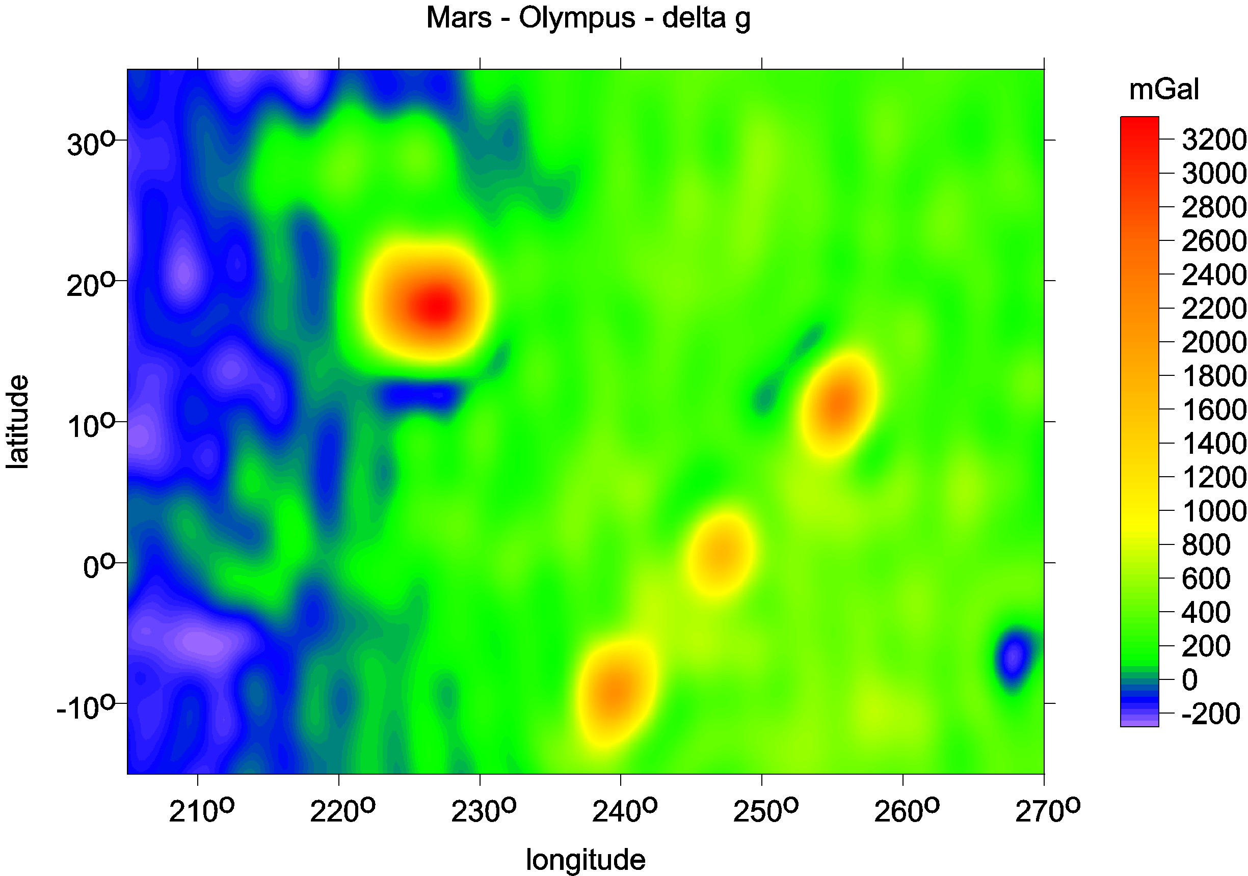
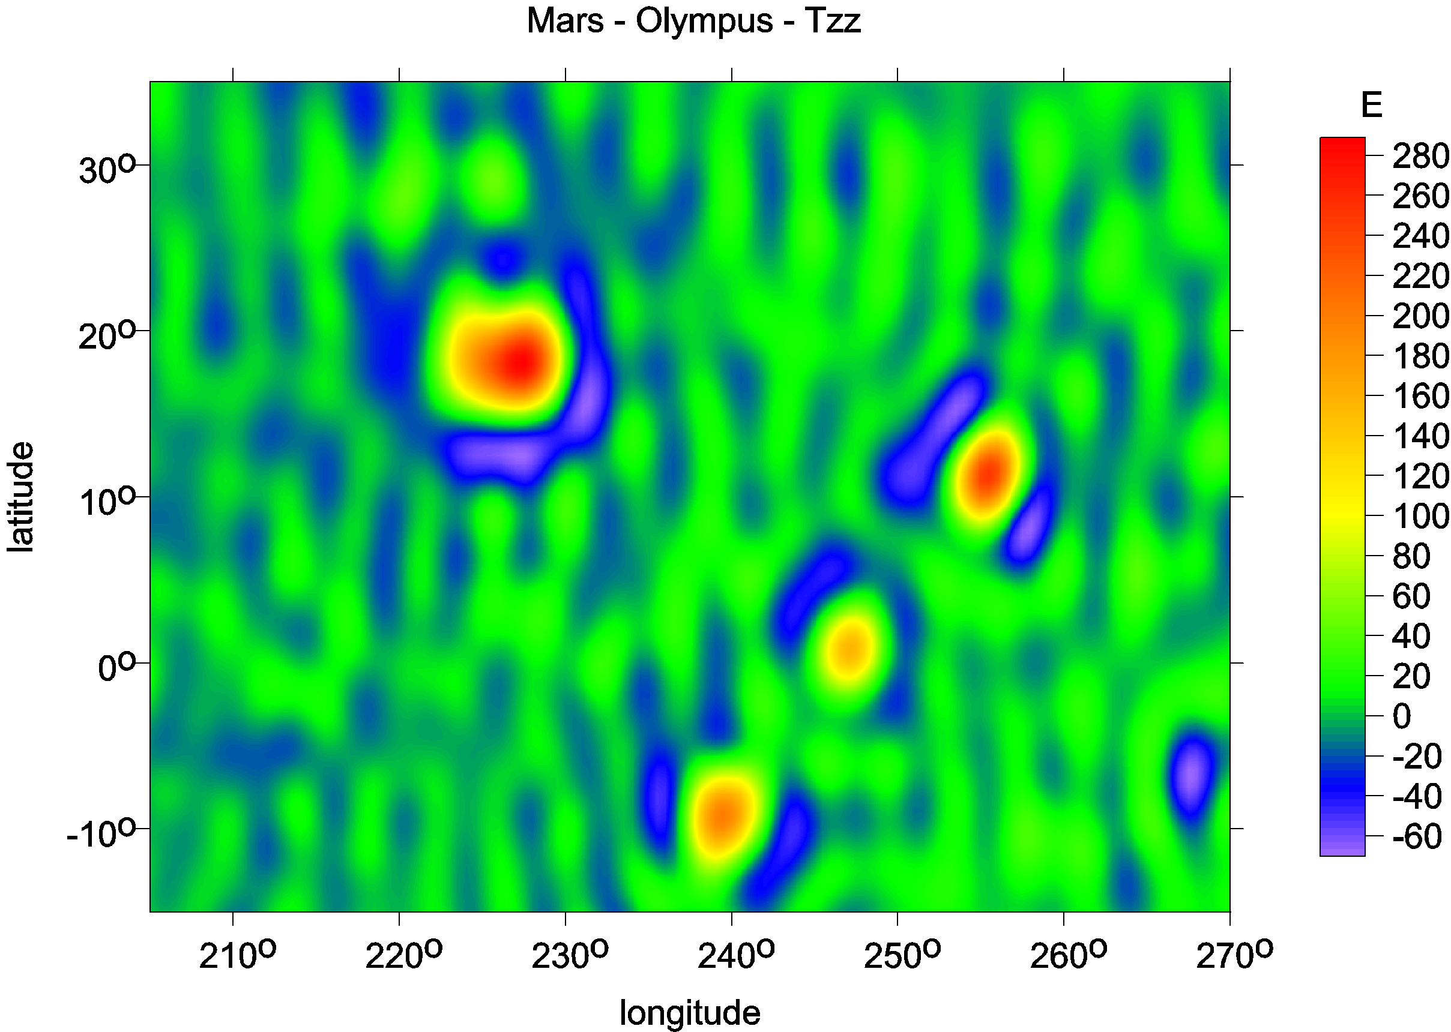
Mt Olymp, Mars
Marty et al,
potential to 95

Slide 40
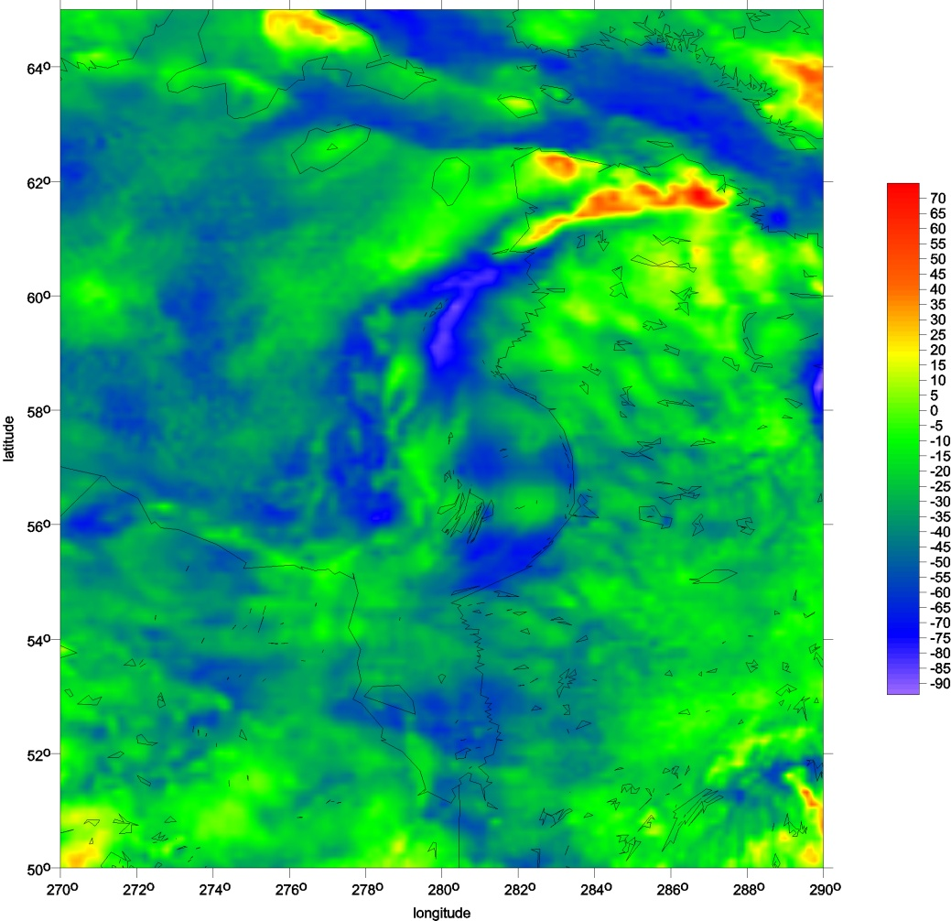
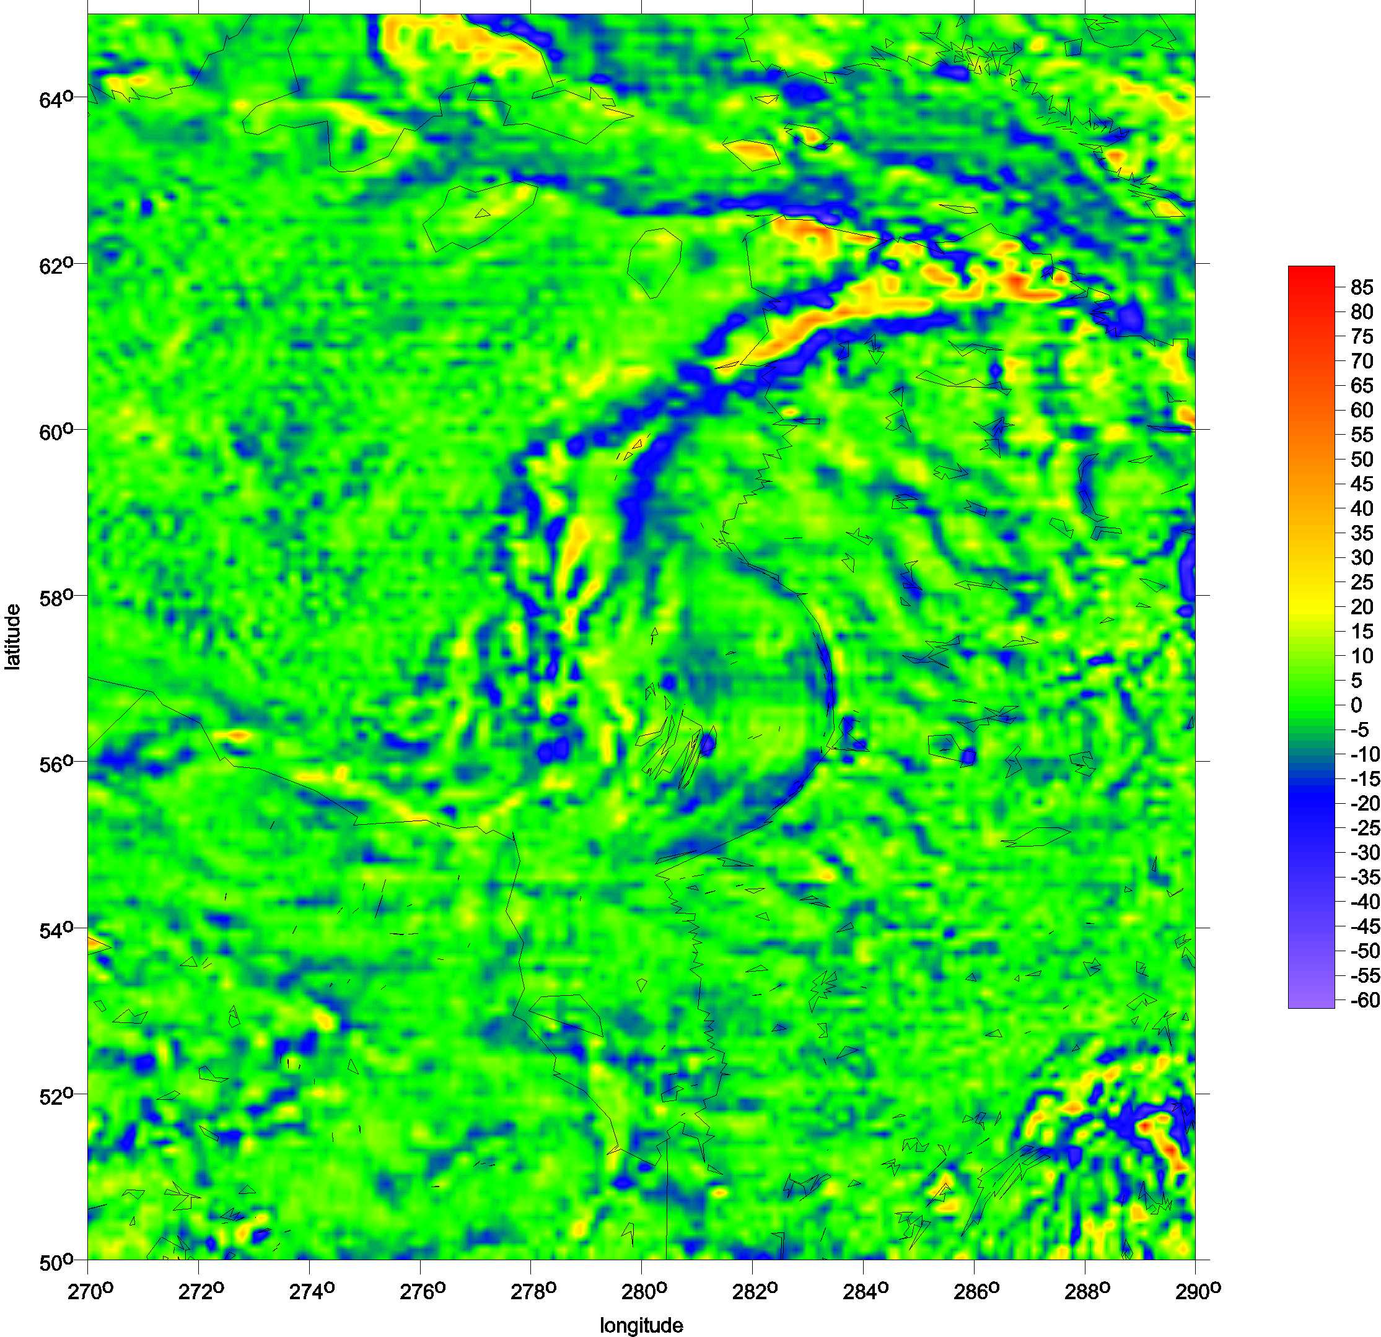
Canada – Hudson bay
EGU General Assembly Vienna, April 2009

Slide 41
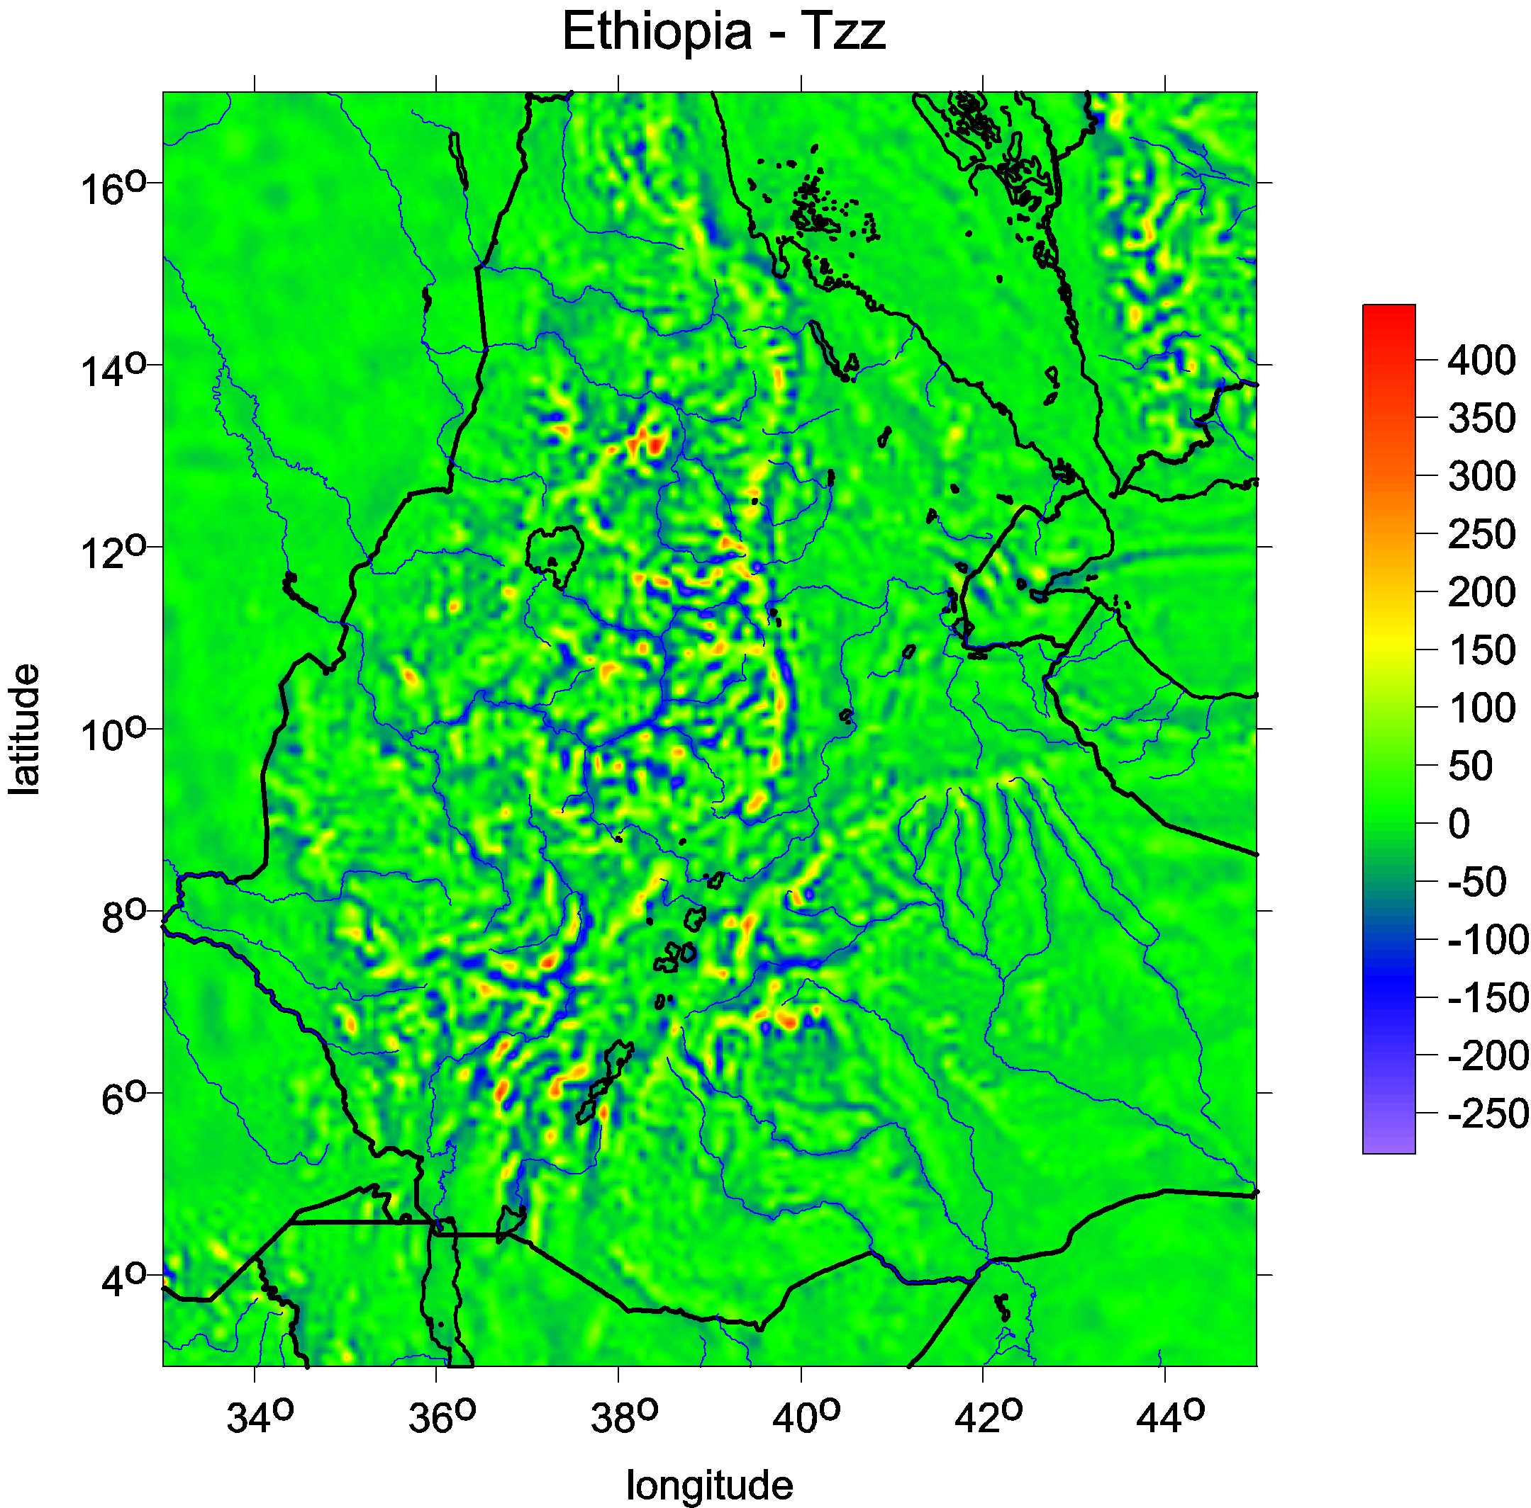
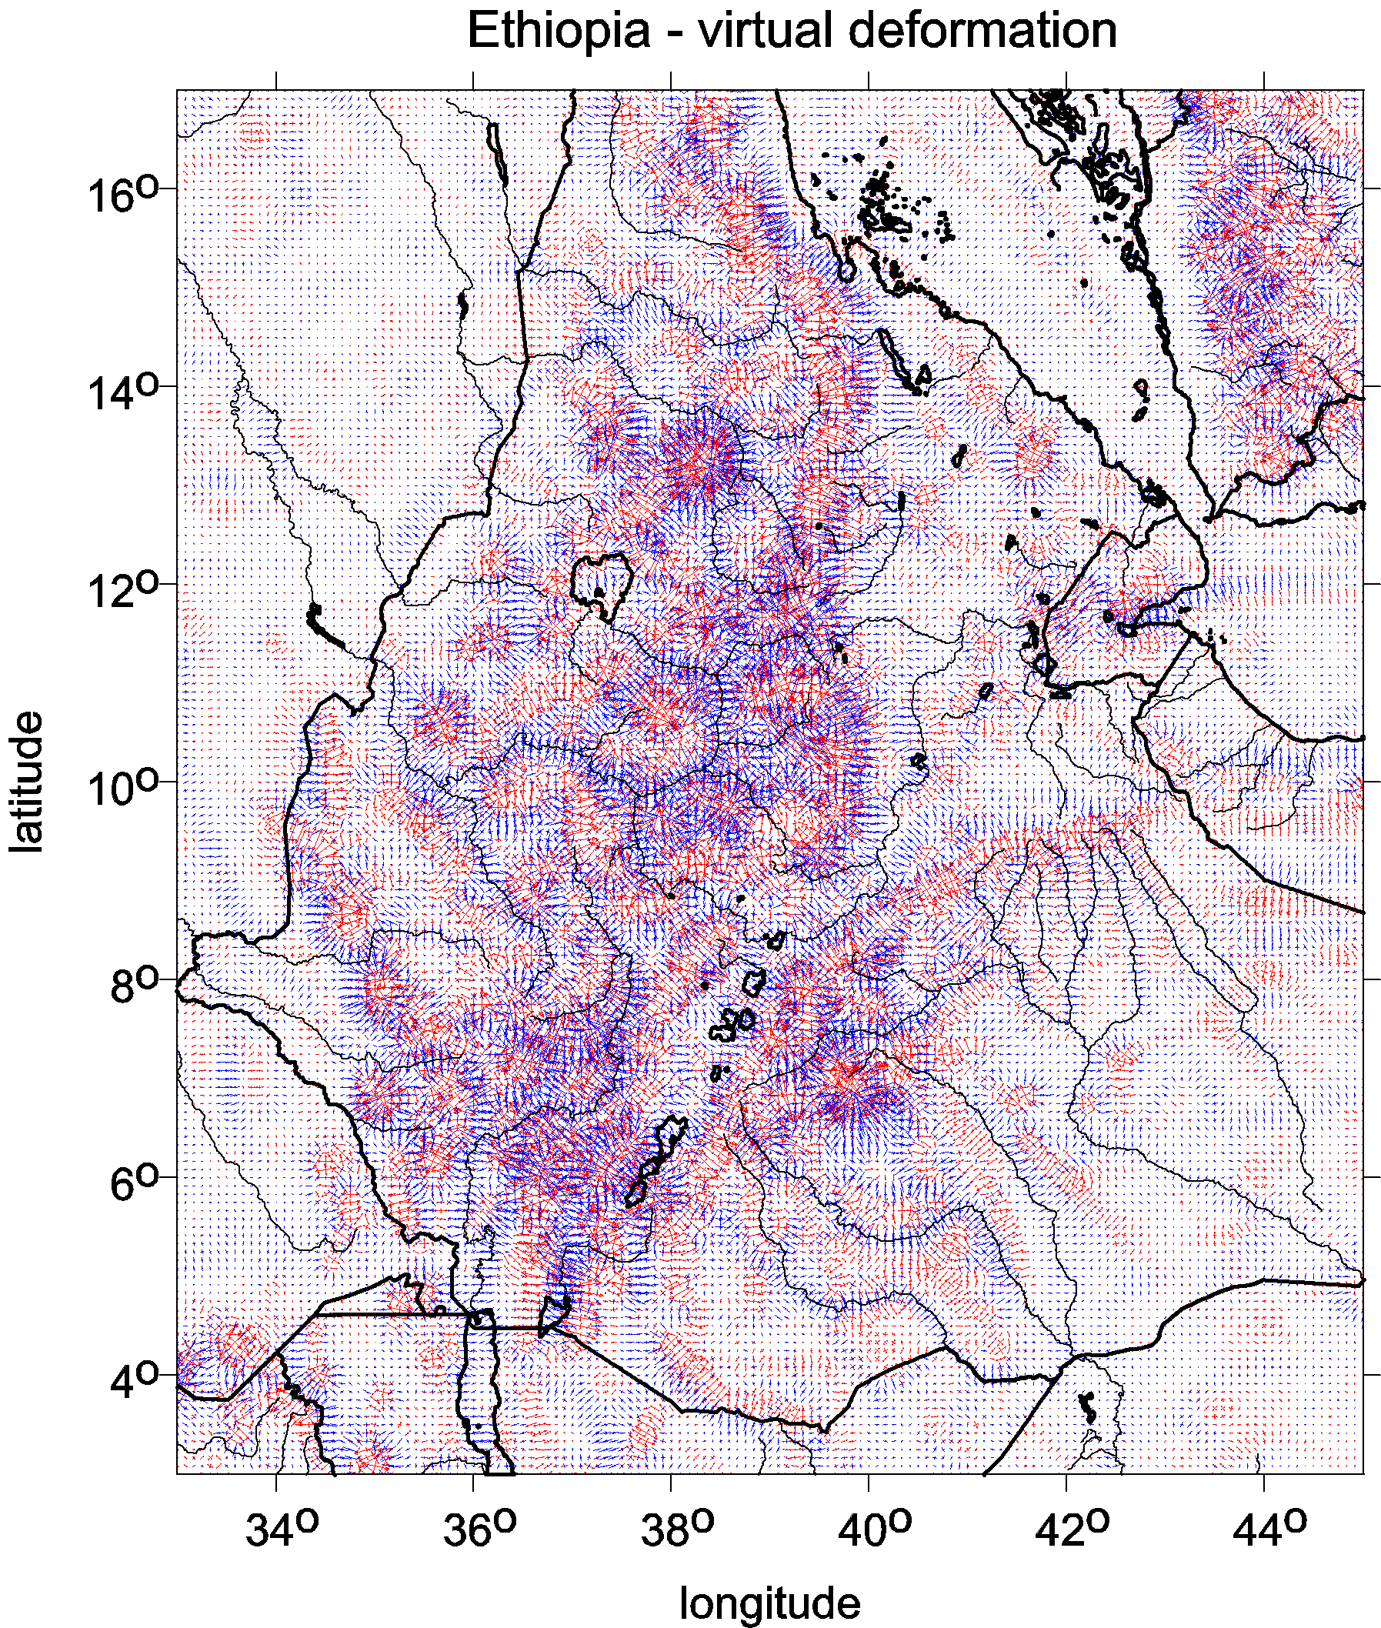
Ethiopia African land with quality terrestrial data in EGM 2008, rich river network, huge erosion

Slide 42


Slide 43



Yucon - Alaska
∆g
Google Earth
T_{rr}

Slide 44



Grand Canyon
Δg
T_{zz}

Slide 45


red… dilatation
blue …compression

Slide 46


Slide 47


Slide 48
Volcanoes in Antarctica
known and suspected

Slide 49



Slide 50


Mount Erebus is the second highest volcano in Antarctica (after Mount Sidley)
and the southernmost active volcano on earth. It is the sixth highest mountain on
an island. With a summit elevation of 3,794 metres, it is located on Ross Island,
which is also home to three inactive volcanoes, Mount Terror, Mount Bird, and Mount Terra Nova.
The volcano has been active since c. 1.3 million years ago and is the site of the Mount Erebus Volcano
Observatory run by the New Mexico Institute of Mining and Technology]
the RAT14 combination of the gravity from the EIGEN 6C4 and the topography from the Bedmap 2 in T_{zz},
the Ross Island topography detail.

Slide 51




e
f g
 | Version to print Weather at: Sidley Object map: Sidley |  | Regions: Antarctica Objects: Mt. Sidley (4181m) Activities: Mountaineering Service: VIP Program's difficulty: 3, relatively easy ( technical 2 + altitudinal 1 ) Group size: 6-10 Price: 56 990 USD or see cheaper option » Deposit for reservations 5 000 USD Full payment 90 days before No refund if you cancel less than 90 days! Buy it CHEAPER - TODAY!!! Next month the price will rise. The price is fixed at the moment of prepayment. Dates ( Days 17 / Nights 16 )………………..

Slide 52
Two questions:
Dvě otázky:
resolution
rozlišení
attentuation of the gravity signal under ice
tlumení tíhového signálu pod ledem
No principal obstacle to detect volcanoes under the ice?
Není tu žádná principiální překážka k detekci sopek pod ledem?

Slide 53



Havaj, Velký ostrov
Full model to 2190 vs cut at 300

Slide 54

A usual simple estimation of the smallest representable feature of the gravity field
or the shortest half-wavelength L_{half} (as a distance on the sphere)
that can be resolved with all C_{lm}, S_{lm} to L_{max}, is
L_{half} = π R/ L_{max}
or equivalently, taking the circumference 2πR = 40 050 km:
L_{half} = 2 π R/ 2 L_{max} = 40 050/ 2 L_{max}
For L_{max}= 300 and 2190, we have L_{half} = 67 and 9 km, respectively. BUT:
GOCE
and GRACE
groundtrack
densification
at poles
Example: Ground tracks of satellite missions GRACE (red) and GOCE (blue) near the South Pole. The latitude turning points result from orbit inclination, which is 89° for GRACE and 96.7° for GOCE. The ground track points of both missions are displayed for 5 days in December 2010.

Slide 55

Model of volcano under ice - attenuation of the signal
A model of volcano for investigation
of the attenuation of the gravitational signal (in Δg and T_{zz}) under a layer of ice,
as observed from the point P.
The volcanoes are modelled by
a homogeneous truncated cone,
with a "crater" of diameter 0.5 km
on its top.
Both Δg and T_{zz} due to the ice layer are given by closed formulae, namely
Δg = 2 π G σ R² h r⁻² (1 – cos Θ/2)
T_{zz} = –2 Δg r⁻¹,
where G is the universal gravitational constant, σ density,
r distance from the Earth's centre to the computed point P,
and Θ denotes the central angle of the spherical cap.

Slide 56
The slopes of the volcano model are taken as 83% and 15% for a stratovolcano and a shield volcano, respectively. The base of the cone depends on the volcano height and the slope. A constant density of 3.4 tons per km³ is used, but in the part of the volcano embedded in ice, it is reduced by the density of ice to avoid duplication of the ice contribution. The effect of the volcano model has to be obtained by numerical integration.
The anomalies Δg are calculated for a set of points distributed at an altitude of h_{P}=2.5 km over the volcano basis. The altitude strongly affects the resolution, e.g. at altitude h_{P}=10 km, the effect of the volcano is practically not detectable. The ice layers affect Δg by 5.6h [mGal] and their influence is small, while the relevant changes in T_{zz} [E] are negligible.
Stratovolcano (height h_{v} 2 km)
ice height h [km] | Dg [mGal] |  |  | T_{zz} [E]
 | volcano+ice | ice cap | volcano- ice
0 | 79 | 0 | 79 | 752
1 | 72 | 6 | 66 | 675
2 | 67 | 11 | 56 | 531
Shield volcano (h_{v} 0.67 km ; the same volume as the stratovolcano)
0 | 35 | 0 | 35 | 150
1 | 31 | 6 | 25 | 106
2 | 36 | 11 | 25 | 106
Shield volcano (height h_{v} 1 km)
ice height h [km] | Dg [mGal] |  |  |  | T_{zz} [E]
 | volcano + ice | ice cap | volcano - ice
0 | 71 | 0 | 71 |  | 242
1 | 56 | 6 | 50 |  | 271
2 | 62 | 11 | 51 |  | 174
Shield volcano (h_{v} 2 km)
0 | 220 | 0 |  | 220 |  | 544
1 | 188 | 6 |  | 182 |  | 501
2 | 167 | 11 |  | 156 |  | 384
The attenuation in gravity disturbancies is low, of about 20 % of the original value. The second radial derivative T_{zz} is not affected at all.

Slide 57
Two answers:
resolution
attentuation of the gravity signal under ice
No principal obstacle to detect volcanoes under the ice

Slide 58
Bedmap2 bedrock topography
Ross shelf glacier
and Ross Island,
2 Victoria Land
3 Transantarctic Mountains
4 Wilkes Land
5 Marie Byrd Land
Queen (Dronning)
Maud Land
7 Princess Elizabeth Land
Gamburtsev Mountains
(under the ice).
Lake Vostok
9

Slide 60


Slide 61


Slide 62


Slide 63


Slide 64


Slide 65


Slide 66








4

Slide 67





1
2
3
(a) T_{zz}, (b) I₂,
(c) the topography
from Badmap2,
(d) the Ross Island
topography detail.
(e) RET 14

Slide 68



5

Slide 69




8

Slide 70





9
9

Slide 71



Slide 72


Slide 73


Slide 74



Slide 75


Slide 76



Slide 77


Slide 78


Slide 79


Slide 80
Conclusions
No principal obstacle to detect volcanoes and other objects under the ice of A.
Low resolution today but progress expected in future.
Attenuation of the gravity signal under the ice not significant.
Use of various functions of the disturbing potential (EIGEN C64),
not only traditional gravity anomalies.
A combination of gravitational (EIGEN C64) and topographic (BEDMAP 2) data.
Tentative results for Queen Maud Land and area around Lake Vostok.
Testing of any other area on your request.

Slide 81
závěr si udělejte sami
tak děkuji za výdrž

Slide 82


Thank you for your attention
Děkuji Vám za pozornost
jklokocn@asu.cas.cz
Please visit
www.asu.cas.cz/~jklokocn

