Slide 1
Galaxy counterparts of DLAs
Johan Fynbo
Niels Bohr Institute /
University of Copenhagen
Collaborators:
Lise Christensen
Stefan Geier
Kasper Heintz
Jens-Kristian Krogager
Cedric Ledoux
Palle Møller
Pasquier Noterdaeme
CedrBram Venemans

Slide 2
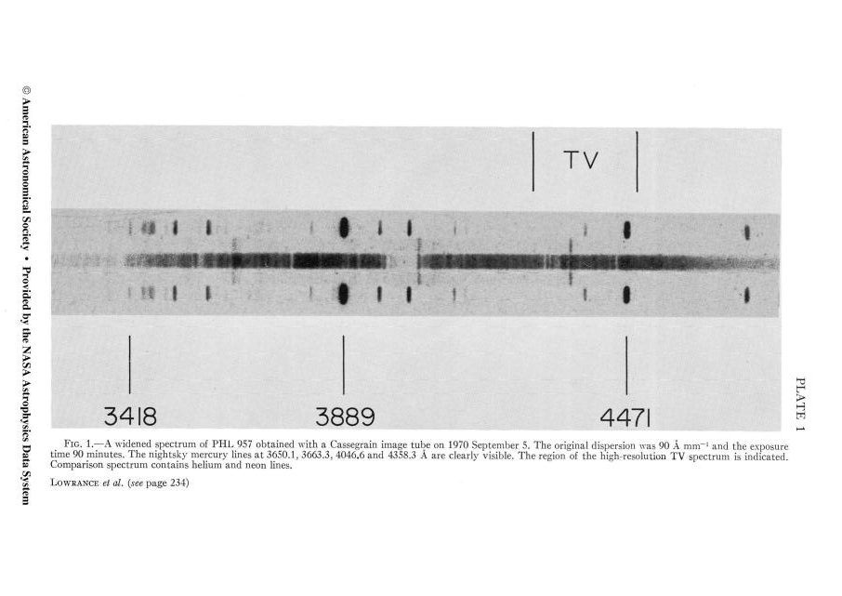
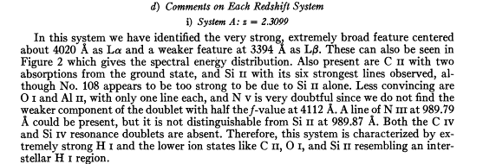
FIRST DLA: PHL957
PHL957, Lowrance et al. (1972), see also Beaver et al. (1972)

Slide 3
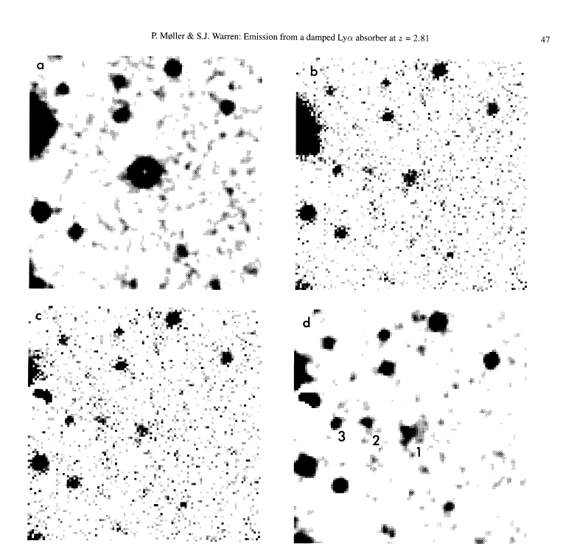
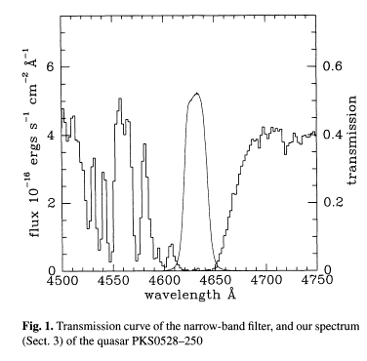
First detection of light from a DLA galaxy
PKS0528-250, z(DLA) = 2.81
Ly-alpha narrow-band imaging
Møller & Warren (1993)

Slide 4
Lyman-break Galaxies
(Steidel et al. 1996)

Slide 5
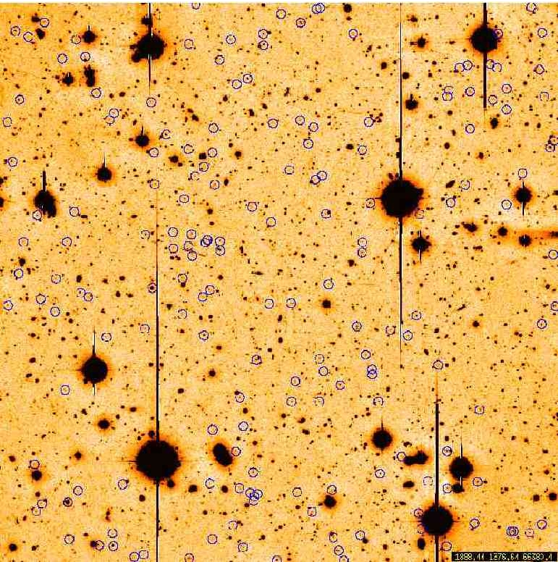

Slide 6
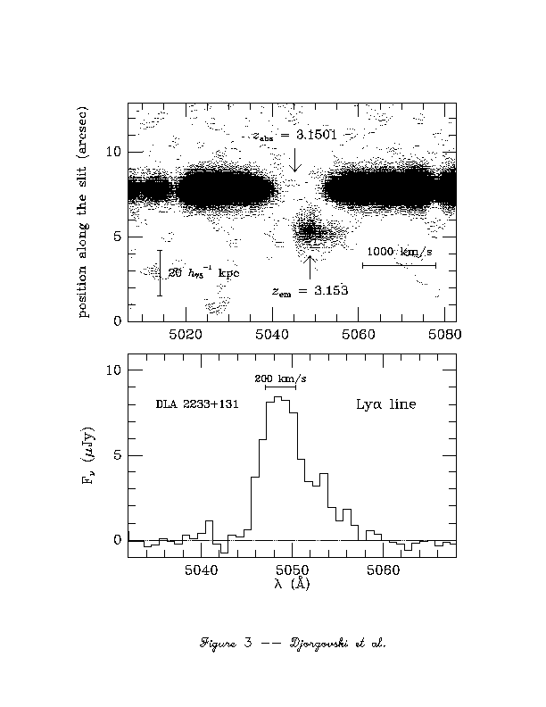
Djorgovski et al. (1996, Nature)

Slide 7
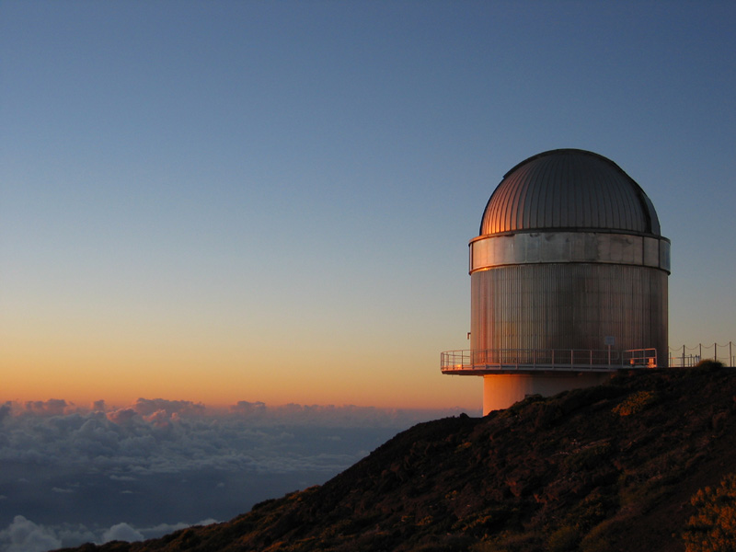
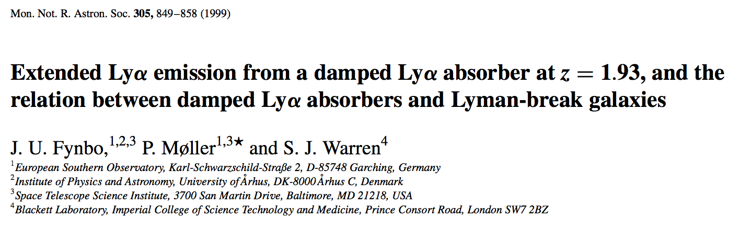

LBGs
DLAs
Similar conclusions reached by Haehnelt et al. (2000) and Schaye (2001)

Slide 8
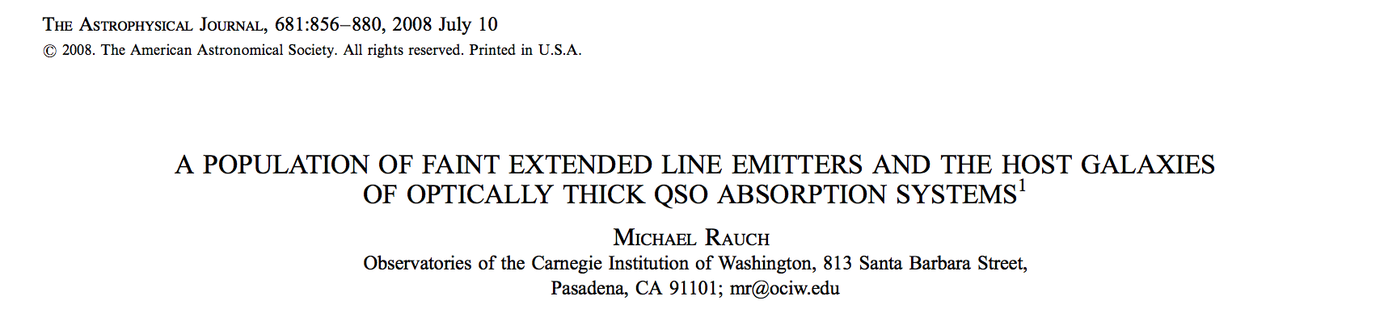
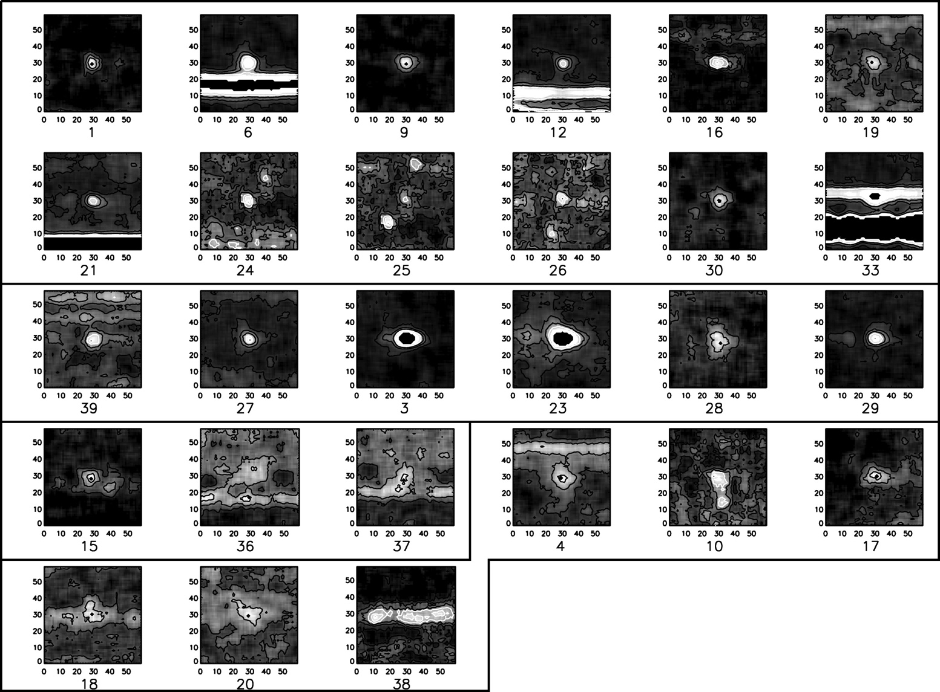
92 hr with FORS2 / VLT

Slide 9
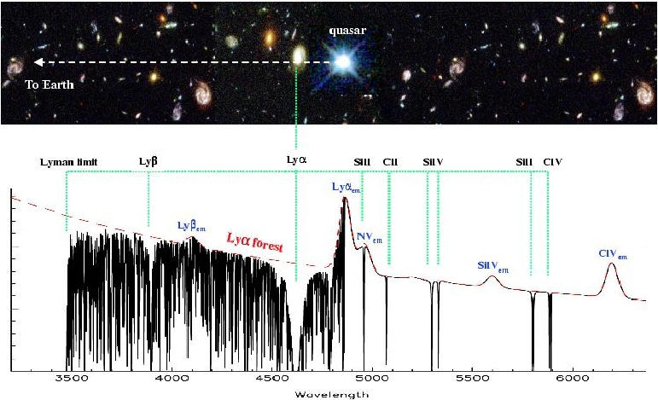
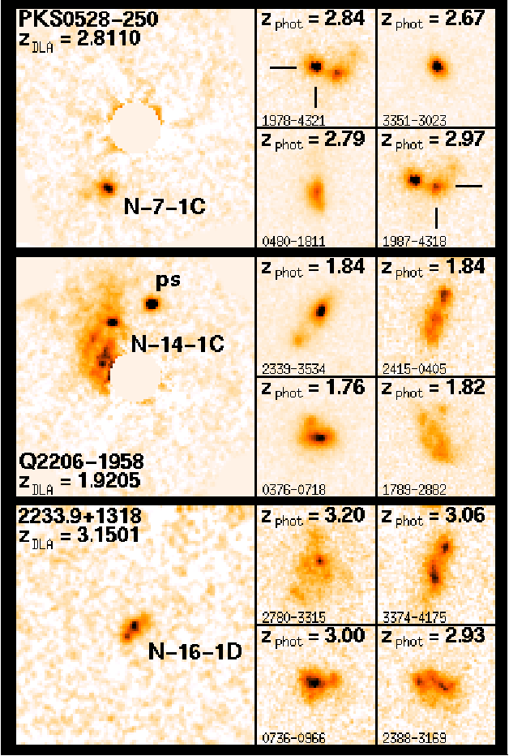
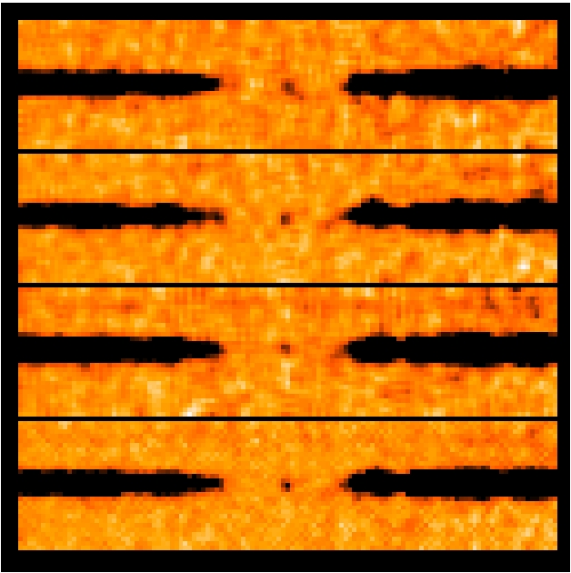
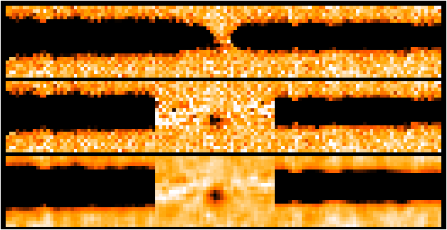
Galaxy counterparts
HST / STIS
VLT
Q2206-199, z(DLA)=1.92
VLT
PKS0458-02, z(DLA)=2.04
10 null detections per detection
Møller et al. (2002)

Slide 10
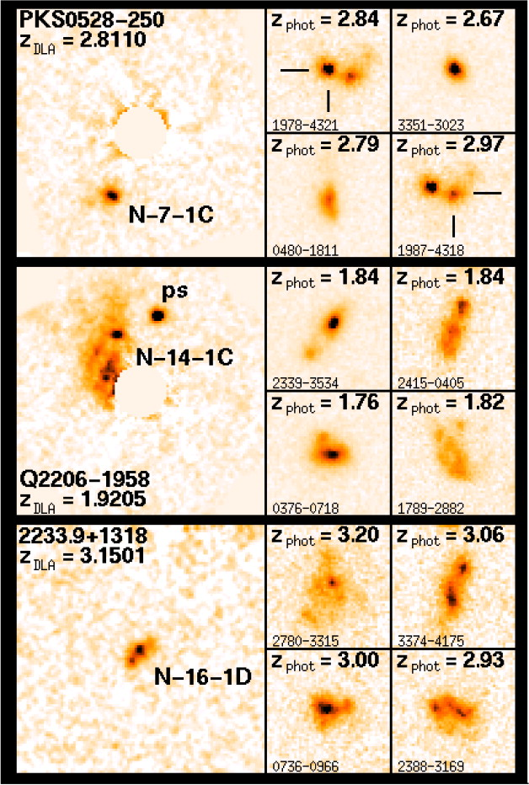
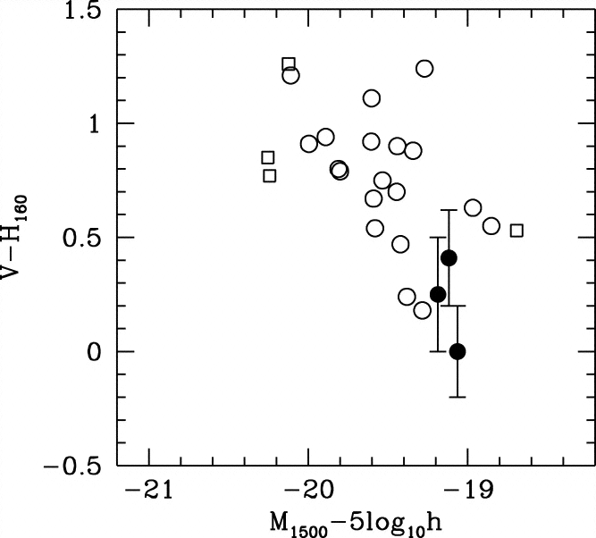
DLA galaxies are (faint) LBGs
(Møller et al. 2002)

Slide 11
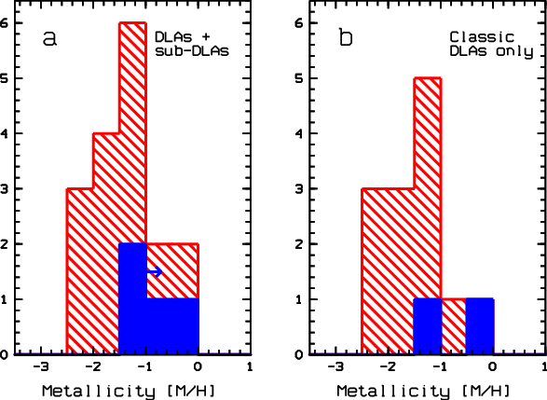
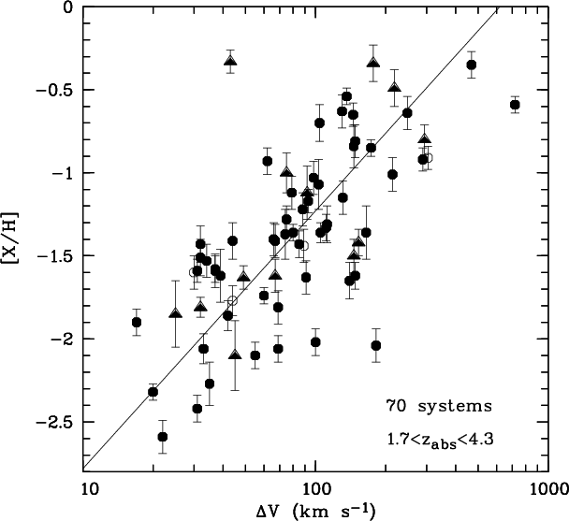
Mass(?)-metallicity and Luminosity-Metallicity relations?
Møller et al. 2004; Ledoux et al. 2006

Slide 12
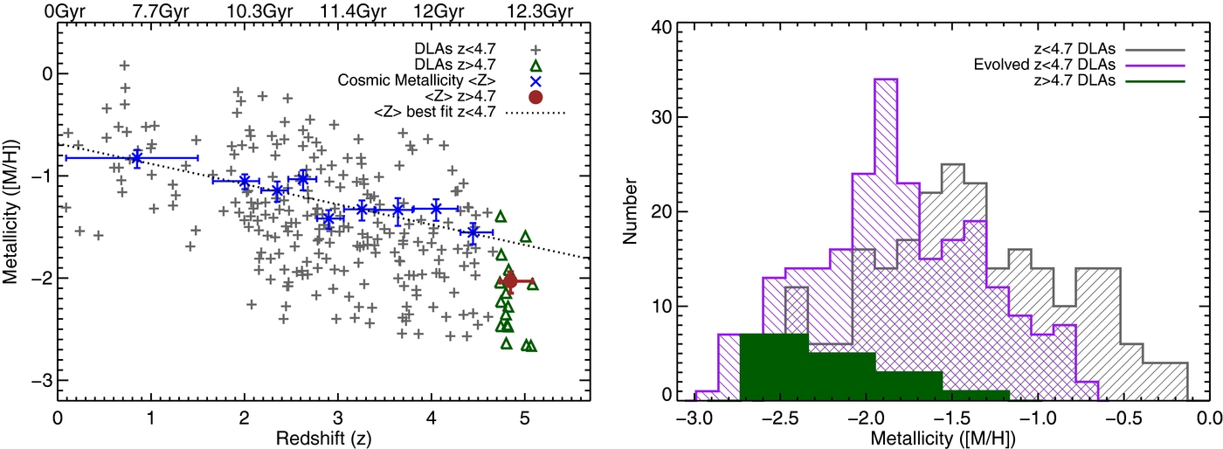
Galaxy counterparts: wide range of metallicities
Rafelski et al. (2014)

Slide 13
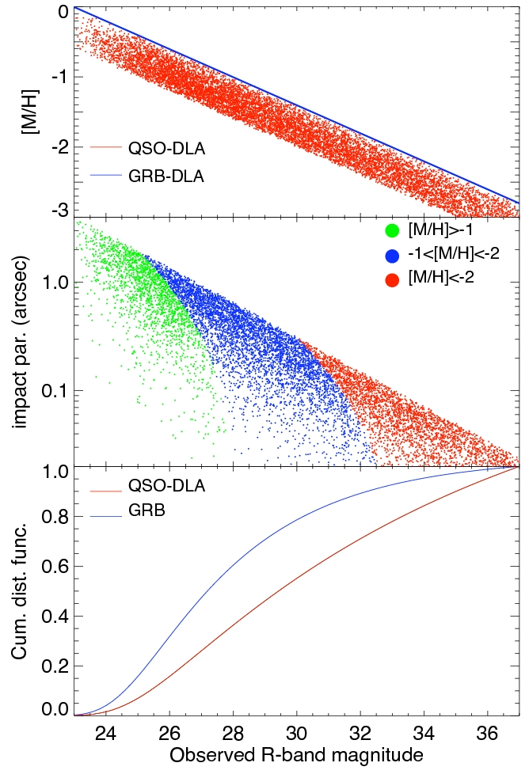
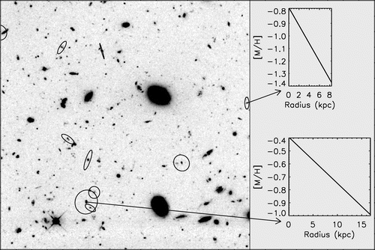
Reconciling metallicity distributions for LBGs, GRB hosts and DLAs
Fynbo et al. (2008), see also #843

Slide 14
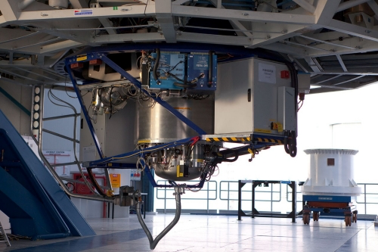
X-shooter Project
(ALMA & MUSE: #838, #93, #94)

Slide 15
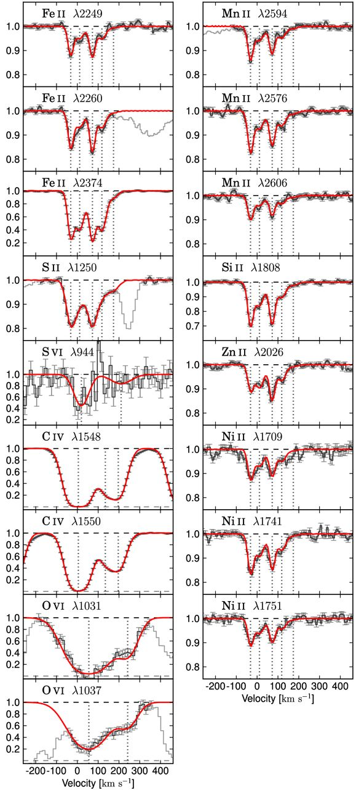
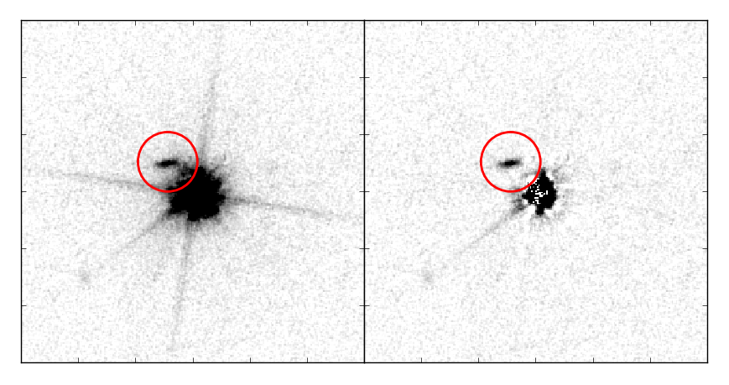

Krogager et al. (2013)

Slide 16
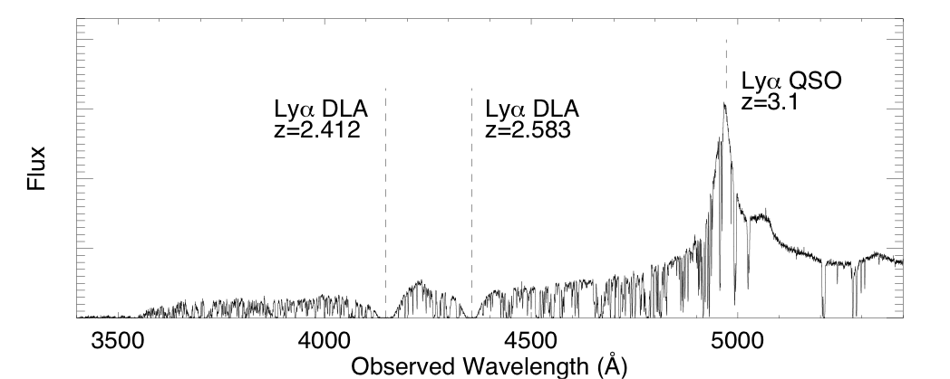
Two DLAs at z=2.42 and z=2.58 towards Q0918+1636
Fynbo et al. 2011, 2013

Slide 17
Two DLAs at z=2.42 and z=2.58 towards Q0918+1636
Fynbo et al. 2011, 2013

Slide 18
z=2.58 DLA towards Q0918+1636:
[Zn/H]=-0.12, [Zn/Cr]=0.8, H₂, CI, SFR≈20M/yr

Slide 20
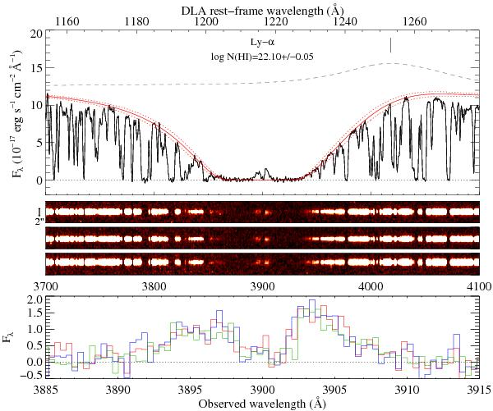
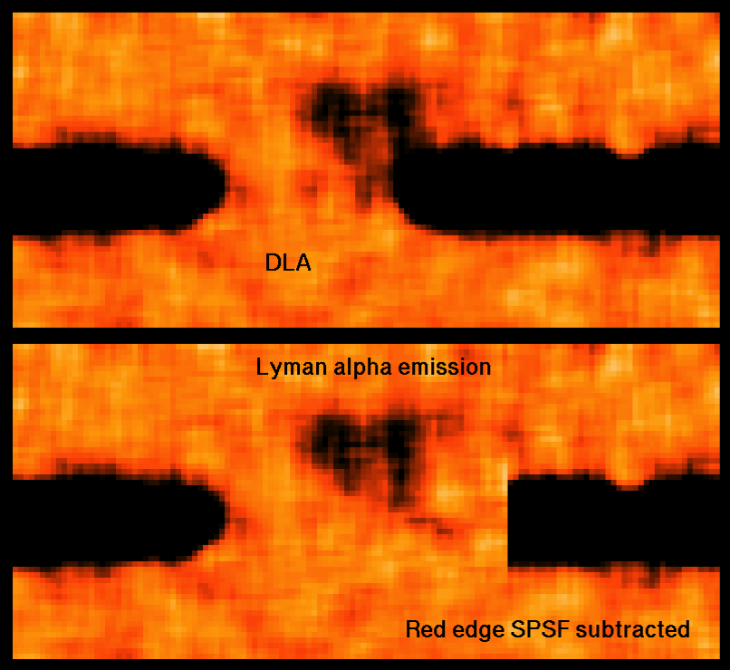
More detections
Noterdaeme et al. (2012)
Zafar et al. (2016)

Slide 21
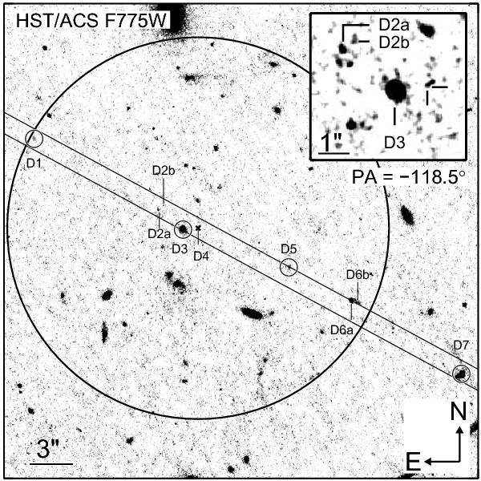
Non-QSO sightlines
Schulze et al. (2012)

Slide 22
Scaling relations

Slide 23
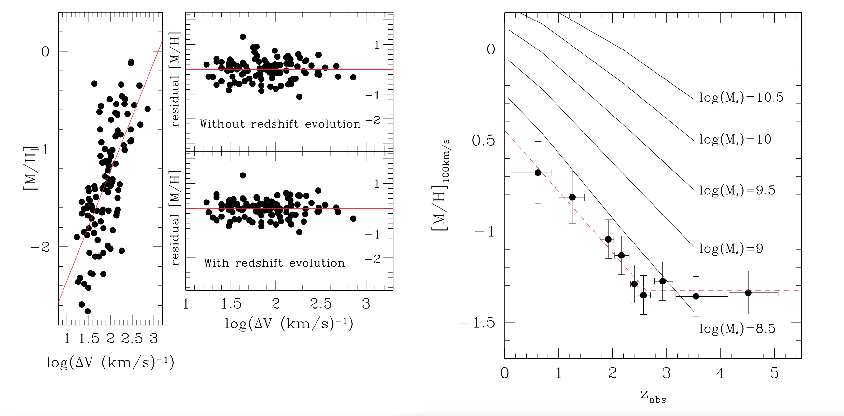
Møller et al. (2013) : Mass-metallicity relation from z = 5 to the present: evidence for a transition in the mode of galaxy growth at z = 2.6 due to the end of sustained primordial gas infall

Slide 24
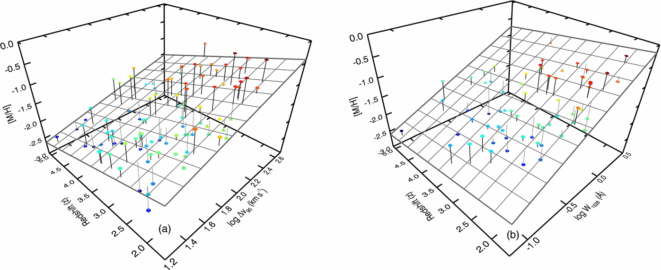
Neeleman et al. (2013): THE FUNDAMENTAL PLANE OF DAMPED Lyα SYSTEMS

Slide 25
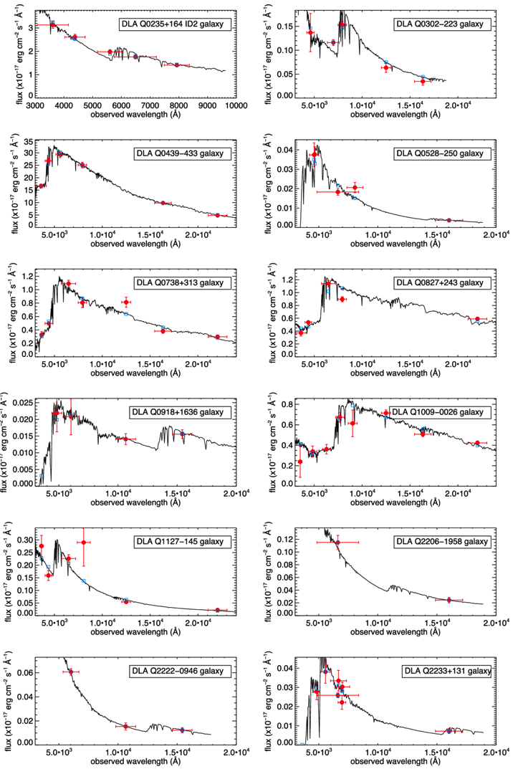
From: Verifying the mass–metallicity relation in damped Lyman α selected galaxies at 0.1 < z < 3.2
Christensen et al. (2014)
Notes:
Figure 1. Best-fitting SED models for all the DLA galaxies. The red dots denote the measured photometric points and the blue open squares are the expected flux density from the best-fitting SED model.
25

Slide 26
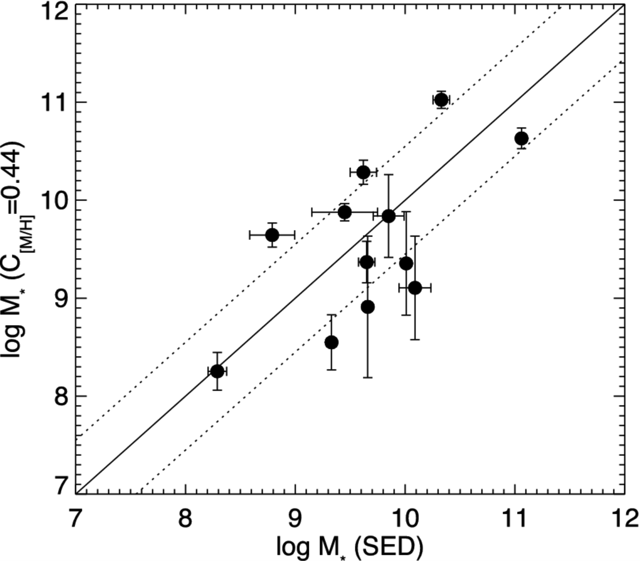
From: Verifying the mass–metallicity relation in damped Lyman α selected galaxies at 0.1 < z < 3.2
Christensen et al. (2014)
Notes:
Figure 2. Predicted stellar masses of DLA galaxies based on equation (1) with C<sub>[M/H]</sub> = 0.44 as a function of the stellar mass measured directly from the SED fits. The straight solid line represents equal masses and the measured scatter of ± 0.55 dex in logM<sub>*</sub> is represented by the dotted straight lines.
26

Slide 27
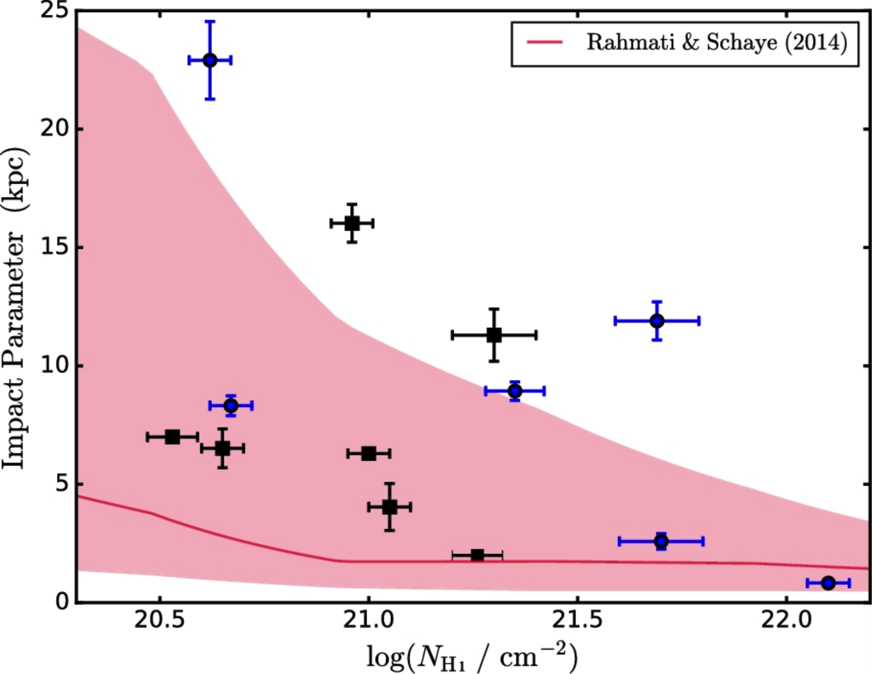
Krogager et al. (2017): Consensus report on 25 yr of searches for damped Ly α galaxies in emission: confirming their metallicity-luminosity relation at z ≳ 2
Notes:
Figure 8. Column density of neutral hydrogen versus impact parameter. Black squares and blue circles mark the detections from our X-shooter campaign and the literature sample, respectively, see Table 5. The red line shows the median of the distribution of impact parameters from the simulations by Rahmati & Schaye (2014), and the red shaded region encompasses 68 per cent of this impact parameter distribution.
27

Slide 28
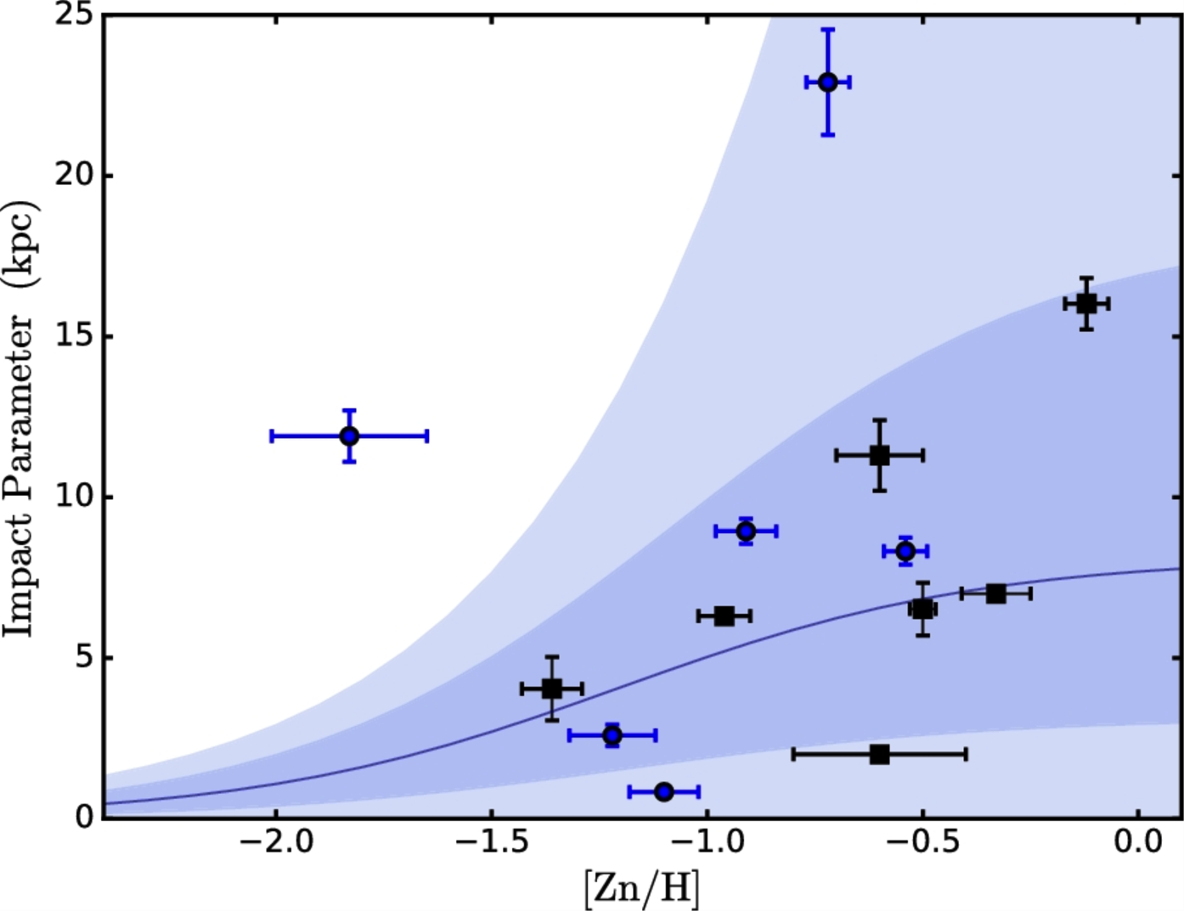
Krogager et al. (2017): Consensus report on 25 yr of searches for damped Ly α galaxies in emission: confirming their metallicity-luminosity relation at z ≳ 2
Notes:
Figure 9. Metallicity versus impact parameter. Black squares refer to detections from the X-shooter campaign presented in this work. Blue circles indicate detections from the literature, see Table 5. The light blue shaded region shows the extent of DLAs as a function of metallicity from the model of F08-CG. The solid blue line marks the median impact parameter expected from the F08-CG model and the darker shaded region encompasses 68 per cent of the impact parameter distribution.
28

Slide 29
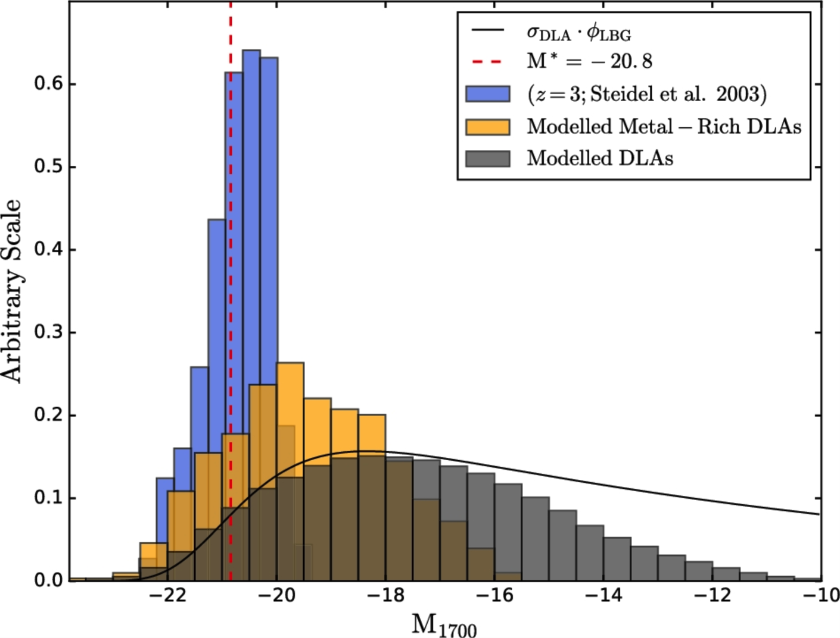
Krogager et al. (2017): Consensus report on 25 yr of searches for damped Ly α galaxies in emission: confirming their metallicity-luminosity relation at z ≳ 2
Notes:
Figure 10. Distribution of rest-frame UV luminosities. The solid black line marks the LBG luminosity function weighted by the DLA cross-section from the F08 model.
29

Slide 30
Main points and a bit of an outlook
Major progress
Strong evidence for scaling
relations. Origin?
Would be interesting to probe
both lower metallicities
(MUSE, JWST, ELTs) and
higher metallicities (dust bias)
better.
Connection to simulations.

Slide 31
Evidence for dust extinction

Slide 32
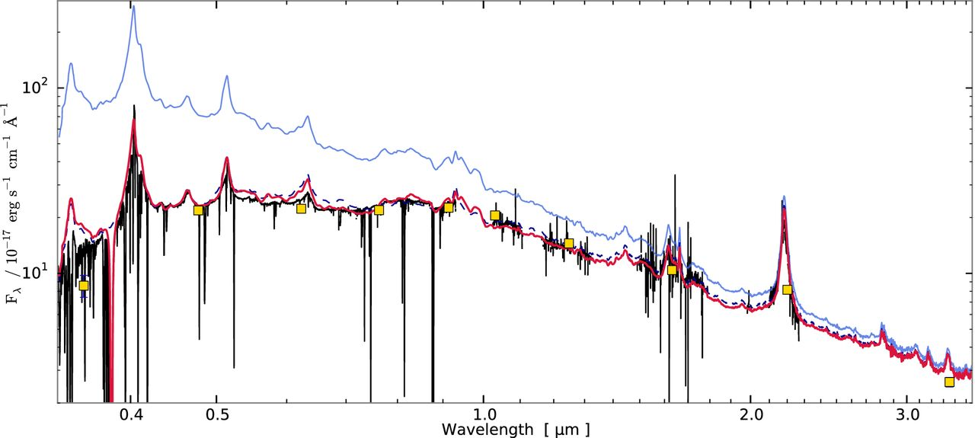
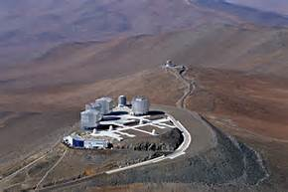
The X-shooter spectrum of quasar J 2225+0527 shown in black together with the photometry from SDSS, UKIDSS, and WISE band.
J.-K. Krogager et al. MNRAS 2016;455:2698-2711
Notes:
The X-shooter spectrum of quasar J 2225+0527 shown in black together with the photometry from SDSS, UKIDSS, and WISE band 1 (shown in yellow squares, the errorbars are too small to be seen). The spectrum in the top panel has been smoothed for presentation purposes. The telluric absorption regions in the NIR (at ∼1.0, 1.1, 1.5, and 1.9 μm) have been masked out. The blue solid curve shows the unreddened quasar template, and the red solid curve shows the same template assuming the best-fitting dust model with iron emission and Ly α absorption included, see Section 4. For reference, the blue dashed line shows the best-fitting dust model without including the iron emission template. The largest offset between the red and the dashed line is observed around the C iii] emission line at ∼ 0.6 μm.

Slide 34
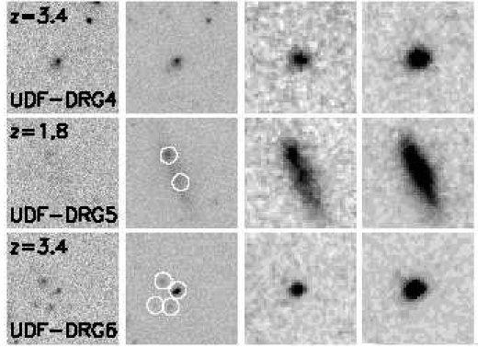
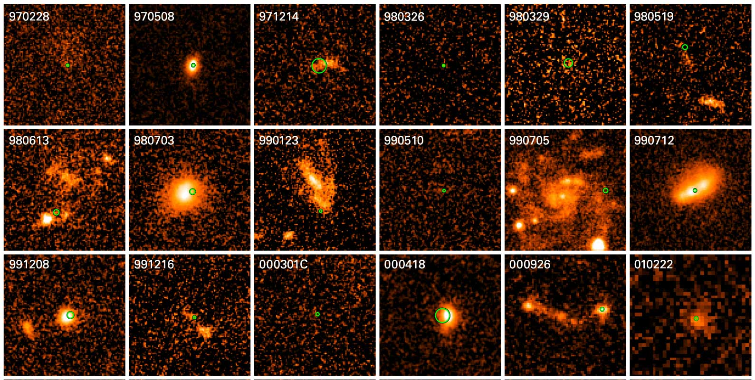

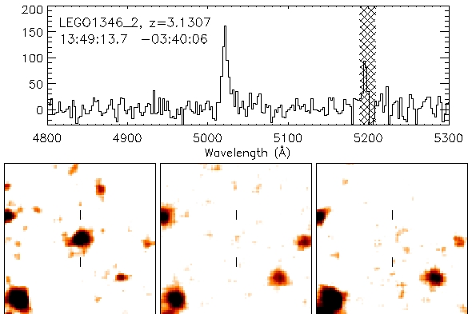
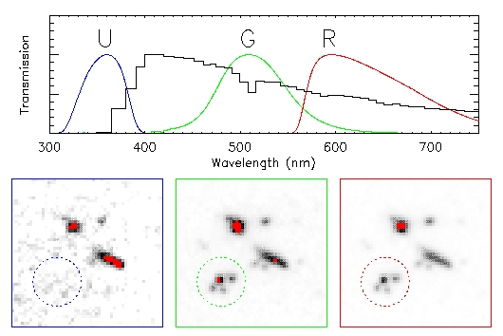
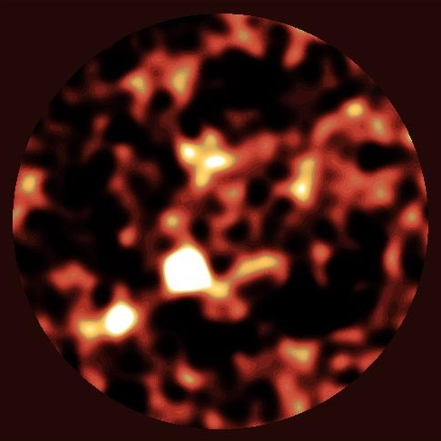
Distant red galaxies (2000+)
GRB hosts (1997+)
Damped Lyman-α Absorbers
(1972, 1986+)
Lyman-α galaxies (1990+)
Lyman-break galaxies (1996+)
Sub-mm galaxies
(1996+)

Slide 35
QSO sightline
Gamma-ray Burst sightline
Halo
HII regions
Pontzen et al. (2008)
protodisk
HI, HII, H₂, metals, dust
DM, supermassive BH
(Cold) accretion
IGM
Outflows driven by SNe or AGN
Scaling relations between
Metallicity, Mass, SFR, Size, Luminosity,…
Notes:
Mention ongoing X-shooter projects, I am PI of those!
Mention the lighthouse principle.
Mention the discovery potential of the GRB program.
Mention the added advandtage of GRBs: that we can study the host galaxy without the problem with a bright source close to the line-of-sight.

Slide 36
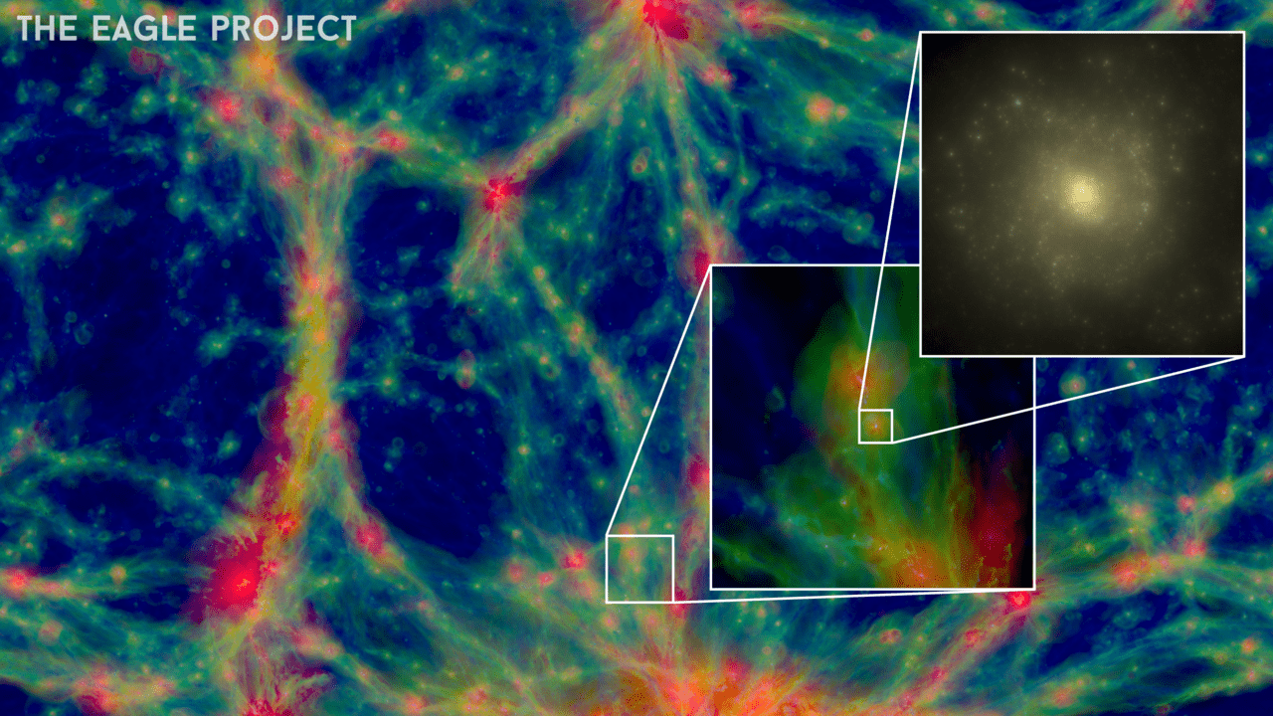
Supercomputers are now large enough to simulate large volumes, but we need to improve our understanding of both dark matter and the baryonic processes (star-formation, heating, cooling, accretion, dust-physics) #1429.

Slide 37
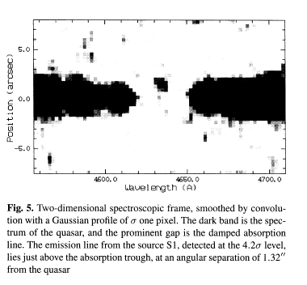
Spectroscopic confirmation

Slide 38
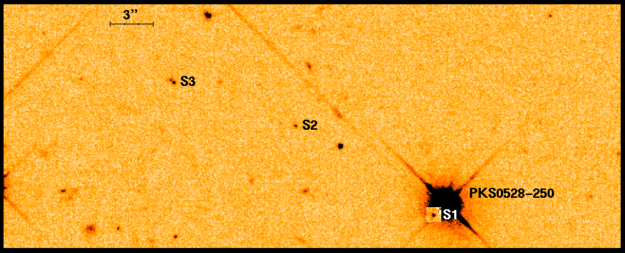
HST imaging of DLA0528-250
Palle Møller og Stephen Warren, 1998
Møller & Warren (1998)

Slide 41
DLA at z=2.354 towards Q2222-0946

