Slide 1
Short versus long gamma-ray bursts: prompt energetics and correlations
Robert J. Nemiroff (Michigan Tech U.)
&
Amir Shahmoradi (U. Texas, Austin)
presented at
EWASS 2017
Prague, Czech Republic
June 27, 2017

Slide 2
Why are GRBs of interest?
Tests of cosmological models
Sources of gravitational waves
Physics of large explosions

Slide 3
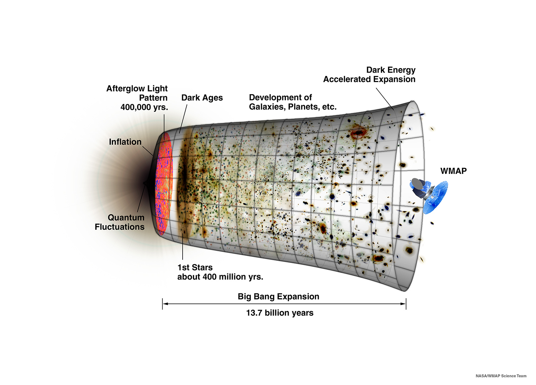
Major problem with supernovae-Ia as standard candles? Limited detectability out to $z\sim 1.7$
Candidate
Standard Candle:
Gamma-Ray Bursts: $Z<65$
Supernovae projects: $Z<1.7$

Slide 4
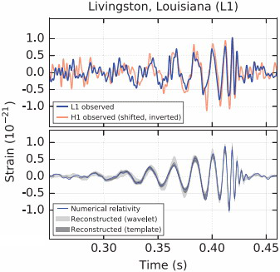
There are two types of Gamma-Ray Bursts (GRBs)
Short-duration class
Long-duration class
Discovery of Gravitational Wave Radiation in Feb 2016
Predicted by Albert Einstein in 1916
Kouveliotou et al. 1993
Piran 1992
LIGO collaboration 2016
Paczynski 1998

Slide 5
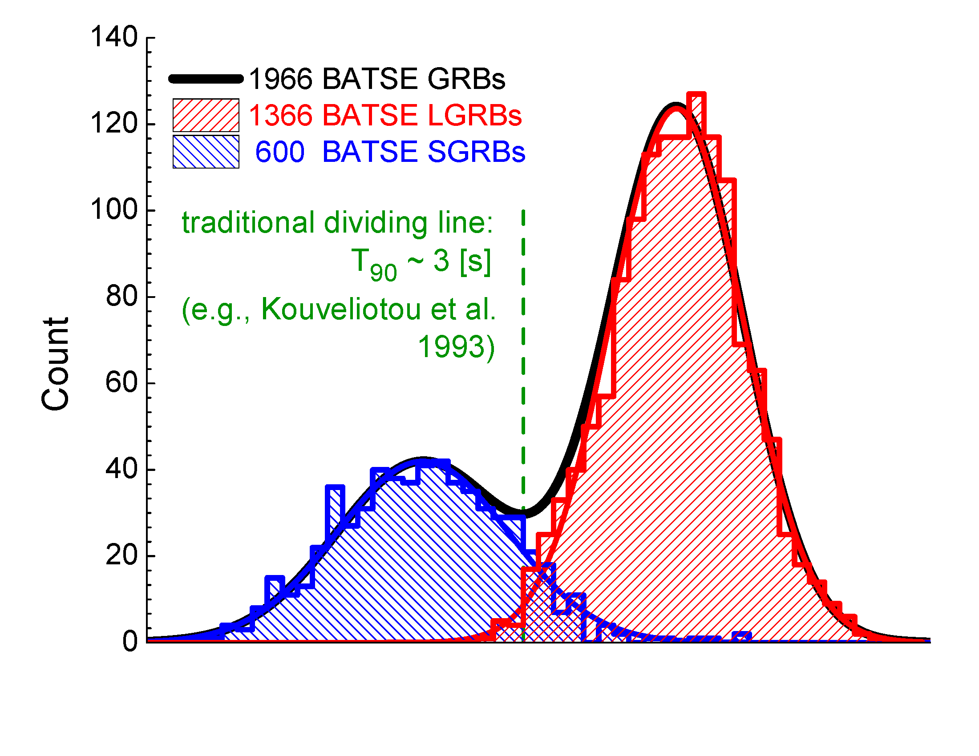
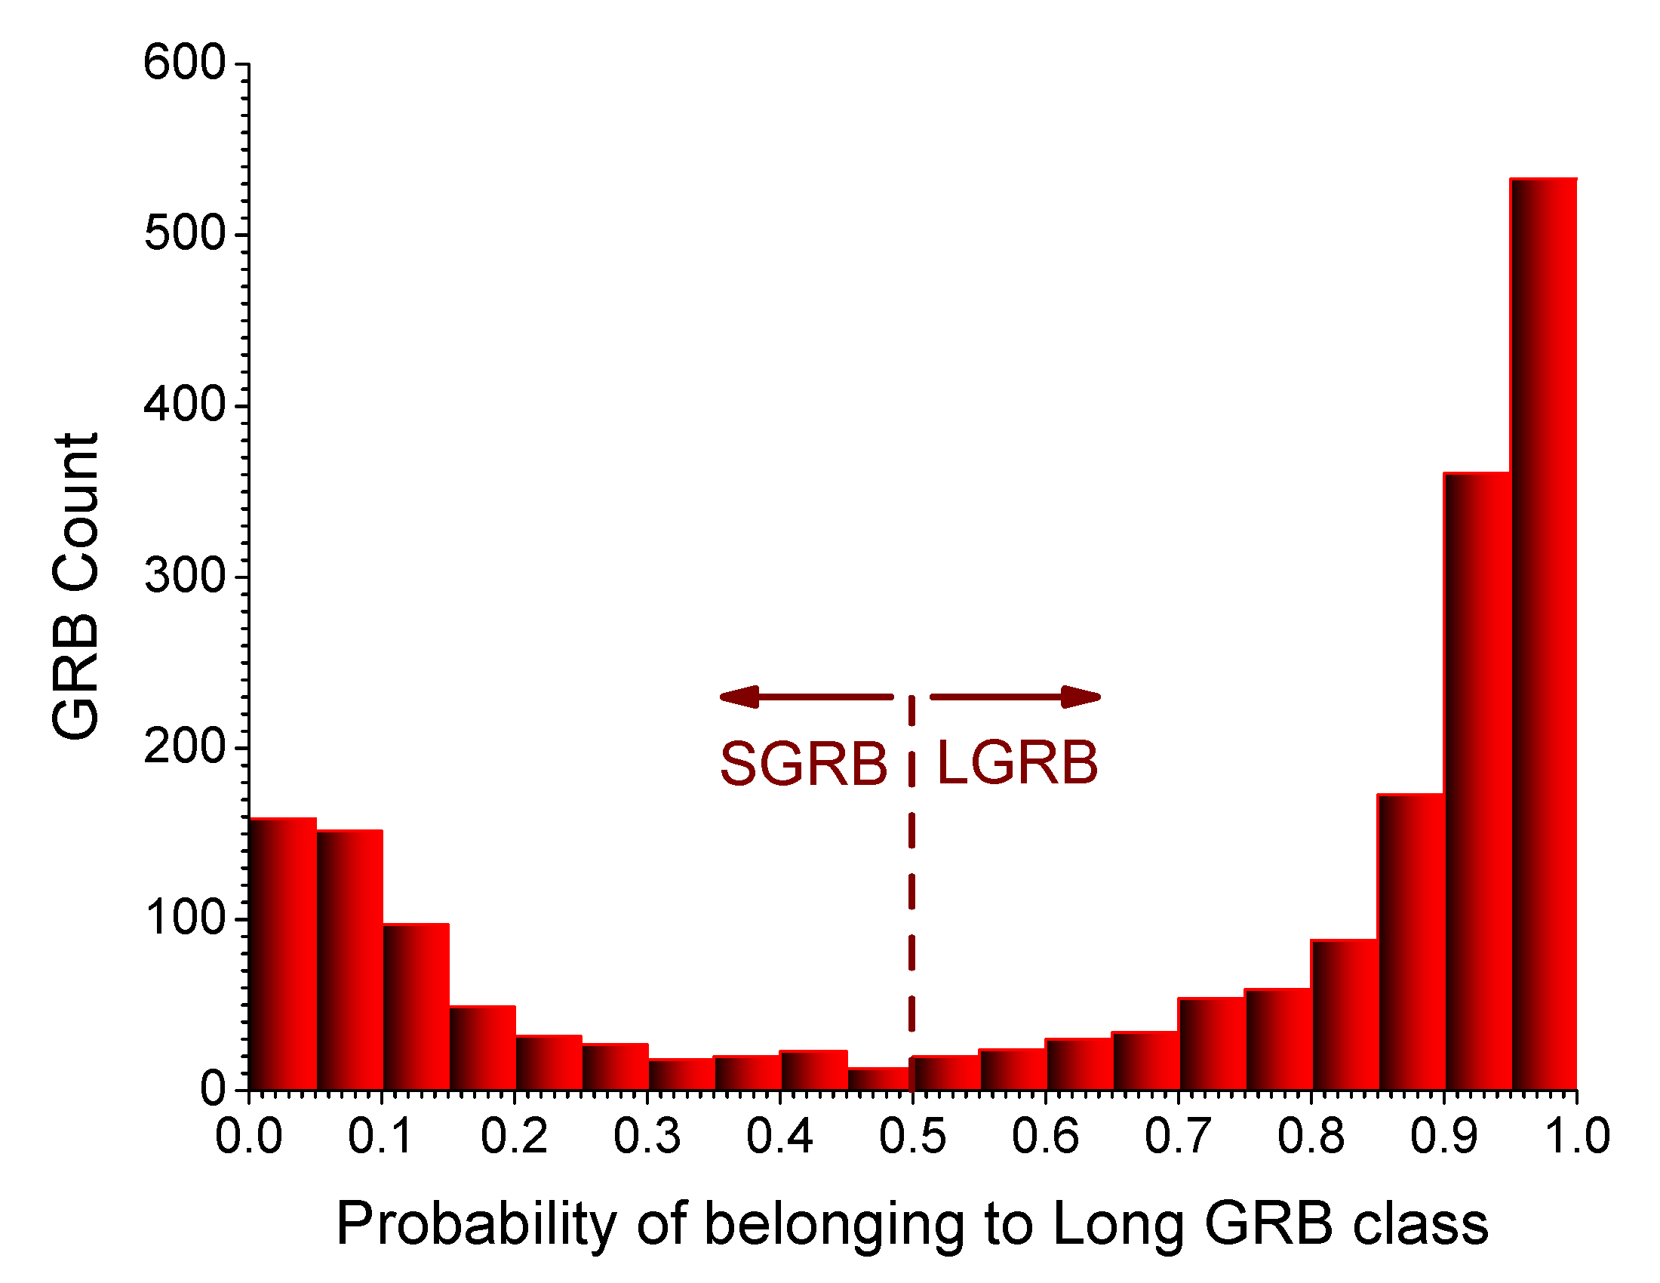
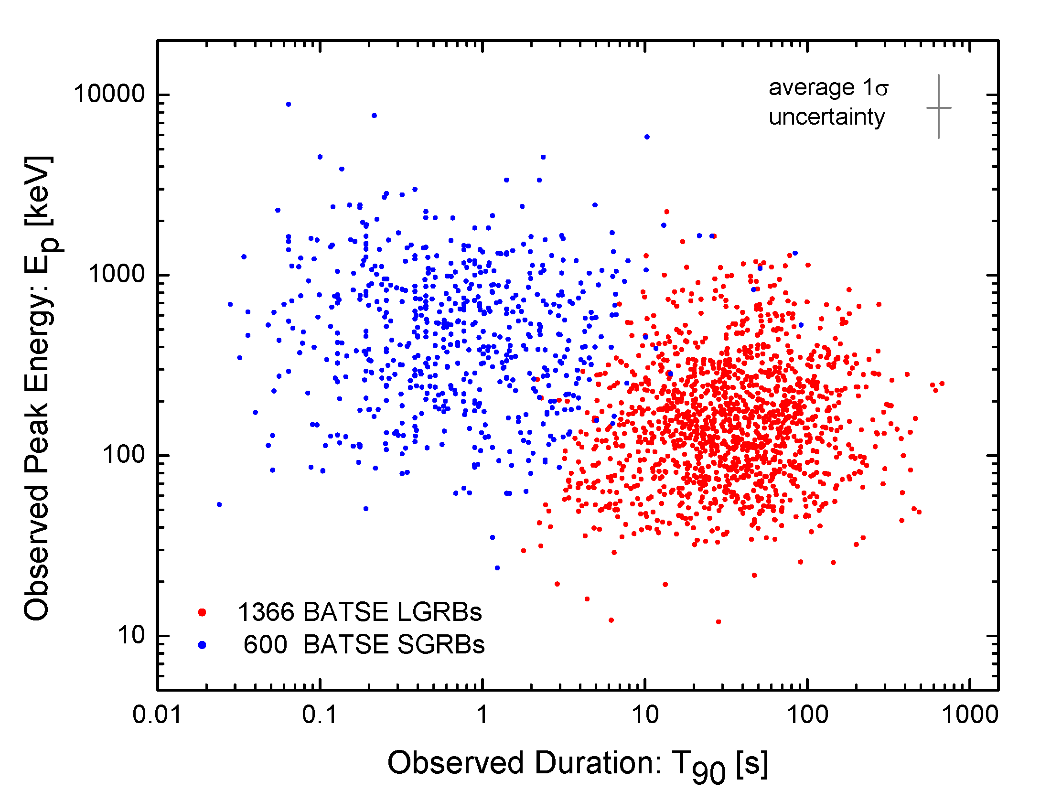
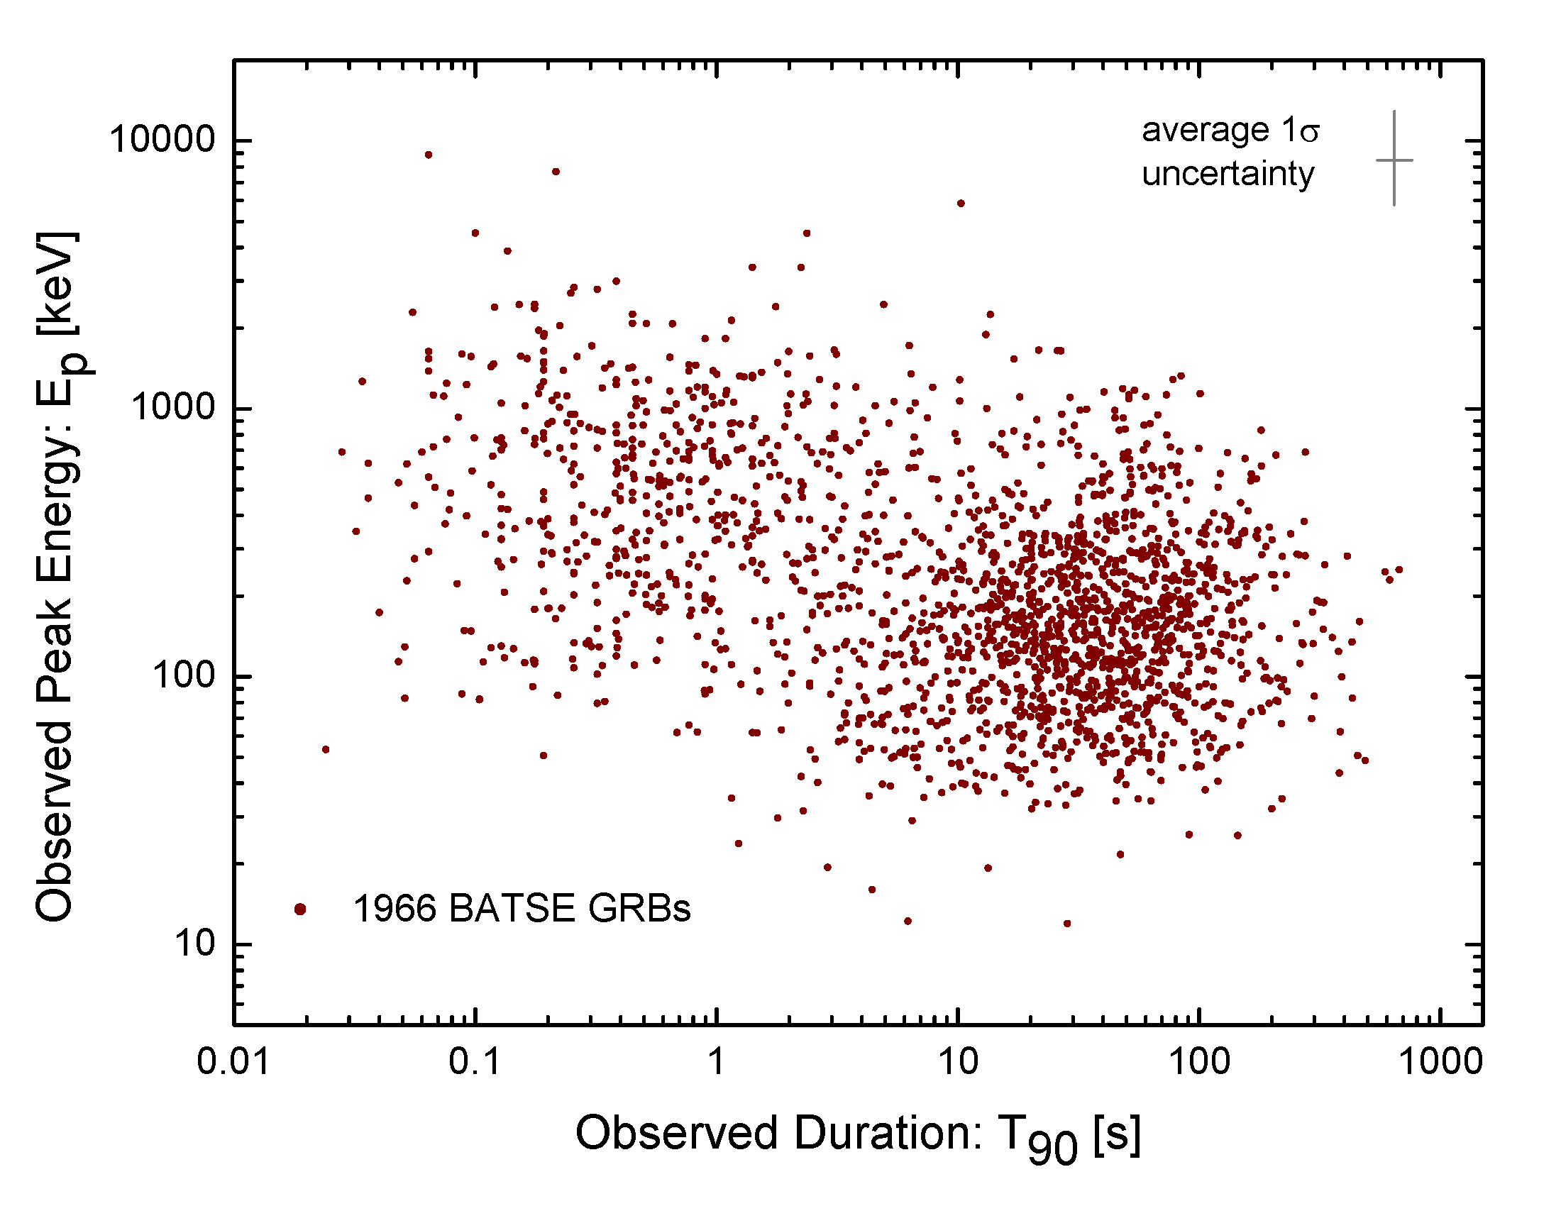
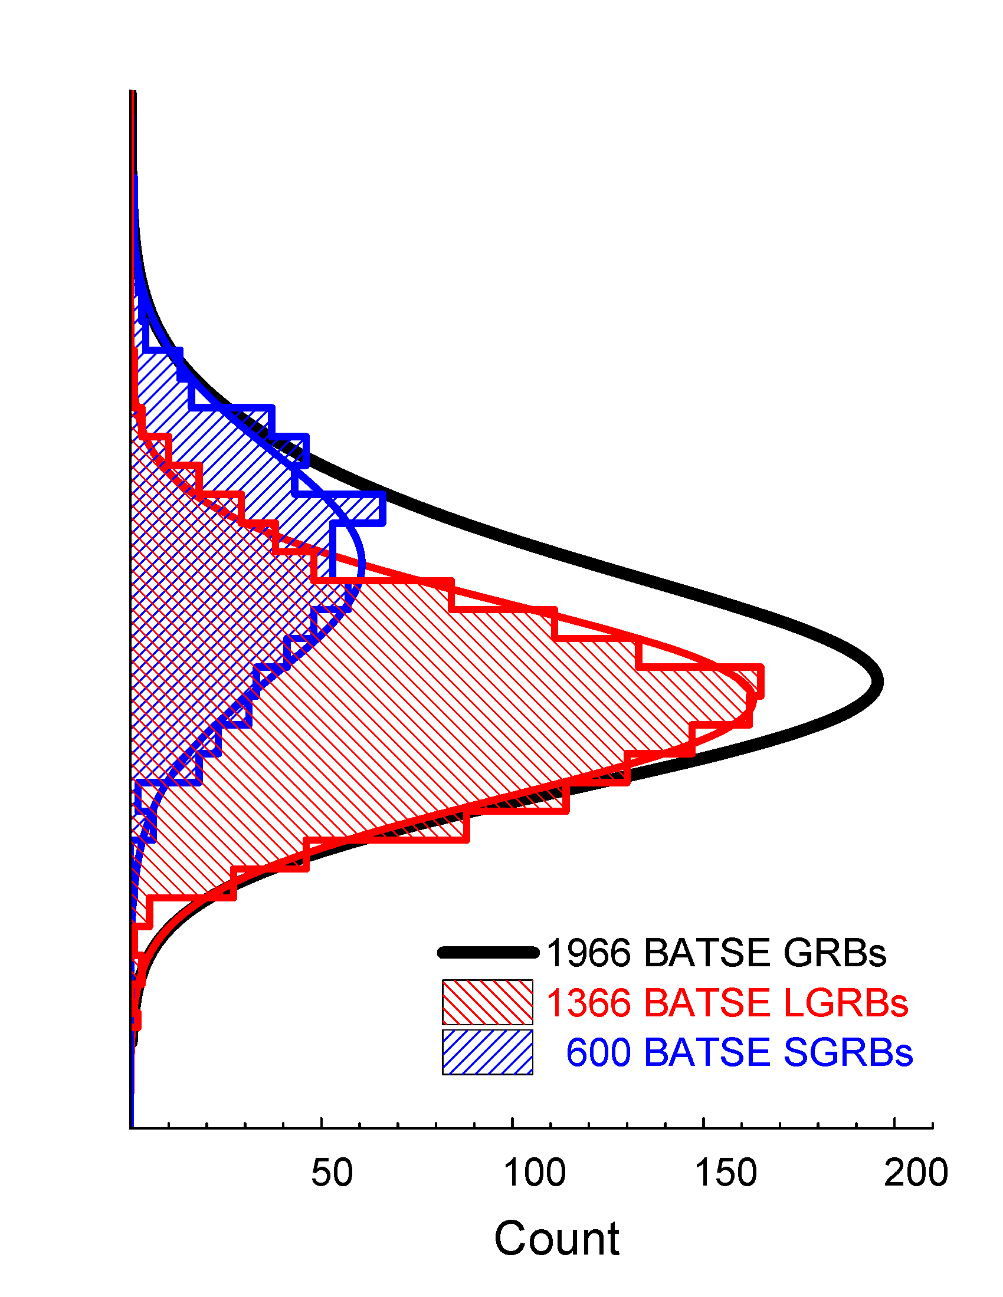
Classification of BATSE GRBs: fuzzy clustering vs. cutoff line (Shahmoradi & Nemiroff, 2011, MNRAS, 411, 1843–1856)
30%
70%

Slide 6
Each and every GRB has two sets of properties
Observer-frame
Rest-frame
GRB observed duration: $T_{90 }$
GRB peak photon flux: $P_{bol}$
GRB total observed energy: $S_{bol}$
GRB observed peak energy: $E_{p }$
GRB intrinsic duration: $T_{90,z }=\frac{T_{90 }}{1+z}$
GRB peak luminosity: ${L_{iso}=4π{D_{L}^{}(z)}_{}^{2}P}_{bol}$
GRB total energy release ${E_{iso}=4π{D_{L}^{}(z)}_{}^{2}S}_{bol}$
GRB intrinsic peak energy: $E_{p,z }=E_{p}(1+z)$
z transformation

Slide 7
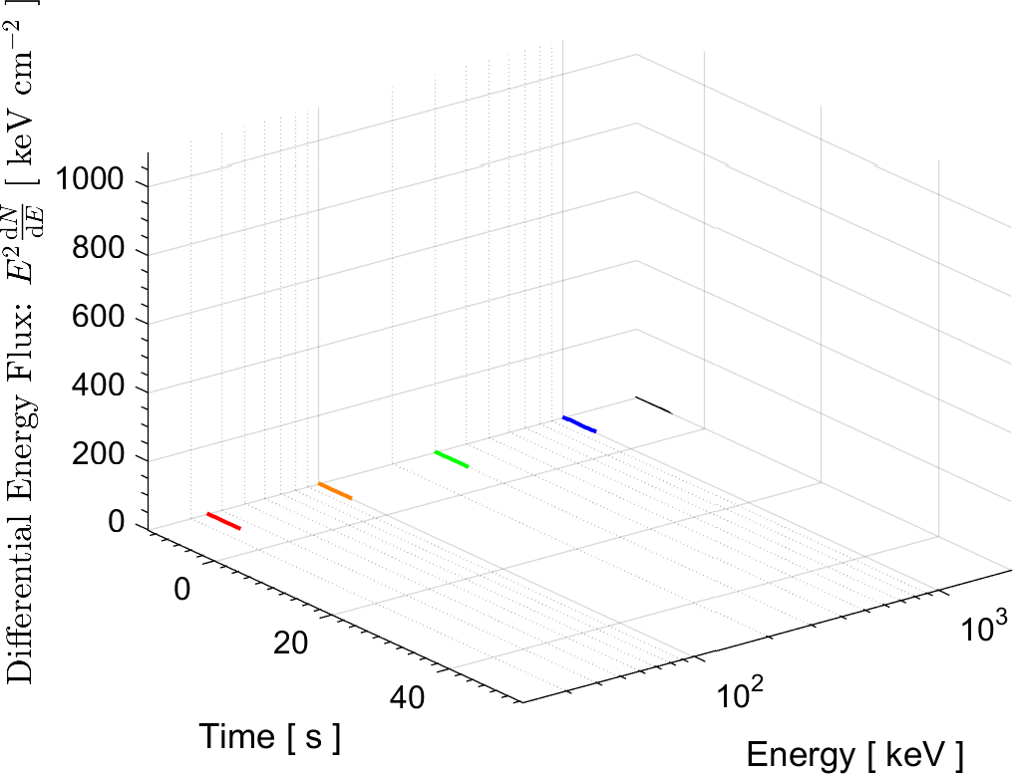
Example GRB light-curve and spectrum: BATSE trigger #1085
Observer-frame: What is observed on earth
Rest-frame: What is really happening far in the cosmos
Fishman et al. 1994

Slide 8
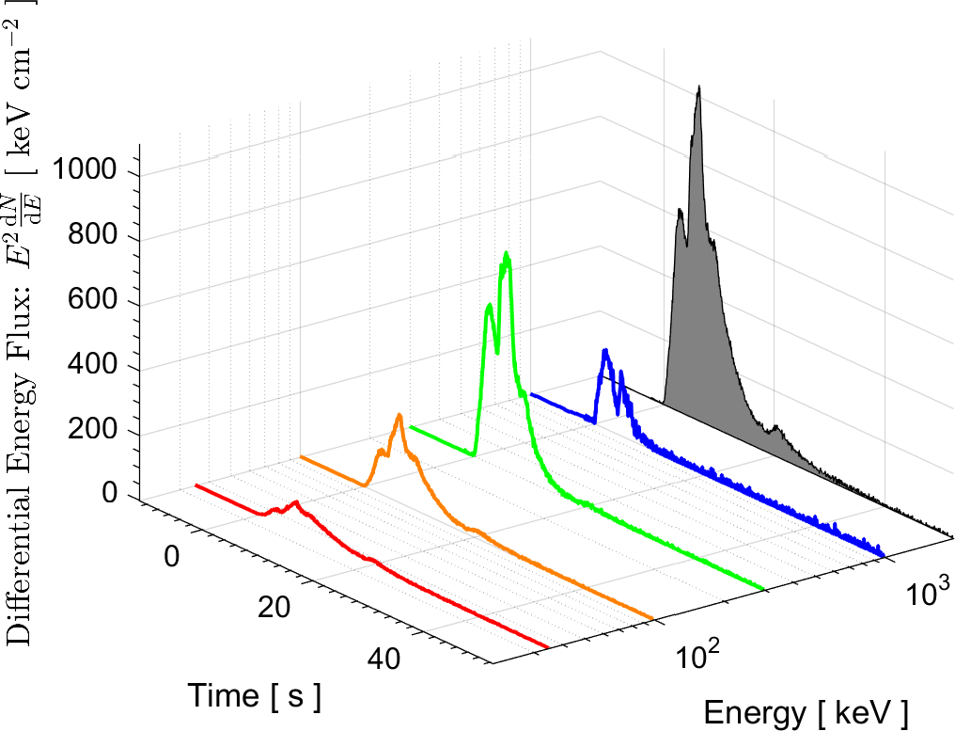
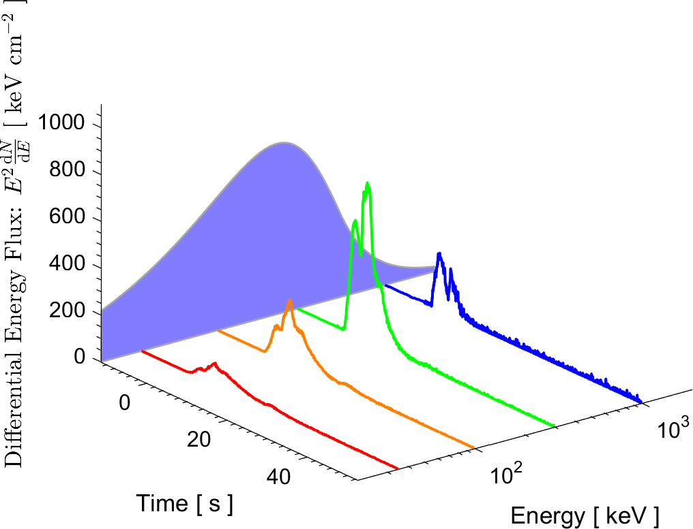
Example GRB light-curve and spectrum: BATSE trigger #1085
Observer-frame: peak brightness
Rest-frame: peak luminosity
Observer-frame: observed peak energy
Rest-frame: intrinsic peak energy
Observer-frame: fluence
Rest-frame: total energy released
$$T_{90}$$
Observer-frame: What is observed on earth
Rest-frame: What is really happening far in the cosmos
Fishman et al. 1994

Slide 9
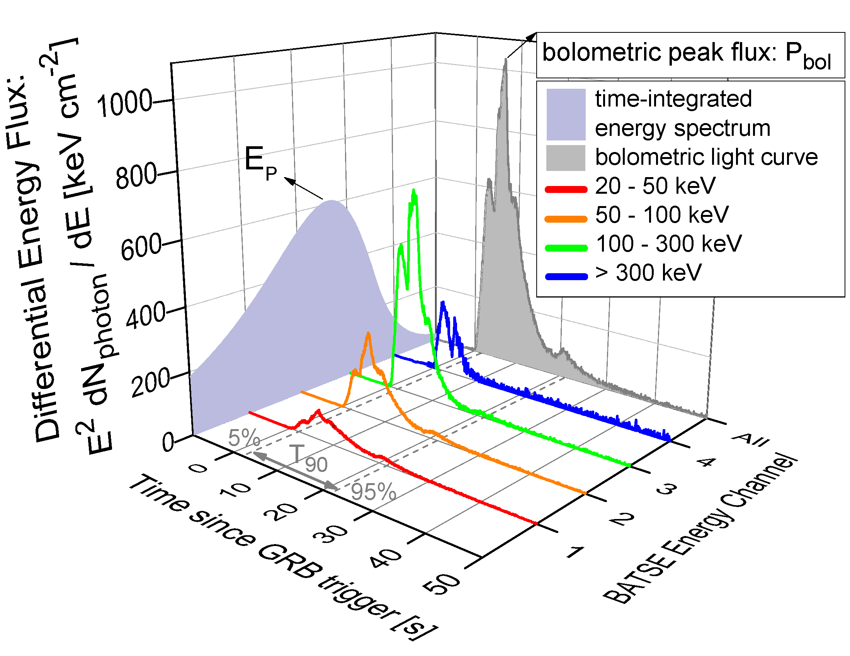
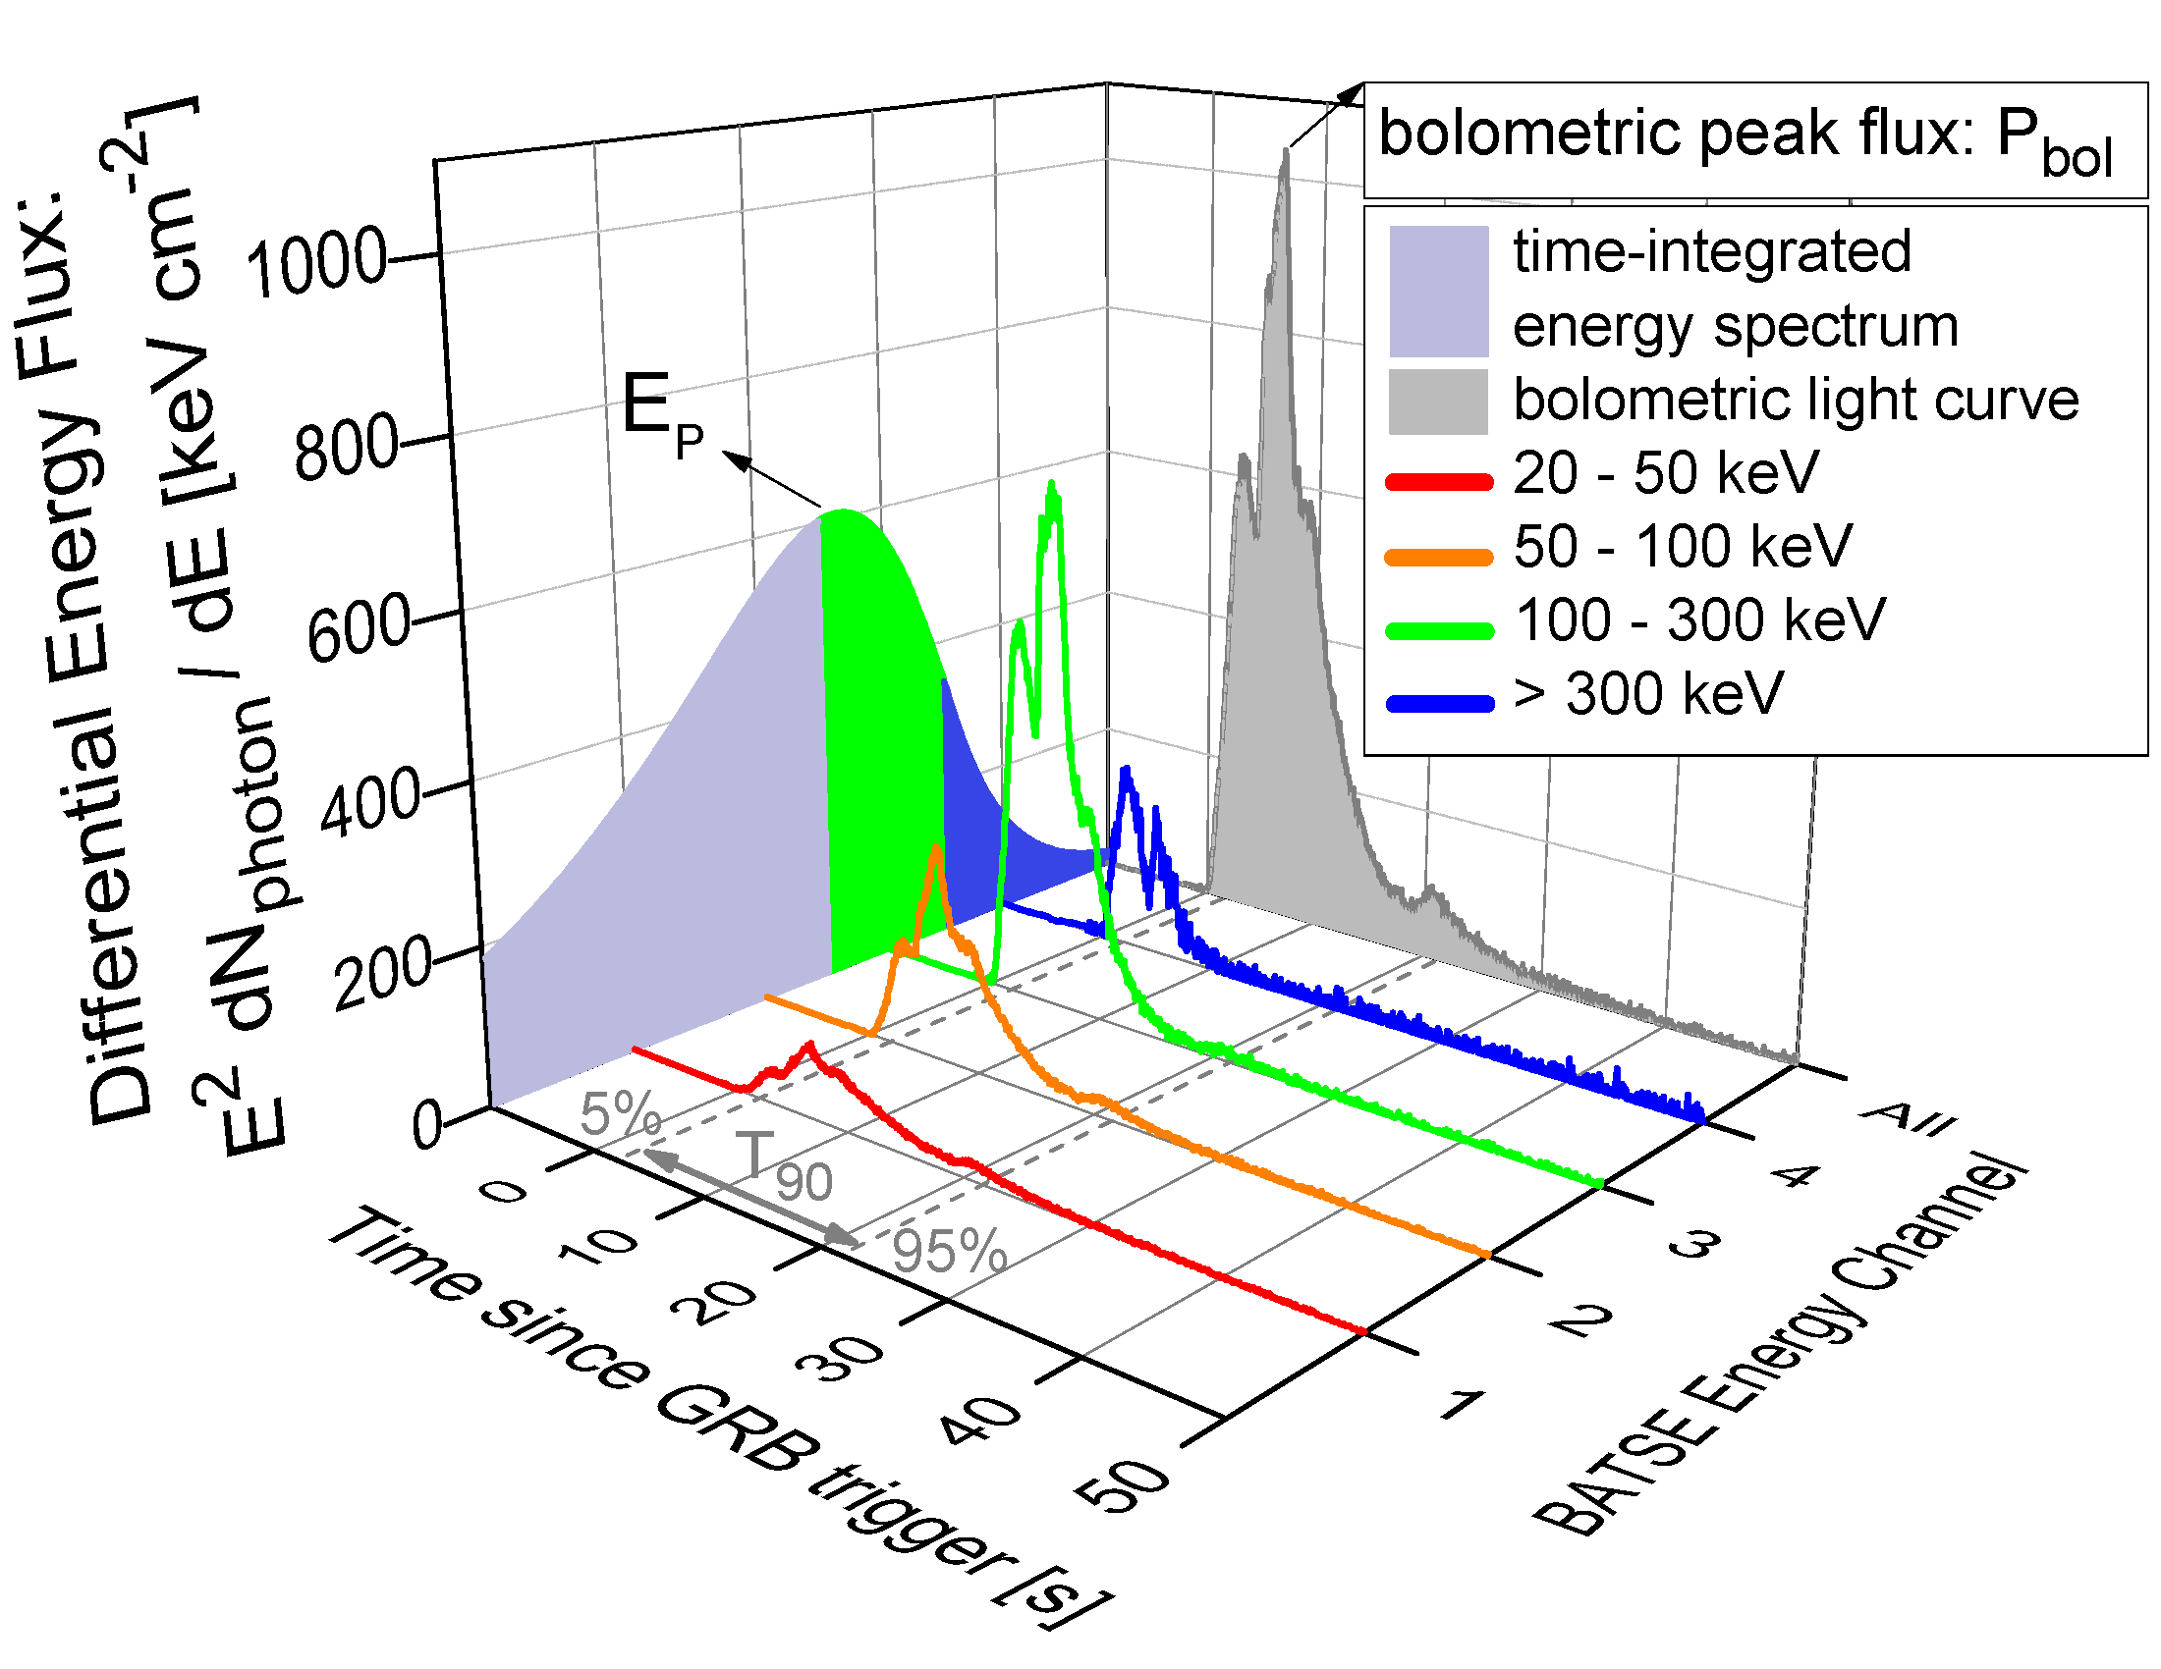
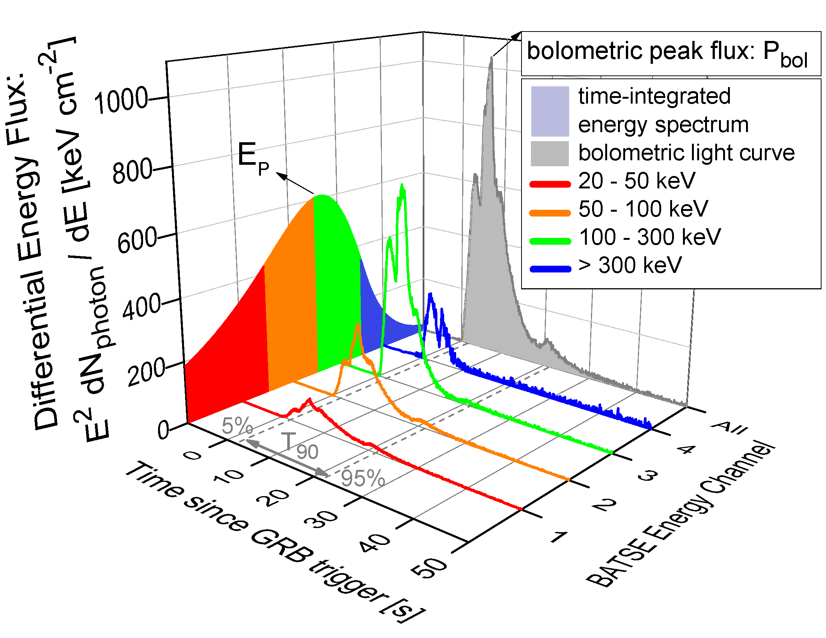
Example GRB lightcurve and spectrum (BATSE GRB trigger 1085)
$$HR=\frac{fluence(3+4)}{}$$
$$HR=\frac{fluence(3+4)}{fluence(1+2)}$$

Slide 10
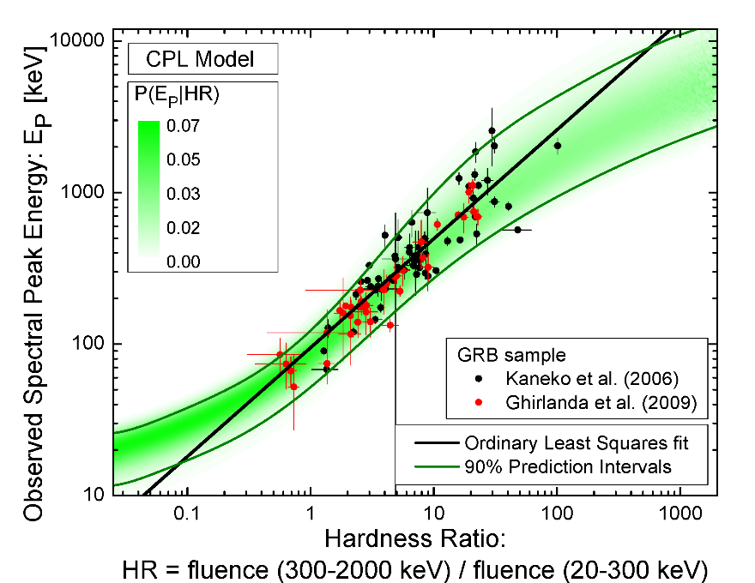
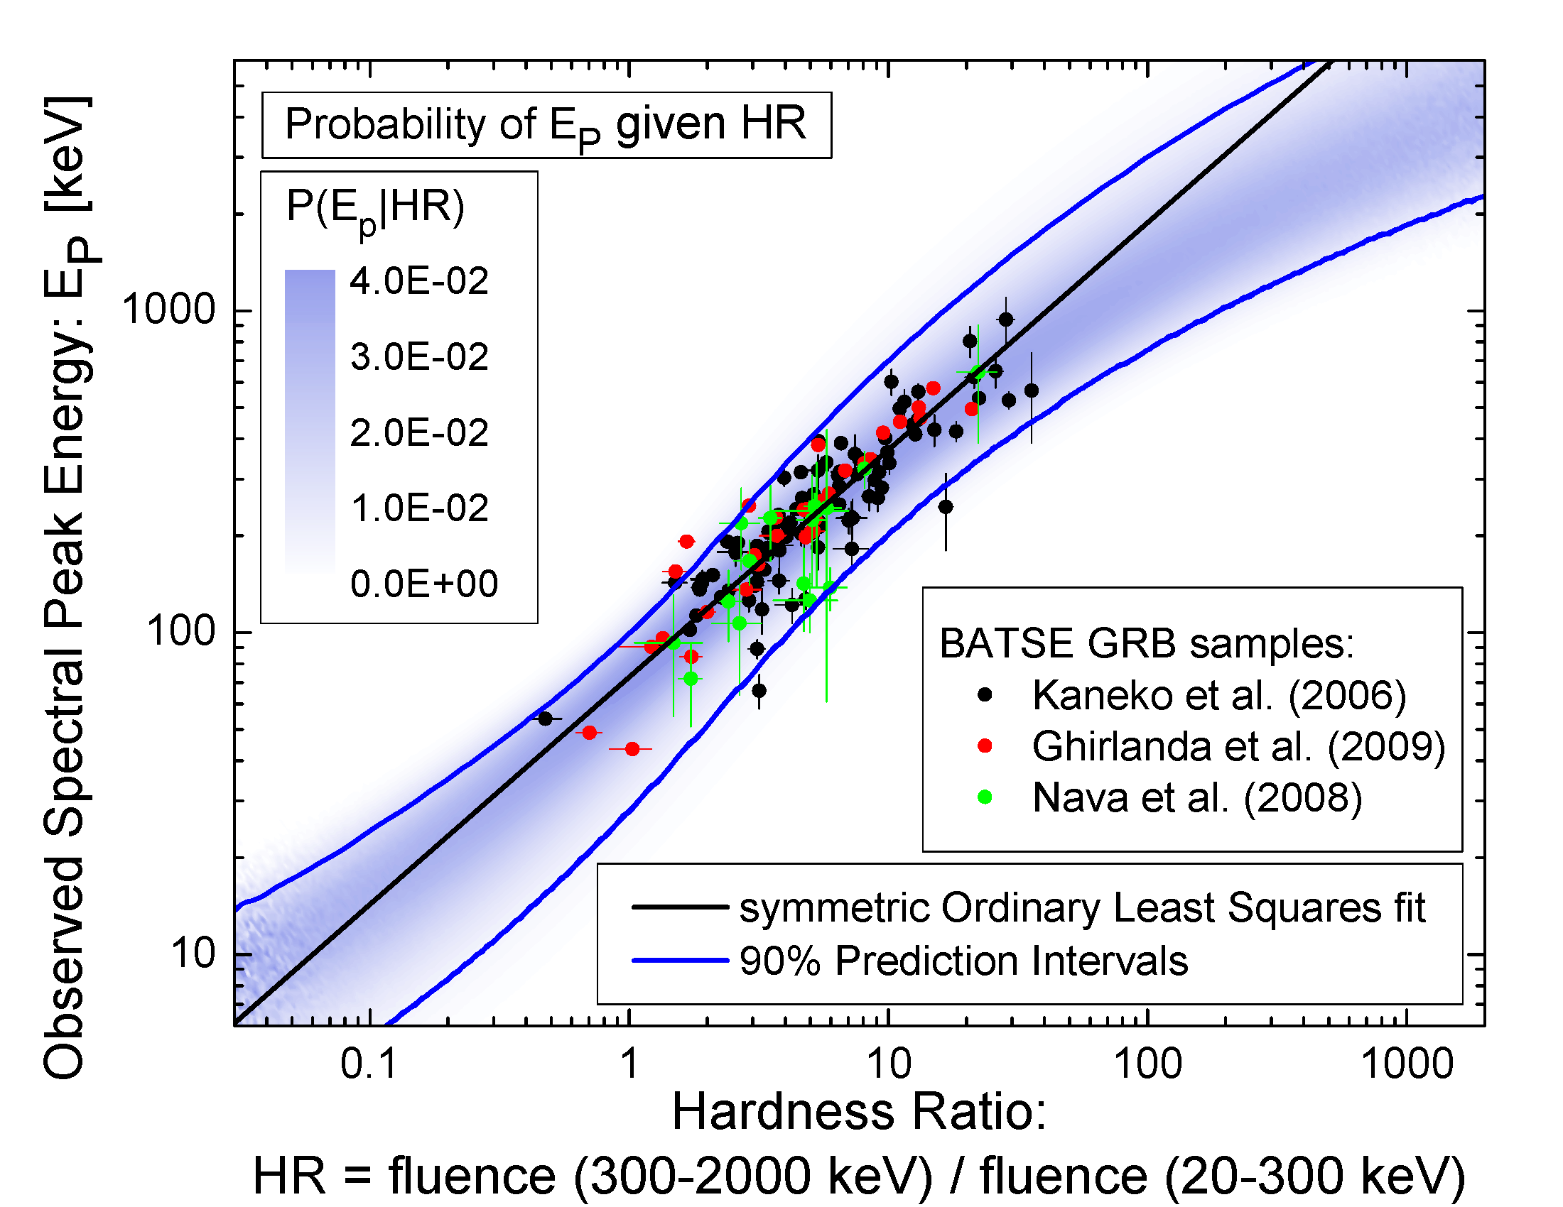
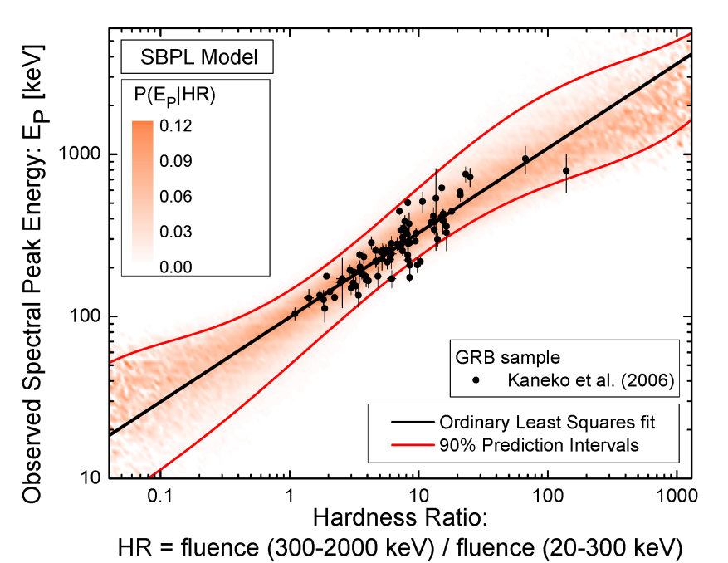
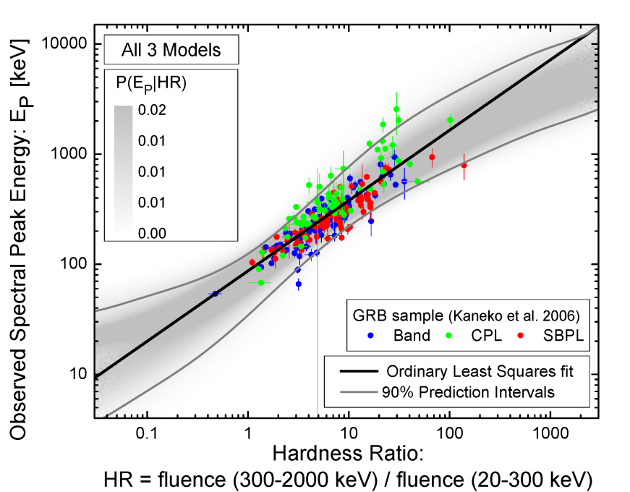
Hardness is a proxy measure of spectral peak energy of GRBs (Shahmoradi & Nemiroff, 2010, MNRAS, 407, 2075–2090)

Slide 11
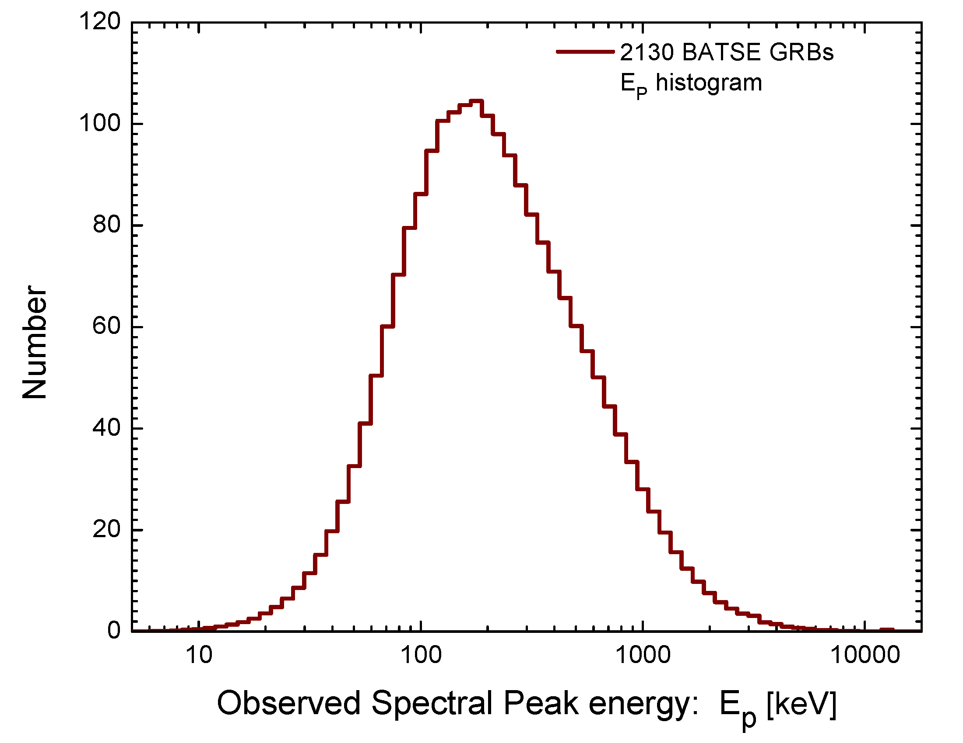
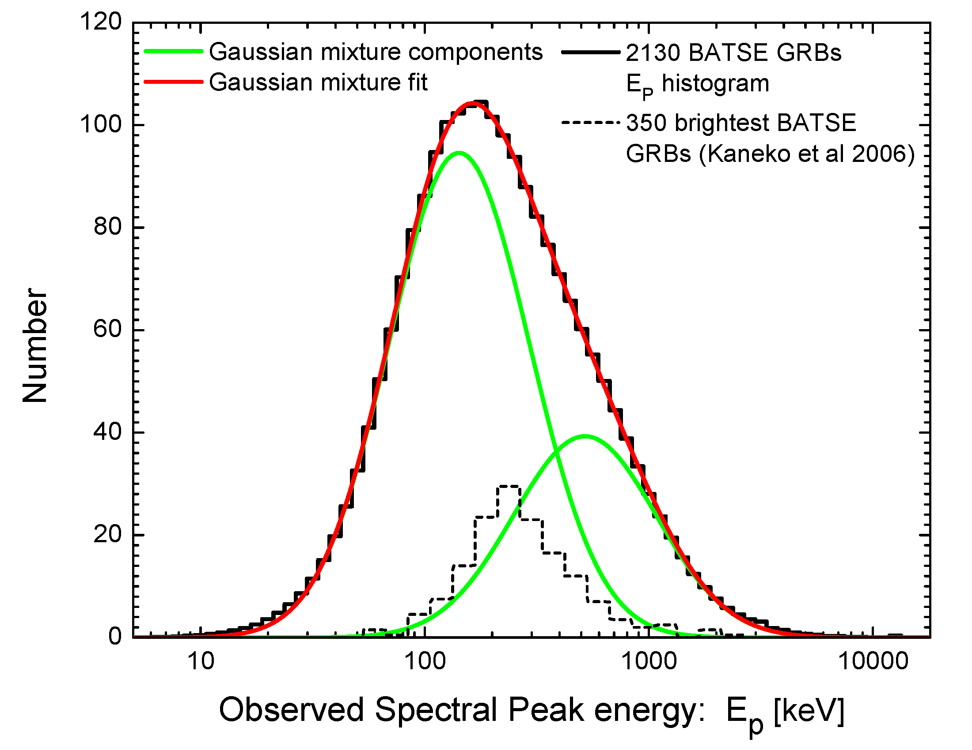
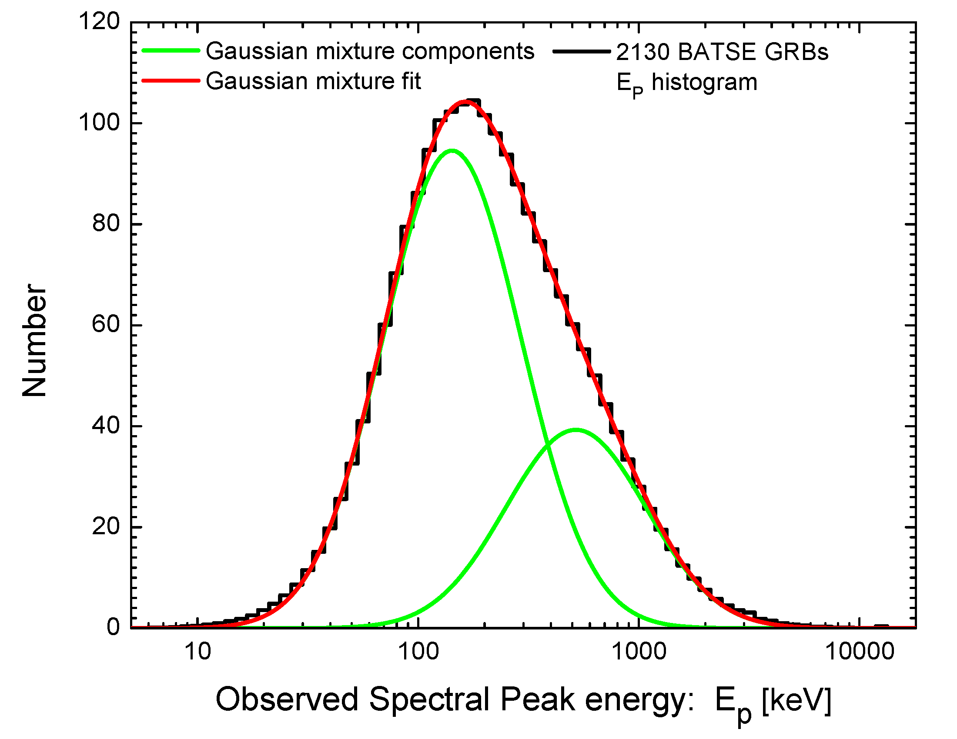
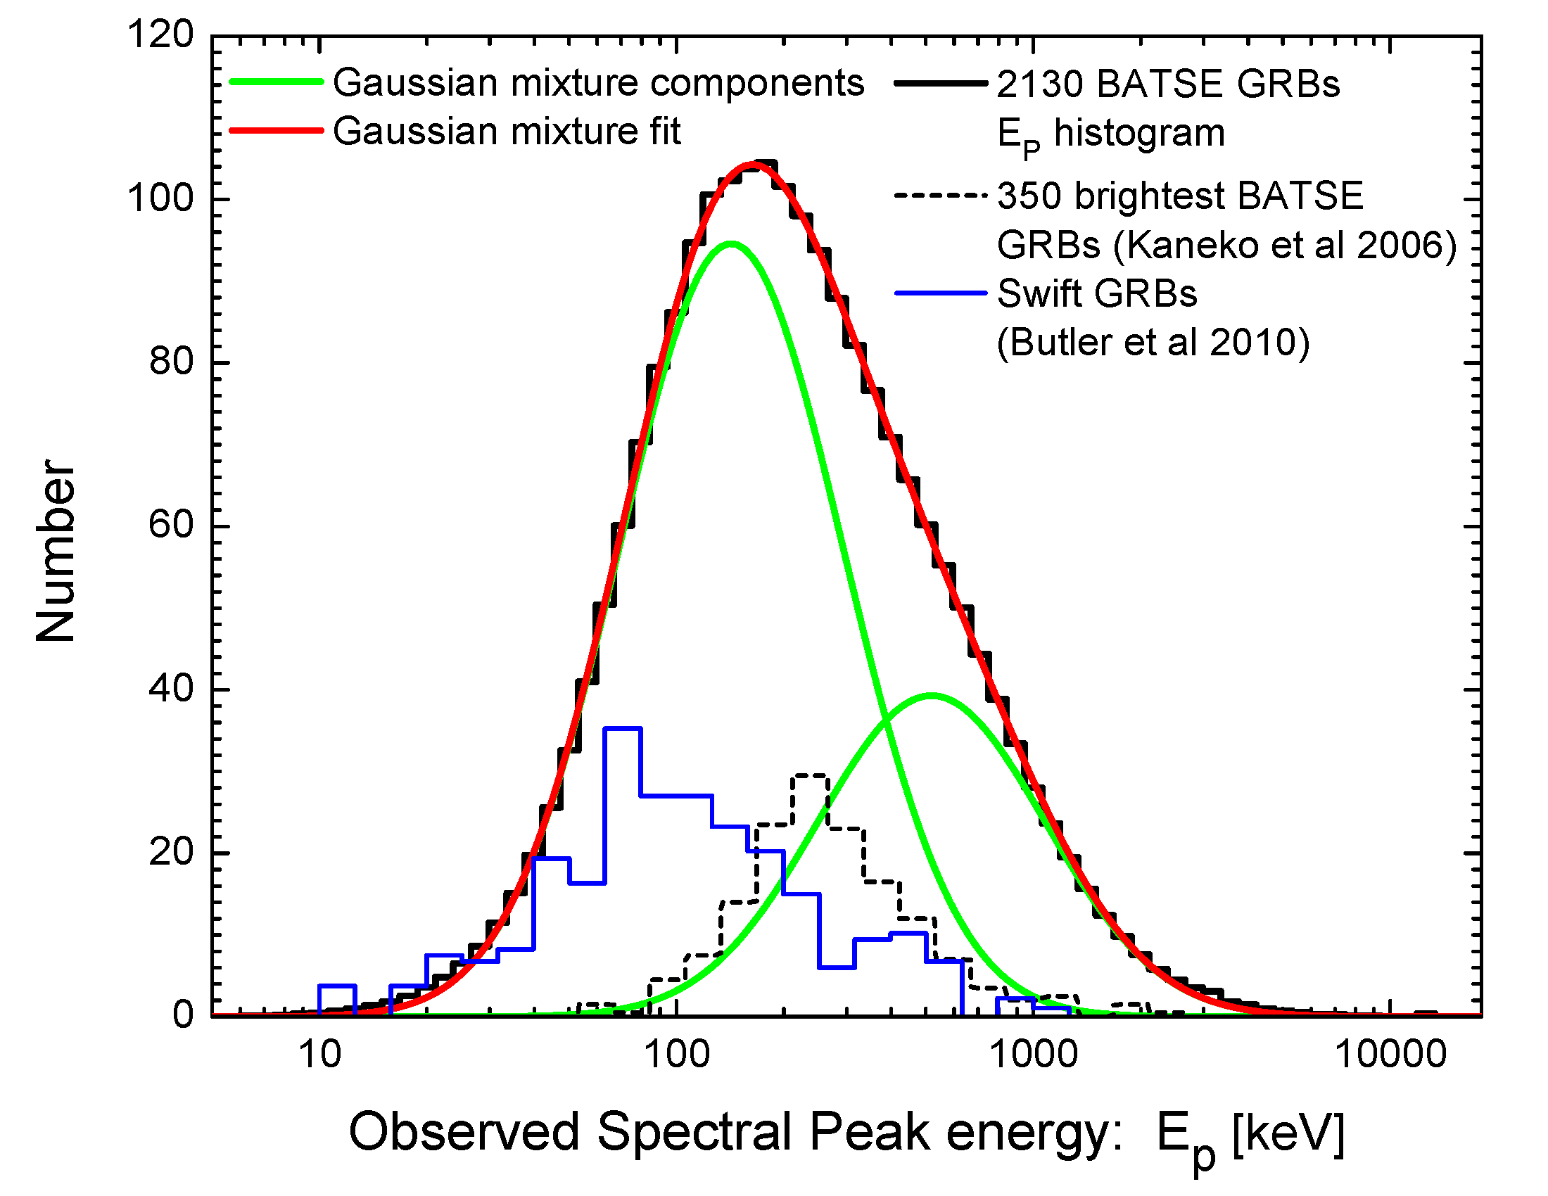
The peak energy distribution of 2130 BATSE GRBs (Shahmoradi & Nemiroff, 2010, MNRAS, 407, 2075–2090)
LGRBs: ~ 140 keV
SGRBs: ~ 520 keV

Slide 12
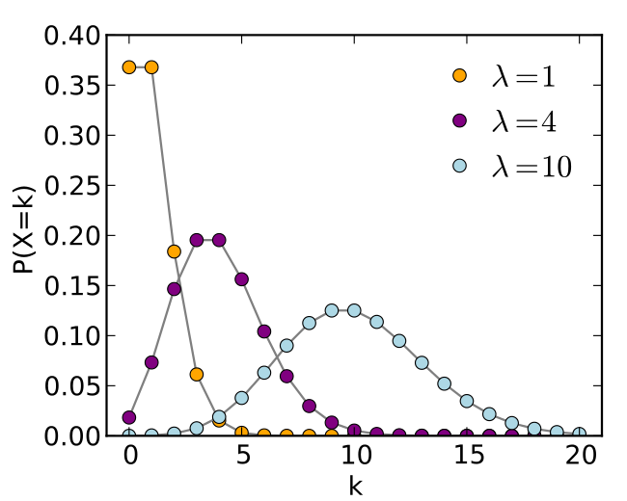
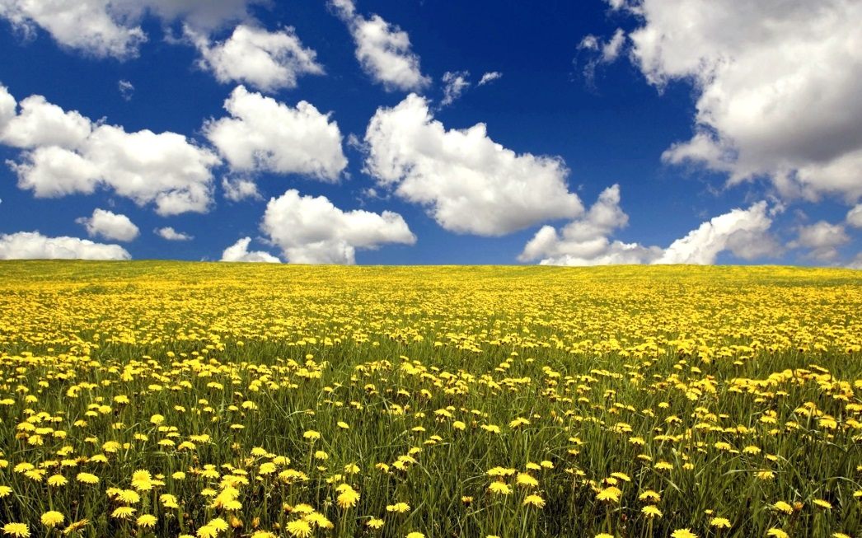
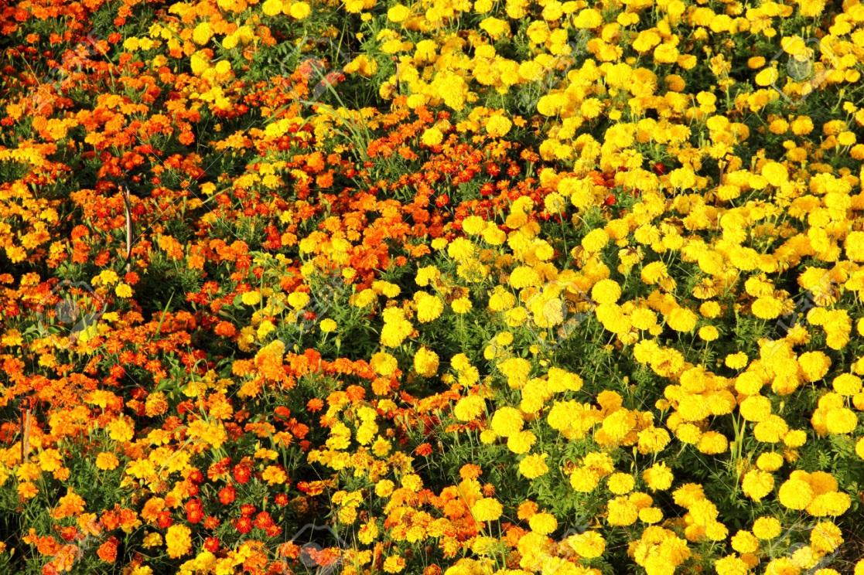
Poisson distribution: The distribution of counts of independent events within a given interval of time, space, …
$$n_{1}$$
$$n_{2}$$
$$n_{3}$$
$$n_{4}$$
$$n_{5}$$
$$n_{6}$$
$$n_{7}$$
$$n_{8}$$
$$n_{9}$$
$$n_{10}$$
$$n_{11}$$
$$n_{12}$$
$$n_{13}$$
$$n_{14}$$
$$n_{15}$$
$$n_{16}$$
$$n_{17}$$
$$n_{18}$$
$$n_{19}$$
$$n_{20}$$
$$n_{21}$$
$$n_{22}$$
$$n_{23}$$
$$n_{24}$$
$$n_{25}$$
$$n_{26}$$
$$n_{27}$$
$$n_{28}$$
$$n_{29}$$
$$n_{30}$$
$$λ= \frac{1}{N}\sum_{N=0}^{N=30}{n_{i}}$$
$$P\left(k\right)= \frac{λ^{k}}{k!}e^{−λ}$$

Slide 13
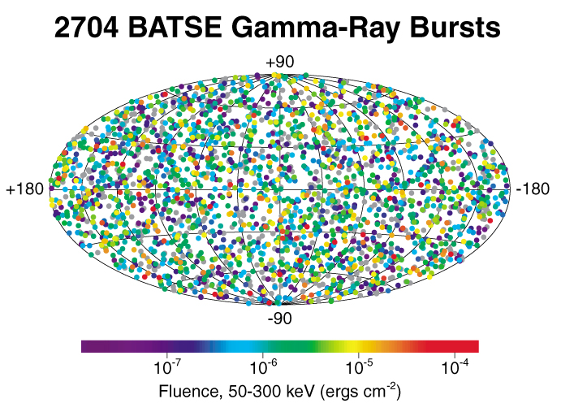
GRB detection process can be modeled as a non-homogenous Poisson process
What is the rate of occurrence of GRBs as a function of their distance and properties, $R\left(θ\right)$?
$$P\left({E_{iso}, L_{iso}, E_{p,z},T}_{90,z}\right){dE}_{iso}{ dL}_{iso}{ dE}_{p,z}{ dT}_{90,z} d\vec{r} dt∝ \frac{{λ({E_{iso}, L_{iso}, E_{p,z},T}_{90,z},\vec{r},t)}^{k}}{k!}e^{−λ({E_{iso}, L_{iso}, E_{p,z},T}_{90,z},\vec{r},t)}×{dE}_{iso}{ dL}_{iso}{ dE}_{p,z} {dT}_{90,z} d\vec{r} dt$$
$$R\left(θ\right)dθ≡λ({E_{iso}, L_{iso}, E_{p,z},T}_{90,z},\vec{r},t)$$
$T_{90 }$ duration
$S_{bol}$ total energy
$E_{p }$ peak energy
$P_{bol}$ peak photon flux
$z_{ }$ redshift (distance from earth)
Fishman et al. 1994

Slide 14
With a statistical model in hand, we can proceed to construct the likelihood function of the model to estimate model parameters
$$P\left(k\right)= \frac{{λ(m)}^{k}}{k!}e^{−λ(m)}$$
$$P_{0}\left(m\right)= \frac{{(R(m)Δm)}^{0}}{0!}e^{−R(m)Δm}=e^{−R(m)Δm}$$
$$P_{1}\left(m\right)= \frac{{(R(m)Δm)}^{1}}{1!}e^{−R(m)Δm}=R\left(m\right)Δm e^{−R(m)Δm}$$
$$L\left(DATA|R\left(m\right)\right)=\prod_{i=1}^{N}{P_{1}(m_{i})}\prod_{j=1}^{M}{P_{0}(m_{j})}=({Δm)}^{N}\left[\prod_{i=1}^{N}{R \left(m_{i}\right)}\right]\left[e^{−\sum_{j=1}^{N+M}{R\left(m_{j}\right)Δm}}\right]=({Δm)}^{N}\left[\prod_{i=1}^{N}{R \left(m_{i}\right)}\right]exp⁡\left(−\int_{M}{R\left(m\right)dm}\right)$$

Slide 15
How about the likelihood function for the non-homogenous Poisson process of GRB detection?
$$L\left(DATA|R\left(m\right)\right)=({Δm)}^{N}\left[\prod_{i=1}^{N}{R \left(m_{i}\right)}\right]exp⁡\left(−\int_{M}{R\left(m\right)dm}\right)$$
$$L\left(GRB DATA|R\left(θ\right)\right)=({Δθ)}^{N}\left[\prod_{i=1}^{N}{R \left(θ_{i}\right)}\right]exp⁡\left(−\int_{θ}{R\left(θ\right)dθ}\right)$$
$$θ≡\vec{θ}≡\left[{E_{iso}, L_{iso}, E_{p,z} , T}_{90,z} , z, t\right]$$
Now that we have the likelihood function, what is the most appropriate model for GRB rate as a function of GRB parameters?
$$R \left(θ\right)= ?$$

Slide 16
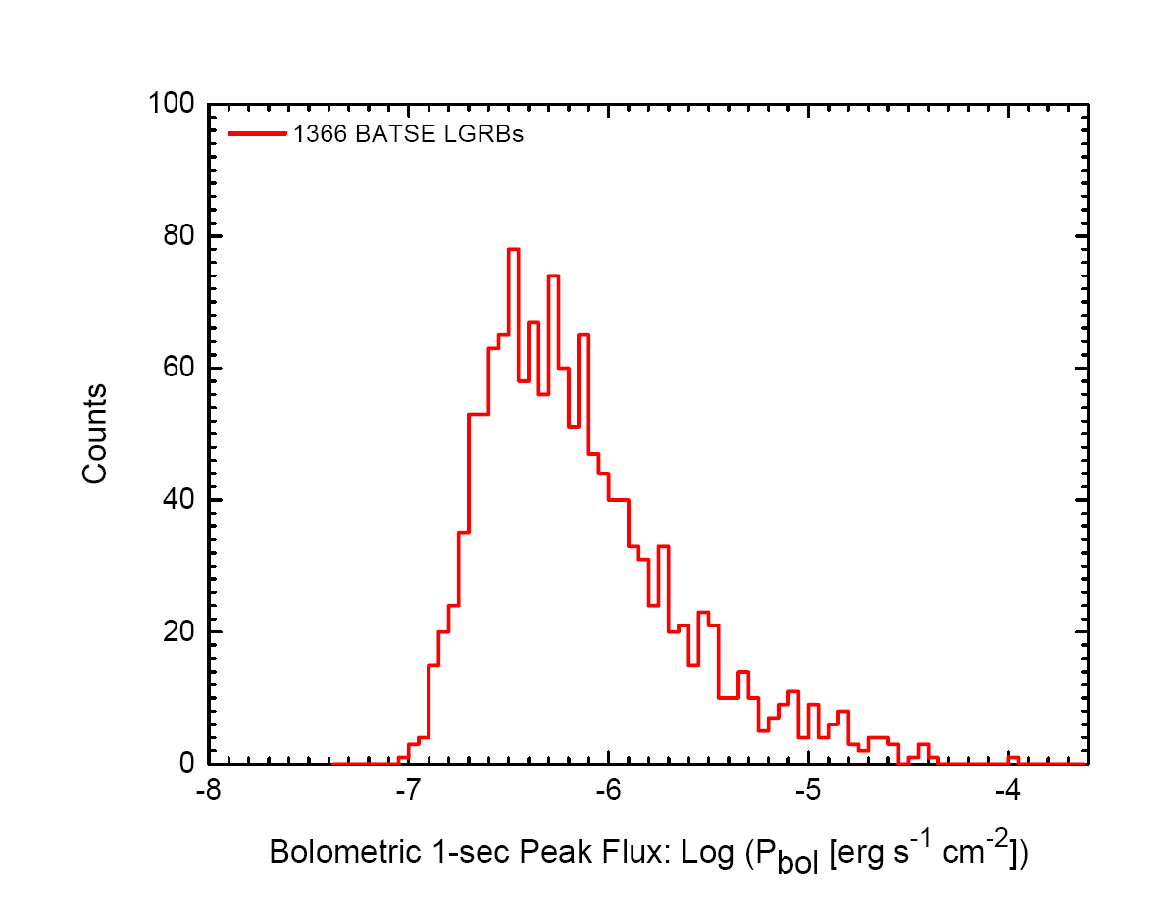
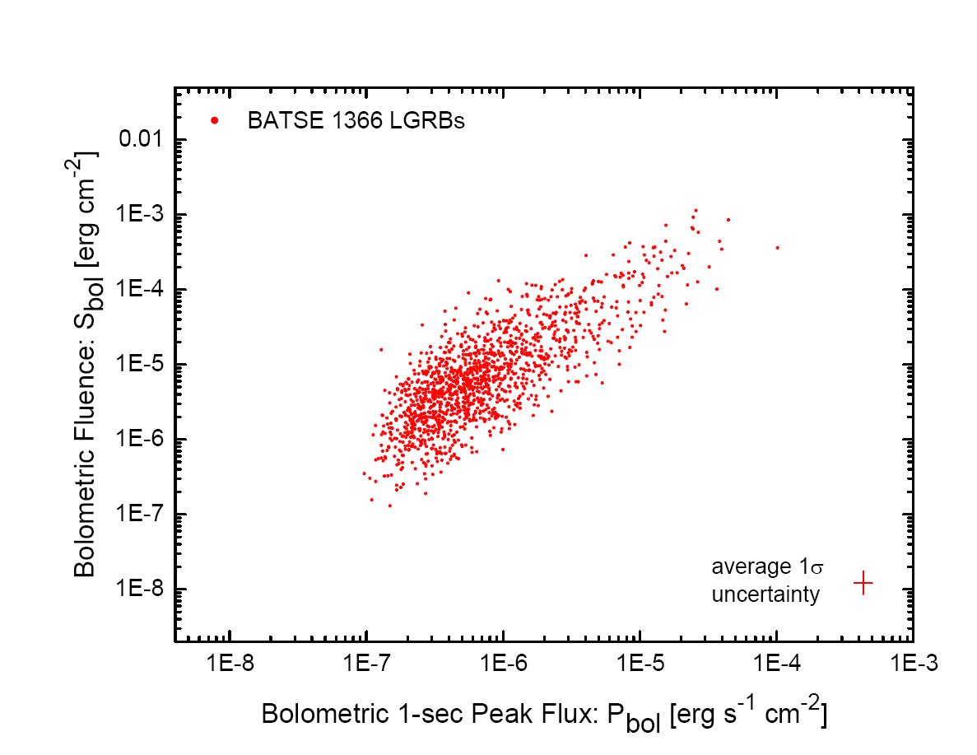
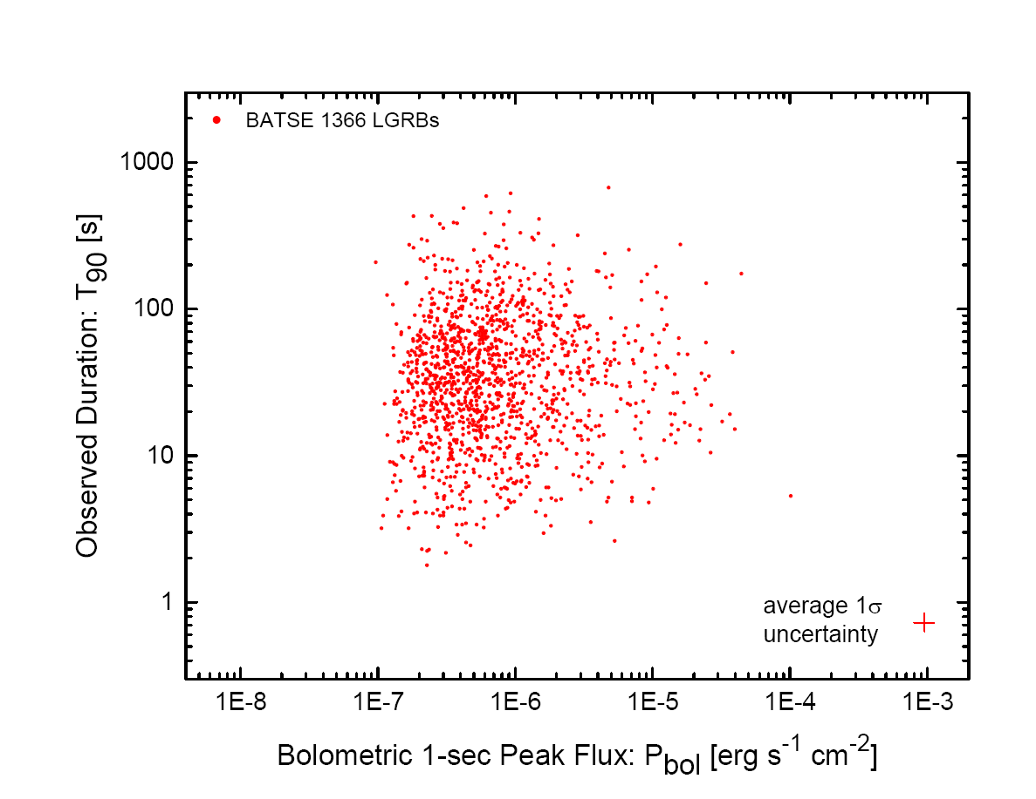
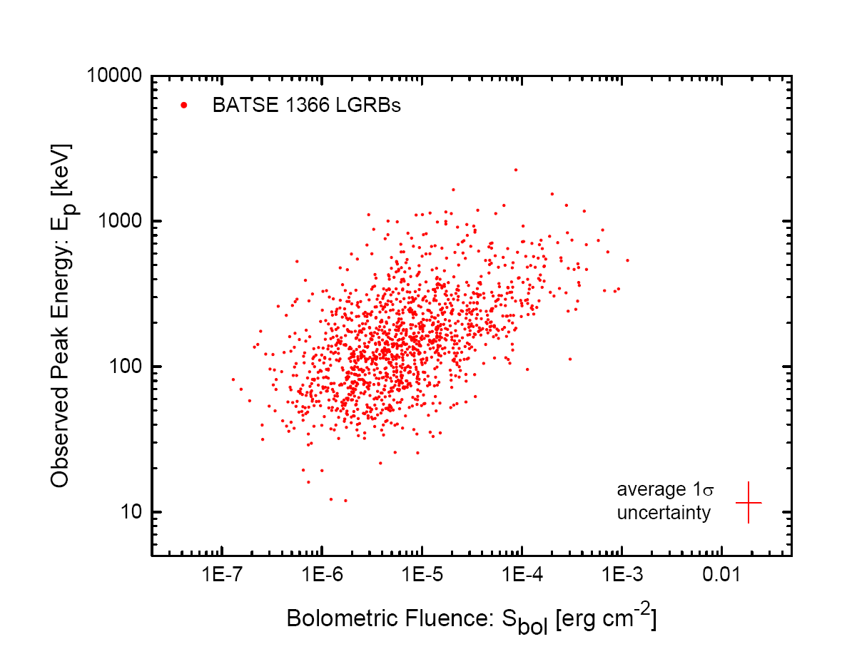
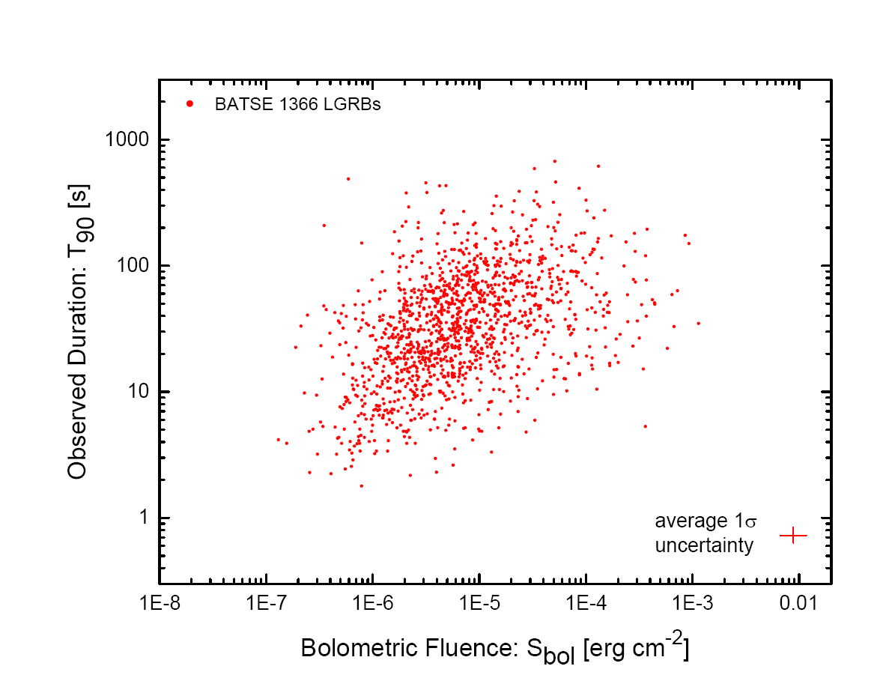
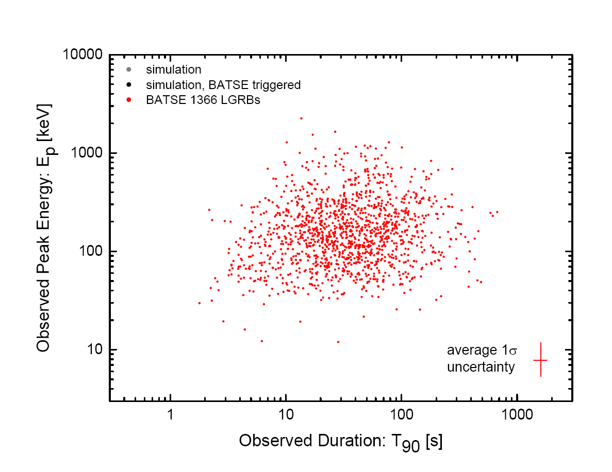
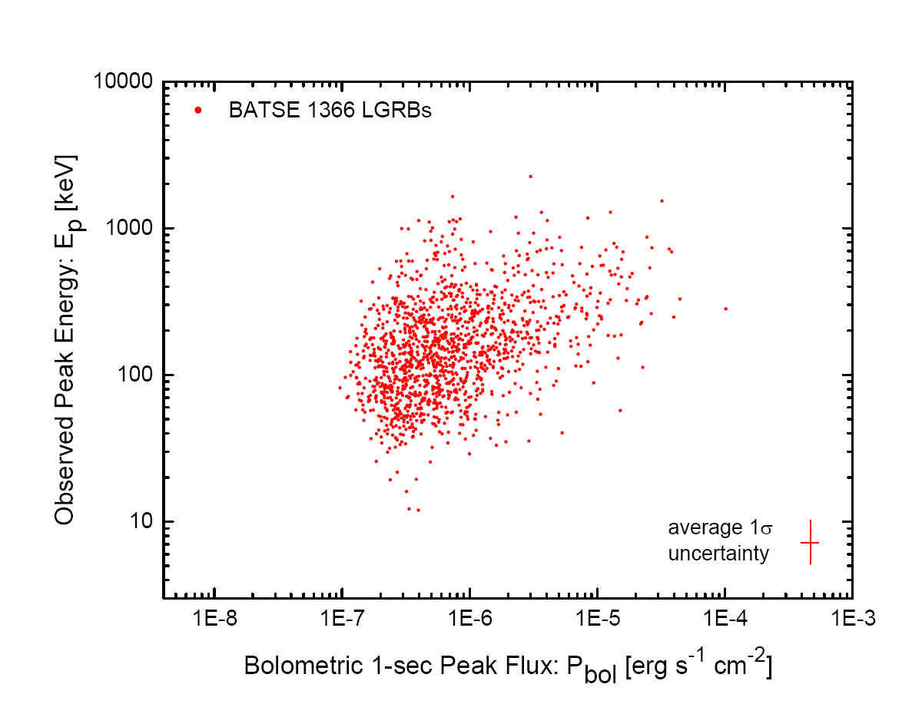
Multivariate Log-normal distribution The simplest most natural model of GRB occurrence rate $R_{cosmic}$ as a function of GRB properties (${E_{iso}, L_{iso}, E_{p,z} , T}_{90,z},z$)
The rate parameter
Detector threshold
Shahmoradi & Nemiroff, MNRAS, 2015

Slide 17
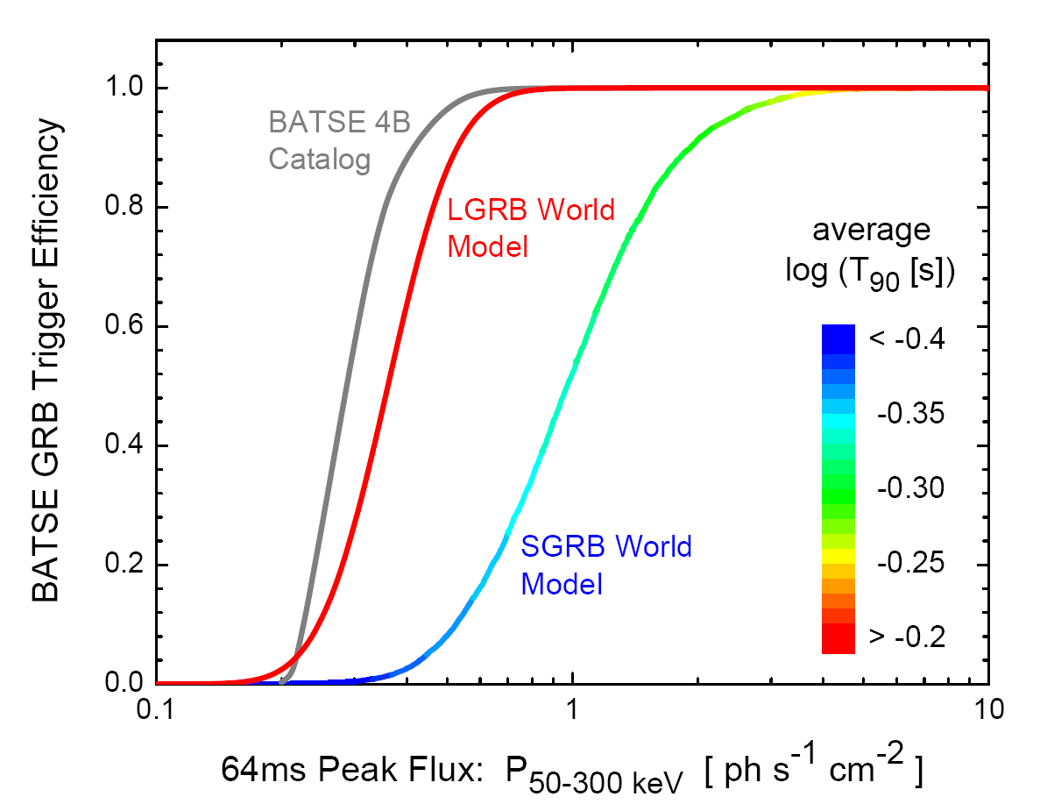
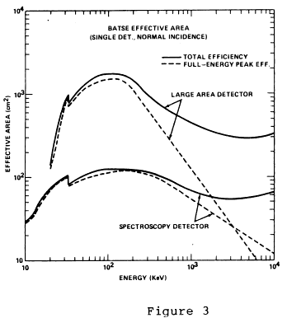
GRB detection is therefore a Poisson process with mean $λ=R_{obs}\left(θ\right)dθ$

Slide 18
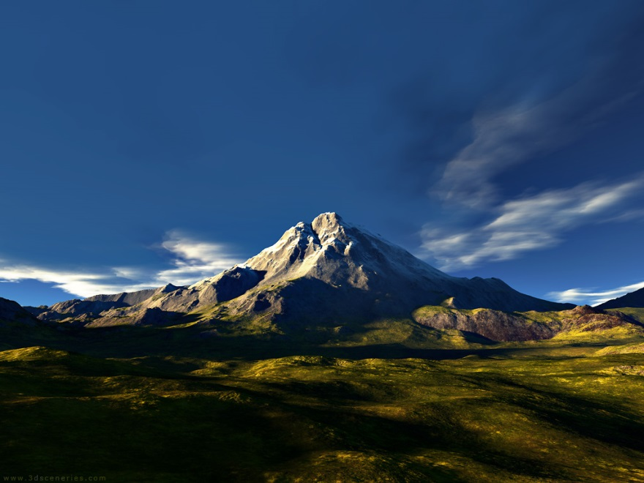
The posterior probability density of model parameters can be obtained from Bayes rule
$$P\left(A|B\right)=\frac{P(A)P(B|A)}{P(B)}$$
$$\underset{P(A|B)}{\underbrace{ }}$$
$$\underset{P(A)}{\underbrace{ }}$$
$$\underset{P(B|A)}{\underbrace{ }}$$
The 16-D parameter posterior density is sampled via an Adaptive Metropolis-Hastings Markov Chain Monte Carlo algorithm
https://github.com/shahmoradi/grb_world

Slide 19
The posterior probability density of model parameters can be obtained from Bayes rule
Notes:
Now with this data at hand we can proceed to set constraints on GRB energetics and correlations. To achieve this goal, we assumed that the joint population distribution of these four GRB variables can be well described by a four dimensional log-normal distribution subject to BATSE trigger threshold. Skipping any further details, I will present some final results here.

Slide 20
GRB rate set to star formation rate
Follows cosmic rate tracing metallicity evolution. Results consistent
with a cutoff Z/Z⊙ ∼ 0.2–0.5, assuming no luminosity–redshift evolution.
Following Hopkins & Beacom 2006, Nakar 2007, Li 2008

Slide 21
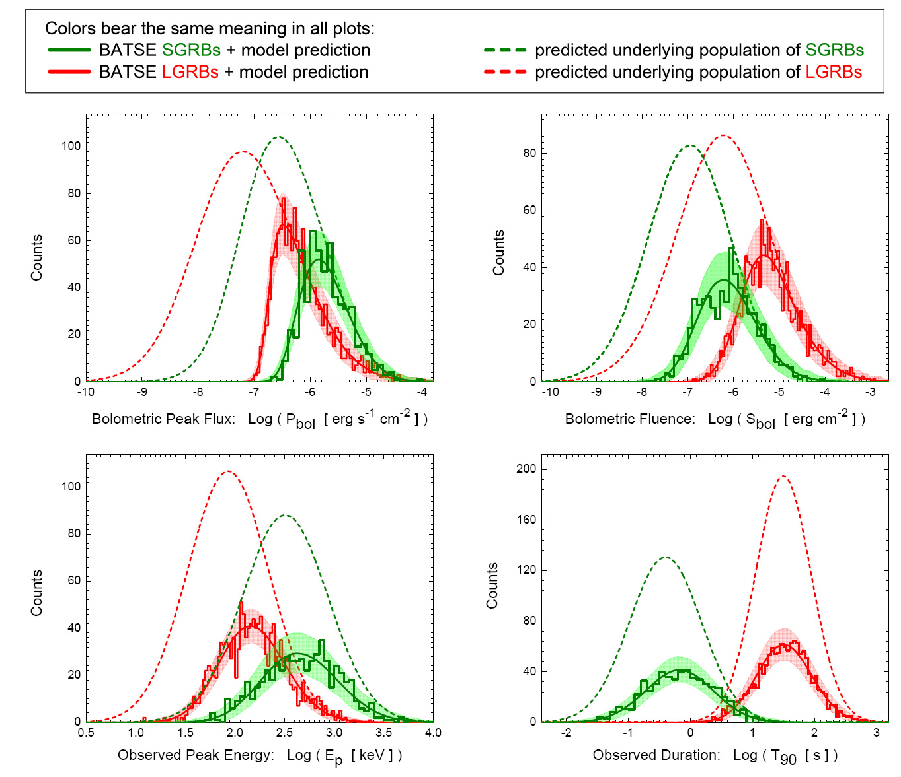
Shahmoradi & Nemiroff, MNRAS, 2015

Slide 22
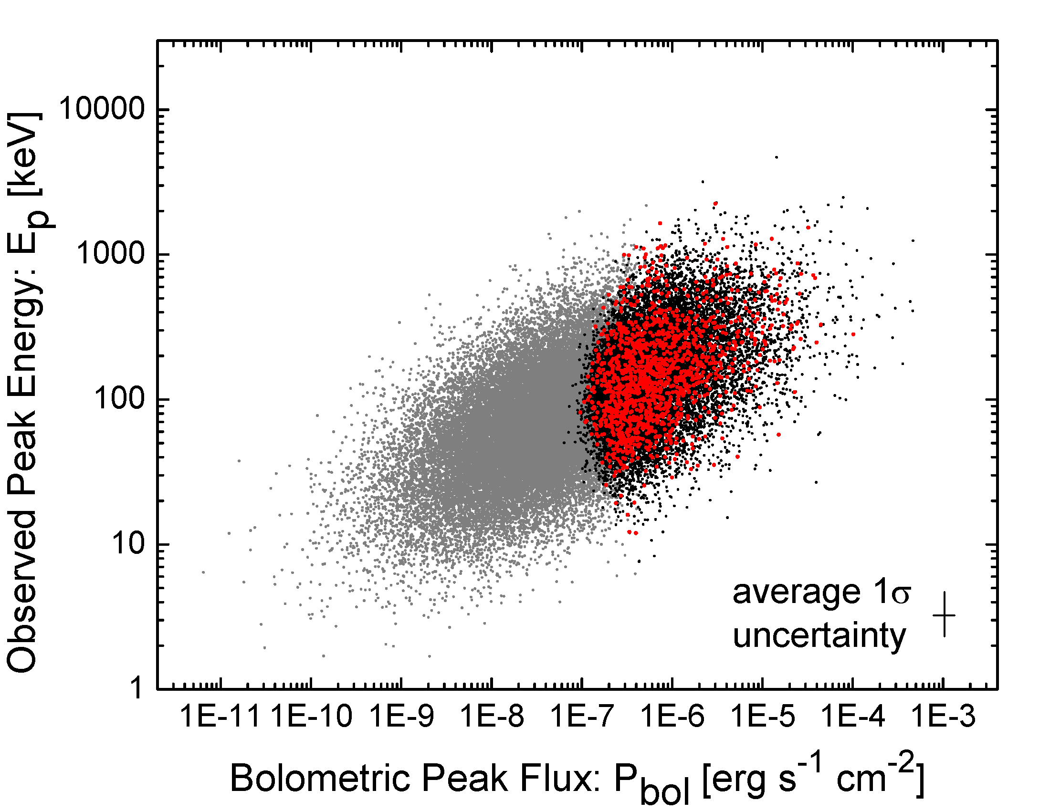
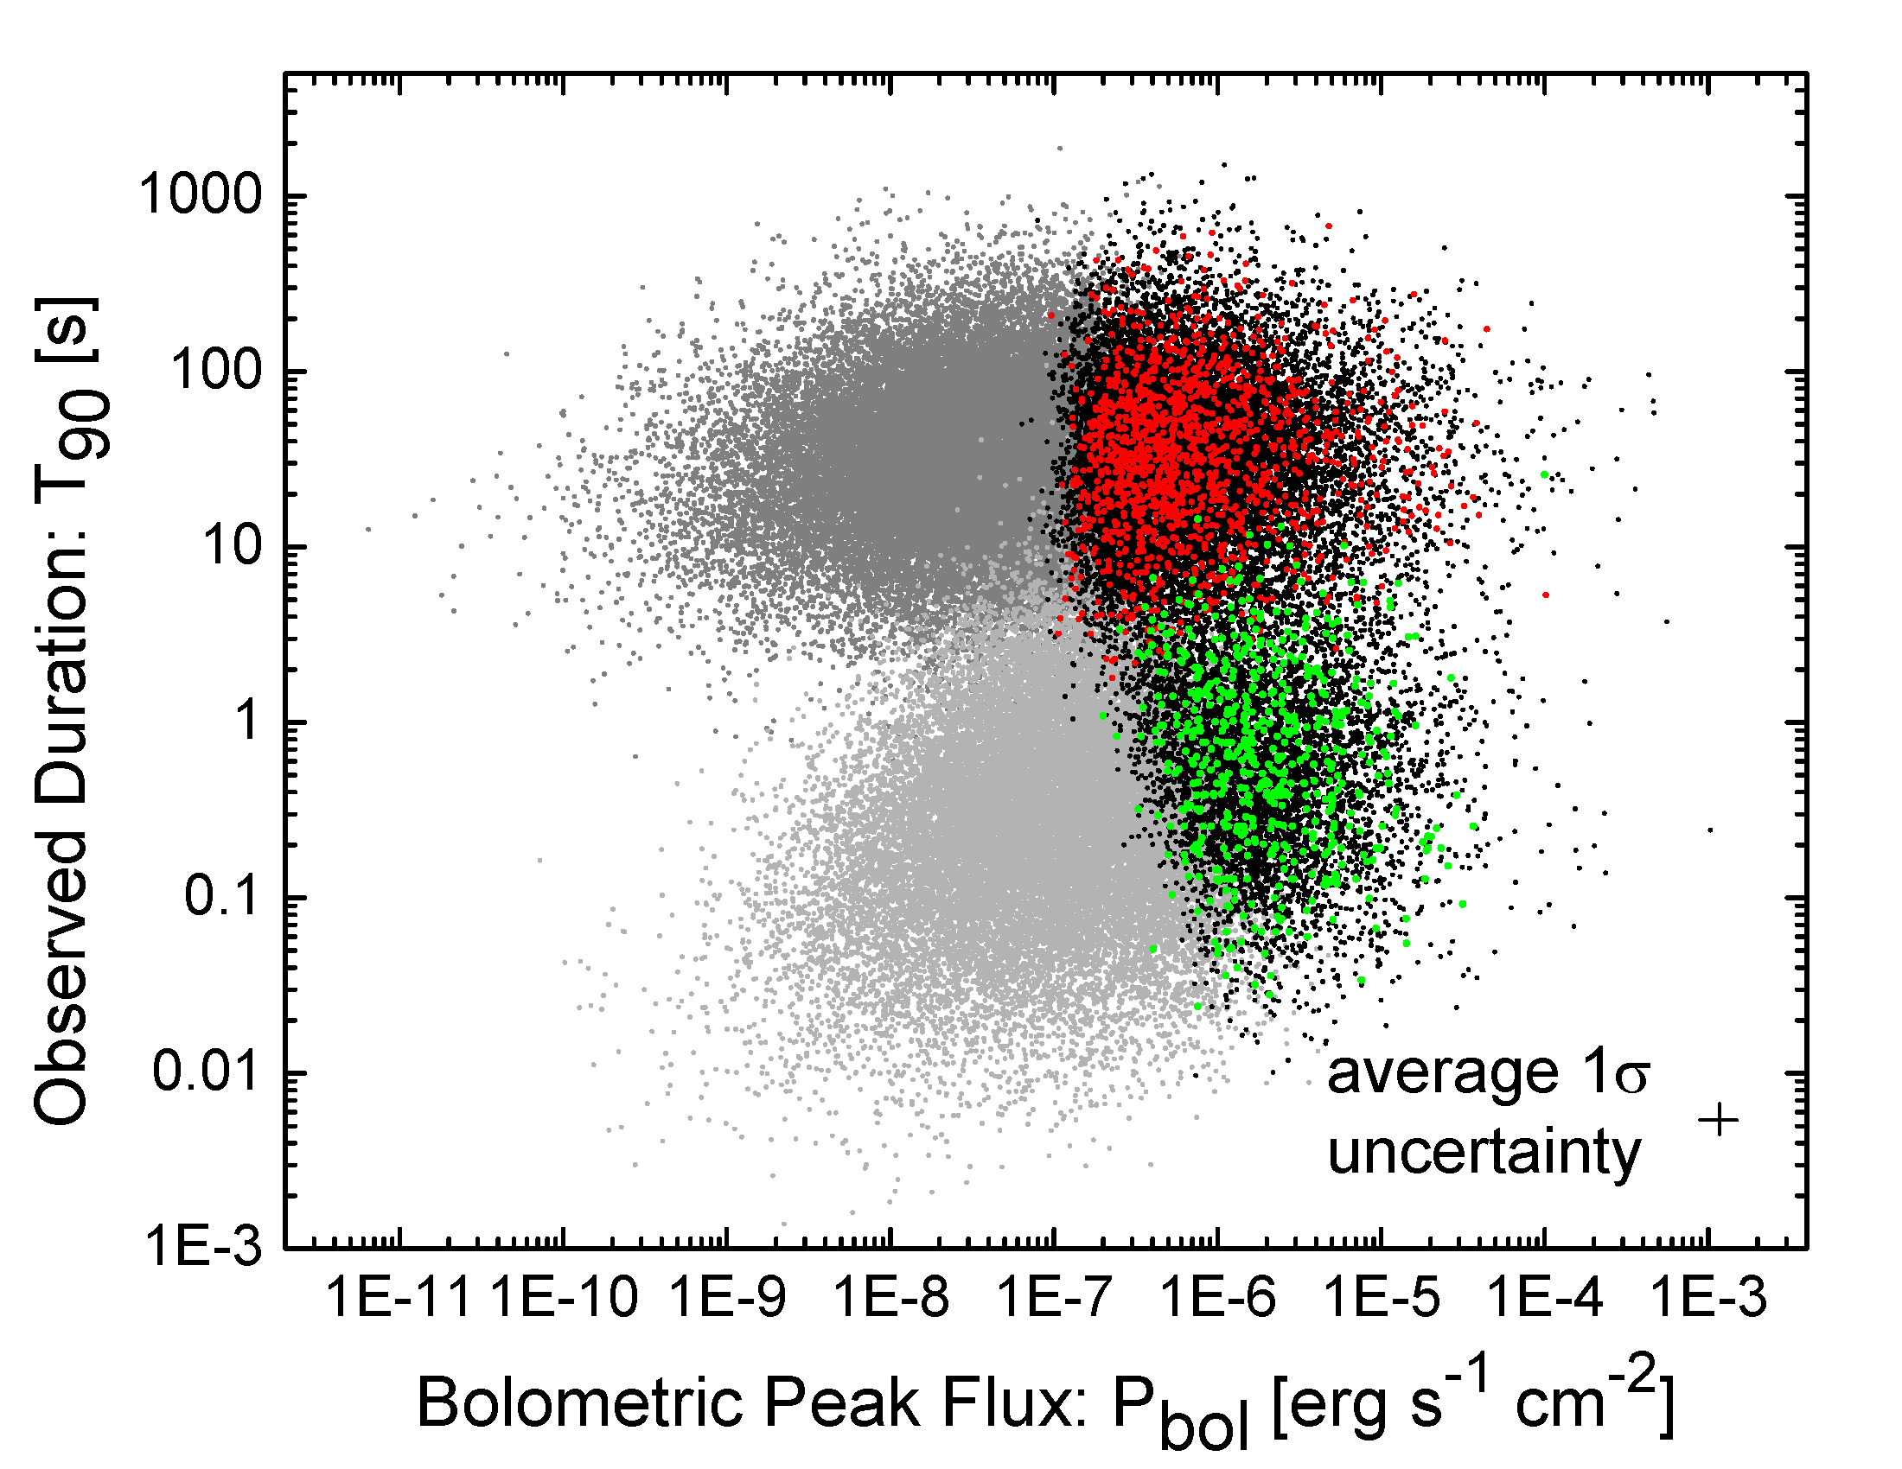
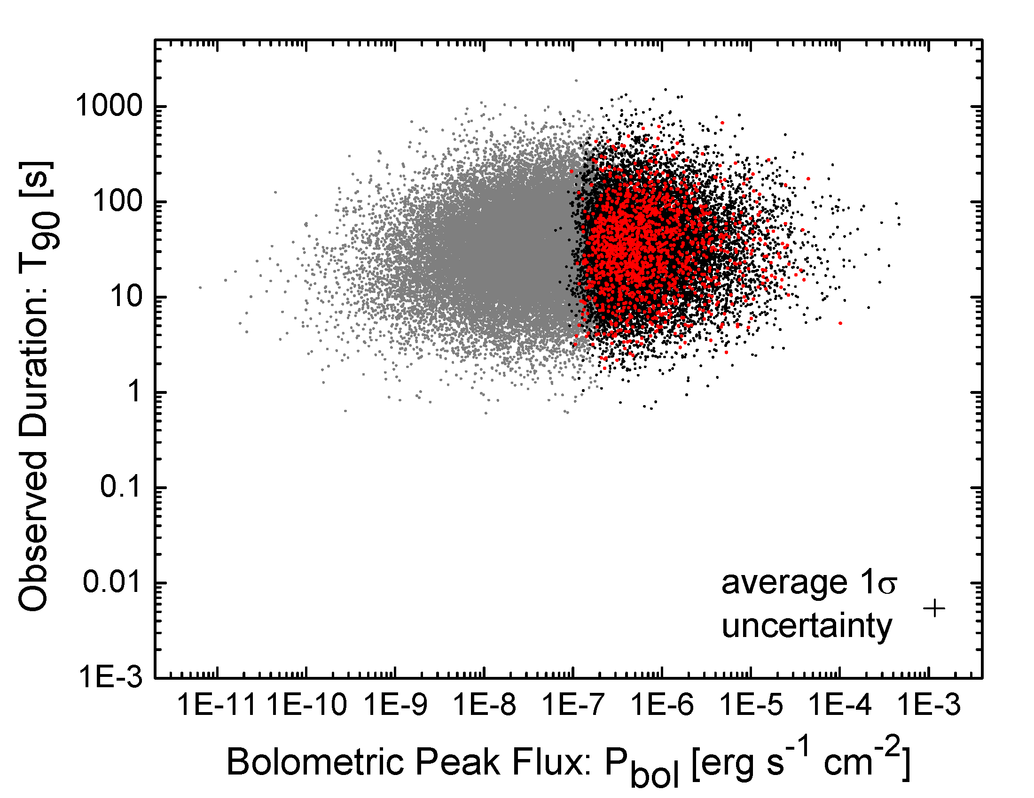
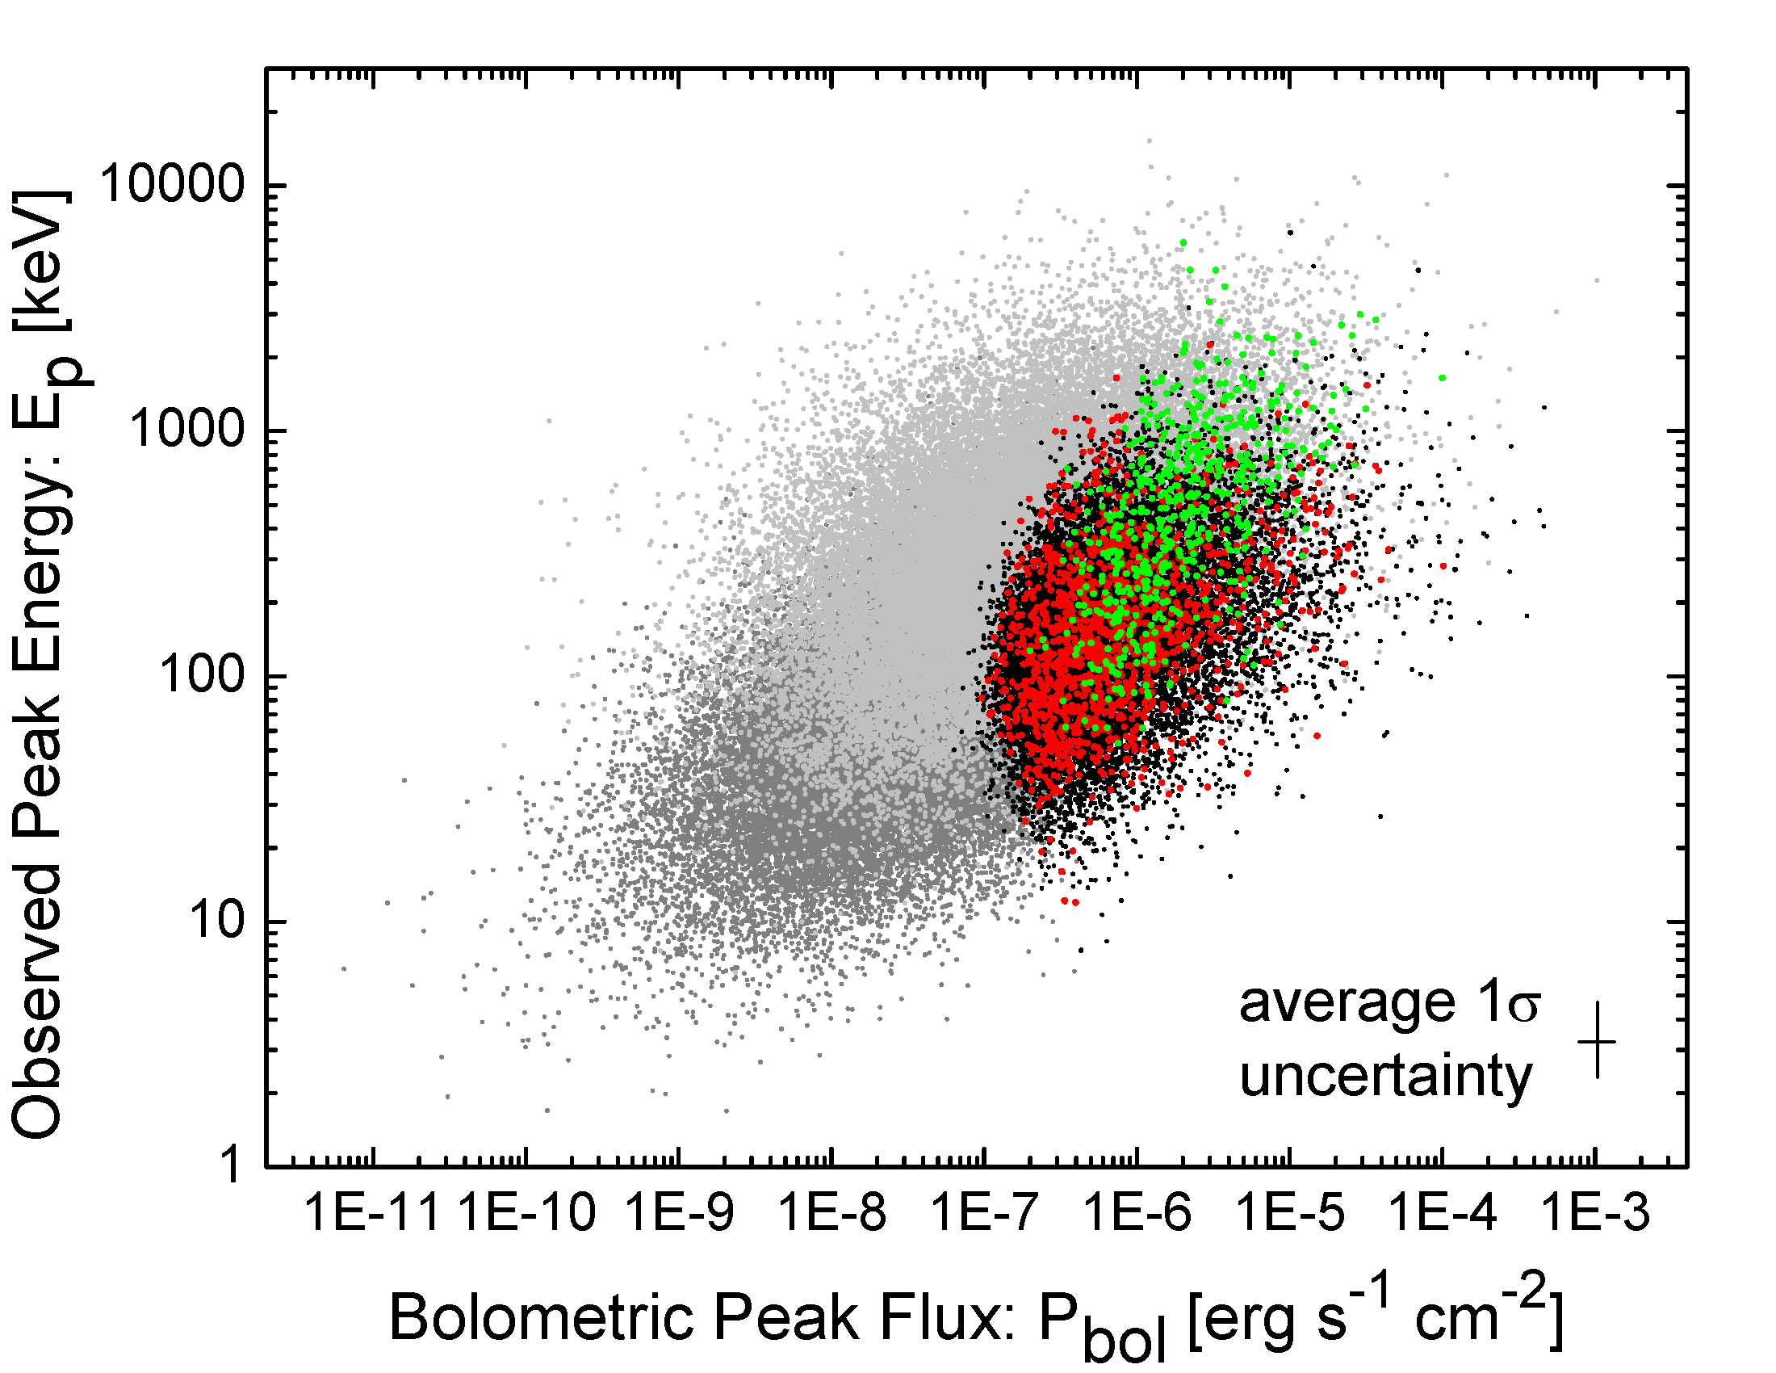
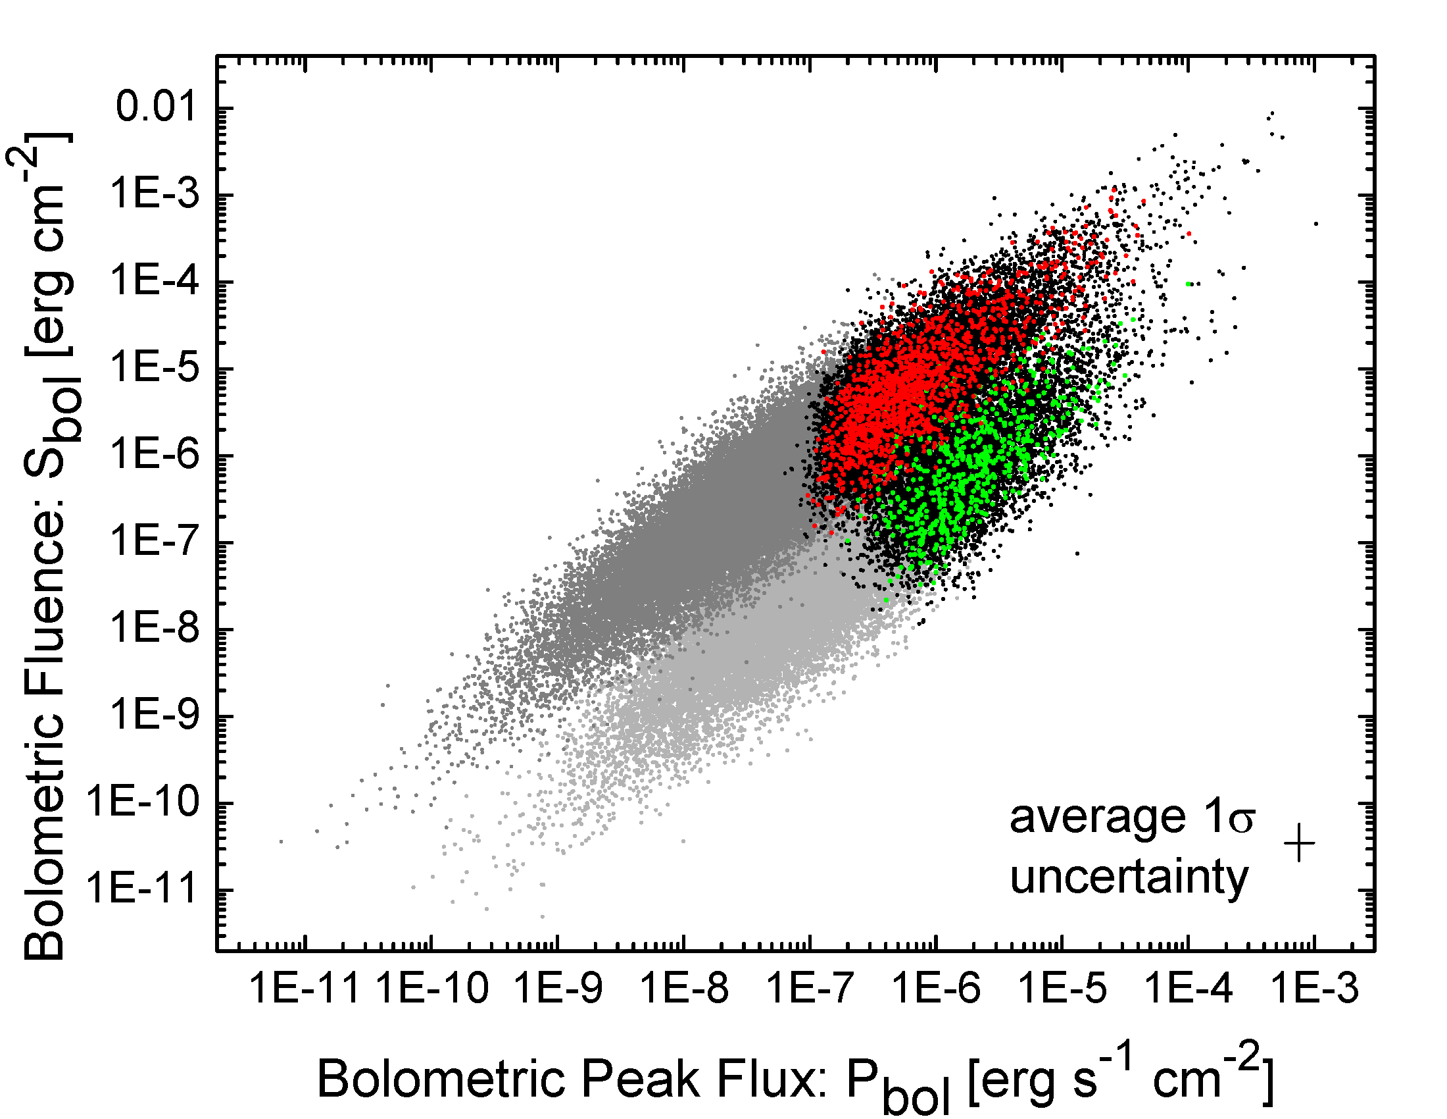
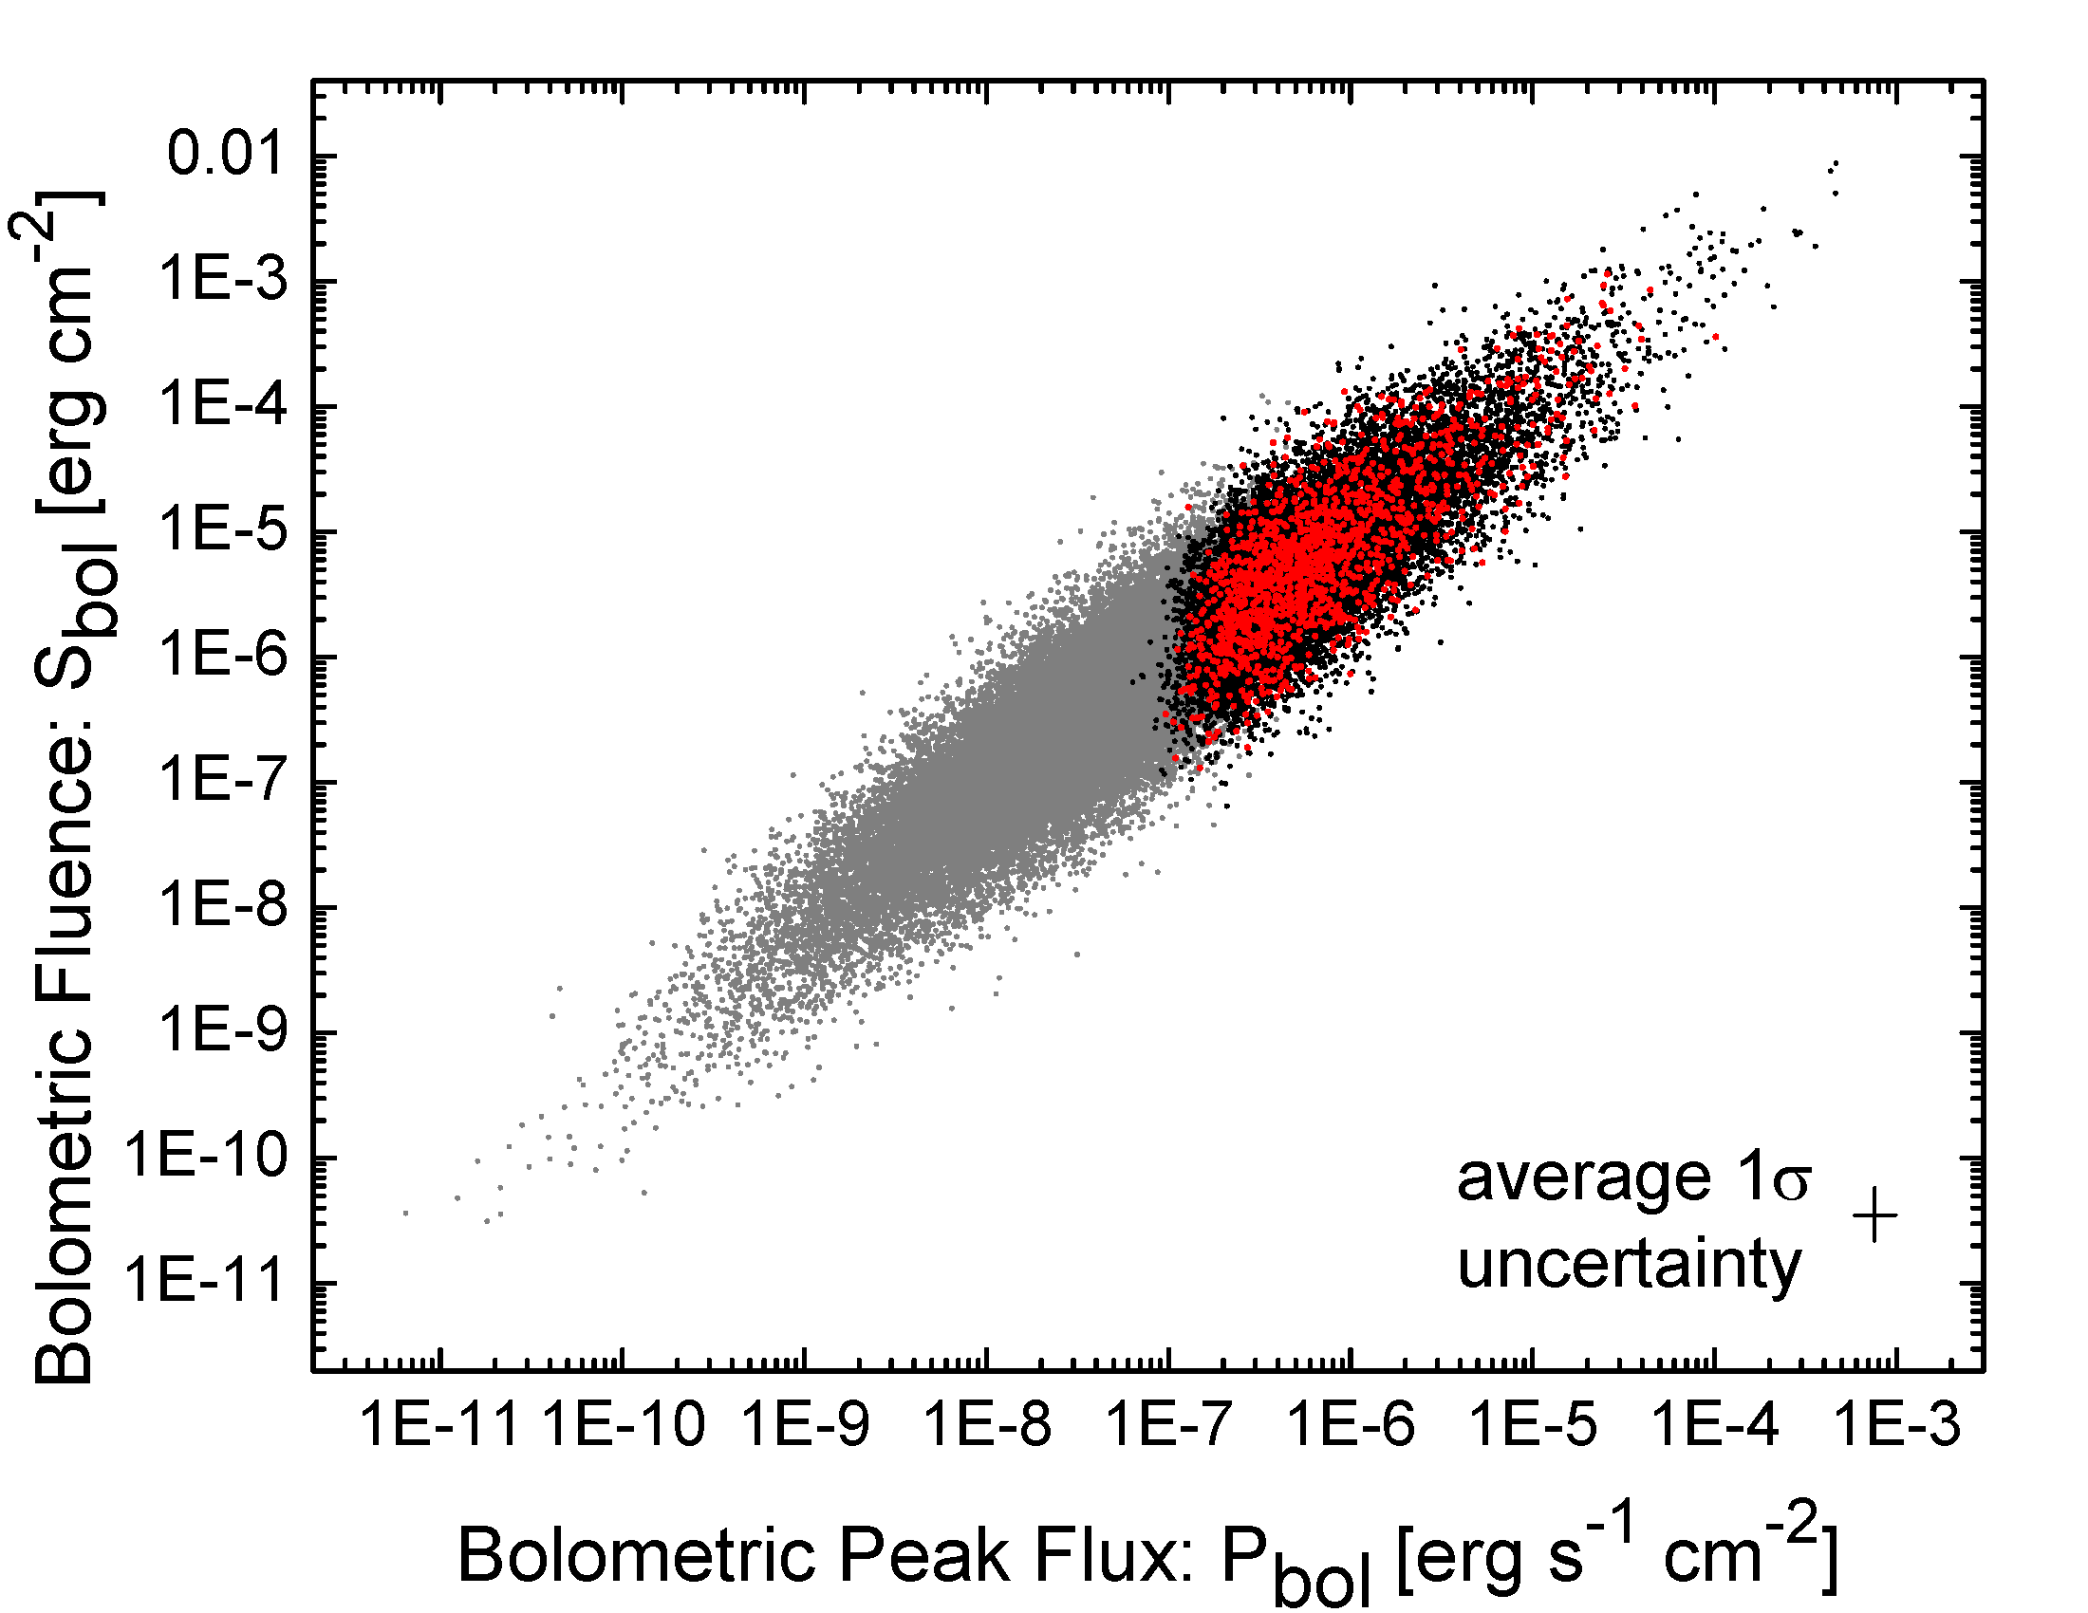
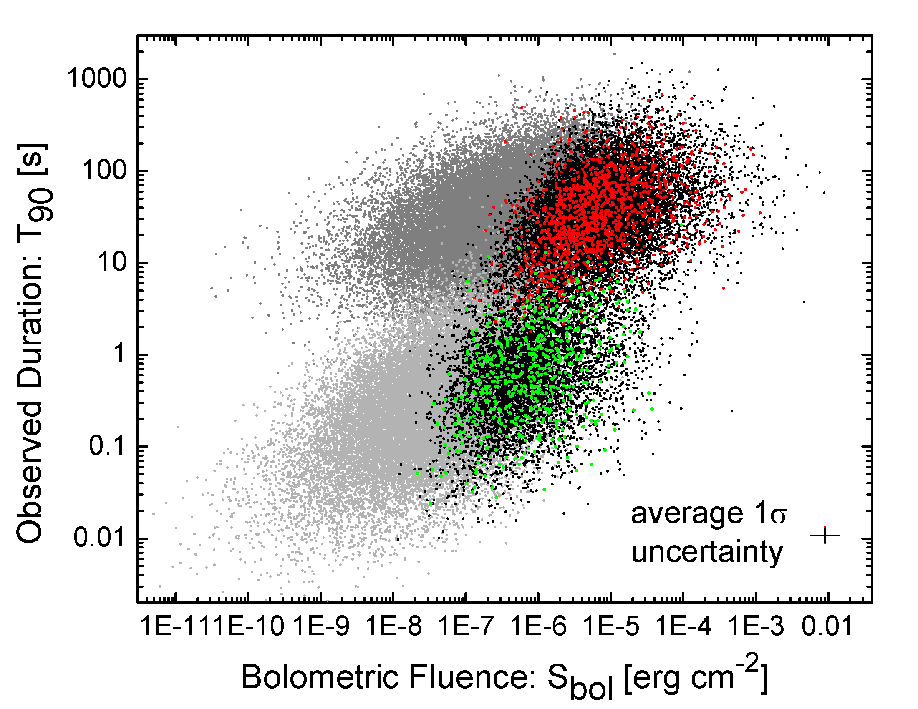
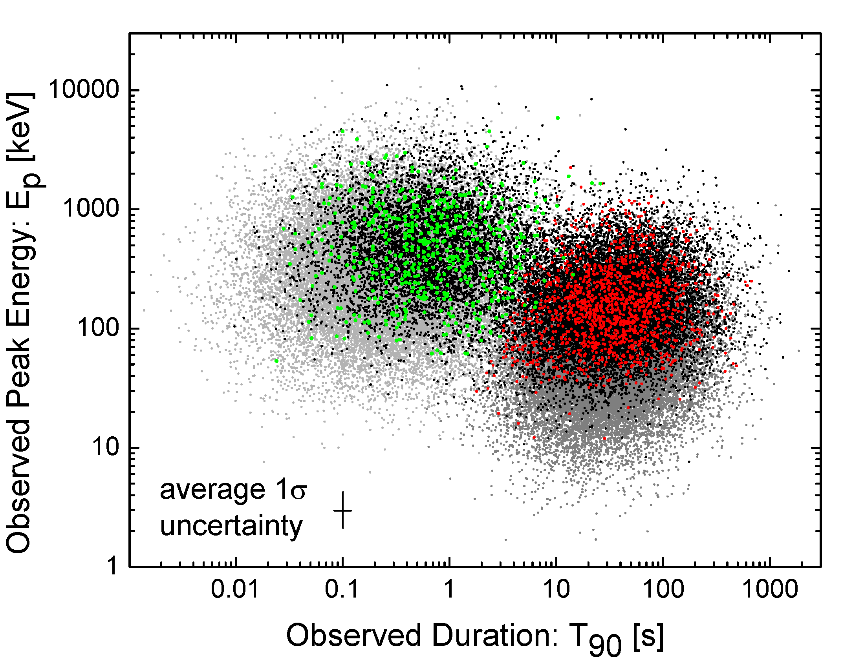
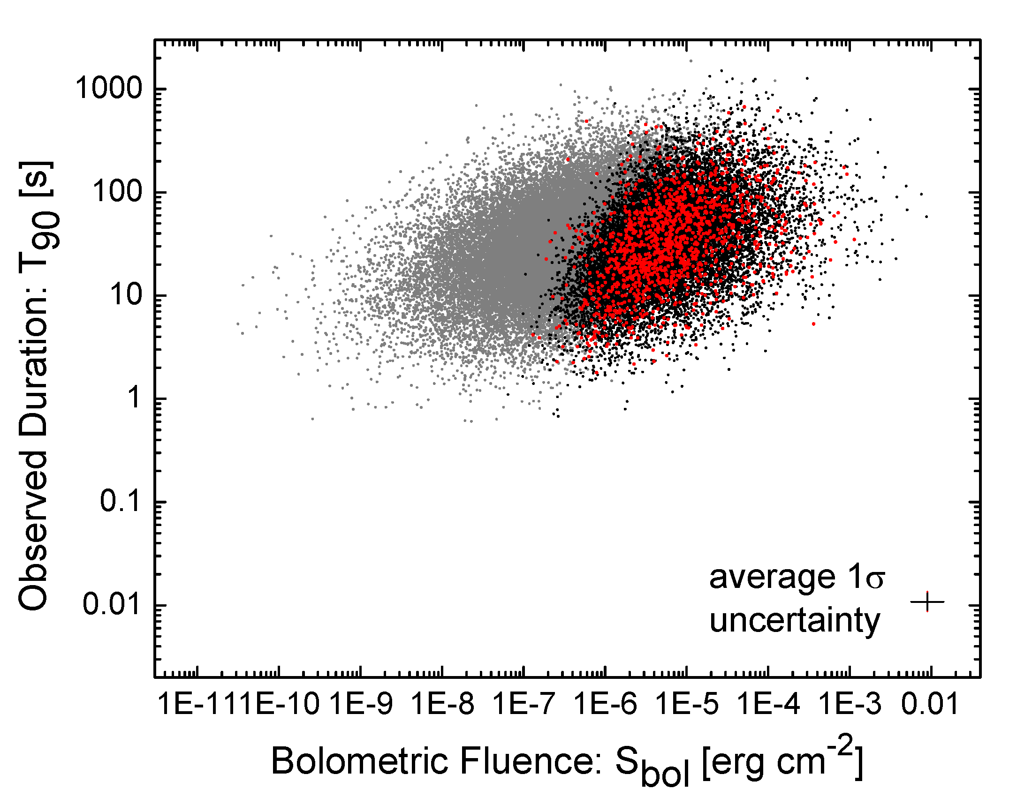
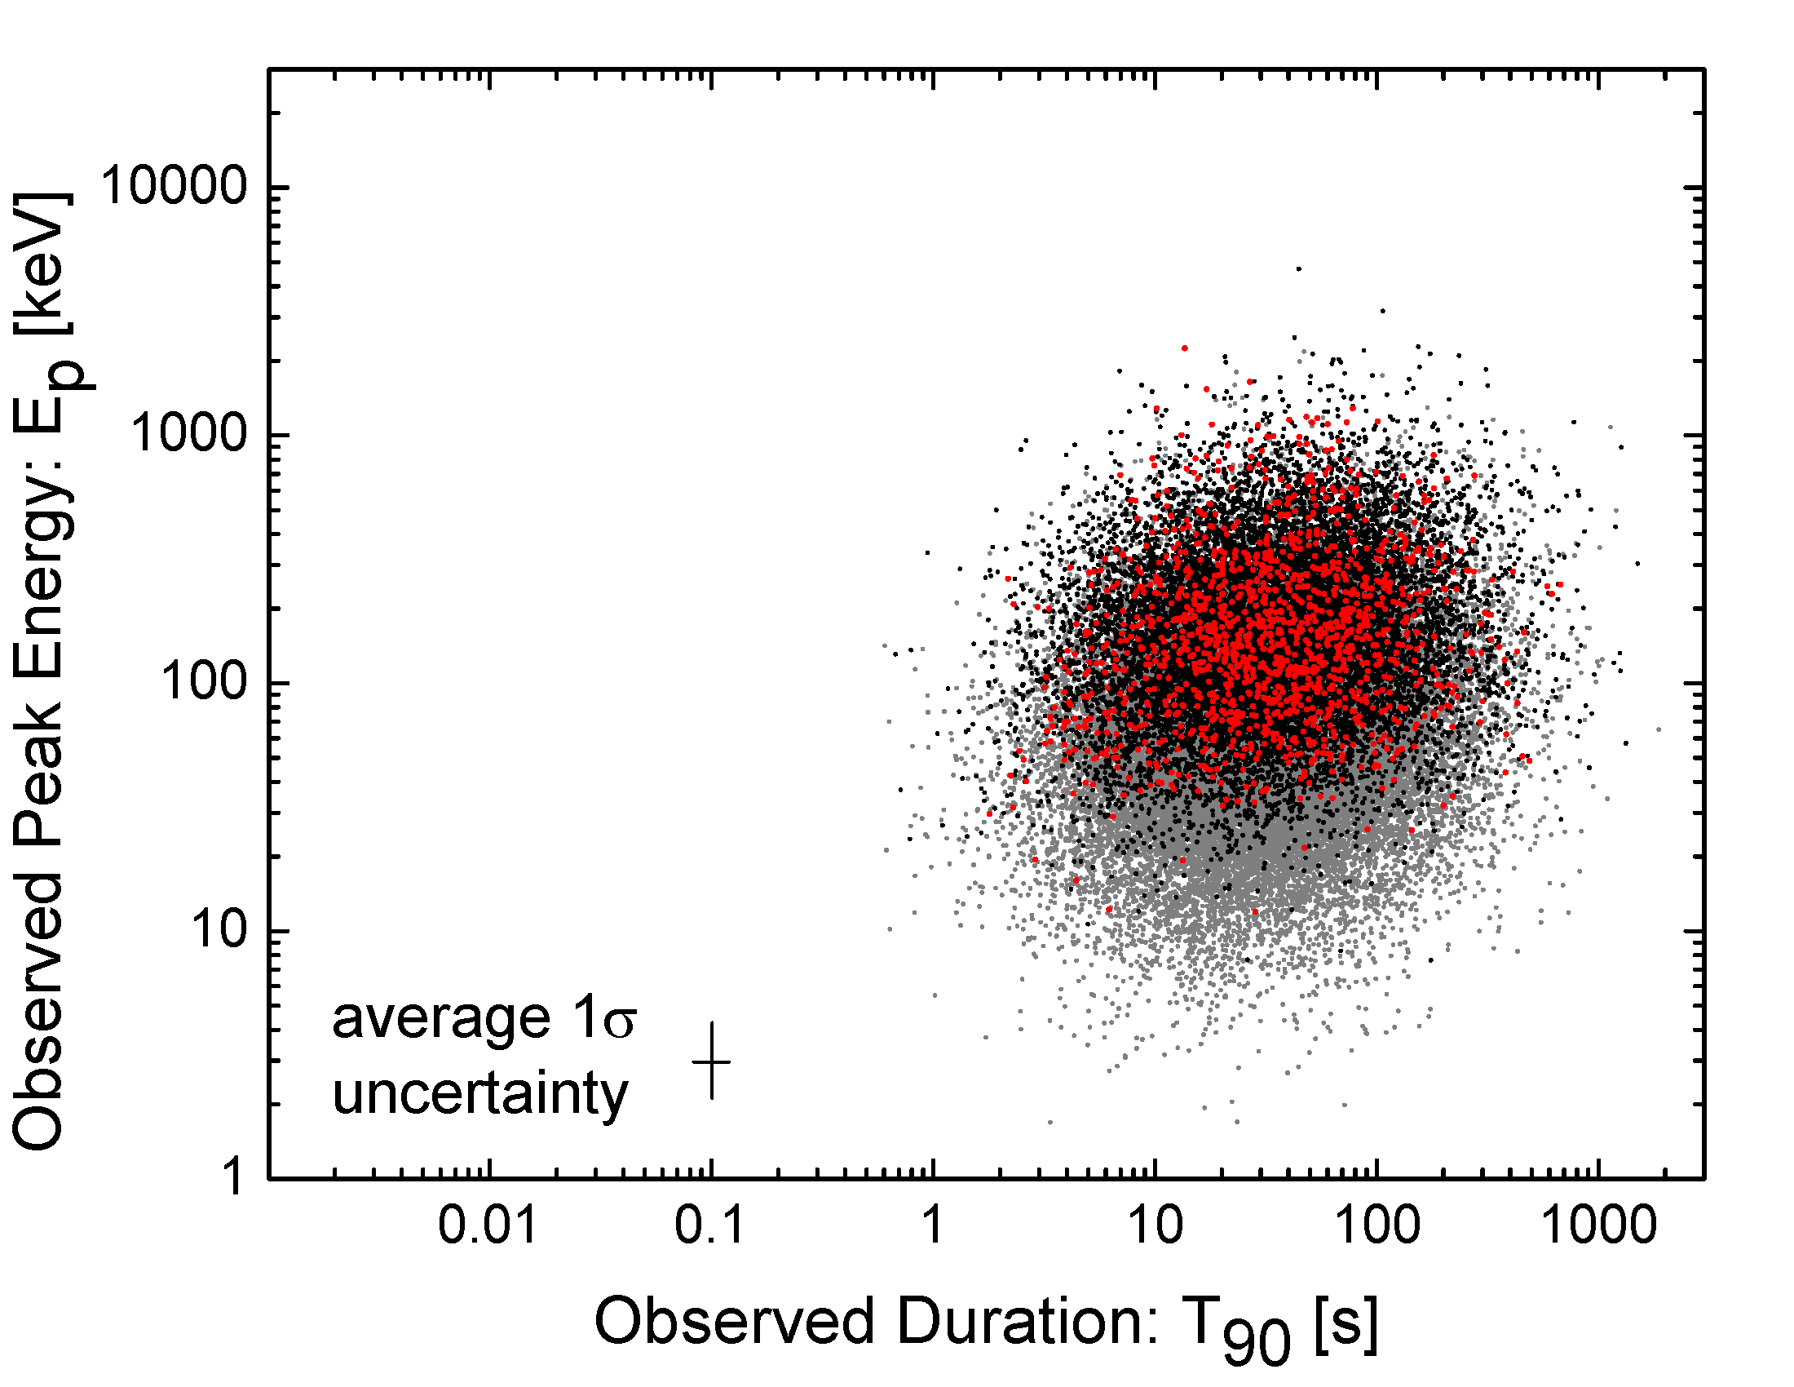
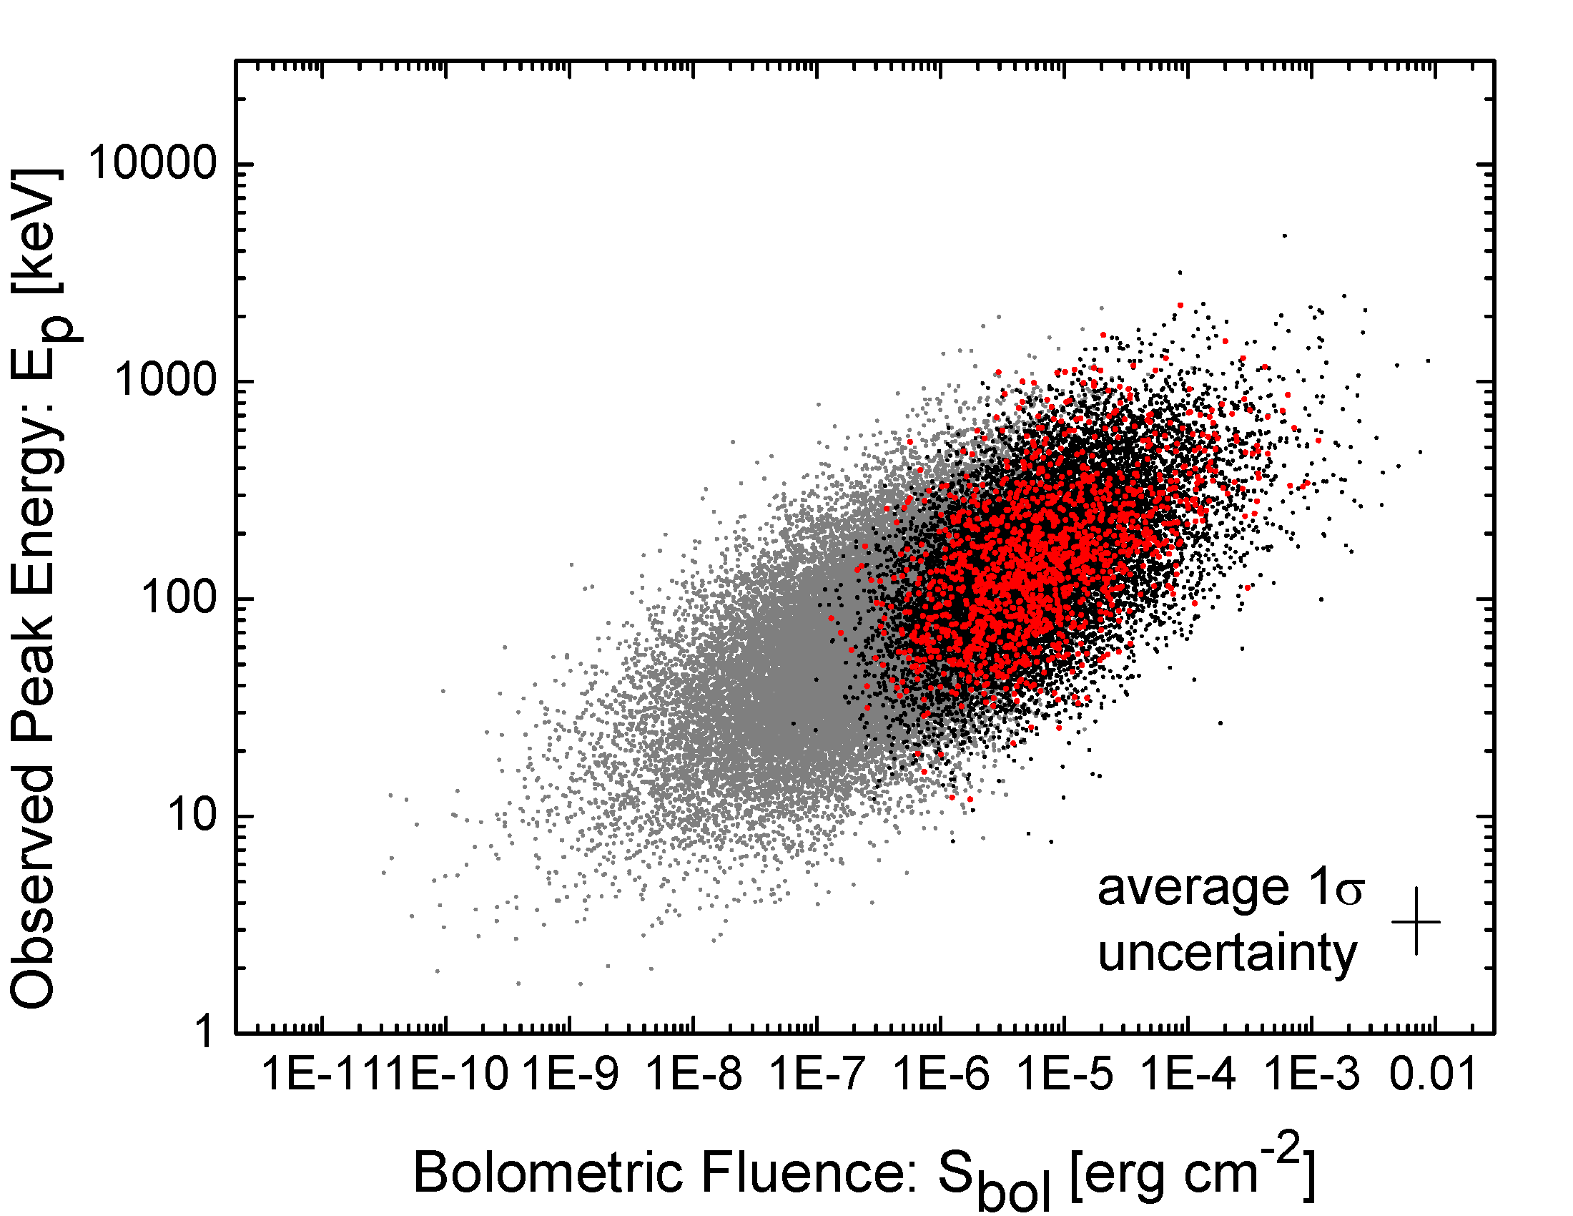
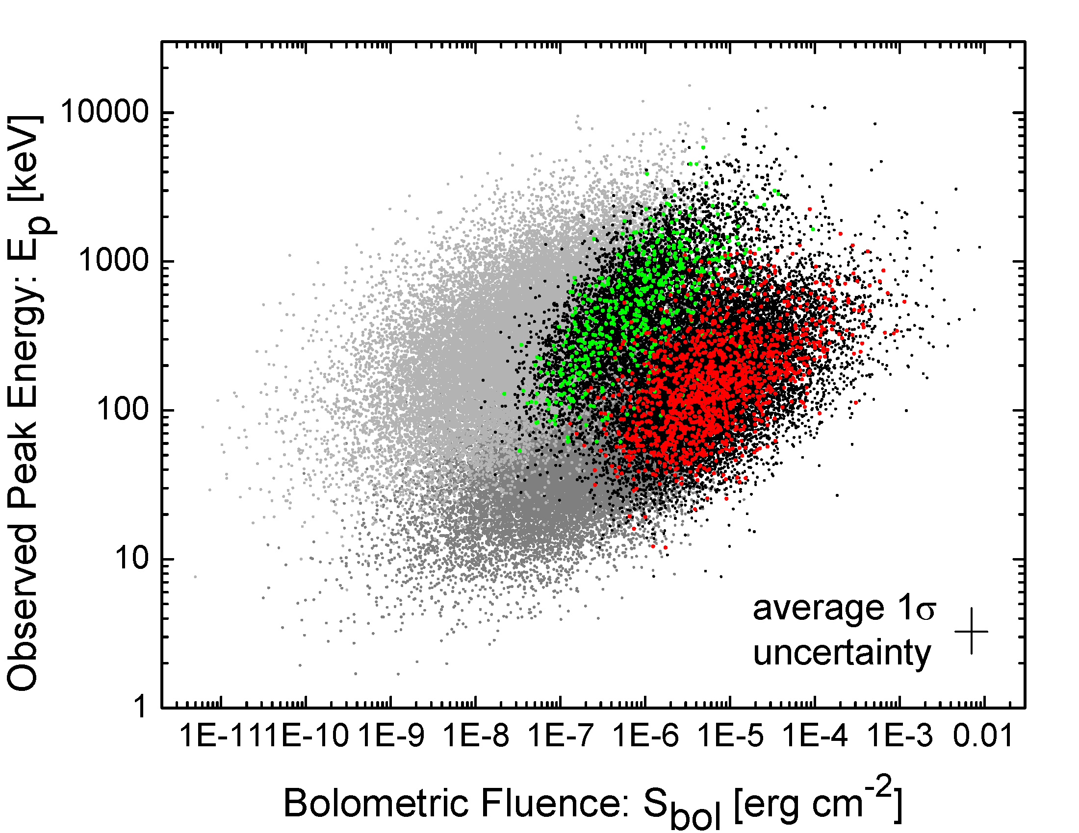
Shahmoradi & Nemiroff, MNRAS, 2015

Slide 23
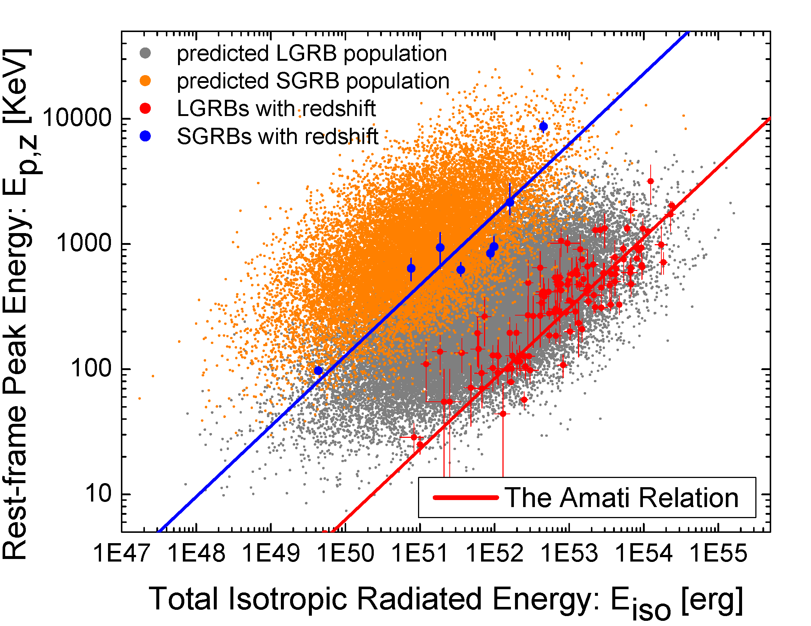
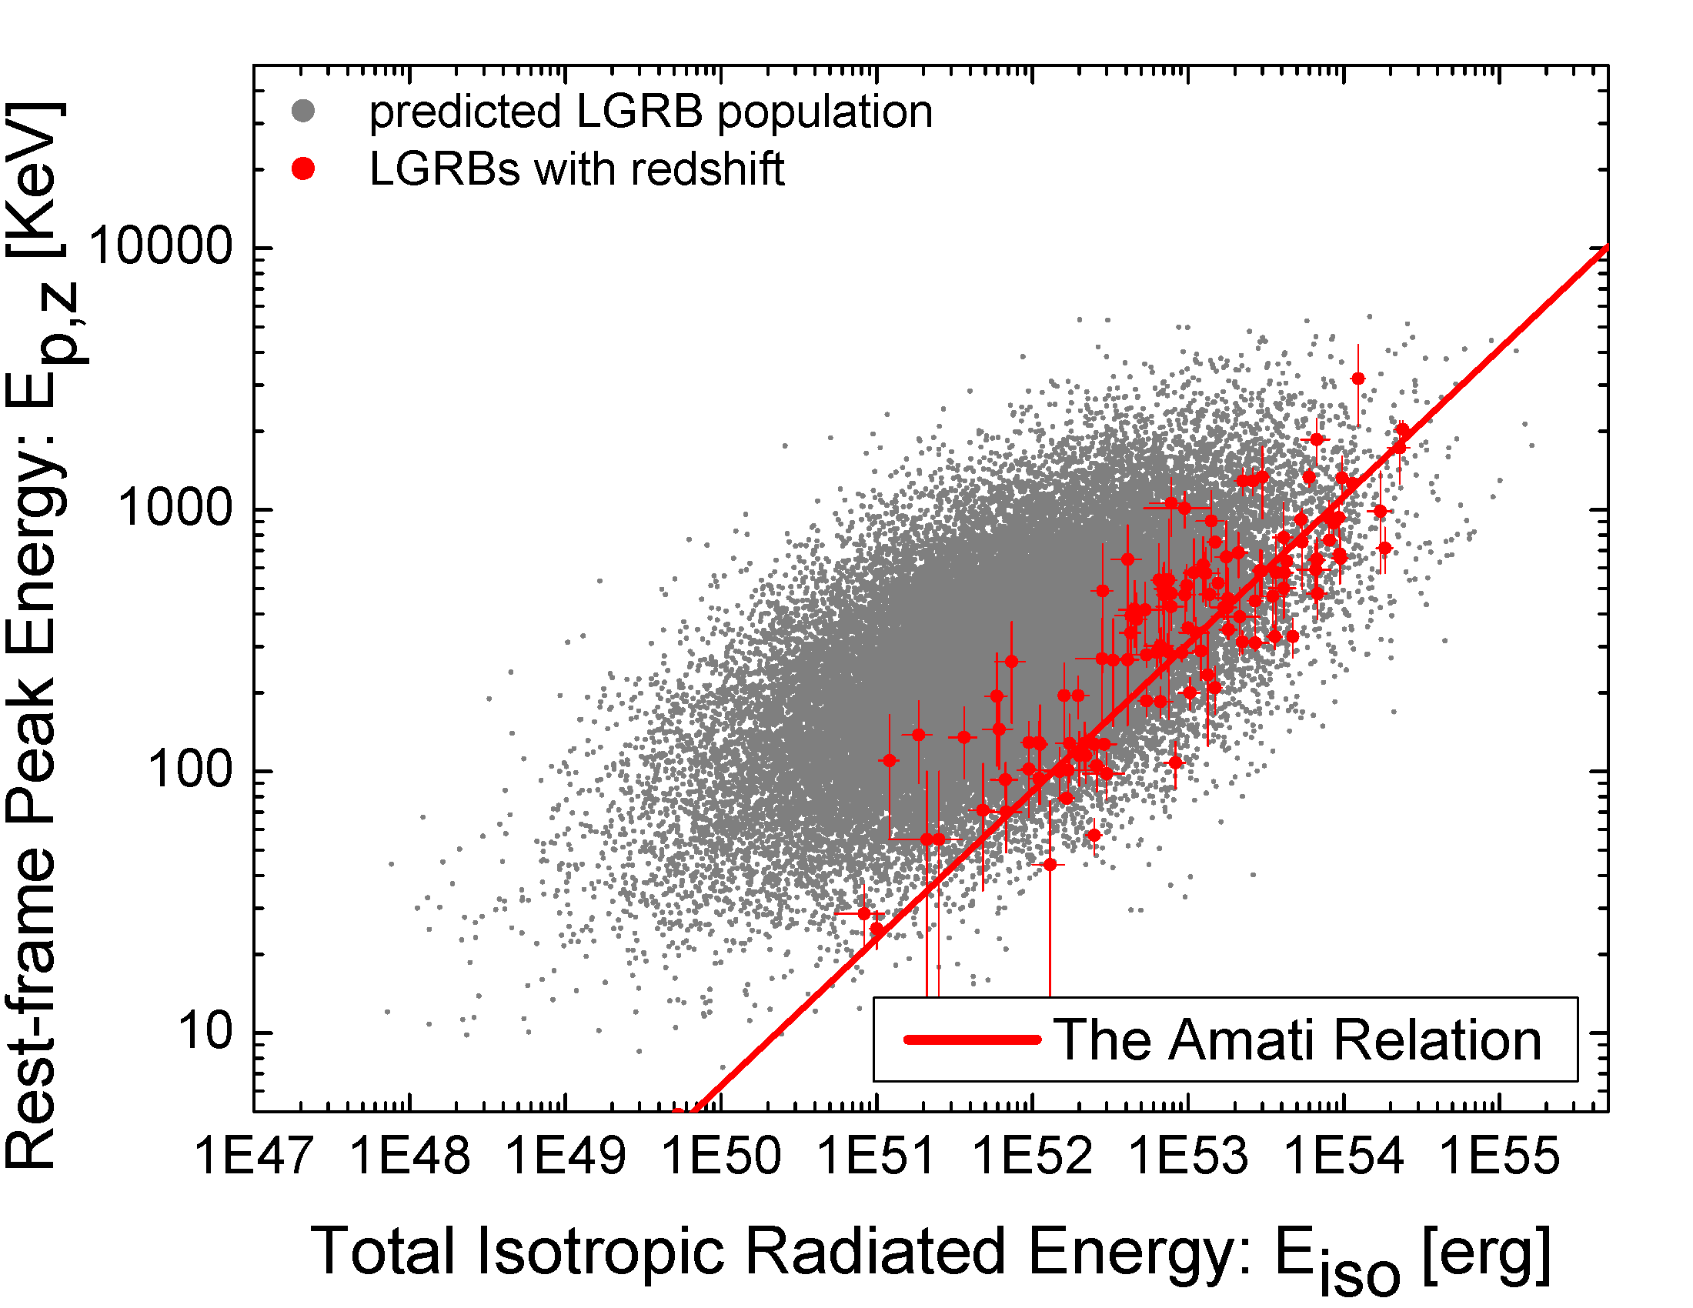
Short and long GRBs exhibit similar prompt correlations
Shahmoradi & Nemiroff, MNRAS, 2015
See also: Demianski, Piedipalumbo, Sawani & Amati 2017a,b

Slide 24
The Amati relation
Larger dispersion is predicted (Shahmoradi, 2013, ApJ, 766, 111)
Different slope is predicted (Shahmoradi, 2013, Stanford eConf Proc. C1304143, paper 14; arXiv:1308.1097)
$$ρ \sim 0.58±0.04$$

Slide 25
Summary (Detailed)
Multivariate log-normal distributions fit both BATSE SGRBs and LGRBs
Best SGRB / LGRB discriminator: Ep/T90 <> 50 keV/sec
Most GRBs were missed by BATSE – both SGRBs and LGRBs
Significant hard – bright & long – bright correlations exist in both populations
Strange: Correlation strengths similar between SGRBs & LGRBs
Prompt photon generation mechanism similar?
The Amati (E_{iso}-E_{P,z}) relation is confirmed, but with significantly higher dispersion and shallower slope of the regression line (0.25 vs. 0.55)
Details on GRB energetics & correlations
Shahmoradi & Nemiroff, 2015, MNRAS, 451, 126-143
Shahmoradi, 2013, ApJ, 766, 111
Shahmoradi & Nemiroff, 2010, MNRAS, 407, 2075–2090
Shahmoradi & Nemiroff, 2011, MNRAS, 411, 1843–1856
Shahmoradi & Nemiroff, 2009, AIP Conf Proc, 1133, 425
Nemiroff, 2000, ApJ, 544, 805
Marani, Nemiroff, Bonnell & Norris, 1999, BAAS, 194, 31, 825

Slide 26
Why are GRBs of interest?
Tests of cosmological models
Created detailed, statistical “GRB-World” for testing
Found corrections to GRB standard candle model
Sources of gravitational waves
Confirmed most GRBs undetected
Found better boundary, unusual similarity, between short and long GRBs

Slide 27
Observational data uncertainties are very important and must be taken into account
$$L\left(GRB DATA|R\left(θ\right)\right)=({Δθ)}^{N}exp⁡\left(−\int_{θ}{R\left(θ\right)dθ}\right)\left[\prod_{i=1}^{N}{R \left(θ_{i}\right)}\right]$$
This is the likelihood of data given model parameters.
How do we get the posterior distribution for model parameters $P(\vec{μ},Σ|GRB DATA)$ ?
Shahmoradi & Nemiroff, MNRAS, 2015

