Slide 1
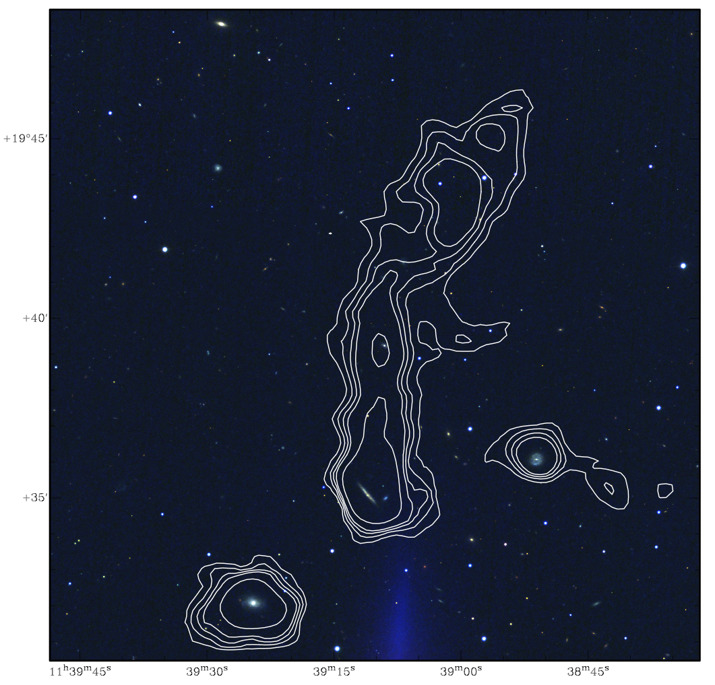
“Ram pressure and pre-processing
in Abell 1367: a tale of tails”
based on a recent paper by
Tom Scott , Elias Brinks,
Luca Cortese, Alessandro Boselli,
Hector Bravo Alfaro
FGC1287
group

Slide 2
Content
Interactions and impact on HI content and morphology
A cunning plan…
…applied to Abell 1367: a merging cluster
Summary

Slide 3
HI Perturbations
HI, especially that further out in LTGs, is sensitive to environmental effects, through a wide range of mechanisms
LTGs infalling into clusters are ram pressure stripped of HI
tidal interactions in the cluster environment give rise to “harassment” (low impact, high velocity) and pre-processing (high impact, low velocity)
Ram pressure stripping
CGCG 97-121 in A1367
Scott et al. 2017 (submitted)

Slide 4
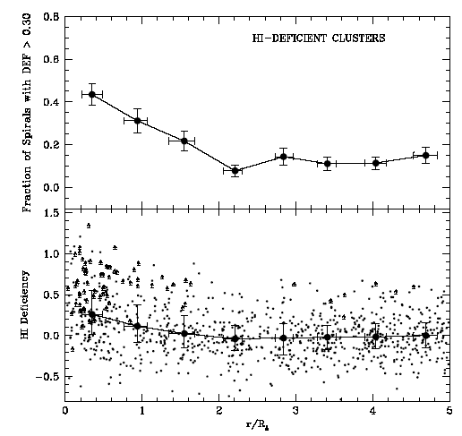
Cluster LTG’s HI Deficiency
HI Deficiency (Def HI) is defined as:
log(HIexpected/HIobserved)
+ = deficient, − = excess (Haynes & Giovanelli 1984)
Fraction of HI deficient late type galaxies (LTGs) increases with proximity to cluster centres (Solanes et al. 2001)
HI deficiency correlated with truncated H𝜶 (SF) and dust disks (Koopmann & Kenney 2004; Cortese et al. 2012)
FRACTION GALAXIES WITH HI DEFICIENCY
Fraction of spirals with DEF > 0.3
HI DEFICIENCY
HI deficiency
R/R_{A}
distance from the cluster centre normalised by RA, the Abell radius, of a composite of 11 clusters (Solanes 2001)

Slide 5
HI in clusters
Evidence cluster environment is impacting late type galaxies (LTGs), out to several Abell radii (Ellingson 2004)
ISM stripping from LTGs important aspect of transformation of LTGs to earlier Hubble types
Low z clusters - consensus ram pressure stripping is the dominant LTG transforming mechanism (Boselli et al. 2016)
Unclear extent to which ram pressure and/or tidal mechanisms operate at different radii or clusters of different types, or as a function of z
Ram pressure stripping
CGCG 97-121 in A1367
Scott et al. 2017 (submitted)

Slide 6
The Plan
Question: can HI be used to determine the dominant mechanism affecting LTGs in clusters?
Problem: determining Def HI or spatially mapping HI is expensive
Solution: investigate 4 proxies
HI profile asymmetry, Aflux
opt − HI velocity or position offset
Ram pressure stripping
CGCG 97-121 in A1367
Scott et al. 2017 (submitted)

Slide 7
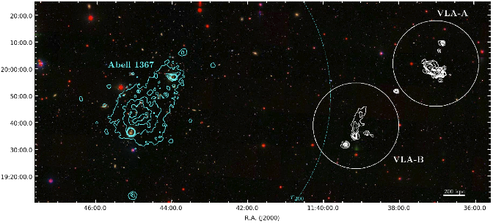
Abell 1367
A 1367
(z =0.02) merging cluster: X-ray emission (cyan contours) from the ICM (NW and SE sub-cluster)
A 1367 central ICM density ∿1/5 of Coma (Fukazawa et al 2004).
X-ray (ROSAT)
NW
SE
HI

Slide 8
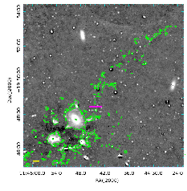
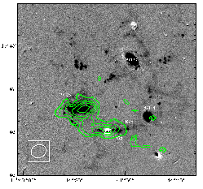
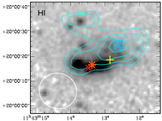
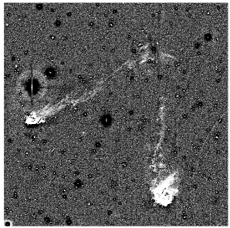
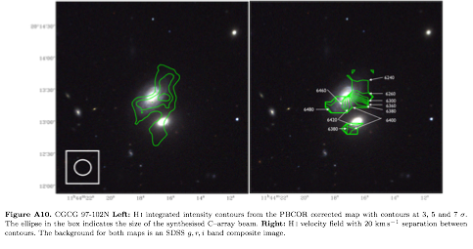
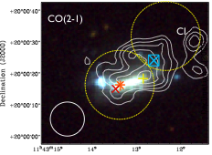
A1367: ISM stripping observations
Blue Infalling Group (BIG)
HI single dish 1º x 5º blind survey (AGES n=43)
HI interferometric resolved (VLA n=30)
H𝜶 deep imaging (Yagi et al. 2017). H𝜶 tails longer, more massive and more frequent in A1367 compared to Coma
Complex cluster environment; examples of multiple mechanisms operating simultaneously, e.g., tidally loosened material aiding ram pressure stripping
H 𝜶
Yagi et al 2017
HI
HI contours on H alpha
Scott et al. 2017 (subm.)
Preprocessing + ram pressure
Harassment type + ram pressure?
Pair interaction
CGCG 97079
HI
Scott et al. 2015
H 𝜶
Boselli and Gavazzi 2014

Slide 9
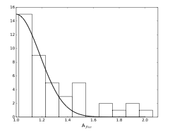
Four HI perturbation signatures
Current investigation, using available HI single dish (AGES) and interferometric resolved (VLA) data in A1367, four types HI perturbation signatures:
1 Asymmetries in the HI (AGES) profiles Aflux
Aflux ratio is a measure of the asymmetry in its integrated HI flux (within its W20 velocity range) at velocities above and below a galaxy’s systemic velocity, VHI (Espada et al. 2011).
3 𝜎
(Aflux =1.39)
Half gaussian Fit to isolated
galaxy sample and 3𝜎
(Espada et al. 2011)
Aflux =1.04
26% A1367 (AGES) have Aflux > 3𝜎 in
an isolated sample (2%) and other dense environments (10 to 20%)
Aflux =1.90
Histogram: A1367 Aflux

Slide 10
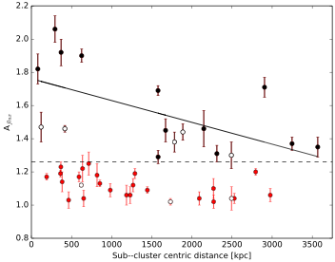
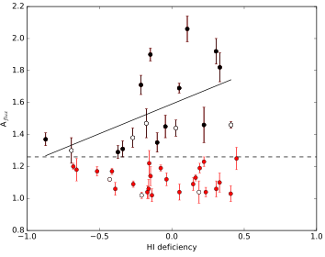
Four HI perturbation signatures
1 Asymmetries in the HI profile Aflux
Two statistically significant relations for LTGs
with Aflux > 1.26 in isolated sample found:
Subcluster distance (r = −0.598)
HI deficiency (r = 0.522)
Aflux
56% of LTGs with Aflux > 1.26 are members of groups and pairs => significant contribution from tidal interactions.
Subcluster distance [kpc]
Aflux
Symbols:
Black Aflux > 2 𝝈 (Aflux =1.26) in isolated sample
Red Aflux < 2 𝝈 (Aflux =1.26) in isolated sample
Open symbols = members of groups and pairs
HI Deficiency

Slide 11
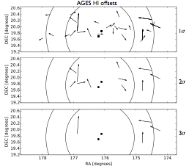
Four HI perturbation signatures
2 Differences between optical and HI velocities
Velocity offsets found in a few cases, where Aflux is also high and tidal interactions are suspected
3 Offsets between single dish HI and optical positions (AGES HI offsets)
Single dish HI offsets orientation and
projected magnitude x 20
Surprising the largest offsets (> 3𝝈 pointing uncertainties) are not near the cluster centre. One case is group tidal interaction another is FGC1287
FGC 1287 raises the question of the effectiveness of ram pressure stripping beyond the virial radius and X–ray detected ICM.
NW
SE
R200
Viral
radius
sub-clusters
centres

Slide 12
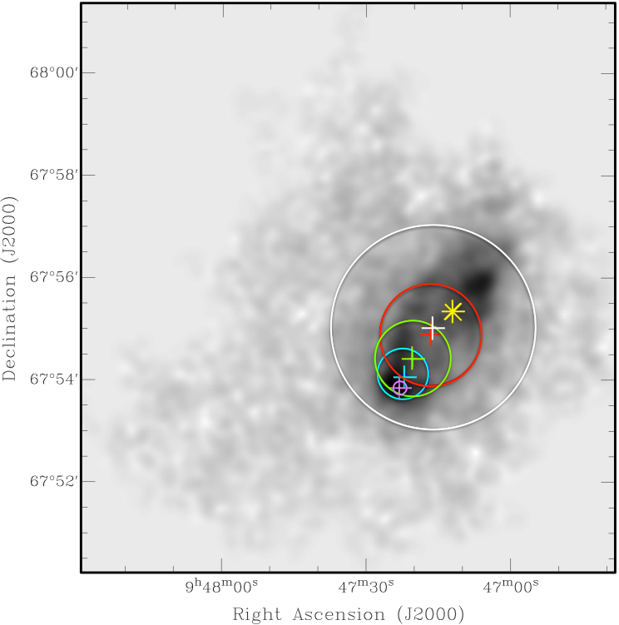
Four HI perturbation signatures
4 Offsets between intensity maxima in resolved HI maps and optical positions (Resolved HI VLA offsets)
Location of HI maximum column density in resolved maps depends on resolution.
At lower resolutions the HI maximum moves toward HI flux weighted mean position, i.e., the Single Dish HI position
Conclusion: unresolved offset reflects large scale displacement of low density gas
VLA HI image of NGC2976 (D = 3.56 Mpc) from THINGS. + = location of resolved maxima for 15” (purple), 60” (cyan), 90” (green) 120” (red) and 240” (white) beams. The circles of the same colour indicate the FWHP beam. The yellow marks the optical centre

Slide 13
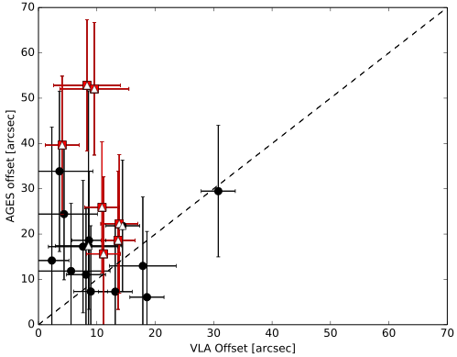
Four HI perturbation signatures INTERACTIONS
4 Offsets between intensity maxima in resolved HI maps and optical positions (Resolved HI VLA offsets)
19 LTGs have VLA and AGES offsets
Largest differences occur in cases with resolved HI tails and Aflux greater than 2𝝈, supporting low density ISM displacement
= LTGs with HI tails
= Aflux > 2 𝝈 and HI tail
AGES offset [arcsec]
VLA offset [arcsec]

Slide 14
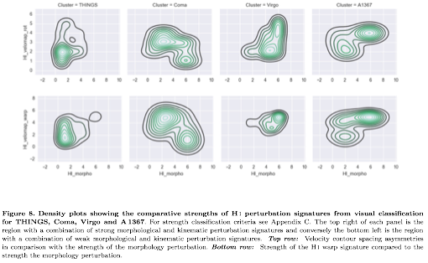
Other clusters: HI perturbation signatures INTERACTIONS
THINGS
Coma
Virgo
A1367
HI velocity
rotation
asymmetries
HI
warp
signatures
Increasing
asymmetry
HI morphology asymmetries

Slide 15
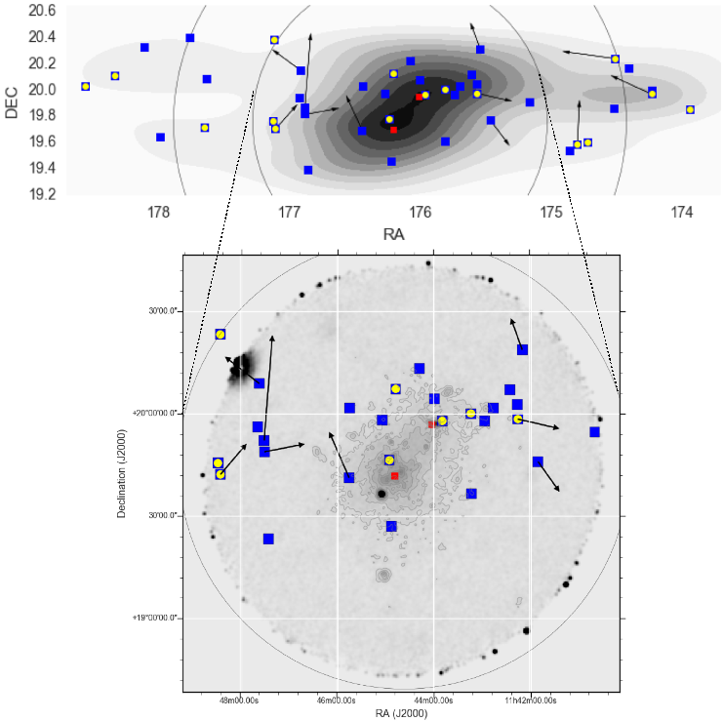
A1367: HI perturbation signatures
Galaxy Density map
LTGs with HI AGES HI detections
LTGs with AGES Aflux >2 𝝈
Subcluster positions (NW and SE)
AGES HI offset x 20
r200
Neither HI AGES offsets > 2 𝝈 nor Aflux > 2 𝝈 are well correlated with galaxy density or ICM, traced by X-ray emission
X-ray(ROSAT) image and contours

Slide 16
Summary
Extensive HI data for Abell 1367 reveal widespread strong ongoing HI interaction signatures, within and beyond the virial radius. Almost all LTGs with HI detections show at least one HI perturbation signature.
Overall distribution of the HI perturbation signatures is not easily interpreted. Aflux and single dish offset being most powerful.
Aflux (> 2𝝈 ) indicator: galaxies undergoing recent interactions; correlates with HI def and sub-cluster centric distance; 56%, are group or pair members suggesting a tidal origin
Detailed studies indicate several cases where multiple mechanisms appear to operate simultaneously
HI appears more perturbed than in Coma, consistent with more massive and longer ionised gas (H𝜶) tails in A1367 than Coma (Yagi et al. 2017)

Slide 17
The End

Slide 18
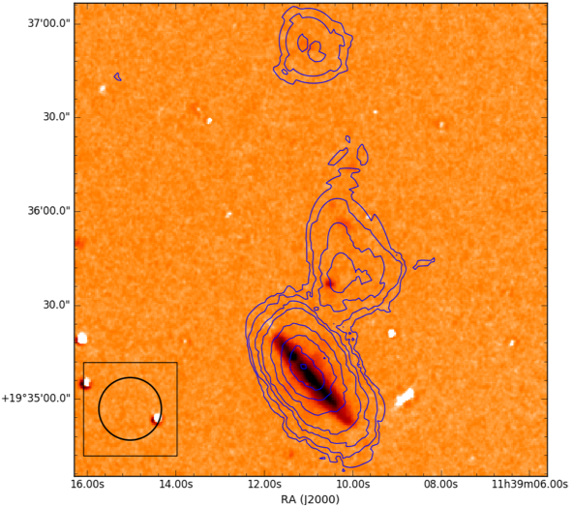
FGC 1287
Interesting case beyond the A1367 virial radius, an LTG with a 250 kpc HI tail.
Member of triplet; only FGC 1287 shows perturbed HI
No other likely tidal interaction companions
Many properties in FGC 1287 HI tail like ram pressure stripping, e.g., SF in tail
BUT no X—ray (XMM) from ICM/IGM!
Does this imply ram pressure stripping by warm undetected ICM? If so what does it tell us about the stripping medium
VLA HI 45”
resolution
contours on
SDSS griz
image
VLA HI 15”
resolution
contours
on Hα image
SF clumps in
HI tail
(Velocity confirmed
with VMOS)

