Slide 1
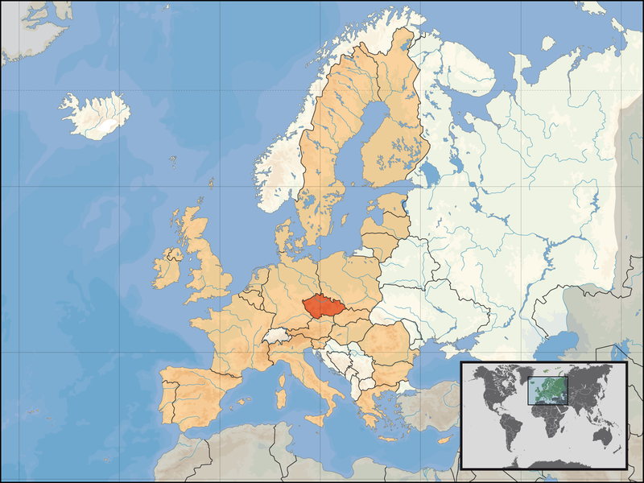
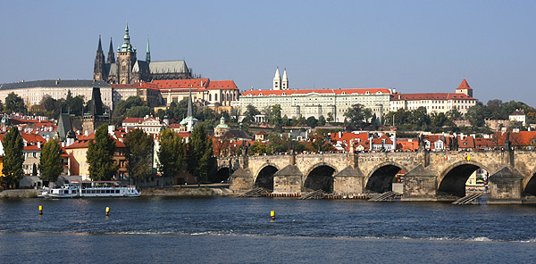
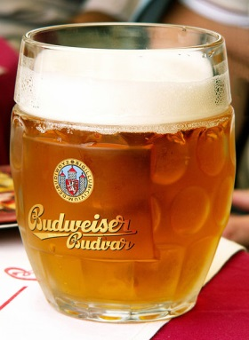
Didymos Observer Workshop 2018 Prague, Czech Republic 2018 June 19-21
Contacts: Petr Pravec (petr.pravec@asu.caz.cz), Petr Scheirich (petr.scheirich@gmail.com)

Slide 2
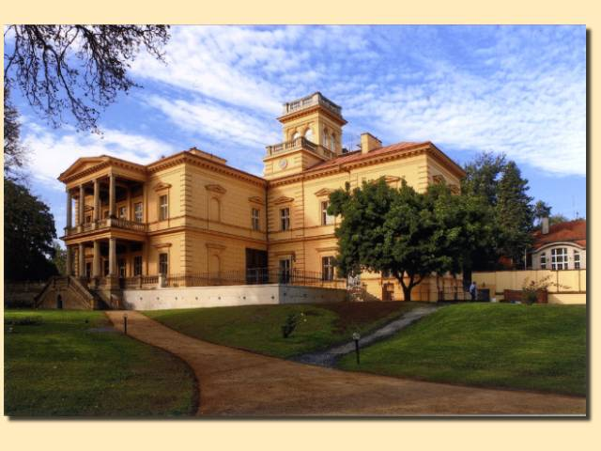
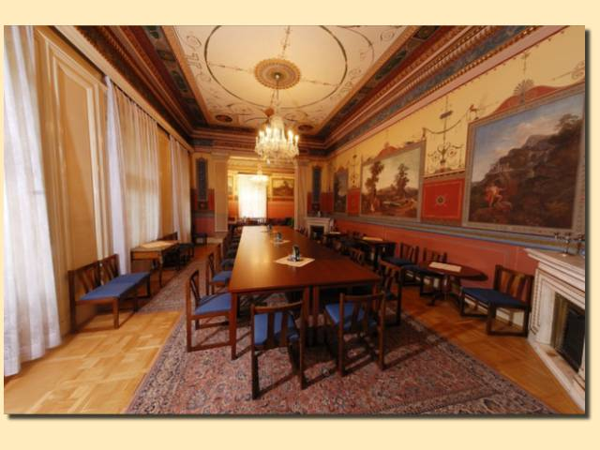
Didymos Observer Workshop 2018 Prague, Czech Republic 2018 June 19-21
Meeting venue: Vila Lanna
Historic villa from the 19th century, belonging to the Czech Academy of Sciences.
Close to both the city centre (20 min) and the airport (40 min) by public transportation.
Capacity: 50
Contacts: Petr Pravec (petr.pravec@asu.caz.cz), Petr Scheirich (petr.scheirich@gmail.com)

Slide 3
Didymos Observer Workshop 2018 Prague, Czech Republic 2018 June 19-21
Schedule: 2 and half day (5 half-day sessions)
Main topics:
Observations in the 2019 apparition, detailed planning
Observations in 2020-2021, preliminary plans
Observations in 2022 (before, during and after the DI), intentions, ideas
Talks on other (related) topics welcome.
Plenty of time for discussions.
Evening social program (dinner, banquet).
Contacts: Petr Pravec (petr.pravec@asu.caz.cz), Petr Scheirich (petr.scheirich@gmail.com)

Slide 4
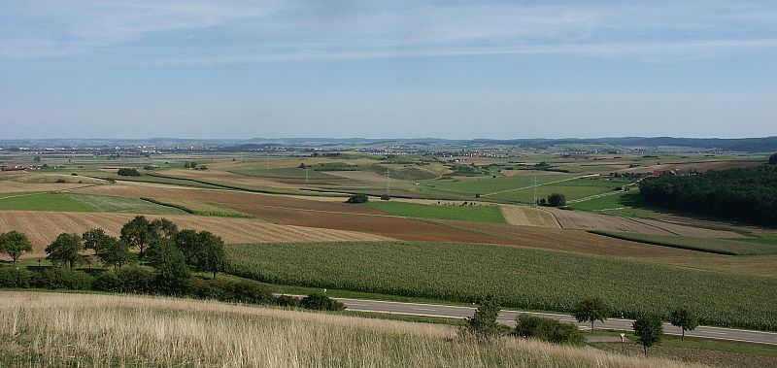
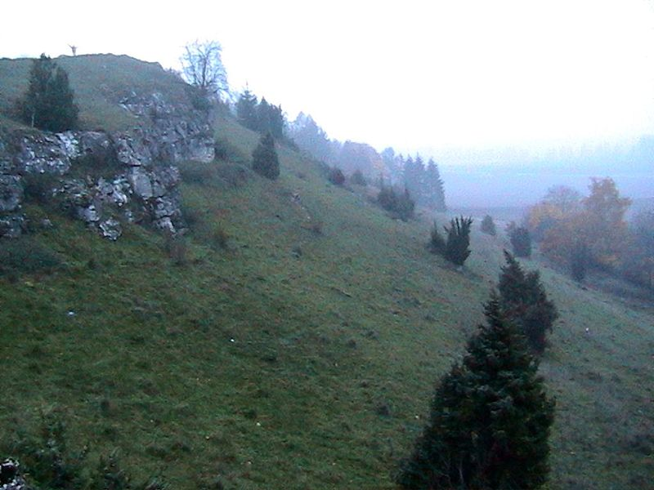
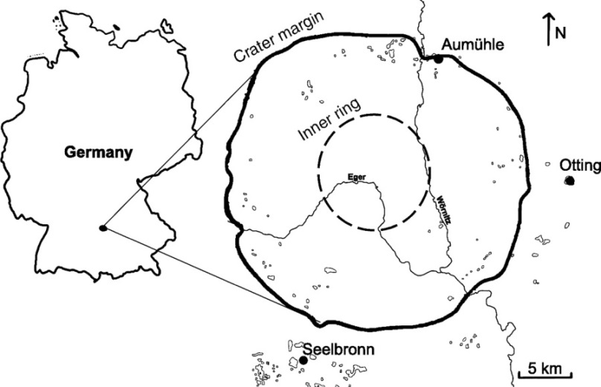
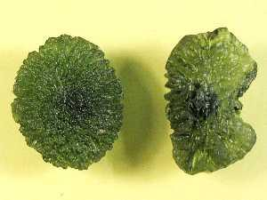
Ries-Steinheim double crater
A 2-day field trip (after the workshop)
A crater rim near Mönchsdeggingen
Ries crater
Diameter: ~ 30 km
Age: ~ 15 Myr
Tectites from southern Bohemia
Contacts: Petr Pravec (petr.pravec@asu.caz.cz), Petr Scheirich (petr.scheirich@gmail.com)

