Slide 1
N E O P O P S
The NEO Physical Observations and Properties Simulation
The NEOPOPS task on NEO rotations, shapes and binaries (WP2)
Observing plans for 2025B (July-December)
Petr Pravec and Petr Fatka
Astronomical Institute AS CR, Ondřejov, Czech Republic
NEOPOPS project Meeting
Rome, Italy
2025 June 17-19

Slide 2
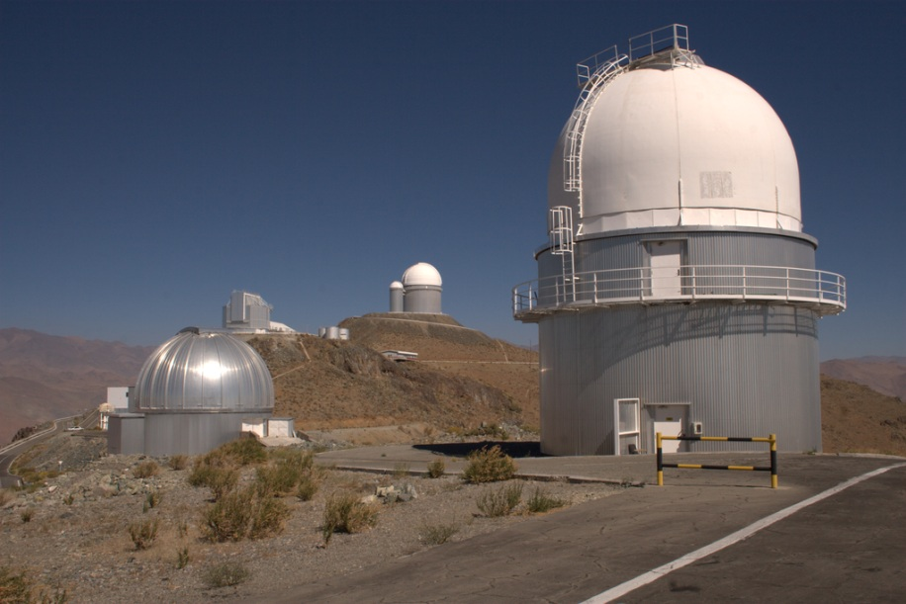
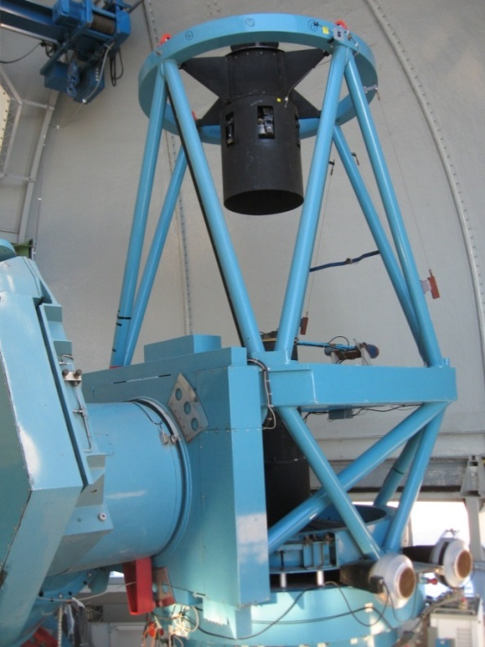
NEOPOPS observations in 2025B
12.5 nights available at the Danish 1.54-m telescope for NEOPOPS in each semester.
Our next scheduled run (evening dates):
2025-06-30 to 07-04 (1+4 nights, 2025A+2025B)
Available slots for the remaining 8-9 nights (evening dates) in 2025B:
2025-08-27 to 30
2025-09-28 and 29
2025-10-12 to 29
2025-11-10 to 27
2025-12-10 to 22
How to distribute the remaining 8-9 nights within the available slots?
Our preference: 2 observing runs, each 4 (or 5) nights long.
Advantage: Longer runs are favored because they provide more thorough data that allow to detect tumblers and binaries more efficiently.
Disadvantage: Longer runs can be scheduled in only a few lunations (months) per semester.

Slide 3
Target selection criteria and strategy (0)
Our standard NEO target selection criteria for lightcurve photometry:
H > 18 (i.e., D <~ 1 km)
Photometric errors (according to the telescope's ETC) < 0.03 mag
Dec < +30°
Elong > 70°
Abs(B_gal) > 15°
App.Mot. < 5°/d
Moon distance > 45°
Bright-star avoidance
Physically, dynamically, or otherwise interesting properties
Non-zero probability of impact
None of these criteria is “carved in stone”, we can modify them in justified cases (sometimes on the expense of data quality or quantity).

Slide 4
Target selection criteria and strategy (1)
Our standard NEO target selection criteria for lightcurve photometry:
H > 18 (i.e., D <~ 1 km)
Photometric errors (according to the telescope's ETC) < 0.03 mag
Dec < +30°
Elong > 70°
Abs(B_gal) > 15°
App.Mot. < 5°/d
Moon distance > 45°
Bright-star avoidance
Physically, dynamically, or otherwise interesting properties
Non-zero probability of impact
Re. 1: We are mainly interested in small NEOs.
For H = 18.0 and p_{V} = 0.20 (the mean albedo for S type asteroids), the estimated D = 0.75 km.
Possible relaxation of the criterion: We certainly can observe larger NEOs where there is an interest.

Slide 5
Target selection criteria and strategy (2)
Our standard NEO target selection criteria for lightcurve photometry:
H > 18 (i.e., D <~ 1 km)
Photometric errors (according to the telescope's ETC) < 0.03 mag
Dec < +30°
Elong > 70°
Abs(B_gal) > 15°
App.Mot. < 5°/d
Moon distance > 45°
Bright-star avoidance
Physically, dynamically, or otherwise interesting properties
Non-zero probability of impact
Re. 2: We aim to get high-quality data so that to get unique spin solutions and can detect tumblers and binaries.
Data with higher errors may not always allow to get a unique spin solution, and detection of tumblers and binaries is difficult or impossible.
Possible relaxation of the criterion: We can observe also fainter NEOs with lower S/N in justified cases (where a data of lower quality can bring usable results).

Slide 6
Target selection criteria and strategy (3)
Our standard NEO target selection criteria for lightcurve photometry:
H > 18 (i.e., D <~ 1 km)
Photometric errors (according to the telescope's ETC) < 0.03 mag
Dec < +30°
Elong > 70°
Abs(B_gal) > 15°
App.Mot. < 5°/d
Moon distance > 45°
Bright-star avoidance
Physically, dynamically, or otherwise interesting properties
Non-zero probability of impact
Re. 3: We aim to get sufficiently long nightly runs so that we get unique spin period solutions, resolve binaries etc.
From La Silla (lat. -29.26°), an object at Dec = +30° can be observed at altitude > 20° for 5.1 h.
Possible relaxation of the criterion: We can observe also NEOs at higher declinations where shorter runs are usable. (For instance, an object at Dec = +35° or +38° can be observed at altitude > 20° for 3.9 or 2.7 h.)

Slide 7
Target selection criteria and strategy (4)
Our standard NEO target selection criteria for lightcurve photometry:
H > 18 (i.e., D <~ 1 km)
Photometric errors (according to the telescope's ETC) < 0.03 mag
Dec < +30°
Elong > 70°
Abs(B_gal) > 15°
App.Mot. < 5°/d
Moon distance > 45°
Bright-star avoidance
Physically, dynamically, or otherwise interesting properties
Non-zero probability of impact
Re. 4: We aim to get sufficiently long nightly runs so that we get unique spin period solutions, resolve binaries etc.
A NEO closer to the sun provides only short nightly runs (duration depending on its declination).
Possible relaxation of the criterion: NEOs at high southern (negative) declinations can be observed for several hours even when they are closer to the sun.

Slide 8
Target selection criteria and strategy (5)
Our standard NEO target selection criteria for lightcurve photometry:
H > 18 (i.e., D <~ 1 km)
Photometric errors (according to the telescope's ETC) < 0.03 mag
Dec < +30°
Elong > 70°
Abs(B_gal) > 15°
App.Mot. < 5°/d
Moon distance > 45°
Bright-star avoidance
Physically, dynamically, or otherwise interesting properties
Non-zero probability of impact
Re. 5: We aim to get high-quality data with small losses of data points due to interferences with background stars.
An asteroid in crowded star fields in or close to the Milky Way can be observed with a high photometric quality only when it is in (infrequent) gaps between field stars.
Possible relaxation of the criterion: For some NEOs, observations with a low quality and high data loss rate can be still useful.

Slide 9
Target selection criteria and strategy (6)
Our standard NEO target selection criteria for lightcurve photometry:
H > 18 (i.e., D <~ 1 km)
Photometric errors (according to the telescope's ETC) < 0.03 mag
Dec < +30°
Elong > 70°
Abs(B_gal) > 15°
App.Mot. < 5°/d
Moon distance > 45°
Bright-star avoidance
Physically, dynamically, or otherwise interesting properties
Non-zero probability of impact
Re. 6: Observations of very fast movers are more demanding (and less effective) as they go through a number of FOVs during a night. Moreover, interpretations of data taken for a FMO over more nights can be ambiguous.
We generally prefer to observe NEOs when they move a little bit slower so that to get solid results effectively.
Possible relaxation of the criterion: For specific NEOs, observations at high apparent speeds can be still useful.

Slide 10
Target selection criteria and strategy (7)
Our standard NEO target selection criteria for lightcurve photometry:
H > 18 (i.e., D <~ 1 km)
Photometric errors (according to the telescope's ETC) < 0.03 mag
Dec < +30°
Elong > 70°
Abs(B_gal) > 15°
App.Mot. < 5°/d
Moon distance > 45°
Bright-star avoidance
Physically, dynamically, or otherwise interesting properties
Non-zero probability of impact
Re. 7: Moon interference needs to be avoided.
Observations closer than ~45° from Moon have a higher risk of being affected by systematic errors from stray light from Moon.
Possible relaxation of the criterion: Occassionally we can get good data also closer to Moon; can be attempted when there is a high-priority target justifiying the risk of loss of data quality.

Slide 11
Target selection criteria and strategy (8)
Our standard NEO target selection criteria for lightcurve photometry:
H > 18 (i.e., D <~ 1 km)
Photometric errors (according to the telescope's ETC) < 0.03 mag
Dec < +30°
Elong > 70°
Abs(B_gal) > 15°
App.Mot. < 5°/d
Moon distance > 45°
Bright-star avoidance
Physically, dynamically, or otherwise interesting properties
Non-zero probability of impact
Re. 8: Bright-star interference needs to be avoided.
A bright star in the FOV can corrupt the photometric measurements of a NEO (depending on its brightness and distance). Typically stars of 9th magnitude and brighter need to be avoided.
Possible relaxation of the criterion: For a typical NEO, we plan its observations for other nights (or parts of a night) when it is sufficiently away from an interfering bright star.

Slide 12
Target selection criteria and strategy (9)
Our standard NEO target selection criteria for lightcurve photometry:
H > 18 (i.e., D <~ 1 km)
Photometric errors (according to the telescope's ETC) < 0.03 mag
Dec < +30°
Elong > 70°
Abs(B_gal) > 15°
App.Mot. < 5°/d
Moon distance > 45°
Bright-star avoidance
Physically, dynamically, or otherwise interesting properties
Non-zero probability of impact
Re. 9: We prefer to observe NEOs where we expect (e.g., based on previous data) to get more interesting results.
We give higher observing priorities to NEOs where we can get more physically or dynamically interesting results (e.g., suspicion on its binarity).
Possible relaxation of the criterion: Sometimes it happens that little or nothing is known on NEOs that are observable on a given night. Then we select our NEO targets a sort of “randomly” (sampling the general NEO population).

Slide 13
Target selection criteria and strategy (10)
Our standard NEO target selection criteria for lightcurve photometry:
H > 18 (i.e., D <~ 1 km)
Photometric errors (according to the telescope's ETC) < 0.03 mag
Dec < +30°
Elong > 70°
Abs(B_gal) > 15°
App.Mot. < 5°/d
Moon distance > 45°
Bright-star avoidance
Physically, dynamically, or otherwise interesting properties
Non-zero probability of impact
Re. 10: When there is a “virtual impactor” (however small the Impact Probability is), we give it a high priority on our target list.
Of course, getting data for NEOs with non-zero IP is most needed for Planetary Defense.
Possible relaxation of the criterion: There are no photometrically observable VIs most of the time, so most often we select NEO targets with zero IP.

Slide 14
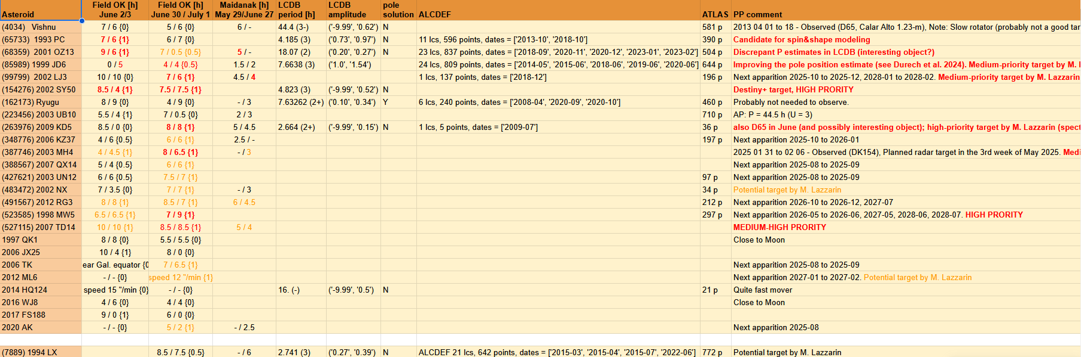
Target list preparation for the 2025-06-30 to -07-04 run (1)
Typically ~20 NEOs satisfying the target selection criteria for a given observing run at the 1.54-m telescope.
Can observe only a few or several NEOs during a typical run.
Narrowing down the target list (setting the target priorities), accounting also for which NEOs other members of the NEOPOPS consortium plan to observe, or considering what previous data are available for them.

Slide 15
Target list preparation for the 2025-06-30 to -07-04 run (2)
Our target list (still under construction) for the 5 nights:
(99799) 2002 LJ3 – 3n, High priority (more observations in 2025-10 to -12 and 2028-01 to -02 → Spin vector and Shape modeling to be attempted; Medium priority target for spectroscopy by M. Lazzarin and coll.)
(154276) 2002 SY50 – 2n, High priority (follow-up to the June 2&3 run)
(263976) 2009 KD5 – 3n, High priority (potential binary; preliminary estimate P = 2.664 h, Hicks et al. 2010; High priority target also for spectroscopy by M. Lazzarin and coll.)
(523585) 1998 MW5 – 1n or more (depending on what the observations show), High priority (follow-up to the June 2&3 run)
(527115) 2007 TD14 – 1 or 2n (depending on what the observations show), Medium-High priority (follow-up to the June 2&3 run)
(85989) 1999 JD6 – 1n, Medium priority (improving the spin pole estimate by Durech et al. 2024; Medium priority target also for spectroscopy by M. Lazzarin and coll.)
(387746) 2003 MH4 – 3n, Medium priority (Medium priority target also for spectroscopy by M. Lazzarin and coll.)
(491567) 2012 RG3 – 3n, Medium priority (more observations in 2026-10 to -12 and 2027-07 → Spin vector and Shape modeling to be attempted)
Lower priority (back-up) targets:
(7889) 1994 LX, (348776) 2006 KZ37, (388567) 2007 QX14, (427621) 2003 UN12, (483472) 2002 NX, 2006 TK, 2012 ML6, 2020 AK

Slide 16
Collaboration with other projects and observers
There are other NEO lightcurve photometry projects running at 1-2m class telescopes, e.g.:
NEOsource project (supported by the Praemium Academiae grant from the Academy of Sciences of the Czech Republic) at the 1.54-m Danish Telescope on La Silla
Maidanak NEO photometry project at the 1.5-m telescope at Maidanak observatory in Uzbekistan
LCOGT (a network of 1-m, plus a few 2-m telescopes) photometry of NEOs around their close approaches
They are independent of our NEOPOPS project, but can occasionally (or intentionally) observe the same NEO targets on nearby nights.
Should we aim to collaborate with them on some specific objects? Or should we avoid observing the same targets as they (so that to obtain data for a completely different NEO sample)?
A collaboration or a coordination with the other projects would provide a synergy! (Getting more thorough data for interesting or demanding objects, e.g., binaries or slow rotating tumblers, would allow to get better results for them.)

Slide 17
Thank you!

Slide 18
Slides from Part 1 and from the KOM of 2025-02-13 follow

Slide 19
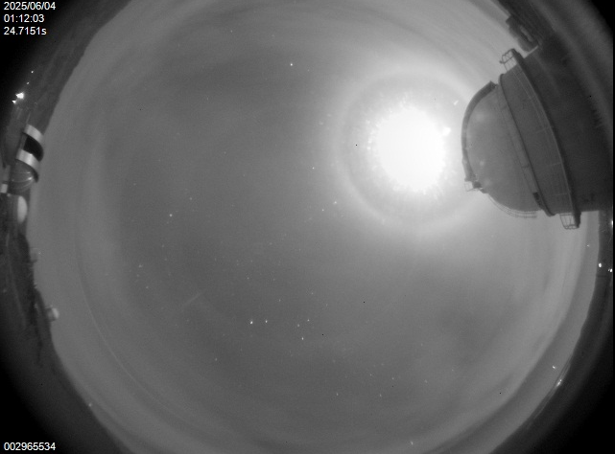
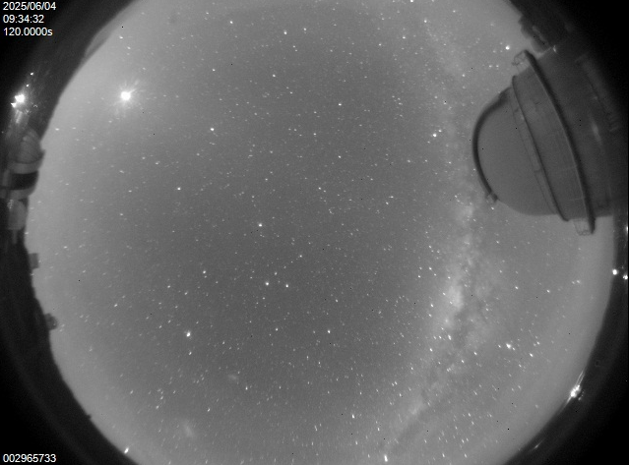
First observing run on 2025 June 3 and 4 UT
The first NEOPOPS run at the 1.54-m telescope, La Silla: 2 nights 2025-06-02/03 and 03/04
Photometric (lightcurve) observations of 5 NEAs:
(65733) 1993 PC
(68359) 2001 OZ13
(154276) 2002 SY50
(523585) 1998 MW5
(527115) 2007 TD14
The targets observed quasi-simultaneously, alternating between (up to 3 of the 5) targets at a given time.
Observations partially successful – partly cloudy.

Slide 20
Data obtained for the 5 NEO targets – summary
The 5 NEOs are between 0.5 and 1.1 km (from thermal observations or estimated from their H).
Spin periods and amplitudes in the most populated range (for their sizes) from 2.4 to 5.1 h and from 0.1 to 1.1 mag.
No excited rotator/tumbler detect yet (will be refined with more observations for 154276, 523585 and 527115).
No binary detected yet (will be refined with more observations for 154276, 523585 and 527115).
Spin vector and Shape modeling (will be) done for (65733) and (523585).
For 2 of the 5 (68359 and 527115), additional data were taken by our Uzbek colleagues with the Maidanak 1.5-m.
NEO | H (mag) | Period (h) | A (mag) | PAR | Bin? | Comments/Notes
(65733) 1993 PC | 18.39 | 4.185 ± <0.001 | 1.08 | +1 | No | (V - R) = 0.381 ± 0.010. Shape modeling (incl. data 2013-2023).
(68359) 2001 OZ13 | (18.1) | 2.4943 ± 0.0003 | 0.10 | +2 | No | Corrected wrong P estimates in LCDB (2.91 h, 18.07 h).
(154276) 2002 SY50 | (17.6) | 5.075 ± 0.002 | 0.70 | (+1) | (No) | DESTINY+ target. More observations in 2025-07.
(523585) 1998 MW5 | (18.9) | (3.236) | 0.66 | 0 | (No) | More obs 2025-07, 2026-05 and -06. 2027-05, 2028-06 and -07.
(527115) 2007 TD14 | (19.0) | 4.882 ± 0.002 | 0.46 | (+1) | (No) | More observations in 2025-07.

Slide 21
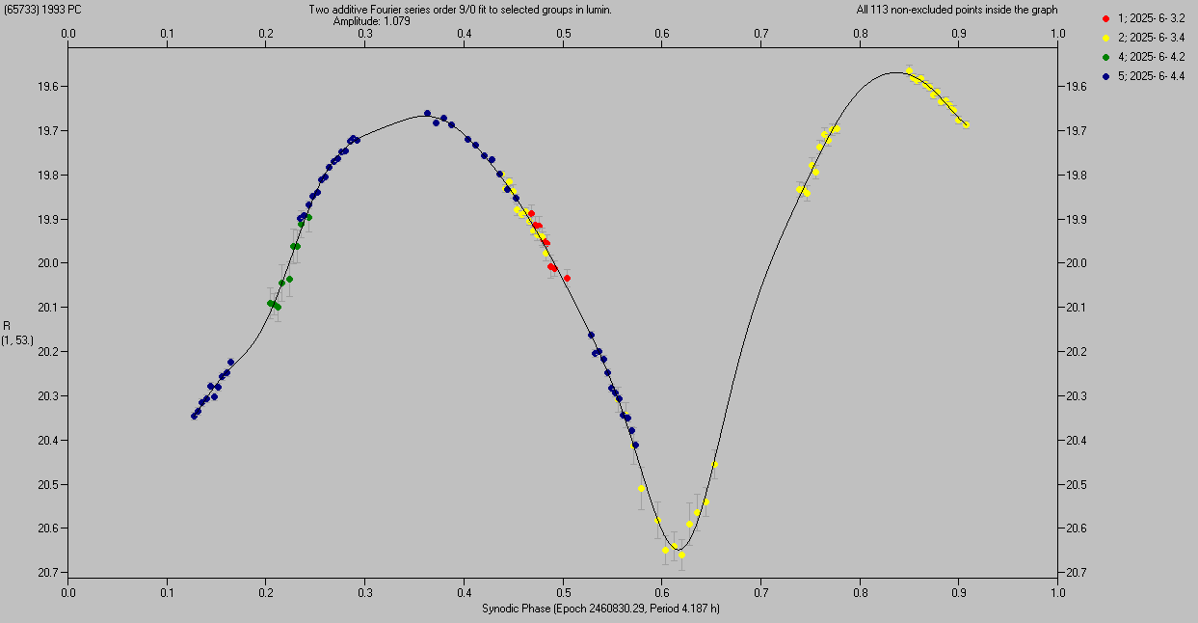
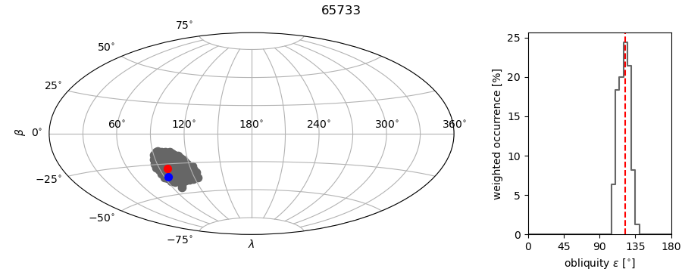
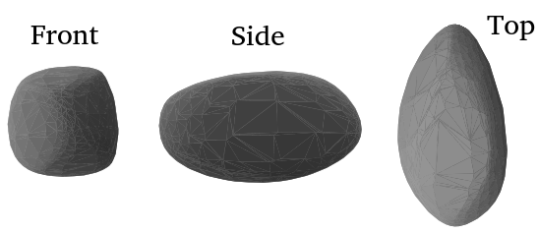
(65733) 1993 PC
Unique period determined from the two nights (4 sessions) 2025-06-03 and 04: P_{syn} = 4.187 ± 0.001 h.
Absolute magnitude H = 18.39 ± 0.40 (relatively large error due to the high phase angle about 53°).
Color index (V – R) = 0.381 ± 0.010 (nearly neutral spectral reflectance; not an SQ type).
High amplitude of 1.08 mag → elongated shape (see Shape model below: a/b ~ 1.8).
No apparent tumbling present (PAR = +1 on the scale of Pravec et al. 2005). No sign of a satellite.
Spin vector and Shape modeling using also previous data (Warner, 2014; Warner and Stephens, 2019; ATLAS) from 2013, 2018, 2020 and 2023 → Two solutions for P_{sid} = 4.18441 and 4.18502 h (± 0.00001 h), Spin pole (L_{p}, B_{p}) = (101°, -32°), unc. radius ~45° (3σ).

Slide 22
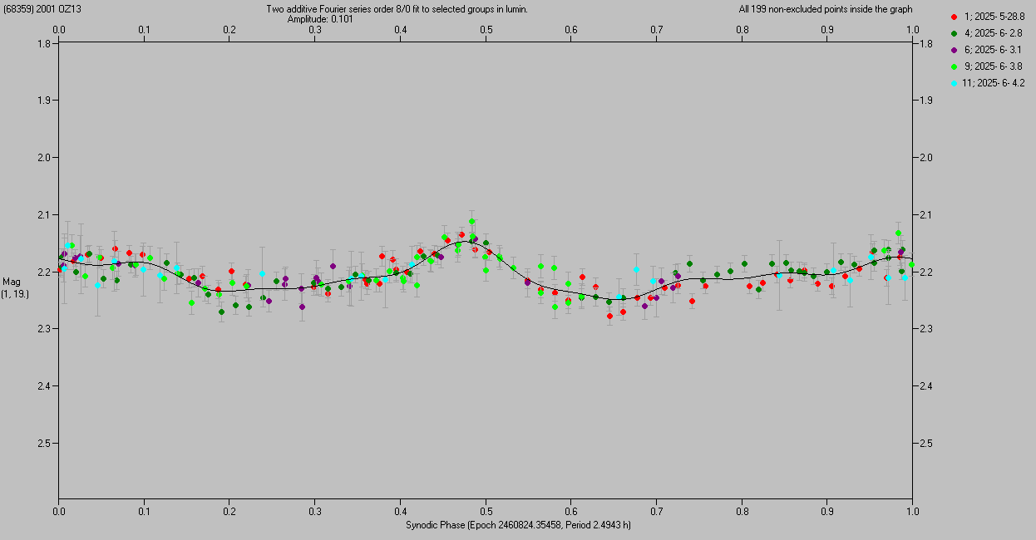
(68359) 2001 OZ13
Spin period determined from the 2 nights 2025-06-03 and 04 from DK154 and 3 partial nights (3-h nightly runs) 2025-05-28, 2025-06-02 and 03 from Maidanak 1.5-m: P = 2.4943 ± 0.0003 h.
Absolute magnitude H and Color index (V – R) TBD.
Low amplitude 0.10 mag → suggests unelongated (nearly spheroidal) shape.
No apparent tumbling present (PAR = +2 on the scale of Pravec et al. 2005). No sign of a satellite.
Previous uncertain (U = 2) data taken by Pal et al. (2020) and Warner and Stephens (2021) in 2018 and 2020: Discrepant P estimates 2.9103 and 18.07 h.

Slide 23
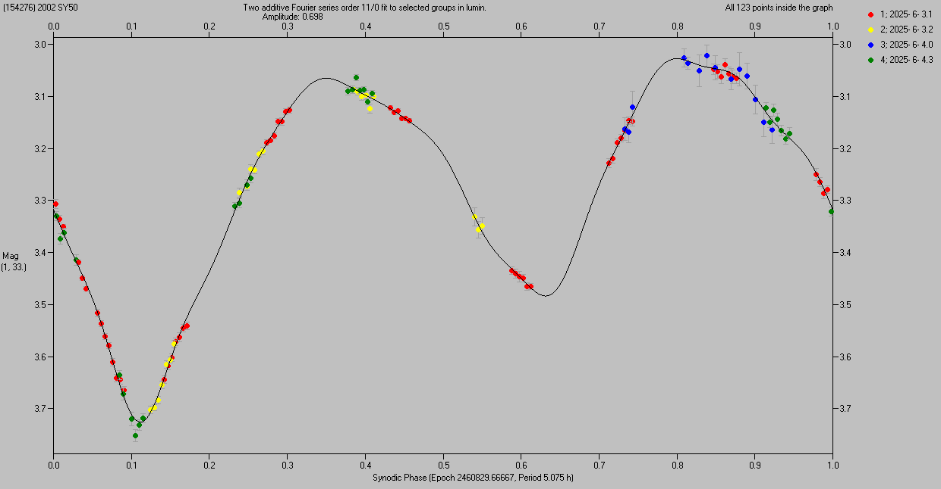
(154276) 2002 SY50
Unique period determined from the two nights (4 sessions) 2025-06-03 and 04: P = 5.075 ± 0.002 h.
Absolute magnitude H and Color index (V – R) TBD.
High amplitude of 0.70 mag → elongated shape.
No apparent tumbling and No sign of a satellite yet (TBC).
More observations planned to be taken during our next run at the 1.54-m from 2025-07-01 to 05.
Previous uncertain data taken by G. Masi in 2002: P = 4.823 h.
Flyby target of JAXA’s DESTINY+ (in their preferred flight scenario) → We plan to publish our results in a paper later in this year and present it at ACM 2026.

Slide 24
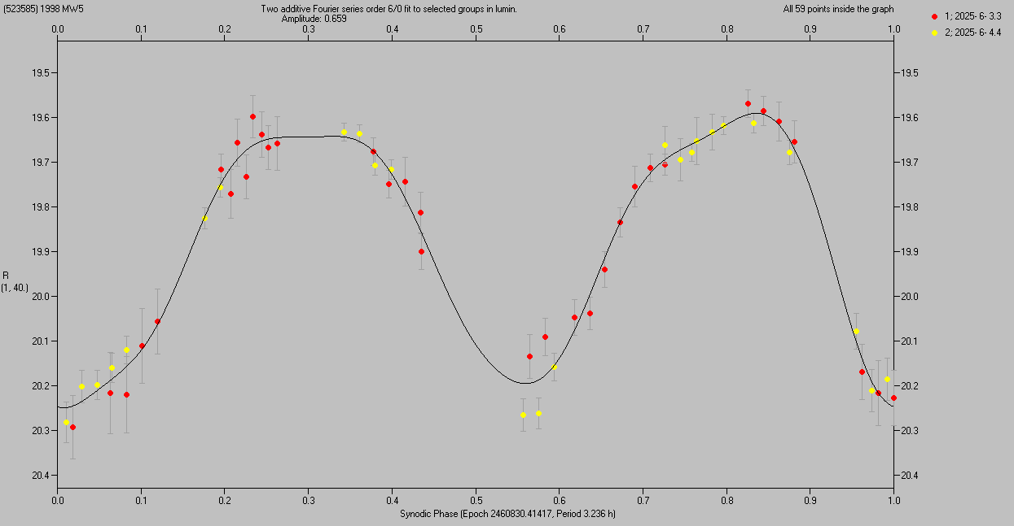
(523585) 1998 MW5
A preliminary estimate for its period from the two nights 2025-06-03 and 04: P = 3.236 h.
Absolute magnitude H and Color index (V – R) TBD.
High amplitude of 0.66 mag → elongated shape.
Data insufficient to detect or rule out potential tumbling and binarity yet.
More observations planned to be taken during our next run at the 1.54-m in 2025-07, and then in its next three apparitions 2026-05 to -06, 2027-05, and 2028-06 to -07 → Will get a unique determination for its period etc., and we will also attempt to create its Spin vector and Shape model (including also sparse data, e.g., from ATLAS).

Slide 25
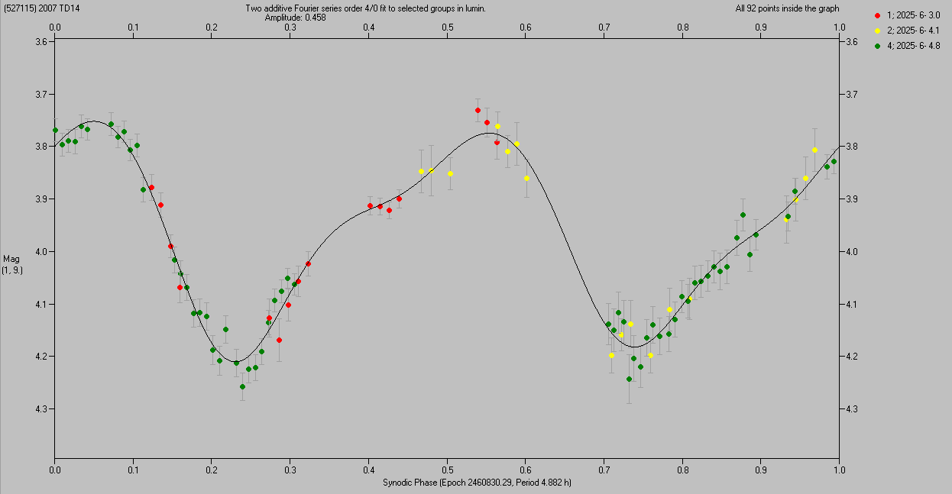
(527115) 2007 TD14
Spin period determined from the 2 nights 2025-06-03 and 04 from DK154 and 1 partial night (3-h nightly run) 2025-06-04 from Maidanak 1.5-m: P = 4.882 ± 0.002 h.
Absolute magnitude H and Color index (V – R) TBD.
Moderately high amplitude of 0.46 mag → moderately elongated shape.
No apparent tumbling and No sign of a satellite yet (TBC).
More observations planned to be taken during our next run at the 1.54-m from 2025-07-01 to 05.

Slide 26
Thank you!

Slide 27
Slides from the KOM of 2025-02-13 follow

Slide 28
The Asteroid team at the ASU Ondřejov
Our team for the NEOPOPS project:
Leading scientist: Petr Pravec
Scientist (also observer): Petr Fatka
Observers/reducers: Kamil Hornoch, Peter Kušnirák
Total amount of personal time for the NEOPOPS project: 0.4 FTE (starting probably sometimes in Spring 2025, after the first money is received and all the administrative steps here are completed).
Other members of our Asteroid team at Ondřejov (not involved in NEOPOPS in the 1st year):
Petr Scheirich (scientist), Hana Kučáková, Adrián Galád (observers), Miroslav Velen (sw specialist)

Slide 29
The ASU team’s primary instrument:
Danish 1.54-m telescope
A remotely-operated photometric telescope at ESO La Silla, Chile. Operated collaboratively by the NBI Copenhagen (owner) and the AI AS CR Ondřejov since 2012.
Precise time-resolved (lightcurve) photometry for NEOs up to V = 19 typically (occasionally may go up to V = 20)

Slide 30
Time allocation and scheduling at the
Danish 1.54-m telescope
The ASU team has got a guaranteed time at the 1.54-m telescope for 50 nights per semester.
Two main projects to be run at the telescope since 2025B:
NEOSource project (supported by the Praemium Academiae grant from the Academy of Sciences of the Czech Republic): 37.5 nights per semester
NEOPOPS project: 12.5 nights per semester
Telescope time allocation:
Done several months ahead before the start of each semester
Swapping between NEOSource and NEOPOPS nights occasionally possible (but not guaranteed) – will try to do it for some special super-interesting NEOs on the last minute notice
Allocation of nights for the NEOPOPS project:
In a given semester we plan to split the 12.5 nights into two blocks (observing runs), each 6-6.5 nights long.
Will coordinate with other NEOPOPS participants when to best allocate the two observing runs in a given semester – to get the best synergy with observations using various techniques.

Slide 31
NEOPOPS task on
NEO rotations, shapes and binaries

Slide 32
Goals
Running photometric lightcurve observations of dangerous or interesting NEOs during their favorable apparitions (usually during their close approaches to Earth)
Determining rotation periods for the observed objects, estimating or constraining their shapes, and estimating their absolute magnitudes
Constraining the spin states (principal-axis or excited) of observed asteroids
Searching for potential mutual eclipse/occultation events (brightness attenuations) caused by satellites of observed asteroids, and estimating parameters of detected binary asteroids.
Potential extension: Observing newly discovered or known near-Earth binary asteroids during their close approaches to Earth, to determine or refine parameters of the satellite orbits.

Slide 33
Observing strategy and target selection
Typically 3 NEOs to be observed on one night (alternating between them, to get a good semi-dense coverage of their lightcurves).
For a typical NEO, 2-3 observing nights are needed to determine its spin period, constrain its spin state (PA vs NPA), and to look for signs of possible satellite.
It means that during each semester (12.5 nights), we will get these data for 15 NEOs
→ We will characterize a sample of 105 NEOs during the 7 semesters (3.5 yr) of the NEOPOPS project.
Target selection:
During the initial telescope time allocation (several months in advance): The most interesting ones among observable known NEOs are selected as our primary targets for each semester (for the two 6-6.5 nights long observing runs)
A few days before each our observing run we will check newly discovered NEOs and select the most interesting ones as “last minute targets” of opportunity.
We will coordinate the selection of targets with other tasks, prioritizing NEOs that are observed also by other techniques (so that to characterize them most thoroughly).

Slide 34
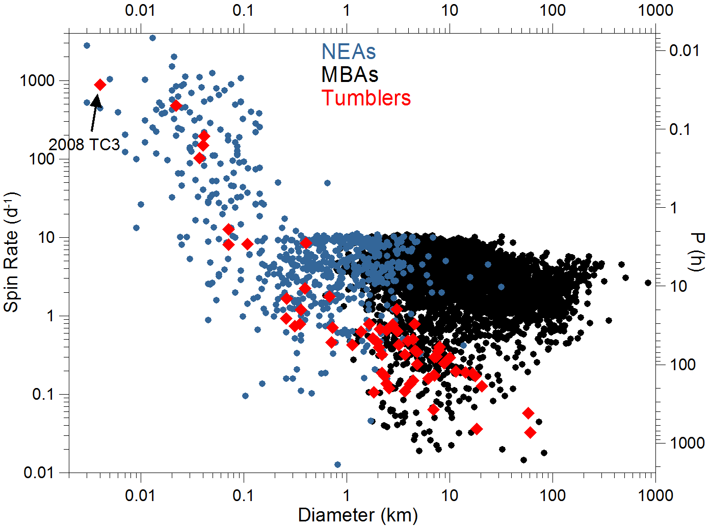
NEA Rotations
Spin rates of NEOs in our targeted diameter range (10 m to 1 km) span from very slow rotations (P of many days) to very fast ones (P of tens of seconds).
A majority of them are in basic (principal-axis) spin states, but a significant fraction of them are in excited (tumbling) spin states.
Observational bias against tumblers – they are actually very frequent: ~30% of small NEAs are in NPA rotation states (our recent result, to be pubslihed).

Slide 35
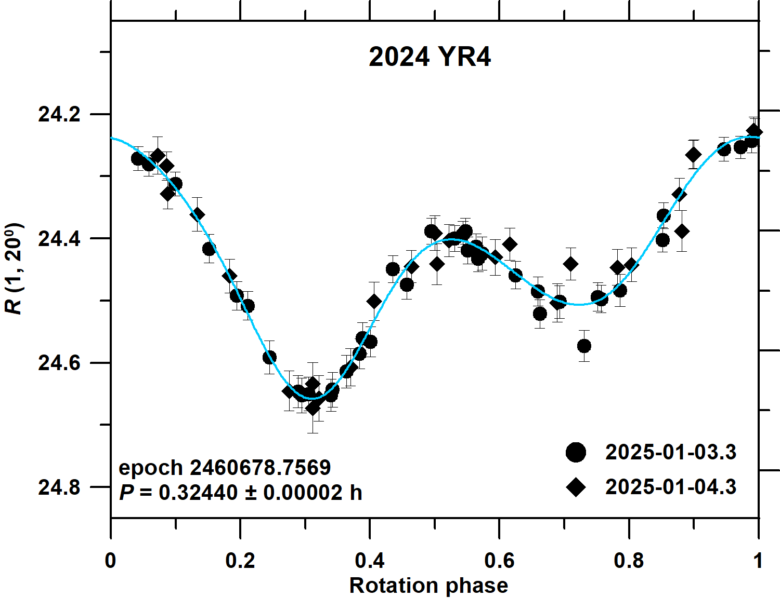
Example 1: Lightcurve of a fast principal-axis rotator
Data from 2 nights sufficient to determine its period and reveal its PA spin state. (Constraints on its elongation and estimating its absolute magnitude H also possible.)

Slide 36
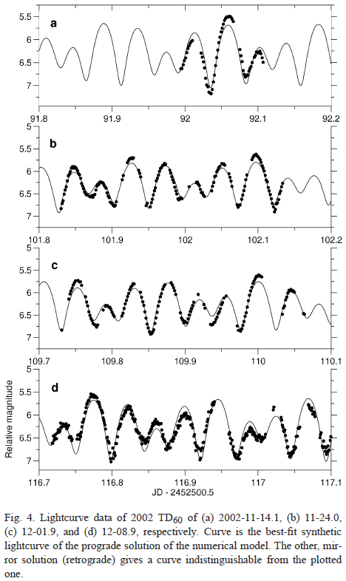
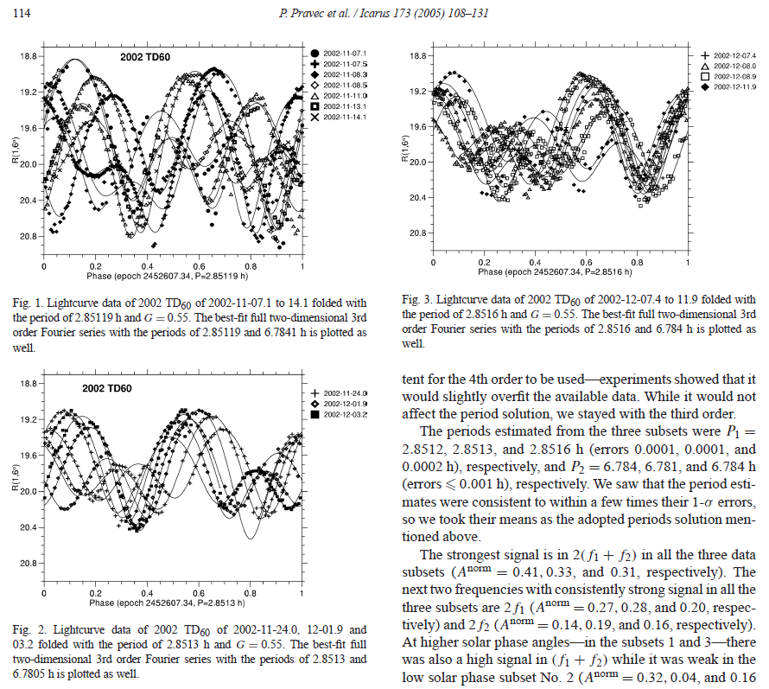
Example 2: Lightcurve of a fast spinning tumbler (2002 TD60)
Data from 3 nights typically needed to reveal its NPA rotation.
(Pravec et al. 2005)

Slide 37
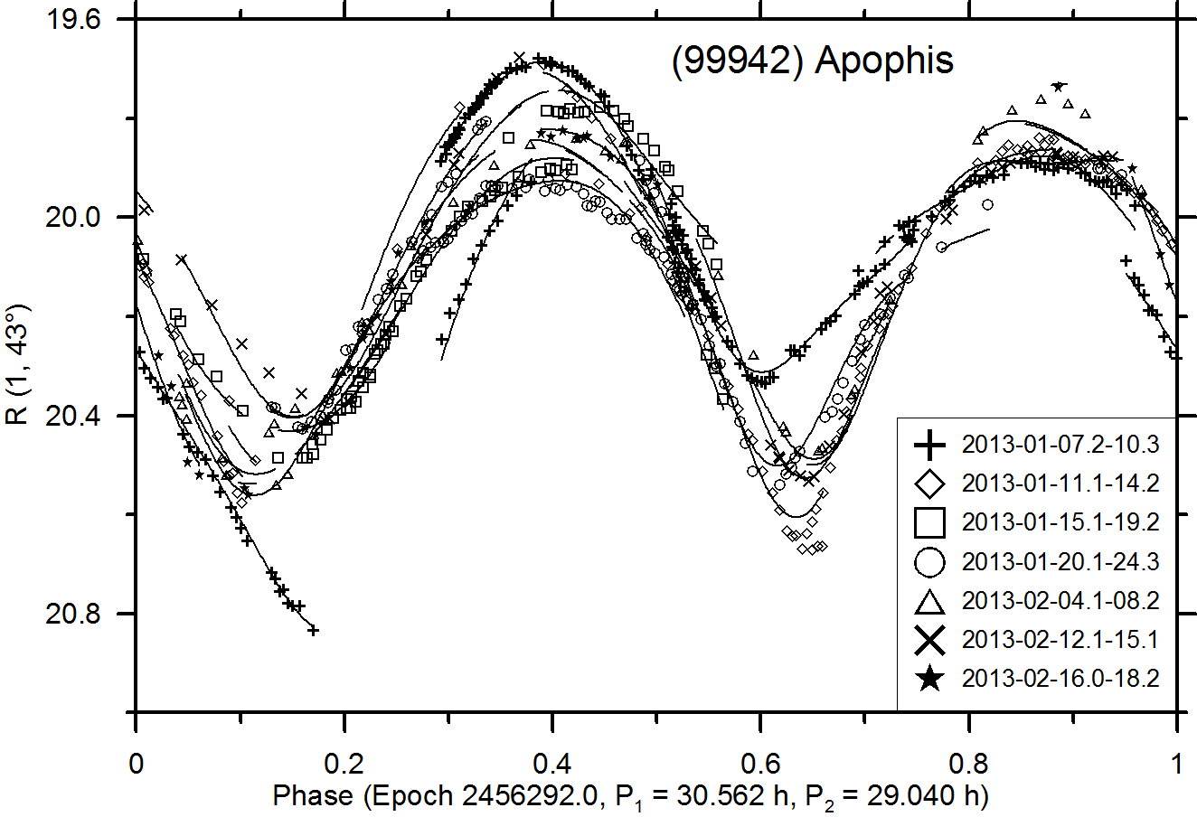
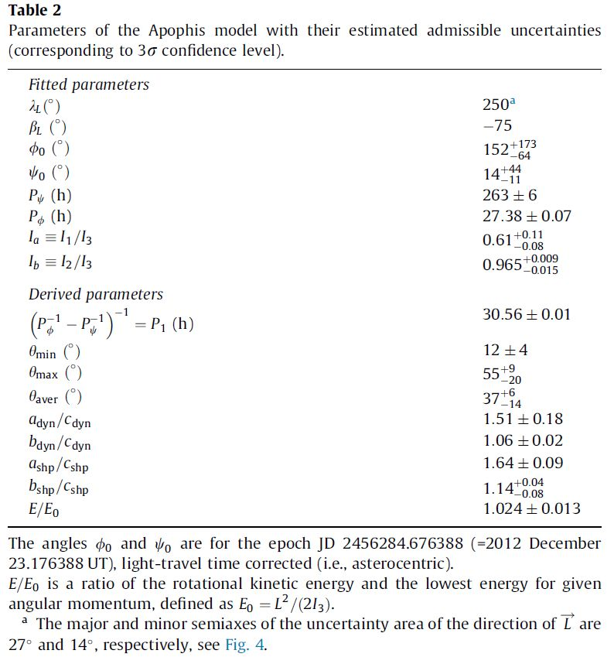
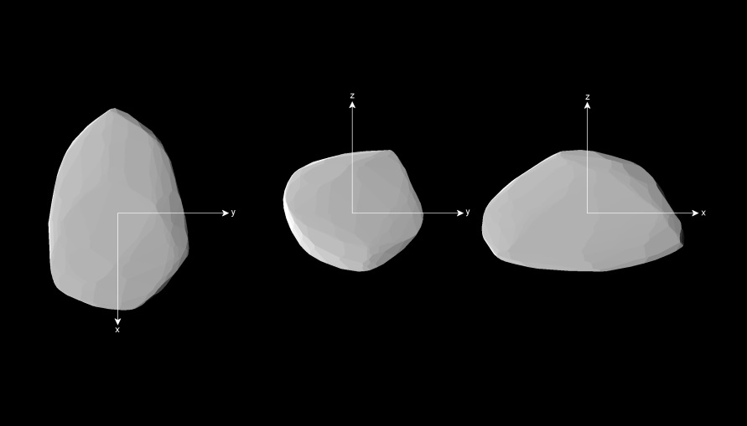
Example 3: Lightcurve of a slow-spinning tumbler (Apophis)
(Pravec et al. 2014)
It required observations on 60+ nights from 2012 Dec. 23 to 2013 April 15. But only “normal points” were taken (i.e., it didn’t require continuous observing runs).

Slide 38
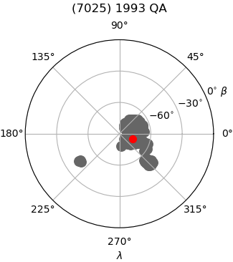
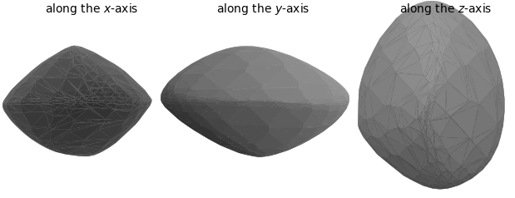
NEA shapes
Shape models of selected NEAs with previous data available (taken by us or from other stations in previous years) will be created.
To derive an asteroid shape model, lightcurve data from 2-4 apparitions are typically needed.
It will be usually enough to observe such NEO target on only one night during an observing run → suitable as a “filler” target.
Derived convex shape model of NEA (7025)
Direction of the spin axis of NEA (7025)

Slide 39
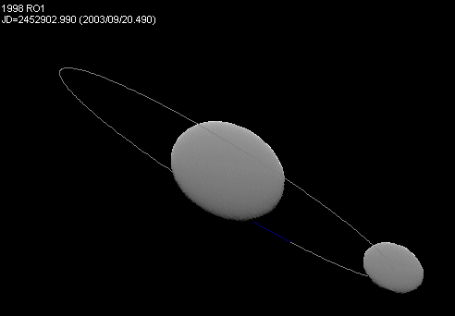
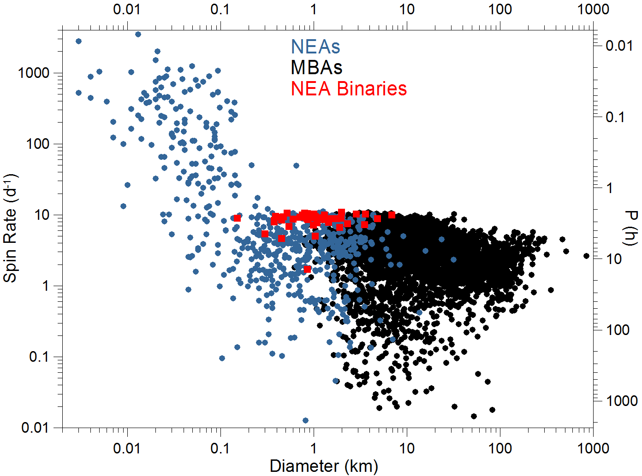
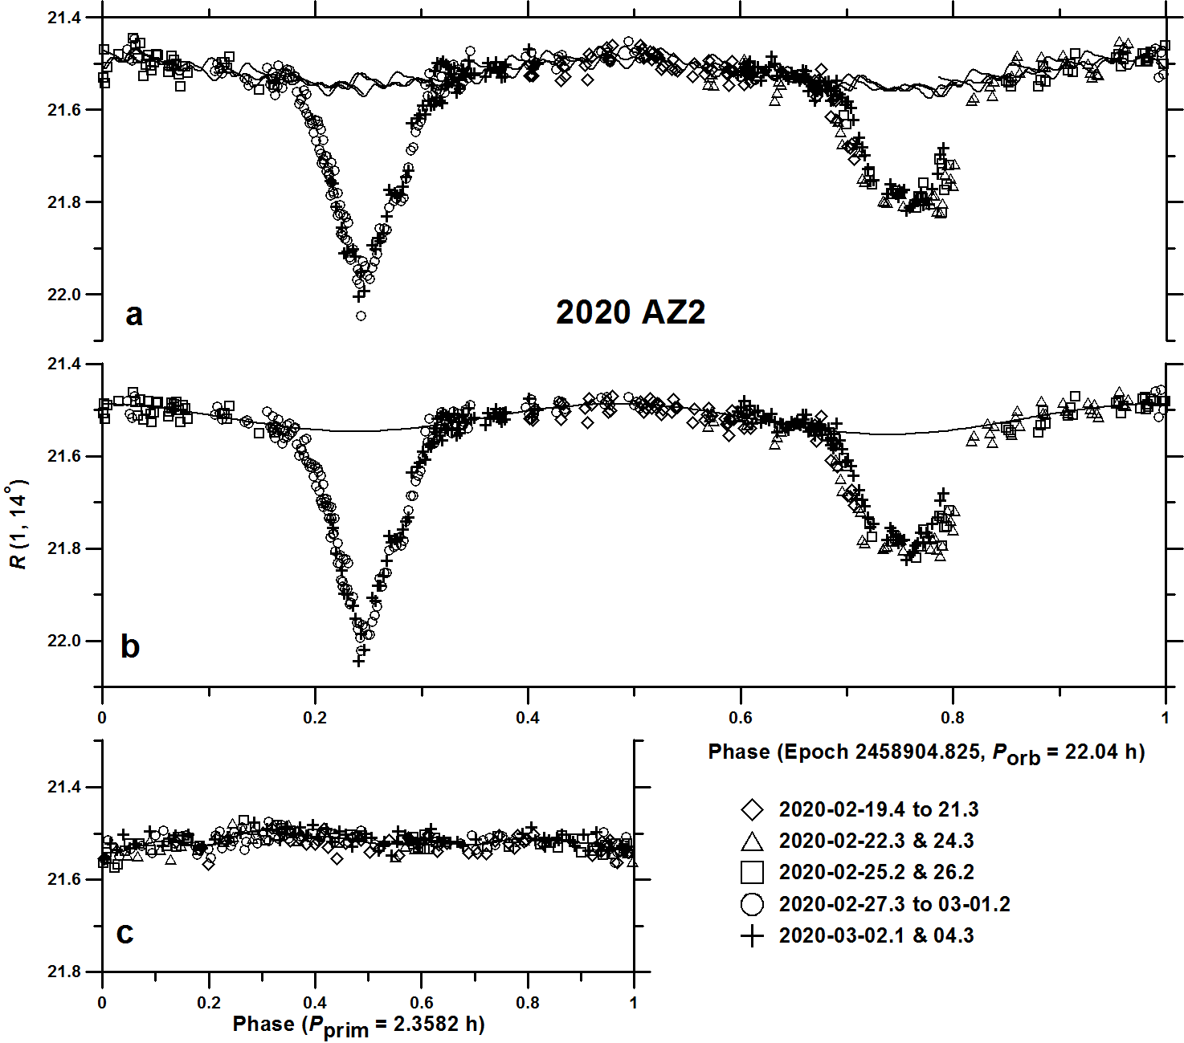
Binary asteroids
Some NEOs have satellites
Binary asteroids are frequent among NEAs larger than about 100-200 m: The fraction of binaries estimated 15 ± 4% (Pravec et al. 2006).
Data from 3 nights can give a hint on binary nature of a studied NEO. More nights needed to estimate basic parameters of the discovered satellite.

Slide 40
Thank you!

