Slide 1
N E O P O P S
The NEO Physical Observations and Properties Simulation
The NEOPOPS task on NEO rotations, shapes and binaries (WP2)
First observations on 2025-06-02/03 and 03/04
Petr Pravec and Petr Fatka
Astronomical Institute AS CR, Ondřejov, Czech Republic
NEOPOPS project Meeting
Rome, Italy
2025 June 17-19

Slide 2
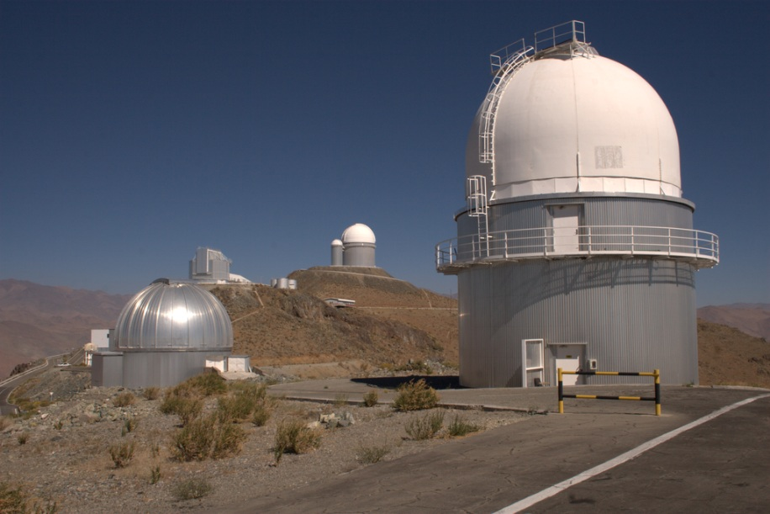
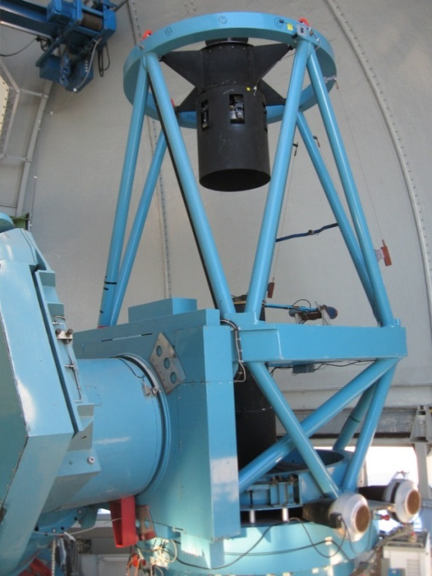
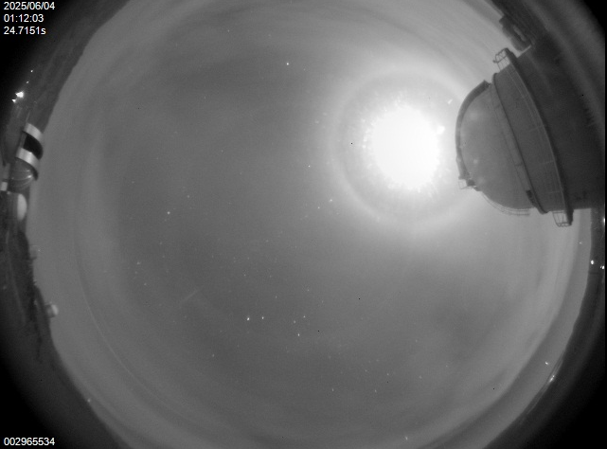
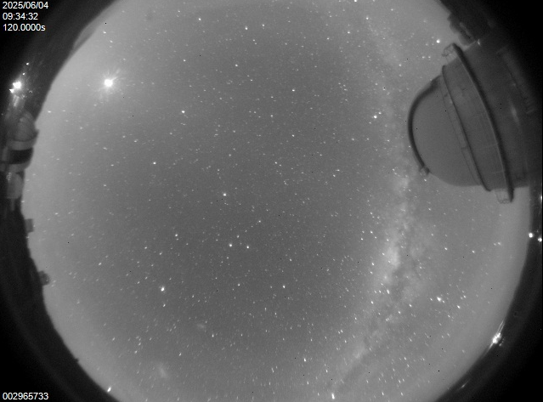
First observing run on 2025 June 3 and 4 UT
The first NEOPOPS run at the 1.54-m telescope, La Silla: 2 nights 2025-06-02/03 and 03/04
Photometric (lightcurve) observations of 5 NEAs:
(65733) 1993 PC
(68359) 2001 OZ13
(154276) 2002 SY50
(523585) 1998 MW5
(527115) 2007 TD14
The targets observed quasi-simultaneously, alternating between (up to 3 of the 5) targets at a given time.
Observations partially successful – partly cloudy.

Slide 3
Data obtained for the 5 NEO targets – summary
The 5 NEOs are between 0.5 and 1.1 km (from thermal observations or estimated from their H).
Spin periods and amplitudes in the most populated range (for their sizes) from 2.4 to 5.1 h and from 0.1 to 1.1 mag.
No excited rotator/tumbler detect yet (will be refined with more observations for 154276, 523585 and 527115).
No binary detected yet (will be refined with more observations for 154276, 523585 and 527115).
Spin vector and Shape modeling (will be) done for (65733) and (523585).
For 2 of the 5 (68359 and 527115), additional data were taken by our Uzbek colleagues with the Maidanak 1.5-m.
NEO | H (mag) | Period (h) | A (mag) | PAR | Bin? | Comments/Notes
(65733) 1993 PC | 18.39 | 4.185 ± <0.001 | 1.08 | +1 | No | (V - R) = 0.381 ± 0.010. Shape modeling (incl. data 2013-2023).
(68359) 2001 OZ13 | (18.1) | 2.4943 ± 0.0003 | 0.10 | +2 | No | Corrected wrong P estimates in LCDB (2.91 h, 18.07 h).
(154276) 2002 SY50 | (17.6) | 5.075 ± 0.002 | 0.70 | (+1) | (No) | DESTINY+ target. More observations in 2025-07.
(523585) 1998 MW5 | (18.9) | (3.236) | 0.66 | 0 | (No) | More obs 2025-07, 2026-05 and -06. 2027-05, 2028-06 and -07.
(527115) 2007 TD14 | (19.0) | 4.882 ± 0.002 | 0.46 | (+1) | (No) | More observations in 2025-07.

Slide 4
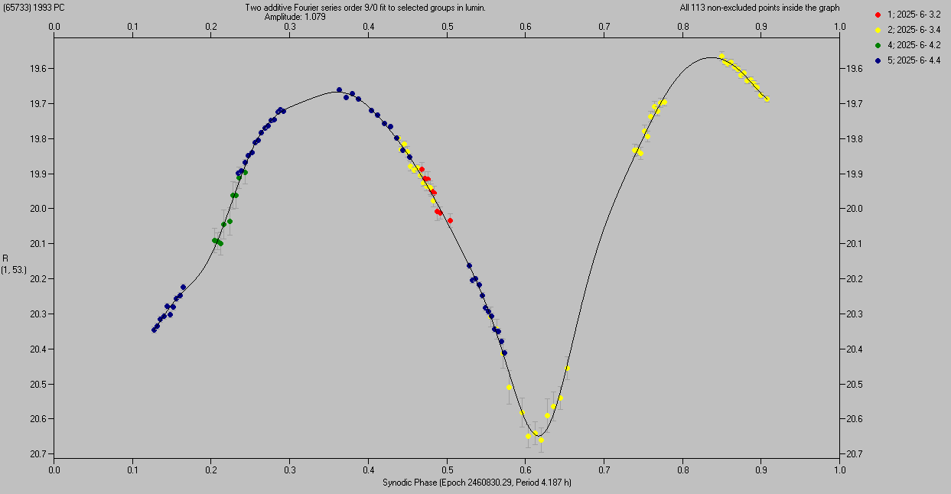
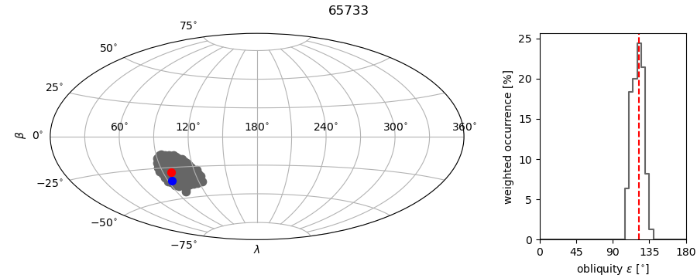
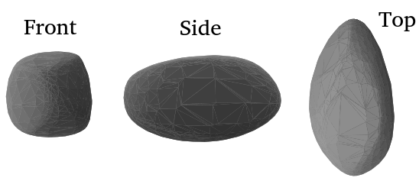
(65733) 1993 PC
Unique period determined from the two nights (4 sessions) 2025-06-03 and 04: P_{syn} = 4.187 ± 0.001 h.
Absolute magnitude H = 18.39 ± 0.40 (relatively large error due to the high phase angle about 53°).
Color index (V – R) = 0.381 ± 0.010 (nearly neutral spectral reflectance; not an SQ type).
High amplitude of 1.08 mag → elongated shape (see Shape model below: a/b ~ 1.8).
No apparent tumbling present (PAR = +1 on the scale of Pravec et al. 2005). No sign of a satellite.
Spin vector and Shape modeling using also previous data (Warner, 2014; Warner and Stephens, 2019; ATLAS) from 2013, 2018, 2020 and 2023 → Two solutions for P_{sid} = 4.18441 and 4.18502 h (± 0.00001 h), Spin pole (L_{p}, B_{p}) = (101°, -32°), unc. radius ~45° (3σ).

Slide 5
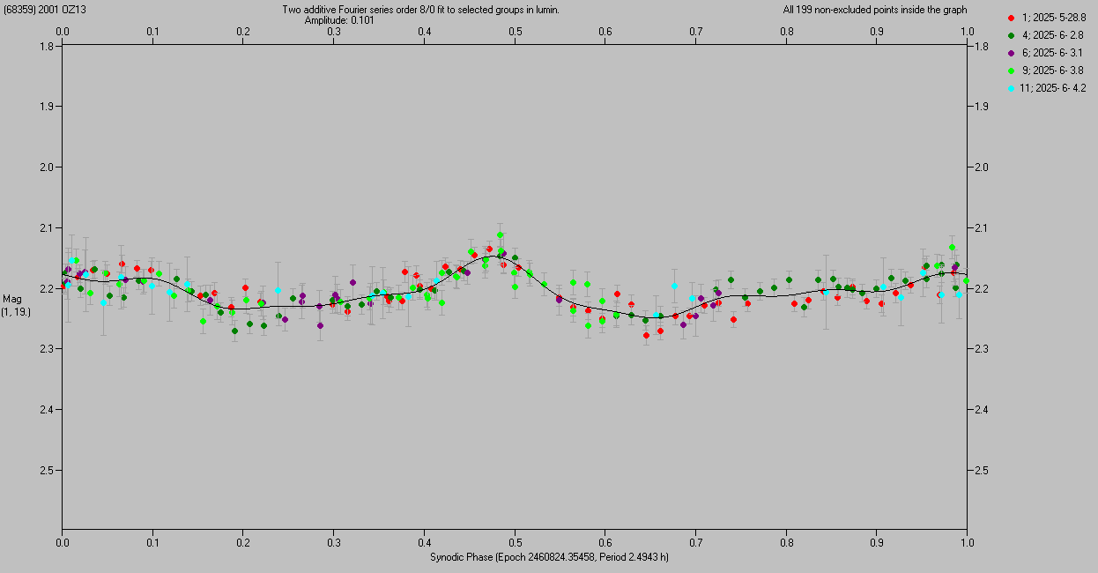
(68359) 2001 OZ13
Spin period determined from the 2 nights 2025-06-03 and 04 from DK154 and 3 partial nights (3-h nightly runs) 2025-05-28, 2025-06-02 and 03 from Maidanak 1.5-m: P = 2.4943 ± 0.0003 h.
Absolute magnitude H and Color index (V – R) TBD.
Low amplitude 0.10 mag → suggests unelongated (nearly spheroidal) shape.
No apparent tumbling present (PAR = +2 on the scale of Pravec et al. 2005). No sign of a satellite.
Previous uncertain (U = 2) data taken by Pal et al. (2020) and Warner and Stephens (2021) in 2018 and 2020: Discrepant P estimates 2.9103 and 18.07 h.

Slide 6
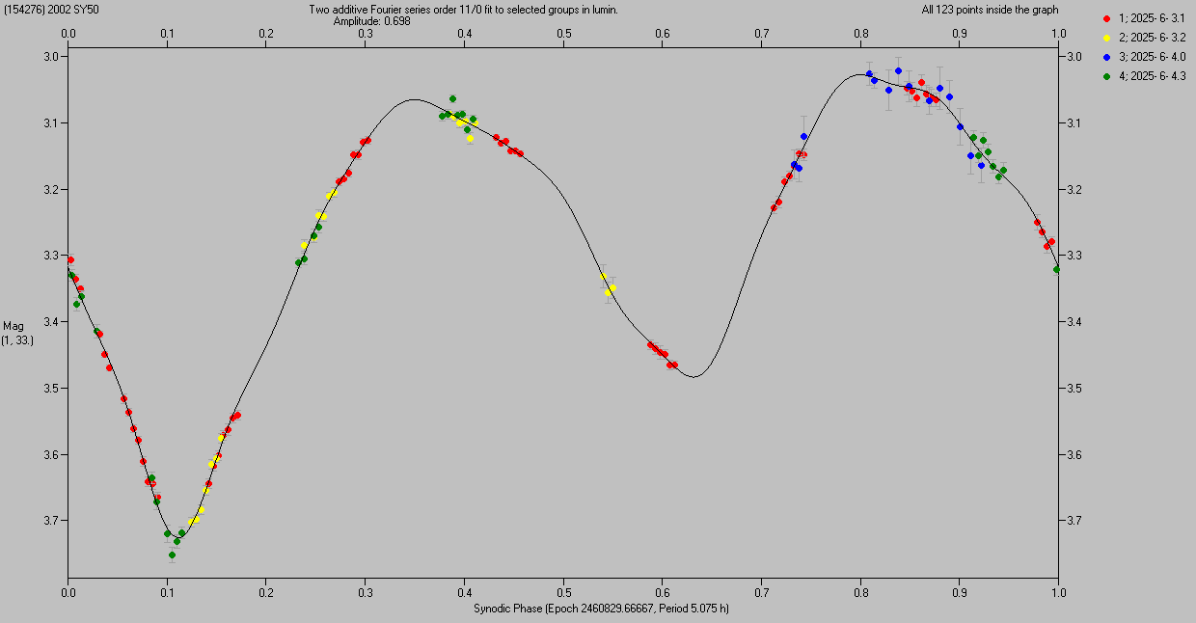
(154276) 2002 SY50
Unique period determined from the two nights (4 sessions) 2025-06-03 and 04: P = 5.075 ± 0.002 h.
Absolute magnitude H and Color index (V – R) TBD.
High amplitude of 0.70 mag → elongated shape.
No apparent tumbling and No sign of a satellite yet (TBC).
More observations planned to be taken during our next run at the 1.54-m from 2025-07-01 to 05.
Previous uncertain data taken by G. Masi in 2002: P = 4.823 h.
Flyby target of JAXA’s DESTINY+ (in their preferred flight scenario) → We plan to publish our results in a paper later in this year and present it at ACM 2026.

Slide 7
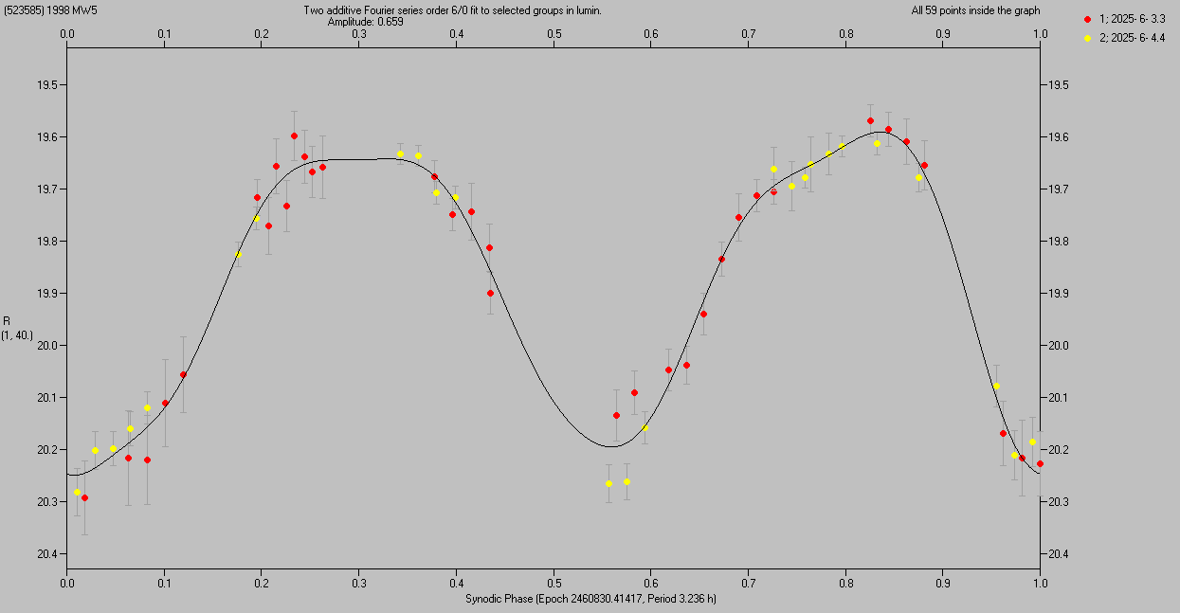
(523585) 1998 MW5
A preliminary estimate for its period from the two nights 2025-06-03 and 04: P = 3.236 h.
Absolute magnitude H and Color index (V – R) TBD.
High amplitude of 0.66 mag → elongated shape.
Data insufficient to detect or rule out potential tumbling and binarity yet.
More observations planned to be taken during our next run at the 1.54-m in 2025-07, and then in its next three apparitions 2026-05 to -06, 2027-05, and 2028-06 to -07 → Will get a unique determination for its period etc., and we will also attempt to create its Spin vector and Shape model (including also sparse data, e.g., from ATLAS).

Slide 8
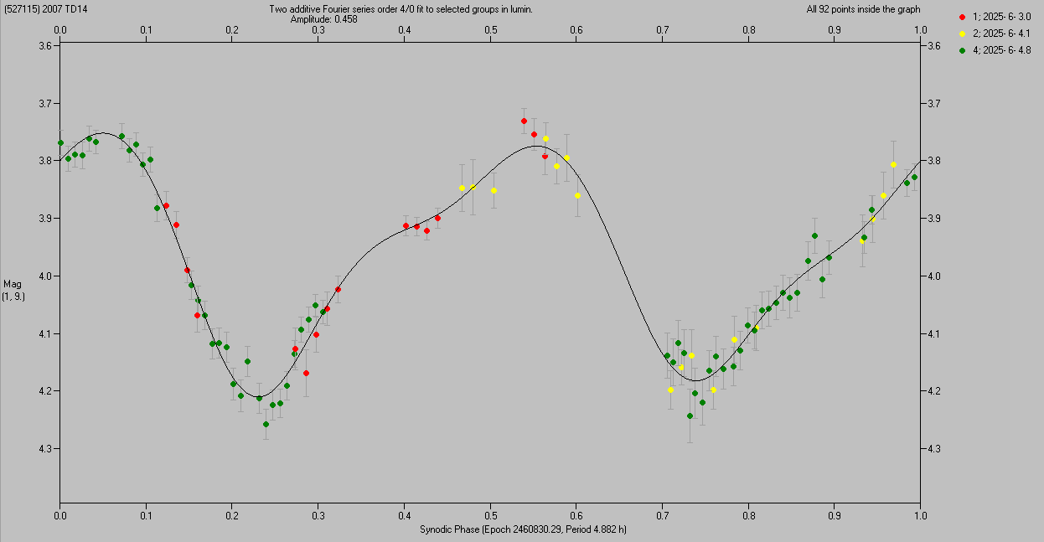
(527115) 2007 TD14
Spin period determined from the 2 nights 2025-06-03 and 04 from DK154 and 1 partial night (3-h nightly run) 2025-06-04 from Maidanak 1.5-m: P = 4.882 ± 0.002 h.
Absolute magnitude H and Color index (V – R) TBD.
Moderately high amplitude of 0.46 mag → moderately elongated shape.
No apparent tumbling and No sign of a satellite yet (TBC).
More observations planned to be taken during our next run at the 1.54-m from 2025-07-01 to 05.

Slide 9
Thank you!

Slide 10
Slides from the KOM of 2025-02-13 follow

Slide 11
The Asteroid team at the ASU Ondřejov
Our team for the NEOPOPS project:
Leading scientist: Petr Pravec
Scientist (also observer): Petr Fatka
Observers/reducers: Kamil Hornoch, Peter Kušnirák
Total amount of personal time for the NEOPOPS project: 0.4 FTE (starting probably sometimes in Spring 2025, after the first money is received and all the administrative steps here are completed).
Other members of our Asteroid team at Ondřejov (not involved in NEOPOPS in the 1st year):
Petr Scheirich (scientist), Hana Kučáková, Adrián Galád (observers), Miroslav Velen (sw specialist)

Slide 12
The ASU team’s primary instrument:
Danish 1.54-m telescope
A remotely-operated photometric telescope at ESO La Silla, Chile. Operated collaboratively by the NBI Copenhagen (owner) and the AI AS CR Ondřejov since 2012.
Precise time-resolved (lightcurve) photometry for NEOs up to V = 19 typically (occasionally may go up to V = 20)

Slide 13
Time allocation and scheduling at the
Danish 1.54-m telescope
The ASU team has got a guaranteed time at the 1.54-m telescope for 50 nights per semester.
Two main projects to be run at the telescope since 2025B:
NEOSource project (supported by the Praemium Academiae grant from the Academy of Sciences of the Czech Republic): 37.5 nights per semester
NEOPOPS project: 12.5 nights per semester
Telescope time allocation:
Done several months ahead before the start of each semester
Swapping between NEOSource and NEOPOPS nights occasionally possible (but not guaranteed) – will try to do it for some special super-interesting NEOs on the last minute notice
Allocation of nights for the NEOPOPS project:
In a given semester we plan to split the 12.5 nights into two blocks (observing runs), each 6-6.5 nights long.
Will coordinate with other NEOPOPS participants when to best allocate the two observing runs in a given semester – to get the best synergy with observations using various techniques.

Slide 14
NEOPOPS task on
NEO rotations, shapes and binaries

Slide 15
Goals
Running photometric lightcurve observations of dangerous or interesting NEOs during their favorable apparitions (usually during their close approaches to Earth)
Determining rotation periods for the observed objects, estimating or constraining their shapes, and estimating their absolute magnitudes
Constraining the spin states (principal-axis or excited) of observed asteroids
Searching for potential mutual eclipse/occultation events (brightness attenuations) caused by satellites of observed asteroids, and estimating parameters of detected binary asteroids.
Potential extension: Observing newly discovered or known near-Earth binary asteroids during their close approaches to Earth, to determine or refine parameters of the satellite orbits.

Slide 16
Observing strategy and target selection
Typically 3 NEOs to be observed on one night (alternating between them, to get a good semi-dense coverage of their lightcurves).
For a typical NEO, 2-3 observing nights are needed to determine its spin period, constrain its spin state (PA vs NPA), and to look for signs of possible satellite.
It means that during each semester (12.5 nights), we will get these data for 15 NEOs
→ We will characterize a sample of 105 NEOs during the 7 semesters (3.5 yr) of the NEOPOPS project.
Target selection:
During the initial telescope time allocation (several months in advance): The most interesting ones among observable known NEOs are selected as our primary targets for each semester (for the two 6-6.5 nights long observing runs)
A few days before each our observing run we will check newly discovered NEOs and select the most interesting ones as “last minute targets” of opportunity.
We will coordinate the selection of targets with other tasks, prioritizing NEOs that are observed also by other techniques (so that to characterize them most thoroughly).

Slide 17
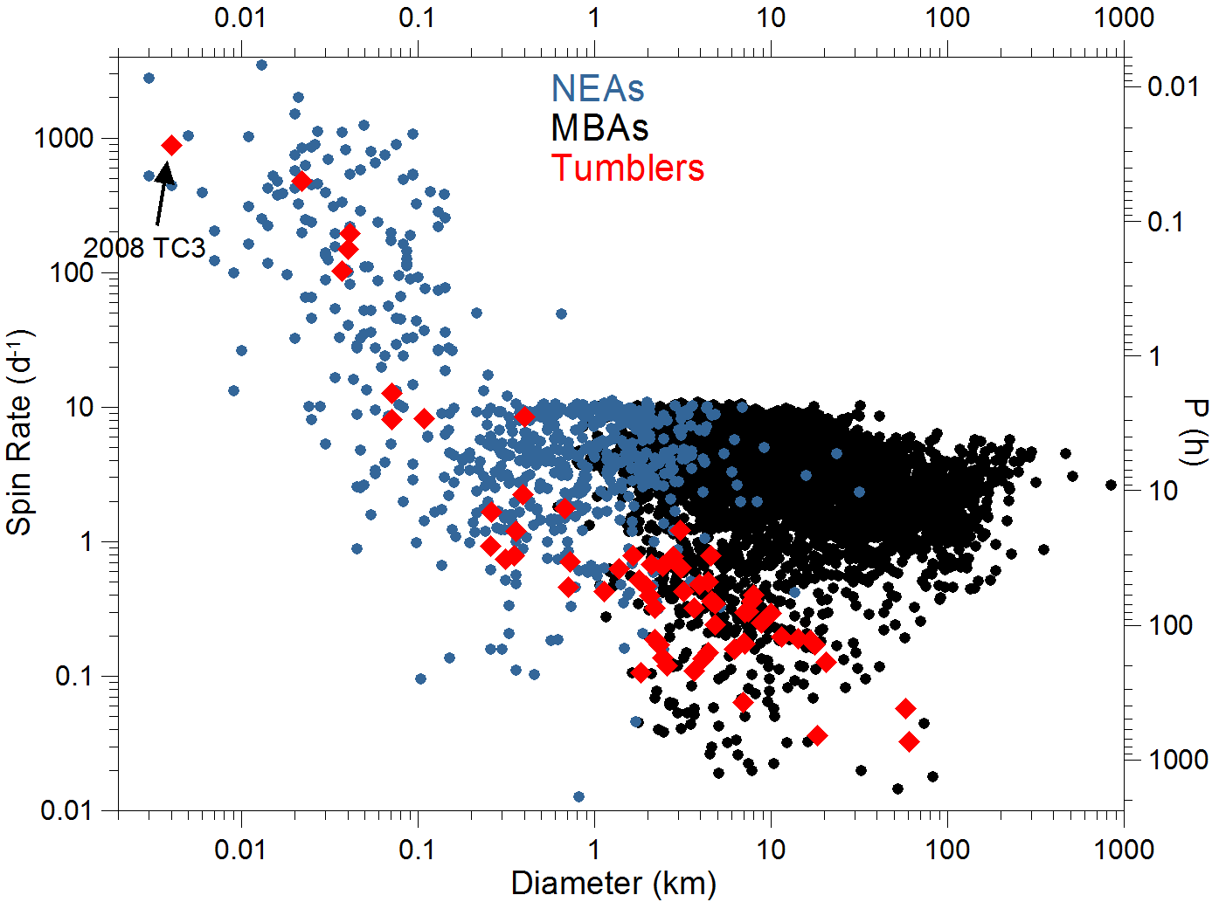
NEA Rotations
Spin rates of NEOs in our targeted diameter range (10 m to 1 km) span from very slow rotations (P of many days) to very fast ones (P of tens of seconds).
A majority of them are in basic (principal-axis) spin states, but a significant fraction of them are in excited (tumbling) spin states.
Observational bias against tumblers – they are actually very frequent: ~30% of small NEAs are in NPA rotation states (our recent result, to be pubslihed).

Slide 18
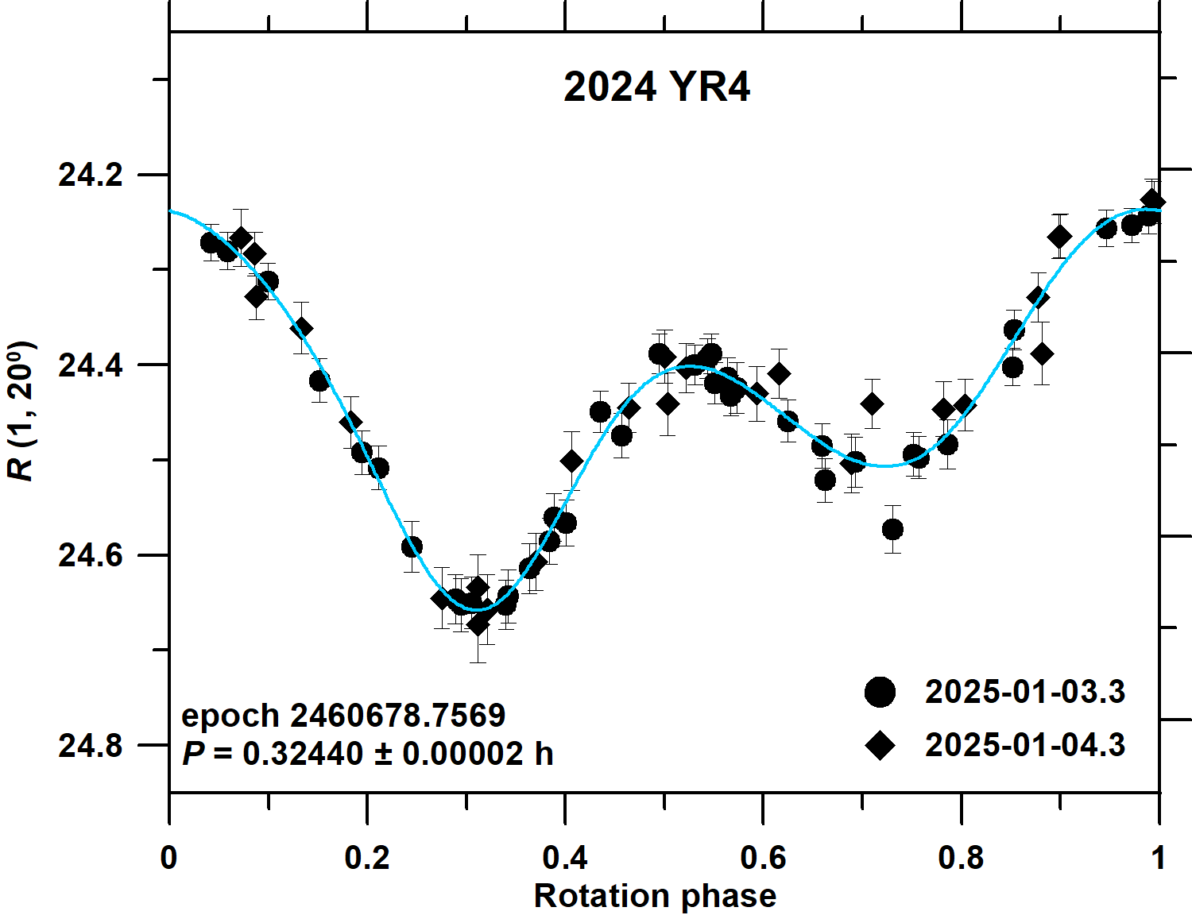
Example 1: Lightcurve of a fast principal-axis rotator
Data from 2 nights sufficient to determine its period and reveal its PA spin state. (Constraints on its elongation and estimating its absolute magnitude H also possible.)

Slide 19
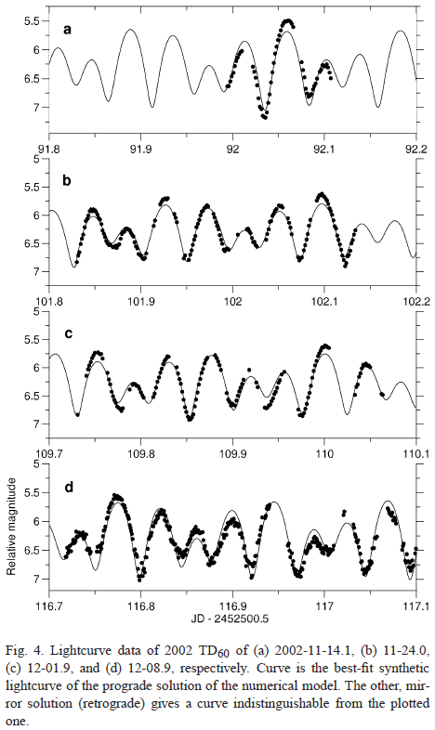
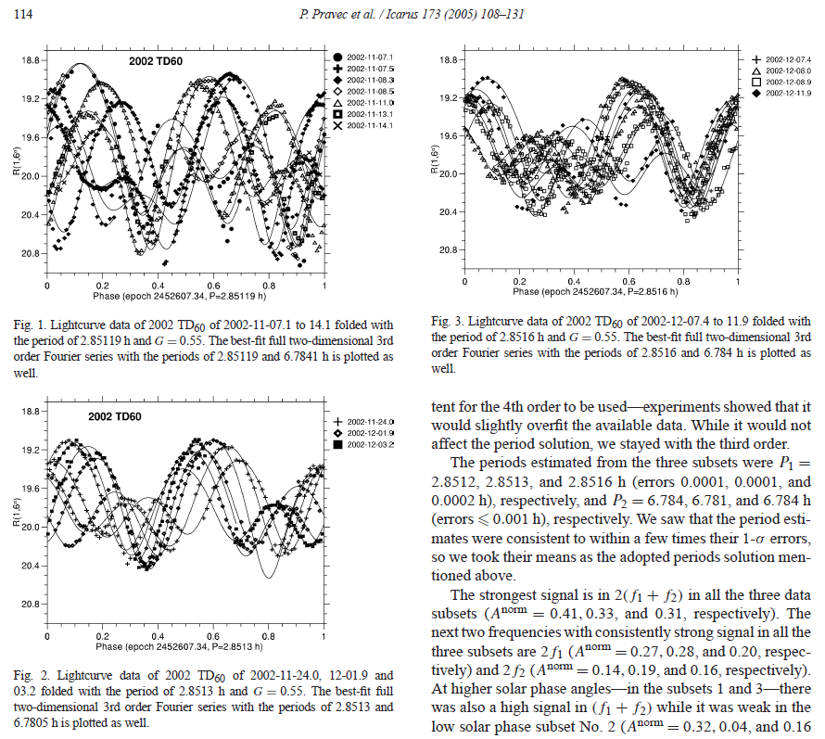
Example 2: Lightcurve of a fast spinning tumbler (2002 TD60)
Data from 3 nights typically needed to reveal its NPA rotation.
(Pravec et al. 2005)

Slide 20
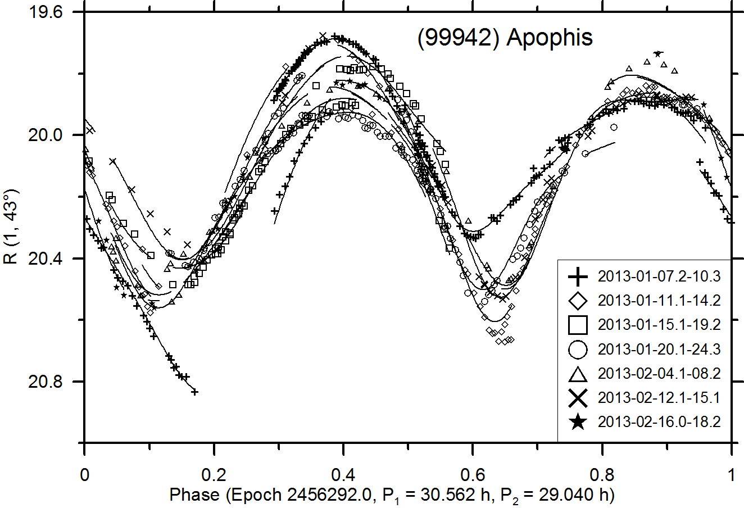
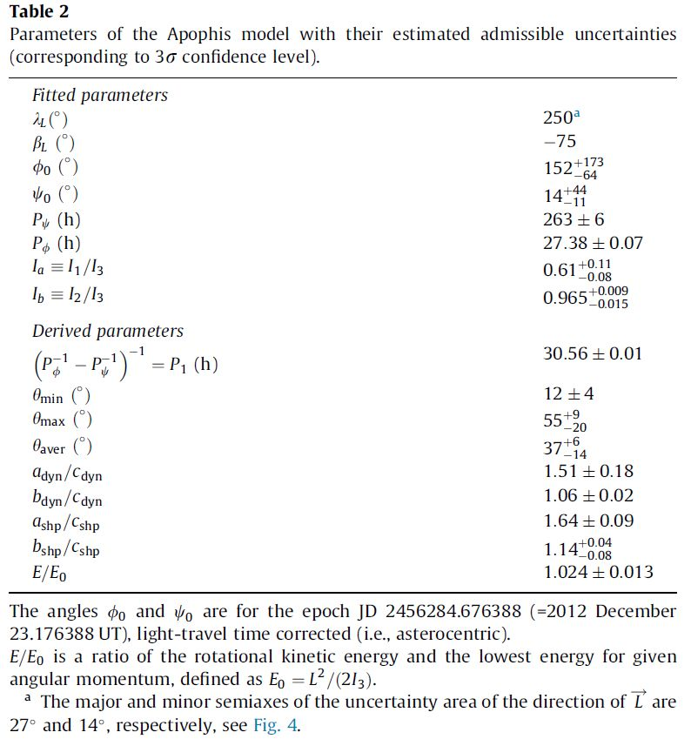
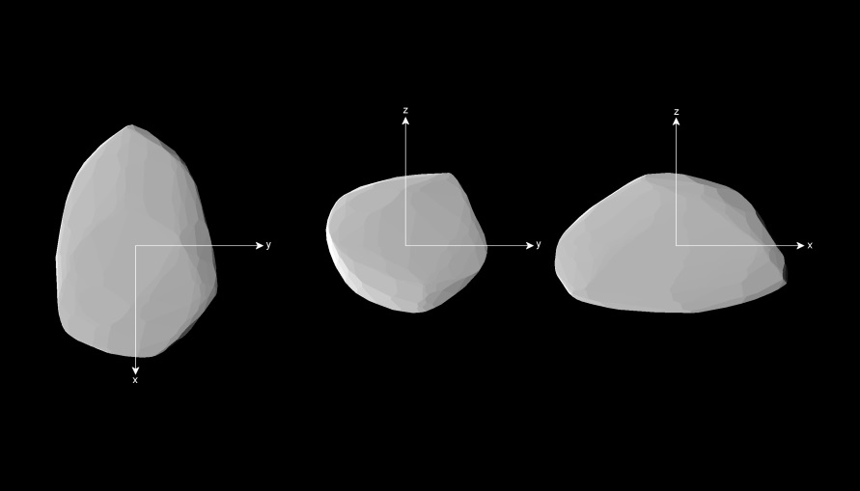
Example 3: Lightcurve of a slow-spinning tumbler (Apophis)
(Pravec et al. 2014)
It required observations on 60+ nights from 2012 Dec. 23 to 2013 April 15. But only “normal points” were taken (i.e., it didn’t require continuous observing runs).

Slide 21
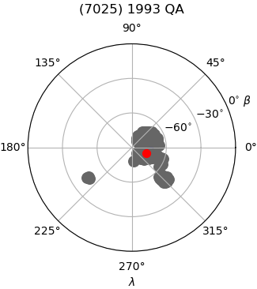
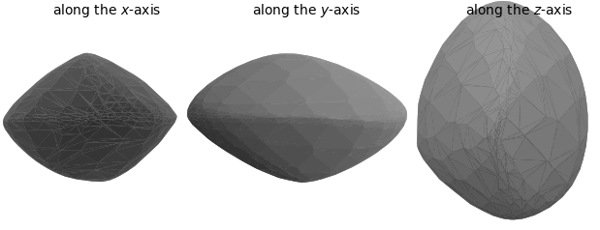
NEA shapes
Shape models of selected NEAs with previous data available (taken by us or from other stations in previous years) will be created.
To derive an asteroid shape model, lightcurve data from 2-4 apparitions are typically needed.
It will be usually enough to observe such NEO target on only one night during an observing run → suitable as a “filler” target.
Derived convex shape model of NEA (7025)
Direction of the spin axis of NEA (7025)

Slide 22
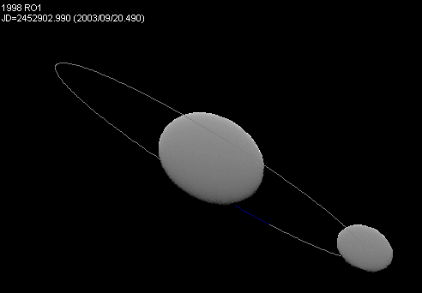
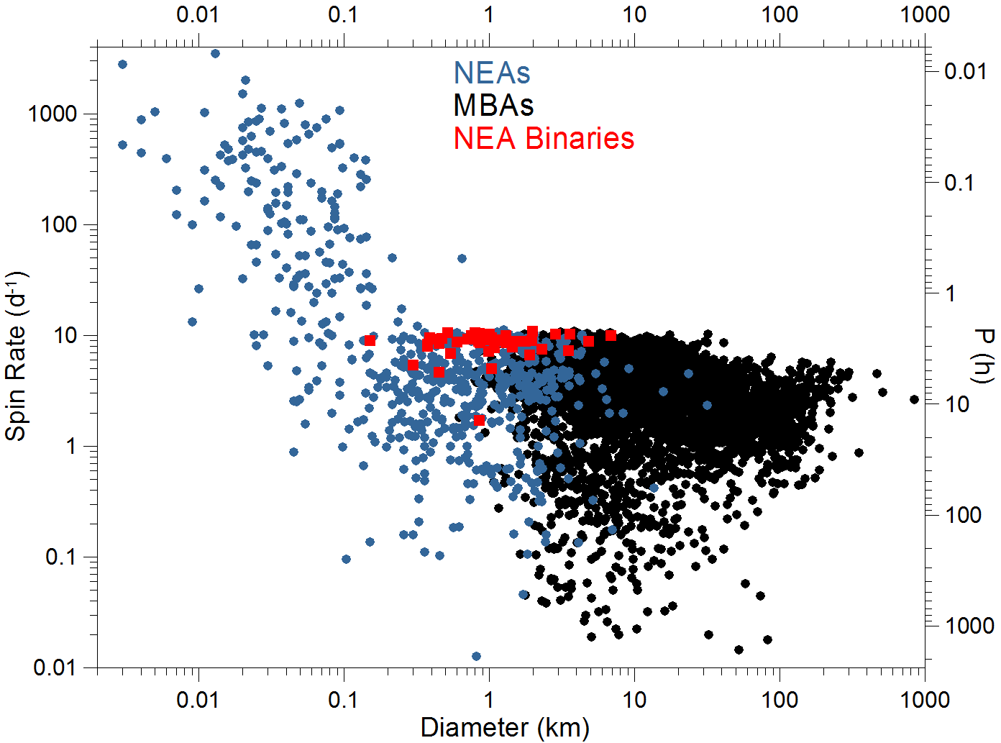
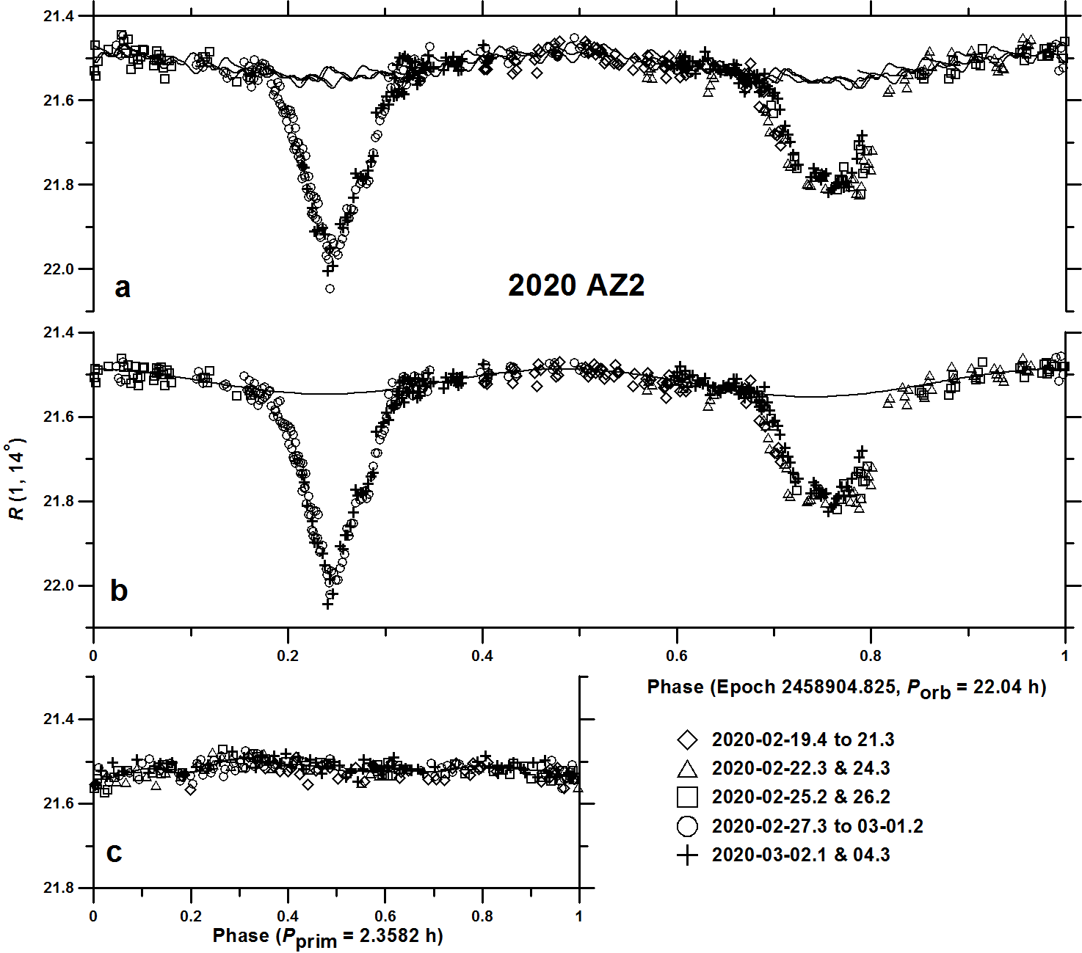
Binary asteroids
Some NEOs have satellites
Binary asteroids are frequent among NEAs larger than about 100-200 m: The fraction of binaries estimated 15 ± 4% (Pravec et al. 2006).
Data from 3 nights can give a hint on binary nature of a studied NEO. More nights needed to estimate basic parameters of the discovered satellite.

Slide 23
Thank you!

